Slide 1
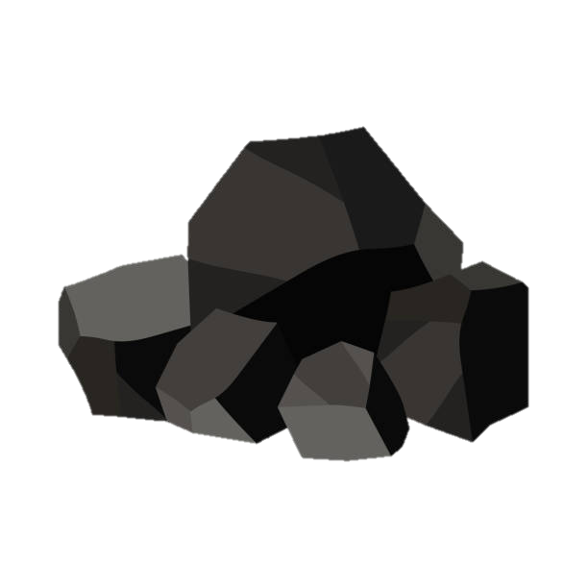
Fail Fast, Fail Cheap
The ideal design process is that we design perfectly once.
Of course, that rarely ever happens.
If the design is not going to work the first time, shouldn’t we…
work on the part that is most likely to have problems,
learn as quickly as possible if the design is going to work, and
do so without investing a lot into an uncertain idea?
A good design process makes learning a safe activity!

Slide 2
Design Studio – Week 4
Today you will:
Evaluate and improve the RC circuit design from last week
Design and model your own RLC circuit
Learn about resonance and natural frequency
Review the rubric for technical reports
Assignments:
Exercise worksheet for RLC circuit design and analysis
Project 1 technical report

Slide 3
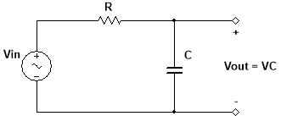
Project 1 Review
Improve
Last week you designed, built, and tested an RC filter circuit.
Did it work, i.e. did it meet the requirements?
Why not?

Slide 4
Project 1 Design Analysis
Improve
What can we say about this RC circuit?
$$MR=\left|\frac{V_{out}}{V_{in}}\right|=\left|\frac{1}{1+jωRC}\right|=\frac{1}{\sqrt{1+{(ωRC)}^{2}}}$$
If we choose $RC$ such that $MR$ > 0.8 at $ω$ = 2π (2 kHz)
Then $MR$ > 0.2577 at $ω$ = 2π (10 kHz)
This design is not capable of meeting the requirements as specified.

Slide 5
Project 1 Requirements
Ask
Recall the filter requirements:
$$\frac{\left|V_{out}\right|}{\left|V_{in}\right|}$$
Magnitude ratio of the output to the input,
which depends on the frequency
At lower frequencies, we want the output magnitude almost the same as the input.
This region is the passband.
1.2
1.0
0.8
At higher frequencies, we want the output magnitude close to zero.
This region is the stopband.
0.1
frequency
2.0 kHz
4.0 kHz
6.0 kHz
8.0 kHz
10.0 kHz

Slide 6
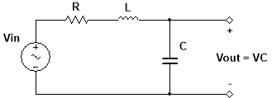
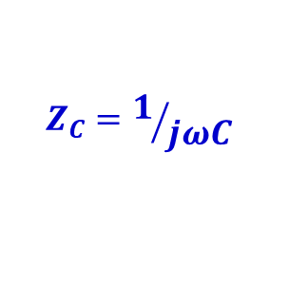
Project 1 Redesign
Imagine
Let’s see if we can improve the performance of the circuit.
Since inductors and capacitors alone with a resistor don’t work, let’s investigate what happens if we use both at the same time.
Using impedances:
$$Z_{L}=jωL$$
$$Z_{R}=R$$
$$Z_{C}=1/{jωC}$$

Slide 7
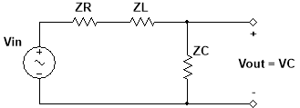
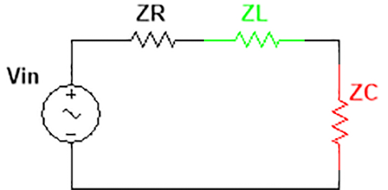
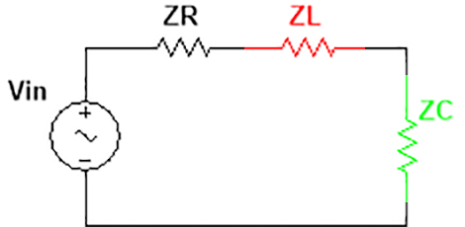
Project 1 Redesign
Plan
How can we choose good values of L and C for our design?
We want $\left|Z_{C}\right|=\left|Z_{L}\right|$ somewhere with 2 kHz < $f$ < 10 kHz.
At frequencies $f$ ≤ 2 kHz (passband region)
At frequencies $f$ ≥ 10 kHz (stopband region)
$$\left|Z_{C}\right|≫\left|Z_{L}\right|$$
$$\left|Z_{C}\right|≪\left|Z_{L}\right|$$

Slide 8
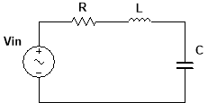
Concept Review – Resonance
So what happens to the inductor and capacitor when $\left|Z_{C}\right|=\left|Z_{L}\right|$?
That means $ωL=1/{ωC}$ …
…and $Z_{L}+Z_{C}=jωL+1/{jωC}=0$!
So $V_{L}+V_{C}=I\left(Z_{L}+Z_{C}\right)=0$, but are $V_{L}=0$ and $V_{C}=0$?
No, they are just opposite of each other…
The amplitudes are equal
Signals are 180° out of phase

Slide 9
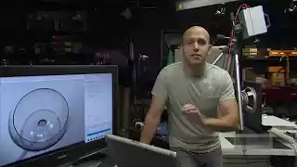
Concept Review – Resonance
The frequency $ω=1/{\sqrt{LC}}$ at which$V_{L}+V_{C}=0$ is called the resonant frequency, or the natural frequency.
The voltages $V_{L}$ and $V_{C}$ actually can become quite large in this case.
The tendency to amplify signals at the natural frequency is called resonance.
Using Resonance to Break a Wine Glass
https://www.youtube.com/watch?v=BE827gwnnk4

Slide 10
Project 1 Redesign
Plan
How can we choose a good value of R for our design?
If R is too big, $\left|Z_{R}\right|=\left|Z_{C}\right|$ around 2 kHz and $V_{out}$ < $V_{in}$.
If R is too small, $V_{out}$ gets very large near the natural frequency.
Write the equations or test some values in Multisim to choose R.

Slide 11
Project 1 Modeling and Test
Create
Follow along with the worksheet to build a working version of your circuit design in Multisim with your team.
Your instructor is here to help answer guiding questions and troubleshoot any problems that your team identifies.

Slide 12
Project 1 Technical Report
Project 1 features your first technical report. Because this is the first time you will be capturing the entire design, the report will be treated mostly as a learning opportunity.
At a top level, the report can be viewed as an account of:
What you planned and decided (Methods)
What you did and what you learned (Results)
What you think you should do next (Conclusions)
The report should also include a cover page and references and appendices as needed.
Let’s review the rubric and example report posted on the Studio website.

Slide 13
Project 1 Methods
The Methods section covers the Ask, Imagine, and Plan phases.
For this project, you should include:
The project requirements
The RLC circuit design you are using this week
The final values of any resistors, capacitors, and inductors
Ask
Imagine
Plan

Slide 14
Project 1 Results
The Results section covers the Create and Test phases.
For this project, you should include:
The Multisim model you developed
A table of your point measurements in Multisim
The frequency plot of your circuit magnitude ratio from Multisim
A check of the performance versus the requirements
Create
Test

Slide 15
Project 1 Conclusions
The Conclusions section covers the Improve phase.
For this project, you should include (as bullet points):
Some valuable things you learned about the circuit along the way
If you met the requirements, a few steps on getting the design to the next version (e.g. prototyping, more measurements)
If you didn’t meet the requirements, some steps on how to go back and specifically change the design to improve it
Improve

Slide 16
Project 1 Report Scope
Next week we will do some prototyping and hands on measurement of our RLC filter design.
The exercises we do next week (Week 5) do not need to be included in the Project 1 report.
Your project report only needs to cover the project work and development through this week (Week 4).

Slide 17
Week 4 Assignments
Exam 1 is during Lab of Week 6.
Since the Project 1 report doesn’t cover the material next week, try to complete most or all of the report this week.
Questions after Studio? Email your instructor or go to office hours.
Exercise
Complete the Week 4 worksheet handed out earlier.
Follow the directions to evaluate the RLC circuit design.
Submit the completed worksheet at the start of the next Studio.
Project 1 Report
Draft a technical report by following the rubric posted online.
Submit the completed report at the start of Week 6 Studio.

