Slide 1
Vector Analysis Toolbox
By the end of this Lab, you should be able to:
Use indicator logic in a loop
Use vector functions to explore data
Develop ideas for your studio sensor project
Laboratory Outcomes:
C.1 solve engineering problems using computer tools.
C.2 apply arrays and array manipulations.
C.3 use and explain text variables & ASCII text files.
C.4 write a function with multiple inputs and outputs at the command line.
C.5 write a function that results in a non-numerical output.
C.6 write programs using logical expressions and conditional statements.
C.7 write programs using loop structures.
C.8 fit data that follows linear, exponential or power law forms.
C.9 properly communicate a solution based on computer calculation or program.

Slide 2
Analyzing Sensor Data A Vector Toolbox Part I: Loops Conclusion
By the end of this Lab, you should be able to:
Use indicator logic in a loop
Use vector functions to explore data
Develop ideas for your studio sensor project
Download: quiz1.m & A.mat
Try the quiz: >> quiz1
make sure all files are in your current directory

Slide 3
Web/Network Drive Materials:
xample data files
Review: a) Quiz Program & Indicator Loops
Exercise: Guessing Game
Review: Addressing questions
Handout: (Include example data files online)
Setup 1) Import Data & convert to t, x, y, & z vectors 2) Time Vector and Sampling Frequency
Vector Analysis Tools: Accelerometer Practice Script
Vector Subsections & Descriptive Statistics
The Find Function
Vector Calculations
Frequency Analysis (analyze1.m)
Exploratory Data Analysis (Interactive Graphing)
Example: Integration using Right Riemann Sum Assignment:

Slide 4
Learning from Code: Quiz Program
Download: quiz1.m & A.mat
Run: >> quiz1 Take the quiz
Answer these questions
How does this program step through the questions in the input file regardless of how many there are?
What does the while loop in this program do? Why is a while loop essential here?
How does the flag or indicator variable “indicate” work (look at all commands where it is used) ?
How is the score determined and maintained?

Slide 5
Indicator-type Loops
Each loop →
Checks to see if indicator variable has been changed
Indicator variable is changed by loop under certain conditions (often based on a users response)
Keys →
Set indicator variable before loop (e.g. test = 1)
While loop checks if indicator equals the initial value (e.g., while test ==1)
Conditions in loop can change indicator variable (e.g., with user input test =0)

Slide 6
Quiz Program I/O statements
Download quiz1.m and A.mat from website
Run quiz1.m from command line (>> quiz1)
Things to notice:
Fill Logic: Use of for loop to move through questions ➔ stored file can contain any number of questions
Accumulation logic: Use of accumulation variables
qscore – decreasing
score – increasing
Indicator Logic: Use of while loop, if statement, and indicator variable (x) to repeat until questions is correct
input via, file & menu command
output via display with some concatenation

Slide 7
Loop Logic: Key Example Problems*
Element-by-Element
for k = 1:length(x)
if x(k) == …
y(k) = f(x(k))
…
end
end
A Loop Counter
k = 0
while … k = k + 1
end
Response Indicator
q = 1
while q == 1
x = input (‘… ? ‘)
if a == x
q =0
end
end
Fill
Accumulation
Indication
* i.e., things you should definitely know for the Lab Practical!

Slide 8
Review Exercise: Develop the following guessing game program
Player starts with 10 points
The program randomly picks a number from 1 to 100. N.B. code for picking this number is: n = ceil(rand*100)
The program asks player to guess a value ➔ player enters a number
Program tells player they are high, low or correct. if correct game is over and score is displayed or elseif incorrect they lose one point & go back to #3
Submit a copy of your program and a copy of some game play including validation (how can you be sure this program is working correctly?)

Slide 9
Analyzing Sensor Data A Vector Toolbox Part II: The toolbox
By the end of this Lab, you should be able to:
✓ Use indicator logic in a loop
Use vector functions to explore data
Develop ideas for your studio sensor project
Download: analyze1.m
(if you have not done so already)

Slide 10
Exercise: Vector Addressing Start with >> x = 1 + 3*(1:20)
Write statements that will return:
The integers from 2 to 10
The elements 2 through 10 of a vector x
Second through the last element of x
First - the second to last elements of x
Display the length of a vector x
The intervals in a vector x (hint: see 3 & 4)
*Return the elements for the first half of x

Slide 11
x = 1 + 3*(1:20)
>> 2 : 25
>> x(2 : 25)
>> x( 2 : end)
>> x(1 : end – 1)
>> length(x)
>> x(2:end) – x(1: end-1)
>> x(1:round(length(x)/2))

Slide 12
Analyzing Sensor Data (Handout)
Setup 1) Import Accelerometer Data & convert to t, x, y, & z vectors 2) Time Vector and Sampling Frequency
Vector Analysis Tools: Accelerometer Practice Script
Vector Subsections & Descriptive Statistics
The Find Function
Vector Calculations
Frequency Analysis (analyze1.m)
Exploratory Data Analysis (Interactive Graphing)
Example: Integration using a Right Riemann Sum
Assignment: 1. Vector Analysis Practice Script (1-6 above)
2. Numerical Integration- Trapezoid Rule
Aside: Multiple graphs in one figure

Slide 13
Time Stamp for iOS version of the Physics Toolbox Suite
Issue: iOS gives a time/date stamp e.g. "2020-04-02 11:17:10.1950“
Program: time = iOS2time(Structure)
Example: if you have a file "iOSPhysicsTool.csv“ and you run:
>> Accel = importdata('iOSPhysicsTool.csv');
>> t = iOS2time( Accel ); % 4 android: = Accel.data(:,1);
>> x = Accel.data(:,1)*9.8; % 4 android: = Accel.data(:,2)*9.8;
The variable t would contain the elapsed time in seconds (to the nearest millisecond).

Slide 14
Using analyze1.m
Call: analyze1(y, Fs);
y = a vector of values in time order ( ~ evenly spaced)
Fs = Sampling frequency (samples/s)
Need Fs: For accelerometer data average Fs = length(time)/time(end)
Output: A Graph : Major peaks show key repeating frequencies
➔ Include graph in execution results

Slide 15
e.g., Walking data
Setup
>> Accel = importdata(‘walk2.csv’);
>> t = Accel.data(:,1);
>> x = Accel.data(:,2);
to show.
>> Fs = length(t)/t(end)
Fs =
62.5872
>> analyze1(x,Fs);

Slide 16
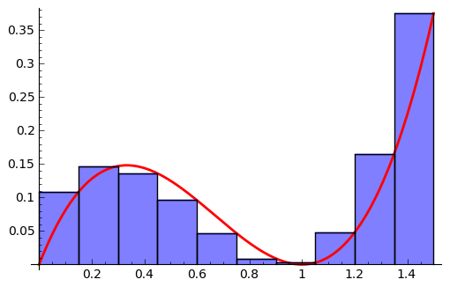
Integrating a Vector (e.g., Right Riemann Sum)
a
b
For one interval:
$$\int_{a}^{b}{f\left(x\right)dx ≈(b −a)f(b) }$$
Calculates the Δ Area for one interval. The results for all intervals must be summed.

Slide 17
Test Vector
t | X | Δt | x * Δt
0 | 0.8
0.5 | 1 | 0.5 | 0.5
1 | 0.5 | 0.5 | 0.25
1.5 | 2 | 0.5 | 1
2 | 1 | 0.5 | 0.5
Σ = 2.25
How do you validate a program like this?

Slide 18
Show coding and validation
for: t = time vector
y = y-coordinate vector
integral = sum(y(2:end).*(t(2:end) - t(1:end-1)))
Code Equations
>> t=0:0.5:2;
>> x=[0.8 1 0.5 2 1];
>> Riemann(x, t)
ans =
2.2500
Validation

Slide 19
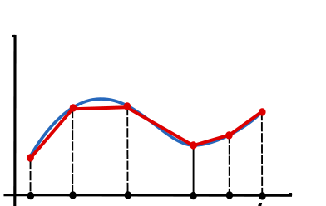
Trapezoidal Rule
a
b
For a single interval:
$$\int_{a}^{b}{f\left(x\right)dx ≈(b −a)\left[\frac{f\left(a\right)+f(b)}{2}\right]}$$
Calculates the Δ Area for one interval. The results for all intervals must be summed.

