Slide 1
Handouts:
Quick Review Quiz
(Finish m-file online)
Loop Lab
Web/Network Drive Materials:
fact.m
Introduction
- Questions from MATLAB work
Outline ➔
Intro
Review:
Slide Intro: Loops & the For structure
Accumulation Logic and Recursion Equations
  Background – loop index & overview
  Example loop: Factorial Function
Lab Handout: Accumulation Loops
  Example Loop: Spring energy
  Exercise: charge on a capacitor vs. time
  Accumulation with while loops
  While Loops (slides available)
  Example Loop: length to Spring energy
  Exercise: time to charge on a capacitor
Assignment: 2 capacitor charging programs

Slide 2
Loops 2: Accumulating an Answer
By the end of this Lab,
you should be able to:
use a for loop to solve problems requiring accumulating an answer in steps
use a while loop to solve problems requiring accumulating an answer in steps
Computer Outcomes:
C.1 solve engineering problems using computer tools.
C.2 apply arrays and array manipulations.
C.3 use and explain text variables & ASCII text files.
C.4 write a function with multiple inputs and outputs at the command line.
C.5 write a function that results in a non-numerical output.
C.6 write programs using logical expressions and conditional statements.
C.7 write programs using loop structures.
C.8 fit data that follows linear, exponential or power law forms.
C.9 properly communicate a solution based on computer calculation or program.
Download fact.m
to your working directory
Try it out, e.g. >> fact(5)

Slide 3
Example: An accumulation problem

Slide 4
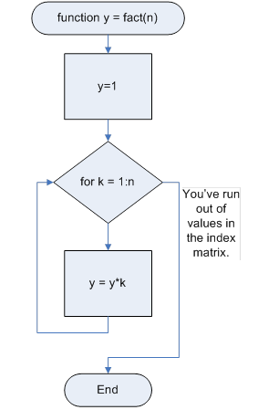
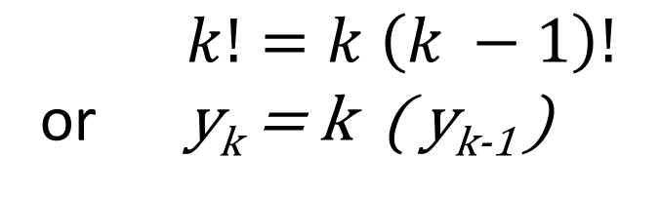
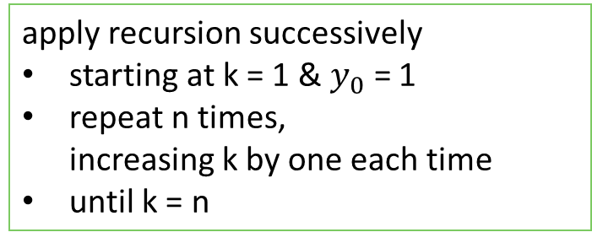
4. Plan & Test Calculations
Test Calculations
k | k! | = k * (k-1)! | y
1 | 1! = 1 |  | = 1
2 | 2! = 2 * 1 | = 2 * 1! | = 2
3 | 3! = 3 * 2 * 1 | = 3 * 2! | = 6
4 | 4! = 4 * 3 * 2 * 1 | = 4 * 3! | = 24
5 | 5! = 5 * 4 * 3 * 2 * 1 | = 5 * 4! | = 120
Recursion Formula:
$k!=k \left(k −1\right)!$
or y_{k} = k ( y_{k-1} )
Calculation Process:
apply recursion successively
starting at k = 1 & $y_{0}$ = 1
repeat n times,
increasing k by one each time
until k = n

Slide 5
Note on variables n & k being used in this example (in calculations, flowchart and code)
k is used to represent the current base value in the recursive calculation
n is used to represent the base input
when the calculation (i.e. the loop) is done k = n.
Programs based on recursion equations usually end up with two program variables for one algebraic variables
  the current value in the recursion calculation
  the final value
It is important to not get them confused.

Slide 6
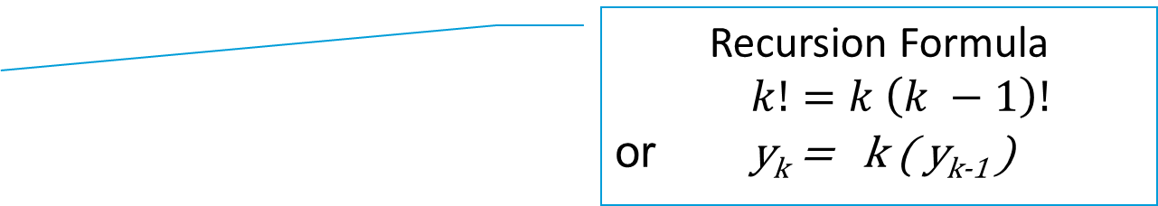
Try it: A Factorial function (Accumulation)
function y = fact(n)
% Lots ‘o’ intro. comments
% internal variable k = loop variable
% initialize accumulation variable
y = 1;
% use for loop to accumulate the
% factorial product in the variable y
for k = 1 : n
y = k * y;
end
The accumulation variable (y) must have an initial value before the loop starts.
You can initialize the accumulation variable by:
carrying out the first calculation outside the loop
or use: ● 1 to start a product
    0 to start a summation
    [ ] to start a concatenation
Inside the loop the accumulation variable appears on both the LHS and RHS to allow information to pass from one loop to the next.
Recursion Formula
$k!=k \left(k −1\right)!$
or y_{k} = k ( y_{k-1} )

Slide 7
Loops: Accumulation to an Answer (Lab Handout)
Example: Elastic Energy (For loop) - energy for a given compression
Exercise: Capacitor Charging (For loop) – energy for a given time
Exercise: Impact of Step Size

Slide 8
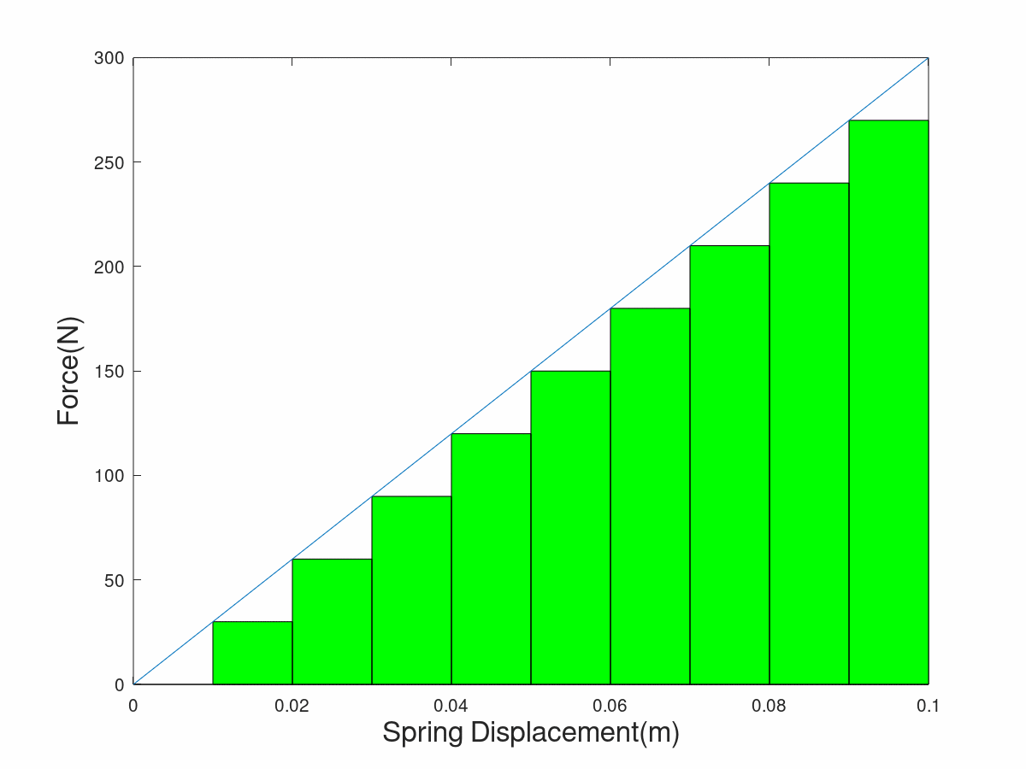
I. Example: Elastic Energy (For loop)
Recursion Equation(s)
E_{i} = E_{i-1} + k *x_{i} *Δx (5)
x_{i} = x_{i-1} + Δx (6)
xf
x

Slide 9
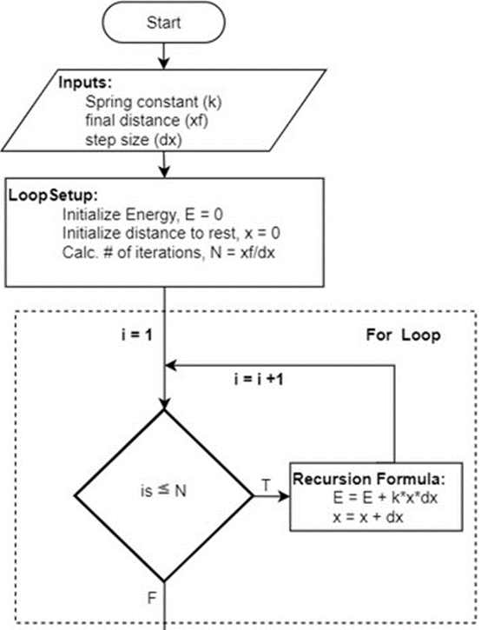
Notice
(i.e., Study)
The Logic Progression
Octave/MATLAB function
function [E, error] = elastic(k, xf, dx)
%
% ➔ Lots ‘o’ intro. Comments
% (purpose author, date …)
% for loop setup, initial energy, initial
% position, and number of steps
E = 0;
x = 0;
N = round(xf/dx);
% Loop to accumulate the total energy by
% making small changes in spring
for i = 1:N
x = x + dx;
E = E + k*(x)*dx;
end
% Energy by analytical equation
Ea = 1/2 * k *xf^2;
% calculation of error
error = E - Ea;
Flowchart
Recursion Equation(s) 5 & 6
E_{i} = E_{i-1} + k *x_{i} *Δx
x_{i} = x_{i-1} + Δx

Slide 10
Loops: Accumulation to an Answer (Lab Handout)
Example: Elastic Energy (For loop)
Exercise: Capacitor Charging (For loop)
Exercise: Impact of Step Size
Accumulating with a While loop (do appendix exercise)
Example: Spring compression for a given energy
Important Note: ^c to stop “crash out” of a program
Exercise: Charging time for a given charge
Lab Assign – Capacitor Charging (Also try new Pig Latin program)
  Voltage at a given time (from part II)
  Time to reach a given voltage (analogous to example in part IV)
  Bonus: Write a function to plot the charge vs time given R, C and V_{s}
  Take it farther: Make it animate the charging in real time!

Slide 11
Problem: Before running the loop, how many iterations are required cannot be determined.
Example 2: Find distance required to reach a given energy
Energy Recursion Formula
E_{i} = E_{i-1} + k *x_{i} *Δx

Slide 12
While Loops: Appendix A
% program whileeg
% this script demonstrates a simple while loop
x=6
k=0; % this initializes the loop vbl.
while k <= x % logical condition controls loop
k % echo print loop variable to see what is happening
k=k+1; % change the loop variable
end
vary index increment step sizes (in k = k + 1)
use a different operation (e.g., try k = k*2)
vary the starting point (the k = 1 line)

