Slide 1
Modeling Techniques
Deterministic : A deterministic model is one in which every set of variable states is uniquely determined by parameters in the model and by sets of previous states of these variables
Probabilistic or Stochastic: In probabilistic model, randomness is present, and variable states are not described by unique values, but rather by probability distributions.

Slide 2
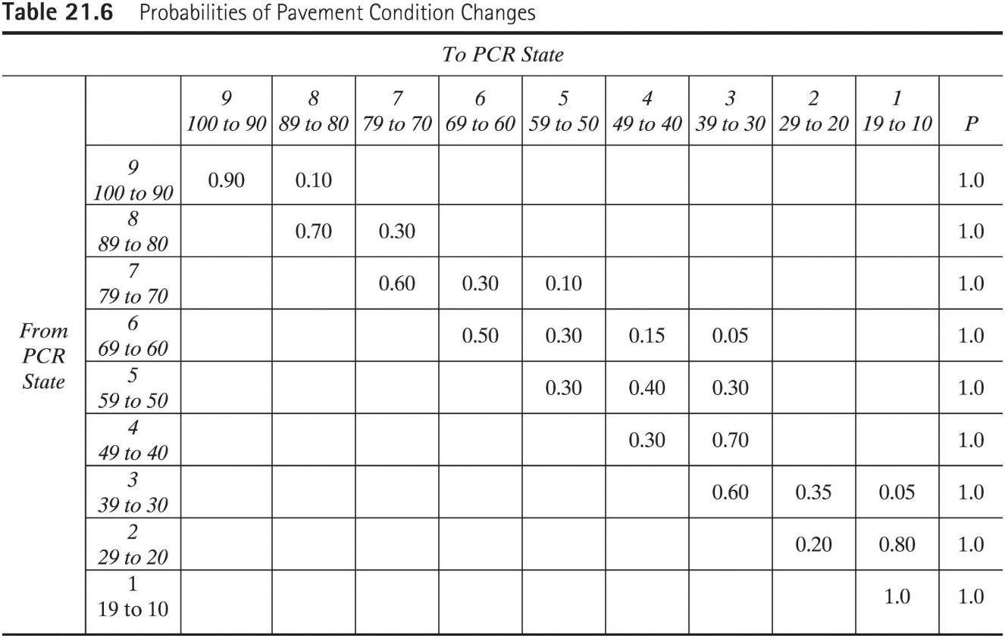
Markovian Probabilistic Model

Slide 3
In-class Example Problem
A state DOT district office is responsible for maintaining a network of 1000 miles. The results of the annual survey is a given year showed that the current network condition of these roads is:
Group 1: 600 mi with a PCR between 90 and 100
Group 2: 300 mi with a PCR between 80 and 89
Group 3: 100 mi with a PCR between 70 and 79
Using the probability matrix given in previous table, determine the condition of the network in year 1 and year 2.

Slide 4
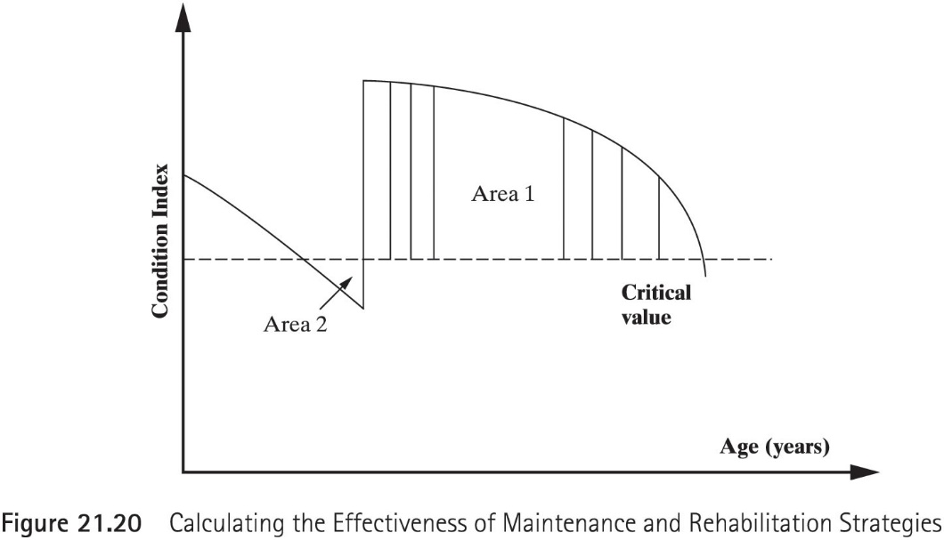
Effectiveness of Maintenance Strategies
$$Effectiveness Ratio=\frac{Effectiveness}{Cost}$$
$$Effectiveness=\left[Area 1 −area 2\right]∗AADT∗L$$

Slide 5
In-class Example Problem
The traffic volume of a 2-mile pavement section is 10,000 veh/day. The deterioration model is:
$$PASER=10−0.5∗Age$$
The city of fort Wayne policy is to maintain pavement section with a PASER < 5. Resurfacing the pavement section will increase the PASER a value of 9. After resurfacing the section is expected to deteriorate at a rate of 1.5 PASER points per year.
Determine the effectiveness of resurfacing the pavement section 12 years after construction. What would the effectiveness be if the resurfacing is postponed until year 13.

Slide 6
This class was finished in 45 minutes. Add quiz and more slides

