Slide 1
Trip Distribution
TAZ 1
1080 A
20 min
20 min
TAZ | Productions | Attractions
1 | 234 | 1080
2 | 76 | 531
3 | 602 | 76
4 | 432 | 47
5 | 472 | 82
7 min
TAZ 2
531 A
TAZ 3
10 min
76 A
602 P
TAZ 4
47 A
25 min
TAZ 5
82 A

Slide 2
Inputs and Outputs
Input
  Trip generation - productions & attractions (balanced by purpose)
  Path skimming - travel times or impedances
  Travel times in form of matrix, each cell represents time it takes to travel from one TAZ to another
Output of trip distribution model: trip table or OD matrix, each cell represents number of person trips between each zonal exchange

Slide 3
Trip Generation P & A per purpose
Impedance: Travel Time Matrix
TAZ | Productions | Attractions
1 | 234 | 1080
2 | 76 | 531
3 | 602 | 76
4 | 432 | 47
5 | 472 | 82
TAZ | 1 | 2 | 3 | 4 | 5
1 | 4 | 12 | 8 | 15 | 21
2 | 6 | 3 | 9 | 23 | 14
3 | 20 | 7 | 4 | 10 | 25
4 | 12 | 18 | 8 | 4 | 17
5 | 24 | 19 | 23 | 15 | 8
Trip Distribution
TAZ | 1 | 2 | 3 | 4 | 5
1 | 199 | 2 | 15 | 2 | 16
2 | 35 | 25 | 12 | 3 | 1
3 | 147 | 350 | 78 | 19 | 8
4 | 330 | 90 | 4 | 6 | 2
5 | 369 | 90 | 7 | 5 | 1
234
76
602
432
472
1816
Production
1080 531 76 47 82
Attraction

Slide 4
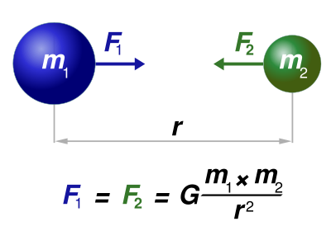
Method: Gravity Model
Adapted from Newton’s Law of Gravitation
  Gravitation force = f(mass & distance between two objects)
Applied to trip distribution
  Travel between two TAZs = f(relative attractiveness of TAZs & accessibility)
Determines number of trips being exchanged between two TAZs
Performed for all zonal interchanges in area

Slide 5
Gravity Model
P_{i}
T_{ij}
F_{ij}
T_{ij} = Trips from zone i to zone j
P_{i} = Trip production in zone i
A_{j} = Trip attraction in zone j
F_{ij} =Friction factor: Effect of travel time, distance & cost between zones i & j
K_{ij} = Socioeconomic factor
K_{ij}
A_{j}

Slide 6
Friction Factor F_{ij}
Represent travel time of impedance in gravity model
Express effects of spatial separation or accessibility on travel patterns
Must be calibrated: frequency of travel from trip distribution matches frequency observed in travel surveys
Assumed not to change for forecast year
Higher as travel time decreases
Differ by trip purposes
  HBW: largest, NHB: middle, HBO: smallest
Greater friction factor or # of attractions compared to other TAZs means greater relative attractiveness of TAZ

Slide 7
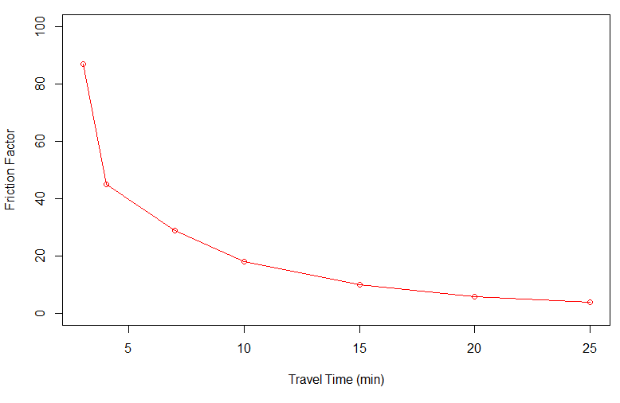
Friction Factor F_{ij}
Power function
Exponential function
Gamma function
Coefficient Estimation for Gamma Functions (Source: NCHRP 365)
Trip Purpose | a | b | c
HBW | 28,507 | -0.020 | -0.123
HBO | 139,173 | -1.285 | -0.094
NHB | 219,113 | -1.332 | -0.100

Slide 8
Intrazonal Travel Times
Generally not produced by software
Must be estimated
Determines # of trips staying within TAZ
Nearest neighbor technique:
Function of TAZ area & intrazonal speed
TT_{intra} – intrazonal TT (min)
TAZ_{area} – area of TAZ (mi²)
V_{intra} – intrazontal speed (mph)
CBD: V_{intra} = 15 mph
Rural: V_{intra} = 30 mph

Slide 9
K_{ij} Factor
Accounts for socioeconomic linkages not accounted for by gravity model
Accounts for variables other than travel time
i-j TAZ specific factor
If i-j pair has too many trips, use K-factor < 1.0
If i-j pair has too few trips, use K-factor > 1.0
K-factor = 0 → prohibit trip
Use with caution, decreases sensitivity of model to variables which may change over time

Slide 10
Trip Distribution, Example, Step 1
TAZ 1
1080 A
20 min
20 min
TAZ | Productions | Attractions
1 | 234 | 1080
2 | 76 | 531
3 | 602 | 76
4 | 432 | 47
5 | 472 | 82
7 min
TAZ 2
531 A
TAZ 3
10 min
76 A
602 P
TAZ 4
47 A
25 min
TAZ 5
82 A

Slide 11
Calculate Friction Factors, Step 2
Travel time (min) | Friction Factor
3 | 87
4 | 45
7 | 29
10 | 18
15 | 10
20 | 6
25 | 4
For TAZ 3:
Attraction TAZ | 1 | 2 | 3 | 4 | 5
TT | 20 | 7 | 4 | 10 | 25
F | 6 | 29 | 45 | 18 | 4
Intra-zonal travel time must be estimated since there is no network within zones

Slide 12
Calculate Attractiveness of Each TAZ, Step 3
i = production TAZ, j = attraction TAZ
Attraction TAZ | 1 | 2 | 3 | 4 | 5
A_{j} | 1,080 | 531 | 76 | 47 | 82
F_{ij} | 6 | 29 | 45 | 18 | 4
A_{j}*F_{ij} | 6,480 | 15,399 | 3,420 | 846 | 328
K_{ij} not given → assume K_{ij} = 1

Slide 13
Calculate Relative Attractiveness of Each TAZ, Step 4
Attraction TAZ | 1 | 2 | 3 | 4 | 5 | Total
A_{j}*F_{ij} | 6,480 | 15,399 | 3,420 | 846 | 328 | 26,473
Att_{rel j} | 6480 /26473 =0.2448 | 0.5817 | 0.1292 | 0.0319 | 0.0124 | 1.000

Slide 14
Distribute Productions to TAZs (apply Gravity Model), Step 5
P₃ = 602 (total production of TAZ 3)
TAZ | Relative attractiveness | Distributed Trips
1 | 0.2448 | 147
2 | 0.5817 | 350
3 | 0.1292 | 78
4 | 0.0319 | 19
5 | 0.0124 | 8
Total | 1.0000 | 602
Repeat 1 – 5 for each TAZ

Slide 15
Trip Distribution:
First Iteration, Step 6
TAZ 1
1080 A
147 trips
350 trips
TAZ 2
531 A
TAZ 3
19 trips
Intra-zonal
78 trips
A
TAZ 4
47 A
TAZ | 1 | 2 | 3 | 4 | 5
1 | 199 | 2 | 15 | 2 | 16
2 | 35 | 25 | 12 | 3 | 1
3 | 147 | 350 | 78 | 19 | 8
4 | 330 | 90 | 4 | 6 | 2
5 | 369 | 90 | 7 | 5 | 1
8 trips
P
TAZ 5
82 A

Slide 16
Adjust Attractions, Step 7
Compare
  # of attractions distributed to each TAZ
  # of attractions estimated from trip generation
Adjust
  In subsequent iterations, # of attractions used in gravity model for each TAZ is adjusted based on whether gravity model over or under estimated trips in previous iteration
  Iterations continues until two (closely) match (typically 4 to 5 iterations required)

