Slide 1
Mode Choice
OD MATRIX (MORNING PEAK PERIOD)
Trips | 1 | 2 | 3 | 4 | Total | Productions
1 | 5383 | 2553 | 5631 | 15120 | 28687 | 28687
2 | 2343 | 10000 | 4412 | 32908 | 49663 | 49663
3 | 3913 | 3340 | 36841 | 54960 | 99055 | 99055
4 | 175 | 414 | 913 | 12263 | 13765 | 13765
Total | 11814 | 16308 | 47797 | 115251 | 191170 | 191170
Available mode: auto and transit
Estimate the trip distribution by mode?

Slide 2
Binary Logit Model
U_{auto} = 1+0.003*Income/1000-0.04*TravelTime-0.24*Cost
U_{transit} = -3-0.001*Income/1000 -0.04*TravelTime-0.24*Cost

Slide 3
Example of Binary Logit Model
Passenger | Income | Travel Time | Cost | Mode
1 | 40000 | 13 | $ 3 | Bus
2 | 60000 | 10 | $ 4 | Auto
3 | 80000 | 10 | $ 5 | Auto
-
-
“In economics, utility function is an important concept that measures preferences over a set of goods and services.”

Slide 4
Binary Logit Model
Probabilities of selecting auto & transit modes:
P_{auto ij} = probability of selecting auto mode for trip from TAZ i to TAZ j
U_{auto ij} = utility of auto mode for trip from TAZ i to TAZ j: f (auto LOS ij, auto cost ij, income i…)
P_{transit ij} = probability of selecting transit mode for trip from TAZ i to TAZ j
U_{transit ij} = utility of transit mode for trip from TAZ i to TAZ j: f (transit LOS ij, transit cost ij, income i…)

Slide 5
Travel time and cost
ZONE DATA (CENSUS)
Zone | Households | Income | Cars | Size | Workers | Office space (ft^2) | Retail space (ft^2)
1 | 23,000 | 30,000 | 1.4 | 2.1 | 1.4 | 2.00E+06 | 5.00E+06
2 | 35,000 | 25,000 | 1.8 | 2.2 | 1.6 | 3.00E+06 | 1.50E+07
3 | 85,000 | 55,000 | 2.5 | 2.3 | 1.5 | 1.00E+07 | 1.00E+07
4 | 15,000 | 85,000 | 1.1 | 1.5 | 1.3 | 2.50E+07 | 2.00E+07
ZONE-TO-ZONE TRAVEL TIMES (CAR) |  |  |  |  |  |  | ZONE-TO-ZONE TRAVEL TIMES (BUS)
 | 1 | 2 | 3 | 4 |  |  |  | 1 | 2 | 3 | 4
1 | 5 | 13 | 17 | 33 |  |  | 1 | 13 | 20 | 35 | 45
2 | 13 | 5 | 25 | 15 |  |  | 2 | 20 | 7 | 55 | 23
3 | 17 | 25 | 5 | 14 |  |  | 3 | 35 | 55 | 10 | 30
4 | 33 | 15 | 14 | 5 |  |  | 4 | 45 | 23 | 30 | 5
ZONE-TO-ZONE COSTS (CAR) |  |  |  |  |  |  | ZONE-TO-ZONE TRAVEL COSTS (BUS)
 | 1 | 2 | 3 | 4 |  |  |  | 1 | 2 | 3 | 4
1 | 2.75 | 8.25 | 8.25 | 13.75 |  |  | 1 | 0.75 | 0.75 | 0.75 | 1.25
2 | 8.25 | 2.75 | 13.75 | 8.25 |  |  | 2 | 0.75 | 0.75 | 1.25 | 0.75
3 | 8.25 | 13.75 | 2.75 | 8.25 |  |  | 3 | 0.75 | 1.25 | 0.75 | 0.75
4 | 13.75 | 8.25 | 8.25 | 2.75 |  |  | 4 | 1.25 | 0.75 | 0.75 | 0.75

Slide 6
Another Example In-class acitivity
Travel characteristics between two zones
U = a_{k}– 0.35t₁ – 0.08t₂ – 0.005c
Trip distribution: total of 12,450 trips going from A to B

Slide 7
Modal Alternatives
Auto modes
SOV – single occupancy vehicle (drive alone)
HOV – high occupancy vehicle (carpool, vanpool…)
Auto + toll
Transit modes
Bus service (local, express, BRT, intercity)
Rail modes (streetcar, LRT, heavy rail, commuter rail)
Paratransit
Non-motorized modes
Walking, biking…

Slide 8
Mode Selection Attributes
Modal characteristics
LOS, in-vehicle travel times, access time, parking fee, tolls, transit fare, transfers, convenience, safety & security, comfort…
Traveler characteristics
Auto availability, HH income, gender, age, worker/student status, preference…
Area characteristic (build environment)
Density, design, distance to transit, pedestrian/bike/transit facilities, land use…

Slide 9
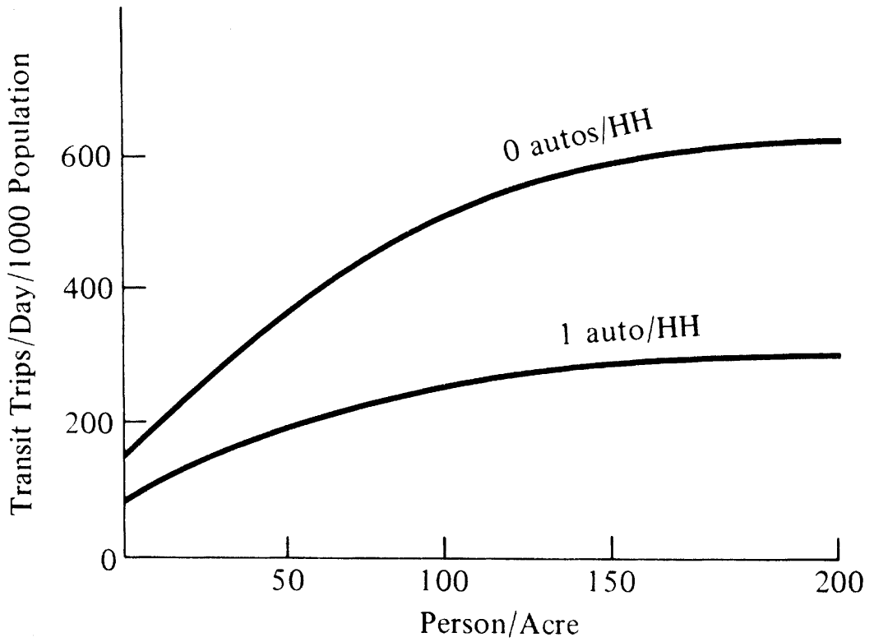
Another Method Direct Generation Model
Input:
5,000 population, 50 acres
(100 persons/acre)
40% 0 cars/HH
60% 1 car/HH
Source: THE, Garber & Hoel

Slide 10
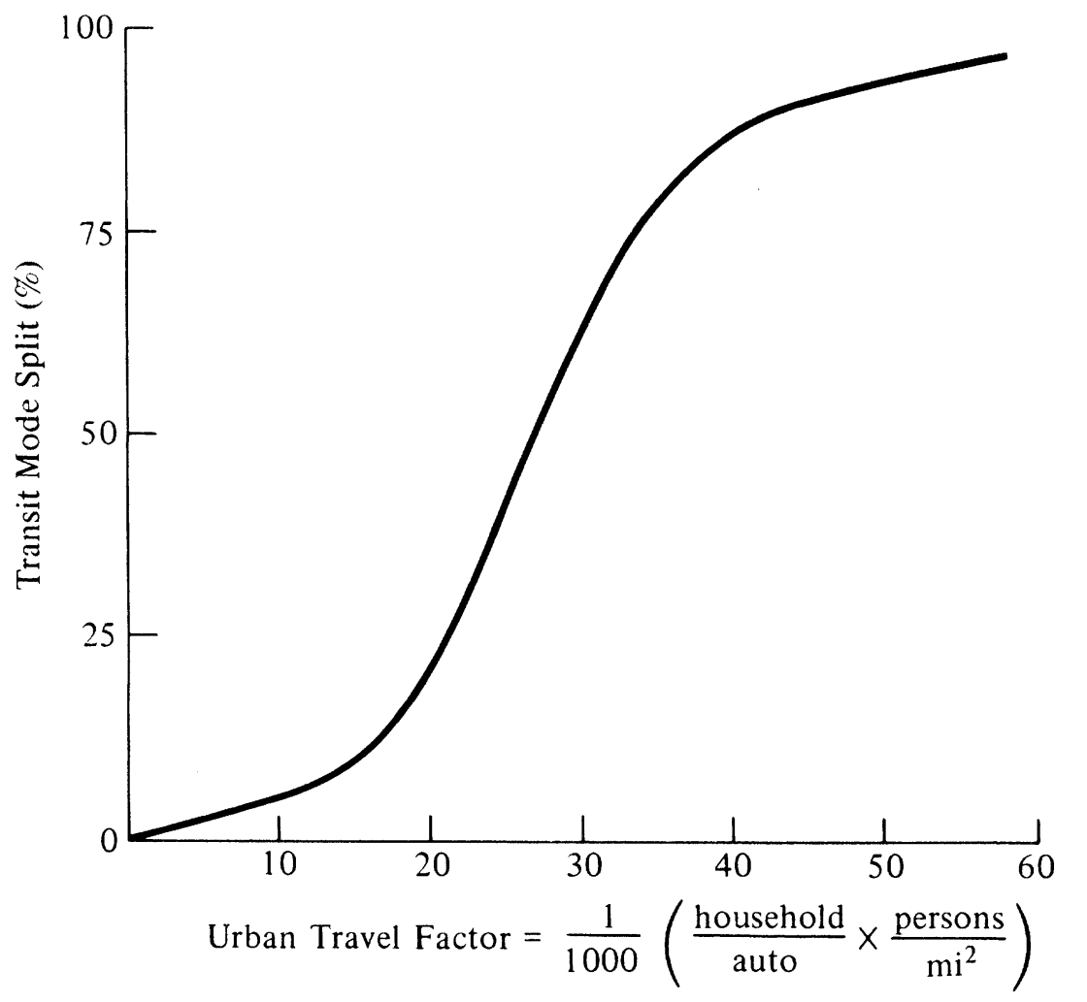
Another method Trip End Model
Input:
P_{TAZ} = 10,000 trips/day
1.80 HHs/auto
15,000 persons/mi²

