Slide 1
Traffic Impact Studies
“Impact studies recommend on- and off-site transportation improvements to improve access to the site as well as mitigate expected impacts”

Slide 2
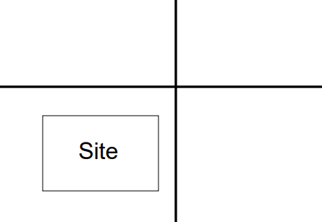
Traffic Impact Study / Assessment (TIA)
Example 1: New development
Example 2:

Slide 3
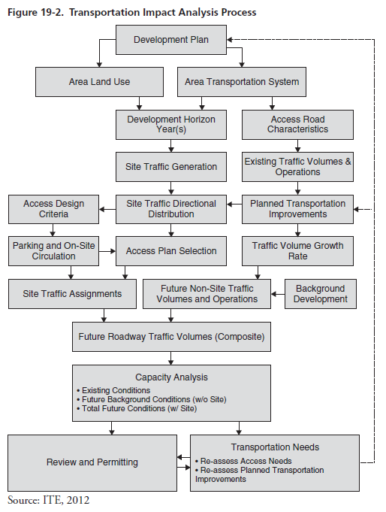
Transportation Impact Analysis Process

Slide 4
Study Area Boundaries

Slide 5
Study Area Boundaries
“A frequency used method is to carry the analysis boundaries to locations where site-generated traffic will represent 5% or more of the roadways peak-hour approach capacity.”
The study area includes critical intersections on the adjacent road network.

Slide 6
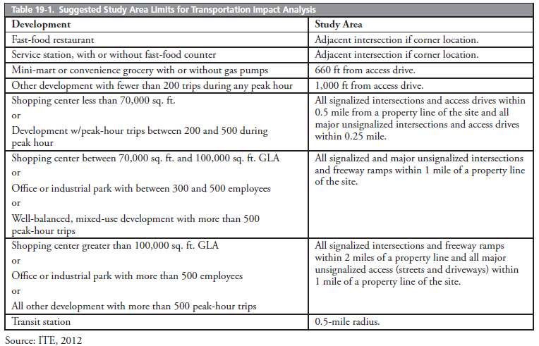
Study Area Boundaries

Slide 7
Horizon Years
The planning horizon year is the future year for estimating traffic impacts.
A general guide to set the planning year for when proposed developments will be fully operational and meeting their market goals, usually 3 to 5 years after opening day.

Slide 8
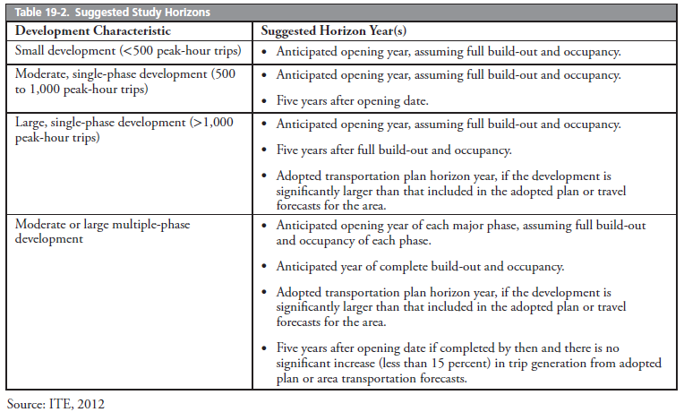
Horizon Years

Slide 9
Data on Existing Conditions
Traffic volumes
Land use
Demographics
Transportation systems
Trip distribution data
Crash data

Slide 10
Performance Measures
Existing LOS
LOS with Project
LOS without Project

Slide 11
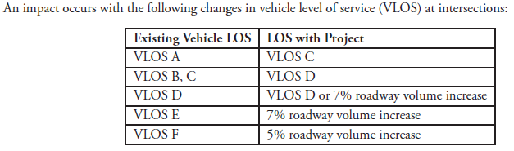
Performance Measures

Slide 12
Deliverables
Traffic Impact Letter
or
Traffic Impact Study
Notes:
According to Iowa DOT: A traffic impact letter is required if the AADT is less than or equal to 500 vehicles, and the peak-hour volume is less than or equal to 100 trips. Volumes over these thresholds require a traffic impact study.

Slide 13
Example of Traffic Impact Study

Slide 14
Problem Statement
Natrona County Schools is proposing to construct the new Kelly
Walsh High School on the site where the current building exists. There are currently 1,632 students at the school and the school is being designed for 2,000 students.

Slide 15
TIA will answer following questions:
What will the effect of a development to the surrounding transport facilities?
What is the additional traffic from the development?
What are the impacts due to the additional traffic?
How do you tackle the impact?

Slide 16
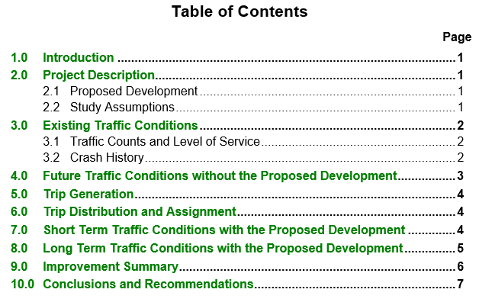
Typical TIA Report

Slide 17
1. Project Description
Site description
Study assumptions

Slide 18
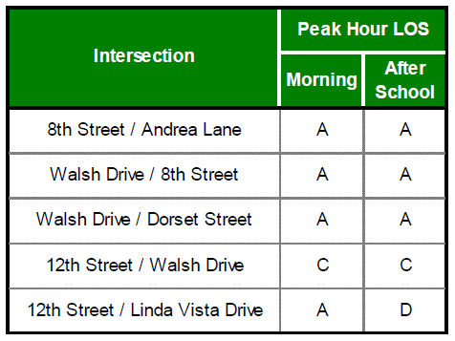
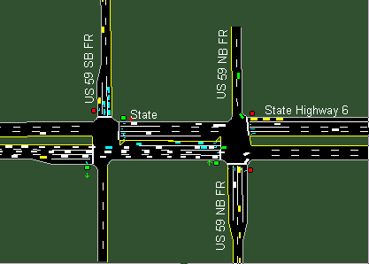
2. Existing Traffic Conditions
1. Traffic counts and level of service
Tutorial: https://www.youtube.com/watch?v=hVTc3GPUVV8

Slide 19
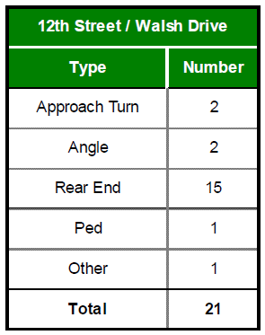
2. Existing Traffic Conditions
2. Crash History:
How many years?
Source?
Which roads?
Define intersection?
Address the problem.

Slide 20
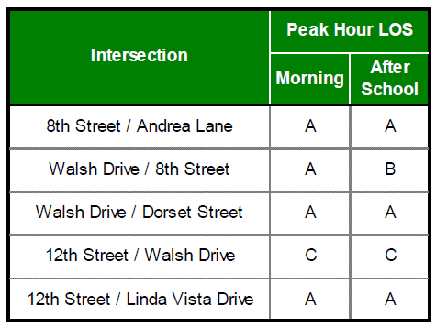
3. Future traffic without development
Level of Service (LOS) in 2038
Annual growth rate?

Slide 21
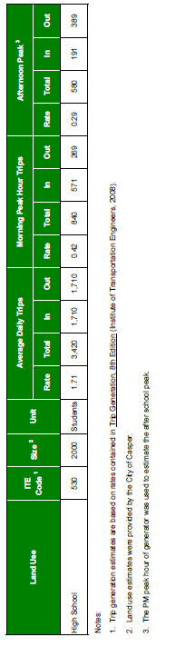
4. Trip Generation
Trip Generation Estimate

Slide 22
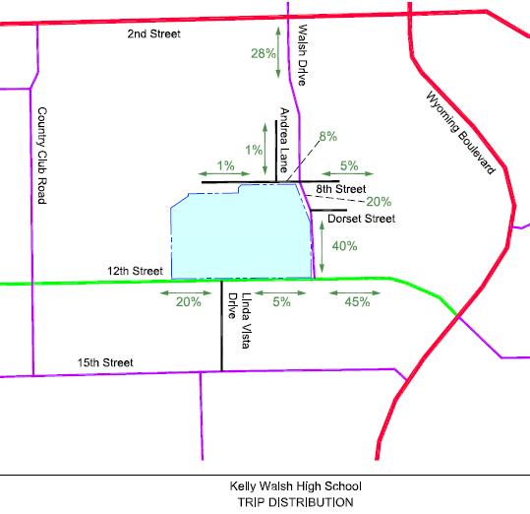
5. Trip Distribution and Assignment

Slide 23
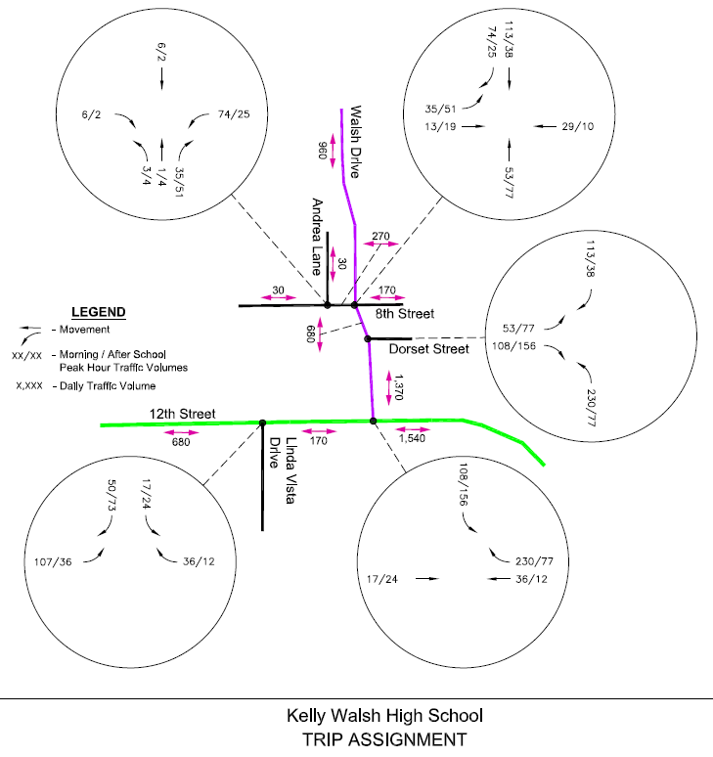
5. Trip Distribution and Assignment

Slide 24
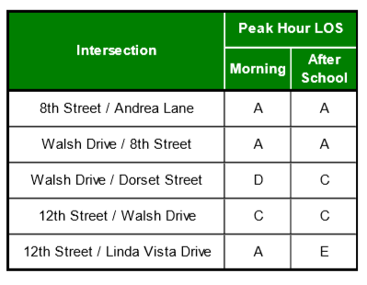
6. Access the Impact

Slide 25
6. Mitigation
Approaches should be expanded? Run Synchro for all the options separately. Conduct Benefit-to-Cost analysis to choose the final option.
  Add left turn?
  Add right turn?
  Add lane?
  Change the intersection control?

Slide 26
Review 4-step Model

