Slide 1
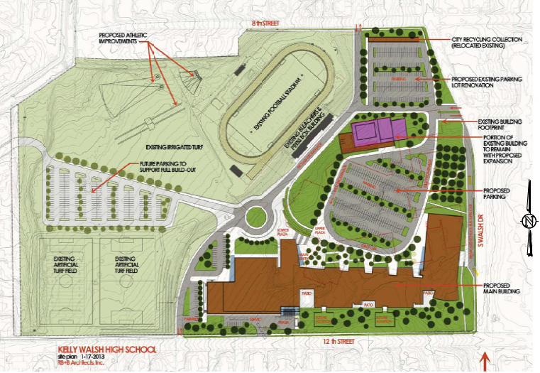
Proposed Development

Slide 2
Estimate Level of Service
LOS at existing condition
LOS in 25 years
LOS with development at existing
LOS with development in 25 years

