Slide 1
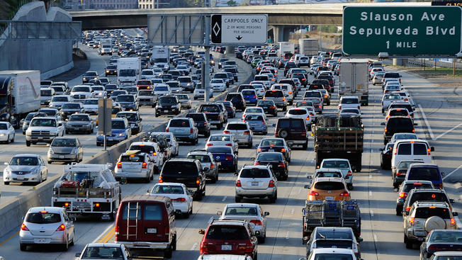
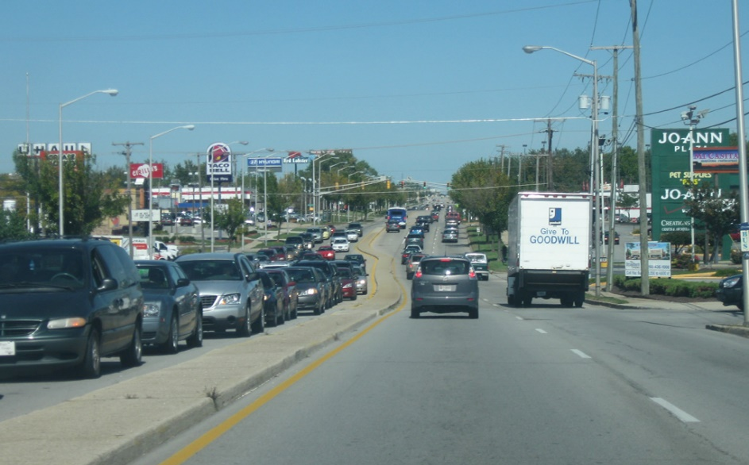
Congestion Management Process (CMP)
Los Angeles
Fort Wayne

Slide 2
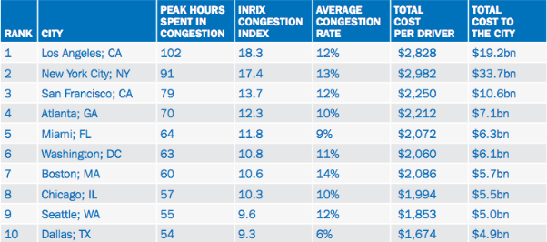
Top 10 congested cities in USA
Source: https://www.citylab.com/transportation/2018/02/traffics-mind-boggling-economic-toll/552488/
Congestion Costs: $305 billion in 2017

Slide 3
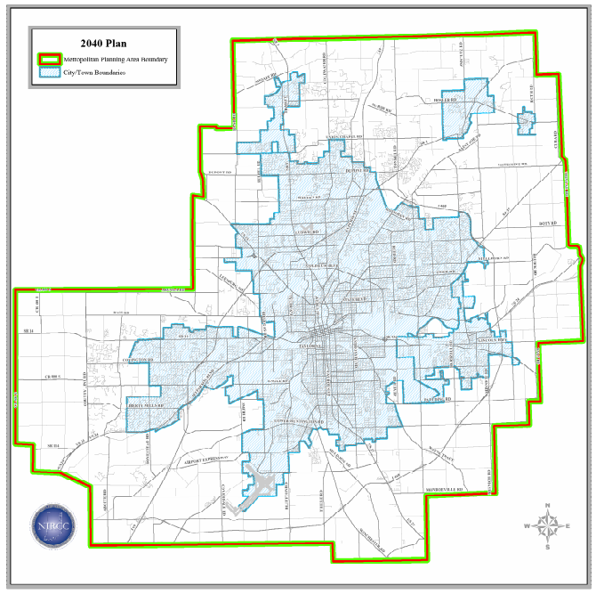
Define Congestion Management Network
Urban areas with populations over 200,000 have been directed to use the Metropolitan Planning Area boundaries for the Congestion Management Network.

Slide 4
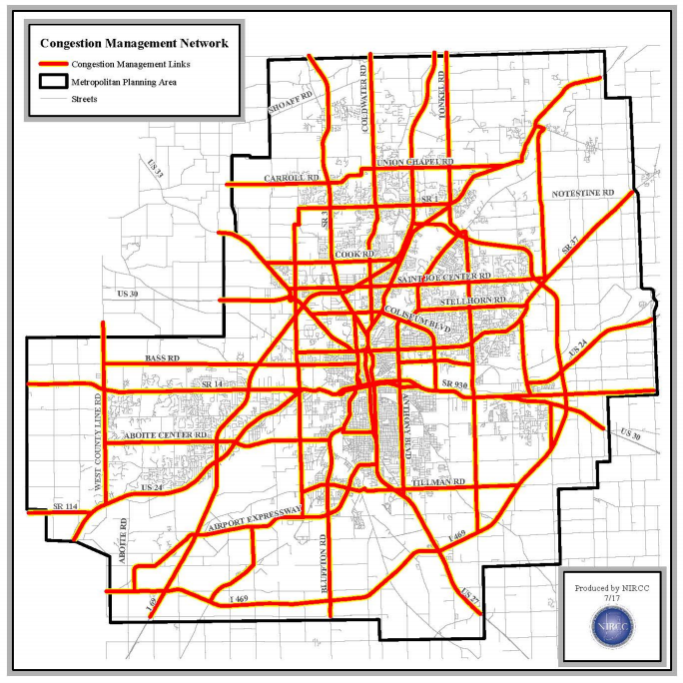
Congestion Management Network
Congestion Management Boundary
Congestion Management Network

Slide 5
System Performance Measures
The roadway system performance measures selected are as follows:
Percent of weekday peak hour vehicle miles traveled (VMT) with volume to capacity greater than “X” (“X” is a defined v/c threshold and can be translated to a level of service).
Total weekday peak hour vehicle miles traveled (VMT) with volume to capacity greater than “X” (“X” is a defined v/c threshold and can be translated to a level of service).

Slide 6
Establish System Performance Standards
Highway System:
LOS
A | Acceptable Service Levels
B
C
D
E | Unacceptable service levels
F

Slide 7
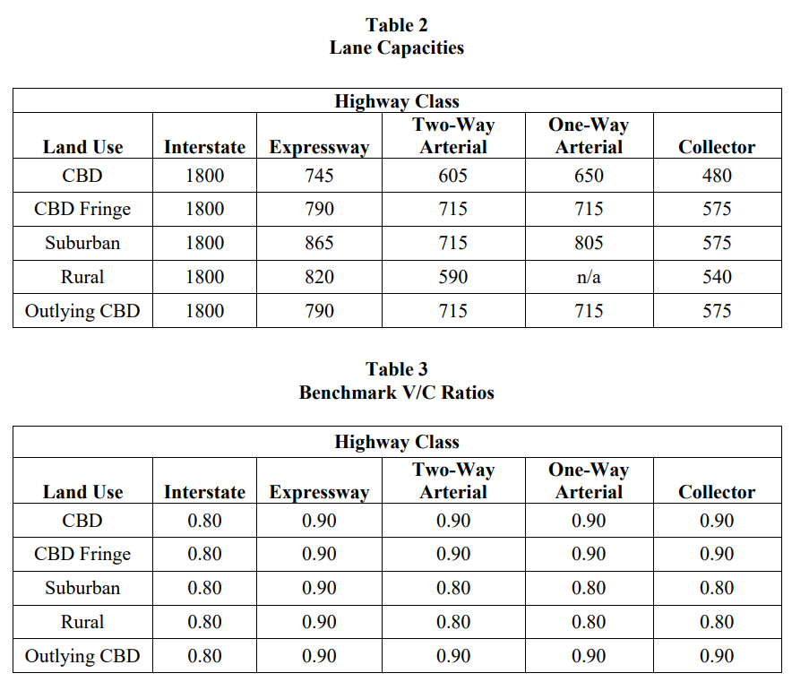
Lane Capacities and benchmark v/c ratios
The selected criteria indicate when congestion is approaching maximum capacities for LOS “D” and exceeding this level will result in volume to capacity ratios over 1.00.

Slide 8
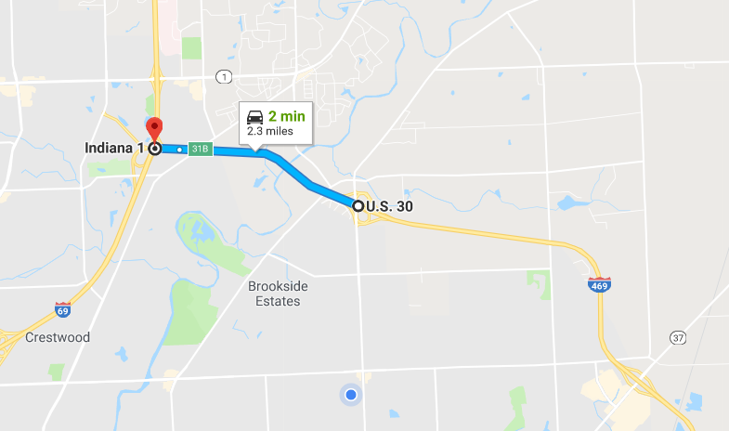
In-class Activity-3
Street | A street | B street | AM Peak Vol | PM Peak Vol | Length
Inter 469 | Maplecrest | Inter 69 | 2542 | 2522 | 2.26
Calculate AM V/C Ratio?
Is this roadway segment congested?

Slide 9
Example V/C Ratio
Street | A street | B street | AM Peak Vol | PM Peak Vol | Length | AM V/C Ratio | PM V/C Ratio
Inter 469 | Maplecrest | Inter 69 | 2542 | 2522 | 2.26 | 0.71 | 0.7
Calculate AM V/C Ratio?
Is this roadway segment congested?

Slide 10
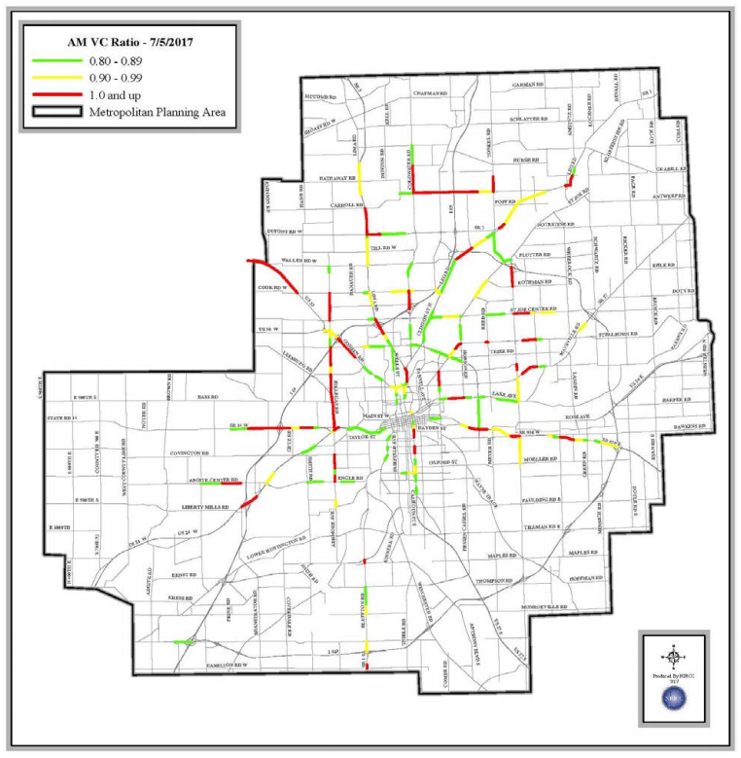
Congested Roadway Segments
Green: 0.8-0.89
Yellow: 0.9-0.99
Red: 1.0+

Slide 11
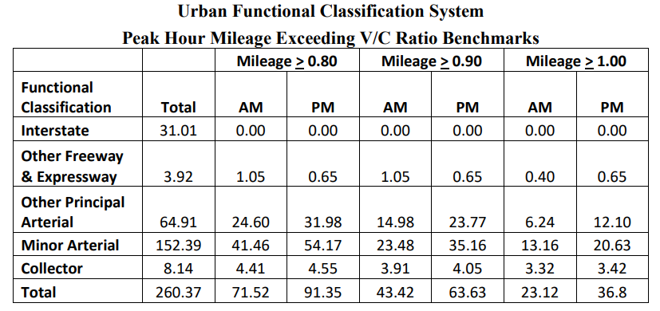
Congested Miles in Urban Area

Slide 12
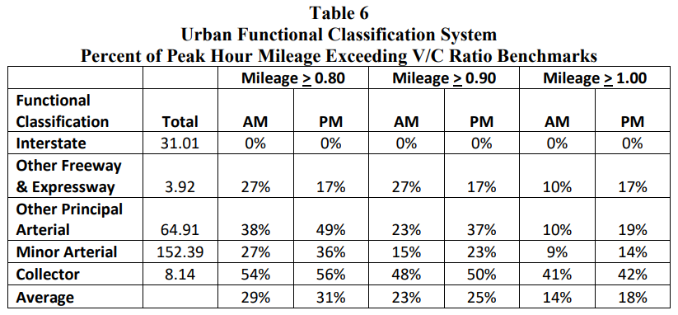
Congested Miles in Urban Area

Slide 13
Congestion Duration
So far, AM and PM peak hour analyzed. How about beyond peak hours?
High risk for congestion issues: locations with v/c rations greater than 0.9 for multiple hours.

Slide 14
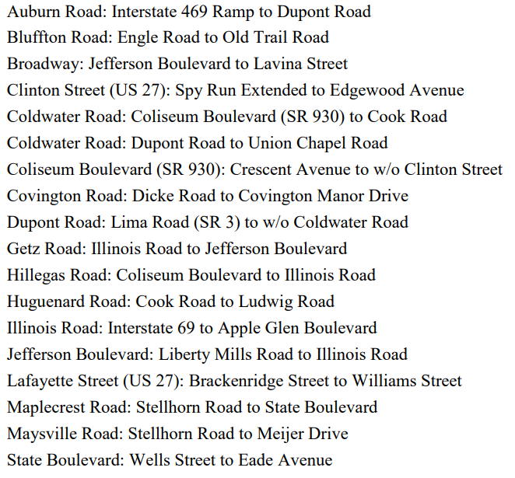
High Risk Congestion Corridors in Fort Wayne
Macro-level Analysis
Micro-level Analysis

Slide 15
Micro-level Analysis
Travel time and delay studies.
Intersection LOS analysis.
Safety analysis.
Corridor studies.

Slide 16
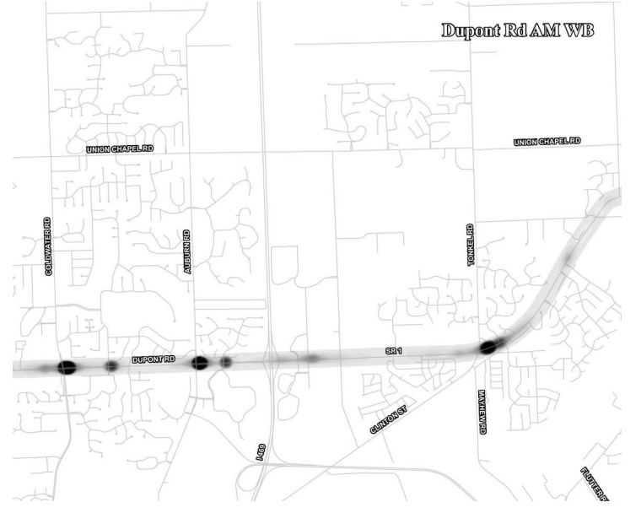
Travel time and Delay Study, example
Using GPS Technology

Slide 17
Comparison of 2012 and 2016 Travel Time and Delay

Slide 18
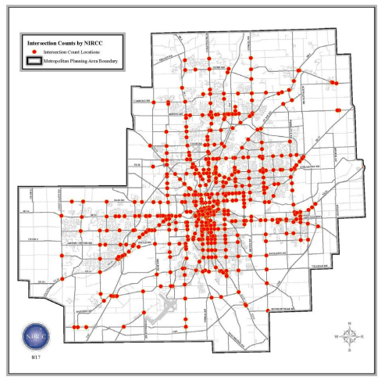
Intersection LOS
Signalized Intersections: 197
Non-signalized: 114

Slide 19
Intersection Analysis
Intersections that are predetermined to have a level of service “D” or less will also be evaluated to determine the number of queued vehicles that do not clear the intersection at the end of the analysis period.

Slide 20
Congestion mitigation strategies
Access management
https://www.youtube.com/watch?v=j58siSPT6S8
Frontage/access road plans
Corridor protection plans
Transit marketing
Bicycle access
Intersection improvements
Signal timing plans
ITS
Incident management

Slide 21
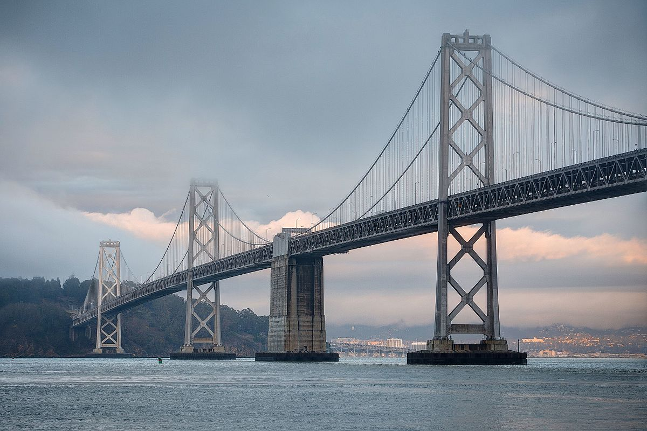
Common congestion management: toll
A toll bridge carries 5,000veh/day. The current toll is 150 cents. When the toll is increased by 25 cents, traffic volume decreases by 500 veh/day. Determine:
The amount of toll that should be charged such that revenue is maximized.
How much additional revenue will be received?

