Slide 1
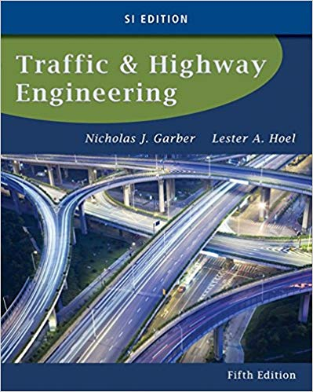
CE 34500 – Transportation Engineering
Chapter 3: Characteristics of the Driver, the Pedestrian, the Vehicle, and the Road

Slide 2
Vehicle Characteristics
Static
  Weight and size of vehicle
Kinematic
  Motion w/o considering forces that cause vehicle to move
Dynamic
  Forces that cause or retard motion of vehicle
Choice of Design Vehicle
  Has characteristics that encompass those of nearly all vehicles expected to use highway
Notes:
Static: Weight and size of the vehicle
Kinematic: Motion, without considering the forces that cause the vehicle to move—speed, accel/ decel rates, etc.
Dynamic: Forces that cause or retard the motion of the vehicle.
Designing any highway involves the selection of a design vehicle, whose characteristics will encompass those of nearly all vehicles expected to use the highway.
The characteristics of the design vehicle are then used to determine criteria for geometric design, intersection design and sight – distance requirements.

Slide 3
Vehicle Characteristics
Static Characteristics
  Size effects—lane & shoulder width, size of parking spaces, lengths of vertical curves, etc.
  Weight effects—pavement thickness, maximum grades, climbing lanes, etc.
Notes:
Size effects: Lane width, Shoulder width, Parking bays (all due to length and width of vehicle) and Lengths of vertical curves (due to eye height of driver in vehicle)
Weight effects: Pavement thickness (due to weight carried by each axle/ number of repetitions of axle load) and maximum grades and climbing lanes (due to the acceleration characteristics of particular vehicle).

Slide 4
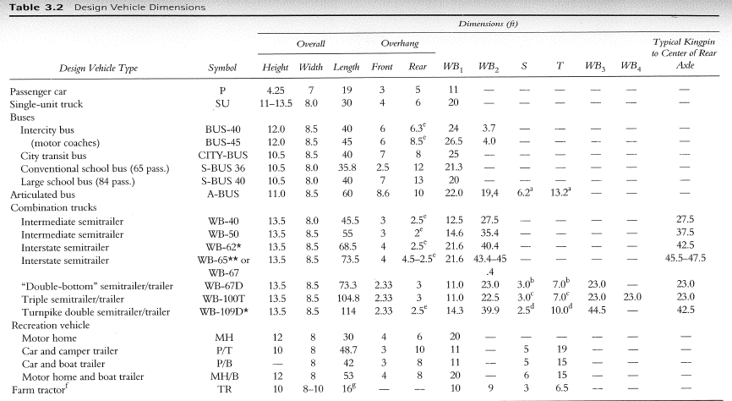
Vehicle Characteristics
Notes:
The AASHTO Green Book gives dimensions for 19 different design vehicles within four classes of vehicles—passenger cars, trucks, buses and recreational vehicles—plus farm tractor.
Examples of vehicles which encompass range of vehicle sizes that are “out there”:
Passenger car (P): Height = 4.3 ft., Width = 7 ft., Length = 19 ft.
Intermediate semi-trailer (WB-40): Height = 13.5 ft., Width = 8.0 ft., Length = 45.5 ft.
Interstate semi-trailer (WB-67): Height = 13.5 ft., Width = 8.5 ft., Length = 73.5 ft.
Triple-semi-trailer / trailers (WB-100T): Height = 13.5 ft., Width = 8.5 ft., Length = 104.8 ft.

Slide 5
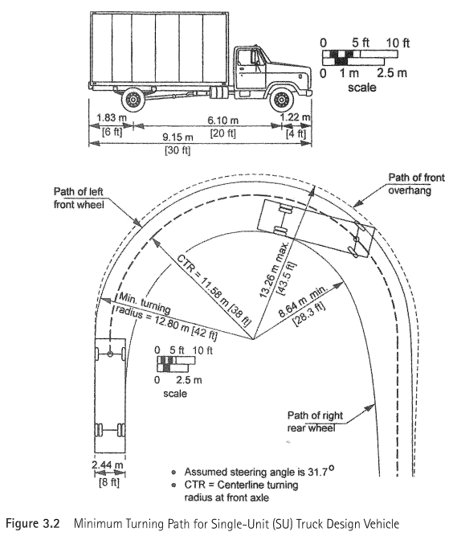
Notes:
The Green Book also gives low speed (<10 mph) turning-radii requirements for the different design vehicles, for use in such) things as intersection design.
Values given above are for the SU (Single Unit Truck) design vehicle (something like a UPS truck)—note the 38 ft. center turning radius and the modest amount of off-tracking (wider width between path of right rear wheel and front overhang—43.5 ft. – 28.3 ft.)
Could be used as the design vehicle for intersections on residential streets and park roads.

Slide 6
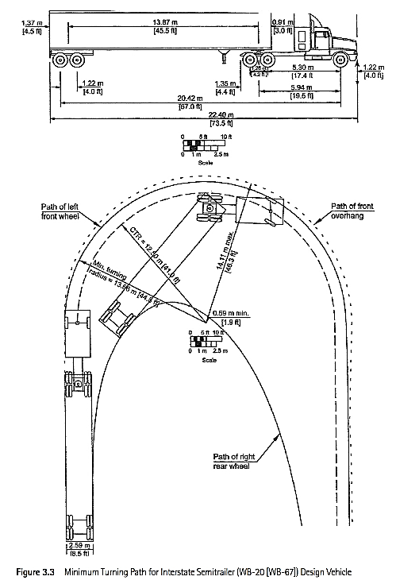
Notes:
As will be mentioned when we cover geometry of intersections, their layout is done with computer software—Autoturn—that allows the turning movements of the design vehicle to be superimposed on the proposed intersection.
Values given above are for the WB-67 (Wheel Base / length from front to rear axles)design vehicle (typical tractor trailer seen on the interstate)—note the 41 ft. center turning radius and the large amount of off-tracking (wider width between path of right rear wheel and front overhang).
Could be used as the design vehicle for intersections of freeway ramp terminals and arterial highways, and for intersections of state highways and industrial streets with high traffic volumes, etc.

Slide 7
Vehicle Characteristics
Acceleration & Deceleration
  Maximum Acceleration Rate
    Tractor-Trailer 1.0 to 2.8 ft/sec²
    Large Car 5.5 to 6.8 ft/sec²
    Sports Car 7.8 to 9.3 ft/sec²
  Braking Deceleration Rate
    Cars : 11.2 ft/sec² (Green Book / 90th percentile)
Notes:
The primary element among kinematic characteristics is the acceleration capability of the vehicle.
Acceleration capability is important in several traffic operations such as passing maneuvers, gap acceptance, etc.
Length of highway features such as freeway acceleration lanes, climbing lanes on grades, etc. are also governed by accel./ decal. capabilities of vehicles (RV’s, trucks, etc.)
Therefore, a study of the kinematic characteristics of the vehicle primarily involves a study of how accel / decel rates influence the elements of motion, such as velocity and distance.
Accel/ decel rates given above are taken from figures from text:
Heavily loaded truck (200 lb/hp): 1.0 to 1.80 ft/ sec^2 ( 0 to 10 mph & 0 to 50 mph)
Lightly loaded truck (100 lb/hp): 1.6 to 2.80 ft/ sec^2
Light, powerful passenger car (25 lb/hp): 7.8 to 9.3 ft/sec^2
Heavy, less powerful passenger car(35 lb/hp): 5.5 to 6.8 ft/ sec^2
AASHTO Green Book uses a deceleration rate of 11.2 ft/sec^2 to determine the braking distance for passenger cars–90th percentile value

Slide 8
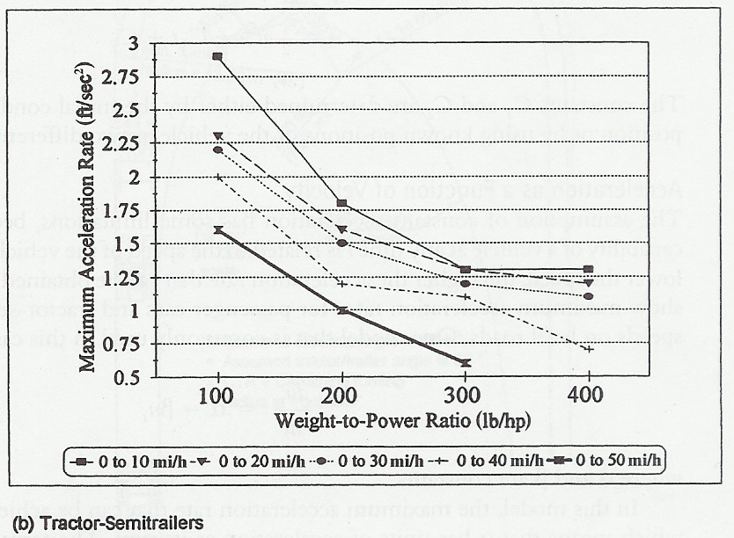
Vehicle Characteristics
Notes:
Fig 3.4 b from text—Tractors-semi-trailers
Note that, for a particular weight-to-power ratio, the acceleration rate decreases as the speed in increases—takes more power to overcome higher air resistance at higher speed
Max. accel. rate for a light/ high-powered car (25 lb/ hp) is 9.3 ft/sec^2 from 0 to 10 mph
Min. accel. rate for a heavy/ low-powered car (35 lb/ hp) is 5.5 ft/ sec^2 from 0 to 50 mph
However, trucks have much lower accel rates than cars—minimum of 1.0 ft/sec^2 for heavy, low-powered truck (200 lb/hp) to minimum of 0.6 ft/sec^2 for a very heavy/ very low-powered (300 lb/hp) truck from 0 to 50 mph.

Slide 9
Example 3.4

Slide 10
Vehicle Characteristics
Dynamic Characteristics
  Air Resistance
    From air in front and around vehicle
  Grade Resistance
    Component of weight when moving up hill
  Rolling Resistance
    Frictional effects on moving parts within the vehicle and between pavement and tires
Notes:
Slide is self-explanatory—but here are some details:
Air resistance:
Related to frontal area of vehicle, square of speed of vehicle, density of the air and aerodynamic drag coefficient.
Will give a more detailed explain on later slide.
Grade resistance:
When trucks encounter a grade they slow down, due to the effect of grade resistance-- especially low-powered, heavily loaded trucks.
The magnitude of this decrease in speed v. the length of grade over which it occurs is used to determine where climbing lanes should start.
Climbing lane design discussed very briefly on a later slide.
One of the topics presented in Geometric Design course.
Rolling resistance:
Forces within the vehicle itself that offer resistance to motion.
Forces are due mainly to frictional effects on moving parts of the vehicle, but they also include the frictional slip between the pavement surface and the tires. The rolling resistance depends on the speed of the vehicle and the type of pavement.
Rolling forces are relatively lower on smooth pavements than on rough pavements.

Slide 11
Vehicle Characteristics
Dynamic Characteristics
  Curve resistance
    Retarding force on front wheels which resist forward motion of vehicle
  Power requirements
    Sufficient to overcome sum of all resisting forces and put vehicle in motion
Notes:
Curve resistance:
Passenger car is maneuvered to take a curve, external forces act on the front wheels of the vehicle.
These forces have components that have a retarding effect on the forward motion of the vehicle.
Power requirements:
Power is the rate at which work is done.
The performance capability of a vehicle is measured in terms of the horsepower the engine can produce to overcome air, grade, curve, and friction resistance forces and put the vehicle in motion.

Slide 12
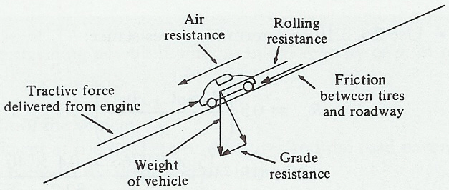
Vehicle Characteristics
Notes:
Figure 3.6
Text gives formulas to determine the lb of resistance due to each of the factors given previously/ shown on figure above.
For example: R_{d} = 0.5 * (2.15 * p * C_{D} * A * u²) / g
R_{d} = Air resistance force (lb)
p = Density of air (0.766 lb/ft^3 at sea level, less
at higher elevations)
C_{D} = Aerodynamic drag coefficient
Current value for cars is 0.4
Trucks range from 0.5 to 0.8, but a typical
value is 0.5
A = Frontal cross sectional area (ft^2)
u = Vehicle speed (mph)
g = Acceleration due to gravity = 32.2 ft/sec^2
The different resistance effects are summed to arrive at the total resistance (R) acting on a vehicle traveling a velocity of u (mph).
The horsepower (P) required to overcome R is :
P = (1.47 * R * u) / 550
Example 3.5 (partial) mentioned on previous slide.
Determine the horsepower produced by a passenger car traveling at a speed of 65 mi/h on a straight road of 5 percent grade with a smooth pavement. Assume the weight of the car is 4000 lb and the cross-sectional area of the car is 40 ft2.
The force produced by the car should be at least equal to the sum of the acting resistance forces.
R = (air resistance) +(rolling resistance) + upgrade resistance)
Use Eq. 3.13 to determine air resistance. Ra = 172.9 lb
Use Eq. 3.14 to determine rolling resistance.
Rr = 72 lb.
Grade resistance = 4000 x 5 / 100 = 200 lb
R = Ra + Rr + Grade resistance = 172.9 + 72 + 200 = 444.9 lb.
Use Eq. 3.17 to determine horsepower produced.
P = 1.47 x 444.9 x 65 / 550 = 77.3 hp

Slide 13
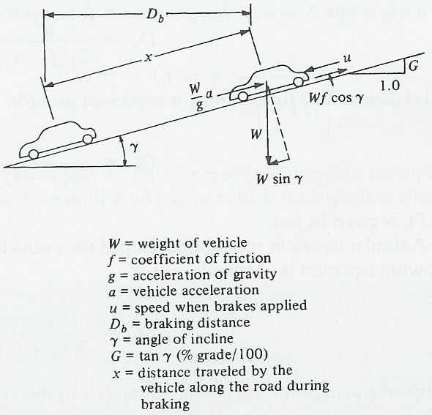
Vehicle Characteristics
Braking Distance
Notes:
Fig. 3.7 in text: Forces Acting on a Vehicle Braking on a Downgrade
Braking Distance
The action of the forces (shown in Figure 3.6) on the moving vehicle and the effect of perception-reaction time are used to determine important parameters related to the dynamic characteristics of the vehicles. These include the braking distance of a vehicle
See handwritten notes for derivation of the braking distance, reaction distance and stopping sight distance formulas, and for example problems in which these formulas are used.
Db = u^2 / ( 30 x (f +- G) )

Slide 14
Example 3.5

Slide 15
Vehicle Characteristics
Stopping Sight Distance Formula
  Stopping distance =
Reaction distance + Braking distance
  Reaction time = 2.5 sec. (>90th percentile)
  Braking deceleration rate = 11.2 ft/sec²
    Can be achieved by most drivers while retaining control of vehicle
    When most drivers make emergency stop, deceleration rate is >14.8 ft/sec²
Notes:
See handwritten notes for derivation of braking distance, reaction distance and stopping sight distance relationships.
The distance traveled by a vehicle between the time the driver observes an object in the vehicle’s path and the time the vehicle actually comes to rest is longer than the braking distance, since it includes the distance traveled during perception-reaction time. This distance is referred to in this text as the stopping sight distance S
Eqn 3.27 for S given on next slide
AASHTO also recommends that a deceleration rate of 11.2 ft/sec2 be used, as this is a comfortable deceleration rate for most drivers.
This rate is further justified because many studies have shown that when most drivers need to stop in an emergency, the rate of deceleration is greater than 14.8 ft/sec2.
As mentioned previously, the perception-reaction time recommended by AASHTO to determine the perception reaction distance is 2.5 sec.—90th - 95th percentile.

Slide 16
Stopping Sight Distance
Notes:
This formula is for:
u in mi/hr
t in sec.
a & g in ft/sec^2
G as a decimal
The values 1.47 and 30 incorporate all required units conversions

Slide 17
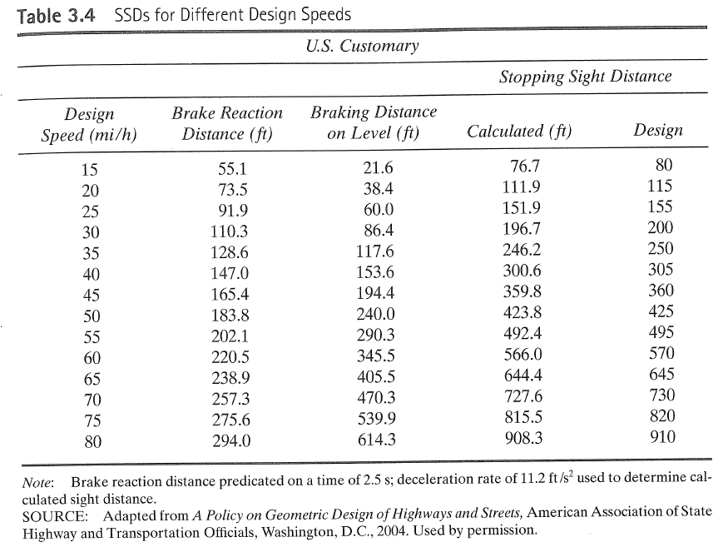
Stopping Sight Distance
Notes:
Table 3.4 in text: Stopping Sight Distances (SSD’s) for Different Speeds on Level Roads

Slide 18
Example 3.6, 3.7

Slide 19
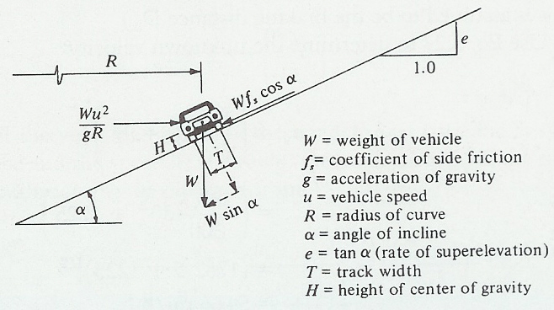
Minimum Radius of a Circular Curve
Notes:
Fig. 3.8 in text: Forces on a Vehicle traveling on a Horizontal Curve Section of Road
When a vehicle is moving around a circular curve, there is an inward radial force acting on the vehicle, usually referred to as the centrifugal force.
There is also an outward radial force acting toward the center of curvature as a result of the centripetal acceleration.
In order to balance the effect of the centripetal acceleration, the cross-slope of the road is inclined downward toward the center of the curve. The inclination of the roadway toward the center of the curve is known as superelevation.
See handwritten notes for derivation of the formula relating e, f, R and u, and for examples using this formula.

Slide 20
Minimum Radius of a Circular Curve
Minimum Curve Radius Formula
  Forces acting on vehicle
    Vehicle weight
    Friction force between tires & roadway
    Centrifugal force
  Sum of forces acting on vehicle parallel to roadway is zero
  Coefficient of “side friction”
    Based on driver comfort
    Given in Table 3.3
Notes:
See handwritten notes for derivation of the formula relating e, f, R and u, and for examples using this formula.

Slide 21
Minimum Radius of a Circular Curve
Minimum Curve Radius Formula
  Maximum Superelevation Rate
    Depends on various factors—rural or urban area, weather conditions, etc.
    Ranges from 0.12 to 0.04
    Maximum rate of 8% used in areas (e.g., Wyoming) which experience winter weather (snow and ice on roadway)
    Maximum rate of 4% used in urban areas to minimize effects on adjacent property, intersections, etc.
Notes:
See handwritten notes for the derivation of the circular curve formula given on this slide.
The minimum radius of a circular curve R for a vehicle traveling at u mi/h can be determined by considering the equilibrium of the forces on the vehicle in a direction parallel to the roadway.
When the vehicle is in equilibrium with respect to the incline (that is, the vehicle moves forward but neither up nor down the incline), equating the relevant forces results in the equations given on this slide.
Stipulated maximum values that should be used for either e or fs.
Several factors control the maximum value for the rate of superelevation, including
…the location of the highway (that is, whether it is in an urban or rural area),
…weather conditions (such as the occurrence of snow),
…the distribution of slow-moving traffic within the traffic stream.
For highways located in rural areas with no snow or ice, a maximum superelevation rate of 0.10 generally is used.
For highways located in rural areas with snow and ice, values ranging from 0.08 to 0.10 are used—WYDOT uses eMAX = 8% in areas that are not mountainous and 6% in mountainous areas.
Because of the relatively low speeds on local urban roads, these roads are usually not superelevated—WYDOT often uses a 2% normal crown section.
Side friction values are given on the next slide.

Slide 22
Minimum Radius of a Circular Curve
---------- Equations 3.33
---------- Equations 3.34
Notes:
See handwritten notes for the derivation of the circular curve formula given on this slide.
The minimum radius of a circular curve R for a vehicle traveling at u mi/h can be determined by considering the equilibrium of the forces on the vehicle in a direction parallel to the roadway.
When the vehicle is in equilibrium with respect to the incline (that is, the vehicle moves forward but neither up nor down the incline), equating the relevant forces results in the equations given on this slide.
Stipulated maximum values that should be used for either e or fs.
Several factors control the maximum value for the rate of superelevation, including
…the location of the highway (that is, whether it is in an urban or rural area),
…weather conditions (such as the occurrence of snow),
…the distribution of slow-moving traffic within the traffic stream.
For highways located in rural areas with no snow or ice, a maximum superelevation rate of 0.10 generally is used.
For highways located in rural areas with snow and ice, values ranging from 0.08 to 0.10 are used—WYDOT uses eMAX = 8% in areas that are not mountainous and 6% in mountainous areas.
Because of the relatively low speeds on local urban roads, these roads are usually not superelevated—WYDOT often uses a 2% normal crown section.
Side friction values are given on the next slide.

Slide 23
Coefficient of Side Friction
Table 3.3
Design Speed | Coefficient of Side Friction, f_{s}
30 | 0.2
40 | 0.16
50 | 0.14
60 | 0.12
70 | 0.10
Notes:
Side friction coefficients given in the AASHTO Green Book are based on observations of driver behavior and are comfortable levels of lateral acceleration/ force that are tolerated by most drivers—not the actual, sliding-impending coefficient of friction between the tires and the pavement.
Essentially, the coefficient of side friction can be regarded as the coefficient of friction between the driver’s butt and the seat, rather than between the tires and the pavement surface.
The values used for side friction, mainly vary with the design speed. Table 3.3 gives values recommended by AASHTO for speeds greater than 50 mph.
AASHTO side friction values for design speeds less than 50 mph are greater than the values given in the table;. for example, for 30 mph…
…0.20 from the 2011 Green Book v. 0.16 from table in text.

Slide 24
General Dynamics Formulas
General dynamics formulas
    V_{f} = v₀ + at
    d = v₀t + ½ at²
    V_{f} ² = v₀ ² + 2ad
Where,
    V_{f} = final velocity (ft/sec)
    v₀ = initial velocity (ft/sec)
    a = acceleration or deceleration rate (ft/sec²)
    t = time (sec)
    d = distance (feet)
Notes:
I prefer to solve accel/ braking problems using the fundamental principles of dynamics, rather than stuffing values in the formulas given above.

Slide 25
Vehicle Characteristics
Where,
W = overall gross weighted (nearest 500 lb)
L = extreme of any group of two or more consecutive axles (ft)
N = number of axles in group under consideration

Slide 26
Stopping Distance Formulas
Notes:
See handwritten notes for additional examples concerning braking distance, reaction distance and stopping sight distance.
Example 3.6
Traveling 55mph down 5% grade see accident. Stopped 30ft from accident--when did he see the accident? P-R time = 2.5 sec
a/g = 0.35
S = 1.47ut + u² / 30 (0.35 – 0.05)
S = 1.47 x 55 x 2.5 + 55² / (30 x 0.30)
S = 202.13 + 336.11
S = 538.2 ft
S + 30 = 568.2 ft

