Slide 1
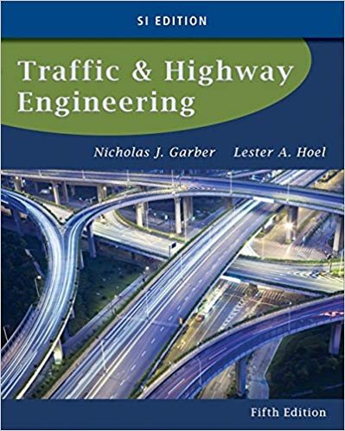
CE 34500 – Transportation Engineering
Chapter 8: Intersection Control

Slide 2
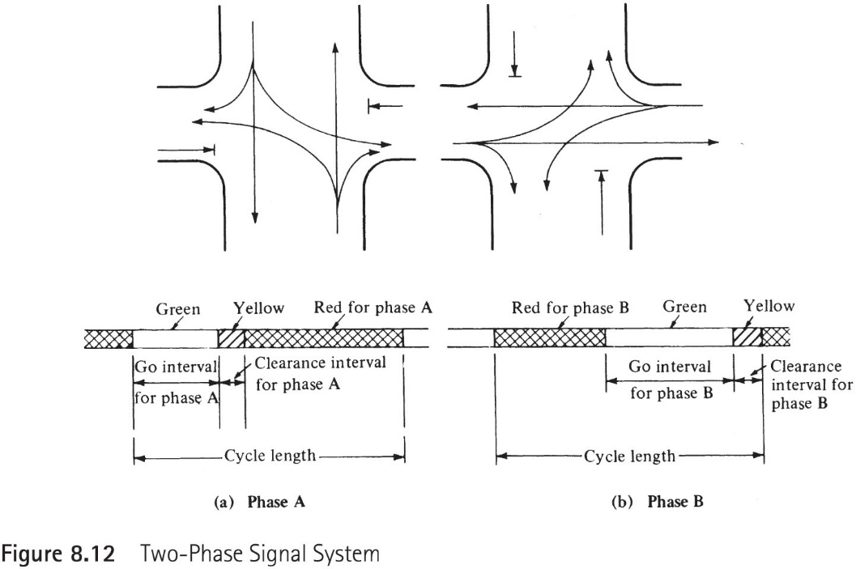
Two-phase signal system

Slide 3
Define terms that are most commonly used in signal timing
Controller: A device that changes the color indicated by the signal.
Cycle length: The time required for one complete color sequence of signal indication.
Signal Phase: Part of the cycle allocated to a stream of traffic.
Change and Clearance interval: yellow and all-red signal indications to clear the intersection.

Slide 4
Define terms that are most commonly used in signal timing
Peak-hour factor:
$$PHF=\frac{Volume during peak hour}{4∗volume during peak 15\min{within peak hour}}$$
$$DHV=\frac{Peak hour volume}{PHF}$$

Slide 5
Example 8.4

Slide 6
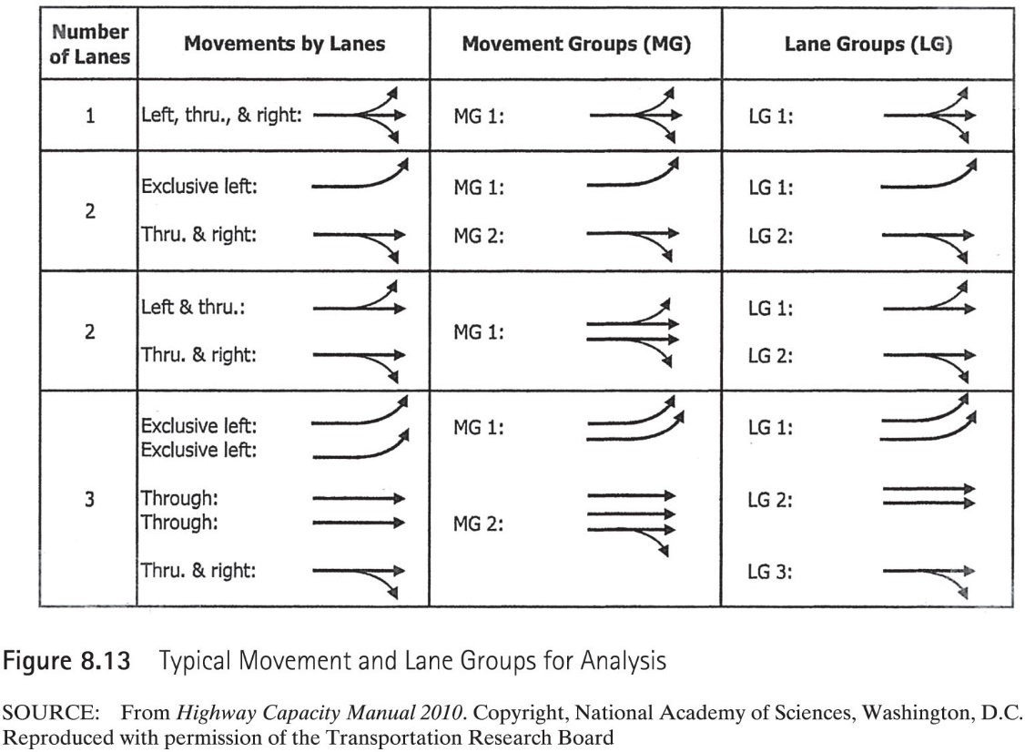
Typical Lane groups for Analysis

Slide 7
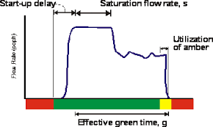
Critical Lane Group: The lane group that requires the longest green time in a phase.
Saturation flow rate:

Slide 8

Example 8.5
$$Y_{min}=δ+\frac{W+L}{u_{0}}+\frac{u_{0}}{2\left(a+Gg\right)}$$

Slide 9
Example 8.6

