Slide 1
4 Heap and Heapsort

Slide 2
When a ≤ b, we say that a is related to b.
  This does not imply that b is also related to a, because the relation need not be symmetric.).
A partial order is a binary relation ≤ over a set P satisfying particular axioms:
the relation ≤ is reflexive, antisymmetric and transitive.
For all a, b, and c in P, the relation ≤ must satisfy:
a ≤ a (reflexivity: every element is related to itself).
If a ≤ b and b ≤ a, then a = b (antisymmetry: two distinct elements cannot be related in both directions).
If a ≤ b and b ≤ c, then a ≤ c (transitivity: if a first element is related to a second element, which is, in turn, related to a third element, then the first element is related to the third element).
In other words, a partial order is an antisymmetric preorder.
1
3
(1, 2, 3)

Slide 3
Heaps and Heapsort
Priority queues:
  implemented based on partially ordered data structure.
A priority queue is
  a multiset of items with an orderable characteristic (an item’s priority), with the following operations:
    Finding an item with the highest (i.e., largest or lowest) priority
    Deleting an item with the highest priority
    Adding a new item to the multiset.
Applications: Operation systems’ Scheduling job executions, traffic management by communication networks; Prim’s algorithm, Dijkstra’s algorithm, Huffman encoding, branch-and-bound applications.

Slide 4
Notion of the Heap
Definition:
A heap (a data structure) can be defined as
  a binary tree with keys assigned to its nodes (one key per node) satisfied the following two conditions:
  1. The tree’s shape requirement:
    the binary tree is essentially complete:
      all its levels are full except possibly the last level, where only some rightmost leaves may be missing.
  2. The parental dominance requirement: It is
  a max-heap if it requires the key at each node to be greater than or equal to the keys at its children, or
  a min-heap if it requires the key at each node to be less than or equal to the keys at its children.

Slide 5
Consider the trees of Figure 6.9.
The tree’s shape requirement:
The parental dominance requirement:
10
1 2 3 4 5 6
5
7
10 | 5 | 7 | 4 | 2 | 1
2i and 2i+1
4
2
1
An example of a heap.
  A complete binary tree and max heap.
The tree has height two;
The tree is stored in an array.
  e.g., The node at index 3 has a value 7.

Slide 6
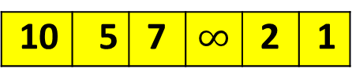
Consider the trees of Figure 6.9.
10
5
7
10 | 5 | 7 | $$∞$$ | 2 | 1
2
1
This is not a heap, because the tree’s shape requirement is violated.
  All its levels are full except possibly the last level, where only some rightmost leaves may be missing.

Slide 7
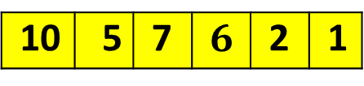
Consider the trees of Figure 6.9.
10
5
7
10 | 5 | 7 | $$6$$ | 2 | 1
6
2
1
It is not a heap, because the parental dominance requirement is violated.
  The binary tree fails to be a max heap for the node with key 5 is less than one of its child node with key 6.

Slide 8
Heap
In a max or min heap,
  Key values in a heap are ordered top down:
  no left-to-right order in key values;

Slide 9
Important properties of heaps:
There exists exactly one essentially complete binary tree with n nodes, with height └ log₂ n ┘.
As a max heap, the root of a heap always has its largest element.
Every subtree of a heap is also a heap.
...

Slide 10
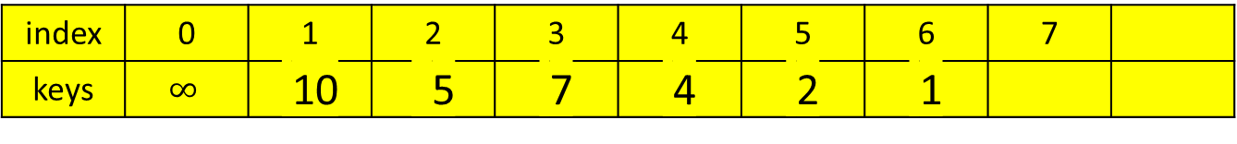
Important properties of heaps:
A heap can be implemented as an array H[0..n] by
  recording its elements in the top down, left-to-right fashion.
  Store the heap’s elements in position 1 through n of the array H[0..n],
position 1
2 3
4 5 6 7
index | 0 | 1 | 2 | 3 | 4 | 5 | 6 | 7
keys | $$∞$$ | 10 | 5 | 7 | 4 | 2 | 1
2i and 2i+1

Slide 11
Important properties of heaps:
In array representation H[0 .. n] of a heap,
  The parental node keys will be in the first └ n/2 ┘ positions of the array, while the leaf keys will occupy the last ┌ n/2 ┐ positions;
    e.g., if n = 7 then
      └ 7/2 ┘= 3 positions will be parental node keys {1, 2, 3}
      and ┌ 7/2 ┐ = 4 positions will be the leaf keys. {4, 5, 6, 7}
  If a parental key is in the array’s parental position i (1 ≤ i ≤ └n/2┘),
    the children of this parental key will be in positions 2i and 2i+1.
  Conversely, if the child key is in position i (2 ≤ i ≤ n),
    the parent of this key will be in position └ i /2 ┘.
position 1
2 3
4 5 6 7

Slide 12
Figure 6.10. Heap and its array representation
10
The array representation
index
1 2 3 4 5 6
5
7
 | 10 | 5 | 7 | 4 | 2 | 1
value parents leaves
4
2
1
An example of a heap.
  A complete binary tree and max heap.
The tree has height of two;
The tree is stored in an array.

Slide 13
The first └n/2┘ = 3 positions are parents nodes keys
The leaf keys occupy the last ┌ n/2 ┐ = 3 positions.
If n = 7, then the leaf keys will occupy the last ┌n/2┐ = 4 positions
The children of the key = 5 in the array’s position i = 2, ( 1 ≤ i ≤ └n/2┘) are in the positions 2i and 2i +1, that is 2*2 = 4 and 2*2 + 1 = 5, which contain keys 4 and 2, respectively.
10
5
7
4
2
1

Slide 14
Define a max heap as an array H[1..n] in which every element (key) in position i in the first half of the array is greater than or equal to the elements (keys) in position 2i and 2i + 1, i.e.,
H[i] ≥ max{H[2i], H[2i+1]} for i = 1, 2, ….,└n/2┘
(the contents at i, 2i and 2i+1).
If 2i + 1 > n (i.e., if 2i = n is the last location), --- test the last loc.
  only H[i] ≥ H[2i] needs to be satisfied.
For heaps as binary trees, their actual implementations are usually much simpler and more efficient with arrays.

Slide 15

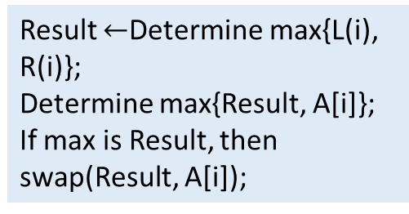
Maintaining the heap property
Max-Heapify (a procedure for manipulating max-heaps):
  Its inputs are an array A and an index i into the array, A[0..i..n], 0 < i.
  When Max-Heapify is called,
    assume that the binary trees rooted at LEFT(i) and RIGHT(i) are max-heaps,
    but that A[i] may be smaller than its children, thus violating the max-heap property.
    The function of Max-Heapify is
      to let the value at A[i] “float down” in the max-heap
      so that the subtree rooted at index i becomes a max-heap.
A[i]
LEFT(i) RIGHT(i)
Result $←$Determine max{L(i), R(i)};
Determine max{Result, A[i]};
If max is Result, then swap(Result, A[i]);
Determine the larger content between LEFT(i) and RIGHT(i) to yield the result.
Determine the larger content between the result and A[i].
If the result is larger, then swap the contents of the result and A[i].

Slide 16

Max-Heapify(A, i)
// the root node of the left/right tree of the node i
left ← LEFT(i);
right ← RIGHT(i);
//the root node(index) is within size-bound,
//if the value of the root node, A[i], A[left] > A[i]
if (left ≤ heap-size[A] and A[left] > A[i])
then largest ← left
else largest ← i;
//if A[right] > max{A[left], A[i]}
if (right ≤ heap-size[A] and A[right] > A[largest])
then largest ← right;
if (largest ≠ i)
then {exchange(A[i], A[largest]);
Max-Heapify(A, largest)};
//quest A(largest) downward
A[i]
A[left] A[right]
Find out which of the A[i] and A[left] is larger? Then name the larger one as A[largest], where largest has the value of i or left.
Then, determine which of the A[right] and A[largest] is larger? If A[right] is larger than A[largest] then largest has the value of right.
Finally, if largest is not i, then swap A[i] and A[largest] where largest can be left or right.
Then call Max-Heapify(A, largest) to ensure that the A[largest] is a max heap.
Determine largest = index(max {A[i], A[left], A[right]})

Slide 17
Figure 6.2 shows the action of Max-Heapify(A, 2), where heap-size[A] = 10.
The initial configuration: at node i = 2 A[2] violates the max-heap property since it is not larger than both children, A[4] and A[5].
Assume that it’s A[left(2)] and A[right(2)] are max-heaps.
(a)
Algorithm: Compare A[2] and A[4] for pick up the larger one.
Compare max{A[2], A[4]} and A[5].
Or another way:
Compare A[4] and A[5] for pick up the larger one.
Compare max{A[4], A[5]} and A[2].
1 16
2 4 3 10
4 14 5 7 6 9 7 3
8 2 9 8 10 1
$$∞$$ | 16 | 4 | 10 | 14 | 7 | 9 | 3 | 2 | 8 | 1
$$0$$ | 1 | 2 | 3 | 4 | 5 | 6 | 7 | 8 | 9 | 10

Slide 18
The max-heap property is restored for node 2 in (b) by exchanging A[2] and A[4], which destroys the max-heap property for node 4. The recursive call Max-Heapify(A, 4) now has i = 4.
(b)
After exchanging the contents of A[2] and A[4], the algorithm continues to check its left(2) = 4’s subtree.
Algorithm: Compare A[4] and A[8] for pick up the larger one.
Compare max{A[4], A[8]} and A[9].
Or another way:
Compare A[8] and A[9] for pick up the larger one. Then, compare max{A[8], A[9]} and A[4].
1 16
2 14 3 10
4 4 5 7 6 9 7 3
8 2 9 8 10 1
$$∞$$ | 16 | 4 | 10 | 14 | 7 | 9 | 3 | 2 | 8 | 1
$$∞$$ | 16 | 14 | 10 | 4 | 7 | 9 | 3 | 2 | 8 | 1
$$0$$ | 1 | 2 | 3 | 4 | 5 | 6 | 7 | 8 | 9 | 10

Slide 19
After swapping A[4] and A[9], as shown in (c), node 4 is fixed up, and the recursive call Max-Heapify(A, 9) yields no further change to the data structure.
1 16
(c)
2 14 3 10
4 8 5 7 6 9 7 3
$$∞$$ | 16 | 14 | 10 | 4 | 7 | 9 | 3 | 2 | 8 | 1
8 2 9 4 10 1
$$∞$$ | 16 | 14 | 10 | 8 | 7 | 9 | 3 | 2 | 4 | 1
$$0$$ | 1 | 2 | 3 | 4 | 5 | 6 | 7 | 8 | 9 | 10

Slide 20
The running time of Max-Heapify on a subtree of size n rooted at given node i is the Θ(1) time to fix up the relationship among the elements A[i], A[LEFT(i)], and A[RIGHT(i)], plus the time to run Max-Heapify on a subtree rooted at one of the children of node i.
The children’s subtrees each have a size at most 2n/3 – the worst case occurs when the bottom level of the tree is exactly half full – and the running time of Max-Heapify can be described by the
T(n) ≤ T(2n/3) + Θ(1).
[e.g, if h = 4, A[left(i)] rooted subtree has 15 nodes, and the half full A[i] rooted tree has 23 nodes. That is 15/23 about 2/3]
The solution to this recurrence, by case 2 of the Master Theorem, is T(n) = O(└ log₂n ┘). Alternatively, we can characterize the running time of Max-Heapify on a node of height h as O(h). [1 = n^{d} implied d =0; a =1, b = 3/2, a = b^{d}, T(n) = n^{d} log₂ n]
15+15 – 7 = 23

Slide 21
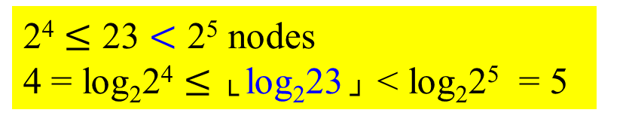
2⁴ $≤$ 23 $<$ 2⁵ nodes
4 = log₂2⁴ $≤$ └ log₂23 ┘ < log₂2⁵ = 5
the worst case
15 nodes
h = 4 for 23 nodes

Slide 22
Heap Construction
Construct a heap for a given list of keys:
Two principal alternatives of doing this:
  The bottom-up heap construction algorithm
  The top-down heap construction algorithm

Slide 23
The bottom-up heap construction algorithm
Figure 6.11. Bottom-up construction of a heap for the given list 2, 9, 7, 6, 5, 8.
Run Heap Heapify from └ lengthA[ ]/2 ┘ to 1, to determine their children node, A[2i] or A[2i+1].
2
2
9
7
9
8
6
5
8
6
5
7
2, 9, 7, 6, 5, 8, -
2, 9, 8, 6, 5, 7, -

Slide 24
The bottom-up heap construction algorithm
Figure 6.11. Bottom-up construction of a heap for the given list 2, 9, 7, 6, 5, 8.
2
2
9
8
9
8
6
5
7
6
5
7
2, 9, 8, 6, 5, 7, -
2, 9, 8, 6, 5, 7, -

Slide 25
The bottom-up heap construction algorithm
Figure 6.11. Bottom-up construction of a heap for the given list 2, 9, 7, 6, 5, 8.
9
9
2
8
6
8
6
5
7
2
5
7
9, 2, 8, 6, 5, 7, -
9, 6, 8, 2, 5, 7, -

Slide 26
The bottom-up heap construction algorithm
Algorithm HeapBottomUp(A[1 .. n])
heap-size[A] ← length[A];
for (i ← └length[A]/2┘ downto 1) do {
Max-Heapify(A, i);}

Slide 27
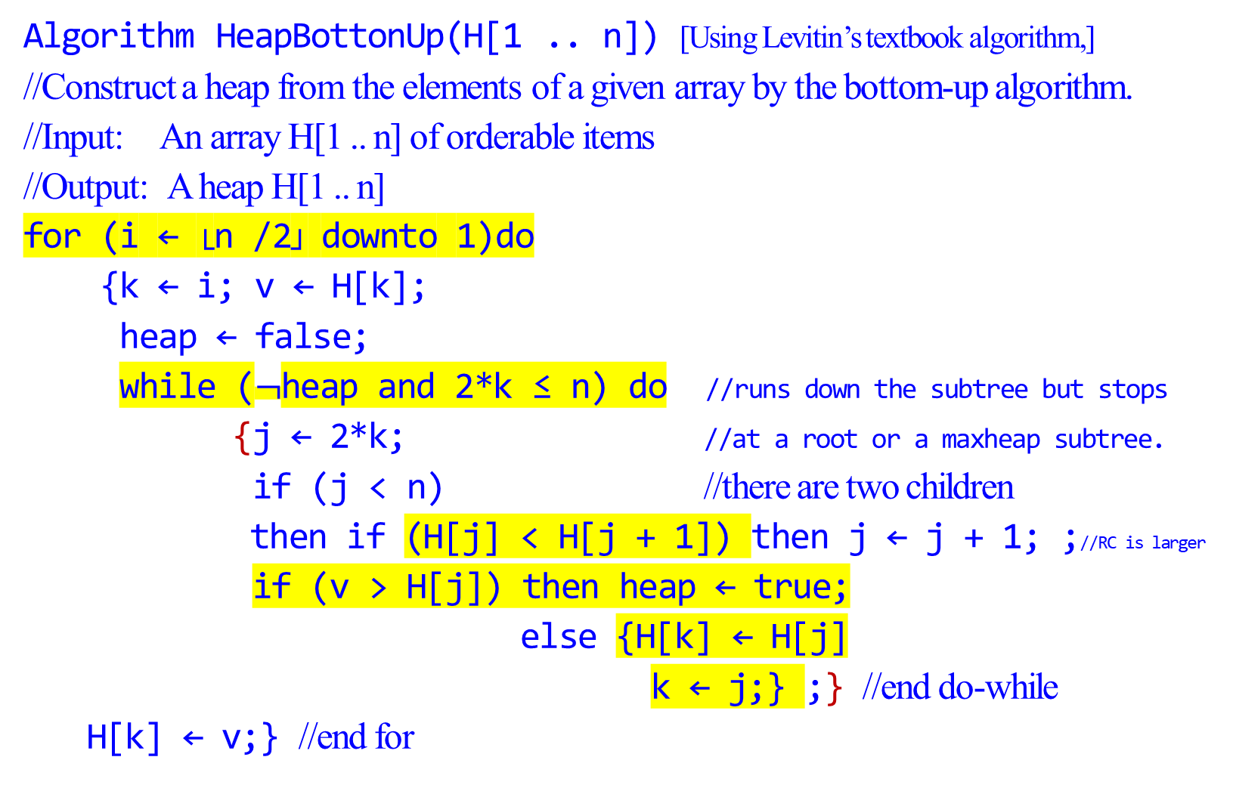
Algorithm HeapBottonUp(H[1 .. n]) [Using Levitin’s textbook algorithm,]
//Construct a heap from the elements of a given array by the bottom-up algorithm.
//Input: An array H[1 .. n] of orderable items
//Output: A heap H[1 .. n]
for (i ← └n /2┘ downto 1)do
{k ← i; v ← H[k];
heap ← false;
while ($¬$heap and 2*k ≤ n) do //runs down the subtree but stops
{j ← 2*k; //at a root or a maxheap subtree.
if (j < n) //there are two children
then if (H[j] < H[j + 1]) then j ← j + 1; ;//RC is larger
if (v > H[j]) then heap ← true;
else {H[k] ← H[j]
k ← j;} ;} //end do-while
H[k] ← v;} //end for
2, 9, 7, 6, 5, 8, -
If LC < RC then j points to RC
If root H[k]< larger Child then heap else store larger Child to the root H[k]

Slide 28
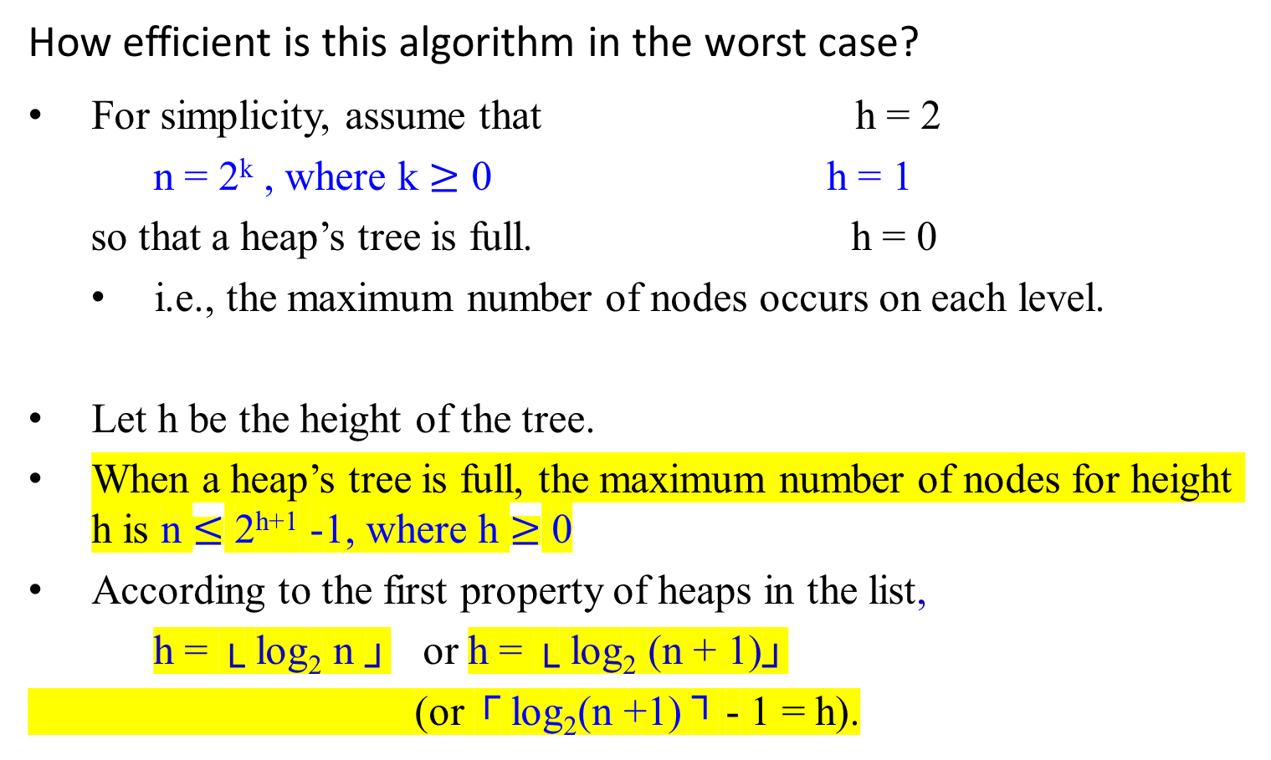
k = 0 (1 node)
k = 1 (2 nodes)
k = 2 (4 nodes)
k = 3 (8 nodes)
k = 4 (16 nodes)
How efficient is this algorithm in the worst case?
For simplicity, assume that h = 2
n = 2^{k} , where k $≥$ 0 h = 1
so that a heap’s tree is full. h = 0
  i.e., the maximum number of nodes occurs on each level.
Let h be the height of the tree.
When a heap’s tree is full, the maximum number of nodes for height h is n $≤$ 2^{h+1} -1, where h $≥$ 0
According to the first property of heaps in the list,
h = └ log₂ n ┘ or h = └ log₂ (n + 1)┘
(or ┌ log₂(n +1) ┐ - 1 = h).

Slide 29
In the worst case of the heap construction algorithm,
  each key on level i of the tree will travel to the leaf level h.
  Since moving to the next level down requires two comparisons:
    one to find the largest child and
    the other to determine whether the exchange is required.
  the total number of key comparisons involving a key on level i with be 2(h - i).
  Ex: consider 1 2 3 4 5 6 7 8 9 10, 11, 12, 13 14 15. 3 is on level 1. h = 3.
  number of comparisons needed = 2(3-1) = 4 comparisons.
  C(6, 7), C(3, 7), C(14, 15) and C(7, 15)

Slide 30
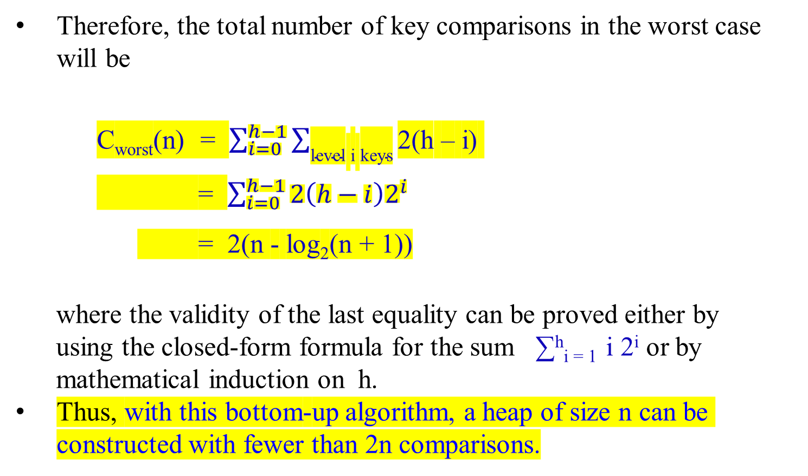
Therefore, the total number of key comparisons in the worst case will be
    C_{worst}(n) = $\sum_{i=0}^{h−1}{\sum_{\text{level} \text{i} \text{keys}}{\text{2(}\text{h}\text{ – }\text{i}\text{) }}}$
    = $\sum_{i=0}^{h−1}{{2\left(h−i\right)2}^{i}}$
    = 2(n - log₂(n + 1))
where the validity of the last equality can be proved either by
using the closed-form formula for the sum ∑^{h}_{i = 1} i 2^{i} or by
mathematical induction on h.
Thus, with this bottom-up algorithm, a heap of size n can be constructed with fewer than 2n comparisons.
2
9
7
6
5
8

Slide 31
Figure 6-3 is an example of the action of HeapBottomUp(A[1..n]).
Figure 6.3 The operation of HeapBottomUp(A[1..n]), showing the data structure before the call to Max-heapify in line 3 of HeapBottomUp(A[1..n]).
A 10 element input array A and the binary tree it represents.
The figure shows that the loop index i refers to node 5 before
the call Max-Heapify(A, i).

Slide 32
A
4 | 1 | 3 | 2 | 16 | 9 | 10 | 14 | 8 | 7
4 | 1 | 3 | 2 | 16 | 9 | 10 | 14 | 8 | 7
1 4
(a)
2 1 3 3
4 2 5 16 6 9 7 10
8 14 9 8 10 7

Slide 33
A
4 | 1 | 3 | 2 | 16 | 9 | 10 | 14 | 8 | 7
1 4
(b)
2 1 3 3
4 2 5 16 6 9 7 10
8 14 9 8 10 7
(b) The data structure that results.
The loop index i for the next iteration refers to node 4.

Slide 34
(c) – (e ) Subsequent iterations of the for loop in HeapBottomUp(A[1..n]).
Observe that when Max-Heapify is called on a node, the two
subtrees of that node are both max-heaps.

Slide 35
4 | 1 | 3 | 2 | 16 | 9 | 10 | 14 | 8 | 7
A
4 | 1 | 3 | 14 | 16 | 9 | 10 | 2 | 8 | 7
4 | 1 | 3 | 14 | 16 | 9 | 10 | 2 | 8 | 7
1 4
(c)
2 1 3 3
4 14 5 16 6 9 7 10
8 2 9 8 10 7

Slide 36
4 | 1 | 3 | 14 | 16 | 9 | 10 | 2 | 8 | 7
A
4 | 1 | 10 | 14 | 16 | 9 | 3 | 2 | 8 | 7
4 | 1 | 10 | 14 | 16 | 9 | 3 | 2 | 8 | 7
1 4
(d)
2 1 3 10
4 14 5 16 6 9 7 3
8 2 9 8 10 7

Slide 37
A
4 | 1 | 10 | 14 | 16 | 9 | 3 | 2 | 8 | 7
4 | 16 | 10 | 14 | 1 | 9 | 3 | 2 | 8 | 7
4 | 16 | 10 | 14 | 1 | 9 | 3 | 2 | 8 | 7
1 4
(e)
2 16 3 10
4 14 5 7 6 9 7 3
4 | 16 | 10 | 14 | 7 | 9 | 3 | 2 | 8 | 1
8 2 9 8 10 1
4 | 16 | 10 | 14 | 7 | 9 | 3 | 2 | 8 | 1

Slide 38
4 | 16 | 10 | 14 | 7 | 9 | 3 | 2 | 8 | 1
A
16 | 4 | 10 | 14 | 7 | 9 | 3 | 2 | 8 | 1
16 | 4 | 10 | 14 | 7 | 9 | 3 | 2 | 8 | 1
16 | 14 | 10 | 4 | 7 | 9 | 3 | 2 | 8 | 1
1 16
(f) The max-heap after
HeapBottomUp(A[1..n])
finishes.
At A[5], it is a max subtree, stop going down to the bottom.
2 14 3 10
4 8 5 7 6 9 7 3
16 | 14 | 10 | 8 | 7 | 9 | 3 | 2 | 4 | 1
8 2 9 4 10 1
16 | 14 | 10 | 8 | 7 | 9 | 3 | 2 | 4 | 1

Slide 39

The top-down heap construction algorithm
Construct a heap by successive insertion of a new key K into a previously constructed heap.
First, attach a new node with key K in it after the last leaf of the existing heap.
Then sift K up to its appropriate place in the new heap as follows:
  Compare K with its parent’s key:
    if the latter is greater than or equal to K, stop (the structure is a heap);
    otherwise,
      swap these two keys and compare K with its new parent.
      This swapping continues until K is not greater than its last parent or it reaches the root.
In this algorithm, we can sift up an empty node until it reaches its proper position, where it will get K’s value.

Slide 40
Figure 6.12: Inserting a key 10 into the heap constructed in Figure 6.11.
The new key is shifted up via a swap with its parent until
it is not larger than its parent (or is in the root).
9
9
6
8
6
10
2
5
7
10
2
5
7
8
The order of their arrival: 2, 9, 7, 6, 5, 8, 10

Slide 41
Figure 6.12: Inserting a key 10 into the heap constructed in Figure 6.11.
The new key is shifted up via a swap with its parent until
it is not larger than its parent (or is in the root).
9
10
6
10
6
9
2
5
7
8
2
5
7
8
2, 9, 7, 6, 5, 8, 10

Slide 42
This insertion operation requires key comparisons no more than the heap’s height.
The time efficiency of insertion is in O(log₂ n), since the height of a heap with n nodes is about log₂ n.

Slide 43
Delete an item from a heap
Consider only the important case of deleting the root’s key,
leaving the question about deleting an arbitrary key in a heap for an exercise.

Slide 44
Maximum Key Deletion from a Heap
Step 1: Exchange the root’s key with the last key K of the heap.
Step 2: Decrease the heap’s size by 1.
Step 3: “Max-Heapify” the smaller tree by sifting K down the
tree exactly in the same way as it is done in the bottom-
up heap construction algorithm.
      i.e., verify the parental dominance for K:
        if it holds, we are done;
        if not, swap K with the larger of its children and repeat this operation until the parental dominance condition holds for K in its new position.

Slide 45
The efficiency of deletion from a heap
The efficiency of deletion is determined by
  the number of key comparisons needed to heapify the tree after the swap has been made and
  the size of the tree is decreased by 1.
  the time efficiency of deletion is in O(log n) as well,
    since it requires key comparisons no more than twice the heap’s height,

Slide 46
Heapsort
Heapsort [discovered by J. W. J. Williams]
A two-stage algorithm:
Stage 1 (heap construction):
  Construct a heap for a given array (Apply Max-Heapify)
Stage 2 (maximum deletions):
  Apply the root-deletion operation n-1 times to the remaining heap.
  As a result, the array elements are eliminated in decreasing order.
    Under the array implementation of heaps,
      an element being deleted is placed last in the remaining heap;
      the resulting array will be exactly the original array sorted in ascending order.

Slide 47
Heapsort
Heapsort(A)
HeapBottomUp(A[1..n]); //Build-Max-Heap(A) (1st Max-Heapify)
for (i ← length[A] downto 2) do
{ exchange(A[1], A[i]); //place the root-deleted
//one to the last in the remaining heap
heap-size[A] ← heapsize[A] – 1;
Max-Heapify(A, 1);} //end for (2nd Max-Heapify)
The procedure Heapsort(A) takes time O(nlog n), since
  the call to HeapBottomUp(A[1..n]) takes time O(n) and
  each of the n-1 calls to Max-Heapify takes time O(log n).

Slide 48
Algorithm HeapBottomUp(A[1 .. n])
heap-size[A] ← length[A];
for (i ← └length[A]/2┘ downto 1) do {
Max-Heapify(A, i);}
(1st Max-Heapify)
  the call to HeapBottomUp(A[1..n]) takes time O(n)
  each of the n-1 calls to Max-Heapify takes time O(log n).

Slide 49

Max-Heapify(A, i) - Max-Heapify takes time O(log n).
// the root node of the left/right tree of the node i
left ← LEFT(i);
right ← RIGHT(i);
//the root node(index) is within size-bound,
//if the value of the root node, A[i], A[left] > A[i]
if (left ≤ heap-size[A] and A[left] > A[i])
then largest ← left
else largest ← i;
//if A[right] > max{A[left], A[i]}
if (right ≤ heap-size[A] and A[right] > A[largest])
then largest ← right;
if (largest ≠ i)
then {exchange(A[i], A[largest]);
Max-Heapify(A, largest)};
A[i]
A[left] A[right]
Find out which of the A[i] and A[left] is larger? Then name the larger one as A[largest], where the largest has the value of i or left.
Then, determine which of the A[right] and A[largest] is larger? If A[right] is larger than A[largest] then the largest has the value of right.
Finally, if the largest is not i, then swap A[i] and A[largest] where the largest can be left or right.
Then call Max-Heapify(A, largest) to ensure that the A[largest] is a max heap.

Slide 50
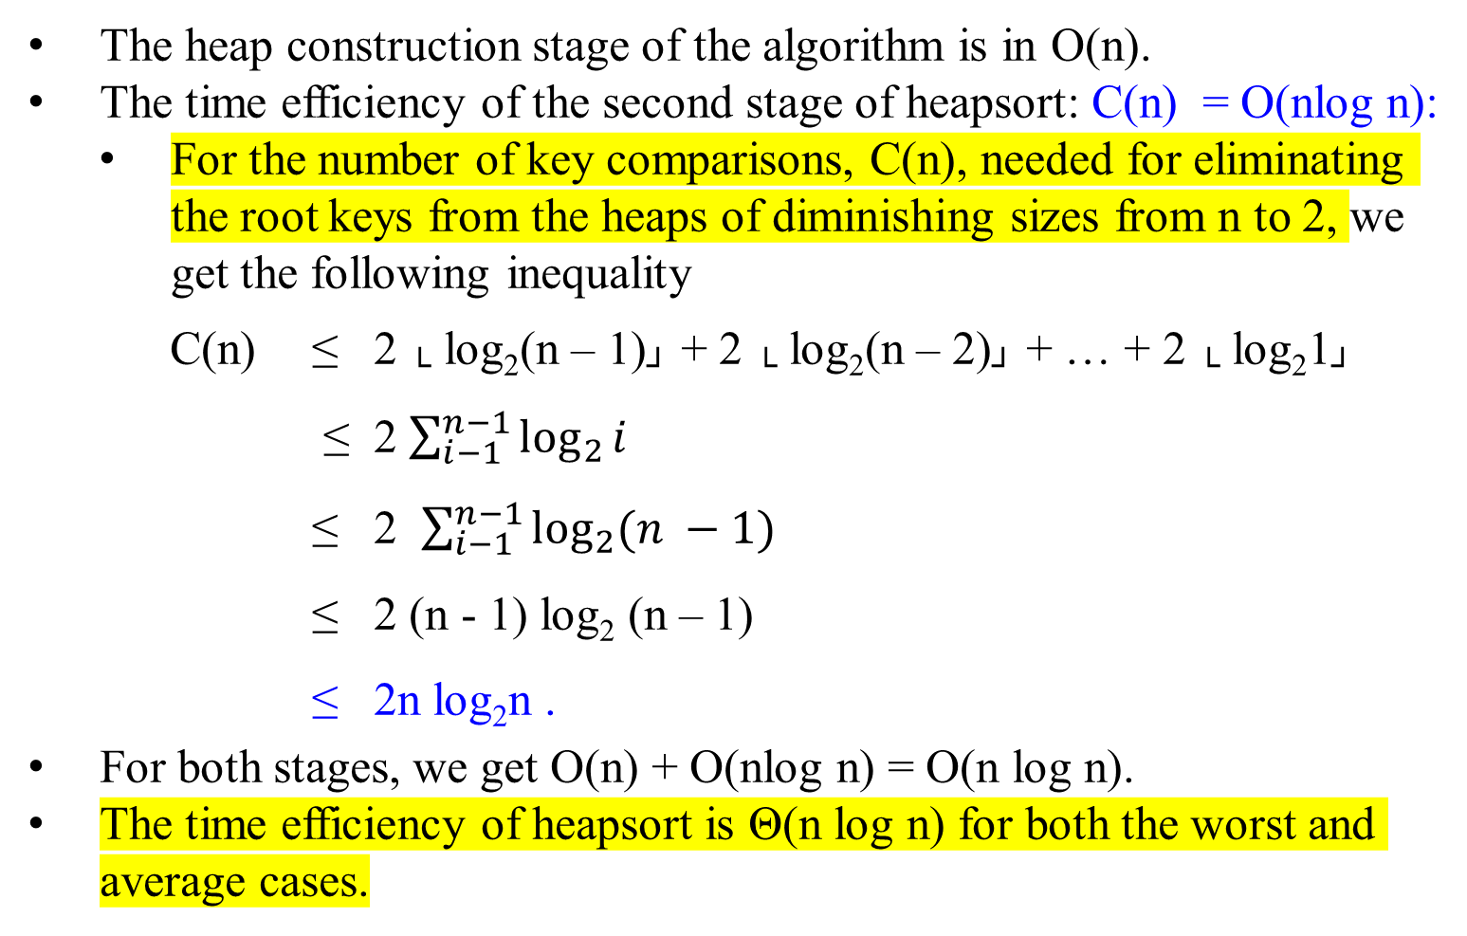
Heapsort
The heap construction stage of the algorithm is in O(n).
The time efficiency of the second stage of heapsort: C(n) = O(nlog n):
  For the number of key comparisons, C(n), needed for eliminating the root keys from the heaps of diminishing sizes from n to 2, we get the following inequality
C(n) ≤ 2 └ log₂(n – 1)┘ + 2 └ log₂(n – 2)┘ + … + 2 └ log₂1┘
≤ 2 $\sum_{i−1}^{n−1}{\log_{2}{i}}$
≤ 2 $\sum_{i−1}^{n−1}{\log_{2}{(n −1)}}$
≤ 2 (n - 1) log₂ (n – 1)
≤ 2n log₂n .
For both stages, we get O(n) + O(nlog n) = O(n log n).
The time efficiency of heapsort is Θ(n log n) for both the worst and average cases.

Slide 51
Figure 6.4 The operation of Heapsort.
The max-heap data structure just
after “HeapBottomUp(A[1..n]);” has built it.
Heapsort
16
14
10
8
7
9
3
2
4
1
16 | 14 | 10 | 8 | 7 | 9 | 3 | 2 | 4 | 1

Slide 52
Heapsort
(b – j) The max-heap just after each call of Max-Heapify in the algorithm Heapsort(A), showing the value of i at that time. Only lightly shaded nodes remain in the heap.

Slide 53
Heapsort
Figure 6.4 The operation of Heapsort.
(b)
16 | 14 | 10 | 8 | 7 | 9 | 3 | 2 | 4 | 1
14
8
10
4
7
9
3
16 | 14 | 10 | 8 | 7 | 9 | 3 | 2 | 4 | 1
2
1
16
i
14 | 8 | 10 | 4 | 7 | 9 | 3 | 2 | 1 | 16
Max-Heapify(A, 1)

Slide 54
14 | 8 | 10 | 4 | 7 | 9 | 3 | 2 | 1 | 16
Max-Heapify(A, 1)
10 | 8 | 9 | 4 | 7 | 1 | 3 | 2 | 14 | 16
8
10
4
7
9
3
2
1
14
16

Slide 55
Heapsort
Figure 6.4 The operation of Heapsort.
(c)
10
8
9
4
7
1
3
2
14
16
10 | 8 | 9 | 4 | 7 | 1 | 3 | 2 | 14 | 16
i

Slide 56
Heapsort
Figure 6.4 The operation of Heapsort.
(d)
9
8
3
4
7
1
2
10
14
16
i

Slide 57
Heapsort
Figure 6.4 The operation of Heapsort.
(e)
8
7
3
4
2
1
9
10
14
16
i

Slide 58
Heapsort
Figure 6.4 The operation of Heapsort.
(f)
7
4
3
1
2
8
9
10
14
16
i

Slide 59
Heapsort
Figure 6.4 The operation of Heapsort.
(g)
4
2
3
1
7
8
9
10
14
16
i

Slide 60
Heapsort
Figure 6.4 The operation of Heapsort.
(h)
3
2
1
4
7
8
9
10
14
16
i

Slide 61
Heapsort
Figure 6.4 The operation of Heapsort.
(i)
2
1
3
4
7
8
9
10
14
16
i

Slide 62
Heapsort
Figure 6.4 The operation of Heapsort.
(j)
1
2
3
4
7
8
9
10
14
16
i

Slide 63
Heapsort
(k) The resulting sorted array A.
1 | 2 | 3 | 4 | 7 | 8 | 9 | 10 | 14 | 16
Time efficiency:
The worst case running time of Heapsort is Ω(n log n).
When all elements are distinct, the best-case running time of Heapsort is Ω(n log n).

Slide 64
Algorithm | Worst-case running time | Average-case/expected running time
Insertion sort | Ɵ(n²) | Ɵ(n²)
Merge sort | Ɵ(n log n) | Ɵ(n log n)
Heapsort | O(n log n) | -
Quicksort | Ɵ(n²) | Ɵ(n log n) (expected)
Counting sort | Ɵ(k + n) | Ɵ(k + n)
Radix sort | Ɵ(d(n +k)) | Ɵ(d(n +k))
Bucket sort | Ɵ(n²) | Ɵ(n) (Average-case)

Slide 65
The End

