Slide 1
Graph Algorithms

Slide 2
To accompany the text .Introduction to Parallel Computing.,
Addison Wesley, 2003.

Slide 3
Topic Overview
Definitions and Representation
Minimum Spanning Tree: Prim's Algorithm
Single-Source Shortest Paths: Dijkstra's Algorithm
All-Pairs Shortest Paths
Transitive Closure
Connected Components
Algorithms for Sparse Graphs

Slide 4

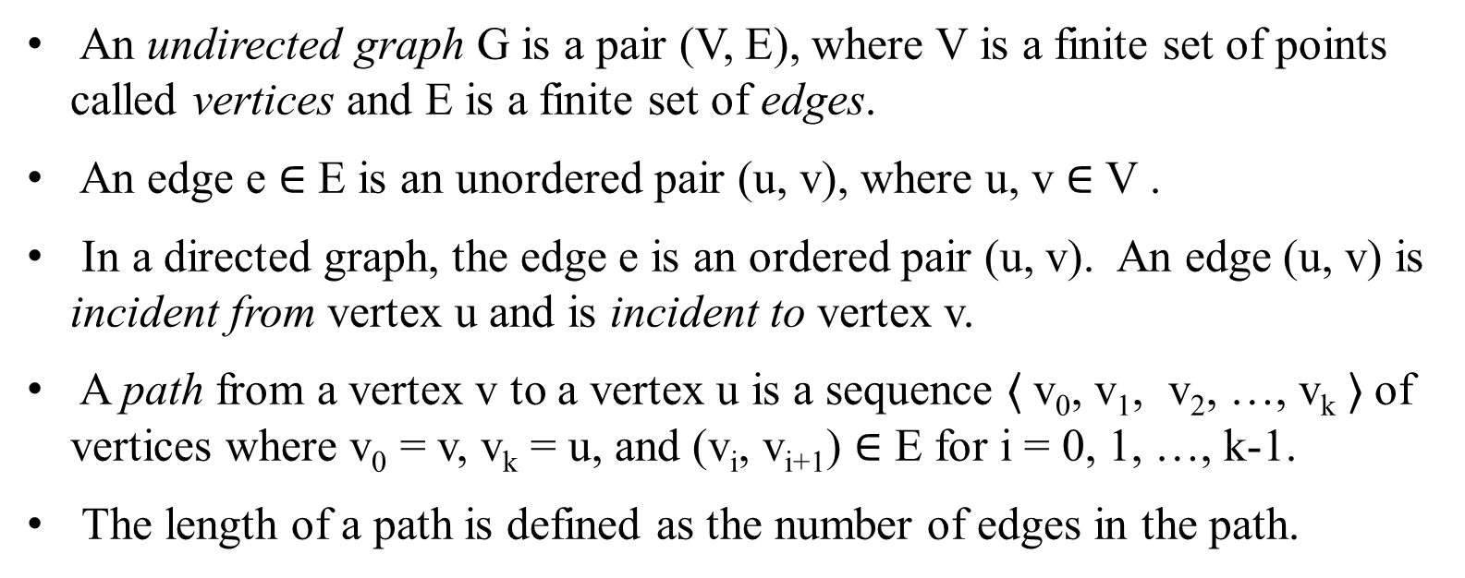
Definitions and Representation
$〈 〉$ $∈(\text{v}\text{i}\text{, }\text{vi}\text{+1)}$
An undirected graph G is a pair (V, E), where V is a finite set of points called vertices and E is a finite set of edges.
An edge e $∈$ E is an unordered pair (u, v), where u, v $∈$ V .
In a directed graph, the edge e is an ordered pair (u, v). An edge (u, v) is incident from vertex u and is incident to vertex v.
A path from a vertex v to a vertex u is a sequence $〈$v₀, v₁, v₂, …, v_{k} $〉$of vertices where v₀ = v, v_{k} = u, and (v_{i}, v_{i+1}) $∈$ E for i = 0, 1, …, k-1.
The length of a path is defined as the number of edges in the path.

Slide 5
Definitions and Representation
e
4
6
5
5
f
3
6
3
4
2
2
1
1
(a)
(b)
(a) An undirected graph and (b) a directed graph.

Slide 6
Definitions and Representation
An undirected graph is connected if every pair of vertices is connected by a path.
A forest is an acyclic graph, and a tree is a connected acyclic graph.
A graph that has weights associated with each edge is called a weighted graph.

Slide 7
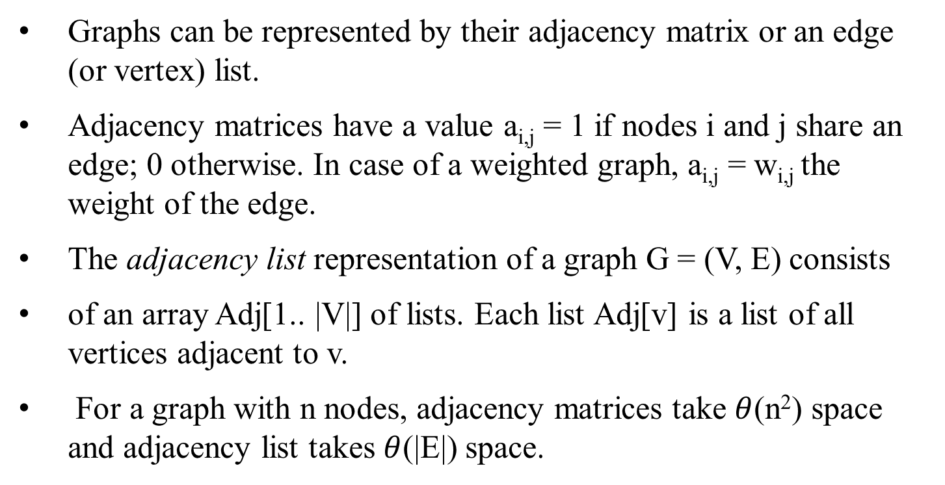
Definitions and Representation
Graphs can be represented by their adjacency matrix or an edge (or vertex) list.
Adjacency matrices have a value a_{i,j} = 1 if nodes i and j share an edge; 0 otherwise. In case of a weighted graph, a_{i,j} = w_{i,j} the weight of the edge.
The adjacency list representation of a graph G = (V, E) consists
of an array Adj[1.. |V|] of lists. Each list Adj[v] is a list of all vertices adjacent to v.
For a graph with n nodes, adjacency matrices take $θ$(n²) space and adjacency list takes $θ$(|E|) space.

Slide 8
Definitions and Representation
G
4
 |  | 0 | 1 | 1 | 1 | 0 | 0
 |  | 1 | 0 | 0 | 0 | 1 | 0
 |  | 1 | 0 | 0 | 0 | 1 | 1
G | = | 1 | 0 | 0 | 0 | 1 | 0
 |  | 0 | 1 | 1 | 1 | 0 | 1
 |  | 0 | 0 | 1 | 0 | 1 | 0
5
1
3
6
2
1
An undirected graph and its adjacency matrix representation.

Slide 9
Definitions and Representation
G
1 |  |  | 2 |  |  | 3 |  |  | 4
4
5
1
2 |  |  | 1 |  |  | 5
3 |  |  | 5 |  |  | 6
3
6
2
4 |  |  | 1 |  |  | 5
1
5 |  |  | 2 |  |  | 3 |  |  | 4 |  |  | 6
6 |  |  | 3 |  |  | 5
(a)
An undirected graph and its adjacency list representation.

Slide 10
Minimum Spanning Tree
A spanning tree of an undirected graph G is a subgraph of G that is a tree containing all the vertices of G.
In a weighted graph, the weight of a subgraph is the sum of the weights of the edges in the subgraph.
A minimum spanning tree (MST) for a weighted undirected graph is a spanning tree with minimum weight.

Slide 11
Minimum Spanning Tree
a
2
b
a
2
b
3
4
5
3
2
4
1
3
c
d
c
1
d
8
2
2
e
e
An undirected graph and its minimum spanning tree.

Slide 12
Minimum Spanning Tree: Prim’s Algorithm
Prim's algorithm for finding an MST is a greedy algorithm.
Start by selecting an arbitrary vertex, include it into the current MST.
Grow the current MST by inserting into it the vertex closest to one of the vertices already in current MST.

Slide 13
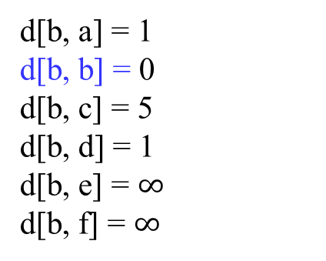
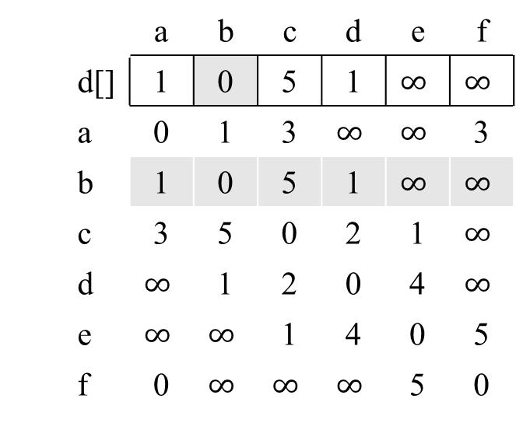
Minimum Spanning Tree: Prim's Algorithm
(a) Original graph
 |  | a | b | c | d | e | f
 | d[] | 1 | 0 | 5 | 1 | $$∞$$ | $$∞$$
 | a | 0 | 1 | 3 | $$∞$$ | $$∞$$ | 3
 | b | 1 | 0 | 5 | 1 | $$∞$$ | $$∞$$
 | c | 3 | 5 | 0 | 2 | 1 | $$∞$$
 | d | $$∞$$ | 1 | 2 | 0 | 4 | $$∞$$
 | e | $$∞$$ | $$∞$$ | 1 | 4 | 0 | 5
 | f | 0 | $$∞$$ | $$∞$$ | $$∞$$ | 5 | 0
a
3
1
f
3
b
5
c
5
1
1
2
e
d
4
d[b, a] = 1
d[b, b] = 0
d[b, c] = 5
d[b, d] = 1
d[b, e] = $∞$
d[b, f] = $∞$

Slide 14
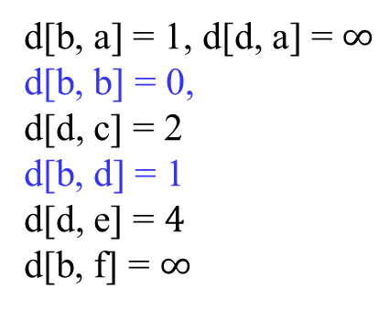
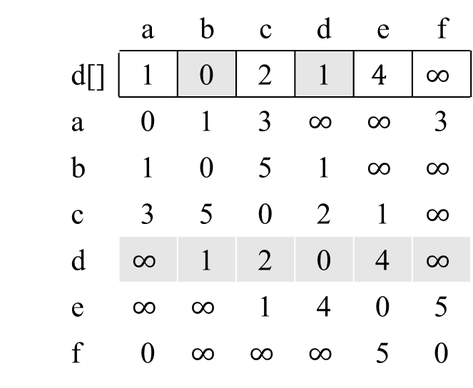
Minimum Spanning Tree: Prim's Algorithm
(b) After the first edge has been selected
 |  | a | b | c | d | e | f
 | d[] | 1 | 0 | 2 | 1 | $$4$$ | $$∞$$
 | a | 0 | 1 | 3 | $$∞$$ | $$∞$$ | 3
 | b | 1 | 0 | 5 | 1 | $$∞$$ | $$∞$$
 | c | 3 | 5 | 0 | 2 | 1 | $$∞$$
 | d | $$∞$$ | 1 | 2 | 0 | 4 | $$∞$$
 | e | $$∞$$ | $$∞$$ | 1 | 4 | 0 | 5
 | f | 0 | $$∞$$ | $$∞$$ | $$∞$$ | 5 | 0
a
3
1
f
3
b
5
c
5
1
1
2
e
d
4
d[b, a] = 1, d[d, a] = $∞$
d[b, b] = 0,
d[d, c] = 2
d[b, d] = 1
d[d, e] = $4$
d[b, f] = $∞$

Slide 15
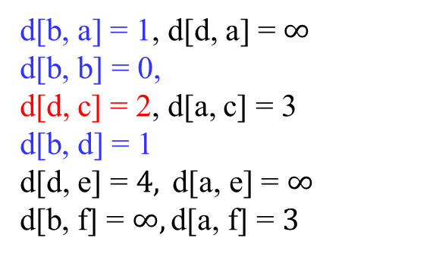
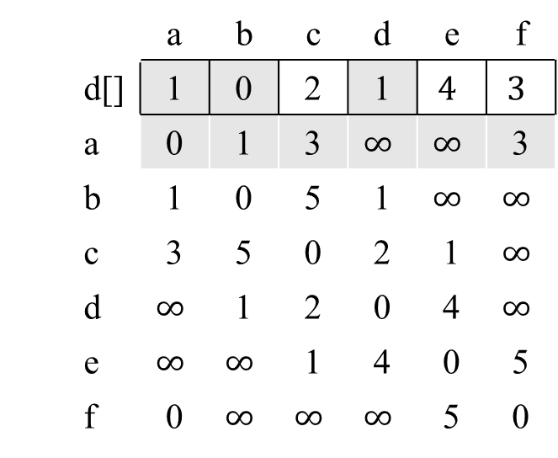
Minimum Spanning Tree: Prim's Algorithm
(c) After the second edge has been selected
 |  | a | b | c | d | e | f
 | d[] | 1 | 0 | 2 | 1 | $$4$$ | $$3$$
 | a | 0 | 1 | 3 | $$∞$$ | $$∞$$ | 3
 | b | 1 | 0 | 5 | 1 | $$∞$$ | $$∞$$
 | c | 3 | 5 | 0 | 2 | 1 | $$∞$$
 | d | $$∞$$ | 1 | 2 | 0 | 4 | $$∞$$
 | e | $$∞$$ | $$∞$$ | 1 | 4 | 0 | 5
 | f | 0 | $$∞$$ | $$∞$$ | $$∞$$ | 5 | 0
a
3
1
f
3
b
5
c
5
1
1
2
e
d
4
d[b, a] = 1, d[d, a] = $∞$
d[b, b] = 0,
d[d, c] = 2, d[a, c] = 3
d[b, d] = 1
d[d, e] = $4, \text{d}\text{[}\text{a}\text{, }\text{e}\text{] = }∞$
d[b, f] = $∞, \text{d}\text{[}\text{a}\text{, }\text{f}\text{] = }3$

Slide 16
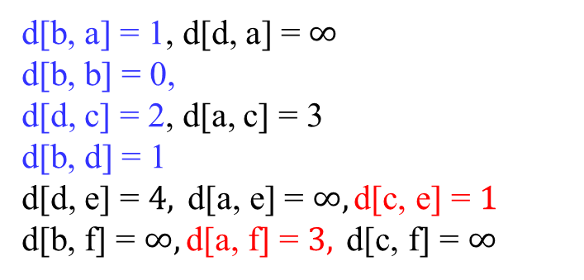
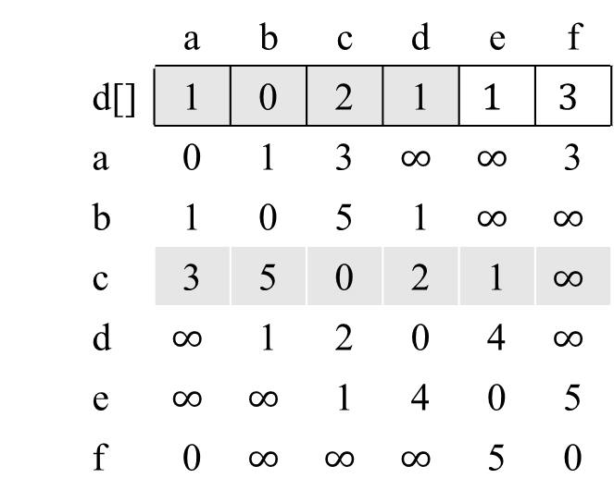
Minimum Spanning Tree: Prim's Algorithm
(d) After the third edge has been selected
 |  | a | b | c | d | e | f
 | d[] | 1 | 0 | 2 | 1 | $$1$$ | $$3$$
 | a | 0 | 1 | 3 | $$∞$$ | $$∞$$ | 3
 | b | 1 | 0 | 5 | 1 | $$∞$$ | $$∞$$
 | c | 3 | 5 | 0 | 2 | 1 | $$∞$$
 | d | $$∞$$ | 1 | 2 | 0 | 4 | $$∞$$
 | e | $$∞$$ | $$∞$$ | 1 | 4 | 0 | 5
 | f | 0 | $$∞$$ | $$∞$$ | $$∞$$ | 5 | 0
a
3
1
f
3
b
5
c
5
1
1
2
e
d
4
d[b, a] = 1, d[d, a] = $∞$
d[b, b] = 0,
d[d, c] = 2, d[a, c] = 3
d[b, d] = 1
d[d, e] = $4, \text{d}\text{[}\text{a}\text{, }\text{e}\text{] = }∞,\text{d}\text{[}\text{c}\text{, }\text{e}\text{] = }1$
d[b, f] = $∞, \text{d}\text{[}\text{a}\text{, }\text{f}\text{] = }3, \text{d}\text{[}\text{c}\text{, }\text{f}\text{] = }∞$

Slide 17
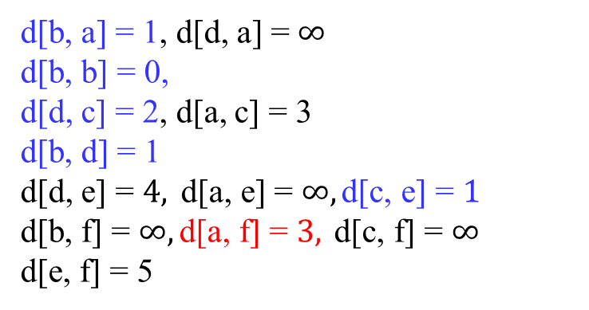
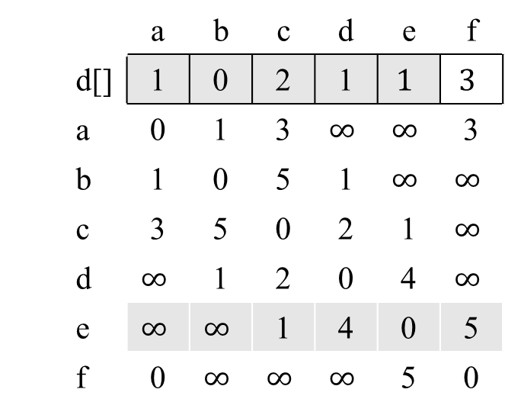
Minimum Spanning Tree: Prim's Algorithm
(e) After the fourth edge has been selected
 |  | a | b | c | d | e | f
 | d[] | 1 | 0 | 2 | 1 | $$1$$ | $$3$$
 | a | 0 | 1 | 3 | $$∞$$ | $$∞$$ | 3
 | b | 1 | 0 | 5 | 1 | $$∞$$ | $$∞$$
 | c | 3 | 5 | 0 | 2 | 1 | $$∞$$
 | d | $$∞$$ | 1 | 2 | 0 | 4 | $$∞$$
 | e | $$∞$$ | $$∞$$ | 1 | 4 | 0 | 5
 | f | 0 | $$∞$$ | $$∞$$ | $$∞$$ | 5 | 0
a
3
1
f
3
b
5
c
5
1
1
2
e
d
4
d[b, a] = 1, d[d, a] = $∞$
d[b, b] = 0,
d[d, c] = 2, d[a, c] = 3
d[b, d] = 1
d[d, e] = $4, \text{d}\text{[}\text{a}\text{, }\text{e}\text{] = }∞,\text{d}\text{[}\text{c}\text{, }\text{e}\text{] = }1$
d[b, f] = $∞, \text{d}\text{[}\text{a}\text{, }\text{f}\text{] = }3, \text{d}\text{[}\text{c}\text{, }\text{f}\text{] = }∞$
d[e, f] = 5

Slide 18
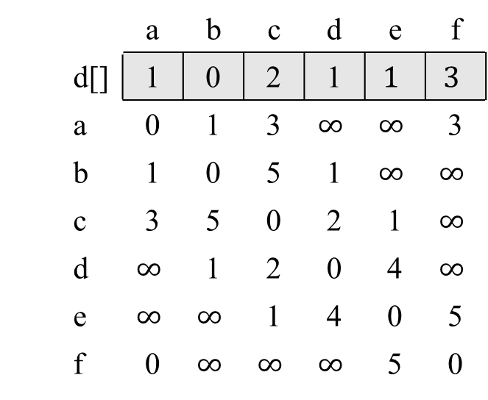
Minimum Spanning Tree: Prim's Algorithm
 |  | a | b | c | d | e | f
 | d[] | 1 | 0 | 2 | 1 | $$1$$ | $$3$$
 | a | 0 | 1 | 3 | $$∞$$ | $$∞$$ | 3
 | b | 1 | 0 | 5 | 1 | $$∞$$ | $$∞$$
 | c | 3 | 5 | 0 | 2 | 1 | $$∞$$
 | d | $$∞$$ | 1 | 2 | 0 | 4 | $$∞$$
 | e | $$∞$$ | $$∞$$ | 1 | 4 | 0 | 5
 | f | 0 | $$∞$$ | $$∞$$ | $$∞$$ | 5 | 0
a
3
1
f
3
b
5
c
5
1
1
2
d
d
4
(f) Final minimum spanning tree

Slide 19
Prim's minimum spanning tree algorithm.

Slide 20
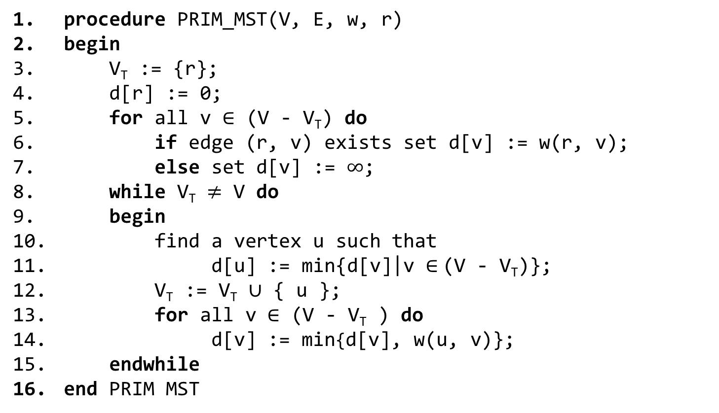
Minimum Spanning Tree: Prim's Algorithm
procedure PRIM_MST(V, E, w, r)
begin
V_{T} := {r};
d[r] := 0;
for all v $∈$ (V - V_{T}) do
if edge (r, v) exists set d[v] := w(r, v);
else set d[v] := $∞$;
while V_{T} $≠$ V do
begin
find a vertex u such that
d[u] := min{d[v]|v $∈$(V - V_{T})};
V_{T} := V_{T} $∪$ { u };
for all v $∈$ (V - V_{T} ) do
d[v] := min{d[v], w(u, v)};
endwhile
end PRIM MST
Prim's sequential minimum spanning tree algorithm.

Slide 21
Prim's Algorithm: Parallel Formulation
The algorithm works in n outer iterations - it is hard to execute these iterations concurrently.
The inner loop is relatively easy to parallelize. Let p be the number of processes, and let n be the number of vertices.
The adjacency matrix is partitioned in a 1-D block fashion, with distance vector d partitioned accordingly.
In each step, a processor selects the locally closest node, followed by a global reduction to select globally closest node.
This node is inserted into MST, and the choice broadcast to all processors.
Each processor updates its part of the d vector locally.

Slide 22
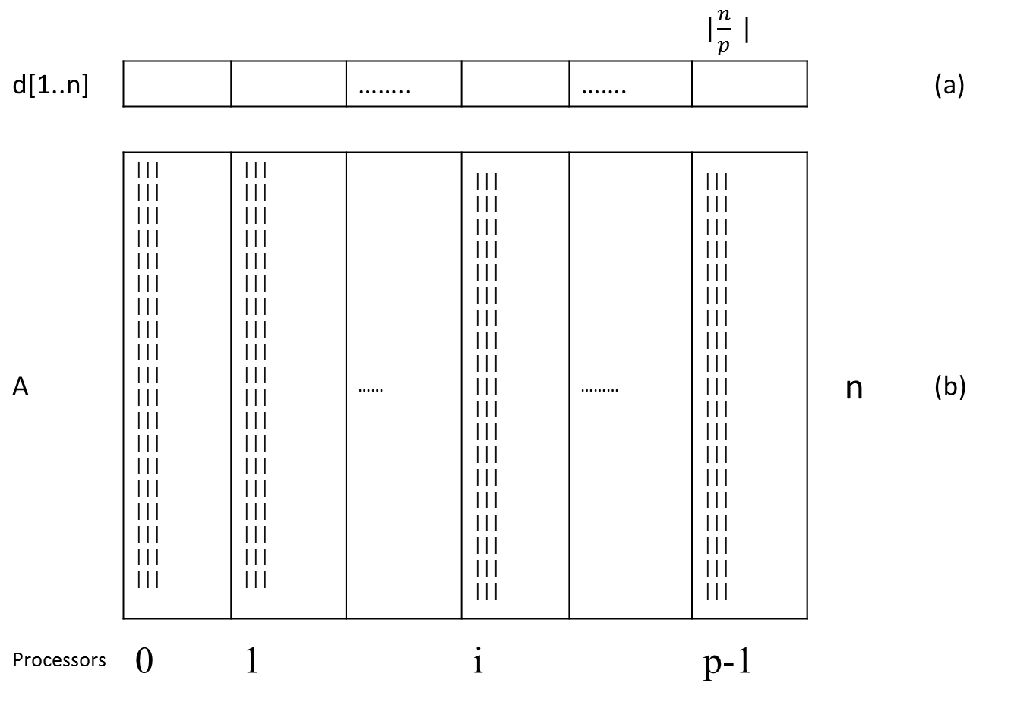
Prim's Algorithm: Parallel Formulation
The partitioning of the distance array d and the adjacency
matrix A among p processes.
 |  |  |  |  |  | |$\frac{n}{p} |$
d[1..n] |  |  | …….. |  | ……. |  |  | (a)
A | ||| ||| ||| ||| ||| ||| ||| ||| ||| ||| ||| ||| ||| ||| ||| ||| ||| ||| ||| | ||| ||| ||| ||| ||| ||| ||| ||| ||| ||| ||| ||| ||| ||| ||| ||| ||| ||| ||| | …… | ||| ||| ||| ||| ||| ||| ||| ||| ||| ||| ||| ||| ||| ||| ||| ||| ||| ||| ||| | ……… | ||| ||| ||| ||| ||| ||| ||| ||| ||| ||| ||| ||| ||| ||| ||| ||| ||| ||| ||| | n | (b)
Processors | 0 | 1 |  | i |  | p-1

Slide 23
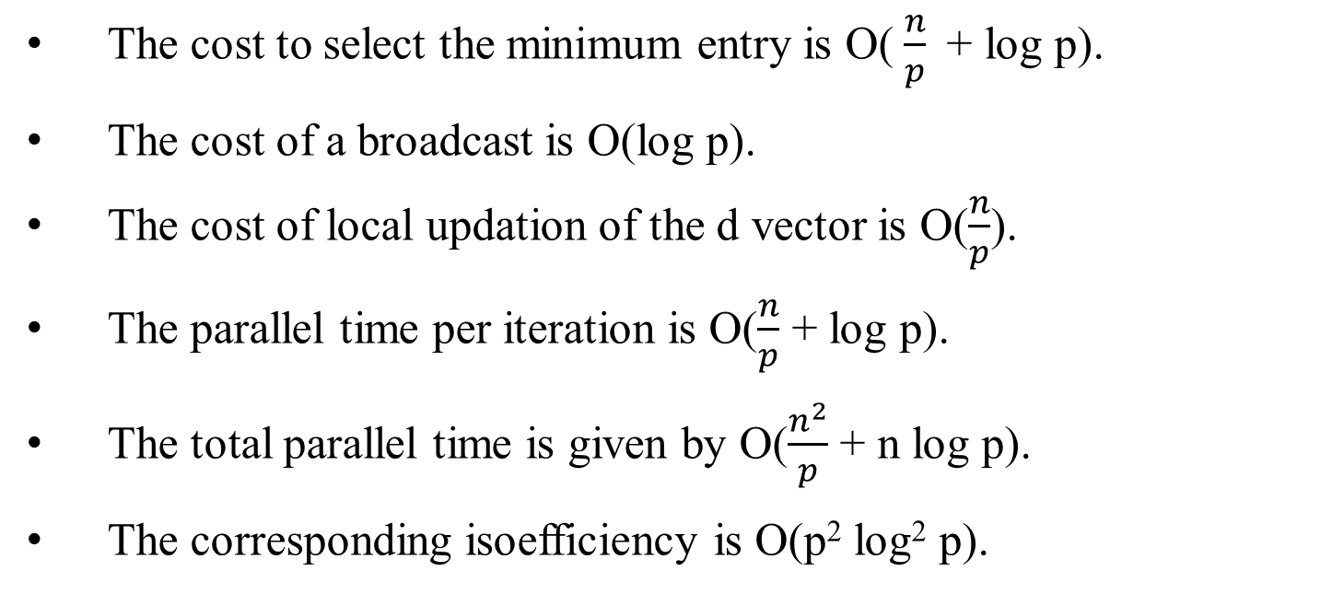
Prim's Algorithm: Parallel Formulation
The cost to select the minimum entry is O( $\frac{n}{p}$+ log p).
The cost of a broadcast is O(log p).
The cost of local updation of the d vector is O($\frac{n}{p}$).
The parallel time per iteration is O($\frac{n}{p}$ + log p).
The total parallel time is given by O($\frac{n^{2}}{p}$ + n log p).
The corresponding isoefficiency is O(p² log² p).

Slide 24
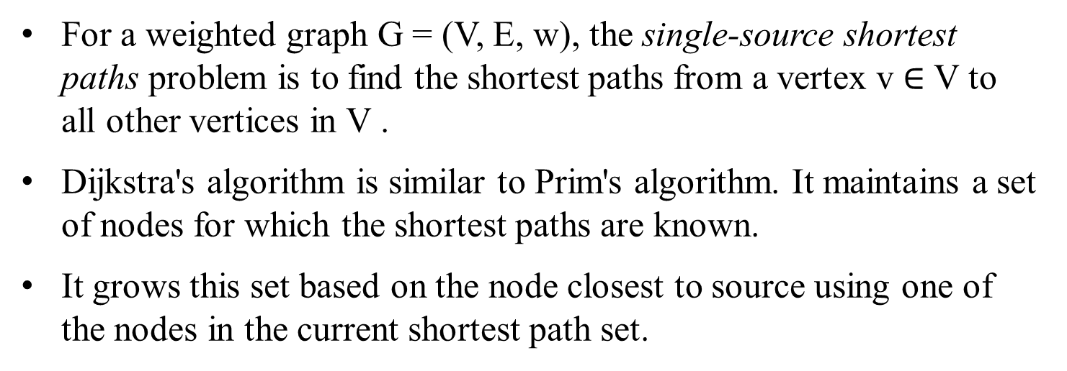
Single-Source Shortest Paths
For a weighted graph G = (V, E, w), the single-source shortest paths problem is to find the shortest paths from a vertex v $∈$ V to all other vertices in V .
Dijkstra's algorithm is similar to Prim's algorithm. It maintains a set of nodes for which the shortest paths are known.
It grows this set based on the node closest to source using one of the nodes in the current shortest path set.

Slide 25
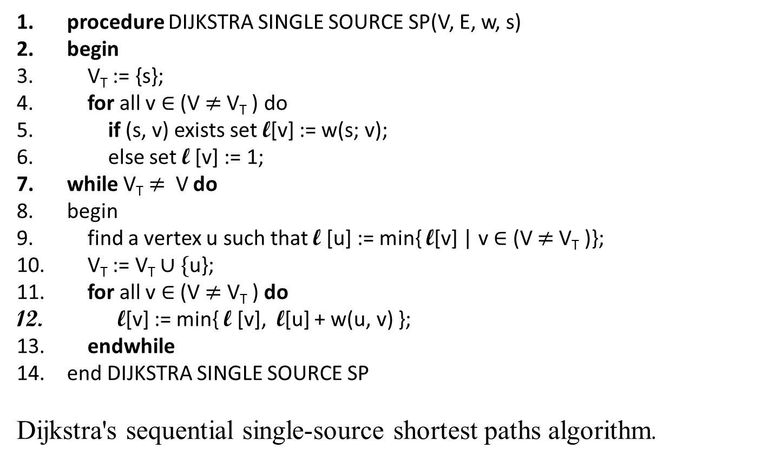
Single-Source Shortest Paths: Dijkstra's Algorithm
procedure DIJKSTRA SINGLE SOURCE SP(V, E, w, s)
begin
V_{T} := {s};
for all v $∈$ (V $≠$V_{T} ) do
if (s, v) exists set l[v] := w(s; v);
else set l [v] := 1;
while V_{T} $≠$ V do
begin
find a vertex u such that l [u] := min{ l[v] | v $∈$ (V $≠$V_{T} )};
V_{T} := V_{T} $∪\{$u};
for all v $∈$ (V $≠$ V_{T} ) do
l[v] := min{ l [v], l[u] + w(u, v) };
endwhile
end DIJKSTRA SINGLE SOURCE SP
Dijkstra's sequential single-source shortest paths algorithm.

Slide 26
Dijkstra's Algorithm: Parallel Formulation
Very similar to the parallel formulation of Prim's algorithm for minimum spanning trees.
The weighted adjacency matrix is partitioned using the 1-D block mapping.
Each process selects, locally, the node closest to the source, followed by a global reduction to select next node.
The node is broadcast to all processors and the l-vector updated.
The parallel performance of Dijkstra's algorithm is identical to that of Prim's algorithm

Slide 27
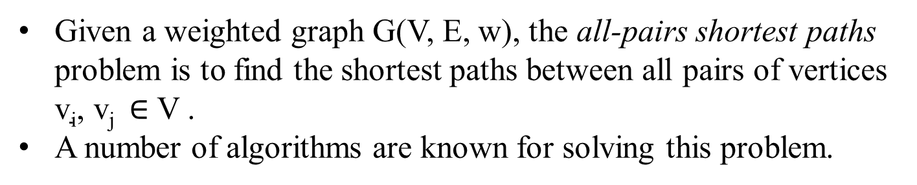
All-Pairs Shortest Paths
Given a weighted graph G(V, E, w), the all-pairs shortest paths problem is to find the shortest paths between all pairs of vertices $\text{v}\text{i}\text{, }\text{vj} ∈$ V .
A number of algorithms are known for solving this problem.

Slide 28
All-Pairs Shortest Paths:
Matrix-Multiplication Based Algorithm
Consider the multiplication of the weighted adjacency matrix with itself - except, in this case, we replace the multiplication operation in matrix multiplication by addition, and the addition operation by minimization.
Notice that the product of weighted adjacency matrix with itself returns a matrix that contains shortest paths of length 2 between any pair of nodes.
It follows from this argument that A^{n} contains all shortest paths.

Slide 29

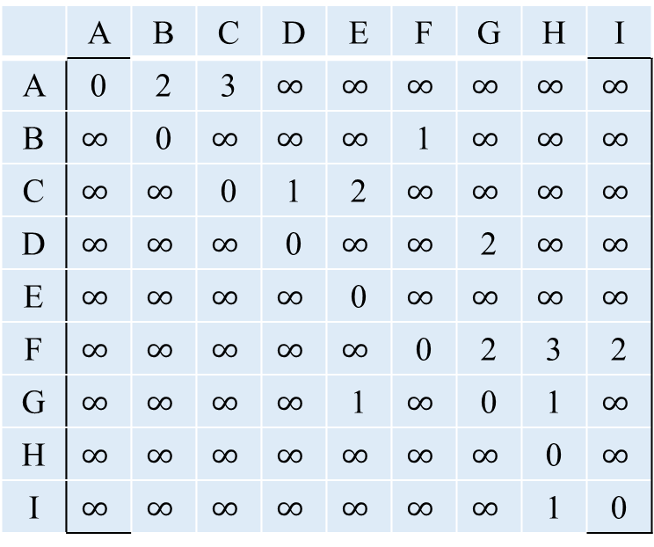
Matrix-Multiplication Based Algorithm
2
I
1
B
F
2
3
1
E
A
2
H
 | A | B | C | D | E | F | G | H | I
A | 0 | 2 | 3 | $$∞$$ | $$∞$$ | $$∞$$ | $$∞$$ | $$∞$$ | $$∞$$
B | $$∞$$ | 0 | $$∞$$ | $$∞$$ | $$∞$$ | 1 | $$∞$$ | $$∞$$ | $$∞$$
C | $$∞$$ | $$∞$$ | 0 | 1 | 2 | $$∞$$ | $$∞$$ | $$∞$$ | $$∞$$
D | $$∞$$ | $$∞$$ | $$∞$$ | 0 | $$∞$$ | $$∞$$ | 2 | $$∞$$ | $$∞$$
E | $$∞$$ | $$∞$$ | $$∞$$ | $$∞$$ | 0 | $$∞$$ | $$∞$$ | $$∞$$ | $$∞$$
F | $$∞$$ | $$∞$$ | $$∞$$ | $$∞$$ | $$∞$$ | 0 | 2 | 3 | 2
G | $$∞$$ | $$∞$$ | $$∞$$ | $$∞$$ | 1 | $$∞$$ | 0 | 1 | $$∞$$
H | $$∞$$ | $$∞$$ | $$∞$$ | $$∞$$ | $$∞$$ | $$∞$$ | $$∞$$ | 0 | $$∞$$
I | $$∞$$ | $$∞$$ | $$∞$$ | $$∞$$ | $$∞$$ | $$∞$$ | $$∞$$ | 1 | 0
2
1
3
D
1
C
1
2
G
$$A^{1}=$$

Slide 30



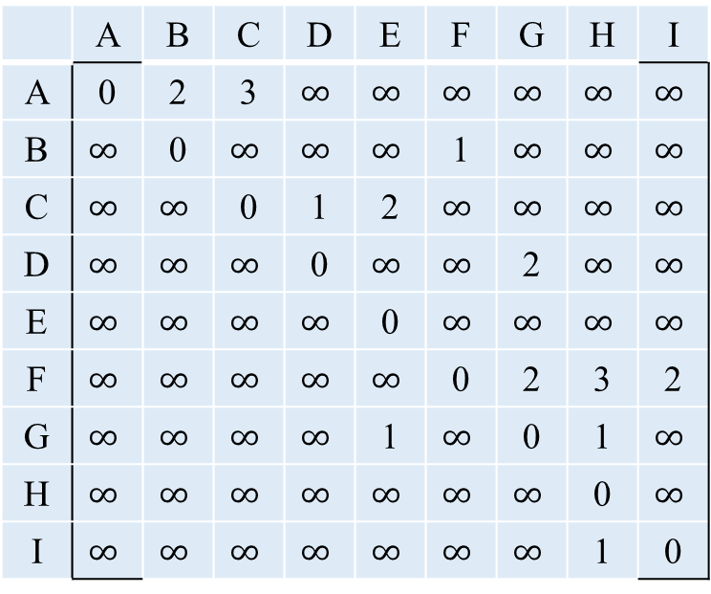
Matrix-Multiplication Based Algorithm
$$A^{1}=$$
 | A | B | C | D | E | F | G | H | I
A | 0 | 2 | 3 | $$∞$$ | $$∞$$ | $$∞$$ | $$∞$$ | $$∞$$ | $$∞$$
B | $$∞$$ | 0 | $$∞$$ | $$∞$$ | $$∞$$ | 1 | $$∞$$ | $$∞$$ | $$∞$$
C | $$∞$$ | $$∞$$ | 0 | 1 | 2 | $$∞$$ | $$∞$$ | $$∞$$ | $$∞$$
D | $$∞$$ | $$∞$$ | $$∞$$ | 0 | $$∞$$ | $$∞$$ | 2 | $$∞$$ | $$∞$$
E | $$∞$$ | $$∞$$ | $$∞$$ | $$∞$$ | 0 | $$∞$$ | $$∞$$ | $$∞$$ | $$∞$$
F | $$∞$$ | $$∞$$ | $$∞$$ | $$∞$$ | $$∞$$ | 0 | 2 | 3 | 2
G | $$∞$$ | $$∞$$ | $$∞$$ | $$∞$$ | 1 | $$∞$$ | 0 | 1 | $$∞$$
H | $$∞$$ | $$∞$$ | $$∞$$ | $$∞$$ | $$∞$$ | $$∞$$ | $$∞$$ | 0 | $$∞$$
I | $$∞$$ | $$∞$$ | $$∞$$ | $$∞$$ | $$∞$$ | $$∞$$ | $$∞$$ | 1 | 0
 | A | B | C | D | E | F | G | H | I
A | 0 | 2 | 3 | $$4$$ | $$5$$ | $$3$$ | $$∞$$ | $$∞$$ | $$∞$$
B | $$∞$$ | 0 | $$∞$$ | $$∞$$ | $$∞$$ | 1 | $$3$$ | 4 | $$3$$
C | $$∞$$ | $$∞$$ | 0 | 1 | 2 | $$∞$$ | $$3$$ | $$∞$$ | $$∞$$
D | $$∞$$ | $$∞$$ | $$∞$$ | 0 | $$3$$ | $$∞$$ | 2 | $$3$$ | $$∞$$
E | $$∞$$ | $$∞$$ | $$∞$$ | $$∞$$ | 0 | $$∞$$ | $$∞$$ | $$∞$$ | $$∞$$
F | $$∞$$ | $$∞$$ | $$∞$$ | $$∞$$ | $$3$$ | 0 | 2 | 3 | 2
G | $$∞$$ | $$∞$$ | $$∞$$ | $$∞$$ | 1 | $$∞$$ | 0 | 1 | $$∞$$
H | $$∞$$ | $$∞$$ | $$∞$$ | $$∞$$ | $$∞$$ | $$∞$$ | $$∞$$ | 0 | $$∞$$
I | $$∞$$ | $$∞$$ | $$∞$$ | $$∞$$ | $$∞$$ | $$∞$$ | $$∞$$ | 1 | 0
$$A^{2}=$$

Slide 31


Matrix-Multiplication Based Algorithm
$$A^{4}=$$
 | A | B | C | D | E | F | G | H | I
A | 0 | 2 | 3 | $$4$$ | $$5$$ | $$3$$ | $$5$$ | $$6$$ | $$5$$
B | $$∞$$ | 0 | $$∞$$ | $$∞$$ | $$4$$ | 1 | $$3$$ | 4 | $$3$$
C | $$∞$$ | $$∞$$ | 0 | 1 | 2 | $$∞$$ | $$3$$ | $$4$$ | $$∞$$
D | $$∞$$ | $$∞$$ | $$∞$$ | 0 | $$3$$ | $$∞$$ | 2 | $$3$$ | $$∞$$
E | $$∞$$ | $$∞$$ | $$∞$$ | $$∞$$ | 0 | $$∞$$ | $$∞$$ | $$∞$$ | $$∞$$
F | $$∞$$ | $$∞$$ | $$∞$$ | $$∞$$ | $$3$$ | 0 | 2 | 3 | 2
G | $$∞$$ | $$∞$$ | $$∞$$ | $$∞$$ | 1 | $$∞$$ | 0 | 1 | $$∞$$
H | $$∞$$ | $$∞$$ | $$∞$$ | $$∞$$ | $$∞$$ | $$∞$$ | $$∞$$ | 0 | $$∞$$
I | $$∞$$ | $$∞$$ | $$∞$$ | $$∞$$ | $$∞$$ | $$∞$$ | $$∞$$ | 1 | 0
 | A | B | C | D | E | F | G | H | I
A | 0 | 2 | 3 | $$4$$ | $$5$$ | $$3$$ | $$∞$$ | $$∞$$ | $$∞$$
B | $$∞$$ | 0 | $$∞$$ | $$∞$$ | $$∞$$ | 1 | $$3$$ | 4 | $$3$$
C | $$∞$$ | $$∞$$ | 0 | 1 | 2 | $$∞$$ | $$3$$ | $$∞$$ | $$∞$$
D | $$∞$$ | $$∞$$ | $$∞$$ | 0 | $$3$$ | $$∞$$ | 2 | $$3$$ | $$∞$$
E | $$∞$$ | $$∞$$ | $$∞$$ | $$∞$$ | 0 | $$∞$$ | $$∞$$ | $$∞$$ | $$∞$$
F | $$∞$$ | $$∞$$ | $$∞$$ | $$∞$$ | $$3$$ | 0 | 2 | 3 | 2
G | $$∞$$ | $$∞$$ | $$∞$$ | $$∞$$ | 1 | $$∞$$ | 0 | 1 | $$∞$$
H | $$∞$$ | $$∞$$ | $$∞$$ | $$∞$$ | $$∞$$ | $$∞$$ | $$∞$$ | 0 | $$∞$$
I | $$∞$$ | $$∞$$ | $$∞$$ | $$∞$$ | $$∞$$ | $$∞$$ | $$∞$$ | 1 | 0
$$A^{2}=$$

Slide 32

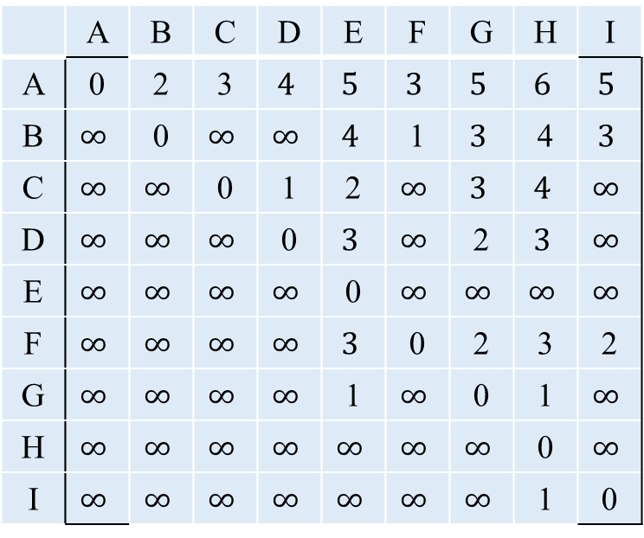
Matrix-Multiplication Based Algorithm
$$A^{4}=$$
 | A | B | C | D | E | F | G | H | I
A | 0 | 2 | 3 | $$4$$ | $$5$$ | $$3$$ | $$5$$ | $$6$$ | $$5$$
B | $$∞$$ | 0 | $$∞$$ | $$∞$$ | $$4$$ | 1 | $$3$$ | 4 | $$3$$
C | $$∞$$ | $$∞$$ | 0 | 1 | 2 | $$∞$$ | $$3$$ | $$4$$ | $$∞$$
D | $$∞$$ | $$∞$$ | $$∞$$ | 0 | $$3$$ | $$∞$$ | 2 | $$3$$ | $$∞$$
E | $$∞$$ | $$∞$$ | $$∞$$ | $$∞$$ | 0 | $$∞$$ | $$∞$$ | $$∞$$ | $$∞$$
F | $$∞$$ | $$∞$$ | $$∞$$ | $$∞$$ | $$3$$ | 0 | 2 | 3 | 2
G | $$∞$$ | $$∞$$ | $$∞$$ | $$∞$$ | 1 | $$∞$$ | 0 | 1 | $$∞$$
H | $$∞$$ | $$∞$$ | $$∞$$ | $$∞$$ | $$∞$$ | $$∞$$ | $$∞$$ | 0 | $$∞$$
I | $$∞$$ | $$∞$$ | $$∞$$ | $$∞$$ | $$∞$$ | $$∞$$ | $$∞$$ | 1 | 0
 | A | B | C | D | E | F | G | H | I
A | 0 | 2 | 3 | $$4$$ | $$5$$ | $$3$$ | $$5$$ | $$6$$ | $$5$$
B | $$∞$$ | 0 | $$∞$$ | $$∞$$ | $$4$$ | 1 | $$3$$ | 4 | $$3$$
C | $$∞$$ | $$∞$$ | 0 | 1 | 2 | $$∞$$ | $$3$$ | $$4$$ | $$∞$$
D | $$∞$$ | $$∞$$ | $$∞$$ | 0 | $$3$$ | $$∞$$ | 2 | $$3$$ | $$∞$$
E | $$∞$$ | $$∞$$ | $$∞$$ | $$∞$$ | 0 | $$∞$$ | $$∞$$ | $$∞$$ | $$∞$$
F | $$∞$$ | $$∞$$ | $$∞$$ | $$∞$$ | $$3$$ | 0 | 2 | 3 | 2
G | $$∞$$ | $$∞$$ | $$∞$$ | $$∞$$ | 1 | $$∞$$ | 0 | 1 | $$∞$$
H | $$∞$$ | $$∞$$ | $$∞$$ | $$∞$$ | $$∞$$ | $$∞$$ | $$∞$$ | 0 | $$∞$$
I | $$∞$$ | $$∞$$ | $$∞$$ | $$∞$$ | $$∞$$ | $$∞$$ | $$∞$$ | 1 | 0
$$A^{8}=$$

Slide 33
Matrix-Multiplication Based Algorithm
A^{n} is computed by doubling powers . i.e., as A, A², A⁴, A⁸, and so on.
We need log n matrix multiplications, each taking time O(n³).
The serial complexity of this procedure is O(n³ log n).
This algorithm is not optimal, since the best known algorithms have complexity O(n³).

Slide 34
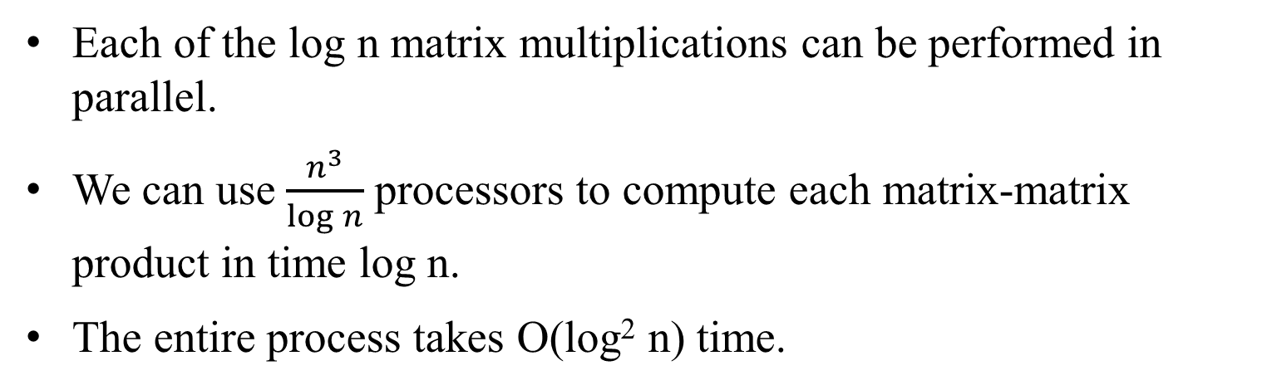
Matrix-Multiplication Based Algorithm :
Parallel Formulation
Each of the log n matrix multiplications can be performed in parallel.
We can use $\frac{n^{3}}{log⁡n}$processors to compute each matrix-matrix product in time log n.
The entire process takes O(log² n) time.

Slide 35
Dijkstra's Algorithm
Execute n instances of the single-source shortest path problem, one for each of the n source vertices.
Complexity is O(n³).

Slide 36
Dijkstra's Algorithm: Parallel Formulation
Two parallelization strategies
execute each of the n shortest path problems on a different processor (source partitioned), or
use a parallel formulation of the shortest path problem to increase concurrency (source parallel).

Slide 37
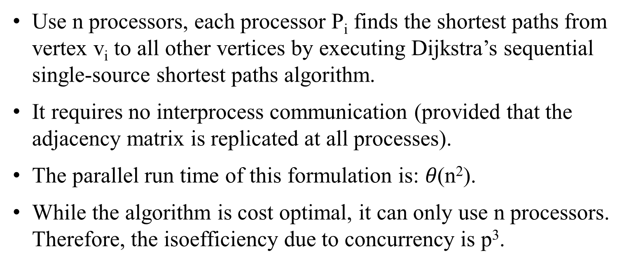
Dijkstra's Algorithm:
Source Partitioned Formulation
Use n processors, each processor P_{i} finds the shortest paths from vertex v_{i} to all other vertices by executing Dijkstra’s sequential single-source shortest paths algorithm.
It requires no interprocess communication (provided that the adjacency matrix is replicated at all processes).
The parallel run time of this formulation is: $θ\text{(}\text{n}\text{2}\text{)}$.
While the algorithm is cost optimal, it can only use n processors. Therefore, the isoefficiency due to concurrency is p³.

Slide 38
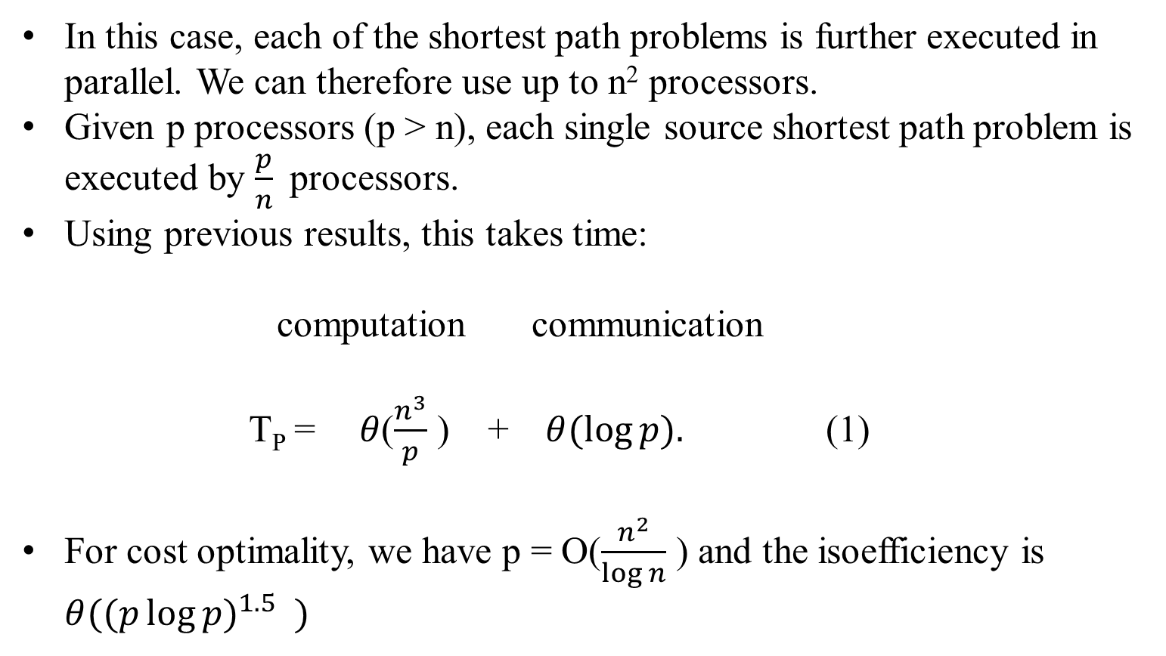
Dijkstra's Algorithm:
Source Parallel Formulation
In this case, each of the shortest path problems is further executed in parallel. We can therefore use up to n² processors.
Given p processors (p > n), each single source shortest path problem is executed by $\frac{p}{n}$processors.
Using previous results, this takes time:
computation communication
T_{P} = $θ$($\frac{n^{3}}{p}$ ) + $θ(\log{p).}$ (1)
For cost optimality, we have p = O($\frac{n^{2}}{\log{n}}$ ) and the isoefficiency is $θ({(p\log{p)}}^{1.5} )$

Slide 39
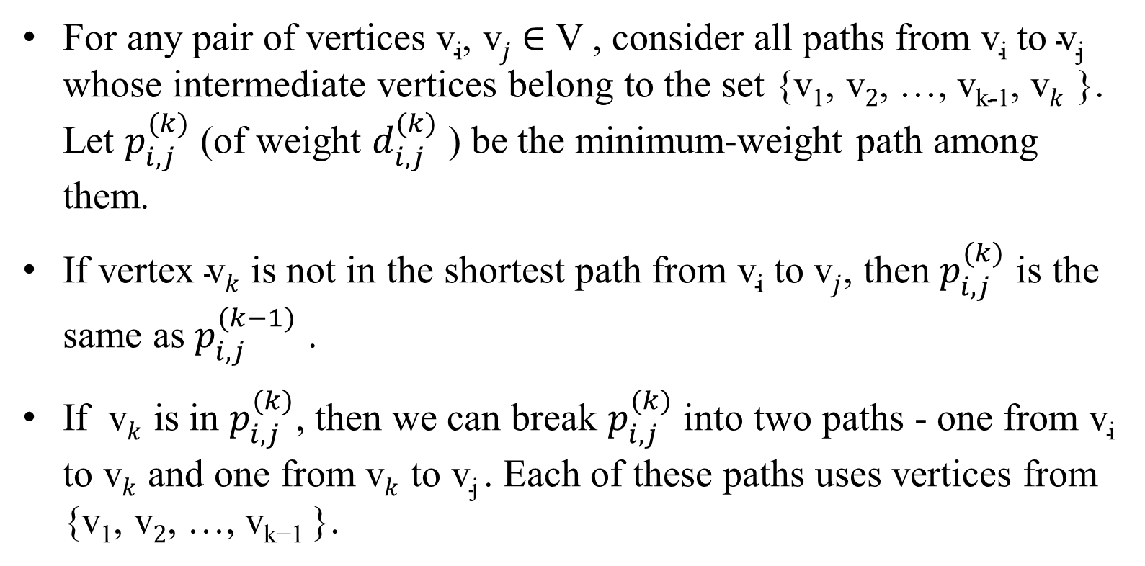
Floyd's Algorithm
For any pair of vertices $\text{v}\text{i}\text{, }\text{v}j$ $∈$ V , consider all paths from $\text{v}\text{i}$ to $\text{v}\text{j}$ whose intermediate vertices belong to the set {$\text{v}\text{1}\text{, }\text{v}2$, …, $\text{v}\text{k}\text{−1, }\text{v}k$ }. Let $p_{i, j}^{(k)}$ (of weight $d_{i, j}^{(k)}$ ) be the minimum-weight path among them.
If vertex $\text{v}k$ is not in the shortest path from $\text{v}\text{i}$ to $\text{v}j$, then $p_{i, j}^{(k)}$ is the same as $p_{i, j}^{(k−1)}$ .
If $\text{v}k$ is in $p_{i, j}^{(k)}$, then we can break $p_{i, j}^{(k)}$ into two paths - one from $\text{v}\text{i}$ to $\text{v}k$ and one from $\text{v}k$ to $\text{v}\text{j}$. Each of these paths uses vertices from {$\text{v}\text{1}\text{, }\text{v}2$, …, $\text{v}\text{k}\text{−1 }$}.

Slide 40
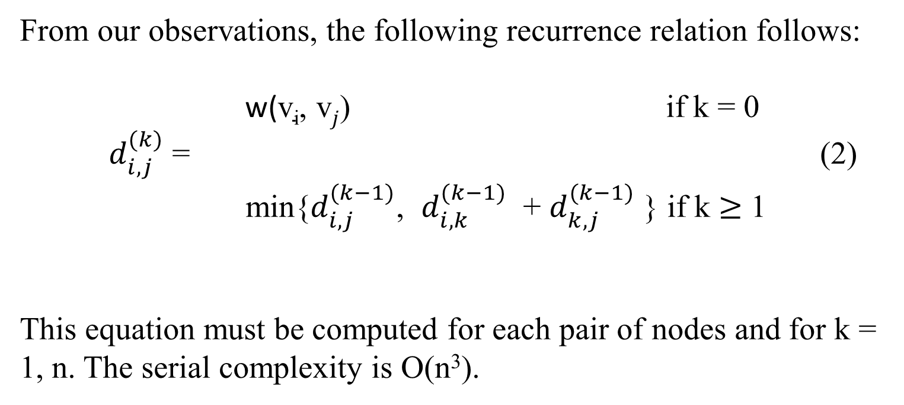
Floyd's Algorithm
From our observations, the following recurrence relation follows:
w($\text{v}\text{i}\text{, }\text{v}j$) if k = 0
$d_{i, j}^{(k)}$ = (2)
min{$d_{i, j}^{(k−1)}$, $d_{i, k}^{(k−1)}$ + $d_{k, j}^{(k−1)}$ } if k $≥$ 1
This equation must be computed for each pair of nodes and for k = 1, n. The serial complexity is O(n³).

Slide 41
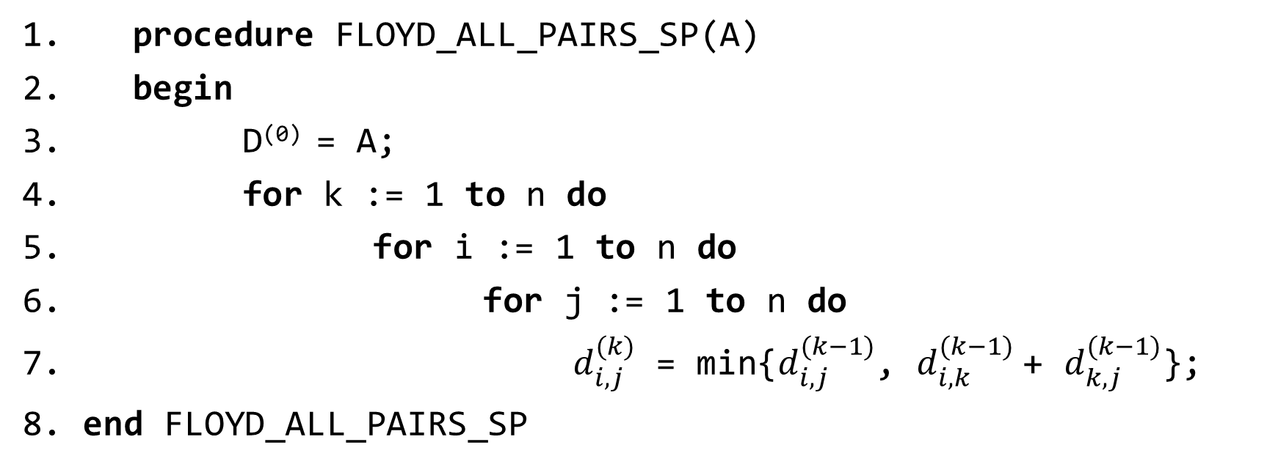
Floyd's Algorithm
1. procedure FLOYD_ALL_PAIRS_SP(A)
2. begin
3. D⁽⁰⁾ = A;
4. for k := 1 to n do
5. for i := 1 to n do
6. for j := 1 to n do
7. $d_{i, j}^{(k)}$ = min{$d_{i, j}^{(k−1)}$, $d_{i, k}^{(k−1)}$+ $d_{k, j}^{(k−1)}$};
8. end FLOYD_ALL_PAIRS_SP
Floyd's all-pairs shortest paths algorithm. This program computes the all-pairs
shortest paths of the graph G = (V, E) with adjacency matrix A.

Slide 42
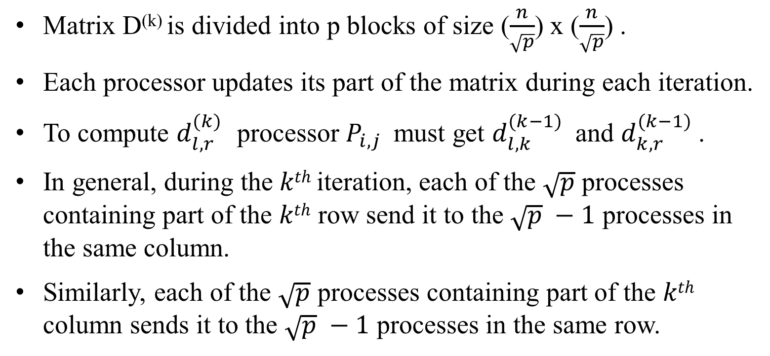
Floyd's Algorithm: Parallel Formulation
Using 2-D Block Mapping
Matrix D^{(k)} is divided into p blocks of size ($\frac{n}{\sqrt{p}}$) x ($\frac{n}{\sqrt{p}}$) .
Each processor updates its part of the matrix during each iteration.
To compute $d_{l, r}^{(k)}$ processor $P_{i,j}$must get $d_{l, k}^{(k−1)}$and $d_{k, r}^{(k−1)}$.
In general, during the $kth$ iteration, each of the $\sqrt{p}$ processes containing part of the $kth$ row send it to the $\sqrt{p} −1$ processes in the same column.
Similarly, each of the $\sqrt{p}$ processes containing part of the $kth$ column sends it to the $\sqrt{p} −1$ processes in the same row.

Slide 43

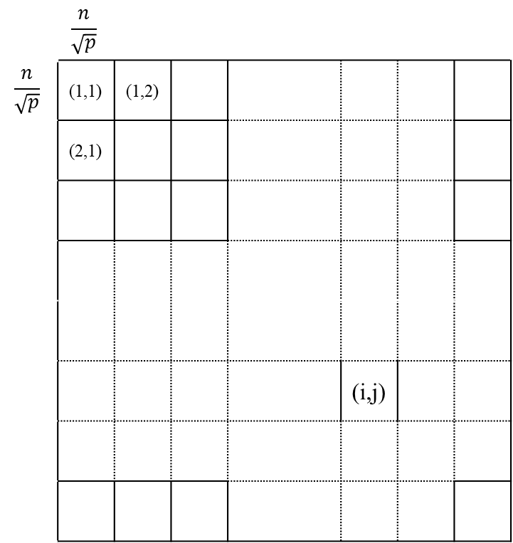
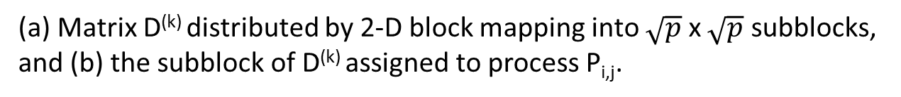

Floyd's Algorithm: Parallel Formulation
Using 2-D Block Mapping
 | $$\frac{n}{\sqrt{p}}$$
$$\frac{n}{\sqrt{p}}$$ | (1,1) | (1,2)
 | (2,1)
 |  |  |  |  |  | (i,j)
(i -1) $\frac{n}{\sqrt{p}}$+ 1, (j - 1) $\frac{n}{\sqrt{p}}$ + 1
(b)
i$\frac{n}{√p},$ j $\frac{n}{√p}$
(a)
(a) Matrix D^{(k)} distributed by 2-D block mapping into $\sqrt{p}$ x $\sqrt{p}$ subblocks, and (b) the subblock of D^{(k)} assigned to process P_{i,j}.

Slide 44


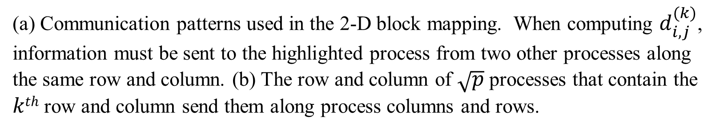

Floyd's Algorithm: Parallel Formulation Using 2-D Block Mapping
k column
k column
$$d_{lk r}^{(k−1)}$$
k row
$$d_{l, k}^{(k−1)}$$
$$d_{l, r}^{(k)}$$
(a)
(b)
(a) Communication patterns used in the 2-D block mapping. When computing $d_{i, j}^{(k)}$, information must be sent to the highlighted process from two other processes along the same row and column. (b) The row and column of $\sqrt{p}$ processes that contain the $kth$ row and column send them along process columns and rows.

Slide 45
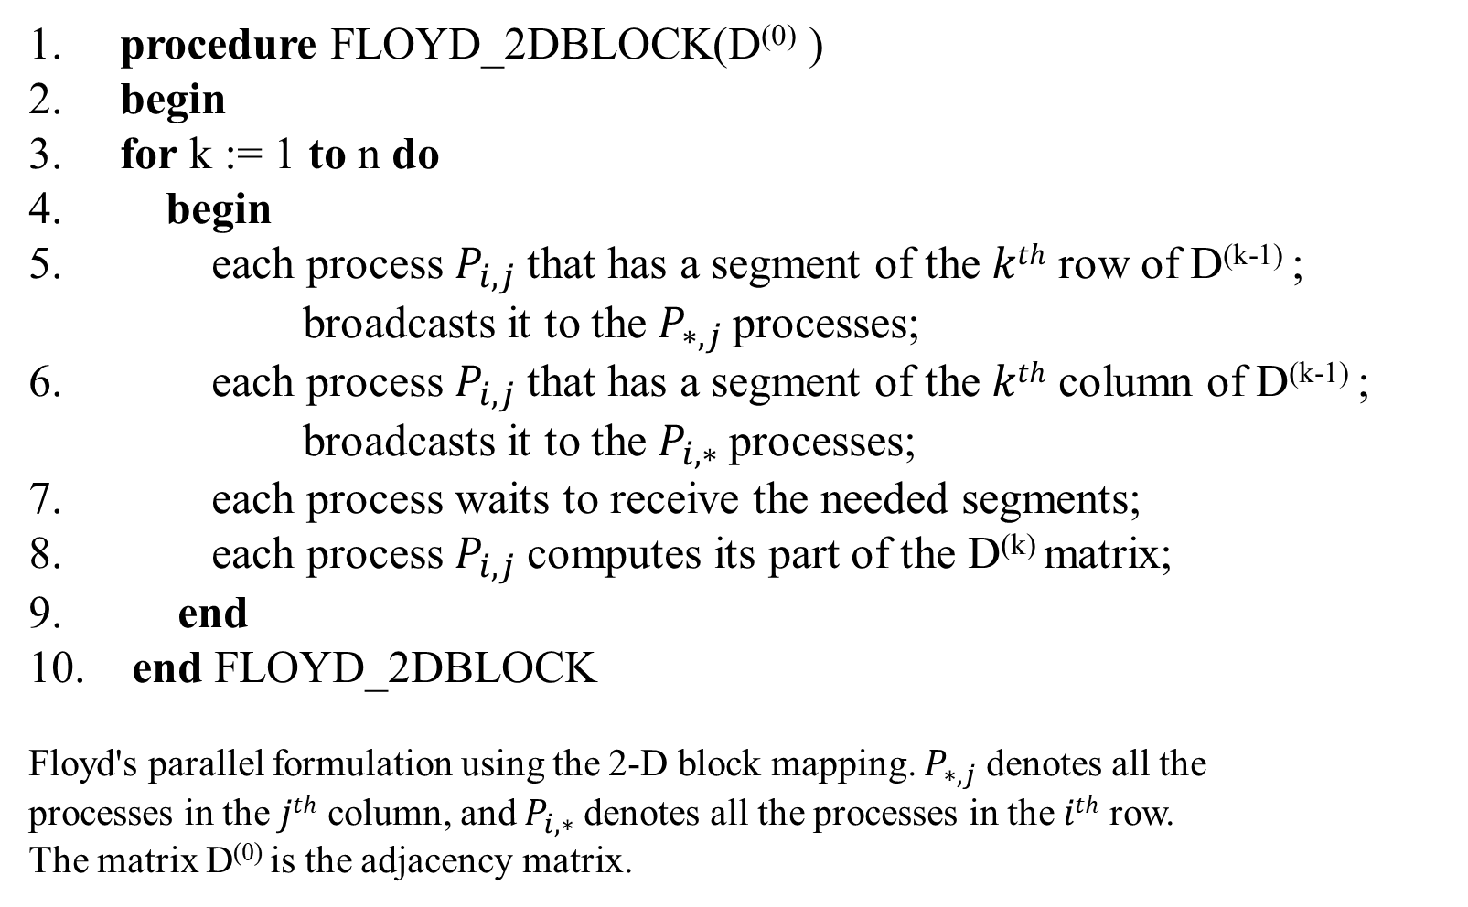
Floyd's Algorithm: Parallel Formulation Using 2-D Block Mapping
1. procedure FLOYD_2DBLOCK(D⁽⁰⁾ )
2. begin
3. for k := 1 to n do
4. begin
5. each process $P_{i,j}$that has a segment of the $kth$ row of D^{(k-1)} ; broadcasts it to the $P_{∗,j}$processes;
6. each process $P_{i,j}$that has a segment of the $kth$ column of D^{(k-1)} ; broadcasts it to the $P_{i,∗}$processes;
7. each process waits to receive the needed segments;
8. each process $P_{i,j}$computes its part of the D^{(k)} matrix;
9. end
10. end FLOYD_2DBLOCK
Floyd's parallel formulation using the 2-D block mapping. $P_{∗,j}$denotes all the
processes in the $jth$ column, and $P_{i,∗}$denotes all the processes in the $ith$ row.
The matrix D⁽⁰⁾ is the adjacency matrix.

Slide 46
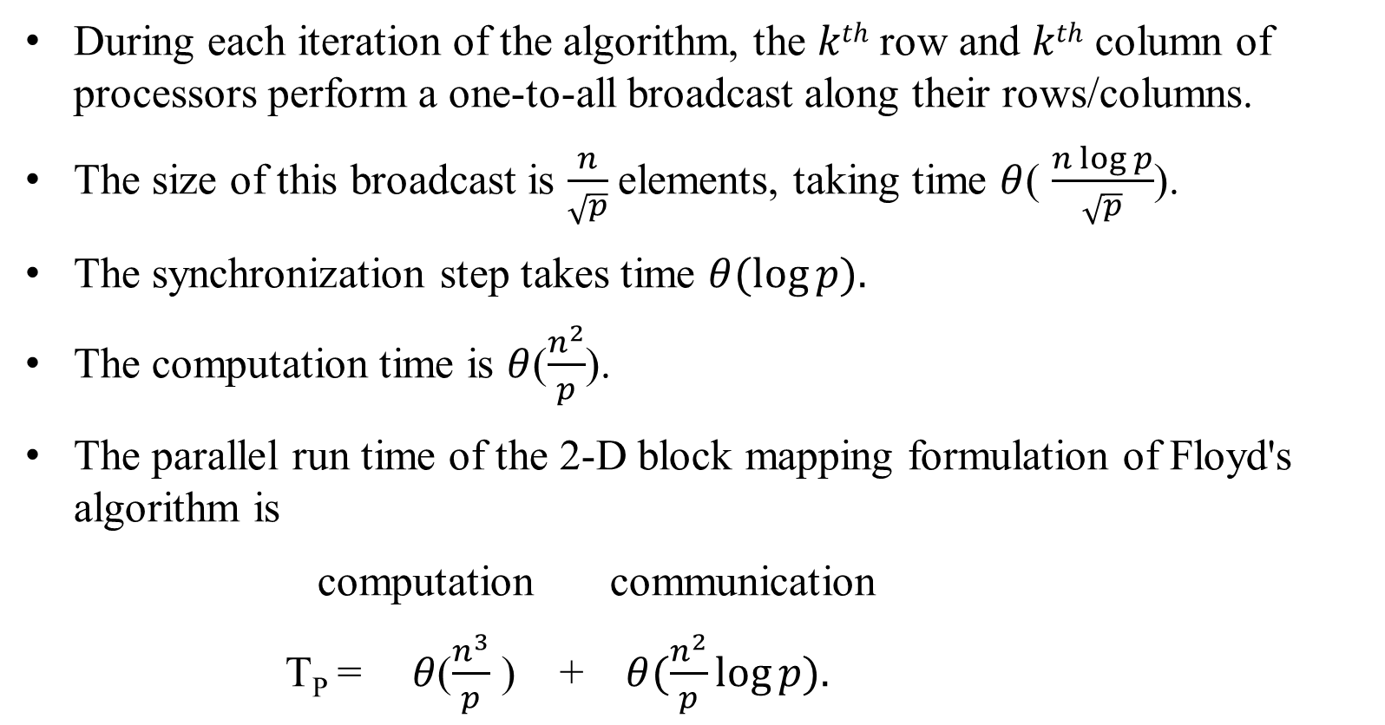
Floyd's Algorithm: Parallel Formulation Using 2-D Block Mapping
During each iteration of the algorithm, the $kth$ row and $kth$ column of processors perform a one-to-all broadcast along their rows/columns.
The size of this broadcast is $\frac{n}{\sqrt{p}}$elements, taking time $θ$( $\frac{n\log{p}}{\sqrt{p}}$).
The synchronization step takes time $θ(\log{p).}$
The computation time is $θ$($\frac{n^{2}}{p}$).
The parallel run time of the 2-D block mapping formulation of Floyd's algorithm is
computation communication
T_{P} = $θ$($\frac{n^{3}}{p}$ ) + $θ(\frac{n^{2}}{p}\log{p).}$

Slide 47
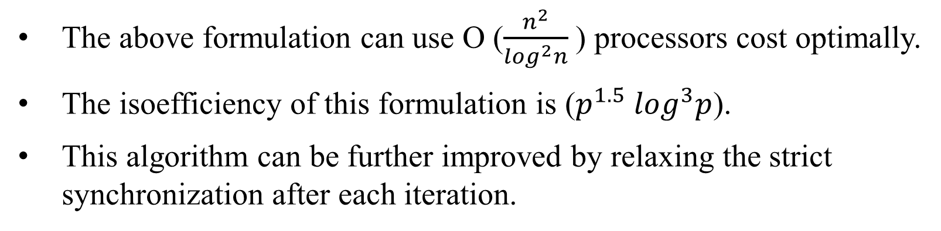
Floyd's Algorithm: Parallel Formulation Using 2-D Block Mapping
The above formulation can use O ($\frac{n^{2}}{\log^{2}n}$) processors cost optimally.
The isoefficiency of this formulation is ($p^{1.5} \log^{3}p$).
This algorithm can be further improved by relaxing the strict synchronization after each iteration.

Slide 48
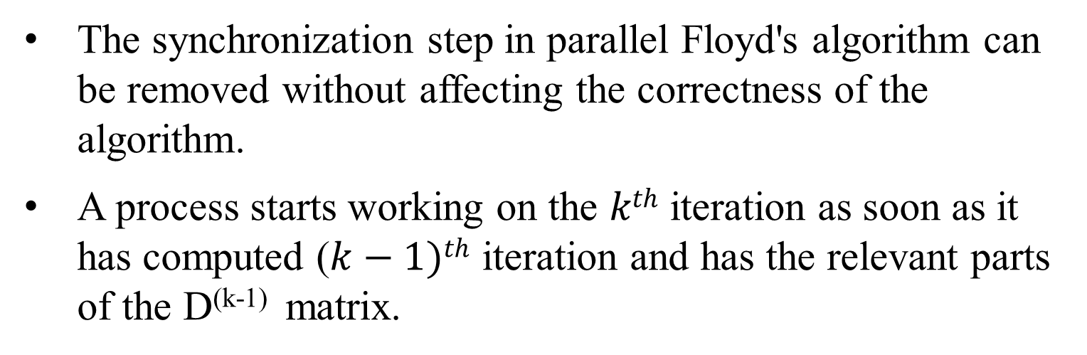
Floyd's Algorithm: Speeding Things Up by Pipelining
The synchronization step in parallel Floyd's algorithm can be removed without affecting the correctness of the algorithm.
A process starts working on the $kth$ iteration as soon as it has computed ($k−1)th$ iteration and has the relevant parts of the D^{(k-1)} matrix.

Slide 49
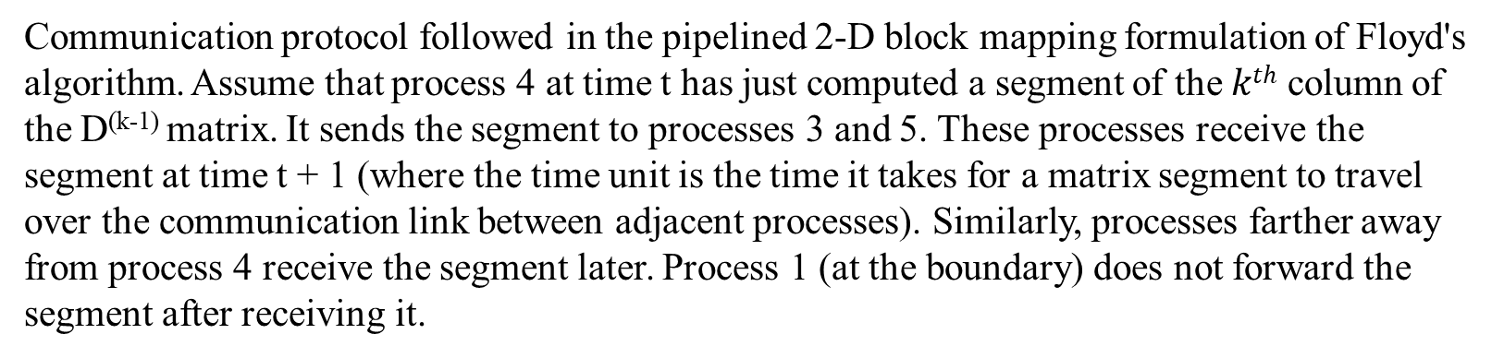
Floyd's Algorithm: Speeding Things Up by Pipelining
t
t + 1
t + 2
t + 3
t + 4
t + 5
 | 1 | 2 | 3 | 4 | 5 | 6 | 7 | 8 | 9 | 10
Time
Processors
Communication protocol followed in the pipelined 2-D block mapping formulation of Floyd's algorithm. Assume that process 4 at time t has just computed a segment of the $kth$ column of the D^{(k-1)} matrix. It sends the segment to processes 3 and 5. These processes receive the segment at time t + 1 (where the time unit is the time it takes for a matrix segment to travel over the communication link between adjacent processes). Similarly, processes farther away from process 4 receive the segment later. Process 1 (at the boundary) does not forward the segment after receiving it.

Slide 50
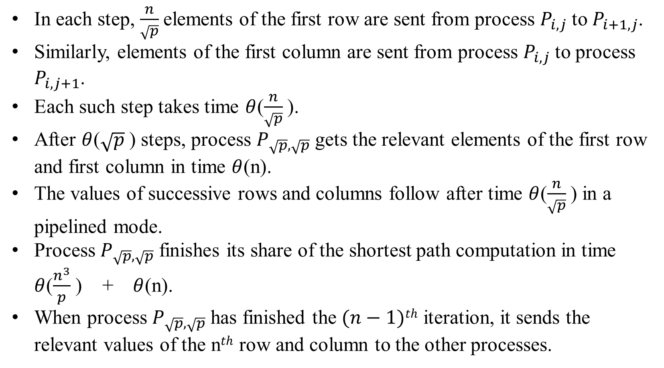
Floyd's Algorithm: Speeding Things Up by Pipelining
In each step, $\frac{n}{\sqrt{p}}$elements of the first row are sent from process $P_{i,j}$to $P_{i+1,j}$.
Similarly, elements of the first column are sent from process $P_{i,j}$to process $P_{i,j+1}$.
Each such step takes time $θ$($\frac{n}{\sqrt{p}}$).
After $θ$($\sqrt{p}$ ) steps, process $P_{\sqrt{p}, \sqrt{p}}$gets the relevant elements of the first row and first column in time $θ$(n).
The values of successive rows and columns follow after time $θ$($\frac{n}{\sqrt{p}}$) in a pipelined mode.
Process $P_{\sqrt{p}, \sqrt{p}}$finishes its share of the shortest path computation in time $θ$($\frac{n^{3}}{p}$ ) + $θ$(n).
When process $P_{\sqrt{p}, \sqrt{p}}$has finished the $(n−1)th$ iteration, it sends the relevant values of the n$th$ row and column to the other processes.

Slide 51
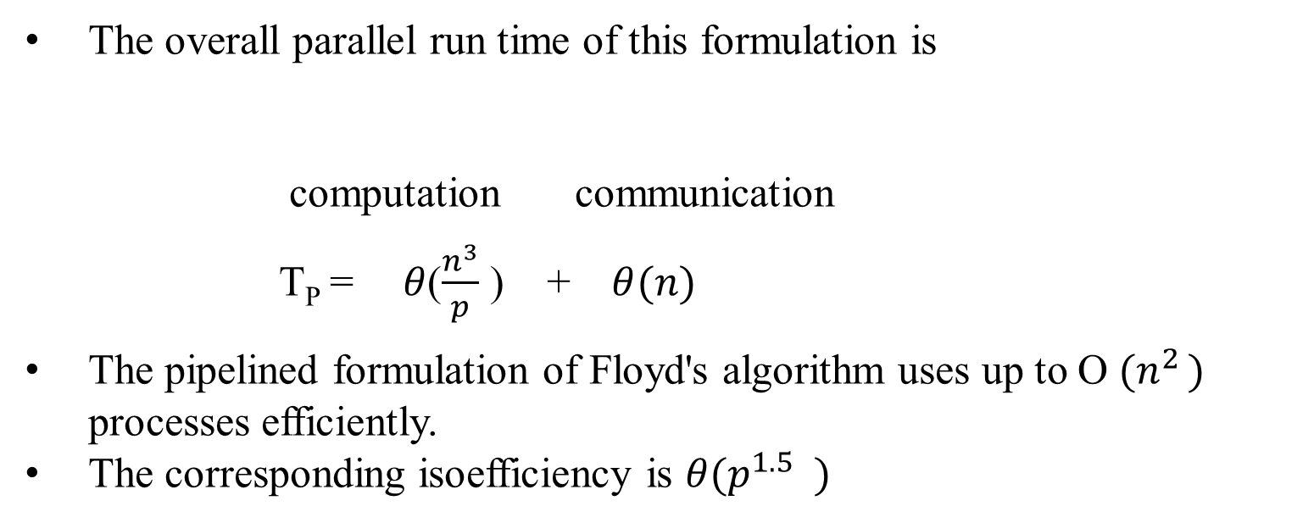
Floyd's Algorithm: Speeding Things Up by Pipelining
The overall parallel run time of this formulation is
computation communication
T_{P} = $θ$($\frac{n^{3}}{p}$ ) + $θ(n)$
The pipelined formulation of Floyd's algorithm uses up to O ${(n}^{2 })$ processes efficiently.
The corresponding isoefficiency is $θ{(p}^{1.5} )$

Slide 52
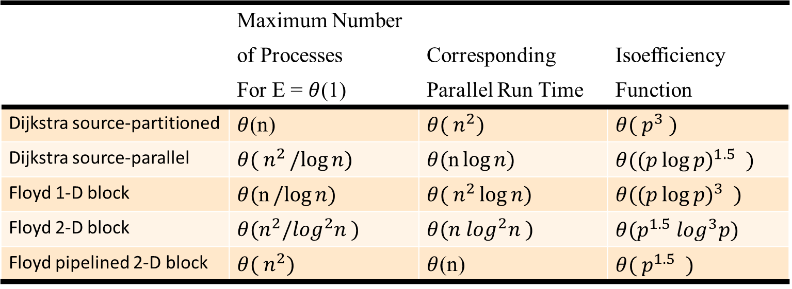
All-pairs Shortest Path: Comparison
The performance and scalability of the all-pairs shortest paths algorithms on various architectures with O(p) bisection bandwidth. Similar run times apply to all k - d cube architectures, provided that processes are properly mapped to the underlying processors.
 | Maximum Number
 | of Processes | Corresponding | Isoefficiency
 | For E = $θ$(1) | Parallel Run Time | Function
Dijkstra source-partitioned | $θ$(n) | $$θ( n^{2})$$ | $$θ({ p}^{3} )$$
Dijkstra source-parallel | $$θ( n^{2}/log{n})$$ | $$θ(\text{n}\log{n})$$ | $$θ({(p\log{p)}}^{1.5} )$$
Floyd 1-D block | $$θ(\text{n}/log{n})$$ | $$θ( n^{2}\log{n})$$ | $$θ({(p\log{p)}}^{3} )$$
Floyd 2-D block | $$θ(n^{2}{/log}^{2}n )$$ | $$θ(n \log^{2}n )$$ | $$θ(p^{1.5} \log^{3}p)$$
Floyd pipelined 2-D block | $$θ( n^{2})$$ | $θ$(n) | $$θ({ p}^{1.5} )$$

Slide 53
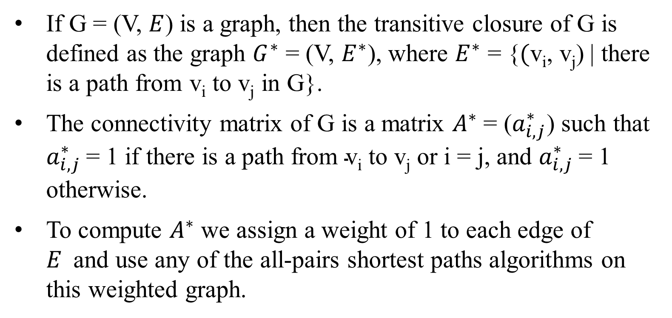
Transitive Closure
If G = (V, $E$) is a graph, then the transitive closure of G is defined as the graph $G^{∗}$ = (V, $E^{∗}$), where $E^{∗}$ = {$(\text{v}\text{i}\text{, }\text{vj}\text{)}$| there is a path from $\text{v}\text{i}$ to $\text{v}\text{j}$ in G}.
The connectivity matrix of G is a matrix $A^{∗}$ = ($a_{i, j}^{∗}$) such that $a_{i, j}^{∗}$= 1 if there is a path from $\text{v}\text{i}$ to $\text{v}\text{j}$ or i = j, and $a_{i, j}^{∗}$= 1 otherwise.
To compute $A^{∗}$ we assign a weight of 1 to each edge of $E$and use any of the all-pairs shortest paths algorithms on this weighted graph.

Slide 54
Connected Components
The connected components of an undirected graph are the equivalence classes of vertices under the “is reachable from” relation.
1
4
6
9
2
3
5
7
8
A graph with three connected components: {1, 2, 3, 4}, {5, 6, 7},
and {8, 9}.

Slide 55
Connected Components: Depth-First Search Based Algorithm
Perform DFS on the graph to get a forest - each tree in the forest corresponds to a separate connected component.
1
4
6
(a)
7
10
8
2
3
5
9
1
4
6
(b)
7
10
8
2
3
5
9
Part (b) is a depth-first forest obtained from depth-first traversal of the graph in part (a). Each of these trees is a connected component of the graph in part (a).

Slide 56
Connected Components: Parallel Formulation
Partition the graph across processors and run independent connected component algorithms on each processor. At this point, we have p spanning forests.
In the second step, spanning forests are merged pairwise until only one spanning forest remains.

Slide 57
Connected Components: Parallel Formulation
 | 1 | 2 | 3 | 4 | 5 | 6 | 7
1 | 0 | 1 | 1 | 1 | 0 | 0 | 0
2 | 1 | 0 | 1 | 0 | 0 | 0 | 0
3 | 1 | 1 | 0 | 1 | 1 | 0 | 0
4 | 1 | 0 | 1 | 0 | 1 | 0 | 0
5 | 0 | 0 | 1 | 1 | 0 | 0 | 0
6 | 0 | 0 | 0 | 0 | 0 | 0 | 1
7 | 0 | 0 | 0 | 0 | 0 | 1 | 0
1
7
Processor 1
4
6
2
Processor 2
3
5
(a)
(b)
Computing connected components in parallel. The adjacency
matrix of the graph G in (a) is partitioned into two parts (b).

Slide 58
Connected Components: Parallel Formulation
1
7
7
1
4
6
4
6
2
2
3
5
3
5
(c)
(d)
Each process gets a subgraph of G ((c) and (e)). Each process then
computes the spanning forest of the subgraph ((d) and (f)).
Finally, the two spanning trees are merged to form the solution.

Slide 59
Connected Components: Parallel Formulation
1
7
7
1
4
6
4
6
2
2
3
5
3
5
(e)
(f)
Each process gets a subgraph of G ((c) and (e)). Each process then
computes the spanning forest of the subgraph ((d) and (f)).
Finally, the two spanning trees are merged to form the solution.

Slide 60
Connected Components: Parallel Formulation
To merge pairs of spanning forests efficiently, the algorithm uses disjoint sets of edges.
We define the following operations on the disjoint sets:
  find(x) returns a pointer to the representative element of the set containing x. Each set has its own unique representative.
  union(x, y) unites the sets containing the elements x and y. The two sets are assumed to be disjoint prior to the operation.

Slide 61
Connected Components: Parallel Formulation
For merging forest A into forest B, for each edge (u; v) of A, a find operation is performed to determine if the vertices are in the same tree of B.
If not, then the two trees (sets) of B containing u and v are united by a union operation.
Otherwise, no union operation is necessary.
Hence, merging A and B requires at most 2(n - 1) find operations and (n - 1) union operations.

Slide 62
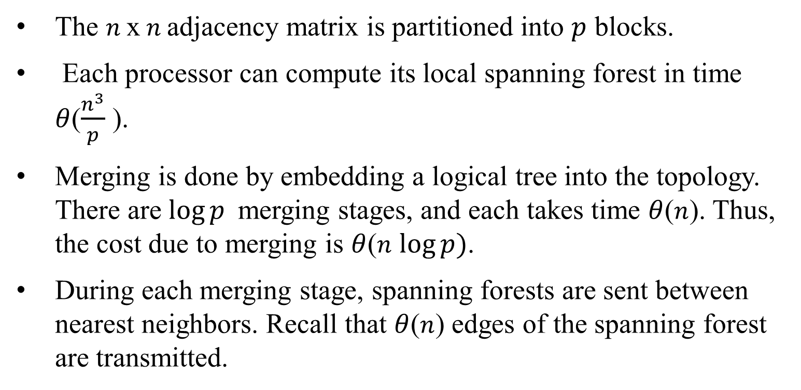
Connected Components: Parallel 1-D Block Mapping
The $n$x $n$adjacency matrix is partitioned into $p$ blocks.
Each processor can compute its local spanning forest in time $θ$($\frac{n^{3}}{p}$ ).
Merging is done by embedding a logical tree into the topology. There are $\log{p }$merging stages, and each takes time $θ$($n$). Thus, the cost due to merging is $θ$($n$ $\log{p)}$.
During each merging stage, spanning forests are sent between nearest neighbors. Recall that $θ$($n$) edges of the spanning forest are transmitted.

Slide 63
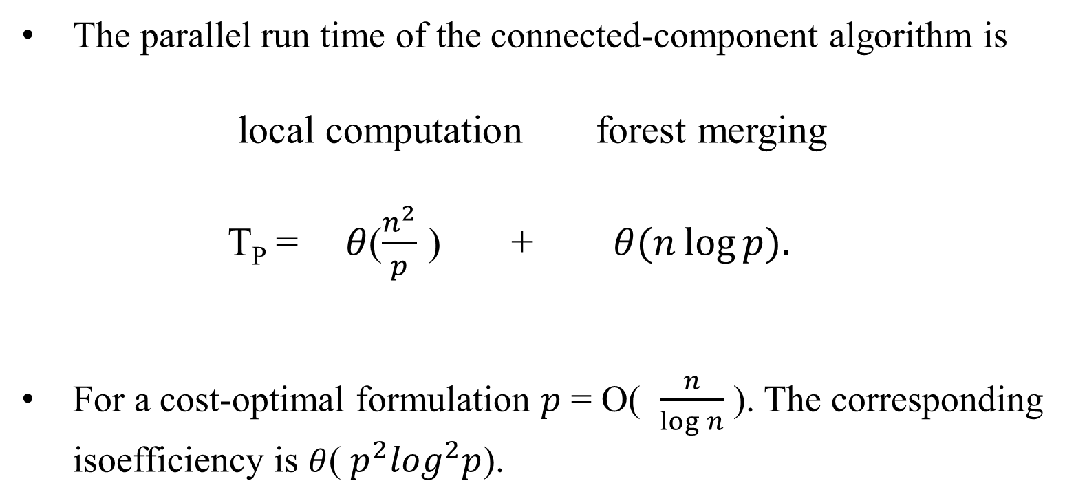
Connected Components: Parallel 1-D Block Mapping
The parallel run time of the connected-component algorithm is
local computation forest merging
T_{P} = $θ$($\frac{n^{2}}{p}$ ) + $θ(n\log{p).}$
For a cost-optimal formulation $p$ = O( $\frac{n}{\log{n}}$ ). The corresponding isoefficiency is $θ$( $p^{2}\log^{2}p$).

Slide 64
Algorithms for Sparse Graphs
A graph G = (V, E) is sparse if |E| is much smaller than | V |².
(a)
Examples of sparse graphs: (a) a linear graph, in which each vertex has two incident edges; (b) a grid graph, in which each vertex has four incident vertices; and (c) a random sparse graph.
(b)
(c)

Slide 65
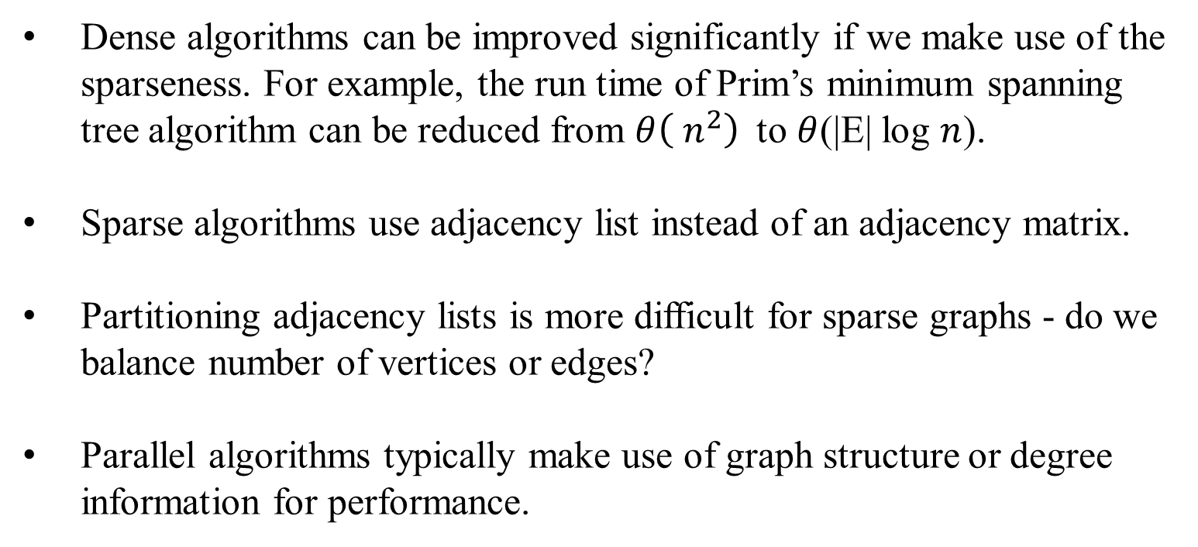
Algorithms for Sparse Graphs
Dense algorithms can be improved significantly if we make use of the sparseness. For example, the run time of Prim’s minimum spanning tree algorithm can be reduced from $θ\left( n^{2}\right)$to $θ$(|E| log $n$).
Sparse algorithms use adjacency list instead of an adjacency matrix.
Partitioning adjacency lists is more difficult for sparse graphs - do we balance number of vertices or edges?
Parallel algorithms typically make use of graph structure or degree information for performance.

Slide 66
Algorithms for Sparse Graphs
(b)
(a)
A street map (a) can be represented by a graph (b). In the graph shown in (b), each street intersection is a vertex and each edge is a street segment. The vertices of (b) are the intersections of (a) marked by dots.

Slide 67
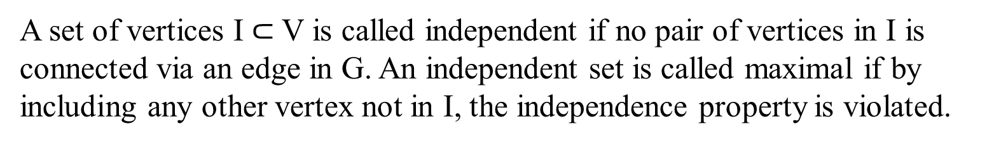
Finding a Maximal Independent Set
A set of vertices I$⊂$ V is called independent if no pair of vertices in I is connected via an edge in G. An independent set is called maximal if by including any other vertex not in I, the independence property is violated.
f
e
{a, d, i, h} is an independent set
{a, c, j, f, g} is a maximal independent set
{a, d, h, f} is a maximal independent set
a
i
g
d
j
b
e
c
h
Examples of independent and maximal independent sets.

Slide 68
Finding a Maximal Independent Set
Simple algorithms start by MIS I to be empty, and assigning all vertices to a candidate set C.
Vertex v from C is moved into I and all vertices adjacent to v are removed from C.
This process is repeated until C is empty.
This process is inherently serial!

Slide 69
Finding a Maximal Independent Set (MIS)
Parallel MIS algorithms use randimization to gain concurrency (Luby's algorithm for graph coloring).
Initially, each node is in the candidate set C. Each node generates a (unique) random number and communicates it to its neighbors.
If a nodes number exceeds that of all its neighbors, it joins set I. All of its neighbors are removed from C.
This process continues until C is empty.
On average, this algorithm converges after O(log |V |) such steps.

Slide 70
Finding a Maximal Independent Set (MIS)
1
Vertex in the independent set
Vertex adjacent to a vertex
in the independent set
7
1
7
11
1
7
11
15
3
15
13
3
2
10
13
2
10
8
0
8
3
0
6
4
3
6
4
15
0
14
12
1
12
(a) After the 1st random number assignment
(b) After the 2nd random number assignment
The different augmentation steps of Luby's randomized maximal independent set algorithm. The numbers inside each vertex correspond to the random number assigned to the vertex.

Slide 71
Finding a Maximal Independent Set (MIS)
1
Vertex in the independent set
Vertex adjacent to a vertex
in the independent set
7
1
7
11
1
7
11
15
3
15
2
13
3
10
13
2
10
8
0
8
3
0
6
4
3
6
4
0
0
1
12
1
12
(c) Final maximal independent set
(b) After the 2nd random number assignment
The different augmentation steps of Luby's randomized maximal independent set algorithm. The numbers inside each vertex correspond to the random number assigned to the vertex.

Slide 72
Finding a Maximal Independent Set (MIS):
Parallel Formulation
We use three arrays, each of length n - I, which stores nodes in MIS, C, which stores the candidate set, and R, the random numbers.
Partition C across p processors. Each processor generates the corresponding values in the R array, and from this, computes which candidate vertices can enter MIS.
The C array is updated by deleting all the neighbors of vertices that entered MIS.
The performance of this algorithm is dependent on the structure of the graph.

Slide 73
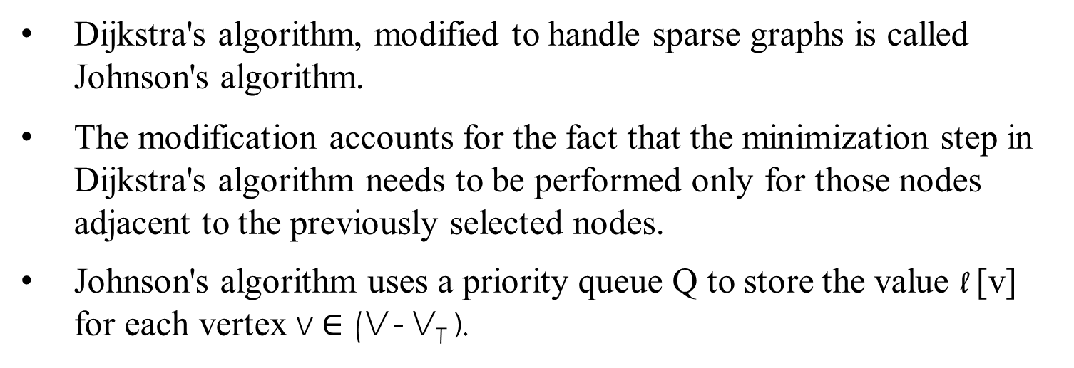
Single-Source Shortest Paths
Dijkstra's algorithm, modified to handle sparse graphs is called Johnson's algorithm.
The modification accounts for the fact that the minimization step in Dijkstra's algorithm needs to be performed only for those nodes adjacent to the previously selected nodes.
Johnson's algorithm uses a priority queue Q to store the value l [v] for each vertex v $∈$ (V - V_{T} ).

Slide 74
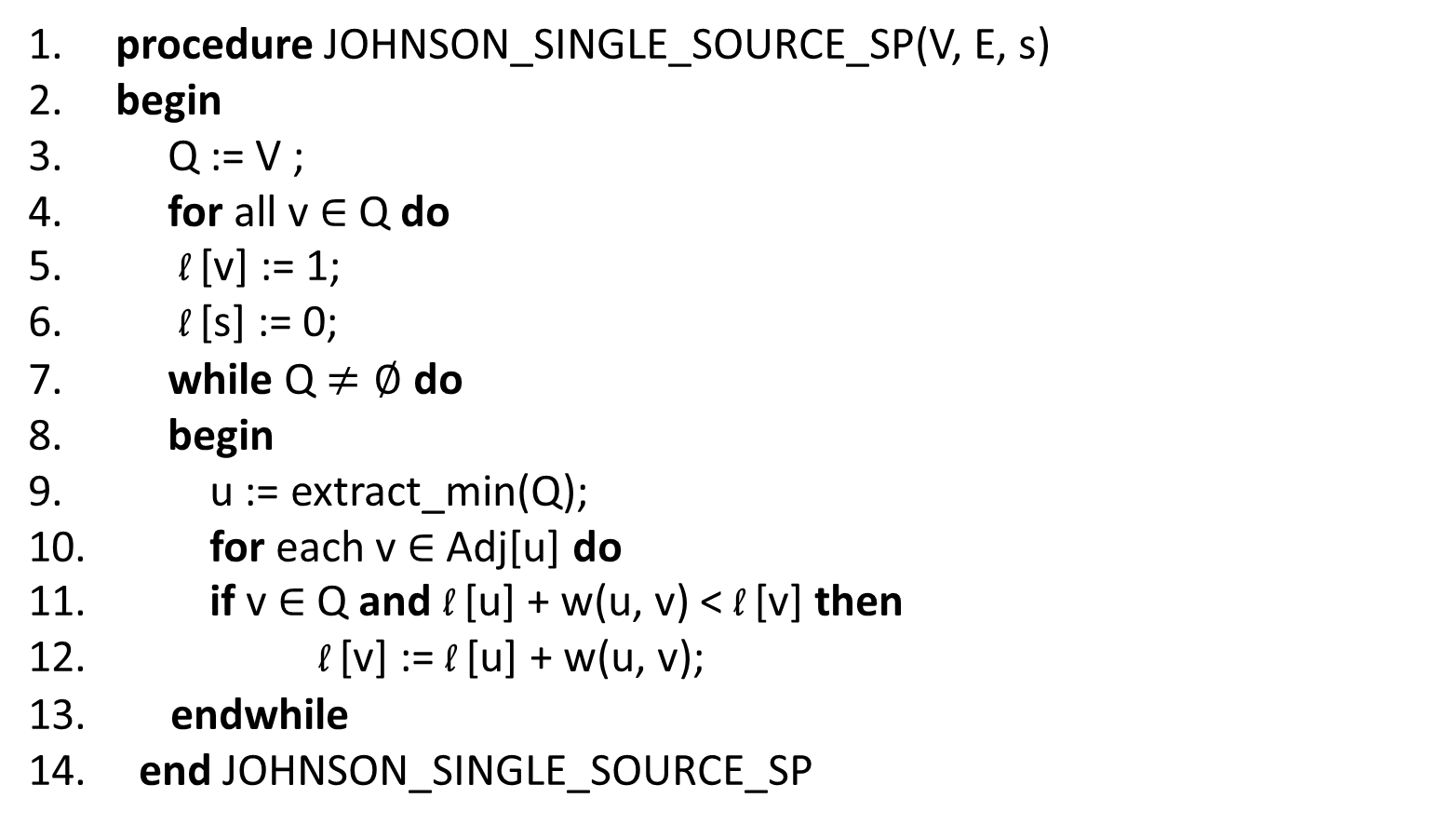
Single-Source Shortest Paths: Johnson’s Algorithm
1. procedure JOHNSON_SINGLE_SOURCE_SP(V, E, s)
2. begin
3. Q := V ;
4. for all v $∈$ Q do
5. l [v] := 1;
6. l [s] := 0;
7. while Q $≠∅$do
8. begin
9. u := extract_min(Q);
10. for each v $∈$ Adj[u] do
11. if v $∈$ Q and l [u] + w(u, v) < l [v] then
12. l [v] := l [u] + w(u, v);
13. endwhile
14. end JOHNSON_SINGLE_SOURCE_SP
Johnson's sequential single-source shortest paths algorithm.

Slide 75
Single-Source Shortest Paths:
Parallel Johnson’s Algorithm
Maintaining strict order of Johnson's algorithm generally leads to a very restrictive class of parallel algorithms.
We need to allow exploration of multiple nodes concurrently. This is done by simultaneously extracting p nodes from the priority queue, updating the neighbors' cost, and augmenting the shortest path.
If an error is made, it can be discovered (as a shorter path) and the node can be reinserted with this shorter path.

Slide 76
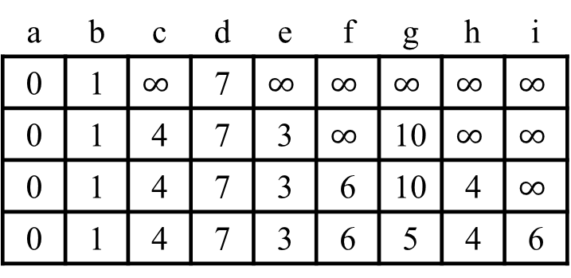
Single-Source Shortest Paths:
Parallel Johnson’s Algorithm
g
1
h
2
i
3
1
1
d
8
e
5
f
7
2
2
a
b
c
Array l []
1
3
Priority Queue
a | b | c | d | e | f | g | h | i
0 | 1 | $$∞$$ | 7 | $$∞$$ | $$∞$$ | $$∞$$ | $$∞$$ | $$∞$$
0 | 1 | 4 | 7 | 3 | $$∞$$ | 10 | $$∞$$ | $$∞$$
0 | 1 | 4 | 7 | 3 | 6 | 10 | 4 | $$∞$$
0 | 1 | 4 | 7 | 3 | 6 | 5 | 4 | 6
(1)
b:1, d:7, c:inf, e:inf, f:inf, g:inf, h:inf, i:inf
(2)
e:3, c:4, g:10, f:inf, h:inf, i:inf
(3)
h:4, f:6, i:inf
(4)
g:5, i:6
An example of the modified Johnson's algorithm for processing unsafe vertices concurrently.

Slide 77
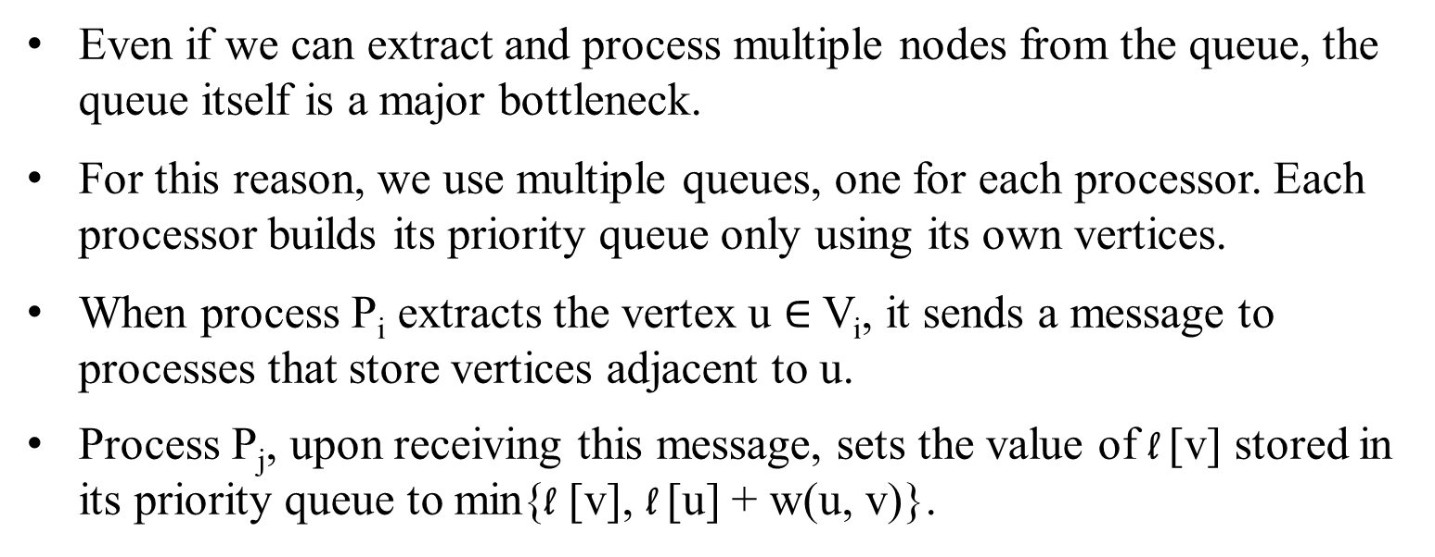
Single-Source Shortest Paths:
Parallel Johnson’s Algorithm
Even if we can extract and process multiple nodes from the queue, the queue itself is a major bottleneck.
For this reason, we use multiple queues, one for each processor. Each processor builds its priority queue only using its own vertices.
When process P_{i} extracts the vertex u $∈$ V_{i}, it sends a message to processes that store vertices adjacent to u.
Process P_{j}, upon receiving this message, sets the value of l [v] stored in its priority queue to min{l [v], l [u] + w(u, v)}.

Slide 78
Single-Source Shortest Paths:
Parallel Johnson’s Algorithm
If a shorter path has been discovered to node v, it is reinserted back into the local priority queue.
The algorithm terminates only when all the queues become empty.
A number of node partitioning schemes can be used to exploit graph structure for performance.

Slide 79
$∪ ≠∞ 〈 〉$ $∈(\text{v}\text{i}\text{, }\text{vi}\text{+1}\text{)} θ\text{(}\text{n}\text{2}\text{)} ⊂⊄⊆⊈⊊$

