Slide 1
Decomposition of Graph
Depth-First Search

Slide 2

Decomposition of Graph
The remaining of this chapter covers:
  graphs, with
  Depth-First Search, and
  Breadth-First Search, and
  Topological Sorting
  Strong Connected Components
  Fake Coin Problem
  Interpolation Search

Slide 3
  Decrease-by-one technique.
Depth-First Search and Breadth-First Search Algorithms
  Viewed as applications of the decrease-by-one technique.
  visiting vertices and traversing edges of a graph.

Slide 4

Decrease-by-one technique
Depth-First Search

Slide 5

Depth-First Search
Depth-first search (dfs):
  is a surprisingly versatile linear-time procedure
  addresses the most basic question: the reachability problem
  What parts of the graph are reachable from a given vertex?
  Find the neighbors of a vertex.
  Reveals a wealth of information about a graph.

Slide 6
Figure 3.1: Exploring a graph is rather like navigating a maze.
L
K
 |  |  |  |  |  |  |  |  | S |  | F |  |  |  |  |  |  |  |  |  | H
 | J |  |  |  |  | B |  |  |  |  |  |  | C
 |  |  |  |  |  |  |  |  |  |  |  | X
R |  |  |  |  |  |  |  |  |  |  | M
 |  |  |  |  | E |  |  |  |  |  |  |  |  |  |  |  |  |  |  |  | G
 |  |  |  |  |  |  |  |  |  |  | P |  |  |  |  | Q
I |  |  |  |  |  |  |  |  |  |  | A |  |  |  |  |  |  | D

Slide 7
Graphs
D
A
B
E
X
M
G
H
C
F
I
J
R
S
K
L
P
Q
Figure 3.1a: This graph is equivalent to the given maze in Figure 3.1,
in terms of reachability.

Slide 8
Depth-First Search
During dfs exploration for any graph traversal,
  Boolean variable : (close list with hashing function)
    mark for each vertex after visited,
      by maintaining a Boolean variable for indicating whether a vertex has been visited already.
  Stack : (open list, FILO queue)
    need a stack with two primitive operations:
      push the new vertex (i.e., unwind to get to a new junction), and
      pop the stack (i.e., rewind to return to the previous junction).

Slide 9
Outline Depth-First Search
Starts visiting vertices of a given graph at an arbitrary vertex by marking it as having been visited.
On each iteration, at a vertex, the algorithm proceeds to its adjacent unvisited vertex.
For several adjacent unvisited vertices, resolves arbitrarily a tie. The data structure representing the graph (such as adjacency list) could dictate the chosen adjacent unvisited vertex.
The process continues until a dead end (a vertex v with no adjacent unvisited vertices) is encountered.
At a dead end (a vertex v), the algorithm backs up one edge to its parental vertex u, and continues visiting unvisited descendant vertices of the vertex u.
The algorithm eventually halts after backing up to the starting vertex with dead end.
  By then, all the vertices in the same connected component of the starting vertex have been visited.
If unvisited vertices still remain, the dfs must be restarted at any one of them.

Slide 10

Depth-First Search
Use a stack to trace the operation of depth-first search.
Push a vertex onto the stack when the vertex is visited for the first time, and
Pop a vertex off the stack when it becomes a dead end.
A stack is a LIFO Queue.

Slide 11
Depth-First Search
Construct a depth-first search forest, accompanying a depth-first search traversal.
[Traversal of a graph] Designate the vertex u₀ as the root of the first tree of a forest, where the traversal starts.
[Form a tree with tree edge] Whenever a new unvisited vertex u_{j} is reached for the first time from a vertex u_{i}, the vertex u_{j} is attached as a child to the parent vertex u_{i} to form a tree edge (u_{i}, u_{j}). The set of all such edges forms a tree of the forest.
[Form a back edge] At a vertex u_{i}, the algorithm may encounter an edge (called a back edge) leading to a previously visited vertex other than its immediate predecessor (i.e., its parent). This edge connects a vertex to its ancestor, other than the parent, in the depth-first search forest.

Slide 12
Depth-First Search
For example: At vertex a, dfs traverses from a to c to form a tree edge (a, c), then from c to d to form a tree edge (c, d). At d, a dead end is encountered. But from d to a, it is a back edge (d, a).
Boolean Variables:
Each of the vertex is designated by either 0 (false) or 1 (true).
a₀ a₁ a₁ a₁
c₀ c₀ c₁ c₁
d₀ d₀ d₀ d₁
a₀ c d
c₀ a d
d₀ a c
a a
c c
d d
back edge
d₃ ₁
c₂ ₂
a₁ ₃
null
tree edge

Slide 13
Depth-First Search(dfs)
Instead of explicitly maintaining a stack,
  do dfs implicitly via recursion
  and is implemented using a stack of activation records.
The resulting algorithm is shown in Algorithm DFS(G).

Slide 14
The Depth-First Search Algorithm
Algorithm DFS(G)
//Implements a depth-first search traversal of a given graph
//Input: Graph G =(V, E)
//Output: Graph G with its vertices marked with consecutive integer in
// the order they are first encountered by the dfs traversal
mark each vertex in V with 0: //as a mark of being “unvisited”
count ← 0; //a global variable; use for timestamp
for each vertex v in V do {
if (v is marked with 0)
dfs(v); }; //end if and end for-do

Slide 15
The Depth-First Search Algorithm
Algorithm DFS(G)
…
dfs(v)
//visits recursively all the unvisited vertices connected to vertex v by a path
//and numbers them in the order they are encountered via global variable count
count ← count + 1;
mark v with count;
for each vertex w in V adjacent to v do {
if (w is marked with 0)
dfs(w); }; //end if and end for-do

Slide 16

Depth-First Search
Example 3.8: A depth-first search (dfs) traversal on a graph (a), with its adjacency list representation.
g
h
Input: An adjacency list
a → c → d → e
b → e → f
c → a → d → f
d → a → c
e → a → b → f
f → b → c → e
g → h → j
h → g → i
i → h → j
j → g → i
c
a
e
d
c
f
b
j
i
(a) Graph

Slide 17
The Depth-First Search Algorithm
Example 3.8: A dfs traversal on a graph(a). Mark each vertex with 0 as unvisited. The traversal’s stack is shown.
g,0
h,0
Input: An adjacency list
a,0 → c → d → e
b,0 → e → f
c,0 → a → d → f
d,0 → a → c
e,0 → a → b → f
f,0 → b → c → e
g,0 → h → j
h,0 → g → i
i,0 → h → j
j,0 → g → i
a,0
e,0
d,0
c,0
f,0
b,0
A traversal’s stack (b)
 | e_{6, 2}
 | b_{5, 3} | j_{10, 7}
d_{3, 1} | f_{4, 4} | i_{9, 8}
c_{2, 5} | c_{2, 5} | h_{8, 9}
a_{1, 6} | a_{1, 6} | g_{7, 10}
j,0
i,0
(a) Graph

Slide 18
Depth-First Search
g,0
h,0
Example 3.8: A dfs traversal on the graph (a), with a traversal’s stack
The first subscript number (the variable count) indicates the order in which a vertex was visited (discovered), i.e., pushed onto the stack;
The second subscript indicates the order in which it became a dead-end (finished), i.e., popped off the stack.
a,0
e,0
d,0
c,0
f,0
b,0
Input: An adjacency list
a → c → d → e
b → e → f
c → a → d → f
d → a → c
e → a → b → f
f → b → c → e
g → h → j
h → g → i
i → h → j
j → g → i
 |  | e_{6, 2}
 |  | b_{5, 3} |  | j_{10, 7}
d_{3, 1} |  | f_{4, 4} |  | i_{9, 8}
c_{2, 5} |  | c_{2, 5} |  | h_{8, 9}
a_{1, 6} |  | a_{1, 6} |  | g_{7, 10}
d | e | b | g | v | s | j | i | h | 8
(b) A history of the traversal’s stack. (subscripts are push- onto/discover or pop- off/finish order).

Slide 19
Depth-First Search
Example 3.8: A dfs traversal on graph (a), with a DFS forest (c) in which the solid lines are the tree edges. and the dashed lines are the back edges.
Parenthesis structure:(push-onto pop-off) or (discover finish) order
(a (c ( d d) (f (b (e e) b) f) c ) a) (g (h (i (j j) i) h) g)
a g
c h
d f i
b j
e
 |  | e_{6, 2}
 |  | b_{5, 3} |  | j_{10, 7}
d_{3, 1} |  | f_{4, 4} |  | i_{9, 8}
c_{2, 5} |  | c_{2, 5} |  | h_{8, 9}
a_{1, 6} |  | a_{1, 6} |  | g_{7, 10}
Input: An adjacency list
a → c → d → e
b → e → f
c → a → d → f
d → a → c
e → a → b → f
f → b → c → e
g → h → j
h → g → i
i → h → j
j → g → i
(c)

Slide 20
Depth-First Search
Using timestamp, the dfs represents
  the discovery (push onto) of vertex u with a left parenthesis “(u”
  its finishing (pop off) by a right parenthesis “u )”
  the history of discoveries and finishings can be written as
    a well-formed expression that the parentheses are properly nested.
    Parenthesis structure :
(a (c ( d d) (f (b (e e) b) f) c ) a) (g (h (i (j j) i) h) g)

Slide 21
Depth-First Search
A basic property:
Let π(v) denote the predecessor of v. (vertices come before vertex v)
The most basic property of depth-first search is
that the predecessor subgraph G_{π} does form a forest of tree since the structure of the depth-first trees exactly mirrors the structure of recursive calls of dfs(v).
That is, u = π(v) iff dfs(v) was called during a search of u’s adjacency list. e.g., … a = π(c)
Additionally, vertex v is a descendant of vertex u in the depth-first forest iff v is discovered during the time in which u is already visited.

Slide 22
Depth-First Search
Theorem 3.1 (Parenthesis theorem)
In any dfs of a (directed or undirected) graph G = (V, E), for any two vertices u and v, exactly one of the following three conditions holds: Let d[u] (or, u.d) and f[u] (or, u.f ) be the discovery (push onto) and finishing (pop off) of vertex u, respectively.
The intervals [d[u], f[u]] and [d[v], f[v]] are entirely disjoint, and neither u nor v is a descendant of the other in the depth-first forest.
(u … u) … (v … v) for the case. u v
The interval [d[u], f[u]] is contained entirely within the interval [d[v], f[v]], and u is a descendant of v in a depth-first tree, or v u
(v … ( u … v) … v) for the case.
The interval [d[v], f[v]] is contained entirely within the interval [d[u], f[u]] and v is a descendant of u in a depth-first tree. u v
(u … (v … v) … u) for the case.

Slide 23

Depth-First Search
Consider again the traversal of the given graph in example 3.8. We have:
 |  | e_{6, 2}
 |  | b_{5, 3} |  | j_{10, 7}
d_{3, 1} |  | f_{4, 4} |  | i_{9, 8}
c_{2, 5} |  | c_{2, 5} |  | h_{8, 9}
a_{1, 6} |  | a_{1, 6} |  | g_{7, 10}
g
h
a
e
a g
c h
d f i
b j
e
d
c
f
b
j
i
Parenthesis structure :
(a (c ( d d) (f (b (e e) b) f) c ) a) (g (h (i (j j) i) h) g)
The predecessor c, π(c), is a. That is, a = π(c).
c is the descendant of a.
c

Slide 24
Depth-First Search
Parenthesis structure :
(a (c ( d d) (f (b (e e) b) f) c ) a) (g (h (i (j j) i) h) g)
Consider again the traversal of the given graph in example 3.8. We have:
 |  | e_{6, 2}
 |  | b_{5, 3} |  | j_{10, 7}
d_{3, 1} |  | f_{4, 4} |  | i_{9, 8}
c_{2, 5} |  | c_{2, 5} |  | h_{8, 9}
a_{1, 6} |  | a_{1, 6} |  | g_{7, 10}
a g
c h
d f i
b j
e
c
Theorem 3.2 (Tree-edge-path theorem)
In a depth-first forest for a (directed or undirected) graph G = (V, E), vertex v is a descendant of vertex u if and only if at the discovery time d[u] that the search discovers u, there is a path from vertex u to vertex v consisting entirely of unvisited vertices.

Slide 25
Figure 3.1: Exploring a graph is rather like navigating a maze.
L
K
 |  |  |  |  |  |  |  |  |  | F
 |  |  |  |  |  | B |  |  |  |  | M |  |  |  |  |  |  |  |  |  | H
 |  |  |  |  | E |  |  |  |  |  | C |  |  |  |  |  |  |  |  |  | G
J
I |  |  |  |  |  |  |  |  |  |  | A |  |  |  |  |  |  | D

Slide 26
Graphs
Consider the given graph of the maze again:
D
A
B
E
M
G
H
C
F
I
J
K
L
Figure 3.1a. Exploring a graph is rather like navigating a maze.

Slide 27
Figure 3.1: Exploring a graph is rather like navigating a maze.
L
K
 |  |  |  |  |  |  |  |  | S |  | F |  |  |  |  |  |  |  |  |  | H
 | J |  |  |  |  | B |  |  |  |  |  |  | C
 |  |  |  |  |  |  |  |  |  |  |  | X
R |  |  |  |  |  |  |  |  |  |  | M
 |  |  |  |  | E |  |  |  |  |  |  |  |  |  |  |  |  |  |  |  | G
 |  |  |  |  |  |  |  |  |  |  | P |  |  |  |  | Q
I |  |  |  |  |  |  |  |  |  |  | A |  |  |  |  |  |  | D

Slide 28
Graphs
Consider the given graph of the maze again:
D
A
B
E
X
M
G
H
C
F
I
J
R
S
K
L
P
Q
Figure 3.1a. Exploring a graph is rather like navigating a maze.

Slide 29
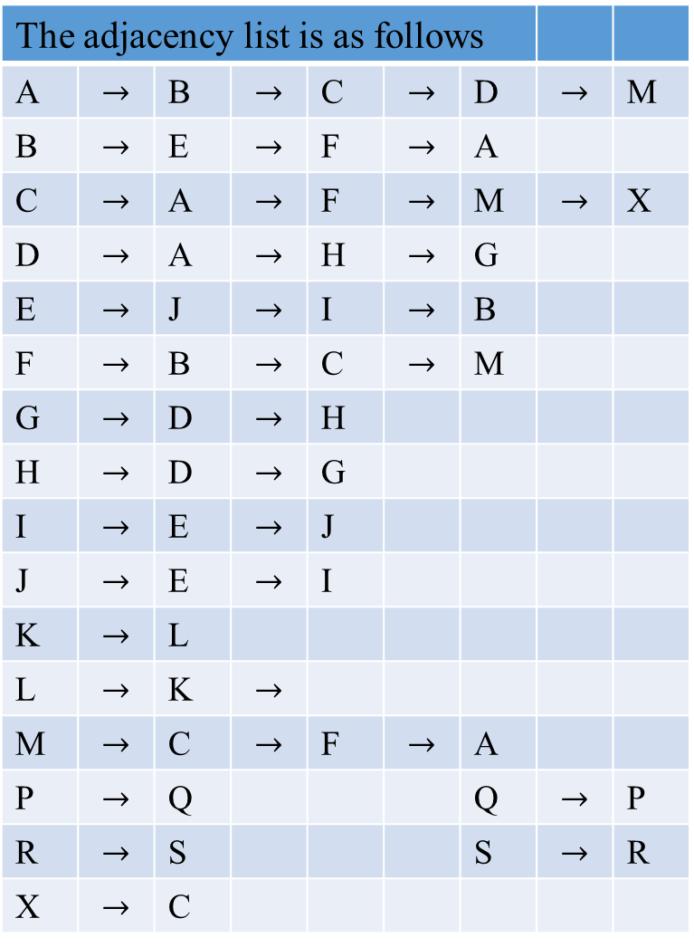
The adjacency list is as follows
A | $$→$$ | B | $$→$$ | C | $$→$$ | D | $$→$$ | M
B | $$→$$ | E | $$→$$ | F | $$→$$ | A
C | $$→$$ | A | $$→$$ | F | $$→$$ | M | $$→$$ | X
D | $$→$$ | A | $$→$$ | H | $$→$$ | G
E | $$→$$ | J | $$→$$ | I | $$→$$ | B
F | $$→$$ | B | $$→$$ | C | $$→$$ | M
G | $$→$$ | D | $$→$$ | H
H | $$→$$ | D | $$→$$ | G
I | $$→$$ | E | $$→$$ | J
J | $$→$$ | E | $$→$$ | I
K | $$→$$ | L
L | $$→$$ | K | $$→$$
M | $$→$$ | C | $$→$$ | F | $$→$$ | A
P | $$→$$ | Q |  |  |  | Q | $$→$$ | P
R | $$→$$ | S |  |  |  | S | $$→$$ | R
X | $$→$$ | C
Depth-First Search
I_{5, 6} M_{11, 12} X_{13, 14}
J_{4, 7} C_{10, 15} G_{20, 21}
E_{3, 8} F_{9, 16} H_{19, 22}
B_{2, 17} D_{18, 23} L_{26, 27} Q_{30, 31} S_{34, 35}
A_{1, 24} K_{25, 28} P_{29, 32} R_{33, 36}
Bottom of the stack

Slide 30
Depth-First Search
Figure 3.2 The result of Algorithm DFS(G) on the graph of Figure 3.1a. is a DFS forest.
A_{1, 22}
B_{2, 15} D_{16, 21}
K_{23, 25} P_{29, 32} R_{23, 25}
L_{24, 26} Q_{30, 31} S_{23, 25}
E_{3, 8} F_{9, 14} H_{17, 20}
J_{4, 7} C_{10, 13} G_{18, 19}
I_{5, 6} M_{11,12} X_{13, 14}
(A (B (E (J (I I) J) E) (F (C (M M) (X X) C) F) B) (D (H (G G) H) D) A)
(K (L L) K) (P (Q Q) P) (R (S S) R)

Slide 31
Depth-First Search - Efficiency
How efficient is the depth-first search?
This algorithm takes the time proportional to the size of the data structure used for representing the graph in question.
For the adjacency matrix representation, the traversal’s time is Θ( |V|² ). e.g., for 100 nodes, time spent Θ( 100² ) = 10,000.
For the adjacency list representation, it is in Θ( |V| + |E|), where |V| and |E| are the number of the graph’s vertices and edges, respectively. e.g., for 100 nodes, 4950 edges (complete, ½ (100)(100-1) = 4950. Then Θ( |V| + |E|) = 5050 (worst case).

Slide 32
Depth-First Search - Forest
Obtain a dfs forest as a by-product of a dfs traversal of a given graph,
  with its edges classified by the dfs traversal into two disjoint classes: tree edges and back edges.
  (No other edge-types are possible for a dfs forest of an undirected graph.)
    Tree edges are edges used by the dfs traversal to reach unvisited vertices.
      (u, v) is a tree edge if v was first discovered (visited) by exploring edge (u, v).
    …

Slide 33

Depth-First Search - Forest
Obtain a dfs forest as a by-product of a dfs traversal of a given graph,
  with its edges classified by the dfs traversal into two disjoint classes: tree edges and back edges.
    Tree edges …
    Back edges connect vertices to previously visited ancestor vertices other than their immediate predecessors (i.e., their parents) in the traversal.
      Back edges are those edges (u, v) connecting a vertex u to an ancestor v in a depth-first forest tree.
    Self-loops, which may occur in directed graphs, are considered to be back edges. No self-loop occurs in any undirected graphs.

Slide 34

Depth-First Search
The dfs yields two orderings of vertices:
The order in which the vertices are reached for the first time (pushed onto the stack) [when it is discovered]
  For example: a, c, d, f, b, e, g, h, i, j is the order in which these vertices are first reached for the first time. [we could assigned a discovery time d[u] for each of these u].
  Example 3.8(b): For the traversal of the given graph, we have:
 | e_{6, 2}
 | b_{5, 3} | j_{10, 7}
d_{3, 1} | f_{4, 4} | i_{9, 8}
c_{2, 5} | c_{2, 5} | h_{8, 9}
a_{1, 6} | a_{1, 6} | g_{7, 10}

Slide 35
Depth-First Search
The order in which the vertices become dead ends (popped off the
stack) [when it is finished].
  For example: d, e, b, f, c, a, j, i, h, g is the order in which these vertices, in turn, become dead ends. [assigned a finishing time f[u] for each of these vertices, says, u]
Example 3.8(b): For the traversal of the given graph, we have:
 | e_{6, 2}
 | b_{5, 3} | j_{10, 7}
d_{3, 1} | f_{4, 4} | i_{9, 8}
c_{2, 5} | c_{2, 5} | h_{8, 9}
a_{1, 6} | a_{1, 6} | g_{7, 10}

Slide 36

Depth-First Search
These orders (push-onto and pop-off) are qualitatively different.
  Various applications can take advantage of either of them.
  e.g., reverse the pop off orderings {d, e, b, f, c, a} yields a topological sorting, such as {a c f b e d} ( Q? )
Example 3.8(b): For the traversal of the given graph, we have:
 | e_{6, 2}
 | b_{5, 3} | j_{10, 7}
d_{3, 1} | f_{4, 4} | i_{9, 8}
c_{2, 5} | c_{2, 5} | h_{8, 9}
a_{1, 6} | a_{1, 6} | g_{7, 10}

Slide 37
Depth-First Search
Applications of dfs include
Checking connectivity:
  Since dfs halts after visiting all the vertices connected by a path to the starting vertex, checking a graph’s connectivity can be done as follows:
    Start a dfs traversal at an arbitrary vertex and check whether all the graph’s vertices have been visited, after the algorithm halts,.
      [Why? All vertices were marked other than 0.]
    If the vertices visited, the graph is connected;
    otherwise, it is not connected.

Slide 38

Depth-First Search
Applications of dfs include
Checking connectivity:
More generally, we can use dfs for identifying connected components of a graph (how?)
    The interval between push onto and pop off times for each vertex of the second connected components are entirely disjointed from the intervals [push-onto, pop-off] of vertices of the other connected component(s).
g h
j i
 | e_{6, 2}
 | b_{5, 3} | j_{10, 7}
d_{3, 1} | f_{4, 4} | i_{9, 8}
c_{2, 5} | c_{2, 5} | h_{8, 9}
a_{1, 6} | a_{1, 6} | g_{7, 10}
a
e
d
c
f
b

Slide 39
Depth-First Search
Applications of dfs include
Checking connectivity.
Checking acyclicity of a graph:
  Checking for a cycle presence in a graph, we need to check the graph’s representation in the form of a dfs forest.
    The graph is acyclic, if its dfs forest does not have back edges, .
    If there is a back edge from some vertex u to its ancestor v, the graph has a cycle that comprises a path from v to u via a sequence of tree edges in the dfs forest followed by the back edge from u to v.
      That is, there is a path {v = v₀, v₁, …, v_{i} = u, v}.

Slide 40

Depth-First Search
Example 3.8 Consider again traversing the given graph (a). A dfs tree forest (c) is formed with the tree edges (shown with solid lines) and the back edges (shown with dashed lines)
g h
j i
(a) Graph
The graph (a) has
  four cycles, and
  two connected components.
a g
c h
d f i
b j
e
c
a
e
d
c
f
b
(c)
(a (c ( d d) (f (b (e e) b) f) c ) a) (g (h (i (j j) i) h) g)

Slide 41

Graph
Articulation points, bridges, and bi-connected components
Let G = (V, E) be a connected, undirected graph.
An articulation point of G is a vertex whose removal disconnects G.
  (i.e., it’s articulation point if its removal with all edges incident to it (the articulation point) breaks the graph into disjoint pieces.
A bridge (heavily shaded) of G is an edge whose removal disconnects G.
Bridge
Articulation point (the heavily shaded vertices)

Slide 42

Graph
Let G = (V, E) be a connected, undirected graph.
A biconnected component (shaded) of G is a maximal set of edges such that any two edges in the set lie on a common simple cycle.
1
2
3
3 biconnected components
(which are the edges in the
shaded regions)

Slide 43
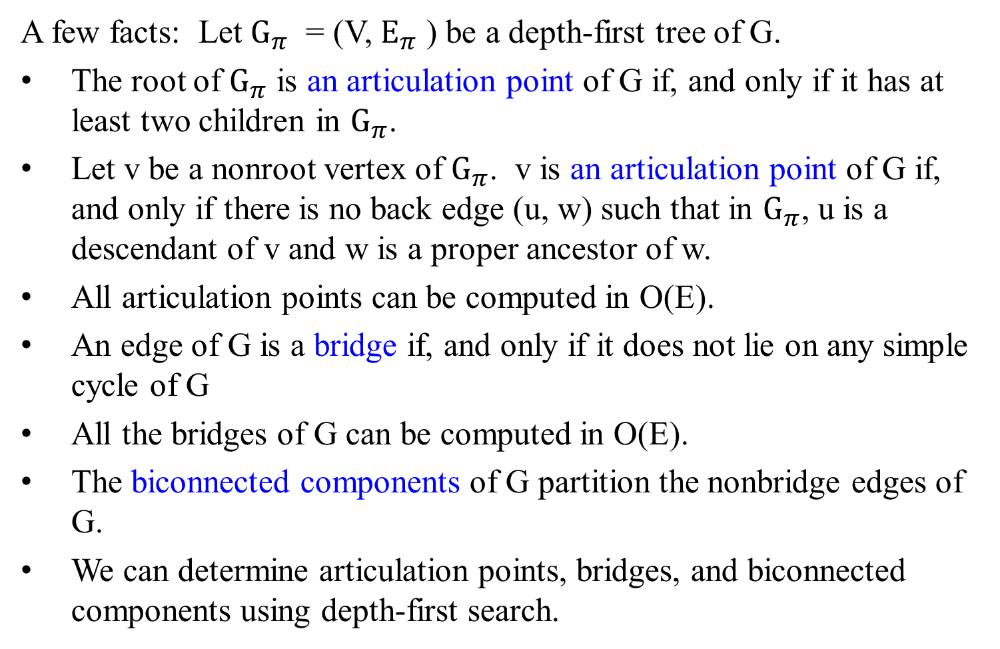
Graph
A few facts: Let $G_{π}$ = (V, $E_{π}$ ) be a depth-first tree of G.
The root of $G_{π}$ is an articulation point of G if, and only if it has at least two children in $G_{π}$.
Let v be a nonroot vertex of $G_{π}$. v is an articulation point of G if, and only if there is no back edge (u, w) such that in $G_{π}$, u is a descendant of v and w is a proper ancestor of w.
All articulation points can be computed in O(E).
An edge of G is a bridge if, and only if it does not lie on any simple cycle of G
All the bridges of G can be computed in O(E).
The biconnected components of G partition the nonbridge edges of G.
We can determine articulation points, bridges, and biconnected components using depth-first search.
w
.
.
.
v X
.
.
.
u

Slide 44

Graph
f
g
b
n
r
1
2
4
a
h
m
6
e
p
q
s
u
v
d
3
i
o
y
t
c
5
j
k
z
w
x
Figure 3.9. The articulation points, bridges, and biconnected components
(bcc) of a connected, undirected graph G.
The articulation points are the heavily shaded vertices.
The bridge are the heavily shaded edges, and
The biconnected components are the edges in the shaded regions, with a bcc numbering shown.

Slide 45
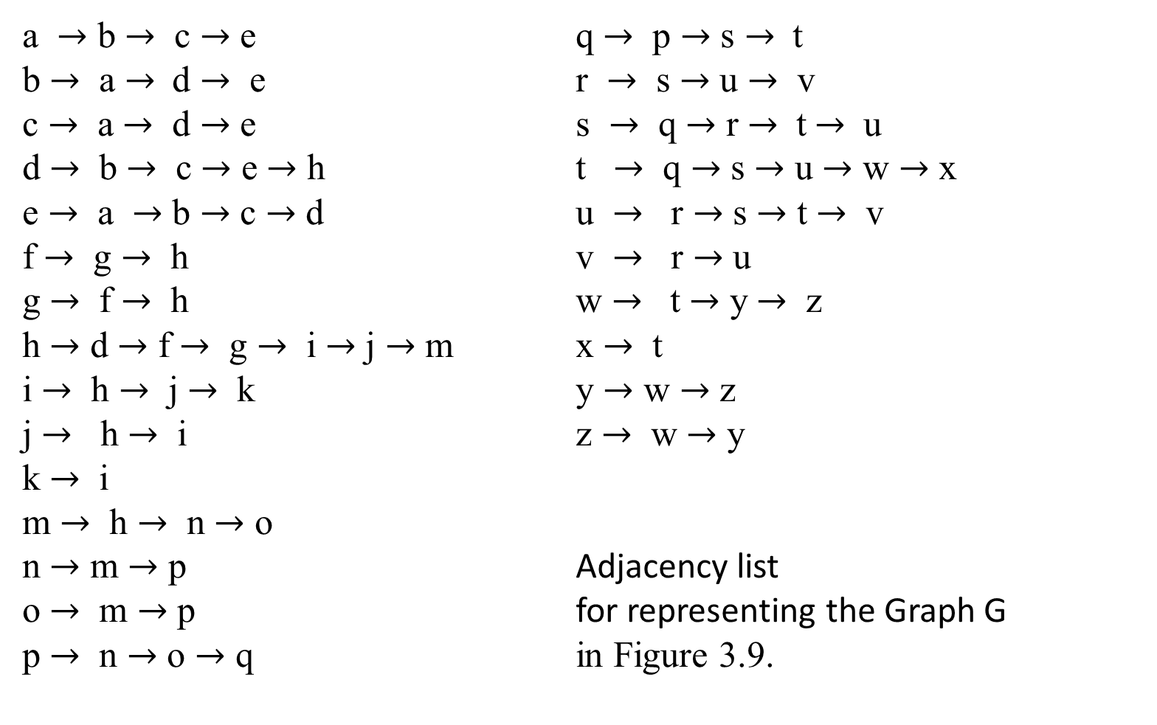
a $→$ b $→$ c $→$ e q $→$ p $→$ s $→$ t
b $→$ a $→$d $→$ e r $→$ s $→$ u $→$ v
c $→$ a $→$ d $→$ e s $→$ q $→$ r $→$ t $→$ u
d $→$ b $→$ c $→$ e $→$ h t $→$ q $→$ s $→$ u $→$ w $→$ x
e $→$ a $→$ b $→$ c $→$ d u $→$ r $→$ s $→$ t $→$ v
f $→$ g $→$ h v $→$ r $→$ u
g $→$ f $→$ h w $→$ t $→$ y $→$ z
h $→$ d $→$ f $→$ g $→$ i $→$ j $→$ m x $→$ t
i $→$ h $→$ j $→$ k y $→$ w $→$ z
j $→$ h $→$ i z $→$ w $→$ y
k $→$ i
m $→$ h $→$ n $→$ o
n $→$ m $→$ p Adjacency list
o $→$ m $→$ p for representing the Graph G
p $→$ n $→$ o $→$ q in Figure 3.9.

Slide 46
a | b | c | e |  |  |  |  |  | o | m | p
b | a | d | e |  |  |  |  |  | p | n | o | q
c | a | d | e |  |  |  |  |  | q | p | s | t
d | b | c | e | h |  |  |  |  | r | s | u | v
e | a | b | c | d |  |  |  |  | s | q | r | t | u
f | g | h |  |  |  |  |  |  | t | q | s | u | w | x
g | f | h |  |  |  |  |  |  | u | r | s | t | v
h | d | f | g | i | j | m |  |  | v | r | u
i | h | j | k |  |  |  |  |  | w | t | y | z
j | h | i |  |  |  |  |  |  | x | t
k | i |  |  |  |  |  |  |  | y | w | z
m | h | n | o |  |  |  |  |  | z | w | y
n | m | p

Slide 47
The result of a depth-first search of the Graph G in Figure 3.9
 | a
 | b
 | d
 | c |  | h
 | e |  | f |  | i |  |  |  | m
 |  |  | g |  | j |  | k |  | n
 |  |  |  |  |  |  |  |  | p
 |  |  |  |  |  |  |  |  | 0 |  | q
 |  |  |  |  |  |  |  |  |  |  | s
 |  |  |  |  |  |  |  |  |  |  | r
 |  |  |  |  |  |  |  |  |  |  | u
 |  |  |  |  |  |  |  |  |  |  | t |  | v
 |  |  |  |  |  |  |  |  |  |  | w |  | x
 |  |  |  |  |  |  |  |  |  |  | y
 |  |  |  |  |  |  |  |  |  |  | z

Slide 48
 |  |  |  |  | z23, 9
 |  |  |  |  | y22, 10
 |  |  |  |  | w21, 11 | x24, 12
 |  |  |  |  | t20, 13 |  | v25, 14
 |  |  |  |  | u19, 15
 |  |  |  |  | r18, 16
 |  |  |  |  | s17, 17
 |  |  |  | o15, 8 | q16, 18
 |  |  |  | p14, 19
 | g8, 3 | j10, 5 | k11, 6 | n13, 20
e5, 1 | f7, 4 | i9, 7 |  | m12, 21
c4, 2 | h6, 22
d3, 23
b2, 24
a1, 25
The Stack
Push Order: a1, 25 b2, 24 d3, 23 c4, 2 e5, 1 h6, 22 f7, 4 g8, 3 i9, 7 j10, 5 k11, 6 m12, 21 n13, 20 p14, 19 o15, 8 q16, 18 s17, 17 r18, 16 u19, 15 t20, 13 w21, 11 y22, 10 z23, 9 x24, 12 v25, 14
Pop Order: e5, 1 c4, 2 g8, 3 f7, 4 j10, 5 k11, 6 i9, 7 o15, 8 z23, 9 y22, 10 w21, 11 x24, 12 t20, 13 v25, 14 u19, 15 r18, 16 s17, 17 q16, 18 p14, 19 n13, 20 m12, 21 h6, 22 d3, 23 b2, 24 a1, 25

Slide 49
Depth-first search on directed graphs
Depth-first search on directed graphs
The depth-first search algorithm on a directed graph:
  runs verbatim (edge for edge) on directed graphs,
  traverses edges only in their prescribed directions.
Use dfs to classify the edges of undirected graphs into two types:
  tree edges and nontree edges (back edges).
In the directed graphs, there is a slightly more elaborate taxonomy:

Slide 50
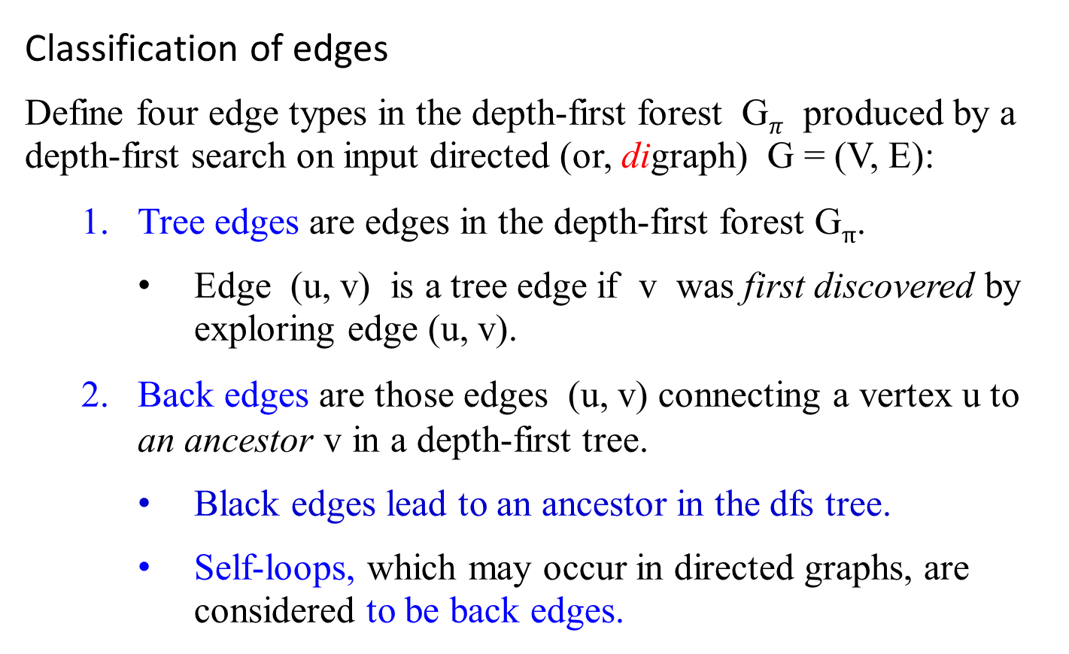
Depth-first search on directed graphs
Classification of edges
Define four edge types in the depth-first forest G$π$ produced by a depth-first search on input directed (or, digraph) G = (V, E):
Tree edges are edges in the depth-first forest G_{π}.
  Edge (u, v) is a tree edge if v was first discovered by exploring edge (u, v).
Back edges are those edges (u, v) connecting a vertex u to an ancestor v in a depth-first tree.
    Black edges lead to an ancestor in the dfs tree.
    Self-loops, which may occur in directed graphs, are considered to be back edges.

Slide 51
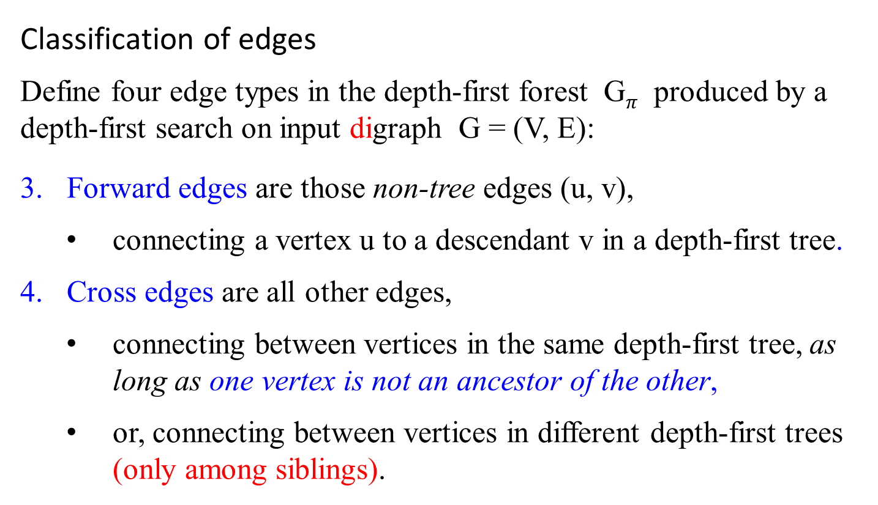
Depth-first search on directed graphs
Classification of edges
Define four edge types in the depth-first forest G$π$ produced by a depth-first search on input digraph G = (V, E):
Forward edges are those non-tree edges (u, v),
  connecting a vertex u to a descendant v in a depth-first tree.
Cross edges are all other edges,
  connecting between vertices in the same depth-first tree, as long as one vertex is not an ancestor of the other,
  or, connecting between vertices in different depth-first trees (only among siblings).

Slide 52
Depth-first search on directed graphs
Classification of edges
u.d/u.f ordering for Edge
An edge (u, v) Type
[ [ ] ] Tree/Forward
u v v u
[ [ ] ] Back
v u u v
[ ] [ ] Cross
v v u u
The tree structure representation has tree edges
(a (b (c c) (d d) b) a)
with
a forward edge
(a (d d) a),
a back edge
(c (a a) c), and
a cross edge
(d (c c) d).
A
Back
B
Forward
Tree
C
D
Cross

Slide 53
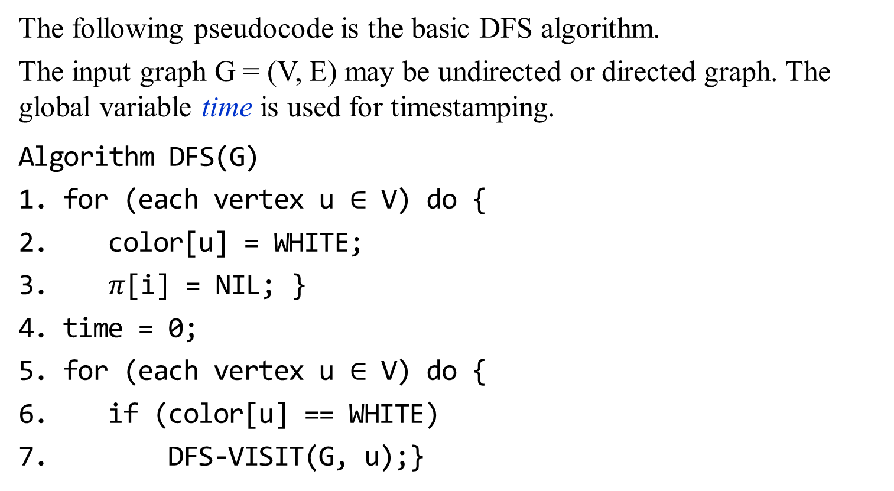
Depth-first search on undirected or directed graphs
The following pseudocode is the basic DFS algorithm.
The input graph G = (V, E) may be undirected or directed graph. The global variable time is used for timestamping.
Algorithm DFS(G)
for (each vertex u $∈$ V) do {
color[u] = WHITE;
$π$[i] = NIL; }
time = 0;
for (each vertex u $∈$ V) do {
if (color[u] == WHITE)
DFS-VISIT(G, u);}

Slide 54
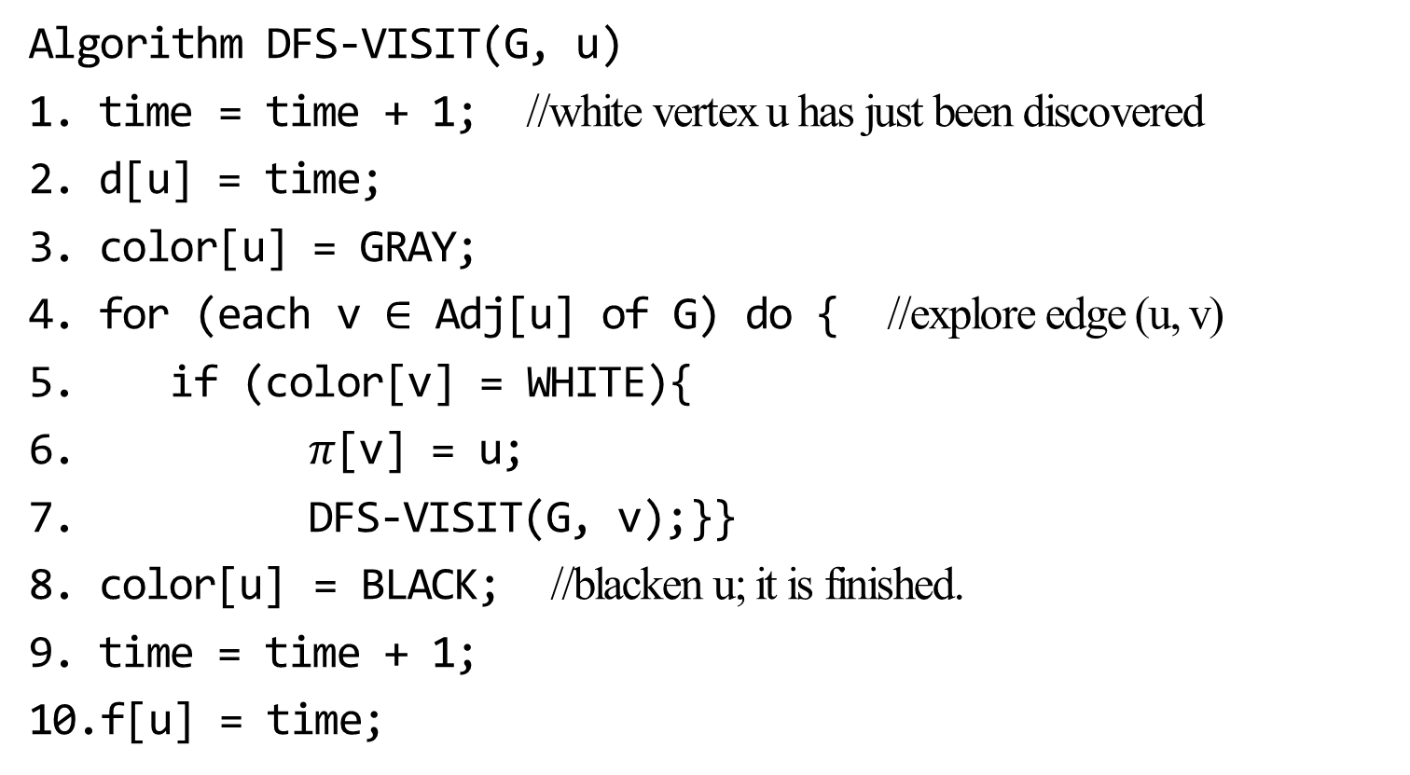
Depth-first search on undirected or directed graphs
Algorithm DFS-VISIT(G, u)
time = time + 1; //white vertex u has just been discovered
d[u] = time;
color[u] = GRAY;
for (each v $∈$ Adj[u] of G) do { //explore edge (u, v)
if (color[v] = WHITE){
$π$[v] = u;
DFS-VISIT(G, v);}}
color[u] = BLACK; //blacken u; it is finished.
time = time + 1;
f[u] = time;

Slide 55
Depth-first search on directed graphs
Consider the following directed graph given in Figure 3.10. The adjacency list is as follows:
Figure 3.10 Properties of depth-first search.
  The result of a depth-first search of a directed graph.
    Vertices are time-stamped and edge types are indicated.
    Non-tree edges are labeled B, C, or F according to whether they are back, cross, or forward edges.
    Timestamps within vertices indicate discovery time(visited) / finishing time(ended-visit).
  The graph of a part a redrawn with all tree and forward edges going down with a depth-first tree and all back edges going up from a descendant to an ancestor.

Slide 56

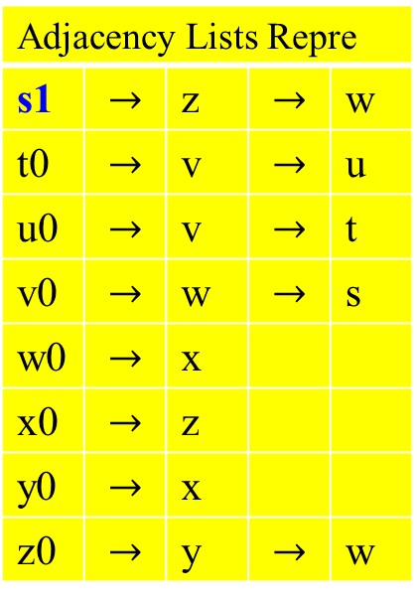
Depth-first search on directed graphs
Adjacency Lists Repre
s1 | $$→$$ | z | $$→$$ | w
t0 | $$→$$ | v | $$→$$ | u
u0 | $$→$$ | v | $$→$$ | t
v0 | $$→$$ | w | $$→$$ | s
w0 | $$→$$ | x
x0 | $$→$$ | z
y0 | $$→$$ | x
z0 | $$→$$ | y | $$→$$ | w
c
y z s t
x w v u
?/?
?/?
1/?
?/?
?/?
?/?
?/?
?/?
s 1/?
Stack Top
S_{1,}
Figure 3.10 The progress of the algorithm DFS(G) on a directed graph.

Slide 57
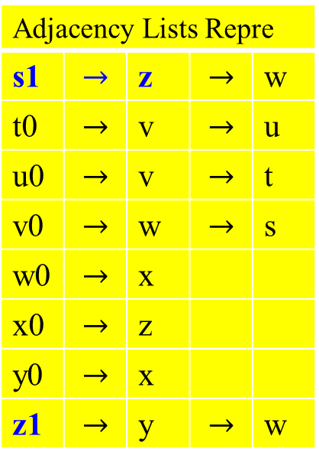
Depth-first search on directed graphs
Adjacency Lists Repre
s1 | $$→$$ | z | $$→$$ | w
t0 | $$→$$ | v | $$→$$ | u
u0 | $$→$$ | v | $$→$$ | t
v0 | $$→$$ | w | $$→$$ | s
w0 | $$→$$ | x
x0 | $$→$$ | z
y0 | $$→$$ | x
z1 | $$→$$ | y | $$→$$ | w
y z s t
x w v u
?/?
2/?
1/?
?/?
?/?
?/?
?/?
?/?
s 1/?
Stack Top
Z_{2,}
S_{1,}
z 2/?
Figure 3.10 The progress of the algorithm DFS(G) on a directed graph.

Slide 58
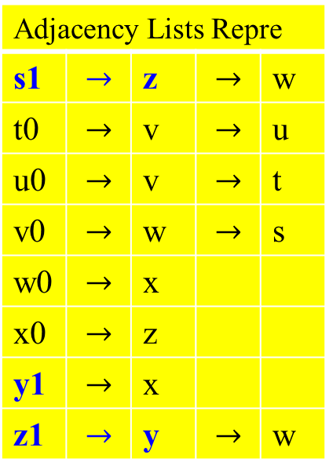
Depth-first search on directed graphs
Adjacency Lists Repre
s1 | $$→$$ | z | $$→$$ | w
t0 | $$→$$ | v | $$→$$ | u
u0 | $$→$$ | v | $$→$$ | t
v0 | $$→$$ | w | $$→$$ | s
w0 | $$→$$ | x
x0 | $$→$$ | z
y1 | $$→$$ | x
z1 | $$→$$ | y | $$→$$ | w
y z s t
x w v u
3/?
2/?
1/?
?/?
?/?
?/?
?/?
?/?
s 1/?
Stack Top
Y_{3,}
Z_{2,}
S_{1,}
z 2/?
y 3/?
Figure 3.10 The progress of the algorithm DFS(G) on a directed graph.

Slide 59
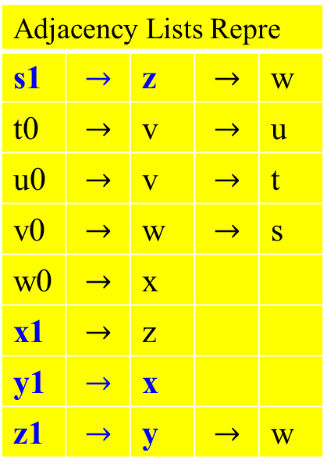
Depth-first search on directed graphs
Adjacency Lists Repre
s1 | $$→$$ | z | $$→$$ | w
t0 | $$→$$ | v | $$→$$ | u
u0 | $$→$$ | v | $$→$$ | t
v0 | $$→$$ | w | $$→$$ | s
w0 | $$→$$ | x
x1 | $$→$$ | z
y1 | $$→$$ | x
z1 | $$→$$ | y | $$→$$ | w
y z s t
x w v u
3/?
2/?
1/?
?/?
4/?
?/?
?/?
?/?
s 1/?
Stack Top
X_{4,}
Y_{3,}
Z_{2,}
S_{1,}
z 2/?
y 3/?
x 4/?
Figure 3.10 The progress of the algorithm DFS(G) on a directed graph.

Slide 60
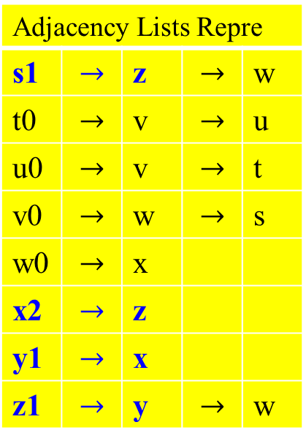
Depth-first search on directed graphs
Adjacency Lists Repre
s1 | $$→$$ | z | $$→$$ | w
t0 | $$→$$ | v | $$→$$ | u
u0 | $$→$$ | v | $$→$$ | t
v0 | $$→$$ | w | $$→$$ | s
w0 | $$→$$ | x
x2 | $$→$$ | z
y1 | $$→$$ | x
z1 | $$→$$ | y | $$→$$ | w
y z s t
B
x w v u
3/?
2/?
1/?
?/?
4/5
?/?
?/?
?/?
s 1/?
Stack Top
X_{4,5}
Y_{3,}
Z_{2,}
S_{1,}
z 2/?
B
y 3/?
Note that there needs a variable with only 3 integer values (or, 3 colors):
0 : the vertex has not visited (discovered).
1 : the vertex has just visited
2 : the vertex has completed (finishing or dead end)
x 4/5
Figure 3.10 The progress of the algorithm DFS(G) on a directed graph.

Slide 61

Depth-first search on directed graphs
Adjacency Lists Repre
s1 | $$→$$ | z | $$→$$ | w
t0 | $$→$$ | v | $$→$$ | u
u0 | $$→$$ | v | $$→$$ | t
v0 | $$→$$ | w | $$→$$ | s
w0 | $$→$$ | x
x2 | $$→$$ | z
y2 | $$→$$ | x
z1 | $$→$$ | y | $$→$$ | w
y z s t
B
x w v u
3/6
2/?
1/?
?/?
4/5
?/?
?/?
?/?
s 1/?
Stack Top
X_{4,5}
Y_{3,6}
Z_{2,}
S_{1,}
B
z 2/?
y 3/6
x 4/5
Figure 3.10 The progress of the algorithm DFS(G) on a directed graph.

Slide 62
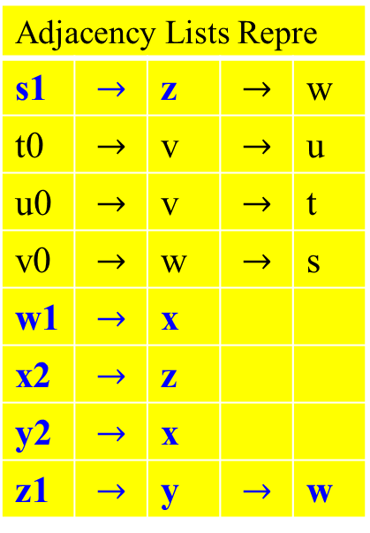

Depth-first search on directed graphs
Adjacency Lists Repre
s1 | $$→$$ | z | $$→$$ | w
t0 | $$→$$ | v | $$→$$ | u
u0 | $$→$$ | v | $$→$$ | t
v0 | $$→$$ | w | $$→$$ | s
w1 | $$→$$ | x
x2 | $$→$$ | z
y2 | $$→$$ | x
z1 | $$→$$ | y | $$→$$ | w
y z s t
B
x w v u
3/6
2/?
1/?
?/?
4/6
7/?
?/?
?/?
s 1/?
B
z 2/?
Stack Top
X_{4,5}
Y_{3,6} |  | W_{7,}
Z_{2,}
S_{1,}
y 3/6
w 7/?
x 4/5
Why x $→$ z is a back edge?
Figure 3.10 The progress of the algorithm DFS(G) on a directed graph.

Slide 63
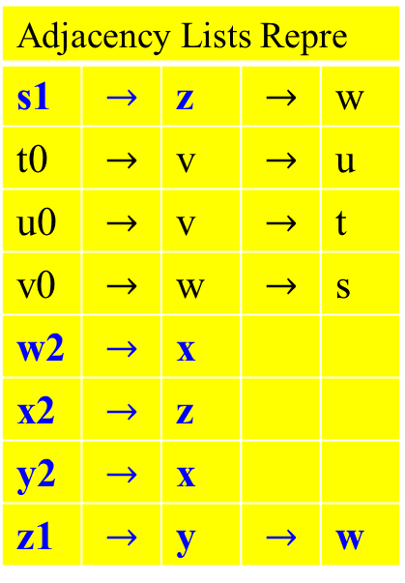

Depth-first search on directed graphs
Adjacency Lists Repre
s1 | $$→$$ | z | $$→$$ | w
t0 | $$→$$ | v | $$→$$ | u
u0 | $$→$$ | v | $$→$$ | t
v0 | $$→$$ | w | $$→$$ | s
w2 | $$→$$ | x
x2 | $$→$$ | z
y2 | $$→$$ | x
z1 | $$→$$ | y | $$→$$ | w
y z s t
B
C
x w v u
3/6
2/?
1/?
?/?
4/6
7/8
?/?
?/?
s 1/?
B
z 2/?
Stack Top
X_{4,5}
Y_{3,6} |  | W_{7,8}
Z_{2,}
S_{1,}
y 3/6
w 7/8
x 4/5
C
Why W $→$ X is a cross edge?
Figure 3.10 The progress of the algorithm DFS(G) on a directed graph.

Slide 64
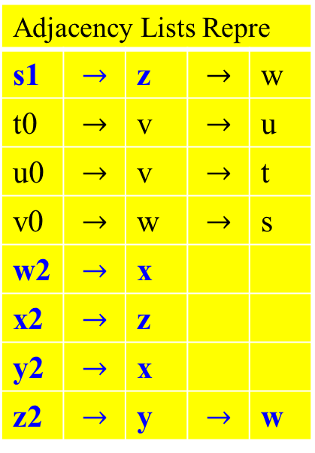
Depth-first search on directed graphs
Adjacency Lists Repre
s1 | $$→$$ | z | $$→$$ | w
t0 | $$→$$ | v | $$→$$ | u
u0 | $$→$$ | v | $$→$$ | t
v0 | $$→$$ | w | $$→$$ | s
w2 | $$→$$ | x
x2 | $$→$$ | z
y2 | $$→$$ | x
z2 | $$→$$ | y | $$→$$ | w
y z s t
B
C
x w v u
3/6
2/9
1/?
?/?
4/6
7/8
?/?
?/?
s 1/?
B
z 2/9
Stack Top
X_{4,5}
Y_{3,6} |  | W_{7,8}
Z_{2,9}
S_{1,}
y 3/6
w 7/8
x 4/5
C
Figure 3.10 The progress of the algorithm DFS(G) on a directed graph.

Slide 65

Depth-first search on directed graphs
Adjacency Lists Repre
s2 | $$→$$ | z | $$→$$ | w
t0 | $$→$$ | v | $$→$$ | u
u0 | $$→$$ | v | $$→$$ | t
v0 | $$→$$ | w | $$→$$ | s
w2 | $$→$$ | x
x2 | $$→$$ | z
y2 | $$→$$ | x
z2 | $$→$$ | y | $$→$$ | w
y z s t
B F
C
x w v u
3/6
2/?
1/10
?/?
4/6
7/8
?/?
?/?
s 1/10
B
z 2/9
Stack Top
X_{4,5}
Y_{3,6} |  | W_{7,8}
Z_{2,9}
S_{1,10}
F
y 3/6
w 7/8
x 4/5
C
Figure 3.10 The progress of the algorithm DFS(G) on a directed graph.

Slide 66
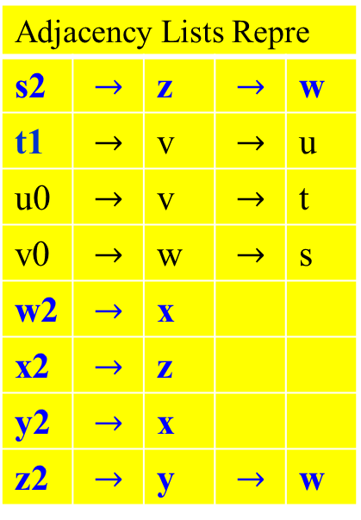
Depth-first search on directed graphs
Adjacency Lists Repre
s2 | $$→$$ | z | $$→$$ | w
t1 | $$→$$ | v | $$→$$ | u
u0 | $$→$$ | v | $$→$$ | t
v0 | $$→$$ | w | $$→$$ | s
w2 | $$→$$ | x
x2 | $$→$$ | z
y2 | $$→$$ | x
z2 | $$→$$ | y | $$→$$ | w
y z s t
B F
C
x w v u
3/6
2/?
1/10
11/?
4/6
7/8
?/?
?/?
s 1/10
t 11/?
B
z 2/9
Stack Top
X_{4,5}
Y_{3,6} |  | W_{7,8}
Z_{2,9}
S_{1,10} |  |  |  | T_{11,}
F
y 3/6
w 7/8
x 4/5
C
Figure 3.10 The progress of the algorithm DFS(G) on a directed graph.

Slide 67

Depth-first search on directed graphs
Adjacency Lists Repre
s2 | $$→$$ | z | $$→$$ | w
t1 | $$→$$ | v | $$→$$ | u
u0 | $$→$$ | v | $$→$$ | t
v1 | $$→$$ | w | $$→$$ | s
w2 | $$→$$ | x
x2 | $$→$$ | z
y2 | $$→$$ | x
z2 | $$→$$ | y | $$→$$ | w
y z s t
B F
C
x w v u
3/6
2/?
1/10
11/?
4/6
7/8
12/?
?/?
s 1/10
t 11/?
B
z 2/9
Stack Top
X_{4,5}
Y_{3,6} |  | W_{7,8}
Z_{2,9} |  |  |  | V_{12,}
S_{1,10} |  |  |  | T_{11,}
F
y 3/6
w 7/8
v 12/?
x 4/5
C
Figure 3.10 The progress of the algorithm DFS(G) on a directed graph.

Slide 68
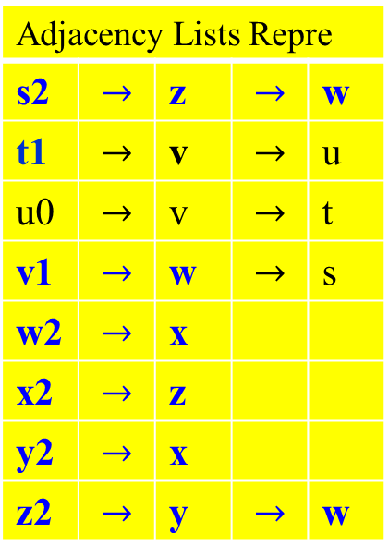
Depth-first search on directed graphs
Adjacency Lists Repre
s2 | $$→$$ | z | $$→$$ | w
t1 | $$→$$ | v | $$→$$ | u
u0 | $$→$$ | v | $$→$$ | t
v1 | $$→$$ | w | $$→$$ | s
w2 | $$→$$ | x
x2 | $$→$$ | z
y2 | $$→$$ | x
z2 | $$→$$ | y | $$→$$ | w
y z s t
B F
C C
x w v u
3/6
2/?
1/10
11/?
4/6
7/8
12/?
?/?
s 1/10
t 11/?
B
z 2/9
Stack Top
X_{4,5}
Y_{3,6} |  | W_{7,8}
Z_{2,9} |  |  |  | V_{12,}
S_{1,10} |  |  |  | T_{11,}
F
y 3/6
w 7/8
v 12/?
C
x 4/5
C
Figure 3.10 The progress of the algorithm DFS(G) on a directed graph.

Slide 69
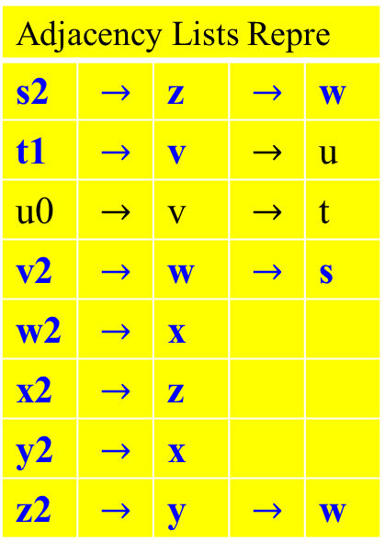
Depth-first search on directed graphs
Adjacency Lists Repre
s2 | $$→$$ | z | $$→$$ | w
t1 | $$→$$ | v | $$→$$ | u
u0 | $$→$$ | v | $$→$$ | t
v2 | $$→$$ | w | $$→$$ | s
w2 | $$→$$ | x
x2 | $$→$$ | z
y2 | $$→$$ | x
z2 | $$→$$ | y | $$→$$ | w
y z s t
B F C
C C
x w v u
3/6
2/?
1/10
11/?
4/6
7/8
12/13
?/?
s 1/10
t 11/?
B
z 2/9
C
Stack Top
X_{4,5}
Y_{3,6} |  | W_{7,8}
Z_{2,9} |  |  |  | V_{12,13}
S_{1,10} |  |  |  | T_{11,}
F
y 3/6
w 7/8
v 12/13
C
x 4/5
C
Figure 3.10 The progress of the algorithm DFS(G) on a directed graph.

Slide 70
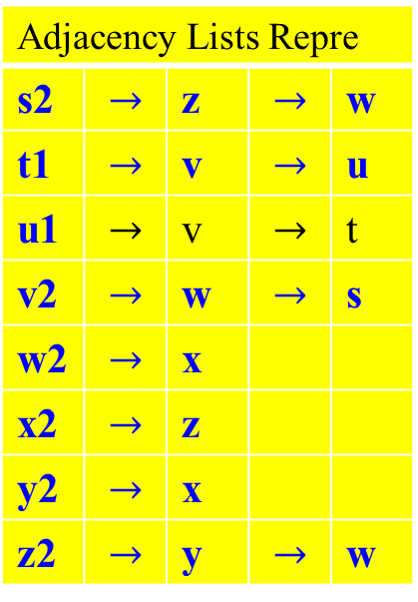
Depth-first search on directed graphs
Adjacency Lists Repre
s2 | $$→$$ | z | $$→$$ | w
t1 | $$→$$ | v | $$→$$ | u
u1 | $$→$$ | v | $$→$$ | t
v2 | $$→$$ | w | $$→$$ | s
w2 | $$→$$ | x
x2 | $$→$$ | z
y2 | $$→$$ | x
z2 | $$→$$ | y | $$→$$ | w
y z s t
B F C
C C
x w v u
3/6
2/?
1/10
11/?
4/6
7/8
12/13
14/?
s 1/10
t 11/?
B
z 2/9
C
Stack Top
X_{4,5}
Y_{3,6} |  | W_{7,8}
Z_{2,9} |  |  |  | V_{12,13} |  | U_{14,}
S_{1,10} |  |  |  | T_{11,}
F
u 14/?
y 3/6
w 7/8
v 12/13
C
x 4/5
C
Figure 3.10 The progress of the algorithm DFS(G) on a directed graph.

Slide 71
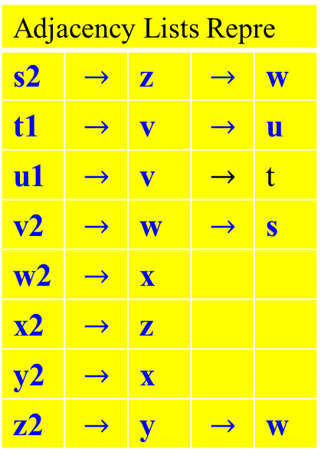
Depth-first search on directed graphs
Adjacency Lists Repre
s2 | $$→$$ | z | $$→$$ | w
t1 | $$→$$ | v | $$→$$ | u
u1 | $$→$$ | v | $$→$$ | t
v2 | $$→$$ | w | $$→$$ | s
w2 | $$→$$ | x
x2 | $$→$$ | z
y2 | $$→$$ | x
z2 | $$→$$ | y | $$→$$ | w
y z s t
B F C
C C C
x w v u
3/6
2/?
1/10
11/?
4/6
7/8
12/13
14/?
s 1/10
t 11/?
B
z 2/9
C
Stack Top
X_{4,5}
Y_{3,6} |  | W_{7,8}
Z_{2,9} |  |  |  | V_{12,13} |  | U_{14,}
S_{1,10} |  |  |  | T_{11,}
F
u 14/?
y 3/6
C
w 7/8
v 12/13
C
x 4/5
C
Figure 3.10 The progress of the algorithm DFS(G) on a directed graph.

Slide 72
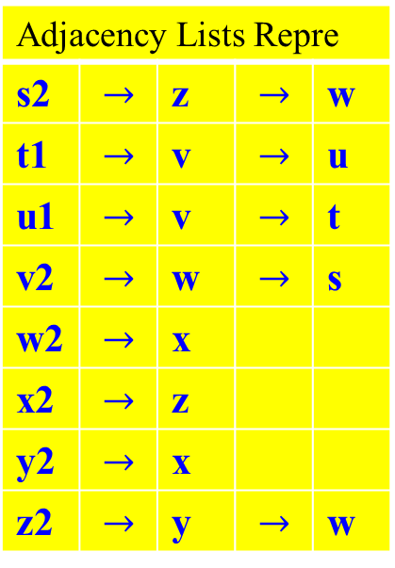
Depth-first search on directed graphs
Adjacency Lists Repre
s2 | $$→$$ | z | $$→$$ | w
t1 | $$→$$ | v | $$→$$ | u
u1 | $$→$$ | v | $$→$$ | t
v2 | $$→$$ | w | $$→$$ | s
w2 | $$→$$ | x
x2 | $$→$$ | z
y2 | $$→$$ | x
z2 | $$→$$ | y | $$→$$ | w
y z s t
B F C B
C C C
x w v u
3/6
2/?
1/10
11/?
4/6
7/8
12/13
14/?
s 1/10
t 11/?
z 2/9
C
B
B
Stack Top
X_{4,5}
Y_{3,6} |  | W_{7,8}
Z_{2,9} |  |  |  | V_{12,13} |  | U_{14,}
S_{1,10} |  |  |  | T_{11,}
F
u 14/?
y 3/6
C
w 7/8
v 12/13
C
x 4/5
C
Figure 3.10 The progress of the algorithm DFS(G) on a directed graph.
(S (Z (y (x x) y) (w w) Z) S) (t (v v) (u u) t)

Slide 73

Depth-first search on directed graphs
Adjacency Lists Repre
s2 | $$→$$ | z | $$→$$ | w
t1 | $$→$$ | v | $$→$$ | u
u2 | $$→$$ | v | $$→$$ | t
v2 | $$→$$ | w | $$→$$ | s
w2 | $$→$$ | x
x2 | $$→$$ | z
y2 | $$→$$ | x
z2 | $$→$$ | y | $$→$$ | w
y z s t
B F C B
C C C
x w v u
3/6
2/?
1/10
11/?
4/6
7/8
12/13
14/15
s 1/10
t 11/?
z 2/9
C
B
B
Stack Top
X_{4,5}
Y_{3,6} |  | W_{7,8}
Z_{2,9} |  |  |  | V_{12,13} |  | U_{14,15}
S_{1,10} |  |  |  | T_{11,}
F
u 14/15
y 3/6
C
w 7/8
v 12/13
C
x 4/5
C
Figure 3.10 The progress of the algorithm DFS(G) on a directed graph.

Slide 74


Depth-first search on directed graphs
Adjacency Lists Repre
s2 | $$→$$ | z | $$→$$ | w
t2 | $$→$$ | v | $$→$$ | u
u2 | $$→$$ | v | $$→$$ | t
v2 | $$→$$ | w | $$→$$ | s
w2 | $$→$$ | x
x2 | $$→$$ | z
y2 | $$→$$ | x
z2 | $$→$$ | y | $$→$$ | w
c
y z s t
B F C B
C C C
x w v u
3/6
2/?
1/10
11/16
4/6
7/8
12/13
14/15
s 1/10
t 11/16
z 2/9
C
B
B
Stack Top
X_{4,5}
Y_{3,6} |  | W_{7,8}
Z_{2,9} |  |  |  | V_{12,13} |  | U_{14,15}
S_{1,10} |  |  |  | T_{11,16}
F
u 14/15
y 3/6
C
w 7/8
v 12/13
C
x 4/5
C
Figure 3.10 The progress of the algorithm DFS(G) on a directed graph.

Slide 75

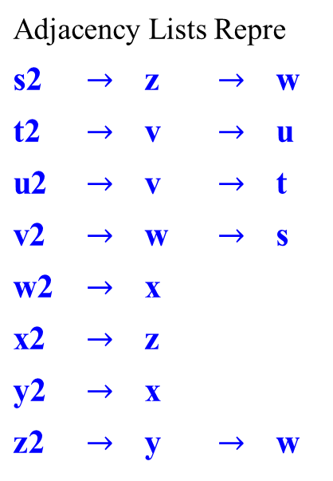
c
Depth-first search on directed graphs
Adjacency Lists Repre
s2 | $$→$$ | z | $$→$$ | w
t2 | $$→$$ | v | $$→$$ | u
u2 | $$→$$ | v | $$→$$ | t
v2 | $$→$$ | w | $$→$$ | s
w2 | $$→$$ | x
x2 | $$→$$ | z
y2 | $$→$$ | x
z2 | $$→$$ | y | $$→$$ | w
y z s t
B F C B
C C C
x w v u
3/6
2/9
1/10
11/16
4/5
7/8
12/13
14/15
Summarize Figure 3.10. Starting at s, and then t, the forest tree generated is not the same as the forest tree that generated by starting z and t.
Stack Top
X_{4,5}
Y_{3,6} |  | W_{7,8}
Z_{2,9} |  |  |  | V_{12,13} |  | U_{14,15}
S_{1,10} |  |  |  | T_{11,16}

Slide 76

y z s t
B F C B
C C C
x w v u
3/6
Adjacency Lists Repre
s2 | $$→$$ | z | $$→$$ | w
t2 | $$→$$ | v | $$→$$ | u
u2 | $$→$$ | v | $$→$$ | t
v2 | $$→$$ | w | $$→$$ | s
w2 | $$→$$ | x
x2 | $$→$$ | z
y2 | $$→$$ | x
z2 | $$→$$ | y | $$→$$ | w
2/9
1/10
11/16
4/5
7/8
12/13
14/15
s 1/10
t 11/16
C B
F
z 2/9
v 12/13
u 14/15
C
B C
Stack Top
X_{4,5}
Y_{3,6} |  | W_{7,8}
Z_{2,9} |  |  |  | V_{12,13} |  | U_{14,15}
S_{1,10} |  |  |  | T_{11,16}
y 3/6
w 7/8
C
Redraw the graph of Figure 3.10 with all tree and forward edges going down within a depth-first tree and all back edges going up from a descendant to an ancestor.
(s (z ( y (x x) y) (w w) z) s) (t (v v) (u u) t)
x 4/5

Slide 77

Depth-first search on undirected graphs
Note that forward and cross edges never occur in a depth-first search of an undirected graph.
Theorem 3.3
In a depth-first search of an undirected graph G, every edge of G is either a tree edge or a back edge.
c

Slide 78

Depth-first search on undirected graphs
y z s t
s → z → w → v
z → y → x → w → s
w →v → s → z → x
v → t → u → s → w
y → x → z
x → w →z → y
w → v →s → z → x
u → t → v
t → u → v
3/14
2/15
1/10
7/10
B B B B
4/13
5/12
6/11
8/9
B
x w v u
c
Figure 3.11 The result of a depth-first search of an undirected graph with its adjacency list of the graph.

Slide 79

Depth-first search on undirected graphs
s → z → w → v
z → y → x → w → s
w →v → s → z → x
v → t → u → s → w
y → x → z
x → w →z → y
w → v →s → z → x
u → t → v
t → u → v
s 1/16
z 2/15
c
y 3/14
B
B
B
B
x 4/13
Push onto order
s z y x w v t u
Pop off order
u t v w x y z s
w 5/12
v 6/11
t 7/10
String representation of the DFS Tree
(s (z ( y (x (w (v (t (u u) t) v) w) x) y) z) s)
B
u 8/9
DFS requires a Pushdown Automaton with markers.

Slide 80

Depth-first search on directed graph
Directed acyclic graphs (DAG)
A cycle in a directed graph is a circular path
v₀ → v₁ → v₂ → … → v_{k} → v₀ .
For example, Figure 3.10 has three of them.
  It has a cycle z → w → x → z, and a cycle z → y → x → z, and a cycle t → u → t .
A graph without cycles is acyclic.
We can test acyclicity in linear time, with a single depth-first search.
  A digraph has a cycle if and only if its dfs reveals a back edge.
c

Slide 81
Depth-first search on directed graph
Property
A directed graph has a cycle if and only if its dfs reveals a back edge.
Shown in Figure 10. in which a cycle between vertices t and u.
c

Slide 82
Decrease and Conquer
Breadth-First Search

