Slide 1
Polynomials and
The Fast Fourier Transform (FFT)

Slide 2

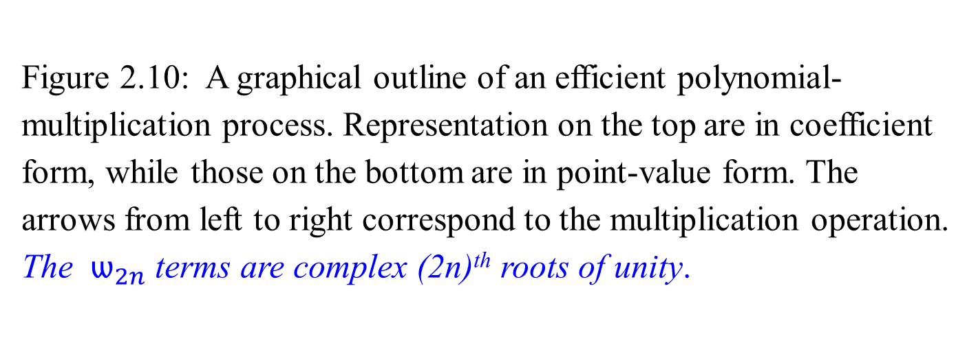
Fast multiplication
of polynomials in coefficient form
Figure 2.10: A graphical outline of an efficient polynomial-multiplication process. Representation on the top are in coefficient form, while those on the bottom are in point-value form. The arrows from left to right correspond to the multiplication operation. The $ѡ_{2n}$terms are complex (2n)^{th} roots of unity.
FFT
2n points around a unit circle.

Slide 3
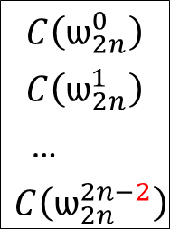
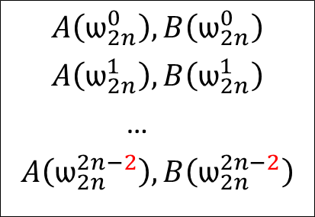
Comment: for x³, If n-1=3, then n=4 terms for x⁶, if 2n-2=6, then 2n-1=7 terms. a₃ x³ * b₃ x³ = a₃ b₃ x⁶.
a₀ , a₁, …, a_{n-1}
b₀ , b₁, …, b_{n-1}
Ordinary
Multiplication
Time Θ(n²)
convolution
c₀ , c₁, …, c_{2n-2}
Coefficient
representation
FFT
Evaluation Interpolation
Time Θ(n log n) Time Θ(n log n)
$$A\left(ѡ_{2n}^{0}\right), B\left(ѡ_{2n}^{0}\right)$$
$$A\left(ѡ_{2n}^{1}\right), B\left(ѡ_{2n}^{1}\right)$$
…
$$A\left(ѡ_{2n}^{2n−2}\right), B\left(ѡ_{2n}^{2n−2}\right)$$
$$C\left(ѡ_{2n}^{0}\right)$$
$$C\left(ѡ_{2n}^{1}\right)$$
…
$$C\left(ѡ_{2n}^{2n−2}\right)$$
Pointwise multiplication
Point-value
multiplication
Time Θ(n)
Figure 2.10:
The $ѡ_{2n}$terms are complex (2n)^{th} roots of unity.

Slide 4
Polynomials and
The Fast Fourier Transform (FFT)
FFT is an efficient process in applications such as polynomial multiplication, digital signal processing, image processing, and more, involving the Discrete Fourier Transform (DFT) and its inverse to convert between coefficient and point-value representations of a vector in Θ(n logn) time.
Steps Involving FFT:
  Convert Polynomial Coefficients to Point-Values: Use FFT to perform the DFT.
  Multiply Point-Values (Pointwise Multiplication): Takes linear time.
  Convert Point-Values Back to Coefficients: Use the inverse FFT to perform the IDFT.

Slide 5
Polynomials and
The Fast Fourier Transform (FFT)
Overview: Discrete Fourier Transform (DFT) and its Inverse (IDFT)
Conversion Between Coefficient and Point-Value Representation:
  Coefficient Representation: Traditional way of representing a polynomial P(x), expressed as a sum of terms with coefficients and powers of x.
  Point-Value Representation. The polynomial is evaluated at a specific set of points, producing a vector of values (point-value pairs).

Slide 6
Polynomials and
The Fast Fourier Transform (FFT)
Overview: Discrete Fourier Transform (DFT) and its Inverse (IDFT)
Conversion Between Coefficient and Point-Value Representation:
2. Discrete Fourier Transform (DFT):
The DFT converts a sequence of coefficients (representing a polynomial) into its point-value form, using specific evaluation points known as the "roots of unity."
The roots of unity are complex numbers of the form ω_{k}=e^{2πik/n} where n is the number of points (usually a power of 2), and k ranges from 0 to n−1.

Slide 7
Polynomials and
The Fast Fourier Transform (FFT)
Overview: Discrete Fourier Transform (DFT) and its Inverse (IDFT)
Conversion Between Coefficient and Point-Value Representation:
2. Discrete Fourier Transform (DFT):
3. Evaluation Process Using DFT:
Input: A vector of coefficients of the polynomial A(x).
Output: A vector of the values of A(x) evaluated at the roots of unity (point-value form).
Time Complexity: The DFT is performed in Θ(n logn) time when using the FFT algorithm, which is much faster than the direct evaluation method, which would take Θ(n²) time.

Slide 8
Polynomials and
The Fast Fourier Transform (FFT)
Overview: Discrete Fourier Transform (DFT) and its Inverse (IDFT)
Conversion Between Coefficient and Point-Value Representation:
2. Discrete Fourier Transform (DFT):
3. Evaluation Process Using DFT:
4. Interpolation Process Using Inverse DFT (IDFT):
Once you have a polynomial in its point-value form (after multiplication, for instance), you need to convert it back to its coefficient form.
The inverse DFT (IDFT) takes the point-value representation and converts it back to the coefficient form.
Time Complexity: Like the DFT, the IDFT also takes Θ(n logn) time when implemented using the FFT algorithm.

Slide 9
Polynomials and
The Fast Fourier Transform (FFT): Summary
A process involving the Discrete Fourier Transform (DFT) and its inverse to convert between coefficient and point-value representations of a vector.
Evaluation Process
Use any points as evaluation points.
    Choose “complex roots of unity” as the evaluation points.
    Apply the discrete Fourier transform (DFT) to a coefficient vector to produce a point-value representation of a coefficient vector.
    This conversion between representations is done in Θ(n log n) time.
For the interpolation process,

Slide 10
Polynomials and
The Fast Fourier Transform (FFT): Summary
A process involving the Discrete Fourier Transform (DFT) and its inverse to convert between coefficient and point-value representations of a vector.
Evaluation Process:
Interpolation Process,
  perform the inverse operation by taking the “inverse DFT” (IDFT) of point-value pairs to yield a coefficient vector.
  This operation also takes Θ(n log n) time.
  FFT Usage:
  Use the FFT to accomplish the DFT and inverse DFT (IDFT) operations in Θ(n log n) time.
  It leverages the symmetry and periodicity properties of the roots of unity to reduce the number of operations required.

Slide 11
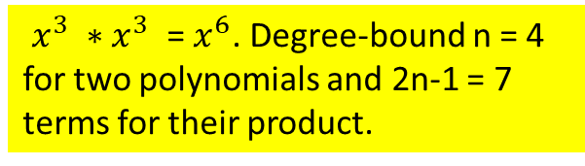
Polynomials and
The Fast Fourier Transform (FFT)
$x^{3} ∗x^{3}$ = $x^{6}$. Degree-bound n = 4 for two polynomials and 2n-1 = 7 terms for their product.
Outlines the steps for multiplying two polynomials using the Discrete Fourier Transform (DFT) and its inverse.
A concern is degree-bounds - Figure 2.10 shows the strategy graphically.
Given polynomials
  A(x) = a₀ + a₁x¹ + … + a_{n-1}x^{n-1} of degree-bound n (of degree n-1)
  B(x) = b₀ + b₁x¹ + … + b_{n-1}x^{n-1} of degree-bound n (of degree n-1),
Product polynomial:
C(x) = A(x) * B(x) is a polynomial
  C(x) = c₀ + c₁x¹ + … + c_{n-1}x^{n-1} + c_{n}x^{n} + c_{n+1}x^{n+1} + … + c_{2n-2}x^{2n-2} ) of degree-bound 2n-1 (of degree 2n -2).
Degree-Bounds: Evaluating the input polynomials A and B

Slide 12

Polynomials and
The Fast Fourier Transform (FFT)
$x^{3} ∗x^{3}$ = $x^{6}$. Degree-bound n = 4 for two polynomials and 2n-1 = 7 terms for their product.
Outlines the steps for multiplying two polynomials using the Discrete Fourier Transform (DFT) and its inverse.
Given polynomials
Product polynomial:
Degree-Bounds: Evaluating the input polynomials A and B
  To multiply A(x) and B(x), first double their degree-bounds to 2n-1 by adding n-1 high-order coefficients of 0.
  e.g.,
  A(x) = a₀ + a₁x¹ + … + a_{n-1}x^{n-1} + 0_{n}x^{n} + 0_{n+1}x^{n+1} + … + 0_{2n-2}x^{2n-2}
  Represented as a₀, a₁, …, a_{n-1}, 0_{n}, 0_{n+1}, …, 0_{2n-2} (with 2n-1 elements).
  Complex Roots Unity:
  Because the vectors have 2n-1 elements, the “complex (2n)^{th} roots of unity,” are used, denoted by the $ѡ_{2n}$terms.

Slide 13
Polynomials and the Fast Fourier Transform (FFT)
Outlines the steps for multiplying two polynomials using the Discrete Fourier Transform (DFT) and its inverse.
Given polynomials
Product polynomial:
Degree-Bounds: Evaluating the input polynomials A and B
  Complex Roots Unity:
  Polynomial Multiplication Process:
  Extend Degree-Bound: Extend the degree of the input polynomials A(x) and B(x) by padding with zeros to make their lengths 2n – 1.
  DFT Application: Apply the DFT to the extended coefficient vectors of A(x) and B(x) using the (2n)^{th} roots of unity.
  Pointwise Multiplication: Multiply the DFT results pointwise.
  Inverse DFT: Apply the inverse DFT to the result of the pointwise multiplication to get the coefficients of the product polynomial C(x).
  By using the FFT, these operations can be done efficiently in Θ(n log n) time.

Slide 14
Polynomials and
The Fast Fourier Transform (FFT)
Instead, we check the obtained point-value pairs by computing A(x) * B(x):
6x³ + 7x² - 10x + 9 …A(x)
- 2x³ + 4x - 5 …B(x)
- 30x³ - 35x² + 50x - 45
- 24x⁴ - 28x³ + 40x² - 36x
- 12x⁶ - 14x⁵ + 20x⁴ - 18x³ .
- 12x⁶ - 14x⁵ + 44x⁴ - 20x³ - 75x² + 86x - 45 …C(x)
Degree Bounds:
The degree-bound of A(x) and B(x) is n = 4, which means each has 4 terms.
Then the degree-bound of C(x) is 2n -1 = 7, implying it has 7 terms.
Coefficient Representation:
A(x) coefficients: ( 9, -10, 7, 6, 0, 0, 0),
B(x) coefficients: (-5, 4, 0, -2, 0, 0, 0).
The coefficient representation for C(x) = A(x) * B(x) is (-45, 86, -75, -20, 44, -14, -12).

Slide 15

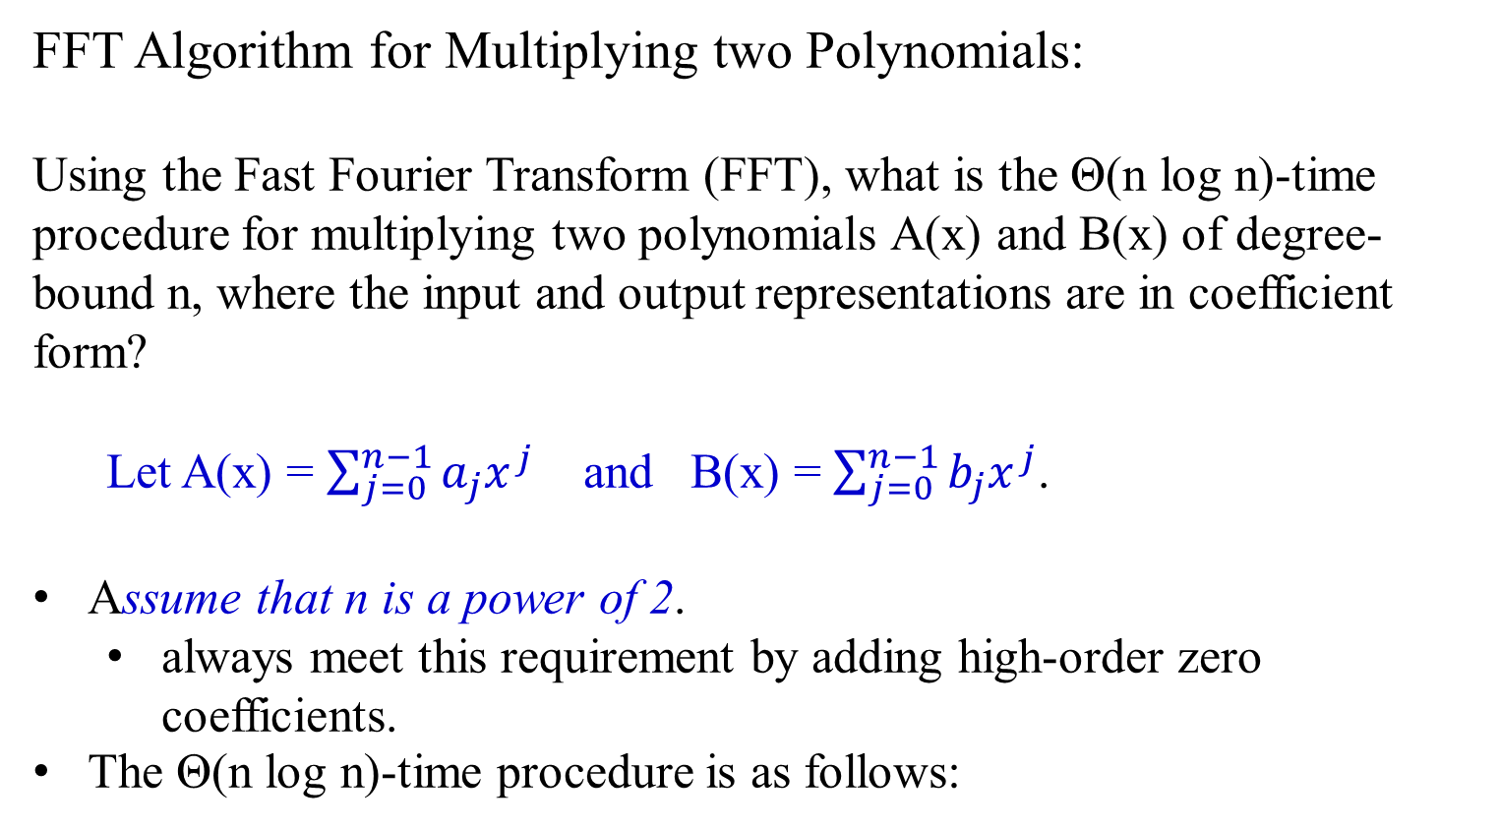
Polynomials and
The Fast Fourier Transform (FFT)
FFT Algorithm for Multiplying two Polynomials:
Using the Fast Fourier Transform (FFT), what is the Θ(n log n)-time procedure for multiplying two polynomials A(x) and B(x) of degree-bound n, where the input and output representations are in coefficient form?
Let A(x) = $\sum_{j=0}^{n−1}{a_{j}x^{j}}$ and B(x) = $\sum_{j=0}^{n−1}{b_{j}x^{j}}$.
Assume that n is a power of 2.
  always meet this requirement by adding high-order zero coefficients.
The Θ(n log n)-time procedure is as follows:
If n = $2^{k}$, then 2n is also a power of 2 also since 2n = $2^{k+1}$.

Slide 16
The Θ(n log n)-time FFT procedure is as follows:
Let polynomials be
  A(x) = a₀ + a₁x¹ + … + a_{n-1}x^{n-1} of degree-bound n (of degree n-1)
  B(x) = b₀ + b₁x¹ + … + b_{n-1}x^{n-1} of degree-bound n (of degree n-1),
Double degree-bound: Create coefficient representations of A(x) and B(x) as degree-bound 2n-1 polynomials by adding n - 1 high-order zero coefficients to each. e.g.,
a₀, a₁, …, a_{n-1}, 0_{n}, 0_{n+1}, …, 0_{2n-2}.
b₀, b₁, …, b_{n-1}, 0_{n}, 0_{n+1}, …, 0_{2n-2}.
This takes Θ(n).
2. Evaluate: Compute point-value representation of A(x) and B(x) of length 2n-1 by applying the FFT of order 2n-2 on each polynomial. These representations contain the values of the two polynomials at the (2n)^{th} roots of unity.
This takes time Θ(n log n).
3. …

Slide 17
3. Pointwise multiply: Compute a point-value representation for the polynomial C(x) = A(x)*B(x) by multiplying these point-values of A(x) and B(x) together pointwise. This representation contains the value of C(x) at each (2n)^{th} root of unity. This takes Θ(n).
4. Interpolate: Create the coefficient representation of the polynomial C(x) by applying the FFT on 2n -1 point-value pairs to compute the inverse DFT.
This take time Θ(n log n).
Step (1) and (3) take time Θ(n), and step (2) and (4) take time Θ(n log n).
Theorem 2.5
Time efficiency for multiply two polynomials of degree-bound n is Θ(n log n), with both the input and output representation in coefficient form.
we show how to use the FFT.

Slide 18
The DFT and FFT
Claimed that if we use complex roots of unity, we can evaluate and interpolate polynomials in Θ(n log n) time.
In the following,
  define complex roots of unity and their properties,
  define the DFT and then
  show how the FFT computes the DFT and
  its inverse in Θ(n log n) time.

Slide 19
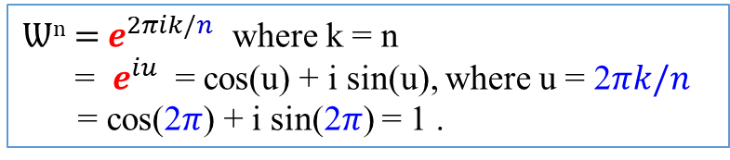
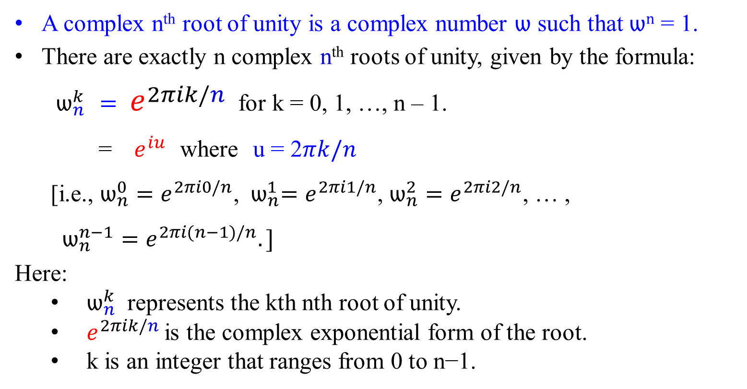

Ѡ^{n} = $e^{2πik/n}$ where k = n
= $e^{iu}$ = cos(u) + i sin(u), where u = 2$πk/n$
= cos(2$π$) + i sin(2$π$) = 1 .
Complex roots of unity
A complex n^{th} root of unity is a complex number ѡ such that ѡ^{n} = 1.
There are exactly n complex n^{th} roots of unity, given by the formula:
${ ѡ}_{n}^{k}$ $= e^{2πik/n}$ for k = 0, 1, …, n – 1.
= ${ e}^{iu}$ where u = 2$πk/n$
[i.e., ${ѡ_{n}^{0}=e}^{2πi0/n}$, ${{ ѡ}_{n}^{1}=e}^{2πi1/n}$, ${ѡ_{n}^{2}=e}^{2πi2/n}$, … , $ѡ_{n}^{n−1}=e^{2πi(n−1)/n}.]$
Here:
$ѡ_{n}^{k}$​ represents the kth nth root of unity.
$e^{2πik/n}$ is the complex exponential form of the root.
k is an integer that ranges from 0 to n−1.
Let n = 8. For k = 0, 1, 2, 3, …
u = 2$π0/8$ = 0, 2$\frac{π1}{8}=\frac{π}{\text{4,}}$ 2$\frac{π2}{8}=\text{ =}\frac{π}{\text{2}\text{,}}\text{, }$ 2$\frac{π3}{8}=\text{ =}\frac{3π}{\text{4}\text{,}}\text{, }$… , 2$\frac{π7}{8}=\frac{7π}{\text{4,}}$ , then next will be 2$\frac{π8}{8}=\text{2}π$….

Slide 20
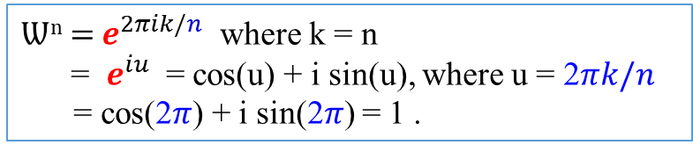
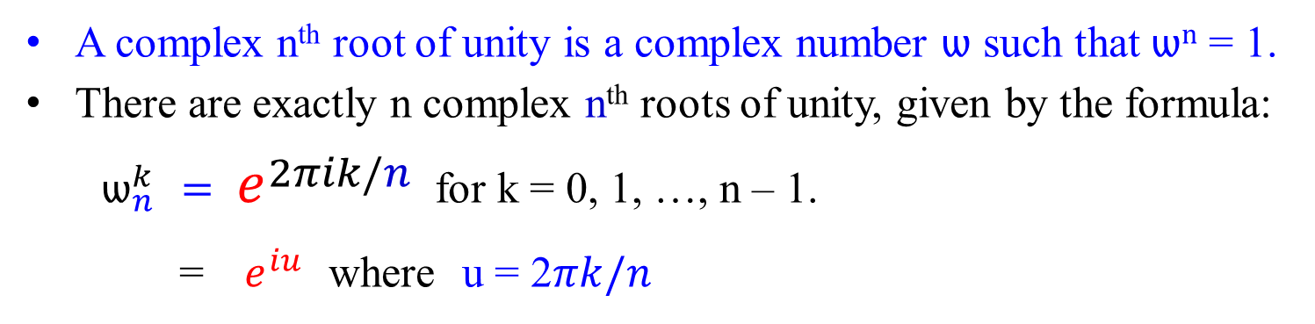
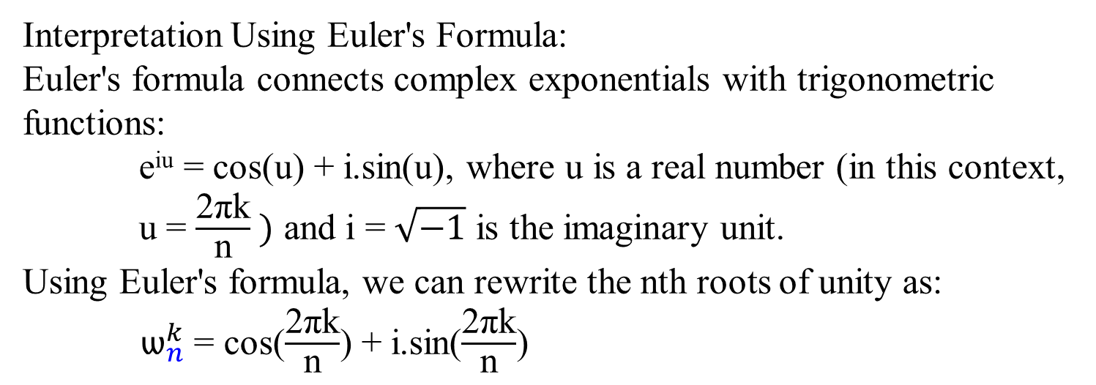

Ѡ^{n} = $e^{2πik/n}$ where k = n
= $e^{iu}$ = cos(u) + i sin(u), where u = 2$πk/n$
= cos(2$π$) + i sin(2$π$) = 1 .
Complex roots of unity
A complex n^{th} root of unity is a complex number ѡ such that ѡ^{n} = 1.
There are exactly n complex n^{th} roots of unity, given by the formula:
${ ѡ}_{n}^{k}$ $= e^{2πik/n}$ for k = 0, 1, …, n – 1.
= ${ e}^{iu}$ where u = 2$πk/n$
Let n = 8. For k = 0, 1, 2, 3, …
u = 2$π0/8$ = 0, 2$\frac{π1}{8}=\frac{π}{\text{4,}}$ 2$\frac{π2}{8}=\text{ =}\frac{π}{\text{2}\text{,}}\text{, }$ 2$\frac{π3}{8}=\text{ =}\frac{3π}{\text{4}\text{,}}\text{, }$… , 2$\frac{π7}{8}=\frac{7π}{\text{4,}}$ , then next will be 2$\frac{π8}{8}=\text{2}π$….
Interpretation Using Euler's Formula:
Euler's formula connects complex exponentials with trigonometric functions:
e^{iu} = cos(u) + i.sin(u), where u is a real number (in this context, u = $\frac{\text{2}\text{π}\text{k}\text{​}}{\text{n}} )$ and i = $\sqrt{−1}$​ is the imaginary unit.
Using Euler's formula, we can rewrite the nth roots of unity as:
${ ѡ}_{n}^{k}$ = ​cos($\frac{\text{2}\text{π}\text{k}\text{​}}{\text{n}}$​) + i.sin($\frac{\text{2}\text{π}\text{k}\text{​}}{\text{n}}$)

Slide 21
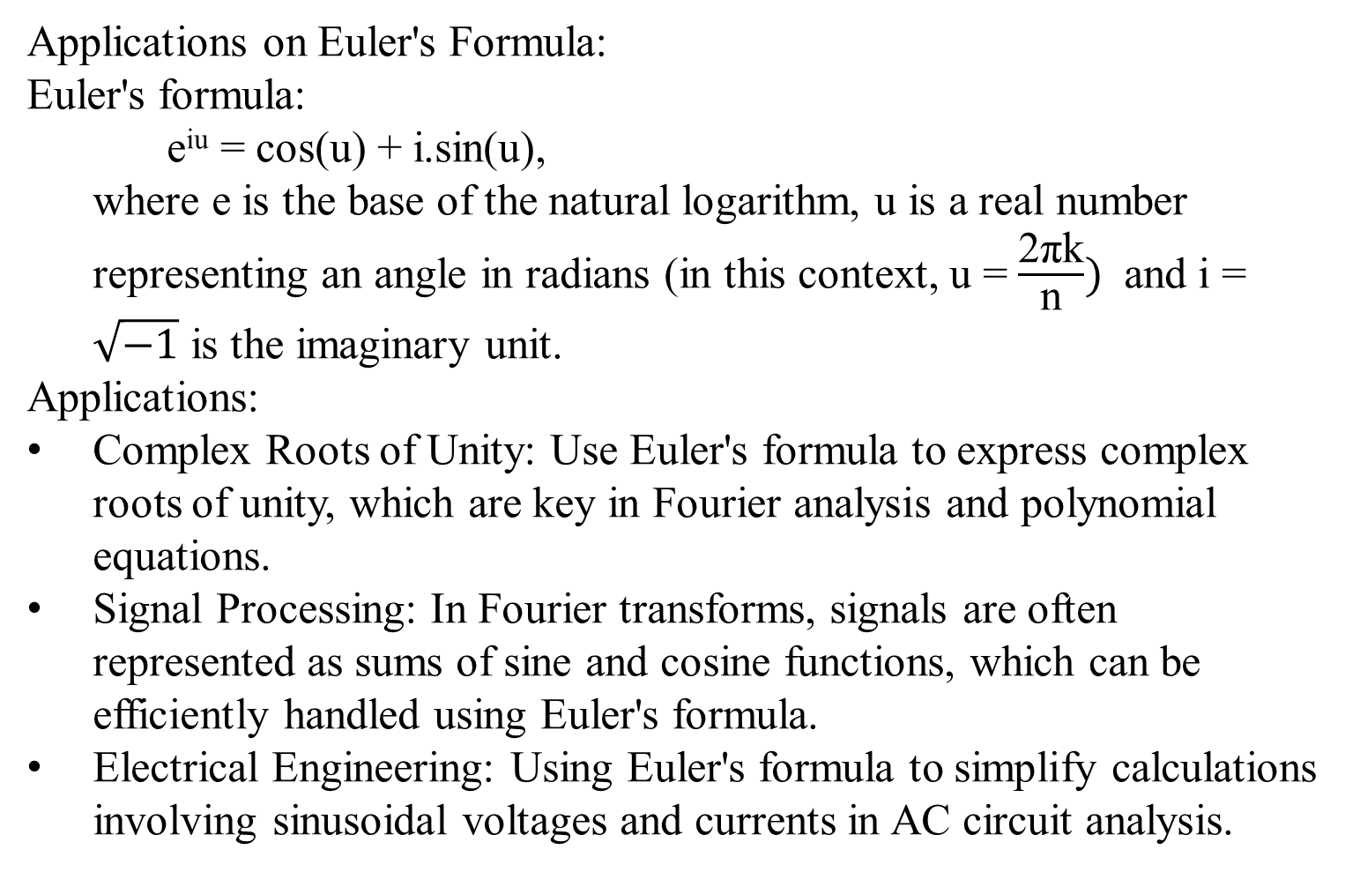
Complex roots of unity
Applications on Euler's Formula:
Euler's formula:
e^{iu} = cos(u) + i.sin(u),
where e is the base of the natural logarithm, u is a real number representing an angle in radians (in this context, u = $\frac{\text{2}\text{π}\text{k}\text{​}}{\text{n}})$ and i = $\sqrt{−1}$​ is the imaginary unit.
Applications:
Complex Roots of Unity: Use Euler's formula to express complex roots of unity, which are key in Fourier analysis and polynomial equations.
Signal Processing: In Fourier transforms, signals are often represented as sums of sine and cosine functions, which can be efficiently handled using Euler's formula.
Electrical Engineering: Using Euler's formula to simplify calculations involving sinusoidal voltages and currents in AC circuit analysis.

Slide 22
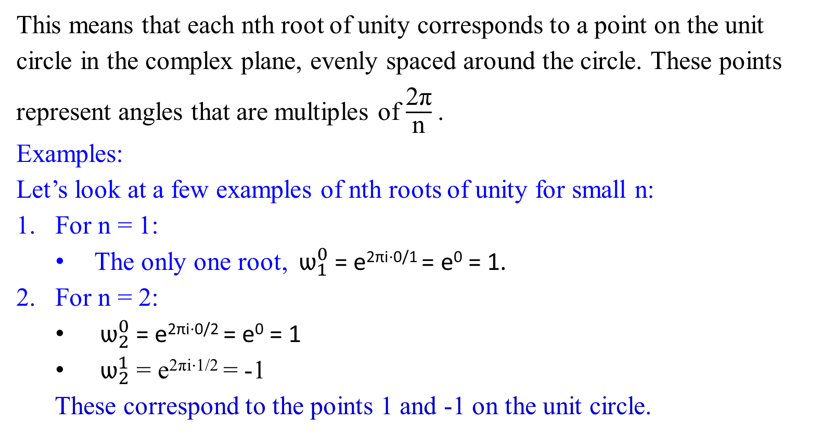
Complex roots of unity
This means that each nth root of unity corresponds to a point on the unit circle in the complex plane, evenly spaced around the circle. These points represent angles that are multiples of $\frac{\text{2}\text{π}\text{​}}{\text{n}}$​.
Examples:
Let’s look at a few examples of nth roots of unity for small n:
For n = 1:
The only one root, ${ ѡ}_{1}^{0}$ ​= e^{2πi⋅0/1} = e⁰ = 1.
For n = 2:
${ ѡ}_{2}^{0}$ ​= e^{2πi⋅0/2} = e⁰ = 1
${ ѡ}_{2}^{1}$ ​= e^{2πi⋅1/2} = -1
These correspond to the points 1 and -1 on the unit circle.

Slide 23
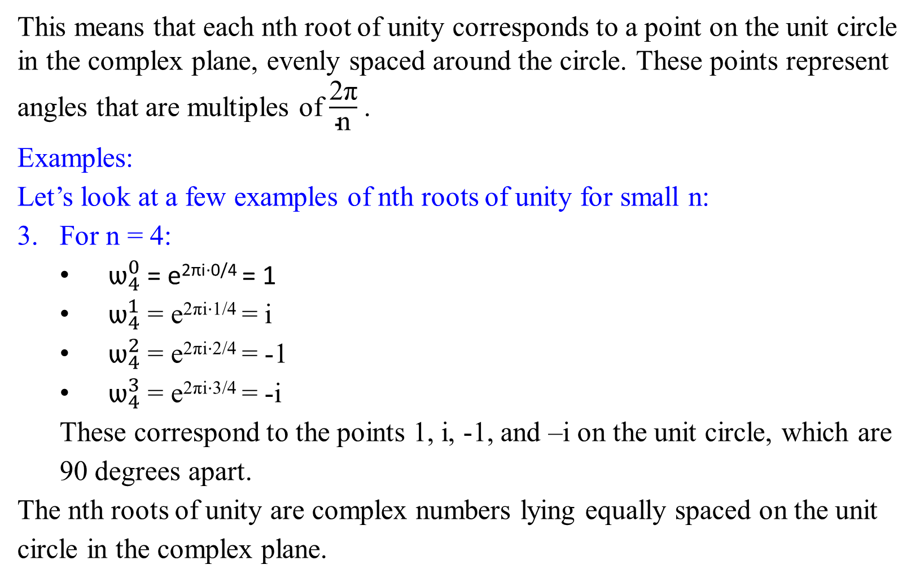
Complex roots of unity
This means that each nth root of unity corresponds to a point on the unit circle in the complex plane, evenly spaced around the circle. These points represent angles that are multiples of $\frac{\text{2}\text{π}\text{​}}{\text{n}}$​.
Examples:
Let’s look at a few examples of nth roots of unity for small n:
3. For n = 4:
${ ѡ}_{4}^{0}$ ​= e^{2πi⋅0/4} = 1
${ ѡ}_{4}^{1}$ ​= e^{2πi⋅1/4} = i
${ ѡ}_{4}^{2}$ ​= e^{2πi⋅2/4} = -1
${ ѡ}_{4}^{3}$ ​= e^{2πi⋅3/4} = -i
These correspond to the points 1, i, -1, and –i on the unit circle, which are 90 degrees apart.
The nth roots of unity are complex numbers lying equally spaced on the unit circle in the complex plane.

Slide 24
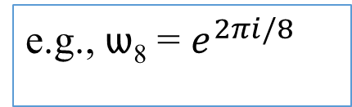

Complex roots of unity
Figure 2.11 shows that the n complex roots of unity are equally spaced around the circle of unit radius centered at the origin of the complex plane.
The value
ѡ_{n} = $e^{2πi/n}$ ……………… (2.18)
is the principal n^{th} root of unity;
all other complex nth roots of unity are powers of ѡ_{n}.
e.g., ѡ₈ = $e^{2πi/8}$

Slide 25
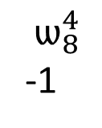
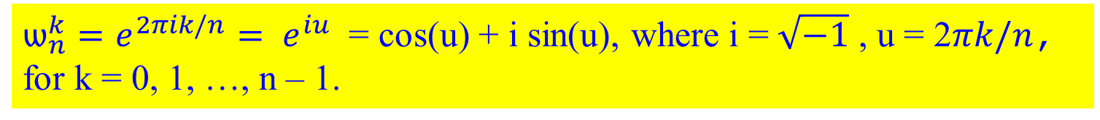


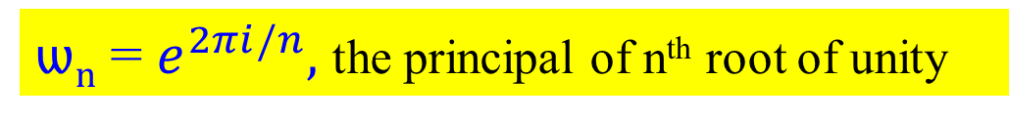
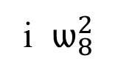
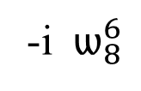
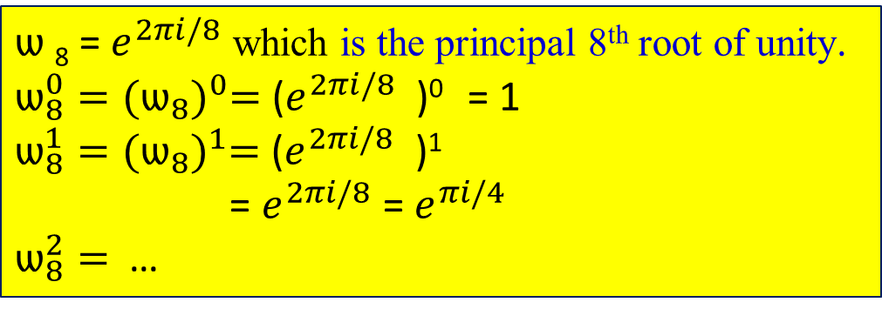

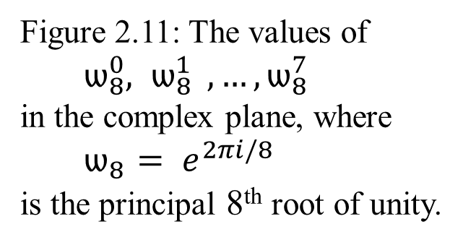
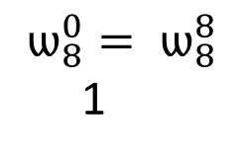

ѡ_{n} = $e^{2πi/n},$ the principal of n^{th} root of unity
${ѡ_{n}^{k}=e^{2πik/n}= e}^{iu}$ = cos(u) + i sin(u), where i = $\sqrt{−1}$ , u = 2$πk/n$, for k = 0, 1, …, n – 1.
i $ѡ_{8}^{2}$
$ѡ_{8}^{3}$
$$ѡ_{8}^{1}$$
Figure 2.11: The values of ${ ѡ}_{8}^{0}{, ѡ}_{8}^{1} , …, ѡ_{8}^{7}$ in the complex plane, where ${ ѡ}_{8 }{= e}^{2πi/8}$ is the principal 8th root of unity.
$$ѡ_{8}^{4}$$
-1
$$ѡ_{8}^{0}= ѡ_{8}^{8}$$
1
$ѡ$₈ = $e^{2πi/8}$ which is the principal 8th root of unity.
$ѡ_{8}^{0}={(ѡ_{8})}^{0}=$($e^{2πi/8}$ )⁰ = 1
$ѡ_{8}^{1}={(ѡ_{8})}^{1}=$($e^{2πi/8}$ )¹
= $e^{2πi/8}$ = $e^{πi/4}$
$ѡ_{8}^{2}=$ …
$${ ѡ}_{8}^{5}$$
$$ѡ_{8}^{7}$$
-i $ѡ_{8}^{6}$

Slide 26


Example 2.26: Analysis of the complex n^{th} root of unity
$ѡ_{8}^{0}={(ѡ_{8})}^{0}=$($e^{2πi/8}$ )⁰ = 1, for k = 0.
${ѡ_{n}^{k}=e^{2πik/n}= e}^{iu}$ = cos(u) + i sin(u), where
i = $\sqrt{−1}$ , u = 2$πk/n$, for k = 0, 1, …, n – 1.
$ѡ_{8}^{1}$ = $e^{i2πk/8}$ = $e^{i2π/8}$
= cos($\frac{2π}{8}$) + i sin($\frac{2π}{8}$), where i = $\sqrt{−1}$
= cos($\frac{π}{4}$) + i sin($\frac{π}{4}$),
= $\frac{1}{\sqrt{2}} +i \frac{1}{\sqrt{2}}$ = $\frac{1}{\sqrt{2}}$(1 + i) $={(ѡ_{8})}^{1}$ = $ѡ_{8}^{1}$
cos 0 = 1 sin 0 = 0
cos $\frac{π}{4}$ = $\frac{1}{\sqrt{2}}$ sin $\frac{π}{4}$ = $\frac{1}{\sqrt{2}}$
cos $\frac{π}{2}$ = 0 sin $\frac{π}{2}$ = 1
cos $\frac{3π}{4}$ =- $\frac{1}{\sqrt{2}}$ sin $\frac{3π}{4}$ = $\frac{1}{\sqrt{2}}$
cos π = -1 sin π = 0
cos $\frac{5π}{4}$ =- $\frac{1}{\sqrt{2}}$ sin $\frac{5π}{4}$ = - $\frac{1}{\sqrt{2}}$
cos $\frac{3π}{2}$ = 0 sin $\frac{3π}{2}$ = -1
cos $\frac{7π}{4}$ = $\frac{1}{\sqrt{2}}$ sin $\frac{7π}{4}$ = - $\frac{1}{\sqrt{2}}$
cos 2π = 1 sin 2π = 0

Slide 27
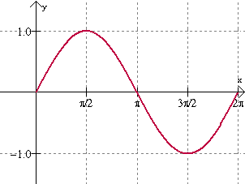
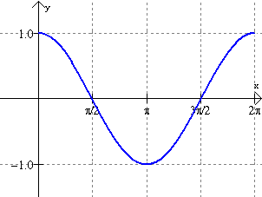

Slide 28

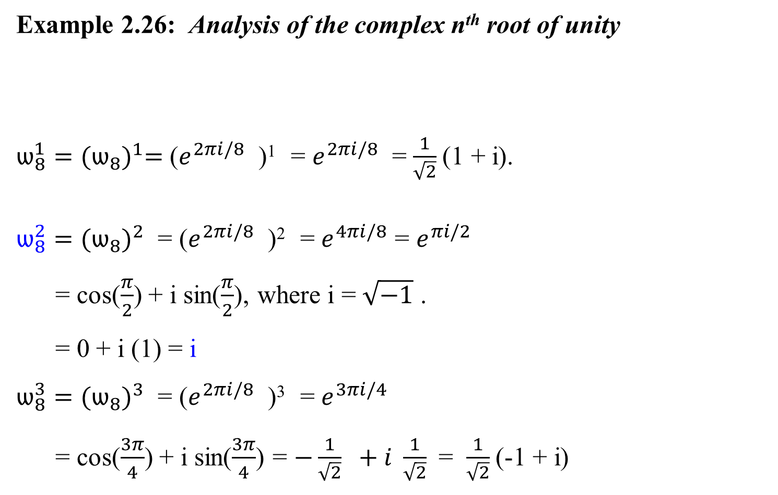
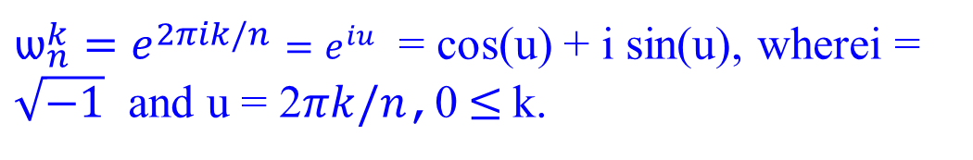
Example 2.26: Analysis of the complex n^{th} root of unity
$ѡ_{8}^{1}={(ѡ_{8})}^{1}=$($e^{2πi/8}$ )¹ = $e^{2πi/8}$ = $\frac{1}{\sqrt{2}}$(1 + i).
$ѡ_{8}^{2}={(ѡ_{8})}^{2}$ = ($e^{2πi/8}$ )² = $e^{4πi/8}$ = $e^{πi/2}$
= cos($\frac{π}{2}$) + i sin($\frac{π}{2}$), where i = $\sqrt{−1}$ .
= 0 + i (1) = i
$ѡ_{8}^{3}={(ѡ_{8})}^{3}$ = ($e^{2πi/8}$ )³ = $e^{3πi/4}$
= cos($\frac{3π}{4}$) + i sin($\frac{3π}{4}$) = $−\frac{1}{\sqrt{2}} +i \frac{1}{\sqrt{2}}$ = $\frac{1}{\sqrt{2}}$(-1 + i)
${ѡ_{n}^{k}=e^{2πik/n}=e}^{iu}$ = cos(u) + i sin(u), wherei = $\sqrt{−1}$ and u = 2$πk/n$,0$≤$k.
cos 0 = 1 sin 0 = 0
cos $\frac{π}{4}$ = $\frac{1}{\sqrt{2}}$ sin $\frac{π}{4}$ = $\frac{1}{\sqrt{2}}$
cos $\frac{π}{2}$ = 0 sin $\frac{π}{2}$ = 1
cos $\frac{3π}{4}$ =- $\frac{1}{\sqrt{2}}$ sin $\frac{3π}{4}$ = $\frac{1}{\sqrt{2}}$
cos π = -1 sin π = 0
cos $\frac{5π}{4}$ =- $\frac{1}{\sqrt{2}}$ sin $\frac{5π}{4}$ = - $\frac{1}{\sqrt{2}}$
cos $\frac{3π}{2}$ = 0 sin $\frac{3π}{2}$ = -1
cos $\frac{7π}{4}$ = $\frac{1}{\sqrt{2}}$ sin $\frac{7π}{4}$ = - $\frac{1}{\sqrt{2}}$
cos 2π = 1 sin 2π = 0

Slide 29


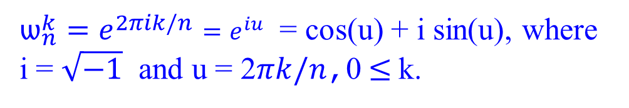

Example 2.26: Analysis of the complex n^{th} root of unity
$ѡ_{8}^{4}={(ѡ_{8})}^{4}$ = ($e^{2πi/8}$ )⁴ = $e^{8πi/8}$
= $e^{πi}$ = cos (π) + i sin (π), where i = $\sqrt{−1}$ .
= -1 + i (0) = -1
$ѡ_{8}^{5}={(ѡ_{8})}^{5}=$($e^{2πi/8}$ )⁵ = $e^{5πi/4}$
= cos($\frac{5π}{4}$) + i sin($\frac{5π}{4}$) = $−\frac{1}{\sqrt{2}} −i \frac{1}{\sqrt{2}}$ = $\frac{1}{\sqrt{2}}$(-1 - i)
$ѡ_{8}^{6}={(ѡ_{8})}^{6}$ = ($e^{2πi/8}$ )⁶ = $e^{12πi/8}$
= $e^{3πi/2}$ = cos($\frac{3π}{2}$) + i sin($\frac{3π}{2}$), where i = $\sqrt{−1}$ .
= 0 + i (-1) = - i
${ѡ_{n}^{k}=e^{2πik/n}=e}^{iu}$ = cos(u) + i sin(u), where
i = $\sqrt{−1}$ and u = 2$πk/n$,0$≤$k.
cos 0 = 1 sin 0 = 0
cos $\frac{π}{4}$ = $\frac{1}{\sqrt{2}}$ sin $\frac{π}{4}$ = $\frac{1}{\sqrt{2}}$
cos $\frac{π}{2}$ = 0 sin $\frac{π}{2}$ = 1
cos $\frac{3π}{4}$ =- $\frac{1}{\sqrt{2}}$ sin $\frac{3π}{4}$ = $\frac{1}{\sqrt{2}}$
cos π = -1 sin π = 0
cos $\frac{5π}{4}$ =- $\frac{1}{\sqrt{2}}$ sin $\frac{5π}{4}$ = - $\frac{1}{\sqrt{2}}$
cos $\frac{3π}{2}$ = 0 sin $\frac{3π}{2}$ = -1
cos $\frac{7π}{4}$ = $\frac{1}{\sqrt{2}}$ sin $\frac{7π}{4}$ = - $\frac{1}{\sqrt{2}}$
cos 2π = 1 sin 2π = 0
Note: This says, $\sqrt{−1}\sqrt{−1}$ = -1

Slide 30
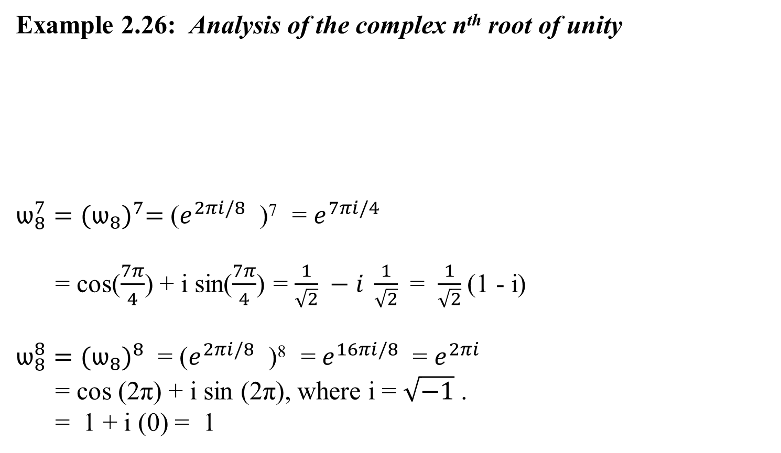
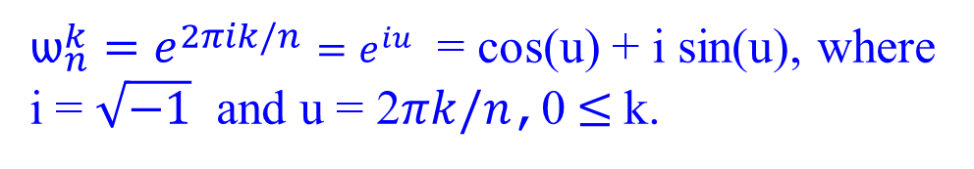
Example 2.26: Analysis of the complex n^{th} root of unity
$ѡ_{8}^{7}={(ѡ_{8})}^{7}=$($e^{2πi/8}$ )⁷ = $e^{7πi/4}$
= cos($\frac{7π}{4}$) + i sin($\frac{7π}{4}$) = $\frac{1}{\sqrt{2}} −i \frac{1}{\sqrt{2}}$ = $\frac{1}{\sqrt{2}}$(1 - i)
$ѡ_{8}^{8}={(ѡ_{8})}^{8}$ = ($e^{2πi/8}$ )⁸ = $e^{16πi/8}$ = $e^{2πi}$
= cos (2π) + i sin (2π), where i = $\sqrt{−1}$ .
= 1 + i (0) = 1
cos 0 = 1 sin 0 = 0
cos $\frac{π}{4}$ = $\frac{1}{\sqrt{2}}$ sin $\frac{π}{4}$ = $\frac{1}{\sqrt{2}}$
cos $\frac{π}{2}$ = 0 sin $\frac{π}{2}$ = 1
cos $\frac{3π}{4}$ =- $\frac{1}{\sqrt{2}}$ sin $\frac{3π}{4}$ = $\frac{1}{\sqrt{2}}$
cos π = -1 sin π = 0
cos $\frac{5π}{4}$ =- $\frac{1}{\sqrt{2}}$ sin $\frac{5π}{4}$ = - $\frac{1}{\sqrt{2}}$
cos $\frac{3π}{2}$ = 0 sin $\frac{3π}{2}$ = -1
cos $\frac{7π}{4}$ = $\frac{1}{\sqrt{2}}$ sin $\frac{7π}{4}$ = - $\frac{1}{\sqrt{2}}$
cos 2π = 1 sin 2π = 0
${ѡ_{n}^{k}=e^{2πik/n}=e}^{iu}$ = cos(u) + i sin(u), where
i = $\sqrt{−1}$ and u = 2$πk/n$,0$≤$k.

Slide 31


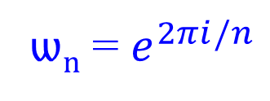

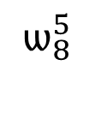


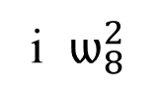

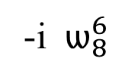
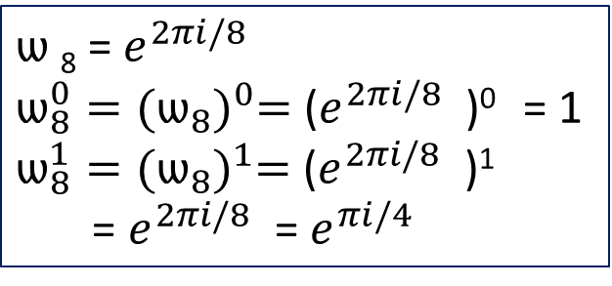


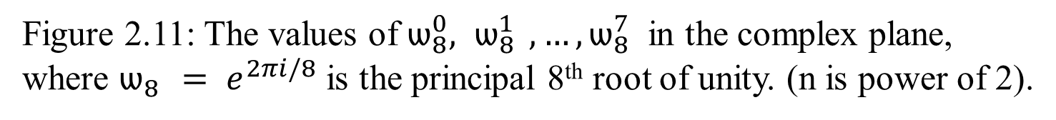
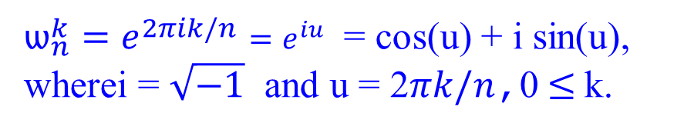



${ѡ_{n}^{k}=e^{2πik/n}=e}^{iu}$ = cos(u) + i sin(u), wherei = $\sqrt{−1}$ and u = 2$πk/n$,0$≤$k.
ѡ_{n} = $e^{2πi/n}$
$ѡ$₈ = $e^{2πi/8}$
$ѡ_{8}^{0}={(ѡ_{8})}^{0}=$($e^{2πi/8}$ )⁰ = 1
$ѡ_{8}^{1}={(ѡ_{8})}^{1}=$($e^{2πi/8}$ )¹
= $e^{2πi/8}$ = $e^{πi/4}$
i $ѡ_{8}^{2}$
$$\frac{π}{2}$$
$$\frac{3π}{4}$$
$ѡ_{8}^{3}$
$$\frac{π}{4}$$
$$ѡ_{8}^{1}$$
$$ѡ_{8}^{4}$$
$$ѡ_{8}^{0}= ѡ_{8}^{8}$$
0π
π
-1
1
2π
$$ѡ_{8}^{7}$$
$$\frac{7π}{4}$$
$$\frac{5π}{4}$$
${ ѡ}_{8}^{5}$
-i $ѡ_{8}^{6}$
$$\frac{3π}{2}$$
Figure 2.11: The values of $ѡ_{8}^{0}{, ѡ}_{8}^{1} , …, ѡ_{8}^{7}$ in the complex plane, where $ѡ_{8 }{= e}^{2πi/8}$ is the principal 8th root of unity. (n is power of 2).

Slide 32
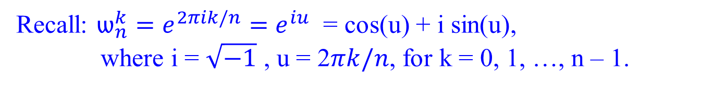

Complex roots of unity
Recall: $ѡ_{n}^{k}=e^{2πik/n}=$ $e^{iu}$ = cos(u) + i sin(u),
where i = $\sqrt{−1}$ , u = 2$πk/n$, for k = 0, 1, …, n – 1.
Roots of Unity as a Group:
n Complex nth Roots of Unity: The n complex n^{th} roots of unity, $ѡ_{n}^{0}, { ѡ}_{n}^{1}, …, { ѡ}_{n}^{n−1},$ form a group under multiplication.
  This group consists of all complex numbers that satisfy $ѡ_{n}^{n} = ѡ_{n}^{0} =1$.
Group Structure: …
Inverse Element: …

Slide 33
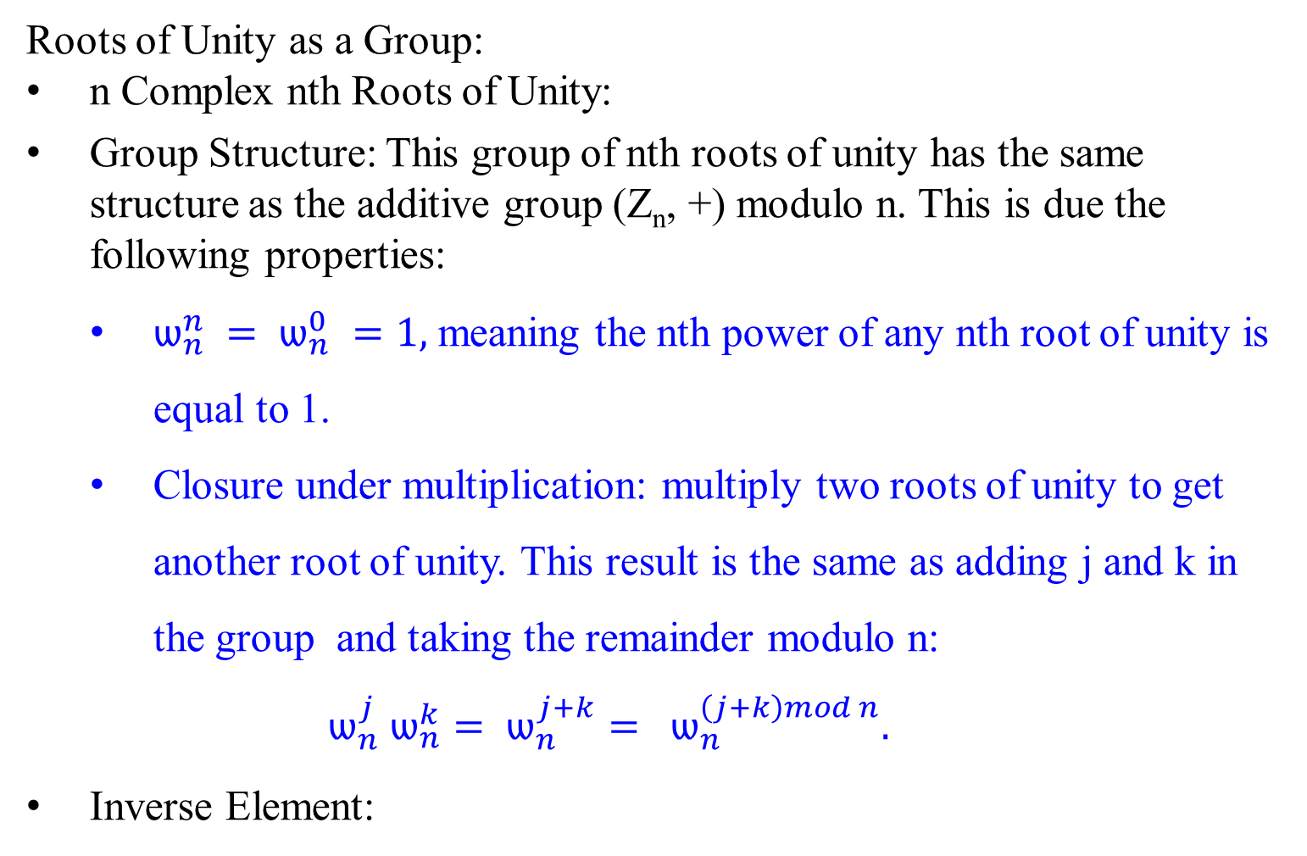
Complex roots of unity
Roots of Unity as a Group:
n Complex nth Roots of Unity:
Group Structure: This group of nth roots of unity has the same structure as the additive group (Z_{n}, +) modulo n. This is due the following properties:
  $ѡ_{n}^{n} = ѡ_{n}^{0} =1,$ meaning the nth power of any nth root of unity is equal to 1.
  Closure under multiplication: multiply two roots of unity to get another root of unity. This result is the same as adding j and k in the group and taking the remainder modulo n:
  $$ѡ_{n}^{j} ѡ_{n}^{k}= ѡ_{n}^{j+k}= ѡ_{n}^{\left(j+k\right)mod n}.$$
Inverse Element:

Slide 34

Complex roots of unity
Recall: $ѡ_{n}^{k}=e^{2πik/n}=$ $e^{iu}$ = cos(u) + i sin(u),
where i = $\sqrt{−1}$ , u = 2$πk/n$, for k = 0, 1, …, n – 1.
Roots of Unity as a Group:
n Complex nth Roots of Unity:
Group Structure:
Inverse Element: For every element $ѡ_{n}^{j}$, the inverse is $ѡ_{n}^{−j}$. Since $ѡ_{n}^{−j}= ѡ_{n}^{n−j}$, the inverse in the group of nth roots of unity corresponds to subtracting j from n and then taking modulo n. Similarly, $ѡ_{n}^{−1}= ѡ_{n}^{n−1}.$

Slide 35

Complex roots of unity
The following lemmas furnish some essential properties of the complex nth roots of unity.
Lemma 2.1(Cancellation lemma)
For any integers n ≥ 0, k ≥ 0, and d > 0,
$ѡ_{dn}^{dk}=ѡ_{n}^{k}.$ …………..……. (2.19)
Proof. The lemma follows directly from equation (2.18): ѡ_{n} = $e^{2πi/n}$ ,
since ${ ѡ}_{dn}^{dk} =( e^{\frac{2πi}{dn}}{ )}^{dk}$
$=( e^{\frac{2πi}{n}}{ )}^{k}$
${ = ѡ}_{n}^{k}$ QED

Slide 36


Complex roots of unity
Corollary 2.1.1
For any even integer n > 0,
$$ѡ_{n}^{n/2}= ѡ_{2}= −1.$$
Proof: $ѡ_{n}^{n/2}=( e^{\frac{2πi}{n}}{ )}^{\frac{n}{2}}= ( e^{\frac{2πi}{2}} )=ѡ_{2}= −1,$
for cos($π)+ i\sin\left(π\right)=−1+i∗0= −1$[ using e^{iu} = cos(u) + i sin(u)]. Or ${ ѡ}_{n}^{n/2}={ ѡ}_{2n}^{2n/2}= { ѡ}_{2n}^{n}= ѡ_{2}= −1.$
ѡ_{n} = $e^{2πi/n}$

Slide 37

Complex roots of unity
Corollary 2.1.1
For any even integer n > 0,
$$ѡ_{n}^{n/2}= ѡ_{2}= −1.$$
Explanation:
$ѡ_{n}$ is a primitive nth root of unity. This means $ѡ_{n}$ is a complex number such that $ѡ_{n}^{n}=1.$
The expression ${ ѡ}_{n}^{n/2} refers to raising$ $ѡ_{n}$ to the power of n/2, when n is even, this specific root $ѡ_{n}^{n/2}$ corresponds to $ѡ_{2} −1$.
This is because ѡ₂ = $e^{2πi/2}$= $e^{πi}$ = -1.
Use frequently in mathematical proofs and applications involving complex numbers and Fourier transforms.

Slide 38


Complex roots of unity
$ѡ_{n}^{k}=e^{2πik/n};$ if k = 1, ѡ_{n} = $e^{2πi/n}$.
$e^{iu}$ = cos(u) + i sin(u), where i = $\sqrt{−1}$ ,
u = 2$πk/n$, for k = 0, 1, …, n – 1.
FFT
Lemma 2.2 (Halving lemma)
If n > 0 is even, then the squares of the n complex n^{th} roots of unity are the n/2 complex (n/2)^{th} roots of unity. [note: needs n is divisible by 2. i.e., n is even.]
[note: n > 0 for any k =0, 1, …, n-1, $e^{2πik/n} implies n cannot be 0.]$
Proof. By the cancellation lemma 2.1, we have
${{ (ѡ}_{n}^{k})}^{2}= ѡ_{n}^{2k}= ѡ_{2n/2}^{2k}= ѡ_{n/2}^{k}$, for any nonnegative integer k.
Note that if we square all the complex n^{th} roots of unity, then we obtain each (n/2)^{th} root of unity exactly twice, since
${{ (ѡ}_{n}^{k+ n/2})}^{2}= ѡ_{n}^{2k+n}$
${ = ѡ}_{n}^{2k} { ѡ}_{n}^{n}$
${ = ѡ}_{n}^{2k}$
${ =(ѡ}_{n}^{k})^{2}$ .

Slide 39

Complex roots of unity
Thus, ${ ѡ}_{n}^{k}$ and ${ ѡ}_{n}^{k+n/2}$ have the same square. We could also use Corollary 2.1.1 to prove this property, since ${ ѡ}_{n}^{n/2}= −1$ implies
${ ѡ}_{n}^{k+n/2}= ѡ_{n}^{k}{ ѡ}_{n}^{n/2}= −{ ѡ}_{n}^{k},$ and
thus
${ ( ѡ}_{n}^{k+n/2})^{2}= ({ ѡ}_{n}^{k} )^{2}$ . QED.
**********************************************************
The halving lemma is essential to our divide-and-conquer approach for converting between coefficient and point-value representations of polynomials, since it guarantees that the recursive sub-problems are only half as large.
FFT

Slide 40

Lemma 2.2 (Halving Lemma)
If n > 0 is even, then the squares of the n complex n^{th} roots of unity are the n/2 complex (n/2)^{th} roots of unity.
Explanation:
A complex nth root of unity ω_{n}​ is a number such that $ѡ_{n}^{n} = ѡ_{n}^{0} =1$.
When n is even, we can consider the squares of these roots $ѡ_{n}^{2}$​.
The Halving Lemma states that when you square each of the n complex nth roots of unity, you obtain the n/2 complex (n/2)^{th} roots of unity.
Essentially, this lemma shows a relationship between the nth roots of unity and the (n/2)^{th} roots of unity when n is even, by squaring the nth roots. This is a useful concept in number theory and Fourier analysis.

Slide 41

Complex roots of unity
Lemma 2.3 (Summation lemma)
For any integer n ≥ 1 and nonzero integer k not divisible by n,
$\sum_{j=0}^{n−1}{({ ѡ}_{n}^{k} )^{j} }=0.$
Proof:
Equation $\sum_{k=0}^{n}{x^{k}= \frac{x^{n+1}−1}{x−1}}$ (A.5) applies to complex values as well as to reals. So we have
$\sum_{j=0}^{n−1}{({ ѡ}_{n}^{k} )^{j} }=\frac{({ ѡ}_{n}^{k} )^{n}−1}{{ ѡ}_{n}^{k}−1}$ $= \frac{({ ѡ}_{n}^{n} )^{k}−1}{{ ѡ}_{n}^{k}−1}$ $= \frac{(1 )^{k}−1}{{ ѡ}_{n}^{k}−1}$= 0.
Because we require that k is not divisible by n, and because ${ ѡ}_{n}^{k}=1$ only when k is divisible by n, we ensure that the denominator is not 0.
QED
DFT

Slide 42

Complex roots of unity
Lemma 2.3 (Summation lemma)
For any integer n ≥ 1 and nonzero integer k not divisible by n,
$\sum_{j=0}^{n−1}{({ ѡ}_{n}^{k} )^{j} }=0.$
Explanation:
$ѡ_{n}$ ​represents a complex nth root of unity, which satisfies $ѡ_{n}^{n} =1$.
The lemma states that if k is a nonzero integer and k is not divisible by n, then the sum of the powers of $ѡ_{n}^{k}$​ from j = 0 to j = n−1 equals zero.
This result is significant in the study of Fourier transforms and cyclic groups. It shows that the sum of these powers cancels out when k is not a multiple of n. This cancellation is a consequence of the symmetry and periodicity properties of the roots of unity.
DFT

Slide 43

Complex roots of unity
FFT
Example 2.27: Example of Lemma 2.2 (Halving lemma)
${( ѡ}_{8}^{0} )^{2}= ѡ_{4}^{0}$ = 1;
${( ѡ}_{8 }^{1})^{2 }$ = $ѡ_{4}^{1}$ = $ѡ_{4}$ , for ${( ѡ}_{8 }^{1})^{2 }$ = ( $\frac{1}{\sqrt{2}}$(1 + i) )² = i ; and
$ѡ_{4}^{1}$ = $e^{2πi∗1/4}$ = cos($\frac{π}{2}$ ) + i sin($\frac{π}{2}$ ) = 0 + i
${( ѡ}_{8 }^{2})^{2 }$ = $ѡ_{4}^{2}$ = -1
${( ѡ}_{8 }^{3})^{2 }$ = $ѡ_{4}^{3}$ = $−i$
${( ѡ}_{8}^{4} )^{2}= ѡ_{4}^{4} = ѡ_{4}^{4 mod 4}= ѡ_{4}^{0}$, for ${( ѡ}_{8}^{4} )^{2}=$ (-1)² = 1; and
$ѡ_{4}^{0}$ = $e^{2πi∗0/4}$ = cos(0) + i sin(0)
= 1 + i *0 = 1

Slide 44

Complex roots of unity
…
($ѡ_{8}^{7}$ $)^{2}$ = $ѡ_{4}^{7}$ = $ѡ_{4}^{7 mod 4}$ = $ѡ_{4}^{3}$ , for ($ѡ_{8}^{7}$ $)^{2}$ = ( $\frac{1}{\sqrt{2}}$(1 - i) )² = -i; and
$ѡ_{4}^{3}= e^{2πi∗3/4}= e^{3πi/2}$
= cos($\frac{3π}{2}$) + i sin($\frac{3π}{2}$)
= 0 + i *-1 = -i
FFT

Slide 45

Complex roots of unity
DFT
Example 2.28: Example of Lemma 2.3 (Summation lemma)
$\sum_{j=0}^{n−1}{({ ѡ}_{n}^{k} )^{j} }=0.$
= ${( ѡ}_{n}^{k}{ )}^{0}+ ({ ѡ}_{n}^{k}{ )}^{1}$ $+ ( ѡ_{n}^{k} )^{2}$ $+ ( ѡ_{n}^{k} )^{3}$ $+ …$ $+ ( ѡ_{n}^{k}{ )}^{n−1}$
= $ѡ_{n}^{k∗0}+ ѡ_{n}^{k∗1}$ $+ ѡ_{n}^{k∗2}$ $+ ѡ_{n}^{k∗3}$ $+ …$ $+ ѡ_{n}^{k∗n−1}$
Let k = 3 and n = 8. 3 is indivisible by 8
$\sum_{j=0}^{n−1}{({ ѡ}_{n}^{k} )^{j} }$
${= ( ѡ}_{8}^{3}{ )}^{0}+ ({ ѡ}_{8}^{3}{ )}^{1}$ $+ ( ѡ_{8}^{3} )^{2}$ $+ ( ѡ_{8}^{3} )^{3}$ $+ …$ $+ ( ѡ_{8}^{3}{ )}^{7}$
= $ѡ_{8}^{3∗0}+ ѡ_{8}^{3∗1}$ $+ ѡ_{8}^{3∗2}$ $+ ѡ_{8}^{3∗3}$ $+ ѡ_{8}^{3∗4}$ $+ ѡ_{8}^{3∗5}$ $+ ѡ_{8}^{3∗6}$ $+ ѡ_{8}^{3∗7}$

Slide 46

Complex roots of unity
Example 2.28: Example of Lemma 2.3 (Summation lemma)
= …
= $ѡ_{8}^{3∗0}+ ѡ_{8}^{3∗1}$ $+ ѡ_{8}^{3∗2}$ $+ ѡ_{8}^{3∗3}$ $+ ѡ_{8}^{3∗4}$ $+ ѡ_{8}^{3∗5}$ $+ ѡ_{8}^{3∗6}$ $+ ѡ_{8}^{3∗7}$
= $(ѡ_{8}^{0})^{3}+ (ѡ_{8}^{1})^{3}$ $+ (ѡ_{8}^{2})^{3}$ $+ (ѡ_{8}^{3})^{3}+ (ѡ_{8}^{4})^{3}$ $+ (ѡ_{8}^{5}{ )}^{3}$ $+ (ѡ_{8}^{6})^{3}$ $+ (ѡ_{8}^{7})^{3}$
= $(1)^{3}+ (\frac{1}{\sqrt{2}} \left(1 + i\right))^{3}+ (i)^{3}+(\frac{1}{\sqrt{2}} \left(−1 + i\right))^{3}+$
$(−1)^{3}+ (\frac{1}{\sqrt{2}} (−1 − i))^{3}+(−i)^{3}+(\frac{1}{\sqrt{2}}$(1 - i)$)^{3}$
= 0
In fact, if k = 1, 2, 3, 4, 5, 6, 7, … k is indivisible by 8, and $\sum_{j=0}^{n−1}{({ ѡ}_{n}^{k} )^{j} }=0.$

Slide 47


Evaluate a polynomial A(x)
Example 2.29
1 x₀ $x_{0}^{2}$ … $x_{0}^{n−1}$ a₀ y₀
1 x₁ $x_{1}^{2}$ … $x_{1}^{n−1}$ a₁ y₁
. . . . . . .
1 x_{k} $x_{k}^{2}$ … $x_{k}^{n−1}$ a_{k} = y_{k} …. (2.16)
. . . . . . .
1 x_{n-1} $x_{n−1}^{2}$ … $x_{n−1}^{n−1}$ a_{n-1} y_{n-1}
y_{k} = a₀ *1 + a₁ * x_{k} + a₂ * $x_{k}^{2}$ + … + a_{n-1} * $x_{k}^{n−1}$
When k = 1, then
y₁ = a₀ *1 + a₁ * x₁ + a₂ * $x_{1}^{2}$ + … + a_{n-1} * $x_{1}^{n−1}$
The Vandermonde matrix could be evaluated at x₀ = $ѡ_{n}^{0}, { \text{x}\text{1}\text{ =} ѡ}_{n}^{1}, …, {\text{x}\text{n}\text{ =}ѡ}_{n}^{n−1}.$

Slide 48

Evaluate DFT of a polynomial A(x) at the complex nth roots of unity
Outline the DFT evaluates a polynomial A(x) = $\sum_{j=0}^{n−1}{a_{j}x^{j}}$ of degree-bound n at $ѡ_{n}^{0}, { ѡ}_{n}^{1}, …, ѡ_{n}^{n−1}$, i.e., at the n complex n^{th} roots of unity).
Polynomial Representation:
The polynomial A(x) is given by:
A(x) = $\sum_{j=0}^{n−1}{a_{j}x^{j}}$
where a = ($a_{0}, a_{1}, …, { a}_{n−1}$) is the coefficient vector.
Evaluation at Roots of Unity:
DFT Vector:
DFT

Slide 49

Evaluate DFT of a polynomial A(x) at the complex nth roots of unity
Outline the DFT evaluates a polynomial A(x) = $\sum_{j=0}^{n−1}{a_{j}x^{j}}$ of degree-bound n at $ѡ_{n}^{0}, { ѡ}_{n}^{1}, …, ѡ_{n}^{n−1}$, i.e., at the n complex n^{th} roots of unity).
Polynomial Representation:
Evaluation at Roots of Unity:
The DFT evaluates this polynomial at the nth root of unity $ѡ_{n}^{k}$, where ѡ_{n} = $e^{2πi/n}$. Specifically, for each k = 0, 1, 2, …, n – 1, the result y_{k} is:
y_{k} $=$ A(${ ѡ}_{n}^{k}$)
$= \sum_{j=0}^{n−1}{{ a_{j} ѡ}_{n}^{kj} }$. …………….. (2.20)
i.e., y_{k} = a₀ *1 + a₁ * x_{k} + a₂ * $x_{k}^{2}$ + … + a_{n-1} * $x_{k}^{n−1}$
= ${ a_{0} ѡ}_{n}^{k∗0}$+ ${ a_{1} ѡ}_{n}^{k∗1}$ + ${ a_{2} ѡ}_{n}^{k∗2}$ + … + ${ a_{n−1} ѡ}_{n}^{k∗(n−1)}$
3. DFT Vector:
DFT

Slide 50

Evaluate DFT of a polynomial A(x) at the complex nth roots of unity
Outline the DFT evaluates a polynomial A(x) = $\sum_{j=0}^{n−1}{a_{j}x^{j}}$ of degree-bound n at $ѡ_{n}^{0}, { ѡ}_{n}^{1}, …, ѡ_{n}^{n−1}$, i.e., at the n complex n^{th} roots of unity).
Polynomial Representation:
Evaluation at Roots of Unity:
the result y_{k} is:
y_{k} = ${ a_{0} ѡ}_{n}^{k∗0}$+ ${ a_{1} ѡ}_{n}^{k∗1}$ + ${ a_{2} ѡ}_{n}^{k∗2}$ + … + ${ a_{n−1} ѡ}_{n}^{k∗(n−1)}$
3. DFT Vector:
The vector y = ($y_{0}, y_{1}, …, { y}_{n−1}$) represents the discrete Fourier transform (DFT) of the coefficient vector a = ($a_{0}, a_{1}, …, { a}_{n−1}$). In another words,
y = DFT_{n} (a).
DFT

Slide 51

Evaluate DFT of a polynomial A(x) at the complex nth roots of unity
The DFT
Evaluate a polynomial A(x) = $\sum_{j=0}^{n−1}{a_{j}x^{j}}$ of degree-bound n at $ѡ_{n}^{0}, { ѡ}_{n}^{1}, …, ѡ_{n}^{n−1}$, i.e., at the n complex n^{th} roots of unity).
The DFT transforms the polynomial’s coefficient representation into a frequency domain representation where each $y_{k}$provides information about the polynomial’s behavior at the kth frequency component.
DFT

Slide 52

Evaluate DFT of a polynomial A(x) at the complex nth roots of unity
The DFT (Summary):
Evaluate a polynomial A(x) = $\sum_{j=0}^{n−1}{a_{j}x^{j}}$ of degree-bound n at $ѡ_{n}^{0}, { ѡ}_{n}^{1}, …, ѡ_{n}^{n−1}$, i.e., at the n complex n^{th} roots of unity).
Given A(x) in coefficient form: a = ($a_{0}, a_{1}, …, { a}_{n−1}$),
define the result y_{k} , for k = 0, 1, 2, …, n – 1, by
y_{k} $=$ A(${ ѡ}_{n}^{k}$)
$= \sum_{j=0}^{n−1}{{ a_{j} ѡ}_{n}^{kj} }$. …………….. (2.20)
i.e., y_{k} = a₀ *1 + a₁ * x_{k} + a₂ * $x_{k}^{2}$ + … + a_{n-1} * $x_{k}^{n−1}$
= ${ a_{0} ѡ}_{n}^{k∗0}$+ ${ a_{1} ѡ}_{n}^{k∗1}$ + ${ a_{2} ѡ}_{n}^{k∗2}$ + … + ${ a_{n−1} ѡ}_{n}^{k∗(n−1)}$
The vector y = ($y_{0}, y_{1}, …, { y}_{n−1}$) is the discrete Fourier transform (DFT) of the coefficient vector a = ($a_{0}, a_{1}, …, { a}_{n−1}$).
We also write y = DFT_{n} (a).
DFT

Slide 53
















$ѡ$₈ = $e^{2πi/8}$
$ѡ_{8}^{0} \text{=} {(ѡ_{8})}^{0} \text{=}$ ($e^{2πi/8}$ )⁰
= 1
$ѡ_{8}^{1 }\text{=}{ (ѡ_{8})}^{1} \text{=}$($e^{2πi/8}$ )¹
= $e^{2πi/8}$
i $ѡ_{8}^{2}$
$$\frac{π}{2}$$
$$\frac{3π}{4}$$
$ѡ_{8}^{3}$
$$\frac{π}{4}$$
$$ѡ_{8}^{1}$$
$$ѡ_{8}^{4}$$
$$ѡ_{8}^{0}= ѡ_{8}^{8}$$
0π
π
-1
1
2π
$$ѡ_{8}^{7}$$
$$\frac{7π}{4}$$
$$\frac{5π}{4}$$
${ ѡ}_{8}^{5}$
-i $ѡ_{8}^{6}$
$$\frac{3π}{2}$$
Figure 2.11: The values of $ѡ_{8}^{0}{, ѡ}_{8}^{1} , …, ѡ_{8}^{7}$ in the complex plane, where $ѡ_{8 }{= e}^{2πi/8}$ is the principal 8th root of unity.

Slide 54

Evaluate a polynomial A(x) - Interpolation at the complex roots of unity
FFT
Example 2.30: for n = 8
For k = 0, y₀ = y_{k} = A(${ ѡ}_{n}^{k}$) = A(${ ѡ}_{8}^{0}$) $= \sum_{j=0}^{n−1}{{ a_{j} ѡ}_{n}^{kj} }$ $= \sum_{j=0}^{8−1}{{ a_{j} ѡ}_{8}^{0j} }$
= $a_{0} ѡ_{8}^{0∗0}+ a_{1} ѡ_{8}^{0∗1}$ $+ a_{2} ѡ_{8}^{0∗2}$ $+ a_{3} ѡ_{8}^{0∗3}$ $+ a_{4} ѡ_{8}^{0∗4}$
$+ a_{5} ѡ_{8}^{0∗5}$ $+ a_{6} ѡ_{8}^{0∗6}$ $+ a_{7} ѡ_{8}^{0∗7}$
= $a_{0} (ѡ_{8}^{0})^{0}+ a_{1} (ѡ_{8}^{1})^{0}$ $+ a_{2} (ѡ_{8}^{2})^{0}$ $+ a_{3} (ѡ_{8}^{3})^{0}+ a_{4} (ѡ_{8}^{4})^{0}$
$+ a_{5} (ѡ_{8}^{5}{ )}^{0}$ $+ a_{6} (ѡ_{8}^{6})^{0}$ $+ a_{7} (ѡ_{8}^{7})^{0}$
= $a_{0}+ a_{1}+ a_{2}+a_{3}+a_{4}+a_{5}+a_{6}+{ a}_{7}$.

Slide 55

Evaluate a polynomial A(x)
FFT
For k = 1, y₁ = y_{k} = A(${ ѡ}_{n}^{k}$) = A(${ ѡ}_{8}^{1}$) $= \sum_{j=0}^{n−1}{{ a_{j} ѡ}_{n}^{kj} }$ $= \sum_{j=0}^{8−1}{{ a_{j} ѡ}_{8}^{1j} }$
= $a_{0} ѡ_{8}^{1∗0}+ a_{1} ѡ_{8}^{1∗1}$ $+ a_{2} ѡ_{8}^{1∗2}$ $+ a_{3} ѡ_{8}^{1∗3}$ $+ a_{4} ѡ_{8}^{1∗4}$
$+ a_{5} ѡ_{8}^{1∗5}$ $+ a_{6} ѡ_{8}^{1∗6}$ $+ a_{7} ѡ_{8}^{1∗7}$
= $a_{0} (ѡ_{8}^{0})^{1}+ a_{1} (ѡ_{8}^{1})^{1}$ $+ a_{2} (ѡ_{8}^{2})^{1}$ $+ a_{3} (ѡ_{8}^{3})^{1}+ a_{4} (ѡ_{8}^{4})^{1}$
$+ a_{5} (ѡ_{8}^{5}{ )}^{1}$ $+ a_{6} (ѡ_{8}^{6})^{1}$ $+ a_{7} (ѡ_{8}^{7})^{1}$
= $a_{0}\left(1\right)+ a_{1}\left(\frac{1}{\sqrt{2}} \left(1 + i\right)\right)+ a_{2}\left(i\right)+a_{3}\left(\frac{1}{\sqrt{2}} \left(−1 + i\right)\right)+$
$a_{4}(−1)+a_{5}(\frac{1}{\sqrt{2}} (−1 − i))+a_{6}(−i)+{ a}_{7}(\frac{1}{\sqrt{2}}$(1 - i)).

Slide 56

Evaluate a polynomial A(x)
For k = 2, y₂ = y_{k} = A(${ ѡ}_{n}^{k}$) = A(${ ѡ}_{8}^{2}$) $= \sum_{j=0}^{n−1}{{ a_{j} ѡ}_{n}^{kj} }$ $= \sum_{j=0}^{8−1}{{ a_{j} ѡ}_{8}^{2j} }$
= $a_{0} ѡ_{8}^{2∗0}+ a_{1} ѡ_{8}^{2∗1}$ $+ a_{2} ѡ_{8}^{2∗2}$ $+ a_{3} ѡ_{8}^{2∗3}$ $+ a_{4} ѡ_{8}^{2∗4}$
$+ a_{5} ѡ_{8}^{2∗5}$ $+ a_{6} ѡ_{8}^{2∗6}$ $+ a_{7} ѡ_{8}^{2∗7}$
= $a_{0} (ѡ_{8}^{0})^{2}+ a_{1} (ѡ_{8}^{1})^{2}$ $+ a_{2} (ѡ_{8}^{2})^{2}$ $+ a_{3} (ѡ_{8}^{3})^{2}+ a_{4} (ѡ_{8}^{4})^{2}$
$+ a_{5} (ѡ_{8}^{5}{ )}^{2}$ $+ a_{6} (ѡ_{8}^{6})^{2}$ $+ a_{7} (ѡ_{8}^{7})^{2}$
= $a_{0}(1)^{2}+ a_{1}(\frac{1}{\sqrt{2}} \left(1 + i\right))^{2}+ a_{2}(i)^{2}+a_{3}(\frac{1}{\sqrt{2}} \left(−1 + i\right))^{2}+$
${ a}_{4}(−1)^{2}+a_{5}(\frac{1}{\sqrt{2}} (−1 − i))^{2}+a_{6}(−i)^{2}+{ a}_{7}(\frac{1}{\sqrt{2}}$(1 - i)$)^{2}$.

Slide 57

Evaluate a polynomial A(x)
For k = 3, y₃ = y_{k} = A(${ ѡ}_{n}^{k}$) = A(${ ѡ}_{8}^{3}$) $= \sum_{j=0}^{n−1}{{ a_{j} ѡ}_{n}^{kj} }$ $= \sum_{j=0}^{8−1}{{ a_{j} ѡ}_{8}^{3j} }$
= $a_{0} ѡ_{8}^{3∗0}+ a_{1} ѡ_{8}^{3∗1}$ $+ a_{2} ѡ_{8}^{3∗2}$ $+ a_{3} ѡ_{8}^{3∗3}$ $+ a_{4} ѡ_{8}^{3∗4}$
$+ a_{5} ѡ_{8}^{3∗5}$ $+ a_{6} ѡ_{8}^{3∗6}$ $+ a_{7} ѡ_{8}^{3∗7}$
= $a_{0} (ѡ_{8}^{0})^{3}+ a_{1} (ѡ_{8}^{1})^{3}$ $+ a_{2} (ѡ_{8}^{2})^{3}$ $+ a_{3} (ѡ_{8}^{3})^{3}+ a_{4} (ѡ_{8}^{4})^{3}$
$+ a_{5} (ѡ_{8}^{5}{ )}^{3}$ $+ a_{6} (ѡ_{8}^{6})^{3}$ $+ a_{7} (ѡ_{8}^{7})^{3}$
= $a_{0}(1)^{3}+ a_{1}(\frac{1}{\sqrt{2}} \left(1 + i\right))^{3}+ a_{2}(i)^{3}+a_{3}(\frac{1}{\sqrt{2}} \left(−1 + i\right))^{3}+$
${ a}_{4}(−1)^{3}+a_{5}(\frac{1}{\sqrt{2}} (−1 − i))^{3}+a_{6}(−i)^{3}+{ a}_{7}(\frac{1}{\sqrt{2}}$(1 - i)$)^{3}$.

Slide 58

Evaluate a polynomial A(x)
FFT
For k = 4, y₄ = y_{k} = A(${ ѡ}_{n}^{k}$) = A(${ ѡ}_{8}^{4}$) $= \sum_{j=0}^{n−1}{{ a_{j} ѡ}_{n}^{kj} }$ $= \sum_{j=0}^{8−1}{{ a_{j} ѡ}_{8}^{4j} }$
= $a_{0} ѡ_{8}^{4∗0}+ a_{1} ѡ_{8}^{4∗1}$ $+ a_{2} ѡ_{8}^{4∗2}$ $+ a_{3} ѡ_{8}^{4∗3}$ $+ a_{4} ѡ_{8}^{4∗4}$
$+ a_{5} ѡ_{8}^{4∗5}$ $+ a_{6} ѡ_{8}^{4∗6}$ $+ a_{7} ѡ_{8}^{4∗7}$
= $a_{0} (ѡ_{8}^{0})^{4}+ a_{1} (ѡ_{8}^{1})^{4}$ $+ a_{2} (ѡ_{8}^{2})^{4}$ $+ a_{3} (ѡ_{8}^{3})^{4}+ a_{4} (ѡ_{8}^{4})^{4}$
$+ a_{5} (ѡ_{8}^{5}{ )}^{4}$ $+ a_{6} (ѡ_{8}^{6})^{4}$ $+ a_{7} (ѡ_{8}^{7})^{4}$
= $a_{0}(1)^{4}+ a_{1}(\frac{1}{\sqrt{2}} \left(1 + i\right))^{4}+ a_{2}(i)^{4}+a_{3}(\frac{1}{\sqrt{2}} \left(−1 + i\right))^{4}+$
$a_{4}(−1)^{4}+a_{5}(\frac{1}{\sqrt{2}} (−1 − i))^{4}+a_{6}(−i)^{4}+{ a}_{7}(\frac{1}{\sqrt{2}}$(1 - i)$)^{4}$.

Slide 59

Evaluate a polynomial A(x)
For k = 5, y₅ = y_{k} = A(${ ѡ}_{n}^{k}$) = A(${ ѡ}_{8}^{5}$) $= \sum_{j=0}^{n−1}{{ a_{j} ѡ}_{n}^{kj} }$ $= \sum_{j=0}^{8−1}{{ a_{j} ѡ}_{8}^{5j} }$
= $a_{0} ѡ_{8}^{5∗0}+ a_{1} ѡ_{8}^{5∗1}$ $+ a_{2} ѡ_{8}^{5∗2}$ $+ a_{3} ѡ_{8}^{5∗3}$ $+ a_{4} ѡ_{8}^{5∗4}$
$+ a_{5} ѡ_{8}^{5∗5}$ $+ a_{6} ѡ_{8}^{5∗6}$ $+ a_{7} ѡ_{8}^{5∗7}$
= $a_{0} (ѡ_{8}^{0})^{5}+ a_{1} (ѡ_{8}^{1})^{5}$ $+ a_{2} (ѡ_{8}^{2})^{5}$ $+ a_{3} (ѡ_{8}^{3})^{5}+ a_{4} (ѡ_{8}^{4})^{5}$
$+ a_{5} (ѡ_{8}^{5}{ )}^{5}$ $+ a_{6} (ѡ_{8}^{6})^{5}$ $+ a_{7} (ѡ_{8}^{7})^{5}$
= $a_{0}(1)^{5}+ a_{1}(\frac{1}{\sqrt{2}} \left(1 + i\right))^{5}+ a_{2}(i)^{5}+a_{3}(\frac{1}{\sqrt{2}} \left(−1 + i\right))^{5}+$
$a_{4}(−1)^{5}+a_{5}(\frac{1}{\sqrt{2}} (−1 − i))^{5}+a_{6}(−i)^{5}+{ a}_{7}(\frac{1}{\sqrt{2}}$(1 - i)$)^{5}$.

Slide 60

Evaluate a polynomial A(x)
For k = 6, y₆ = y_{k} = A(${ ѡ}_{n}^{k}$) = A(${ ѡ}_{8}^{6}$) $= \sum_{j=0}^{n−1}{{ a_{j} ѡ}_{n}^{kj} }$ $= \sum_{j=0}^{8−1}{{ a_{j} ѡ}_{8}^{6j} }$
= $a_{0} ѡ_{8}^{6∗0}+ a_{1} ѡ_{8}^{6∗1}$ $+ a_{2} ѡ_{8}^{6∗2}$ $+ a_{3} ѡ_{8}^{6∗3}$ $+ a_{4} ѡ_{8}^{6∗4}$
$+ a_{5} ѡ_{8}^{6∗5}$ $+ a_{6} ѡ_{8}^{6∗6}$ $+ a_{7} ѡ_{8}^{6∗7}$
= $a_{0} (ѡ_{8}^{0})^{6}+ a_{1} (ѡ_{8}^{1})^{6}$ $+ a_{2} (ѡ_{8}^{2})^{6}$ $+ a_{3} (ѡ_{8}^{3})^{6}+ a_{4} (ѡ_{8}^{4})^{6}$
$+ a_{5} (ѡ_{8}^{5}{ )}^{6}$ $+ a_{6} (ѡ_{8}^{6})^{6}$ $+ a_{7} (ѡ_{8}^{7})^{6}$
= $a_{0}(1)^{6}+ a_{1}(\frac{1}{\sqrt{2}} \left(1 + i\right))^{6}+ a_{2}(i)^{6}+a_{3}(\frac{1}{\sqrt{2}} \left(−1 + i\right))^{6}+$
$a_{4}(−1)^{6}+a_{5}(\frac{1}{\sqrt{2}} (−1 − i))^{6}+a_{6}(−i)^{6}+{ a}_{7}(\frac{1}{\sqrt{2}}$(1 - i)$)^{6}$.

Slide 61

Evaluate a polynomial A(x)
For k = 7, y₇ = y_{k} = A(${ ѡ}_{n}^{k}$) = A(${ ѡ}_{8}^{7}$) $= \sum_{j=0}^{n−1}{{ a_{j} ѡ}_{n}^{kj} }$ $= \sum_{j=0}^{8−1}{{ a_{j} ѡ}_{8}^{7j} }$
= $a_{0} ѡ_{8}^{7∗0}+ a_{1} ѡ_{8}^{7∗1}$ $+ a_{2} ѡ_{8}^{7∗2}$ $+ a_{3} ѡ_{8}^{7∗3}$ $+ a_{4} ѡ_{8}^{7∗4}$
$+ a_{5} ѡ_{8}^{7∗5}$ $+ a_{6} ѡ_{8}^{7∗6}$ $+ a_{7} ѡ_{8}^{7∗7}$
= $a_{0} (ѡ_{8}^{0})^{7}+ a_{1} (ѡ_{8}^{1})^{7}$ $+ a_{2} (ѡ_{8}^{2})^{7}$ $+ a_{3} (ѡ_{8}^{3})^{7}+ a_{4} (ѡ_{8}^{4})^{7}$
$+ a_{5} (ѡ_{8}^{5}{ )}^{7}$ $+ a_{6} (ѡ_{8}^{6})^{7}$ $+ a_{7} (ѡ_{8}^{7})^{7}$
= $a_{0}(1)^{7}+ a_{1}(\frac{1}{\sqrt{2}} \left(1 + i\right))^{7}+ a_{2}(i)^{7}+a_{3}(\frac{1}{\sqrt{2}} \left(−1 + i\right))^{7}+$
$a_{4}(−1)^{7}+a_{5}(\frac{1}{\sqrt{2}} (−1 − i))^{7}+a_{6}(−i)^{7}+{ a}_{7}(\frac{1}{\sqrt{2}}$(1 - i)$)^{7}$

Slide 62
Evaluate a polynomial A(x)
The FFT
The fast Fourier transform (FFT) is an efficient algorithm for computing the DFT of a sequence n and IDFT (later):
takes advantage of the properties of the complex roots of unity and
compute DFT_{n} (a) in time Θ(n log n), as opposed to the Θ(n²) time of the straightforward method.
Assume throughout that n is an exact power of 2.
The FFT algorithm works efficiently when the length of the sequence n is an exact power of 2 (i.e., n = 2^{m} for some integer m). [allow divide into 1/2]
Although strategies for dealing with non-power-of-2 sizes are known, they are beyond the scope of this course.

Slide 63
Evaluate a polynomial A(x)
The FFT
The FFT algorithm exploits the recursive structure of the DFT computation and uses the following key ideas:
Divide and Conquer: The FFT algorithm recursively divides the DFT into smaller DFTs. It splits the sequence into even and odd indexed elements and computes the DFT of these smaller sequences.
Butterfly Computations: At each level of recursion, the algorithm performs "butterfly" operations that combine the results of the smaller DFTs to compute the final DFT. These operations involve complex multiplications and additions but are done efficiently due to the recursive nature.
Combining Results: The results of the smaller DFTs are combined in a way that leverages the periodicity and symmetry properties of the roots of unity.

Slide 64
Example: Radix-2 Decimation-in-Time FFT
For simplicity, let's consider the radix-2 decimation-in-time (DIT) FFT algorithm, which is commonly used and assumes n is a power of 2. Here’s an outline of the steps:
Bit-Reversal Permutation: Reorder the input sequence according to the bit-reversal permutation. For example, for n = 8, the permutation would reorder the sequence as follows:
(0,4,2,6,1,5,3,7).
Recursive Computation: Compute the DFT of the even and odd indexed elements recursively. For n = 8, this would mean computing the 4-point DFTs for the even and odd indexed elements and then combining these results.
Combine Results: Use the results from the recursive step and perform the butterfly operations to combine them into the final DFT result.

Slide 65
Dealing with Non-Power-of-2 Sizes
While the FFT algorithm is most efficient when n is a power of 2, there are various strategies for handling sequences where n is not a power of 2:
Padding: Increase the size of the sequence by padding with zeros until the length is the next power of 2. This approach is straightforward and often used in practice.
Mixed-Radix FFT: Generalizes the FFT to handle sizes that are products of different prime factors, not just powers of 2.
These strategies ensure that the FFT can be applied to a wide range of sequence lengths, though details on their implementation are beyond the basic scope.

Slide 66

Evaluate DFT of a polynomial A(x) at the complex roots of unity
How the FFT method uses the divide-and-conquer strategy to compute DFT:
Given a polynomial A(x) = $a_{0}x^{0}+ a_{1}x^{1}+ a_{2}x^{2}+ a_{3}x^{3}+ a_{4}x^{4}+…+ a_{n−1}x^{n−1}$ of degree-bound n polynomial.
The FFT algorithm decomposes this polynomial into two smaller polynomial
  using the even-indexed and odd-indexed coefficients of A(x) separately,
  define the two new polynomials, even-indexed polynomial A^{[0]} (x) and odd-indexed polynomial A^{[1]} (x), of degree-bound n/2:
A^{[0]} (x) = $a_{0}+ a_{2}x^{1}+a_{4}x^{2}+…+ a_{n−2}x^{\frac{n}{2} −1}$.
A^{[1]} (x) = $a_{1}+ a_{3}x^{1}+a_{5}x^{2}+…+ a_{n−1}x^{\frac{n}{2} −1}$.
  A^{[0]} contains all the even-indexed coefficients of $a_{k}$ (the binary representation of the index ends in 0) and
  A^{[1]} contains all the odd-indexed coefficients of $a_{k+1}$ (the binary representation of the index ends in 1).
FFT

Slide 67

Evaluate a polynomial A(x)
The polynomial A(x) can be expressed in terms of A^{[0]} (x) and A^{[1]} (x):
A(x) = A^{[0]} (x²) + x *A^{[1]} (x²). …………….. (2.21)
This relation comes from substituting x² into A^{[0]} (x) and x² into A^{[0]} (x) A^{[1]} (x) and then combining them.
Evaluation at Roots of Unity:
The problem of evaluating A(x) at $ѡ_{n}^{0}, ѡ_{n}^{1}, …, ѡ_{n}^{n−1}$reduces to
  Evaluation of A^{[0]} (x) and A^{[1]} (x):
  2. Combining Results:
FFT

Slide 68

Evaluate a polynomial A(x)
The polynomial A(x) can be expressed in terms of A^{[0]} (x) and A^{[1]} (x):
A(x) = A^{[0]} (x²) + x *A^{[1]} (x²). …………….. (2.21)
Evaluation at Roots of Unity:
  Evaluation of A^{[0]} (x) and A^{[1]} (x):
  Need to evaluate A^{[0]} (x) and A^{[1]} (x) at points
  ($ѡ_{n}^{0})2 , (ѡ_{n}^{1})2, …, {(ѡ}_{n}^{n−1}$) $2$
  Here $ѡ_{n }{= e}^{2πi/n}$ is the primitive nth root of unity, and squaring it gives: $\left(ѡ_{n}^{k}\right)2=ѡ_{n}^{2k}= ѡ_{n/2}^{k}$.
  This means that A^{[0]} (x) and A^{[1]} (x) are evaluated at the points:
  $ѡ_{n/2}^{0} , ѡ_{n/2}^{1}, …, { ѡ}_{n/2}^{(\frac{n}{2})−1}$
  2. Combining Results:
FFT

Slide 69

Evaluate a polynomial A(x)
The polynomial A(x) can be expressed in terms of A^{[0]} (x) and A^{[1]} (x):
A(x) = A^{[0]} (x²) + x *A^{[1]} (x²). …………….. (2.21)
Evaluation at Roots of Unity:
  Evaluation of A^{[0]} (x) and A^{[1]} (x):
  Combining Results:
  After evaluating A^{[0]} (x) and A^{[1]} (x) at the required points, combine the results using the equation:
  y_{k} = A(${ ѡ}_{n}^{k}$) = A^{[0]} ($ѡ_{n}^{2k}$) + ${ ѡ}_{n}^{k}$ * A^{[1]} ($ѡ_{n}^{2k}$)
  This step involves combining the results from the evaluations of the smaller polynomials to get the final values.
FFT

Slide 70
Evaluate a polynomial A(x)
The polynomial A(x) can be expressed in terms of A^{[0]} (x) and A^{[1]} (x):
A(x) = A^{[0]} (x²) + x *A^{[1]} (x²). …………….. (2.21)
Recursive Application
The process is recursive. To compute the DFT efficiently, the algorithm repeats the above steps on A[0](x) and A[1](x) until the polynomials are reduced to simple cases (often of degree 1), which can be evaluated directly.
This divide-and-conquer approach drastically reduces the number of computations from Θ(n²) in the naive method to Θ(n logn) in the FFT algorithm, making it suitable for practical applications where n is large.
FFT

Slide 71

Evaluate a polynomial A(x)
Example 2.31: Consider n = 8.
Let A(x) = $a_{0}x^{0}+ a_{1}x^{1}+ a_{2}x^{2}+ a_{3}x^{3}+ a_{4}x^{4}+…+ a_{n−1}x^{n−1}$ of degree-bound n polynomial.
Use the even-indexed and odd-indexed coefficients of A(x) separately to define the two new polynomials of degree n/2.
If n = 8, then
A(x) = $a_{0}x^{0}+ a_{1}x^{1}+a_{2}x^{2}+a_{3}x^{3}+a_{4}x^{4}+a_{5}x^{5}+a_{6}x^{6}+ a_{7}x^{7}$
If A^{[0]} (x) = $a_{0}+ a_{2}x^{1}+a_{4}x^{2}+ a_{6}x^{3}$ then
A^{[0]} (x²) = $a_{0}+ a_{2}{(x^{2})}^{1}+a_{4}({x^{2})}^{2}+ a_{6}({x^{2})}^{3}$
= $a_{0}+ a_{2}{(x^{1})}^{2}+a_{4}({x^{2})}^{2}+ a_{6}({x^{3})}^{2}$
= $a_{0}+ a_{2}x^{2}+a_{4}x^{4}+ a_{6}x^{6}$

Slide 72

Evaluate a polynomial A(x)
If n = 8, then
A(x) = $a_{0}x^{0}+ a_{1}x^{1}+a_{2}x^{2}+a_{3}x^{3}+a_{4}x^{4}+a_{5}x^{5}+a_{6}x^{6}+ a_{7}x^{7}$ .
If A^{[1]} (x) = $a_{1}+ a_{3}x^{1}+a_{5}x^{2}+ a_{7}x^{3}$, then
x*A^{[1]} (x²) = $x∗(a_{1}+ a_{3}{\left(x^{2}\right)}^{1}+a_{5}({x^{2})}^{2}+ a_{7}({x^{2})}^{3} )$
= $x∗(a_{1}+ a_{3}{\left(x^{1}\right)}^{2}+a_{5}({x^{2})}^{2}+ a_{7}({x^{3})}^{2} )$
= ${x∗(a}_{1}+ a_{3}x^{2}+a_{5}x^{4}+ a_{7}x^{6} )$
= ${(a}_{1}x+ a_{3}x^{2}x+a_{5}x^{4}x+ a_{7}x^{6} x)$
= ${ (a}_{1}x+ a_{3}x^{3}+a_{5}x^{5}+ a_{7}x^{7} )$

Slide 73

Evaluate a polynomial A(x)
So far we have
A^{[0]} (x²) = $a_{0}+ a_{2}x^{2}+a_{4}x^{4}+ a_{6}x^{6}$ , and
x*A^{[1]} (x²) = ${ (a}_{1}x+ a_{3}x^{3}+a_{5}x^{5}+ a_{7}x^{7} )$.
Then
A(x) = A^{[0]} (x²) + x * A^{[1]} (x²)
= ( $a_{0}+ a_{2}x^{2}+a_{4}x^{4}+ a_{6}x^{6}$ ) + ${ (a}_{1}x+ a_{3}x^{3}+a_{5}x^{5}+ a_{7}x^{7} )$
= $a_{0}+a_{1}x+ a_{2}x^{2}+ a_{3}x^{3}+a_{4}x^{4}+ a_{5}x^{5}+ a_{6}x^{6}+ a_{7}x^{7}$
Thus, A(x) = A^{[0]} (x²) + x *A^{[1]} (x²). …………….. (2.21)

Slide 74

Evaluate a polynomial A(x)
Therefore we can write, as shown in (2.21),
A(x) = A^{[0]} (x²) + x A^{[1]} (x²)
where A(x) = $a_{0}x^{0}+ a_{1}x^{1}+a_{2}x^{2}+a_{3}x^{3}+a_{4}x^{4}+…+ a_{n−1}x^{n−1}$ of degree-bound n;
A^{[0]} (x) = $a_{0}+ a_{2}x^{1}+a_{4}x^{2}+…+ a_{n−2}x^{\frac{n}{2} −1}$; and
A^{[1]} (x) = $a_{1}+ a_{3}x^{1}+a_{5}x^{2}+…+ a_{n−1}x^{\frac{n}{2} −1}$.

Slide 75

Evaluate a polynomial A(x)
This shows that the problem of evaluating A(x) at $ѡ_{n}^{0}, { ѡ}_{n}^{1}, …, ѡ_{n}^{n−1}$
(i.e., A(${ ѡ}_{n}^{k}$) $= \sum_{j=0}^{n−1}{{ a_{j} ѡ}_{n}^{kj} }$, k = 0, 1, 2, …, n-1 ……..(2.20) )
1. reduces to evaluating the degree-bound n/2 polynomials
A^{[0]} (x) and A^{[1]} (x) at the points ${(ѡ}_{n}^{0})^{2}, {(ѡ}_{n}^{1})^{2}, …, {(ѡ}_{n}^{n−1})^{2}$,
………(2.22)
and then
2. combining the results according to (2.21)
A(x) = A^{[0]} (x²) + x * A^{[1]} (x²) .
End of example 2.31

Slide 76
Evaluate a polynomial A(x) at the complex roots of unity: Summary
Let’s describe the core principle behind the Fast Fourier Transform (FFT) algorithm, particularly the Radix-2 Decimation-in-Time (DIT) version. Let's break down the process and the logic behind it:
Key Idea:
Recursive Decomposition
The FFT algorithm leverages the fact that evaluating a polynomial A(x) at the n complex nth roots of unity can be recursively broken down into smaller problems.
The Halving Lemma
Evaluating at Squared Roots
Recursive Evaluation
Recursive FFT Algorithm

Slide 77

Evaluate a polynomial A(x) at the complex roots of unity: Summary
Let’s describe the core principle behind the Fast Fourier Transform (FFT) algorithm, particularly the Radix-2 Decimation-in-Time (DIT) version. Key Idea:
Recursive Decomposition
The Halving Lemma
Given a polynomial A(x) of degree n−1 and the primitive nth root of unity ω^{n​} = e^{2πi/n}, we want to evaluate A(x) at the points $ѡ_{n}^{0}, { ѡ}_{n}^{1}, …, ѡ_{n}^{n−1}$.
The polynomial is split into two smaller polynomials A[0](x) and A[1](x) using the even-indexed and odd-indexed coefficients, respectively.
Evaluating at Squared Roots
Recursive Evaluation
Recursive FFT Algorithm

Slide 78

Evaluate a polynomial A(x) at the complex roots of unity: Summary
Let’s describe the core principle behind the Fast Fourier Transform (FFT) algorithm, particularly the Radix-2 Decimation-in-Time (DIT) version. Key Idea:
Recursive Decomposition
The Halving Lemma
Evaluating at Squared Roots
For the polynomials A[0](x) and A[1](x), the points of evaluation are:
($ѡ_{n}^{0})2 , (ѡ_{n}^{1})2, …, {(ѡ}_{n}^{n−1}$) $2$
These points simplify to: $ѡ_{n}^{2k}= ѡ_{n/2}^{k},$ for k = 0, 1, …, n−1
Since $ѡ_{n}^{2k}$and $ѡ_{n}^{2(k+\frac{n}{2})}$​ both map to $ѡ_{n/2}^{k}$​, the list of points $\left(ѡ_{n}^{k}\right)2$ contains only n/2 distinct values, each occurring twice. These distinct values are the n/2th roots of unity.
Recursive Evaluation
Recursive FFT Algorithm

Slide 79

Evaluate a polynomial A(x) at the complex roots of unity: Summary
Let’s describe the core principle behind the Fast Fourier Transform (FFT) algorithm, particularly the Radix-2 Decimation-in-Time (DIT) version. Key Idea:
Recursive Decomposition
The Halving Lemma
Evaluating at Squared Roots
Recursive Evaluation
The FFT algorithm recursively evaluates the polynomials A[0](x) and A[1](x) at these n/2 points:
$$ѡ_{n/2}^{0} , ѡ_{n/2}^{1}, …, { ѡ}_{n/2}^{(\frac{n}{2})−1}$$
These subproblems have the same form as the original problem but are half the size.
Recursive FFT Algorithm

Slide 80

Evaluate a polynomial A(x) at the complex roots of unity: Summary
Let’s describe the core principle behind the Fast Fourier Transform (FFT) algorithm, particularly the Radix-2 Decimation-in-Time (DIT) version. Key Idea:
Recursive Decomposition
The Halving Lemma
Evaluating at Squared Roots
Recursive Evaluation
Recursive FFT Algorithmwhere n is a power of 2.
2. Base Case:
The decomposition reduces the original problem of computing the DFT of n elements into two smaller problems of size n/2:
1. Input: a = ($a_{0}, a_{1}, …, { a}_{n−1}$), if n = 1, return $a_{0}$.
3. Recursive Case:

Slide 81

Evaluate a polynomial A(x) at the complex roots of unity: Summary
Key Idea:
Recursive FFT Algorithm
3. Recursive Case:
Split the sequence into even-indexed coefficients a_{even} = ($a_{0}, a_{2}, …, { a}_{n−2}$) and odd-indexed coefficients a_{odd} = ($a_{1}, a_{3}, …, { a}_{n−1}$).
Recursively compute the DFT of a_{even} and a_{odd} (size n/2).
Combine the results using the butterfly operation:
y_{k} = A^{[0]} ($ѡ_{n/2}^{k}$) + ${ ѡ}_{n}^{k}$ * A^{[1]} ($ѡ_{n/2}^{k}$)
y_{k+n/2} = A^{[0]} ($ѡ_{n/2}^{k}$) - ${ ѡ}_{n}^{k}$ * A^{[1]} ($ѡ_{n/2}^{k}$)
This combination is performed for k = 0, 1, …, (n/2) – 1
4. Output: The combined results $y_{0}, y_{1}, …, { y}_{n−1}$ give the DFT of the original sequence.

Slide 82
Computational Complexity
By recursively applying this decomposition, the FFT algorithm reduces the time complexity from Θ(n²) (in the naive DFT) to Θ(n logn), making it highly efficient for large sequences.

Slide 83

Evaluate a polynomial A(x) at the complex roots of unity
By the halving lemma, the list of values
${(ѡ}_{n}^{0})^{2}, {(ѡ}_{n}^{1})^{2}, …, {(ѡ}_{n}^{n−1})^{2}$ …..….(2.22)
  consists only of the n/2 complex (n/2)^{th} roots of unity, with each root occurring exactly twice.
Therefore, recursively evaluate the polynomials A^{[0]} (x) and A^{[1]} (x) of degree-bound n/2 at the n/2 complex (n/2)^{th} roots of unity.
These subproblems have exactly the same form as the original problem, but are half the size.
We have successfully divided an n-element DFT_{n} computation into two n/2-element DFT_{n/2} computations.
This decomposition is the basis for the following recursive FFT algorithm, which computes the DFT of an n-element vector a = ($a_{0}, a_{1}, …, { a}_{n−1}$), where n is a power of 2.

Slide 84

Evaluate a polynomial A(x)
Recursive-FFT(a)
n = a.length; //n is a power of 2
if n == 1;
then return a;
ѡ_{n} = $e^{2πi/n}$;
ѡ = 1;
a^{[0]} = ($a_{0}, a_{2}, …, { a}_{n−2}$);
a^{[1]} = ($a_{1}, a_{3}, …, { a}_{n−1}$);
y^{[0]} = Recursive-FFT(a^{[0]} );
y^{[1]} = Recursive-FFT(a^{[1]} );
for k = 0 to n/2 – 1 {
y_{k} = $y_{k}^{[0]}+ ѡy_{k}^{[1]}$;
y_{k+(n/2)} = $y_{k}^{[0]}− ѡy_{k}^{[1]}$;
ѡ = ѡѡ_{n}; } //end for k = 0 loop
return y; //y is assumed to be a column vector

Slide 85
Interpolation at the complex roots of unity
To complete the polynomial multiplication scheme, we describing the process of converting a polynomial from its point-value form back to its coefficient form by using the DFT and its inverse.
We interpolate by
writing the DFT of a polynomial as a matrix equation V and then
Computing the inverse DFT to get the inverse of the matrix V⁻¹.

Slide 86
Interpolation at the complex roots of unity
Key Points:
DFT as a Matrix Equation
Represent the DFT of a polynomial as a matrix multiplication.
If y = DFT_{n}​(a), where y = (y₀, y₁, …, y_{n−1}) are the values at the nth roots of unity, and a = (a₀​, a₁​, … , a_{n−1​}) are the coefficients of the polynomial, then this transformation can be written in matrix form as y = V⋅a, where V is the Vandermonde matrix associated with the nth roots of unity.

Slide 87


Example: From the equation (2.16) in Example 2.29,
1 x₀ $x_{0}^{2}$ … $x_{0}^{n−1}$ a₀ y₀
1 x₁ $x_{1}^{2}$ … $x_{1}^{n−1}$ a₁ y₁
. . . . . . .
. . . . . . = . …. (2.16)
. . . . . . .
1 x_{n-1} $x_{n−1}^{2}$ … $x_{n−1}^{n−1}$ a_{n-1} y_{n-1}
y_{k} = a₀ *1 + a₁ * x_{k} + a₂ * $x_{k}^{2}$ + … + a_{n-1} * $x_{k}^{n−1}$
When k = 1, then
y₁ = a₀ *1 + a₁ * x₁ + a₂ * $x_{1}^{2}$ + … + a_{n-1} * $x_{1}^{n−1}$
The Vandermonde matrix could be evaluated at $ѡ_{n}^{0}, { ѡ}_{n}^{1}, …, ѡ_{n}^{n−1}.$

Slide 88


We write the DFT as the matrix product y = V_{n}a, where
V_{n} is a Vandermonde matrix containing the appropriate powers of ѡ_{n}:
1 1 1 1 … 1 a₀ y₀
1 ѡ₀ $ѡ_{n}^{2}$ $ѡ_{n}^{3}$ … $ѡ_{n}^{n−1}$ a₁ y₁
1 $ѡ_{n}^{2}$ $ѡ_{n}^{4}$ $ѡ_{n}^{6}$ … $ѡ_{n}^{2(n−1)}$ a₂ y₂
1 $ѡ_{n}^{3}$ $ѡ_{n}^{6}$ $ѡ_{n}^{9}$ … $ѡ_{n}^{3(n−1)}$ a₄ = y₃
. . . . . .
. . . . . .
. . . . . .
1 $ѡ_{n}^{n−1}$ $ѡ_{n}^{2(n−1)}$ $ѡ_{n}^{3(n−1)}$… $ѡ_{n}^{(n−1)(n−1)}$ a_{n-1} y_{n-1}
The (k, j) entry of V_{n} is $ѡ_{n}^{kj}$ , for j, k = 0, 1, 2, …, n – 1.
The exponents of the entries of V_{n} form a multiplication table.

Slide 89

Interpolation at the complex roots of unity
Key Points:
2. Inverse DFT:
To revert from the point-value form y back to the coefficient form a, you need to compute the inverse DFT.
This involves finding the inverse of the matrix V.
The inverse DFT is given by the inverse of this matrix, V⁻¹, and is multiplied by the vector y to recover the coefficients a.
3. Structure of the Matrix V:
The matrix V is composed of the powers of the nth roots of unity. The structure of its inverse V⁻¹ is related to the DFT matrix, with modifications like scaling by $\frac{1}{n}$ and using the conjugates of the roots of unity.

Slide 90
Interpolation at the complex roots of unity
Interpolation Process:
To convert the point-value representation back to the coefficient representation:
  Compute the inverse DFT using the formula involving V⁻¹.
  The result is the original coefficient vector a.
This process is critical in polynomial multiplication when using FFT, as it allows you to move between the coefficient and point-value forms efficiently.

Slide 91

Interpolation at the complex roots of unity
Example:
Let's walk through an example of the interpolation process using the inverse Discrete Fourier Transform (DFT) to convert from point-value form back to coefficient form.
Consider a polynomial A(x) = a₀ + a₁x + a₂x² + a₃x³.
Suppose we have evaluated this polynomial at the 4th roots of unity to get the point-value form y = (y₀​, y_{1​}, y₂​, y₃​), where:
y_{k} ​= A($ѡ_{4}^{k}$​) for k = 0, 1, 2, 3
Here, ω₄​ = e^{2πi/4} = i is the primitive 4th root of unity, and the points $ѡ_{4}^{k}$​​ are 1, i, −1, −i.

Slide 92
Interpolation at the complex roots of unity
Example:
Step 1: DFT Matrix V
The DFT can be expressed as a matrix multiplication:
y =V⋅a
where a = (a₀​, a₁​, a₂, a₃) and V is the Vandermonde matrix associated with ω₄​:
1 1 1 1
V = 1 i −1 −i
1 −1 1 −1
1 −i −1 i

Slide 93

Interpolation at the complex roots of unity
Example:
Step 2: Inverse DFT Matrix V⁻¹
The inverse DFT matrix V⁻¹ is computed by taking the conjugate transpose of V and then scaling by $\frac{1}{n}$ ​ (where n = 4 in this case):
1 1 1 1
V⁻¹ = $\frac{1}{4}$ ​ 1 −i −1 i
1 −1 1 −1
1 i −1 −i

Slide 94
Conjugate Transpose of a Matrix – Special Note
The conjugate transpose (also known as the Hermitian transpose) of a matrix V is obtained by first taking the transpose of the matrix (i.e., swapping rows with columns) and then taking the complex conjugate of each element.
Given the matrix V: 1 1 1 1
V = 1 i −1 −i
1 −1 1 −1
1 −i −1 i
Step 1: Transpose of V
The transpose of V (denoted V^{T}) is obtained by swapping the rows and columns:
1 1 1 1
V^{T} = 1 i −1 −i
1 −1 1 −1
1 −i −1 i

Slide 95

Conjugate Transpose of a Matrix – Special Note
Step 2: Conjugate of V^{T}
The conjugate of a matrix involves changing the sign of the imaginary part of each element:
The conjugate of i is −i.
The conjugate of −i is i.
So, the conjugate transpose V* of V is:
1 1 1 1
V* = 1 −i −1 i
1 −1 1 −1
1 i −1 −i
This matrix V* is the conjugate transpose of the original matrix V.
Thus, the inverse DFT V is V⁻¹ = $\frac{1}{4}$ ​ V*

Slide 96
Interpolation at the complex roots of unity
Example:
Step 3: Interpolation (Inverse DFT)
To recover the coefficient vector a = (a₀​, a₁​, a₂, a₃), multiply the inverse DFT matrix V⁻¹ by the point-value vector y = (y₀​, y₁​, y₂, y₃):
a=V⁻¹⋅y

Slide 97

Interpolation at the complex roots of unity
Example Calculation
Let’s say we have the following point-value form:
y = (y₀​, y₁​, y₂, y₃) = (10, 2i, −6, −2i)
We now multiply V⁻¹ by y:
1 1 1 1 10
a = $\frac{1}{4}$ ​ 1 −i −1 i . 2i
1 −1 1 −1 -6
1 i −1 −i -2i

Slide 98

Interpolation at the complex roots of unity
Example Calculation
Let’s say we have the following point-value form:
y = (y₀​, y₁​, y₂, y₃) = (10, 2i, −6, −2i)
We now multiply V⁻¹ by y:
1 1 1 1 10
a = $\frac{1}{4}$ ​ 1 −i −1 i . 2i
1 −1 1 −1 -6
1 i −1 −i -2
Performing the matrix multiplication:
First row: $\frac{1}{4}$ ​(10+2i−6−2i) = $\frac{1}{4}$​×4 = 1
Second row: $\frac{1}{4}$(10(−i) + 2i(−i) + (−6)(−1) + (−2i)(i)) = $\frac{1}{4}$ ​×(10(−i)−2+6−2(−1)) = $\frac{1}{4}$ ​×(4) =1

Slide 99

Interpolation at the complex roots of unity
Example Calculation
Let’s say we have the following point-value form:
y = (y₀​, y₁​, y₂, y₃) = (10, 2i, −6, −2i)
We now multiply V⁻¹ by y:
1 1 1 1 10
a = $\frac{1}{4}$ ​ 1 −i −1 i . 2i
1 −1 1 −1 -6
1 i −1 −i -2i
Performing the matrix multiplication:
Third row: $\frac{1}{4}$ ​(10 − 2i − 6 + 2i) = $\frac{1}{4}$ ​× 4 = 1
Fourth row: $\frac{1}{4}$ (10(i) + 2i(i) + (−6)(−1) + (−2i)(−i)) = $\frac{1}{4}$ ​× 4 = 1

Slide 100

Interpolation at the complex roots of unity
Example Calculation
Let’s say we have the following point-value form:
y = (y₀​, y₁​, y₂, y₃) = (10, 2i, −6, −2i)
We now multiply V⁻¹ by y:
1 1 1 1 10
a = $\frac{1}{4}$ ​ 1 −i −1 i . 2i
1 −1 1 −1 -6
1 i −1 −i -2i
So, we get:
a =​ 1
              1
              1
              1
​​This implies that the coefficients a₀​,a_{1​},a_{2​},a₃​ are all 1.

Slide 101
The remaining slide is the theory.

Slide 102

Interpolation at the complex roots of unity
For the inverse operation, which is written as a = ${DFT}_{n}^{−1}\left(y\right),$
then proceed by multiplying y by the matrix ${ V}_{n}^{−1},$ the inverse of V_{n} .
(a) = ${ V}_{n}^{−1}$ (y)
Use the following Theorem 2.6 to compute the inverse of V_{n} .
Theorem 2.6
For j, k = 0 $≤$ j, k $≤$ n – 1, the (j, k)-entry of ${ V}_{n}^{−1}$ is $ѡ_{n}^{−kj}/n$.

Slide 103

Interpolation at the complex roots of unity
For the inverse operation, which is written as a = ${DFT}_{n}^{−1}\left(y\right),$ we proceed by multiplying y by the matrix ${ V}_{n}^{−1},$ the inverse of V_{n} .
Theorem 2.6 For j, k = 0, 1, 2, …, n – 1, the (j, k) entry of ${ V}_{n}^{−1}$ is $ѡ_{n}^{−kj}/n$.
Proof. We show that ${ V}_{n}^{−1}V_{n}= I_{n} ,$ the n x n identity matrix.
Consider the (j, j’) entry of ${ V}_{n}^{−1}V_{n}:$
${ { [V}_{n}^{−1}V_{n} ]}_{j j′}$ = $\sum_{k=0}^{n−1}{( ѡ_{n}^{−kj} /n)(ѡ_{n}^{kj′}}$)
= $\sum_{k=0}^{n−1}{( ѡ_{n}^{k(j^{′}−j)} /n)}$.
The summation equals 1 if j’ = j, and it is 0 otherwise by the summation lemma (Lemma 2.3). Note that we rely on – (n – 1) ≤ j’ – j ≤ n – 1, so that j’ – j is not divisible by n, in order for the summation lemma to apply.
QED

Slide 104

Interpolation at the complex roots of unity
Given the inverse matrix ${ V}_{n}^{−1}$, we have that ${DFT}_{n}^{−1}\left(y\right)$ is given by
$a_{j}= \frac{1}{n} \sum_{k=0}^{n−1}{y_{k}ѡ_{n}^{−kj}}$ ………………….(2.23)
for j = 0, 1, 2, …., n-1.
By comparing equations (2.20) and (2.23), we see that by modifying the FFT algorithm to
  switch the roles of a and y,
  replace $ѡ_{n }$by $ѡ_{n}^{−1},$ and
  divide each element of the result of n,
we compute the inverse DFT.
Thus, we can compute ${DFT}_{n}^{−1}$ in Θ(n log n) time.

Slide 105
Evaluation and Interpolation at the complex roots of unity
We see that,
by using the FFT and the inverse FFT,
we can transform a polynomial of degree-bound n back and forth between its coefficient representation and a point-value representation in time Θ(n log n).
In the context of polynomial multiplication, we have shown the following.

Slide 106

Theorem 2.7 (Convolution theorem)
For any two vectors a and b of length n, where n is a power of 2,
a $⊗$b = ${DFT}_{2n}^{−1}\left({DFT}_{2n}\left(a\right)∗{DFT}_{2n}(b)\right)$
where the vectors a and b are padded with 0’s to length 2n and * denotes the component-wise product of two 2n-element vectors.

Slide 107
Efficient FFT Implementation (for reference)
This section examines two efficient FFT implementations.
Examine an iterative version of the FFT algorithm that
  runs in Θ(n log n) time but
  have a lower constant hidden in the Θ-notation than the recursive version, Recursive-FFT in the section “The DFT and FFT”.
Then use the insights that led us to the iterative implementation to design an efficient parallel FFT circuit.
An iterative FFT implementation
Consider the Recursive-FFT algorithm:

Slide 108

Recursive-FFT(a)
n = a.length //n is a power of 2
if n == 1
return a
ѡ_{n} = $e^{2πi/n}$
ѡ = 1
a^{[0]} = ($a_{0}, a_{2}, …, { a}_{n−2}$)
a^{[1]} = ($a_{1}, a_{3}, …, { a}_{n−1}$)
y^{[0]} = Recursive-FFT(a^{[0]} )
y^{[1]} = Recursive-FFT(a^{[1]} )
for k = 0 to n/2 – 1
y_{k} = $y_{k}^{[0]}+ ѡy_{k}^{[1]}$
y_{k+(n/2)} = $y_{k}^{[0]}− ѡy_{k}^{[1]}$
ѡ = ѡѡ_{n}
return y //y is assumed to be a column vector

Slide 109

The for-loop of line 10-13 of Recursive-FFT involves computing the value ${ ѡ}_{n }^{k}y_{k}^{[1]}$ twice. In compiler terminology, we call such a value a common subexpression. We can change the loop to compute it only once, storing it in a temporary variable t.
for k = 0 to n/2 – 1
t = $ѡy_{k}^{[1]}$
y_{k} = $y_{k}^{[0]}+t$
y_{k+(n/2)} = $y_{k}^{[0]}− t$
ѡ = ѡѡ_{n}

Slide 110

The operation in this loop, multiplying the twiddle factor ѡ = ${ ѡ}_{n }^{k}$ by $y_{k}^{[1]}$, storing the product into t, and adding and subtracting t from $y_{k}^{[0]}$, is known as butterfly operation and is known schematically in Figure 2.12.

Slide 111

yk[0] ⨁ yk[0] + ѡn kyk[1]
ѡn k (a)
yk[1] ⊛ ⊖ yk[0] - ѡn kyk[1]
yk[0] yk[0] + ѡn kyk[1]
ѡn k (b)
yk[1] yk[0] - ѡn kyk[1]
Figure 2.12: 30.3 A butterfly operation. (a) The two input values enter from the left, the twiddle factor ${ ѡ}_{n }^{k}$ is multiplied by $y_{k}^{[1]}$, and the sum and difference are output on the right. (b) A simplified drawing of a butterly operation. We will us this representation in a parallel FFT circuit.

Slide 112
We now show how to make the FFT algorithm iterative rather than recursive in structure. In Figure 2.13, we have arranged the input vectors to the recursive calls in an invocation of Recursive-FFT in a tree structure, where the initial call is for n = 8. The tree has one node for each call of the procedure, labeled by the corresponding input vector. Each Recursive FFT invocation makes two recursive calls, unless it has received a 1-element vector. The first call appears in the left child, and the second call appears in the right child.

Slide 113















($a_{0}, a_{1}, a_{2}, a_{3}, { a}_{4}, a_{5}, { a}_{6},{ a}_{7}$)
($a_{0}, a_{2}, { a}_{4}, a_{6}$)
($a_{1}, a_{3}, { a}_{5}, a_{7}$)
($a_{0}, a_{4})$
($a_{2}, a_{6})$
($a_{1}, a_{5})$
($a_{3}, a_{7})$
($a_{0})$
($a_{4})$
($a_{2})$
($a_{6})$
($a_{1})$
($a_{5})$
($a_{3})$
($a_{7})$
Figure 2.13: The tree of input vectors to the recursive calls of the Recursive-FFT procedure. The initial invocation is for n = 8.

Slide 114
Looking at the tree, we observe that if we could arrange the elements of the initial vector a into the order in which they appear in the leaves, we could trace the execution of the Recursive-FFT procedure, but bottom up instead of top down. First we take the elements in pairs, compute the DFT of each pair using one butterfly operation, and replace the pair with its DFT. The vector then holds n/2 2-element DFTs. Next, we take these n/2 DFTs in pairs and compute the DFT of the four vector elements they come from by executing two butterfly operations, replacing two 2-element DFTs with one 4-element DFT. The vector then holds n/4 4-element DFTs. We continue in this manner until the vector holds two (n/2)-element DFTs, which we combine using n/2 butterfly operations into the final n-element DFT.

Slide 115
To turn this bottom-up approach into code, we use an array A[0 .. n – 1] that initially holds the elements of the input vector a in the order in which they appear in the leaves of the tree of 2.13. We shall show later how to determine this order, which is known as a bit-reversal permutation.) But we have to combine DFTs on each level of the tree, we introduce a variable s to count the levels, ranging from 1 (at the bottom, when we are combining pairs to form 2-element DFTs) to log n (at the top, when we are combining two (n/2)-element DFTs to produce the final result). The algorithm therefore has the following structure:

Slide 116
for s = 1 to log n
for k = 0 to n – 1 by 2^{s}
combine the two 2^{s-1}-element DFTs in
A[k, .. k + 2^{s-1} - 1] and A[k + 2^{s-1} .. k +2^{s} - 1]
into one 2^{s}-element DFT in A[k .. k + 2^{s} - 1]

Slide 117
We can express the body of the look (line 3) as more precise pseudocode. We copy the for-loop from the Recursive-FFT procedure, identifying y^{[0]} with A[k .. k + 2^{s-1} - 1] and y^{[1]} with A[k + 2^{s-1} .. k +2^{s} - 1]. The twiddle factor used in each butterfly operation depends on the value of s; it is a power of ѡ_{m}, where m = 2^{s}. (We introduce the variable m solely for the sake of readability.) We introduce another temporary variable u that allows us to perform the butterfly operation in place. When we replace line 3 of the overall structure by the loop body, we get the following pseudocode, which forms the basis of the parallel implementation we shall present later. The code first calls the auxiliary procedure Bit-Reverse-Copy(a, A) to copy vector a into array A in the initial order in which we need the values.

Slide 118

Iterative-FFT(a)
Bit-Reverse-Copy(a, A)
n = a.length //n is a power of 2
for s = 1 to log n
m = 2^{s}
ѡ_{m} = $e^{2πi/m}$
for k = 0 to n – 1 by m
ѡ = 1
for j = 0 to m/2 -1
t = ѡA[k + j + m/2]
u = A[k + j]
A[k + j] = u + t
A[k + j + m/2] = u – 1
ѡ = ѡ ѡ_{m}
return A

Slide 119
How does Bit-Reverse-Copy get the elements of the input vector a into the desired order in the array A? The order in which the leaves appear in Figure 2.13 is a bit-reverse permutation. That is, if we let rev(k) be the log n-bit integer formed by reversing the bits of the binary representation of k, then we want to place vector element ak in array position A[rev(k)]. In Figure 2.13, for example, the leaves appear in the order 0, 4, 2, 6, 1, 5, 3, 7; this sequence in binary is 000, 100, 010, 110, 001, 101, 011, 111, and when we reverse the bits of each value we get the sequence 000, 001, 010, 011, 100, 101, 110, 111. To see that we want n bit-reversal permutation in general, we note that at the top level of the tree, indices whose low-order bit is 0 go into the left subtree and indices whose low-order bit is 1 go into the right subtree. Stripping off the low-order bit at each level, we continue this process down the tree, until we get the order given by the bit-reversal permutation at the leaves.

Slide 120
Since we can easily compute the function rev(k), the Bit-Reverse-Copy procedure is simple:
Bit-Reverse-Copy(a, A)
n = a.length
for k = 0 to n – 1
A[rev(k)] = a_{k}

Slide 121
The iterative FFT implementation runs in time Θ(n log n). The call to Bit-Reverse-Copy(a, A) certainly runs in O(n log n) time, since we iterate n times and can reverse an integer between 0 to n – 1, with log n bits , in O( log n) time. (in practice, because we usually know the initial value of n in advance, we would probably code a table mapping k to rev(k), making Bit-Reverse-Copy run in Θ(n) time with a low hidden constant. Alternatively, we could use the clever amortized reverse binary counter scheme.) To complete the proof that Iterative-FFT runs in time Θ(n log n), we show that L(n), the number of times the body of the innermost loop (lines 8 -13) executes, is Θ(n log n). The for-loop of lines 6-13 iterates n/m = n/2^{s} times for each value of s, and the innermost loop of lines 8-13 iterates m/2 = 2^{s - 1} times. Thus,

Slide 122

L(n) = $\sum_{s=1}^{\log{n}}{\frac{n}{2^{s}}} . 2^{s−1}$
= $\sum_{s=1}^{\log{n}}{\frac{n}{2}}$
= Θ(n log n).

Slide 123
A parallel FFT circuit
We can exploit many of the properties that allowed us to implement an efficient iterative FFT algorithm to produce an efficient parallel algorithm for the FFT. We will express the parallel FFT algorithm as a circuit. Figure 2.14 shows a parallel FFT circuit, which computes the FFT on n inputs, for n = 8.

Slide 124












vvvvvvvvvvvvv
a₀ y₀
$$ѡ_{2}^{0}$$
a₁ y₁
$$ѡ_{4}^{0}$$
a₂ y₂
$$ѡ_{2}^{0}$$
$$ѡ_{4}^{1}$$
a₃ y₃
$${ ѡ}_{8}^{0}$$
a₄ y₄
$$ѡ_{2}^{0}$$
$${ ѡ}_{8}^{1}$$
a₅ y₅
$$ѡ_{4}^{0}$$
$${ ѡ}_{8}^{2}$$
a₆ y₆
$$ѡ_{2}^{0}$$
$$ѡ_{4}^{1}$$
$$ѡ_{8}^{3}$$
a₇ y₇
stage s = 1 stage s = 2 stage s = 3

Slide 125
Figure 2.14: A circuit that computes the FFT in parallel, her shown on n = 8 inputs. Each butterfly operation takes as input the values on two wires, along with a twiddle factor, and it produces as outputs the values on two wires. The stages on butterflies are labeled to correspond to iterations of the outermost loop of the Iterative-FFT procedure. Only the top and bottom wires passing through a butterfly interact with it; wires that pass through the middle of a butterfly do not affect that butterfly, nor are their values changed by that butterfly. For example, the top butterfly in stage 2 has nothing to do with wire 1 (the wire whose output is labeled y₁); its inputs and outputs are only on wire 0 and 2 (labeled y₀ and y₂, respectively). This circuit has depth Θ(log n) and performs Θ(n log n) butterfly operations altogether.

Slide 126

The circuit begins with a bit-reverse permutation of the inputs, followed by log n stages, each stage consisting of n/2 butterflies executed in parallel. The depth of the circuit - the maximum number of computational elements between any output and any input that can reach it – is therefore Θ(log n).
The leftmost part of the parallel FFT circuit performs the bit-reverse permutation, and the remainder mimics the iterative Iterative-FFT procedure. Because each iteration of the outermost for-loop performs n/2 independent butterfly operations, the circuit performs them in parallel. The value of s in each iteration within Iterative-FFT corresponds to a stage of butterflies shown in Figure 2.14 For s = 1, 2, 3, …, log n, stage s consists of n/ 2^{s} groups of butterflies (corresponding to each value of k in Iterativ-FFT), with 2^{s-1} butterflies per group (corresponding to each value of j in Iterative-FFT). The butterflies shown in Figure 2.14 corrrespond to the butterfly operations of the innermost loop (lines 9-12 of Iterative-FFT). Note also that the twiddle factors used in the butterflies correspond to those used in Iterative-FFT: in stage s, we use ${ ѡ}_{m }^{0},$ ${ ѡ}_{m }^{1}.,$ ${ ѡ}_{m }^{2}$ , …, ${ ѡ}_{m }^{\frac{m}{2}−1}$ , where m = 2^{s} .

