Slide 1
Chapter 02
Divide-and-Conquer Algorithm

Slide 2
Common Recurrence Types in Algorithm Analysis
Divide-and-Conquer
T(n) = aT(n/b) + f(n)
e.g., Mergesort algorithm;
Quicksort algorithm;
Multiplication of large Integers;
Strassen’s Matrix Multiplication;
Decrease-and-Conquer
Transform-and-Conquer

Slide 3

Common Recurrence Types in Algorithm Analysis
Divide-and-Conquer
Decrease-and-Conquer
Decrease-by-One
T(n) = T(n – 1) + f(n)
e.g., Insertion Sort Algorithm;
Topological Sorting Algorithm;
Compute f(n) = a^{n} where a ≠ 0 and n ≥ 0.
  The relationship between a solution to an instance of size n and
  an instance of size n – 1 is obtained by the formula a^{n} = a^{n-1} * a.
  So, f(n) = f(n – 1) * a, if n > 0.
  f(n) = 1, if n = 0.
In As01, Algorithm b is an example of this Decrease-by-One case.
divide(x, y) { …
(q, r) = divide (└ $\frac{x}{2}$ ┘, y);
q = 2*q; r = 2*r;
…}

Slide 4
Common Recurrence Types in Algorithm Analysis
Decrease-and-Conquer
Decrease-by-a-Constant-Factor
T(n) = T(n/b) + f(n)
e.g., Binary Search algorithm;
Fake-Coin Problem;
Russian Peasant Multiplication;
Compute f(n) = a^{n} where a ≠ 0 and n ≥ 0.
a^{n} = (a^{n/2} )² , if n is even and positive;
a^{n} = (a^{(n-1)/2} )² * a, if n is odd and
a^{n} = 1 if n = 0.

Slide 5
Common Recurrence Types in Algorithm Analysis
Decrease-and-Conquer
Decrease-by-Variable-Size
Euclid algorithm - gcd(m, n) = gcd(n, m mod n);
Interpolation Search;
Searching and Insertion in a Binary Search Tree.
Transform-and-Conquer
e.g., Gaussian Elimination;
Balanced Search Trees (AVL Trees, 2-3 Trees, and B-Trees;
Heapsort

Slide 6
Divide-and-Conquer: The best-known general algorithm design technique
Divide-and-conquer algorithms work accordingly:
  Divide the problem into a number of subproblems,
  smaller instances of the same problem,
  ideally of about the same size.
  Conquer the subproblems by solving them recursively.
    Sometimes, solve them in a straightforward manner.
    A different algorithm may use, when the subproblems become small enough
  3. If necessary, combine the obtained solutions of the smaller subproblems to get a solution to the original problem.

Slide 7

Divide-and-Conquer
Algorithms apply the Divide-and-Conquer technique for solving problems to get faster time efficiency.
For example,
  Mergesort,
  Quicksort,
  Binary Tree Traversals,
  Multiplication of Large Integers,
  Strassen’s Matrix Multiplication,
  The Closest-Pair Problem, and
  Convex-Hull Problem

Slide 8
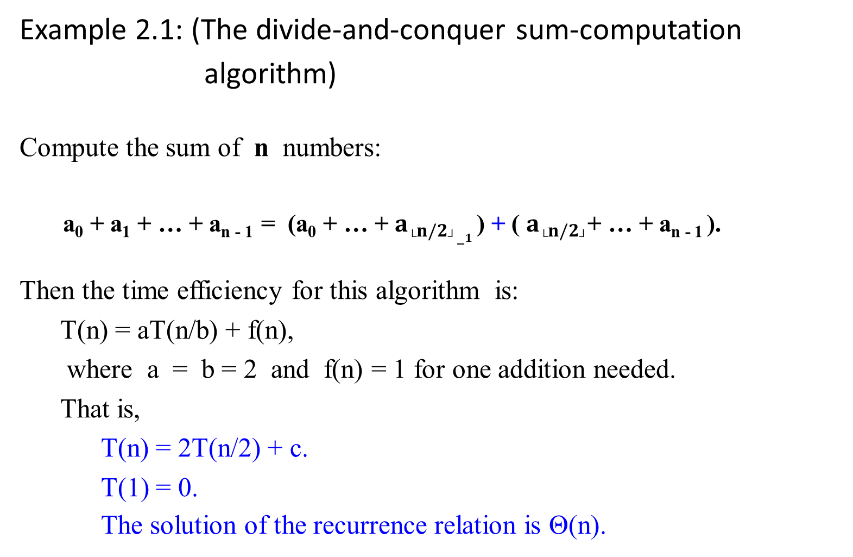
Example 2.1: (The divide-and-conquer sum-computation
algorithm)
Compute the sum of n numbers:
a₀ + a₁ + … + a_{n - 1} = (a₀ + … + $a_{└n/2┘−1}$ ) + ( $a_{└n/2┘}$+ … + a_{n - 1} ).
Then the time efficiency for this algorithm is:
  T(n) = aT(n/b) + f(n),
  where a = b = 2 and f(n) = 1 for one addition needed.
  That is,
    T(n) = 2T(n/2) + c.
    T(1) = 0.
    The solution of the recurrence relation is Θ(n).

Slide 9
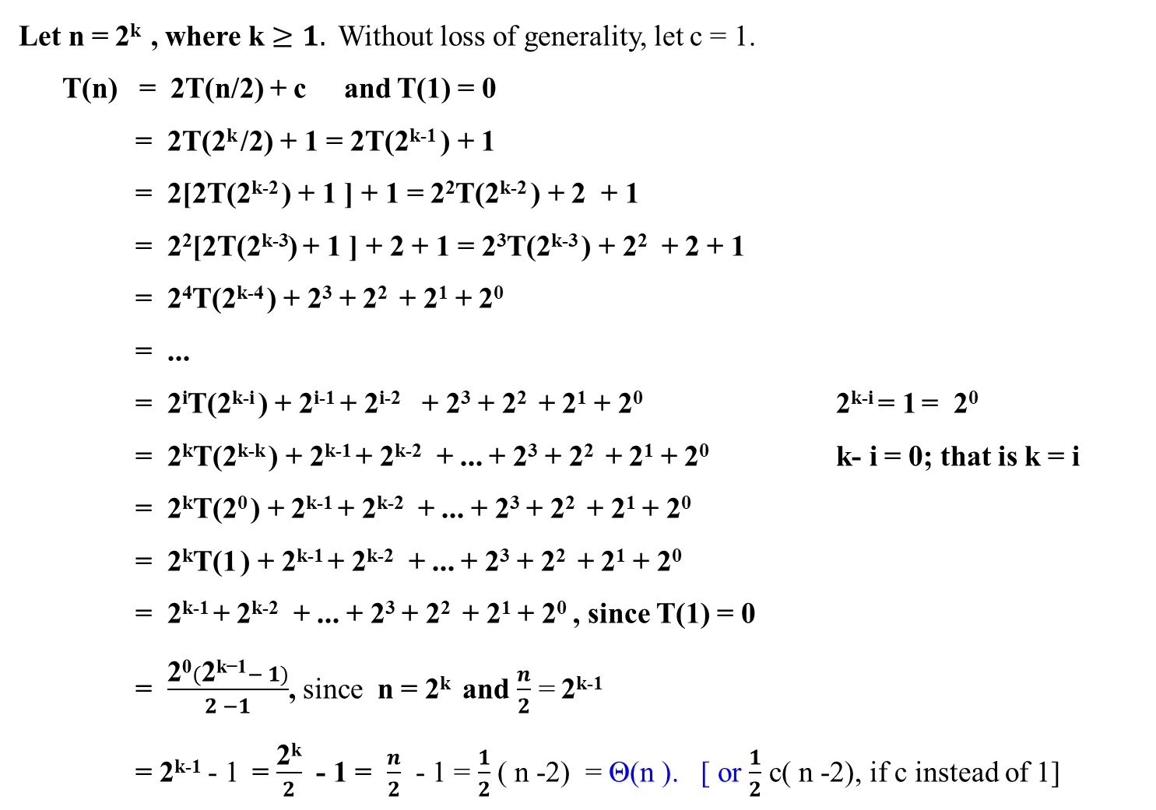
Let n = 2^{k} , where k $≥1.$Without loss of generality, let c = 1.
T(n) = 2T(n/2) + c and T(1) = 0
= 2T(2^{k} /2) + 1 = 2T(2^{k-1} ) + 1
= 2[2T(2^{k-2} ) + 1 ] + 1 = 2²T(2^{k-2} ) + 2 + 1
= 2²[2T(2^{k-3}) + 1 ] + 2 + 1 = 2³T(2^{k-3} ) + 2² + 2 + 1
= 2⁴T(2^{k-4} ) + 2³ + 2² + 2¹ + 2⁰
= ...
= 2^{i}T(2^{k-i} ) + 2^{i-1} + 2^{i-2} + 2³ + 2² + 2¹ + 2⁰ 2^{k-i} = 1 = 2⁰
= 2^{k}T(2^{k-k} ) + 2^{k-1} + 2^{k-2} + ... + 2³ + 2² + 2¹ + 2⁰ k- i = 0; that is k = i
= 2^{k}T(2⁰ ) + 2^{k-1} + 2^{k-2} + ... + 2³ + 2² + 2¹ + 2⁰
= 2^{k}T(1 ) + 2^{k-1} + 2^{k-2} + ... + 2³ + 2² + 2¹ + 2⁰
= 2^{k-1} + 2^{k-2} + ... + 2³ + 2² + 2¹ + 2⁰ , since T(1) = 0
= $\frac{\text{2}\text{0}(\text{2}\text{k}\text{−1}− 1)}{2 −1}$, since n = 2^{k} and $\frac{n}{2}$ = 2^{k-1}
= 2^{k-1} - 1 = $\frac{\text{2}\text{k}}{2}$ - 1 = $\frac{n}{2}$ - 1 = $\frac{1}{2}$ ( n -2) = Θ(n ). [ or $\frac{1}{2}$ c( n -2), if c instead of 1]
What is T(2^{k-1} )?
Since T(n) = 2T(n/2 ) + 1,
T(2^{k-1}) = 2T(2^{k-1} /2 ) + 1, letting n = 2^{k-1}
= 2T(2^{k-2}) + 1.
Likewise,
T(2^{k-2}) = 2T(2^{k-2} /2 ) + 1, letting n = 2^{k-2}
= 2T(2^{k-3}) + 1.
etc.

Slide 10
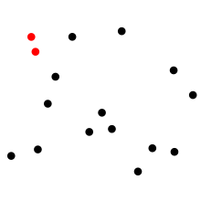
The Closest-Pair Problem
The closest pair of points problem is
a problem of computational geometry:
given n points in metric space, find a pair of points with the smallest distance between them.
T(n) = Θ(n log₂n).

Slide 11

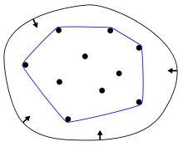
Convex-Hull Problem - quickhull
Given a set X of points in the plane,
the convex hull of the set is
the smallest convex polygon that contains all the points X.
T(n) = Θ(n log₂n).
In mathematics,
the convex hull or convex envelope of a set X of points in the Euclidean plane or in a Euclidean space (or, more generally, in an affine space over the reals) is
the smallest convex set that contains X.

Slide 12

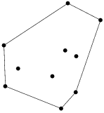
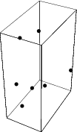
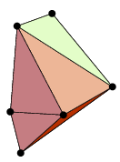
Convex-Hull Problem
Given a set X of points in the plane,
the convex hull of the set is
the smallest convex polygon that contains all the points X.
T(n) = Θ(n log₂n).

Slide 13
Analyzing divide and conquer algorithms, in general:
Let T(n) be the running time on solving a problem of size n.
T(n) takes constant time Θ(1), if the input size is small enough, say n ≤ c for some constant c.
Divide the problem into a subproblems, each of which has n/b, the input size of the original. Let
  take D(n) time to divide the problem into a subproblems of size n/b.
  take T(n/b) to solve one subproblem of size n/b. (conquer)
  take aT(n/b) to find the solution to a subproblems. (conquer)
  take C(n) time to combine the solutions for the subproblems into the solution of the original problem.
The recurrence is obtained:
Θ(1) if n ≤ c,
aT(n/b) + D(n) + C(n) otherwise.
T(n) =

Slide 14
The time efficiency for any of these algorithms is a nontrivial problem:
An example:
Consider the Mergesort Algorithm.
What are the time efficiencies for the Mergesort Algorithm (with Merge Algorithm), which has the following recurrence relation?
  T(n) = 2 T(n/2) + cn.
  T(1) = 0.
Solution: How?
  T(n) = Θ(n log₂n).

Slide 15
Merge-Sort Algorithm
Design a sorting algorithm, using divide-and-conquer technique.
Its worst-case running time is much less than that of insertion sort.

Slide 16
Merge Sort - The Mergesort algorithm
Uses the divide-and-conquer paradigm.
  A successive application of the divide-and-conquer technique.
Sorts a given array A[0 . .n-1] of orderable elements accordingly:
  Divide: Divide n-element array A into two halves
        A[0… └n/2┘ -1] and A[└n/2┘ .. n -1].
        Repeat the process on each of the halves.
  Conquer: For each of the halves, sort the two subarrays recursively
  using Mergesort.
  Combine: Merge the two smaller sorted arrays into a single sorted one.
The key operation of the Mergesort algorithm is the merging of two sorted sequences in the “combine” step.

Slide 17
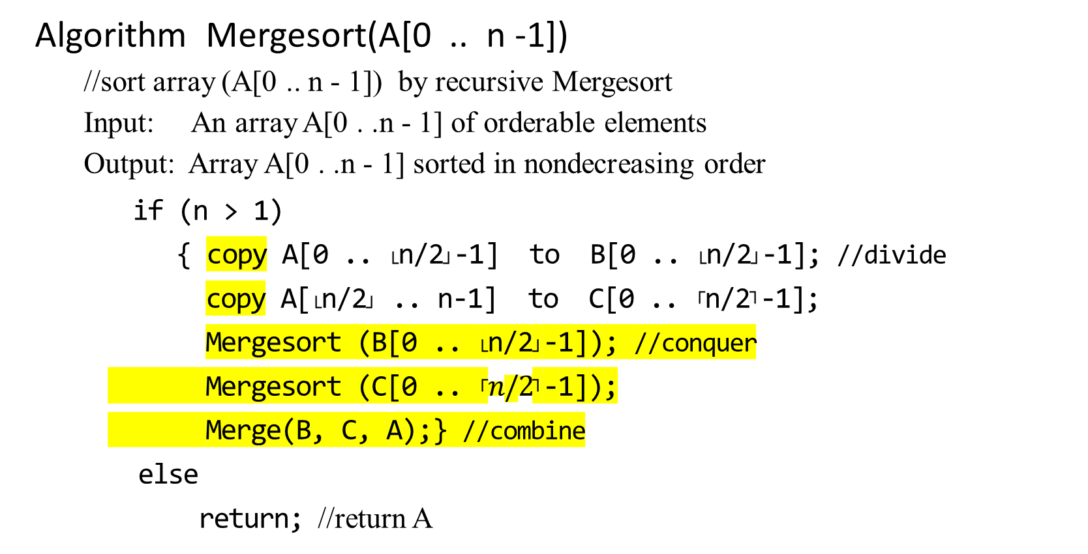
Algorithm Mergesort(A[0 .. n -1])
  //sort array (A[0 .. n - 1]) by recursive Mergesort
  Input: An array A[0 . .n - 1] of orderable elements
  Output: Array A[0 . .n - 1] sorted in nondecreasing order
    if (n > 1)
    { copy A[0 .. └n/2┘-1] to B[0 .. └n/2┘-1]; //divide
    copy A[└n/2┘ .. n-1] to C[0 .. ┌n/2┐-1];
    Mergesort (B[0 .. └n/2┘-1]); //conquer
    Mergesort (C[0 .. ┌$n/2$┐-1]);
    Merge(B, C, A);} //combine
    else
    return; //return A
Why n = 2 as the baseline?
Why copy ?
A[0 .. 12]; i.e., n = 13 elements.
└n/2┘-1 = 6 -1 = 5
┌n/2┐-1 = 7 -1 = 6
B[0 .. 5] and C[0 .. 6]

Slide 18

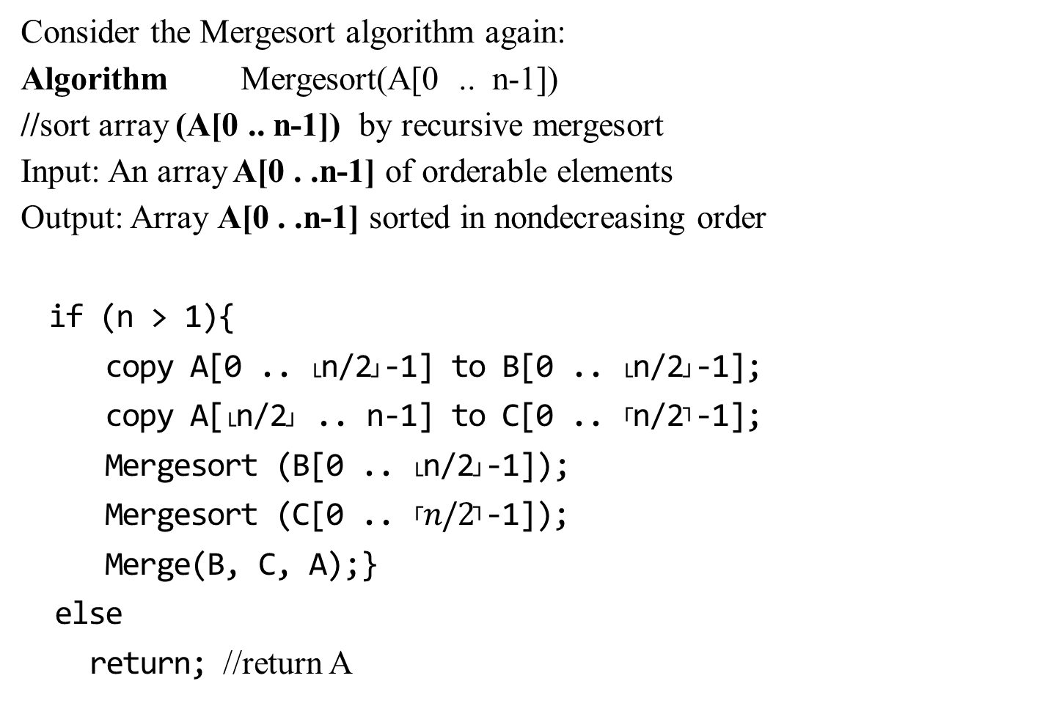
Consider the Mergesort algorithm again:
Algorithm Mergesort(A[0 .. n-1])
//sort array (A[0 .. n-1]) by recursive mergesort
Input: An array A[0 . .n-1] of orderable elements
Output: Array A[0 . .n-1] sorted in nondecreasing order
if (n > 1){
copy A[0 .. └n/2┘-1] to B[0 .. └n/2┘-1];
copy A[└n/2┘ .. n-1] to C[0 .. ┌n/2┐-1];
Mergesort (B[0 .. └n/2┘-1]);
Mergesort (C[0 .. ┌$n/2$┐-1]);
Merge(B, C, A);}
else
return; //return A
A[0] A[1] … A[10], n=11
B[0] … B[4], n = 5
C[0] … C[5], n = 6
B[0] B[1], n = 2
C[0] … C[2], n = 3
B[0], n =1 C[1], n = 1
B[0], n =1 C[0],C[1] n = 2
… …
Merge

Slide 19

Algorithm Merge(B[0 .. p-1] , C[0 .. q-1], A[0 .. p+q-1])
  //Merges two sorted arrays into one sorted array
  Input: Array B[0 .. p-1]) and C[0 .. q-1] both sorted.
  Output: Sorted array A[0 .. p+q-1] of the elements of B and C
    i ← 0; j ← 0; k ← 0;
    while (i < p and j < q) do
    { if (B[i] ≤ C[j])
    { A[k] ← B[i];
    i ← i + 1;}
    else { A[k] ← C[j];
    j ← j + 1;} //end of if-else
    k ← k + 1
    } //end of while-do
    if (i = p)
    copy C[j .. q-1] to A[k .. p+q-1];
    else
    copy B[i .. p-1] to A[k .. p+q-1];
    return;
O(n)
B[..] C[..]
0………i……….p 0 ….. j …………..q
if (B[i] ≤ C[j])
Why copy the remainder?
while j < q do
{
A[k] ← C[j];
j++;
k++;
}
while i < p do
{
A[k] ← B[i];
i++;
k++;
}

Slide 20

Algorithm Merge(B[0 .. p-1] , C[0 .. q-1], A[0 .. p+q-1])
//Merges two sorted arrays into one sorted array
Input: Array B[0 .. p-1]) and C[0 .. q-1] both sorted.
Output: Sorted array A[0 .. p+q-1] of the elements of B and C
//set pointers i, j and k to the first element of B, C and A, respectively.
i ← 0; j ← 0; k ← 0;
while (i < p and j < q) do
{ if (B[i] ≤ C[j])
{ A[k] ← B[i];
i ← i + 1;}
else { A[k] ← C[j];
j ← j + 1;} //end of if-else
k ← k + 1
} //end of while-do
if (i = p)
copy C[j .. q-1] to A[k .. p+q-1];
else
copy B[i .. p-1] to A[k .. p+q-1];
return;
B[0] … B[4], n = 5
…
B[0] B[1], n = 2
C[0] … C[2], n = 3
B[0], n =1 C[1], n = 1
B[0], n =1 C[0], C[1] n = 2
B[0], n =1 C[0] , n = 1
A[0] A[1], p = 2
A[0] A[1], q = 2
A[0] A[1] A[3], q = 4
A[0] A[1] A[3] A[4] A[5], p = 6

Slide 21
Figure 1.4: The operation of merge sort on the array A = <5, 2, 4, 7, 1, 3, 2, 6>. The lengths of the sorted sequences being merged increase as the algorithm progresses from bottom to top. Invoke MERGE_SORT(A, p, r)

Slide 22

1 2 2 3 4 5 6 7
merge
2 4 5 7 1 2 3 6
merge merge
Conquer(sort)
2 5 4 7 1 3 2 6 Combine(merge)
Merge merge merge merge
5 2 4 7 1 3 2 6
5 2 4 7 1 3 2 6
5 2 4 7 1 3 2 6 Call MERGE_SORT to Divide
5 2 4 7 1 3 2 6
Figure 1.4:
8 sorted sequences

Slide 23

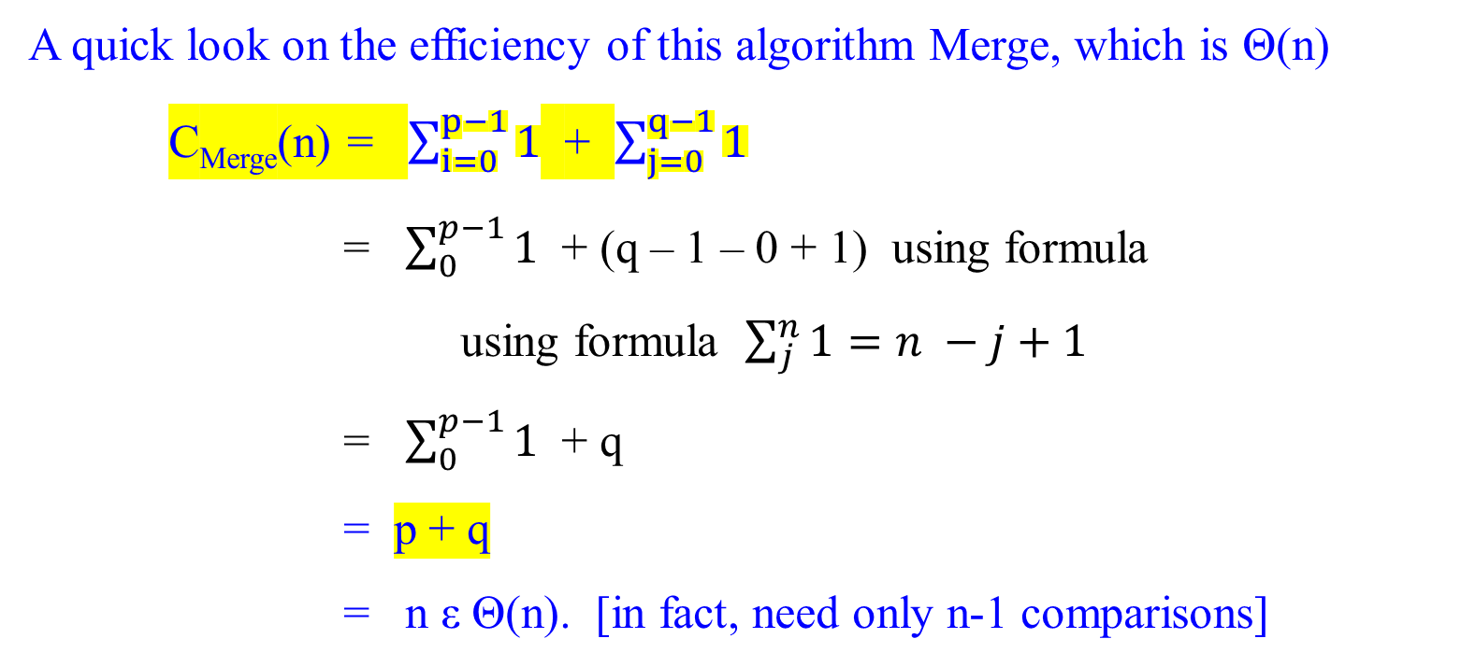
A quick look on the efficiency of this algorithm Merge, which is Θ(n)
C_{Merge}(n) = $\sum_{i=0}^{p−1}{1}$ + $\sum_{j=0}^{q−1}{1}$
= $\sum_{0}^{p−1}{1}$ + (q – 1 – 0 + 1) using formula using formula $\sum_{j}^{n}{1=n −j+1}$
= $\sum_{0}^{p−1}{1}$ + q
= p + q
= n ε Θ(n). [in fact, need only n-1 comparisons]
i ← 0; j ← 0;
while (i < p and j < q) do{ }
In the worse case, merging 1 3 5 7 2 4 6 8
requires 7 comparisons to merge them to yield
1 2 3 4 5 6 7 8_{c}
why add 1?
B has {5678} and C has {12349}. n = 9. comp(5, 1) leads to A ={ 1 }. Comp(5, 2) leads to A={12}. Comp(5, 3) leads toA{123}. Comp(5, 4) leads to A{1234}. Comp(4, 9) leads to A = {12345}. Comp(6, 9) leads to A = {123456}. Comp(7, 9) leads to A = {1234567}. Comp(8, 9) leads to A = {1 2345678}. B is empty, copy(9) into A to have A = {123456789}. Total # of Comp is {9 -1} = n-1.

Slide 24
For the Mergesort algorithm,
Divide: Take constant time to compute the middle of the subarray, D(n) = Θ(1).
Conquer: Take 2T(n/2) for recursively solving (a = 2) two subproblems, each of size n/2.
Combine: The Merge procedure on an n-element subarray takes C_{merge}(n) = Θ(n).
The time efficiency T(n) for Mergesort algorithm is:
0 if n = 1
T(n) =
2T(n/2) + D(n) + C_{merge}(n) if n > 1

Slide 25
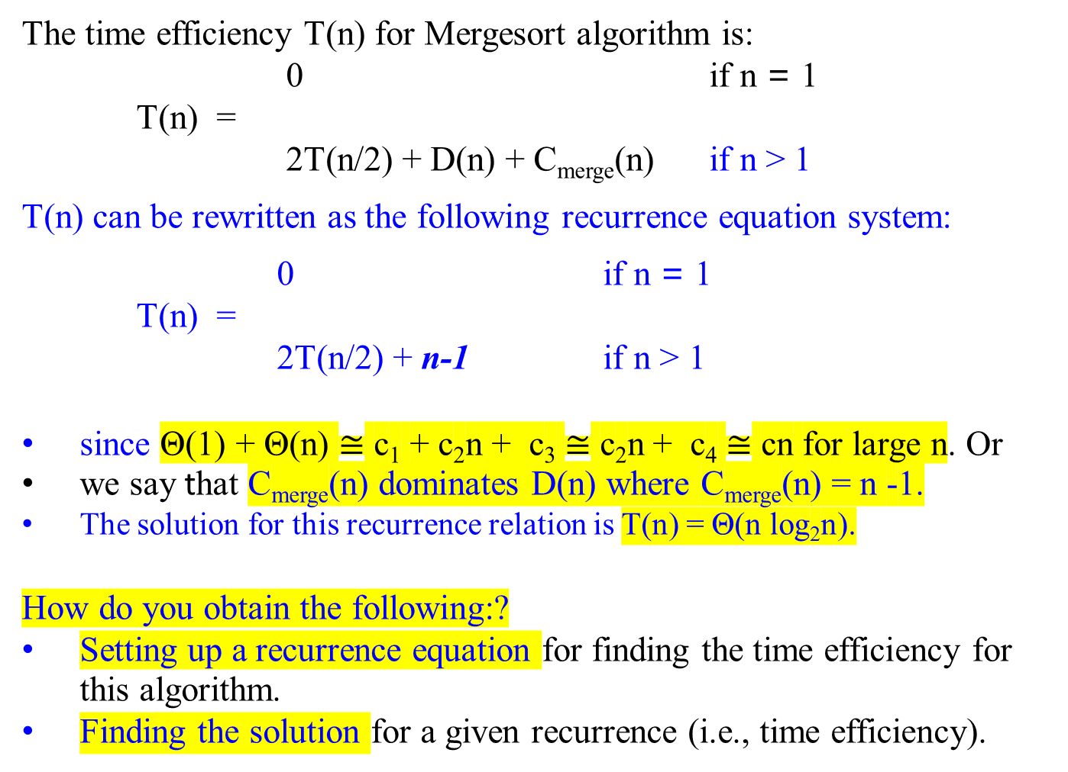
The time efficiency T(n) for Mergesort algorithm is:
0 if n = 1
T(n) =
2T(n/2) + D(n) + C_{merge}(n) if n > 1
T(n) can be rewritten as the following recurrence equation system:
0 if n = 1
T(n) =
2T(n/2) + n-1 if n > 1
since Θ(1) + Θ(n) $≅$ c₁ + c₂n + c₃ $≅$ c₂n + c₄ $≅$ cn for large n. Or
we say that C_{merge}(n) dominates D(n) where C_{merge}(n) = n -1.
The solution for this recurrence relation is T(n) = Θ(n log₂n).
How do you obtain the following:?
Setting up a recurrence equation for finding the time efficiency for this algorithm.
Finding the solution for a given recurrence (i.e., time efficiency).

Slide 26
For the Mergesort algorithm,
we can show that T(n) = Θ(n log₂ n).
Mergesort outperforms insertion sort with a running time Θ(n²)

Slide 27

How do you solve any given recurrence equation?
How do you find the order of growth of solution T(n) in terms of ϴ, O, and Ω?
  Backward substitution
  Master Theorem
  Others

Slide 28
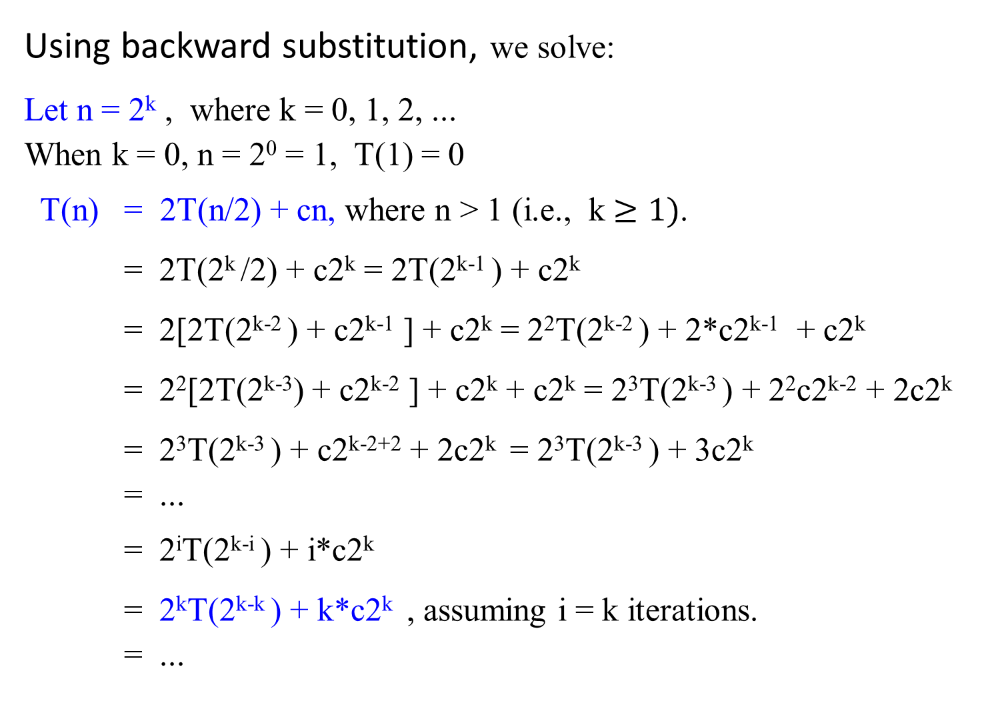
Using backward substitution, we solve:
Let n = 2^{k} , where k = 0, 1, 2, ...
When k = 0, n = 2⁰ = 1, T(1) = 0
T(n) = 2T(n/2) + cn, where n > 1 (i.e., k $≥1)$.
= 2T(2^{k} /2) + c2^{k} = 2T(2^{k-1} ) + c2^{k}
= 2[2T(2^{k-2} ) + c2^{k-1} ] + c2^{k} = 2²T(2^{k-2} ) + 2*c2^{k-1} + c2^{k}
= 2²[2T(2^{k-3}) + c2^{k-2} ] + c2^{k} + c2^{k} = 2³T(2^{k-3} ) + 2²c2^{k-2} + 2c2^{k}
= 2³T(2^{k-3} ) + c2^{k-2+2} + 2c2^{k} = 2³T(2^{k-3} ) + 3c2^{k}
= ...
= 2^{i}T(2^{k-i} ) + i*c2^{k}
= 2^{k}T(2^{k-k} ) + k*c2^{k} , assuming i = k iterations.
= ...
T(n) = 2T(n/2) + n-1 if n > 1
T(1) = 0

Slide 29

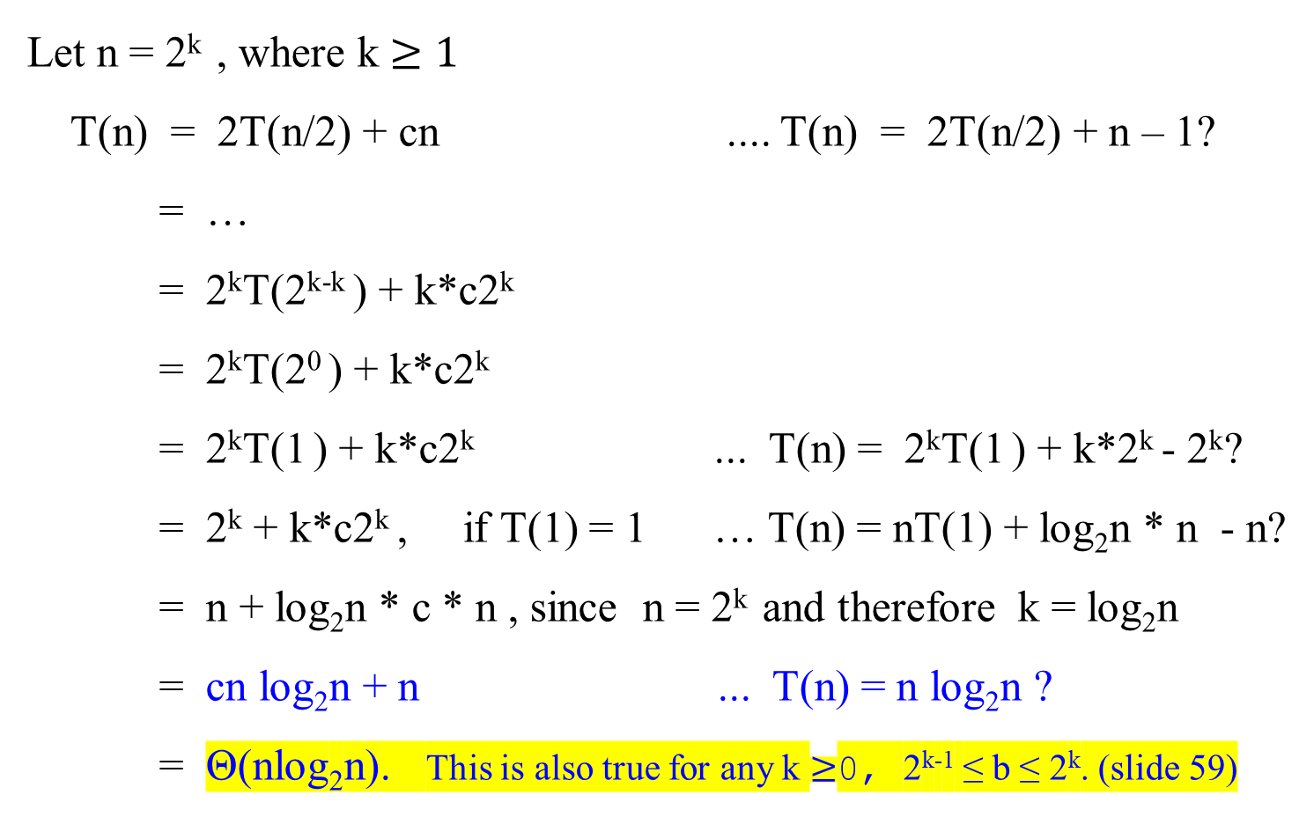
Let n = 2^{k} , where k $≥1$
T(n) = 2T(n/2) + cn .... T(n) = 2T(n/2) + n – 1?
= …
= 2^{k}T(2^{k-k} ) + k*c2^{k}
= 2^{k}T(2⁰ ) + k*c2^{k}
= 2^{k}T(1 ) + k*c2^{k} ... T(n) = 2^{k}T(1 ) + k*2^{k} - 2^{k}?
= 2^{k} + k*c2^{k} , if T(1) = 1 … T(n) = nT(1) + log₂n * n - n?
= n + log₂n * c * n , since n = 2^{k} and therefore k = log₂n
= cn log₂n + n ... T(n) = n log₂n ?
= Θ(nlog₂n). This is also true for any k $≥$0, 2^{k-1} ≤ b ≤ 2^{k}. (slide 59)

Slide 30
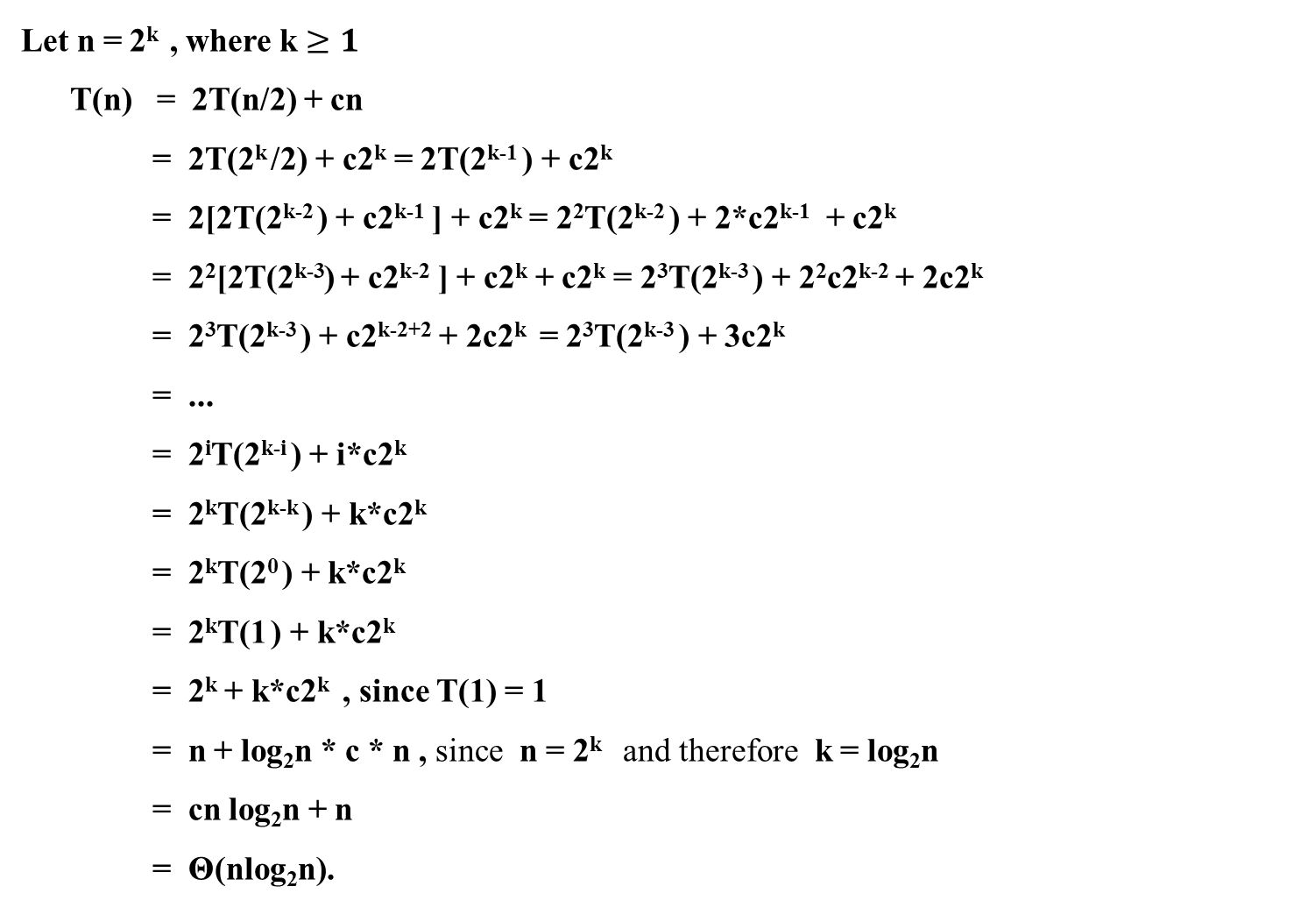
Let n = 2^{k} , where k $≥1$
T(n) = 2T(n/2) + cn
= 2T(2^{k} /2) + c2^{k} = 2T(2^{k-1} ) + c2^{k}
= 2[2T(2^{k-2} ) + c2^{k-1} ] + c2^{k} = 2²T(2^{k-2} ) + 2*c2^{k-1} + c2^{k}
= 2²[2T(2^{k-3}) + c2^{k-2} ] + c2^{k} + c2^{k} = 2³T(2^{k-3} ) + 2²c2^{k-2} + 2c2^{k}
= 2³T(2^{k-3} ) + c2^{k-2+2} + 2c2^{k} = 2³T(2^{k-3} ) + 3c2^{k}
= ...
= 2^{i}T(2^{k-i} ) + i*c2^{k}
= 2^{k}T(2^{k-k} ) + k*c2^{k}
= 2^{k}T(2⁰ ) + k*c2^{k}
= 2^{k}T(1 ) + k*c2^{k}
= 2^{k} + k*c2^{k} , since T(1) = 1
= n + log₂n * c * n , since n = 2^{k} and therefore k = log₂n
= cn log₂n + n
= Θ(nlog₂n).
For ease of reading, the previous two slides combine into one displayed in this slide:

Slide 31

T(n) = 2T(n/2) + n-1 if n > 1
T(1) = 0
Using Mathematical induction, show that
when n is an exact power of 2, the solution of the recurrence
0 or 2 if n = 1 or 2, respectively
T(n) =
2T(n/2) + n if n = 2^{k} , for k > 1
is T(n) = n log₂n.

Slide 32

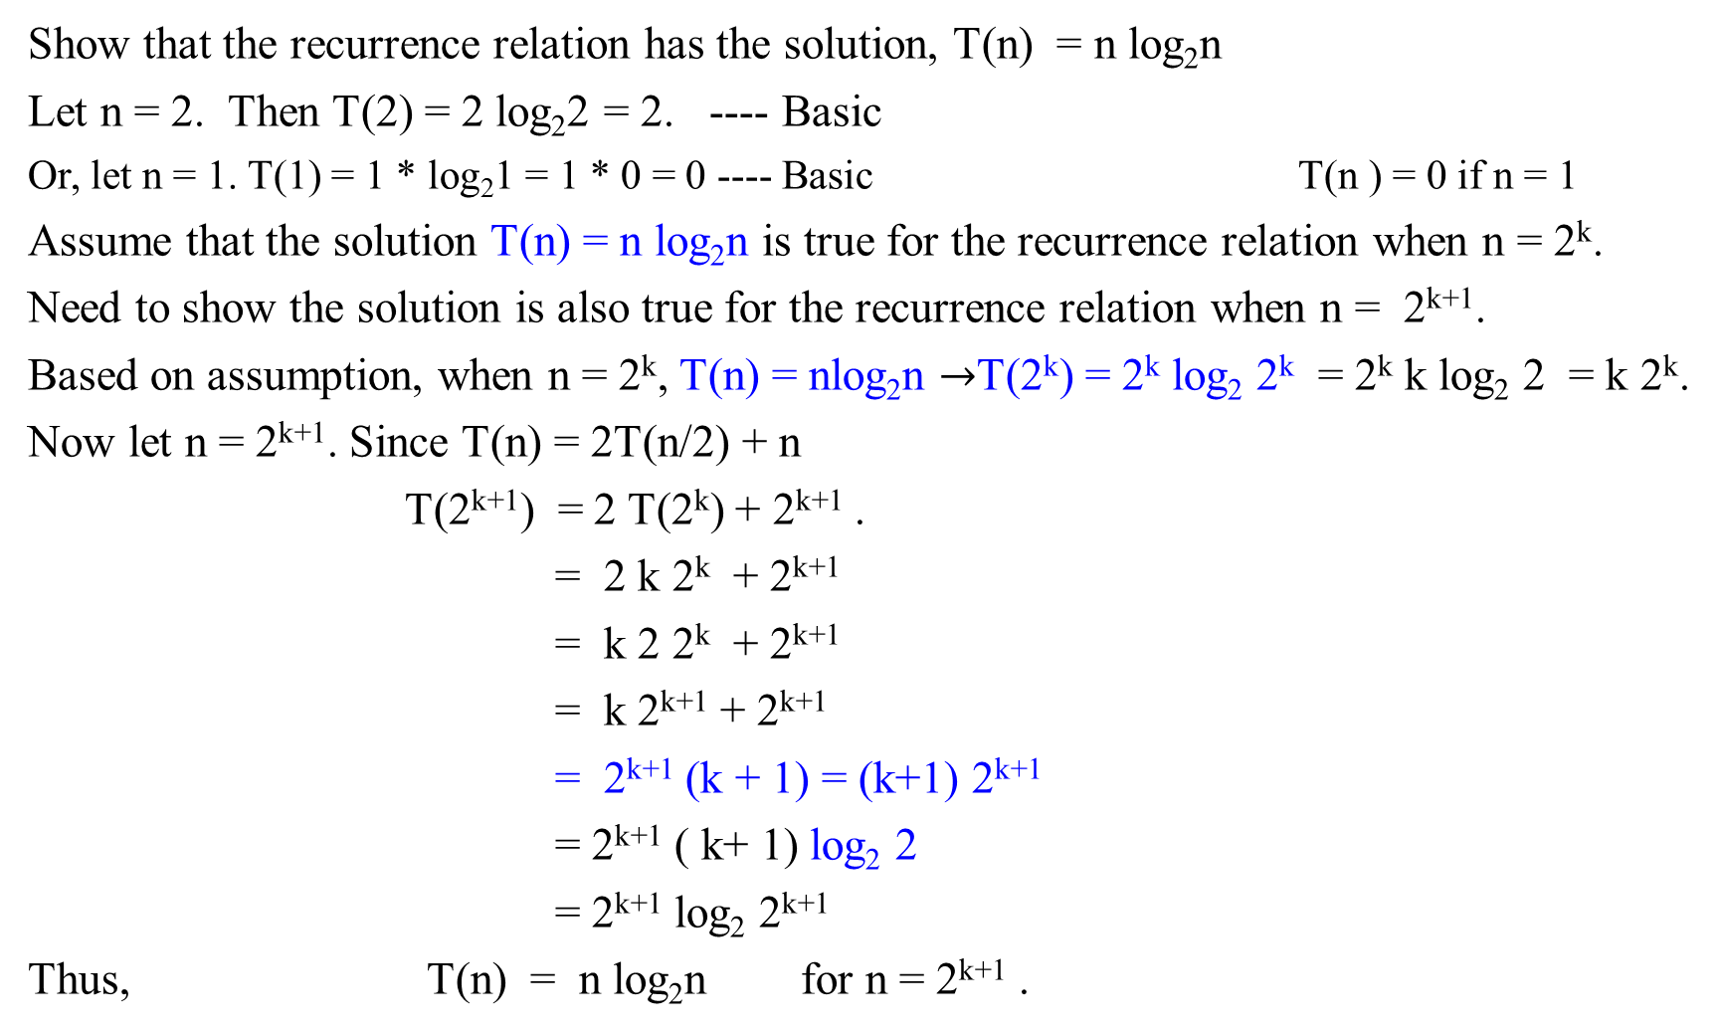
Show that the recurrence relation has the solution, T(n) = n log₂n
Let n = 2. Then T(2) = 2 log₂2 = 2. ---- Basic
Or, let n = 1. T(1) = 1 * log₂1 = 1 * 0 = 0 ---- Basic T(n ) = 0 if n = 1
Assume that the solution T(n) = n log₂n is true for the recurrence relation when n = 2^{k}.
Need to show the solution is also true for the recurrence relation when n = 2^{k+1}.
Based on assumption, when n = 2^{k}, T(n) = nlog₂n $→$T(2^{k}) = 2^{k} log₂ 2^{k} = 2^{k} k log₂ 2 = k 2^{k}.
Now let n = 2^{k+1}. Since T(n) = 2T(n/2) + n
T(2^{k+1}) = 2 T(2^{k}) + 2^{k+1} .
= 2 k 2^{k} + 2^{k+1}
= k 2 2^{k} + 2^{k+1}
= k 2^{k+1} + 2^{k+1}
= 2^{k+1} (k + 1) = (k+1) 2^{k+1}
= 2^{k+1} ( k+ 1) log₂ 2
= 2^{k+1} log₂ 2^{k+1}
Thus, T(n) = n log₂n for n = 2^{k+1} .
T(n) = 2, if n = 2
T(n) = 2T(n/2) + n if n = 2^{k}

Slide 33
Solving Recurrence Relations
Backward substitution
Master Theorem

Slide 34

Recurrence Relations
Divide a problem’s instance of size n into b instances of size, n/b, with a of them needing to be solved, for the constants a ≥ 1 and b > 1.
For simplifying the analysis, assuming that
  the input size n = b^{k}, a power of b, k = 0, 1, 2, ….
  The general divide-and-conquer recurrence for its running time T(n):
T(n) = aT(n/b) + f(n), …………………(2.1)
where
    a ≥ 1, b > 1 and
    f(n) is a function that accounts for the time spent on, such as dividing the problem into smaller ones and combining their solutions.
From (2.1), the solution T(n) is the order of growth depends on
  the values of the constants a and b and
  the order of growth of the function f(n).

Slide 35
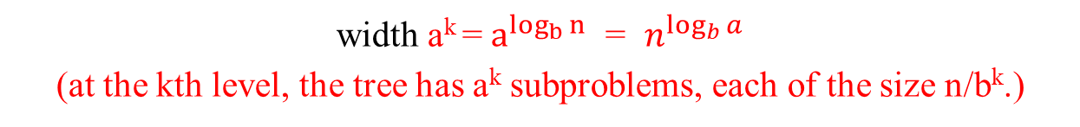
Recurrence Relations
Figure 2.2-2.3 Each problem of size n is divided into a subproblems of size n/b
size n
size n/b
Branching factor a
size n/b²
a²
n = b^{k}
depth k = log_{b}n
. . .
. . .
size 1 = n/b^{k}
width a^{k} = $a^{\log_{b}{n}}$ = $n^{\log_{b}{a}}$
(at the kth level, the tree has a^{k} subproblems, each of the size n/b^{k}.)

Slide 36
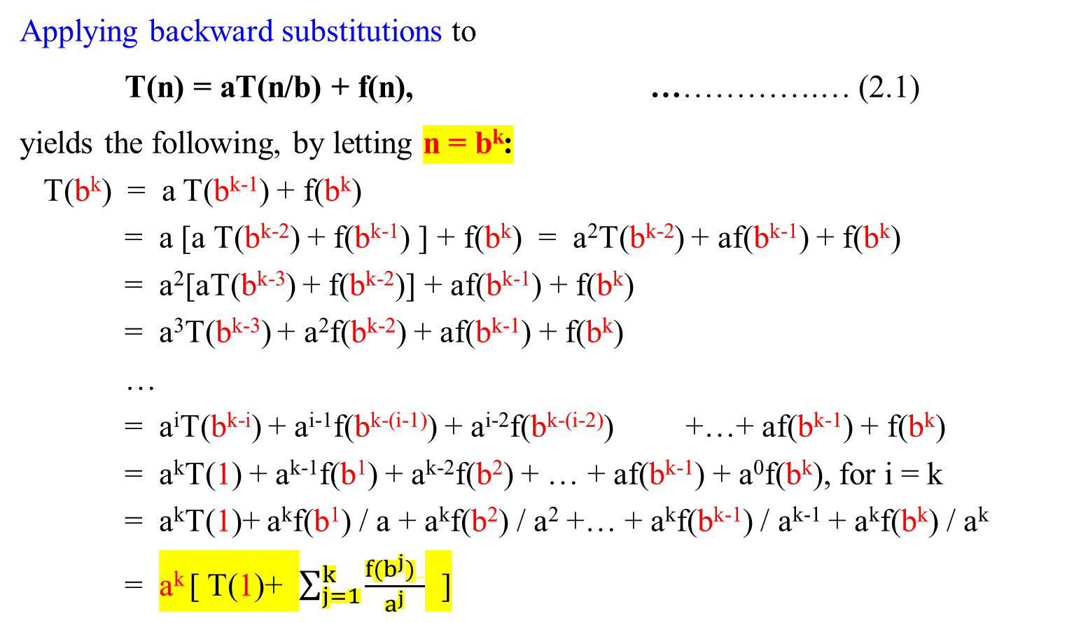
  Backward substitution
Applying backward substitutions to
T(n) = aT(n/b) + f(n), …………….… (2.1)
yields the following, by letting n = b^{k}:
T(b^{k}) = a T(b^{k-1}) + f(b^{k})
= a [a T(b^{k-2}) + f(b^{k-1}) ] + f(b^{k}) = a²T(b^{k-2}) + af(b^{k-1}) + f(b^{k})
= a²[aT(b^{k-3}) + f(b^{k-2})] + af(b^{k-1}) + f(b^{k})
= a³T(b^{k-3}) + a²f(b^{k-2}) + af(b^{k-1}) + f(b^{k})
…
= a^{i}T(b^{k-i}) + a^{i-1}f(b^{k-(i-1)}) + a^{i-2}f(b^{k-(i-2)}) +…+ af(b^{k-1}) + f(b^{k})
= a^{k}T(1) + a^{k-1}f(b¹) + a^{k-2}f(b²) + … + af(b^{k-1}) + a⁰f(b^{k}), for i = k
= a^{k}T(1)+ a^{k}f(b¹) / a + a^{k}f(b²) / a² +… + a^{k}f(b^{k-1}) / a^{k-1} + a^{k}f(b^{k}) / a^{k}
= a^{k} [ T(1)+ $\sum_{j=1}^{k}{\frac{f(b^{j}) }{a^{j}}}$ ]

Slide 37
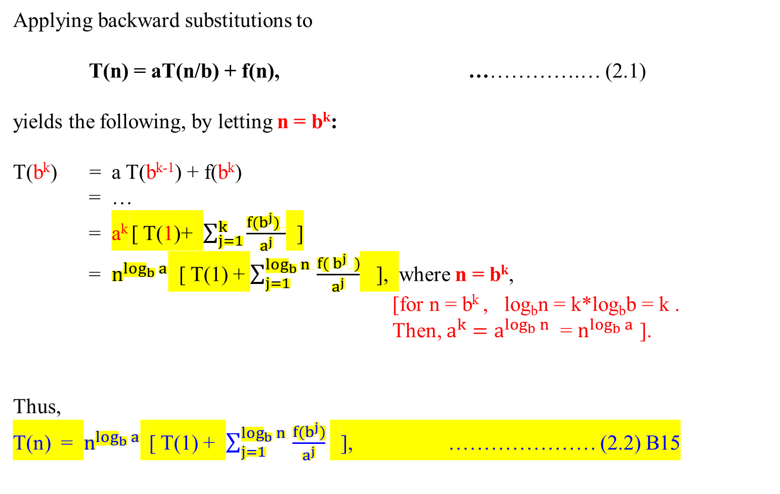
Applying backward substitutions to
T(n) = aT(n/b) + f(n), …………….… (2.1)
yields the following, by letting n = b^{k}:
T(b^{k}) = a T(b^{k-1}) + f(b^{k})
= …
= a^{k} [ T(1)+ $\sum_{j=1}^{k}{\frac{f(b^{j}) }{a^{j}}}$ ]
= $n^{\log_{b}{a}}$ [ T(1) + $\sum_{j=1}^{\log_{b}{n} }{\frac{f( b^{j} )}{a^{j}}}$ ], where n = b^{k},
[for n = b^{k} , log_{b}n = k*log_{b}b = k .
Then, $a^{k}=a^{\log_{b}{n}}$ = $n^{\log_{b}{a}}$ ].
Thus,
T(n) = $n^{\log_{b}{a}}$ [ T(1) + $\sum_{j=1}^{\log_{b}{n} }{\frac{f(b^{j})}{a^{j}}}$ ], ………………… (2.2) B15

Slide 38
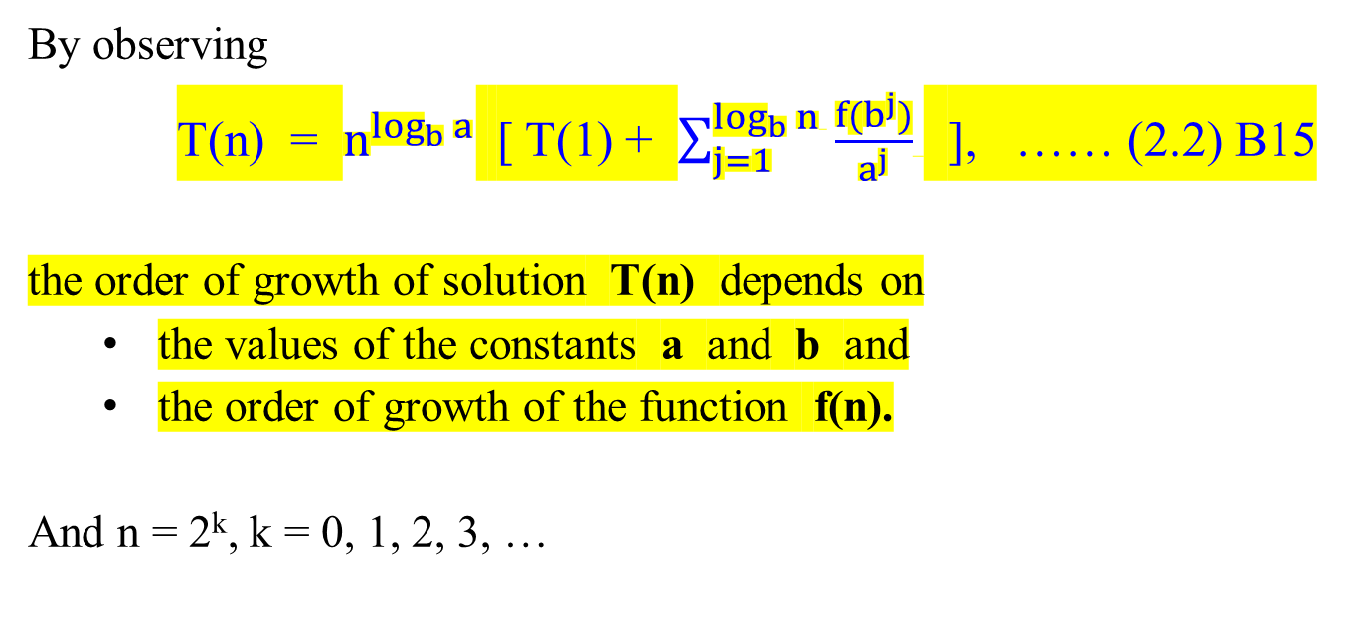
  Backward substitution
By observing
T(n) = $n^{\log_{b}{a}}$ [ T(1) + $\sum_{j=1}^{\log_{b}{n} }{\frac{f(b^{j})}{a^{j}}}$ ], …… (2.2) B15
the order of growth of solution T(n) depends on
  the values of the constants a and b and
  the order of growth of the function f(n).
And n = 2^{k}, k = 0, 1, 2, 3, …

Slide 39
Natural Numbers
Counting Numbers
The numbers used for counting. That is, the numbers 1, 2, 3, 4, etc.
Natural numbers is also called positive integers
Whole numbers is also called non-negative integers.

Slide 40
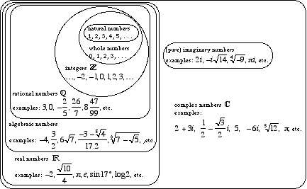

Slide 41

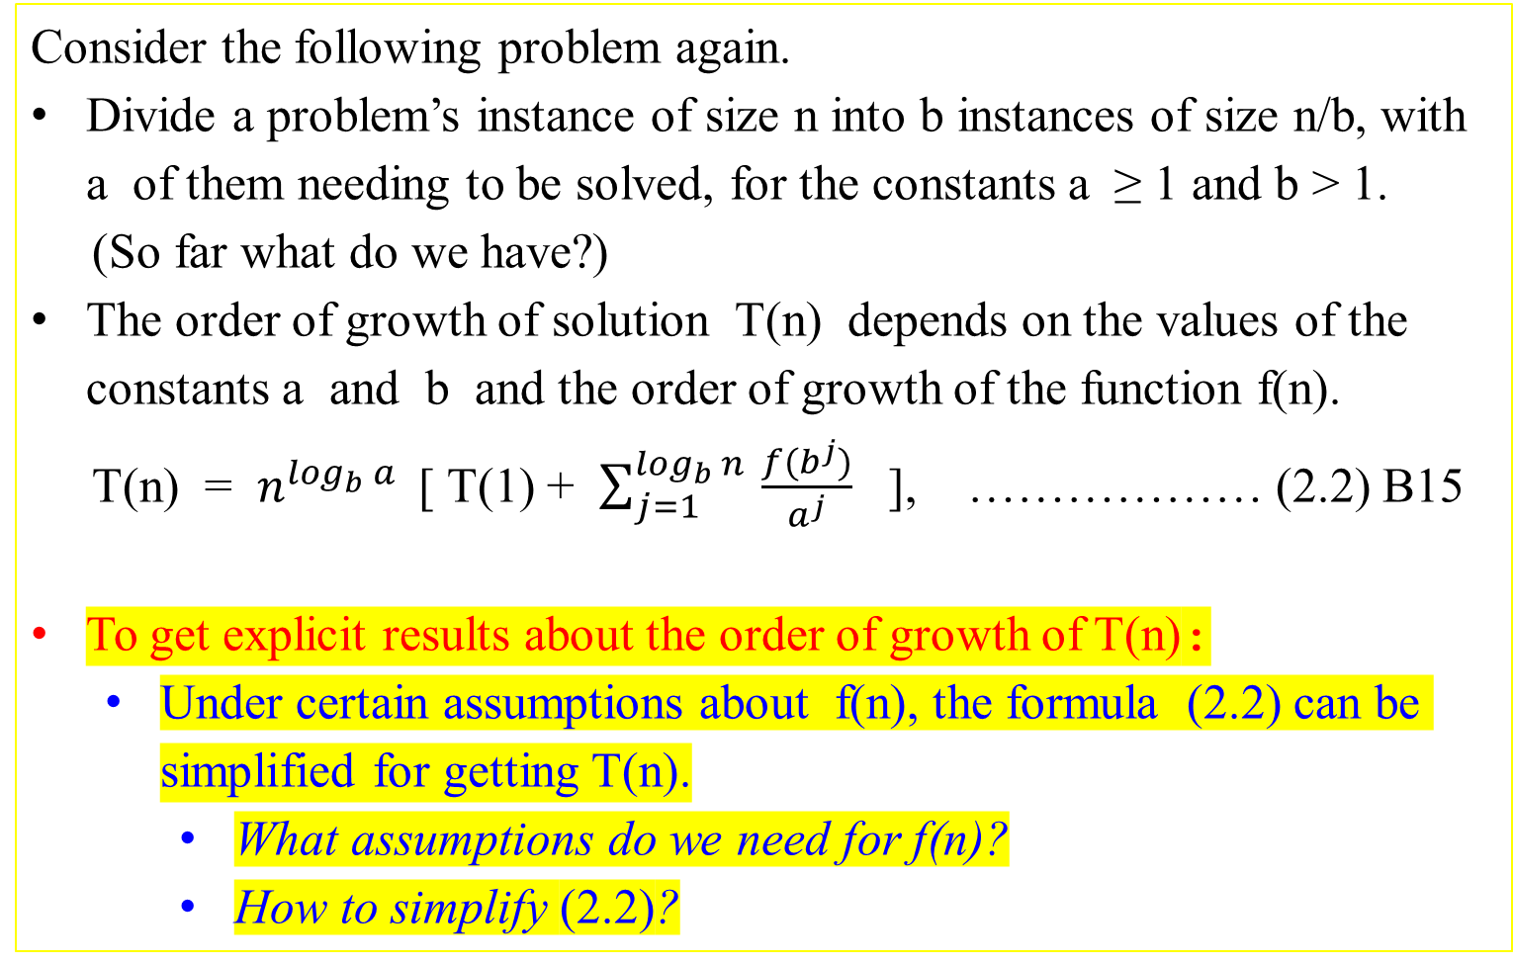
Consider the following problem again.
Divide a problem’s instance of size n into b instances of size n/b, with a of them needing to be solved, for the constants a ≥ 1 and b > 1.
(So far what do we have?)
The order of growth of solution T(n) depends on the values of the constants a and b and the order of growth of the function f(n).
T(n) = $n^{\log_{b}{a}}$ [ T(1) + $\sum_{j=1}^{\log_{b}{n} }{\frac{f(b^{j})}{a^{j}}}$ ], ……………… (2.2) B15
To get explicit results about the order of growth of T(n):
  Under certain assumptions about f(n), the formula (2.2) can be simplified for getting T(n).
    What assumptions do we need for f(n)?
    How to simplify (2.2)?

Slide 42
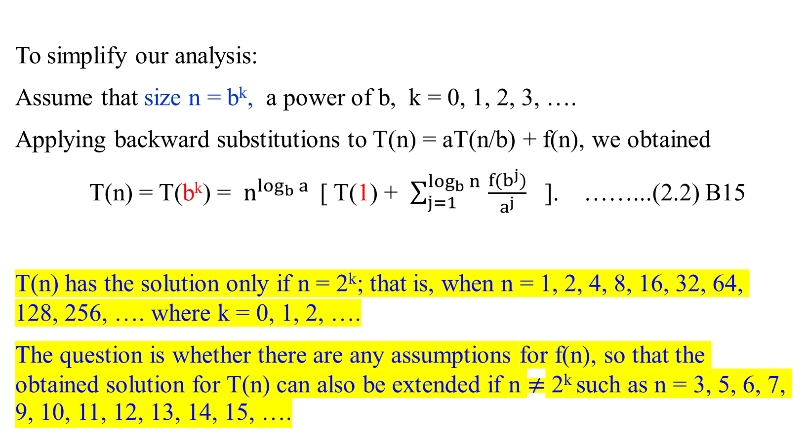
To simplify our analysis:
Assume that size n = b^{k}, a power of b, k = 0, 1, 2, 3, ….
Applying backward substitutions to T(n) = aT(n/b) + f(n), we obtained
T(n) = T(b^{k}) = $n^{\log_{b}{a}}$ [ T(1) + $\sum_{j=1}^{\log_{b}{n} }{\frac{f(b^{j})}{a^{j}}}$ ]. ……...(2.2) B15
T(n) has the solution only if n = 2^{k}; that is, when n = 1, 2, 4, 8, 16, 32, 64, 128, 256, …. where k = 0, 1, 2, ….
The question is whether there are any assumptions for f(n), so that the obtained solution for T(n) can also be extended if n $≠$ 2^{k} such as n = 3, 5, 6, 7, 9, 10, 11, 12, 13, 14, 15, ….
summary

Slide 43

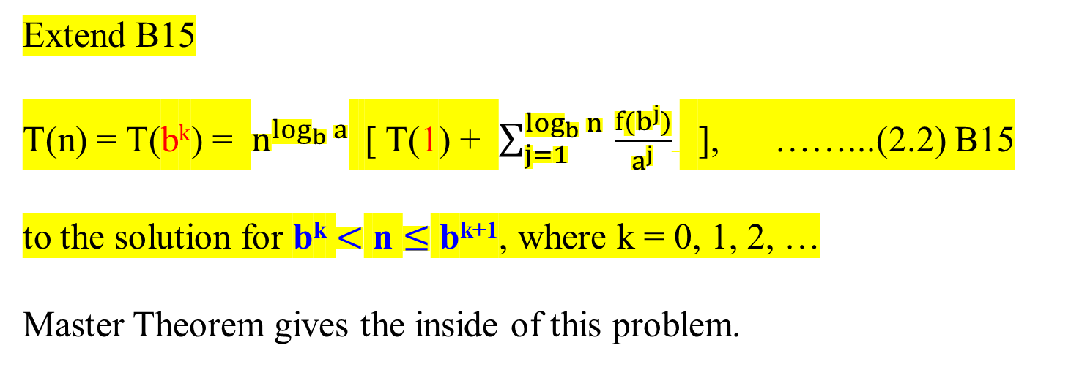
Extend B15
T(n) = T(b^{k}) = $n^{\log_{b}{a}}$ [ T(1) + $\sum_{j=1}^{\log_{b}{n} }{\frac{f(b^{j})}{a^{j}}}$ ], ……...(2.2) B15
to the solution for b^{k} $<$ n $≤$ b^{k+1}, where k = 0, 1, 2, …
Master Theorem gives the inside of this problem.
v

Slide 44
Definition 2.1: (Eventually Non-decreasing)
Let f(n) be a nonnegative function defined on the set of natural numbers, {1, 2, 3, …}.
f(n) is called eventually non-decreasing if there exists some nonnegative integers n₀ so that f(n) is non-decreasing on the interval [n₀ , ∞), i.e.,
f(n₁) ≤ f(n₂) for any n₁ and n₂, 0 ≤ n₀ ≤ n₁ < n₂ < ∞.
f(n)
f(n₂)
f(n₁)
n
n₀ n₁ n₂

Slide 45
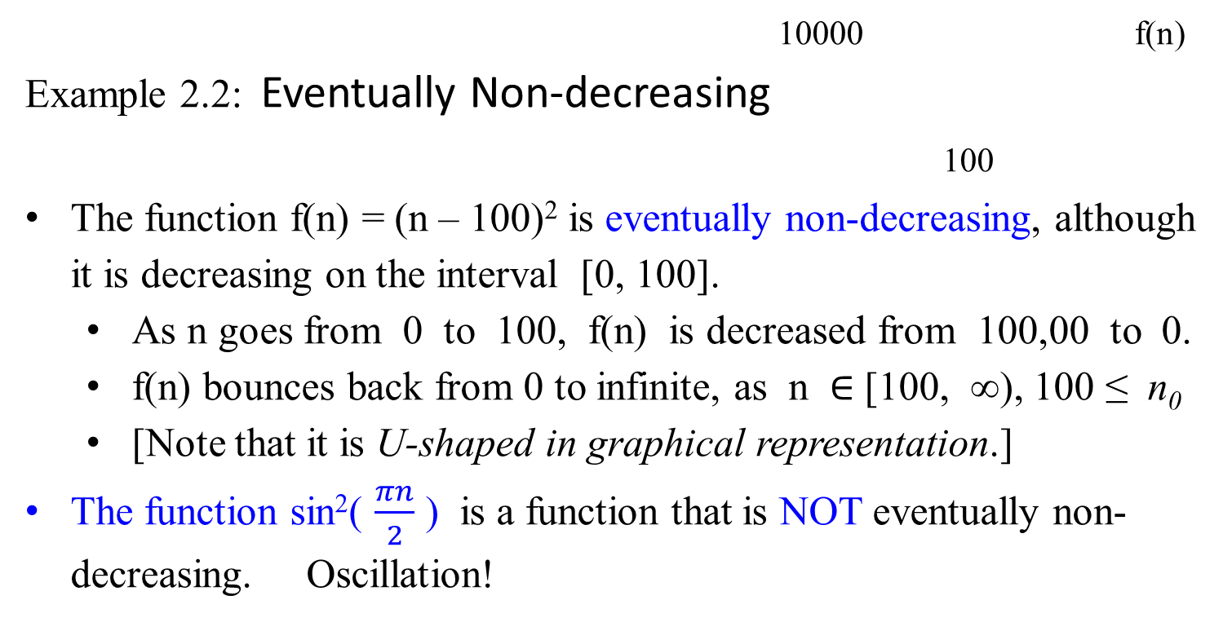
10000 f(n)
Example 2.2: Eventually Non-decreasing
100
The function f(n) = (n – 100)² is eventually non-decreasing, although it is decreasing on the interval [0, 100].
  As n goes from 0 to 100, f(n) is decreased from 100,00 to 0.
  f(n) bounces back from 0 to infinite, as n $∈$ [100, ∞), 100 ≤ n₀
  [Note that it is U-shaped in graphical representation.]
The function sin²( $\frac{πn}{2}$ ) is a function that is NOT eventually non-decreasing. Oscillation!

Slide 46
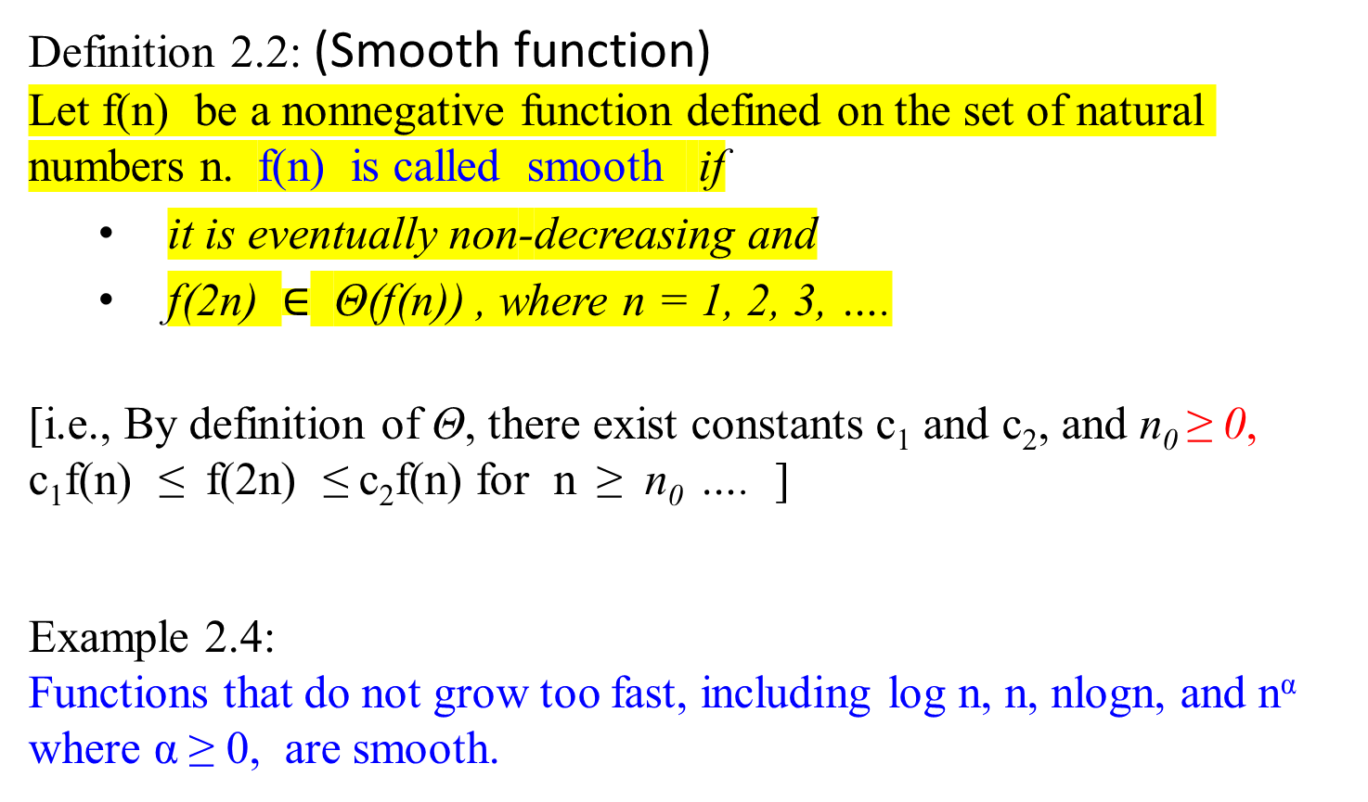
Definition 2.2: (Smooth function)
Let f(n) be a nonnegative function defined on the set of natural numbers n. f(n) is called smooth if
  it is eventually non-decreasing and
  f(2n) $∈$ Θ(f(n)) , where n = 1, 2, 3, ….
[i.e., By definition of Θ, there exist constants c₁ and c₂, and n₀ ≥ 0,
c₁f(n) ≤ f(2n) ≤ c₂f(n) for n ≥ n₀ …. ]
Example 2.4:
Functions that do not grow too fast, including log n, n, nlogn, and n^{α} where α ≥ 0, are smooth.

Slide 47
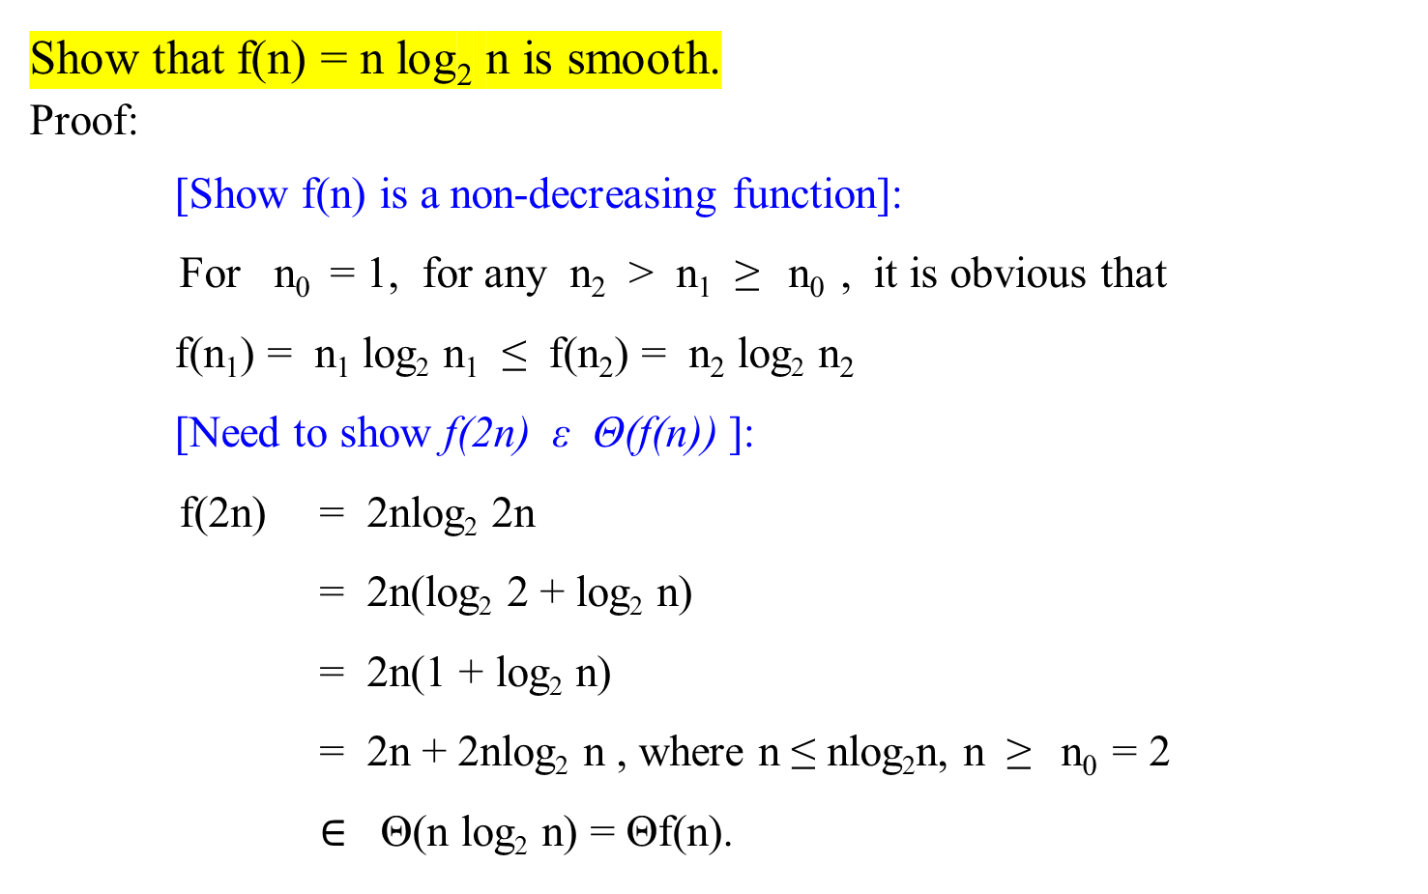
Smooth function
Show that f(n) = n log₂ n is smooth.
Proof:
[Show f(n) is a non-decreasing function]:
For n₀ = 1, for any n₂ > n₁ ≥ n₀ , it is obvious that
f(n₁) = n₁ log₂ n₁ ≤ f(n₂) = n₂ log₂ n₂
[Need to show f(2n) ε Θ(f(n)) ]:
f(2n) = 2nlog₂ 2n
= 2n(log₂ 2 + log₂ n)
= 2n(1 + log₂ n)
= 2n + 2nlog₂ n , where n ≤ nlog₂n, n ≥ n₀ = 2
$∈$ Θ(n log₂ n) = Θf(n).

Slide 48
Smooth function
Show that f(n) = n log₂ n is smooth.
Proof:
[Show f(n) is a non-decreasing function]:
…
Another way to show that f(2n) ε Θ(f(n)) is by using the definition of ϴ.
[There exist constants c₁= 2 and c₂ = 4 such that c₁(n log n) ≤
(f(2n) = 2nlog₂ 2n) ≤ c₂(n log₂ n)], according to definition of ϴ.
{2nlog₂2n = 2n(log₂ 2 + log₂ n)
= 2n(1 + log₂ n)
= 2n + 2nlog₂ n ≤ 4nlog₂ n since n < nlog₂ n. Likewise, we can claim that 2nlog₂n ≤ 2n + 2nlog₂n }]

Slide 49
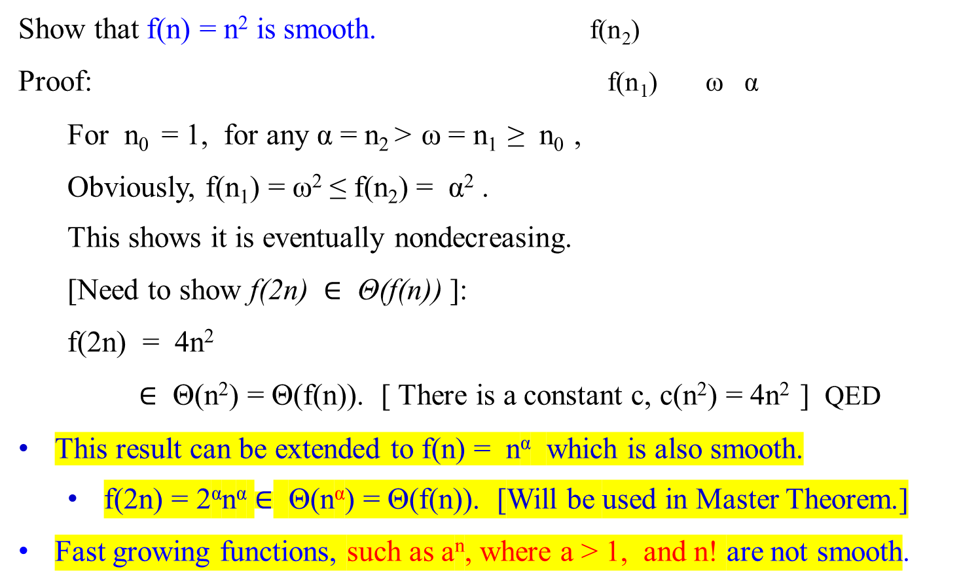
f(2n) = 4n²
Smooth function
f(n) = n²
Show that f(n) = n² is smooth. f(n₂)
Proof: f(n₁) ω α
For n₀ = 1, for any α = n₂ > ω = n₁ ≥ n₀ ,
Obviously, f(n₁) = ω² ≤ f(n₂) = α² .
This shows it is eventually nondecreasing.
[Need to show f(2n) $∈$ Θ(f(n)) ]:
f(2n) = 4n²
$∈$ Θ(n²) = Θ(f(n)). [ There is a constant c, c(n²) = 4n² ] QED
This result can be extended to f(n) = n^{α} which is also smooth.
  f(2n) = 2^{α}n^{α} $∈$ Θ(n^{α}) = Θ(f(n)). [Will be used in Master Theorem.]
Fast growing functions, such as a^{n}, where a > 1, and n! are not smooth.

Slide 50

Smooth function
Example 2.5:
Show that f(n) = 2^{n} is NOT smooth.
Proof:
f(n) is a nondecreasing function, since for n₀ = 0, α = n₂ > ω = n₁ ≥ n₀, it is obvious that f(n₁) = 2^{ω} ≤ f(n₂) = 2 ^{α}.
But it does not satisfy f(2n) ε Θ(f(n)), since
f(2n) = 2^{2n}
= (2² )^{n} = (4^{n}), since x^{mn} = (x^{m})^{n} = (x^{n})^{m}
= (2^{n} ) ² = 2^{n} 2^{n} , which is not Θ(2^{n}) (i.e., not Θ(f(n)) . [There is no constant c, such that c ≥ 2^{n} , or c2^{n} ≥ (2^{n} 2^{n})]
Note that a^{mn} = (a^{m} )^{n} = a^{nm}
a^{m} a^{n} = a^{m + n}

Slide 51
Smooth function
Example 2.6:
Show that f(n) = a^{n} is NOT smooth.
Proof:
It is eventually nondecreasing, since for n₀ = 1, α = n₂ > ω = n₁ ≥ n₀. It is obvious that f(n₁) = a^{ω} ≤ f(n₂) = a^{α}.
But it does not satisfy f(2n) ε Θ(f(n)), since
f(2n) = a^{2n}
= a^{n2}
= ( a^{n} ) ², which is not Θ(a^{n}) = Θf(n). [There is no constant c, c(a^{n}) ≥ ( a^{n} ) ² ]
That is, f(2n) cannot be Θf(n).

Slide 52

Smooth function
From these examples:
f(2n) cannot be Θ(f(n)), if f(n) is not smooth, otherwise
f(2n) = Θ(f(n)), if f(n) is smooth.
Then, if f(n) is smooth, will f(bn) be bounded by Θ(f(n)), for b = 3, 4, 5, 6, 7, 8, 9, 10, ….?

Slide 53
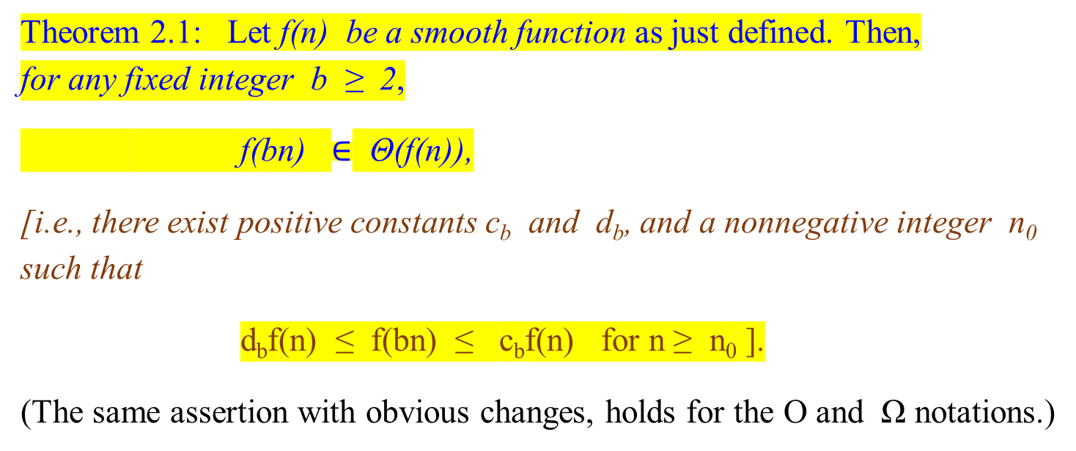
Smooth function
Theorem 2.1: Let f(n) be a smooth function as just defined. Then,
for any fixed integer b ≥ 2,
f(bn) $∈$ Θ(f(n)),
[i.e., there exist positive constants c_{b} and d_{b}, and a nonnegative integer n₀ such that
d_{b}f(n) ≤ f(bn) ≤ c_{b}f(n) for n ≥ n₀ ].
(The same assertion with obvious changes, holds for the O and Ω notations.)

Slide 54
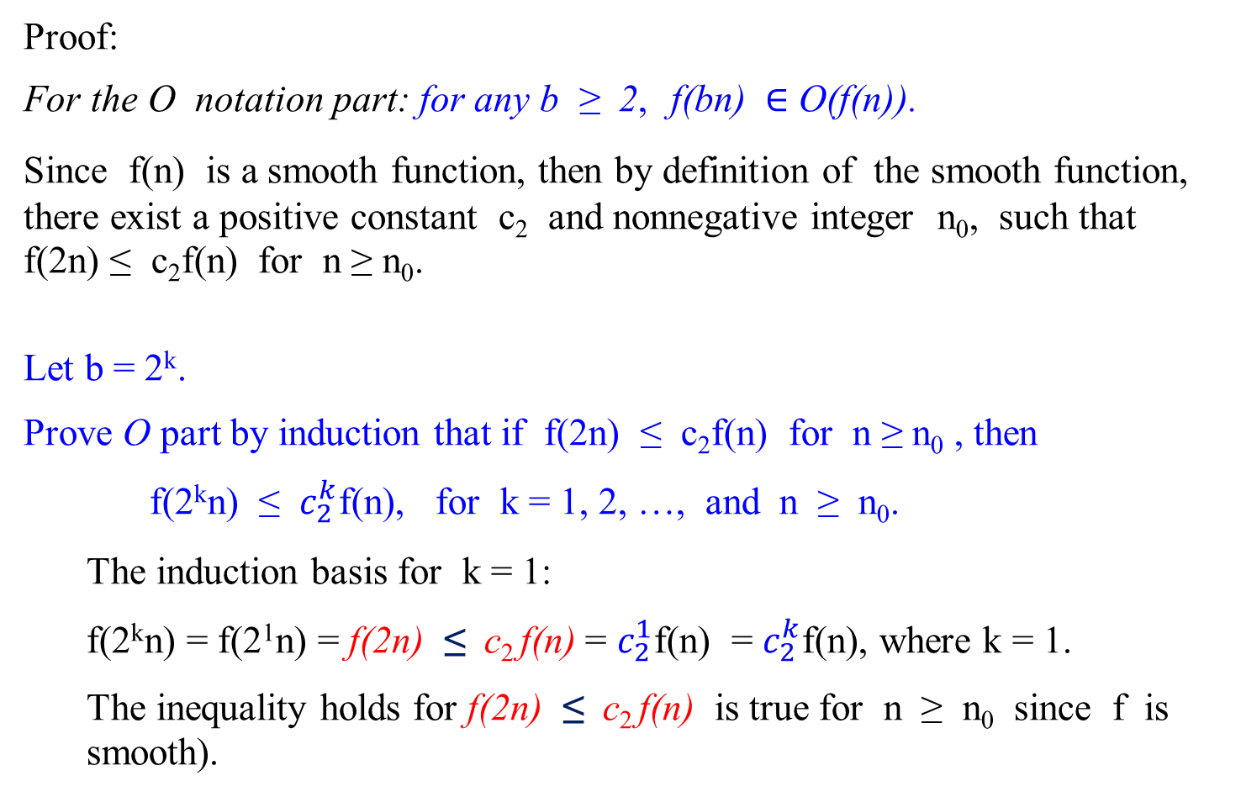
Proof:
For the O notation part: for any b ≥ 2, f(bn) $∈$ O(f(n)).
Since f(n) is a smooth function, then by definition of the smooth function, there exist a positive constant c₂ and nonnegative integer n₀, such that f(2n) ≤ c₂f(n) for n ≥ n₀.
Let b = 2^{k}.
Prove O part by induction that if f(2n) ≤ c₂f(n) for n ≥ n₀ , then
f(2^{k}n) ≤ $c_{2}^{k}$f(n), for k = 1, 2, …, and n ≥ n₀.
  The induction basis for k = 1:
  f(2^{k}n) = f(2¹n) = f(2n) ≤ c₂ f(n) = $c_{2}^{1}$f(n) = $c_{2}^{k}$f(n), where k = 1.
  The inequality holds for f(2n) ≤ c₂ f(n) is true for n ≥ n₀ since f is smooth).

Slide 55
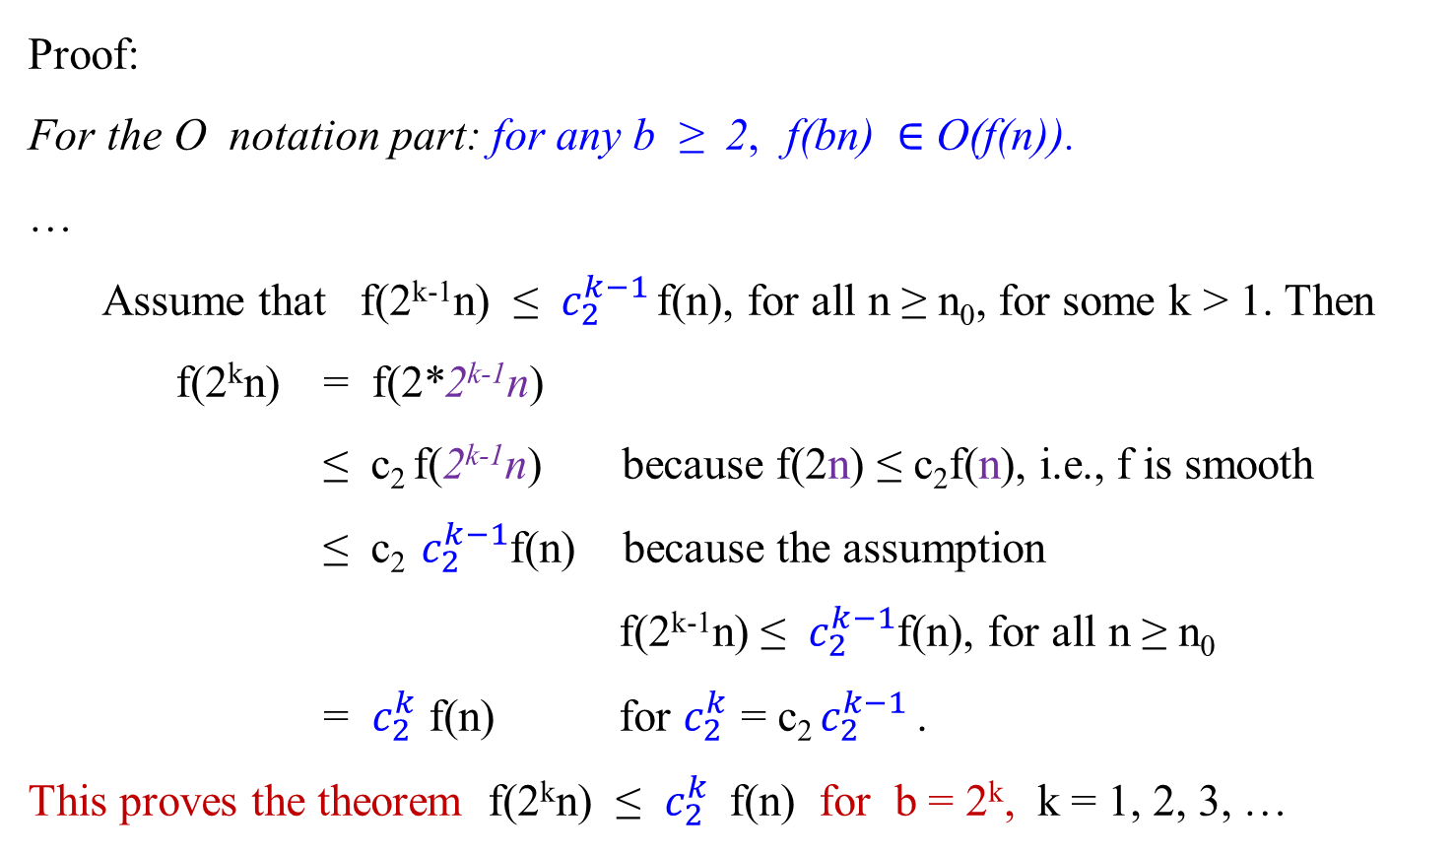
Proof:
For the O notation part: for any b ≥ 2, f(bn) $∈$ O(f(n)).
…
  Assume that f(2^{k-1}n) ≤ $c_{2}^{k−1}$ f(n), for all n ≥ n₀, for some k > 1. Then
f(2^{k}n) = f(2*2^{k-1}n)
≤ c₂ f(2^{k-1}n) because f(2n) ≤ c₂f(n), i.e., f is smooth
≤ c₂ $c_{2}^{k−1}$f(n) because the assumption
f(2^{k-1}n) ≤ $c_{2}^{k−1}$f(n), for all n ≥ n₀
= $c_{2}^{k}$ f(n) for $c_{2}^{k}$ = c₂ $c_{2}^{k−1}$ .
This proves the theorem f(2^{k}n) ≤ $c_{2}^{k}$ f(n) for b = 2^{k}, k = 1, 2, 3, …

Slide 56
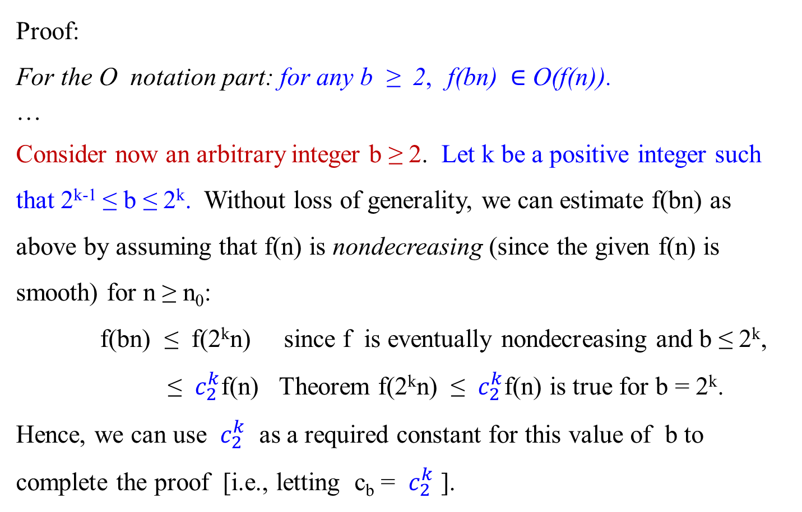
Proof:
For the O notation part: for any b ≥ 2, f(bn) $∈$ O(f(n)).
…
Consider now an arbitrary integer b ≥ 2. Let k be a positive integer such that 2^{k-1} ≤ b ≤ 2^{k}. Without loss of generality, we can estimate f(bn) as above by assuming that f(n) is nondecreasing (since the given f(n) is smooth) for n ≥ n₀:
f(bn) ≤ f(2^{k}n) since f is eventually nondecreasing and b ≤ 2^{k},
≤ $c_{2}^{k}$f(n) Theorem f(2^{k}n) ≤ $c_{2}^{k}$f(n) is true for b = 2^{k}.
Hence, we can use $c_{2}^{k}$ as a required constant for this value of b to complete the proof [i.e., letting c_{b} = $c_{2}^{k}$ ].

Slide 57
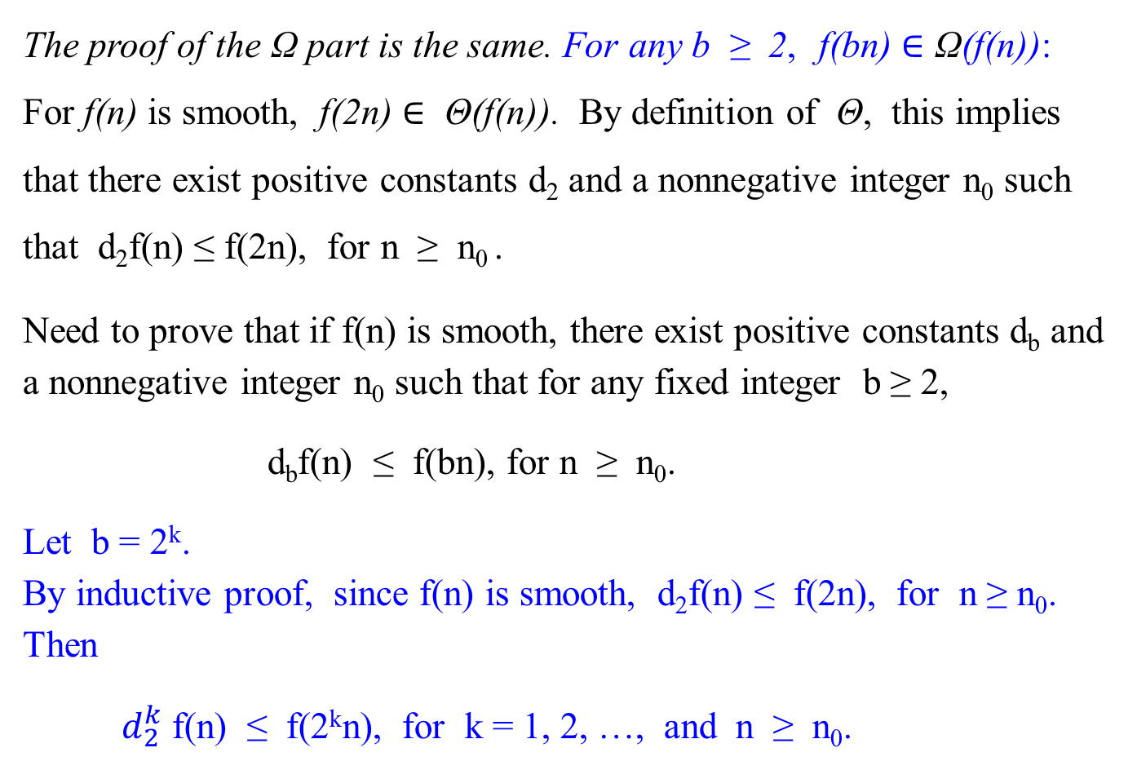
The proof of the Ω part is the same. For any b ≥ 2, f(bn) $∈$ Ω(f(n)):
For f(n) is smooth, f(2n) $∈$ Θ(f(n)). By definition of Θ, this implies that there exist positive constants d₂ and a nonnegative integer n₀ such that d₂f(n) ≤ f(2n), for n ≥ n₀ .
Need to prove that if f(n) is smooth, there exist positive constants d_{b} and a nonnegative integer n₀ such that for any fixed integer b ≥ 2,
d_{b}f(n) ≤ f(bn), for n ≥ n₀.
Let b = 2^{k}.
By inductive proof, since f(n) is smooth, d₂f(n) ≤ f(2n), for n ≥ n₀. Then
$d_{2}^{k}$ f(n) ≤ f(2^{k}n), for k = 1, 2, …, and n ≥ n₀.

Slide 58
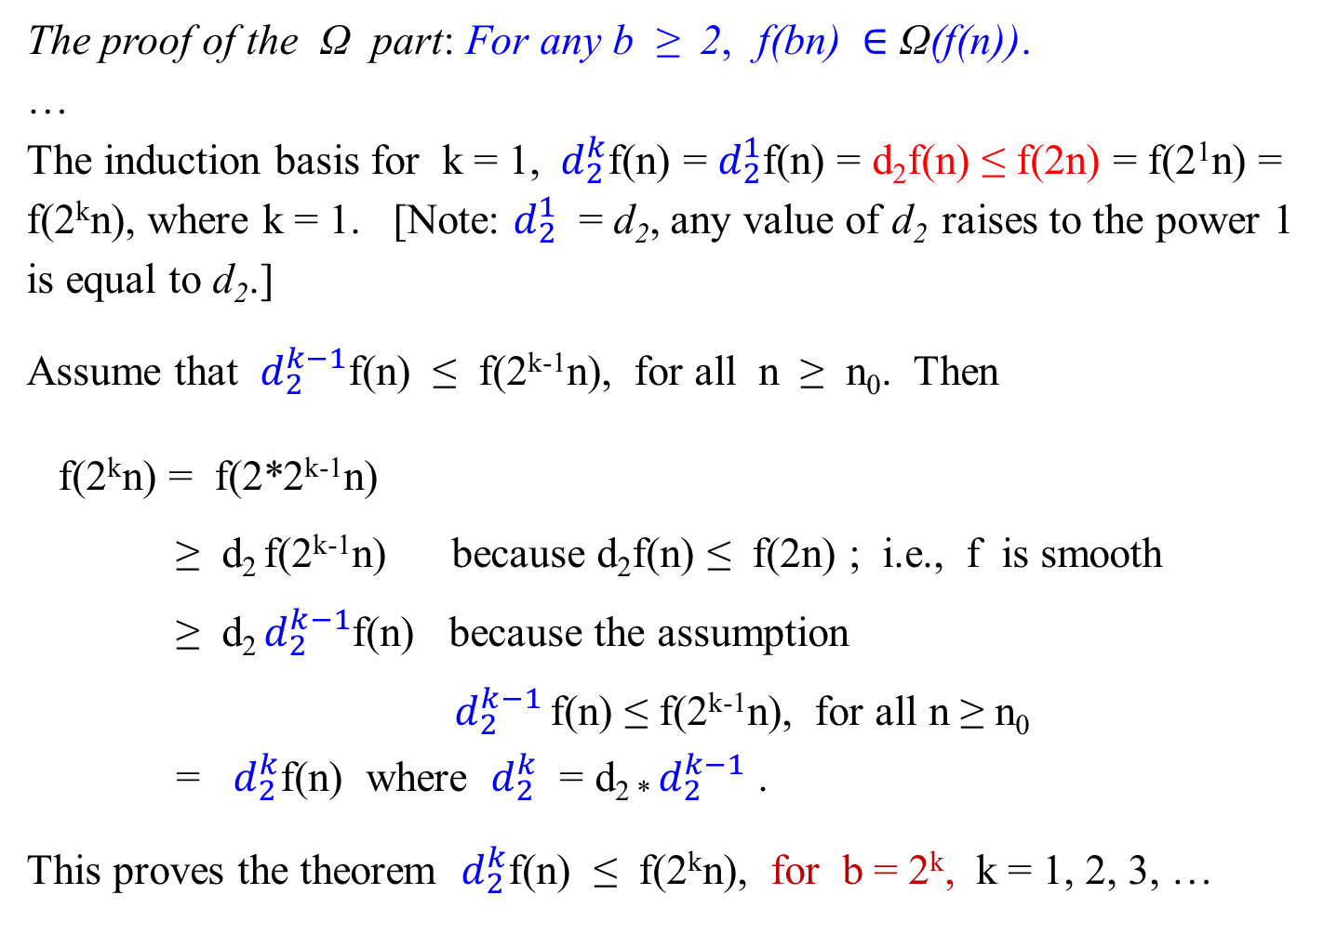
The proof of the Ω part: For any b ≥ 2, f(bn) $∈$ Ω(f(n)).
…
The induction basis for k = 1, ${ d}_{2}^{k}$f(n) = $d_{2}^{1}$f(n) = d₂f(n) ≤ f(2n) = f(2¹n) = f(2^{k}n), where k = 1. [Note: $d_{2}^{1}$ = d₂, any value of d₂ raises to the power 1 is equal to d₂.]
Assume that $d_{2}^{k−1}$f(n) ≤ f(2^{k-1}n), for all n ≥ n₀. Then
f(2^{k}n) = f(2*2^{k-1}n)
≥ d₂ f(2^{k-1}n) because d₂f(n) ≤ f(2n) ; i.e., f is smooth
≥ d₂ $d_{2}^{k−1}$f(n) because the assumption
$d_{2}^{k−1}$ f(n) ≤ f(2^{k-1}n), for all n ≥ n₀
= $d_{2}^{k}$f(n) where $d_{2}^{k}$ = d_{2 *} $d_{2}^{k−1}$ .
This proves the theorem $d_{2}^{k}$f(n) ≤ f(2^{k}n), for b = 2^{k}, k = 1, 2, 3, …

Slide 59
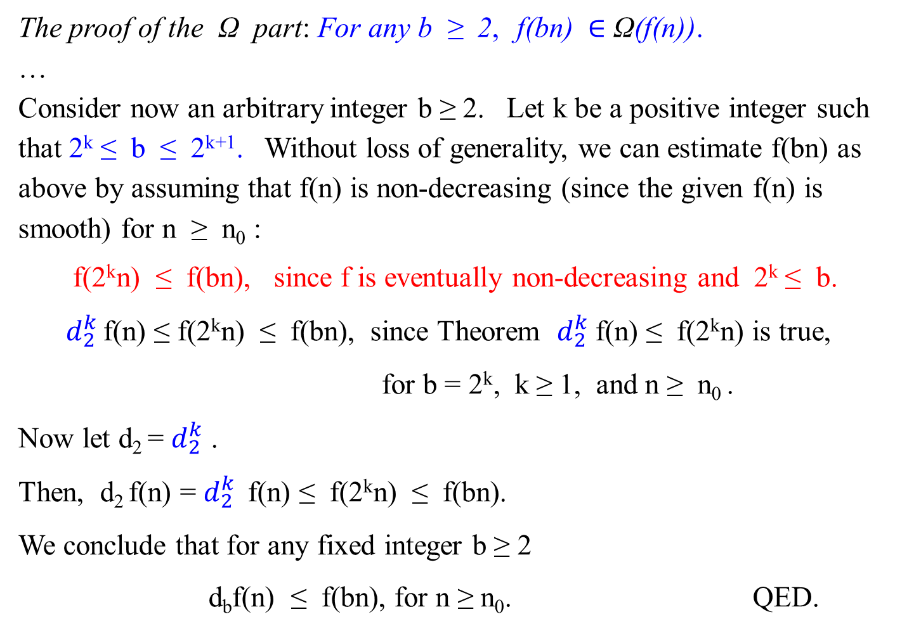
The proof of the Ω part: For any b ≥ 2, f(bn) $∈$ Ω(f(n)).
…
Consider now an arbitrary integer b ≥ 2. Let k be a positive integer such that 2^{k} ≤ b ≤ 2^{k+1}. Without loss of generality, we can estimate f(bn) as above by assuming that f(n) is non-decreasing (since the given f(n) is smooth) for n ≥ n₀ :
f(2^{k}n) ≤ f(bn), since f is eventually non-decreasing and 2^{k} ≤ b.
$d_{2}^{k}$ f(n) ≤ f(2^{k}n) ≤ f(bn), since Theorem $d_{2}^{k}$f(n) ≤ f(2^{k}n) is true,
for b = 2^{k}, k ≥ 1, and n ≥ n₀ .
Now let d₂ = $d_{2}^{k}$ .
Then, d₂ f(n) = $d_{2}^{k}$ f(n) ≤ f(2^{k}n) ≤ f(bn).
We conclude that for any fixed integer b ≥ 2
d_{b}f(n) ≤ f(bn), for n ≥ n₀. QED.

Slide 60

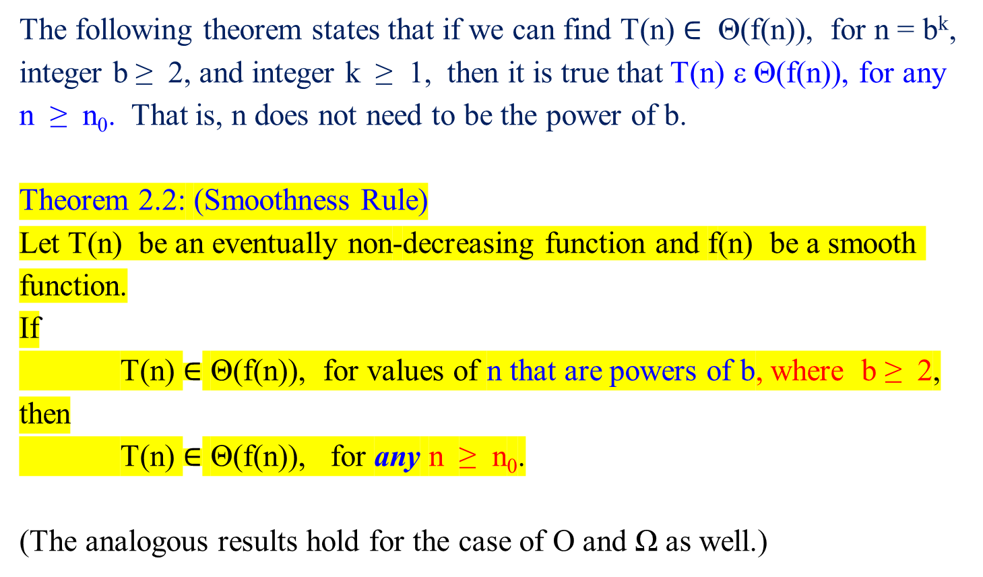
Smoothness Rule
The following theorem states that if we can find T(n) $∈$ Θ(f(n)), for n = b^{k}, integer b ≥ 2, and integer k ≥ 1, then it is true that T(n) ε Θ(f(n)), for any n ≥ n₀. That is, n does not need to be the power of b.
Theorem 2.2: (Smoothness Rule)
Let T(n) be an eventually non-decreasing function and f(n) be a smooth function.
If
T(n) $∈$ Θ(f(n)), for values of n that are powers of b, where b ≥ 2,
then
T(n) $∈$ Θ(f(n)), for any n ≥ n₀.
(The analogous results hold for the case of O and Ω as well.)
proof
! n does not have to be 2^{k} …

Slide 61
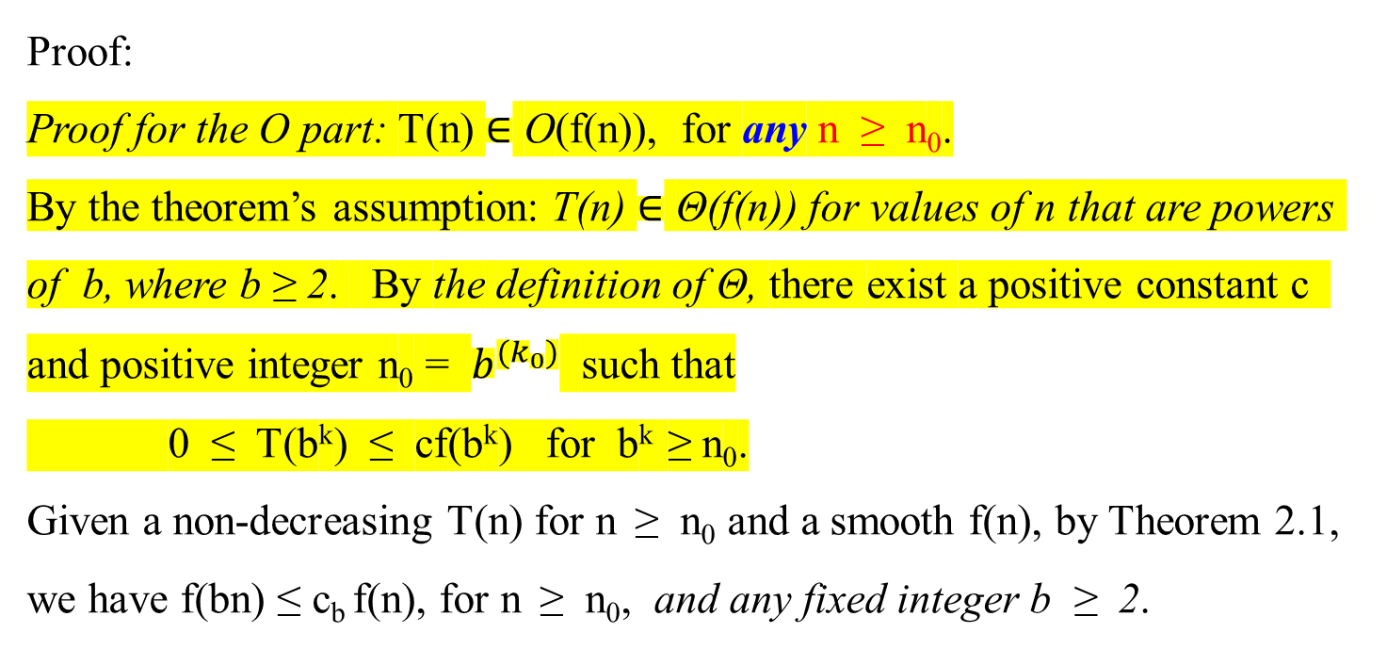
Proof:
Proof for the O part: T(n) $∈$ O(f(n)), for any n ≥ n₀.
By the theorem’s assumption: T(n) $∈$ Θ(f(n)) for values of n that are powers of b, where b ≥ 2. By the definition of Θ, there exist a positive constant c and positive integer n₀ = $b^{{(k}_{0})}$ such that
0 ≤ T(b^{k}) ≤ cf(b^{k}) for b^{k} ≥ n₀.
Given a non-decreasing T(n) for n ≥ n₀ and a smooth f(n), by Theorem 2.1, we have f(bn) ≤ c_{b} f(n), for n ≥ n₀, and any fixed integer b ≥ 2.

Slide 62
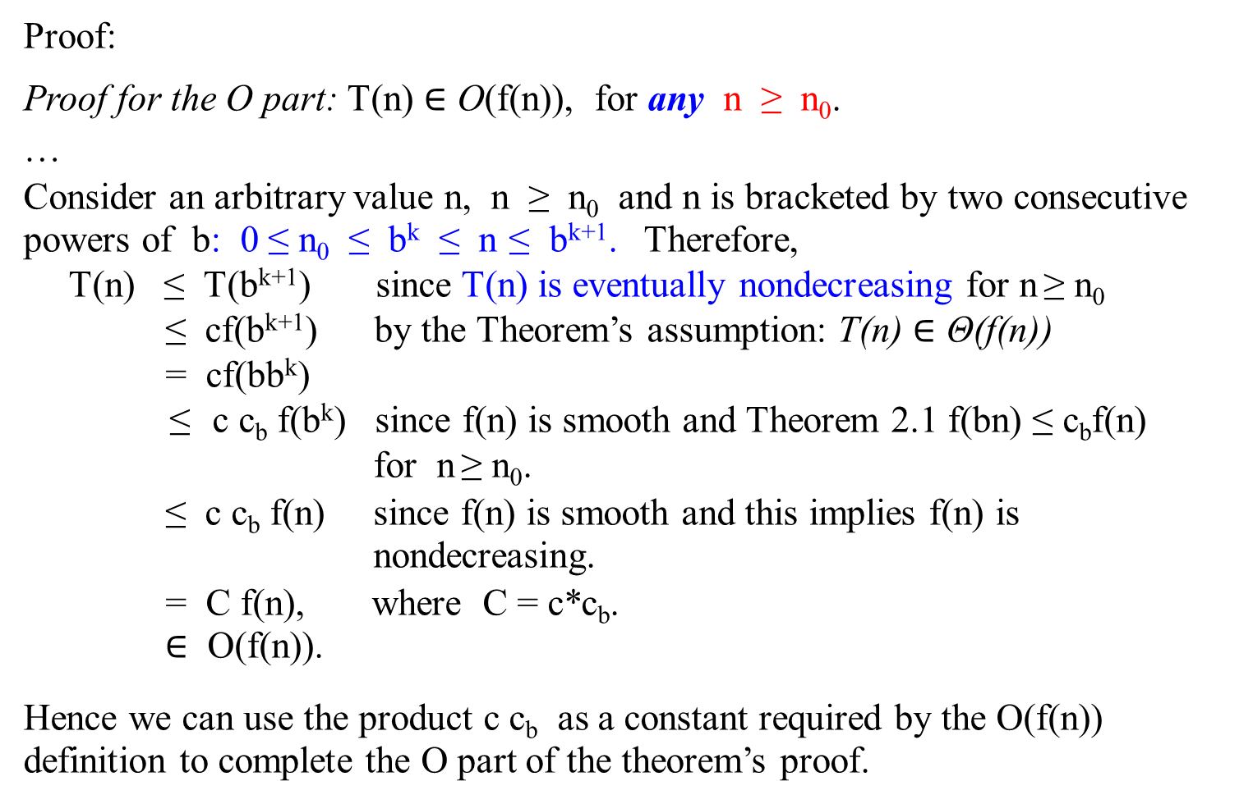
Proof:
Proof for the O part: T(n) $∈$ O(f(n)), for any n ≥ n₀.
…
Consider an arbitrary value n, n ≥ n₀ and n is bracketed by two consecutive powers of b: 0 ≤ n₀ ≤ b^{k} ≤ n ≤ b^{k+1}. Therefore,
T(n) ≤ T(b^{k+1}) since T(n) is eventually nondecreasing for n ≥ n₀
≤ cf(b^{k+1}) by the Theorem’s assumption: T(n) $∈$ Θ(f(n))
= cf(bb^{k})
≤ c c_{b} f(b^{k}) since f(n) is smooth and Theorem 2.1 f(bn) ≤ c_{b}f(n)
for n ≥ n₀.
≤ c c_{b} f(n) since f(n) is smooth and this implies f(n) is
nondecreasing.
= C f(n), where C = c*c_{b}.
$∈$ O(f(n)).
Hence we can use the product c c_{b} as a constant required by the O(f(n)) definition to complete the O part of the theorem’s proof.

Slide 63
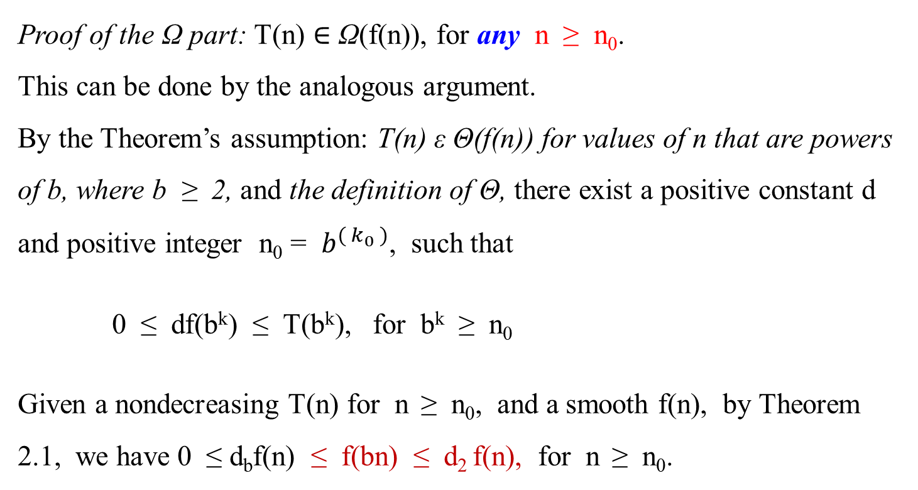
Proof of the Ω part: T(n) $∈$ Ω(f(n)), for any n ≥ n₀.
This can be done by the analogous argument.
By the Theorem’s assumption: T(n) ε Θ(f(n)) for values of n that are powers of b, where b ≥ 2, and the definition of Θ, there exist a positive constant d and positive integer n₀ = $b^{( k_{0} )}$, such that
0 ≤ df(b^{k}) ≤ T(b^{k}), for b^{k} ≥ n₀
Given a nondecreasing T(n) for n ≥ n₀, and a smooth f(n), by Theorem 2.1, we have 0 ≤ d_{b}f(n) ≤ f(bn) ≤ d₂ f(n), for n ≥ n₀.

Slide 64
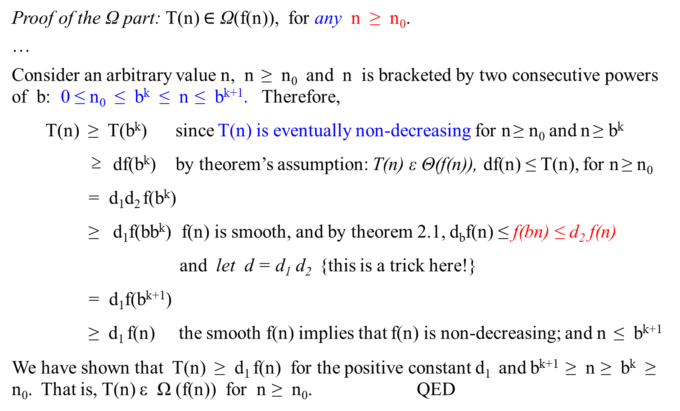
Proof of the Ω part: T(n) $∈$ Ω(f(n)), for any n ≥ n₀.
…
Consider an arbitrary value n, n ≥ n₀ and n is bracketed by two consecutive powers of b: 0 ≤ n₀ ≤ b^{k} ≤ n ≤ b^{k+1}. Therefore,
T(n) ≥ T(b^{k}) since T(n) is eventually non-decreasing for n ≥ n₀ and n ≥ b^{k}
≥ df(b^{k}) by theorem’s assumption: T(n) ε Θ(f(n)), df(n) ≤ T(n), for n ≥ n₀
= d₁d₂ f(b^{k})
≥ d₁f(bb^{k}) f(n) is smooth, and by theorem 2.1, d_{b}f(n) ≤ f(bn) ≤ d₂ f(n)
and let d = d₁ d₂ {this is a trick here!}
= d₁f(b^{k+1})
≥ d₁ f(n) the smooth f(n) implies that f(n) is non-decreasing; and n ≤ b^{k+1}
We have shown that T(n) ≥ d₁ f(n) for the positive constant d₁ and b^{k+1} ≥ n ≥ b^{k} ≥ n₀. That is, T(n) ε Ω (f(n)) for n ≥ n₀. QED

Slide 65

Master Theorem
Theorem 2.2 allows us to expand the information about the order of growth established for T(n) on a convenient subset of values (powers of b) to its entire domain.
Here is one of the most useful assertions of this kind.
Theorem 2.3 (Master Theorem)

Slide 66

Master Theorem
Here is one of the most useful assertions of this kind.
Theorem 2.3 (Master Theorem)
Let T(n) be an eventually non-decreasing function that satisfies the recurrence
T(n) = aT(n/b) + f(n), for n = b^{k}, k = 1, 2, ….
T(1) = c,
where a ≥ 1, b ≥ 2, and c > 0.
If f(n) ε Θ(n^{d} ) [or assume that f(n) = n^{d} ], where d ≥ 0, then
Θ( n^{d} ) if a < b^{d}
T(n) $∈$ Θ(n^{d} log_{b}n) if a = b^{d}
Θ( $n^{\log_{b}{a}}$ ) if a > b^{d}
(Similar results hold for the O and Ω notations, too).

Slide 67
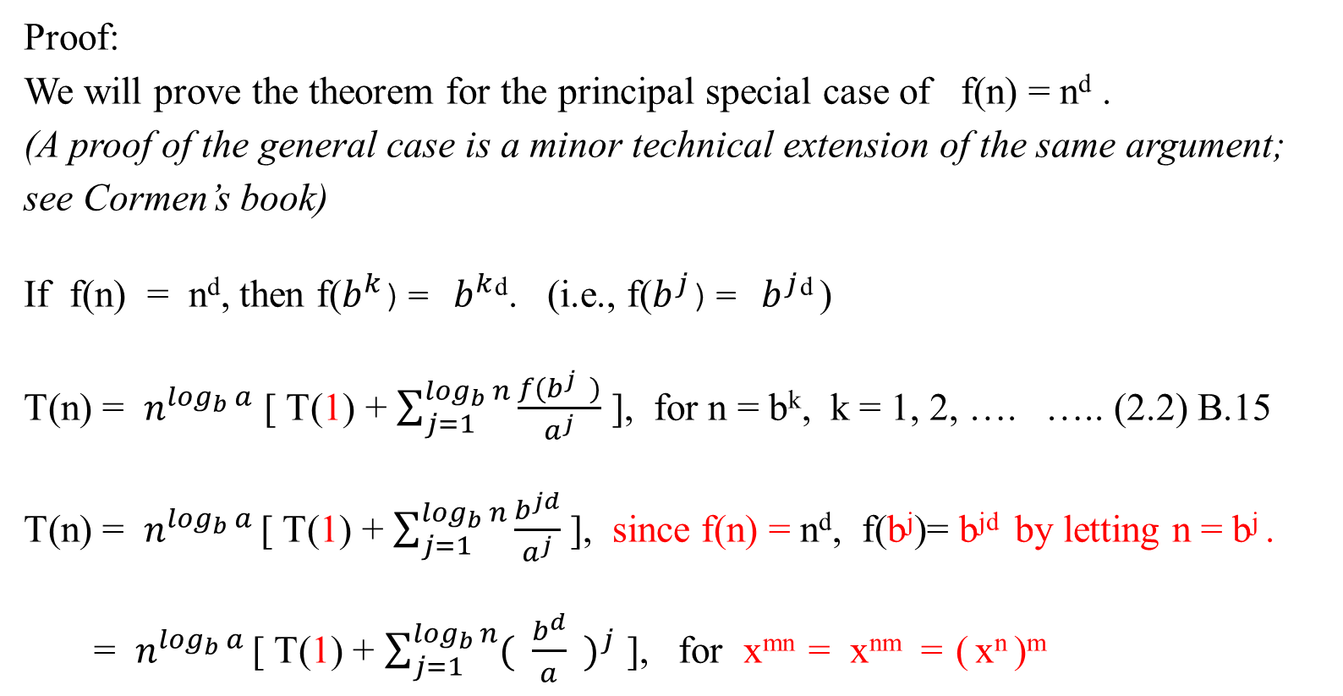
Master Theorem
Proof:
We will prove the theorem for the principal special case of f(n) = n^{d} .
(A proof of the general case is a minor technical extension of the same argument; see Cormen’s book)
If f(n) = n^{d}, then f($b^{k}$)= $b^{k}$^{d}. (i.e., f($b^{j}$)= $b^{j}$^{d} )
T(n) = $n^{\log_{b}{a}}$ [ T(1) + $\sum_{j=1}^{\log_{b}{n}}{\frac{f(b^{j} )}{a^{j}}}$ ], for n = b^{k}, k = 1, 2, …. ….. (2.2) B.15
T(n) = $n^{\log_{b}{a}}$ [ T(1) + $\sum_{j=1}^{\log_{b}{n}}{\frac{b^{jd}}{a^{j}}}$ ], since f(n) = n^{d}, f(b^{j})= b^{jd} by letting n = b^{j} .
= $n^{\log_{b}{a}}$ [ T(1) + $\sum_{j=1}^{\log_{b}{n}}{{( \frac{b^{d}}{a} )}^{j}}$ ], for x^{mn} = x^{nm} = ( x^{n} )^{m}

Slide 68
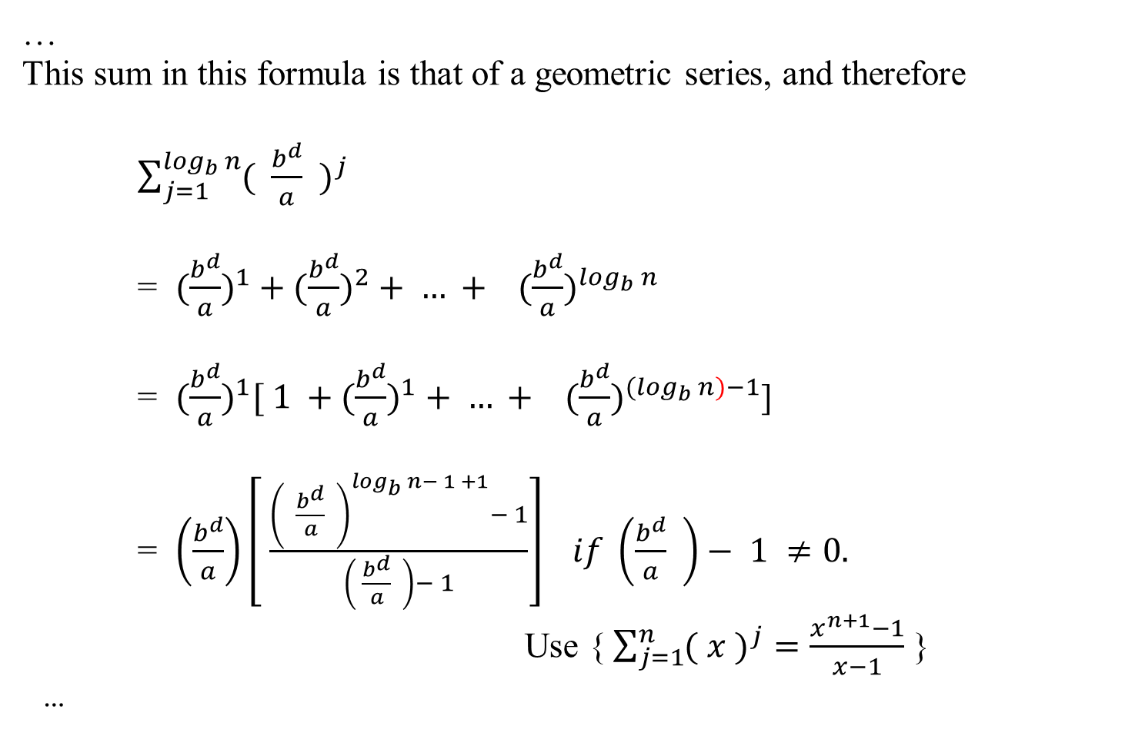
Master Theorem
…
This sum in this formula is that of a geometric series, and therefore
$\sum_{j=1}^{\log_{b}{n}}{{( \frac{b^{d}}{a} )}^{j}}$
= $(\frac{b^{d}}{a})^{1}+(\frac{b^{d}}{a})^{2}+ … + (\frac{b^{d}}{a})^{\log_{b}{n}}$
= $(\frac{b^{d}}{a})^{1}[ 1 +(\frac{b^{d}}{a})^{1}+ … + (\frac{b^{d}}{a})^{{(log}_{b}{n)−1}}$]
= $\left(\frac{b^{d}}{a}\right)\left[ \frac{{\left( \frac{b^{d}}{a} \right)}^{\log_{b}{n}− 1 +1}− 1}{\left( \frac{b^{d}}{a} \right)− 1}\right] if \left(\frac{b^{d}}{a} \right)− 1 ≠0.$
Use {$\sum_{j=1}^{n}{{( x )}^{j}}=\frac{x^{n+1}−1}{x−1}$ }
…

Slide 69
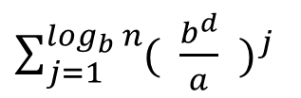

Master Theorem
$\sum_{j=1}^{\log_{b}{n}}{{( \frac{b^{d}}{a} )}^{j}}$
$( \frac{b^{d}}{a} )$ $\left[ \frac{{\left( \frac{b^{d}}{a} \right)}^{\log_{b}{n}− 1 +1}− 1}{\left( \frac{b^{d}}{a} \right)− 1}\right]$, if b^{d} ≠ a
=
log_{b}n, if b^{d} = a, and $\sum_{j=1}^{\log_{b}{n}}{{( \frac{b^{d}}{a} )}^{j}}$ = $\sum_{j=1}^{\log_{b}{n}}{{( 1 )}^{j}}$ ……(2.3)
Proof of (2.3) : Let x = (b^{d}/a).
Then $\sum_{j=1}^{\log_{b}{n}}{{( \frac{b^{d}}{a} )}^{j}}$ = $\sum_{j=1}^{\log_{b}{n}}{x^{j}}$

Slide 70
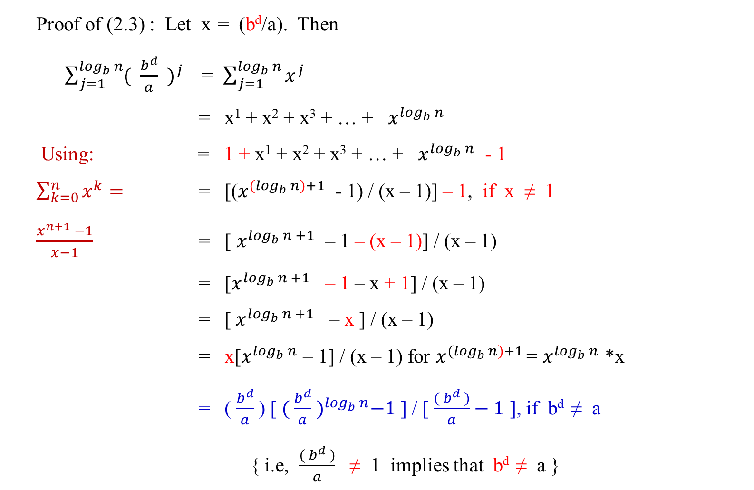
Master Theorem
Proof of (2.3) : Let x = (b^{d}/a). Then
$\sum_{j=1}^{\log_{b}{n}}{{( \frac{b^{d}}{a} )}^{j}}$ = $\sum_{j=1}^{\log_{b}{n}}{x^{j}}$
= x¹ + x² + x³ + … + $x^{\log_{b}{n}}$
Using: = 1 + x¹ + x² + x³ + … + $x^{\log_{b}{n}}$ - 1
$\sum_{k=0}^{n}{x^{k}}=$ = [($x^{{(log}_{b}{n)+1}}$ - 1) / (x – 1)] – 1, if x ≠ 1
$\frac{x^{n+1} −1}{x−1}$ = [ $x^{\log_{b}{n +1}}$ – 1 – (x – 1)] / (x – 1)
= [$x^{\log_{b}{n +1}}$ – 1 – x + 1] / (x – 1)
= [${ x}^{\log_{b}{n +1}}$ – x ] / (x – 1)
= x[$x^{\log_{b}{n}}$ – 1] / (x – 1) for $x^{{(log}_{b}{n)+1}}$ = $x^{\log_{b}{n}}$ *x
= ( $\frac{b^{d}}{a}$ ) [ ${( \frac{b^{d}}{a} )}^{\log_{b}{n}}−1$ ] / [ $\frac{( b^{d} )}{a}−1$ ], if b^{d} ≠ a
{ i.e, $\frac{( b^{d} )}{a}$ ≠ 1 implies that b^{d} ≠ a }

Slide 71

Master Theorem
…
If b^{d} = a then
$\sum_{j=1}^{\log_{b}{n}}{{( \frac{b^{d}}{a} )}^{j}}$ = $\sum_{j=1}^{\log_{b}{n}}{1^{j}}$
= 1¹ + 1² + 1³ + … + $1^{\log_{b}{n}}$
= log_{b}n ( 1 )
= log_{b}n, if b^{d} = a End of proof of (2.3)
QED

Slide 72
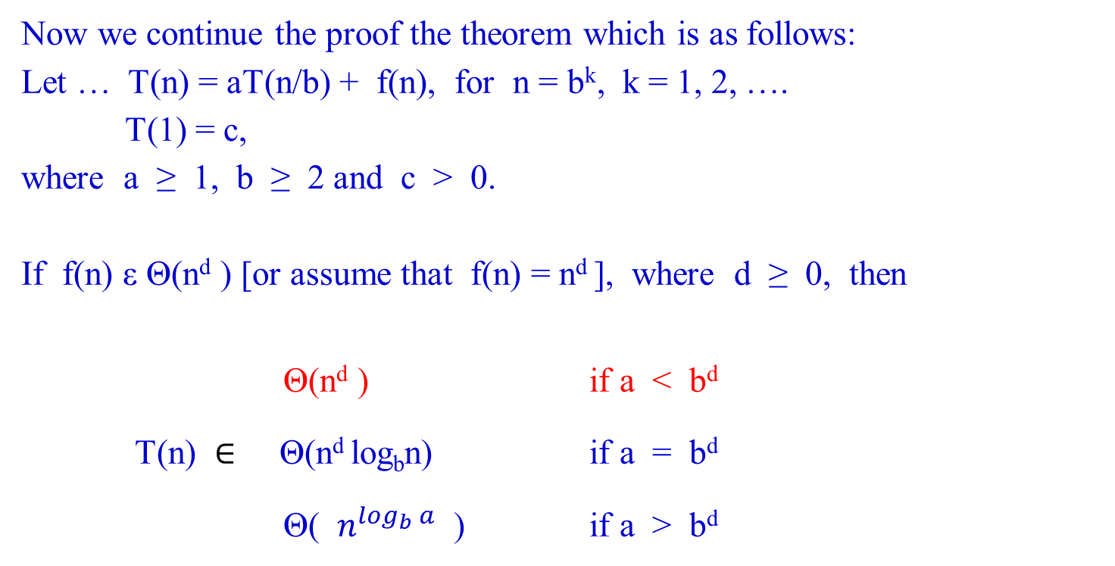
Master Theorem
Now we continue the proof the theorem which is as follows:
Let … T(n) = aT(n/b) + f(n), for n = b^{k}, k = 1, 2, ….
T(1) = c,
where a ≥ 1, b ≥ 2 and c > 0.
If f(n) ε Θ(n^{d} ) [or assume that f(n) = n^{d} ], where d ≥ 0, then
Θ(n^{d} ) if a < b^{d}
T(n) $∈$ Θ(n^{d} log_{b}n) if a = b^{d}
Θ( $n^{\log_{b}{a}}$ ) if a > b^{d}

Slide 73

Master Theorem
…
Let if b^{d} ≠ a.
If a < b^{d} , then b^{d}/a > 1, and therefore
$\sum_{j=1}^{\log_{b}{n}}{{( \frac{b^{d}}{a} )}^{j}}$ = $(\frac{b^{d}}{a}) \left[\frac{{\left( \frac{b^{d}}{a} \right)}^{\log_{b}{n}}− 1}{\left( \frac{b^{d}}{a} \right)− 1}\right] if \left(\frac{b^{d}}{a} \right)− 1 ≠0$
= $( \frac{b^{d}}{a} )$ [ { $({ \frac{b^{d}}{a} )}^{\log_{b}{n}}− 1$ } / { $( \frac{b^{d}}{a} )$ – 1 }],
= c*{ $({ \frac{b^{d}}{a} )}^{\log_{b}{n}}−1$ }, where a constant c =$( \frac{b^{d}}{a} )$ /{ $( \frac{b^{d}}{a} )$– 1},
$∈$ Θ( $({ \frac{b^{d}}{a} )}^{\log_{b}{n}}$ ).

Slide 74

Master Theorem
…
Hence,
T(n) = $n^{\log_{b}{a}}$ [ T(1) + $\sum_{j=1}^{\log_{b}{n}}{\frac{b^{jd}}{a^{j}}}$ ],
= $n^{\log_{b}{a}}$ [ T(1) + $\sum_{j=1}^{\log_{b}{n}}{{( \frac{b^{d}}{a} )}^{j}}$ ],
= $n^{\log_{b}{a}}$ * T(1) + $n^{\log_{b}{a}}$ * $\sum_{j=1}^{\log_{b}{n}}{{( \frac{b^{d}}{a} )}^{j}}$ ,
= $n^{\log_{b}{a}}∗T\left(1\right)+n^{\log_{b}{a}}∗\left(\frac{b^{d}}{a}\right)\left[ \frac{{\left( \frac{b^{d}}{a} \right)}^{\log_{b}{n}}− 1}{\left( \frac{b^{d}}{a} \right)− 1}\right],$ $if \left(\frac{b^{d}}{a} \right)−1≠0$
…

Slide 75

Master Theorem
…
= $n^{\log_{b}{a}}∗T\left(1\right)+n^{\log_{b}{a}}∗$ { c *$({ \frac{b^{d}}{a} )}^{\log_{b}{n}}− 1$ }, if a < b^{d} ,
≤ C $n^{\log_{b}{a}}∗$ $({ \frac{b^{d}}{a} )}^{\log_{b}{n}}$, where C is a constant and a < b^{d} ,
= Θ($n^{\log_{b}{a}}$ ${( \frac{b^{d}}{a} )}^{\log_{b}{n}}$ )
= Θ($a^{\log_{b}{n}}$ ${( \frac{b^{d}}{a} )}^{\log_{b}{n}}$)
= Θ($a^{\log_{b}{n}}$ $( \frac{b^{d\log_{b}{n}}}{a^{\log_{b}{n}}} )$ )
= Θ( $b^{d\log_{b}{n}}$ )
= Θ( $b^{\log_{b}{n^{d}}}$ )
[Let x = n^{d}. Then, $b^{\log_{b}{n^{d}}}$ = $b^{\log_{b}{x}}$ = $x^{\log_{b}{b}}$ = x = n^{d}]
= Θ(n^{d} ), if a < b^{d}.

Slide 76

Master Theorem
Consider again the Theorem:
Let … T(n) = aT(n/b) + f(n), for n = b^{k}, k = 1, 2, ….
T(1) = c,
where a ≥ 1, b ≥ 2 and c > 0.
If f(n) $∈$ Θ(n^{d} ) [or assume that f(n) = n^{d} ], where d ≥ 0, then
Θ(n^{d} ) if a < b^{d}
T(n) $∈$ Θ(n^{d} log_{b}n) if a = b^{d}
Θ( $n^{\log_{b}{a}}$ ) if a > b^{d}

Slide 77

Master Theorem
If a > b^{d} , then $\frac{b^{d}}{a}$< 1, and therefore
$\sum_{j=1}^{\log_{b}{n}}{{( \frac{b^{d}}{a} )}^{j}}$ = $\left(\frac{b^{d}}{a}\right)\left[\frac{{\left( \frac{b^{d}}{a} \right)}^{\log_{b}{n}}− 1}{\left( \frac{b^{d}}{a} \right)− 1}\right] if \left(\frac{b^{d}}{a} \right)− 1 ≠0$
[ If a > b^{d} then 1 > $(\frac{b^{d}}{a})$. Let $(\frac{b^{d}}{a})$ = c < 1, where c is a constant.
n = $b^{k}, k= 1, 2, 3, …$. Then, $\log_{b}n$ = ${klog}_{b}b$ = k ].
= $(\frac{b^{d}}{a}) \left[\frac{{\left( \frac{b^{d}}{a} \right)}^{\log_{b}{n}}− 1}{\left( \frac{b^{d}}{a} \right)− 1}\right] if \left(\frac{b^{d}}{a} \right)− 1 ≠0$
= c [ $\frac{c^{k}− 1}{c−1}$ ], if c – 1 $≠0$
$∈$ Θ (1).

Slide 78

Master Theorem
Hence,
T(n) = $n^{\log_{b}{a}}$ [ T(1) + $\sum_{j=1}^{\log_{b}{n}}{{( \frac{b^{d}}{a} )}^{j}}$ ],
= $n^{\log_{b}{a}}$ [ T(1) + C ], where a constant C = c [ $\frac{c^{k}− 1}{c−1}$ ]
$∈$ Θ($n^{\log_{b}{a}}$ )

Slide 79

Master Theorem
Now we continue the proof the theorem which is as follows:
Let … T(n) = aT(n/b) + f(n), for n = b^{k}, k = 1, 2, ….
T(1) = c,
where a ≥ 1, b ≥ 2 and c > 0.
If f(n) ε Θ(n^{d} ) [or assume that f(n) = n^{d} ], where d ≥ 0, then
Θ(n^{d} ) if a < b^{d}
T(n) $∈$ Θ(n^{d} log_{b}n) if a = b^{d}
Θ( $n^{\log_{b}{a}}$ ) if a > b^{d}

Slide 80

Master Theorem
If a = b^{d} , then b^{d} / a = 1, and therefore
T(n) = $n^{\log_{b}{a}}$ [ T(1) + $\sum_{j=1}^{\log_{b}{n}}{{( \frac{b^{d}}{a} )}^{j}}$ ],
= $n^{\log_{b}{a}}$ [ T(1) + log_{b}n ]
ε Θ($n^{\log_{b}{a}}$ log_{b}n ) where a = b^{d}
= $Θ(n^{\log_{b}{b^{d}}}\log_{b}{n} )$
= $Θ(n^{d\log_{b}{b}}\log_{b}{n} )$
= Θ(n^{d} log_{b}n ).
Since f(n) = n^{d} is a smooth function for any d, a reference to Theorem 2.2 completes the proof. QED.

Slide 81

Master Theorem’s Applications
Note that Theorem 2.3 provides a very convenient tool for a quick efficiency analysis of divide-and-conquer and decreasing-by-a-constant-factor algorithms.
Example 2.7: (The divide-and-conquer sum-computation algorithm)
For the summation example (compute the sum of n numbers):
a₀ + a₁ + … + a_{n - 1} = (a₀ + … + $a_{└n/2┘−1}$ ) + ( $a_{└n/2┘}$+ … + a_{n - 1} ),
Then the time efficiency for this algorithm is
  T(n) = aT(n/b) + f(n), where a = b = 2 and f(n) = 1. That is,
  T(n) = 2T(n/2) + c.

Slide 82

Master Theorem’s Applications
Rewrite the time efficiency for this algorithm
in terms of required number of additions as follows:
The recurrence equation for the number of additions A(n) made by the divide-and-conquer sum-computation algorithm on inputs of size n = 2^{k} is
A(n) = 2A(n/2) + 1.
a = 2, b = 2 and for f(n) = n^{d} = 1, d = 0;
Since a = 2 and b^{d} = 2⁰ , therefore, a > b^{d} , (which is 2 > 2⁰)
Using Master Theorem, for a > b^{d} ,
A(n) ε Θ($n^{\log_{b}{a}}$ ) = Θ($n^{\log_{2}{2}}$ ) = Θ(n).

Slide 83

Master Theorem
Using Theorem 2.3, the solution can be found as follows:
Let … T(n) = aT(n/b) + f(n), for n = b^{k}, k = 1, 2, ….
T(1) = c,
where a ≥ 1, b ≥ 2 and c > 0.
If f(n) ε Θ(n^{d} ) [or assume that f(n) = n^{d} ], where d ≥ 0, then
Θ(n^{d} ) if a < b^{d}
T(n) $∈$ Θ(n^{d} log_{b}n) if a = b^{d}
Θ( $n^{\log_{b}{a}}$ ) if a > b^{d}

Slide 84

Master Theorem’s Applications
Example 2.8: Solve the recurrence equation:
T(n) = 9T(n/3) + n.
From this example, a = 9, b = 3; and d = 1, since n^{d} = n.
Since a = 9 and b^{d} = 3¹ therefore a > b^{d}.
Since a > b^{d} , using Master Theorem,
T(n) ε Θ($n^{\log_{b}{a}}$ ) = Θ($n^{\log_{3}{9}}$ )
= Θ($n^{{2log}_{3}{3}}$ )
= Θ(n²).
:a hypothetical case

Slide 85

For this problem, we use Theorem 2.3, which is as follows:
Let … T(n) = aT(n/b) + f(n), for n = b^{k}, k = 1, 2, ….
T(1) = c,
where a ≥ 1, b ≥ 2 and c > 0.
If f(n) ε Θ(n^{d} ) [or assume that f(n) = n^{d} ], where d ≥ 0, then
Θ(n^{d} ) if a < b^{d}
T(n) $∈$ Θ(n^{d} log_{b}n) if a = b^{d}
Θ( $n^{\log_{b}{a}}$ ) if a > b^{d}

Slide 86
Master Theorem’s Applications
Example 2.9: Solve the recurrence equation
T(n) = 3T(n/4) + nlogn.
We have a = 3 and b= 4. n^{d} = nlogn.
For n^{d} = nlogn, log n^{d} = log(nlogn)
dlog n = log(nlogn)
d = [log(nlogn)] / logn
= [logn + log(logn)] / logn
= 1 + (log(logn) / logn)
d ≥ 1
Therefore a < b^{d}, when d ≥ 1.
Since a < b^{d}, T(n) ε Θ(n^{d} ) = Θ(nlogn) using n^{d} = nlogn.
:pay price for using mergeSort case

Slide 87

For this problem, we use Theorem 2.3, which is as follows:
Let … T(n) = aT(n/b) + f(n), for n = b^{k}, k = 1, 2, ….
T(1) = c,
where a ≥ 1, b ≥ 2 and c > 0.
If f(n) ε Θ(n^{d} ) [or assume that f(n) = n^{d} ], where d ≥ 0, then
Θ(n^{d} ) if a < b^{d}
T(n) $∈$ Θ(n^{d} log_{b}n) if a = b^{d}
Θ( $n^{\log_{b}{a}}$ ) if a > b^{d}

Slide 88
Master Theorem’s Applications
{I do not like this way for getting this solution since we only know d ≥ 1 without a precise value for it. However, we can check the solution by letting n = 4^{k}, and using backward substitution.}
Example 2.10: Solve the recurrence equation
T(n) = 2T(n/2) + nlogn.
We have a = 2 and b = 2. n^{d} = nlogn.
We fail to find the solution if we apply the Master Theorem.
[Reason: if d ≥ 1, then a ≤ b^{d}. The Theorem could not applied.
If you use backward substitution, T(n) = nT(1) + n(logn) ((logn) + 1)/2 which is Θ(nlogn logn). ……..[It seems that it is a = b^{d}, then applies on the middle one!]
n^{d} = nlogn.
log n^{d} = log(nlogn)
d logn = log n + loglogn
d = 1 + (log logn)/logn
d ≥ 1
This implies a ≤ b^{d}
when b = 2, a =2 and if d = 1, then a = b^{d}. And if d > 1, then a < b^{d}.
Thus, if d ≥ 1, then a ≤ b^{d}. ,

Slide 89

Mergesort efficiency:
For the sake of simplicity, assume that n = 2^{k}, a power of 2.
2. The recurrence relation for the number of key comparisons C(n) is:
C(n) = 2C(n/2) + C_{merge}(n), for n > 1,
C(1) = 1
3. For the worst case C_{merge}(n) = n - 1, the recurrence is
C_{worst}(n) = 2 C_{worst}(n/2) + n – 1, for n > 1,
C_{worst}(1) = 1.
4. According to the Master Theorem, C_{worst}(n) ε Θ(n log n)
[why? ]

Slide 90

For this problem, we use Theorem 2.3, which is as follows:
Let … T(n) = aT(n/b) + f(n), for n = b^{k}, k = 1, 2, ….
T(1) = c,
where a ≥ 1, b ≥ 2 and c > 0.
If f(n) ε Θ(n^{d} ) [or assume that f(n) = n^{d} ], where d ≥ 0, then
Θ(n^{d} ) if a < b^{d}
T(n) $∈$ Θ(n^{d} log_{b}n) if a = b^{d}
Θ( $n^{\log_{b}{a}}$ ) if a > b^{d}
C_{worst}(n) = 2 C_{worst}(n/2) + n – 1, for n > 1,
C_{worst}(1) = 1.

Slide 91


Mergesort efficiency:
  Given T(n) = aT(n/b) + f(n), where f(n) = n-1 ε Θ(n):
f(n) = Θ(n) = Θ(n^{d}) implies that d = 1 ≥ 0.
  For Mergesort, a = 2, b = 2, then a = b^{d} $↔$ 2 = 2¹.
  using the Master Theorem, T(n) = Θ(n^{d} log n).
  Thus, C_{worst}(n) ε Θ(n logn).
C_{worst}(n) = 2 C_{worst}(n/2) + n – 1, for n > 1,
C_{worst}(1) = 1.

Slide 92

Mergesort efficiency:
5. In fact, the exact solution to the worst-case recurrence for n = 2^{k},
C_{worst}(n) = n log₂n – n + 1.
6. The number of key comparisons made by Mergesort in the worst-case comes very close to the theoretical minimum that any general comparison-based sorting algorithm can have.
7. The principal shortcoming of Mergesort is the linear amount of storage the algorithm requires.

Slide 93
Another Way for Analyzing Mergesort
Set up the recurrence for T(n), the worst-case running time of merge sort on n numbers.
2. Merge sort on one element takes constant time. i.e., T(n) = Θ(1).
When we have n > 1 elements, we break down the running time as follows:
Divide: Compute the middle of the subarray, which takes constant time. Thus D(n) = Θ(1).
Conquer: Recursively solve two subproblems, each of size n/2, which takes the running time 2T(n/2).
Combine: That Merge procedure on an n-element subarray takes Θ(n), so C(n) = Θ(n).

Slide 94
3. Adding the functions D(n) and C(n) for the merge sort, this yields Ɵ(1) + Θ(n). The sum is a linear function of n, that is, Θ(n).
4. Therefore, the recurrence for the worst-case running time T(n) of Mergesort:
Θ(1) if n = 1,
T(n) =
2T(n/2) + Θ(n) if n > 1. ……………(2.4)
5. According to the Master Theorem, T(n) is Ɵ(n log₂n).
6. The logarithm function grows more slowly than any linear function. For large enough input n, in the worse case, the running time of the merge sort is Θ(nlog₂n) which outperforms insertion sort, whose running time is Θ(n²).

Slide 95
In fact, this does not need the Master Theorem to intuitively understand why the solution to the recurrence (2.4) is
T(n) = Θ(nlog₂n).
Let rewrite (2.4) as
  T(1) = c
  T(n) = 2T(n/2) + cn if n > 1. …………….….. (2.5)
  where the constant c represents the time required to solve problems of size 1 as well as the time per array element of the divide and combine steps
The following figure shows how we can solve the recurrence (2.5). For the sake of convenience, assume that n is exact power of 2, say, n = 2^{k}.

Slide 96
T(n) cn cn .....cost cn to merge n elem.
T(n/2) T(n/2) cn/2 cn/2
T(n/4) T(n/4) T(n/4) T(n/4)
(a) (b) (c)
Figure 2.3(a) shows T(n), which in Figure 2.3(b) has been expanded into an equivalent tree representing the recurrence. The cn term is the root (the cost at the top level of recursion), and two subtrees of the root are two smaller recurrence T(n/2).
Figure 2.3(c) shows this process carried one step further by expanding T(n/2). The cost of each of the two sub-nodes at the second level of recursion is cn/2.

Slide 97
Continue expanding each node in the tree by
breaking it into its constituent parts as determined by the recurrence, until the problem sizes get down to 1, each with a cost of c.
Figure 2.3(d) shows the result tree.

Slide 98
cn → cn
cn/2 cn/2 → cn
height= cn/4 cn/4 cn/4 cn/4 → cn
log₂n
(level =
log₂n+1) . . . . . . . .
. . . . . . . .
. . . . . . . .
| | | | | | | |
c c c c c c c c → cn
←------------------ n -----------------→
2.3(d) Total cost: cn log₂n + cn, which is Θ(n log₂n)

Slide 99
cn → cn
cn/2 cn/2 → cn
height= cn/4 cn/4 cn/4 cn/4 → cn
log₂n
(level =
log₂n+1) . . . . . . . .
. . . . . . . .
. . . . . . . .
| | | | | | | |
c c c c c c c c → cn
←------------------ n -----------------→
The fully expanded tree in part (d) has log n + 1 levels (i.e., it has height log₂n as shown), and each level contributes a total cost of cn. Therefore, the total cost, is cn log₂n + cn, which is Θ(n log₂n).

Slide 100
The base case occurs when n = 1, there is only one level.
  Since log₂1 = 0, this log₂n+1 gives the correct number of levels.
  Label the level from top to bottom by 0, 1, … i….)
The top level has total cost cn.
The next level down has total cost c(n/2) + c(n/2) = cn.
In general, the level i below the top has 2^{i} nodes,
  each node at ith level has a cost of c(n/2^{i}),
  the total cost at the ith level 2^{i} c(n/2^{i}) = cn.
At the bottom level,
  there are n nodes,
  each node has a cost of c,
  a total cost of cn.

Slide 101
Assume as an inductive hypothesis,
  the number of levels of a recursion tree for 2^{i} nodes is
  log₂ 2^{i} + 1 = i + 1.
Assuming that the original input size is a power of 2, the next input size to consider is 2^{i+1}.
  A tree with 2^{i+1} nodes has one more level than a tree of 2^{i} nodes.
  the total number of levels is (i+1) + 1 = log₂ 2^{i+1} + 1.
To compute the total cost represented by the recurrence (2.5), this simply add up the costs of all the levels.
There are log₂n + 1 levels, each costing cn, for a total cost of cn (log₂n + 1) = cn log₂n + cn.
Ignoring the low-order term and the constant c gives the desired result Θ(nlog₂n).

