Slide 1
Chapter 1
Fundamentals of the Analysis of Algorithm Efficiency

Slide 2

Body of Knowledge Coverage:
Basis Analysis (AL)
Basis Analysis (AL)
  Asymptotic Analysis, empirical measurement.
  Differences among best, average, and worst case behaviors of an algorithm.
  Complexity classes, such as constant, logarithmic, linear, quadratic, and exponential.
  Recurrence Relations and their solutions.
  Time and space trade-offs in algorithms.

Slide 3

Algorithms: Efficiency, Analysis and Order
  Developing efficient algorithms,
  Complexity analysis of algorithms
  finally, orders

Slide 4
Algorithms: Efficiency, Analysis and Order
Developing efficient algorithms,
Algorithms’ efficiency remains always an important consideration, regardless of the development of fast computers and cheap memory.
For example:
finding a name in the phone book:
  a modified binary search is faster than a sequential search.
  Compare algorithms for the two approaches:
    show how much faster the binary search is.
  (an interpolation approach)
Generating the Fibonacci sequence by:
  a recursive or iterative algorithm based on its definition.
  Compare algorithms for the two approaches:
    show how much faster the iterative way is.

Slide 5
Algorithms: Efficiency, Analysis and Order
2. Analysis of algorithm complexity
Analyze the algorithm
  to determine how efficiently an algorithm solves a problem,
  in terms of time and space.

Slide 6
Algorithms: Efficiency, Analysis and Order
2. Analysis of algorithm complexity
Time efficiency analysis - measures the algorithm’s performance in terms of the number of times the algorithm’s basic operation is executed with any input size.
Time complexity - classifies the efficiency of an algorithm’s performance as a function of the algorithm’s input size.
  Represented in terms of Big-O notation, O(n), O(log n), O(n²), …
Classify time complexity – consider the worst-case, average-case, and best-case efficiencies by analyzing the maximum, average, or minimum number of operations the algorithm performs for all possible inputs.
Grouping algorithms based on their time complexity into classes: Constant time O(1), Logarithmic time O(log n), Linear time O(n), …

Slide 7
Algorithms: Efficiency, Analysis and Order
Analysis of algorithm complexity
Amortized analysis - considers the overall performance of an algorithm over a series of operations in terms of both the costly and less costly operations together. (This analysis helps understand the average performance over multiple operations.)
Space efficiency analysis - measures an algorithm's performance by counting the number of extra memory units it consumes.
space (memory) complexity - classifies an algorithm's efficiency based on the total memory space required for its execution relative to the input size. (Space complexity focuses on the algorithm's memory requirements.)

Slide 8
Algorithms: Efficiency, Analysis and Order
3. Delves into the order of growth of algorithms and their classification:
Compute the algorithm’s complexity - determine the complexity as a function of input size n. This will show how it grows as input size n approaches infinity.
Oder of growth - determine the order of growth of the algorithm’s running time (or the extra memory units consumed) as its input size goes toward infinity.
Classify the time-efficient algorithms based on their order of growth - their running time or memory usage relative to the input size.
  Constant-time algorithms Ω(1), Ο(1), Θ(1),
  Linear-time algorithms Ω(n), Ο(n), Θ(n),
  Quadratic-time algorithms Ω(n²), Ο(n²), Θ(n²),
  Exponential-time algorithms Ω(2^{n}), Ο(2^{n}), Θ(2^{n}), etc.

Slide 9

The order of growth of the algorithm’s running time (or memory consumption) as input size goes toward infinity.
How bad is exponential complexity
  Fibonacci example – the recursive fib cannot even compute fib(50)
Big O Complexity
c

Slide 10
Important Problem Types to be considered
The following problems illustrate the application of different:
  algorithms design techniques and
  methods of algorithm analysis.
  Sorting,
  Searching
  String processing
  String matching
  Graph problems
  Graph traversal algorithm
  Shortest-path algorithm
  Topological sorting
  Traveling salesperson problem
  Numerical problems
  Graph-color problem
Combinatorial problems
  Graph-color problem
Geometric problems
  Closet-pair problem
  Convex-hull problem

Slide 11
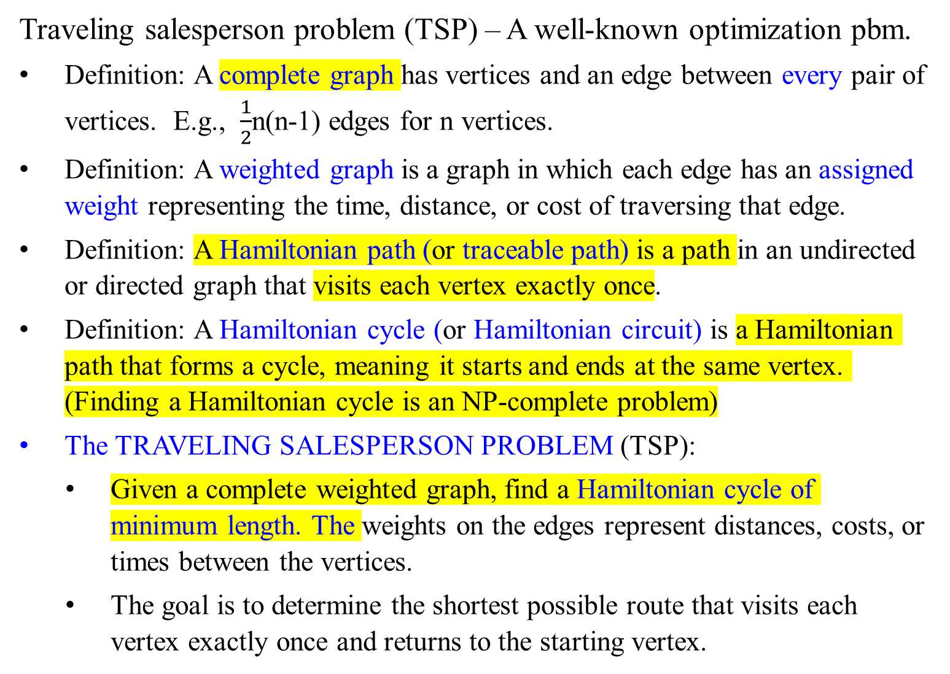
Traveling salesperson problem (TSP) – A well-known optimization pbm.
Definition: A complete graph has vertices and an edge between every pair of vertices. E.g., $\frac{1}{2}$n(n-1) edges for n vertices.
Definition: A weighted graph is a graph in which each edge has an assigned weight representing the time, distance, or cost of traversing that edge.
Definition: A Hamiltonian path (or traceable path) is a path in an undirected or directed graph that visits each vertex exactly once.
Definition: A Hamiltonian cycle (or Hamiltonian circuit) is a Hamiltonian path that forms a cycle, meaning it starts and ends at the same vertex. (Finding a Hamiltonian cycle is an NP-complete problem)
The TRAVELING SALESPERSON PROBLEM (TSP):
  Given a complete weighted graph, find a Hamiltonian cycle of minimum length. The weights on the edges represent distances, costs, or times between the vertices.
  The goal is to determine the shortest possible route that visits each vertex exactly once and returns to the starting vertex.

Slide 12
Key Characteristics of TSP:
NP-Complete:
  TSP is classified as an NP-complete problem, indicating that no known polynomial-time algorithm can solve all instances of this problem efficiently.
  NP-complete problems are significant in computational theory because a polynomial-time solution to any NP-complete problem would solve all NP problems in polynomial time.
Applications:
  TSP has practical applications in logistics, manufacturing, DNA sequencing, and more, where optimal routing is crucial.

Slide 13
Key Characteristics of TSP:
Solution Approaches:
  Exact Algorithms: Methods like branch and bound dynamic programming and integer linear programming guarantee finding the optimal solution but can be computationally expensive for large instances.
  Approximation Algorithms: Heuristics like the nearest neighbor, genetic algorithms, and simulated annealing offer good solutions within a reasonable time, even if they may not be the optimal ones.
Understanding TSP and its complexity helps in appreciating the challenges of optimization in real-world scenarios and the importance of developing efficient algorithms and heuristics.

Slide 14
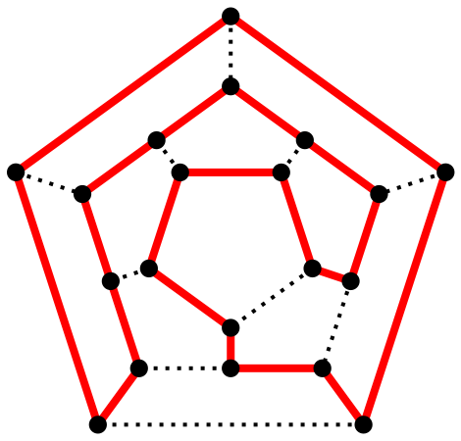
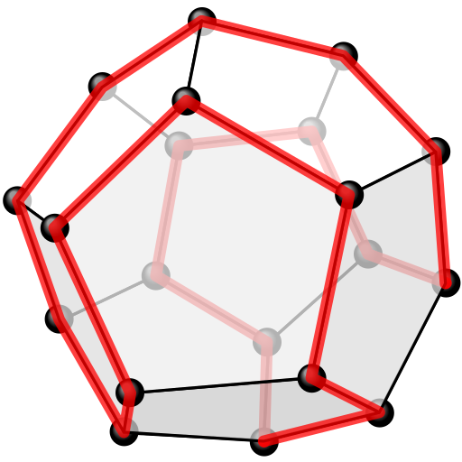
A polyhedron with twelve plane faces
Y
Y
X
X
Z
Z
B
C
A
D
S
D
A
S
C
B
One possible Hamiltonian cycle through every vertex of a dodecahedron is shown in red – like all platonic solids, the dodecahedron is Hamiltonian
The above as a two-dimensional planar graph

Slide 15
An overview of key concepts in computational complexity theory related to P (polynomial) class, NP (nondeterministic polynomial time), NP-complete, and NP-hard problems.
P (Polynomial) Class:
Definition: Problems in P are those for which a polynomial-time algorithm exists. (Equivalently, problems that belong to the P class can be solved by an algorithm in polynomial time.)
This means that the time it takes to solve the problem grows at most as a polynomial function of the input size.
Notation: O(n^{k}), where n is the input size and k is a constant.
Formally, a problem is in P if there exists a deterministic Turing machine that can solve it in O(n^{k}) time, where n is the input size and k is a constant.
Examples: Sorting algorithms like Merge Sort and Quick Sort and shortest path algorithms like Dijkstra’s algorithm.

Slide 16
An overview of key concepts in computational complexity theory related to P (polynomial) class, NP (nondeterministic polynomial time), NP-complete, and NP-hard problems.
NP (Nondeterministic Polynomial) Time:
  Definition: NP is the class of problems for which a given solution can be verified quickly (in polynomial time).
  Formally, a problem is in NP if there exists a nondeterministic Turing machine that can verify a given solution in O(n^{k}) time.
  This means that the solution verification process is polynomial. It also implies that a nondeterministic Turing machine can solve the problem (can check a guess solution) in polynomial time.
  Nondeterministic means that a "guess" for a solution could be checked quickly, but finding that solution might not be quick.
  Example: Satisfiability problems like the Boolean satisfiability problem (SAT). Consider the following Boolean formula in Conjunctive Normal Form (CNF): Assign values to the variables, evaluate all the clauses true;
(x₁ ∨ ¬x₂) ∧ (¬x₁ ∨ x₃) ∧ (x₂ ∨ ¬x₃)

Slide 17
An overview of key concepts in computational complexity theory related to P (polynomial) class, NP (nondeterministic polynomial time), NP-complete, and NP-hard problems.
NP-Hard Problems:
Definition: NP-hard problems are at least as hard as the hardest problems in NP. (i.e., solving an NP-hard problem is at least as difficult as solving any problem in NP)
Formally, any problem in NP can be polynomial-time reduced to an NP-hard problem.
This means that if you had a polynomial-time solution to an NP-hard problem, you could use it to solve any NP problem efficiently.
However, unlike NP-complete problems, NP-hard problems do not have to be in NP, meaning they do not have to have solutions that can be verified in polynomial time.
Example: The Halting Problem, some optimization problems where the verification of a solution is not necessarily polynomial.

Slide 18
An overview of key concepts in computational complexity theory related to P (polynomial) class, NP (nondeterministic polynomial time), NP-complete, and NP-hard problems.
NP-Complete Problems:
Definition: NP-complete problems are a subset of NP problems that are both in NP and as hard as any problem in NP.
NP-Completeness: A problem is NP-complete if it is both in NP (it can verify a solution in polynomial time), and NP-hard (at least as hard as any other NP problem).
In other words, if any NP-complete problem can be solved in polynomial time, then all problems in NP can also be solved in polynomial time.
Example: Traveling Salesperson Problem (TSP), SAT, Hamiltonian Cycle
NP-Hardness: A problem X is NP-hard if every problem in NP can be transformed (reduced) to X in polynomial time.

Slide 19
Relationships Between Classes:
P vs. NP: It is an open question whether P = NP. If P = NP, then every problem for which a solution can be verified in polynomial time can also be solved in polynomial time.
NP-Complete: If any NP-complete problem is solved in polynomial time, then P = NP. However, solving any NP-hard problem in polynomial time does not necessarily mean P = NP unless the problem is also in NP.
Hierarchy:
  P ⊆ NP
  NP-Complete ⊆ NP
  NP-Hard ⊇ NP-Complete

Slide 20
Summary:
P Class: Problems solvable in polynomial time.
NP Class: Problems verifiable in polynomial time.
NP-Complete: Hardest problems in NP; if one is solved in polynomial time, all NP problems are.
NP-Hard: At least as hard as the hardest NP problems; not necessarily verifiable in polynomial time

Slide 21
P versus NP Question:
The P versus NP question asks whether every problem for which a solution can be checked (verified) in polynomial time can also be solved in polynomial time, which means whether polynomial-time algorithms exist for problems in NP.
In formal terms:
If P ≠ NP, there are problems in NP that are not in P. This means there are problems for which verifying a solution (verification) is easy (polynomial time), but finding a solution is inherently hard (not polynomial time).
If P = NP, it implies that every problem for which a solution can be quickly checked in polynomial time can also be solved quickly in polynomial time.
  This would mean that the process of finding a solution is no more complex than verifying a solution.
The question of whether P ≠ NP or P = NP remains an unsolved problem in computer science. It is an open problem.

Slide 22
P versus NP Question:
The question of whether P ≠ NP or P = NP remains an unsolved problem in computer science. It is an open problem.
Most computer scientists believe that P ≠ NP, suggesting that there are inherently difficult problems, like in cryptography and optimization, that cannot be solved in polynomial time, but no proof has been found either way.

Slide 23
NP-Complete Problem:
  Definition: An NP-complete problem is an NP problem that is, in a certain sense, the "hardest" problem in NP.
  Significance: If a polynomial-time algorithm exists for any NP-complete problem, then a polynomial-time algorithm exists for all problems in NP, implying P = NP.
  Examples of the NP-Complete problems are:
Traveling Salesperson Problem (TSP),
Knapsack problem,
Boolean Satisfiability Problem (SAT),
3-Satisfiability (3-SAT), and
Clique Problem.

Slide 24
Examples of NP-Complete Problems
Boolean Satisfiability Problem (SAT)
  Description: Determine if there is an assignment to variables that satisfies a given Boolean formula.
3-SAT
  Description: A specific case of SAT where each clause has exactly three literals.
Hamiltonian Cycle Problem
  Description: Determine if there is a cycle that visits each vertex exactly once in a given graph.
Clique Problem
  Description: Determine if there is a clique of size k in a given graph.
Vertex Cover Problem
  Description: Determine if there is a subset of vertices of size k that covers all edges in a given graph.
Subset Sum Problem
  Description: Determine if there is a non-empty subset of integers that sums to a given target.

Slide 25
Examples of NP-Complete Problems
7. Partition Problem
  Description: Determine if a set of integers can be partitioned into two subsets with equal sums.
8. Graph Coloring Problem
  Description: Determine if the vertices of a graph can be colored with k colors such that no two adjacent vertices share the same color.
9. Knapsack Problem
  Description: Determine the most valuable subset of items that can be carried in a knapsack of limited capacity.
10. Longest Path Problem
  Description: Determine the longest simple path between two vertices in a graph.
Understanding these classifications helps determine the computational difficulty of problems and the potential for finding efficient algorithms to solve them.

Slide 26
NP-Hard Problem:
  Definition: An NP-hard problem is, informally, at least as "hard" as any problem in NP.
  Relationship: NP-complete problems are a subset of NP-hard problems.
Complexity’s Hierarchy:
  P ≠ NP ≤ NP-Complete ≤ NP-Hard: The hierarchy of problem complexities states that NP-complete problems are the most challenging/difficult problems within the class NP. NP-hard problems are at least as challenging/difficult as NP-complete problems.
The P ≠ NP conjecture remains a central question in complexity theory, with significant implications for computer science and mathematics if resolved.

Slide 27
Examples of NP-Hard Problems that are not NP-Complete:
Halting Problem:
  Description: Given a description of a program and an input, determine whether the program finishes running or continues to run forever.
  Reason: The Halting Problem is undecidable, meaning there is no algorithm that can solve all instances of the problem. It is not in NP because there is no way to verify a solution in polynomial time for all possible inputs.
2. Post Correspondence Problem (PCP):
Description: Given a collection of pairs of strings, determine if there is a sequence of indices that form equal strings when the strings are concatenated.
Reason: PCP is undecidable. While it is at least as hard as the hardest problems in NP, it does not belong to NP because there is no polynomial-time verification for all inputs.
Given two lists:
A=["ab","a","b"] B=["a","ba","b"]
the sequence [2,1] is not a valid solution for this instance of the PCP, for aab and baa are not equal.

Slide 28
Examples of NP-Hard Problems that are not NP-Complete:
3. Traveling Salesman Problem (TSP) with Real Distances:
Description: Find the shortest possible route that visits each city and returns to the origin city, where the distances between cities are real numbers.
Reason: If the distances are real numbers (not integers), the problem can be NP-hard due to precision issues, making it difficult to verify solutions in polynomial time.
4. Knapsack Problem with Arbitrary Precision:
Description: Given items with weights and values that are arbitrary real numbers, determine the most valuable subset of items that can be carried in a knapsack with a weight limit.
Reason: The arbitrary precision of weights and values can make verification in polynomial time infeasible, even though the problem remains NP-hard.

Slide 29
Conclusion: These concepts describe the complexity relationships for different types of computational problems and have significant implications for algorithm design and the theory of computation.

Slide 31
Computational Complexity and Intractability
Complexity Classes
A complexity class is
  the set of all the computational problems that can be solved using a certain amount of a certain computational resource (such as time and space).

Slide 32
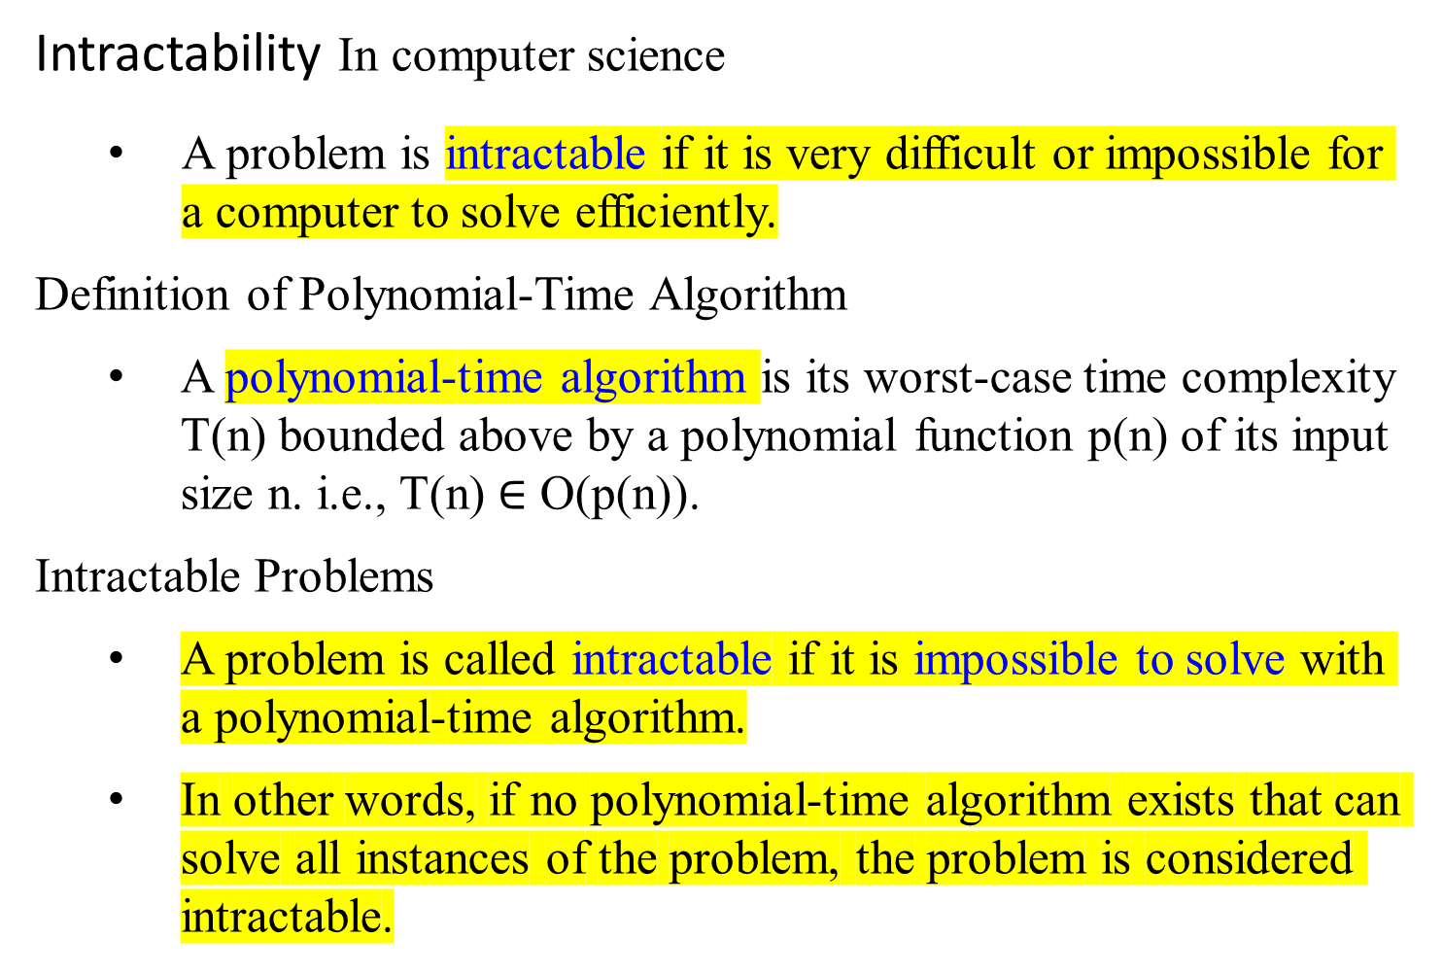
Computational Complexity and Intractability
Intractability In computer science
  A problem is intractable if it is very difficult or impossible for a computer to solve efficiently.
Definition of Polynomial-Time Algorithm
A polynomial-time algorithm is its worst-case time complexity T(n) bounded above by a polynomial function p(n) of its input size n. i.e., T(n) $∈$ O(p(n)).
Intractable Problems
A problem is called intractable if it is impossible to solve with a polynomial-time algorithm.
In other words, if no polynomial-time algorithm exists that can solve all instances of the problem, the problem is considered intractable.

Slide 33
Characteristics of Intractable Problems
Exponential or Worse Time Complexity:
Intractable problems often have time complexities that grow exponentially or faster with respect to the input size, such as O(2^{n}), O(n!), or even worse.
NP-Hard and NP-Complete Problems:
Many intractable problems belong to the classes of NP-hard or NP-complete problems.
These problems are at least as hard as the hardest problems in NP, and no polynomial-time algorithm is known for solving them.

Slide 34
Examples of Intractable Problems
Travelling Salesperson Problem (TSP):
  Description: Given a list of cities and the distances between each pair of cities, find the shortest possible route that visits each city exactly once and returns to the origin city.
  Complexity: The problem is NP-hard, and the best-known algorithms have exponential time complexity.
Knapsack Problem:
  Description: Given a set of items, each with a weight and a value, determine the most valuable subset of items that can be fit into a knapsack of limited capacity.
  Complexity: The decision version of the problem is NP-complete, and the optimization version is NP-hard.
Boolean Satisfiability Problem (SAT):
  Description: Determine if there exists an interpretation that satisfies a given Boolean formula.
  Complexity: The problem is NP-complete.

Slide 35
Why Intractability Matters
Practical Implications:
Intractable problems are significant because they imply that certain computational tasks cannot be performed efficiently as the input size grows.
This has practical implications in cryptography, operations research, and artificial intelligence.
Research Focus:
Understanding intractability drives research in finding efficient approximation algorithms and heuristic methods and exploring the boundaries of computational complexity.

Slide 36
Computational Complexity and Intractability
Definition of Intractable Problems:
Problems that cannot be solved in polynomial time for all possible inputs.
Categories of Problems Based on Intractability
Three general categories of problems:
  Problems for which polynomial-time algorithms have been found for solving them.
  Problems that have been proven to be intractable.
  Problems that have not been proven to be intractable but for which polynomial-time algorithms have never been found.

Slide 37
Computational Complexity and Intractability
Intractability
1. Problems with known Polynomial-Time Algorithms:
Problems for which efficient algorithms exist and their worst-case time complexity are bounded by the polynomial function of the input size.
Examples:
Sorting Algorithms:
Algorithms like QuickSort, MergeSort, and HeapSort have polynomial-time complexity, O(n log n).
Shortest Path Problems:
Algorithms like Dijkstra's algorithm and the Bellman-Ford algorithm solve shortest-path problems in polynomial time.
Minimum Spanning Tree:
Algorithms like Prim’s and Kruskal’s have polynomial-time complexities.

Slide 38
Computational Complexity and Intractability
Intractability
2. Problems that have been proven to be intractable:
These are problems that have been proven to be intractable, meaning that no algorithm exists that can solve them in polynomial time for all possible inputs.
Examples:
Determining All Hamilton Circuits:
  This problem is to find all possible Hamiltonian circuits in a given graph. A Hamiltonian circuit is a cycle that visits every vertex exactly once. The number of Hamiltonian circuits in a complete graph with n vertices is (n−1)! (factorial), making the problem intractable because the problem requires a nonpolynomial amount of output.
  As the input size (number of vertices) increases, the factorial growth of the number of Hamiltonian circuits makes it impossible to solve the problem in polynomial time.

Slide 39
Computational Complexity and Intractability
Intractability
Problems that have been proven to be intractable:
Examples:
  The Halting problem: given an algorithm and an input, the problem is determining whether the algorithm will eventually halt when run with that input.
    Alan Turing showed that this problem is undecidable. Turing proved that no general algorithm exists that can always correctly decide whether the program halts or runs indefinitely for any arbitrary program and input.
    This means there is no algorithm that can solve the Halting Problem in finite time for all possible inputs.
Does its Halt? Decidable?
input
Yes
no

Slide 40
Definition of Intractable Problems:
Problems that cannot be solved in polynomial time for all possible inputs.
Definition of Decidable but Intractable:
Some problems have solutions (are decidable) but are proven intractable because no polynomial-time algorithm exists to solve them.

Slide 41
Computational Complexity and Intractability
Intractability
Problems that have been proven to be intractable:
Decidable but Intractable
  Some natural decidable decision problems have been proven intractable
  The decision problems are decidable (meaning a solution exists) but have been proven intractable because no efficient algorithm (polynomial-time algorithm) has been found to solve them.
These problems may have solutions, but finding them takes an impractical amount of time for large inputs.

Slide 42
Examples
Traveling Salesperson Problem (TSP):
  Description: Given a list of cities and the distances between each pair of cities, the problem is to find the shortest possible route that visits each city exactly once and returns to the origin city.
  Explanation: TSP is NP-hard, and no polynomial-time algorithm is known for solving it. The problem becomes intractable because the number of possible routes grows factorially with the number of cities.
Knapsack Problem:
  Description: Given a set of items, each with a weight and a value, determine the most valuable subset of items that can be carried in a knapsack with a weight limit.
  Explanation: The decision version of the Knapsack Problem is NP-complete, and the optimization version is NP-hard. While a solution exists, finding it in polynomial time is not possible with current algorithms, making it intractable for large inputs.

Slide 43
Examples
3. Boolean Satisfiability Problem (SAT):
  Description: Determine if there exists an interpretation that satisfies a given Boolean formula.
  Explanation: SAT is NP-complete. While it is decidable (a solution exists), finding a solution in polynomial time is infeasible for large instances, making it intractable.

Slide 44
Summary
Intractable Problems: Problems that cannot be solved in polynomial time for all possible inputs.
Decidable but Intractable: Some problems have solutions (are decidable) but are proven intractable because no polynomial-time algorithm exists to solve them.
Examples:
  Determining All Hamiltonian Circuits: The number of solutions grows factorially with the input size.
  Halting Problem: Proven undecidable by Alan Turing.
  Traveling Salesperson Problem, Knapsack Problem, Boolean Satisfiability Problem: Decidable but intractable due to their NP-complete or NP-hard nature.

Slide 45
Computational Complexity and Intractability
Intractability
3. Problems not Proven to be Intractable but without Polynomial-Time algorithms:
These problems have never been solved using polynomial-time algorithms, but they have not been proven to be intractable either.
The lack of known polynomial-time solutions suggested that they might be intractable, but this has not been definitively proven.
These problems often belong to the class NP.
Examples are: (no known polynomial-time solution)
  0-1 Knapsack problem, NP-complete,
  Traveling Salesperson problem, NP-hard

Slide 46
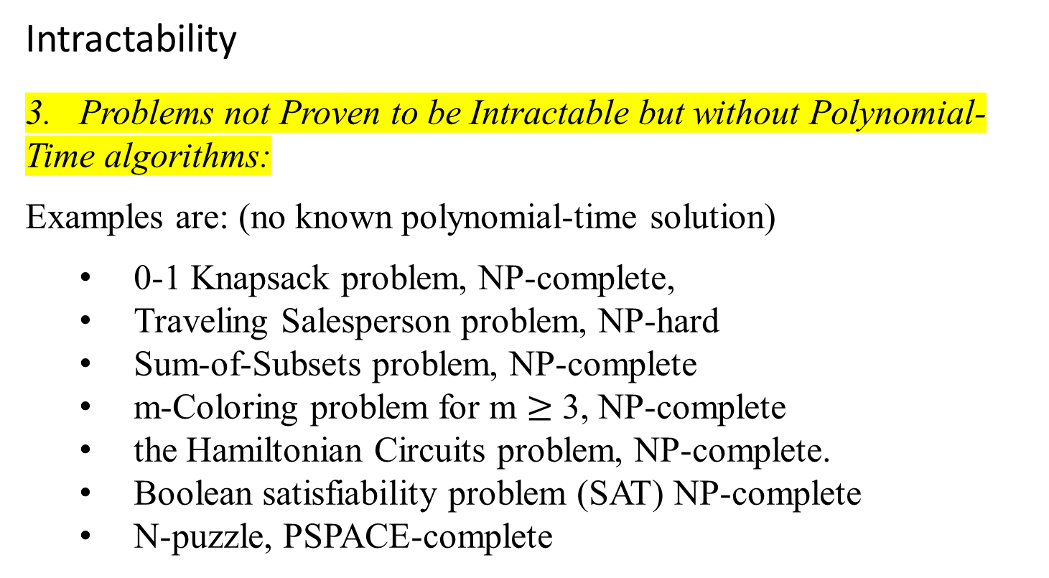
Computational Complexity and Intractability
Intractability
3. Problems not Proven to be Intractable but without Polynomial-Time algorithms:
Examples are: (no known polynomial-time solution)
  0-1 Knapsack problem, NP-complete,
  Traveling Salesperson problem, NP-hard
  Sum-of-Subsets problem, NP-complete
  m-Coloring problem for m $≥$ 3, NP-complete
  the Hamiltonian Circuits problem, NP-complete.
  Boolean satisfiability problem (SAT) NP-complete
  N-puzzle, PSPACE-complete

Slide 47
0-1 Knapsack Problem:
  Description: Given a set of items, each with a weight and a value, determine the most valuable subset of items that can be carried in a knapsack with a weight limit. Each item can either be included or excluded (0-1)in the knapsack or not, without fractions of items being taken.
  Explanation: The decision version of the 0-1 Knapsack Problem is NP-complete. While dynamic programming approaches exist for solving it, they do not run in polynomial time for all input sizes.
  Nature: Optimization problem.

Slide 48
Traveling Salesperson Problem (TSP):
  Description: Given a list of cities and the distances between each pair of cities, find the shortest possible route that visits each city exactly once and returns to the origin city.
  Explanation: TSP is NP-hard. No polynomial-time algorithm is known, although heuristic and approximation algorithms can find good solutions for practical purposes.
  Nature: Optimization problem

Slide 49
Sum-of-Subsets Problem:
Description: Given a set of integers, determine if there exists a non empty subset whose sum is equal to a given target sum.
Explanation: This problem is NP-complete. While subset sum problems can be solved using dynamic programming, these solutions are not polynomial-time in the worst case.
  Nature: Decision problem.
m-Coloring Problem for m ≥ 3:
Description: Given a graph and an integer m, determine if the graph's vertices can be colored with m colors such that no two adjacent vertices share the same color.
Explanation: The problem is NP-complete for m ≥ 3. Efficient polynomial-time algorithms for all instances are not known.
  Nature: Decision problem.

Slide 50
Hamiltonian Circuits Problem:
Description: Given a graph, determine if there exists a Hamiltonian circuit, which is a cycle that visits every vertex exactly once. Equivalently, determine if a closed tour exists in a graph that visits each vertex exactly once.
Explanation: This problem is NP-complete. No polynomial-time algorithm is known for finding Hamiltonian circuits in all graphs.
  Nature: Decision problem.

Slide 51
Boolean Satisfiability Problem (SAT):
Description: Given a Boolean formula, determine if there exists an assignment of truth values to variables such that the formula is true. Equivalently, determine if there exists an interpretation that satisfies a given Boolean formula.
Explanation: SAT is NP-complete. While polynomial-time algorithms exist for specific cases (like 2-SAT), no such algorithm exists for the general case.
  Nature: Decision problem.

Slide 52
N-Puzzle:
Description: Given an n×n board with numbered tiles and one blank space, rearrange the tiles to achieve a specific goal configuration using the blank space.
Explanation: This problem is PSPACE-complete, which is a class of problems that are solvable in polynomial space but not necessarily in polynomial time.
No polynomial-time solution is known for all instances of the problem.
  Nature: Search problem.
These problems are considered challenging due to the absence of known polynomial-time algorithms, and they often serve as benchmarks for algorithmic and computational complexity studies.

Slide 54
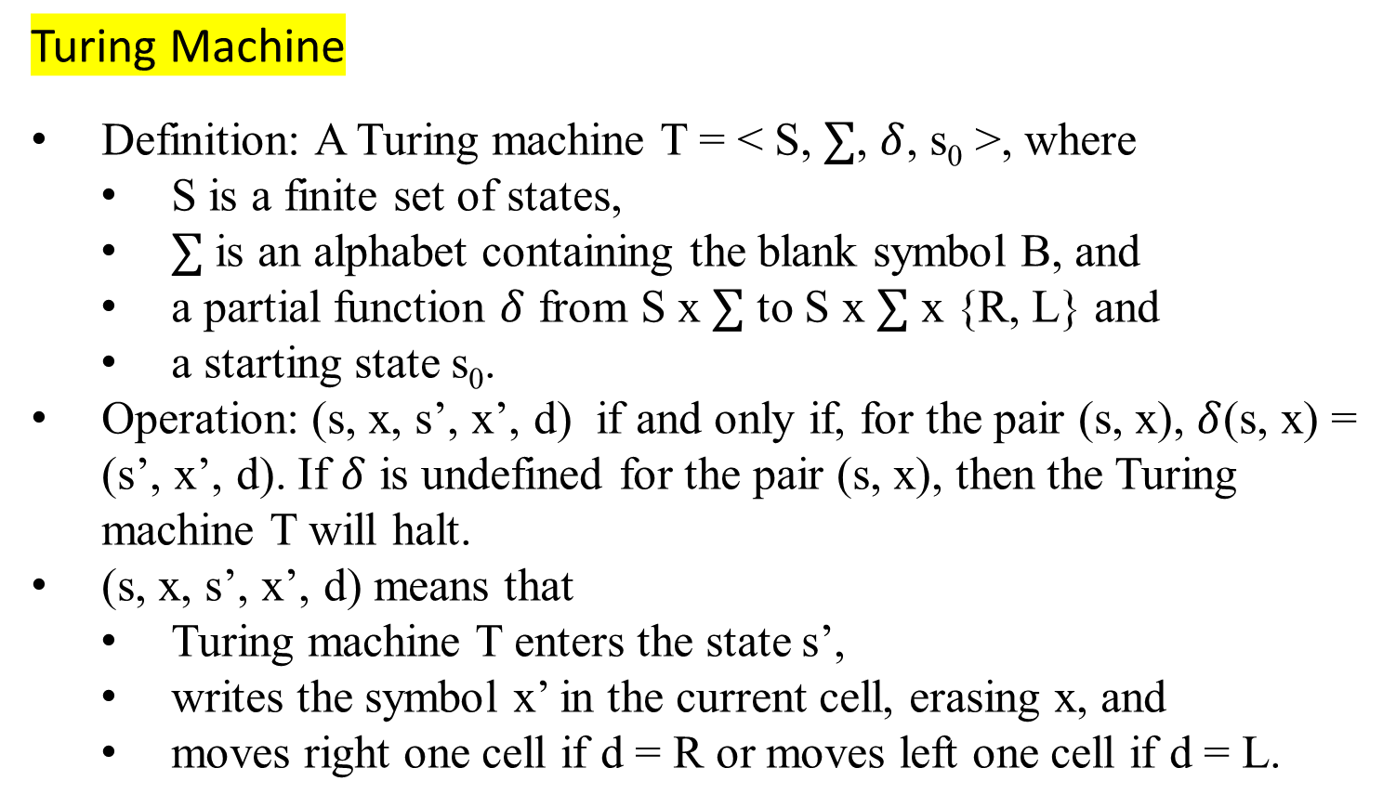
Computational Complexity and Intractability
Turing Machine
Definition: A Turing machine T = < S, $∑$, $δ$, s₀ >, where
  S is a finite set of states,
  $∑$ is an alphabet containing the blank symbol B, and
  a partial function $δ$ from S x $∑$ to S x $∑$ x {R, L} and
  a starting state s₀.
Operation: (s, x, s’, x’, d) if and only if, for the pair (s, x), $δ$(s, x) = (s’, x’, d). If $δ$ is undefined for the pair (s, x), then the Turing machine T will halt.
(s, x, s’, x’, d) means that
  Turing machine T enters the state s’,
  writes the symbol x’ in the current cell, erasing x, and
  moves right one cell if d = R or moves left one cell if d = L.

Slide 55
Turing Machine
Example:
  What is the final tape when the Turing machine T is defined by the seven five-tuples
      (s₀, 0, s₀, 0, R),
      (s₀, 1, s₁, 1, R),
      (s₀, B, s₃, B, R),
      (s₁, 0, s₀, 0, R),
      (s₁, 1, s₂, 0, L),
      (s₁, B, s₃, B, R),
      (s₂, 1, s₃, 0, R)
    is run on the tape shown in the following figure?
0/0/R
s₀
1/1/R
s₁
0/0/R
0/0/R
B/B/R
1/1/R
1/0/L
B/B/R
B/B/R
s₃
s₂
1/0/R

Slide 56
s₀
ReadWrite Head at initial position
… | B | B | 0 | 1 | 0 | 1 | 1 | 0 | B | B | …
      (s₀, 0, s₀, 0, R),
      (s₀, 1, s₁, 1, R),
      (s₀, B, s₃, B, R),
      (s₁, 0, s₀, 0, R),
      (s₁, 1, s₂, 0, L),
      (s₁, B, s₃, B, R),
      (s₂, 1, s₃, 0, R)
      Erase the first
      11 to 00 only.
      Add:
      (s₃, B, s₃, B, R)
      (s₃, 0, s₀, 0, R)
      (s₃, 1, s₁, 1, R)
      Erase all the even pairs of 1s to 0 between B’s only
s₀
… | B | B | 0 | 1 | 0 | 1 | 1 | 0 | B | B | …
s₁
… | B | B | 0 | 1 | 0 | 1 | 1 | 0 | B | B | …
s₀
… | B | B | 0 | 1 | 0 | 1 | 1 | 0 | B | B | …
s₁
… | B | B | 0 | 1 | 0 | 1 | 1 | 0 | B | B | …
s₂
… | B | B | 0 | 1 | 0 | 1 | 0 | 0 | B | B | …
s₃
… | B | B | 0 | 1 | 0 | 0 | 0 | 0 | B | B | …
Figure: The steps produced by running T on the tape.
Machine Halts

Slide 57
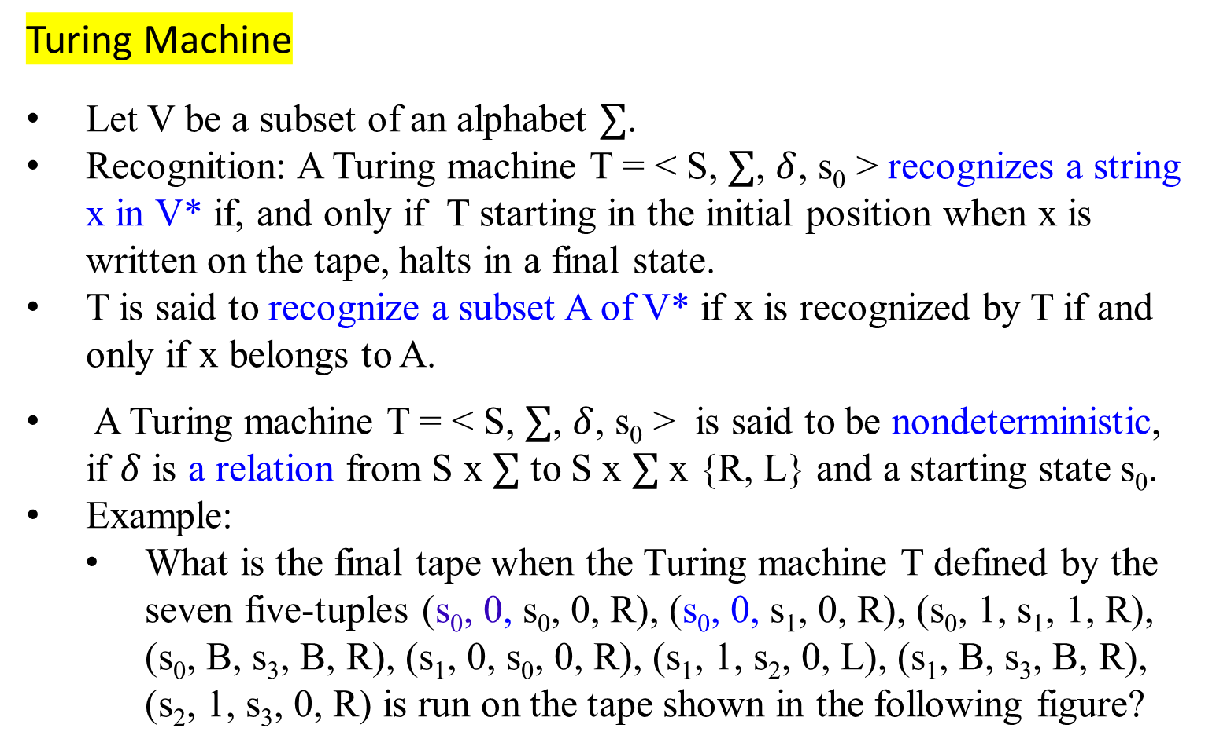
Turing Machine
Let V be a subset of an alphabet $∑$.
Recognition: A Turing machine T = < S, $∑$, $δ$, s₀ > recognizes a string x in V* if, and only if T starting in the initial position when x is written on the tape, halts in a final state.
T is said to recognize a subset A of V* if x is recognized by T if and only if x belongs to A.
A Turing machine T = < S, $∑$, $δ$, s₀ > is said to be nondeterministic, if $δ$ is a relation from S x $∑$ to S x $∑$ x {R, L} and a starting state s₀.
Example:
  What is the final tape when the Turing machine T defined by the seven five-tuples (s₀, 0, s₀, 0, R), (s₀, 0, s₁, 0, R), (s₀, 1, s₁, 1, R), (s₀, B, s₃, B, R), (s₁, 0, s₀, 0, R), (s₁, 1, s₂, 0, L), (s₁, B, s₃, B, R), (s₂, 1, s₃, 0, R) is run on the tape shown in the following figure?

Slide 58
Computational Complexity and Intractability
An overview of the Turing Machine model and its application to computational complexity, especially about decision problems and the halting problem.
Turing Machine – An Overview:
Turing machine are theoretical models of computation introduced by Alan Turing.
Consist of an infinite tape, a read/write head, and a set of states.
The machine reads and writes symbols on the tape based on a set of rules, moving left or right along the tape.
Fundamental concept in the theory of computation, especially for decision problems and the halting problem.

Slide 59
Computational Complexity and Intractability
Decision problems
The decision problems are binary (yes-or-no) problems that ask whether a particular statement or input belongs to a certain class. They seek adefinitive yes-or-no answer.
For example, Primality Test: Given a number n, is n a prime number?
Graph Connectivity: given a graph G, is G connected? The halting problem
The halting problem is a specific decision problem that asks whether a Turing machine T eventually halts when given a specific input string x.
Formally, it is the question of whether T halts on input x. The halting problem is crucial in understanding the limits of computation.

Slide 60
Unsolvable Decision Problem:
The halting problem is proven to be an unsolvable decision problem. This meaning that:
  No Turing machine can decide, for any arbitrary Turing machine T and input x, whether T halts on x.
  Alan Turing established this result and is a cornerstone in the theory of undecidability.
The proof of the undecidability of the halting problem is a decisive result. It shows that there are problems that are inherently unsolvable by any algorithmic means. This insight has profound implications for the study of computational complexity and the limits of what can be computed algorithmically.

Slide 62
The P class problem:
Definition: The complexity class P consists of all decision problems that can be solved by a deterministic Turing machine using a polynomial amount of computation time, or polynomial time.
Characteristics:
Efficiently Solvable: Problems in P are considered efficiently solvable or “tractable.”
Polynomial Time: The time required to solve these problems can be expressed as a polynomial function of the size of the input.
Examples: Decision versions of linear programming, computing GCD, and finding a maximum matching.

Slide 63
Computational Complexity and Intractability
The P class problem - Definition:
A language L is in P if and only if there exists a deterministic Turing machine M, such that
M runs for polynomial time on all inputs,
for all x in L, M outputs 1, and
for all x not in L, M outputs 0.
Cobham’s Thesis Statement:
Cobham’s thesis holds that P is the class of computational problems that are "efficiently solvable" or “tractable”;
  Feasibility: Asserts that computational problems can be feasibly computed on some computational device only if they can be computed in polynomial time (that is, if they are in the complexity class P).
  Practical Solutions: some problems not known to be in P have practical solutions, and some in P do not.
TM(01011) yields 1.
TM(11) yields 0

Slide 64
Computational Complexity and Intractability
In Computational complexity theory
Definition: A decision problem is in the complexity class NP, (the class of nondeterministic polynomial time problems),
  if the set of decision problems for which the problem instances, where the answer is “yes”, have proofs verifiable in polynomial time by a deterministic Turing machine.
Equivalently, if a nondeterministic Turing machine can solve the set of decision problems that can be solved in polynomial time.

Slide 65
Computational Complexity and Intractability
Characteristics:
Verification: If a “yes” instance of the problem has a proof that can be verified in polynomial time by a deterministic Turing machine.
Nondeterministic Turing Machine: A problem is in NP if a nondeterministic Turing machine can solve it in polynomial time.
Equivalence:
These two definitions are equivalent because the algorithm based on the Turing machine consists of two phases:
Guessing Phase: A guess about the solution is generated in a nondeterministic way.
Verification Phase: A deterministic algorithm verifies if the guess is a solution to the problem.

Slide 66
Computational Complexity and Intractability
Relationship Between P and NP
Inclusion:
A problem in P (solvable in polynomial time) is always also in NP.
Tractability:
  Problem in P are called tractable.
  Problems not in P are called intractable.
  Tractable Problem Example:
  Deterministic whether an item is in a list of n elements is a tractable problem because it can be decided in polynomial time.

Slide 67
Computational Complexity and Intractability
xxxIn Computational complexity theory
Problems in P are called tractable, whereas problems not in P are called intractable.
For a problem to be in P, a deterministic Turing machine must exist that can decide in polynomial time whether a particular statement of the class addressed by the decision problem is true.
Example:
  Determining whether an item is in a list of n elements is a tractable problem.

Slide 68
Computational Complexity and Intractability
Definition of Complexity Class NP:
A decision problem is in NP (nondeterministic polynomial time) if there exists a nondeterministic Turing machine that can verify the truth of a statement in polynomial time by making the correct guess at each step from the set of allowable steps corresponding to the current state and tape symbol.
Characteristics:
  Nondeterministic Verification: Verification of a “yes” instance can be performed in polynomial time by a nondeterministic Turing machine.
  Correct Guess: The nondeterministic Turing machine makes the correct guess at each step to verify the solution.

Slide 69
Computational Complexity and Intractability
Definition of Complexity Class NP:
Example:
  Hamiltonian Circuit Problem: Determining whether a given graph has a Hamilton circuit is an NP problem, because
    a nondeterministic Turing machine can verify that a simple circuit in a graph passes through each vertex exactly once.

Slide 70
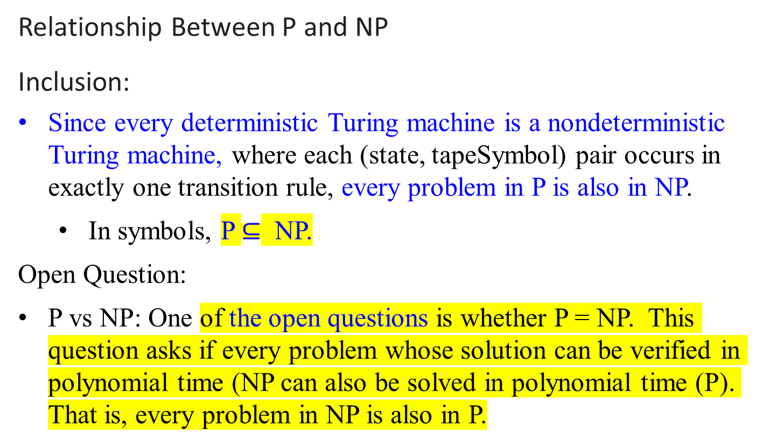
Computational Complexity and Intractability
Relationship Between P and NP
Inclusion:
Since every deterministic Turing machine is a nondeterministic Turing machine, where each (state, tapeSymbol) pair occurs in exactly one transition rule, every problem in P is also in NP.
  In symbols, P $⊆$ NP.
Open Question:
P vs NP: One of the open questions is whether P = NP. This question asks if every problem whose solution can be verified in polynomial time (NP can also be solved in polynomial time (P). That is, every problem in NP is also in P.

Slide 71
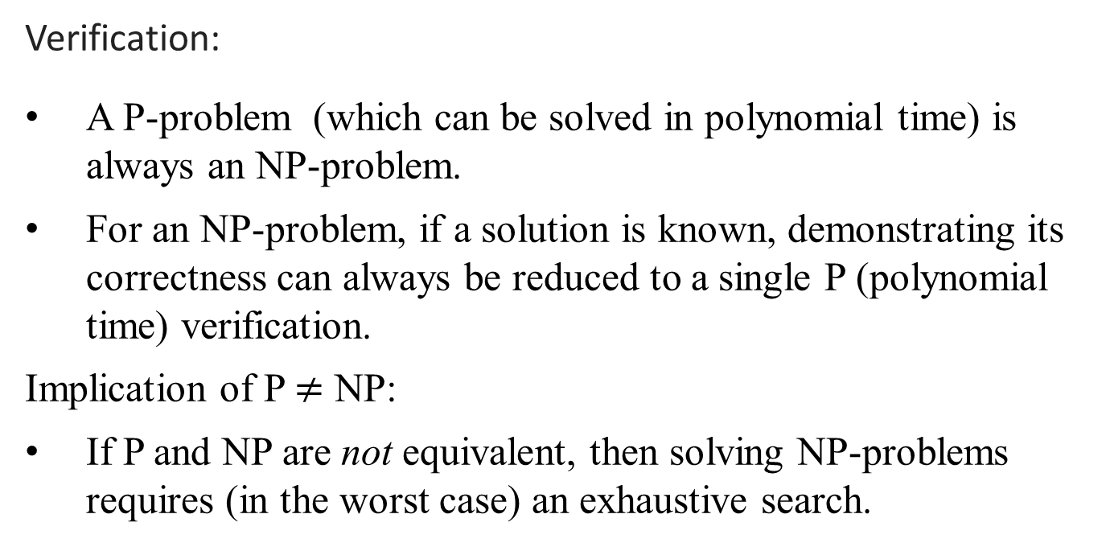
Computational Complexity and Intractability
Verification:
A P-problem (which can be solved in polynomial time) is always an NP-problem.
For an NP-problem, if a solution is known, demonstrating its correctness can always be reduced to a single P (polynomial time) verification.
Implication of P $≠$ NP:
If P and NP are not equivalent, then solving NP-problems requires (in the worst case) an exhaustive search.

Slide 72
NP problems
Examples in Graph Theory
Shortest path algorithms:
  Shortest Path is solvable in polynomial time (P).
  Longest path is NP-complete.
  Eulerian Tours:
  Definition: Eulerian tours visit every vertex but cover every edge only once.
  Complexity: Solvable in polynomial time P.
  Hamiltonian tours:
  Definition: visit every vertex; no vertices can be repeated).
  Complexity: NP-complete

Slide 73
Computational Complexity and Intractability
Summary
Class P: Problems that can be solved in polynomial time by a deterministic Turing machine.
Class NP: Problems for which a "yes" instance can be verified in polynomial time by a nondeterministic Turing machine.
Relationship: P ⊆ NP; however, it is not known whether P = NP.
Verification: NP-problems can be verified in polynomial time, but their solution might require nondeterministic steps or exhaustive search if P ≠ NP.
Understanding these classes and their relationships is crucial for analyzing the complexity and feasibility of solving various computational problems.

Slide 74
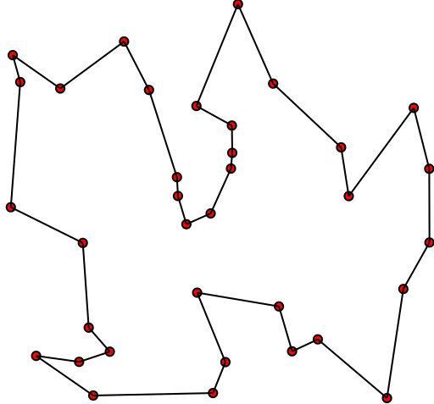

Traveling salesman problem
Solution of a traveling salesman problem: the black line shows the shortest possible loop that connects every dot

Slide 75

What is the complexity of primality testing?
This loops until the square root of n.
So this should be O($\sqrt{n}$ ), which is not a polynomial time but is exponential time.
What is the input size?
How many bits does it take to
represent the number n?
$⨽\log_{2}{n}$ ⨼ + 1. Says, log₂ n = k bits.
What is $\sqrt{n}?$
Since log₂ n = log₂ n *log₂ 2
= $\log_{2}{2^{\text{log}\text{2} \text{n}}}$
n = $2^{\log_{2}{n}}$
$O(\sqrt{n })=O(\sqrt{2^{\log_{2}{n}}} )$= O((${2^{\log_{2}{n}})}^{\frac{1}{2}}$)
Naïve primality testing is exponential!!
public static boolean isPrime(int n){
boolean answer = (n>1)? true: false;
for(int i = 2; i*i <= n; ++i)
{
System.out.printf("%d\n", i);
if(n%i == 0)
{
answer = false;
break;
}
}
return answer;
}

Slide 76
Why obsess about primes?
Primes in Cryptography: Prime numbers are crucial for secure cryptographic systems.
Primality Testing in P: The AKS primality test (named after Agrawal, Kayal, and Saxena), proven in 2002, used advanced concepts from the number theory to establish that primality testing is in the class P by providing a deterministic polynomial-time algorithm for primality testing.
The ability to efficiently test for primality is essential for the continued development and security of cryptographic systems.

Slide 77
The complexity class NP
NP is not the same as non-polynomial complexity/running time. NP does not stand for not polynomial.
NP stands for Non-Deterministic polynomial time
NP means verifiable in polynomial time
Verifiable?
    If we are somehow given a ‘certificate’ of a solution, we can verify the legitimacy in polynomial time

Slide 78
P = the set of problems that are solvable in polynomial time by a deterministic Turing machine.
NP = the set of decision problems (the answer is either yes or no) that are solvable in nondeterministic polynomial time; i.e., can be solved in polynomial time by a nondeterministic Turing machine.

Slide 79
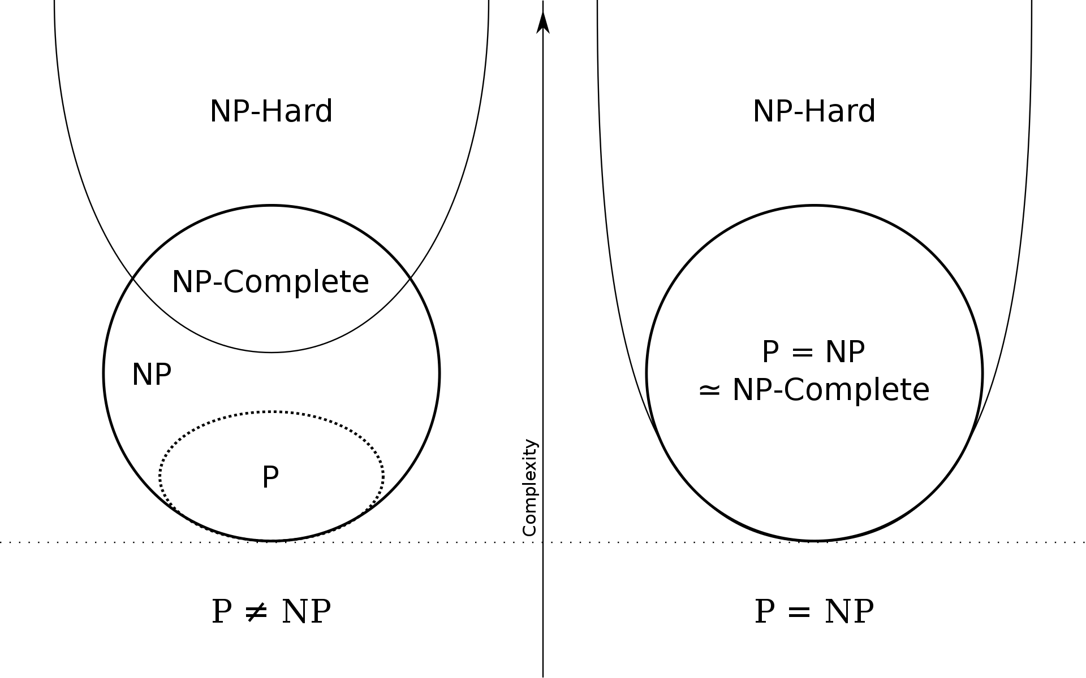
Euler diagram for P, NP, NP-complete, and NP-hard set of problems (excluding the empty language and its complement, which belong to P but are not NP-complete)

Slide 80
To be continued

Slide 81
The Sum of Subsets problem

Slide 82
The Sum of Subsets problem
The Sum of Subsets problem is a classic combinatorial problem that involves finding a subset of a given set of integers such that the sum of the elements in the subset equals a specified value.

Slide 83
Problem Statement
Given a set of integers S={s₁, s₂, …, s_{n}} and an integer K, the goal is to determine whether there exists a subset S′ ⊆ S such that the sum of the elements in S′ equals K.
Example
Input: S={3, 34, 4, 12, 5, 2}, K = 9
Output: Yes, because there exists a subset{4,5} whose sum is 9.

Slide 84
Approaches to Solve the Problem
Recursive Approach:
  Base Case: If K = 0, return true (an empty subset has a sum of 0).
  If K < 0 or the set is empty and K ≠ 0, return false.
  Otherwise, check if the sum can be obtained by including or excluding the last element of the set.
Dynamic Programming:
  Create a 2D boolean array dp where dp[i][j] is true if there is a subset of the first i elements of S that has a sum of j.
  Initialize dp[0][0] to true (an empty subset has a sum of 0).
  Fill the dp table based on whether the current element is included in the subset or not.
Backtracking:
  Explore all possible subsets and backtrack if the current subset sum exceeds.

Slide 85
Complexity
The problem is NP-complete, meaning that there is no known polynomial-time solution. The time complexity of the naive recursive approach is O(2^{n}), where n is the number of elements in the set.
The dynamic programming approach improves this to O(nK), in time and space, making it more feasible for larger sets and sums.
Applications
Resource allocation problems
Financial planning
Decision-making in business and operations

Slide 86
Applications:
1. Resource Allocation:
Project Budgeting: Determine which projects or tasks can be funded within a given budget.
Knapsack Problem: A variation of the Sum of Subsets problem, where items with given weights and values must be selected to maximize the total value without exceeding a weight limit.
2. Financial Planning:
Investment Portfolios: Select a subset of investment opportunities to achieve a desired return within a specified investment limit.
Expense Management: Identify a combination of expenses that fits within a budget while maximizing utility or satisfaction.
3.

Slide 87
Applications:
3. Operations and Logistics:
Load Balancing: Distribute workloads or resources among different entities to achieve an even distribution.
Shipping and Packing: Determine how to pack items into containers such that the weight or volume does not exceed the container's capacity.
4. Subset Selection Problems:
Feature Selection in Machine Learning: Select a subset of features that contribute most to the prediction model while keeping the model simple and efficient.
Data Mining: Identify significant subsets of data that meet specific criteria for analysis.
5.

Slide 88
Applications:
5. Game Theory and Combinatorial Games:
Game Design: Develop levels or challenges in games that require players to achieve specific sums or combinations.
Puzzle Solving: Create and solve puzzles where the objective is to find subsets that meet particular conditions.
6. Cryptography and Security:
Subset Sum Problems in Cryptography: Some cryptographic protocols rely on the hardness of the subset sum problem for security. For example, the Merkle-Hellman knapsack cryptosystem.
7. Health and Medicine:
Diet Planning: Determine a combination of foods that meet nutritional requirements within caloric limits.
Medication Management: Select a combination of medications that achieve the desired therapeutic effect without exceeding dosage limits.
8.

Slide 89
Applications:
8. Environmental and Energy Planning:
Renewable Energy Planning: Select a combination of renewable energy sources to meet a specific energy demand within budget constraints.
Resource Conservation: Identify a combination of conservation strategies that achieve desired environmental goals within resource limits.
9. Scheduling and Planning:
Event Planning: Determine which events or activities can be scheduled within a given timeframe or budget.
Task Scheduling: Allocate tasks to workers or machines to achieve a target workload balance.

