Slide 1
Chapter 1
Fundamentals of
the Analysis of Algorithm Efficiency

Slide 2
The Asymptotic Efficiency of Algorithms:
The running time of a program T(n) is defined as a function f(n) of the size of its input, (i.e, T(n) ∞ f(n))
  The running time of an algorithm increases with the size of the input
  The running time of an algorithm increases in the limit, as the size of the input increases without bound.
The asymptotic running time of an algorithm T(n) is defined in terms of functions f whose domains are the set of natural numbers.
  How to describe the worst-case running-time function f(n) , defined only on integer input sizes?

Slide 3

Example 1.1:
The worst-case running time of insertion sort and exchange sort is
T(n) = Ɵ(n²),
as the input size n becomes large enough.
The worse-case running time of merge sort is
T(n) = Ɵ(nlog₂n).

Slide 4
Background:
Standards, Notations,
and Common Functions

Slide 5
Background: Standards, Notations and Common Functions
Monotonicity
A function f(n) is monotonically increasing if m ≤ n implies f(m) ≤ f(n).
It is monotonically decreasing if m ≤ n implies f(m) ≥ f(n).
Note: Give a situation that If m = n implies f(m) ≤ f(n)!!!!
A function f(n) is strictly increasing if m < n implies f(m) < f(n) and
strictly decreasing if m < n implies f(m) > f(n).
The coordination of this point is x = n and y = f(n).
f(n)
f(m)
m
n

Slide 6
Example 1.16:
For any real constant a ≥ 0, the polynomial function nª is monotonically increasing,
e.g., 3ª ≤ 4ª for all a ≥ 0.
For any real constant a ≤ 0, the function n^{-a} is monotonically decreasing. e.g., 3^{-a} ≥ 4^{-a} for all a ≤ 0.
For all n and a ≥ 1, the exponential function a^{n} is monotonically increasing in n.
e.g., a³ ≤ a⁴ for all a ≥ 1.
Note define a⁰ = 1 for any a.

Slide 7
Floors and Ceilings
For any real number x, we denote
  └x┘ to be the greatest integer less than or equal x
  (read “the floor of x”) and
  ┌x┐ to be the least integer greater than or equal to x
  (read “the ceiling of x”).
For all real x, x – 1 < └x┘ ≤ x ≤ ┌x┐ < x + 1.
e.g., 2.1 – 1 < └2.1┘ = 2 ≤ 2.1 ≤ ┌2.1┐ = 3 < 2.1 + 1;
3 – 1 < └ 3 ┘ ≤ 3 ≤ ┌ 3 ┐ < 3 + 1;

Slide 8
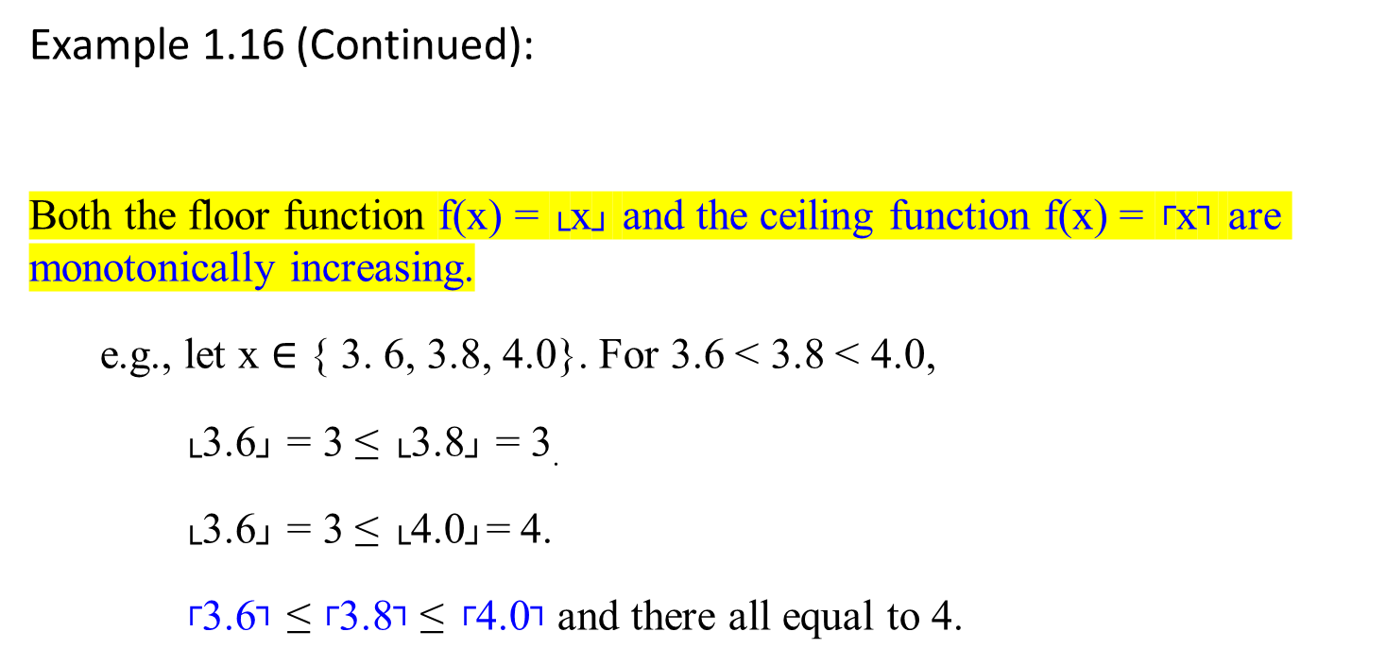
Example 1.16 (Continued):
Both the floor function f(x) = └x┘ and the ceiling function f(x) = ┌x┐ are monotonically increasing.
  e.g., let x $∈$ { 3. 6, 3.8, 4.0}. For 3.6 < 3.8 < 4.0,
    └3.6┘ = 3 ≤ └3.8┘ = 3.
    └3.6┘ = 3 ≤ └4.0┘= 4.
    ┌3.6┐ ≤ ┌3.8┐ ≤ ┌4.0┐ and there all equal to 4.

Slide 9
Example 1.17:
  If x = 2, an integer number then └x┘ = x = ┌x┐
  If x is decimal number such as 2.1 then └x┘ < x < ┌x┐
  └x+n┘ = └x┘ + n, for real x and integer n.
  ┌x+n┐ = ┌x┐ + n, for real x and integer n.
  e.g.,
  └3.1 + 4┘ = └3.1┘ + 4
  ┌ 3.1+ 4┐ = ┌3.1┐ + 4

Slide 10
Example 1.18:
└ 3.8 ┘ = 3
└ -3.8 ┘ = -4
└ 3 ┘ = 3
┌ 3.8 ┐ = 4 └7.6/2_{┘ +} ┌7.6/2┐ = 3 + 4 =7 ≠ 7.6
┌ -3.8 ┐ = -3 where a real number n is 7.6 (not an integer).
┌ 3 ┐ = 3 └7/2_{┘ +} ┌7/2┐ = 3 + 4 = 7
For any integer n,
└ n/2 ┘ + ┌ n/2 ┐ = n. [Proof: (x-1)/2 + (x+1)/2 = x]
┌ log(n+1) ┐ = └ log n ┘ + 1

Slide 11
For any real number n ≥ 0 and integers a, b > 0
  ┌┌ n/a ┐/b ┐ = ┌ n/ab ┐ e.g., ┌┌ 7.6/2 ┐/3 ┐ = ┌ 7.6/(2*3) ┐
  └└ n/a ┘/b ┘ = └ n/ab ┘ e.g., └ └ 7.6/2 ┘ /3┘ = └ 7.6/(2*3) ┘
  ┌ a/b ┐ ≤ (a + (b-1))/b e.g., ┌ 7.6/2 ┐ ≤ (7.6 + (2 – 1))/2 = 8.6/2
  └ a/b ┘ ≥ (a - (b-1))/b e.g., └ 7.6/2 ┘ ≥ (7.6 - (2 – 1))/2 = 6.6/2

Slide 12
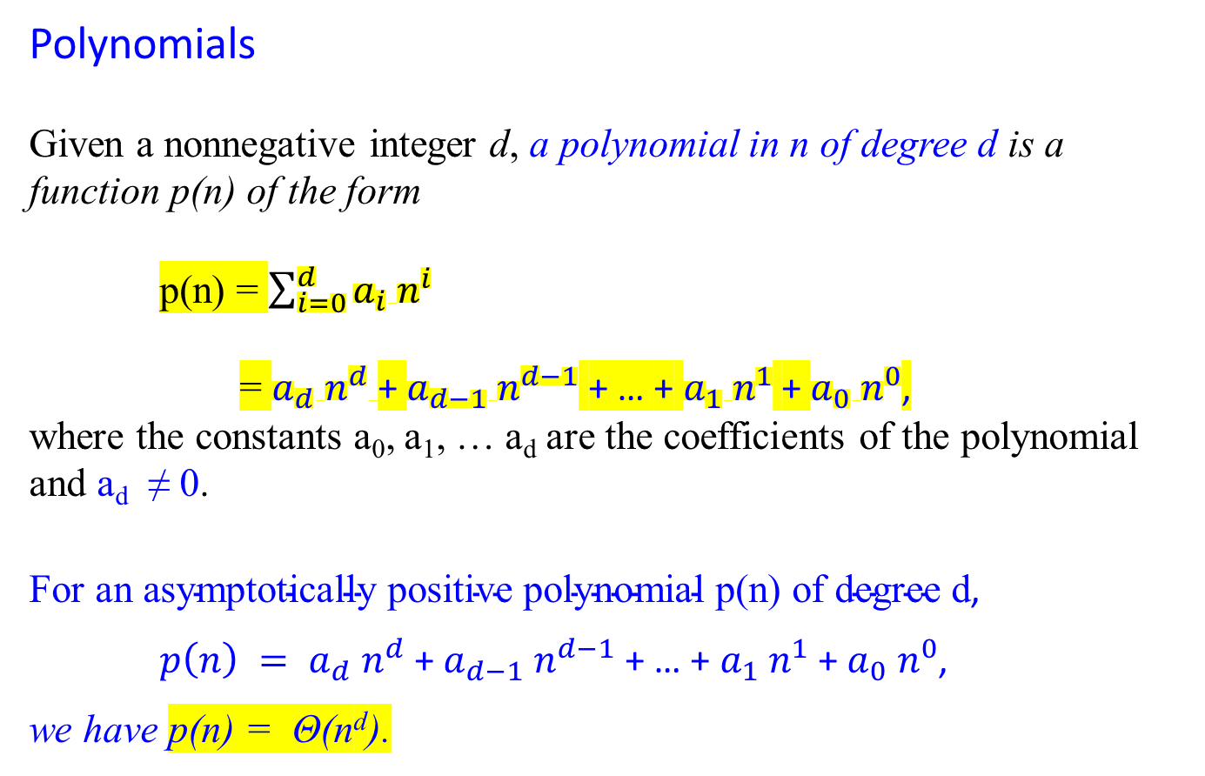
Polynomials
Given a nonnegative integer d, a polynomial in n of degree d is a function p(n) of the form
p(n) = $\sum_{i=0}^{d}{a_{i} n^{i}}$
= $a_{d} n^{d}$+ $a_{d−1} n^{d−1}$ + … + $a_{1} n^{1}$ + $a_{0} n^{0}$,
where the constants a₀, a₁, … a_{d} are the coefficients of the polynomial and a_{d} ≠ 0.
$\text{For} \text{an} \text{asymptotically} \text{positive} \text{polynomial} \text{p}\text{(}\text{n}\text{) }\text{of} \text{degree} \text{d}$,
$p\left(n\right) = a_{d} n^{d}$+ $a_{d−1} n^{d−1}$ + … + $a_{1} n^{1}$ + $a_{0} n^{0}$,
we have p(n) = Θ(n^{d}).
Is a constant , (or a linear) a polynomial?

Slide 13
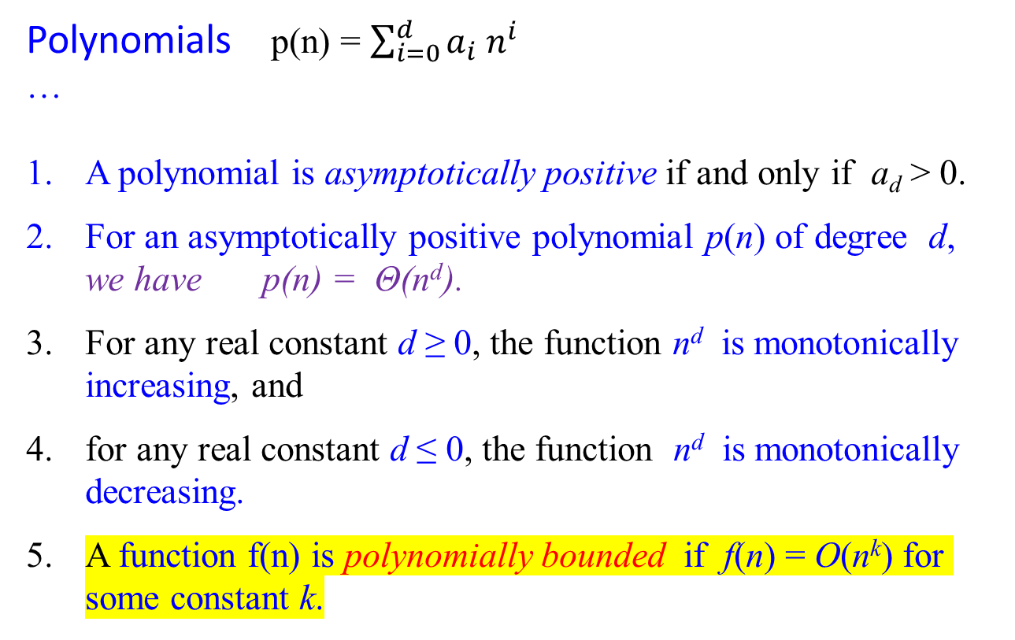
Polynomials p(n) = $\sum_{i=0}^{d}{a_{i} n^{i}}$
…
A polynomial is asymptotically positive if and only if a_{d} > 0.
For an asymptotically positive polynomial p(n) of degree d, we have p(n) = Θ(n^{d}).
For any real constant d ≥ 0, the function n^{d} is monotonically increasing, and
for any real constant d ≤ 0, the function n^{d} is monotonically decreasing.
A function f(n) is polynomially bounded if f(n) = O(n^{k}) for some constant k.

Slide 14

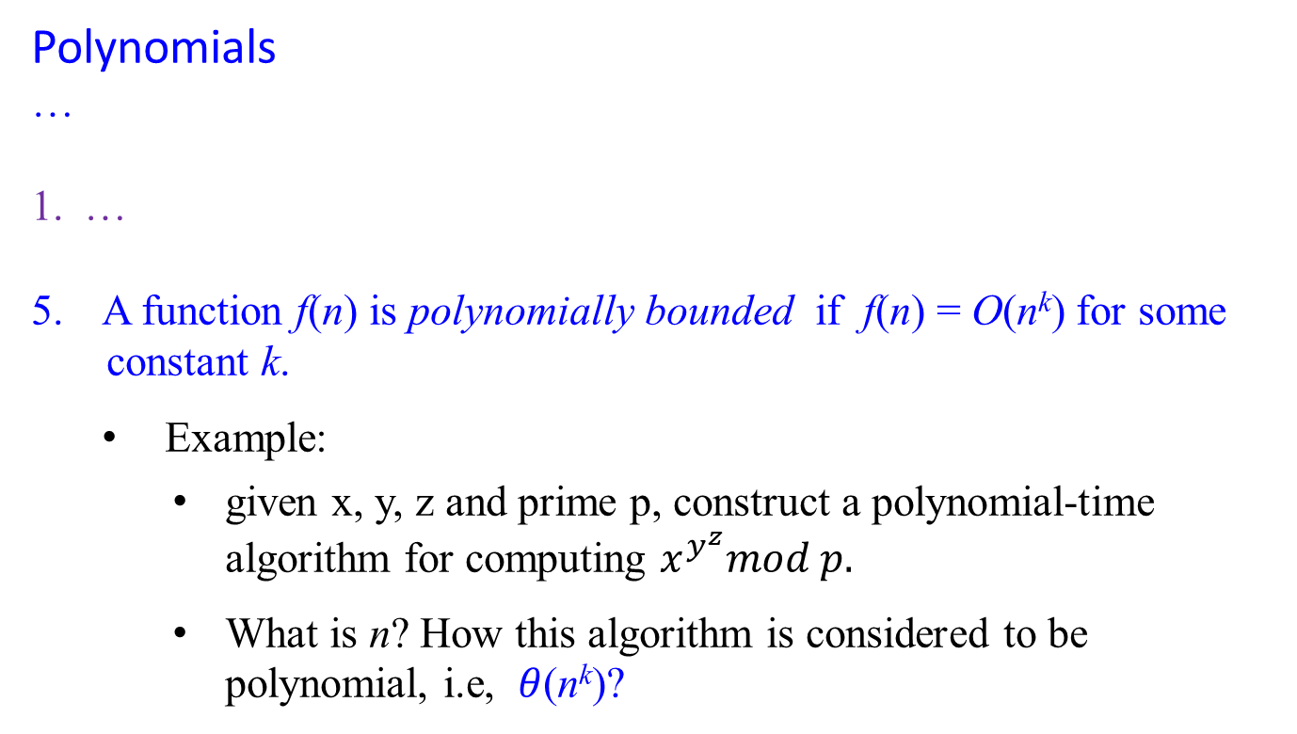
Polynomials
…
…
A function f(n) is polynomially bounded if f(n) = O(n^{k}) for some
constant k.
  Example:
    given x, y, z and prime p, construct a polynomial-time algorithm for computing $x^{y^{z}}mod p.$
    What is n? How this algorithm is considered to be polynomial, i.e, $θ$(n^{k})?

Slide 15

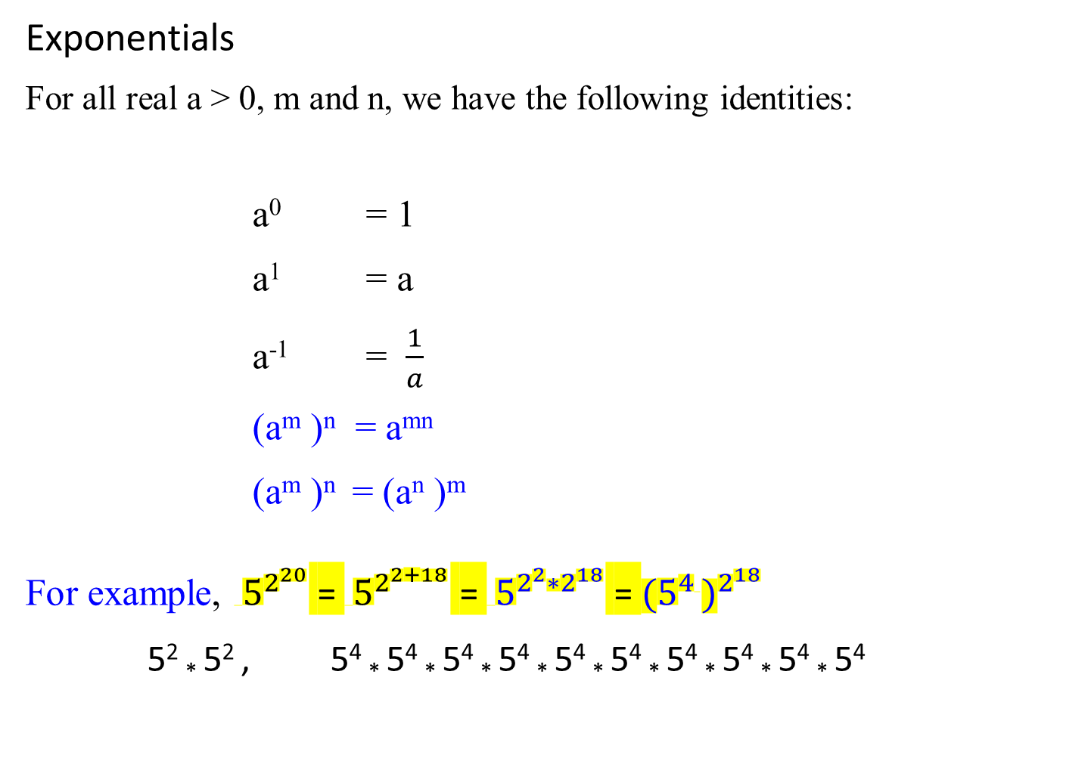
Exponentials
For all real a > 0, m and n, we have the following identities:
a⁰ = 1
a¹ = a
a⁻¹ = $\frac{1}{a}$
(a^{m} )^{n} = a^{mn}
(a^{m} )^{n} = (a^{n} )^{m}
For example, ${ 5}^{2^{20}}$ = ${ 5}^{2^{2+18}}$ = ${ 5}^{2^{2}{∗2}^{18}}$ = ${{(5}^{4 })}^{2^{18}}$
5² * 5² , 5⁴ * 5⁴ * 5⁴ * 5⁴ * 5⁴ * 5⁴ * 5⁴ * 5⁴ * 5⁴ * 5⁴
Required 6 *

Slide 16
Using Limits for Comparing Orders of Growth
A much more convenient method for comparing the orders of growth of two specific functions is based on computing the limit of the ratio of two functions in question.
Three principal cases may arise:
f(n) 0 implies that f(n) has a smaller order of growth than g(n)
lim ---- = c > 0 implies that f(n) has the same order of growth as g(n)
n → ∞ g(n) ∞ implies that f(n) has a larger order of growth than g(n).
Note that
  The first two cases mean that f(n) ε O(g(n)).
  The second case means that f(n) ε Ɵ(g(n))
  The last two mean that f(n) ε Ω(g(n)).
R

Slide 17
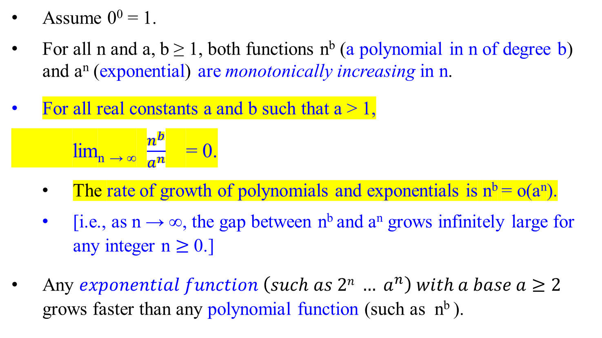
Assume 0⁰ = 1.
For all n and a, b ≥ 1, both functions n^{b} (a polynomial in n of degree b) and a^{n} (exponential) are monotonically increasing in n.
For all real constants a and b such that a > 1,
lim_{n → ∞} $\frac{n^{b}}{a^{n}}$ = 0.
  The rate of growth of polynomials and exponentials is n^{b} = o(a^{n}).
  [i.e., as n → ∞, the gap between n^{b} and a^{n} grows infinitely large for any integer n $≥$ 0.]
Any $exponential function \left(such as 2n … a^{n}\right) with a base a≥2$ grows faster than any polynomial function (such as n^{b} ).

Slide 18
Logarithms (the inverse function to exponentiation)
The following notations may be used:
log n = log₂n (binary logarithm)
ln n = log_{e}n (natural logarithm)
log^{k} n = (log n)^{k} (exponentiation)
log log n = log(log n) (composition)
Adopt that logarithm functions will apply only to the next term in the formula.
  For example: log n + k will mean (log n) + k but not log(n + k).
The function log_{b}n is strictly increasing, if a constant b > 1, for n > 0. (i.e., log₂n)

Slide 19
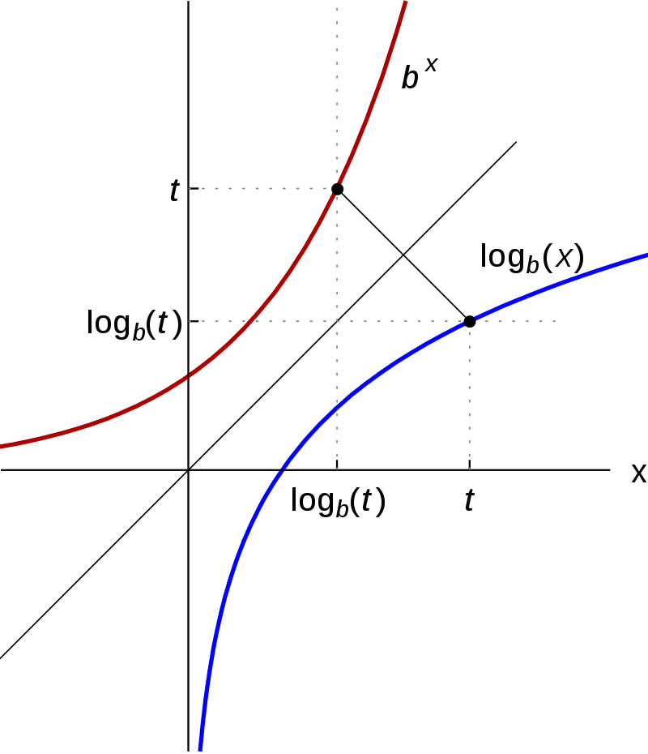

Slide 20
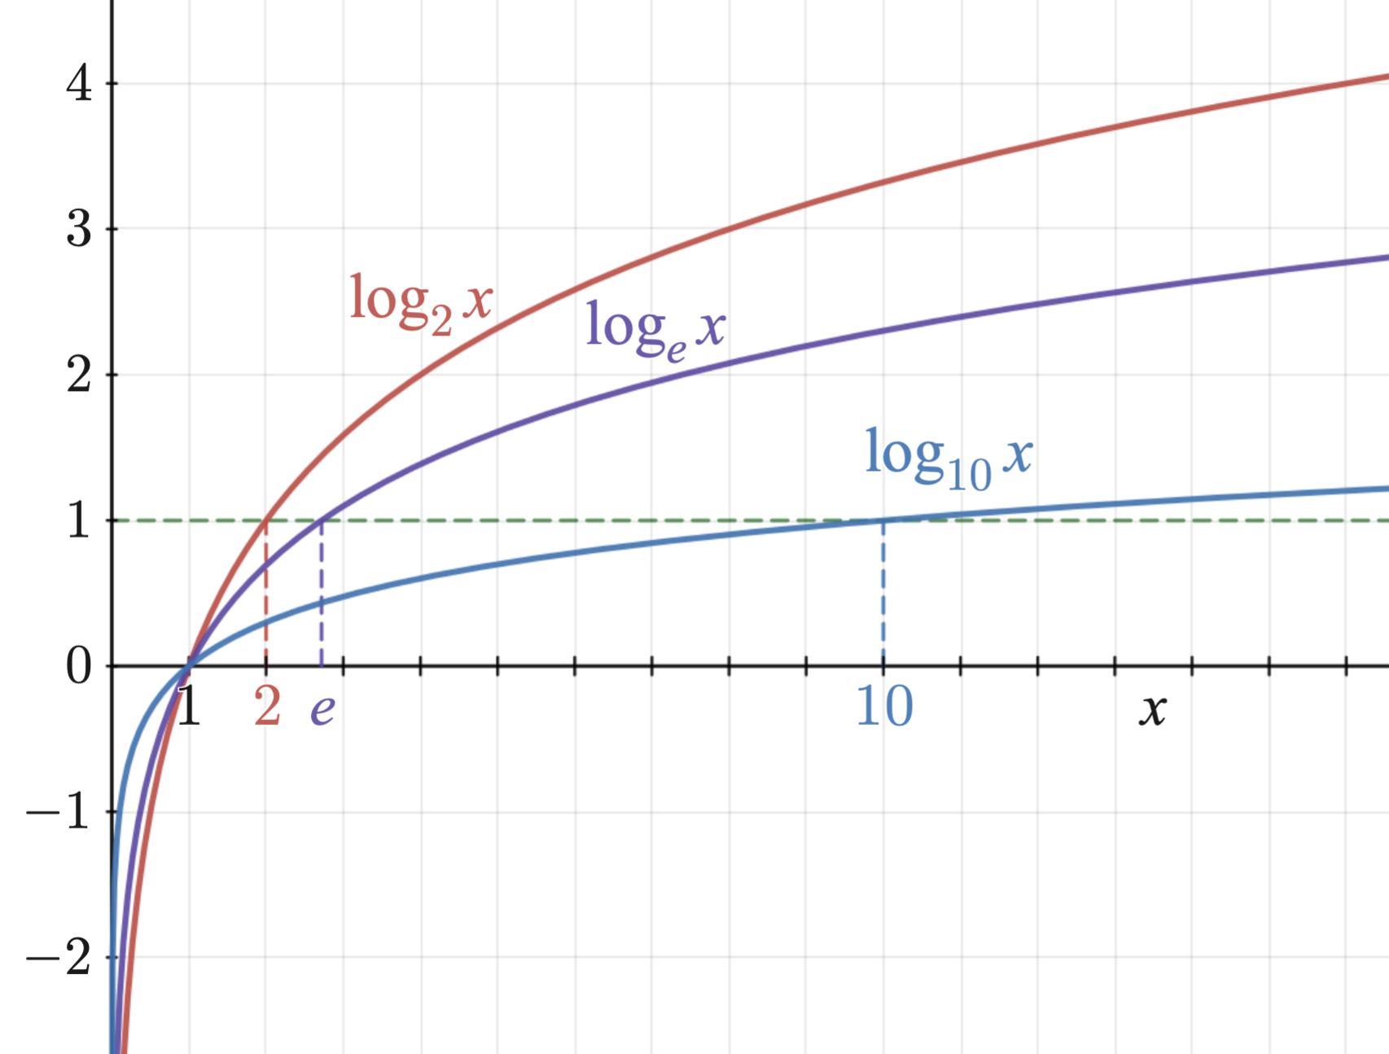

Slide 21
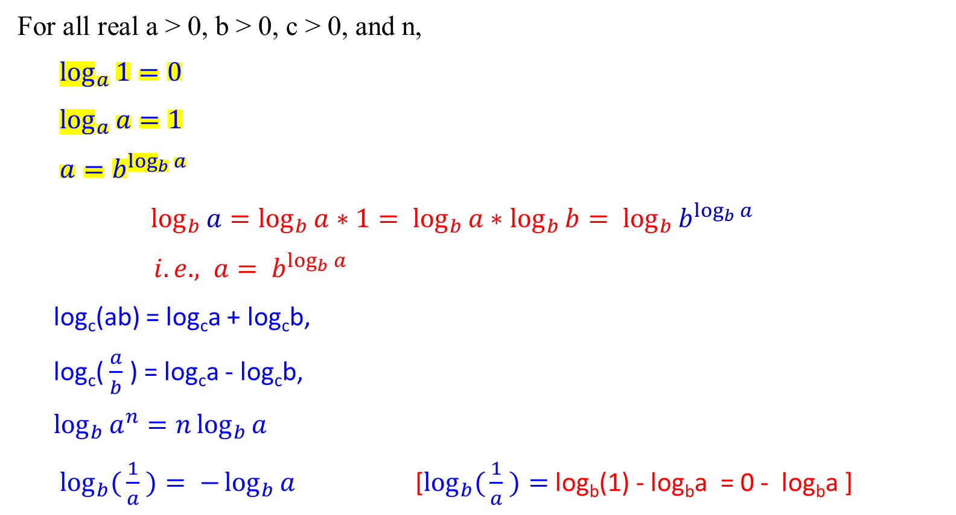
For all real a > 0, b > 0, c > 0, and n,
$\log_{a}{1}=0$
$\log_{a}{a=1}$
$a=b^{\log_{b}{a}}$
$\log_{b}{a=\log_{b}{a}}∗1= \log_{b}{a}∗\log_{b}{b}= \log_{b}{b^{\log_{b}{a}}}$
$i.e., a= b^{\log_{b}{a}}$
log_{c}(ab) = log_{c}a + log_{c}b,
log_{c}( $\frac{a}{b}$ ) = log_{c}a - log_{c}b,
$\log_{b}{a^{n}}=n\log_{b}{a}$
$\log_{b}({\frac{1}{a}} )= −\log_{b}{a}$ [$\log_{b}({\frac{1}{a}} )=$log_{b}(1) - log_{b}a = 0 - log_{b}a ]

Slide 22
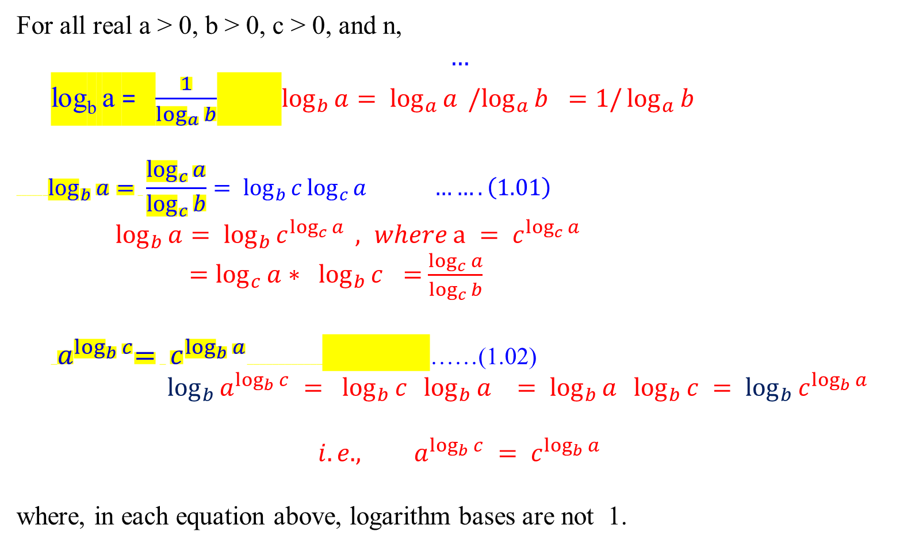
For all real a > 0, b > 0, c > 0, and n,
$$…$$
log_{b} a = $\frac{1}{\log_{a}{b}}$ $\log_{b}{a}= \log_{a}{a }{/log}_{a}{b} =1/\log_{a}{b}$
$$\log_{b}{a= \frac{\log_{c}{a}}{\log_{c}{b}}}= \log_{b}{c}\log_{c}{a …….\left(1.01\right)}$$
$\log_{b}{a}= \log_{b}{c^{\log_{c}{a}}} , where a = c^{\log_{c}{a}}$
$=\log_{c}{a}∗ \log_{b}{c }=$ $\frac{\log_{c}{a}}{\log_{c}{b}}$
${ a}^{\log_{b}{c}}= c^{\log_{b}{a}}$ ……(1.02)
$\log_{b}{a^{\log_{b}{c}}} = \log_{b}{c} \log_{b}{a }= \log_{b}{a} \log_{b}{c} = \log_{b}{c^{\log_{b}{a}}}$
$${i.e., a}^{\log_{b}{c}} = c^{\log_{b}{a}}$$
where, in each equation above, logarithm bases are not 1.

Slide 23
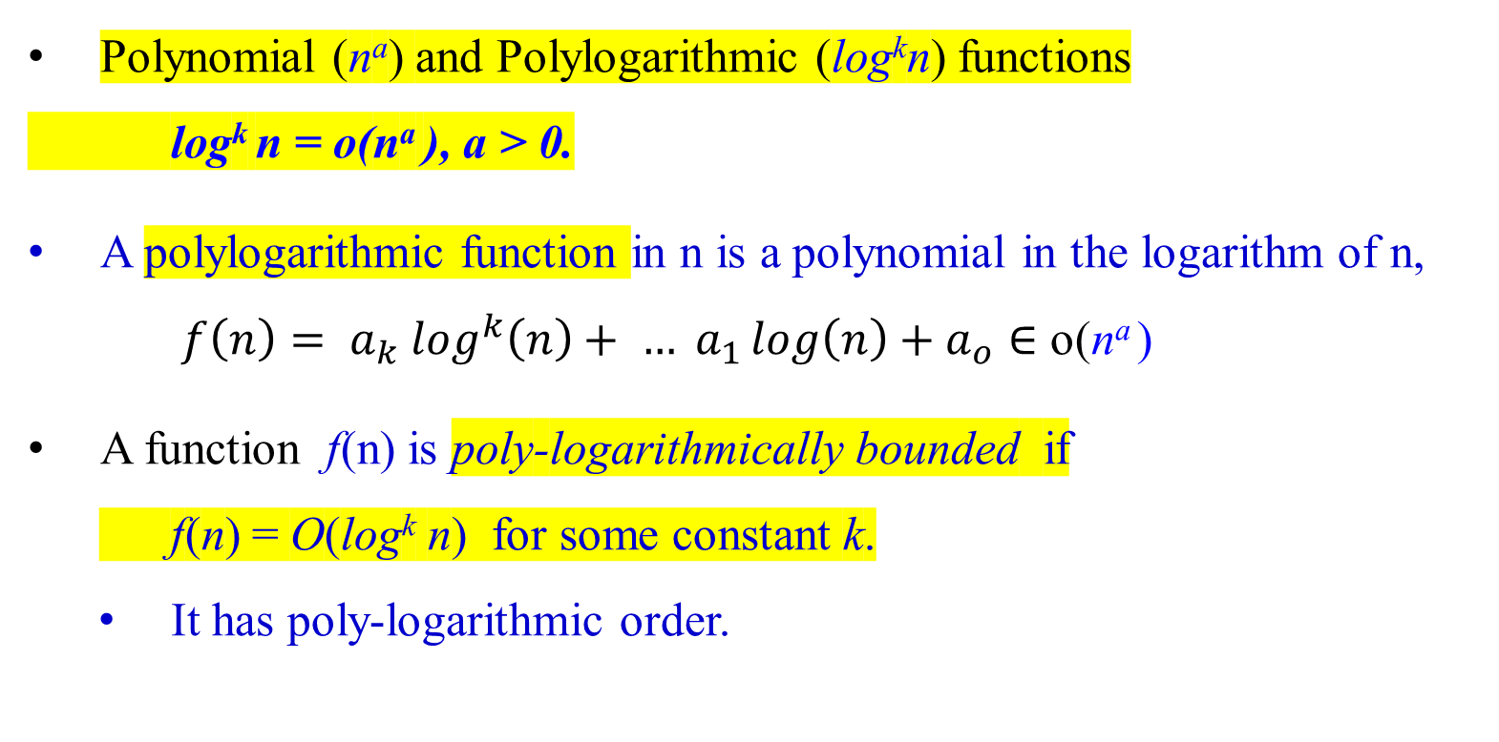
Polynomial (nª) and Polylogarithmic (log^{k}n) functions
log^{k} n = o(nª ), a > 0.
A polylogarithmic function in n is a polynomial in the logarithm of n,
${f\left(n\right)= a}_{k} \log^{k}\left(n\right)+ … a_{1}\log\left(n\right)+a_{o}∈$ o(nª )
A function f(n) is poly-logarithmically bounded if
f(n) = O(log^{k} n) for some constant k.
It has poly-logarithmic order.

Slide 24
Using Limits for Comparing Orders of Growth
A convenient method for comparing the orders of growth of two specific functions is based on computing the limit of the ratio of the two functions in question.
Three principal cases may arise:
f(n) 0 implies that f(n) has a smaller order of growth than g(n)
lim ---- = c > 0 implies that f(n) has the same order of growth as g(n)
n → ∞ g(n) ∞ implies that f(n) has a larger order of growth than g(n).
Note that
  The first two cases mean that f(n) ε O(g(n)).
  The second case means that f(n) ε Ɵ(g(n))
  The last two mean that f(n) ε Ω(g(n)).
R

Slide 25
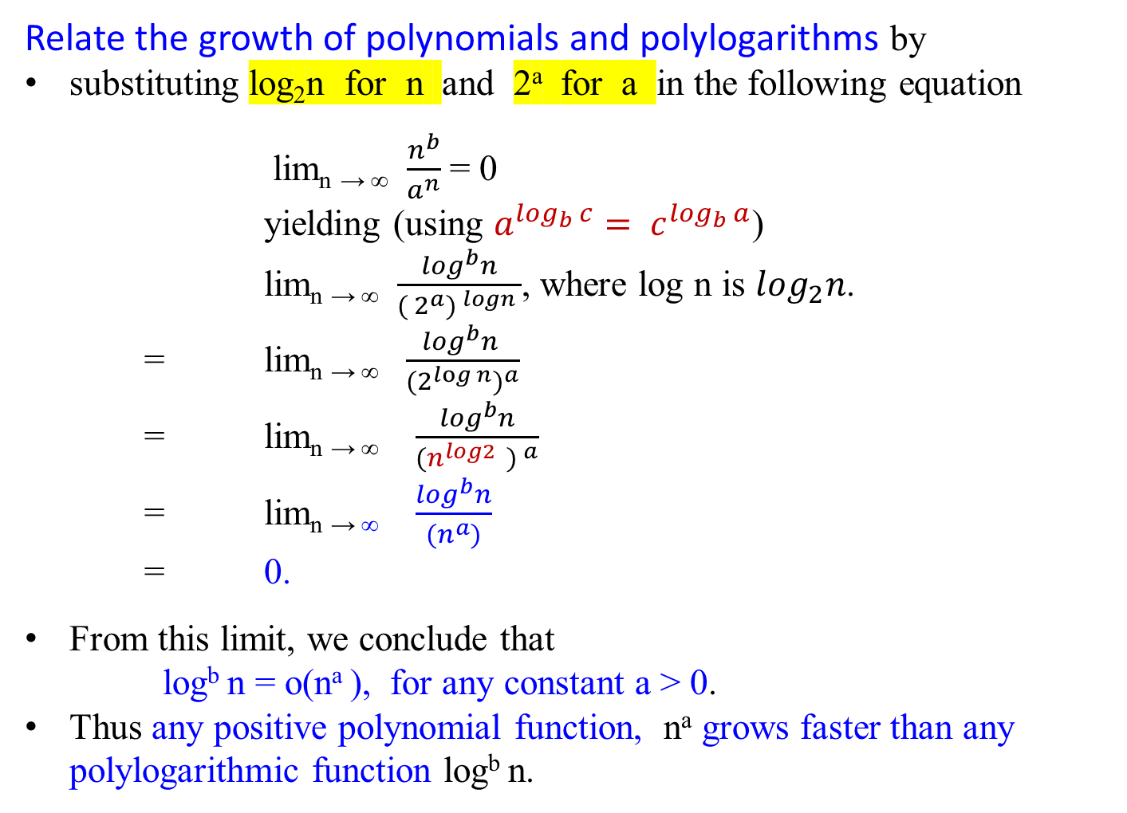
Relate the growth of polynomials and polylogarithms by
substituting log₂n for n and 2ª for a in the following equation
lim_{n → ∞} $\frac{n^{b}}{a^{n}}$ = 0
yielding (using $a^{\log_{b}{c}}= c^{\log_{b}{a}}$)
lim_{n → ∞} $\frac{\log^{b}n}{{( 2^{a}) }^{logn} }$, where log n is $\log_{2}n$.
= lim_{n → ∞} $\frac{\log^{b}n }{{{(2}^{\log{n}})}^{a}}$
= lim_{n → ∞} $\frac{\log^{b}n}{{(n^{log2 } ) }^{a}}$
= lim_{n → ∞} $\frac{\log^{b}n}{{(n}^{a})}$
= 0.
From this limit, we conclude that
log^{b} n = o(nª ), for any constant a > 0.
Thus any positive polynomial function, nª grows faster than any polylogarithmic function log^{b} n.

Slide 26
Functional iteration
Let f(n) be a function over the real. For non-negative integers i, we recursively define
n if i = 0
f^{(i)}(n) =
f ( f^{(i-1)} (n) ) if i > 0
For example, if f(n) = 2n, then f^{(i)}(n) = 2^{i}n.
f⁽⁰⁾(n) = n, by definition of f^{(i)}(n) = n if i = 0
f⁽¹⁾(n) = f(f⁽⁰⁾(n)) = f(n) = 2n, letting n = f⁽⁰⁾(n) = n
f⁽²⁾(n) = f(f⁽¹⁾(n)) = f(2n)= 2(2n) = 2²n
f⁽³⁾(n) = f(f⁽²⁾(n)) = f(f(f⁽¹⁾(n))) = f(f(2n))= f(2(2n)) = 2 (2(2 n))
= 2³n, letting n = f⁽²⁾(n) = 2(2n)
…
f^{(i)}(n) = f(f^{(i-1)}(n)) = f(2^{i-1}n) = 2(2^{i-1}n) = 2^{i}n

Slide 27

The iterated logarithm function, log*n
Be sure to distinguish
log^{(i)} n ( the logarithm function applied i times in
succession, starting with argument n).
i.e., log(log( … log(log n) ...))
from
log^{i} n (the logarithm of n raised to the i^{th} power).
i.e., (log n) (log n) …. (log n), multiplying log n for i times.)
i times

Slide 28

The iterated logarithm function, log*n
Let log^{(i)} n be defined as successive i time applications of log(n), with f(n) = log n; i.e., log(… log(log(n))…).
Because the logarithm of a non-positive number is undefined,
log^{(i)} n is defined only if log^{(i-1)} n > 0.
The iterated algorithm, log*n (read log star of n), is defined as:
log*n = min{ i ≥ 0 | log^{(i)} n ≤ 1}.
i.e., the minimum number of i iterations such that the number of application log stops when log^{(i)} n ≤ 1
log^{(i)} n = log(log^{(i-1)} n )

Slide 29

The iterated logarithm function, log*n
The iterated logarithm function is defined as
log*n = min{ i ≥ 0 | log^{(i)} n ≤ 1}.
i.e., the minimum number of i iterations is the number of times that logarithm function must be iteratively applied before the result is less than or equal to 1.
The iterated logarithm is a very slowly growing function.
log* 2 = 1 [since log⁽¹⁾ 2 = 1 ≤ 1]
log* 4 = 2 [since log⁽²⁾ 4 = log (log⁽¹⁾ 2²) = log 2 ≤ 1]
log* 16 = 3 [since log⁽³⁾ 16 = log (log (log⁽¹⁾ 2⁴))
= log (log 4) = log 2 ≤ 1]

Slide 30

The iterated logarithm function, log*n
The iterated logarithm function is defined as
log*n = min{ i ≥ 0 | log^{(i)} n ≤ 1}.
i.e., the minimum number of i iterations such that the number of application log stops when it is less than or equal to 1.
log* 65536 = 4 [since log⁽⁴⁾ 65536 = log (log (log (log⁽¹⁾ 2¹⁶)) )
= log (log ( log (16))), 16 = 2⁴
= log (lg 4)
= log 2 ≤ 1]
log* 4294967296 =
log* (2⁶⁵⁵³⁶ ) = 5 [since log⁽⁵⁾ 2⁶⁵⁵³⁶ = log (log⁽⁴⁾ 2⁶⁵⁵³⁶ )
= log( log (log (log (log⁽¹⁾ 2⁶⁵⁵³⁶)) ))
= log (log (log (log (65536)))) ≤ 1]

Slide 31
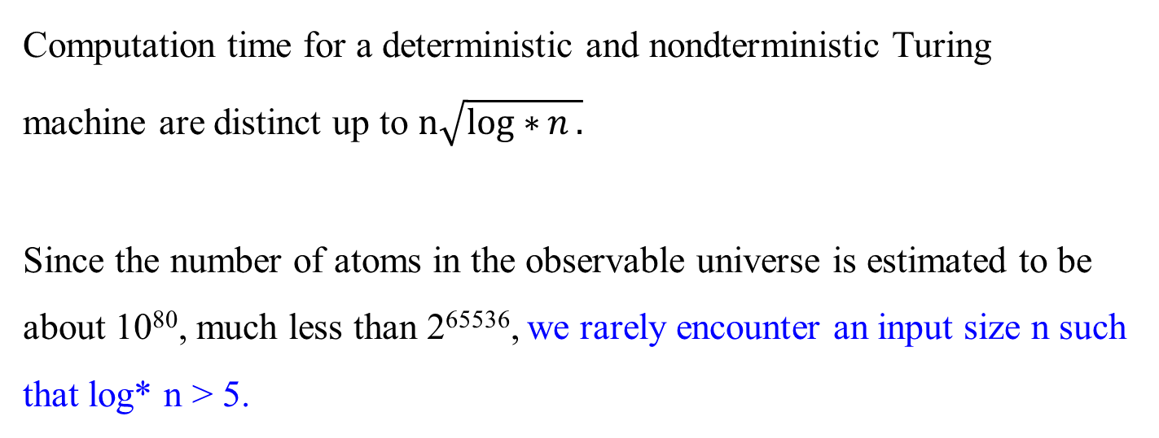
Computation time for a deterministic and nondterministic Turing machine are distinct up to $n\sqrt{log∗{n}.}$
Since the number of atoms in the observable universe is estimated to be about 10⁸⁰, much less than 2⁶⁵⁵³⁶, we rarely encounter an input size n such that log* n > 5.
Recall: Using binary representation, the input size will be the number of bits it takes to encode n, which is └ log₂ n ┘ + 1. For example, the total number of bits for multiplying two integers n, m. (i.e, bits(n) * bits(m))

