Slide 1
Chapter 00_03
Prime Numbers

Slide 2

Outlines
The Sieve of Eratosthenes to find all the primes that are less than a given number n and their time efficiency.
Prime Testing
Relative Prime

Slide 3

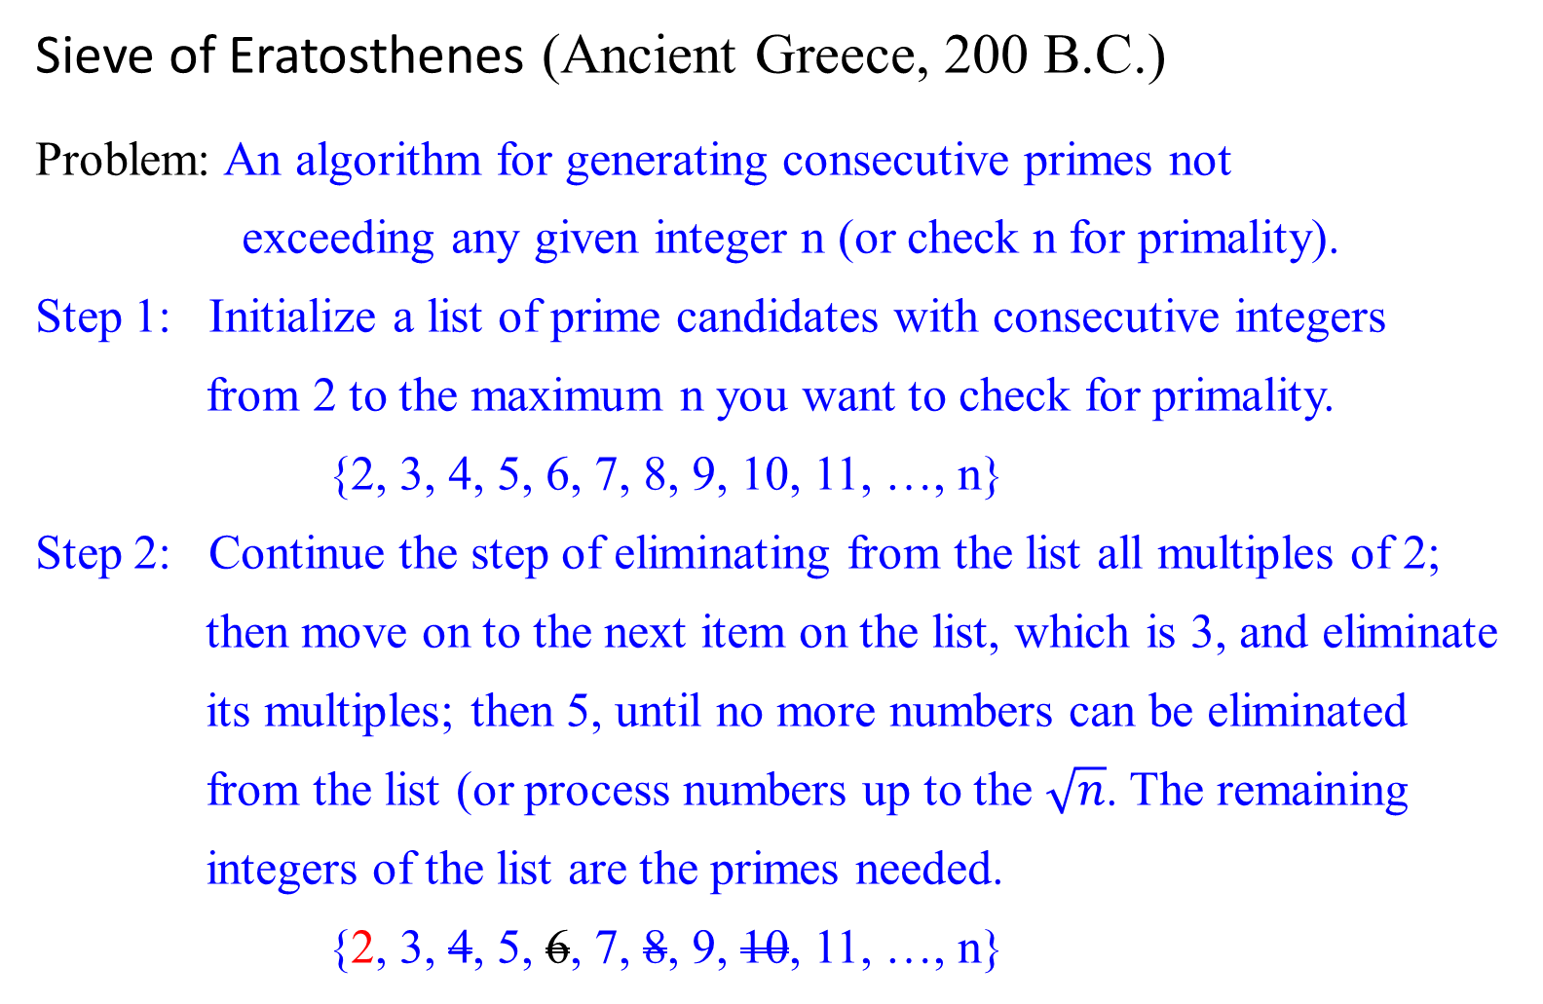
Sieve of Eratosthenes (Ancient Greece, 200 B.C.)
Problem: An algorithm for generating consecutive primes not
exceeding any given integer n (or check n for primality).
Step 1: Initialize a list of prime candidates with consecutive integers
from 2 to the maximum n you want to check for primality.
{2, 3, 4, 5, 6, 7, 8, 9, 10, 11, …, n}
Step 2: Continue the step of eliminating from the list all multiples of 2;
then move on to the next item on the list, which is 3, and eliminate
its multiples; then 5, until no more numbers can be eliminated
from the list (or process numbers up to the $\sqrt{n}$. The remaining
integers of the list are the primes needed.
{2, 3, 4, 5, 6, 7, 8, 9, 10, 11, …, n}

Slide 4


Example 0.37: Let n = 31. [p = 2, 3, 5], using p² + i*p, 0 $≤$ i for elimination.
How far do you go to eliminate the non-prime number for a given n?
What is the largest number p whose multiples can remain on the list?
  e.g., for this case, the largest number p is 5 since p = 5 $≤$ $\sqrt{31}$.
.
.
.
n/p:31/2 = 15
ActualDel= 14
n₂ /p: 15/3 =5
ActualDel = 4
n₂₃ /p:12/5 =2
ActualDel =1
31= 20 (del) + 11(Remain)
if p = | 2 | 3 | 4 | 5 | 6 | 7 | 8 | 9 | 10 | 11 | 12 | 13 | 14 | 15 | 16 | 17 | 18 | 19 | 20 | 21 | 22 | 23 | 24 | 25 | 26 | 27 | 28 | 29 | 30 | 31
2 | 2 | 3 | d | 5 | d | 7 | d | 9 | d | 11 | d | 13 | d | 15 | d | 17 | d | 19 | d | 21 | d | 23 | d | 25 | d | 27 | d | 29 | d | 31
3 | 2 | 3 |  | 5 |  | 7 |  | d |  | 11 | r | 13 |  | d |  | 17 | r | 19 |  | d |  | 23 | r | 25 |  | d |  | 29 | r | 31
5 | 2 | 3 |  | 5 |  | 7 |  |  |  | 11 |  | 13 |  |  |  | 17 |  | 19 |  |  |  | 23 |  | d |  |  |  | 29 | r | 31

Slide 5
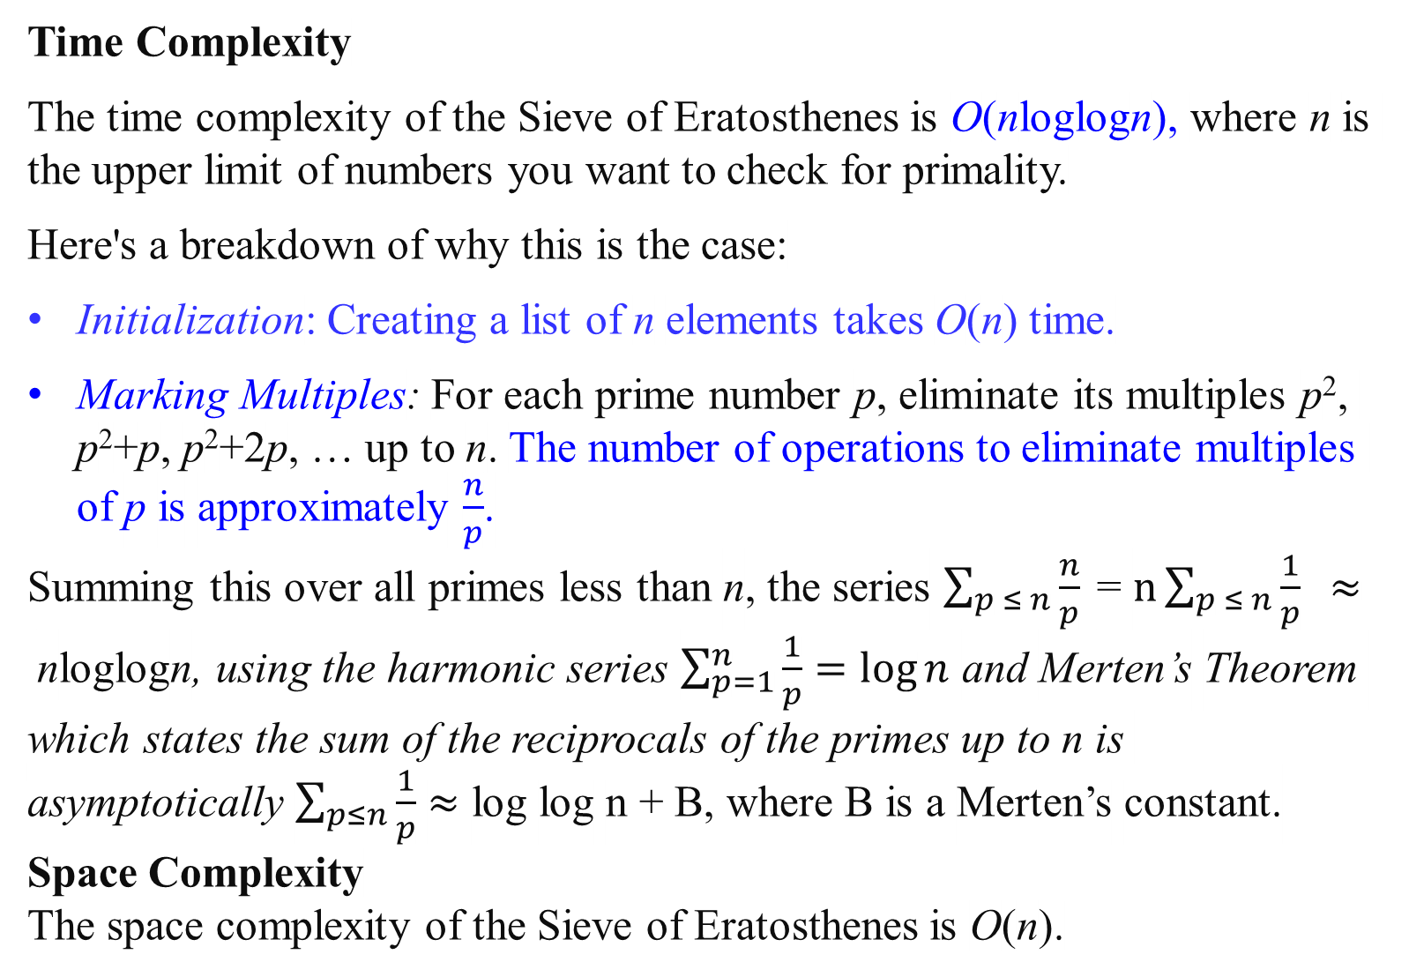
Time Complexity
The time complexity of the Sieve of Eratosthenes is O(nloglogn), where n is the upper limit of numbers you want to check for primality.
Here's a breakdown of why this is the case:
Initialization: Creating a list of n elements takes O(n) time.
Marking Multiples: For each prime number p, eliminate its multiples p², p²+p, p²+2p, … up to n. The number of operations to eliminate multiples of p is approximately $\frac{n}{p}$​.
Summing this over all primes less than n, the series $\sum_{p ≤ n}{\frac{n}{p}\text{​}}$= $n\sum_{p ≤ n}{\frac{1}{p}\text{​}} ≈$nloglogn, using the harmonic series $\sum_{p=1}^{n}{\frac{1}{p}}=\log{n}$ and Merten’s Theorem which states the sum of the reciprocals of the primes up to n is asymptotically $\sum_{p≤n}{\frac{1}{p}}$ $≈$ log log n + B, where B is a Merten’s constant.
Space Complexity
The space complexity of the Sieve of Eratosthenes is O(n).

Slide 6
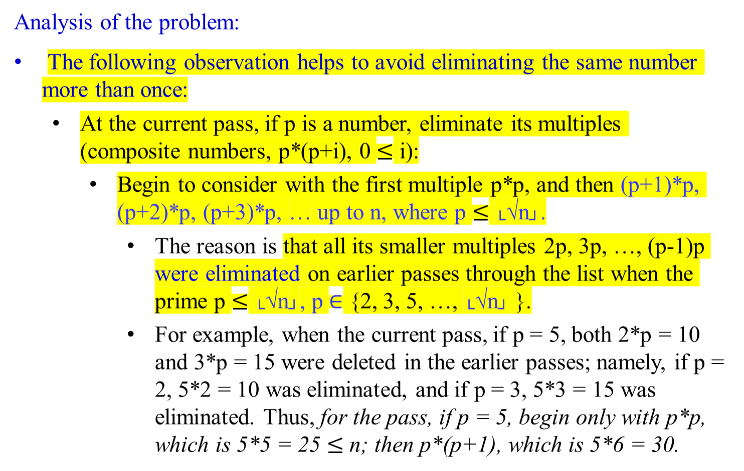
Analysis of the problem:
The following observation helps to avoid eliminating the same number more than once:
At the current pass, if p is a number, eliminate its multiples (composite numbers, p*(p+i), 0 $≤$ i):
  Begin to consider with the first multiple p*p, and then (p+1)*p, (p+2)*p, (p+3)*p, … up to n, where p $≤$ └√n┘.
    The reason is that all its smaller multiples 2p, 3p, …, (p-1)p were eliminated on earlier passes through the list when the prime p $≤$ └√n┘, p $∈$ {2, 3, 5, …, └√n┘ }.
    For example, when the current pass, if p = 5, both 2*p = 10 and 3*p = 15 were deleted in the earlier passes; namely, if p = 2, 5*2 = 10 was eliminated, and if p = 3, 5*3 = 15 was eliminated. Thus, for the pass, if p = 5, begin only with p*p, which is 5*5 = 25 $≤$ n; then p*(p+1), which is 5*6 = 30.

Slide 7

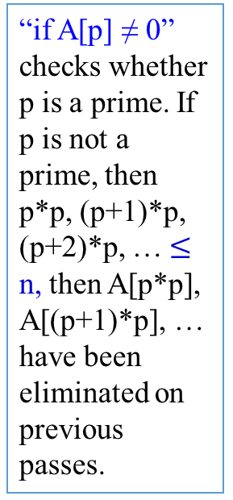
Algorithm Sieve(n)
//Implements the sieve of Eratosthenes
Input: An integer n ≥ 2
Output: Array L of all prime numbers less than or equal to n
for p ← 2 to n do A[p] ← p; //Generate a copy of the number from 2 on.
for p ← 2 to └√n┘ do { // $n^{\frac{1}{2}}$ times
if A[p] ≠ 0 //p has not been eliminated on previous passes
{ j ← p * p; // size of p * size of p $≤$ size of $n^{\frac{1}{2}}$ * size of $n^{\frac{1}{2}}$
while j ≤ n do { //says n times
A[j] ← 0; //mark the element as eliminated
j ← j + p; //j = p*p + p = (p+1)p}//end while_do
} //end if (else back to for after p = p+1)
p = p + 1;
} //end for
//copy the remaining elements of A to array L of the primes
i ← 0;
for p ← 2 to n do {
if A[p] ≠ 0 {
L[i] ← A[p];
i ← i + 1; } //end if
} //end for
return L
“if A[p] ≠ 0” checks whether p is a prime. If p is not a prime, then p*p, (p+1)*p, (p+2)*p, … $≤$ n, then A[p*p], A[(p+1)*p], … have been eliminated on previous passes.
A[2] = 2, A[4] = 0 A[6]=0, A[8]=0, A[10]=0, A[12] =0, A[14]=0, A[16]=0, A[18]=0, A[20]=0, A[22]=0, A[24]=0, A[26]=0, A[28]=0, A[30]=0, …, A[48]=0.
A[3]= 3, A[9]=0, A[12] = 0, A[15] = 0, A[18]=0, A[21] = 0, A[24] = 0, A[27]=0, A[30]=0, A[33]=0, …, A[45]=0, A[48]=0.
A[5] =5, A[25] = 0, A[30]=0, A[35]=0, A[40]=0, A[45]=0.

Slide 8
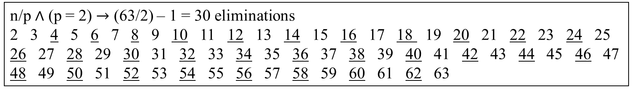
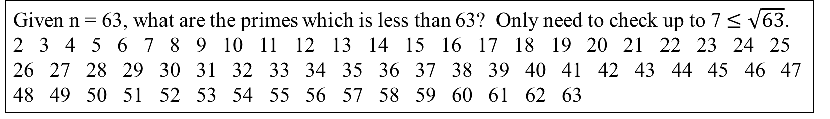
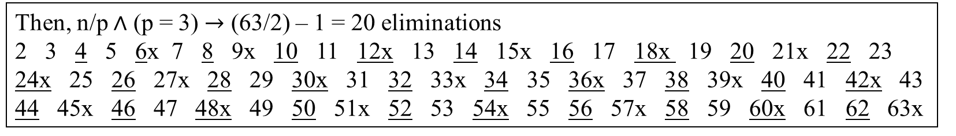
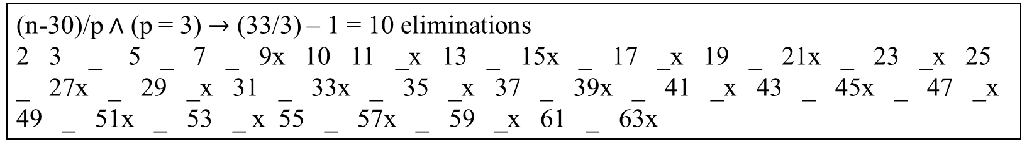
Given n = 63, what are the primes which is less than 63? Only need to check up to 7 $≤\sqrt{63}$.
2 3 4 5 6 7 8 9 10 11 12 13 14 15 16 17 18 19 20 21 22 23 24 25 26 27 28 29 30 31 32 33 34 35 36 37 38 39 40 41 42 43 44 45 46 47 48 49 50 51 52 53 54 55 56 57 58 59 60 61 62 63
n/p $∧$ (p = 2) $→$ (63/2) – 1 = 30 eliminations
2 3 4 5 6 7 8 9 10 11 12 13 14 15 16 17 18 19 20 21 22 23 24 25 26 27 28 29 30 31 32 33 34 35 36 37 38 39 40 41 42 43 44 45 46 47 48 49 50 51 52 53 54 55 56 57 58 59 60 61 62 63
Then, n/p $∧$ (p = 3) $→$ (63/2) – 1 = 20 eliminations
2 3 4 5 6x 7 8 9x 10 11 12x 13 14 15x 16 17 18x 19 20 21x 22 23 24x 25 26 27x 28 29 30x 31 32 33x 34 35 36x 37 38 39x 40 41 42x 43 44 45x 46 47 48x 49 50 51x 52 53 54x 55 56 57x 58 59 60x 61 62 63x
(n-30)/p $∧$ (p = 3) $→$ (33/3) – 1 = 10 eliminations
2 3 _ 5 _ 7 _ 9x 10 11 _x 13 _ 15x _ 17 _x 19 _ 21x _ 23 _x 25 _ 27x _ 29 _x 31 _ 33x _ 35 _x 37 _ 39x _ 41 _x 43 _ 45x _ 47 _x 49 _ 51x _ 53 _ x 55 _ 57x _ 59 _x 61 _ 63x

Slide 9
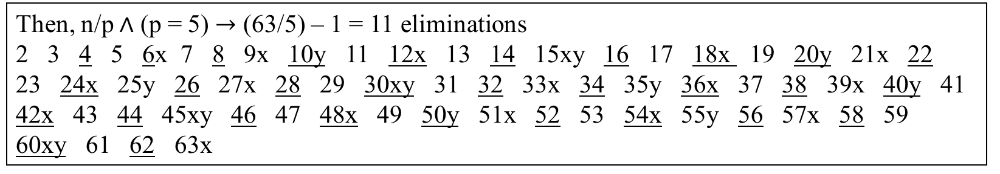
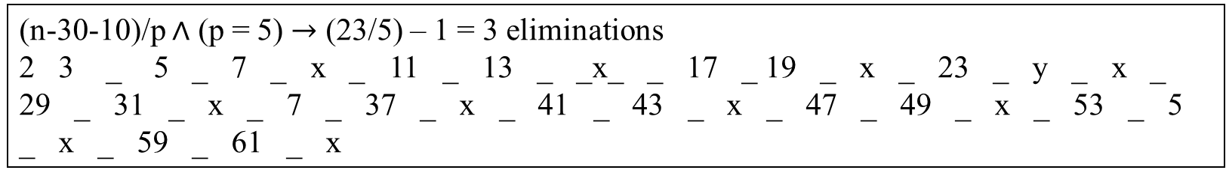
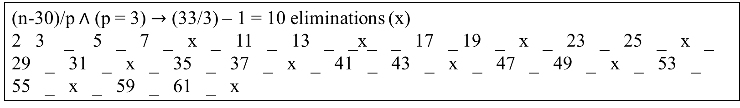

Then, n/p $∧$ (p = 3) $→$ (63/2) – 1 = 20 eliminations
2 3 4 5 6x 7 8 9x 10 11 12x 13 14 15x 16 17 18x 19 20 21x 22 23 24x 25 26 27x 28 29 30x 31 32 33x 34 35 36x 37 38 39x 40 41 42x 43 44 45x 46 47 48x 49 50 51x 52 53 54x 55 56 57x 58 59 60x 61 62 63x
Then, n/p $∧$ (p = 5) $→$ (63/5) – 1 = 11 eliminations
2 3 4 5 6x 7 8 9x 10y 11 12x 13 14 15xy 16 17 18x 19 20y 21x 22 23 24x 25y 26 27x 28 29 30xy 31 32 33x 34 35y 36x 37 38 39x 40y 41 42x 43 44 45xy 46 47 48x 49 50y 51x 52 53 54x 55y 56 57x 58 59 60xy 61 62 63x
(n-30)/p $∧$ (p = 3) $→$ (33/3) – 1 = 10 eliminations (x)
2 3 _ 5 _ 7 _ x _ 11 _ 13 _ _x_ _ 17 _ 19 _ x _ 23 _ 25 _ x _ 29 _ 31 _ x _ 35 _ 37 _ x _ 41 _ 43 _ x _ 47 _ 49 _ x _ 53 _ 55 _ x _ 59 _ 61 _ x
(n-30-10)/p $∧$ (p = 5) $→$ (23/5) – 1 = 3 eliminations
2 3 _ 5 _ 7 _ x _ 11 _ 13 _ _x_ _ 17 _ 19 _ x _ 23 _ y _ x _ 29 _ 31 _ x _ 7 _ 37 _ x _ 41 _ 43 _ x _ 47 _ 49 _ x _ 53 _ 5 _ x _ 59 _ 61 _ x

Slide 10
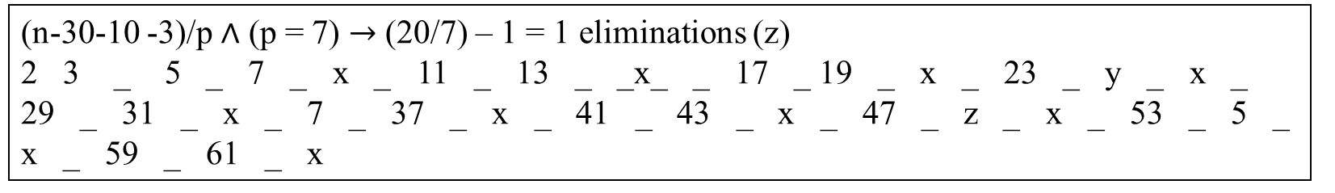
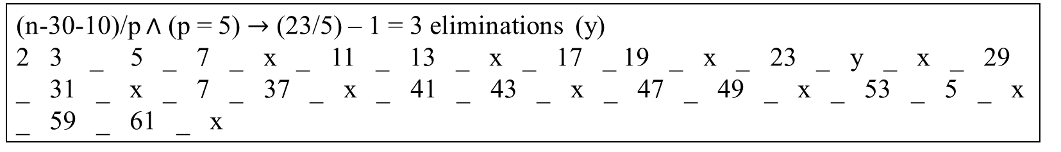
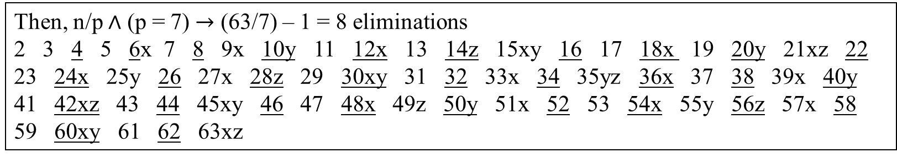

Then, n/p $∧$ (p = 5) $→$ (63/5) – 1 = 11 eliminations
2 3 4 5 6x 7 8 9x 10y 11 12x 13 14 15xy 16 17 18x 19 20y 21x 22 23 24x 25y 26 27x 28 29 30xy 31 32 33x 34 35y 36x 37 38 39x 40y 41 42x 43 44 45xy 46 47 48x 49 50y 51x 52 53 54x 55y 56 57x 58 59 60xy 61 62 63x
Then, n/p $∧$ (p = 7) $→$ (63/7) – 1 = 8 eliminations
2 3 4 5 6x 7 8 9x 10y 11 12x 13 14z 15xy 16 17 18x 19 20y 21xz 22 23 24x 25y 26 27x 28z 29 30xy 31 32 33x 34 35yz 36x 37 38 39x 40y 41 42xz 43 44 45xy 46 47 48x 49z 50y 51x 52 53 54x 55y 56z 57x 58 59 60xy 61 62 63xz
(n-30-10)/p $∧$ (p = 5) $→$ (23/5) – 1 = 3 eliminations (y)
2 3 _ 5 _ 7 _ x _ 11 _ 13 _ x _ 17 _ 19 _ x _ 23 _ y _ x _ 29 _ 31 _ x _ 7 _ 37 _ x _ 41 _ 43 _ x _ 47 _ 49 _ x _ 53 _ 5 _ x _ 59 _ 61 _ x
(n-30-10 -3)/p $∧$ (p = 7) $→$ (20/7) – 1 = 1 eliminations (z)
2 3 _ 5 _ 7 _ x _ 11 _ 13 _ _x_ _ 17 _ 19 _ x _ 23 _ y _ x _ 29 _ 31 _ x _ 7 _ 37 _ x _ 41 _ 43 _ x _ 47 _ z _ x _ 53 _ 5 _ x _ 59 _ 61 _ x

Slide 11
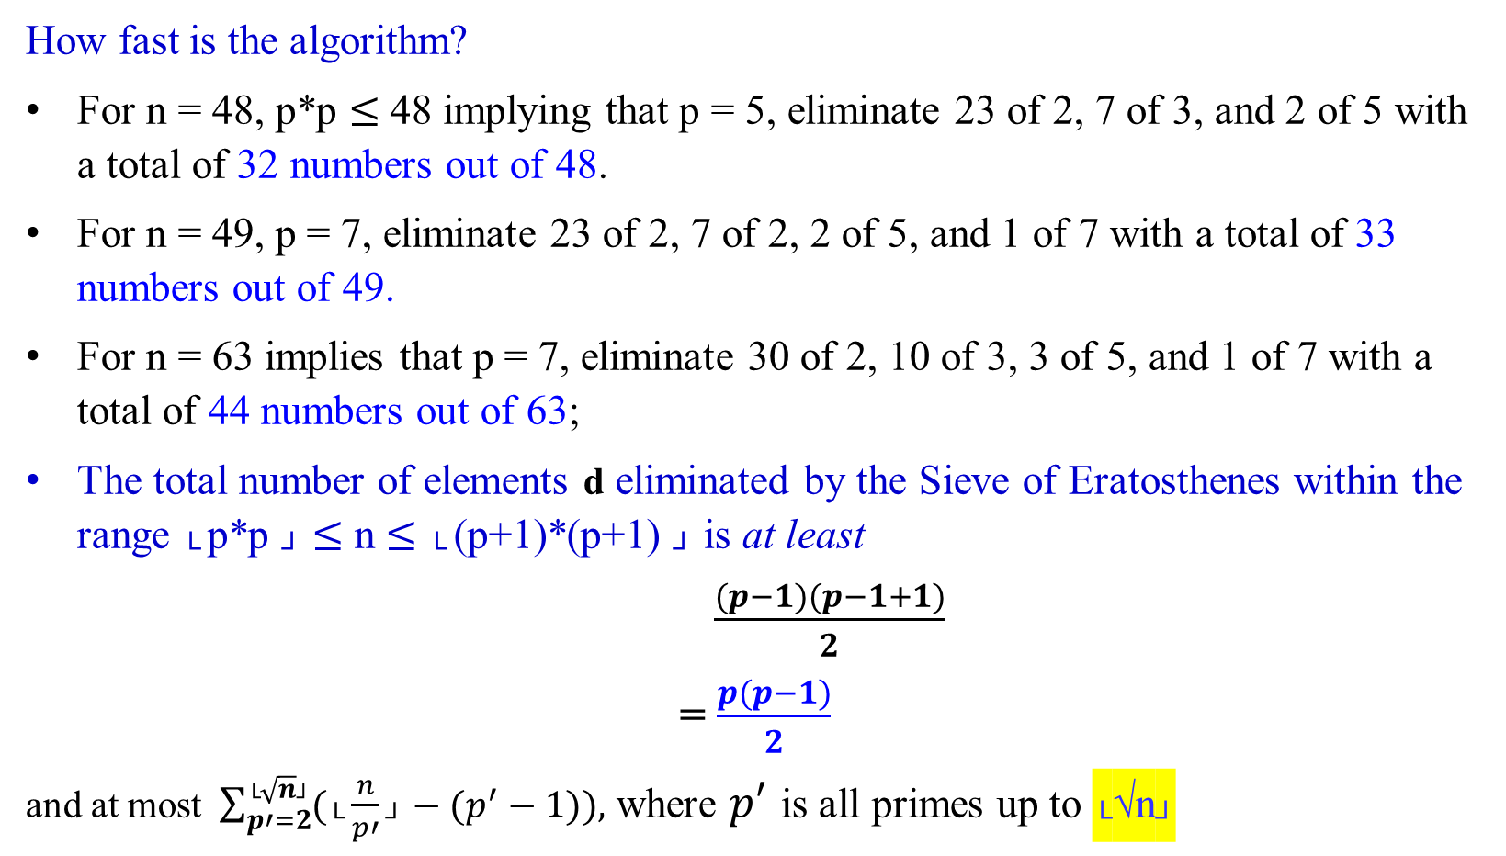
How fast is the algorithm?
For n = 48, p*p $≤$48 implying that p = 5, eliminate 23 of 2, 7 of 3, and 2 of 5 with a total of 32 numbers out of 48.
For n = 49, p = 7, eliminate 23 of 2, 7 of 2, 2 of 5, and 1 of 7 with a total of 33 numbers out of 49.
For n = 63 implies that p = 7, eliminate 30 of 2, 10 of 3, 3 of 5, and 1 of 7 with a total of 44 numbers out of 63;
The total number of elements d eliminated by the Sieve of Eratosthenes within the range └ p*p ┘ $≤$ n $≤$ └ (p+1)*(p+1) ┘ is at least
$\frac{(p−1)(p−1+1)}{2}$
= $\frac{p(p−1)}{2}$
and at most $\sum_{p′=2}^{\text{└}\sqrt{n}\text{┘}}{(\text{└}\frac{n}{p′}\text{┘}}−(p^{′}−1)),$ where $p′$ is all primes up to └√n┘

Slide 12
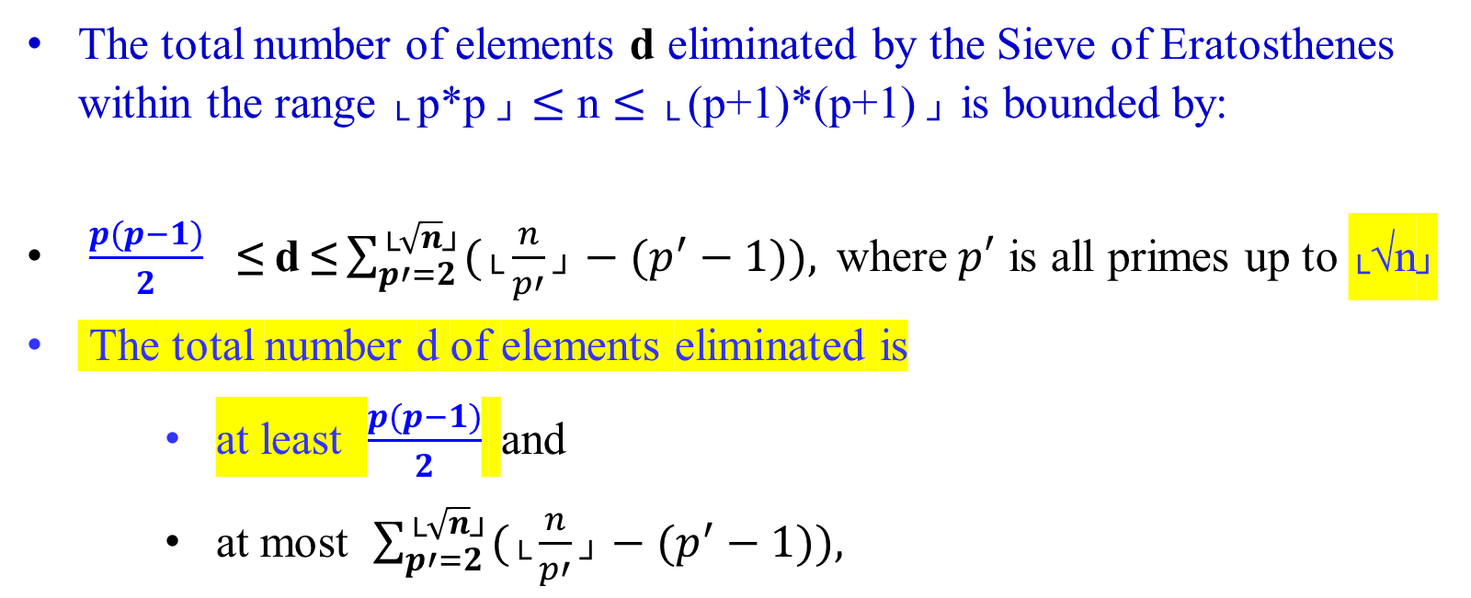
The total number of elements d eliminated by the Sieve of Eratosthenes within the range └ p*p ┘ $≤$ n $≤$ └ (p+1)*(p+1) ┘ is bounded by:
$\frac{p(p−1)}{2}$ ≤ d ≤$\sum_{p′=2}^{\text{└}\sqrt{n}\text{┘}}{(\text{└}\frac{n}{p′}\text{┘}}−(p^{′}−1)), \text{where} p′$ is all primes up to └√n┘
The total number d of elements eliminated is
    at least $\frac{p(p−1)}{2}$ and
    at most $\sum_{p′=2}^{\text{└}\sqrt{n}\text{┘}}{(\text{└}\frac{n}{p′}\text{┘}}−(p^{′}−1)),$

Slide 13

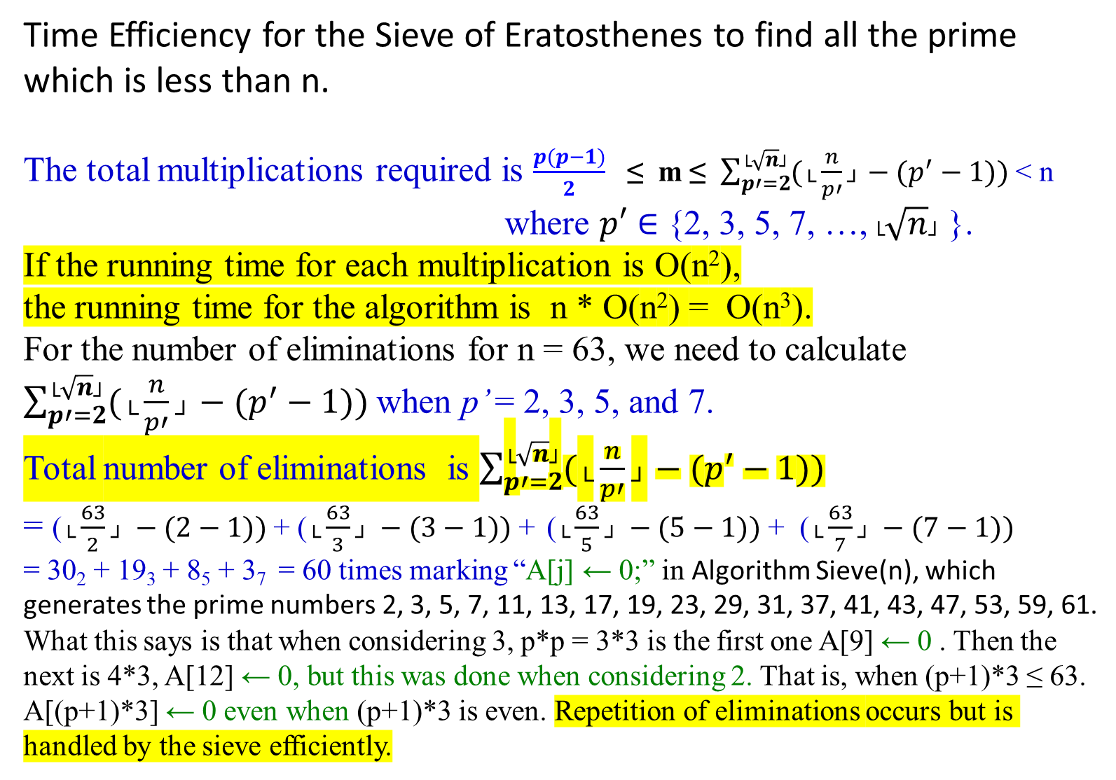
Time Efficiency for the Sieve of Eratosthenes to find all the prime which is less than n.
The total multiplications required is $\frac{p(p−1)}{2}$ ≤ m ≤ $\sum_{p′=2}^{\text{└}\sqrt{n}\text{┘}}{(\text{└}\frac{n}{p′}\text{┘}}−(p^{′}−1))$ < n
where $p′$ $∈$ {2, 3, 5, 7, …, $\text{└}\sqrt{n}\text{┘}$ }.
If the running time for each multiplication is O(n²),
the running time for the algorithm is n * O(n²) = O(n³).
For the number of eliminations for n = 63, we need to calculate
$\sum_{p′=2}^{\text{└}\sqrt{n}\text{┘}}{(\text{└}\frac{n}{p′}\text{┘}}−(p^{′}−1))$when p’ = 2, 3, 5, and 7.
Total number of eliminations is $\sum_{p′=2}^{\text{└}\sqrt{n}\text{┘}}{(\text{└}\frac{n}{p′}\text{┘}}−(p^{′}−1))$
= ($\text{└}\frac{63}{2}\text{┘} −(2−1))$ + ($\text{└}\frac{63}{3}\text{┘} −(3−1))$ + ($\text{└}\frac{63}{5}\text{┘} −(5−1))$ + ($\text{└}\frac{63}{7}\text{┘} −(7−1))$
= 30₂ + 19₃ + 8₅ + 3₇ = 60 times marking “A[j] ← 0;” in Algorithm Sieve(n), which generates the prime numbers 2, 3, 5, 7, 11, 13, 17, 19, 23, 29, 31, 37, 41, 43, 47, 53, 59, 61.
What this says is that when considering 3, p*p = 3*3 is the first one A[9] ← 0 . Then the next is 4*3, A[12] ← 0, but this was done when considering 2. That is, when (p+1)*3 ≤ 63. A[(p+1)*3] ← 0 even when (p+1)*3 is even. Repetition of eliminations occurs but is handled by the sieve efficiently.

Slide 14
Despite the O(n³) time complexity analysis for individual multiplications, the actual running time of the Sieve of Eratosthenes in practice is much better, approximating O(n log log n) for eliminating multiples.
The practical efficiency of the Sieve of Eratosthenes, despite theoretical bounds, is due to the efficient elimination process and low actual computational overhead.

Slide 15
Congruence Modulo n Primality testing

Slide 16
Elementary Number-Theoretic Notions
An application of number-theoretic algorithms is in cryptography
  the discipline concerned with encrypting a message sent from one party to another, such that someone who intercepts the message will not be able to decode it.
Let the set Z = { …., -2, -1, 0, 1, 2, 3, ….} of integers.
Let the set N = {0, 1, 2, 3, ….} of natural numbers (nonnegative integers.
The notation d | a (read “d divides a”) means
  that a = k*d for some integer k, (i.e., a is k multiple of d).

Slide 17

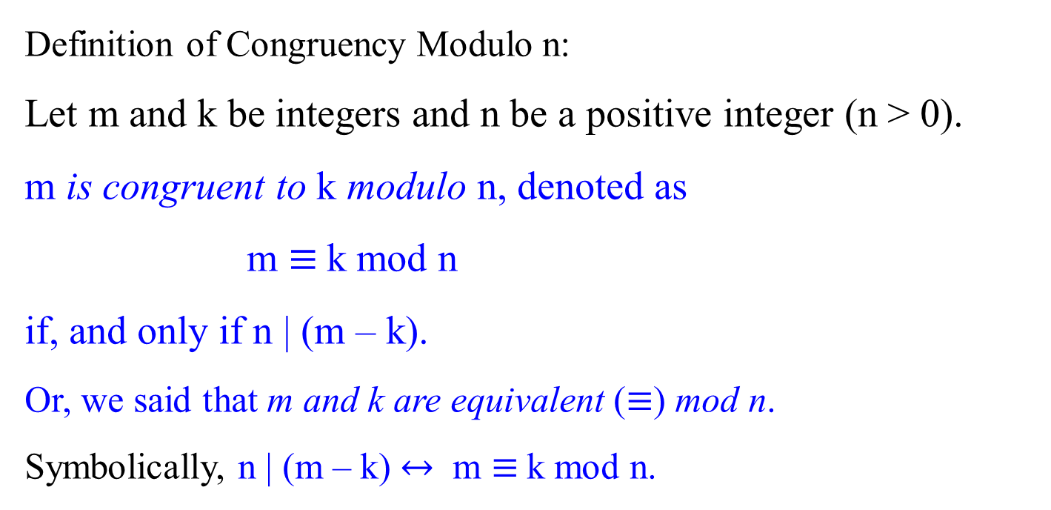
Congruence Modulo n : m and k are congruent modulo n
Definition of Congruency Modulo n:
Let m and k be integers and n be a positive integer (n > 0).
m is congruent to k modulo n, denoted as
m $≡$k mod n
if, and only if n | (m – k).
Or, we said that m and k are equivalent ($≡$) mod n.
Symbolically, n | (m – k) $↔$ m $≡$k mod n.

Slide 18
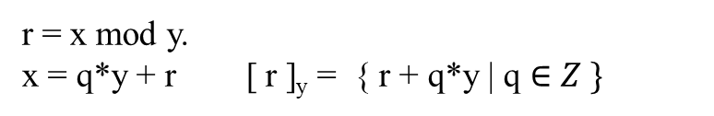

r = x mod y.
x = q*y + r [ r ]_{y} = { r + q*y | q $∈Z \}$
Let Z be the set of integers {…, -2, -1, 0, 1, 2, … }.
All integers can be partitioned into n equivalence classes, according to their remainders modulo n.
Define the equivalence class modulo n containing an integer a to be
[a]_{n} = {a + k n | k ɛ Z},
For example, [3]₇ = { …, - 25, -18, -11, -4, 3, 10, 17, 24, 31, 38, …}.
i.e., b $∈$ [a]_{n} iff b ≡ a (mod n).
iff n | (b – a). i.e., b must be equal to a + kn.

Slide 19

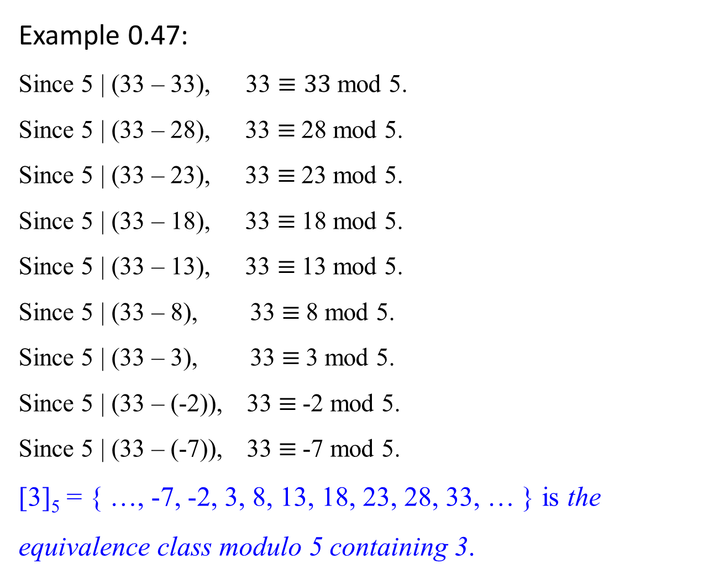
Example 0.47:
Since 5 | (33 – 33), 33 $≡33$ mod 5.
Since 5 | (33 – 28), 33 $≡$28 mod 5.
Since 5 | (33 – 23), 33 $≡$23 mod 5.
Since 5 | (33 – 18), 33 $≡$18 mod 5.
Since 5 | (33 – 13), 33 $≡$13 mod 5.
Since 5 | (33 – 8), 33 $≡$8 mod 5.
Since 5 | (33 – 3), 33 $≡$3 mod 5.
Since 5 | (33 – (-2)), 33 $≡$-2 mod 5.
Since 5 | (33 – (-7)), 33 $≡$-7 mod 5.
[3]₅ = { …, -7, -2, 3, 8, 13, 18, 23, 28, 33, … } is the equivalence class modulo 5 containing 3.
5 | (33 – (-7)) or 5 | (-7-33)

Slide 20

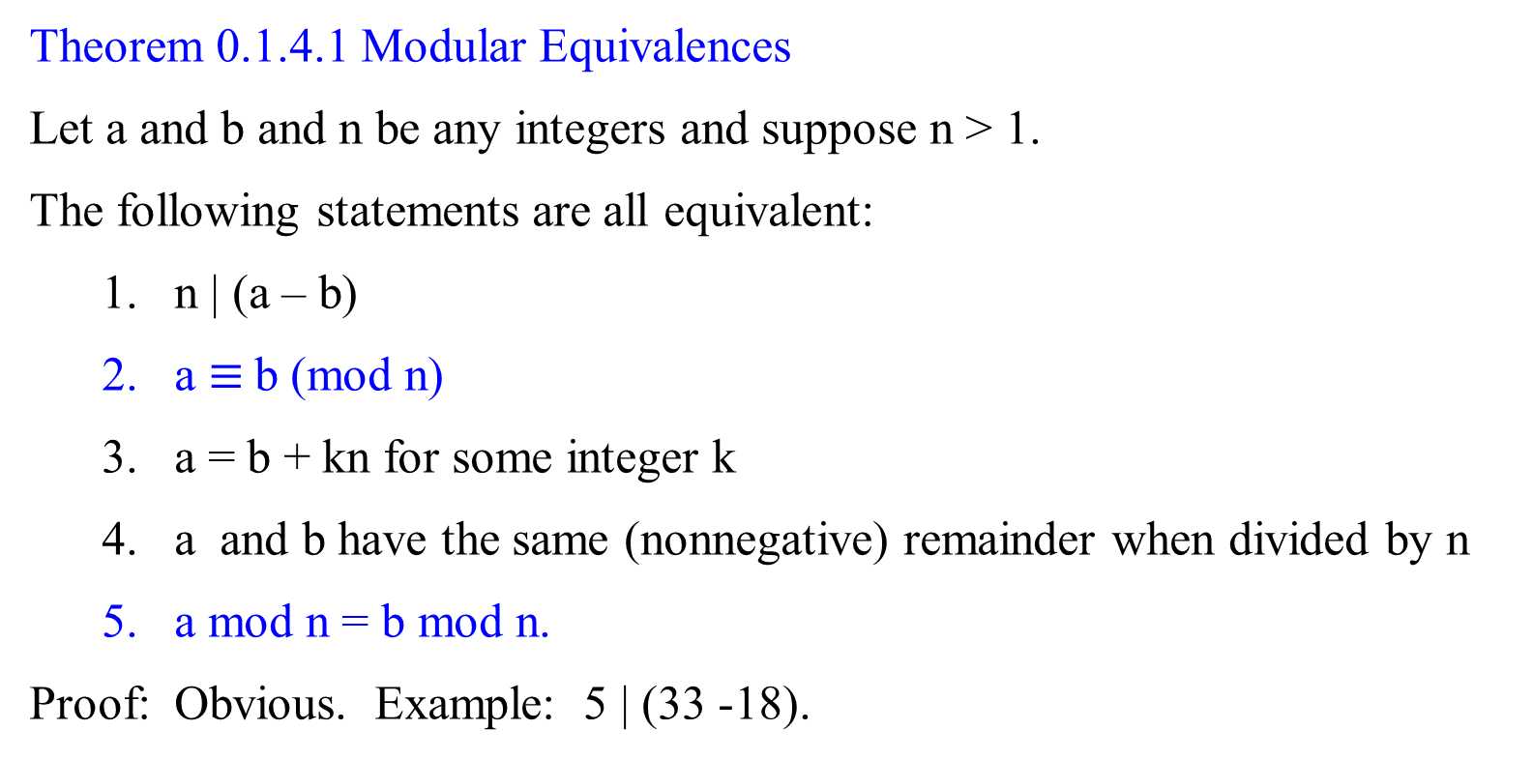
Theorem 0.1.4.1 Modular Equivalences
Let a and b and n be any integers and suppose n > 1.
The following statements are all equivalent:
  n | (a – b)
  a $≡$b (mod n)
  a = b + kn for some integer k
  a and b have the same (nonnegative) remainder when divided by n
  a mod n = b mod n.
Proof: Obvious. Example: 5 | (33 -18).

Slide 21
Primality testing

Slide 22

Primality testing
Do we have any way to know a number is prime without actually trying to factor the number?
Fermat's little theorem states that if p is a prime number, then for any integer a, the number a^{p} − a is an integer multiple of p.
In the notation of modular arithmetic, a^{p} ≡ a (mod p).
That is, p | (a^{p} – a)
For example,
  if a = 2 and p = 11, 2¹¹ = 2048, and
  2048 − 2 = 186 × 11, an integer 186 multiple of 11.
  That is, 11 | 2¹¹ – 2, where 11 is a prime. i.e., 2¹¹ ≡ 2(mod p).
  If a = 2, and p = 12, 2¹² = 4096, then 12 ┼ 2¹² -2
i.e., (a^{p} – a) mod p = 0.

Slide 23
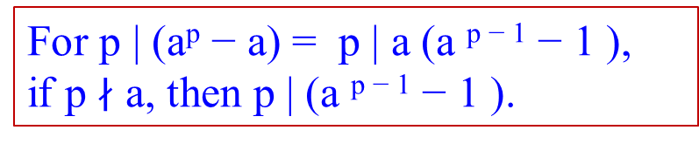
Primality testing
Do we have any way to know a number is prime without actually trying to factor the number?
Fermat's little theorem states that:
  if p is a prime number,
  then for any integer a, the number a^{p} − a is an integer
  multiple of p.
  In the notation of modular arithmetic, a^{p} ≡ a (mod p).
If a is not divisible by p, Fermat's little theorem is equivalent to the statement that a^{p − 1} − 1 is an integer multiple of p, or in symbols.
a^{p-1} ≡ 1 (mod p).
i.e., (a^{p} – a) mod p = 0.
a(a^{p-1} – 1) mod p = 0
(a^{p-1} – 1) mod p = 0
a^{p-1} ≡ 1 (mod p)
For p | (a^{p} − a) = p | a (a ^{p − 1} − 1 ),
if p $∤$ a, then p | (a ^{p − 1} − 1 ).
gcd(a^{p-1}, p) = 1

Slide 24

Let formally state:
Fermat’s little theorem (1640):
  If p is prime, then for every integer 1 ≤ a < p,
a^{p-1} ≡ 1 (mod p).
Since m $≡$k mod n if, and only if n | (m – k),
a^{p-1} ≡ 1 (mod p) if, and only if p | (a^{p-1} - 1).
a^{p-1} is congruent to 1 modulo n
1 ≤ a < p condition is to define the equivalence classes modulo p. such as [1]_{p}, [2]_{p}, …, [a]_{p}, [a+1]_{p}, …, [p-2]_{p}, and [p-1]_{p}.
If a = 0, a^{p-1} is undefined.
If a $≥$ p then it will repeat the equivalence classes.

Slide 25


Congruence Modulo n
[3]₅ = { …, -7, -2, 3, 8, 13, 18, 23, 28, 33, … } is the equivalence class modulo 5 containing 3.
Theorem 0.1.4.1 Modular Equivalences
Let a, b, and n be any integers. Let n > 1.
The following statements are all equivalent:
  n | (a – b)
  a $≡$b (mod n), a is congruent to b modulo n
  a = b + i*n for some integer i, the division theorem a = i*n + b
  a and b have the same (nonnegative) remainder when divided by n;
  i.e., $\frac{a}{n}$ = $\frac{b}{n}$ = r
  5. a mod n = b mod n.
Proof: Obvious. Example: 5 | (33 -18).

Slide 26

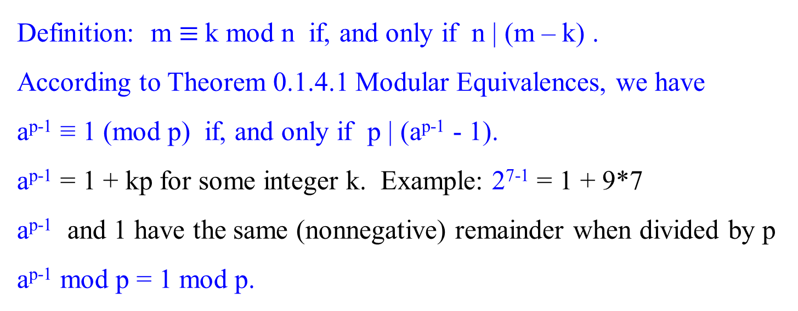
Definition: m $≡$k mod n if, and only if n | (m – k) .
According to Theorem 0.1.4.1 Modular Equivalences, we have
a^{p-1} ≡ 1 (mod p) if, and only if p | (a^{p-1} - 1).
a^{p-1} = 1 + kp for some integer k. Example: 2⁷⁻¹ = 1 + 9*7
a^{p-1} and 1 have the same (nonnegative) remainder when divided by p
a^{p-1} mod p = 1 mod p.

Slide 27

Recall:
Fermat’s little theorem (1640):
If p is prime, then for every integer 1 ≤ a < p,
a^{p-1} ≡ 1 (mod p).
i.e., gcd(a^{p-1}, p) = 1; p|(a^{p-1} -1); a^{p-1} mod p = 1 mod p.
This theorem suggests a “factorless” test for determining whether a number N is prime:
Determine whether 13 is a prime.
Assume that p =13 is a prime.
Pick a = 2, such that 1 ≤ 2 < 13.
Check whether 2¹³⁻¹ ≡ 1 (mod 13).
1. gcd(2¹³⁻¹ , 13) = 1; or
2. 13| 2¹³⁻¹ - 1; i.e., 13|4096-1.
3. 2¹³⁻¹ mod 13 = 1 mod 13
Pass “prime”
Pick some a
Fail “composite” Fermat’s test
Is a^{N-1} ≡ 1 mod N?

Slide 28
The problem is that Fermat’s theorem :
  The Fermat’s theorem is not an if-and-only-if condition;
  It says that p is prime → a^{p-1} ≡ 1 (mod p). But not vice versa.
It does not say what happens when N is not prime.
If N is not prime, Fermat’s test diagram is questionable. i.e.,
    for any N, if a^{N-1} ≡ 1 (mod N), can we say that N is prime?
In fact, a composite number N can possibly pass Fermat’s test (that is, a^{N-1} ≡ 1 (mod N), for certain choices of a.
  e.g., for a non-prime N = 341 = 11 * 31, 2³⁴⁰ ≡ 1 (mod 341).
But it is true that for composite N, most values of a will fail the test.
Show 2³⁴⁰ mod 341= 2²⁵⁶⁺⁶⁴⁺¹⁶⁺⁴ mod 341
= (2²⁵⁶ mod 341 * 2⁶⁴ mod 341 * 2¹⁶ mod 341 * 2⁴ mod 341) mod 341
= (64 * 16 * 64 *16) mod 341
= (1024 mod 341 * 1024 mod 341) mod 341
= (1 * 1) mod 341 = 1

Slide 29
Figure 1.7 An algorithm for testing primality.
For this algorithm, choose a randomly from {1, 2, … N-1}, rather than fixing an arbitrary value of a in advance.
function primality(N)
Input: Positive integer N
Output: yes/no
Pick a positive integer a < N at random
if a^{N-1} ≡ 1 (mod N)
then return yes;
else return no;
Test whether N | a^{N-1} – 1?
or gcd(a^{N-1}, N) = 1?
or a^{N-1} mod N = 1 mod N?

Slide 30
In analyzing the behavior of this algorithm for testing primality:
  It turns out that
    certain extremely rare composite numbers N, called Carmichael numbers, pass Fermat’s test for all a relatively prime to N. [i.e., a^{N-1} ≡ 1 (mod N)]
    On such numbers, this algorithm will fail.

Slide 31


Begin +++++++++++++++++++++++++++++++++++++++++++++++++++++++++++++++
What is Carmichael number?
The smallest Carmichael number is 561 = 3 * 11 * 17.
It is not a prime.
It passes the Fermat test, because a⁵⁶⁰ ≡ 1 (mod 561) for all values of a relatively prime to 561, if a $is not one of${3, 11, 17}. [i.e., gcd(a, 561) = 1.]
The numbers of this type are infinite but exceedingly rare.

Slide 32
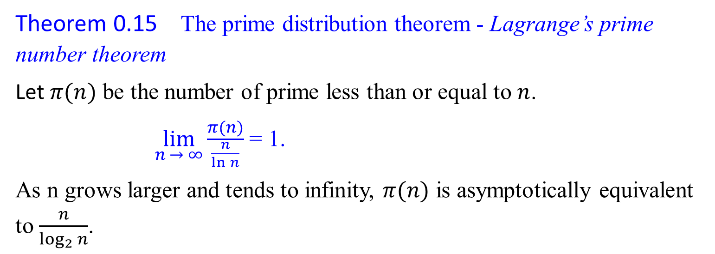
Search of a Large Prime
Theorem 0.15 The prime distribution theorem - Lagrange’s prime number theorem
Let $π(n)$ be the number of prime less than or equal to $n$.
$\lim_{n → ∞}{\frac{π(n)}{\frac{n}{\ln{n}}}}$ = 1.
As n grows larger and tends to infinity, $π(n)$ is asymptotically equivalent to $\frac{n}{\log_{2}{n}}$.

Slide 33
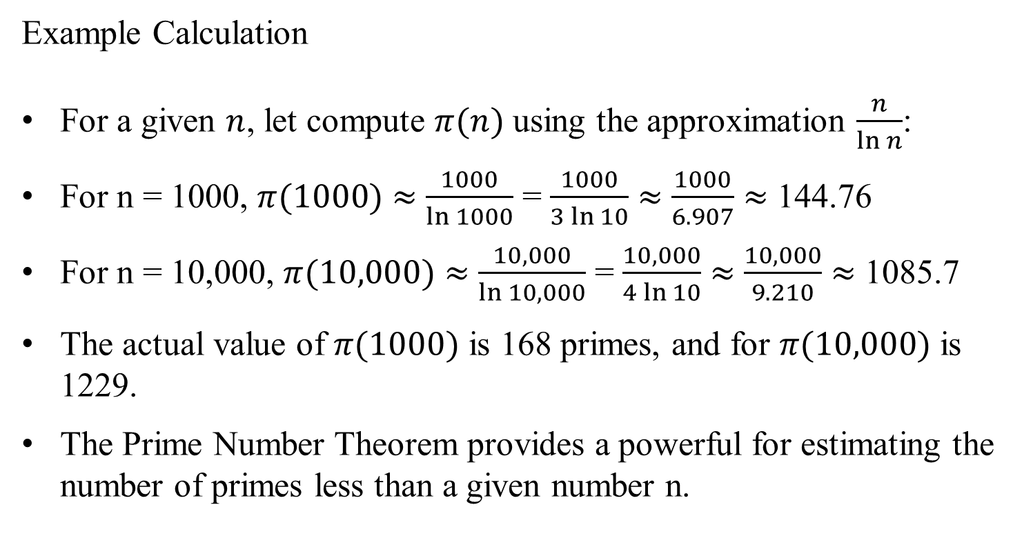
Example Calculation
For a given $n$, let compute $π(n)$ using the approximation $\frac{n}{\ln{n}}$:
For n = 1000, $π(1000)$ $≈$ $\frac{1000}{\ln{1000}}$ = $\frac{1000}{3\ln{10}}$ $≈$ $\frac{1000}{6.907}$ $≈$ 144.76
For n = 10,000, $π(10,000)$ $≈$ $\frac{10,000}{\ln{10,000}}$ = $\frac{10,000}{4\ln{10}}$ $≈$ $\frac{10,000}{9.210}$ $≈$ 1085.7
The actual value of $π(1000)$ is 168 primes, and for $π(10,000)$ is 1229.
The Prime Number Theorem provides a powerful for estimating the number of primes less than a given number n.

Slide 34
If we randomly choose an integer between 1 and n = 10¹⁶ according to the uniform distribution, the probability of it being prime is about
$\frac{1}{\ln{{10}^{16}}}=0.027143.$
Suppose we choose 200 such numbers at random. The probability of them all not being prime is then about
(1 – 0.027143)²⁰⁰ = 0.004.
If we randomly choose an integer between 1 and n = 10¹⁰⁰ according to the uniform distribution, the probability of it being prime is about
$\frac{1}{\ln{{10}^{100}}}=0.0043429.$
Suppose we choose 200 such numbers at random. The probability of them all not being prime is then about
(1 – 0.0043429)²⁰⁰ = 0.04.

Slide 35
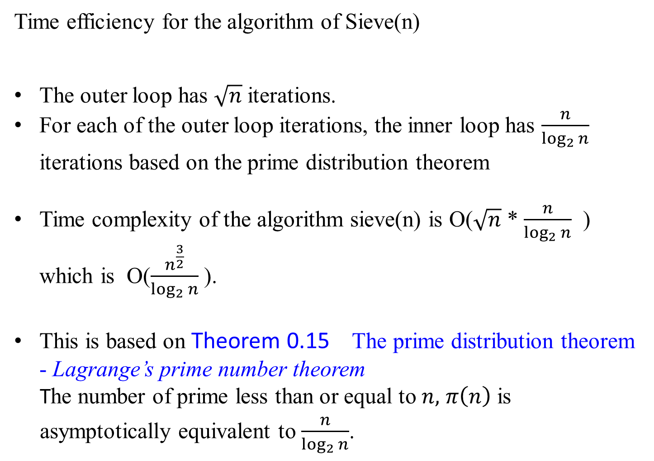
Time efficiency for the algorithm of Sieve(n)
The outer loop has $\sqrt{n}$ iterations.
For each of the outer loop iterations, the inner loop has $\frac{n}{\log_{2}{n}}$ iterations based on the prime distribution theorem
Time complexity of the algorithm sieve(n) is O($\sqrt{n}$ * $\frac{n}{\log_{2}{n}}$ ) which is O($\frac{n^{\frac{3}{2}}}{\log_{2}{n}}$ ).
This is based on Theorem 0.15 The prime distribution theorem - Lagrange’s prime number theorem
The number of prime less than or equal to $n,$ $π\left(n\right)$ is asymptotically equivalent to $\frac{n}{\log_{2}{n}}$.

Slide 36
Prime Factorization and Relative Prime

Slide 37
Relatively prime integers
Two integers a and b are relatively prime if, and only if gcd(a, b) = 1, that is, iff their only common divisor is 1.
For example:
8 and 15 are relatively prime, because gcd(8, 15) =1.
gcd(8 15) = 1, because
the divisors of 8 are 1, 2, 4, and 8, and
the divisors of 15 are 1, 3, 5, and 15.

Slide 38
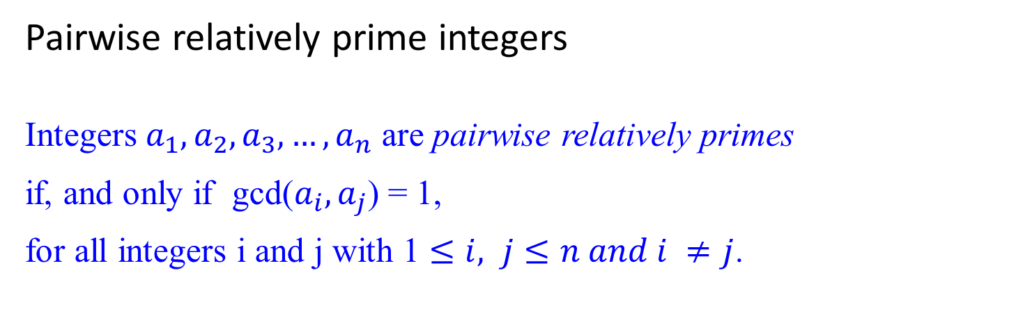
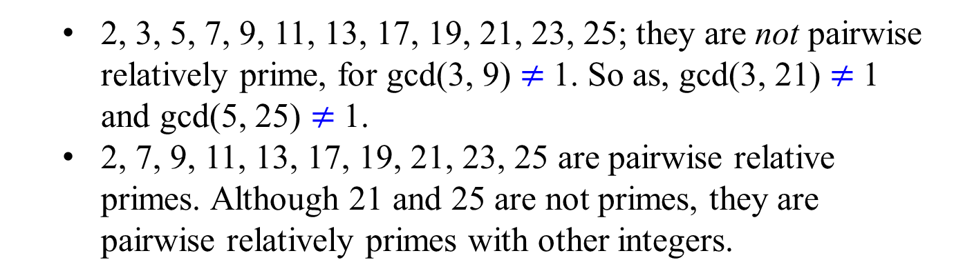
Pairwise relatively prime integers
Integers $a_{1},a_{2},a_{3}, …,a_{n}$ are pairwise relatively primes
if, and only if gcd($a_{i},a_{j}$) = 1,
for all integers i and j with 1 $≤i, j≤n and i ≠j$.
  2, 3, 5, 7, 9, 11, 13, 17, 19, 21, 23, 25; they are not pairwise relatively prime, for gcd(3, 9) $≠$1. So as, gcd(3, 21) $≠$1 and gcd(5, 25) $≠$1.
  2, 7, 9, 11, 13, 17, 19, 21, 23, 25 are pairwise relative primes. Although 21 and 25 are not primes, they are pairwise relatively primes with other integers.

Slide 39
Prime Factorization and Relative Prime
Every integer greater than one can be written as a unique product of primes.
We next develop theory that proves this assertion.
The following theorem states that if two integers are each relatively prime to an integer p, then their product is relatively prime to p.
Example: Let p = 15, x = 4, y = 16 such that gcd(4, 15) = 1 and gcd(16, 15) = 1. Then gcd(4*16, 15) = 1.

Slide 40
Theorem 0.7
For all primes p and all integers a, b, if p | ab, then p | a or p | b (or both). That is, gcd(a, p) = 1 or gcd(b, p) = 1, but not both.
Example: Let p = 7, x = 5, y = 7 such that 7 | 5*7, and 7 | 7. gcd(5, 7) = 1.
Note: gcd(4, 15) = 1 and gcd(16, 15) = 1. Then gcd(4*16, 15) = 1.
A consequence of Theorem 0.7 is that
  every integer n > 1 has a unique factorization as a product of prime numbers.

Slide 41


The following unique factorization theorem is also called the fundamental theorem of arithmetic. Every integer greater than one can be written as a unique product of primes.
Theorem 0.8 (Unique factorization)
There is exactly one way to write any composite integer n as a product of the form
n = $p_{1}^{e_{1}} p_{2}^{e_{2}}… p_{j}^{e_{j}}$,
where the p_{i} are prime, p₁ < p₂ < p₃ < …. < p_{j} , and
the e_{i} are positive integers.
This representation of n is unique.
The integer e_{i} is called the order of p_{i} in n.
?

Slide 43

Cryptography – The RSA Public Key Cryptosystem
The Rivest-Shamir-Adleman (RSA) cryptosystem uses all the ideas we have introduced in this lecture note. It derives very strong guarantees of security by ingeniously exploiting the wide gulf between the polynomial-time computability of certain number-theoretic tasks: (
  modular exponentiation,
  greatest common divisor,
  primality testing) and
  the intractability of others (factoring).

