Slide 1
Chapter 07_02
Greedy Algorithms
Minimum Spanning Tree Problem
Prim’s and Krushal’s Algorithms

Slide 2
In the design of electronic circuitry,
we model to use the pins of several components electrically equivalent by wiring them together.
To connect a set of n pins (vertices), there need n-1 wires (edges), each connecting two pins.
The use of the least amount of wire is the most desirable.

Slide 3
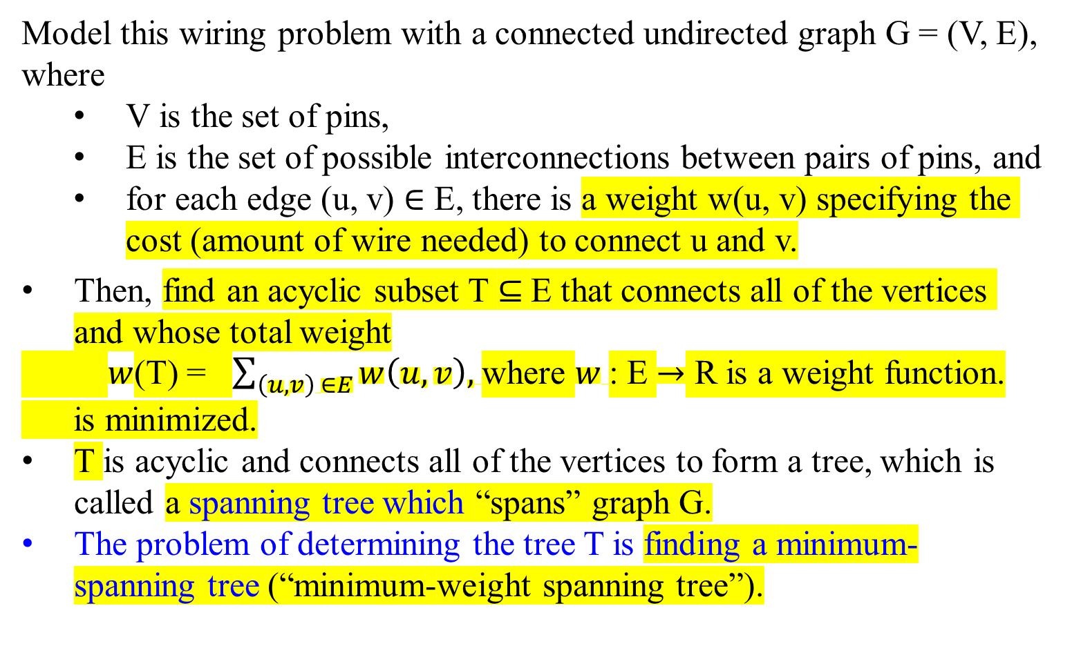
Model this wiring problem with a connected undirected graph G = (V, E), where
  V is the set of pins,
  E is the set of possible interconnections between pairs of pins, and
  for each edge (u, v) $∈$ E, there is a weight w(u, v) specifying the cost (amount of wire needed) to connect u and v.
Then, find an acyclic subset T ⊆ E that connects all of the vertices and whose total weight
$w$(T) = $\sum_{\left(u, v\right) ∈E}{w\left(u, v\right), }$where $w$: E $→$ R is a weight function.
is minimized.
T is acyclic and connects all of the vertices to form a tree, which is called a spanning tree which “spans” graph G.
The problem of determining the tree T is finding a minimum-spanning tree (“minimum-weight spanning tree”).

Slide 4
8 7
4 2 9
11 4 14
8 7 6 10
1 2
b
c
d
a
i
e
h
g
f
Figure 24.1 A minimum spanning tree for a connected graph G.
The weights on edges are shown, and the edges in a minimum spanning tree are shaded.
The total weight of the tree shown is 37.
The tree is not unique:
  removing the edge (b, c) and replacing it with (a, h) yields another spanning tree with weight 37.

Slide 5
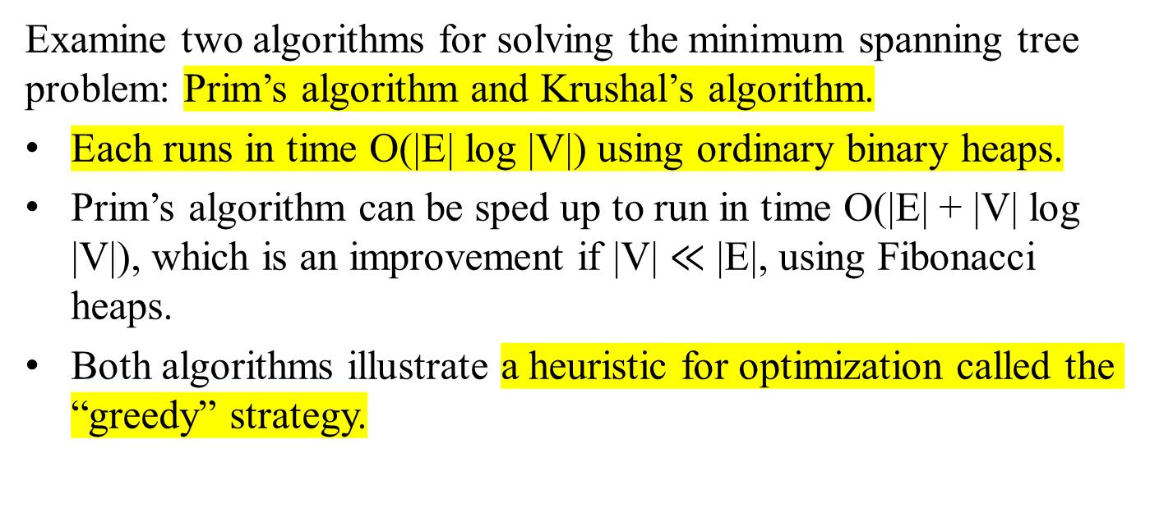
Examine two algorithms for solving the minimum spanning tree problem: Prim’s algorithm and Krushal’s algorithm.
Each runs in time O(|E| log |V|) using ordinary binary heaps.
Prim’s algorithm can be sped up to run in time O(|E| + |V| log |V|), which is an improvement if |V| $≪$ |E|, using Fibonacci heaps.
Both algorithms illustrate a heuristic for optimization called the “greedy” strategy.

Slide 6
Examine two algorithms for solving the minimum spanning tree problem: Prim’s algorithm and Krushal’s algorithm.
Both algorithms illustrate a heuristic for optimization called the “greedy” strategy.
  At each step of an algorithm, one of several possible choices must be made.
  The greedy strategy advocates making the choice that is the best at the moment. (locally optimal)
  Such a strategy is not generally guaranteed to find globally optimal solutions to problems.
For the minimum spanning tree problem, we can show that certain greedy strategies do yield a spanning tree with a minimum weight.

Slide 7
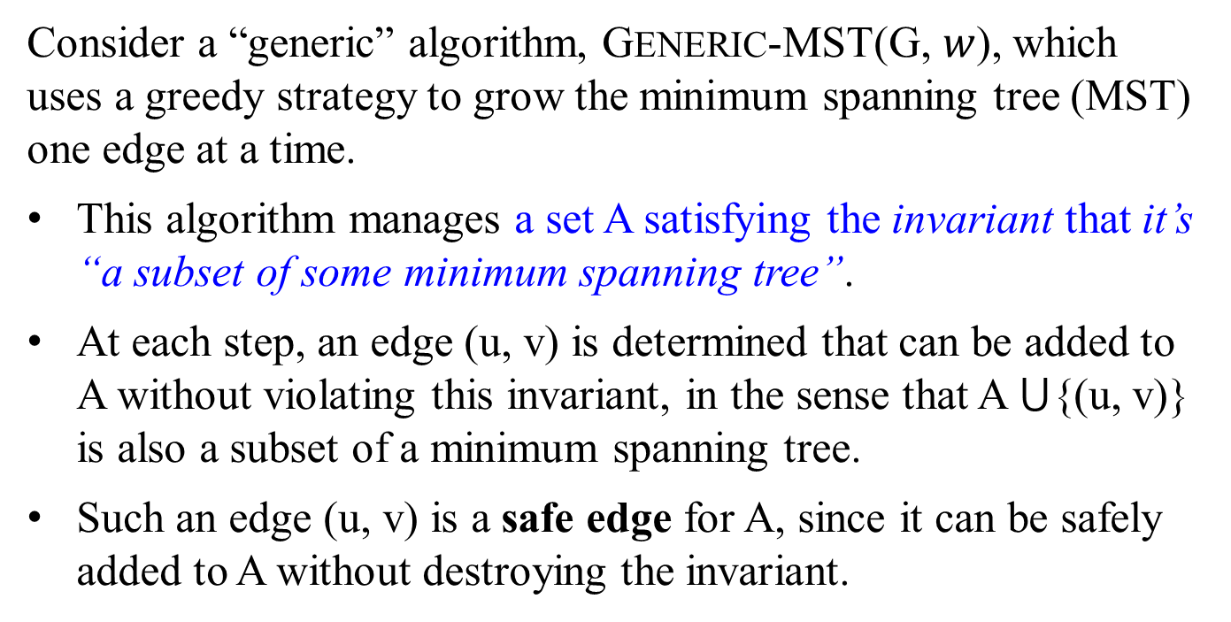
Consider a “generic” algorithm, GENERIC-MST(G, $w$), which uses a greedy strategy to grow the minimum spanning tree (MST) one edge at a time.
This algorithm manages a set A satisfying the invariant that it’s “a subset of some minimum spanning tree”.
At each step, an edge (u, v) is determined that can be added to A without violating this invariant, in the sense that A ⋃{(u, v)} is also a subset of a minimum spanning tree.
Such an edge (u, v) is a safe edge for A, since it can be safely added to A without destroying the invariant.

Slide 8
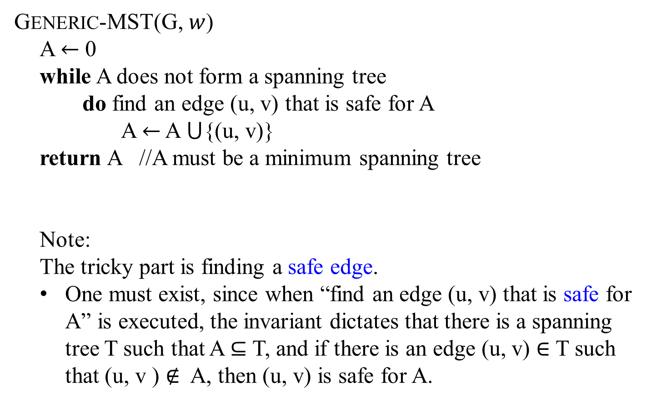
GENERIC-MST(G, $w$)
A $←$ 0
while A does not form a spanning tree
do find an edge (u, v) that is safe for A
A $←$ A ⋃{(u, v)}
return A //A must be a minimum spanning tree
Note:
The tricky part is finding a safe edge.
One must exist, since when “find an edge (u, v) that is safe for A” is executed, the invariant dictates that there is a spanning tree T such that A ⊆ T, and if there is an edge (u, v) $∈$ T such that (u, v ) $∉$ A, then (u, v) is safe for A.

Slide 9
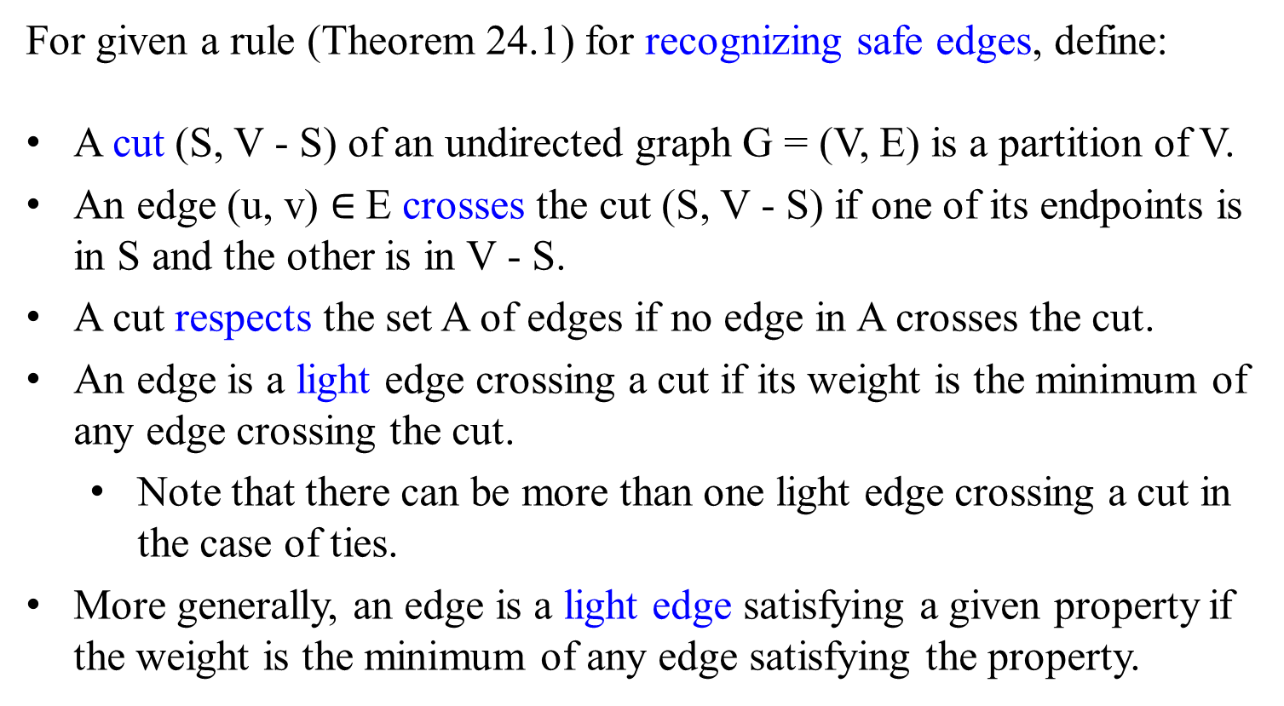
For given a rule (Theorem 24.1) for recognizing safe edges, define:
A cut (S, V - S) of an undirected graph G = (V, E) is a partition of V.
An edge (u, v) $∈$E crosses the cut (S, V - S) if one of its endpoints is in S and the other is in V - S.
A cut respects the set A of edges if no edge in A crosses the cut.
An edge is a light edge crossing a cut if its weight is the minimum of any edge crossing the cut.
  Note that there can be more than one light edge crossing a cut in the case of ties.
More generally, an edge is a light edge satisfying a given property if the weight is the minimum of any edge satisfying the property.

Slide 10
8 7
4 2 9
11 4 14
8 7 6 10
1 2
b
c
d
a
i
e
$S$ $↑$
$$↑S$$
$$S−V↓$$
h
g
f
$$↓S−V$$
Figure 24.2 Viewing a cut (S, V – S) of the graph from Figure 24.1. (a) The vertices in the set S are shown in red (referred as black), and those in V-S are shown in white. The edges crossing the cut are those connecting white vertices with red (referred as black) vertices. The edge (d, e) is the unique light edge crossing the cut. A subset A of the edges is shaded; note that the cut (S, V – S) respects A, since no edges of A crosses the cut.

Slide 11
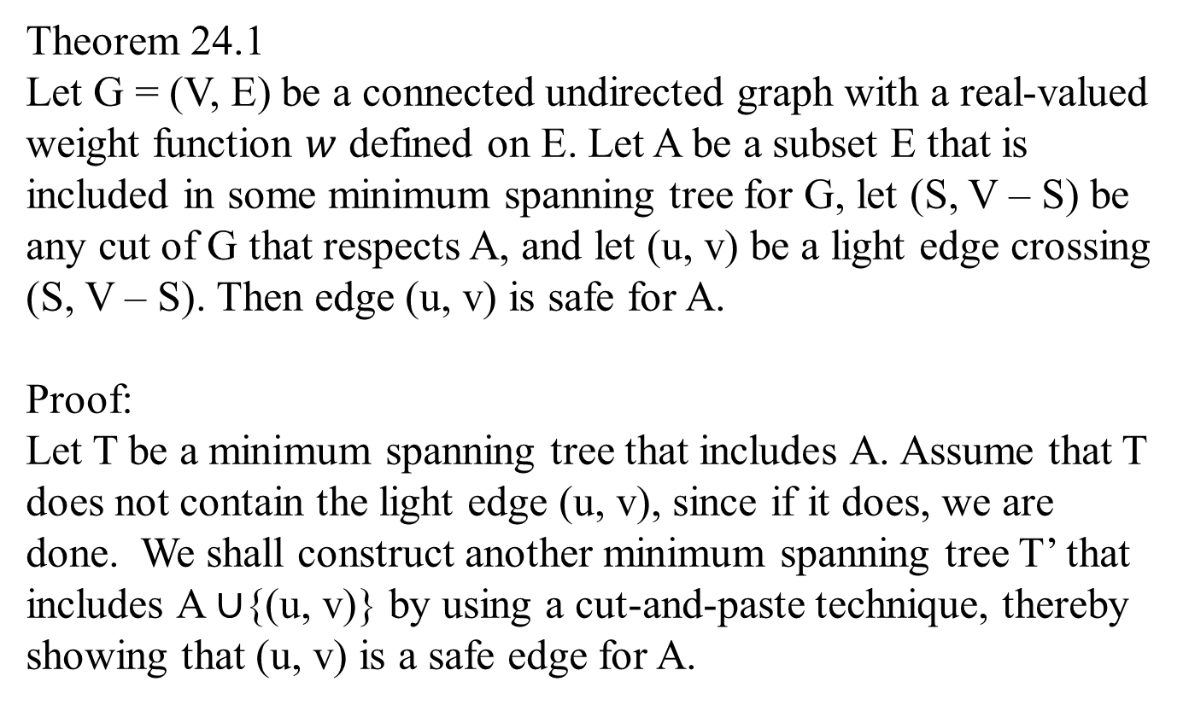
Theorem 24.1
Let G = (V, E) be a connected undirected graph with a real-valued weight function $w$ defined on E. Let A be a subset E that is included in some minimum spanning tree for G, let (S, V – S) be any cut of G that respects A, and let (u, v) be a light edge crossing (S, V – S). Then edge (u, v) is safe for A.
Proof:
Let T be a minimum spanning tree that includes A. Assume that T does not contain the light edge (u, v), since if it does, we are done. We shall construct another minimum spanning tree T’ that includes A $∪${(u, v)} by using a cut-and-paste technique, thereby showing that (u, v) is a safe edge for A.

Slide 12
Figure 24.3 The proof of Theorem 24.1. The vertices in S are black, and the vertices in V – S are white. The edges in the minimum spanning tree T are shown, but the edge in the graph G are not. The edge in A are shaded, and (u, v) is a light edge (for its weight is the minimum of any edge crossing the cut) crossing the cut (S, V – S). The edge (x, y) is an edge on the unique path p from u to v in T. A minimum spanning tree T’ that contains (u, v) is formed by removing the edge (x, y) from T and added the edge (u, v).
x
u
P
y
v

Slide 13
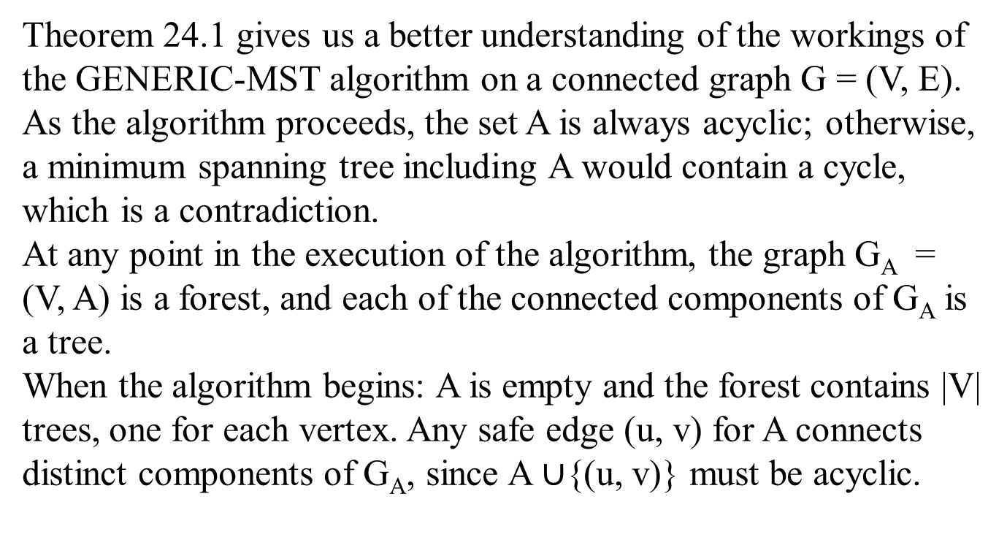
Theorem 24.1 gives us a better understanding of the workings of the GENERIC-MST algorithm on a connected graph G = (V, E). As the algorithm proceeds, the set A is always acyclic; otherwise, a minimum spanning tree including A would contain a cycle, which is a contradiction.
At any point in the execution of the algorithm, the graph G_{A} = (V, A) is a forest, and each of the connected components of G_{A} is a tree.
When the algorithm begins: A is empty and the forest contains |V| trees, one for each vertex. Any safe edge (u, v) for A connects distinct components of G_{A}, since A $∪${(u, v)} must be acyclic.

Slide 15
Prim’s algorithm
Constructs a minimum spanning tree through a sequence of expanding subtrees.

Slide 16

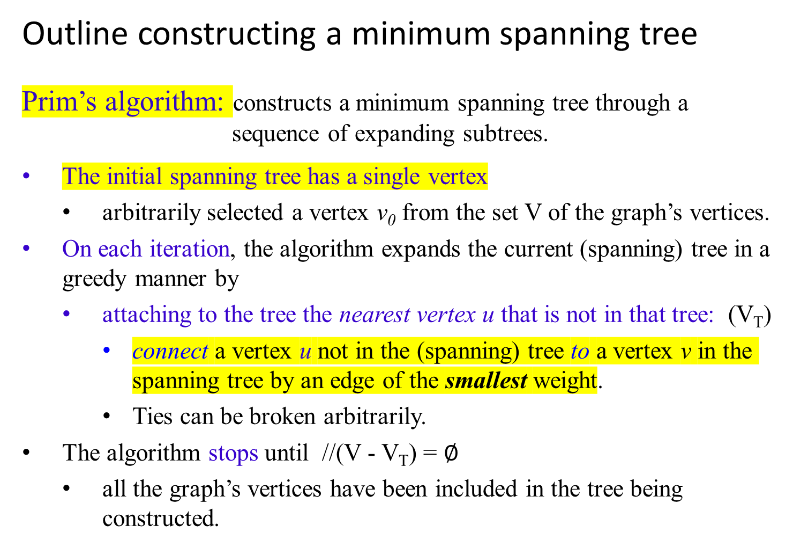
Outline constructing a minimum spanning tree
Prim’s algorithm: constructs a minimum spanning tree through a sequence of expanding subtrees.
The initial spanning tree has a single vertex
  arbitrarily selected a vertex v₀ from the set V of the graph’s vertices.
On each iteration, the algorithm expands the current (spanning) tree in a greedy manner by
  attaching to the tree the nearest vertex u that is not in that tree: (V_{T})
    connect a vertex u not in the (spanning) tree to a vertex v in the spanning tree by an edge of the smallest weight.
    Ties can be broken arbitrarily.
The algorithm stops until //(V - V_{T}) = $∅$
  all the graph’s vertices have been included in the tree being constructed.

Slide 17
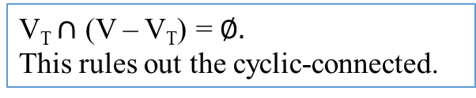
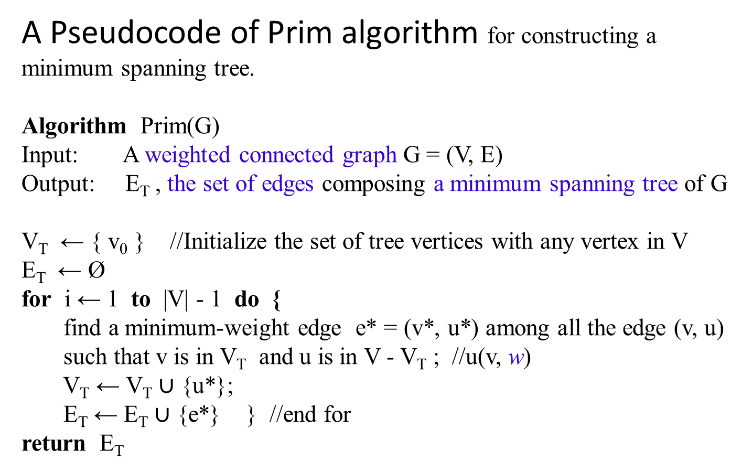
A Pseudocode of Prim algorithm for constructing a minimum spanning tree.
Algorithm Prim(G)
Input: A weighted connected graph G = (V, E)
Output: E_{T} , the set of edges composing a minimum spanning tree of G
V_{T} ← { v₀ } //Initialize the set of tree vertices with any vertex in V
E_{T} ← Ø
for i ← 1 to |V| - 1 do {
find a minimum-weight edge e* = (v*, u*) among all the edge (v, u)
such that v is in V_{T} and u is in V - V_{T} ; //u(v, w)
V_{T} ← V_{T} $∪$ {u*};
E_{T} ← E_{T} $∪$ {e*} } //end for
return E_{T}
V_{T} $∩$ (V – V_{T}) = $∅.$
This rules out the cyclic-connected.

Slide 18
Outline constructing a minimum spanning tree
Prim’s algorithm: constructs a minimum spanning tree through a sequence of expanding subtrees.
The algorithm expands a tree T = (V_{T}, E_{T}) by
  exactly one vertex u on each of its iterations.
The total number of n - 1 such iterations is
  the number of vertices in the graph, where n is |T|.
The tree T = (V_{T}, E_{T}) generated by the algorithm is obtained
  using the set n-1 of edges for the tree expansions.

Slide 19
The Prim’s algorithm needs:
  a vertex V - V_{T} not in the current (spanning) tree vertices V_{T}
  information about the shortest edge connecting the vertex in V-V_{T} to a spanning tree vertex in V_{T}.
  information by attaching each vertex u in V - V_{T} to a tree vertex v in V_{T} :
    the nearest tree vertex v in V_{T} and
    the weight, w of the corresponding edge.
    u(v, w).
Vertices of V - V_{T}, such as {c, d}, that are not adjacent to any of the tree vertices of V_{T}, such as {a, …} can be written:
  c(-, ∞) and d(-, ∞), where
  ∞ indicates their “infinite” distance to the tree vertices and
  a null (or -) for the name of the nearest tree vertex.
1
b
c
3
4
6
4
a
5
f
5
d
6
2
8
e
b(a, 3), f(a, 5), e(6, a)
c(-, ∞), d(-, ∞)

Slide 20
Always split the vertices, e.g., V - V_{T} = { c, d, f, e}, that are not in the tree, (with tree vertices V_{T} = {a, b}) into two sets, the “fringe” and the “unseen.”
  The fringe contains only the vertices, such as {c, e, f}:
    they are not in the (spanning) tree, V_{T} = {a, b |(a, 3, b)};
    they are adjacent to at least one tree vertex in V_{T} , e.g, c(b, 1).
    These vertices {c, e, f} are the candidates from which the next tree vertex such as c is selected.
a(-, -) b(a, 3) c(b, 1) e(a, 6) f(b, 4) f(a, 5) d(-, ∞)
  The unseen vertices such as d are all the other vertices of the graph, because they are yet to be affected by the algorithm (i.e., not directly connected to any vertices in V_{T}, and d(-, ∞) ).
From the fringe, find the next vertex to be added to the current (spanning) tree T = <V_{T}, E_{T} > by selecting a vertex in the set V - V_{T} with the smallest distance connected to a tree vertex.
  V_{T} = { a, b } and V - V_{T} = { c, d, f, e}
Ties can be broken arbitrarily.
B
1
b
c
3
4
6
4
a
5
f
5
d
6
2
8
e

Slide 21
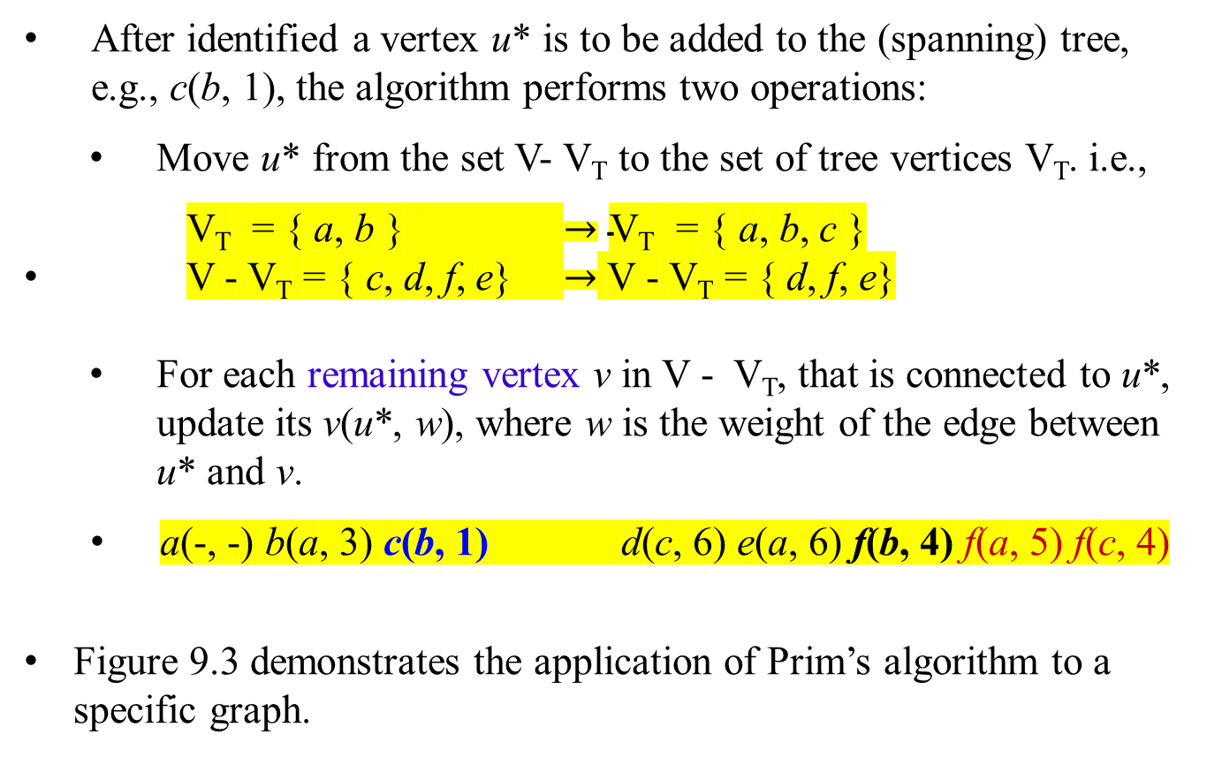
a(-, -) b(a, 3) c(b, 1) d(-, ∞) e(a, 6) f(b, 4) f(a, 5)
After identified a vertex u* is to be added to the (spanning) tree, e.g., c(b, 1), the algorithm performs two operations:
Move u* from the set V- V_{T} to the set of tree vertices V_{T}. i.e.,
V_{T} = { a, b } $→\text{V}\text{T}\text{ = \{ }\text{a}\text{, }\text{b}\text{, }\text{c}\text{ \}}$
V - V_{T} = { c, d, f, e} $→$ V - V_{T} = { d, f, e}
For each remaining vertex v in V - V_{T}, that is connected to u*, update its v(u*, w), where w is the weight of the edge between u* and v.
  a(-, -) b(a, 3) c(b, 1) d(c, 6) e(a, 6) f(b, 4) f(a, 5) f(c, 4)
Figure 9.3 demonstrates the application of Prim’s algorithm to a specific graph.
1
b
c
3
4
6
4
a
5
f
5
d
6
2
8
e

Slide 22
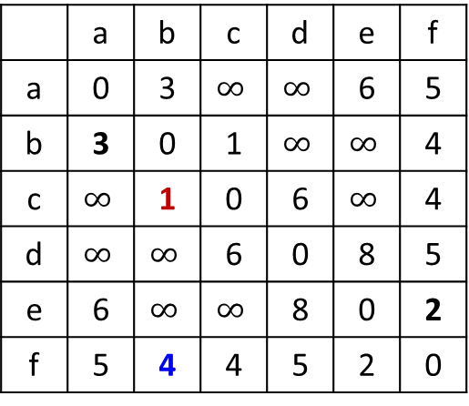
Figure 9.3 Application of Prim’s algorithm. The parenthesized labels of a vertex in the middle column indicate the nearest tree vertex and edge weight; selected vertices and edges are shown in bold.
b
1
c
 | a | b | c | d | e | f
a | 0 | 3 | $$∞$$ | $$∞$$ | 6 | 5
b | 3 | 0 | 1 | $$∞$$ | $$∞$$ | 4
c | $$∞$$ | 1 | 0 | 6 | $$∞$$ | 4
d | $$∞$$ | $$∞$$ | 6 | 0 | 8 | 5
e | 6 | $$∞$$ | $$∞$$ | 8 | 0 | 2
f | 5 | 4 | 4 | 5 | 2 | 0
3
4
6
4
a
5
f
5
d
2
6
8
e

Slide 23
Algorithm Prim(G)
e* = (v*, u*) iff u(v, w) is a min
Tree vertices | Remaining vertices | Illustration
a(-, -) b(a, 3) f(a, 5) d(-, ∞) e(a, 6) c(-, ∞)
1
b
c
3
4
4
6
a
5
f
5
d
V_{T} = { a } and
V - V_{T} = { b, c d, e, f}
2
6
8
e
From these two sets, we conclude:
(b 3 a), (c ∞ -), (d ∞ -), (e 6 a), (f 5 a).
Minheap
b(a, 3) f(a, 5) d(-, ∞) e(a, 6) c(-, ∞)
or
b(a, 3) e(a, 6) f(a, 5)
After b(a, 3) is selected, the minheap:
f(a, 5) e(a, 6) d(-, ∞) c(-, ∞)
or
f(a, 5) e(a, 6)

Slide 24
After c(b, 1) is selected, the minheap:
f(a, 4) f(a, 5) e(a, 6) d(-, ∞): which is not required
Tree vertices | Remaining vertices | Illustration
a(-, -) b(a, 3) f(a, 5) d(-, ∞) e(a, 6) c(-, ∞)
1
b
c
b(a, 3) c(b, 1) f(b, 4) e(a, 6) f(a, 5) d(-, ∞)
3
4
4
6
a
5
f
5
d
V_{T} = { a, b } and
V - V_{T} = { c, d, e, f}
2
6
8
e
From these two sets, we conclude:
(c ∞ a), (c 1 b), (d ∞ -), (e 6 a) , (e ∞ b), (f 5 a), (f 4 b).
heap
(c 1 b), (d ∞ -), (e 6 a), (f 5 a), (f 4 b).
or
(c ∞ a), (c 1 b), (d ∞ -), (e 6 a), (e ∞ b), (f 5 a), (f 4 b).
Use bottom-up to build a Minheap
c(1, b) f(b, 4) e(a, 6) f(a, 5) d(-, ∞)
or
(c 1 b), (e 6 a), (f 4 b), (c ∞ a), (e ∞ b), (f 5 a), (d ∞ -).

Slide 25
Use bottom-up to build a Minheap
c(1, b) f(a, 5) f(b, 4) e(a, 6) c(-, ∞) d(-, ∞)
Tree vertices | Remaining vertices | Illustration
a(-, -) b(a, 3) f(a, 5) d(-, ∞) e(a, 6) c(-, ∞)
1
b
c
b(a, 3) c(b, 1) f(b, 4) e(a, 6) f(a, 5) d(-, ∞)
3
4
4
6
a
5
f
5
d
c(b, 1) f(b, 4) f(c, 4) f(a, 5) e(a, 6) d(c, 6)
6
2
8
e
V_{T} = { a, b, c } and
V - V_{T} = { d, e, f}
From these two sets, we conclude:
(d ∞ a), (d ∞ b), (d 6 c), (e 6 a), (e ∞ b), (e ∞ c), (f 5 a), (f 4 b), (f 4 c).
heap
(d 6 c), (e 6 a), (f 5 a), (f 4 b), (f 4 c).
minheap
f(b, 4) f(c, 4) f(a, 5) e(a, 6) d(c, 6)

Slide 26
minheap
f(b, 4) f(c, 4) e(a, 6) d(c, 6) f(a, 5)
Tree vertices | Remaining vertices | Illustration
a(-, -) b(a, 3) f(a, 5) d(-, ∞) e(a, 6) c(-, ∞)
1
b(a, 3) c(b, 1) f(b, 4) e(a, 6) f(a, 5) d(-, ∞)
b
c
3
4
4
6
c(b, 1) f(b, 4) f(c, 4) f(a, 5) e(a, 6) d(c, 6)
a
5
f
5
d
f(b, 4) e(f, 2) d(f, 5) e(a, 6) d(c, 6)
6
2
8
e
V_{T} = { a, b, c, f } and
V - V_{T} = { d, e}
From these two sets, we conclude:
(d 6 c), (d 5 f), (e 6 a), (e 2 f), which can be organized as heap
Note: heap (Since c, a, b, f are in V_{T} , cycle could be formed.)
f(c, 4) e(a, 6) d(c, 6) f(a, 5) d(f, 5) e(f, 2)
minheap
e(f, 2) d(f, 5) e(a, 6) d(c, 6)

Slide 27
minheap
e(f, 2) e(a, 6) d(f, 5) d(c, 6)
Tree vertices | Remaining vertices | Illustration
a(-, -) b(a, 3) f(a, 5) d(-, ∞) e(a, 6) c(-, ∞)
b(a, 3) c(b, 1) f(b, 4) e(a, 6) f(a, 5) d(-, ∞)
1
b
c
c(b, 1) f(b, 4) f(c, 4) f(a, 5) e(a, 6) d(c, 6)
3
4
4
6
a
5
f
5
d
f(b, 4) e(f, 2) d(f, 5) e(a, 6) d(c, 6)
6
2
8
e(f, 2) d(f, 5) d(c,6) d(e, 8)
d(f, 5)
V_{T} = { a, b, c, f , e} and
V - V_{T} = { d}
e
From these two sets, we conclude:
(d 6 c), (d 5 f), (d 8 e).
Heap and it is a minheap
e(a, 6) d(f, 5) d(c, 6) d(e, 8)
After adding d(f, 5) in V_{T} , d, c, e are in V_{T} , cycle could be formed. Those d(c, 6) and d(e, 8) should be striken out.
V_{T} = { a, b, c, f , e, d} and
V - V_{T} = { }

Slide 28
Tree vertices | Remaining vertices | Illustration
a(-, -) b(a, 3) f(a, 5) d(-, ∞) e(a, 6) c(-, ∞)
b(a, 3) c(b, 1) f(b, 4) e(a, 6) f(a, 5) d(-, ∞)
c(b, 1) f(b, 4) f(c, 4) f(a, 5) e(a, 6) d(c, 6)
f(b, 4) e(f, 2) d(f, 5) e(a, 6) d(c, 6)
e(f, 2) d(f, 5) d(c,6) d(e, 8)
d(f, 5)
1
b
c
3
4
4
6
a
5
f
5
d
6
2
8
e
V_{T} = { a, b, c, f , e, d} and
V - V_{T} = { }
This spanning tree has
the minimum weight, 15.

Slide 29
Tree vertices | Remaining vertices | Illustration
a(-, -) b(a, 3) f(a, 5) d(-, ∞) e(a, 6) c(-, ∞)
1
b
c
b(a, 3) c(b, 1) f(b, 4) e(a, 6) f(a, 5) d(-, ∞)
3
4
4
6
a
5
f
5
d
c(b, 1) f(c, 4) f(b, 4) f(a, 5) d(c, 6) e(a, 6)
6
2
8
e
V_{T} = { a, b, c } and
V - V_{T} = { d, f, e}

Slide 30
Tree vertices | Remaining vertices | Illustration
a(-, -) b(a, 3) f(a, 5) d(-, ∞) e(a, 6) c(-, ∞)
1
b
c
b(a, 3) c(b, 1) f(b, 4) e(a, 6) f(a, 5) d(-, ∞)
3
4
4
6
a
5
f
5
d
c(b, 1) f(c, 4) f(b, 4) f(a, 5) d(c, 6) e(a, 6)
6
2
8
f(c, 4) e(f, 2) d(f, 5) e(a, 6) d(c, 6)
e
V_{T} = { a, b, c, f } and
V - V_{T} = { d, e}
(d 6 c), (d 5 f), (e 6 a), (e 2 f)
heap (Since f, c, a, b are in V_{T} , cycle could be formed.)
f(b, 4) e(a, 6) d(c, 6) f(a, 5) d(f, 5) e(f, 2)
Minheap
e(f, 2) d(f, 5) e(a, 6) d(c, 6)

Slide 31
Minheap
e(f, 2) e(a, 6) d(f, 5) d(c, 6)
Tree vertices | Remaining vertices | Illustration
a(-, -) b(a, 3) f(a, 5) d(-, ∞) e(a, 6) c(-, ∞)
b(a, 3) c(b, 1) f(b, 4) e(a, 6) f(a, 5) d(-, ∞)
1
b
c
3
4
4
6
c(b, 1) f(c, 4) f(b, 4) f(a, 5) d(c, 6) e(a, 6)
a
5
f
5
d
f(c, 4) e(f, 2) d(f, 5) e(a, 6) d(c, 6)
6
2
8
e(f, 2) d(f, 5) d(c, 6) d(e, 8)
e
V_{T} = { a, b, c, f , e} and
V - V_{T} = { d }
(d 6 c), (d 5 f), (d 8 e)
Minheap
e(a, 6) d(f, 5) d(c, 6) d(e, 8)

Slide 32
Minheap
d(f, 5) d(c, 6) d(e, 8)
Tree vertices | Remaining vertices | Illustration
a(-, -) b(a, 3) f(a, 5) d(-, ∞) e(a, 6) c(-, ∞)
b(a, 3) c(b, 1) f(b, 4) e(a, 6) f(a, 5) d(-, ∞)
1
b
c
c(b, 1) f(c, 4) f(b, 4) f(a, 5) d(c, 6) e(a, 6)
3
4
4
6
f(c, 4) e(f, 2) d(f, 5) e(a, 6) d(c, 6)
5
5
a
f
d
e(f, 2) d(f, 5) d(c, 6) d(e, 8)
6
2
8
d(f, 5)
e
V_{T} = { a, b, c, f , e, d} and
V - V_{T} = { }
This spanning tree has the minimum weight, which is 15.
Heap (d, c, e are in V_{T} , cycle could be formed.)
d(c, 6) d(e, 8)

Slide 33
1
1
b
c
b
c
3
4
4
6
3
4
4
6
a
5
f
5
d
a
5
f
5
d
6
2
8
6
2
8
e
e
Both spanning trees have the same minimum weight, which is 15.

Slide 34
Does Prim’s algorithm always yield a minimum spanning tree?
  The answer to this question is yes.
Prove that
  each of the subtrees T_{i} , i = 0, 1, …, n-1, generated by Prim’s algorithm is a part (i.e., a subgraph) of some minimum spanning tree.
  (This implies that the last tree in the sequence, T_{n-1}, is a minimum spanning tree itself because it contains all n vertices of the graph.)
Proof: Let prove by induction:
  The basis of the induction is trivial, since T₀ consists of a single vertex and hence must be a part of any minimum spanning tree.
  For the inductive step, assume that T_{i-1} is part of some minimum spanning tree T.
    …

Slide 35
Does Prim’s algorithm always yield a minimum spanning tree? The answer to this question is yes.
  For the inductive step, assume that T_{i-1} is part of some minimum spanning tree T.
  Need to prove that T_{i} , generated from T_{i-1} by Prim’s algorithm, is also a part of a minimum spanning tree.
    We prove this by contradiction. Assume that no minimum spanning tree of the graph can contain T_{i} .
      Let e_{i} = (v, u) be the minimum weight edge from a vertex in T_{i-1} to a vertex not in T_{i-1} used by Prim’s algorithm to expand T_{i-1} to T_{i}.
      By the assumption, e_{i} cannot belong to any minimum spanning tree, indicating T.
Therefore, if we add e_{i} to T, a cycle must be formed (Figure 9.4).

Slide 36
u’
v’ e_{i}
v u
Figure 9.4 Correctness proof of Prim’s algorithm.
v' u’
T_{i-1}
e_{i}
v u
v'
T_{i-1}
e_{i} u’
v u
T_{i-1}

Slide 37
    In addition to edge e_{i} = (v, u), this cycle must contain another edge (v’, u’) connecting a vertex v’ ϵ T_{i-1} to a vertex u’ that is not in T_{i-1}.
    It is possible that v’ coincides with v or u’ coincides with u but not both.
    If we now delete the edge (v’, u’) from this cycle, we will obtain another spanning tree of the entire graph whose weight is less than or equal to the weight of T since the weight of e_{i} is less than or equal to the weight of (v’, u’).
  Hence, this spanning tree is a minimum spanning tree, which contradicts the assumption that no minimum spanning tree contains T_{i} .
This completes the correctness proof of Prim’s algorithm.

Slide 38


How efficient is Prim’s algorithm?
The time efficiency depends on the data structure chosen for
  the graph itself and
  the priority queue of the set V – V_{T}
    whose vertex priorities are the distances to the nearest tree vertices.
If a graph is represented by its weight matrix and:
  if the priority queue is implemented as an unordered array, the algorithm’s running time will be in ϴ(| V² |).
    On each of the |V| - 1 iterations, the array implementing the priority queue is traversed to find the “delete the minimum” and then to update, if necessary, the priorities of the remaining vertices. This requires O($\text{|}\text{V}\text{|}$-1) for each iteration.
  If the priority queue is implemented as a min-heap, deletion of the smallest element and insertion of a new element into a min-heap of size n are O(log n) operation.
  Weight adjacency matrix is ϴ(| V² |).
  Weight adjacency list is ϴ(| V | + |E|).

Slide 39
If the priority queue is implemented as a min-heap.
A min-heap is a complete binary tree in which every element is less than or equal to its children.
All the principal properties of heaps remain valid for min-heaps, with some obvious modifications. For example,
  the root of a min-heap contains the smallest rather than the largest element.
  Deletion of the smallest element from and insertion of a new element into a min-heap of size n are O(log n) operations, and so is the operation of changing an element’s priority.
…

Slide 40
We can also implement the priority queue as a min-heap.
…
The running time of the Prim’s Algorithm is O(|E| log |V|).
  If a graph is represented by its adjacency lists and
  the priority queue is implemented as a min-heap,
The reason is that the algorithm
  performs |V| - 1 deletions of the smallest element and
  makes |E| verifications and,
  possibly, changes of an element’s priority in a min-heap of size not exceeding |V|.
  Each of these operations is a O(log|V|) operation.
  Hence, the running time of this implementation of Prim’s algorithm is in
( |V| - 1 + | E | ) O( log |V| ) = O( | E | log |V| )
because, in a connected graph, |V| - 1 ≤ |E |.

Slide 41
Tree vertices | Remaining vertices | Illustration
a(-, -)
Priority Queue
(updated)
b(a, 1), d(a, 2), c(a, 5), e(a, 7),
V_{T} = { a }
V - V_{T} = {b, c, d, e}
1
a
b
2
2
7
4
e
d(a, 2), c(b, 4), e(b, 2), c(a, 5),
d(b, 4), e(a, 7)
5
4
a(-, -)
b(a, 1)
7
c
d
1
V_{T} = { a, b }
V - V_{T} = {c, d, e}
3
a(-, -)
b(a, 1)
d(a, 2),
e(d, 1), c(d, 3), e(b, 2), c(a, 5), c(b, 4), e(a, 7),
a(-, -)
b(a, 1)
d(a, 2)
e(d, 1)
c(d, 3), c(a, 5), c(b, 4), c(e, 7),
a(-, -)
b(a, 1)
d(a, 2)
e(d, 1)
c(d, 3)
V_{T} = { a, b, d }
V - V_{T} = {c, e}
V_{T} = { a, b, d, e }
V - V_{T} = {c}
V_{T} = { a, b, d, e, c }
V - V_{T} = { }

Slide 42
1
a
b
2
2
7
4
e
5
4
7
c
d
1
3
1
1
a
b
a
b
2
2
e
e
3
c
d
1
c
d
1
3
T(Weight) = 7

Slide 43
Krushal’s algorithm
a greedy algorithm for finding the minimum spanning tree
always yields an optimal solution.

Slide 44
Kruskal’s Algorithm
The Prim’s Algorithm is a greedy algorithm that “grows” a minimum spanning tree through a greedy inclusion of the nearest vertex to the vertices already in the tree.
Krushal’s algorithm is also a greedy algorithm for finding the minimum spanning tree that also always yields an optimal solution.
The algorithm constructs a minimum spanning tree of a weighted, connected, undirected graph G = (V, E) as
  an acyclic subgraph with |V| - 1 edges for which the sum of the edge weights is the smallest.
  an expanding sequence of subgraphs that are
    always acyclic
    but are not necessarily connected on the intermediate stages (of the expanding sequence) of the algorithm.
  (It is not difficult to prove that such a subgraph must be a tree.)

Slide 45
The Krushal’s algorithm begins by
Creating disjoint subsets of V, one for each vertex, the graph is represented by a set E that contains the edges in the graph along with their weights.
Sorting
  sorting the graph’s edges in nondecreasing order of their weights.
Then, starting with the empty subgraph,
  Scan
    the algorithm scans this sorted list,
  Add edge
    adding the next edge on the list to the current subgraph
      Check for cycle
        if such an inclusion does not create a cycle;
        Otherwise, simply skipping the edge.

Slide 46
Algorithm Krushal (G)
//Krushal’s algorithm for constructing a minimum spanning tree
Input: A weighted, connected, undirected graph G = (V, E)
Output: E_{T} , the set of edges composing a minimum spanning tree G
sort E in nondecreasing order of the edge weight w(e_{i1} ) ≤ w(e_{i2} ) ≤
… w(e_{ix} ) , where x = | E |.
E_{T} ← Ø ; ecounter ← 0 //initialize the set of tree edges and its size
k ← 0 //initialize the number of processed edges
while ecounter < |V| - 1 do { //while the nos of edges in E_{T} is less than |V|-1
k ← k + 1
if E_{T} U { e_{ik} } is acyclic {
E_{T} ← E_{T} U { e_{ik} };
ecounter ← ecounter + 1} //end if
} //end while do
return E_{T}
For a given G = (V, E), maxNosEdges= ½ (|V| * (|V|-1))
Total number of edges of the minimal spanning tree is one less than the number of vertices of G

Slide 47
The fact that
E_{T} is actually a tree in Prim’s algorithm
but generally just an acyclic subgraph in Kruskal’s algorithm turns out to be an obstacle that can be overcome.

Slide 48
Figure 9.5 demonstrates the application of Kruskal’s algorithm to the same graph we used for illustrating Prim’s algorithm in our previous section. As you trace the algorithm’s operations, note the disconnectedness of some of the immediate subgraphs.
1
b
c
3
4
4
6
a
5
f
5
d
6
2
8
e

Slide 49

Tree edges | Sorted list of edges | Illustration
1
bc ef ab bf cf af df
1 2 3 4 4 5 5 ae cd de
6 6 8
b
c
3
4
4
6
a
5
f
5
d
6
2
8
e
Merge - Sort Algorithm $θ($n logn)

Slide 50
Tree edges | Sorted list of edges | Illustration
1
bc bc ef ab bf cf af df
1 1 2 3 4 4 5 5 ae cd de
6 6 8
b
c
3
4
4
6
a
5
f
5
d
6
2
8
e
  an expanding sequence of subgraphs that are
    always acyclic
    but are not necessarily connected on the intermediate stages (of the expanding sequence) of the algorithm.

Slide 51
Tree edges | Sorted list of edges | Illustration
1
bc ef bc ef ab bf cf af df
1 2 1 2 3 4 4 5 5 ac cd de
6 6 8
b
c
3
4
4
6
a
5
f
5
d
b(c, 1)
e(f, 2)
6
2
8
e

Slide 52
Tree edges | Sorted list of edges | Illustration
1
ab bc ef ab bf cf af df
3 1 2 3 4 4 5 5 ae cd de
6 6 8
b
c
3
4
4
6
a
5
f
5
d
b(c, 1)
e(f, 2)
a(b, 3)
6
2
8
e

Slide 53
Tree edges | Sorted list of edges | Illustration
bf bc ef ab bf cf af df
4 1 2 3 4 4 5 5 ae cd de
6 6 8
df
5
1
b
c
b(c, 1)
e(f, 2)
a(b, 3)
b(f, 4)
3
4
4
6
a
5
f
5
d
b(c, 1)
e(f, 2)
a(b, 3)
b(f, 4)
d(f, 5)
6
2
8
e
bc and bf imply that cf belongs to the same connected component.
bf and ab (i.e., ba) imply that af belongs to the same connected component.
Figure 9.5 Application of Kruskal’s algorithm. Selected edges
are shown in bold.
Adding cf or af into “Tree edges”, a new cycle is created if and only if the two vertices, {c, f} or {a, f}, belongs to the same connected component

Slide 54
Applying both algorithms to the same small graph by hand may create the wrong impression that the Kruskar’s algorithm is simpler than the Prim’s algorithm.
on each of iterations,
    Kruskal’s algorithm has to check whether the addition of the next edge to the edges already selected would create a cycle.
    It is not difficult to see that ( a way for checking a cycle created)
      a new cycle is created if and only if the new edge connects two vertices already connected by a path, i.e.,
      if and only if the two vertices belong to the same connected component (Figure 9.6).
Each connected component of a subgraph generated by Kruskal’s algorithm is a tree because it has no cycles.

Slide 55
v
Figure 9.6 New edge connecting two vertices
  may create a cycle, or
  may not create a cycle.
u
(a)
a new cycle is created if and only if the two vertices belong to the same connected component
v
(b)
u
Spanning tree created
Remaining vertices in the Graph

Slide 56
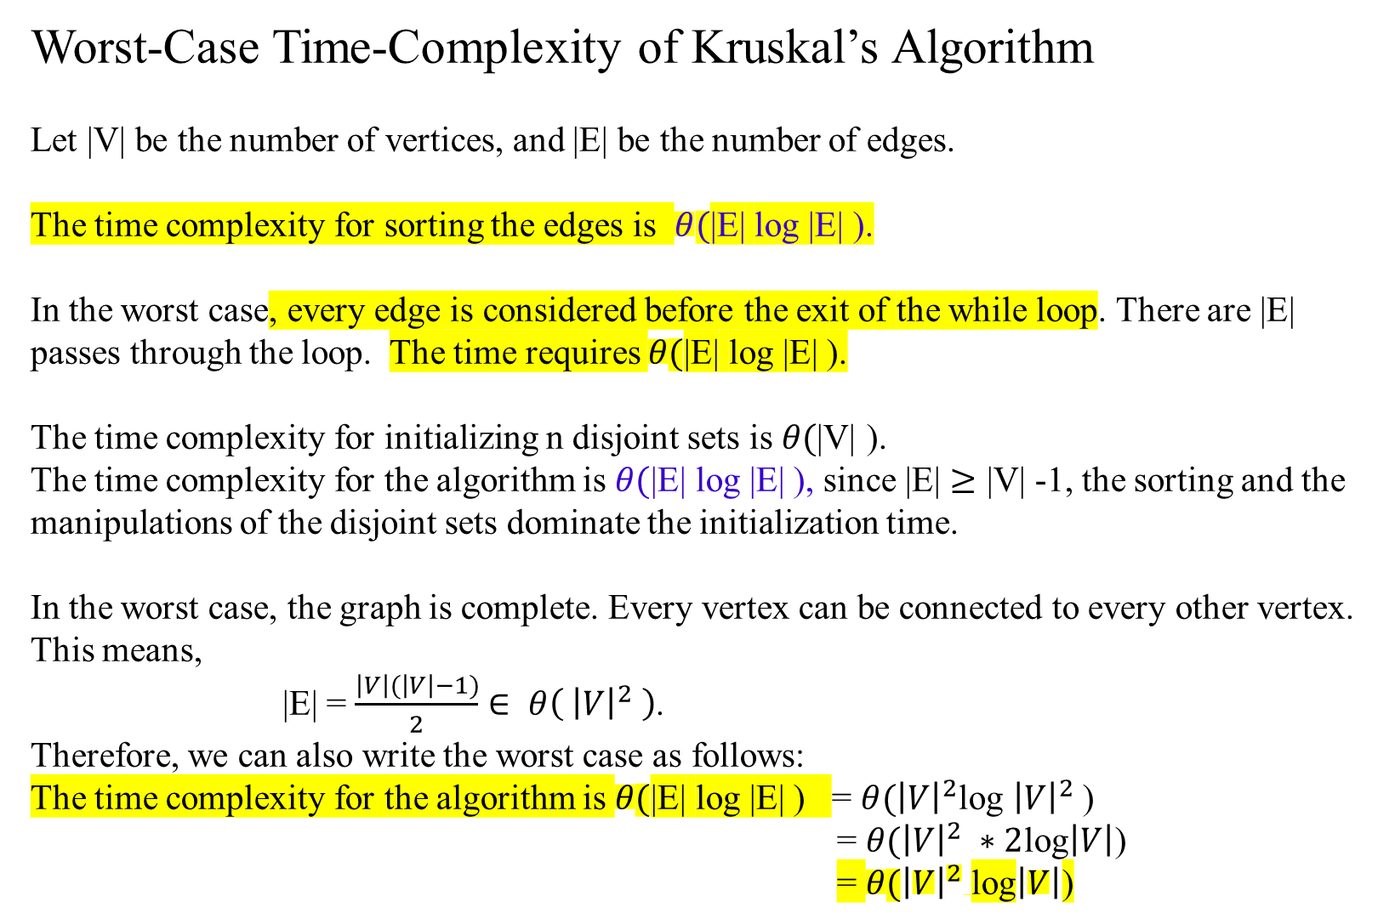
Worst-Case Time-Complexity of Kruskal’s Algorithm
Let |V| be the number of vertices, and |E| be the number of edges.
The time complexity for sorting the edges is $θ(\text{|}\text{E}\text{|}$ log |E| ).
In the worst case, every edge is considered before the exit of the while loop. There are |E| passes through the loop. The time requires $θ(\text{|}\text{E}\text{|}$ log |E| ).
The time complexity for initializing n disjoint sets is $θ(\text{|}\text{V}\text{|}$ ).
The time complexity for the algorithm is $θ(\text{|}\text{E}\text{|}$ log |E| ), since $\text{|}\text{E}\text{|}$ $≥\text{|}\text{V}\text{|}$ -1, the sorting and the manipulations of the disjoint sets dominate the initialization time.
In the worst case, the graph is complete. Every vertex can be connected to every other vertex. This means,
|E| = $\frac{\left|V\right|(\left|V\right|−1)}{2}$ $∈ θ\left( {\left|V\right|}^{2} \right)$.
Therefore, we can also write the worst case as follows:
The time complexity for the algorithm is $θ(\text{|}\text{E}\text{|}$ log |E| ) = $θ({\left|V\right|}^{2}$log ${\left|V\right|}^{2}$)
= $θ({\left|V\right|}^{2} ∗2$log$\left|V\right|$)
= $θ({\left|V\right|}^{2}$log$\left|V\right|$)
Time efficiency of Prim’s is O( | E | log |V| )

Slide 57
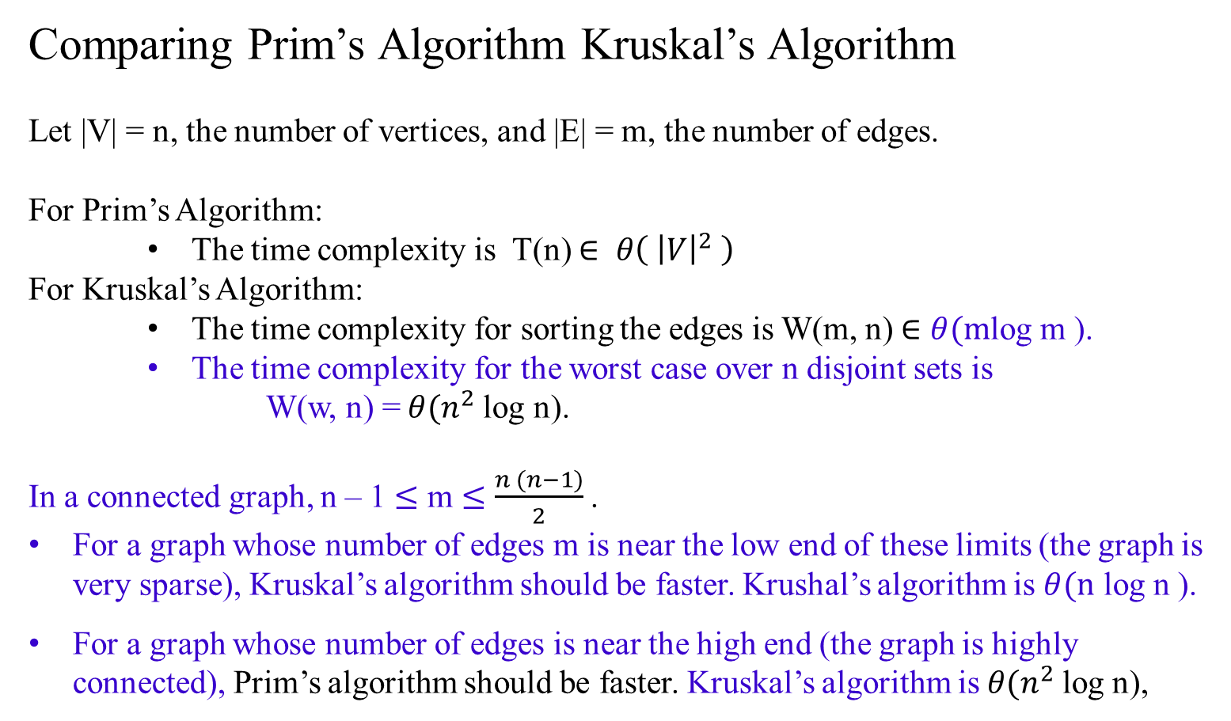
Comparing Prim’s Algorithm Kruskal’s Algorithm
Let |V| = n, the number of vertices, and |E| = m, the number of edges.
For Prim’s Algorithm:
The time complexity is T(n) $∈ θ\left( {\left|V\right|}^{2} \right)$
For Kruskal’s Algorithm:
The time complexity for sorting the edges is W(m, n) $∈$ $θ(m$log m ).
The time complexity for the worst case over n disjoint sets is
W(w, n) = $θ(n^{2}$log n).
In a connected graph, n – 1 $≤$ m $≤$ $\frac{n (n−1)}{2}$ .
For a graph whose number of edges m is near the low end of these limits (the graph is very sparse), Kruskal’s algorithm should be faster. Krushal’s algorithm is $θ(\text{n}$ log n ).
For a graph whose number of edges is near the high end (the graph is highly connected), Prim’s algorithm should be faster. Kruskal’s algorithm is $θ(n^{2}$log n),

Slide 58
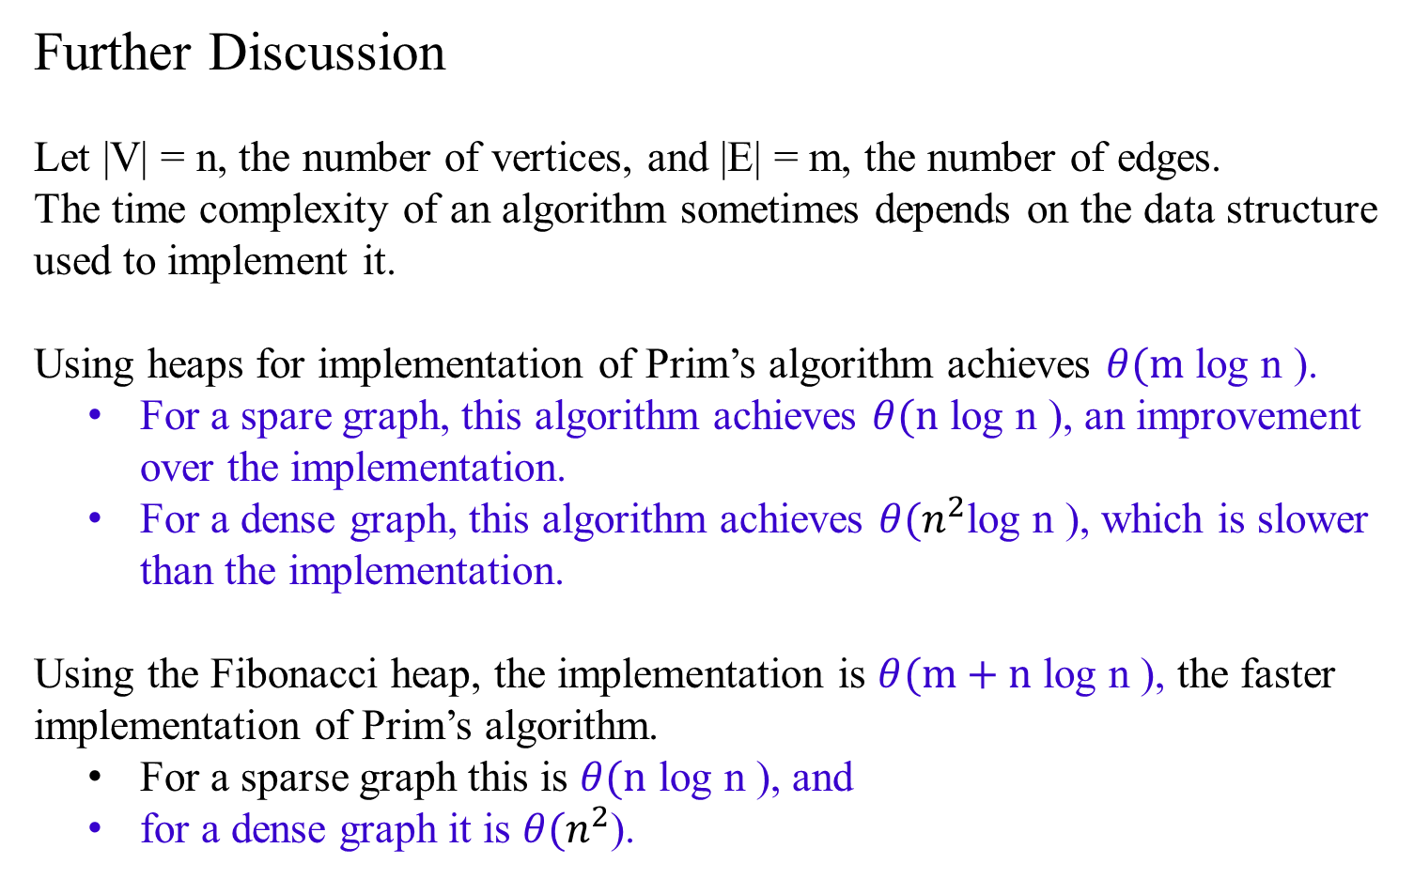
Further Discussion
Let |V| = n, the number of vertices, and |E| = m, the number of edges.
The time complexity of an algorithm sometimes depends on the data structure used to implement it.
Using heaps for implementation of Prim’s algorithm achieves $θ(\text{m}$ log n ).
For a spare graph, this algorithm achieves $θ(\text{n}$ log n ), an improvement over the implementation.
For a dense graph, this algorithm achieves $θ(n^{2}$log n ), which is slower than the implementation.
Using the Fibonacci heap, the implementation is $θ(\text{m}\text{ + }\text{n}$ log n ), the faster implementation of Prim’s algorithm.
For a sparse graph this is $θ(\text{n}$ log n ), and
for a dense graph it is $θ(n^{2}$).

Slide 59
Chapter 07_03
Greedy Algorithms
Dijkstra’s Algorithm
Single-Source Shortest Paths

