Slide 1
Basic Graph Algorithms
Written by Jaehyun Park
Stanford University
June 29, 2015

Slide 2
Outline
Graphs
Adjacency Matrix and Adjacency List
Special Graphs
Depth-First and Breadth-First Search
Topological Sort
Eulerian Circuit
Minimum Spanning Tree (MST)
Strongly Connected Components (SCC)

Slide 3
Graphs
◮ An abstract way of representing connectivity using nodes (also called vertices) and edges
◮ We will label the nodes from 1 to n
◮ m edges connect some pairs of nodes
– Edges can be either one-directional (directed) or bidirectional
◮ Nodes and edges can have some auxiliary information

Slide 4
Graphs

Slide 5
Why Study Graphs?
◮ Lots of problems formulated and solved in terms of graphs
Shortest path problems
Network flow problems
Matching problems
2-SAT problem
Graph coloring problem
Traveling Salesman Problem (TSP): still unsolved!
and many more...

Slide 6
Outline
Graphs
Adjacency Matrix and Adjacency List
Special Graphs
Depth-First and Breadth-First Search
Topological Sort
Eulerian Circuit
Minimum Spanning Tree (MST)
Strongly Connected Components (SCC)

Slide 7
Storing Graphs?
◮ Need to store both the set of nodes V and the set of edges E
Nodes can be stored in an array
Edges must be stored in some other way
◮ Want to support operations such as:
Retrieving all edges incident to a particular node
Testing if given two nodes are directly connected
◮ Use either adjacency matrix or adjacency list to store the edges

Slide 8
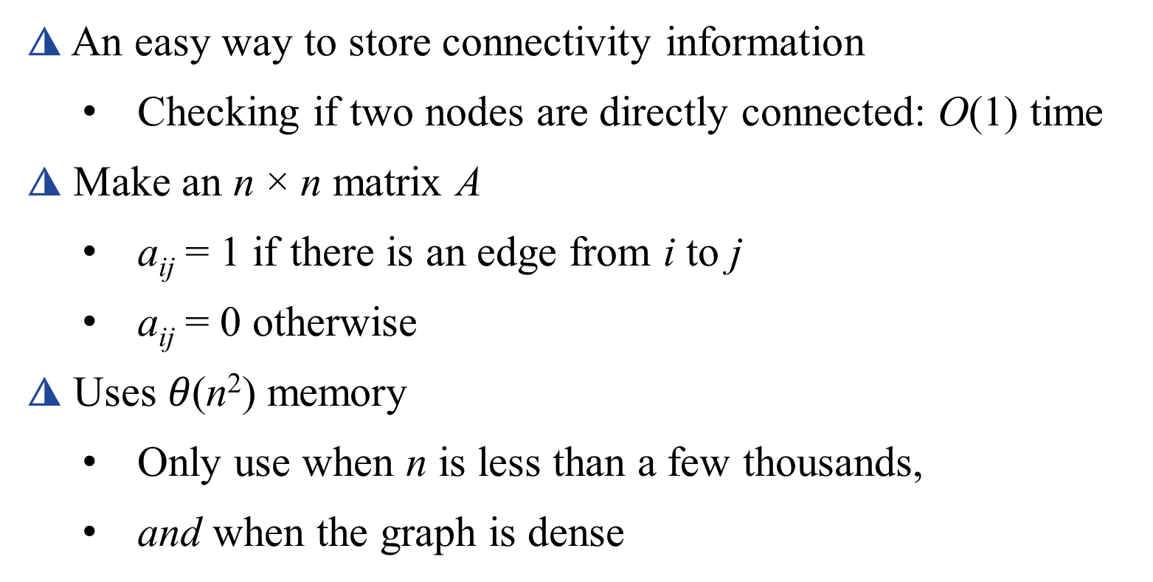
Adjacency Matrix
◮ An easy way to store connectivity information
Checking if two nodes are directly connected: O(1) time
◮ Make an n × n matrix A
a_{ij} = 1 if there is an edge from i to j
a_{ij} = 0 otherwise
◮ Uses $θ\text{(}\text{n}\text{2}\text{)}$memory
Only use when n is less than a few thousands,
and when the graph is dense

Slide 9
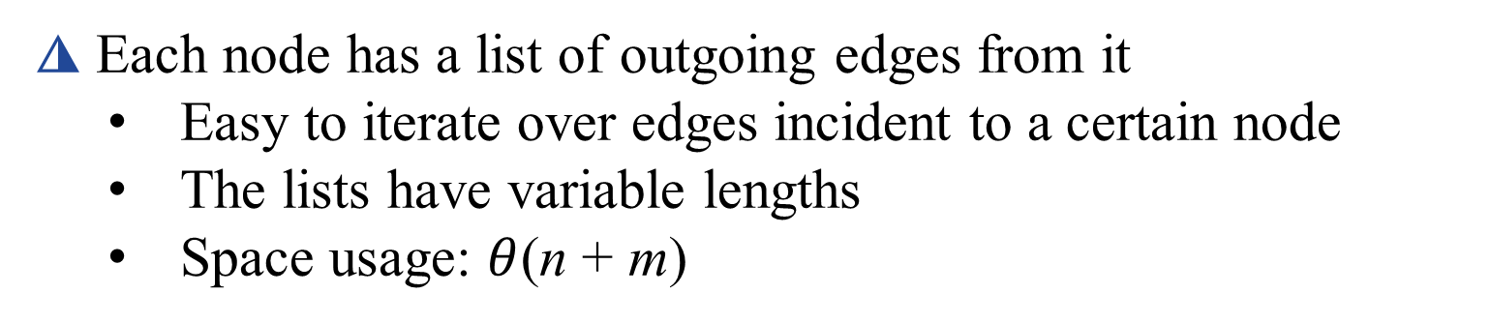
Adjacency List
◮ Each node has a list of outgoing edges from it
Easy to iterate over edges incident to a certain node
The lists have variable lengths
Space usage: $θ$(n + m)

Slide 10
Implementing Adjacency List
◮ Solution 1. Using linked lists
Too much memory/time overhead
Using dynamic allocated memory or pointers is bad
◮ Solution 2. Using an array of vectors
Easier to code, no bad memory issues
But very slow
◮ Solution 3. Using arrays (!)
Assuming the total number of edges is known
Very fast and memory-efficient

Slide 11
Implementation Using Arrays
(fr, id, to)
(1, 1, 2)
(2, 2, 3)
(1, 3, 3)
(1, 4, 5)
(4, 5, 3)
(3, 6, 2)
(4, 7, 2)
(2, 8, 5)

Slide 12
Implementation Using Arrays
◮ Have two arrays E of size m and LE of size n
E contains the edges
LE contains the starting pointers of the edge lists
◮ Initialize LE[i] = -1 for all i
LE[i] = 0 is also fine if the arrays are 1-indexed
◮ Inserting a new edge from u to v with ID k
E[k].to = v
E[k].nextID = LE[u]
LE[u] = k

Slide 13
Implementation Using Arrays
◮ Iterating over all edges starting at u:
for(ID = LE[u]; ID != -1; ID = E[ID].nextID)
// E[ID] is an edge starting from u
◮ Once built, it’s hard to modify the edges
– The graph better be static!
– But adding more edges is easy

Slide 14
Outline
Graphs
Adjacency Matrix and Adjacency List
Special Graphs
Depth-First and Breadth-First Search
Topological Sort
Eulerian Circuit
Minimum Spanning Tree (MST)
Strongly Connected Components (SCC)

Slide 15
Tree
◮ A connected acyclic graph
◮ Most important type of special graphs
– Many problems are easier to solve on trees
◮ Alternate equivalent definitions:
– A connected graph with n − 1 edges
– An acyclic graph with n − 1 edges
– There is exactly one path between every pair of nodes
– An acyclic graph but adding any edge results in a cycle
– A connected graph but removing any edge disconnects it

Slide 16
Other Special Graphs
◮ Directed Acyclic Graph (DAG): the name says what it is
– Equivalent to a partial ordering of nodes
◮ Bipartite Graph: Nodes can be separated into two groups S
and T such that edges exist between S and T only (no edges
within S or within T)

Slide 17
Outline
Graphs
Adjacency Matrix and Adjacency List
Special Graphs
Depth-First and Breadth-First Search
Topological Sort
Eulerian Circuit
Minimum Spanning Tree (MST)
Strongly Connected Components (SCC)

Slide 18
Graph Traversal
◮ The most basic graph algorithm that visits nodes of a graph
in certain order
◮ Used as a subroutine in many other algorithms
◮ We will cover two algorithms
– Depth-First Search (DFS): uses recursion (stack)
– Breadth-First Search (BFS): uses queue

Slide 19
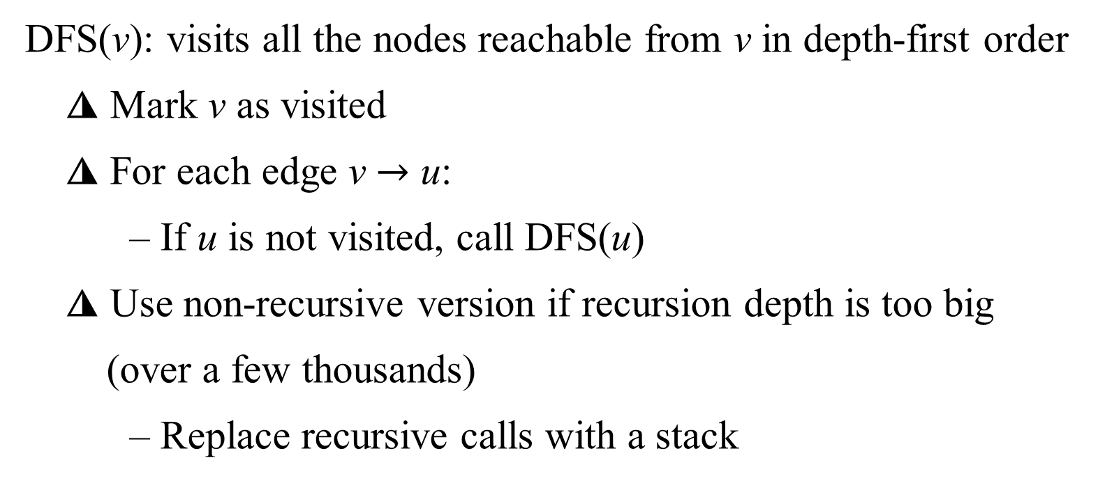
Depth-First Search
DFS(v): visits all the nodes reachable from v in depth-first order
◮ Mark v as visited
◮ For each edge v $→$ u:
– If u is not visited, call DFS(u)
◮ Use non-recursive version if recursion depth is too big
(over a few thousands)
– Replace recursive calls with a stack

Slide 20
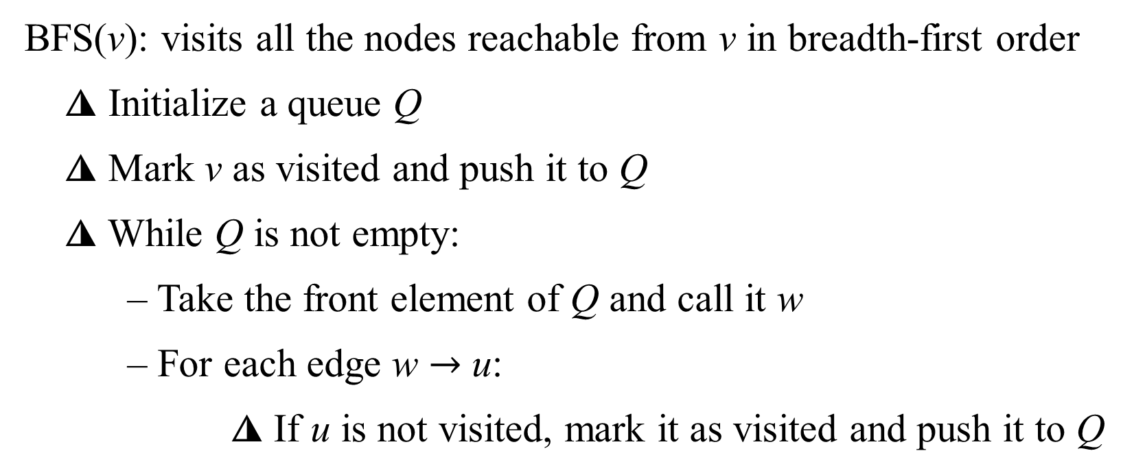
Breadth-First Search
BFS(v): visits all the nodes reachable from v in breadth-first order
◮ Initialize a queue Q
◮ Mark v as visited and push it to Q
◮ While Q is not empty:
– Take the front element of Q and call it w
– For each edge w $→$ u:
◮ If u is not visited, mark it as visited and push it to Q

Slide 21
Outline
Graphs
Adjacency Matrix and Adjacency List
Special Graphs
Depth-First and Breadth-First Search
Topological Sort
Eulerian Circuit
Minimum Spanning Tree (MST)
Strongly Connected Components (SCC)

Slide 22
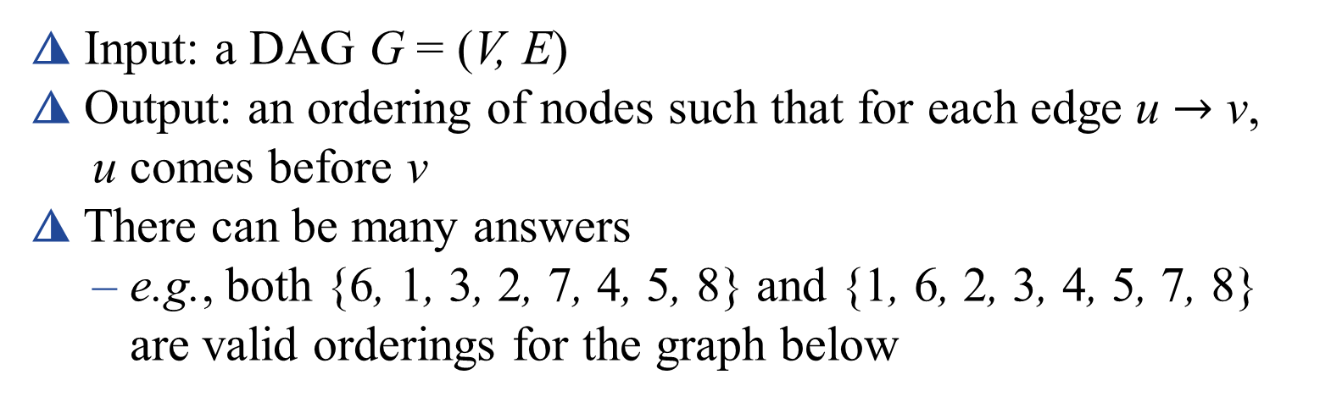
Topological Sort
◮ Input: a DAG G = (V, E)
◮ Output: an ordering of nodes such that for each edge u $→$ v,
u comes before v
◮ There can be many answers
– e.g., both {6, 1, 3, 2, 7, 4, 5, 8} and {1, 6, 2, 3, 4, 5, 7, 8}
are valid orderings for the graph below

Slide 23
Topological Sort
◮ Any node without an incoming edge can be the first element
◮ After deciding the first node, remove outgoing edges from it
◮ Repeat!
◮ Time complexity: O(n² + m)
– Too slow...
{6, 1, 3, 2, 7, 4, 5, 8}
{1, 6, 2, 3, 4, 5, 7, 8}

Slide 24
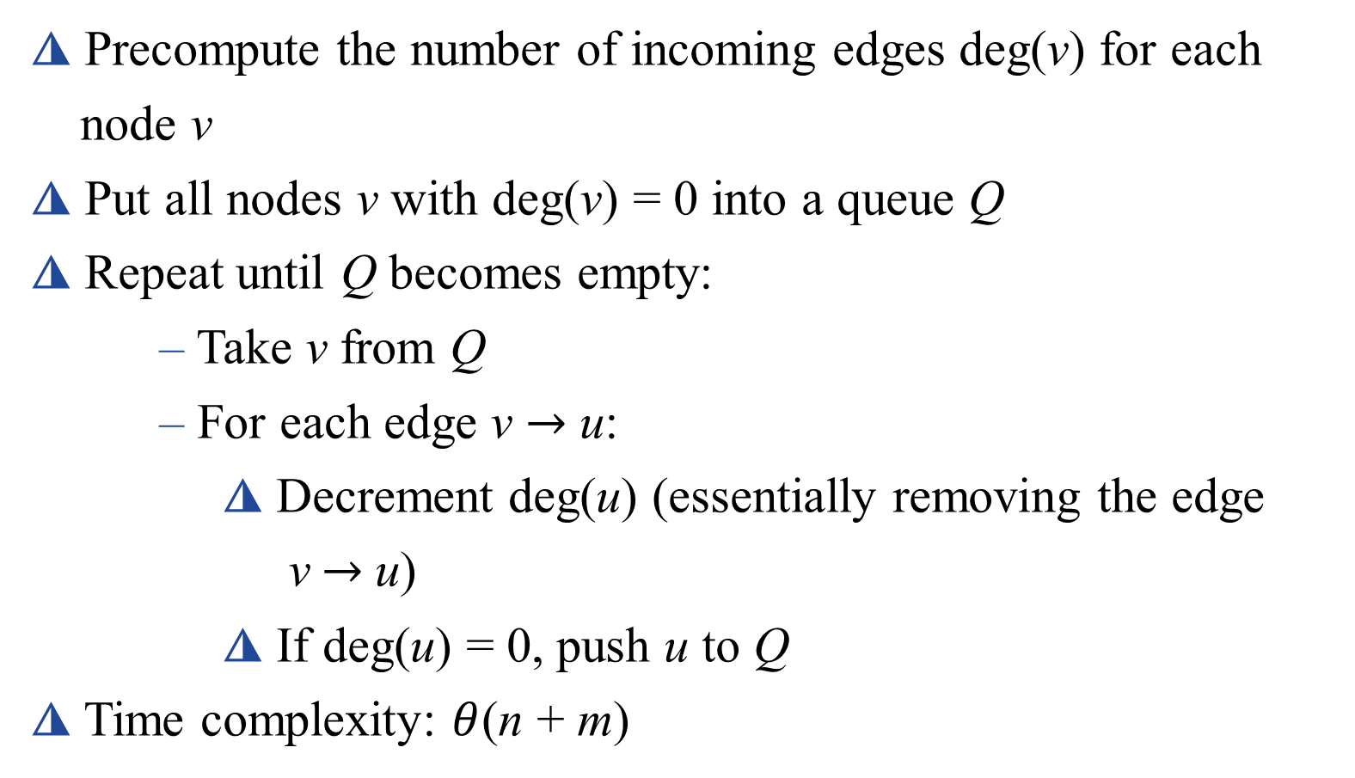
Topological Sort : (faster version)
◮ Precompute the number of incoming edges deg(v) for each
node v
◮ Put all nodes v with deg(v) = 0 into a queue Q
◮ Repeat until Q becomes empty:
– Take v from Q
– For each edge v $→$ u:
◮ Decrement deg(u) (essentially removing the edge
v $→$u)
◮ If deg(u) = 0, push u to Q
◮ Time complexity: $θ$(n + m)

Slide 25
Outline
Graphs
Adjacency Matrix and Adjacency List
Special Graphs
Depth-First and Breadth-First Search
Topological Sort
Eulerian Circuit
Minimum Spanning Tree (MST)
Strongly Connected Components (SCC)

Slide 26
Eulerian Circuit
◮ Given an undirected graph G
◮ Want to find a sequence of nodes that visits every edge
exactly once and comes back to the starting point
◮ Eulerian circuits exist if and only if
– G is connected
– and each node has an even degree

Slide 27
Constructive Proof of Existence
◮ Pick any node in G and walk randomly without using the
same edge more than once
◮ Each node is of even degree, so when you enter a node,
there will be an unused edge you exit through
– Except at the starting point, at which you can get stuck
◮ When you get stuck, what you have is a cycle
– Remove the cycle and repeat the process in each connected component
– Glue the cycles together to finish!

Slide 28
Related Problems
◮ Eulerian path: exists if and only if the graph is connected and
the number of nodes with odd degree is 0 or 2.
◮ Hamiltonian path/cycle: a path/cycle that visits every node in
the graph exactly once. Looks similar but very hard (still
unsolved)!

Slide 29
Outline
Graphs
Adjacency Matrix and Adjacency List
Special Graphs
Depth-First and Breadth-First Search
Topological Sort
Eulerian Circuit
Minimum Spanning Tree (MST)
Strongly Connected Components (SCC)

Slide 30
Minimum Spanning Tree (MST)
◮ Given an undirected weighted graph G = (V, E)
◮ Want to find a subset of E with the minimum total weight
that connects all the nodes into a tree
◮ We will cover two algorithms:
– Kruskal’s algorithm
– Prim’s algorithm

Slide 31
Kruskal’s Algorithm
◮ Main idea: the edge e⋆ with the smallest weight has to be in
the MST
◮ Simple proof:
– Assume not. Take the MST T that doesn’t contain e⋆.
– Add e⋆ to T, which results in a cycle.
– Remove the edge with the highest weight from the cycle.
◮ The removed edge cannot be e⋆ since it has the smallest weight.
– Now we have a better spanning tree than T
– Contradiction!

Slide 32
Kruskal’s Algorithm
◮ Another main idea: after an edge is chosen, the two nodes at
the ends can be merged and considered as a single node
(supernode)
◮ Pseudocode:
– Sort the edges in increasing order of weight
– Repeat until there is one supernode left:
◮ Take the minimum weight edge e⋆
◮ If e⋆ connects two different supernodes, then
connect them and merge the supernodes (use union- find)
– Otherwise, ignore e⋆ and try the next edge

Slide 33
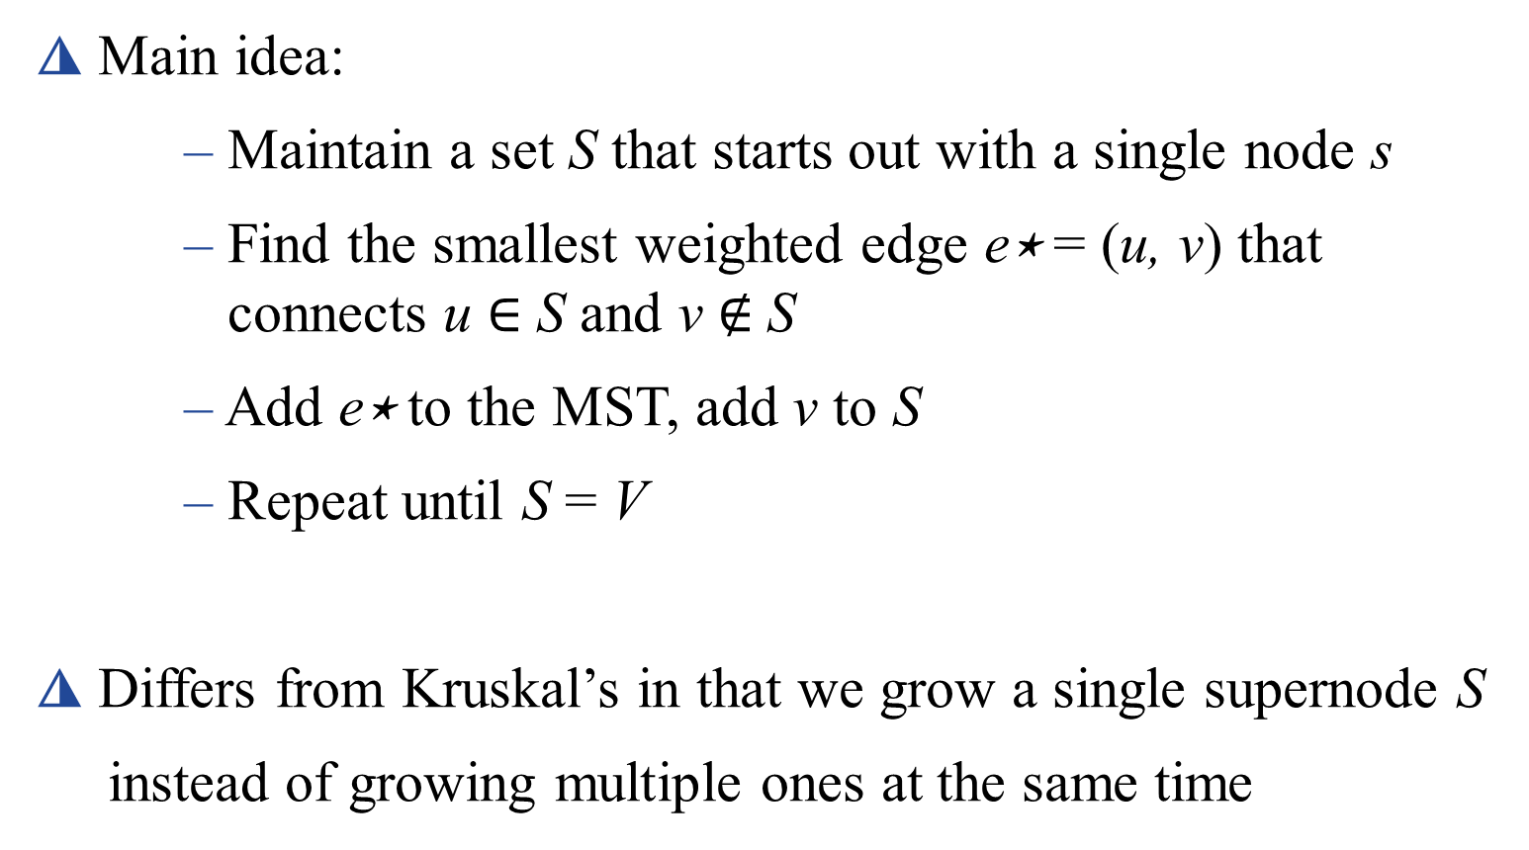
Prim’s Algorithm
◮ Main idea:
– Maintain a set S that starts out with a single node s
– Find the smallest weighted edge e⋆ = (u, v) that connects u $∈$ S and v ∉ S
– Add e⋆ to the MST, add v to S
– Repeat until S = V
◮ Differs from Kruskal’s in that we grow a single supernode S
instead of growing multiple ones at the same time

Slide 34
Prim’s Algorithm Pseudocode
◮ Initialize S := {s}, D_{v} := cost(s, v) for every v
– If there is no edge between s and v, cost(s, v) = 1
◮ Repeat until S = V :
– Find v ∉ S with smallest D_{v}
◮ Use a priority queue or a simple linear search
– Add v to S, add D_{v} to the total weight of the MST
– For each edge (v, w):
◮ Update D_{w} := min(D_{w} , cost(v, w))
◮ Can be modified to compute the actual MST along with the
total weight

Slide 35
Kruskal’s vs Prim’s Algorithm
◮ Kruskal’s Algorithm
– Takes O(m logm) time
– Pretty easy to code
– Generally slower than Prim’s
◮ Prim’s Algorithm
– Time complexity depends on the implementation:
◮ Can be O(n² + m), O(m log n), or O(m + n log n)
– A bit trickier to code
– Generally faster than Kruskal’s

Slide 36
Outline
Graphs
Adjacency Matrix and Adjacency List
Special Graphs
Depth-First and Breadth-First Search
Topological Sort
Eulerian Circuit
Minimum Spanning Tree (MST)
Strongly Connected Components (SCC)

Slide 37
Strongly Connected Components (SCC)
◮ Given a directed graph G = (V, E)
◮ A graph is strongly connected if all nodes are reachable from
every single node in V
◮ Strongly connected components of G are maximal strongly
connected subgraphs of G
◮ The graph below has 3 SCCs: {a, b, e}, {c, d, h}, {f, g}

Slide 38
Kosaraju’s Algorithm
◮ Initialize counter c := 0
◮ While not all nodes are labeled:
– Choose an arbitrary unlabeled node v
– Start DFS from v
◮ Check the current node x as visited
◮ Recurse on all unvisited neighbors
◮ After the DFS calls are finished, increment c and set the label of x as c
◮ Reverse the direction of all the edges
◮ For node v with label n, n − 1, . . . , 1:
– Find all reachable nodes from v and group them as an SCC

Slide 39
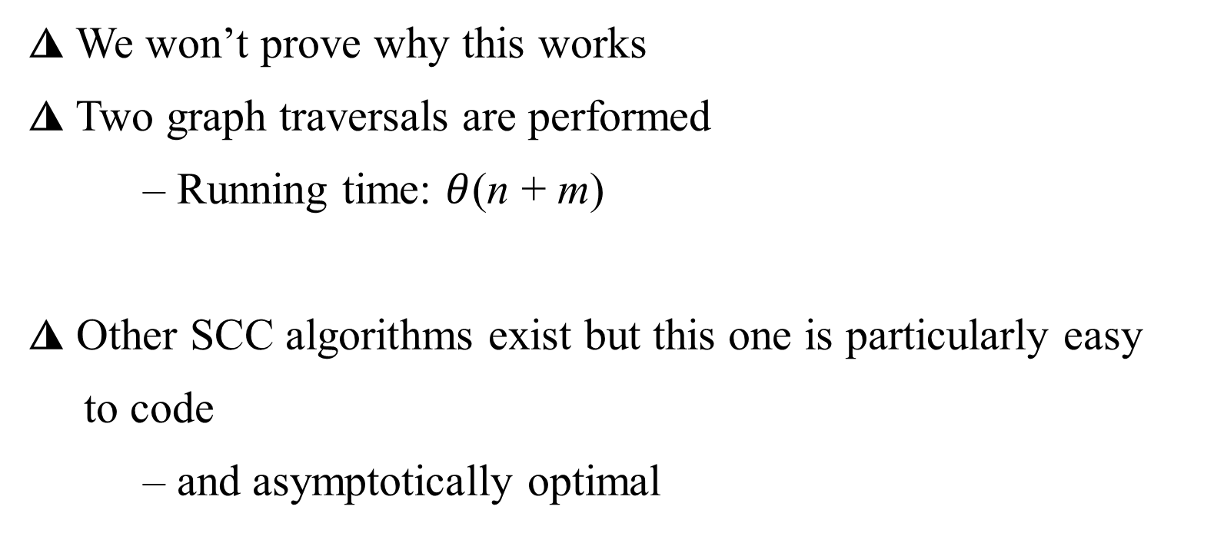
Kosaraju’s Algorithm
◮ We won’t prove why this works
◮ Two graph traversals are performed
– Running time: $θ$(n + m)
◮ Other SCC algorithms exist but this one is particularly easy
to code
– and asymptotically optimal

Slide 40
$∪ ≠∞ 〈 〉$ $∈ (\text{v}\text{i}\text{, }\text{vi}\text{+1}\text{)} θ\text{(}\text{n}\text{2}\text{)} θ\text{(}\text{n}\text{2}\text{)}⊂⊄⊆⊈⊊ →$ ∉ ∄ ∃

