Slide 1
Introduction to Graphs

Slide 2

Graph
The remaining of this chapter covers:
  Introduction to graphs, with
  Depth-First Search, and
  Breadth-First Search, and
  Topological Sorting
  Strong Connected Components
  Fake Coin Problem
  Interpolation Search

Slide 3
Graphs
A graph G = (V, E) is defined by a pair of two sets:
  V is a finite set of vertices (nodes) and
  E is a set of pairs of vertices, called edges.

Slide 4
Directed Graphs
A directed graph (or digraph) G is a pair (V, E), where V is a finite set of vertices, and E is a binary relation on V, called directed edges.
The pair of vertices (u, v) is not the same as the pair (v, u)
For (u, v), an edge is directed from the vertex u to the vertex v.
  The vertex u is called the edge’s tail, and
  the vertex v is called the edge’s head.
  We can omit .
  Pictorially,
Without loss of clarity, the edge (u, v) is incident from or leaves vertex u and is incident to or enters vertex v.
u
v

Slide 5
1
2
3
4
5
6
Figure 5.2a A directed graph G = (V, E), where V = {1, 2, 3, 4, 5, 6} and E = {(1, 2), (2, 2), (2, 4), (2, 5), (4, 1), (4, 5), (5, 4), (6, 3)}. The edge (2, 2) is a self-loop.

Slide 6
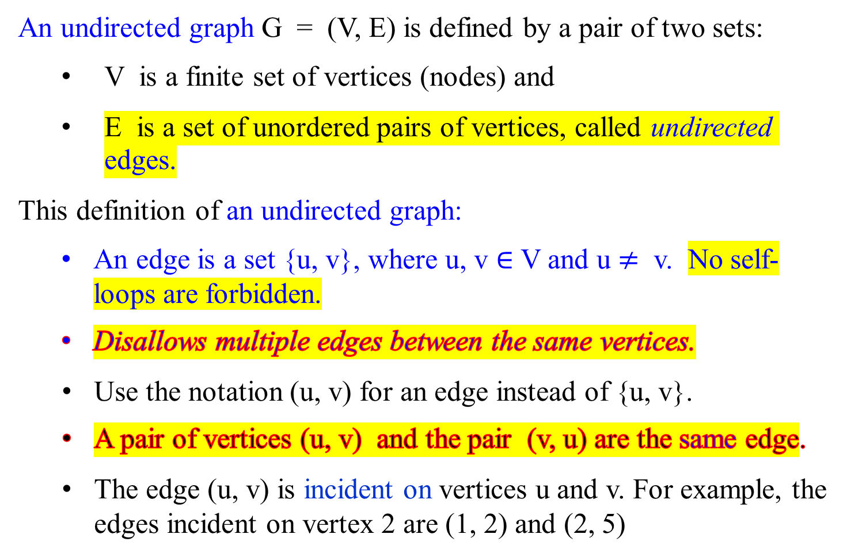
Undirected Graphs
An undirected graph G = (V, E) is defined by a pair of two sets:
  V is a finite set of vertices (nodes) and
  E is a set of unordered pairs of vertices, called undirected edges.
This definition of an undirected graph:
  An edge is a set {u, v}, where u, v $∈$ V and u $≠$ v. No self-loops are forbidden.
  Disallows multiple edges between the same vertices.
    Use the notation (u, v) for an edge instead of {u, v}.
    A pair of vertices (u, v) and the pair (v, u) are the same edge.
    The edge (u, v) is incident on vertices u and v. For example, the edges incident on vertex 2 are (1, 2) and (2, 5)

Slide 7
1
2
3
4
5
6
Figure 5.2b An undirected graph G = (V, E), where V = {1, 2, 3, 4, 5, 6} and E = {(1, 2), (1, 5), (2, 5), (3, 6)}. The vertex 4 is isolated.
It is a pictorial representation of an undirected graph on the vertex set {1, 2, 3, 4, 5. 6}

Slide 8

1
2
3
1
2
3
4
5
6
4
5
6
(5.2a)
(5.2c)
Figure 5.2c The subgraph of the graph in Figure 5.2a
induced by the vertex set {1, 2, 3, 6}.

Slide 9
Given a graph G = (V, E), the vertex is adjacent to vertex u if (u, v) is an edge.
The adjacency relation is symmetric for an undirected graph.
The adjacency relation is not necessarily symmetric for a directed graph.
The degree of a vertex in an undirected graph is the number of edges incident on it. For example, vertex 2 in Figure 5.2b has degree 2.
The out-degree of a vertex in a directed graph is the number of edges leaving it, and the in-degree of a vertex is the number of edges entering it.
The degree of a vertex in a directed graph is its in-degree plus its out-degree. Vertex 2 in Figure 5.2a has in-degree 2, out-degree 3, and therefore degree 5.

Slide 10
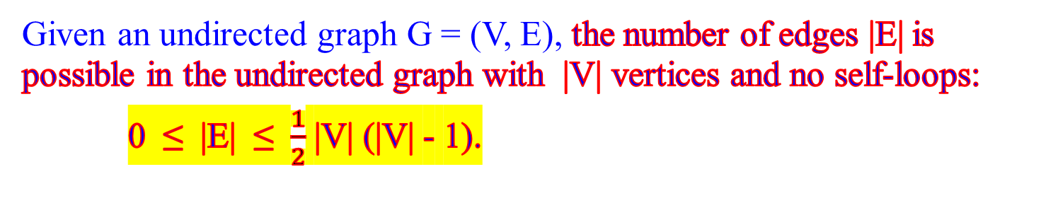
Undirected Graphs
Given an undirected graph G = (V, E), the number of edges |E| is possible in the undirected graph with |V| vertices and no self-loops:
0 ≤ |E| ≤ $\frac{1}{2}$ |V| (|V| - 1).

Slide 11

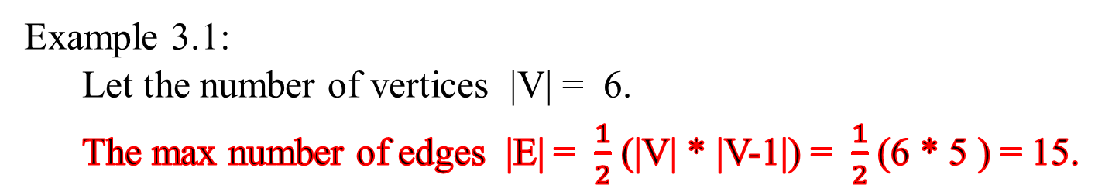
1
2
3
4
5
6
Example 3.1:
  Let the number of vertices |V| = 6.
  The max number of edges |E| = $\frac{1}{2}$ (|V| * |V-1|) = $\frac{1}{2}$ (6 * 5 ) = 15.

Slide 12
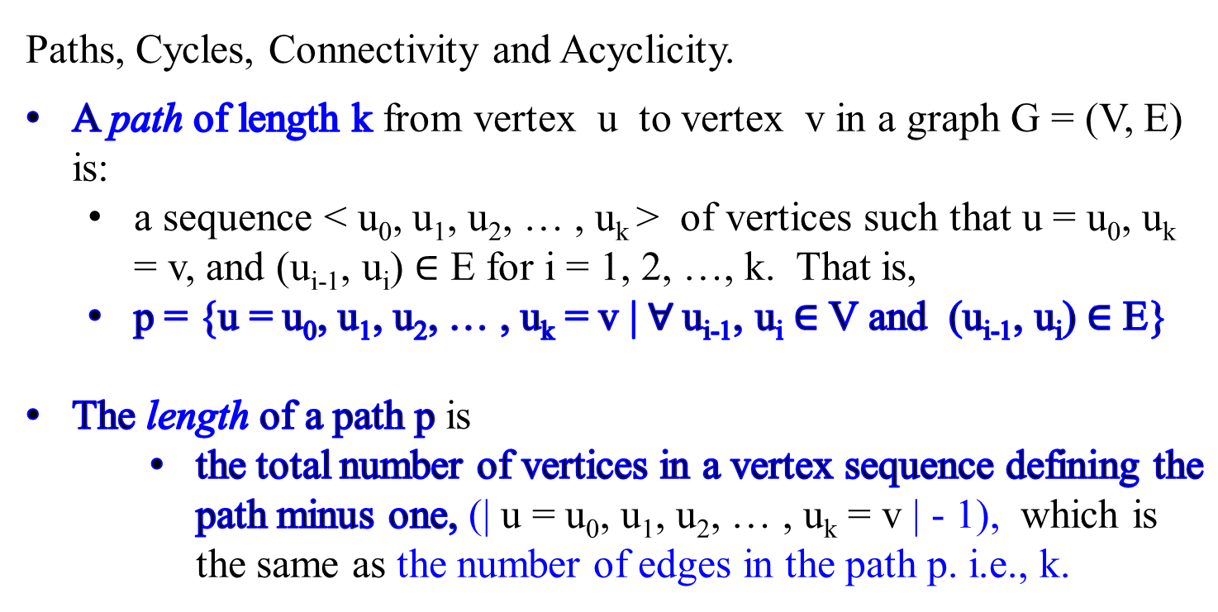
Graphs
c
Paths, Cycles, Connectivity and Acyclicity.
A path of length k from vertex u to vertex v in a graph G = (V, E) is:
  a sequence < u₀, u₁, u₂, … , u_{k} > of vertices such that u = u₀, u_{k} = v, and (u_{i-1}, u_{i}) $∈$ E for i = 1, 2, …, k. That is,
  p = {u = u₀, u₁, u₂, … , u_{k} = v | $∀$u_{i-1}, u_{i} $∈$ V and (u_{i-1}, u_{i}) $∈$ E}
The length of a path p is
    the total number of vertices in a vertex sequence defining the path minus one, (| u = u₀, u₁, u₂, … , u_{k} = v | - 1), which is the same as the number of edges in the path p. i.e., k.

Slide 13
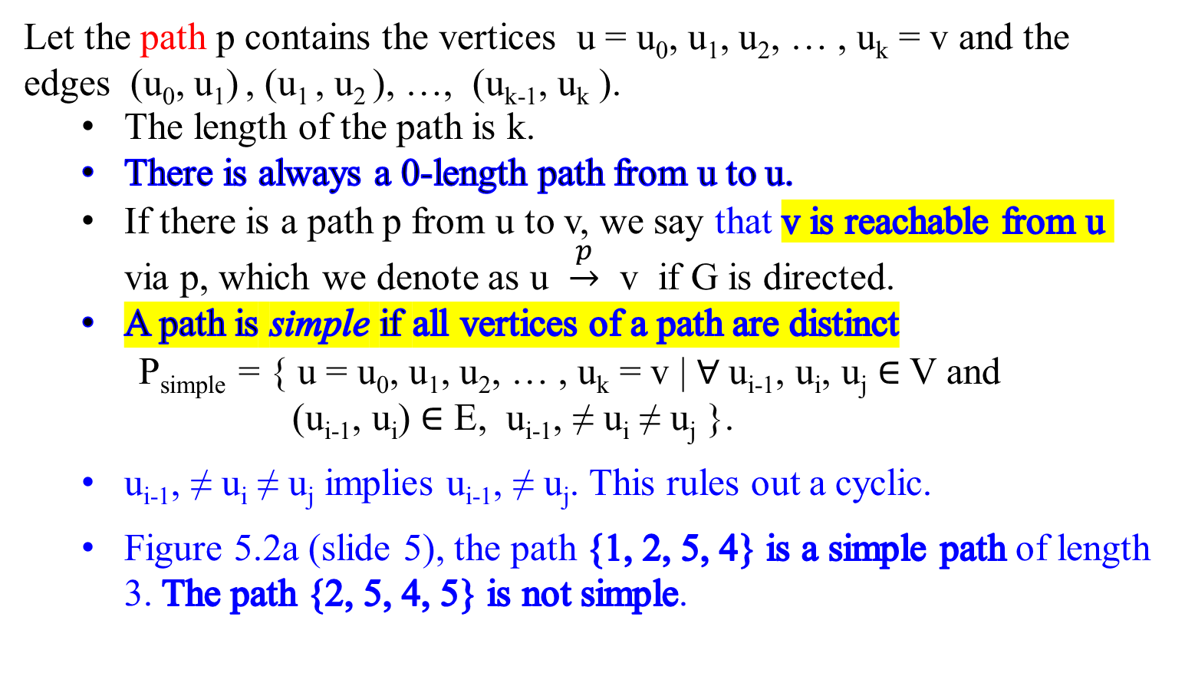
Graphs
Let the path p contains the vertices u = u₀, u₁, u₂, … , u_{k} = v and the edges (u₀, u₁) , (u₁ , u₂ ), …, (u_{k-1}, u_{k} ).
  The length of the path is k.
  There is always a 0-length path from u to u.
  If there is a path p from u to v, we say that v is reachable from u via p, which we denote as u $\underset{→}{p}$ v if G is directed.
  A path is simple if all vertices of a path are distinct
P_{simple} = { u = u₀, u₁, u₂, … , u_{k} = v | $∀$u_{i-1}, u_{i}, u_{j} $∈$ V and
(u_{i-1}, u_{i}) $∈$ E, u_{i-1}, ≠ u_{i} ≠ u_{j} }.
  u_{i-1}, ≠ u_{i} ≠ u_{j} implies u_{i-1}, ≠ u_{j}. This rules out a cyclic.
  Figure 5.2a (slide 5), the path {1, 2, 5, 4} is a simple path of length 3. The path {2, 5, 4, 5} is not simple.
c
1
2
4
5
(5.2a)

Slide 14
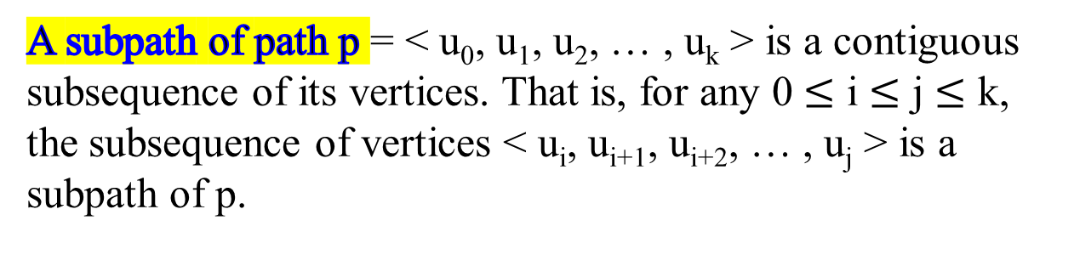
Graphs
A subpath of path p = < u₀, u₁, u₂, … , u_{k} > is a contiguous subsequence of its vertices. That is, for any 0 $≤$ i $≤$ j $≤$ k, the subsequence of vertices < u_{i}, u_{i+1}, u_{i+2}, … , u_{j} > is a subpath of p.
c

Slide 15
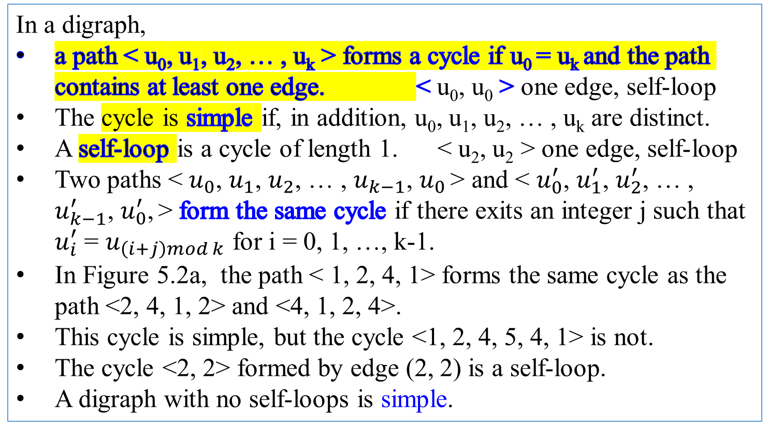
Graphs
In a digraph,
a path < u₀, u₁, u₂, … , u_{k} > forms a cycle if u₀ = u_{k} and the path contains at least one edge. < u₀, u₀ > one edge, self-loop
The cycle is simple if, in addition, u₀, u₁, u₂, … , u_{k} are distinct.
A self-loop is a cycle of length 1. < u₂, u₂ > one edge, self-loop
Two paths < $u_{0}$, $u_{1}$, $u_{2}$, … , $u_{k−1}$, $u_{0}$ > and < $u_{0}^{′}$, $u_{1}^{′}$, $u_{2}^{′}$, … , $u_{k−1}^{′}$, $u_{0}^{′}$, > form the same cycle if there exits an integer j such that $u_{i}^{′}$ = $u_{\left(i+j\right)mod k}$ for i = 0, 1, …, k-1.
In Figure 5.2a, the path < 1, 2, 4, 1> forms the same cycle as the path <2, 4, 1, 2> and <4, 1, 2, 4>.
This cycle is simple, but the cycle <1, 2, 4, 5, 4, 1> is not.
The cycle <2, 2> formed by edge (2, 2) is a self-loop.
A digraph with no self-loops is simple.
c
1
2
4
5
(5.2a)

Slide 16
Graphs
In an undirected graph,
a path < u₀, u₁, u₂, … , u_{k} > forms a cycle if u₀ = u_{k} and u₁, u₂, … , u_{k} are distinct.
In Figure 5.2b, the path < 1, 2, 5, 1> is a cycle.
A graph with no cycle is acyclic.
c
1
2
3
Figure 5.2b An undirected graph G = (V, E), where V = {1, 2, 3, 4, 5, 6} and E = {(1, 2), (1, 5), (2, 5), (3, 6)}. The vertex 4 is isolated.
It is a pictorial representation of an undirected graph on the vertex set {1, 2, 3, 4, 5. 6}
4
5
6

Slide 17
Undirected Graphs
An undirected graph is connected if every pair of vertices is connected by a path.
The connected components of a graph are the equivalence classes of vertices under the “is reachable from” relation. For example, Figure 5.2b has three connected components: {1, 2, 5}, {3, 6} and {4}. Every vertex in {1, 2, 5} is reachable from every other vertex in {1, 2, 5}.
An undirected graph is connected if it has exactly one connected component, i.e., if every vertex is reachable from every other vertex.
1
2
3
4
5
6

Slide 18
1
2
3
4
5
6
Figure 5.2a A directed graph G = (V, E), where V = {1, 2, 3, 4, 5, 6} and E = {(1, 2), (2, 2), (2, 4), (2, 5), (4, 1), (4, 5), (5, 4), (6, 3)}. The edge (2, 2) is a self-loop.

Slide 19
Digraphs
A digraph is strongly connected if every two vertices are reachable from each other.
The strongly connected components of a graph are the equivalence classes of vertices under the “are mutually reachable” relation.
A digraph is strongly connected if it has only one strongly connected component.
For example, the graph in Figure 5.2a has three strongly connected components: {1, 2, 4, 5}, {3} and {6}. All pairs of vertices in {1, 2, 4, 5} are mutually reachable.
The vertices {3, 6} do not form a strongly connected component, since vertex 6 cannot be reached from vertex 3.
1
2
3
4
5
6

Slide 20
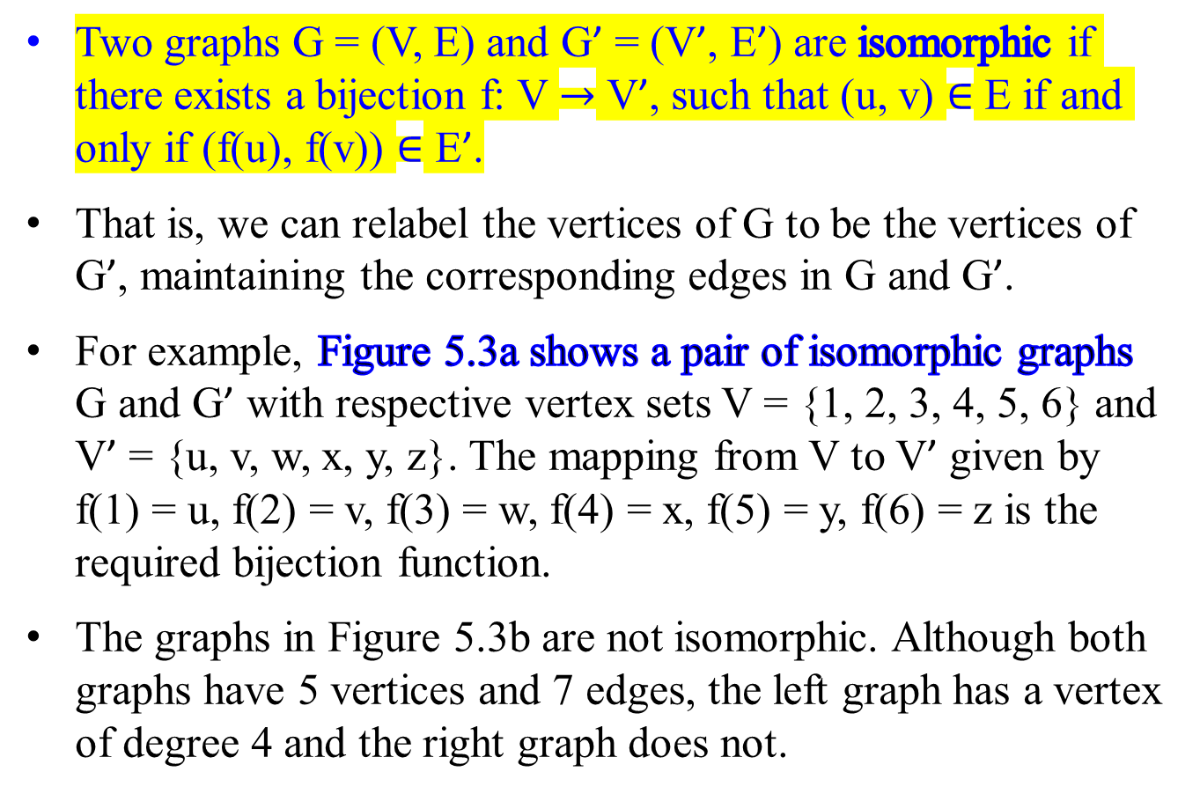
Graphs
Two graphs G = (V, E) and G’ = (V’, E’) are isomorphic if there exists a bijection f: V $→$ V’, such that (u, v) $∈$ E if and only if (f(u), f(v)) $∈$ E’.
That is, we can relabel the vertices of G to be the vertices of G’, maintaining the corresponding edges in G and G’.
For example, Figure 5.3a shows a pair of isomorphic graphs G and G’ with respective vertex sets V = {1, 2, 3, 4, 5, 6} and V’ = {u, v, w, x, y, z}. The mapping from V to V’ given by f(1) = u, f(2) = v, f(3) = w, f(4) = x, f(5) = y, f(6) = z is the required bijection function.
The graphs in Figure 5.3b are not isomorphic. Although both graphs have 5 vertices and 7 edges, the left graph has a vertex of degree 4 and the right graph does not.

Slide 21
Preserve same number of vertices and edges.
Preserve the degree of corresponding vertices.
Preserve the adjacency structure.
1
2
6
3
u
v
w
x
y
z
5
4
Figure 5.3a: A pair of isomorphic graphs. The vertices of the left graph are mapped to the vertices of the right graph by f(1) = u, f(2) = v, f(3) = w, f(4) = x, f(5) = y, f(6) = z.

Slide 22
1
2
3
u
v
w
x
y
5
4
Figure 5.3b: Two graphs that are not isomorphic graphs., since the left graph has a vertex (vertex 1) of degree 4 and the right graph does not.

Slide 23
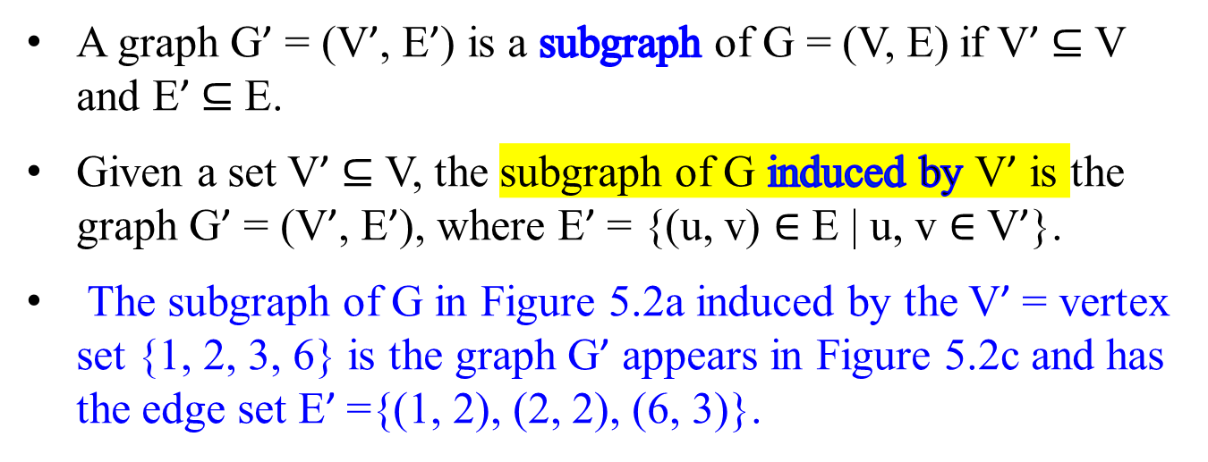
Graphs
A graph G’ = (V’, E’) is a subgraph of G = (V, E) if V’ $⊆$ V and E’ $⊆$ E.
Given a set V’ $⊆$ V, the subgraph of G induced by V’ is the graph G’ = (V’, E’), where E’ = {(u, v) $∈$ E | u, v $∈$ V’}.
The subgraph of G in Figure 5.2a induced by the V’ = vertex set {1, 2, 3, 6} is the graph G’ appears in Figure 5.2c and has the edge set E’ ={(1, 2), (2, 2), (6, 3)}.

Slide 24
1
2
3
1
2
3
4
5
6
4
5
6
(5.2a)
(5.2c)
Figure 5.2c The subgraph of the graph in Figure 5.2a
induced by the vertex set {1, 2, 3, 6}.

Slide 25
1
2
3
4
5
6
Figure 5.2b An undirected graph G = (V, E), where V = {1, 2, 3, 4, 5, 6} and E = {(1, 2), (1, 5), (2, 5), (3, 6)}. The vertex 4 is isolated.
It is a pictorial representation of an undirected graph on the vertex set {1, 2, 3, 4, 5. 6}

Slide 26
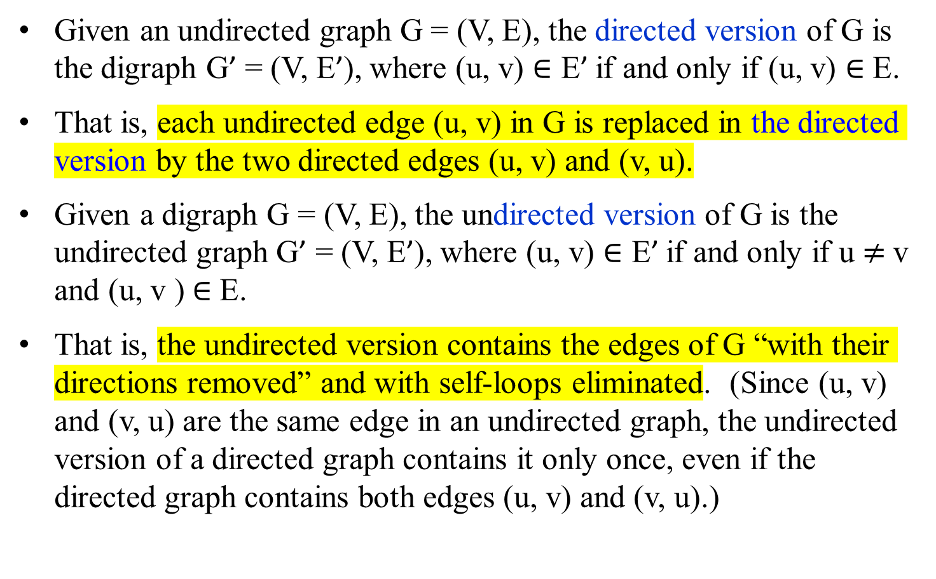
Graphs
Given an undirected graph G = (V, E), the directed version of G is the digraph G’ = (V, E’), where (u, v) $∈\text{E}\text{’}$if and only if (u, v) $∈$ E.
That is, each undirected edge (u, v) in G is replaced in the directed version by the two directed edges (u, v) and (v, u).
Given a digraph G = (V, E), the undirected version of G is the undirected graph G’ = (V, E’), where (u, v) $∈\text{E}\text{’}$if and only if u $≠$v and (u, v ) $∈$ E.
That is, the undirected version contains the edges of G “with their directions removed” and with self-loops eliminated. (Since (u, v) and (v, u) are the same edge in an undirected graph, the undirected version of a directed graph contains it only once, even if the directed graph contains both edges (u, v) and (v, u).)

Slide 27
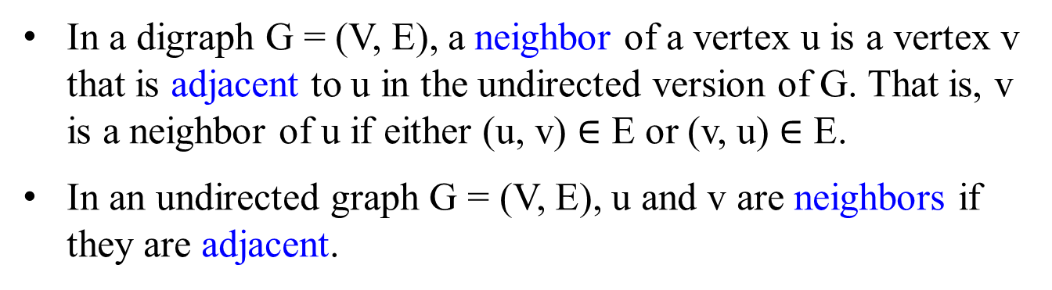
Graphs
In a digraph G = (V, E), a neighbor of a vertex u is a vertex v that is adjacent to u in the undirected version of G. That is, v is a neighbor of u if either (u, v) $∈$ E or (v, u) $∈$ E.
In an undirected graph G = (V, E), u and v are neighbors if they are adjacent.

Slide 28
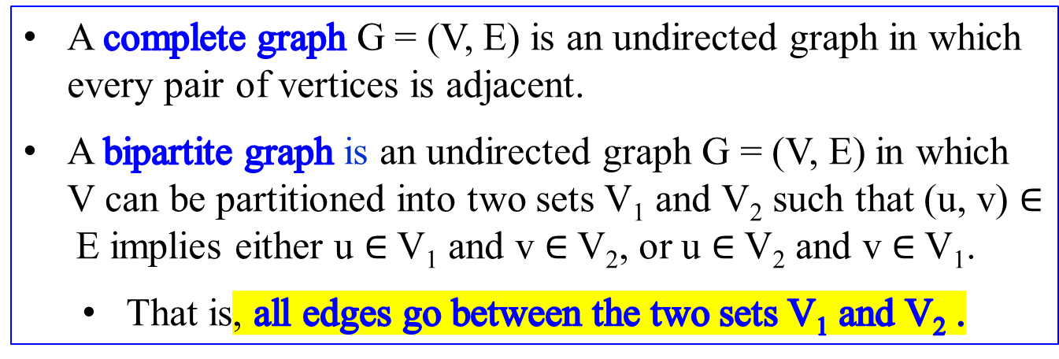
Graphs
A complete graph G = (V, E) is an undirected graph in which every pair of vertices is adjacent.
A bipartite graph is an undirected graph G = (V, E) in which V can be partitioned into two sets V₁ and V₂ such that (u, v) $∈$E implies either u $∈$V₁ and v $∈$V₂, or u $∈$V₂ and v $∈$V₁.
  That is, all edges go between the two sets V₁ and V₂ .

Slide 29
Graphs
A connected, acyclic, undirected graph is a (free) tree.
An acyclic, undirected graph G = (V, E) is a forest.
A directed acyclic graph (a dag).
A multigraph is an undirected graph, but it can have both multiple edges between vertices and self-loops.
A hypergraph is like an undirected graph, but each hyperedge, rather than connecting two vertices, connects an arbitrary subset of vertices.

Slide 30
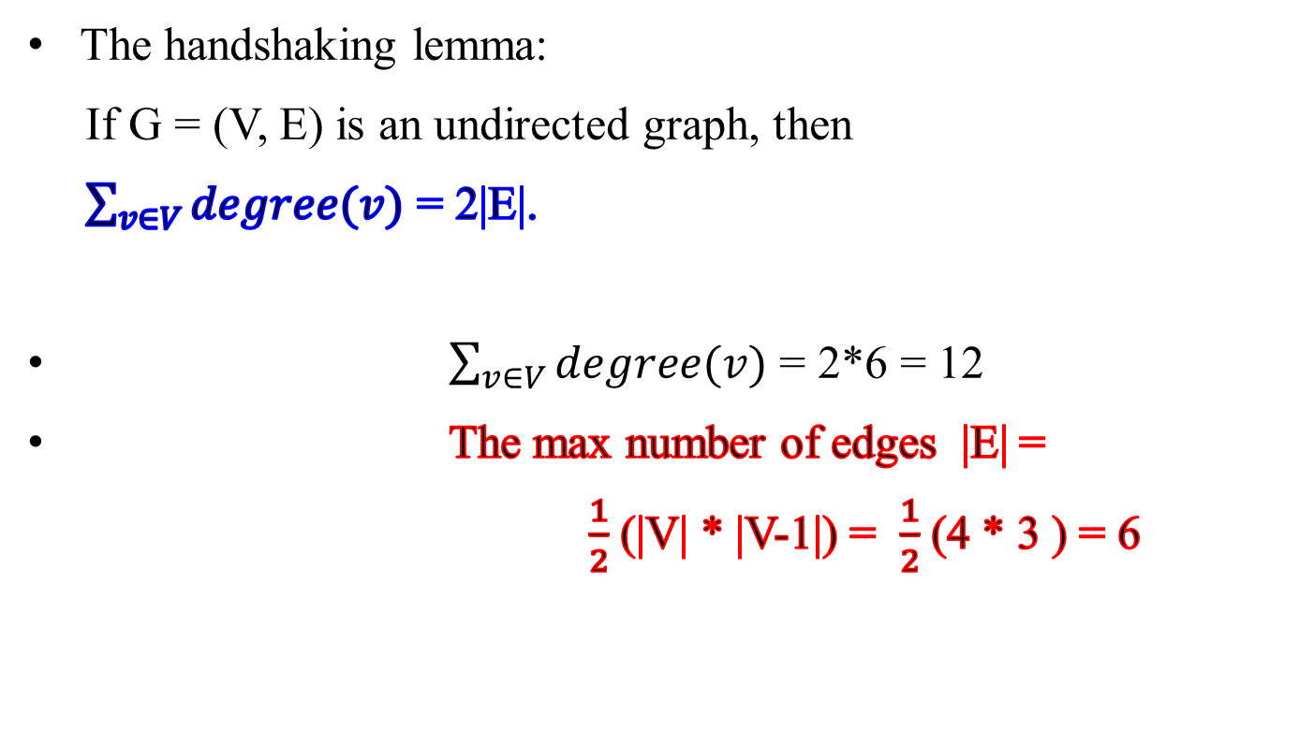
Graphs
The handshaking lemma:
If G = (V, E) is an undirected graph, then
$\sum_{v∈V}{degree(v)}$ = 2|E|.
$\sum_{v∈V}{degree(v)}$ = 2*6 = 12
The max number of edges |E| =
  $\frac{1}{2}$ (|V| * |V-1|) = $\frac{1}{2}$ (4 * 3 ) = 6

Slide 32
Graphs’ Adjacency Matrix Representations
Two ways to represent a graph G = (V, E) for computer algorithms:
  an adjacency matrix representation
  an adjacency list representation

Slide 33
Graphs’ Adjacency Matrix Representations
The adjacency matrix representation of a graph G = (V, E) with n = |V| vertices is
  For n = |V| vertices v₁, v₂, …, v_{n}, there is an n x n Boolean matrix, (n by n array), whose (i_{row}, j_{col})^{th} entry is
1 if there is an edge from v_{i} to v_{j},
a_{ij} =
0 otherwise.
Figure 23.1(c) and 23.2(c) are the adjacency matrices of the undirected and directed graphs in Figure 23.1(a) and Figure 23.2(a), respectively.

Slide 34
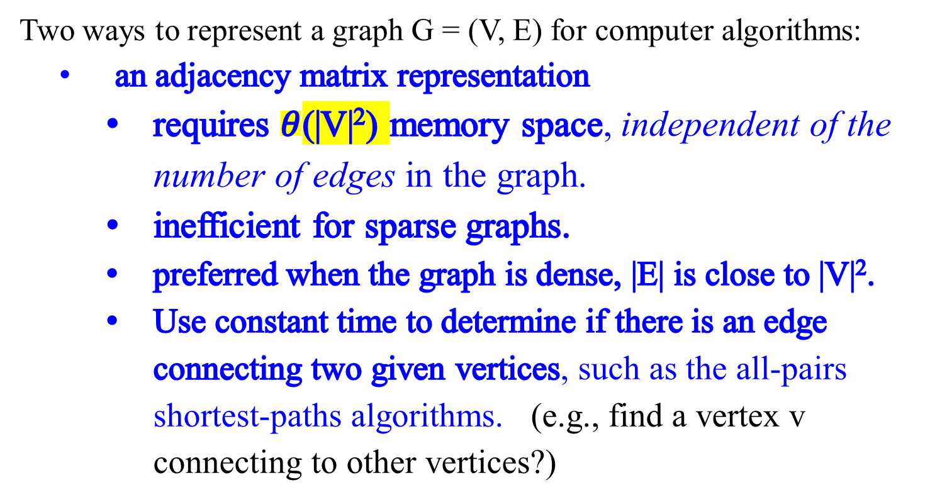
Graphs’ Adjacency Matrix Representations
Two ways to represent a graph G = (V, E) for computer algorithms:
  an adjacency matrix representation
    requires $θ$(|V|²) memory space, independent of the number of edges in the graph.
    inefficient for sparse graphs.
    preferred when the graph is dense, |E| is close to |V|².
    Use constant time to determine if there is an edge connecting two given vertices, such as the all-pairs shortest-paths algorithms. (e.g., find a vertex v connecting to other vertices?)

Slide 35
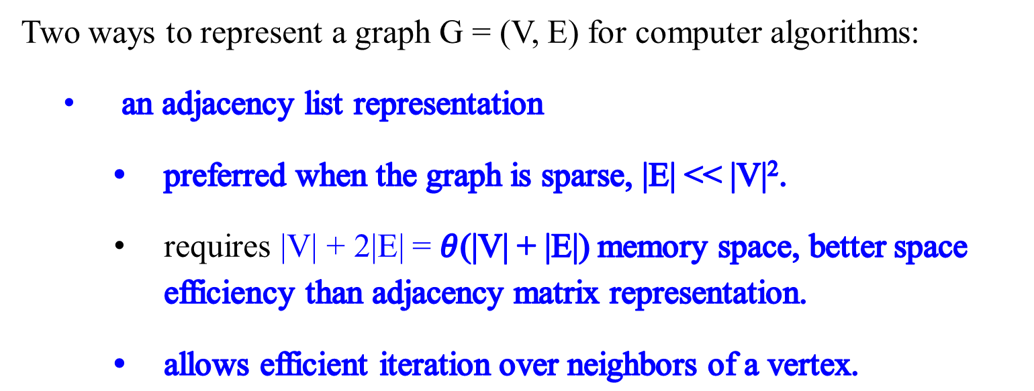
Graphs’ Adjacency Matrix Representations
Two ways to represent a graph G = (V, E) for computer algorithms:
  an adjacency list representation
    preferred when the graph is sparse, |E| << |V|².
    requires |V| + 2|E| = $θ$(|V| + |E|) memory space, better space efficiency than adjacency matrix representation.
    allows efficient iteration over neighbors of a vertex.

Slide 36
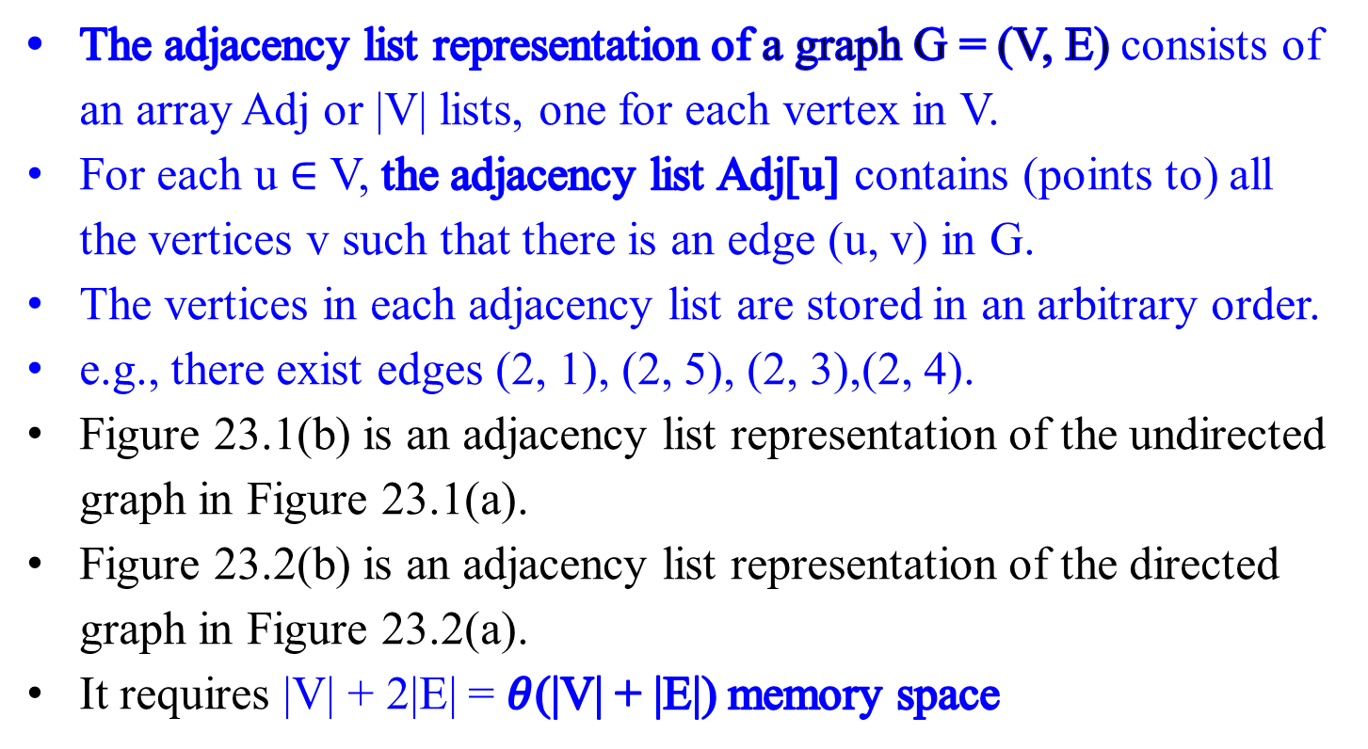
Graphs
Graphs’ Adjacency List Representations
The adjacency list representation of a graph G = (V, E) consists of an array Adj or |V| lists, one for each vertex in V.
For each u $∈$ V, the adjacency list Adj[u] contains (points to) all the vertices v such that there is an edge (u, v) in G.
The vertices in each adjacency list are stored in an arbitrary order.
e.g., there exist edges (2, 1), (2, 5), (2, 3),(2, 4).
Figure 23.1(b) is an adjacency list representation of the undirected graph in Figure 23.1(a).
Figure 23.2(b) is an adjacency list representation of the directed graph in Figure 23.2(a).
It requires |V| + 2|E| = $θ$(|V| + |E|) memory space
2 | 1 | 5 | 3 | 4

Slide 37
Undirected Graphs’ Representations
1
2
3
4
5
 |  | 2 |  |  | 5
 |  | 1 |  |  | 5 |  |  | 3 |  |  | 4
 |  | 2 |  |  | 4
 |  | 2 |  |  | 5 |  |  | 3
 |  | 4 |  |  | 1 |  |  | 2
1
2
3
5
4
(b)
(c)
(a)
1 2 3 4 5
1
2
3
4
5
0 | 1 | 0 | 0 | 1
1 | 0 | 1 | 1 | 1
0 | 1 | 0 | 1 | 0
0 | 1 | 1 | 0 | 1
1 | 1 | 0 | 1 | 0
Figure 23.1 Two representations of an undirected graph.
An undirected graph G has 5 vertices and 7 edges.
An adjacency list representation of G.
The adjacency-matrix representation of G.

Slide 38
Directed Graphs’ Representations
1 2 3 4 5 6 |  |  | 2 |  |  | 4
 |  |  | 5
 |  |  | 6 |  |  | 5
 |  |  | 2
 |  |  | 4
 |  |  | 6
1
2
3
(b)
4
5
6
(c)
(a)
1 2 3 4 5 6
1
2
3
4
5
6
0 | 1 | 0 | 1 | 0 | 0
0 | 0 | 0 | 0 | 1 | 0
0 | 0 | 0 | 0 | 1 | 1
0 | 1 | 0 | 0 | 0 | 0
0 | 0 | 0 | 1 | 0 | 0
0 | 0 | 0 | 0 | 0 | 1
Figure 23.2 Two representations of a directed graph.
A digraph G having 6 vertices and 8 edges.
An adjacency list representation of G.
The adjacency matrix representation of G.

Slide 39
Graphs
Graphs- Graphs’ Representations
If G = (V, E) is a digraph, the sum of the lengths of all the adjacency lists is |E|, since an edge of the form (u, v) is represented by having v appear in Adj[u].
If G = (V, E) is an undirected graph, the sum of the lengths of all the adjacency lists is 2|E|, since if (u, v) is an undirected edge, then u appears in v’s adjacency list and vice versa.
Whether a graph is directed or not, the adjacency list representation has the desirable property that the amount of memory it requires is O( |V| + |E|).

Slide 40
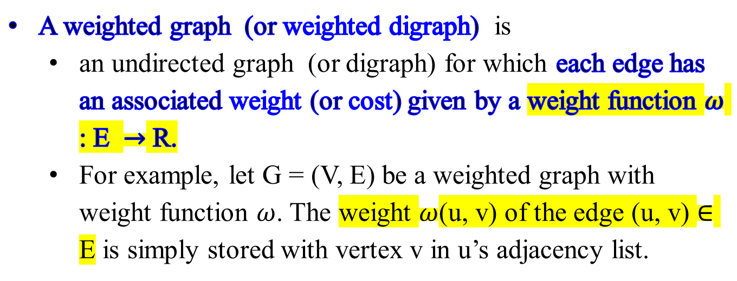
Graphs - Weighted graphs
c
A weighted graph (or weighted digraph) is
  an undirected graph (or digraph) for which each edge has an associated weight (or cost) given by a weight function $ω$ : E $→$ R.
  For example, let G = (V, E) be a weighted graph with weight function $ω$. The weight $ω$(u, v) of the edge (u, v) $∈$ E is simply stored with vertex v in u’s adjacency list.

Slide 41
Graphs - Weighted graphs
c
Extend both adjacency-list and adjacency-matrix representations of a graph to accommodate weighted graphs.
  For an adjacency-matrix of a weighted graph (called the weight matrix or cost matrix), its element A[i, j] contains
    the weight of the edge from the i^{th} vertex to the j^{th} vertex if there is such an edge and
    a special symbol, e.g., ∞, there is no such edge.
  Likewise, define an adjacency lists for a weighted graph.

Slide 43
Undirected Graphs Representations
The adjacency matrix of an undirected graph with n vertices:
  The presence of a particular edge can be checked in constant time Θ(1),
    just one memory access. (i.e., the entry of i^{th} row and j^{th} column, A[i, j] = 1.)
  The matrix takes up O(|V|²) space.
    It is wasteful for a spare graph.

Slide 44
Undirected and Directed Graphs
The adjacency-list has |V| linked lists, one per vertex.
Each edge of a direct graph appears in exactly one of the linked lists.
Each edge of an undirected graph appears in two of the lists.
  v is in u’s adjacency list if and only if u is in v’s adjacency list.
For the adjacency-list, the total size of the data structure for the linked lists is O(|V| + |E|), vs the matrix takes up O(|V|²) space.
  Checking for a particular edge (u, v) for a digraph is O(|V|), no longer constant time Θ(1).
  it requires sifting through u’s adjacency list.
  It requires iterating through all neighbors of a vertex (by running down the corresponding linked list).

Slide 45
Graphs - Weighted graphs
A weighted graph (or weighted digraph) is
  an undirected graph (or digraph) with numbers (called weights or costs) assigned to its edges.
Extend both adjacency-list and adjacency-matrix representations of a graph to accommodate weighted graphs.
  For an adjacency-matrix of a weighted graph (called the weight matrix or cost matrix), its element A[i, j] contains
    the weight of the edge from the i^{th} vertex to the j^{th} vertex if there is such an edge and
    a special symbol, e.g., ∞, there is no such edge.
  Likewise, define an adjacency lists for a weighted graph.
c

Slide 46
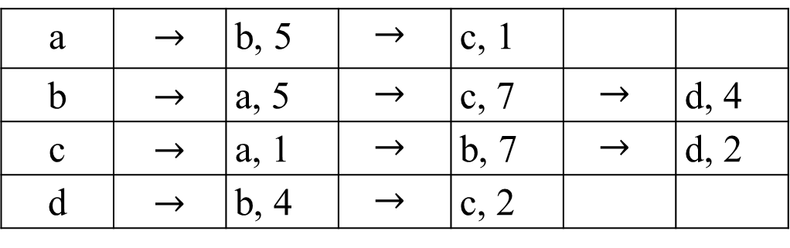
Graphs - Weighted graphs
c
 | a | b | c | d
a | ∞ | 5 | 1 | ∞
b | 5 | ∞ | 7 | 4
c | 1 | 7 | ∞ | 2
d | ∞ | 4 | 2 | ∞
Example 3.65a of a weighted graph
a 5 b
1 4
c 2 d
7
The weight adjacency-matrix
or cost adjacency-matrix.
7
a | $$→$$ | b, 5 | $$→$$ | c, 1
b | $$→$$ | a, 5 | $$→$$ | c, 7 | $$→$$ | d, 4
c | $$→$$ | a, 1 | $$→$$ | b, 7 | $$→$$ | d, 2
d | $$→$$ | b, 4 | $$→$$ | c, 2
The weight adjacency-lists or cost adjacency-lists.

Slide 47
Graphs
An undirected graph is connected if it has exactly one connected component.
The graph has three connected components:
{1, 2, 5}, {3, 6} and { 4 }
  Therefore, the given graph is disconnected.
4
5
6
1
2
3

Slide 48
Graphs-Free Trees
A free tree is a connected, acyclic, undirected graph.
When we say that a graph is a tree, we often omit the adjective “free”
An undirected graph is a forest,
  if the graph is acyclic but possibly disconnected, and
  each of its connected components is a tree,
Many algorithms that work for trees also work for forests.

Slide 49
Graphs-Free Trees
Figure 3..87(b) A forest containing five free trees.
Figure 3.87(a) A free tree.

Slide 50
Graphs-Free Trees
Figure 3.87(c) A graph that contains a cycle and is therefore neither a tree nor a forest.

Slide 51
Graphs-Free Trees
The following theorem captures important facts about free trees.
Theorem 3.6 (Properties of free trees)
Let G = (V, E) be an undirected graph.
The following statements are equivalent.
G is a free tree.
Any two vertices in G are connected by a unique simple path.
G is connected, but if any edge is removed from E, the resulting graph is disconnected.
G is connected, and | E | = | V | - 1.
G is acyclic, and | E | = | V | - 1.
G is acyclic, but if any edge is added to E, the resulting graph contains a cycle.

Slide 52
Graphs-Rooted Trees
The Theorem 3.6 states the following facts:
For every two vertices in a free tree, there always exists exactly one simple path from one of these vertices to the other.
This property makes it possible to choose an arbitrary vertex in a free tree to be the root of the rooted tree.
Definition of a rooted tree:
A rooted tree is a free tree in which one of the vertices (also referred as nodes of the tree) is distinguished from the others. The distinguished vertex is called the root of the tree.

Slide 53
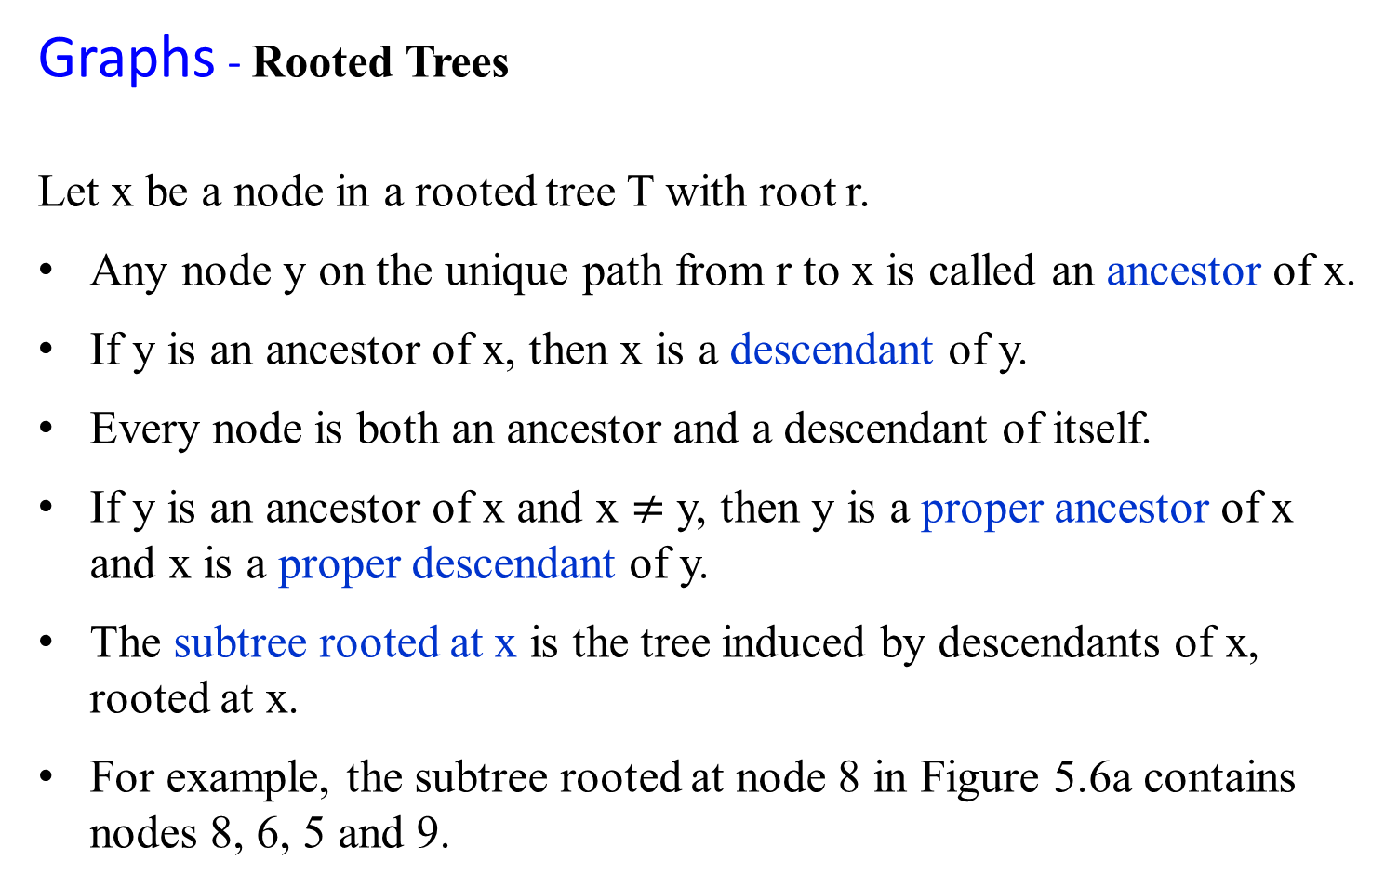
Graphs - Rooted Trees
Let x be a node in a rooted tree T with root r.
Any node y on the unique path from r to x is called an ancestor of x.
If y is an ancestor of x, then x is a descendant of y.
Every node is both an ancestor and a descendant of itself.
If y is an ancestor of x and x $≠$ y, then y is a proper ancestor of x and x is a proper descendant of y.
The subtree rooted at x is the tree induced by descendants of x, rooted at x.
For example, the subtree rooted at node 8 in Figure 5.6a contains nodes 8, 6, 5 and 9.

Slide 54
Graphs - Rooted Trees
Let x be a node in a rooted tree T with root r.
If the last edge on the path from the root r of a tree T to a node x is (y, x), then y is the parent of x, and x is a child of y.
The root is the only node in T with no parent.
If two nodes have the same parent, they are siblings.
A node with no children is an external node or leaf.
A nonleaf node is an internal node.

Slide 55
7
 | depth 0
 | depth 1
height = 4 | depth 2
 | depth 3
 | depth 4
7
3
10
4
3
10
4
8
12
11
1
12
8
11
2
6
5
1
6
5
(a)
(b)
9
9
Figure 5.6a: Rooted and ordered trees. (a) A rooted tree with height 4. The root (node 7) is at the top, its children (nodes with depth 1) are beneath it, their children (nodes with depth 2) are beneath them, etc. If the tree is ordered, the relative left-to-right order of the children of a node matter, otherwise it doesn’t. (b) Another rooted tree. As a rooted tree, it is identical to the tree in (a), but as an ordered tree it is different, since the children of node 3 appear in a different order.

Slide 56
Graphs - Rooted and Ordered Trees
Let x be a node in a rooted tree T with root r.
The degree of a node x is the number of children of the node x in a rooted tree T .
The level of a node x is the number of the nodes (edges) along unique path between it and the root. (e.g., the root is at level 0; its immediate children nodes are at level 1.)
The depth of a node x in T is the length of the simple path from the root r to a node x. (e.g., the root has the depth 0; its immediate children are at depth 1. Then the depth of a node is simply its level in the tree.)
The height of a rooted tree T is the longest simple path from the root to a leaf of the tree (i.e., the largest depth of any node in T).

Slide 57
Graphs - Rooted and Ordered Trees
Let x be a node in a rooted tree T with root r.
An ordered tree is a rooted tree in which the children of each node are ordered.
i.e., if a node has k children, then there is a 1st child, a 2nd child, …, and a kth child.
The two trees in Figure 5.6 are different when considered to be ordered trees, but the same when considered to be just rooted trees.

Slide 58
Rooted Trees
r
Level 0
f
e, f and g are siblings.
e, f and g are children of d.
d is the parents of e, f and g.
u
b
c
Level 1
11
e
g
d
d
Level 2
11
11
11
u
c
CV
CV
CV
Level 3
b
e
f
g
r
CV
CV
Level 4
Nodes in the enclosed region are descendants of c, which is an ancestor of each.
Figure 3.87(a) A free tree.
Figure 3.87(dc) A rooted tree.

Slide 60
Binary and Positional Trees
Define binary tree recursively:
  A binary tree T is a structure defined on a finite set of nodes that either
    contains no nodes (empty tree or null tree, denoted NIL), or
    is comprised of three disjoint sets of nodes: a root node, a binary tree called its left subtree, and a binary tree called its right subtree.
If the left subtree is nonempty, its root is called the left child of the root of the entire tree.
Likewise, the root of a nonnull right subtree is the right child of the root of the entire tree.
The child is absent or missing if a subtree is the null tree NIL.

Slide 61
Binary and Positional Trees
An ordered tree is a rooted tree in which all the children of each node are ordered.
In an ordered tree, there is no distinguishing a sole child as being whether left or right.
A binary tree is not simply an ordered tree in which each node has degree at most 2.
For example, in a binary tree, if a node has only one child, the position of the child - whether it is the left child or the right child -matters.
Figure5.7b shows a binary tree that differs from the tree in Figure 5.7a, because of the position of one node. Considered as ordered trees, the two trees are identical.

Slide 62
3
3
3
3
7
3
7
3
7
4
1
5
4
1
5
4
1
5
6
6
6
(a)
(b)
(c)
Figure 5.7 Binary trees. (a) A binary tree. The left child of a node is drawn beneath the node and to the left. The right child is drawn beneath and to the right. (b) A binary tree different from the one in (a). In (a), the left child of node 7 is 5 and right child is absent. In (b), the left child of node 7 is absent and the right child is 5. As ordered trees, these trees are the same, but as binary trees, they are distinct. (c) The binary tree in (a) represented by the internal nodes of a full binary tree: an ordered tree in which each internal node has degree 2. The leaves in the tree are shown as squares.

Slide 63
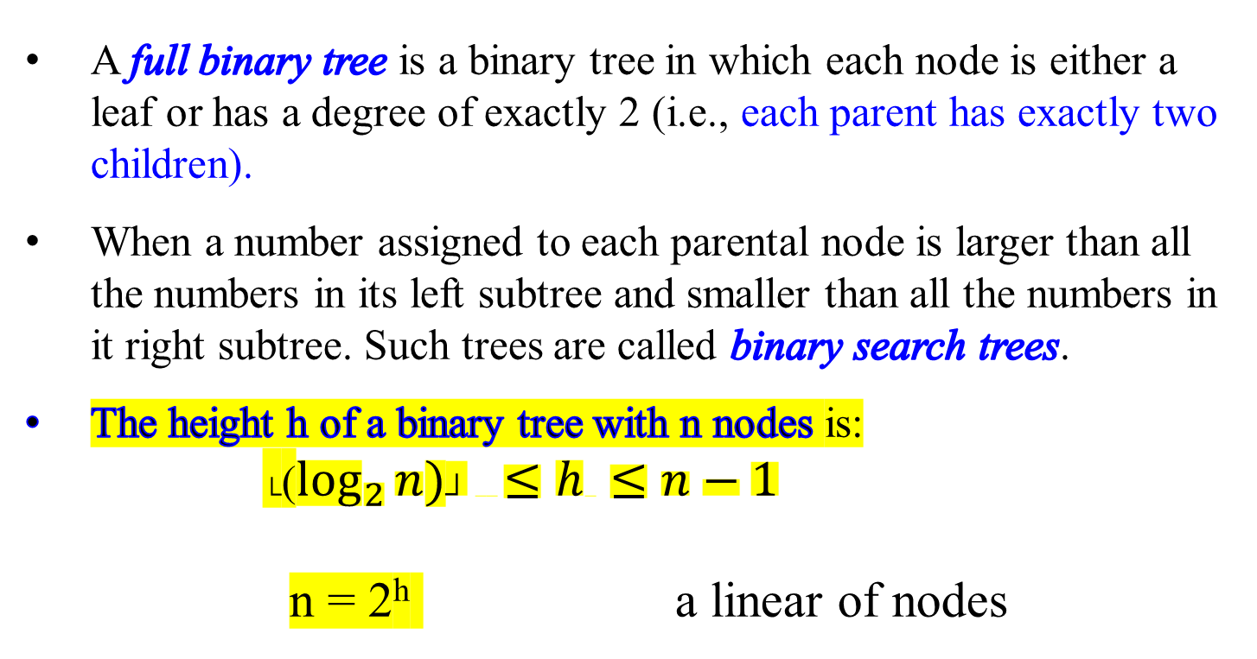
Binary and Positional Trees
A full binary tree is a binary tree in which each node is either a leaf or has a degree of exactly 2 (i.e., each parent has exactly two children).
When a number assigned to each parental node is larger than all the numbers in its left subtree and smaller than all the numbers in it right subtree. Such trees are called binary search trees.
The height h of a binary tree with n nodes is:
└($\log_{2}{n)┘} ≤h ≤n−1$
n = 2^{h} a linear of nodes

Slide 64
Binary and Positional Trees
Extend the positioning information that distinguishes binary trees from ordered trees to trees with more than 2 children per node.
In a positional tree, the children of a node are labeled with distinct positive integers.
The i^{th} child of a node is absent if no child is labeled with integer i.
A k-ary tree is a positional tree in which for every node, all children with labels greater than k are missing.
e.g., A binary tree is a k-ary tree with k =2.
A complete k-ary tree is a k-ary tree in which all leaves have the same depth and all internal nodes have degree k.

Slide 65
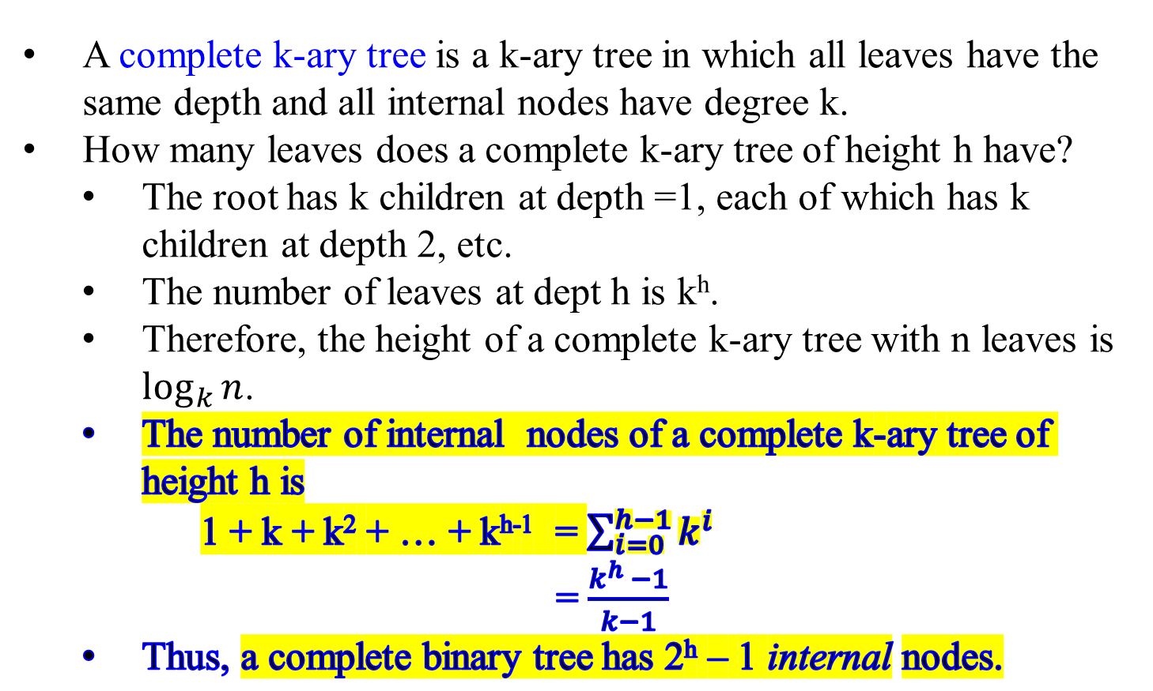
Binary and Positional Trees
A complete k-ary tree is a k-ary tree in which all leaves have the same depth and all internal nodes have degree k.
How many leaves does a complete k-ary tree of height h have?
  The root has k children at depth =1, each of which has k children at depth 2, etc.
  The number of leaves at dept h is k^{h}.
  Therefore, the height of a complete k-ary tree with n leaves is $\log_{k}{n}$.
  The number of internal nodes of a complete k-ary tree of height h is
  1 + k + k² + … + k^{h-1} = $\sum_{i=0}^{h−1}{k^{i}}$
= $\frac{k^{h} −1}{k−1}$
  Thus, a complete binary tree has 2^{h} – 1 internal nodes.

Slide 66
Figure 5.8 A complete binary tree of height 3 with 8 leaves and 7 internal nodes.
30
depth 0
depth 1
depth 2
depth 3
20
39
height = 3
13
25
36
50
40
51
12
17
24
27
33
38

Slide 67
The predecessor and successor of a node X in a binary tree, assuming all keys are distinct? 12, 13, 17, 20, 24, 25, 27 30, 33, 36, 38, 39, 40, 50, 51
Inorder walks: 20 30 39
30
A binary tree and
a full binary tree
X
20
39
13
25
36
50
40
51
12
17
24
27
33
38
Predecessor(X)
Successor(X)

Slide 68
The predecessor and successor of a node X in a binary tree, assuming all keys are distinct? 20, 21, 22, 23, 24, 25, 28, 30, 48,50, 55
30
Predecessor(X)
20
50
28
Inorder walks: 20 30 50
55
24
48
23
25
21
A binary tree but not
a full binary tree
X
22
Successor(X)

Slide 69
  Decrease-by-one technique.
Depth-First Search and Breadth-First Search Algorithms
  Viewed as applications of the decrease-by-one technique.
  Doing their main job of visiting vertices and traversing edges of a graph.

Slide 70
Decrease-by-one technique
Depth-First Search

