Slide 1
Chapter 03 Decrease-and-Conquer

Slide 2

Decrease-and-Conquer
Decrease-and-Conquer
Exploiting the relationship between
  a solution to a given instance of a problem and
  a solution to a smaller instance of the same problem.
The decrease-and-conquer technique can be exploited
  top down - a recursive implementation, and may be non-recursive
  bottom up - iterative implementation, also called incremental approach.

Slide 3
Decrease-and-Conquer
Three major variations of decrease-and-conquer:
Decrease by a constant
    Strategy: Reduce the size of an instance by the same constant on each iteration of the algorithm.
Decrease by a constant factor
    Strategy: Reduce a problem’s instance by the same constant factor on each iteration of the algorithm.
Variable size decrease
    Strategy: A size reduction pattern varies from one iteration of an algorithm to another.

Slide 4
Decrease-and-Conquer
An example of decrease-by-one:
Consider the exponentiation problem of computing a^{n},
  where a ≠ 0 and n is a positive (nonnegative) integer, 1, 2, 3, ….
The relationship between
  a solution to a given instance of a problem with size n and
  a solution to a smaller instance of the same problem with size n-1
  is obtained by the formula:
a^{n} = a^{n-1} * a.

Slide 5
Decrease-and-Conquer - Decrease-by-a-constant
Compute function f(n) = a^{n} by:
“top-down”, using its recursive definition a^{n} = a^{n-1} * a.
f(n-1)* a if n > 1
f(n) =
a if n = 1 (or 1 if n =0) …(3.1)
  “bottom up”, by multiplying a by itself n-1 times (or 1 by a n times). (This is the same as the brute-force algorithm). (iterative)
a^{n} = (… ((a * a) * a) * … * a) or (…((1 * a) * a) * … * a)
n-1 times * n times *
T(n) = T(n-1) + 1
T(1) = 0
Soln: T(n) = ϴ(n) of multiplications.
a * a * a * …..* a

Slide 6
Decrease-and-Conquer - Decrease-by-a-constant
Decrease-by-one
Example 3.1: Compute the factorial function F(n) = n! based on the factorial n! definition:
n! = 1 * 2 * … * (n-1) * n for any nonnegative integer n ≥ 1, and
0! = 1
Bottom-up approach: ( … (((1 * 2) * 3) * 4) * … *)
Top-down approach:
Compute F(n) = F(n-1) * n with the recursive algorithm.
Algorithm F(n)
//Compute n! recursively
//Input: A nonnegative integer n
//Output: The value of n!
if (n == 0) return 1
else return F(n-1) * n;
//Top-down approach

Slide 7
Decrease-and-Conquer - Decrease-by-a-constant
Decrease by a constant
Consider the Algorithm F(n) – a top-down approach (3.1):
Let M(n) be the number of multiplication operations * needed.
M(n) = M(n -1) +1 when n >1
M(1) = 0
Solution
M(n) = M(n-2) +1 + 1, where M(n-1) = M(n-2) + 1.
M(n) = M(n – i) + i
Let i = n-1. Then M(n) = M(n – (n-1)) + n-1
= M(1) + n – 1
= 0 + n – 1
= n -1 = ϴ(n) numbers of multiplication
Can we use Masters Thm to compute this pbm? If not why?

Slide 8
Decrease-by-a-Constant-Factor
The decrease-by-a-constant-factor technique
Strategy: Reduce a problem’s instance by the same constant factor on each iteration of the algorithm.
Decrease-by-a-constant-factor algorithms usually run in logarithmic time.
An example
  The binary search is an example of decrease-by-half.
  The worst-case time efficiency of binary search,
  T(n) = ϴ(log₂ n).

Slide 9
Decrease-by-a-Constant-Factor
An example of decrease-by-half for the exponentiation problem:
  Compute a^{n}
    If the instance of size n (n is an even only), the instance of half its size will be to compute a^{n/2} [decrease-by-half], with the relationship between the two: a^{n} = (a^{n/2})².
    If n is odd, then compute a^{n-1}, by using the rule for even-valued exponents and then multiply the result by a.
(a^{n/2})² if n is even and positive
a^{n} = (a^{(n-1)/2})² * a if n is odd
1 if n = 0. (3.2)
The algorithm requires O(log n) of multiplication.
A brute force approach: Reducing by a constant (using the top-down approach, a recursive call, (3.1, slide 5) ) takes ϴ(n).

Slide 10
Decrease-by-a-Constant-Factor - decrease-by-half
  To compute a^{n} recursively according to formula (3.2),
the algorithm’s efficiency can be measured by the number of multiplications, and the algorithm is in O(log n).
The reason is that, on each iteration, the size is reduced by at least one-half at the expense of no more than two multiplications [if n is odd.].
2 * 2 * 2 * 2 * 2 * 2 * 2 * 2 * 2 * 2 * 2 * 2 * 2 * 2 * 2 * 2 = 2¹⁶
Decrease by a constant factor 2.
Total number of * needed = log₂16 = 4 multiply.

Slide 11



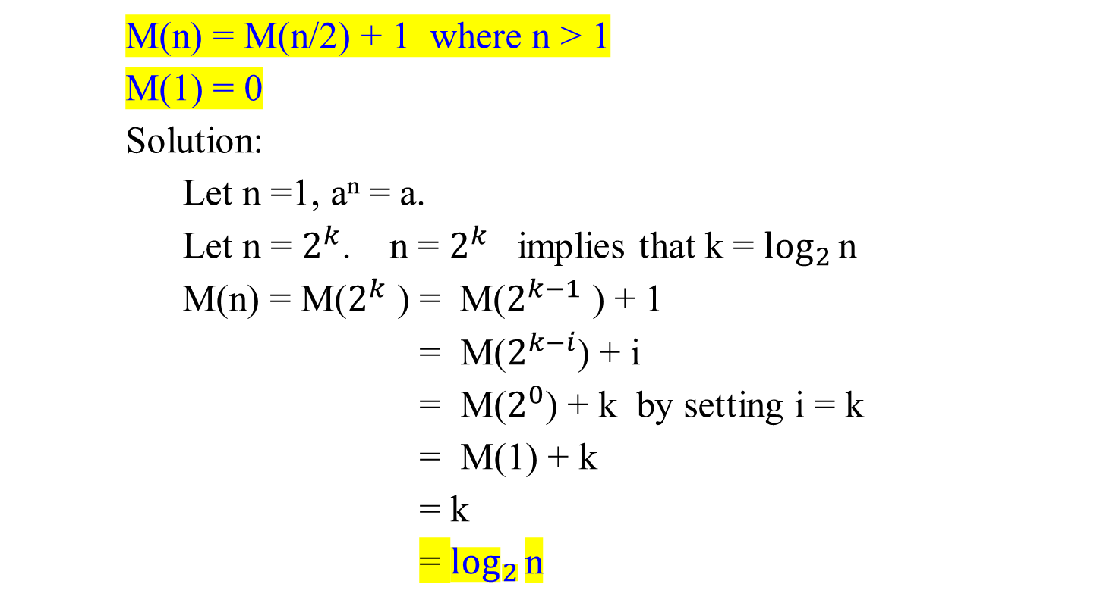
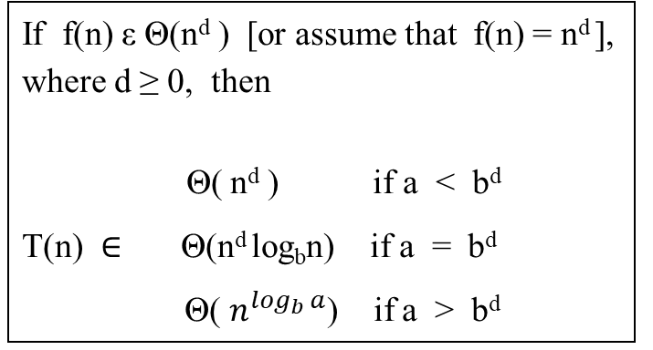
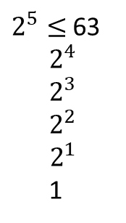



Decrease-by-a-Constant-Factor - decrease-by-half
Pbm: Cut any stick into an unit stick.
M(n) = M(n/2) + 1 where n > 1
M(1) = 0
Solution:
Let n =1, a^{n} = a.
Let n = $2^{k}$. n = $2^{k}$ implies that k = $\log_{2}{\text{n}}$
M(n) = M($2^{k}$ ) = M($2^{k−1}$ ) + 1
= M($2^{k−i}$) + i
= M($2^{0}$) + k by setting i = k
= M(1) + k
= k
= $\log_{2}{\text{n}}$
$2^{k}≤$n
$${n −2}^{k}$$
n
$$2^{k−1}$$
$$2^{k−1}$$
$2^{k}≤$n
$${n −2}^{k}$$
$2^{5}≤$63
$$2^{4}$$
$$2^{3}$$
$$2^{2}$$
$$2^{1}$$
1
If f(n) ε Θ(n^{d} ) [or assume that f(n) = n^{d} ],
where d ≥ 0, then
Θ( n^{d} ) if a < b^{d}
T(n) $∈$ Θ(n^{d} log_{b}n) if a = b^{d}
Θ( $n^{\log_{b}{a}}$) if a > b^{d}

Slide 12
Divide-and-Conquer
Based on the divide-and-conquer
A difference between the algorithm based on divide-by-half and the one based on the divide-and-conquer idea foe solving two instances of the exponentiation problem of size n/2:
a└^{n/2}┘ * a^{┌n/2┐} if n > 1
a^{n} =
a if n = 1 (2.3)
Their time efficiency is
M(n) = M(└n/2┘) + M(┌n/2┐ ) + 1
M(1) = 0 (2.3)
The algorithm based on formula (2.3) is inefficient (why?), whereas the one based on (3.2) is much faster.
Pbm: Cut any stick into an unit stick.

Slide 13
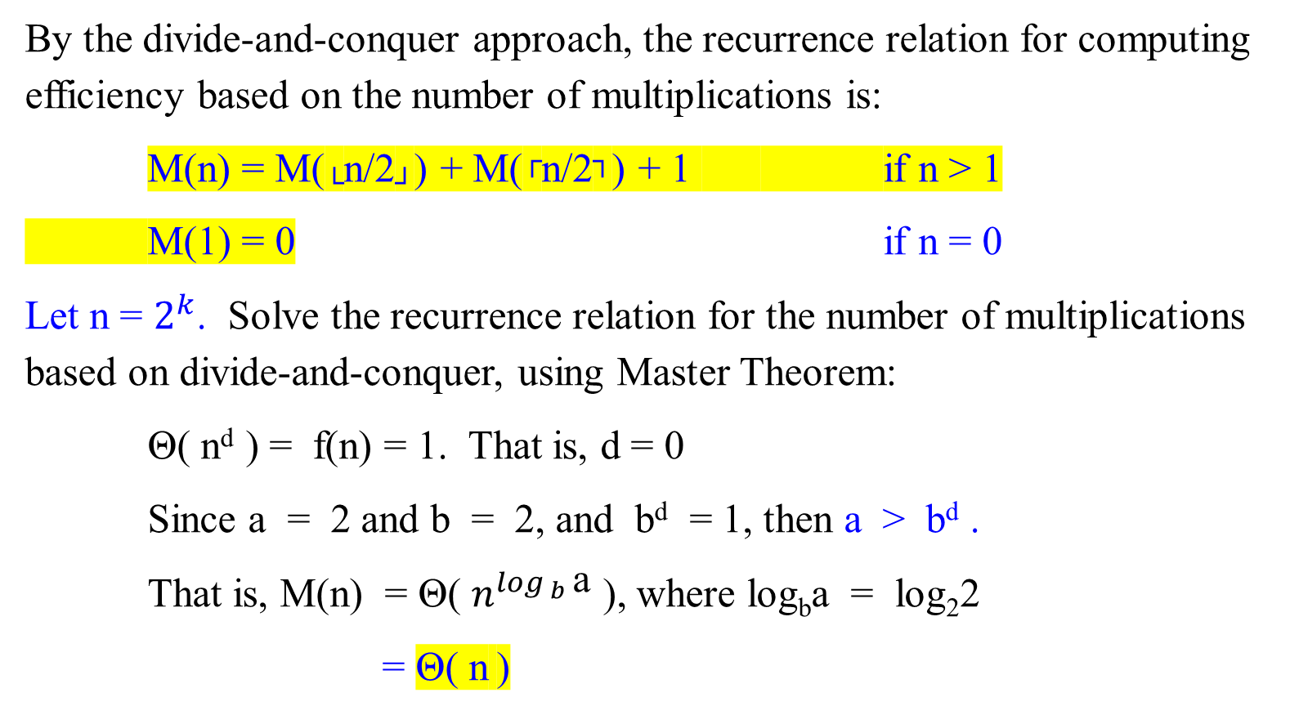
Divide-and-Conquer
By the divide-and-conquer approach, the recurrence relation for computing efficiency based on the number of multiplications is:
M(n) = M(└n/2┘) + M(┌n/2┐) + 1 if n > 1
M(1) = 0 if n = 0
Let n = $2^{k}$. Solve the recurrence relation for the number of multiplications based on divide-and-conquer, using Master Theorem:
Θ( n^{d} ) = f(n) = 1. That is, d = 0
Since a = 2 and b = 2, and b^{d} = 1, then a > b^{d} .
That is, M(n) = Θ( $n^{\log_{ b}{\text{a}}}$ ), where log_{b}a = log₂2
= Θ( n )

Slide 14
Divide-and-Conquer
Or, M(n) = 2 M(n/2) + 1 and M(1) = 0
Let n = 2^{k} . M(n) = 2M(2^{k-1} ) + 1
= 2(2M(2^{k-2} ) + 1) + 1
= 2² M(2^{k-2} ) + 2 + 1
= 2³ M(2^{k-3} ) + 2² + 2 + 1
= 2^{i} M(2^{k-i} ) + 2^{i-1} + … + 2² + 2 + 1
= 2^{k} M(2^{k-k} ) + 2^{k-1} + … + 2² + 2 + 1
= 0 + 2^{k-1} + … + 2² + 2 + 1
= 2^{k} – 1 = n – 1
= Θ( n )

Slide 15
Variable-Size-Decrease
The variable-size-decrease technique
Strategy: A size-reduction pattern varies from one iteration of an algorithm to another iteration.
Euclid’s algorithm for computing the greatest common divisor is a good example.

Slide 16
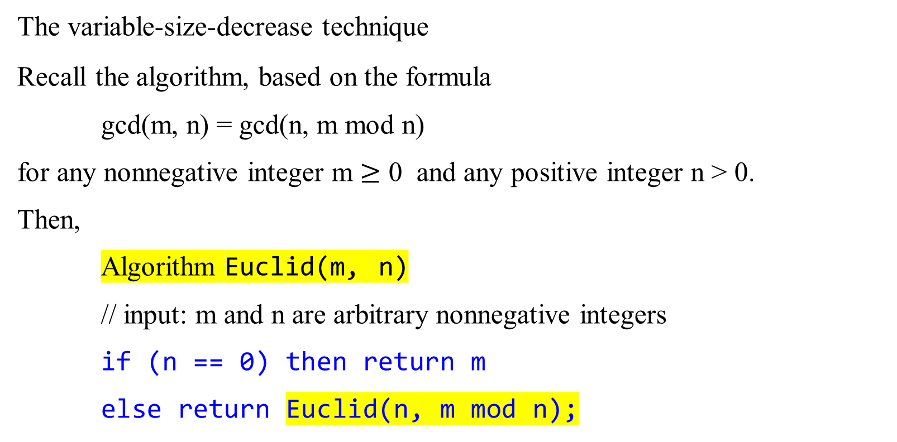
Variable-Size-Decrease
The variable-size-decrease technique
Recall the algorithm, based on the formula
  gcd(m, n) = gcd(n, m mod n)
for any nonnegative integer m $≥$ 0 and any positive integer n > 0.
Then,
Algorithm Euclid(m, n)
// input: m and n are arbitrary nonnegative integers
if (n == 0) then return m
else return Euclid(n, m mod n);

Slide 17
Variable-Size-Decrease
The running time of Euclid’s algorithm
Analyze the worse-case running time of Euclid
  as a function of the size of m and n (their magnitude).
  Assume that m > n ≥ 0.
    If m < n, Euclid spends one recursive call swapping its arguments m and n, and then proceeds.
  The overall running time of Euclid is proportional to the number of recursive calls it makes.
    This analysis makes use of the Fibonacci number F_{k}.
Lemma 0.1
If m > n ≥ 1 and the invocation Euclid(m, n) performs k ≥ 1 recursive calls, then m ≥ F_{k+2} and n ≥ F_{k+1}.
Theorem 0.5 (Lame’s Theorem)
For any integer k ≥ 1, if m > n ≥ 1 and n < F_{k+1}, then the call Euclid(m, n) makes fewer than k recursive calls.

Slide 18
Common Recurrence Types in Algorithm Analysis
Common Recurrence Types:
Decrease-by-one
A decrease-by-one algorithm solves a problem by exploiting a relationship between solutions for
  a given instance of size n and
  a smaller instance of size n-1.
Specific examples include recursive evaluation of
  factorial n! and
  insertion sort.

Slide 19
Common Recurrence Types in Algorithm Analysis
Decrease-by-one
Example 3.1: Compute the factorial function F(n) = n! based on the factorial n! definition:
n! = 1 * 2 * … * (n-1) * n for any nonnegative integer n ≥ 1, and
0! = 1
Then we can compute F(n) = F(n-1) * n with the following recursive algorithm.
Algorithm F(n)
//Compute n! recursively
//Input: A nonnegative integer n
//Output: The value of n!
if (n == 0) then return 1
else return F(n-1) * n;
Top-down approach
The recurrence relation is:
T(n) = T(n-1) + 1
T(0) = 0
T(n) = ϴ(n), numbers of multiplication needed

Slide 20
Common Recurrence Types in Algorithm Analysis
Decrease-by-one
Example 3.2: Insertion sort:
Using iteration of insertion sort, insert A[i] in its proper position among the preceding elements previously sorted.
A[0] ≤ A[1] ≤ A[2] ≤ … A[j] < A[j+1] ≤ … ≤ A[i-1] | A[i] … A[n-1]
Smaller than or equal to A[i] greater than A[i]
← j
i →

Slide 21
Algorithm InsertionSort(A[0..n-1])
//Sorts a given array by insertion sort.
//Input: An array A[0..n-1] of an orderable elements.
//Output: Array A[0..n-1] sorted in nondecreasing order.
for (i ← 1) to (n-1) do {
v ← A[i];
j ← i - 1;
while (j ≥ 0 and A[j] > v) do {
A[j+1] ← A[j]; //move the elements of A[j] to the
//right into A[j+1]; open a slot for v j ← j – 1; } //end while-do
A[j+1] ← v; } //end for-do

Slide 22
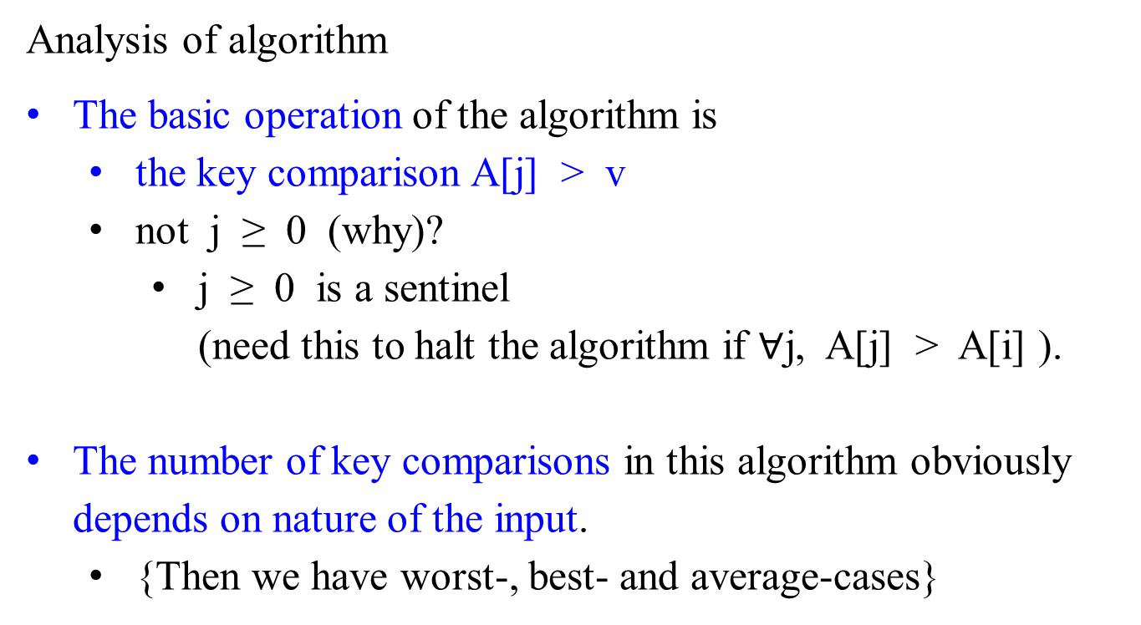
Common Recurrence Types in Algorithm Analysis
Analysis of algorithm
The basic operation of the algorithm is
  the key comparison A[j] > v
  not j ≥ 0 (why)?
    j ≥ 0 is a sentinel (need this to halt the algorithm if $∀$j, A[j] > A[i] ).
The number of key comparisons in this algorithm obviously depends on nature of the input.
  {Then we have worst-, best- and average-cases}

Slide 23
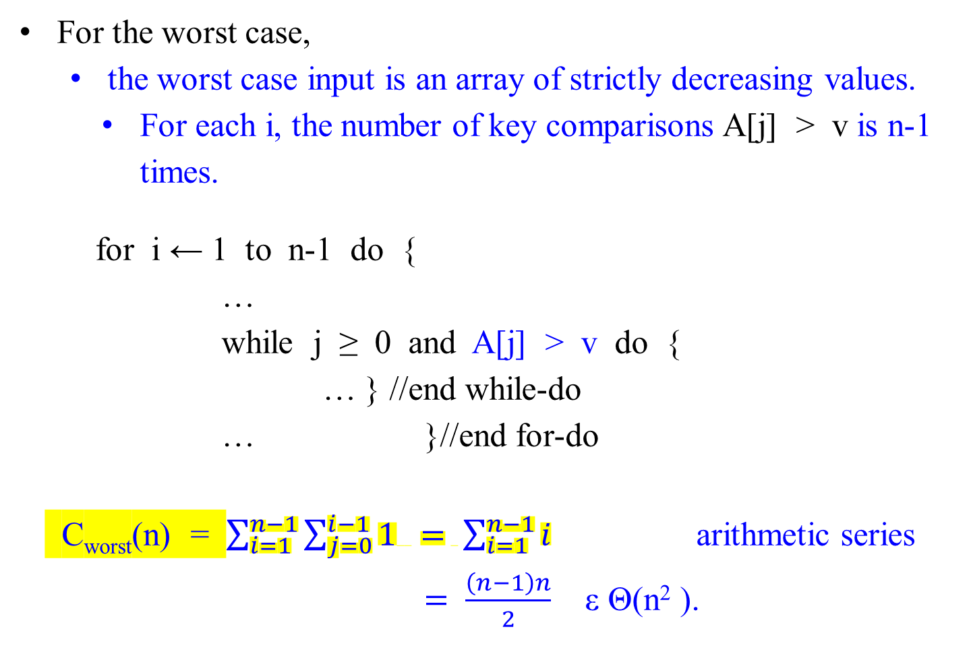
For the worst case,
  the worst case input is an array of strictly decreasing values.
    For each i, the number of key comparisons A[j] > v is n-1 times.
for i ← 1 to n-1 do {
…
while j ≥ 0 and A[j] > v do {
… } //end while-do
… }//end for-do
C_{worst}(n) = $\sum_{i=1}^{n−1}{\sum_{j=0}^{i−1}{1 = \sum_{i=1}^{n−1}{i}}}$ arithmetic series
$=$ $\frac{\left(n−1\right)n}{2}$ ε Θ(n² ).

Slide 24
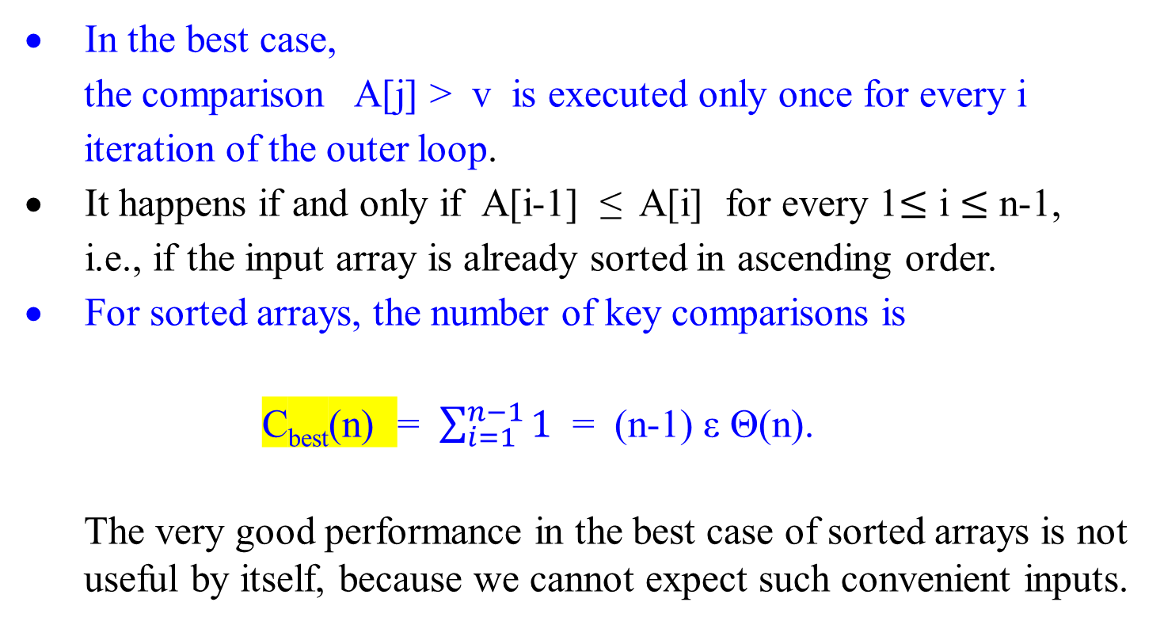
In the best case,
the comparison A[j] > v is executed only once for every i iteration of the outer loop.
It happens if and only if A[i-1] ≤ A[i] for every 1$≤$ i $≤$ n-1, i.e., if the input array is already sorted in ascending order.
For sorted arrays, the number of key comparisons is
C_{best}(n) = $\sum_{i=1}^{n−1}{1}$ = (n-1) ε Θ(n).
  The very good performance in the best case of sorted arrays is not useful by itself, because we cannot expect such convenient inputs.

Slide 25
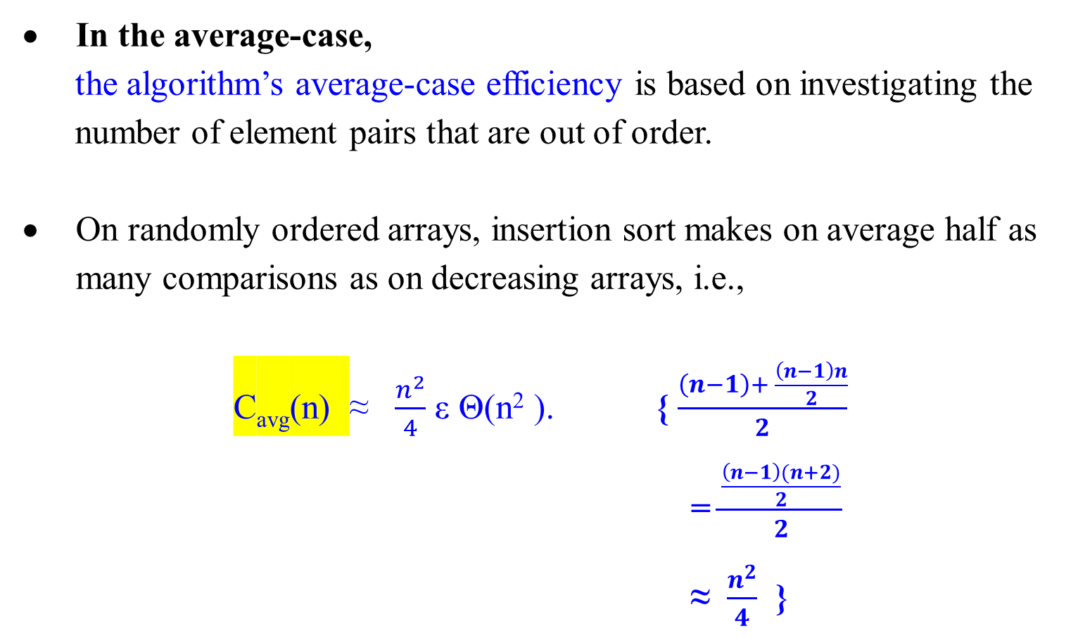
In the average-case,
the algorithm’s average-case efficiency is based on investigating the number of element pairs that are out of order.
On randomly ordered arrays, insertion sort makes on average half as many comparisons as on decreasing arrays, i.e.,
C_{avg}(n) ≈ $\frac{n^{2}}{4}$ ε Θ(n² ). { $\frac{\left(n−1\right)+ \frac{\left(n−1\right)n}{2}}{2}$
= $\frac{\frac{\left(n−1\right)(n+2)}{2}}{2}$
≈ $\frac{n^{2}}{4}$ }

Slide 26
Common Recurrence Types in Algorithm Analysis
Common Recurrence Types: Decrease-by-one
The recurrence equation for investigating the time efficiency of such type of algorithms typically has the form
T(n) = T(n - 1) + f(n) (3.4)
where function f(n) accounts for the time needed
  to reduce an instance to a smaller one and
  to extend the solution of the smaller instance to a solution of the larger instance.
Reduce by one algorithms

Slide 27
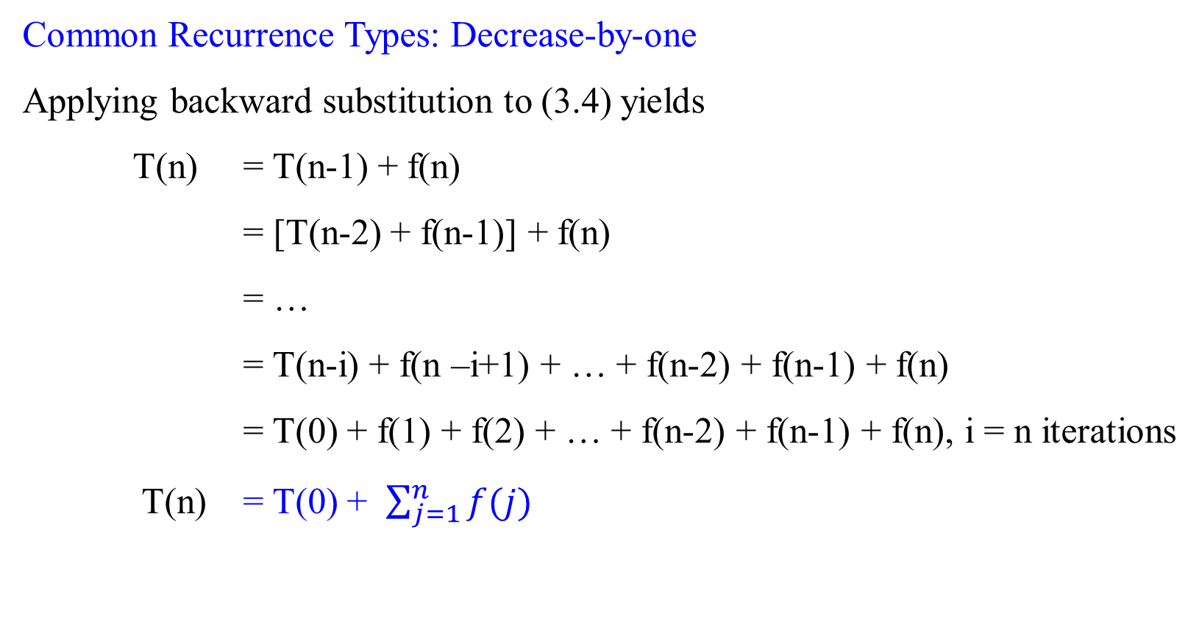
Common Recurrence Types in Algorithm Analysis
Common Recurrence Types: Decrease-by-one
Applying backward substitution to (3.4) yields
T(n) = T(n-1) + f(n)
= [T(n-2) + f(n-1)] + f(n)
= …
= T(n-i) + f(n –i+1) + … + f(n-2) + f(n-1) + f(n)
= T(0) + f(1) + f(2) + … + f(n-2) + f(n-1) + f(n), i = n iterations
T(n) = T(0) + $\sum_{j=1}^{n}{f(j)}$

Slide 28
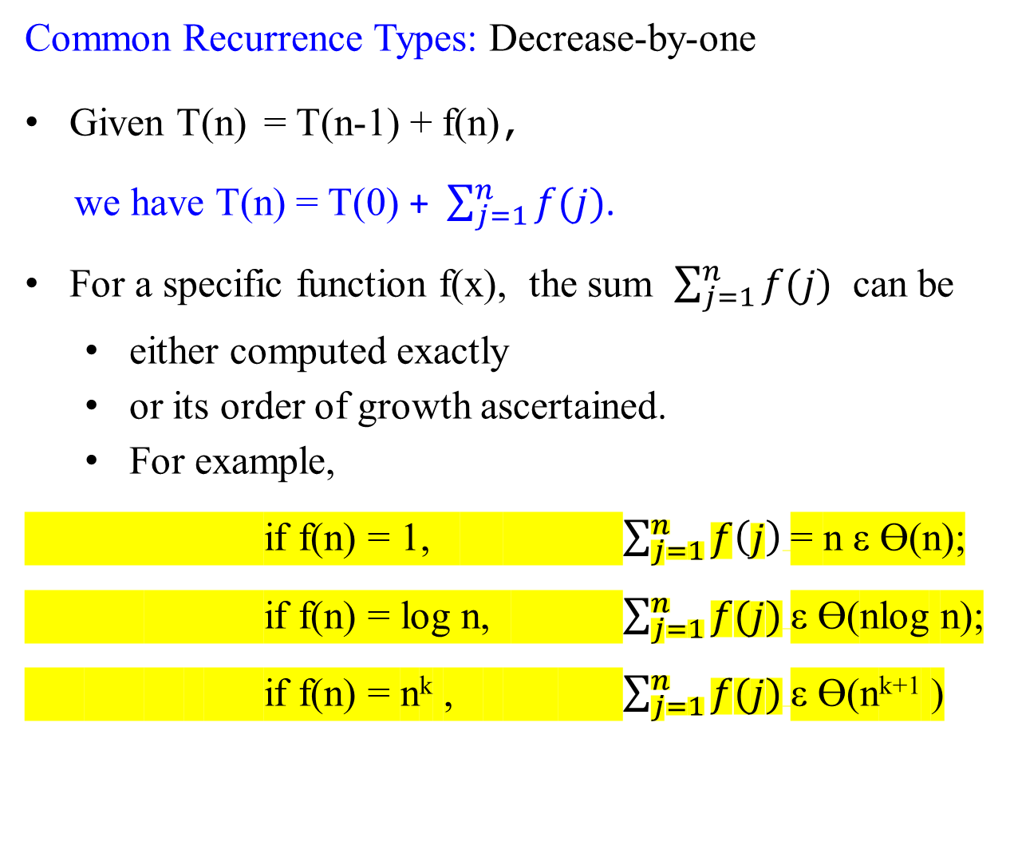
Common Recurrence Types in Algorithm Analysis
Common Recurrence Types: Decrease-by-one
Given T(n) = T(n-1) + f(n),
we have T(n) = T(0) + $\sum_{j=1}^{n}{f(j)}$.
For a specific function f(x), the sum $\sum_{j=1}^{n}{f(j)}$ can be
  either computed exactly
  or its order of growth ascertained.
  For example,
if f(n) = 1, $\sum_{j=1}^{n}{f\left(j\right)}$= n ε Ɵ(n);
if f(n) = log n, $\sum_{j=1}^{n}{f(j)}$ε Ɵ(nlog n);
if f(n) = n^{k} , $\sum_{j=1}^{n}{f(j)}$ε Ɵ(n^{k+1} )

Slide 29

Common Recurrence Types in Algorithm Analysis
Common Recurrence Types: Decrease-by-one
if f(n) = 1, $\sum_{j=1}^{n}{f\left(j\right)}$= n ε Ɵ(n)
if f(n) = log n, $\sum_{j=1}^{n}{f(j)}$ε Ɵ(nlog n);
$\int_{1}^{n}{\log{n}}=$ $[ xlogx −x]\begin{matrix}n \\ 1\end{matrix}$ = nlogn – n + 1 ε O(nlog n). $\int_{1}^{n}{\log{n}}$ $≤ \sum_{j=1}^{n}{\log{j}}$ $≤$ $\int_{1}^{n+1}{\log{n}}$ implies that
nlogn – n + 1 $≤ \sum_{j=1}^{n}{\log{j}}$ $≤$ (n+1)log(n +1) – (n+1) + 1
nlogn – n + 1 $≤ \sum_{j=1}^{n}{\log{j}}$ implies that Ω (nlog n)
if f(n) = n^{k} , $\sum_{j=1}^{n}{f(j)}$ε Ɵ(n^{k+1} )
$\sum_{j=1}^{n}{j^{k}}$ = $\frac{1}{k+1} n^{k+1}+O(n^{k})$ a closed-formed Bernoulli numbers.

Slide 30
Common Recurrence Types in Algorithm Analysis
Common Recurrence Types: Decreased-by-a-constant-factor
A decrease-by-a-constant-factor algorithm
  solves a problem by reducing its instance of size n to an instance of size n/b
    (b = 2 for most but not all such algorithms),
    solve the smaller instance recursively, and then,
    if necessary, extend the solution of the smaller instance to a solution of the given instance.
The most important example is binary search:
Compare a search key K with the array’s middle element A[m].
If they match, the algorithm stops;
otherwise, the same operation is repeated recursively for the first half of the array if K < A[m], and for the second half if K > A[m]:

Slide 31
Algorithm BinarySearch(A[0 .. n-1], K)
//Implements nonrecursive binary search
//Input: An array A[0 .. n-1] sorted in ascending order and
// a search key K
//Output: An index of the array’s element that is equal to K
// or -1 if there is no such element
p ← 0;
r ← n - 1;
while (p ≤ r) do {
m ← └ (p + r) /2 ┘;
if (K == A[m]) return m
else if (K < A[m]) then r ← m - 1
else p ← m + 1; }//end if-else-if-else
return -1;

Slide 32
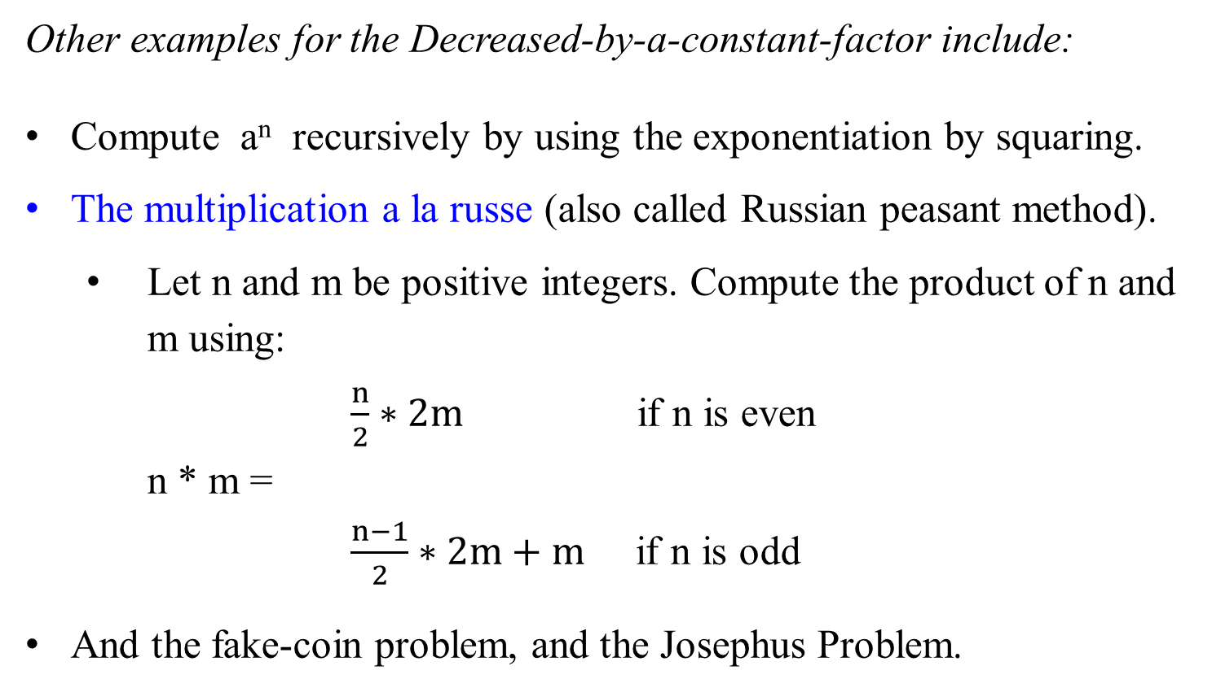
Common Recurrence Types in Algorithm Analysis
Other examples for the Decreased-by-a-constant-factor include:
Compute a^{n} recursively by using the exponentiation by squaring.
The multiplication a la russe (also called Russian peasant method).
  Let n and m be positive integers. Compute the product of n and m using:
$\frac{n}{2}∗2m$ if n is even
n * m =
$\frac{n−1}{2}∗2m+m$ if n is odd
And the fake-coin problem, and the Josephus Problem.
See slide 9
For determining the fake coin whether is heavy or light, two comparisons and divide n coins into three bags.

Slide 33
Common Recurrence Types in Algorithm Analysis
Common Recurrence Types: Decreased-by-a-constant-factor
The recurrence equation for investigating the time efficiency of such decrease-by-a-constant-factor algorithms typically has the form
T(n) = T(n/b) + f(n) (3.5)
where
    b > 1 and
    function f(n) accounts for the time needed to
      reduce an instance to a smaller one, and
      extend the solution of the smaller instance to a solution of the larger instance.

Slide 34
Common Recurrence Types in Algorithm Analysis
Common Recurrence Types: Decreased-by-a-constant-factor
The recurrence equation for finding the time efficiency of such decrease-by-a-constant-factor algorithms typically has the form
T(n) = T(n/b) + f(n) (3.5)
Strictly speaking, equation (3.5) is valid
  only for n = b^{k}, k = 0, 1, …
  For values of n that are not the powers of b, there is typically some round-off, usually involving the floor and/or ceiling functions.
    The standard approach to solving such equations is
      to solve them for n = b^{k} first. Afterward,
      either the solution is tweaked to make it valid for all n’s,
      or the order of growth of the solution is established based on the smoothness rule (Theorem 2.2).

Slide 35
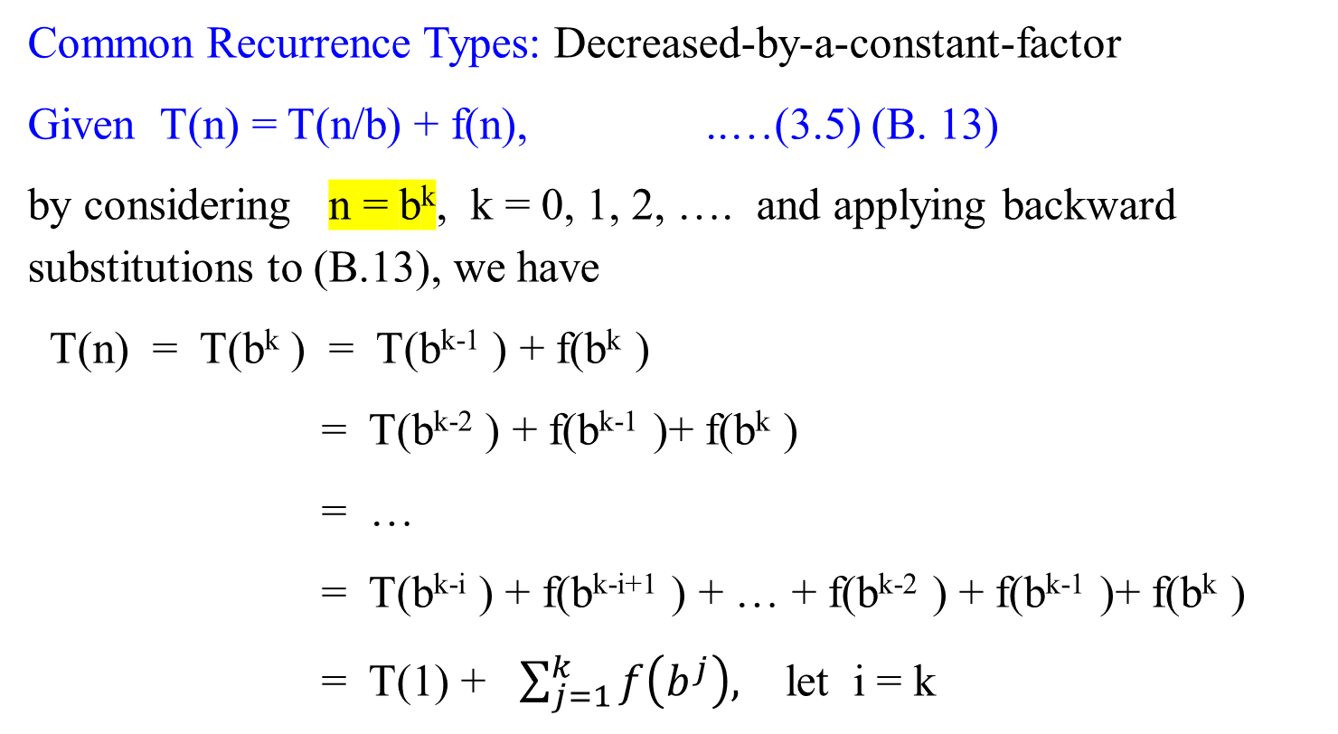
Common Recurrence Types in Algorithm Analysis
Common Recurrence Types: Decreased-by-a-constant-factor
Given T(n) = T(n/b) + f(n), ..…(3.5) (B. 13)
by considering n = b^{k}, k = 0, 1, 2, …. and applying backward substitutions to (B.13), we have
T(n) = T(b^{k} ) = T(b^{k-1} ) + f(b^{k} )
= T(b^{k-2} ) + f(b^{k-1} )+ f(b^{k} )
= …
= T(b^{k-i} ) + f(b^{k-i+1} ) + … + f(b^{k-2} ) + f(b^{k-1} )+ f(b^{k} )
= T(1) + $\sum_{j=1}^{k}{f\left(b^{j}\right),}$ let i = k

Slide 36
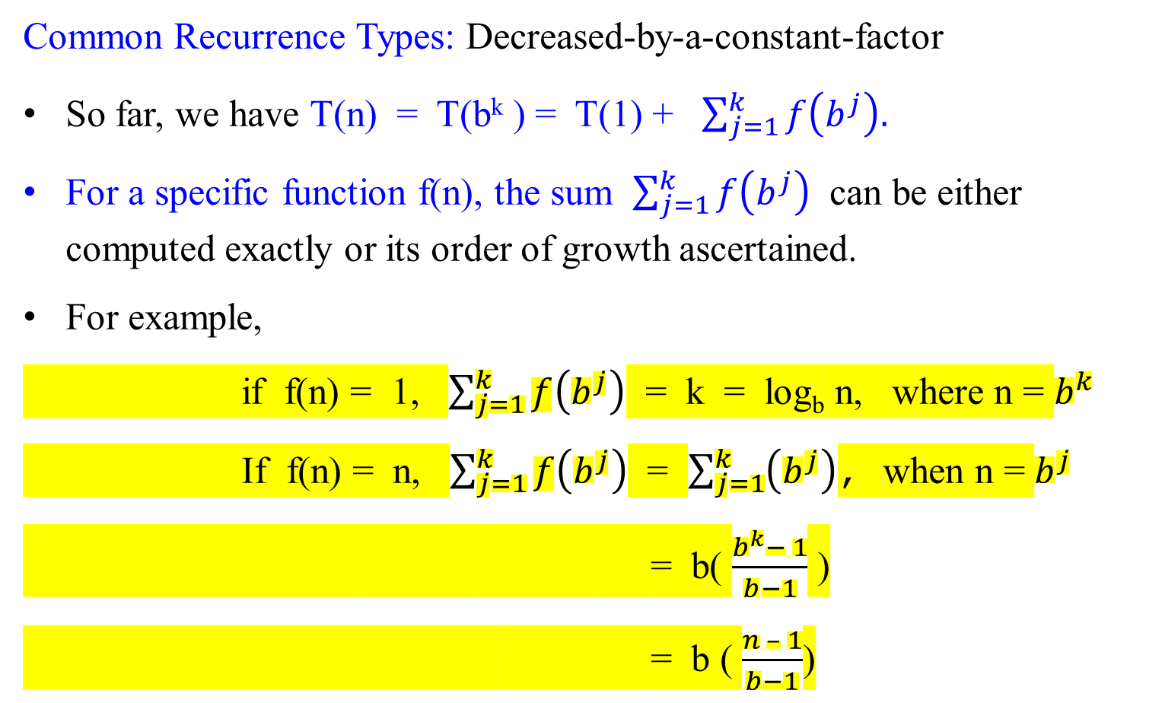
Common Recurrence Types: Decreased-by-a-constant-factor
Common Recurrence Types: Decreased-by-a-constant-factor
So far, we have T(n) = T(b^{k} ) = T(1) + $\sum_{j=1}^{k}{f\left(b^{j}\right).}$
For a specific function f(n), the sum $\sum_{j=1}^{k}{f\left(b^{j}\right)}$ can be either computed exactly or its order of growth ascertained.
For example,
if f(n) = 1, $\sum_{j=1}^{k}{f\left(b^{j}\right)}$ = k = log_{b} n, where n = $b^{k}$
If f(n) = n, $\sum_{j=1}^{k}{f\left(b^{j}\right)}$ = $\sum_{j=1}^{k}{\left(b^{j}\right)}$, when n = $b^{j}$
= b( $\frac{b^{k}− 1}{b−1}$ )
= b ( $\frac{n – 1}{b−1}$)

Slide 37
Common Recurrence Types: Decreased-by-a-constant-factor
Common Recurrence Types: Decreased-by-a-constant-factor
This recurrence
T(n) = T(n/b) + f(n) (3.5)
is a special case of recurrence for Divide-and-conquer
T(n) = aT(n/b) + f(n),
which is covered by the Master Theorem (Theorem 2.3).
According to this theorem, in particular,
if f(n) ε Ω( n^{d} ) where d > 0, then T(n) ε Ω( n^{d} ) as well.

Slide 38
Decomposition of Graph
In the remaining of this chapter, we will cover graphs,
  including Depth-First Search and Breadth-First Search
  and Topological Sorting

