Slide 1
Polynomials and
The Fast Fourier Transform (FFT)

Slide 2

The Fast Fourier Transform (FFT)
Fourier analysis – a mathematical operation that
  converts a signal from its original domain (x-axis, usually time or space) to a representation in the frequency domain, and vice versa.
  Uses FT to decompose a time-varying signal into sine waves.
  It is an algorithm that computes the discrete Fourier transform (DFT) of a sequence, or its inverse (IDFT).
  The DFT is obtained by decomposing a sequence of values into components of different frequencies.

Slide 3
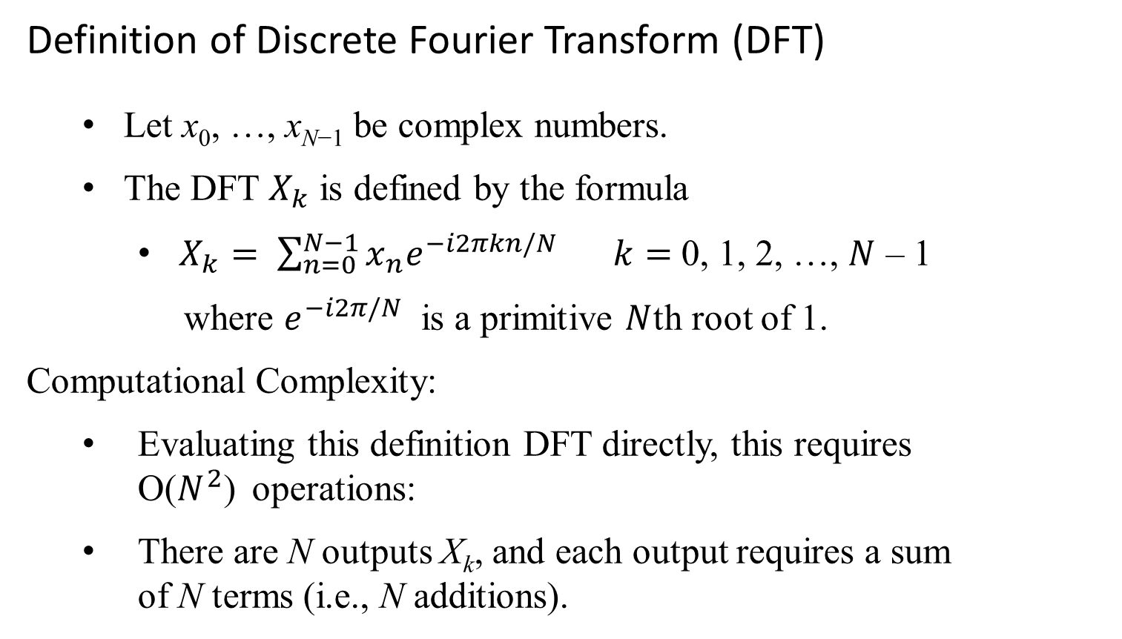
Polynomials and the Fast Fourier Transform (FFT)
Definition of Discrete Fourier Transform (DFT)
  Let x₀, …, x_{N−1} be complex numbers.
  The DFT $X_{k}$ is defined by the formula
    $X_{k}= \sum_{n=0}^{N−1}{x_{n}e^{−i2πkn/N}} k=$ 0, 1, 2, …, $N$ – 1
    where $e^{−i2π/N}$ is a primitive $N$th root of 1.
    Computational Complexity:
  Evaluating this definition DFT directly, this requires O($N^{2}$) operations:
    There are N outputs X_{k}, and each output requires a sum of N terms (i.e., N additions).

Slide 4
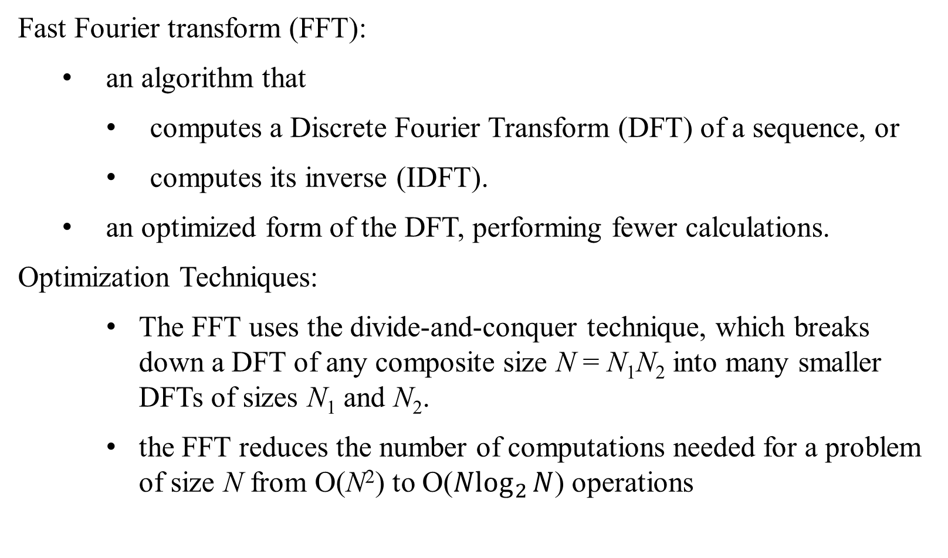
Polynomials and the Fast Fourier Transform (FFT)
Fast Fourier transform (FFT):
  an algorithm that
    computes a Discrete Fourier Transform (DFT) of a sequence, or
    computes its inverse (IDFT).
  an optimized form of the DFT, performing fewer calculations.
  Optimization Techniques:
    The FFT uses the divide-and-conquer technique, which breaks down a DFT of any composite size N = N₁N₂ into many smaller DFTs of sizes N₁ and N₂.
    the FFT reduces the number of computations needed for a problem of size N from O(N²) to O(${Nlog}_{2}{N}$) operations

Slide 5
Polynomials and the Fast Fourier Transform (FFT)
Fast Fourier transform (FFT) algorithm:
  Widely used in engineering, music, science, and mathematics applications.
  Used in digital recording, sampling, additive synthesis, and pitch correction software.
  Used extensively in audio processing, radar, sonar, and software-defined radio.
  Compression techniques are used to encode digital video and audio information, such as MP3 files (formally MPEG-1 Audio Layer III or MPEG-2 Audio Layer III), which are an audio coding format for digital audio.
  Used in signal processing.

Slide 6
Polynomials
The time complexity of adding and multiplying polynomials and the use of the Fast Fourier Transform (FFT) to optimize polynomial multiplication:
The straightforward method:
  Adding Polynomials: Takes Θ(n) time for two polynomials of degree n.
  Multiplying Polynomials: Takes Θ(n² ) time for two polynomials of degree n.
FFT for Polynomial Multiplication:
The Fast Fourier transform (FFT) can reduce the time to Θ(n log n) for multiplying polynomials.

Slide 7
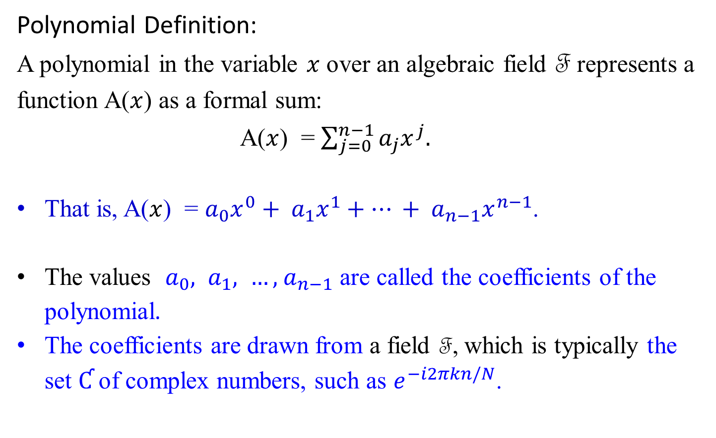
Polynomials
Polynomial Definition:
A polynomial in the variable $x$ over an algebraic field F represents a function A($x$) as a formal sum:
A($x$) = $\sum_{j=0}^{n−1}{a_{j}x^{j}.}$
That is, A($x$) = $a_{0}x^{0}+ a_{1}x^{1}+… + a_{n−1}x^{n−1}$.
The values $a_{0}, a_{1}, …, { a}_{n−1}$ are called the coefficients of the polynomial.
The coefficients are drawn from a field F, which is typically the set Ƈ of complex numbers, such as $e^{−i2πkn/N}$.
r

Slide 8
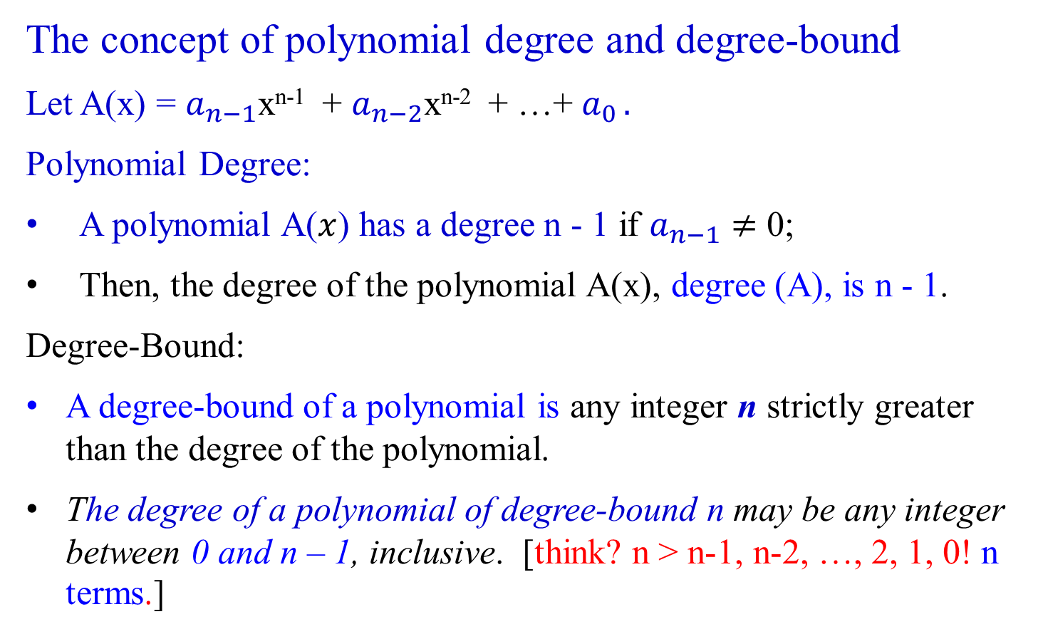
Polynomials
The concept of polynomial degree and degree-bound
Let A(x) = $a_{n−1}$x^{n-1} + $a_{n−2}$x^{n-2} + …+ $a_{0 }.$
Polynomial Degree:
A polynomial A($x$) has a degree n - 1 if $a_{n−1}≠$ 0;
Then, the degree of the polynomial A(x), degree (A), is n - 1.
Degree-Bound:
A degree-bound of a polynomial is any integer n strictly greater than the degree of the polynomial.
The degree of a polynomial of degree-bound n may be any integer between 0 and n – 1, inclusive. [think? n > n-1, n-2, …, 2, 1, 0! n terms.]

Slide 9
Operations on Polynomials
  Polynomial addition:
  Polynomial multiplication:

Slide 10
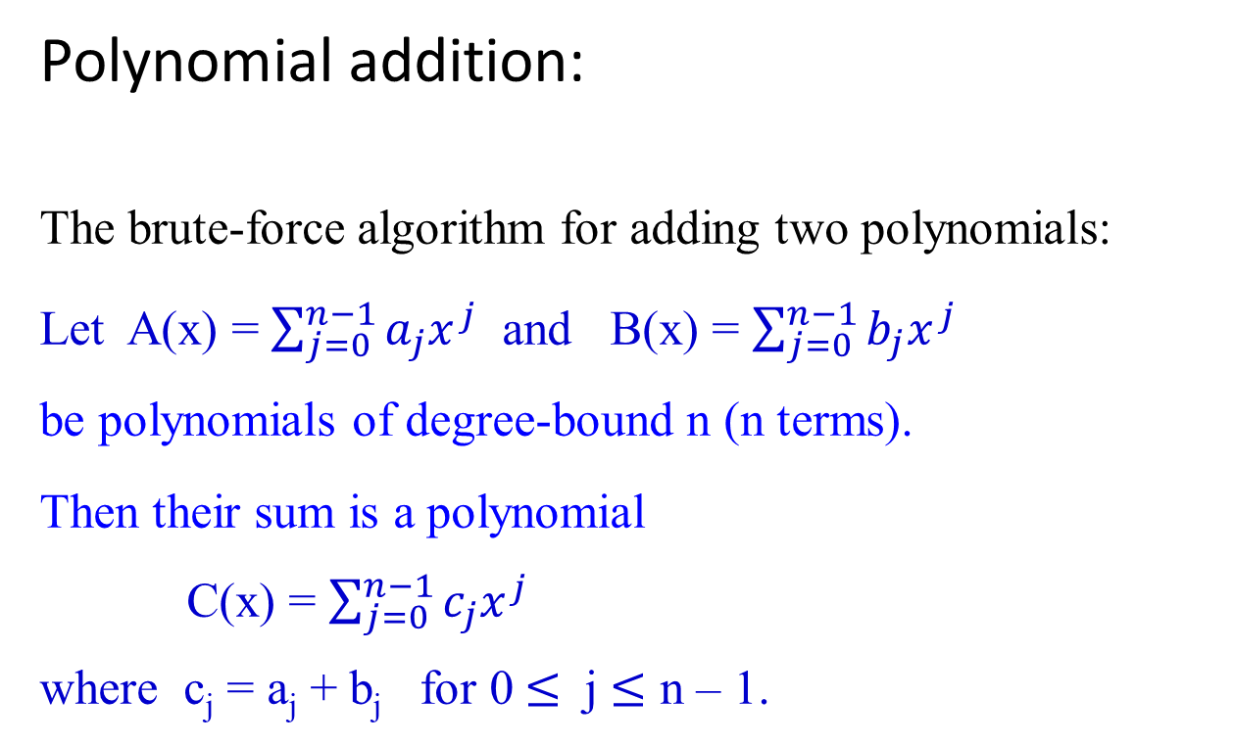
Polynomial addition:
The brute-force algorithm for adding two polynomials:
Let A(x) = $\sum_{j=0}^{n−1}{a_{j}x^{j}}$ and B(x) = $\sum_{j=0}^{n−1}{b_{j}x^{j}}$
be polynomials of degree-bound n (n terms).
Then their sum is a polynomial
C(x) = $\sum_{j=0}^{n−1}{c_{j}x^{j}}$
where c_{j} = a_{j} + b_{j} for 0 $≤$ j $≤$ n – 1.

Slide 11
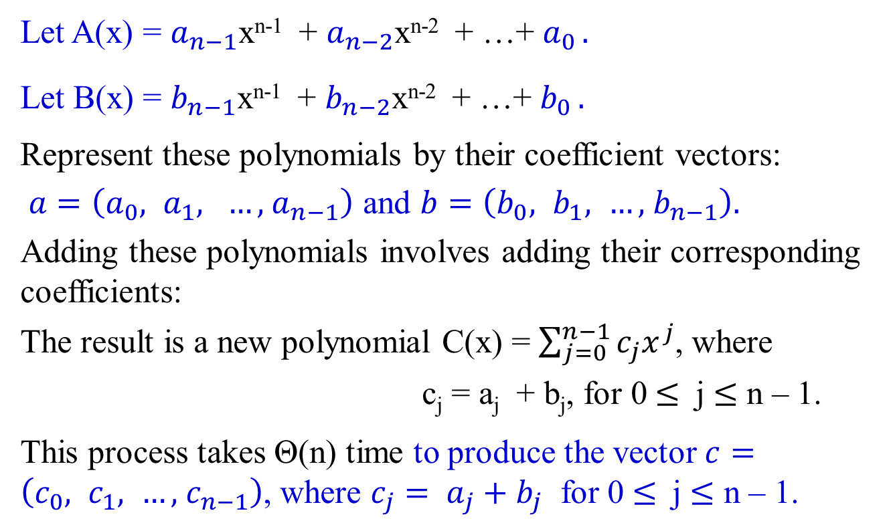
Polynomial addition: Illustration
Let A(x) = $a_{n−1}$x^{n-1} + $a_{n−2}$x^{n-2} + …+ $a_{0 }.$
Let B(x) = $b_{n−1}$x^{n-1} + $b_{n−2}$x^{n-2} + …+ $b_{0 }.$
Represent these polynomials by their coefficient vectors:
$a=\left(a_{0}, a_{1}, …, { a}_{n−1}\right)$ and $b=\left(b_{0}, b_{1}, …, { b}_{n−1}\right).$
Adding these polynomials involves adding their corresponding coefficients:
The result is a new polynomial C(x) = $\sum_{j=0}^{n−1}{c_{j}x^{j}}$, where
c_{j} = a_{j} + b_{j}, for 0 $≤$ j $≤$ n – 1.
This process takes Θ(n) time to produce the vector $c=\left(c_{0}, c_{1}, …, { c}_{n−1}\right)$, where $c_{j}= a_{j}+b_{j}$ for 0 $≤$ j $≤$ n – 1.

Slide 12
Polynomial addition:
Example 2.18:
A(x) = 6x³ + 7x² - 10x + 9 i.e., ( 9, -10, 7, 6)
B(x) = -2x³ + 4x - 5 + i.e., (-5, 4, 0, -2)
C(x) = 4x³ + 7x² - 6x + 4. i.e., (9+(-5), (-10)+4, 7+0, 6+(-2))
encoded using 2’ complement as strings of 0 and 1 with 1 in the sign bit

Slide 13

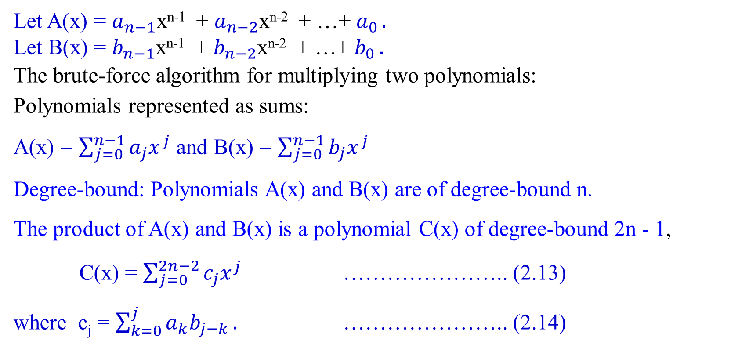
Polynomial multiplication:
Let A(x) = $a_{n−1}$x^{n-1} + $a_{n−2}$x^{n-2} + …+ $a_{0 }.$
Let B(x) = $b_{n−1}$x^{n-1} + $b_{n−2}$x^{n-2} + …+ $b_{0 }.$
The brute-force algorithm for multiplying two polynomials:
Polynomials represented as sums:
A(x) = $\sum_{j=0}^{n−1}{a_{j}x^{j}}$ and B(x) = $\sum_{j=0}^{n−1}{b_{j}x^{j}}$
Degree-bound: Polynomials A(x) and B(x) are of degree-bound n.
The product of A(x) and B(x) is a polynomial C(x) of degree-bound 2n - 1,
C(x) = $\sum_{j=0}^{2n−2}{c_{j}x^{j}}$ ………………….. (2.13)
where c_{j} = $\sum_{k=0}^{j}{a_{k}b_{j−k}}.$ ………………….. (2.14)

Slide 14
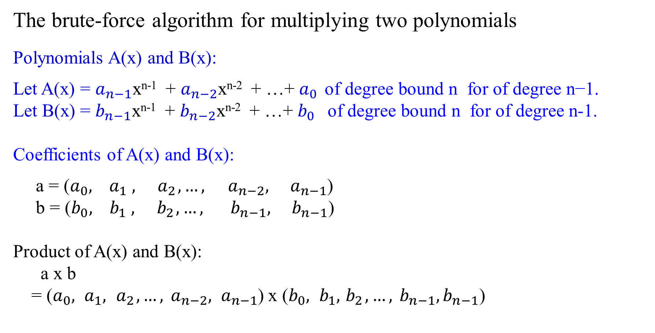
The brute-force algorithm for multiplying two polynomials
Polynomials A(x) and B(x):
Let A(x) = $a_{n−1}$x^{n-1} + $a_{n−2}$x^{n-2} + …+ $a_{0 } \text{of} \text{degree} \text{bound} \text{n} \text{for} \text{of} \text{degree} \text{n}\text{−1}$.
Let B(x) = $b_{n−1}$x^{n-1} + $b_{n−2}$x^{n-2} + …+ $b_{0 }$ of degree bound n for of degree n-1.
Coefficients of A(x) and B(x):
a = ($a_{0}, { a}_{1},{ a}_{2},…, {{ a}_{n−2}, a}_{n−1}$)
b = ($b_{0}, { b}_{1},{ b}_{2},…, {{ b}_{n−1}, b}_{n−1}$)
Product of A(x) and B(x):
a x b
= ($a_{0}, a_{1},{ a}_{2},…, {{ a}_{n−2}, a}_{n−1}$) x ($b_{0}, b_{1},{ b}_{2},…, {{ b}_{n−1}, b}_{n−1}$)

Slide 15
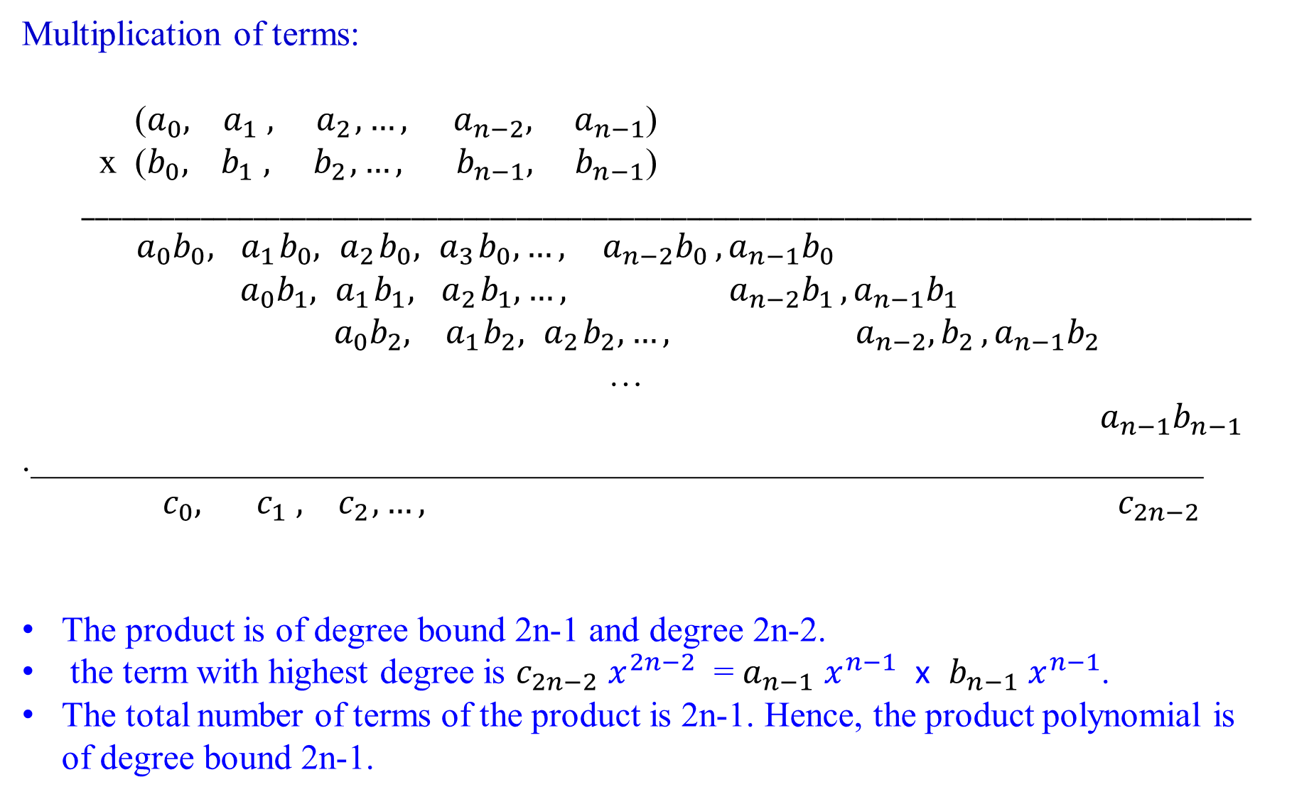
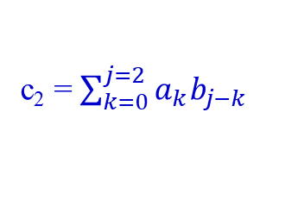
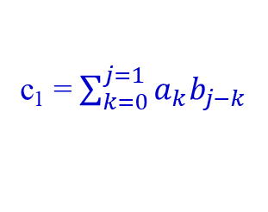
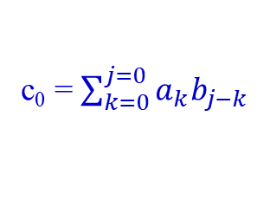
Multiplication of terms:
($a_{0}, { a}_{1},{ a}_{2},…, {{ a}_{n−2}, a}_{n−1}$)
x ($b_{0}, { b}_{1},{ b}_{2},…, {{ b}_{n−1}, b}_{n−1}$) $_________________________________________________________________________________________$
$a_{0}b_{0},{ a}_{1}b_{0},{ a}_{2}b_{0},{ a}_{3}b_{0},…, {{ a}_{n−2}b_{0 }, a}_{n−1}b_{0}$
$${ a}_{0}b_{1},{ a}_{1}b_{1},{ a}_{2}b_{1}, …, {{ a}_{n−2}b_{1 }, a}_{n−1}b_{1}$$
$${ a}_{0}b_{2},{ a}_{1}b_{2},{ a}_{2}b_{2}, …, {{ a}_{n−2},b_{2 }, a}_{n−1}b_{2}$$
…
${ a}_{n−1}b_{n−1}$
.__________________________________________________________________${ c}_{0}, { c}_{1},{ c}_{2},…, { c}_{2n−2}$
The product is of degree bound 2n-1 and degree 2n-2.
the term with highest degree is $c_{2n−2}$ $x^{2n−2}$ = $a_{n−1}$ $x^{n−1}$ x $b_{n−1}$ $x^{n−1}$.
The total number of terms of the product is 2n-1. Hence, the product polynomial is of degree bound 2n-1.
c₀ = $\sum_{k=0}^{j=0}{a_{k}b_{j−k} }$
c₁ = $\sum_{k=0}^{j=1}{a_{k}b_{j−k} }$
c₂ = $\sum_{k=0}^{j=2}{a_{k}b_{j−k} }$

Slide 16
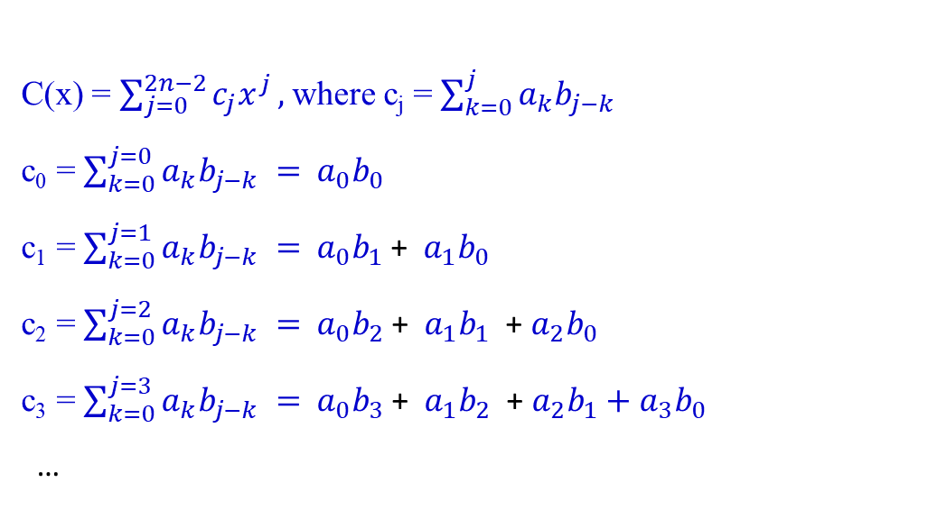
A and B are degree-bound n.
i.e., each of A and B has n=4 terms.
They are of degree n-1 which is 3.
Their product is of degree-bound 2n-1.
e.g.,the product A*B has 7 terms.
It is of degree 2n-2 (i.e., 6).
C(x) = $\sum_{j=0}^{2n−2}{c_{j}x^{j}},$where c_{j} = $\sum_{k=0}^{j}{a_{k}b_{j−k} }$
c₀ = $\sum_{k=0}^{j=0}{a_{k}b_{j−k} }=$ $a_{0}b_{0}$
c₁ = $\sum_{k=0}^{j=1}{a_{k}b_{j−k} }=$ $a_{0}b_{1}$ + $a_{1}b_{0}$
c₂ = $\sum_{k=0}^{j=2}{a_{k}b_{j−k} }=$ $a_{0}b_{2}$ + $a_{1}b_{1}$ + $a_{2}b_{0}$
c₃ = $\sum_{k=0}^{j=3}{a_{k}b_{j−k} }=$ $a_{0}b_{3}$ + $a_{1}b_{2}$ + $a_{2}b_{1}+a_{3}b_{0}$
…
Example 2.19
6x³ + 7x² - 10x + 9
- 2x³ + 0x² + 4x - 5
- 30x³ - 35x² + 50x - 45
- 24x⁴ - 28x³ - 40x² - 36x
+ 0x⁵ + 0x⁴ + 0x³ + 0x²
- 12x⁶ - 14x⁵ + 20x⁴ - 18x³ .
- 12x⁶ - 14x⁵ + 44x⁴ - 20x³ - 75x² + 86x - 45

Slide 17

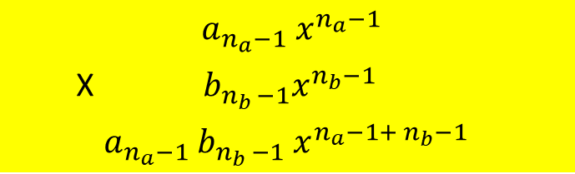

Polynomial multiplication:
${ a_{n_{a}−1} x}^{n_{a}−1}$ * $b_{n_{b −1}}x^{n_{b}−1}$
$${ a_{n_{a}−1} x}^{n_{a}−1}$$
X $b_{n_{b }−1}x^{n_{b}−1}$
${ a}_{n_{a}−1}$ $b_{n_{b }−1}$ $x^{{n_{a}−1+ n}_{b}−1}$
i.e., (n_{a} – 1) + (n_{b} – 1) = n_{a} + n_{b} – 2
Degrees of A(x) and B(x):
Let A(x) be a polynomial of degree n_{a} - 1 (therefore, degree-bound n_{a}).
Let B(x) be a polynomial of degree n_{b} - 1 (therefore, degree-bound n_{b}).
Degree of the product polynomial C(x):
For C = A * B, degree(C) = degree(A) + degree(B).
Therefore, degree(C) = (n_{a} - 1) + (n_{b} – 1) = n_{a} + n_{b} – 2.
Degree-bound of the product polynomial C(x):
C(x) is a polynomial of degree-bound n_{a} + n_{b} – 1. (i.e., terms???).
Since a polynomial of degree-bound k is also a polynomial of degree-bound k + 1, then the product polynomial C(x) is a polynomial of degree-bound n_{a} + n_{b}.
C(x) has a degree-bound of n_{a} + n_{b} – 1, which can be extended to n_{a} + n_{b}.

Slide 18
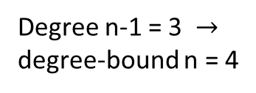
Degree n-1 = 3 $→$ degree-bound n = 4
Example 2.20
a₃ x³ + a₂ x² + a₁ x¹ + a₀ x⁰
* b₃ x³ + b₂ x² + b₁ x¹ + b₀ x⁰
a₃b₀ x³ + a₂b₀ x² + a₁b₀ x¹ + a₀b₀ x⁰
a₃b₁ x⁴ + a₂b₁ x³ + a₁b₁ x² + a₀b₁ x¹
a₃b₂ x⁵ + a₂b₂ x⁴ + a₁b₂ x³ + a₀b₂ x²
a₃b₃ x⁶ + a₂b₃ x⁵ + a₁b₃ x⁴ + a₀b₃ x³
a₃b₃ x⁶ + (a₃b₂ + a₂b₃) x⁵ + (a₃b₁ + a₂b₂ + a₁b₃ ) x⁴ + (a₃b₀ + a₂b₁ + a₁b₂+ a₀b₃ ) x³ + (a₂b₀+ a₁b₁+ a₀b₂) x² + (a₁b₀ + a₀b₁) x¹ + a₀b₀ x⁰
Degree bound is 7
n = 4
16 = 4² multiplications (in general multiplying two polynomials, each of degree-bounded n, requires n² ) plus 15 additions

Slide 19
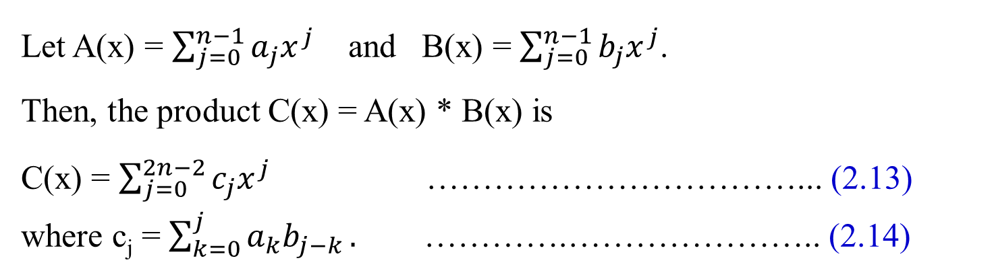
Polynomial multiplication:
Let A(x) = $\sum_{j=0}^{n−1}{a_{j}x^{j}}$ and B(x) = $\sum_{j=0}^{n−1}{b_{j}x^{j}}$.
Then, the product C(x) = A(x) * B(x) is
C(x) = $\sum_{j=0}^{2n−2}{c_{j}x^{j}}$ ……………………………... (2.13)
where c_{j} = $\sum_{k=0}^{j}{a_{k}b_{j−k}}.$ ………….………………….. (2.14)

Slide 20
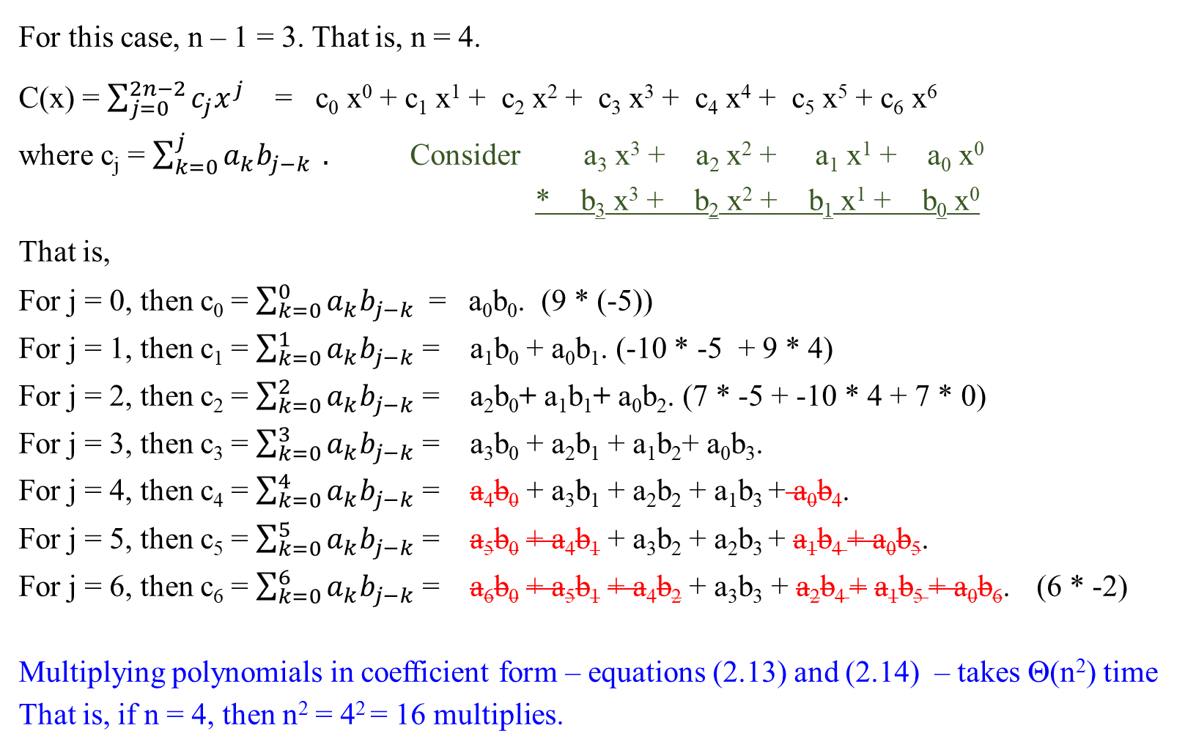
Polynomial multiplication:
For this case, n – 1 = 3. That is, n = 4.
C(x) = $\sum_{j=0}^{2n−2}{c_{j}x^{j}}$ = c₀ x⁰ + c₁ x¹ + c₂ x² + c₃ x³ + c₄ x⁴ + c₅ x⁵ + c₆ x⁶
where c_{j} = $\sum_{k=0}^{j}{a_{k}b_{j−k}} .$ Consider a₃ x³ + a₂ x² + a₁ x¹ + a₀ x⁰
* b₃ x³ + b₂ x² + b₁ x¹ + b₀ x⁰
That is,
For j = 0, then c₀ = $\sum_{k=0}^{0}{a_{k}b_{j−k}}$ = a₀b₀. (9 * (-5))
For j = 1, then c₁ = $\sum_{k=0}^{1}{a_{k}b_{j−k}}$ = a₁b₀ + a₀b₁. (-10 * -5 + 9 * 4)
For j = 2, then c₂ = $\sum_{k=0}^{2}{a_{k}b_{j−k}}$ = a₂b₀+ a₁b₁+ a₀b₂. (7 * -5 + -10 * 4 + 7 * 0)
For j = 3, then c₃ = $\sum_{k=0}^{3}{a_{k}b_{j−k}}$ = a₃b₀ + a₂b₁ + a₁b₂+ a₀b₃.
For j = 4, then c₄ = $\sum_{k=0}^{4}{a_{k}b_{j−k}}$ = a₄b₀ + a₃b₁ + a₂b₂ + a₁b₃ + a₀b₄.
For j = 5, then c₅ = $\sum_{k=0}^{5}{a_{k}b_{j−k}}$ = a₅b₀ + a₄b₁ + a₃b₂ + a₂b₃ + a₁b₄ + a₀b₅.
For j = 6, then c₆ = $\sum_{k=0}^{6}{a_{k}b_{j−k}}$ = a₆b₀ + a₅b₁ + a₄b₂ + a₃b₃ + a₂b₄ + a₁b₅ + a₀b₆. (6 * -2)
Multiplying polynomials in coefficient form – equations (2.13) and (2.14) – takes Θ(n²) time That is, if n = 4, then n² = 4² = 16 multiplies.

Slide 21
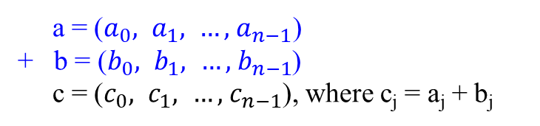
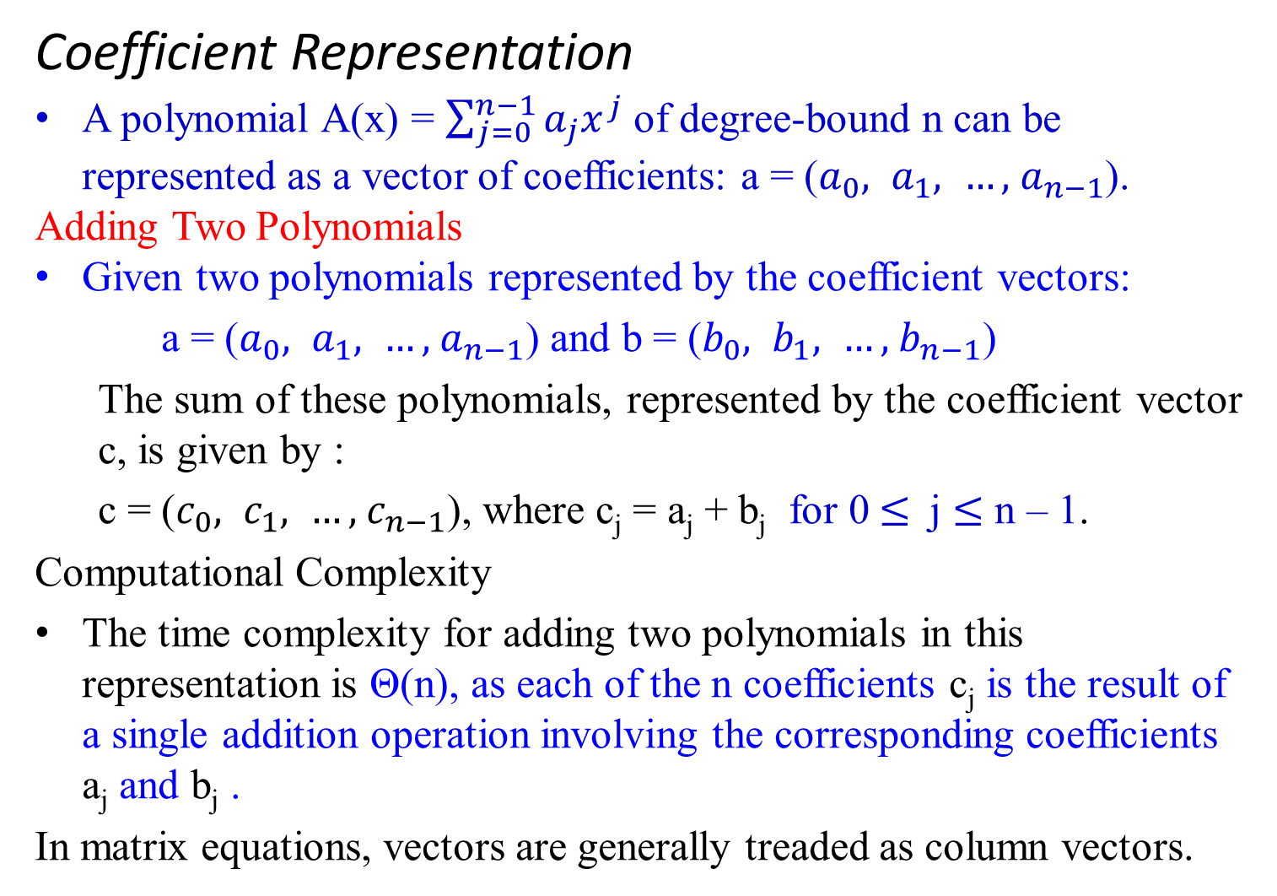
a = ($a_{0}, a_{1}, …, { a}_{n−1}$)
+ b = ($b_{0}, b_{1}, …, { b}_{n−1}$)
c = ($c_{0}, c_{1}, …, { c}_{n−1}$), where c_{j} = a_{j} + b_{j}
Coefficient Representation
A polynomial A(x) = $\sum_{j=0}^{n−1}{a_{j}x^{j}}$ of degree-bound n can be represented as a vector of coefficients: a = ($a_{0}, a_{1}, …, { a}_{n−1}$).
Adding Two Polynomials
Given two polynomials represented by the coefficient vectors:
a = ($a_{0}, a_{1}, …, { a}_{n−1}$) and b = ($b_{0}, b_{1}, …, { b}_{n−1}$)
  The sum of these polynomials, represented by the coefficient vector c, is given by :
  c = ($c_{0}, c_{1}, …, { c}_{n−1}$), where c_{j} = a_{j} + b_{j} for 0 $≤$ j $≤$ n – 1.
  Computational Complexity
  The time complexity for adding two polynomials in this representation is Θ(n), as each of the n coefficients c_{j} is the result of a single addition operation involving the corresponding coefficients a_{j} and b_{j} .
  In matrix equations, vectors are generally treaded as column vectors.

Slide 22

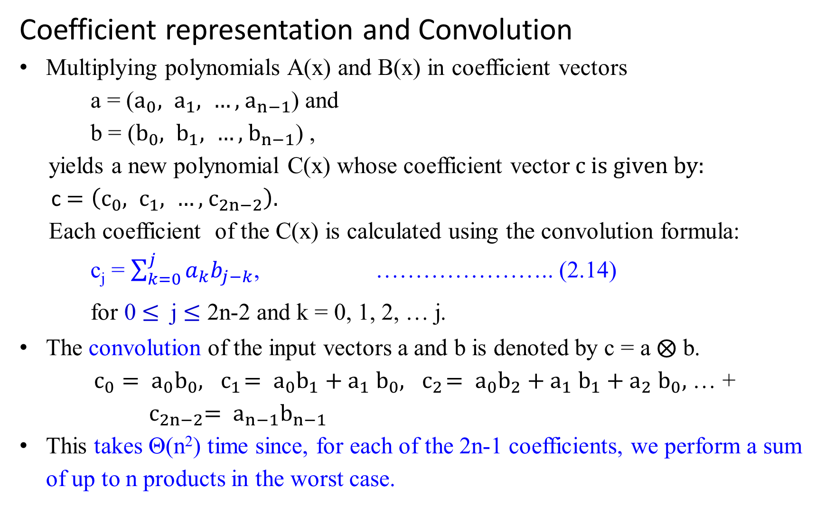
Coefficient representation and Convolution
Multiplying polynomials A(x) and B(x) in coefficient vectors
    a = ($a_{0}, a_{1}, …, { a}_{n−1}$) and
    b = ($b_{0}, b_{1}, …, { b}_{n−1}$) ,
yields a new polynomial C(x) whose coefficient vector $c is given by:$
c $=\left(c_{0}, c_{1}, …, { c}_{2n−2}\right).$
Each coefficient of the C(x) is calculated using the convolution formula:
c_{j} = $\sum_{k=0}^{j}{a_{k}b_{j−k}}$, ………………….. (2.14)
for 0 $≤$ j $≤$ 2n-2 and k = 0, 1, 2, … j.
The convolution of the input vectors a and b is denoted by c = a $⨂$ b.
$c_{0}= a_{0}b_{0}, { c}_{1}= a_{0}b_{1}{+ a}_{1}b_{0}, { c}_{2}= a_{0}b_{2}{+ a}_{1}b_{1}{+ a}_{2}b_{0},$ … +
${ c}_{2n−2}= a_{n−1}b_{n−1}$
This takes Θ(n²) time since, for each of the 2n-1 coefficients, we perform a sum of up to n products in the worst case.

Slide 23
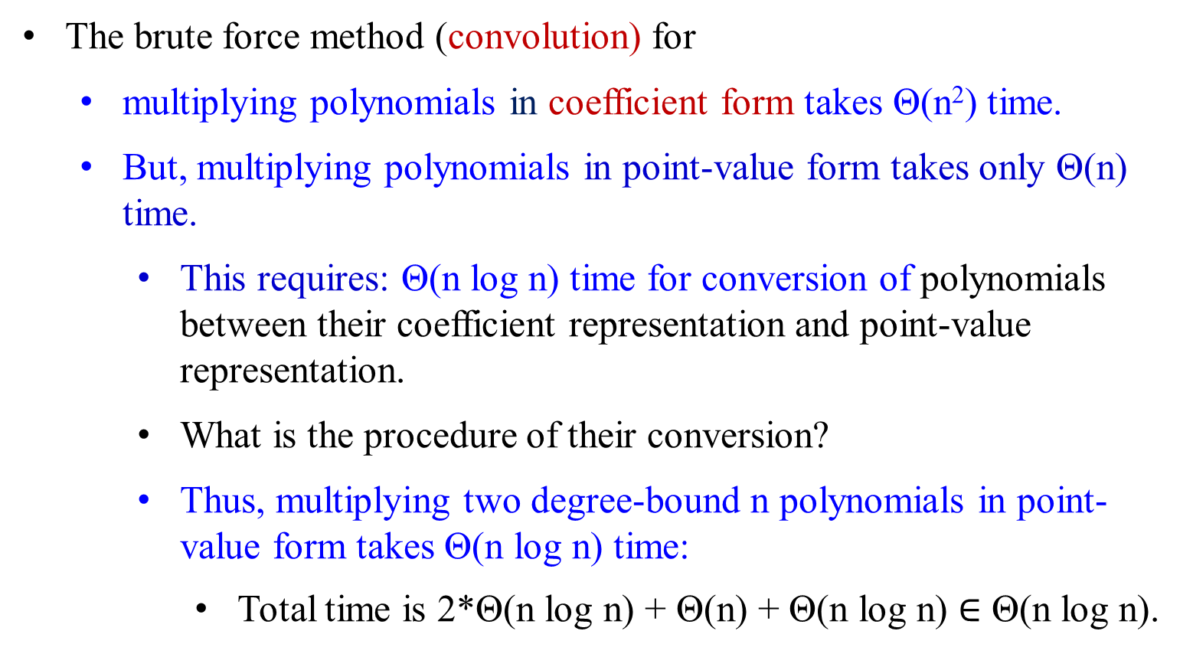
Polynomial multiplication:
The brute force method (convolution) for
  multiplying polynomials in coefficient form takes Θ(n²) time.
  But, multiplying polynomials in point-value form takes only Θ(n) time.
    This requires: Θ(n log n) time for conversion of polynomials between their coefficient representation and point-value representation.
    What is the procedure of their conversion?
    Thus, multiplying two degree-bound n polynomials in point-value form takes Θ(n log n) time:
      Total time is 2*Θ(n log n) + Θ(n) + Θ(n log n) $∈$ Θ(n log n).

Slide 24
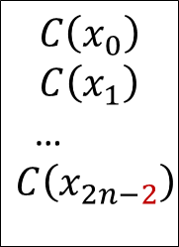
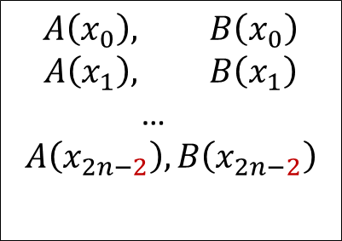
Comment: for x³, If n-1=3, then n=4 terms for x⁶, if 2n-2=6, then 2n-1=7 terms
a₀ , a₁, …, a_{n-1}
b₀ , b₁, …, b_{n-1}
Ordinary
Multiplication
Time Θ(n²)
c₀ , c₁, …, c_{2n-2}
Coefficient
representation
convolution
Evaluation Interpolation
Time Θ(n²), Time Θ(n²)
using Horner Rule using Lagrange’s formula
$$A\left(x_{0}\right), B\left(x_{0}\right)$$
$$A\left(x_{1}\right), B\left(x_{1}\right)$$
…
$$A\left(x_{2n−2}\right), B\left(x_{2n−2}\right)$$
Pointwise multiplication
$$C\left(x_{0}\right)$$
$$C\left(x_{1}\right)$$
…
$$C\left(x_{2n−2}\right)$$
Point-value
multiplication
Time Θ(n)
Polynomial multiplication:

Slide 25

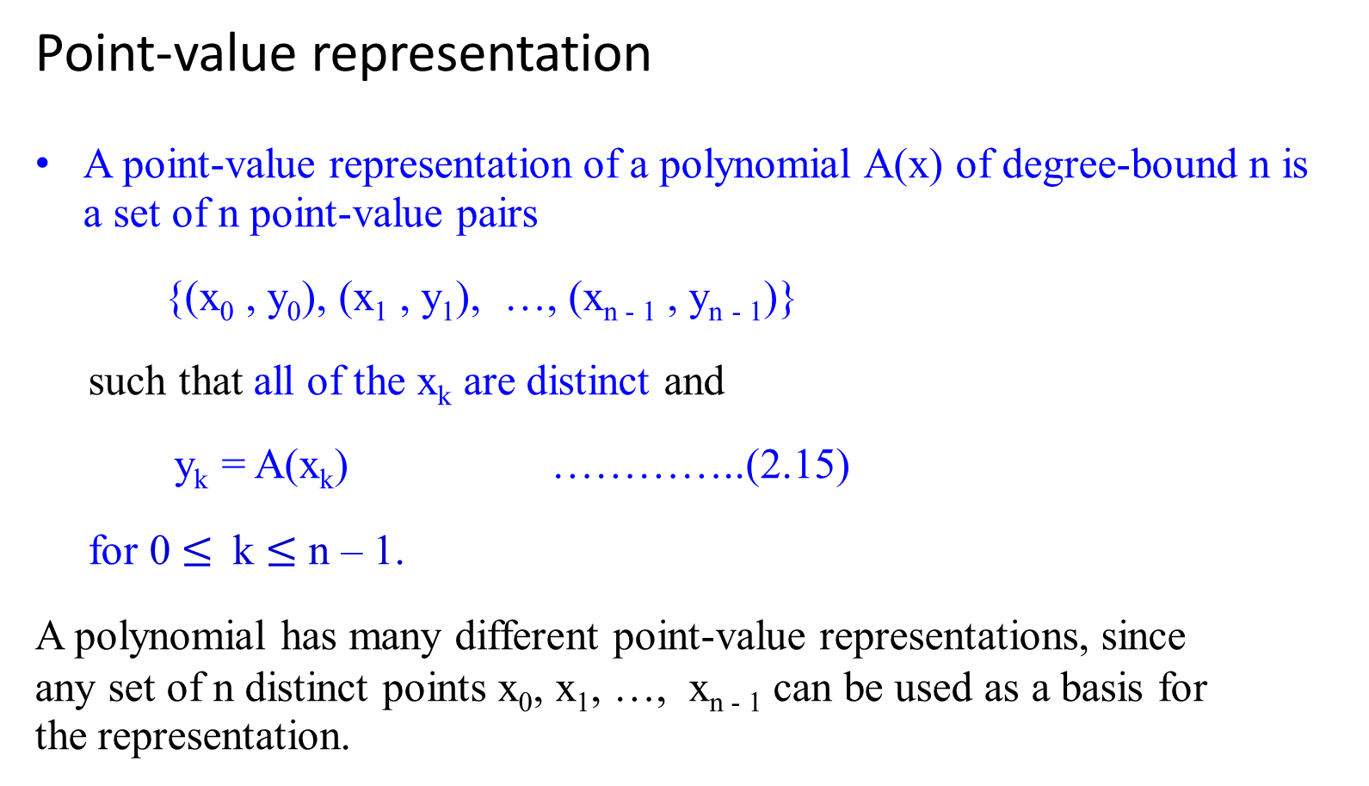
Point-value representation
A point-value representation of a polynomial A(x) of degree-bound n is a set of n point-value pairs
{(x₀ , y₀), (x₁ , y₁), …, (x_{n - 1} , y_{n - 1})}
such that all of the x_{k} are distinct and
y_{k} = A(x_{k}) …………..(2.15)
for 0 $≤$ k $≤$ n – 1.
A polynomial has many different point-value representations, since any set of n distinct points x₀, x₁, …, x_{n - 1} can be used as a basis for the representation.
y = A(x) = a₃ x³ + a₂ x² + a₁ x¹ + a₀ x⁰
y_{k} = A(x_{k}) = a₃ x_{k}³ + a₂ x_{k}² + a₁ x_{k}¹ + a₀ x_{k}⁰

Slide 26
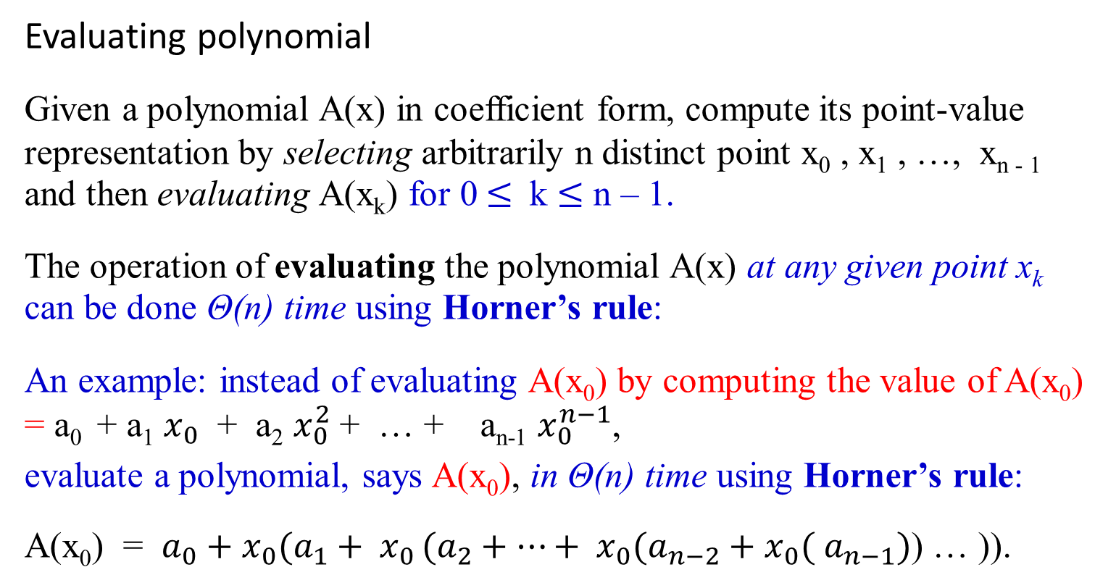
Converting between Coefficient form and Point-value Representation
Evaluating polynomial
Given a polynomial A(x) in coefficient form, compute its point-value representation by selecting arbitrarily n distinct point x₀ , x₁ , …, x_{n - 1} and then evaluating A(x_{k}) for 0 $≤$ k $≤$ n – 1.
The operation of evaluating the polynomial A(x) at any given point x_{k} can be done Θ(n) time using Horner’s rule:
An example: instead of evaluating A(x₀) by computing the value of A(x₀) = a₀ + a₁ $x_{0}$ + a₂ $x_{0}^{2}$ + … + a_{n-1} $x_{0}^{n−1}$,
evaluate a polynomial, says A(x₀), in Θ(n) time using Horner’s rule:
A(x₀) = $a_{0}+x_{0}(a_{1}+ x_{0 }(a_{2}+…+ x_{0}(a_{n−2}+x_{0}( a_{n−1})$) … )).
y_{k} = a₃ x_{k}³ + a₂ x_{k}² + a₁ x_{k}¹ + a₀ x_{k}⁰ yields y_{k} = (((a₃) x_{k} + a₂ ) x_{k} + a₁) x_{k} + a₀

Slide 27
Converting between Coefficient form and Point-value Representation
Evaluating polynomial A(x)
Using the Horner’s rule, compute the value of A(x) at a point x₀, i.e., A(x₀) in Θ(n) time.
  Then, evaluate a polynomial at n points, A(x₀), A(x₁), A(x₂), …, A(x_{n-1}) take time Θ(n²) of multiplications.
From this set of slides, let learn how to
  convert (evaluate) coefficient form to point-value form
  convert (interpolate) point-value form to coefficient form, using Lagrange’s formula) .
We shall see later that if we choose the points x_{k} cleverly, this computation can be accelerated to run in time Θ(n log n).

Slide 28
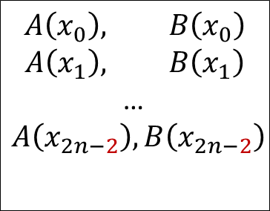
Comment: for x³, If n-1=3, then n=4 terms for x⁶, if 2n-1=6, then 2n=7 terms
a₀ , a₁, …, a_{n-1}
b₀ , b₁, …, b_{n-1}
Ordinary
Multiplication
Time Θ(n²)
convolution
c₀ , c₁, …, c_{2n-2}
Coefficient
representation
Evaluation Interpolation
Time Θ(n²), Time Θ(n²)
using Horner Rule using Lagrange’s formula
$$A\left(x_{0}\right), B\left(x_{0}\right)$$
$$A\left(x_{1}\right), B\left(x_{1}\right)$$
…
$$A\left(x_{2n−2}\right), B\left(x_{2n−2}\right)$$
$$C\left(x_{0}\right)$$
$$C\left(x_{1}\right)$$
…
$$C\left(x_{2n−2}\right)$$
Pointwise multiplication
Point-value
multiplication
Time Θ(n)
To compute A*B

Slide 29
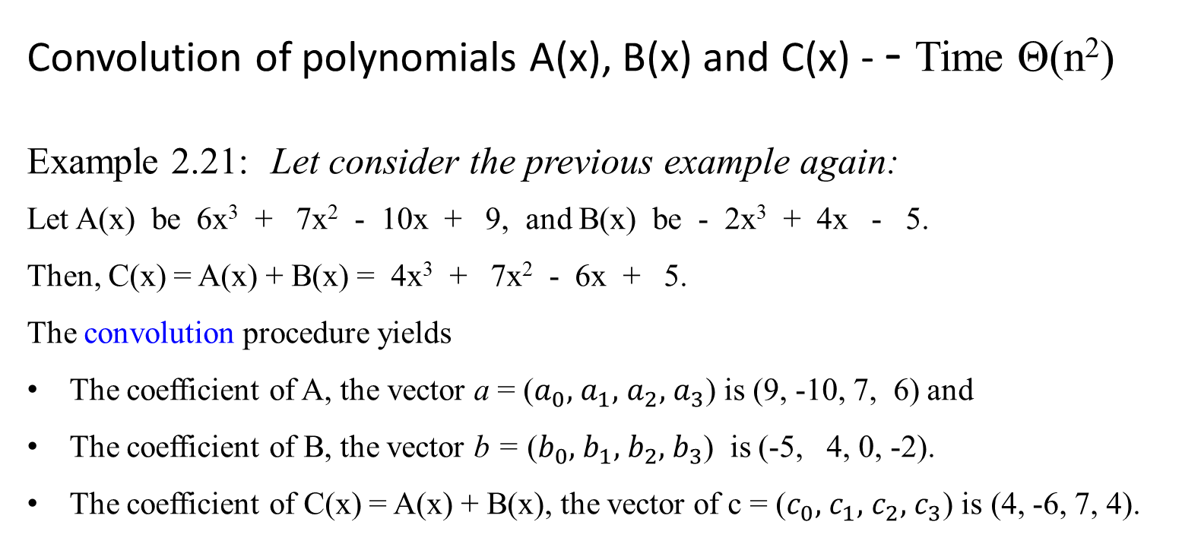
Converting between Coefficient form and Point-value Representation
Convolution of polynomials A(x), B(x) and C(x) - - Time Θ(n²)
Example 2.21: Let consider the previous example again:
Let A(x) be 6x³ + 7x² - 10x + 9, and B(x) be - 2x³ + 4x - 5.
Then, C(x) = A(x) + B(x) = 4x³ + 7x² - 6x + 5.
The convolution procedure yields
The coefficient of A, the vector a = ($a_{0},$ $a_{1},$ $a_{2},$ $a_{3}$) is (9, -10, 7, 6) and
The coefficient of B, the vector b = ($b_{0},$ $b_{1},$ $b_{2},$ $b_{3}$) is (-5, 4, 0, -2).
The coefficient of C(x) = A(x) + B(x), the vector of c = ($c_{0},$ $c_{1},$ $c_{2},$ $c_{3}$) is (4, -6, 7, 4).
Convo lut
ion

Slide 30

Evaluating polynomials A(x), B(x) and C(x)
Let A(x) be 6x³ + 7x² - 10x + 9, and B(x) be - 2x³ + 4x - 5.
Then, C(x) = A(x) + B(x) = 4x³ + 7x² - 6x + 5.
Using Horner’s rule, their point-value representations can be computed by:
A(x₀) = $9 + x_{0}(−10+ x_{0 }(7 + x_{0}(6$))), and
B(x₀) = $−5 + x_{0}(4+ x_{0 }(0 + x_{0}(−2$))).
Since the polynomial A(x) of degree-bound 4, a set of 4 point-value pairs is needed for the summation of A(x) and B(x):
Pick arbitrarily x₀ = {0, 1, 2, 3}. Then
A(0) = 9, A(1) = 12, A(2) = 65, A(3) = 204, and
B(0) = -5, B(1) = -3, B(2) = -13, B(3) = -47.
Evaluation
x | A(x) | B(x) | C(x) = A(x) + B(x)
0 | 9 | -5 | 4
1 | 12 | -3 | 9
2 | 65 | -13 | 52
3 | 204 | -47 | 157
Point-value representations of A(x) is {(0, 9), (1, 12), (2, 65), (3, 204)},
of B(X) of degree-bound 4 is {(0, -5), (1, -3), (2, -13), (3, -47)}, and
of C(x) is {(0, 4), (1, 9), (2, 52), (3, 157)}
Point-value representations

Slide 31


a₀ , a₁, …, a_{n-1}
b₀ , b₁, …, b_{n-1}
Ordinary
Multiplication
Time Θ(n²)
c₀ , c₁, …, c_{2n-2}
(4, -6, 7, 4)
Coefficient
representation
(9, -10, 7, 6)
(-5, 4, 0, -2).
convolution
addition
Evaluation Interpolation
Time Θ(n²), Time Θ(n²)
using Horner Rule using Lagrange’s formula
$$A\left(x_{0}\right), B\left(x_{0}\right)$$
$$A\left(x_{1}\right), B\left(x_{1}\right)$$
…
$$A\left(x_{2n−2}\right), B\left(x_{2n−2}\right)$$
$$C\left(x_{0}\right)$$
$$C\left(x_{1}\right)$$
…
$$C\left(x_{2n−2}\right)$$
Pointwise multiplication
Point-value
multiplication
Time Θ(n)
(0, 9), (0, -5)
(1, 12), (1, -3)
(2, 65), (2, -13)
(3, 207), (3, -47)
(0, 4)
(1, 9)
(2, 52)
(3, 157)
To compute A*B

Slide 32

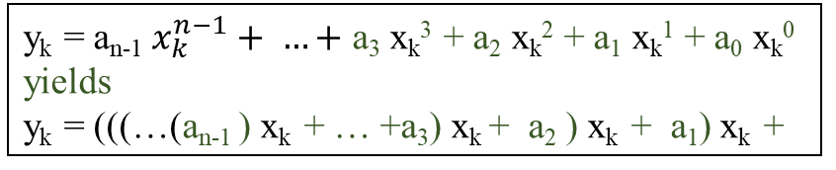
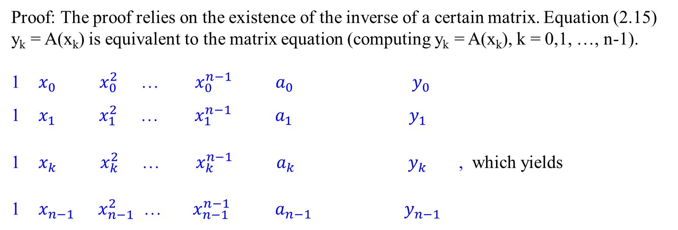

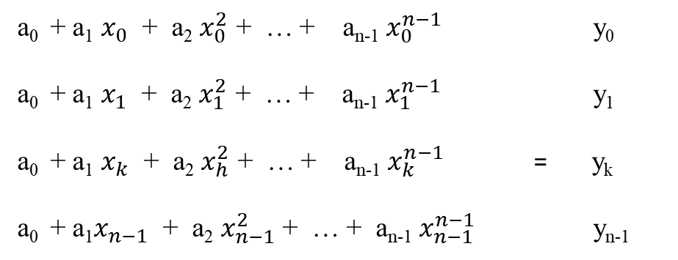
Evaluation: Another way to compute point-value representation of a polynomial
$${ x}_{k}^{0}=1{ x}_{k}^{1}=x_{k}$$
Proof: The proof relies on the existence of the inverse of a certain matrix. Equation (2.15) y_{k} = A(x_{k}) is equivalent to the matrix equation (computing y_{k} = A(x_{k}), k = 0,1, …, n-1).
1 $x_{0} { x}_{0}^{2}$ … $x_{0}^{n−1} a_{0}$ $y_{0}$
1 $x_{1} { x}_{1}^{2}$ … $x_{1}^{n−1}{ a}_{1}$ ${ y}_{1}$
1 $x_{k} { x}_{k}^{2}$ … $x_{k}^{n−1}$ ${ a}_{k}$ ${ y}_{k}$ , which yields
1 $x_{n−1} x_{n−1}^{2}$ … $x_{n−1}^{n−1}$ $a_{n−1}$ $y_{n−1}$
This takes Θ(n³).
=
a₀ + a₁ $x_{0}$ + a₂ $x_{0}^{2}$ + … + a_{n-1} $x_{0}^{n−1}$ y₀
a₀ + a₁ $x_{1}$ + a₂ $x_{1}^{2}$ + … + a_{n-1} $x_{1}^{n−1}$ y₁
a₀ + a₁ $x_{k}$ + a₂ $x_{h}^{2}$ + … + a_{n-1} $x_{k}^{n−1}$ = y_{k}
a₀ + a₁$x_{n−1}$ + a₂ $x_{n−1}^{2}$ + … + a_{n-1} $x_{n−1}^{n−1}$ y_{n-1}
(2.16)
y_{k} = a_{n-1} $x_{k}^{n−1}+ …+$ a₃ x_{k}³ + a₂ x_{k}² + a₁ x_{k}¹ + a₀ x_{k}⁰ yields
y_{k} = (((…(a_{n-1} ) x_{k} + … +a₃) x_{k} + a₂ ) x_{k} + a₁) x_{k} +

Slide 33
Example 2.22: Converting representation from point-value pairs form to coefficient form:
Consider A(x) = 6x³ + 7x² - 10x + 9 of degree-bound 4.
The coefficient form for the polynomial A(x) is (9, -10, 7, 6).
Using Horner’s rule, A(x) = 9 + x(-10 + x(7 + x(6))).
Then, compute (evaluate) A(x)’s value-point form.
Let x = {0, 1, 2, 3}.
A(0) = 9.
A(1) = 9 + 1(-10 + 1(7 + 1(6))) = 12 .
A(2) = 9 + 2(-10 + 2(7 + 2(6))) = 65.
A(3) = 9 + 3(-10 + 3(7 + 3(6))) = 204
Its value-point form (0, 9), (1, 12), (2, 65), (3, 204) is obtained.
This above evaluating A(x_{k}), k = 0, 1, 2, 3 can be done:

Slide 34
This above evaluating A(x_{k}), k = 0, 1, 2, 3 can be done:
1 0 0 0 9 9
  1 1 1 1 -10 12
  1 2 4 8 7 65
1 3 9 27 6 204
=
Evaluation : Another way to compute point-value representations from coefficient vector for polynomial A(x)
For A(x) = 6x³ + 7x² - 10x + 9 of degree-bound 4, the coefficient form for the polynomial A(x) is (9, -10, 7, 6). Let {x₀, x₀, x₀, x₀} = {0, 1, 2, 3}. its value-point form representation (0, 9), (1, 12), (2, 65), (3, 204) can be obtained.

Slide 35

Interpolating polynomial –
the inverse of evaluation (interpolation)
Interpolation - the inverse of evaluation:
determining the coefficient form of a polynomial from a point-value representation.
Theorem 2.4 (Uniqueness of an interpolating polynomial)
For any set {(x₀ , y₀), (x₁ , y₁), …, (x_{n - 1} , y_{n - 1})} of n point-value pairs such that all the x_{k} values are distinct, there is a unique polynomial A(x) of degree-bound n such that y_{k} = A(x_{k}) for k = 0, 1, 2, …, n – 1.
This Theorem shows that interpolation is well-defined when the desired interpolating polynomial must have a degree-bound equal to the given number of point-value pairs.

Slide 36

Given the point-value representation, interpolating A(x) can be done:
        0 0 0 0⁰ 0¹ 0² 0³
1 1 1 1 1⁰ 1¹ 1² 1³
1 2 4 8 2⁰ 2¹ 2² 2³
1 3 9 27 3⁰ 3¹ 3² 3³
Since det(V(x₀ , x₁ , …, x_{n - 1}) )
=$\prod_{0 ≤j<k≤n−1}{(x_{k}}− x_{j} )$
= (x₁ – x₀) (x₂ – x₀) (x₃ – x₀) (x₂ – x₁) (x₃ – x₁) (x₃ – x₂)
= (1 - 0)(2 - 0)(3 - 0)(2 - 1)(3 - 1)(3 - 2) = 1*2*3*1*2*1=12
≠ 0, it is nonsingular,
a = V(x₀ , x₁ , …, x_{n - 1})⁻¹ * y. ……2.16
V(0, 1, 2, 3) =
As j goes from 0 to 2, k is from 1 to 3.

Slide 37
That is,
a₀ 1 0 0 0 ⁻¹ 9 9
a₁ 1 1 1 1 12 -10
a₂ 1 2 4 8 65 7
a₃ 1 3 9 27 204 6
=
=
Interpolation: Another way to compute coefficient vector from point-value representations for polynomial A(x). This takes Θ(n³).

Slide 38
The proof of Theorem 2.4 describes an algorithm for interpolation based on solving the set y = V(x₀ , x₁ , …, x_{n - 1}) * a
(2.16) of linear equations. Using the LU decomposition algorithms, we can solve these equations in time Θ(n³).

Slide 39

Fast n-point interpolation algorithm – from point-value form back to coefficients
A fast algorithm for n-point interpolation is based on Lagrange’s formula:
A(x) = $\sum_{k=0}^{n−1}{y_{k}} \frac{\prod_{j≠k}{(x− x_{j})}}{\prod_{j≠k}{(x_{k}}− x_{j})}$ …………… (2.17)
The right-hand side of equation (2.17) is a polynomial of degree-bound n that satisfies A(x_{k}) = y_{k} for all k.
Compute the coefficients of A using Lagrange’s formula in time Θ(n²).
Thus, n-point evaluation and interpolation are well-defined inverse operations that transform between the coefficient representation of a polynomial and a point-value representation.
S

Slide 40


Fast n-point interpolation algorithm – from point-value form back to coefficients
Example 2.23: Example of A(x) interpolation using Lagrange formula:
Consider the polynomial A(x) = 6x³ + 7x² - 10x + 9 of degree-bound 4.
Its value-point form (0, 9), (1, 12), (2, 65), (3, 204) is obtained in example 2.22.
Then, interpolate this point-value representation of a polynomial A(x)
(0, 9), (1, 12), (2, 65), (3, 204)
to form the coefficient (9, -10, 7, 6) of the polynomial A(x) using Lagrange’s formula - (2.17):
A(x) = $\sum_{k=0}^{n−1}{y_{k}} \frac{\prod_{j≠k}{(x− x_{j})}}{\prod_{j≠k}{(x_{k}}− x_{j})}$ ………… (2.17)

Slide 41

Fast n-point interpolation algorithm – from point-value form (0, 9), (1, 12), (2, 65), (3, 204) back to coefficients
A(x) = $\sum_{k=0}^{n−1}{y_{k}} \frac{\prod_{j≠k}{(x− x_{j})}}{\prod_{j≠k}{(x_{k}}− x_{j})}$
= y₀ (x – x₁) (x – x₂) (x – x₃) + y₁ (x – x₀) (x – x₂) (x – x₃)
(x₀ – x₁) (x₀ – x₂) (x₀ – x₃) (x₁ – x₀) (x₁ – x₂) (x₁ – x₃)
+ y₂ (x – x₀) (x – x₁) (x – x₃) + y₃ (x – x₀) (x – x₁) (x – x₂)
(x₂ – x₀) (x₂ – x₁) (x₂ – x₃) (x₃ – x₀) (x₃ – x₁) (x₃ – x₂)
= y₀ (x – 1) (x – 2) (x – 3) + y₁ (x – 0) (x – 2) (x – 3)
(0 – 1) (0 – 2) (0 – 3) (1 – 0) (1 – 2) (1 – 3)
+ y₂ (x – 0) (x – 1) (x – 3) + y₃ (x – 0) (x – 1) (x – 2)
(2 – 0) (2 – 1) (2 – 3) (3 – 0) (3 – 1) (3 – 2)

Slide 42

Fast n-point interpolation algorithm – from point-value form (0, 9), (1, 12), (2, 65), (3, 204) back to coefficients
= 9 (x – 1) (x – 2) (x – 3) + 12 (x – 0) (x – 2) (x – 3)
-6 2
+ 65 (x – 0) (x – 1) (x – 3) + 204 (x – 0) (x – 1) (x – 2)
-2 6
= $\frac{−3}{2}\left(x^{3}−6x^{2}+11x−6\right) +6\left(x^{3}−5x^{2}+6x\right)− \frac{65}{2}\left(x^{3}−4x^{2}+3x\right)+ 34(x^{3}−3x^{2}+2x)$
= A(x) = 6x³ + 7x² - 10x + 9.
This takes time Θ(n²).

Slide 43
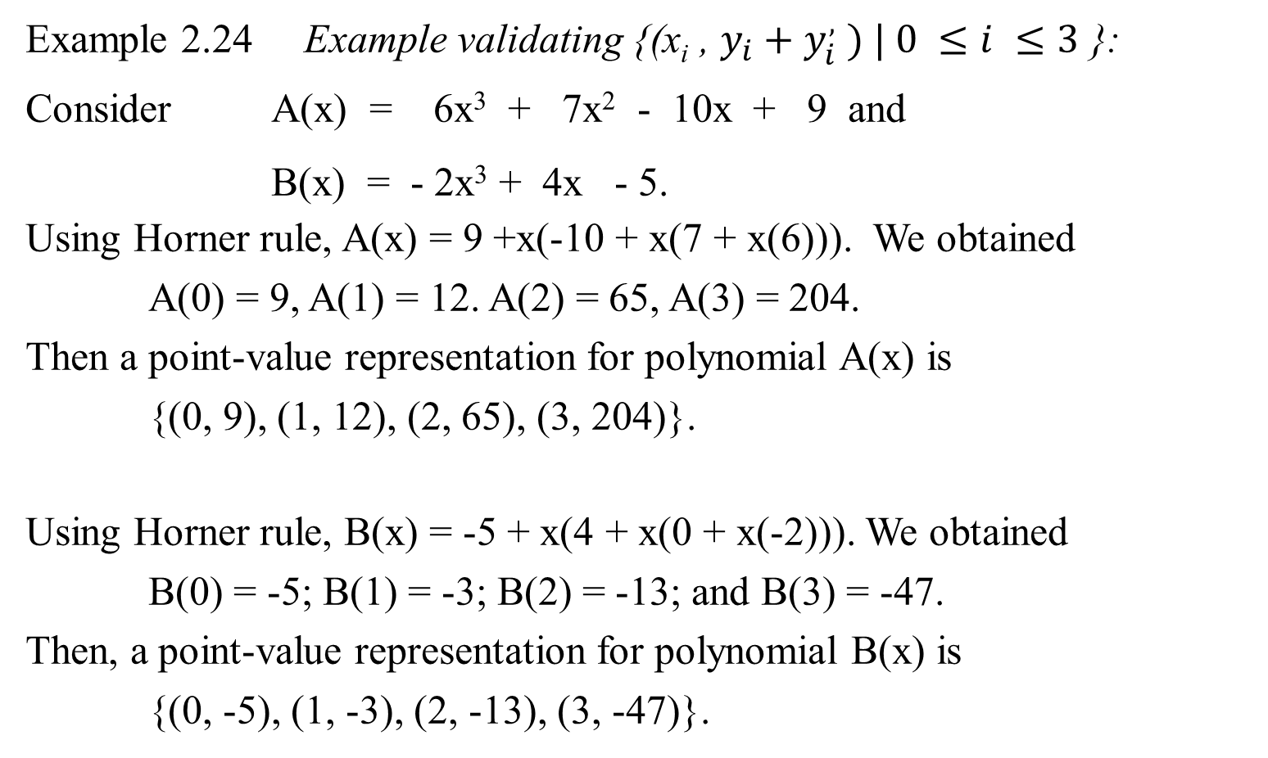
Example 2.24 Example validating {(x_{i} , $y_{i}+y_{i}^{,} ) | 0 ≤i ≤3$ }:
Consider A(x) = 6x³ + 7x² - 10x + 9 and
B(x) = - 2x³ + 4x - 5.
Using Horner rule, A(x) = 9 +x(-10 + x(7 + x(6))). We obtained
A(0) = 9, A(1) = 12. A(2) = 65, A(3) = 204.
Then a point-value representation for polynomial A(x) is
{(0, 9), (1, 12), (2, 65), (3, 204)}.
Using Horner rule, B(x) = -5 + x(4 + x(0 + x(-2))). We obtained
B(0) = -5; B(1) = -3; B(2) = -13; and B(3) = -47.
Then, a point-value representation for polynomial B(x) is
{(0, -5), (1, -3), (2, -13), (3, -47)}.
x | A(x) | B(x) | C(x)
0 | 9 | -5 | 4
1 | 12 | -3 | 9
2 | 65 | -13 | 52
3 | 204 | -47 | 157

Slide 44
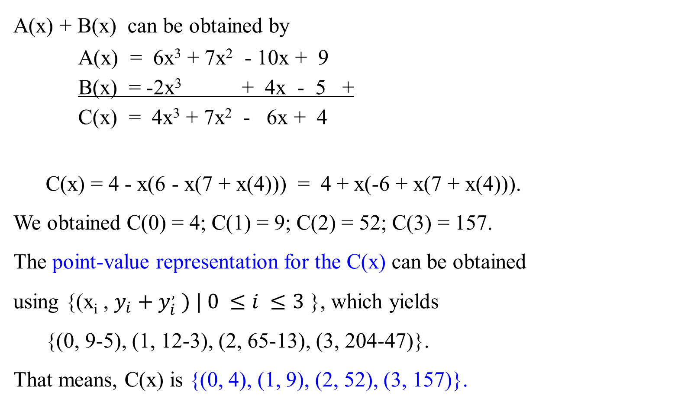
A(x) + B(x) can be obtained by
A(x) = 6x³ + 7x² - 10x + 9
B(x) = -2x³ + 4x - 5 +
C(x) = 4x³ + 7x² - 6x + 4
C(x) = 4 - x(6 - x(7 + x(4))) = 4 + x(-6 + x(7 + x(4))).
We obtained C(0) = 4; C(1) = 9; C(2) = 52; C(3) = 157.
The point-value representation for the C(x) can be obtained
using {(x_{i} , $y_{i}+y_{i}^{,} ) | 0 ≤i ≤3$ }, which yields
{(0, 9-5), (1, 12-3), (2, 65-13), (3, 204-47)}.
That means, C(x) is {(0, 4), (1, 9), (2, 52), (3, 157)}.
For simplicity, use addition to illustrate the obtained the coefficient representation C(x) , then convert to point value representation, which is the same as the result obtained through adding point values pairs.
x | A(x) | B(x) | C(x)
0 | 9 | -5 | 4
1 | 12 | -3 | 9
2 | 65 | -13 | 52
3 | 204 | -47 | 157

Slide 45

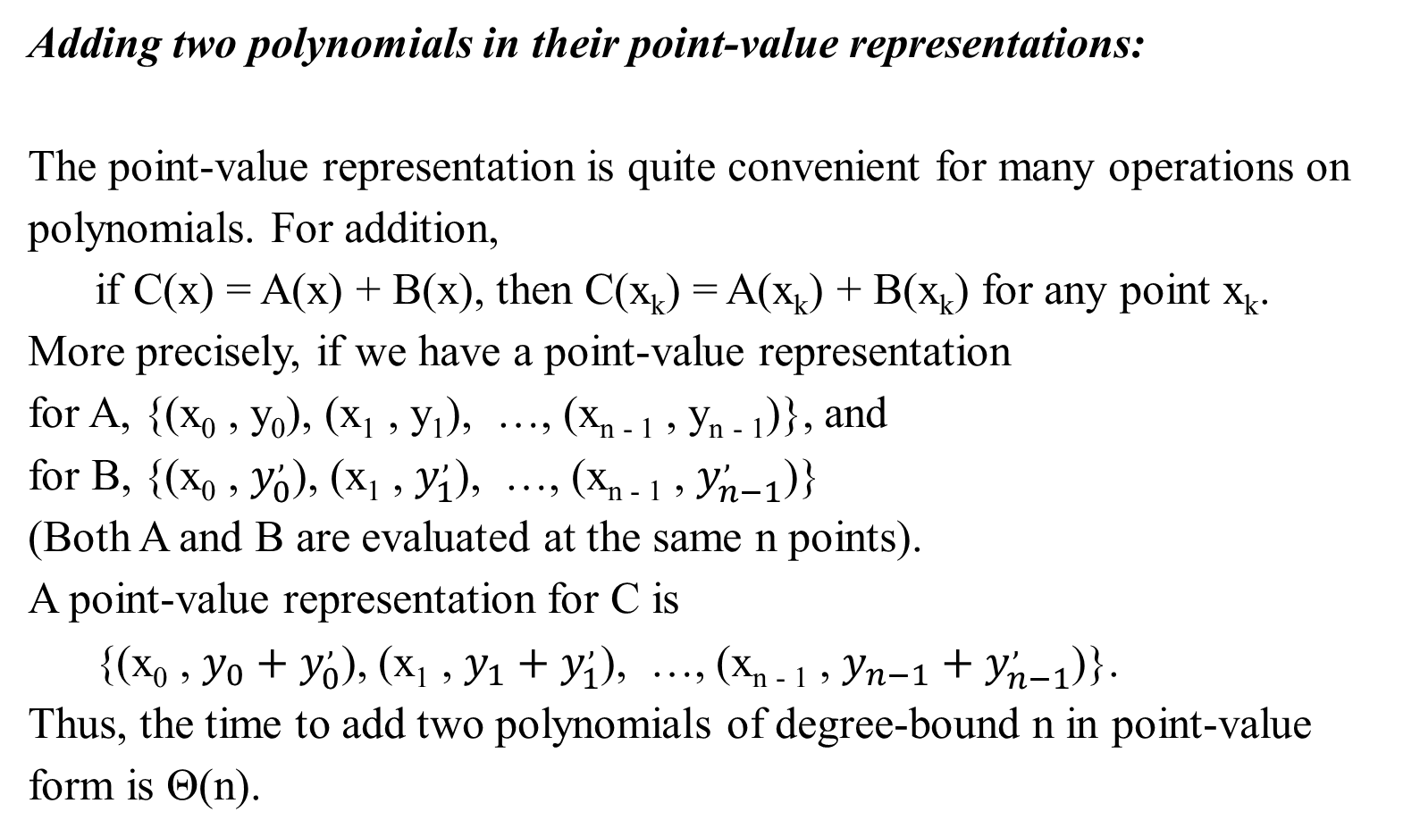
Adding two polynomials in their point-value representations:
The point-value representation is quite convenient for many operations on polynomials. For addition,
if C(x) = A(x) + B(x), then C(x_{k}) = A(x_{k}) + B(x_{k}) for any point x_{k}.
More precisely, if we have a point-value representation
for A, {(x₀ , y₀), (x₁ , y₁), …, (x_{n - 1} , y_{n - 1})}, and
for B, {(x₀ , $y_{0}^{,}$), (x₁ , $y_{1}^{,}$), …, (x_{n - 1} , $y_{n−1}^{,}$)}
(Both A and B are evaluated at the same n points).
A point-value representation for C is
{(x₀ , $y_{0}+y_{0}^{,}$), (x₁ , $y_{1}+y_{1}^{,}$), …, (x_{n - 1} , $y_{n−1}+y_{n−1}^{,}$)}.
Thus, the time to add two polynomials of degree-bound n in point-value form is Θ(n).
S

Slide 46


a₀ , a₁, …, a_{n-1}
b₀ , b₁, …, b_{n-1}
Ordinary
Multiplication
Time Θ(n²)
c₀ , c₁, …, c_{2n-2}
(4, -6, 7, 4, …)
Coefficient
representation
multiple
(9, -10, 7, 6)
(-5, 4, 0, -2).
convolution
Evaluation Interpolation
Time Θ(n²), Time Θ(n²)
using Horner Rule using Lagrange’s formula
$$A\left(x_{0}\right), B\left(x_{0}\right)$$
$$A\left(x_{1}\right), B\left(x_{1}\right)$$
…
$$A\left(x_{2n−2}\right), B\left(x_{2n−2}\right)$$
$$C\left(x_{0}\right)$$
$$C\left(x_{1}\right)$$
…
$$C\left(x_{2n−2}\right)$$
Pointwise multiplication
Point-value
multiplication
Time Θ(n)
(0, 9), (0, -5)
(1, 12), (1, -3)
(2, 65), (2, -13)
(3, 207), (3, -47)
…
(0, 4)
(1, 9)
(2, 52)
(3, 157)
…
To compute A*B

Slide 47

Multiplying two polynomials in their point-value representations:
Let A(x) = a₀ + a₁ $x_{0}$ + a₂ $x_{0}^{2}$ + … + a_{n-1} $x_{0}^{n−1}$ and
B(x) = b₀ + b₁ $x_{0}$ + b₂ $x_{0}^{2}$ + … + b_{n-1} $x_{0}^{n−1}$
An extended point-value representation for A(x) is
{(x₀ , y₀), (x₁ , y₁), …, (x_{2n - 2} , y_{2n - 2})},
and a corresponding extended point-value representation for B(x) is
{(x₀ , $y_{0}^{,}$), (x₁ , $y_{1}^{,}$), …, (x_{2n - 2} , $y_{2n−2}^{,}$)}.
Then a point-value representation for C is
{(x₀ , $y_{0}y_{0}^{,}$), (x₁ , $y_{1}y_{1}^{,}$), …, (x_{2n - 2} , $y_{2n−2}y_{2n−2}^{,}$)}.
--- 2n-1 points; i.e., degree bound 2n-1.
A(x) of degree-bound n=4 can be represented by its coefficient vector (x₀, x₁, x₂, x₃).
A(x) has an extend-represented by (x₀, x₁, x₂, x₃, x₄, x₅, x₆) of degree bound 2n-1=7.

Slide 48

The previous view graphs, we establish the corresponding point value representation and the coefficient representation are equivalent for a given polynomial expressions.
The example 2.21 shows the convolution/evaluation approach to converting the coefficient representation of a polynomial expression to its point value representation
The examples 2.22 and 2.23 show that a point value representation for a polynomial expression can be interpolated to its coefficient representation. 2.23 approach takes Θ(n²) instead of 2.22 approach takes Θ(n³).
The example 2.24 shows that the result of adding two polynomials in coefficient representation is the same result of adding their point value representations.
Now let consider the multiplying two polynomials.

Slide 49
Multiplying two polynomials in their point-value representations

Slide 50
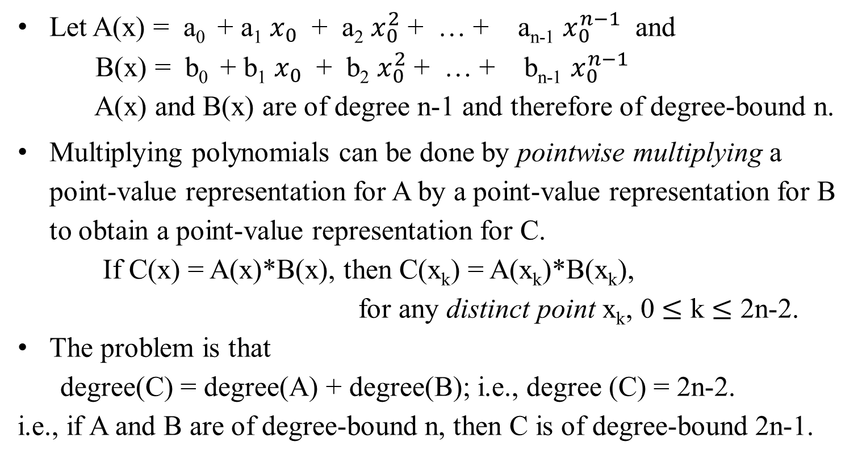
Multiplying two polynomials in their point-value representations:
S
Let A(x) = a₀ + a₁ $x_{0}$ + a₂ $x_{0}^{2}$ + … + a_{n-1} $x_{0}^{n−1}$ and
B(x) = b₀ + b₁ $x_{0}$ + b₂ $x_{0}^{2}$ + … + b_{n-1} $x_{0}^{n−1}$
A(x) and B(x) are of degree n-1 and therefore of degree-bound n.
Multiplying polynomials can be done by pointwise multiplying a point-value representation for A by a point-value representation for B to obtain a point-value representation for C.
If C(x) = A(x)*B(x), then C(x_{k}) = A(x_{k})*B(x_{k}),
for any distinct point x_{k}, 0 $≤$ k $≤$ 2n-2.
The problem is that
degree(C) = degree(A) + degree(B); i.e., degree (C) = 2n-2.
i.e., if A and B are of degree-bound n, then C is of degree-bound 2n-1.

Slide 51
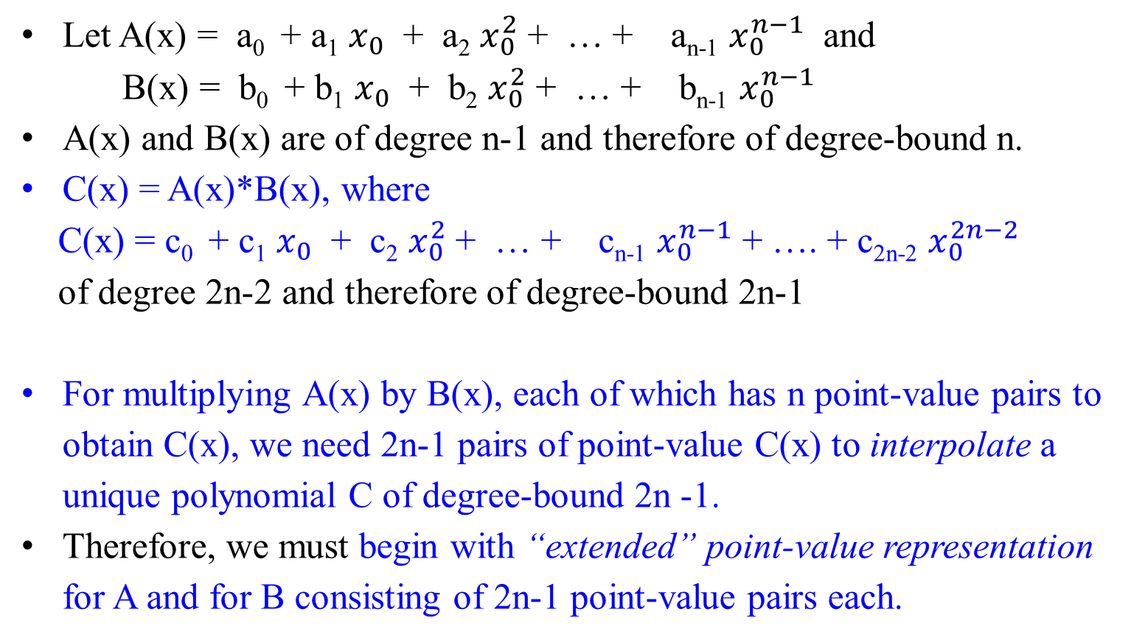
Multiplying two polynomials in their point-value representations:
S
Let A(x) = a₀ + a₁ $x_{0}$ + a₂ $x_{0}^{2}$ + … + a_{n-1} $x_{0}^{n−1}$ and
B(x) = b₀ + b₁ $x_{0}$ + b₂ $x_{0}^{2}$ + … + b_{n-1} $x_{0}^{n−1}$
A(x) and B(x) are of degree n-1 and therefore of degree-bound n.
C(x) = A(x)*B(x), where
C(x) = c₀ + c₁ $x_{0}$ + c₂ $x_{0}^{2}$ + … + c_{n-1} $x_{0}^{n−1}$ + …. + c_{2n-2} $x_{0}^{2n−2}$
of degree 2n-2 and therefore of degree-bound 2n-1
For multiplying A(x) by B(x), each of which has n point-value pairs to obtain C(x), we need 2n-1 pairs of point-value C(x) to interpolate a unique polynomial C of degree-bound 2n -1.
Therefore, we must begin with “extended” point-value representation for A and for B consisting of 2n-1 point-value pairs each.

Slide 52
Multiplying two polynomials in their point-value representations:
Let A(x) = a₀ + a₁ $x_{0}$ + a₂ $x_{0}^{2}$ + … + a_{n-1} $x_{0}^{n−1}$ and
B(x) = b₀ + b₁ $x_{0}$ + b₂ $x_{0}^{2}$ + … + b_{n-1} $x_{0}^{n−1}$
An extended point-value representation for A(x) is
{(x₀ , y₀), (x₁ , y₁), …, (x_{2n - 2} , y_{2n - 2})},
and a corresponding extended point-value representation for B(x) is
{(x₀ , $y_{0}^{,}$), (x₁ , $y_{1}^{,}$), …, (x_{2n - 2} , $y_{2n−2}^{,}$)}.
Then a point-value representation for C is
{(x₀ , $y_{0}y_{0}^{,}$), (x₁ , $y_{1}y_{1}^{,}$), …, (x_{2n - 2} , $y_{2n−2}y_{2n−2}^{,}$)}.
--- 2n-1 points; i.e., degree bound 2n-1.
A(x) of degree-bound n=4 can be represented by its coefficient vector (x₀, x₁, x₂, x₃).
A(x) has an extend-represented by (x₀, x₁, x₂, x₃, x₄, x₅, x₆) of degree bound 2n-1=7.

Slide 53
Multiplying two polynomials in their point-value representations:
Given two input polynomials in extended point-value form,
  the time (i.e., number of times) to multiply them to obtain the point-value form of the result is Θ(n),
  much less than the time required to multiply polynomials in coefficient form (which takes time Θ(n²)), using the Horner Rules method.
Now, consider how to evaluate a polynomial given in point-value form at a new point.
  For this problem, we know of no simpler approach than converting the polynomial to coefficient form first, then evaluating it at the new point.

Slide 54
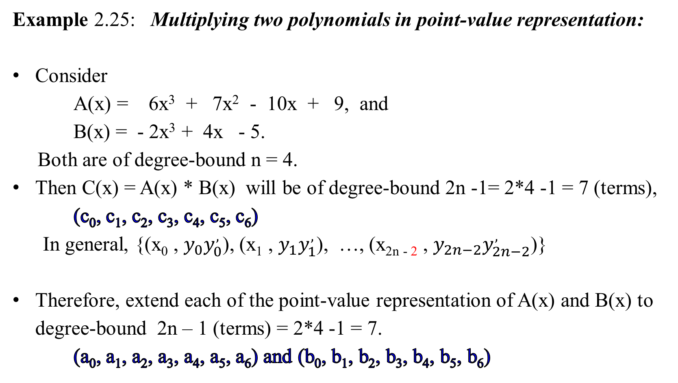
Example 2.25: Multiplying two polynomials in point-value representation:
Consider
  A(x) = 6x³ + 7x² - 10x + 9, and
  B(x) = - 2x³ + 4x - 5.
Both are of degree-bound n = 4.
Then C(x) = A(x) * B(x) will be of degree-bound 2n -1= 2*4 -1 = 7 (terms),
(c₀, c₁, c₂, c₃, c₄, c₅, c₆)
  In general, {(x₀ , $y_{0}y_{0}^{,}$), (x₁ , $y_{1}y_{1}^{,}$), …, (x_{2n - 2} , $y_{2n−2}y_{2n−2}^{,}$)}
Therefore, extend each of the point-value representation of A(x) and B(x) to degree-bound 2n – 1 (terms) = 2*4 -1 = 7.
(a₀, a₁, a₂, a₃, a₄, a₅, a₆) and (b₀, b₁, b₂, b₃, b₄, b₅, b₆)
S

Slide 55
Polynomials in Point-value Representation
Consider A(x) = 6x³ + 7x² - 10x + 9.
We first evaluate 7 point-value pairs for A(x) and B(x):
Using Horner rule,
A(x) = 9 +x(-10 + x(7 + x(6))).
We obtained
A(0) = 9, A(1) = 12, A(2) = 65,
A(3) = 204, A(4) = 465, A(5) = 884,
A(6) = 1497.
The point-value representation for polynomial A(x) is
(0, 9), (1, 12), (2, 65), (3, 204), (4, 465), (5, 884), (6, 1497).
S

Slide 56

Polynomials in Point-value Representation
Consider B(x) = - 2x³ + 4x - 5.
Using Horner rule,
B(x) = -5 + x(4 + x(0 + x(-2))).
We obtained
B(0) = -5, B(1) = -3, B(2) = -13,
B(3) = -47, B(4) = -117, B(5) = -235,
B(6) = -413.
The point-value representation for polynomial B(x) is
(0, -5), (1, -3), (2, -13), (3, -47), (4, -117), (5, -235), (6, -413).
This takes time Θ(n²).

Slide 57
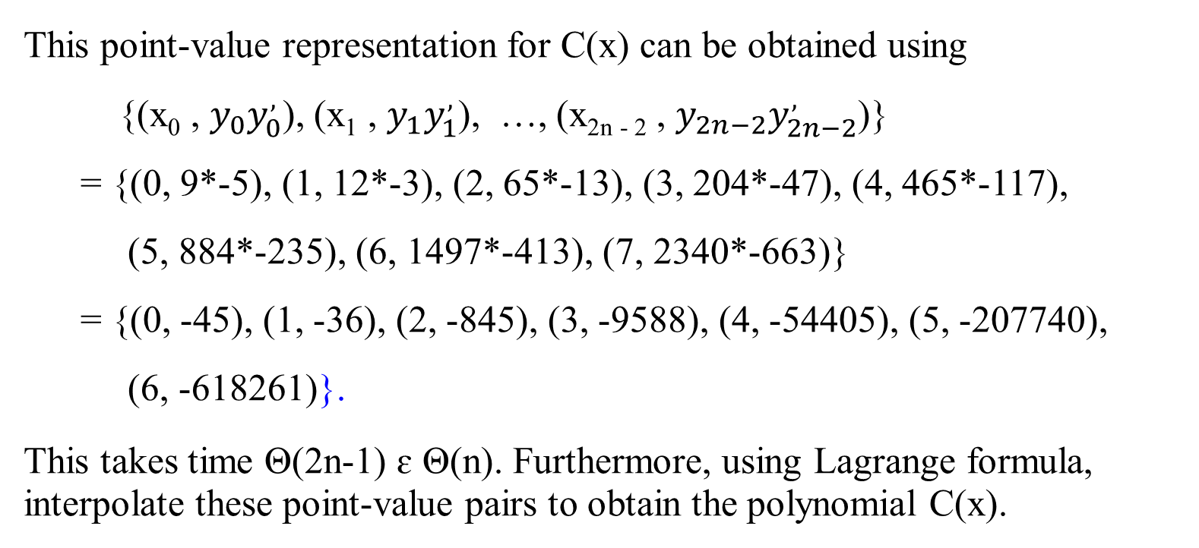
Multiplying two polynomials in point-value representation
S
A(x) is (0, 9), (1, 12), (2, 65), (3, 204), (4, 465), (5, 884), (6, 1497), (7, 2340).
B(x) is (0, -5), (1, -3), (2, -13), (3, -47), (4, -117), (5, -235), (6, -413). (7, -663).
This point-value representation for C(x) can be obtained using
{(x₀ , $y_{0}y_{0}^{,}$), (x₁ , $y_{1}y_{1}^{,}$), …, (x_{2n - 2} , $y_{2n−2}y_{2n−2}^{,}$)}
= {(0, 9*-5), (1, 12*-3), (2, 65*-13), (3, 204*-47), (4, 465*-117),
(5, 884*-235), (6, 1497*-413), (7, 2340*-663)}
= {(0, -45), (1, -36), (2, -845), (3, -9588), (4, -54405), (5, -207740),
(6, -618261)}.
This takes time Θ(2n-1) ɛ Θ(n). Furthermore, using Lagrange formula, interpolate these point-value pairs to obtain the polynomial C(x).

Slide 58
Multiplying two polynomials in point-value representation as in table
 | A(x) * B(x) = C(x)
x | A(x) | B(x) | C(x)
0 | 9 | -5 | -45
1 | 12 | -3 | -36
2 | 65 | -13 | -845
3 | 204 | -47 | -9588
4 | 465 | -117 | -54405
5 | 884 | -235 | -207740
6 | 1497 | -413 | -618261
C(x) = {(0, -45), (1, -36), (2, -845), (3, -9588), (4, -54405), (5, -207740), (6, -618261)}.

Slide 59

In the following two slides, instead of interpolating the point-values of C(x) to its coefficient representation, we first show that: (1) obtain the C(x) in coefficient representation, and then (2) evaluate this representation to form point-values of C(x).
(3) These point-values of C(x) are the same as the previous slide. This shows the correction of the approach.
Instead, we check the obtained point-value pairs by computing A(x) * B(x):
6x³ + 7x² - 10x + 9
- 2x³ + 4x - 5
- 30x³ - 35x² + 50x - 45
+ 24x⁴ + 28x³ - 40x² + 36x
- 12x⁶ - 14x⁵ + 20x⁴ - 18x³ .
- 12x⁶ - 14x⁵ + 44x⁴ - 20x³ - 75x² + 86x - 45
The coefficient for A(x) = 6x³ + 7x² - 10x + 9 is (9, -10, 7, 6, 0, 0, 0).
The coefficient for B(x) = - 2x³ + 4x - 5 is (-5, 4, 0, -2, 0, 0, 0).
The coefficient for C(x) = - 12x⁶ - 14x⁵ + 44x⁴ - 20x³ - 75x² + 86x - 45 is
(-45, 86, -75, -20, 44, -14, -12).

Slide 60
- 12x⁶ - 14x⁵ + 44x⁴ - 20x³ - 75x² + 86x - 45
Using Horner rule
C(x) = -45 + 86x - 75x² - 20x³ + 44x⁴ - 14x⁵ - 12x⁶
= -45 + x(86 + x(-75 + x(-20 + x(44 + x(-14 + x(-12)))))),
we obtained point-value representation for C(x):
C(0) = -45; C(1) = -36; C(2) = -845
C(3) = -9588 C(4) = -54405 C(5) = -207740
C(6) = -618261.
A point-value representation of C(x) is then
{(0, -45), (1, -36), (2, -845), (3, -9588), (4, -54405), (5, -207740),
(6, -618261)}.
Using Lagrange formula, this point-value representation can be interpolated to the corresponding coefficient representation. We will show later.

Slide 61
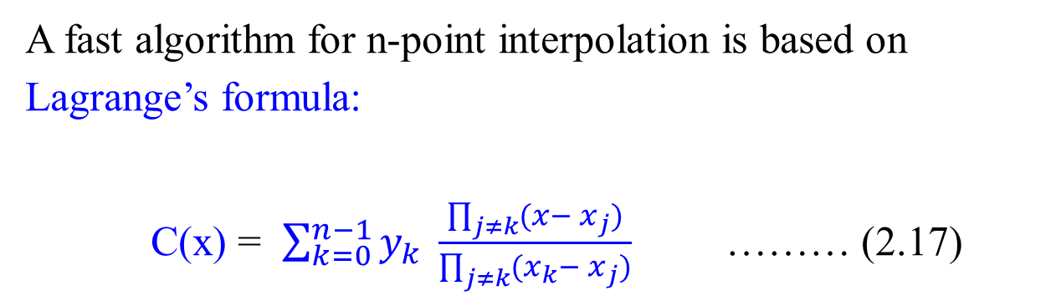
Using Lagrange formula, this point-value representation can be converted to coefficient representation. We will show here.
A fast algorithm for n-point interpolation is based on Lagrange’s formula:
C(x) = $\sum_{k=0}^{n−1}{y_{k}} \frac{\prod_{j≠k}{(x− x_{j})}}{\prod_{j≠k}{(x_{k}}− x_{j})}$ ……… (2.17)

Slide 62
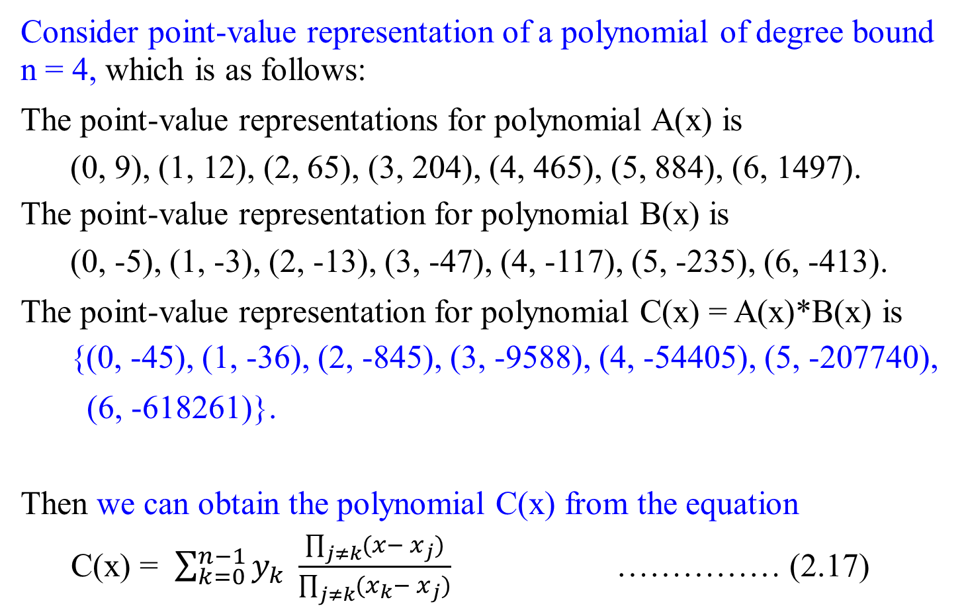
Consider point-value representation of a polynomial of degree bound n = 4, which is as follows:
The point-value representations for polynomial A(x) is
(0, 9), (1, 12), (2, 65), (3, 204), (4, 465), (5, 884), (6, 1497).
The point-value representation for polynomial B(x) is
(0, -5), (1, -3), (2, -13), (3, -47), (4, -117), (5, -235), (6, -413).
The point-value representation for polynomial C(x) = A(x)*B(x) is
{(0, -45), (1, -36), (2, -845), (3, -9588), (4, -54405), (5, -207740),
(6, -618261)}.
Then we can obtain the polynomial C(x) from the equation
C(x) = $\sum_{k=0}^{n−1}{y_{k}} \frac{\prod_{j≠k}{(x− x_{j})}}{\prod_{j≠k}{(x_{k}}− x_{j})}$ …………… (2.17)

Slide 63

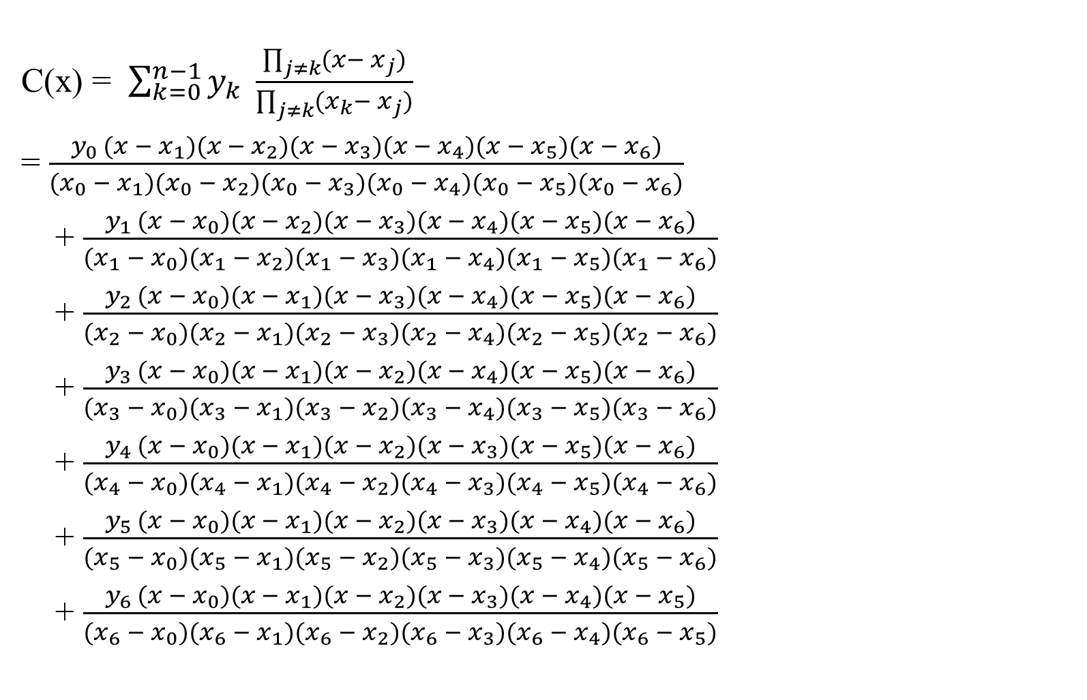
C(x) = $\sum_{k=0}^{n−1}{y_{k}} \frac{\prod_{j≠k}{(x− x_{j})}}{\prod_{j≠k}{(x_{k}}− x_{j})}$
= $\frac{y_{0 }(x − x_{1})(x − x_{2})(x − x_{3})(x − x_{4})(x − x_{5})(x − x_{6})}{(x_{0} − x_{1})(x_{0} − x_{2})(x_{0} − x_{3})(x_{0} − x_{4})(x_{0} − x_{5})(x_{0} − x_{6})}$
+ $\frac{y_{1 }(x − x_{0})(x − x_{2})(x − x_{3})(x − x_{4})(x − x_{5})(x − x_{6})}{(x_{1} − x_{0})(x_{1} − x_{2})(x_{1} − x_{3})(x_{1} − x_{4})(x_{1} − x_{5})(x_{1} − x_{6})}$
+ $\frac{y_{2 }(x − x_{0})(x − x_{1})(x − x_{3})(x − x_{4})(x − x_{5})(x − x_{6})}{(x_{2} − x_{0})(x_{2} − x_{1})(x_{2} − x_{3})(x_{2} − x_{4})(x_{2} − x_{5})(x_{2} − x_{6})}$
+ $\frac{y_{3 }(x − x_{0})(x − x_{1})(x − x_{2})(x − x_{4})(x − x_{5})(x − x_{6})}{(x_{3} − x_{0})(x_{3} − x_{1})(x_{3} − x_{2})(x_{3} − x_{4})(x_{3} − x_{5})(x_{3} − x_{6})}$
+ $\frac{y_{4 }(x − x_{0})(x − x_{1})(x − x_{2})(x − x_{3})(x − x_{5})(x − x_{6})}{(x_{4} − x_{0})(x_{4} − x_{1})(x_{4} − x_{2})(x_{4} − x_{3})(x_{4} − x_{5})(x_{4} − x_{6})}$
+ $\frac{y_{5 }(x − x_{0})(x − x_{1})(x − x_{2})(x − x_{3})(x − x_{4})(x − x_{6})}{(x_{5} − x_{0})(x_{5} − x_{1})(x_{5} − x_{2})(x_{5} − x_{3})(x_{5} − x_{4})(x_{5} − x_{6})}$
+ $\frac{y_{6 }(x − x_{0})(x − x_{1})(x − x_{2})(x − x_{3})(x − x_{4})(x − x_{5})}{(x_{6} − x_{0})(x_{6} − x_{1})(x_{6} − x_{2})(x_{6} − x_{3})(x_{6} − x_{4})(x_{6} − x_{5})}$
Each term requires 2*(2n-1) multiplications. There are (2n-1) terms. Therefore the total number of multiplications needed is 2*(2n-1) * (2n-1). This takes time Θ(n²).

Slide 64
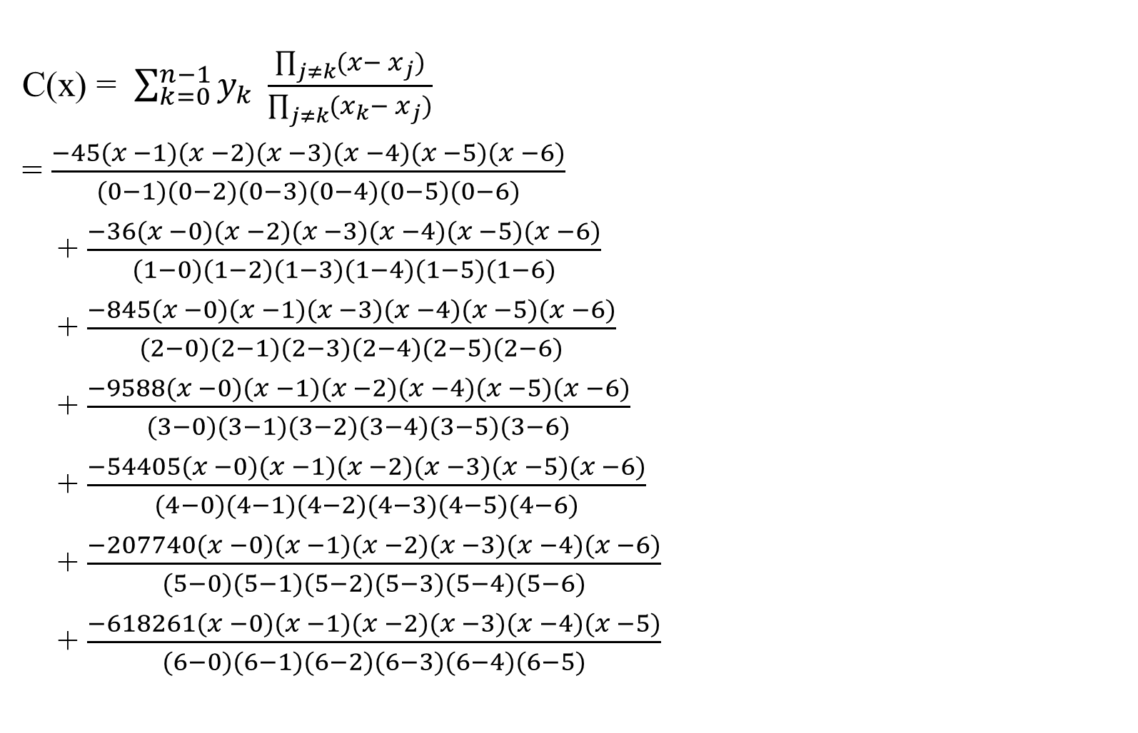
C(x) = $\sum_{k=0}^{n−1}{y_{k}} \frac{\prod_{j≠k}{(x− x_{j})}}{\prod_{j≠k}{(x_{k}}− x_{j})}$
= $\frac{−45(x −1)(x −2)(x −3)(x −4)(x −5)(x −6)}{(0−1)(0−2)(0−3)(0−4)(0−5)(0−6)}$
+ $\frac{−36(x −0)(x −2)(x −3)(x −4)(x −5)(x −6)}{(1−0)(1−2)(1−3)(1−4)(1−5)(1−6)}$
+ $\frac{−845(x −0)(x −1)(x −3)(x −4)(x −5)(x −6)}{(2−0)(2−1)(2−3)(2−4)(2−5)(2−6)}$
+ $\frac{−9588(x −0)(x −1)(x −2)(x −4)(x −5)(x −6)}{(3−0)(3−1)(3−2)(3−4)(3−5)(3−6)}$
+ $\frac{−54405(x −0)(x −1)(x −2)(x −3)(x −5)(x −6)}{(4−0)(4−1)(4−2)(4−3)(4−5)(4−6)}$
+ $\frac{−207740(x −0)(x −1)(x −2)(x −3)(x −4)(x −6)}{(5−0)(5−1)(5−2)(5−3)(5−4)(5−6)}$
+ $\frac{−618261(x −0)(x −1)(x −2)(x −3)(x −4)(x −5)}{(6−0)(6−1)(6−2)(6−3)(6−4)(6−5)}$
{(0, -45), (1, -36), (2, -845), (3, -9588), (4, -54405), (5, -207740), (6, -618261)}.

Slide 65

C(x) = $\sum_{k=0}^{n−1}{y_{k}} \frac{\prod_{j≠k}{(x− x_{j})}}{\prod_{j≠k}{(x_{k}}− x_{j})}$
= $\frac{−45(x −1)(x −2)(x −3)(x −4)(x −5)(x −6)}{(−1)(−2)(−3)(−4)(−5)(−6)}$
+ $\frac{−36(x −0)(x −2)(x −3)(x −4)(x −5)(x −6)}{(1)(−1)(−2)(−3)(−4)(−5)}$
+ $\frac{−845(x −0)(x −1)(x −3)(x −4)(x −5)(x −6)}{(2)(1)(−1)(−2)(−3)(−4)}$
+ $\frac{−9588(x −0)(x −1)(x −2)(x −4)(x −5)(x −6)}{(3)(2)(1)(−1)(−2)(−3)}$
+ $\frac{−54405(x −0)(x −1)(x −2)(x −3)(x −5)(x −6)}{(4)(3)(2)(1)(−1)(−2)}$
+ $\frac{−207740(x −0)(x −1)(x −2)(x −3)(x −4)(x −6)}{(5)(4)(3)(2)(1)(−1)}$
+ $\frac{−618261(x −0)(x −1)(x −2)(x −3)(x −4)(x −5)}{(6)(5)(4)(3)(2)(1)}$
{(0, -45), (1, -36), (2, -845), (3, -9588), (4, -54405), (5, -207740), (6, -618261)}.

Slide 66

C(x) = $\sum_{k=0}^{n−1}{y_{k}} \frac{\prod_{j≠k}{(x− x_{j})}}{\prod_{j≠k}{(x_{k}}− x_{j})}$
= $\frac{−45( x^{6} −21x^{5}+176x^{4} −735x^{3}+1624x^{2}−1764x+720)}{720}$
+ $\frac{−36( x^{6} −20x^{5}+155x^{4} −580x^{3}+1044x^{2}−720x)}{−120}$
+ $\frac{−845( x^{6} −19x^{5}+137x^{4} −461x^{3}+702x^{2}−360x)}{48}$
+ $\frac{−9588( x^{6} −18x^{5}+121x^{4} −372x^{3}+508x^{2}−240x)}{−36}$
+ $\frac{−54405( x^{6} −17x^{5}+110x^{4} −325x^{3}+396x^{2}−180x)}{48}$
+ $\frac{−207740( x^{6} −16x^{5}+95x^{4} −260x^{3}+324x^{2}−144x)}{(5)(4)(3)(2)(1)(−1)}$
+ $\frac{−618261( x^{6} −15x^{5}+80x^{4} −225x^{3}+274x^{2}−120x)}{720}$
{(0, -45), (1, -36), (2, -845), (3, -9588), (4, -54405), (5, -207740), (6, -618261)}.

Slide 67
{(0, -45), (1, -36), (2, -845), (3, -9588), (4, -54405), (5, -207740), (6, -618261)}.
Simplify the above equation to obtain
C(x) = -12x⁶ - 14x⁵ + 44x⁴ - 20x³ - 75x² + 86x - 45,
which is the product of
  A(x) = 6x³ + 7x² - 10x + 9 and
  B(x) = - 2x³ + 4x - 5.
This takes time Θ(n²).

Slide 69
Comment: for x³, If n-1=3, then n=4 terms for x⁶, if 2n-1=6, then 2n=7 terms
a₀ , a₁, …, a_{n-1}
b₀ , b₁, …, b_{n-1}
Ordinary
Multiplication
Time Θ(n²)
c₀ , c₁, …, c_{2n-2}
Coefficient
representation
Evaluation Interpolation
Time Θ(n²), Time Θ(n²)
using Horner Rule using Lagrange’s formula
S
$$A\left(x_{0}\right), B\left(x_{0}\right)$$
$$A\left(x_{1}\right), B\left(x_{1}\right)$$
…
$$A\left(x_{2n−2}\right), B\left(x_{2n−2}\right)$$
$$C\left(x_{0}\right)$$
$$C\left(x_{1}\right)$$
…
$$C\left(x_{2n−2}\right)$$
Pointwise multiplication
Point-value
multiplication
Time Θ(n)

Slide 70

So far, both the evaluation and interpolation take time Θ(n²).
Given two polynomials A(x) and B(x),
  use Horner Rule to evaluate A(x) at n points, and B(x) at n points, (which takes time 2* Θ(n²)), and then
  use the obtained point-value forms to compute pointwise multiplication (which takes time Θ(n) ).
  Then interpolate C(x) from n points of point-value representation to coefficient form, using Lagrange’s formula (this interpolation also take time Θ(n²)).
Therefore, the process of evaluation, then pointwise multiplication and then of interpolation takes total time
Θ(n²) + Θ(n) + Θ(n²) $∈$Θ(n²).
  This considers worse than ordinary multiplication.
S

Slide 71
S
Can we improve our method?
Can we use the linear-time multiplication method for polynomials in point-value form to expedite polynomial multiplication in coefficient form?
The answer hinges on whether we can convert a polynomial quickly from coefficient form to point-value form (evaluate) and vice versa (interpolate).

Slide 72
S
Focus the following after the first 30 slides

Slide 73
Multiplying Polynomials Using the Fast Fourier Transform (FFT)
To multiply two polynomials more efficiently than the brute force method, we can use the Fast Fourier Transform (FFT) to convert the polynomials from their coefficient form to their point-value form, perform the multiplication in the point-value form, and then convert the result back to the coefficient form. This procedure reduces the overall time complexity to Θ(n log n).
Here’s a step-by-step explanation of the procedure:
Convert Coefficient Form to Point-Value Form
Multiply Point-Value Pairs
Convert Point-Value Form Back to Coefficient Form

Slide 74

Fast multiplication of polynomials in coefficient form
Figure 2.10: A graphical outline of an efficient polynomial-multiplication process. Representation on the top are in coefficient form, while those on the bottom are in point-value form. The arrows from left to right correspond to the multiplication operation. The $ѡ_{2n}$terms are complex (2n)^{th} roots of unity.
S

Slide 75



Comment: for x³, If n-1=3, then n=4 terms for x⁶, if 2n-1=6, then 2n=7 terms
a₀ , a₁, …, a_{n-1}
b₀ , b₁, …, b_{n-1}
Ordinary
Multiplication
Time Θ(n²)
c₀ , c₁, …, c_{2n-2}
Coefficient
representation
S
Evaluation Interpolation
Time Θ(n log n) Time Θ(n log n)
$$A\left(ѡ_{2n}^{0}\right), B\left(ѡ_{2n}^{0}\right)$$
$$A\left(ѡ_{2n}^{1}\right), B\left(ѡ_{2n}^{1}\right)$$
…
$$A\left(ѡ_{2n}^{2n−2}\right), B\left(ѡ_{2n}^{2n−2}\right)$$
$$C\left(ѡ_{2n}^{0}\right)$$
$$C\left(ѡ_{2n}^{1}\right)$$
…
$$C\left(ѡ_{2n}^{2n−2}\right)$$
Pointwise multiplication
Point-value
multiplication
Time Θ(n)
The $ѡ_{2n}$terms are complex (2n)^{th} roots of unity.

Slide 76
1. Convert Coefficient Form to Point-Value Form
To convert a polynomial from coefficient form to point-value form, we use the Discrete Fourier Transform (DFT). The FFT algorithm is an efficient way to compute the DFT in Θ(n log n) time.
Steps:
Evaluate the polynomial at n distinct points:
  For polynomials of degree-bound n, we typically use the nth roots of unity, ω_{k} = e^{2πik/n} for k=0, 1, …, n−1, as evaluation points.
  This results in the point-value pairs (x_{i}​, A(x_{i​})) for i = 0, 1, …, n−1.
Compute the DFT:
  Use the FFT algorithm to evaluate the polynomial at the roots of unity.

Slide 77
2. Multiply Point-Value Pairs
Once both polynomials are in point-value form, multiplying them is straightforward:
(x_{i}​, A(x_{i}​)) and (x_{i​}, B(x_{i}​))
Steps:
Multiply the corresponding values:
C(x_{i}) = A(x_{i})⋅B(x_{i})
This step takes Θ(n) time since it involves simple point-wise multiplication of the values at each evaluation point.

Slide 78
3. Convert Point-Value Form Back to Coefficient Form
To convert the result back to coefficient form, we use the Inverse Discrete Fourier Transform (IDFT), which can be computed efficiently using the Inverse FFT (IFFT).
Steps:
Compute the IDFT:
  Apply the IFFT to the point-value pairs (x_{i}, C(x_{i})) to obtain the coefficients of the product polynomial.
  This step also takes Θ(n log n) time.

Slide 79
Total Time Complexity
Combining all the steps, the total time complexity for multiplying two polynomials of degree-bound n is:
FFT to convert to point-value form: 2 × Θ(n log n) (one for each polynomial)
Point-wise multiplication: Θ(n)
IFFT to convert back to coefficient form: Θ(n log n)
Thus, the total time is: 2 × Θ(n log n) + Θ(n) + Θ(n log n)=Θ(n log n)

Slide 80
Summary of the Procedure
Convert A(x) and B(x) from coefficient form to point-value form using FFT: Θ(n log n)
Multiply the point-value pairs: Θ(n)
Convert the result back to coefficient form using IFFT: Θ(n log n)
This efficient approach leverages the power of FFT and IFFT to perform polynomial multiplication in Θ(n log n) time,
which is significantly faster than the brute-force Θ(n²) method.

