Slide 1
Quicksort
Algorithm and its Efficiency

Slide 2

Mergesort vs Quicksort
Based on divide-and-conquer approach.
The Mergesort divides its input’s elements according to their position in the array.
Quicksort divides its input’s elements according to their value.

Slide 3
Quicksort (Decrease and Conquer – decrease by one)
Re-arranges elements of a given array A[0..n-1] to achieve its partition, where
  all the elements before some positive s are smaller than or equal to A[s] and
  all the elements after position s are greater than or equal to A[s].
A[0] A[1] … A[s-1] A[s] A[s+1] A[s+2] … A[n-1]
s is a split position
all are ≤ A[s] all are ≥ A[s]
all may not be in order all may not be in order

Slide 4

Quicksort
After a partition A[s] has been achieved, [Divide]
the element at A[s] is in its final position in the sorted array.
Then, continue sorting the two subarrays of the elements [Conquer]
    A[0] A[1] … A[s-1]
    A[s+1] A[s+2] … A[n-1]
    independently (e.g., by the same method).
[Combine: No work is needed]

Slide 5
Algorithm Quicksort(A[p .. r])
//Sorts a subarray by quicksort.
//Quicksort(A[0 .. n - 1]) is the initial call for sorting an entire array A.
Input: A subarray A[p .. r] of A[0 .. n-1],
defined by its left and right indices p and r.
Output: Subarray A[p .. r] sorted in nondecreasing order
if (p < r )
{s ← Partition(A[p .. r]); //s ← j is a split position
Quicksort(A[p .. s-1]); //there is s - p elements
Quicksort(A[s+1 .. r]);} //there is r - s elements
A[p=0] A[1] … A[s-1] A[s] A[s+1] A[s+2] … A[r = n-1]

Slide 6

Algorithm Partition(A[p .. r])
//Partitions a subarray by using its first element as a pivot.
Input: A subarray A[p .. r] of A[0 .. n-1], defined by its
left and right indices p and r (p < r).
Output: A partition of A[p .. r], with the split position
returned as this function’s value
…

Slide 7

…
x ← A[p]; //set x be the leftmost element of A[p .. r].
i ← p; j ← r+1; //set left and right pointers pointing at p and r+1
repeat
repeat i ← i+1 until A[i] ≥ x; //move i towards right until …
repeat j ← j-1 until A[j] ≤ x; //move j towards left until …
swap(A[i], A[j]); //this enable i and j can continue to move until
until i ≥ j; // i and j cross each other or both i and j point at the same place
swap(A[i], A[j]); //undo last swap when i ≥ j --(crossed)
swap(A[p], A[j]); //swap the leftmost element and the element at
//the partition position j
return j;
i j
5 1 2 3 5 7 8 9
5 1 2 3 5 7 8 9
i j
r5 1 2 6 3 7 8 9
s5 1 2 3 6 7 8 9
r5 1 2 3 6 7 8 9
s5 1 2 6 3 7 8 9
s5 1 2 3 6 7 8 9
s3 1 2 5 6 7 8 9

Slide 8
    After both i and j scans stop, three situations may arise, depending on
    whether the scanning indices (pointers), i and j have crossed.
    If i and j have not crossed (i < j)
    (i.e., A[i] ≥ A[p] and A[j] ≤ A[p]) ,
    exchange A[i] and A[j], to yield A[i] ≤ A[p] and A[j] ≥ A[p]) and
    resume the scans after incrementing i and decrementing j, respectively:
→ i j ←
p = 15 | All are ≤ p | 20 ≥ p | … | 14 ≤ p | All are ≥ p
x
swap(A[i], A[j]);
until A[i] ≥ x A[j] ≤ x
Neither pointer i nor j can move forward unless they swap the contents of A[i] and A[j].

Slide 9
    If i and j have crossed over (i > j), then
    partition the array after exchanging the pivot with
    A[j]. That is, the array partitioned with the split position s = j:
j← →i
p = 5 | All are ≤ p | 3 ≤ p | 6 ≥ p | All are ≥ p
x
swap(A[p], A[j]);
until A[j] ≤ x;
until A[i] ≥ x
swap(A[i], A[j]);
until i ≥ j
swap(A[i], A[j]);
swap(A[p], A[j]);

Slide 10
    c. Finally, if the scanning indices (pointers), i and j stop while pointing to the same element (i = j),
    the value they are pointing to must be equal to p (why?).
    Thus the array partitioned with the split position s = i = j:
→ i = j ←
x
p = 5 | All are ≤ p | 5 = p | All are ≥ p
until A[i] ≥ x
until A[j] ≤ x;
swap(A[i], A[j]);
until i ≥ j
swap(A[i], A[j]);
swap(A[p], A[j]);

Slide 11
    Combine the last case (c) of indices (i = j) with the case (b) of crossed-over indices (i > j) by exchanging the pivot A[p] with A[j] whenever i ≥ j.

Slide 12
Needs n + 1 key comparisons:
i→ ←j
5 1 … 4 8 9 …. 20
…
i j
5 1 … 4 8 9 …. 20
ij
5 1 … 4 8 9 … 20
j i
5 1 … 4 8 9 … 20 4≤5?
  1 … 8 4 9 … 20 (swap)
1 … 4 8 9 … 20 (swap)
4 1 … 5 8 9 … 20 (swap)

Slide 13
Needs n key comparison:
ij
5 1 … 4 5 9 … 20 5≥5?i
5≤5?j

Slide 14
6 comparisons: i j 8 comparisons
6 1 2 3 4 5 6 7 8 9 10 11 12 13 - - n =14 elements
6 comparisons: i j 9 comparisons
6 1 2 3 4 5 7 7 8 9 10 11 12 13 - - n = 14 elements
Analysis of Algorithms
The number of key comparisons made before a partition is achieved is
  n+1 if the scanning indices cross over,
  n if they coincide (why?).
Justification for n + 1 and n

Slide 15
Analysis of Algorithms
Best Case
The best case occurs if all the splits happen in the middle of corresponding subarrays.
Let n be the number of comparisons needed.
The number of key comparisons C_{best} will satisfy the recurrence
C_{best}(n) = 2 C_{best}(n/2) + n for n > 1 C[n]
C_{best}(1) = 0.
According to the Master Theorem, C[n/2] C[n/2]
C_{best}(n) ε Θ(n log₂ n);
C[n/4] C[n/4] C[n/4] C[n/4]
Solving it exactly for n = 2^{k} yields C_{best}(n)= nlog₂n.
H= log₂ n
L = log₂n + 1

Slide 16
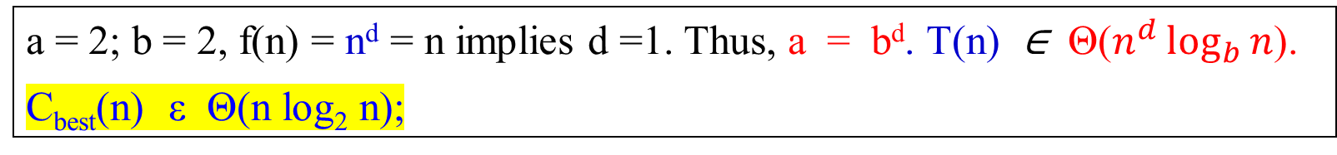
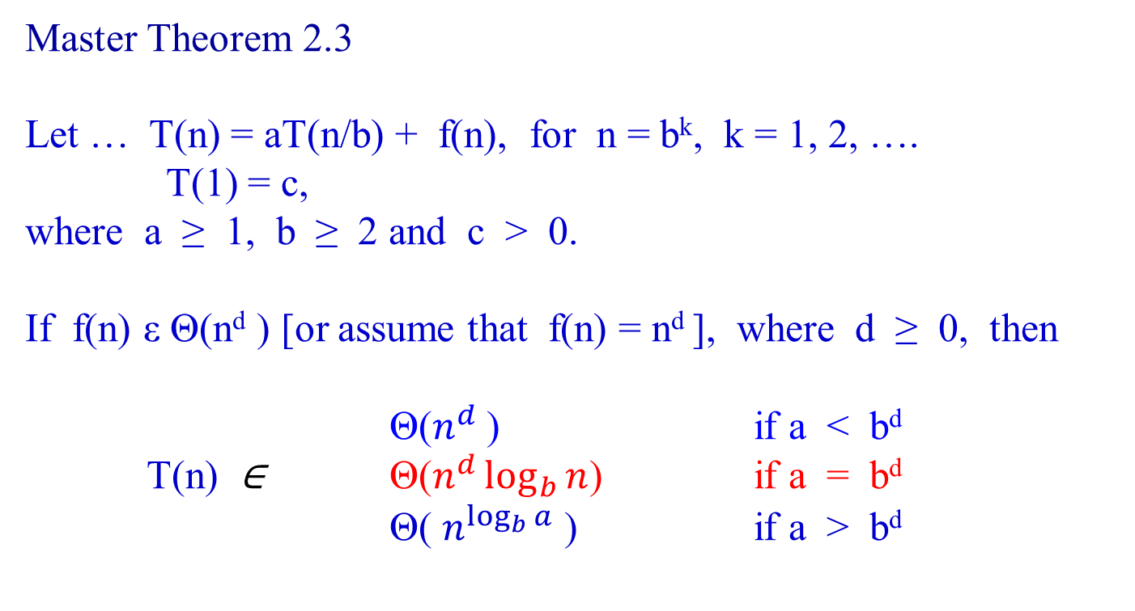
Master Theorem 2.3
Let … T(n) = aT(n/b) + f(n), for n = b^{k}, k = 1, 2, ….
T(1) = c,
where a ≥ 1, b ≥ 2 and c > 0.
If f(n) ε Θ(n^{d} ) [or assume that f(n) = n^{d} ], where d ≥ 0, then
Θ($n^{d}$) if a < b^{d}
T(n) ∈ Θ($n^{d}\log_{b}{n}$) if a = b^{d}
Θ( $n^{\log_{b}{a}}$ ) if a > b^{d}
a = 2; b = 2, f(n) = n^{d} = n implies d =1. Thus, a = b^{d}. T(n) ∈ Θ($n^{d}\log_{b}{n}$).
C_{best}(n) ε Θ(n log₂ n);

Slide 17

Analysis of Algorithms
Worst Case
In the worst case, all the splits will be skewed to the extreme:
one of the two subarrays will be empty, and
the size of the other will be just one less than the size of the subarray being partitioned.
This situation will happen, such as,
  for increasing arrays, i.e.,
    for inputs are in increasing order
  if A[0..n-1] is a strictly increasing array and A[0] is used as the pivot, the split is at position 0, because:
    the left-to-right scan will stop on A[1], and
    the right-to-left scan will go all the way to reach A[0].

Slide 18
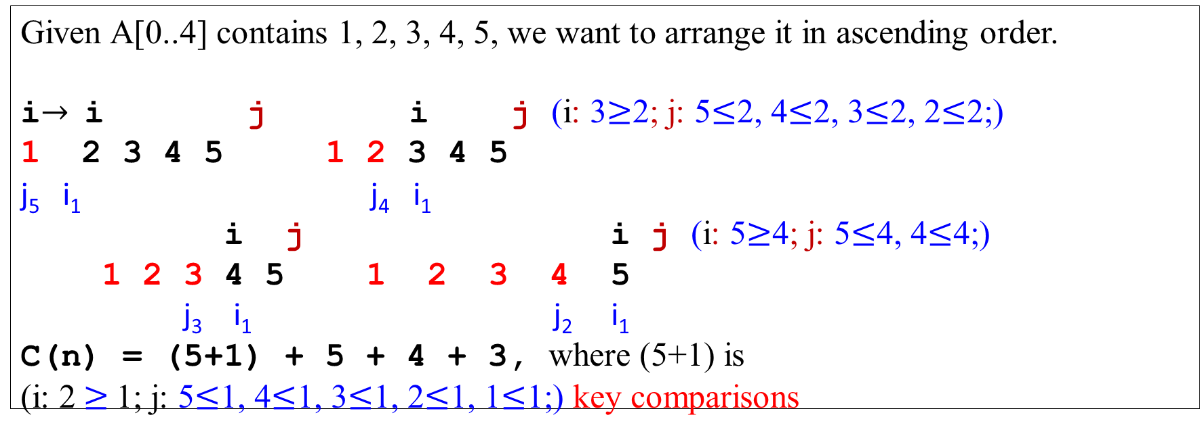
Analysis of Algorithms
Analysis of Algorithms
The total number of key comparisons made will be equal to
C_{worst}(n) = (n+1) + n + … + 3
= [ (n + 1)(n + 2) / 2 ] – 3
ε Θ(n²).
Given A[0..4] contains 1, 2, 3, 4, 5, we want to arrange it in ascending order.
i$→$i j i j (i: 3$≥$2; j: 5$≤$2, 4$≤$2, 3$≤$2, 2$≤$2;)
1 2 3 4 5 1 2 3 4 5
j₅ i₁ j₄ i₁
i j i j (i: 5$≥$4; j: 5$≤$4, 4$≤$4;)
1 2 3 4 5 1 2 3 4 5
j₃ i₁ j₂ i₁
C(n) = (5+1) + 5 + 4 + 3, where (5+1) is
(i: 2 $≥$1; j: 5$≤$1, 4$≤$1, 3$≤$1, 2$≤$1, 1$≤$1;) key comparisons

Slide 19
Analysis of Algorithms
Average Case
Let C_{avg}(n) be the average number of key comparisons made by quicksort on a randomly ordered array of size n.
The partition split can happen in any position s where (0 ≤ s ≤ n -1), after n+1 comparisons are made.
After the partition, the left and right subarrays will have s and n-1-s elements respectively.
e.g., 0 1 2 3 4 5 s 7 8 9 where n = 10.
Assume that the partition split can happen in each position s where (0 ≤ s ≤ n -1) with the same probability 1/n .
s = 6 and n – 1- s =10-1-6 = 3

Slide 20

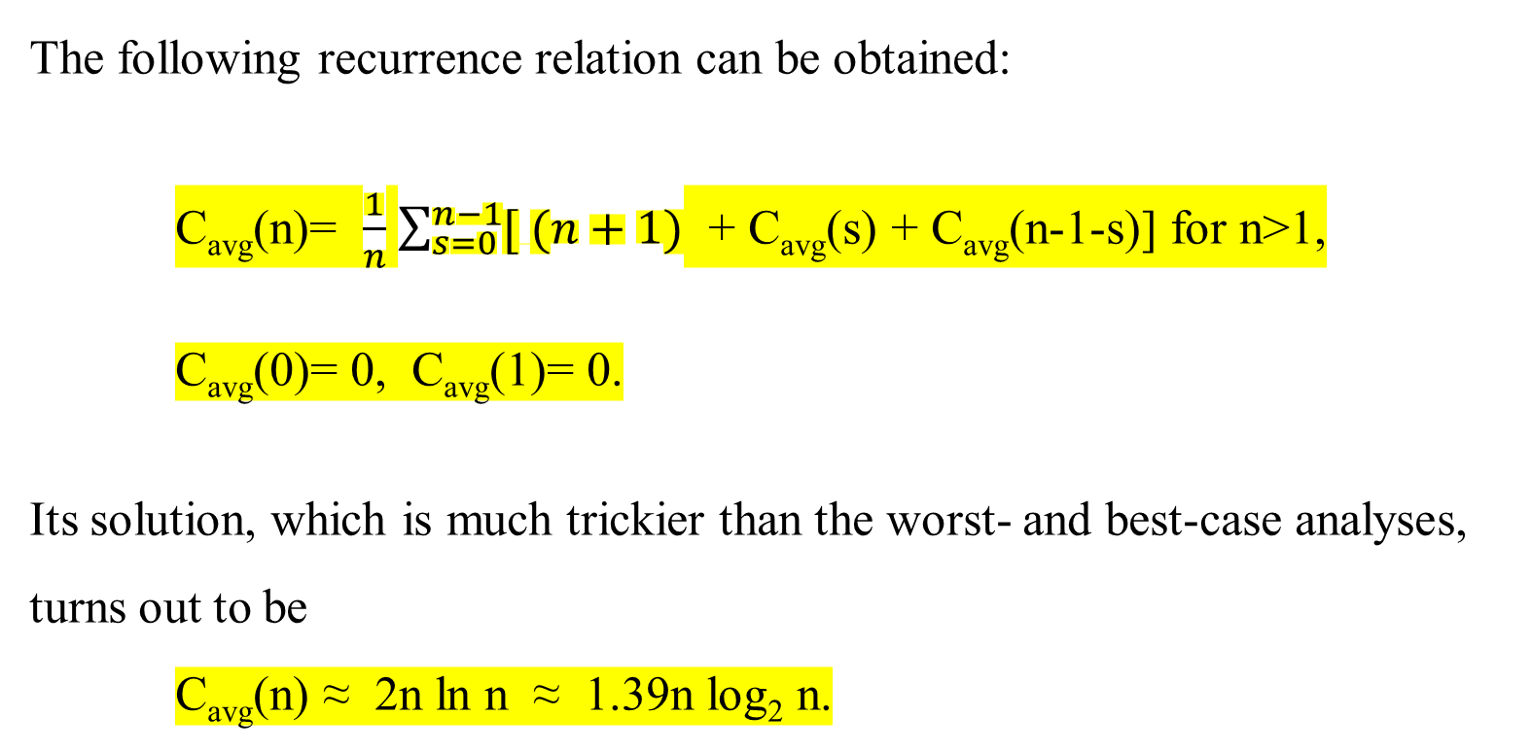
Analysis of Algorithms
The following recurrence relation can be obtained:
C_{avg}(n)= $\frac{1}{n}$ $\sum_{s=0}^{n−1}{[ (n+1)}$ + C_{avg}(s) + C_{avg}(n-1-s)] for n>1,
C_{avg}(0)= 0, C_{avg}(1)= 0.
Its solution, which is much trickier than the worst- and best-case analyses, turns out to be
C_{avg}(n) ≈ 2n ln n ≈ 1.39n log₂ n.
s falls n possible positions
For the first time, it needs n+1 comparisons, and s partitions/relocates at the position from 0 through n-1.
If n =0 (no element) and if n = 1 (one element) then no arrangement is needed.

Slide 21

Analysis of Algorithms
Thus, on average, quicksort makes only 39% more comparisons than in the best case.
The quicksort algorithm has
a worst-case running time of Θ(n²) on an input array of n numbers.
the average running time is 1.39n log₂n, i.e., Θ(n log₂n), and
The best case running time is Θ(n log₂n).

Slide 22









Analysis of Algorithms
The quicksort algorithm has
Despite this slow worst-case running time, quicksort is often the best practical choice for sorting because
its average running time is Θ(n log₂n), which is 1.39n log₂n, and
the constant factors hidden in the Θ(n log₂n) notation are quite small.
The merge sort has a running time Θ(n log₂n), with the slightly, comparative, large constant factors hidden in the Θ(n log₂n) is c and n, since T(n) = c*n log₂n + n (i.e., time spent for copy and merge). [ch 02_01 slide 30]
It also has the advantage of sorting in place:
  It arranges the numbers within the array A, with at most a constant number of them stored outside the array at any time;
  The principal shortcoming of Mergesort is its required linear extra space.
  For the quicksort algorithm, no work is needed to combine them

Slide 23




Analysis of Algorithms
Worst-case partitioning
Since the recursive call on an array of size 0 just returns, T(0) = Θ(1),
and the recurrence for the running time is
T(n) = T(n-1) + T(0) + Θ(n)
= T(n-1) + Θ(n).
Comparisons/swappings
The recurrence relation for the quicksort is:
    T(n) = T(n-1) + Θ(n)
    T(0) = Θ(1)

Slide 24
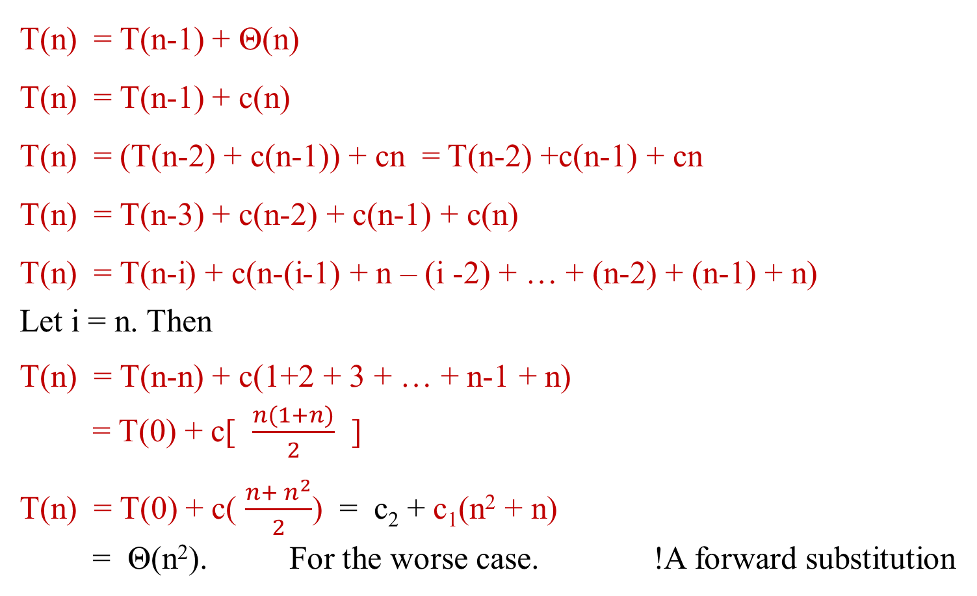
Analysis of Algorithms
T(n) = T(n-1) + Θ(n)
T(n) = T(n-1) + c(n)
T(n) = (T(n-2) + c(n-1)) + cn = T(n-2) +c(n-1) + cn
T(n) = T(n-3) + c(n-2) + c(n-1) + c(n)
T(n) = T(n-i) + c(n-(i-1) + n – (i -2) + … + (n-2) + (n-1) + n)
Let i = n. Then
T(n) = T(n-n) + c(1+2 + 3 + … + n-1 + n)
= T(0) + c[ $\frac{n(1+n)}{2}$ ]
T(n) = T(0) + c( $\frac{n+ n^{2}}{2}$) = c₂ + c₁(n² + n)
= Θ(n²). For the worse case. !A forward substitution
0, 1, 2, 3, 4, 5, …, n-1
s

Slide 25
Use the substitution method to prove that the recurrence T(n) = T(n - 1) + Θ(n) has the solution T(n) = Θ(n²). ]
[Hint: We guess T(n) ≤ cn².
Then T(n) ≤ c(n - 1)² + Θ(n)
= cn² - c(2n - 1) + Θ(n)
≤ cn², since we can pick the constant c large enough so that the c(2n – 1) term dominates the Θ(n) term. Thus T(n) = O(n²).
Now we guess that T(n) ≥ cn².
Then T(n) = T(n - 1) + Θ(n)
≥ c(n - 1)² + Θ(n)
= c(n - 1)² + Θ(n)
= cn² - c(2n - 1) + Θ(n)
≥ cn², since we can pick the constant c small enough so
that the term Θ(n) dominates c(2n-1). Thus, T(n) = Ω(n² ) .
kn

Slide 26

Analysis of Algorithms
Worst-case Analysis
The worst-case running time of the algorithm is Θ(n²) for a worst-case split at every level of recursion in quicksort. We now prove this assertion.
Let T(n) be the worst-case time for the procedure QUICKSORT on an input of size n. We have the recurrence
T(n) = max _{0 ≤ s ≤ n-1} (T(s) + T(n - s -1)) + Θ(n) …………………. (2.7.1)
where the parameter s ranges from 0 to n – 1 because the procedure PARTITION produces two subproblems with total size n -1.

Slide 27

Best-case Partitioning
The equal balancing of the two sides of the partition at every level of the recursion produces an asymptotically faster algorithm.
In the most even possible split, PARTITION produces two subproblems, each size no more than n/2:
  one of the sizes is └ n/2 ┘ and
  one of the sizes is ┌ n/2 ┐ - 1.
In this case, quicksort runs much faster.
The recurrence for the running time is
T(n) ≤ 2T(n/2) + Θ(n),
by case 2 of the Master Theorem, the solution is T(n) = O(n lg₂n).

Slide 28

Balanced Partitioning
The average-case running time of quicksort is closer to the best case than to the worst case.
The key to understanding “why” is to understand how the balance of the partitioning is reflected in the recurrence that describes the running time.
Suppose that the partitioning algorithm always produces a 9-to-1 proportional split, then the recurrence is obtained:
T(n) ≤ T(9n / 10) + T(n / 10) + cn
on the running time of quicksort, where we have explicitly included the constant c hidden in the Θ(n) term.

Slide 29
Thus with a 9-to-1 proportional split at every level of recursion, which seems quite unbalanced split, quicksort runs in O(n log₂ n) time – asymptotically the same as if the split were right down the middle.
In fact, even a 99-to-1 split yields an O(n log₂ n) running time.
The reason is that any split of constant proportionality yields a recursion tree of depth Θ(log₂ n), where the cost at each level is O(n).
The running time is therefore O(n log₂ n) whenever the split has constant proportionality.

Slide 30
Decrease-by-a-Constant-Factor Algorithms

Slide 31
Decrease-by-a-Constant-Factor Algorithms
One of the decrease-and-conquer techniques is
  decrease by a constant factor
Decrease-by-a-constant factor algorithms usually run in logarithmic time
    The binary search is an example
    very efficient but does not happen often.
A reduction by a factor other than two is especially rare.

Slide 32
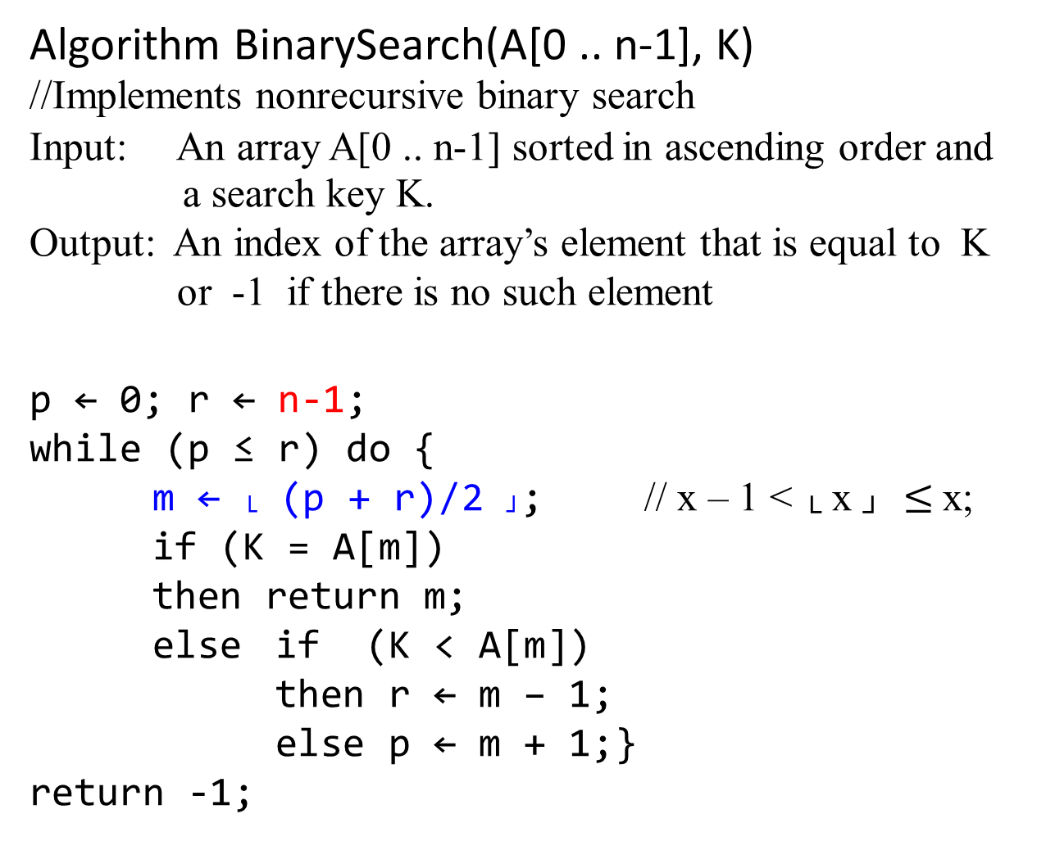

Algorithm BinarySearch(A[0 .. n-1], K)
//Implements nonrecursive binary search
Input: An array A[0 .. n-1] sorted in ascending order and
a search key K.
Output: An index of the array’s element that is equal to K
or -1 if there is no such element
p ← 0; r ← n-1;
while (p ≤ r) do {
m ← └ (p + r)/2 ┘; // x – 1 < └ x ┘ $≤$x;
if (K = A[m])
then return m;
else if (K < A[m])
then r ← m – 1;
else p ← m + 1;}
return -1;

Slide 33


Θ(n^{d} ) if a < b^{d}
T(n) ∈ Θ(n^{d} log_{b}n) if a = b^{d}
Θ( n^{log}_{b}ª ) if a > b^{d}
Binary Search
The worst-case inputs include
  all arrays that do not contain a given search key
  (and some cases of successful searches).
Find the number of key comparisons in the worst case C_{worst}(n).
  The recurrence is C_{worst}(n) = C_{worst}(└ n/2 ┘) + 1, for n > 1.
C_{worst}(1)= 1 …………………….(2.6)
    where a = 1 and b = 2, for this case.
  In this case, a = 1, b = 2 and d = 0 (for n^{d} = 1).
  Applying Master Theorem, C_{worst}(n) = Θ(log_{b}n).

Slide 34
Solve the recurrence relation C_{worst}(n) = C_{worst}(└ n/2 ┘) + 1, for n > 1.
C_{worst}(1)= 1 …………………….(2.6)
by assuming that n = 2^{k}.
Then C_{worst}(n) = C_{worst}(2^{k}) = C_{worst}(└ 2^{k}/2 ┘) + 1
= C_{worst}( 2^{k-1} ) + 1 , for 2^{k} is always divisible by 2
= C_{worst}( 2^{k-2} ) + 1 + 1 …
= C_{worst}( 2^{k-i} ) + i
= C_{worst}( 2^{k-k} ) + k, by letting i = k
= C_{worst}( 1 )+ k
= 1 + k
= log₂n + 1, where {n = 2^{k}, log₂n = log₂2^{k} = k log₂2 = k.}

Slide 35


Decrease-by-a-Constant-Factor Algorithm: Binary Search
  Given the recurrence C_{worst}(n) = C_{worst}(└ n/2 ┘) + 1, for n > 1.
C_{worst}(1)= 1 …………….(2.6)
When n = 2^{k}, the recurrence relation (2.6) has the solution
C_{worst}(n) = log₂n + 1 for n = 2^{k} . ……………(2.7)
The solution (2.7) for n = 2^{k} can be tweaked (i.e., making small change to improve …) to get a solution valid for an arbitrary positive integer n (i.e., n ≥ 1):
C_{worst}(n) = └ log₂n ┘ + 1
= ┌ log₂ (n + 1)┐ ……………(2.8)
Let verify by substitution that (2.8) indeed satisfies equation (2.6) for any n ≥ 1.

Slide 36
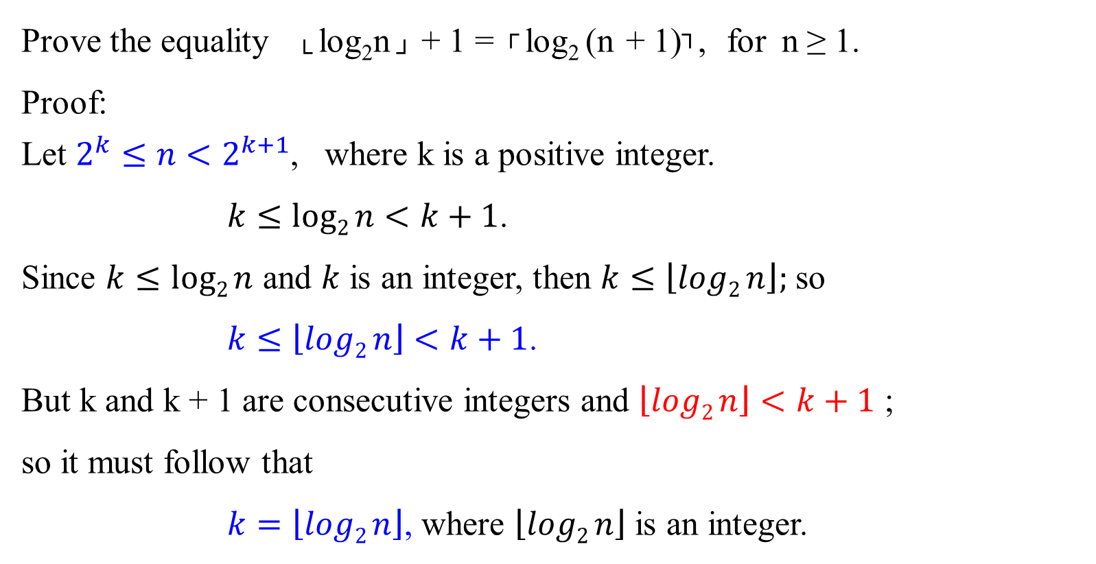
Binary Search
Prove the equality └ log₂n ┘ + 1 = ┌ log₂ (n + 1)┐, for n ≥ 1.
Proof:
Let $2^{k}≤n<2^{k+1}$, where k is a positive integer.
$k≤log2{n}{<k+1}$.
Since $k≤log2{n}$ and $k$ is an integer, then $k≤\left\lfloor log2{n}\right\rfloor ;$ so
$k≤\left\lfloor log2{n}\right\rfloor <k+1$.
But k and k + 1 are consecutive integers and $\left\lfloor log2{n}\right\rfloor <k+1$ ;
so it must follow that
$k=\left\lfloor log2{n}\right\rfloor$, where $\left\lfloor log2{n}\right\rfloor$ is an integer.

Slide 37
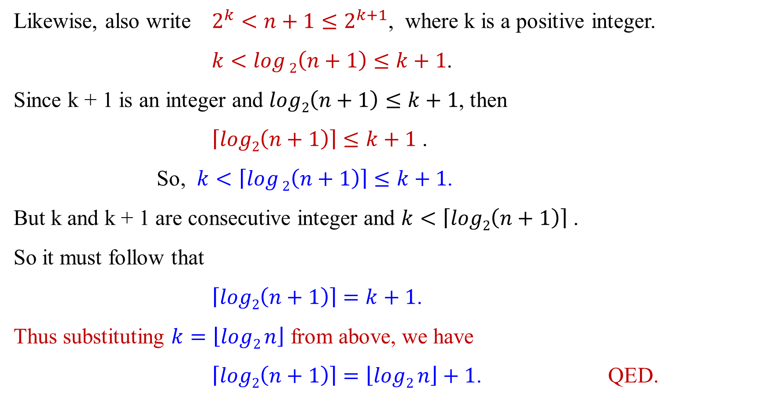
Binary Search
Likewise, also write $2^{k}<n+1≤2^{k+1}$, where k is a positive integer.
$k<\log{2\left(n+1\right)≤k+1}$.
Since k + 1 is an integer and $log2\left(n+1\right)≤k+1$, then
$\left\lceil log2\left(n+1\right)\right\rceil ≤k+1$ .
So, $k<\left\lceil \log{2\left(n+1\right)}\right\rceil ≤k+1$.
But k and k + 1 are consecutive integer and $k<\left\lceil log2\left(n+1\right)\right\rceil$ .
So it must follow that
$\left\lceil log2\left(n+1\right)\right\rceil =k+1$.
Thus substituting $k=\left\lfloor log2{n}\right\rfloor$ from above, we have
$\left\lceil log2\left(n+1\right)\right\rceil =\left\lfloor log2{n}\right\rfloor +1$. QED.

Slide 38
Decrease-by-a-Constant-Factor Algorithm:
Binary Search
The average-case efficiency of binary search?
A sophisticated analysis shows that the average number of key comparisons made by binary search is only slightly smaller than that in the worst case:
C_{avg}(n) ≈ log₂n
[ C_{avg}(n) = (1 + 2 + … + log₂n) / log₂n
= [½ log₂n (log₂ n + 1)] / log₂n
= ½ (log₂ n + 1) ≈ log₂n ]

Slide 39

Decrease-by-a-Constant-Factor Algorithm:
Binary Search
More accurate formulas for the average number of comparisons in a successful and an unsuccessful search are:
C_{yesAvg}(n) ≈ log₂n - 1
and
C_{noAvg}(n) ≈ log₂(n + 1), respectively.

Slide 40
For the Decrease and Conquer approach, other examples such as:
Fake-Coin Problem
Multipliction à la russe (or called Russian Peasant Multiplication) and
Josephus Problem.

Slide 41
Binary Tree Traversals:
The divide-and-conquer technique’s Applications

Slide 42
Apply the divide-and-conquer technique to binary trees.
A binary tree T is defined as a finite set of nodes that is
  either empty,
  or consists of
    a root and
    two disjoint binary trees
      the left T_{L} and right T_{R} subtree of the root.

Slide 43
Consider a binary tree as a special case of an ordered tree [see Figure 2.5].
max{Height(T_{L}), Height(T_{R})} + 1
max{Height(T_{L}), Height(T_{R})}
max{Height(T_{L}), Height(T_{R})} = 0, (leaf)
Figure 2.5: Standard representation of a binary tree.
T_{L}
T_{R}

Slide 44
Consider a recursive algorithm for computing the height of a binary tree.
Define the height as
  the length of the longest path from the root to a leaf.
Compute the height as
  the maximum of the heights of the root’s left and right subtrees plus 1. (Add 1 to account for the extra level of the root.)
Define the height of the empty tree as -1.

Slide 45
The following recursive algorithm
  Computes recursively the height of a binary tree
Algorithm Height(T)
  Input: A binary tree T
  Output: The height of T
  if (T = Ø) return -1; //define the height of an empty tree
  else return max{Height(T_{L}), Height(T_{R})} + 1;

Slide 46
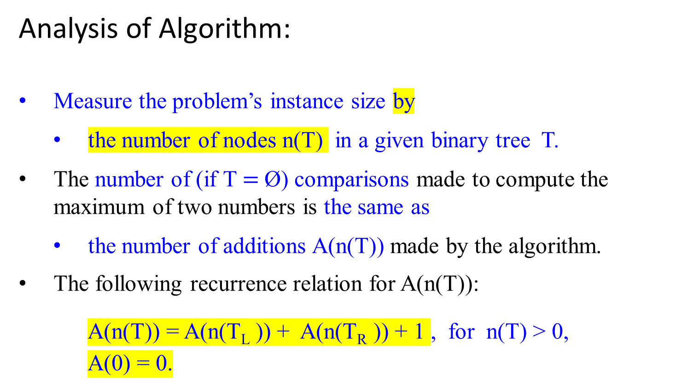
Analysis of Algorithm:
Measure the problem’s instance size by
  the number of nodes n(T) in a given binary tree T.
The number of (if T$=$Ø) comparisons made to compute the maximum of two numbers is the same as
  the number of additions A(n(T)) made by the algorithm.
The following recurrence relation for A(n(T)):
A(n(T)) = A(n(T_{L} )) + A(n(T_{R} )) + 1 , for n(T) > 0,
A(0) = 0.

Slide 47
Analysis of Algorithm:
Thus, to ascertain the algorithm’s efficiency, we need to know
  how many external nodes an extended binary tree with n internal nodes can have.
  (i.e., for an extended binary tree with n internal nodes, how many external nodes can have?)

Slide 48
By observing Figure 2.6 it is easy to hypothesize that the number of external nodes x ( )is always one more than the number of internal nodes n (O ):
x = n + 1 (or x ≤ n + 1) ……………….. (2.11)
H=3
O
O H=2
O
O
O
The number of internal nodes is n = 4; the number of external nodes x = 5, one more than n.
O
The number x of leaves and the number n of internal nodes are:
x=5 and n=4 which implies x=n+1
This leads to 2n+1 = x + n
Figure 2.6: (a) Binary tree. (b) Its extension. Internal nodes are shown as circles; external nodes are shown as squares.

Slide 49
Prove this formula x = n + 1 (2.11):
Consider the total number of nodes, both internal n and external x.
Except the root, every node is one of the two children of an internal node.
Then we have the equation
2n + 1 = x + n (x and n denote number of leaf and parental nodes)
which immediately implies equation (2.11)
The total number of nodes of a rooted tree is 2n + 1

Slide 50
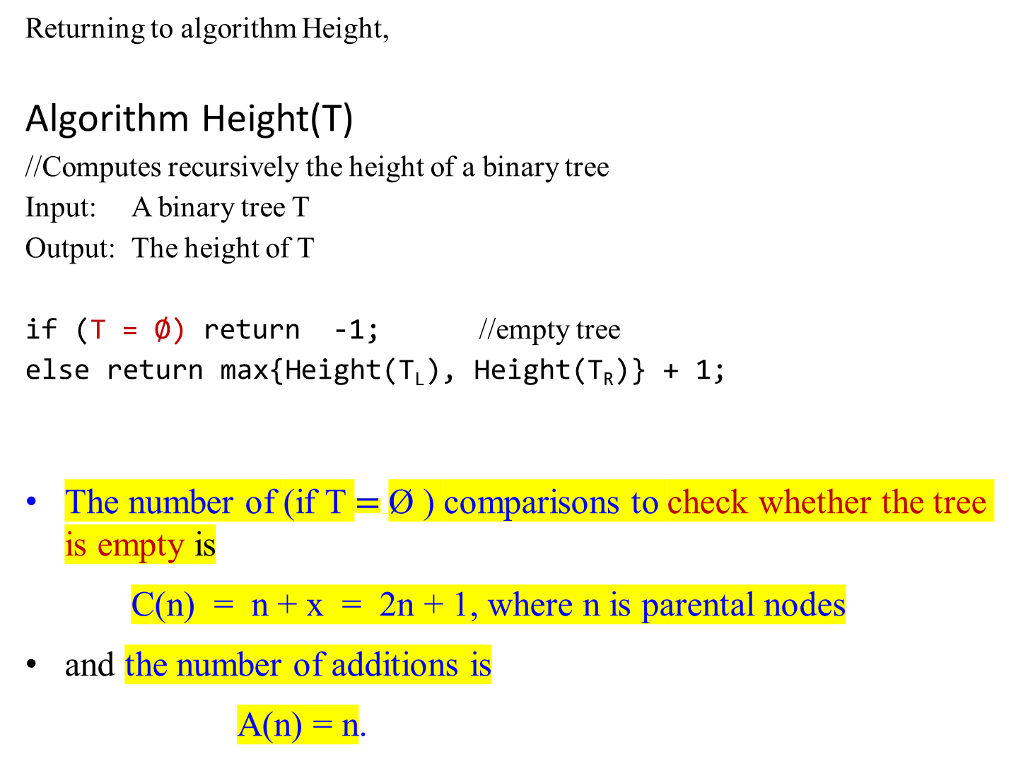
Returning to algorithm Height,
Algorithm Height(T)
//Computes recursively the height of a binary tree
Input: A binary tree T
Output: The height of T
if (T = Ø) return -1; //empty tree
else return max{Height(T_{L}), Height(T_{R})} + 1;
The number of (if T $=$Ø ) comparisons to check whether the tree is empty is
C(n) = n + x = 2n + 1, where n is parental nodes
and the number of additions is
A(n) = n.

Slide 51

Binary Tree Traversals:
For example:
For computing the height of a given a binary tree such as in Figure 2.6,
the number of comparisons to check whether the tree is empty:
C(7) = 2*7 + 1
= 15 comparisons (including empty leave).
And the number of additions:
A(7) = 7 additions.
Figure 2.6: Binary tree and its traversals
a 4
b 3 c 2
d 2 1 e 1 f 0
0 g 1 0 0 0 0
0 0
Preorder: (a, (b, (d, g), e), (c, f)) …. (a b.. c..)
Inorder: (((d, g), b, e), a, (f, c)) ......(b.. a c..)
Postorder: (((g, d), e, b), (f, c), a) …..(b.. c.. a)

Slide 52
The divide-and-conquer algorithms for binary trees are the three classic traversals: preorder, inorder, and postorder.
All three traversals visit nodes of a binary tree recursively, i.e., by visiting the tree’s root and its left and right subtrees.
They differ just by the timing of the root’s visit:
  In the preorder traversal, the root is visited before the left and right subtrees are visited (in that order).
  In the inorder traversal, the root is visited after visiting its left subtree but before visiting the right subtree.
  In the postorder traversal, the root is visited after visiting the left and right subtrees (in that order).
Binary Tree Traversals:
a
b c
d e f
g
Preorder: (a, (b, (d, g), e), (c, f)) …. (a b.. c..)
Inorder: (((d, g), b, e), a, (f, c)) ......(b.. a c..)
Postorder: (((g, d), e, b), (f, c), a) …..(b.. c.. a)

Slide 53
Multiplication of Large Integers

Slide 54
Multiplication of Large Integers
Multiplication of Two Large Integers
To demonstrate the basic idea of the algorithm, let multiply 23 by 14.
23 = 2 * 10¹ + 3 * 10⁰
14 = 1 * 10¹ + 4 * 10⁰
Then 23 * 14 = (2 * 10¹ + 3 * 10⁰)*( 1 * 10¹ + 4 * 10⁰ )
= (2 * 1)10² + (2 * 4 + 3 * 1) 10¹ + (3 * 4)10⁰
= 322 {4 multiplications, 3 Additions}
4M 3A

Slide 55
Multiplication of Large Integers
Multiplication of Two Large Integers
WLOG, consider multiplying two integers, each integer has 2 digits:
ab * cd = (a*10 + b) *(c*10 + d)
= (a * c)10² + (a * d + b * c) 10¹ + (b * d)
= (a * c)10² + (a * d + b * c) 10¹ + (b * d)10⁰
This requires four 4 multiplications and three (3) additions.
a b e.g., 2135 = 21 * 10² + 35 2135
5673 = 56 * 10² + 73 5673
c d 2135 * 5673 = (21*56)* 10⁴ + (21*73 + 56*35)* 10² + (35*73)* 10⁰
4M 3A

Slide 56

Multiplication of Large Integers
23 * 14 = (2 * 1)10² + (2 * 4 + 3 * 1) 10¹ + (3 * 4)10⁰
Compute the middle term (2 * 4 + 3 * 1) can be reduced to one digit multiplication, by taking advantage of the products 2 * 1 and 3 * 4:
2 * 4 + 3 * 1 = 2 * 4 + 3 * 1 + ( 2 * 1 + 3 * 4) – (2 * 1 + 3 * 4)
2 3 = 2 * 4 + 2 * 1 + 3 * 1 + 3 * 4 – (2 * 1 + 3 * 4)
= 2 (4 + 1) + 3(1 + 4) – (2 * 1 + 3 * 4)
1 4 = ( 2 + 3 ) * (1 + 4) – (2 * 1 + 3 * 4).
23 * 14 = (2 * 10¹ + 3 * 10⁰)*( 1 * 10¹ + 4 * 10⁰ )
= (2 * 1)10² + (2 * 4 + 3 * 1) 10¹ + (3 * 4)10⁰
= (2 * 1)10² + ( ( 2 + 3 ) * (1 + 4) – (2 * 1 + 3 * 4) )10¹ + (3 * 4)10⁰
4M 3A
3M 5A 1S

Slide 57
Multiplication of Large Integers
23 * 14 = (2 * 1)10² + (2 * 4 + 3 * 1) 10¹ + (3 * 4)10⁰
= (2 * 1)10² + ( ( 2 + 3 ) * (1 + 4) – (2 * 1 + 3 * 4) ) 10¹ + (3 * 4)10⁰
Rewrite a₁a₀ * b₁b₀ = (a₁ * b₁ )10² + mid 10¹ + a₀ * b₀, where
  mid = a₁ * b₀ + a₀ * b₁
  = (a₁ + a₀) * (b₁ + b₀) – (a₁ * b₁ + a₀ * b₀ )
  = (a₁ + a₀) * (b₁ + b₀) – (c₂ + c₀),
  where c₂ = a₁ * b₁ and c₀ = a₀ * b₀.
a₁ a₀
b₁ b₀

Slide 58
Multiplication of Large Integers
For any pair of two-digit integers a = a₁a₀ and b = b₁b₀, their product p can be computed by the formula:
p = a * b = a₁a₀ * b₁b₀ = (a₁ * 10 + a₀)*( b₁* 10 + b₀ ) a₁ a₀
= c₂10² + c₁10¹ + c₀ , where
c₂ = a₁ * b₁ is the product of their first digits, b₁ b₀
c₀ = a₀ * b₀ is the product of their second digits,
c₁ = (a₁ + a₀) * (b₁ + b₀) – (c₂ + c₀) is the product of the sum of the a’s digits and the sum of the b’s digits minus the sum of c₂ and c₀.
{3 multiplications and 5/1 addition/subtractions instead of 4 “*” and 3 “+”}
ab * cd = (a * c)10² + (a * d + b * c) 10¹ + (b * d)10⁰

Slide 59
Divide-and-Conquer
e.g., 2135 = 21 * 10² + 35 2135
5673 = 56 * 10² + 73 5673
2135 * 5673 = (21*56)* 10⁴ + (21*73 + 56*35)* 10² + (35*73)* 10⁰
Consider multiplying two n-digit integers a and b where n is a positive even number:
a * b = A_{n-1} … A₂ A₁ A₀ * B_{n-1} … B₂ B₁ B₀ .
Applying divide-and-conquer technique, divide both numbers in the middle.
a = a₁a₀ implies that a = a₁10^{n/2} + a₀ and
b = b₁b₀ implies that b = b₁10^{n/2} + b₀.
e.g., 2135 = 21 * 10² + 35
5673 = 56 * 10² + 73
2135 * 5673 = (21*56)* 10⁴ + (21*73 + 56*35)* 10² + (35*73)* 10⁰

Slide 60
Divide-and-Conquer
Then, c = a * b
= (a₁10^{n/2} + a₀ ) * (b₁10^{n/2} + b₀)
= (a₁ * b₁)10^{n} + (a₁ * b₀ + a₀ * b₁)10^{n/2} + (a₀ * b₀ )
= c₂10^{n} + c₁ 10^{n/2} + c₀
where c₂ = a₁ * b₁ is the product of their first halves,
c₀ = a₀ * b₀ is the product of their second halves,
c₁ = (a₁ + a₀) * (b₁ + b₀) – (c₂ + c₀) is the product of
the sum of the a’s halves and the sum of the b’s halves minus the sum of c₂ and c₀.
3*, 5+, 1-

Slide 61
Example 2.13: 7891 x 1234 = ?
7891 = 78 * 10² + 91*10⁰ and 1234 = 12 * 10² + 34 *10⁰
7891 x 1234
= (78 * 10² + 91*10⁰) * (12 * 10² + 34 *10⁰)
= (78*12)*10⁴ + (78*34 + (91*12)*10² + (91*34)
= (78*12)*10⁴ + [(78+91)*(12 + 34) – (78*12 + 91*34) ]*10² + (91*34)*10⁰
= (78*12)*10⁴ + [(0169)*(46) – (78*12 + 91*34) ]*10² + (91*34)*10⁰
= {(7 *1)*10² + [(7+8)*(1+2)-(7*1)-(8*2)]*10 + (8*2)}*10⁴ + [ (0169*46)-(936+3094)]*10² + {(9*3)*10² + [(9+1)*(3+4)-(9*3+1*4)]*10 + (1*4)}
= {700+[45-7-16]10 +16}*10⁴ + [(169*46) – 4030]*10² + {2700+[70-(27+4)]*10+4}
= {700+220+16}*10⁴ + [7774 - 4030] *10² + {2700+390+4}
= 936*10⁴ + 3744*10² + 3094
= 9,737,494

Slide 62
Analysis of this algorithm:
How many digit multiplications does this algorithm make?
Since multiplication of n-digit numbers requires three multiplication of n/2-digit numbers, the recurrence for the number of multiplications M(n) will be
    M(n) = 3M(n/2) for n > 1,
    M(1) = 1.
An example of input size for this algorithm is n number of digits. Not the values of n.
3 * 4 (where n = 1) requires 1 *

Slide 63
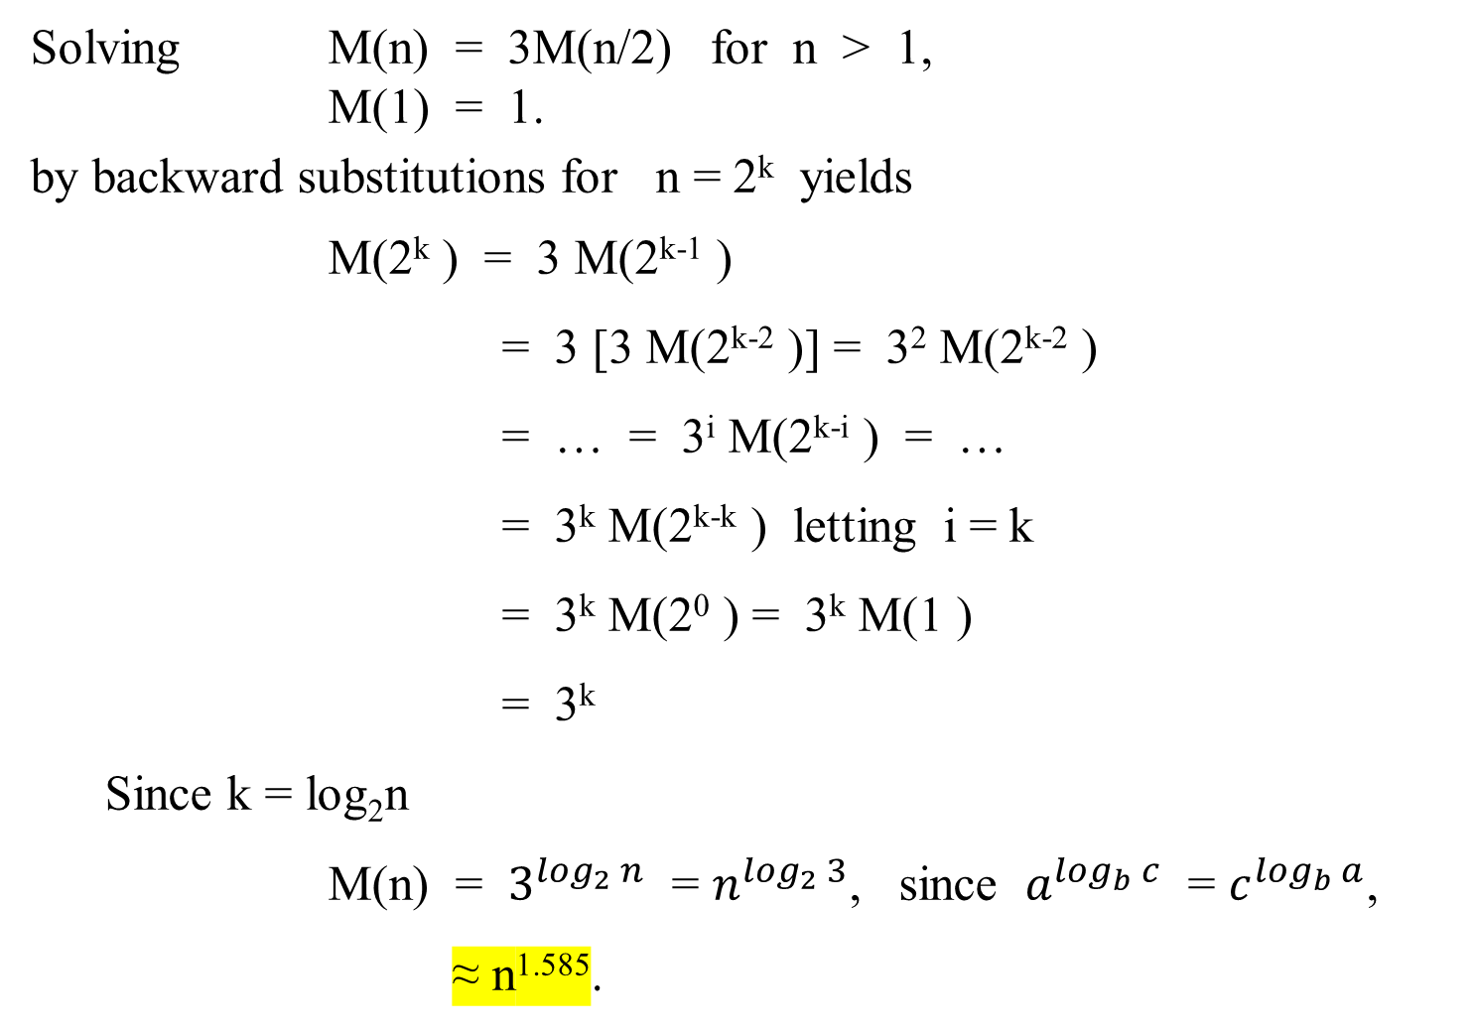
Solving M(n) = 3M(n/2) for n > 1,
M(1) = 1.
by backward substitutions for n = 2^{k} yields
M(2^{k} ) = 3 M(2^{k-1} )
= 3 [3 M(2^{k-2} )] = 3² M(2^{k-2} )
= … = 3^{i} M(2^{k-i} ) = …
= 3^{k} M(2^{k-k} ) letting i = k
= 3^{k} M(2⁰ ) = 3^{k} M(1 )
= 3^{k}
Since k = log₂n
M(n) = $3^{\log_{2}{n}}$ = $n^{\log_{2}{3}}$, since $a^{\log_{b}{c}}$ = $c^{\log_{b}{a}}$,
≈ n^{1.585}.

Slide 64
Multiplication of Large Integers
How to split an n-digit integer into two integers of approximately n/2 digits. Following are two examples of each splits.
567,842 = 567 * 10³ + 832
(6 digits) (3 digits)
9,423,723 = 9423 * 10³ + 723
(7 digits) (4 digits)
or 9,423,723 = 942 * 10⁴ + 3723
(7 digits) (3 digits)

Slide 65
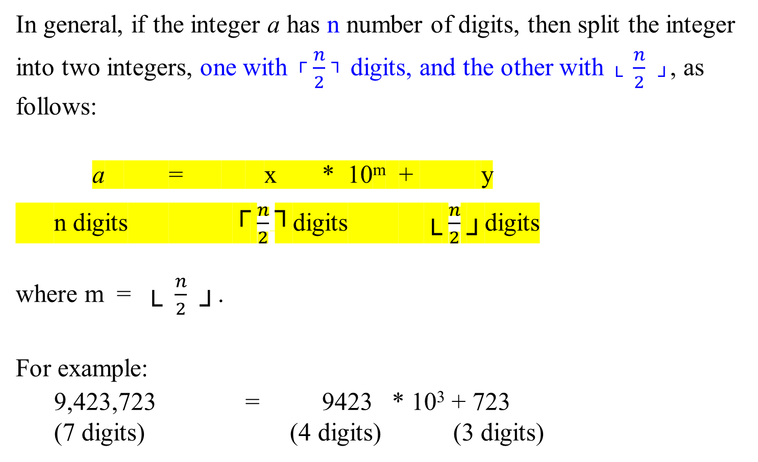
Multiplication of Large Integers
In general, if the integer a has n number of digits, then split the integer into two integers, one with ┌ $\frac{n}{2}$ ┐ digits, and the other with └ $\frac{n}{2}$ ┘, as follows:
a = x * 10^{m} + y
n digits ┌ $\frac{n}{2}$┐digits └ $\frac{n}{2}$ ┘digits
where m = └ $\frac{n}{2}$ ┘.
For example:
  9,423,723 = 9423 * 10³ + 723
  (7 digits) (4 digits) (3 digits)

Slide 66
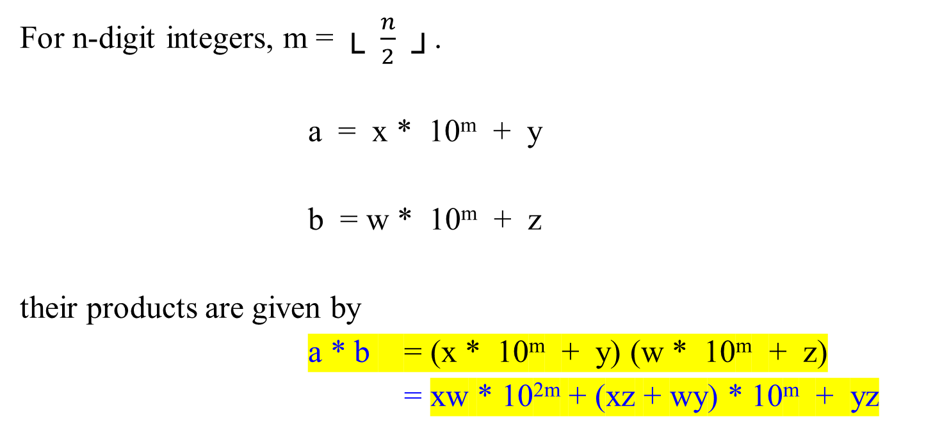
Multiplication of Large Integers
For n-digit integers, m = └ $\frac{n}{2}$ ┘.
a = x * 10^{m} + y
b = w * 10^{m} + z
their products are given by
a * b = (x * 10^{m} + y) (w * 10^{m} + z)
= xw * 10^{2m} + (xz + wy) * 10^{m} + yz

Slide 67
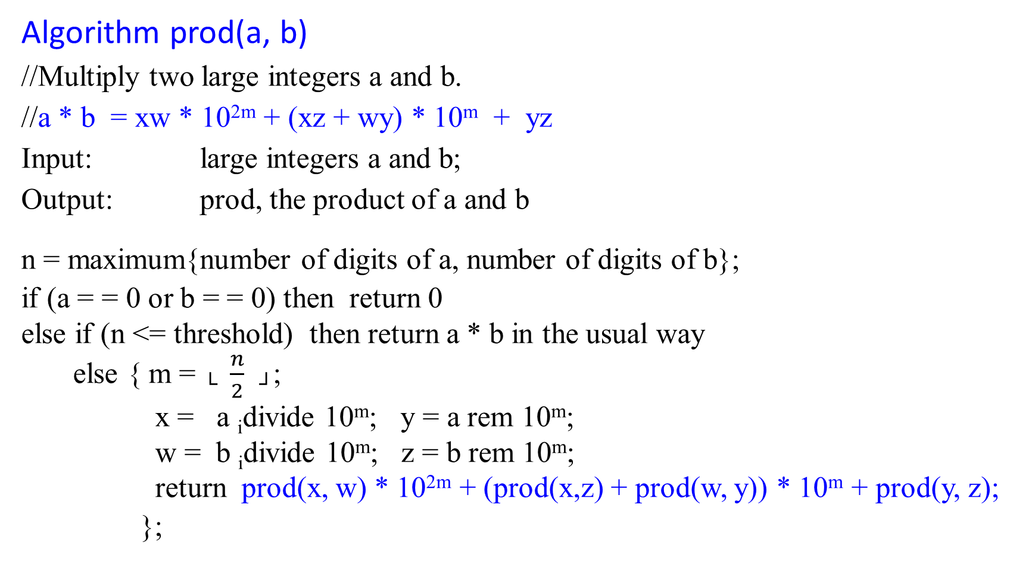
Multiplication of Large Integers
Algorithm prod(a, b)
//Multiply two large integers a and b.
//a * b = xw * 10^{2m} + (xz + wy) * 10^{m} + yz
Input: large integers a and b;
Output: prod, the product of a and b
n = maximum{number of digits of a, number of digits of b};
if (a = = 0 or b = = 0) then return 0
else if (n <= threshold) then return a * b in the usual way
else { m = └ $\frac{n}{2}$ ┘;
x = a _{i}divide 10^{m}; y = a rem 10^{m};
w = b _{i}divide 10^{m}; z = b rem 10^{m};
return prod(x, w) * 10^{2m} + (prod(x,z) + prod(w, y)) * 10^{m} + prod(y, z);
};
normal
a = 9423723, m = 3, x = 9423 y = 723

Slide 68
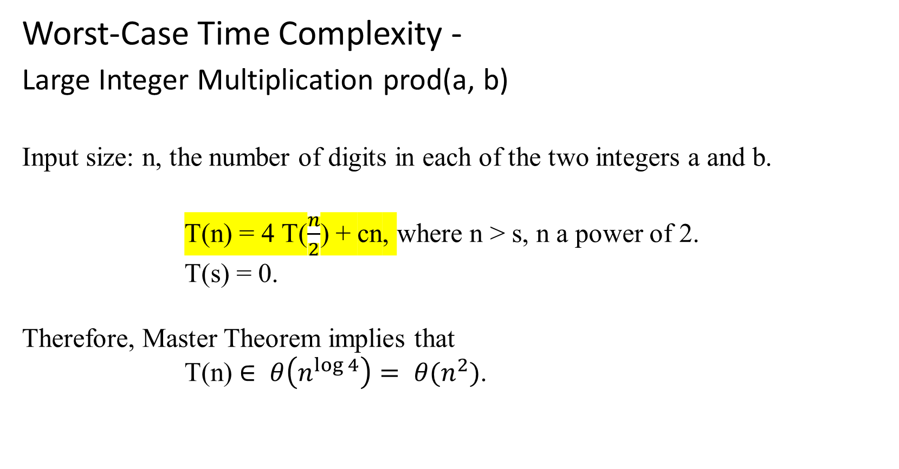
Multiplication of Large Integers
Worst-Case Time Complexity -
Large Integer Multiplication prod(a, b)
Input size: n, the number of digits in each of the two integers a and b.
T(n) = 4 T($\frac{n}{2}$) + cn, where n > s, n a power of 2.
T(s) = 0.
Therefore, Master Theorem implies that
T(n) $∈ θ\left(n^{\log{4}}\right)= θ(n^{2})$.

Slide 69
Multiplication of Large Integers
a * b = (x * 10^{m} + y) (w * 10^{m} + z), where a = xy and b = wz
= xw * 10^{2m} + (xz + yw) * 10^{m} + yz …. (normal way)
Improved approach:
if instead we set
r = (x + y) (w + z) = xw + (xz + yw) + yz,
then
xz + yw = r – xw – yz.
= (x + y) (w + z) – xw – yz.
a * b = (x * 10^{m} + y) (w * 10^{m} + z)
= xw * 10^{2m} + (r – xw – yz) * 10^{m} + yz
= xw * 10^{2m} + ((x + y) (w + z) – xw – yz) * 10^{m} + yz

Slide 70
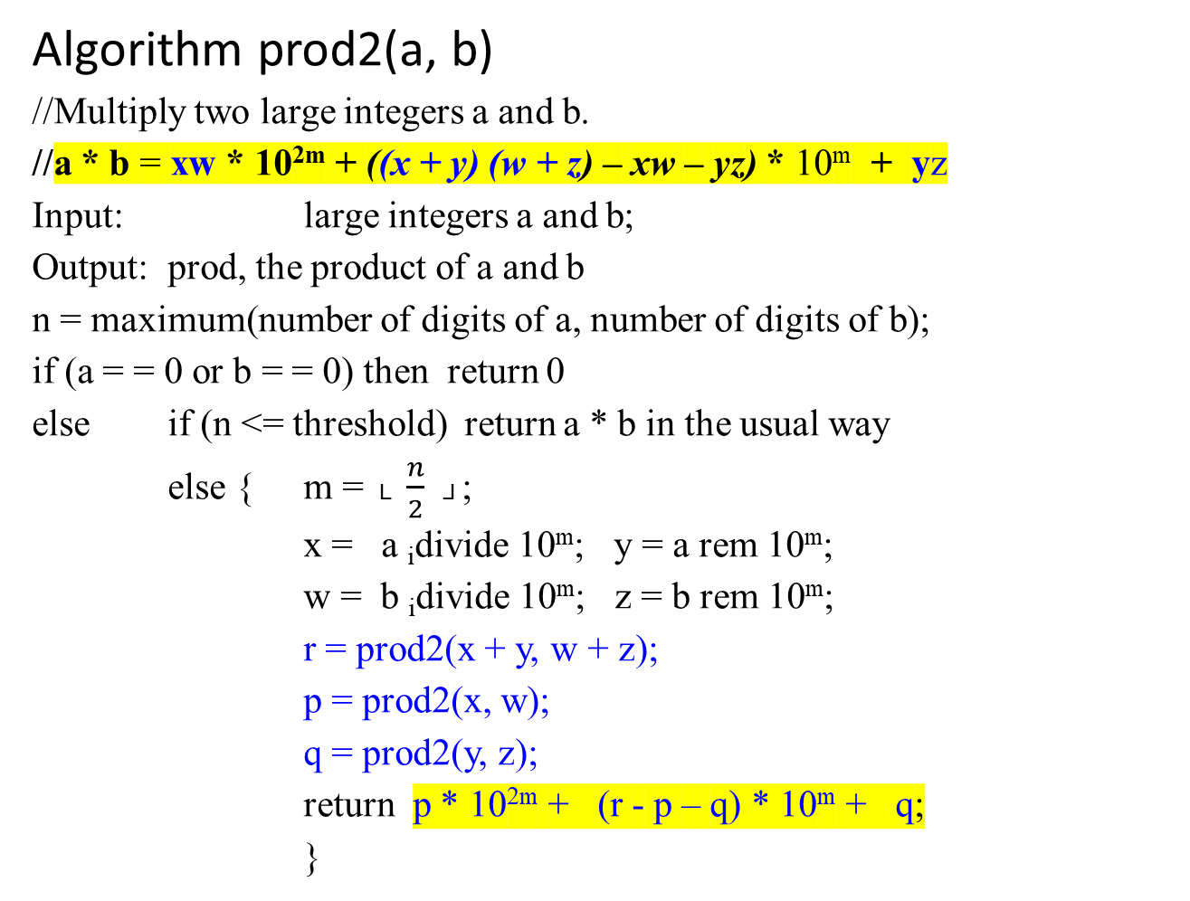
//a * b = xw * 10^{2m} + ((x + y) (w + z) – xw – yz) * 10^{m} + yz
Algorithm prod2(a, b)
//Multiply two large integers a and b.
//a * b = xw * 10^{2m} + ((x + y) (w + z) – xw – yz) * 10^{m} + yz
Input: large integers a and b;
Output: prod, the product of a and b
n = maximum(number of digits of a, number of digits of b);
if (a = = 0 or b = = 0) then return 0
else if (n <= threshold) return a * b in the usual way
else { m = └ $\frac{n}{2}$ ┘;
x = a _{i}divide 10^{m}; y = a rem 10^{m};
w = b _{i}divide 10^{m}; z = b rem 10^{m};
r = prod2(x + y, w + z);
p = prod2(x, w);
q = prod2(y, z);
return p * 10^{2m} + (r - p – q) * 10^{m} + q;
}
improved

Slide 71
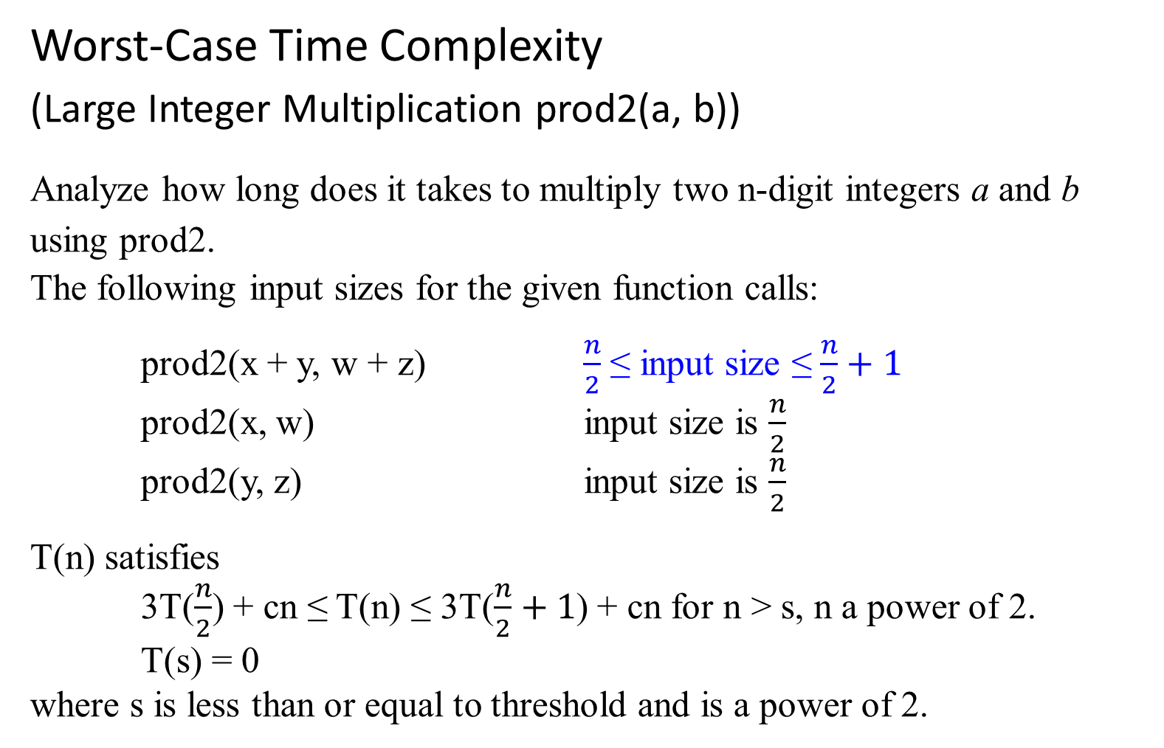
Worst-Case Time Complexity
(Large Integer Multiplication prod2(a, b))
Analyze how long does it takes to multiply two n-digit integers a and b using prod2.
The following input sizes for the given function calls:
prod2(x + y, w + z) $\frac{n}{2}$ ≤ input size ≤ $\frac{n}{2}+1$
prod2(x, w) input size is $\frac{n}{2}$
prod2(y, z) input size is $\frac{n}{2}$
T(n) satisfies
3T($\frac{n}{2}$) + cn ≤ T(n) ≤ 3T($\frac{n}{2}+1$) + cn for n > s, n a power of 2.
T(s) = 0
where s is less than or equal to threshold and is a power of 2.
Needs one more digit for sum of two numbers

Slide 72
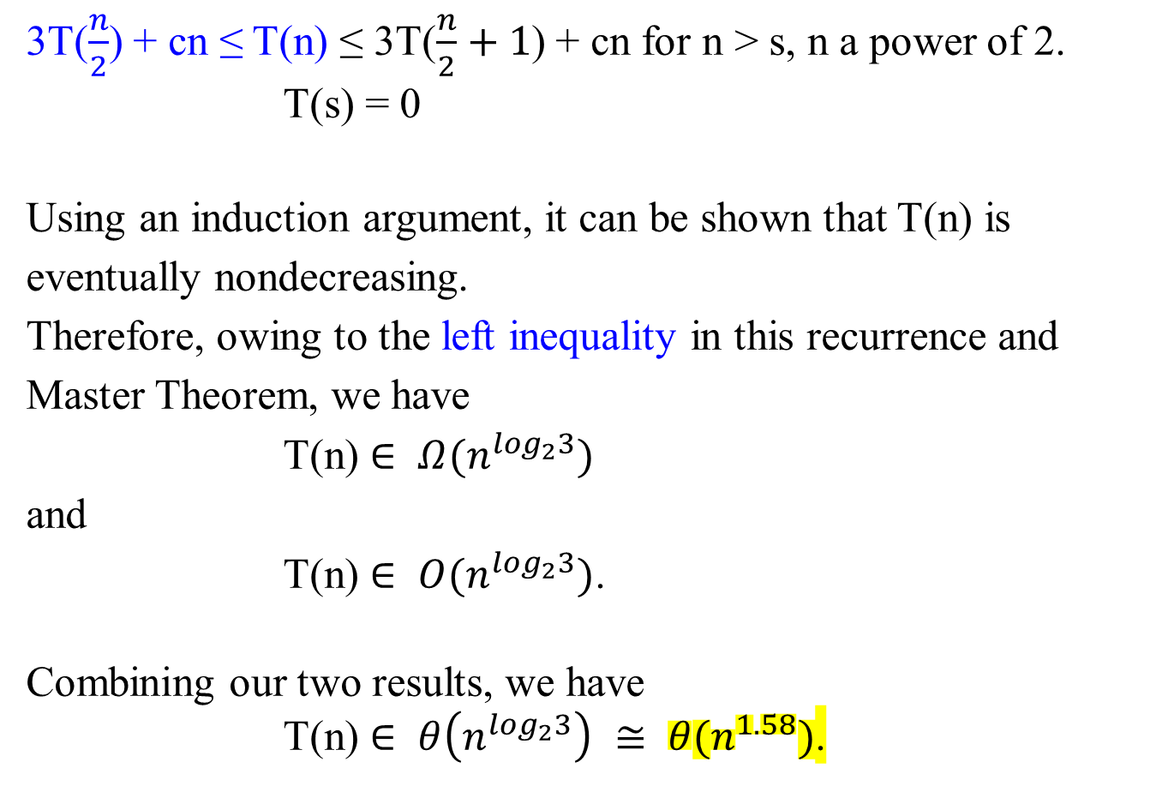
Multiplication of Large Integers
3T($\frac{n}{2}$) + cn ≤ T(n) ≤ 3T($\frac{n}{2}+1$) + cn for n > s, n a power of 2.
T(s) = 0
Using an induction argument, it can be shown that T(n) is eventually nondecreasing.
Therefore, owing to the left inequality in this recurrence and Master Theorem, we have
T(n) $∈ Ω(n^{\log_{2}3})$
and
T(n) $∈ O(n^{\log_{2}3})$.
Combining our two results, we have
T(n) $∈ θ\left(n^{\log_{2}3}\right) ≅ θ(n^{1.58})$.

Slide 73
Matrix Multiplication

Slide 74

Strassen’s Matrix Multiplication
Give two matrices A_{n*n} and B_{n*n}, find the time efficiency of the definition-based algorithm for computing their product C_{n*n} = A x B.
Brute-Force Algorithm: Let A_{row x col} denote A[0 .. n-1, 0 .. n-1].
b_{0,j}
b_{1,j}
…
(a_{i,0}, a_{i,1}, … a_{i,k},... , a_{i,n-1})( b_{k,j} ) = ( c_{ij} ) .
…
b_{n-1,j.}
where C[i,j] = A[i, 0]*B[0, j] + A[i, 1]*B[1, j] + … +
A[i, k]*B[k, j] + … + A[i, n-1]*B[n-1, j]
for every pair of indices 0 ≤ i, j ≤ n - 1.
normal

Slide 75

Algorithm MatrixMultiplication(A[0..n-1, 0..n-1], B[0..n-1, 0..n-1])
//Multiple two n-by-n matrices A_{row x col} and B_{row x col} by the definition-based algorithm. //C[i,j] = A[i, 0]*B[0, j] + A[i, 1]*B[1, j] + … + A[i, k]*B[k, j] + …
+ A[i, n-1]*B[n-1, j]
Input: Two n-by-n matrices A and B
Output: Matrix C = A*B
for ← 0 to n – 1 do
{for j ← 0 to n - 1 do
{ C[i, j] ← 0.0;
for k ← 0 to n – 1 do
{ C[i,j] ← C[i,j] + A[i,k]*B[k,j];}}}
return C;

Slide 76
Analysis of Algorithm
the total number of multiplications M(n) is:
∑^{n-1}_{i=0} ∑^{n-1}_{j=0} ∑^{n-1}_{k=0} 1
Since ∑^{n-1}_{k=0} 1 = n -1 – 0 + 1 = n, we get
M(n) = ∑^{n-1}_{i=0} ∑^{n-1}_{j=0} ∑^{n-1}_{k=0} 1
= ∑^{n-1}_{i=0} ∑^{n-1}_{j=0} n
= ∑^{n-1}_{i=0} n²
= n³
T(n) ≈ c_{m} M(n) + c_{a} A(n) = c_{m} n³ + c_{a} n³
= (c_{m} + c_{a})n³

Slide 77
Analysis of Algorithm
For example
2 3 5 7
*
4 1 6 8
2 * 5 + 3 * 6 2 * 7 + 3 * 8 28 38
= =
4 * 5 + 1 * 6 4 * 7 + 1 * 8 26 36
The brute-force algorithm requires eight multiplications and four additions

Slide 78

Strassen’s Matrix Multiplication
The principal insight of Strassen’s algorithm lies in the discovery that
  the product C of two 2 x 2 matrices A and B can be done with just seven (7) multiplications and eighteen (18) additions/subtractions
as opposed to
  the eight (8) multiplications and four (4) additions required by the brute-force algorithm.
We have saved one multiplication at the expense of doing 14 additional additions or subtractions.

Slide 79
Strassen’s Matrix Multiplication
This is accomplished by using the following formulas:
c₀₀ c₀₁ a₀₀ a₀₁ b₀₀ b₀₁
= *
c₁₀ c₁₁ a₁₀ a₁₁ b₁₀ b₁₁
m₁ + m₄ – m₅ + m₇ m₃ + m₅
=
m₂ + m₄ m₁ + m₃ – m₂ + m₆
where
m₁ = (a₀₀ + a₁₁) * (b₀₀ + b₁₁), m₂ = (a₁₀ + a₁₁) * b₀₀
m₃ = a₀₀ * (b₀₁ - b₁₁), m₄ = a₁₁ * (b₁₀ - b₀₀)
m₅ = (a₀₀ + a₀₁) * b₁₁, m₆ = (a₁₀ - a₀₀) * (b₀₀ + b₀₁)
m₇ = (a₀₁ - a₁₁) * (b₁₀ + b₁₁)

Slide 80
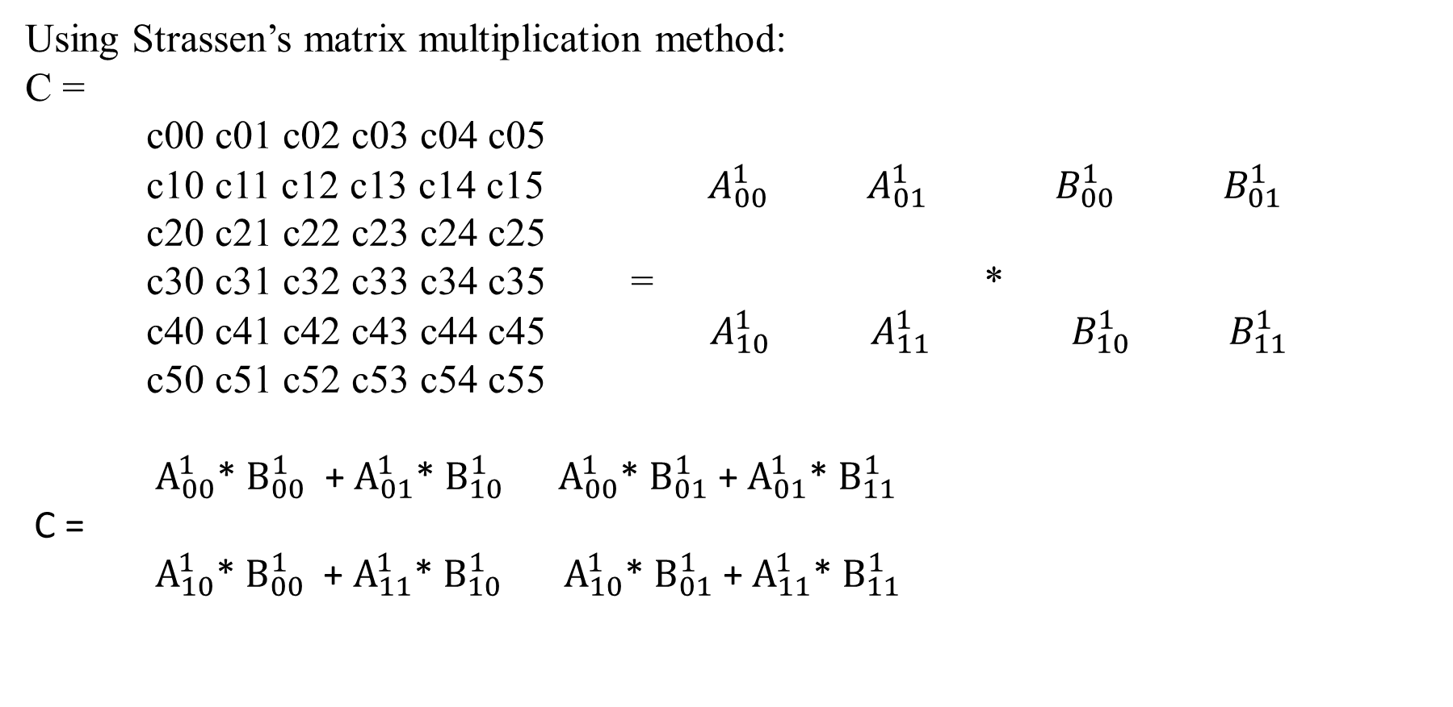
Strassen’s Matrix Multiplication
Using Strassen’s matrix multiplication method:
C =
c00 c01 c02 c03 c04 c05
c10 c11 c12 c13 c14 c15 ${ A}_{00}^{1}$ $A_{01}^{1}$ $B_{00}^{1}$ ${ B}_{01}^{1}$ c20 c21 c22 c23 c24 c25
c30 c31 c32 c33 c34 c35 = *
c40 c41 c42 c43 c44 c45 ${ A}_{10}^{1}$ ${ A}_{11}^{1}$ ${ B}_{10}^{1} { B}_{11}^{1}$ c50 c51 c52 c53 c54 c55
$A_{00}^{1}$*${ B}_{00}^{1}$ + $A_{01}^{1}$*${ B}_{10}^{1}$ $A_{00}^{1}$*${ B}_{01}^{1}$ + $A_{01}^{1}$*${ B}_{11}^{1}$
C =
${ A}_{10}^{1}$*${ B}_{00}^{1}$ + $A_{11}^{1}$*${ B}_{10}^{1}$ ${ A}_{10}^{1}$*${ B}_{01}^{1}$ + $A_{11}^{1}$*${ B}_{11}^{1}$

Slide 81
Analysis of Algorithm
Let evaluate the asymptotic efficiency of this algorithm.
Let M(n) be the number of multiplications made by Strassen’s algorithm in multiplying two n-by-n matrices (where n is a power of 2).
Then, the algorithm has the following recurrence relation:
M(n) = 7M(n/2) for n > 1
M(1) = 1. When n = 1, two numbers are simply multiplied.

Slide 82
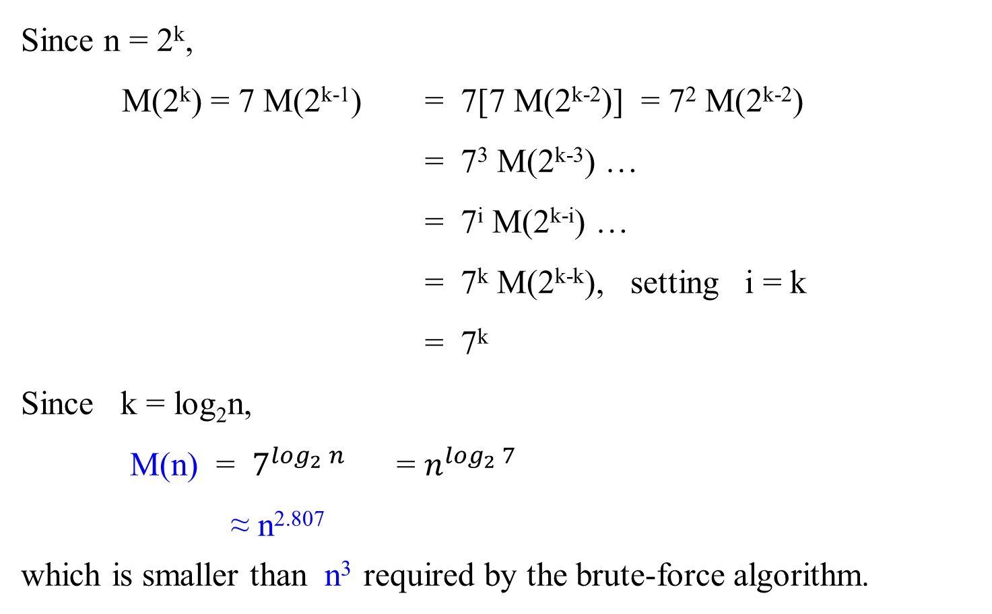
Analysis of Algorithm
Since n = 2^{k},
M(2^{k}) = 7 M(2^{k-1}) = 7[7 M(2^{k-2})] = 7² M(2^{k-2})
= 7³ M(2^{k-3}) …
= 7^{i} M(2^{k-i}) …
= 7^{k} M(2^{k-k}), setting i = k
= 7^{k}
Since k = log₂n,
M(n) = $7^{\log_{2}{n}}$ = $n^{\log_{2}{7}}$
≈ n^{2.807}
which is smaller than n³ required by the brute-force algorithm.

Slide 83
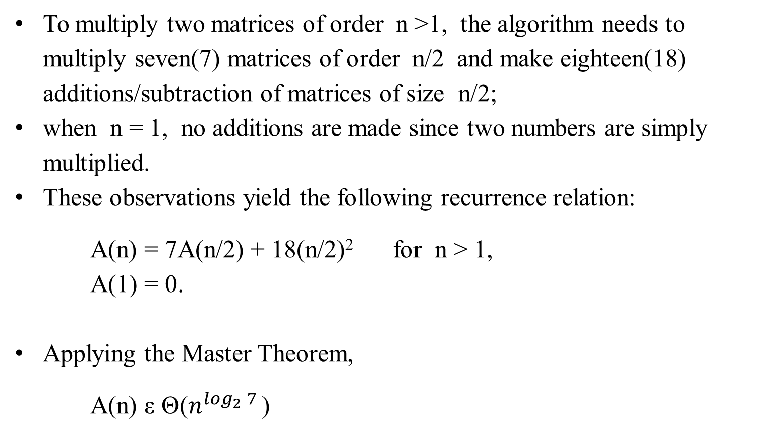
Analysis of Algorithm
To multiply two matrices of order n >1, the algorithm needs to multiply seven(7) matrices of order n/2 and make eighteen(18) additions/subtraction of matrices of size n/2;
when n = 1, no additions are made since two numbers are simply multiplied.
These observations yield the following recurrence relation:
A(n) = 7A(n/2) + 18(n/2)² for n > 1,
A(1) = 0.
Applying the Master Theorem,
A(n) ε Θ($n^{\log_{2}{7}}$ )

Slide 84
Polynomials and
the Fast Fourier Transform (FFT)

