Slide 1
Chapter 01_06
RSA Cryptography

Slide 2

Cryptography – The RSA Public Key Cryptosystem
Contents:
Introduction to RSA Cryptography [4 – 13]
RSA Cryptography – Formalization [28 - 30 ]
Algorithm Modular_Linear_Equation_sL(a, b, n) [31, 34]
Algorithm Extended_Euclid(a, b) [32, 35-36]
An Application Example [39 – 50]

Slide 3
Cryptography – The RSA Public Key Cryptosystem
The Rivest-Shamir-Adleman (RSA) cryptosystem uses
all the ideas to derive strong guarantees of security
the polynomial-time computability of certain number-theoretic tasks
    modular exponentiation,
    greatest common divisor,
    primality testing and
  the intractability of others (factoring).

Slide 4
Cryptography – The RSA Public Key Cryptosystem
How to encrypt and decrypt the message using the RSA cipher:
Pick two large integers p and q,
  [say, in the order of several hundred digits each, and are
  virtually sure to be prime].
To encrypt a plaintext message M using the RSA cipher, a person needs to know the publicly available values of
    pq and
    integer e
Only the person who knows the individual values of p and q can decrypt an encrypted message M.

Slide 5

Cryptography – The RSA Public Key Cryptosystem
Case Study:
To set up an RSA cipher. Elain chooses:
  two prime numbers, p = 5, q = 11, and then computes n = pq = 55,
  a positive integer e = 3, which is relatively prime to (p-1)(q-1) = 40.
To be distributed widely are public keys:
  n = 55, the product of two numbers p and q
  e = 3.
  [Elain keeps p and q as the secret key.]
[The effectiveness of the system is
  the secrecy of the cipher: two distinct large integers p, q
    both are in the order of several hundred digits each
    both are virtually certain to be prime.
  And pick a very large e which is relatively prime to (p -1)(q – 1).]

Slide 6

Cryptography – The RSA Public Key Cryptosystem
Case Study:
The RSA cipher works only on numbers.
Elain informs people how she will interpret the numbers in the message according to the following guidelines:
  Encodes letters of the alphabet the same way as was done for the Caesar cipher:
A = 1, B = 2, C = 3, …, H = 8, I = 9, …, Z = 26.
  Divide long messages into blocks of messages
    e.g., each block has a single, numerically encoded alphabet letter.

Slide 7

Cryptography – The RSA Public Key Cryptosystem
Case Study:
Sending Alex a message, she requires, according to the given guidelines:
  breaks the message into blocks,
    each contains a single letter (or could be multiple letters).
  Finds the numeric equivalent for each block.
  Converts each block plaintext M into ciphertext C:
C = Me mod pq. ……..(RSA 0.1)
Anyone who knows modular arithmetic can use these public keys to encrypt a message sent to Alex since both pq and e are public keys.
(Alex receives the ciphertext C for the plaintext M in a block of several blocks.)

Slide 8

Cryptography – The RSA Public Key Cryptosystem
Case Study:
Example 0.1.1 Encrypting a Message Using RSA Cryptography
For sending Alex a ciphertext of the message HI, Elain
  computes the ciphertext (i.e., the encrypted message) for the message HI.
  Divide the message into two blocks: the H and the I.
  Encode H as 08, or 8.
  Use formula C = Me (mod pq) to compute the ciphertext for H:
    C = 8³ mod 55
  = 512 mod 55 = 17.
  Encode I as 09, or 9.
  Compute the ciphertext for I:
    C = 9³ (mod 55)
    = 729 mod 55 = 14.
    Then, Elain sends Alex the encrypted message 1714.

Slide 9

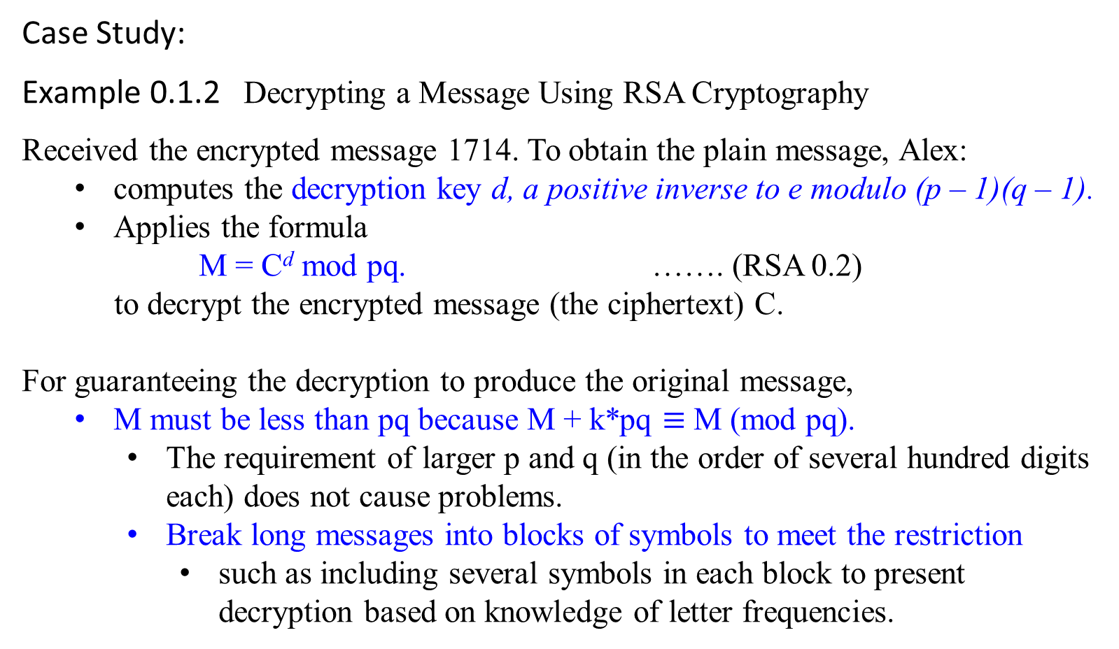
RSA Cryptography
Case Study:
Example 0.1.2 Decrypting a Message Using RSA Cryptography
Received the encrypted message 1714. To obtain the plain message, Alex:
  computes the decryption key d, a positive inverse to e modulo (p – 1)(q – 1).
  Applies the formula
  M = C^{d} mod pq. ……. (RSA 0.2)
  to decrypt the encrypted message (the ciphertext) C.
For guaranteeing the decryption to produce the original message,
  M must be less than pq because M + k*pq $≡$ M (mod pq).
    The requirement of larger p and q (in the order of several hundred digits each) does not cause problems.
    Break long messages into blocks of symbols to meet the restriction
      such as including several symbols in each block to present decryption based on knowledge of letter frequencies.

Slide 10

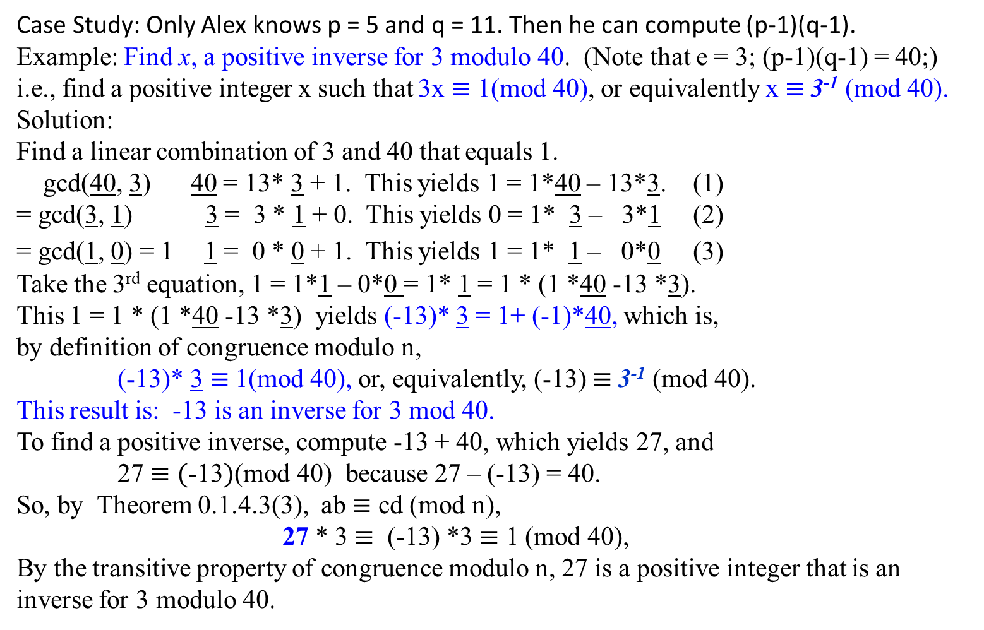
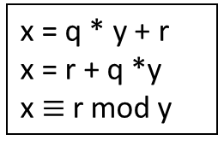
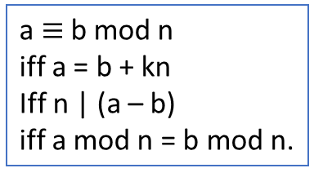
RSA Cryptography
Case Study: Only Alex knows p = 5 and q = 11. Then he can compute (p-1)(q-1).
Example: Find x, a positive inverse for 3 modulo 40. (Note that e = 3; (p-1)(q-1) = 40;)
i.e., find a positive integer x such that 3x $≡$ 1(mod 40), or equivalently x $≡$3⁻¹ (mod 40).
Solution:
Find a linear combination of 3 and 40 that equals 1.
gcd(40, 3) 40 = 13* 3 + 1. This yields 1 = 1*40 – 13*3. (1)
= gcd(3, 1) 3 = 3 * 1 + 0. This yields 0 = 1* 3 – 3*1 (2)
= gcd(1, 0) = 1 1 = 0 * 0 + 1. This yields 1 = 1* 1 – 0*0 (3)
Take the 3rd equation, 1 = 1*1 – 0*0 = 1* 1 = 1 * (1 *40 -13 *3).
This 1 = 1 * (1 *40 -13 *3) yields (-13)* 3 = 1+ (-1)*40, which is,
by definition of congruence modulo n,
(-13)* 3 $≡$1(mod 40), or, equivalently, (-13) $≡$3⁻¹ (mod 40).
This result is: -13 is an inverse for 3 mod 40.
To find a positive inverse, compute -13 + 40, which yields 27, and
27 $≡(\text{−13})$(mod 40) because 27 – (-13) = 40.
So, by Theorem 0.1.4.3(3), ab $≡$ cd (mod n),
27 * 3 $≡$ (-13) *3 $≡$ 1 (mod 40),
By the transitive property of congruence modulo n, 27 is a positive integer that is an inverse for 3 modulo 40.
x = q * y + r
x = r + q *y
x $≡$r mod y
a $≡$b mod n
iff a = b + kn
Iff n | (a – b)
iff a mod n = b mod n.

Slide 11
RSA Cryptography
Case Study:
Example 0.1.2 Decrypting a Message Using RSA Cryptography
Alex knows pq = 55 and e =3 as everyone has.
Alex also knows the secret key: p = 5 and q = 11, allowing him to compute (p -1)(q – 1) = 40.
He finds the decryption key 27, a positive inverse for 3 modulo 40.
He then decrypts the encrypted message C by computing
M = C^{d} mod pq = 17²⁷ mod 55.
The residues obtained when 17 is raised successively to 2⁴ = 16.
27₁₀ = 11011₂ = 2⁴ + 2³ + 2 + 1 = 16 + 8 + 2 + 1
17 mod 55 = 17
17² mod 55 = 14
17⁴ mod 55 = (17²)² mod 55 = (17² mod 55)² mod 55 = (14)² mod 55 = 31
17⁸ mod 55 = (17⁴)² mod 55 = (17⁴ mod 55)² mod 55 = (31)² mod 55 = 26
17¹⁶ mod 55 = (17⁸)² mod 55 = (26)² mod 55 = 16
Then 17²⁷ = 17¹⁶ ⁺ ⁸ ⁺ ² ⁺ ¹ = 17¹⁶ * 17⁸ * 17² * 17¹.

Slide 12

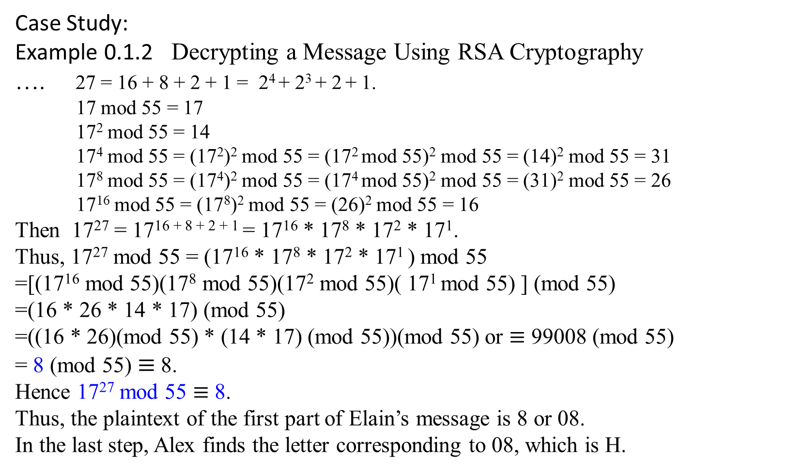
RSA Cryptography
Case Study:
Example 0.1.2 Decrypting a Message Using RSA Cryptography
…. 27 = 16 + 8 + 2 + 1 = 2⁴ + 2³ + 2 + 1.
17 mod 55 = 17
17² mod 55 = 14
17⁴ mod 55 = (17²)² mod 55 = (17² mod 55)² mod 55 = (14)² mod 55 = 31
17⁸ mod 55 = (17⁴)² mod 55 = (17⁴ mod 55)² mod 55 = (31)² mod 55 = 26
17¹⁶ mod 55 = (17⁸)² mod 55 = (26)² mod 55 = 16
Then 17²⁷ = 17¹⁶ ⁺ ⁸ ⁺ ² ⁺ ¹ = 17¹⁶ * 17⁸ * 17² * 17¹.
Thus, 17²⁷ mod 55 = (17¹⁶ * 17⁸ * 17² * 17¹ ) mod 55
=[(17¹⁶ mod 55)(17⁸ mod 55)(17² mod 55)( 17¹ mod 55) ] (mod 55)
=(16 * 26 * 14 * 17) (mod 55)
=((16 * 26)(mod 55) * (14 * 17) (mod 55))(mod 55) or $≡$ 99008 (mod 55)
= 8 (mod 55) $≡$ 8.
Hence 17²⁷ mod 55 $≡$ 8.
Thus, the plaintext of the first part of Elain’s message is 8 or 08.
In the last step, Alex finds the letter corresponding to 08, which is H.

Slide 13
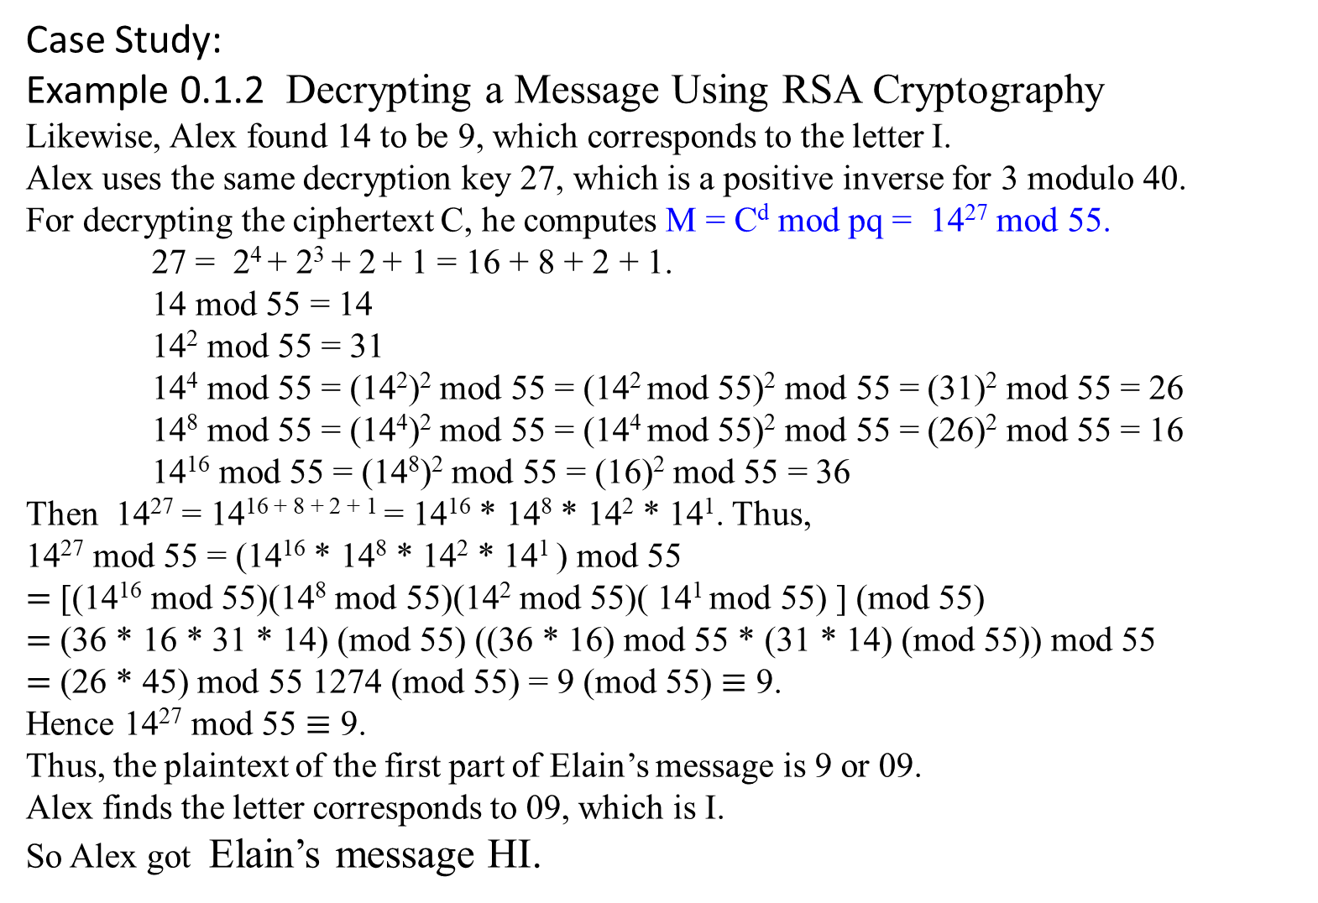
RSA Cryptography
Case Study:
Example 0.1.2 Decrypting a Message Using RSA Cryptography
Likewise, Alex found 14 to be 9, which corresponds to the letter I.
Alex uses the same decryption key 27, which is a positive inverse for 3 modulo 40.
For decrypting the ciphertext C, he computes M = C^{d} mod pq = 14²⁷ mod 55.
27 = 2⁴ + 2³ + 2 + 1 = 16 + 8 + 2 + 1.
14 mod 55 = 14
14² mod 55 = 31
14⁴ mod 55 = (14²)² mod 55 = (14² mod 55)² mod 55 = (31)² mod 55 = 26
14⁸ mod 55 = (14⁴)² mod 55 = (14⁴ mod 55)² mod 55 = (26)² mod 55 = 16
14¹⁶ mod 55 = (14⁸)² mod 55 = (16)² mod 55 = 36
Then 14²⁷ = 14¹⁶ ⁺ ⁸ ⁺ ² ⁺ ¹ = 14¹⁶ * 14⁸ * 14² * 14¹. Thus,
14²⁷ mod 55 = (14¹⁶ * 14⁸ * 14² * 14¹ ) mod 55
$=$ [(14¹⁶ mod 55)(14⁸ mod 55)(14² mod 55)( 14¹ mod 55) ] (mod 55)
$=$ (36 * 16 * 31 * 14) (mod 55) ((36 * 16) mod 55 * (31 * 14) (mod 55)) mod 55
$=$ (26 * 45) mod 55 1274 (mod 55) = 9 (mod 55) $≡$ 9.
Hence 14²⁷ mod 55 $≡$ 9.
Thus, the plaintext of the first part of Elain’s message is 9 or 09.
Alex finds the letter corresponds to 09, which is I.
So Alex got Elain’s message HI.

Slide 14
RSA Cryptography
How secure is it?
The computations it requires of Elain and Alex are elementary.
But how secure is it against others?
The security of RSA hinges upon a simple assumption:
  Give N, e, and y = x^{e} mod N, it is computationally intractable to determine x.

Slide 15
For better understanding, read the following slides.
Why Does the RSA Cipher Work?
Brief summary with an example
Otherwise, skip those slides and go to:
RSA Cryptography – Formalization
Application of the formalism of
RSA Cryptography

Slide 16
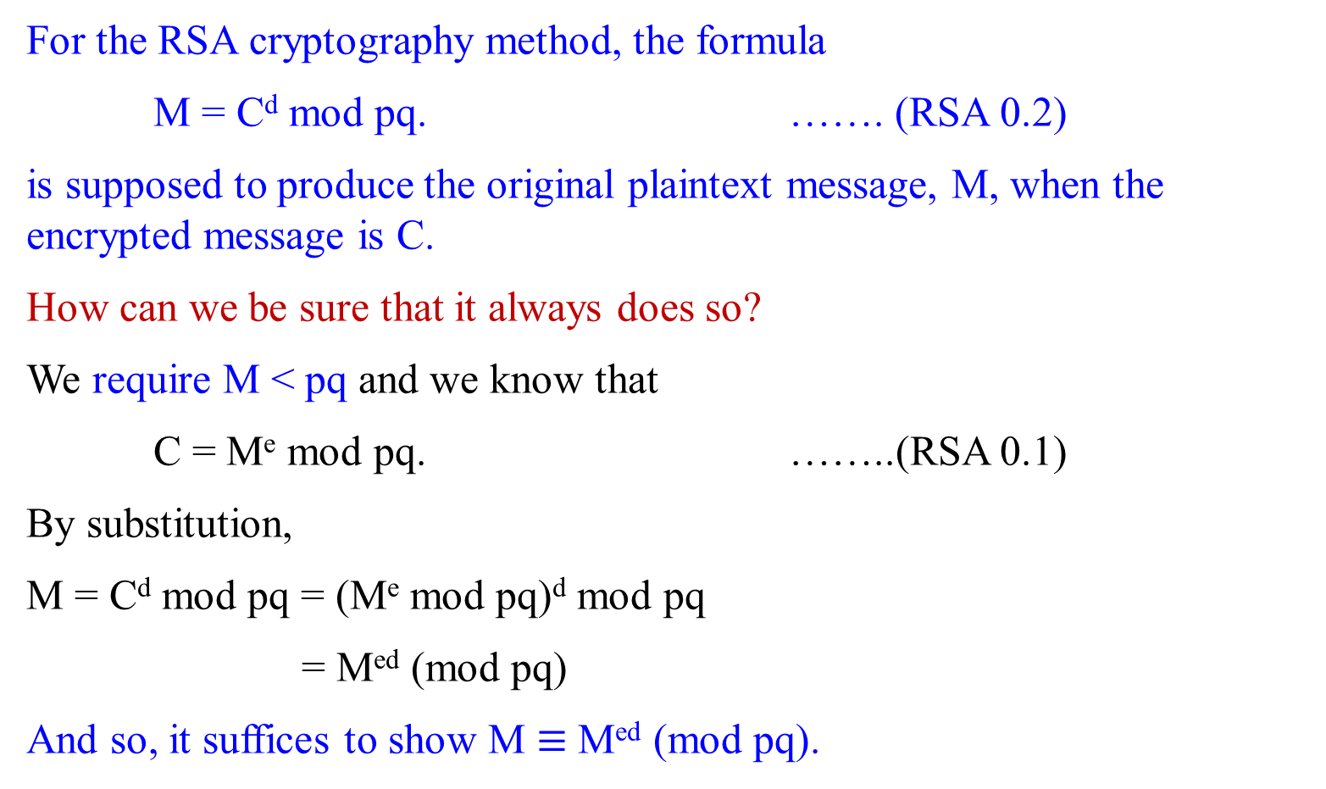
Why Does the RSA Cipher Work?
For the RSA cryptography method, the formula
M = C^{d} mod pq. ……. (RSA 0.2)
is supposed to produce the original plaintext message, M, when the encrypted message is C.
How can we be sure that it always does so?
We require M < pq and we know that
C = Me mod pq. ……..(RSA 0.1)
By substitution,
M = C^{d} mod pq = (Me mod pq)^{d} mod pq
= M^{ed} (mod pq)
And so, it suffices to show M $≡$ M^{ed} (mod pq).
begin

Slide 17
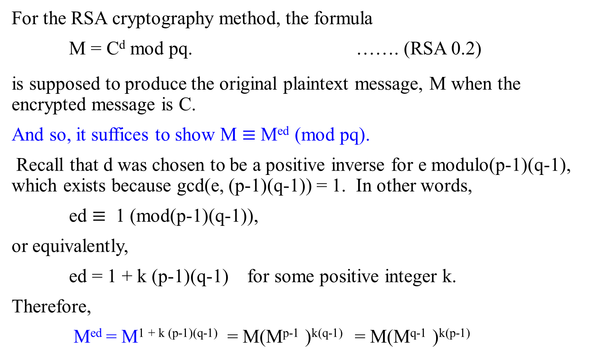
Why Does the RSA Cipher Work?
For the RSA cryptography method, the formula
M = C^{d} mod pq. ……. (RSA 0.2)
is supposed to produce the original plaintext message, M when the encrypted message is C.
And so, it suffices to show M $≡$ M^{ed} (mod pq).
Recall that d was chosen to be a positive inverse for e modulo(p-1)(q-1), which exists because gcd(e, (p-1)(q-1)) = 1. In other words,
ed $≡$ 1 (mod(p-1)(q-1)),
or equivalently,
ed = 1 + k (p-1)(q-1) for some positive integer k.
Therefore,
M^{ed} = M^{1 + k (p-1)(q-1)} = M(M^{p-1} )^{k(q-1)} = M(M^{q-1} )^{k(p-1)}

Slide 18
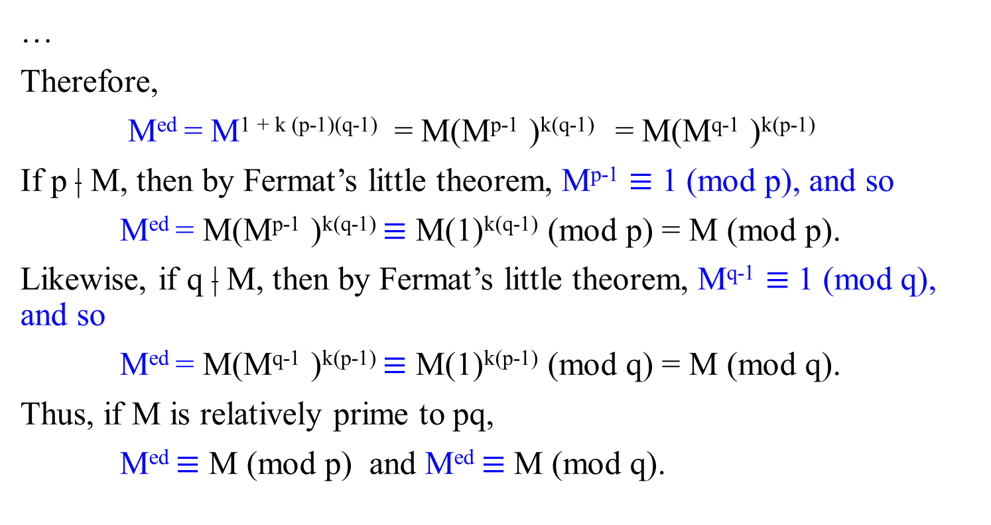
Why Does the RSA Cipher Work?
…
Therefore,
M^{ed} = M^{1 + k (p-1)(q-1)} = M(M^{p-1} )^{k(q-1)} = M(M^{q-1} )^{k(p-1)}
If p | M, then by Fermat’s little theorem, M^{p-1} $≡$ 1 (mod p), and so
M^{ed} = M(M^{p-1} )^{k(q-1)} $≡$ M(1)^{k(q-1)} (mod p) = M (mod p).
Likewise, if q | M, then by Fermat’s little theorem, M^{q-1} $≡$ 1 (mod q), and so
M^{ed} = M(M^{q-1} )^{k(p-1)} $≡$ M(1)^{k(p-1)} (mod q) = M (mod q).
Thus, if M is relatively prime to pq,
M^{ed} $≡$ M (mod p) and M^{ed} $≡$ M (mod q).

Slide 19
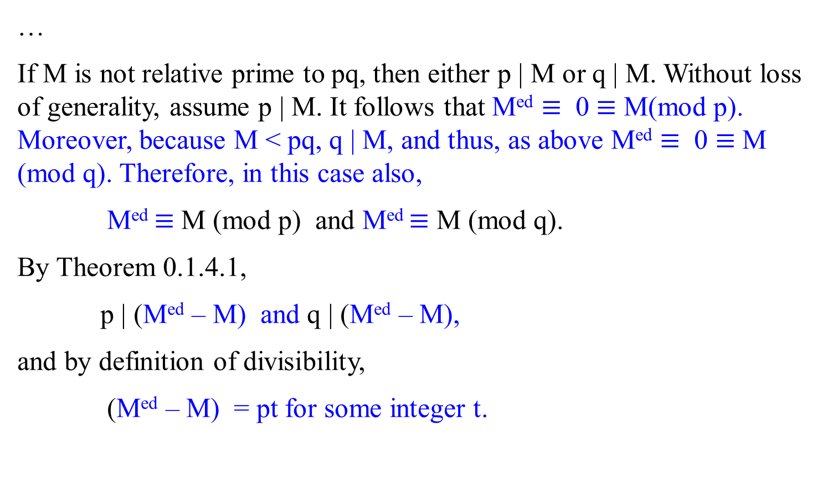
Why Does the RSA Cipher Work?
…
If M is not relative prime to pq, then either p | M or q | M. Without loss of generality, assume p | M. It follows that M^{ed} $≡$ 0 $≡$ M(mod p). Moreover, because M < pq, q | M, and thus, as above M^{ed} $≡$ 0 $≡$ M (mod q). Therefore, in this case also,
M^{ed} $≡$ M (mod p) and M^{ed} $≡$ M (mod q).
By Theorem 0.1.4.1,
p | (M^{ed} – M) and q | (M^{ed} – M),
and by definition of divisibility,
(M^{ed} – M) = pt for some integer t.

Slide 20
Why Does the RSA Cipher Work?
…
and by definition of divisibility,
(M^{ed} – M) = pt for some integer t.
By substitution, q | pt,
and since q and p are distinct prime numbers, Euclid’s lemma applies to give
q | t.
Thus, t = qu for some integer u by definition of divisibility.
By substitution,
M - M^{ed} = pt = p(qu) = (pq)u,
where u is an integer, and so,
pq | (M - M^{ed})

Slide 21
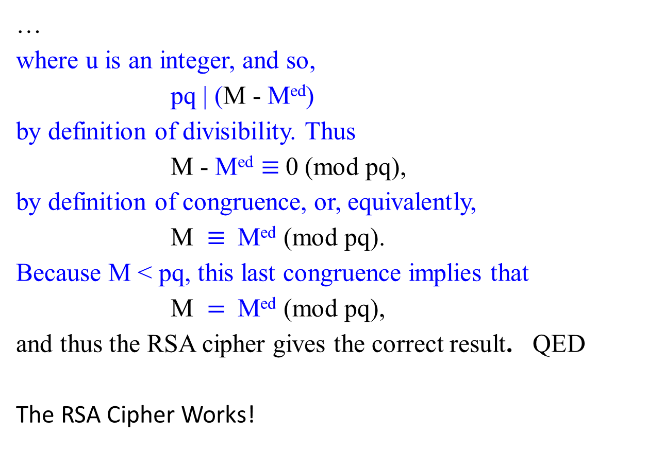
Why Does the RSA Cipher Work?
…
where u is an integer, and so,
pq | (M - M^{ed})
by definition of divisibility. Thus
M - M^{ed} $≡$0 (mod pq),
by definition of congruence, or, equivalently,
M $≡$ M^{ed} (mod pq).
Because M < pq, this last congruence implies that
M $=$ M^{ed} (mod pq),
and thus the RSA cipher gives the correct result. QED
The RSA Cipher Works!
end

Slide 22
Brief summary with an example

Slide 23
RSA
The RSA scheme is based heavily on number theory. Think of
messages from Elain to Alex as numbers modulo N;
messages larger than N can be broken into smaller pieces.
The encryption function will then be a bijection on {0, 1, 2, 3, …, N - 1}, and the decryption function will be its inverse.
What values of N are appropriate, and what bijection should be used?

Slide 24
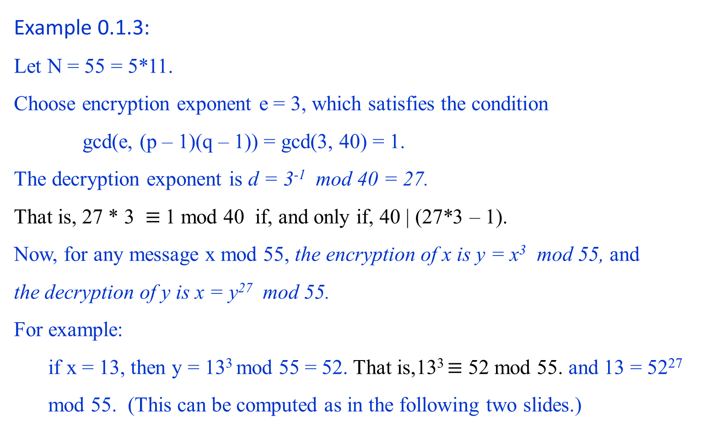
Example 0.1.3:
Let N = 55 = 5*11.
Choose encryption exponent e = 3, which satisfies the condition
gcd(e, (p – 1)(q – 1)) = gcd(3, 40) = 1.
The decryption exponent is d = 3⁻¹ mod 40 = 27.
That is, 27 * 3 $≡$1 mod 40 if, and only if, 40 | (27*3 – 1).
Now, for any message x mod 55, the encryption of x is y = x³ mod 55, and
the decryption of y is x = y²⁷ mod 55.
For example:
  if x = 13, then y = 13³ mod 55 = 52. That is,13³ $≡$ 52 mod 55. and 13 = 52²⁷ mod 55. (This can be computed as in the following two slides.)

Slide 25
Show 13 = 52²⁷ mod 55.
52²⁷ mod 55 = (52 mod 55)²⁷ mod 55
= (-3)²⁷ mod 55
= (-3)^{9*3} mod 55
= (81 * 81 * -3)³ mod 55, where 81 = (-3)⁴
= (26 * 26 * -3)³ mod 55
= (52 * 13 * -3)³ mod 55
= (-3 * 13 * -3)³ mod 55
= (117)³ mod 55
= (7)³ mod 55
= (343) mod 55
= 13
The other way is as follows:
Either this way or the way presented in the following slide.

Slide 26
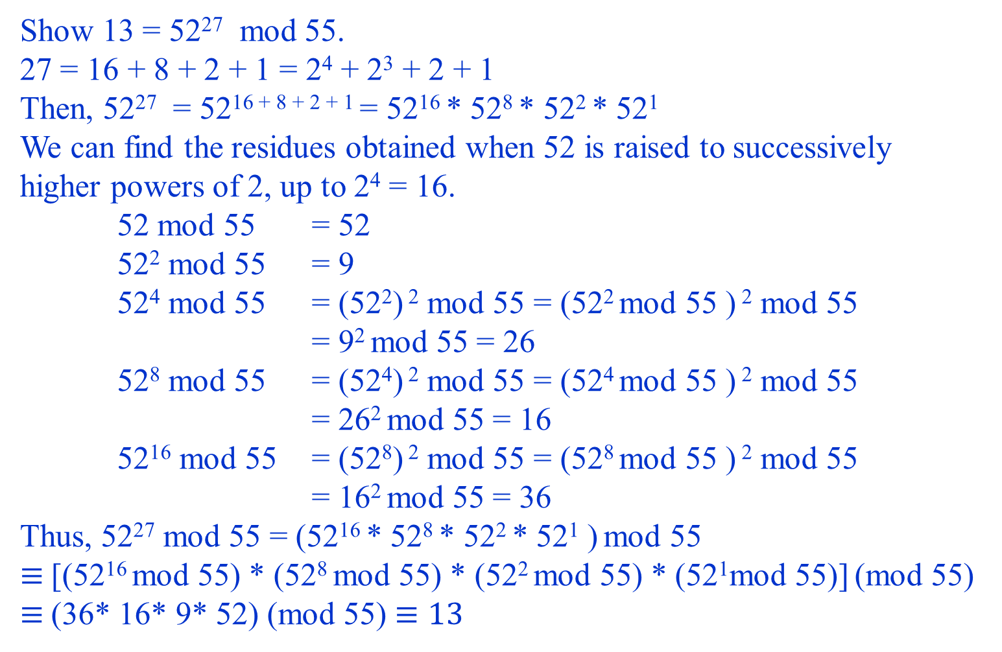
Show 13 = 52²⁷ mod 55.
27 = 16 + 8 + 2 + 1 = 2⁴ + 2³ + 2 + 1
Then, 52²⁷ = 52¹⁶ ⁺ ⁸ ⁺ ² ⁺ ¹ = 52¹⁶ * 52⁸ * 52² * 52¹
We can find the residues obtained when 52 is raised to successively higher powers of 2, up to 2⁴ = 16.
52 mod 55 = 52
52² mod 55 = 9
52⁴ mod 55 = (52²) ² mod 55 = (52² mod 55 ) ² mod 55
= 9² mod 55 = 26
52⁸ mod 55 = (52⁴) ² mod 55 = (52⁴ mod 55 ) ² mod 55
= 26² mod 55 = 16
52¹⁶ mod 55 = (52⁸) ² mod 55 = (52⁸ mod 55 ) ² mod 55
= 16² mod 55 = 36
Thus, 52²⁷ mod 55 = (52¹⁶ * 52⁸ * 52² * 52¹ ) mod 55
$≡$[(52¹⁶ mod 55) * (52⁸ mod 55) * (52² mod 55) * (52¹mod 55)] (mod 55)
$≡$(36* 16* 9* 52) (mod 55) $≡13$

Slide 27
RSA Cryptography - Formalization

Slide 28

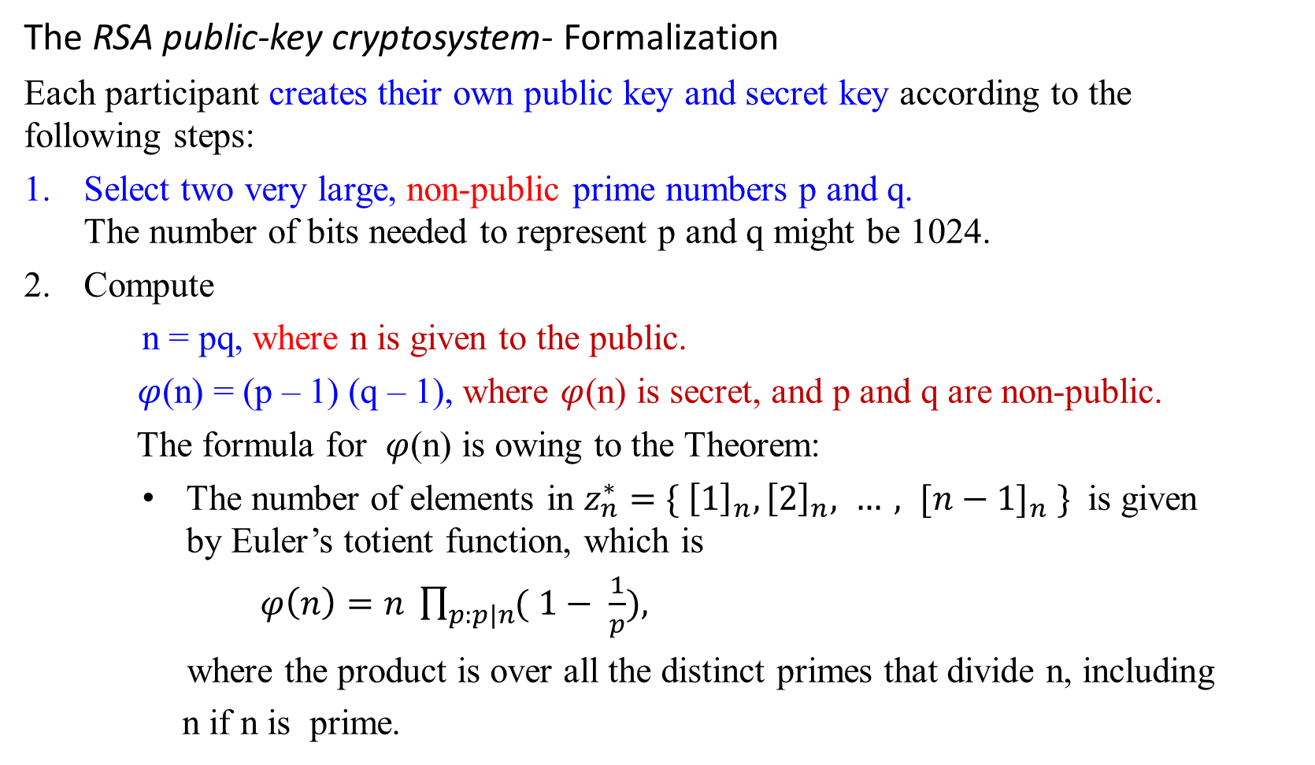

RSA Cryptography - Formalization
The RSA public-key cryptosystem- Formalization
Each participant creates their own public key and secret key according to the following steps:
Select two very large, non-public prime numbers p and q. The number of bits needed to represent p and q might be 1024.
Compute
n = pq, where n is given to the public.
$φ$(n) = (p – 1) (q – 1), where $φ$(n) is secret, and p and q are non-public.
The formula for $φ$(n) is owing to the Theorem:
  The number of elements in $z_{n}^{∗}=\{ {\left[1\right]}_{n}, {\left[2\right]}_{n}, …, {[n−1]}_{n} \}$ is given by Euler’s totient function, which is
$φ\left(n\right)=n \prod_{p:p|n}{( 1− \frac{1}{p}}),$
where the product is over all the distinct primes that divide n, including
n if n is prime.
n( 1 - $\frac{1}{p}$) ( 1 - $\frac{1}{q}$) = n ($\frac{(p−1)(q−1)}{pq}$) =(p-1)(q-1)

Slide 29
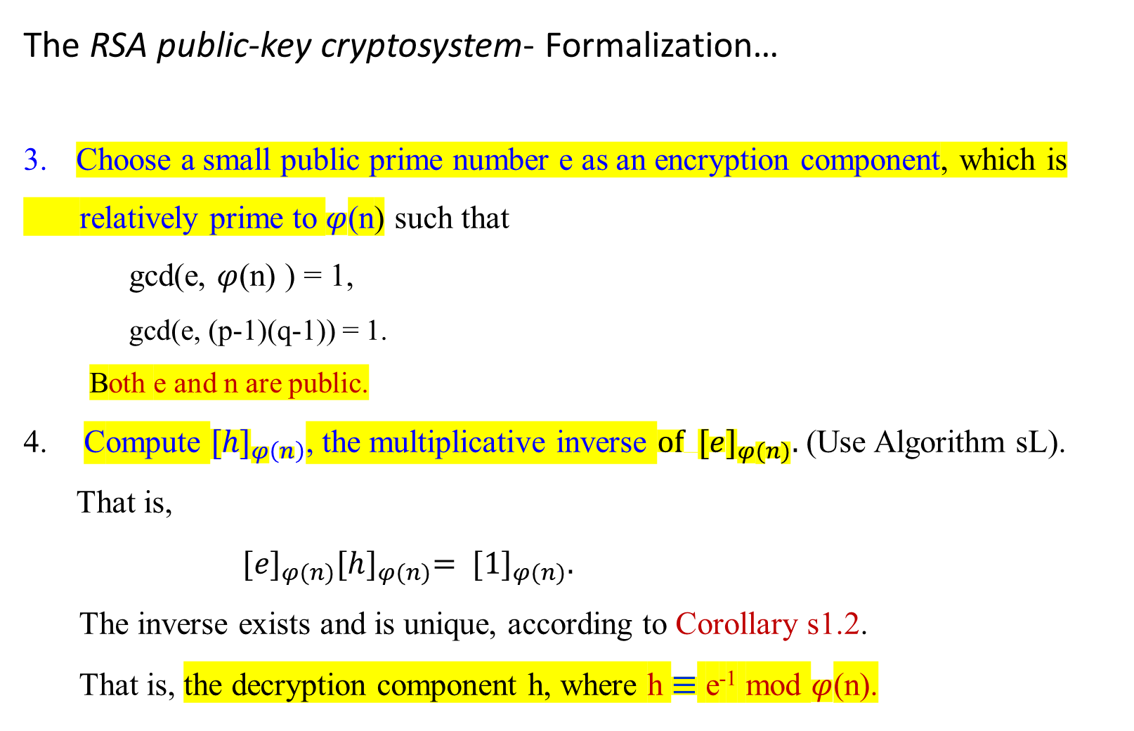
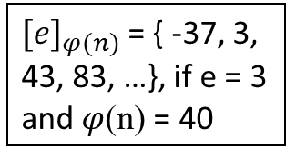
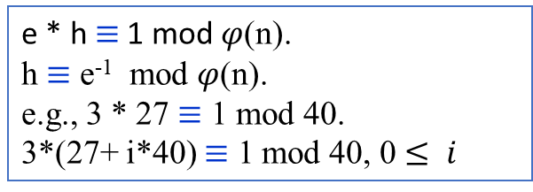
The RSA public-key cryptosystem- Formalization…
Choose a small public prime number e as an encryption component, which is
relatively prime to $φ$(n) such that
gcd(e, $φ$(n) ) = 1,
gcd(e, (p-1)(q-1)) = 1.
Both e and n are public.
Compute ${[h]}_{φ\left(n\right)}$, the multiplicative inverse $of { [e]}_{φ(n)}.$(Use Algorithm sL). That is,
${[e]}_{φ(n)}{[h]}_{φ(n)}= {[1]}_{φ(n)}.$
The inverse exists and is unique, according to Corollary s1.2.
That is, the decryption component h, where h $≡$ e⁻¹ mod $φ$(n).
e * h $≡$1 mod $φ$(n).
h $≡$ e⁻¹ mod $φ$(n).
e.g., 3 * 27 $≡$ 1 mod 40.
3*(27+ i*40) $≡$ 1 mod 40, 0 $≤ i$
${[e]}_{φ(n)}$= { -37, 3, 43, 83, …}, if e = 3 and $φ$(n) = 40

Slide 30

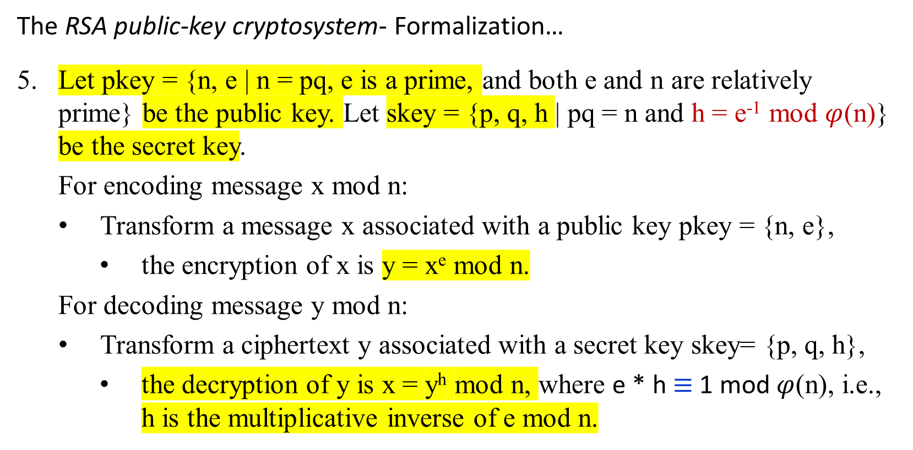
The RSA public-key cryptosystem- Formalization…
Let pkey = {n, e | n = pq, e is a prime, and both e and n are relatively prime} be the public key. Let skey = {p, q, h | pq = n and h = e⁻¹ mod $φ$(n)} be the secret key.
For encoding message x mod n:
  Transform a message x associated with a public key pkey = {n, e},
    the encryption of x is y = x^{e} mod n.
For decoding message y mod n:
  Transform a ciphertext y associated with a secret key skey= {p, q, h},
    the decryption of y is x = y^{h} mod n, where e * h $≡$1 mod $φ$(n), i.e., h is the multiplicative inverse of e mod n.
End of the formalization of the RSA public-key cryptosystem

Slide 31
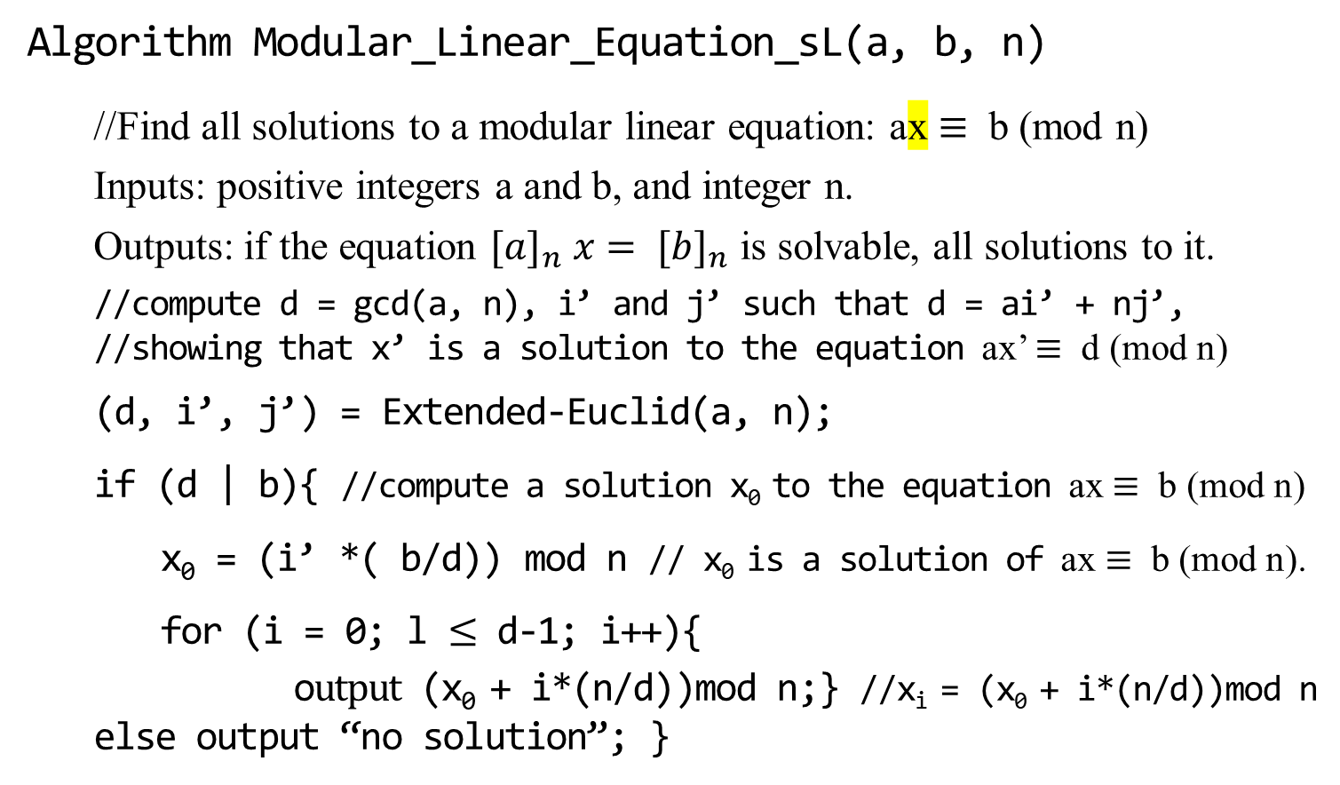
RSA Cryptography - Formalization
Takes O(log₂ n + gcd(a, n)) arithmetic operations
Algorithm Modular_Linear_Equation_sL(a, b, n)
//Find all solutions to a modular linear equation: ax $≡$ b (mod n)
Inputs: positive integers a and b, and integer n.
Outputs: if the equation ${[a]}_{n} x= {[b]}_{n}$ is solvable, all solutions to it.
//compute d = gcd(a, n), i’ and j’ such that d = ai’ + nj’, //showing that x’ is a solution to the equation ax’ $≡$ d (mod n)
(d, i’, j’) = Extended-Euclid(a, n);
if (d | b){ //compute a solution x₀ to the equation ax $≡$ b (mod n)
x₀ = (i’ *( b/d)) mod n // x₀ is a solution of ax $≡$ b (mod n).
for (i = 0; l $≤$ d-1; i++){
o$utput$ (x₀ + i*(n/d))mod n;} //x_{i} = (x₀ + i*(n/d))mod n
else output “no solution”; }
462

Slide 32
RSA Cryptography – Formalization
Takes O(log₂ n ) arithmetic operations
Algorithm Extended_Euclid(a, b)
//Find d = gcd(a, b) = i*a + j*b.
Inputs: a positive integer a and non-negative b.
Outputs: gcd of a and b, and integers i and j such that d = i*a + j*b.
{ if (b == 0) { d = a; i = 1; j= 0;
return(d, i, j);}
else { int i’, j’, d’;
(d’, i’, j’) = extended-Euclid(b, a mod b);
d = d’;
i = j ’;
j = i’ + └ a/b ┘ j’ ;
return(d, i, j);}
}

Slide 33
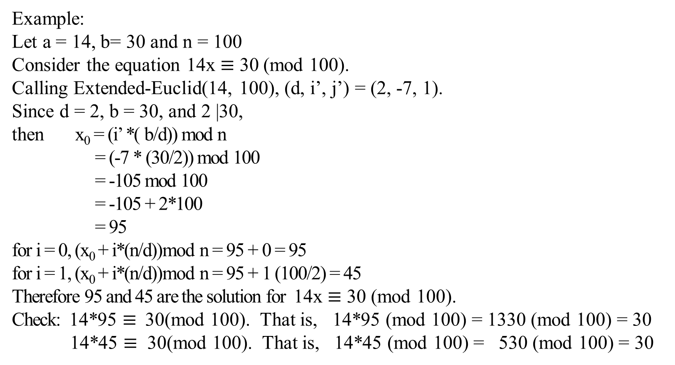
Example:
Let a = 14, b= 30 and n = 100
Consider the equation 14x $≡$ 30 (mod 100).
Calling Extended-Euclid(14, 100), (d, i’, j’) = (2, -7, 1).
Since d = 2, b = 30, and 2 |30,
then x₀ = (i’ *( b/d)) mod n
= (-7 * (30/2)) mod 100
= -105 mod 100
= -105 + 2*100
= 95
for i = 0, (x₀ + i*(n/d))mod n = 95 + 0 = 95
for i = 1, (x₀ + i*(n/d))mod n = 95 + 1 (100/2) = 45
Therefore 95 and 45 are the solution for 14x $≡$ 30 (mod 100).
Check: 14*95 $≡$30(mod 100). That is, 14*95 (mod 100) = 1330 (mod 100) = 30
14*45 $≡$ 30(mod 100). That is, 14*45 (mod 100) = 530 (mod 100) = 30

Slide 34
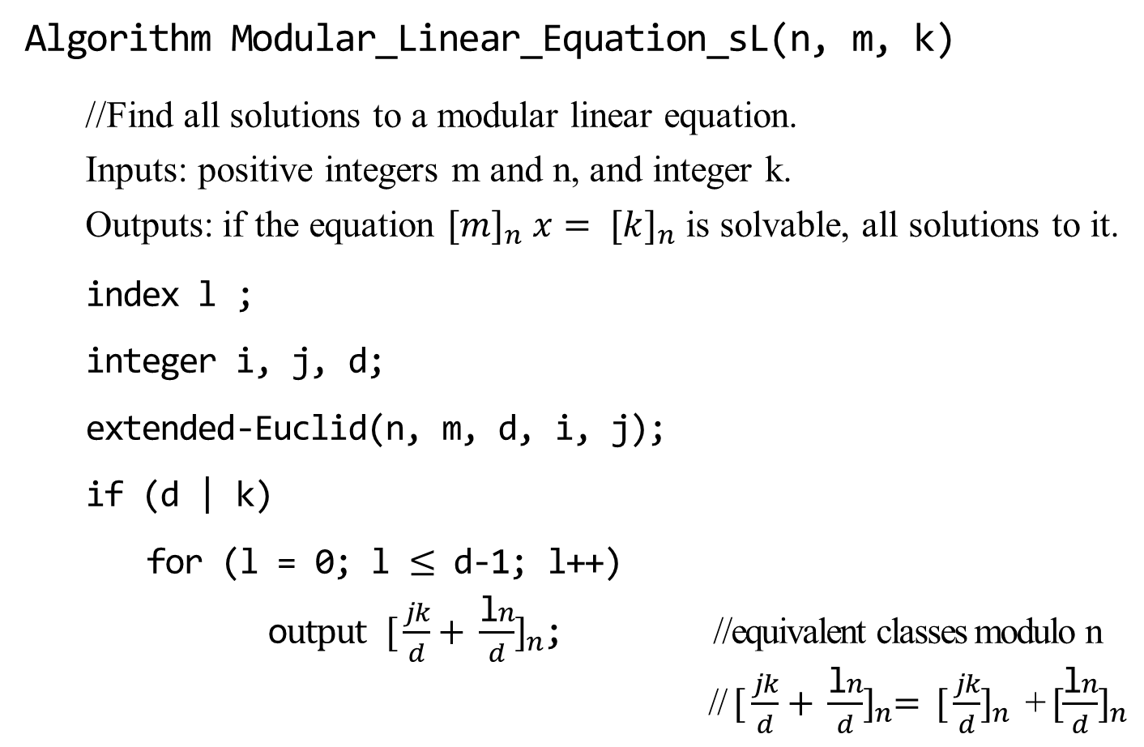
RSA Cryptography – Formalization (another way of writing)
Algorithm Modular_Linear_Equation_sL(n, m, k)
//Find all solutions to a modular linear equation.
Inputs: positive integers m and n, and integer k.
Outputs: if the equation ${[m]}_{n} x= {[k]}_{n}$ is solvable, all solutions to it.
index l ;
integer i, j, d;
extended-Euclid(n, m, d, i, j);
if (d | k)
for (l = 0; l $≤$ d-1; l++)
o$utput {[ \frac{jk}{d}+ \frac{\text{l}n}{d}]}_{n}$; //equivalent classes modulo n
// ${{[ \frac{jk}{d}+ \frac{\text{l}n}{d}]}_{n}= [ \frac{jk}{d}]}_{n}$ + ${[\frac{\text{l}n}{d}]}_{n}$
462

Slide 35
RSA Cryptography – Formalization (another way of writing)
Algorithm Extended_Euclid(int n, int m, int& gcd, int& i, int& j)
//Find gcd(n, m) = i*n + j*m.
Inputs: a positive integer n and a nonnegative m.
Outputs: gcd of n and m, and integers i and j such that gcd = i*n + j*m.
{ if (m == 0) { gcd = n; i = 1; j= 0;}
else { int i’, j’, gcd’;
Extended-Euclid (m, n mod m, gcd’, i’, j’);
gcd = gcd’;
i = j ’;
j = i’ + └ n/m ┘ j’ ;}
}

Slide 36
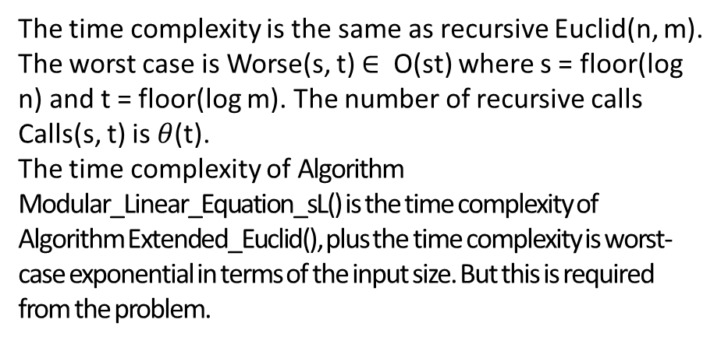
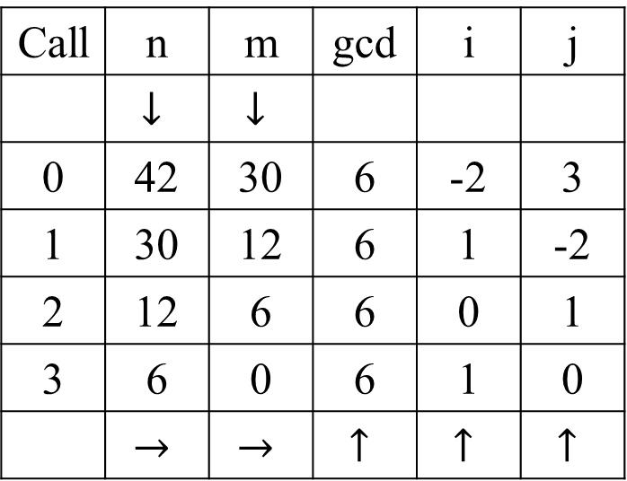
Call | n | m | gcd | i | j
 | $$↓$$ | $$↓$$
0 | 42 | 30 | 6 | -2 | 3
1 | 30 | 12 | 6 | 1 | -2
2 | 12 | 6 | 6 | 0 | 1
3 | 6 | 0 | 6 | 1 | 0
 | $$→$$ | $$→$$ | $$↑$$ | $$↑$$ | $$↑$$
The table illustrates the flow of the Algorithm when the top-level call is
Extended_Euclid(42, 30, gcd, i, j);
The values returned at the top level are gcd = 6, i = -2, and j = 3. That means, gcd(n, m) = i*n + j*m.
The top-level call is labeled 0, the three recursive calls are labeled 1 – 3. The arrows show the order in which the values are determined.
The time complexity is the same as recursive Euclid(n, m). The worst case is Worse(s, t) $∈$ O(st) where s = floor(log n) and t = floor(log m). The number of recursive calls Calls(s, t) is $θ$(t).
The time complexity of Algorithm Modular_Linear_Equation_sL() is the time complexity of Algorithm Extended_Euclid(), plus the time complexity is worst-case exponential in terms of the input size. But this is required from the problem.
+++++++++++++++++++++++++++++++++++++++++++++++++++++++++++++end

Slide 37
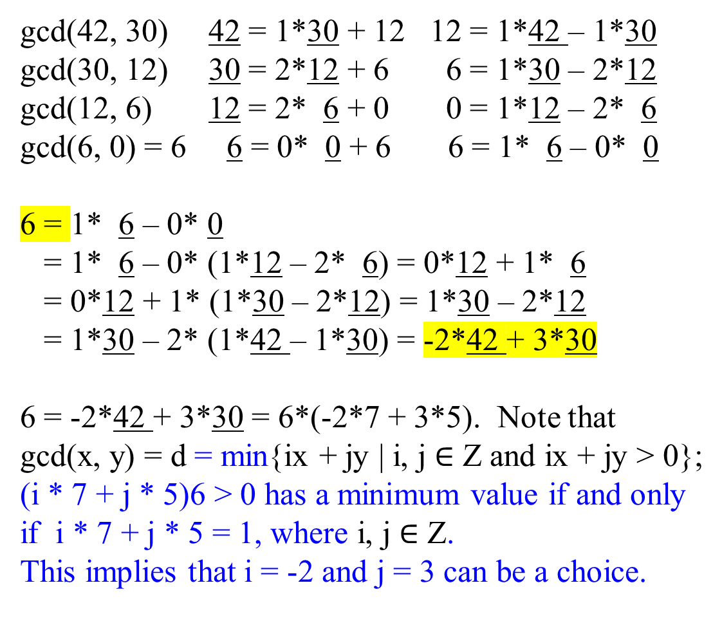
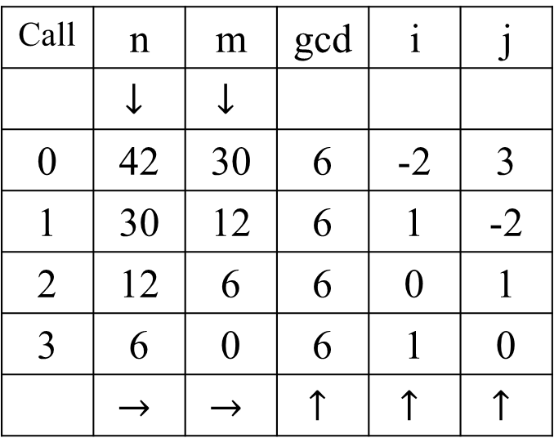
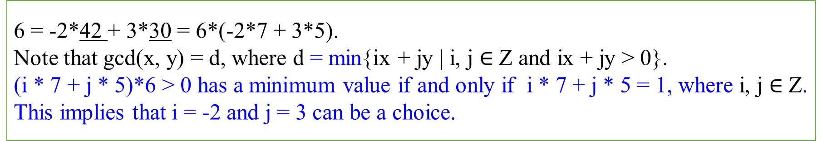
gcd(42, 30) 42 = 1*30 + 12 12 = 1*42 – 1*30
gcd(30, 12) 30 = 2*12 + 6 6 = 1*30 – 2*12
gcd(12, 6) 12 = 2* 6 + 0 0 = 1*12 – 2* 6
gcd(6, 0) = 6 6 = 0* 0 + 6 6 = 1* 6 – 0* 0
6 = 1* 6 – 0* 0
= 1* 6 – 0* (1*12 – 2* 6) = 0*12 + 1* 6
= 0*12 + 1* (1*30 – 2*12) = 1*30 – 2*12
= 1*30 – 2* (1*42 – 1*30) = -2*42 + 3*30
6 = -2*42 + 3*30 = 6*(-2*7 + 3*5). Note that
gcd(x, y) = d = min{ix + jy | i, j $∈$ Z and ix + jy > 0};
(i * 7 + j * 5)6 > 0 has a minimum value if and only if i * 7 + j * 5 = 1, where i, j $∈$ Z.
This implies that i = -2 and j = 3 can be a choice.
Call | n | m | gcd | i | j
 | $$↓$$ | $$↓$$
0 | 42 | 30 | 6 | -2 | 3
1 | 30 | 12 | 6 | 1 | -2
2 | 12 | 6 | 6 | 0 | 1
3 | 6 | 0 | 6 | 1 | 0
 | $$→$$ | $$→$$ | $$↑$$ | $$↑$$ | $$↑$$
6 = -2*42 + 3*30 = 6*(-2*7 + 3*5).
Note that gcd(x, y) = d, where d = min{ix + jy | i, j $∈$ Z and ix + jy > 0}.
(i * 7 + j * 5)*6 > 0 has a minimum value if and only if i * 7 + j * 5 = 1, where i, j $∈$ Z.
This implies that i = -2 and j = 3 can be a choice.
+++++++++++++++++++++++++++++++++++++++++++++++++++++++++++++end

Slide 38

Application of the formalism of
RSA Cryptography

Slide 39

RSA Cryptography - Application
Example: Let e and g be interchangeably used.
Encipher, encode, encrypt
  convert (a message or piece of text) into an encoded form.
Decipher, decode, decrypt.
  convert (a text written in code or an encoded signal) into normal (everyday) language.
Let denote the public key as pkey = {n, g} and the secret key denoted as skey = {p, q, h}.
Consider an RSA cryptosystem using p = 7, q = 17, and g = 5.
  What is the encoded form for 13 mod 119? That is, encipher the message ${[13]}_{119}$.
  What is the encoded form for 39 mod 119? That is, encipher the message ${[39]}_{119}$.

Slide 40

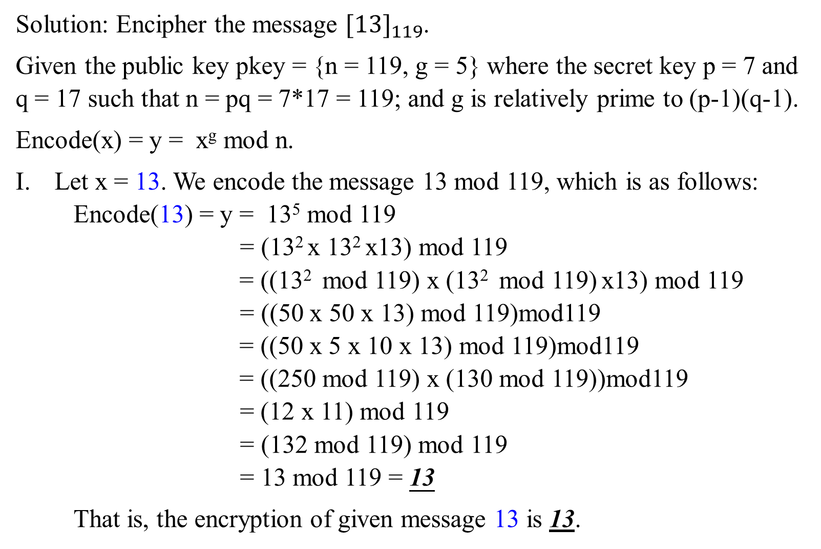
Solution: Encipher the message ${[13]}_{119}$.
Given the public key pkey = {n = 119, g = 5} where the secret key p = 7 and q = 17 such that n = pq = 7*17 = 119; and g is relatively prime to (p-1)(q-1).
Encode(x) = y = x^{g} mod n.
Let x = 13. We encode the message 13 mod 119, which is as follows:
Encode(13) = y = 13⁵ mod 119
= (13² x 13² x13) mod 119
= ((13² mod 119) x (13² mod 119) x13) mod 119
= ((50 x 50 x 13) mod 119)mod119
= ((50 x 5 x 10 x 13) mod 119)mod119
= ((250 mod 119) x (130 mod 119))mod119
= (12 x 11) mod 119
= (132 mod 119) mod 119
= 13 mod 119 = 13
That is, the encryption of given message 13 is 13.

Slide 41

To decode this message 13 mod 119, it requires that
  we know the public key pkey = {n, g} = {119, 5}, and
  we find the private key skey {p, q, h}, where h can be calculated as follows:
  Step 1: For public, n = 119 and g = 5, and the encoded form y =
  13 are given.
  In public, although that n = p*q, and n = 119 are known, it should not easily derive the non-public secret keys p = 7 and q = 17 from the given n = 119.
  For this case, n = 119 = 7*17 = p*q.

Slide 42
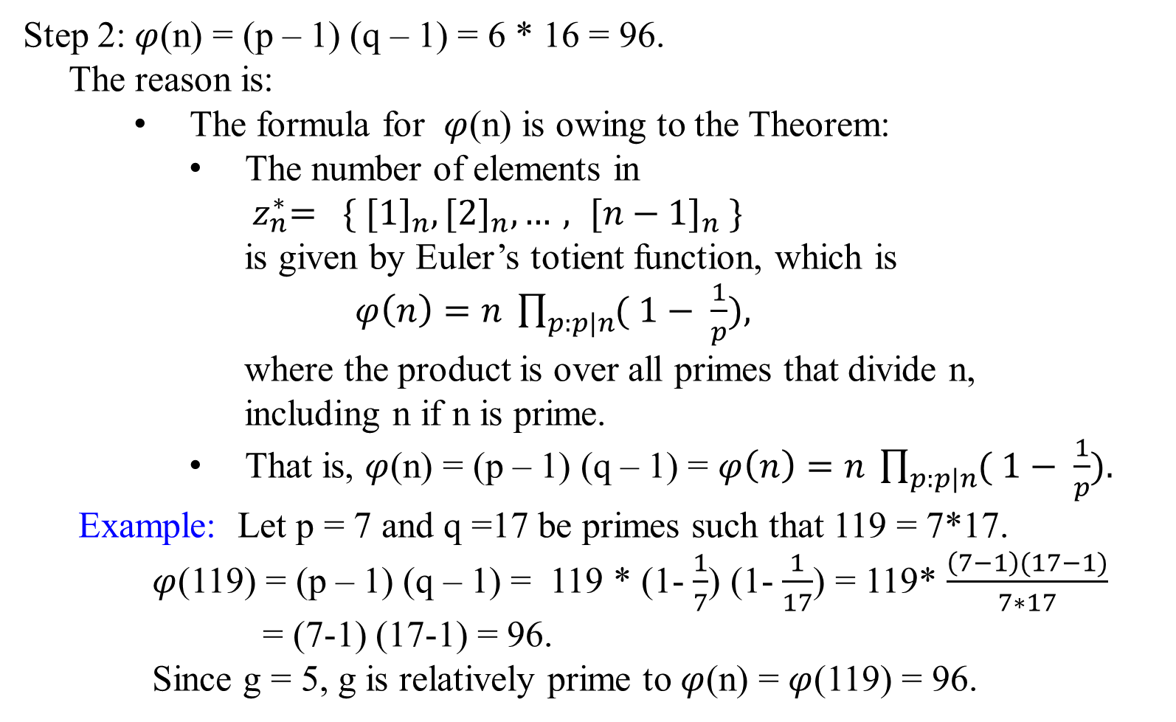
Step 2:$φ$(n) = (p – 1) (q – 1) = 6 * 16 = 96.
The reason is:
    The formula for $φ$(n) is owing to the Theorem:
      The number of elements in
      ${ z}_{n}^{∗}= \{ {[1]}_{n}, {[2]}_{n}, …, {[n−1]}_{n} \}$
    is given by Euler’s totient function, which is
    $φ\left(n\right)=n \prod_{p:p|n}{( 1− \frac{1}{p}}),$
where the product is over all primes that divide n,
including n if n is prime.
      That is, $φ$(n) = (p – 1) (q – 1) = $φ\left(n\right)=n \prod_{p:p|n}{( 1− \frac{1}{p}}).$
  Example: Let p = 7 and q =17 be primes such that 119 = 7*17.
  $φ$(119) = (p – 1) (q – 1) = 119 * (1- $\frac{1}{7}$) (1- $\frac{1}{17}$) = 119* $\frac{\left(7−1\right)(17−1)}{7∗17}$
= (7-1) (17-1) = 96.
Since g = 5, g is relatively prime to $φ$(n) = $φ$(119) = 96.

Slide 43
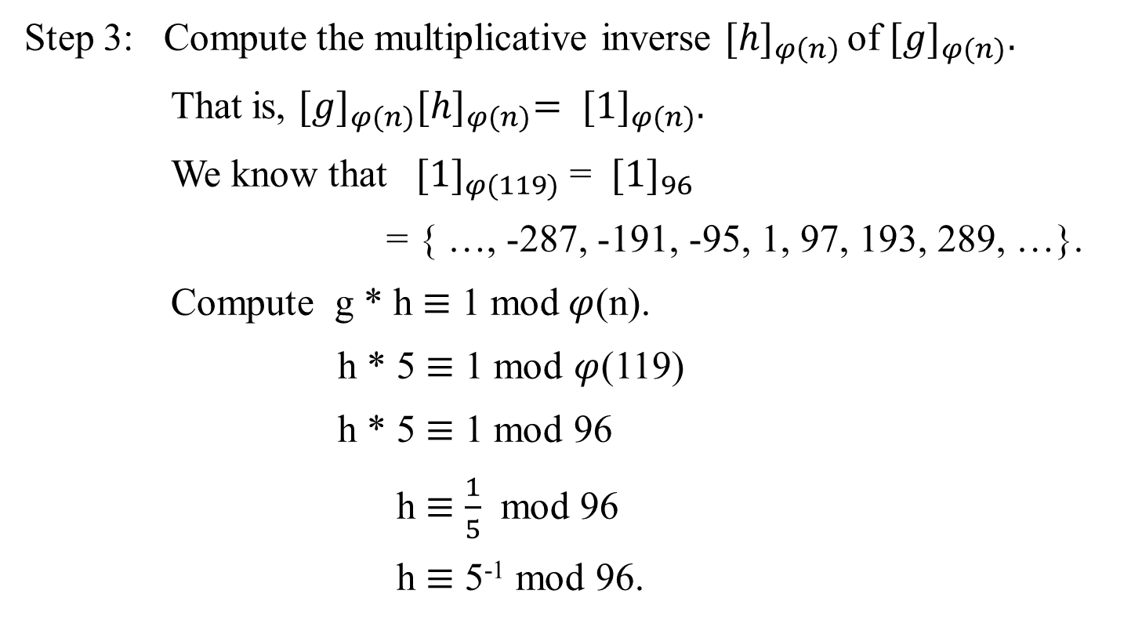
Step 3: Compute the multiplicative inverse ${[h]}_{φ\left(n\right) }$of ${[g]}_{φ(n)}.$
    That is, ${[g]}_{φ(n)}{[h]}_{φ(n)}= {[1]}_{φ(n)}.$
We know that ${[1]}_{φ(119)}$ = ${[1]}_{96}$
= { …, -287, -191, -95, 1, 97, 193, 289, …}.
Compute g * h $≡$ 1 mod$φ$(n).
h * 5 $≡$ 1 mod $φ$(119)
h * 5 $≡$ 1 mod 96
h $≡$ $\frac{1}{5}$ mod 96
h $≡$ 5⁻¹ mod 96.

Slide 44
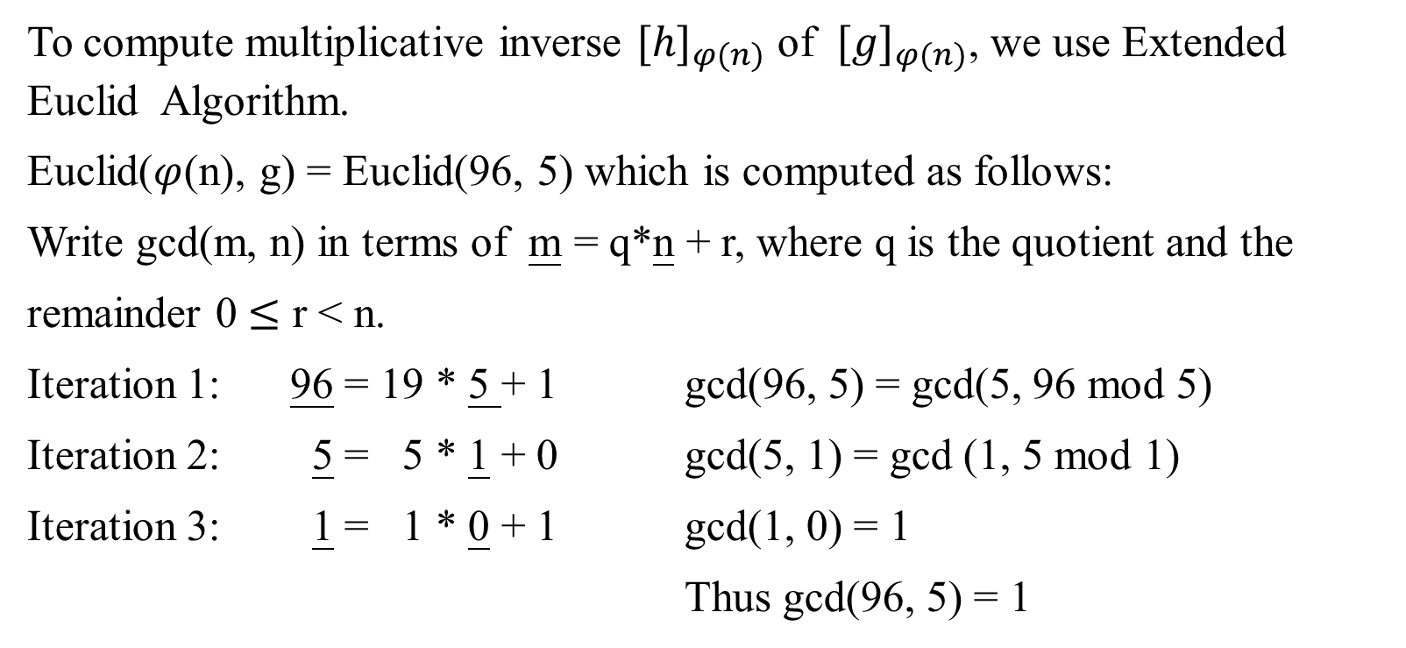
To compute multiplicative inverse ${[h]}_{φ(n)}$ of ${[g]}_{φ(n)}$, we use Extended Euclid Algorithm.
Euclid($φ$(n), g) = Euclid(96, 5) which is computed as follows:
Write gcd(m, n) in terms of m = q*n + r, where q is the quotient and the
remainder 0 $≤$ r < n.
Iteration 1: 96 = 19 * 5 + 1 gcd(96, 5) = gcd(5, 96 mod 5)
Iteration 2: 5 = 5 * 1 + 0 gcd(5, 1) = gcd (1, 5 mod 1)
Iteration 3: 1 = 1 * 0 + 1 gcd(1, 0) = 1
Thus gcd(96, 5) = 1

Slide 45
Iteration 1: 96 = 19 * 5 + 1 gcd(96, 5) = gcd(5, 96 mod 5)
Iteration 2: 5 = 5 * 1 + 0 gcd(5, 1) = gcd (1, 5 mod 1)
Iteration 3: 1 = 1 * 0 + 1 gcd(1, 0) = 1
Rewrite the last iteration 1 = 1 * 0 + 1 in terms of linear combination
1 = 1 * 1 - 1 * 0.
Rewrite the iteration 2, 5 = 5 * 1 + 0 in terms of linear combination
0 = 1 * 5 - 5 * 1.
Substituting 1 * 5 - 5 * 1 for the 0 in 1 = 1 * 1 - 1 * 0, we have
1 = 1 * 1 - 1 * 0
1 = 1 * 1 - 1 * ( 1 * 5 - 5 * 1 )
1 = 1 * 1 - 1 * 5 + 5 * 1
1 = - 1 * 5 + 6 * 1

Slide 46
Iteration 1: 96 = 19 * 5 + 1 gcd(96, 5) = gcd(5, 96 mod 5)
Iteration 2: 5 = 5 * 1 + 0 gcd(5, 1) = gcd (1, 5 mod 1)
Iteration 3: 1 = 1 * 0 + 1 gcd(1, 0) = 1
Rewrite the iteration 1, 96 = 19 * 5 + 1 in terms of linear combination
1 = 1 * 96 - 19 * 5.
Substituting 1 * 96 - 19 * 5 for the 5 in 1 = - 1 * 5 + 6 * 1, it can be rewritten in terms of combination
1 = - 1 * 5 + 6 * ( 1 * 96 - 19 * 5)
1 = - 1 * 5 + 6 * 96 - 114 * 5
1 = 6 * 96 - 115 * 5.

Slide 47
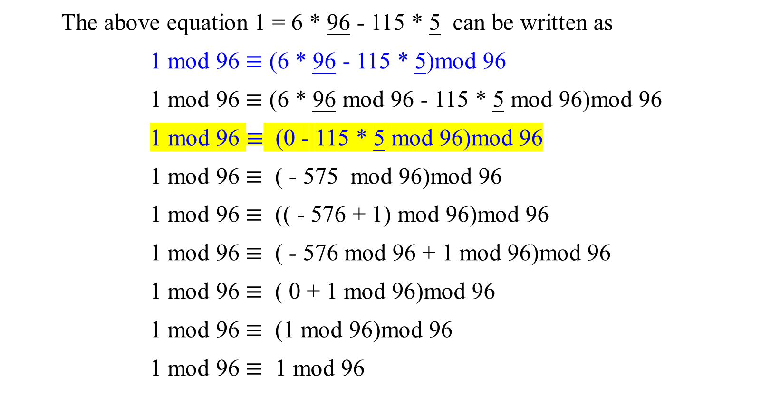
$φ$(n) = $φ$(7*17 =119) = (7-1)*(17-1) = 96.
The above equation 1 = 6 * 96 - 115 * 5 can be written as
1 mod 96 $≡$ (6 * 96 - 115 * 5)mod 96
1 mod 96 $≡$ (6 * 96 mod 96 - 115 * 5 mod 96)mod 96
1 mod 96 $≡$ (0 - 115 * 5 mod 96)mod 96
1 mod 96 $≡$ ( - 575 mod 96)mod 96
1 mod 96 $≡$ (( - 576 + 1) mod 96)mod 96
1 mod 96 $≡$ ( - 576 mod 96 + 1 mod 96)mod 96
1 mod 96 $≡$ ( 0 + 1 mod 96)mod 96
1 mod 96 $≡$ (1 mod 96)mod 96
1 mod 96 $≡$ 1 mod 96

Slide 48

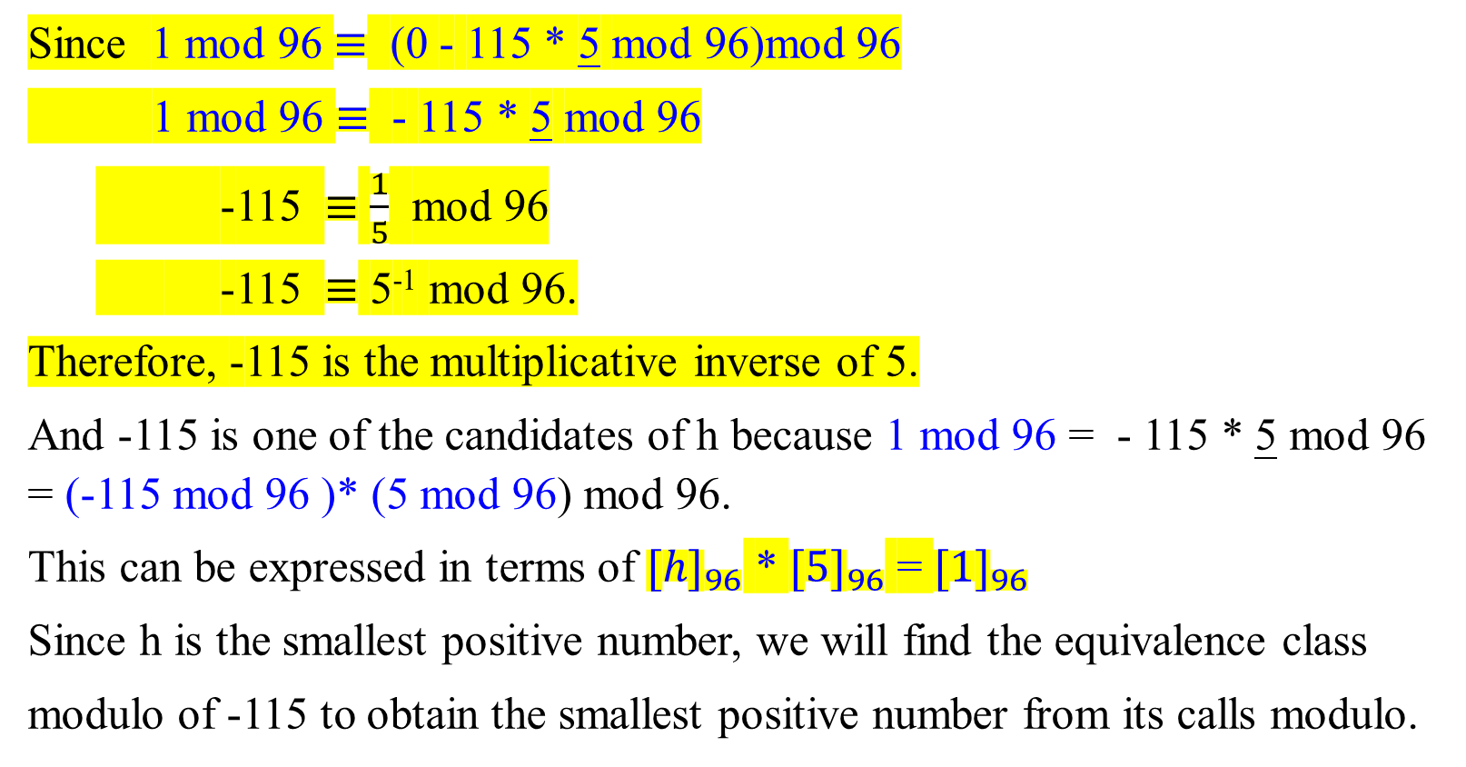
Since 1 mod 96 $≡$ (0 - 115 * 5 mod 96)mod 96
1 mod 96 $≡$ - 115 * 5 mod 96
-115 $≡$ $\frac{1}{5}$ mod 96
-115 $≡$ 5⁻¹ mod 96.
Therefore, -115 is the multiplicative inverse of 5.
And -115 is one of the candidates of h because 1 mod 96 = - 115 * 5 mod 96 = (-115 mod 96 )* (5 mod 96) mod 96.
This can be expressed in terms of ${[h]}_{96}$ * ${[5]}_{96}$ = ${[1]}_{96}$
Since h is the smallest positive number, we will find the equivalence class
modulo of -115 to obtain the smallest positive number from its calls modulo.

Slide 49

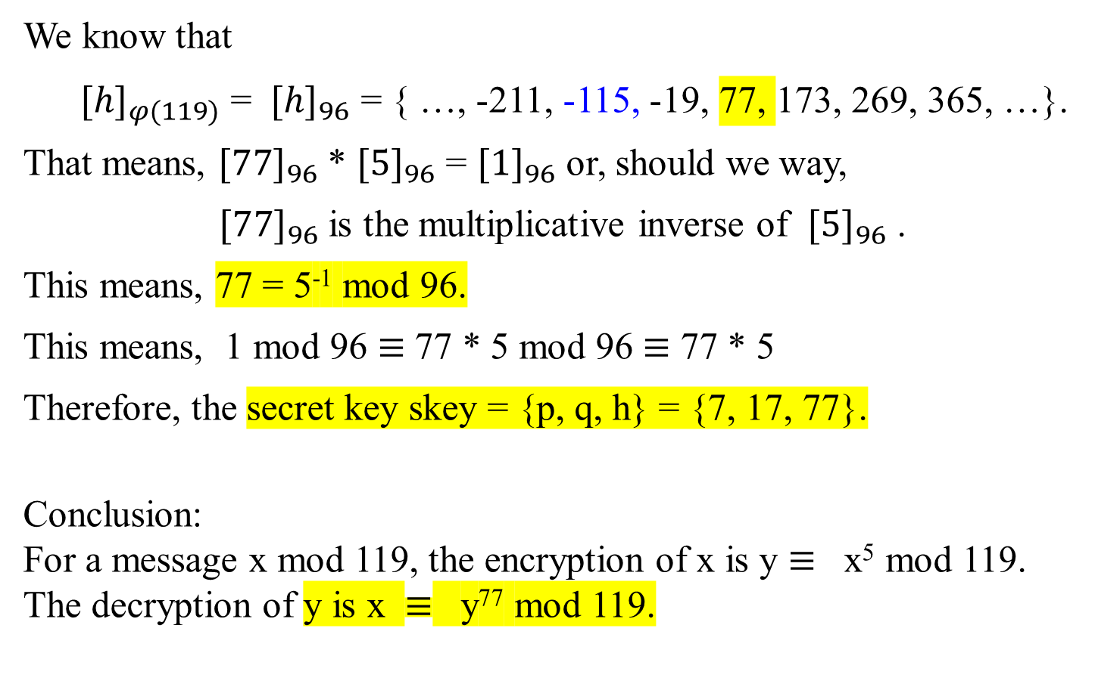
We know that
${[h]}_{φ(119)}$ = ${[h]}_{96}$ = { …, -211, -115, -19, 77, 173, 269, 365, …}.
That means, ${[77]}_{96}$ * ${[5]}_{96}$ = ${[1]}_{96}$ or, should we way,
${[77]}_{96}$ is the multiplicative inverse of ${[5]}_{96}$ .
This means, 77 = 5⁻¹ mod 96.
This means, 1 mod 96 $≡$ 77 * 5 mod 96 $≡$ 77 * 5
Therefore, the secret key skey = {p, q, h} = {7, 17, 77}.
Conclusion:
For a message x mod 119, the encryption of x is y $≡$ x⁵ mod 119.
The decryption of y is x $≡$ y⁷⁷ mod 119.

Slide 50
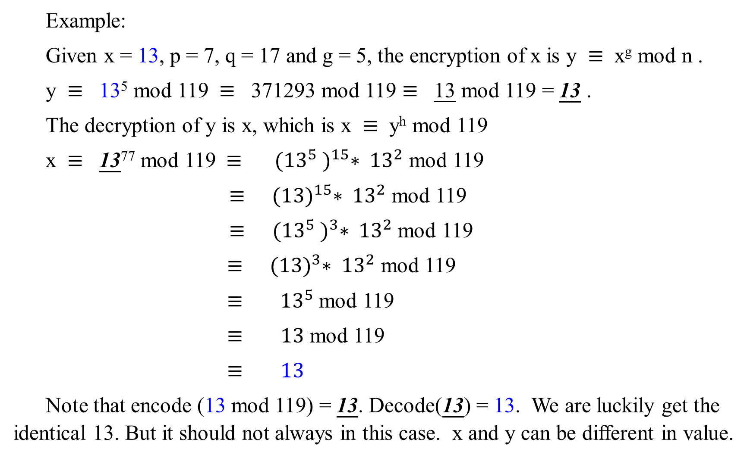
Example:
Given x = 13, p = 7, q = 17 and g = 5, the encryption of x is y $≡$ x^{g} mod n .
y $≡$ 13⁵ mod 119 $≡$ 371293 mod 119 $≡$ 13 mod 119 = 13 .
The decryption of y is x, which is x $≡$ y^{h} mod 119
x $≡$ 13⁷⁷ mod 119 $≡$ ${({13}^{5} )}^{15}∗ {13}^{2}$ mod 119
$≡$ ${(13)}^{15}∗ {13}^{2}$ mod 119
$≡$ ${({13}^{5} )}^{3}∗ {13}^{2}$ mod 119
$≡$ ${(13)}^{3}∗ {13}^{2}$ mod 119
$≡$ ${ 13}^{5}$ mod 119
$≡$ $13$ mod 119
$≡$ $13$
Note that encode (13 mod 119) = 13. Decode(13) = 13. We are luckily get the identical 13. But it should not always in this case. x and y can be different in value.

Slide 51
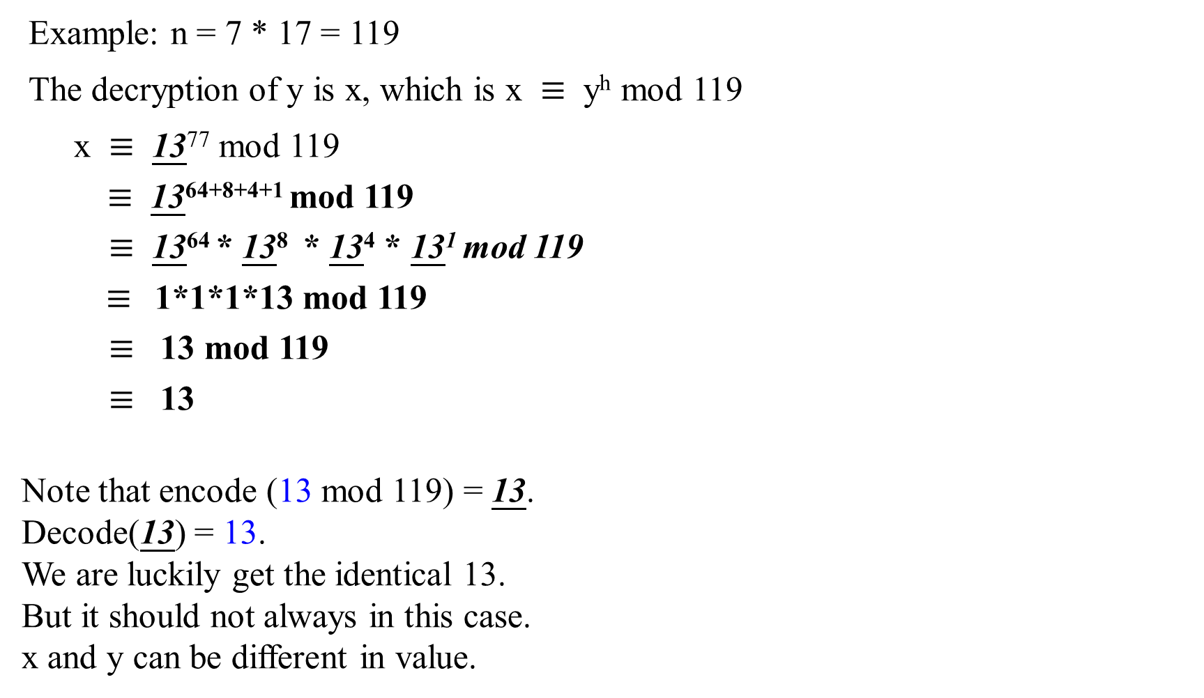
Example: n = 7 * 17 = 119
The decryption of y is x, which is x $≡$ y^{h} mod 119
x $≡$ 13⁷⁷ mod 119
$≡$ 13⁶⁴⁺⁸⁺⁴⁺¹ mod 119
$≡$ 13⁶⁴ * 13⁸ * 13⁴ * 13¹ mod 119
$≡$1*1*1*13 mod 119
$≡$ 13 mod 119
$≡$ 13
Note that encode (13 mod 119) = 13.
Decode(13) = 13.
We are luckily get the identical 13.
But it should not always in this case.
x and y can be different in value.
77 = 64 + 8 + 4 + 1
13⁷⁷ = 13⁶⁴⁺⁸⁺⁴⁺¹
= 13⁶⁴ * 13⁸ * 13⁴ * 13¹
13¹ = 13
13² mod 119 = 50
13⁴ mod 119 = 50 * 50 mod 119
= 1
13⁸ mod 119 = 1*1 mod 119
= 1 mod 119
= 1
13⁶⁴ mod 119 = 1*1 mod 119
= 1

Slide 52
End of
Application of the formalism of RSA Cryptography

