Slide 1
Chapter 01_03
Introducing Basic Addition, Multiplication, Division Algorithms, and Correction Proof

Slide 2

Outlines:
Sum of any three single-digit numbers is at most two digits long.
Number of digits for representing a positive decimal integer N ≥ 0 in base b.
Algorithm for determining the number of binary digits needed in the binary representation of a positive decimal integer n.
Algorithm analysis framework
How much does the size of a number change, when changing base?
Algorithms of Add(x, y), multiple(x, y) and divide(x, y) and their time efficiencies.
Proof of algorithm’s correctness.

Slide 3

Number Theory Review
A basic property of numbers in any base b ≥ 2:
The sum of any three single-digit numbers is at most two digits long.
Example 0.1:
For binary numbers in base 2: 1 + 1 + 1 = 11₂
For Octal numbers in base 8: 7 + 7 + 7 = 111 + 111 + 111
= 25₈
For decimal numbers in base 10: 9 + 9 + 9 = 27₁₀
For hexadecimal numbers in base 16: F + F + F = 1111 + 1111 + 1111
= 2D₁₆
Note that D₁₆ = 1101₂ = 13₁₀
000 111
000 111 +
001 110
000 111 +
010 101 = 25₈
0000 1111 F
0000 1111 + F
0001 1110
0000 1111 +
0010 1101 = 2D₁₆

Slide 4
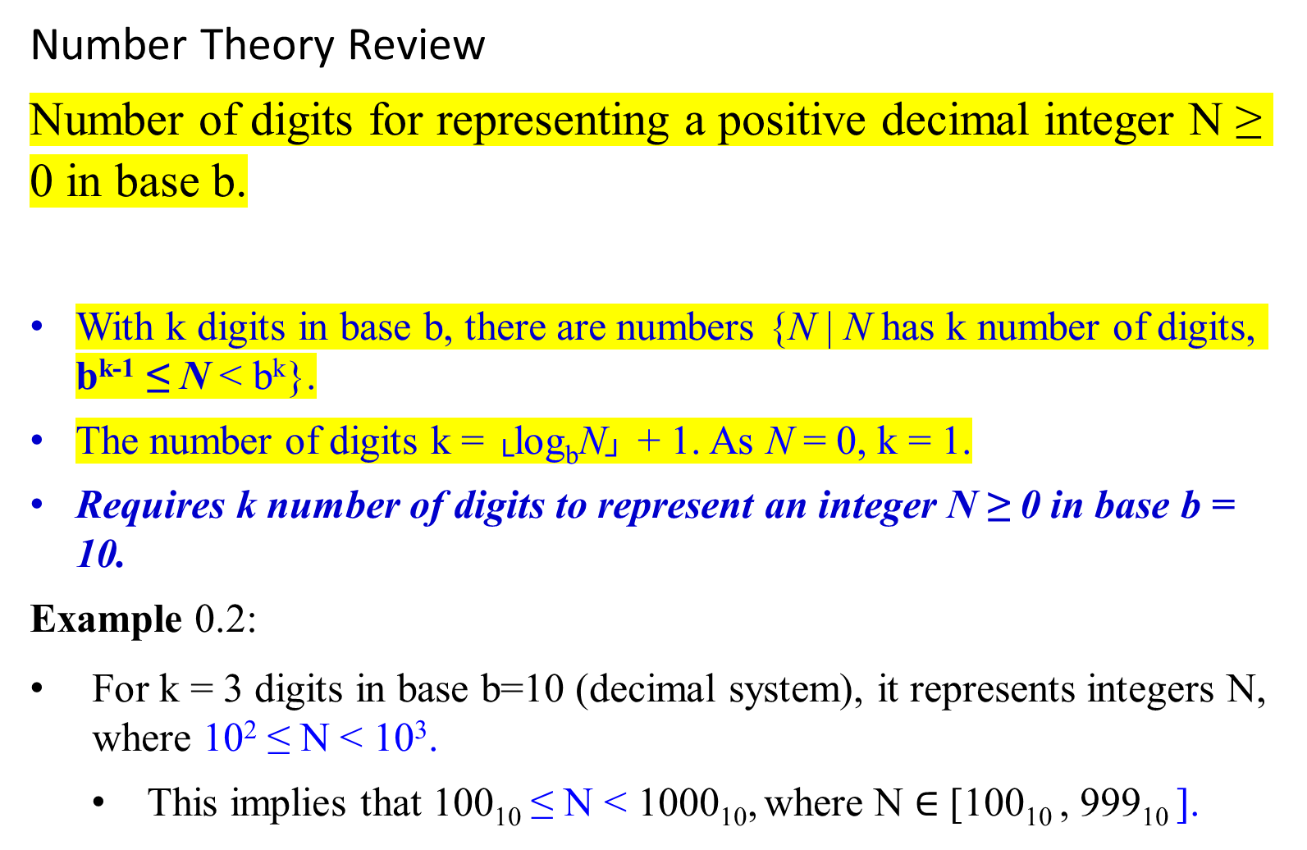
Number Theory Review
Number of digits for representing a positive decimal integer N ≥ 0 in base b.
With k digits in base b, there are numbers {N | N has k number of digits, b^{k-1} ≤ N < b^{k}}.
The number of digits k = └log_{b}N┘ + 1. As N = 0, k = 1.
Requires k number of digits to represent an integer N ≥ 0 in base b = 10.
Example 0.2:
For k = 3 digits in base b=10 (decimal system), it represents integers N, where 10² ≤ N < 10³.
  This implies that 100₁₀ ≤ N < 1000₁₀, where N $∈$ [100₁₀ , 999₁₀ ].
log_{b} b^{k-1} ≤ log_{b} N
(k-1) log_{b} b ≤ log_{b} N
(k-1) ≤ log_{b} N

Slide 5
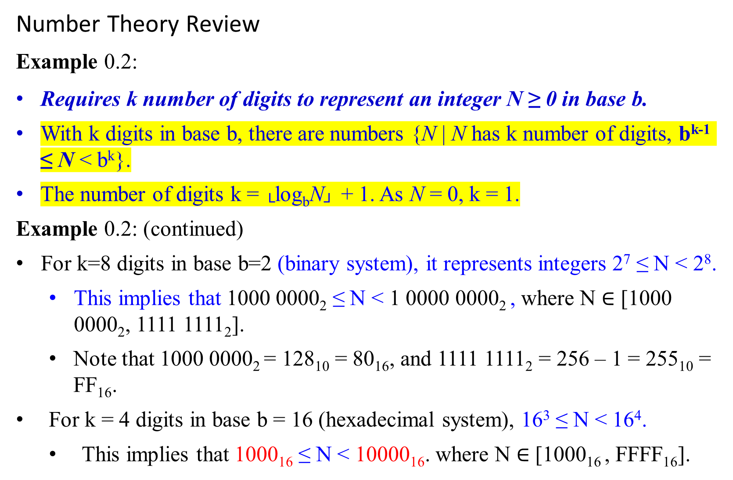
Number Theory Review
Example 0.2:
Requires k number of digits to represent an integer N ≥ 0 in base b.
With k digits in base b, there are numbers {N | N has k number of digits, b^{k-1} ≤ N < b^{k}}.
The number of digits k = └log_{b}N┘ + 1. As N = 0, k = 1.
  Example 0.2: (continued)
For k=8 digits in base b=2 (binary system), it represents integers 2⁷ ≤ N < 2⁸.
  This implies that 1000 0000₂ ≤ N < 1 0000 0000₂ , where N $∈$ [1000 0000₂, 1111 1111₂].
  Note that 1000 0000₂ = 128₁₀ = 80₁₆, and 1111 1111₂ = 256 – 1 = 255₁₀ = FF₁₆.
For k = 4 digits in base b = 16 (hexadecimal system), 16³ ≤ N < 16⁴.
  This implies that 1000₁₆ ≤ N < 10000₁₆. where N $∈$ [1000₁₆ , FFFF₁₆].
log_{b} b^{k-1} ≤ log_{b} N
(k-1) log_{b} b ≤ log_{b} N
(k-1) ≤ log_{b} N

Slide 7
Example of Binary(N)
Design an algorithm, which:
finds the number k of binary digits for representing a positive decimal integer.
Analysis: Let k = 1. Since 2^{k-1} ≤ N < 2^{k}, 2¹⁻¹ ≤ N < 2¹ = 1 ≤ N < 2. One bit can represent 0 or 1.
  Since 2^{k-1} ≤ N < 2^{k}, then log₂ 2^{k-1} ≤ log₂ N < log₂ 2^{k}.
  k-1 ≤ log₂ N < k. That means, k-1 ≤ └ log₂ N ┘ < k.
  k ≤ └ log₂ N ┘ + 1 < k + 1.
For example
  one binary digit to represent 0 or 1. (i.e., 0 or 1 );
  two binary digits to represent 2 through 3. (i.e., 10 through 11);
  three binary digits to represent 4 through 7. (i.e., 100 through 111 ).
  four binary digits to represent 8 through 15. (i.e., 1000 through 1111 ).
  etc.

Slide 8
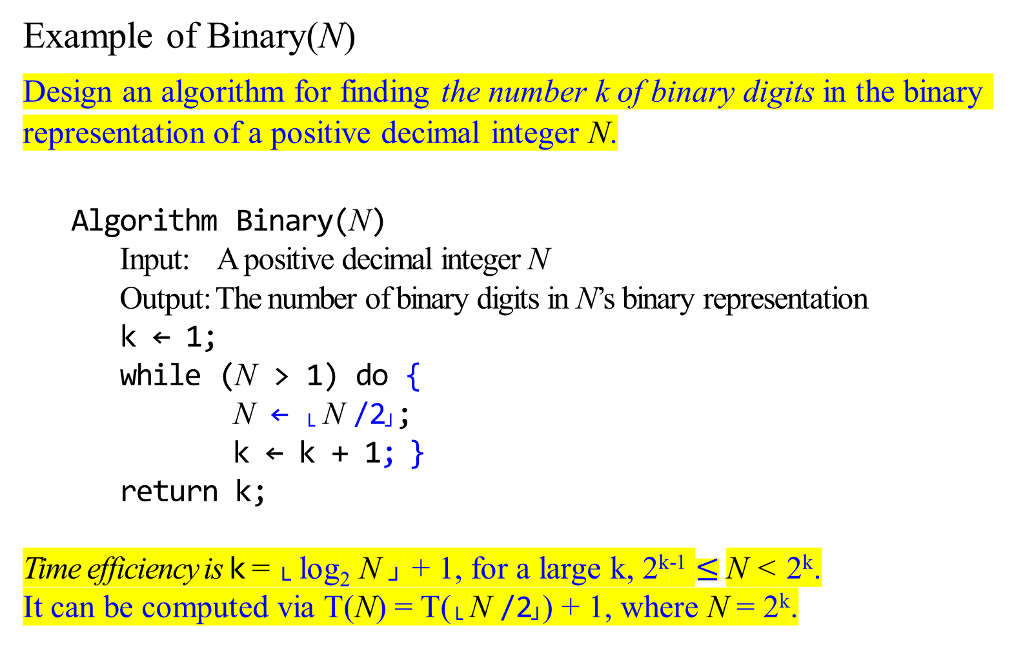
Example of Binary(N)
Design an algorithm for finding the number k of binary digits in the binary representation of a positive decimal integer N.
Algorithm Binary(N)
Input: A positive decimal integer N
Output: The number of binary digits in N’s binary representation
k ← 1;
while (N > 1) do {
N ← └ N /2┘;
k ← k + 1; }
return k;
Time efficiency is k = └ log₂ N ┘ + 1, for a large k, 2^{k-1} $≤$N < 2^{k}.
It can be computed via T(N) = T(└ N /2┘) + 1, where N = 2^{k}.
The number of executions of > is 4 times.
The number of executions of + is 3 times.
The number of executions of / is 3 times.
(N > 1) | 15 > 1 | 7 > 1 | 3 > 1 | 1 > 1 (false)
N =15 | └15/2┘ | └7/2┘ | └3/2┘ | exitWhile at N=1
k = 1 | k = 2 | k = 3 | k = 4 | return k = 4
Requires four bits to encode 15 as 1111.

Slide 9

Analysis Framework
Measuring an input’s size:
  The input for this algorithm is the magnitude of an integer N.
  Define the input size as the number of symbols (i.e., binary digits (bits)) used for encoding a positive integer N.
  The input size is └ log₂ N ┘ + 1 bits.
  Example:
    If N = 15, the input size is └ log₂15 ┘ + 1 = 3 + 1 bits. i.e., 15 in binary representation is 1111₂
    If N = 16, the input size is └ log₂16 ┘ + 1 = 4 + 1 bits. i.e., 16 in binary representation is 10000₂

Slide 10
Algorithm Binary(N)
k ← 1;
while (N > 1) do {
k ← k + 1;
N ← └ N /2┘; }
…
Analysis Framework
2. Units for measuring running time
  The most frequently executed operation:
    The comparison N > 1
      determines whether the loop’s body is to be executed.
    The number of times the comparison is to be executed = the number of repetitions of the loop’s body + 1.
  For the loop’s variable (i.e., N):
    The value of N is about halved on each repetition of the loop (i.e., N ← └ N /2┘), where 2^{k-1} ≤ N < 2^{k} and k is the number of times dividing the number N by 2.
    The number of times the loop to be executed would be about
    k = └ log₂ N ┘ + 1.
      [i.e., 2^{k-1} ≤ N < 2^{k}, then (k-1) log₂2 ≤ log₂ N < k log₂2, k-1 ≤ log₂ N < k]
2^{k-1} ≤ N < 2^{k}
If k = 4 bits then 1000 ≤ N < 1111

Slide 11
Example 0.6:
The exact formula for the number of times, C(N), the comparison N > 1 to be executed is:
C(N) = k, if N = 2^{k-1}, then log₂ N = log₂ 2^{k-1}
= (k-1) log₂2
= k -1
= └ log₂ N ┘ + 1, where 2^{k-1} ≤ N < 2^{k}
= Θ( log₂ N )?
The number of bits in the binary representation of N is
k = └ log₂ N ┘ + 1 bits
Algorithm Binary(N)
k← 1;
while (N > 1) do {
N ← └ N /2┘;
k ← k + 1;
}
…

Slide 12
Note: For 2^{k-1} ≤ N < 2^{k}, the number of bits k for representing N is k = └ log₂ N ┘ + 1
The number of bits representing 8 ≤ N < 16 are:
└ log₂8 ┘ + 1 = 3 + 1, where 8 = 2³ 1 0 0 0
└ log₂9 ┘ + 1 = 3 + 1 1 0 0 1 …
└ log₂15┘ + 1 = 3 + 1 1 1 1 1
└ log₂16┘ + 1 = 4 + 1 where 16 = 2⁴ 1 0 0 0 0
We can show └ log₂ N ┘ + 1 = ⌈log (N + 1)⌉.
How much does the size of a number change when we change the base?

Slide 13
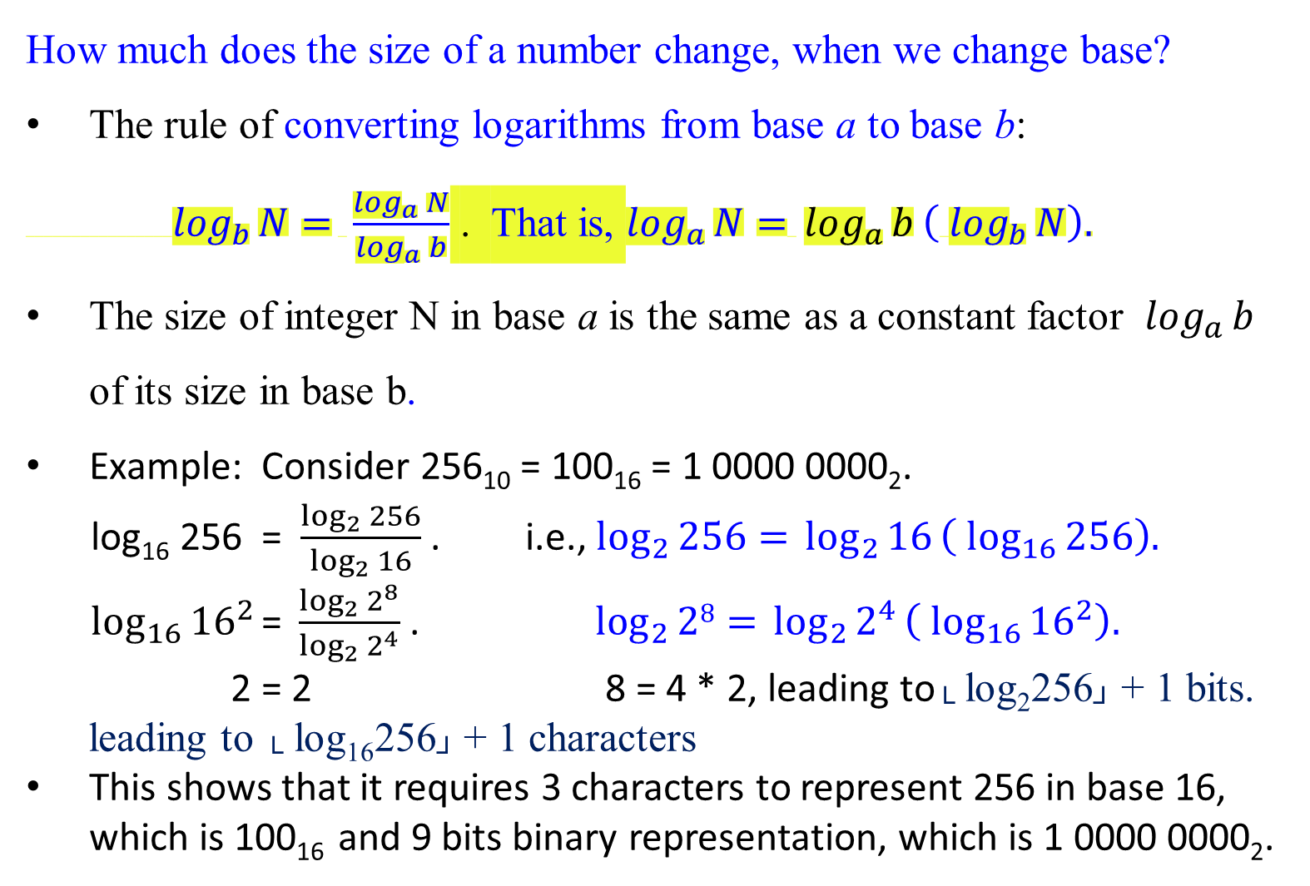
How much does the size of a number change, when we change base?
The rule of converting logarithms from base a to base b:
$\log_{b}{N}= \frac{\log_{a}{N}}{\log_{a}{b}}$ . That is, $\log_{a}{N= }\log_{a}{b}\left( \log_{b}{N}\right).$
The size of integer N in base a is the same as a constant factor $\log_{a}{b}$ of its size in base b.
Example: Consider 256₁₀ = 100₁₆ = 1 0000 0000₂.
log₁₆ 256 = $\frac{\log_{2}{256}}{\log_{2}{16}}$ . i.e., $\log_{2}{256= }\log_{2}{16}\left( \log_{16}{256}\right).$
$\log_{16}{{16}^{2}}\text{=} \frac{\log_{2}{2^{8}}}{\log_{2}{2^{4}}}$ . $\log_{2}{28= }\log_{2}{2^{4}}\left( \log_{16}{{16}^{2}}\right).$
2 = 2 8 = 4 * 2, leading to└ log₂256┘ + 1 bits.
leading to └ log₁₆256┘ + 1 characters
This shows that it requires 3 characters to represent 256 in base 16, which is 100₁₆ and 9 bits binary representation, which is 1 0000 0000₂.

Slide 15

Addition:
  How long does the addition algorithm take to add two given numbers?

Slide 16
Construct an addition algorithm of two numbers in any base.
Analysis:
By the basic property of numbers in any base,
  the sum of two single-digit numbers is a two-digit number;
  the carry is always a single digit.
  At any given step, three single-digit numbers are added.
    The sum of three single-digit numbers is a two-digit number.
Algorithm:
  Align their right-hand ends, and then
  perform a single right-to-left pass in which
    the sum is computed digit by digit,
    maintaining the overflow as a carry.
Q: Given two binary numbers x and y, how long does our algorithm
take to add them?

Slide 17
How long does our algorithm take to add two given binary numbers x = 99₁₀ and y = 97₁₀?
Carry 1 0 0 0 1 1
x 1 1 0 0 0 1 1 (99)
y 1 1 0 0 0 0 1 (97)
sum 1 1 0 0 0 1 0 0 (196)
Total running time as a function of the input size: the number of bits of x or y.

Slide 18
Analysis: Total running time as a function of the input size:
the number of bits for representing two integers x and y,
└ log₂ x ┘ + 1 bits and └ log₂ y ┘ + 1 bits, respectively
Assume that each of x and y is n bits long.
  The sum of x and y is n+1 bits at most.
  Adding three binary digits requires a fixed amount of time.
  Adding two n-bit numbers requires n operations, disregarding at least reading them and writing down the answer.
  The total running time for the addition algorithm is c₁ n + c₀, where c₀ and c₁ are some constants.
  It is linear. The running time is O(n).

Slide 19
Is there a faster algorithm for adding two numbers?
The addition algorithm is optimal, up to a constant multiplicative factor.
Practical Example:
Consider two different addition methods:
  One method takes 3 microseconds per addition.
  Another method takes 5 microseconds per addition.
If both methods add n numbers, their running times are 3n microseconds and 5n microseconds, respectively. Both are O(n), and the difference is the constant factor (3 vs. 5). In asymptotic terms, both methods are considered equally efficient.
  The total running time for the addition algorithm is of c₁ n + c₀, where c₀ and c₁ are some constants.

Slide 20
Multiplication and Division
  Left-shifting is a quick way to multiply by the power of 2.
  How long does the multiplication algorithm take?

Slide 21
Left-shifting is a quick way to multiply an integer by a power of 2 - Reason:
Given two integers 13 and 2, 13 * 2 can be written in binary representation as 1101 * 10. The result 26 (11010 in bit representation) can be obtained by left-shifting one-bit position 1101 and packing a 0 on the rightmost bit to form 11010.
1 1 0 1 (multiplicand)
x 1 0 (multiplier)
0 0 0 0 (multiply 1101 by 0)
1 1 0 1 0 (multiply 1101 by 1, left-shift once)
1 1 0 1 0
In binary multiplication, each intermediate row is
  either filling with 0’s if the multiplier’s bit is 0,
  or copying the multiplicand if the multiplier’s bit is 1.
    right-align the multiplicand with the multiplier’s bit, and
    packing 0 on the rightmost bit(s).
    Equivalently, left-shifted the multiplicand an appropriate number of times with packing 0 on the rightmost bit(s).
An array of intermediate sums

Slide 22

Multiplication
1 3
x 1 1
1 3
1 3 1 4 3
How long the grade-school algorithm takes:
Consider 13 x 11, which is (1101 x 1011)
The multiplication would proceed as follows.
1 1 0 1
x 1 0 1 1
1 1 0 1 (1101 times 1)
1 1 0 1 0 (1101 times 1, shift once)
0 0 0 0 0 0 (1101 times 0, shift twice)
+ 1 1 0 1 0 0 0 (1101 times 1, shift thrice)
1 0 0 0 1 1 1 1 (binary for 143)
n-1 times row additions

Slide 23
Let x and y be both n = └ log₂ x ┘ + 1 bits and n = └ log₂ y ┘ + 1 bits.
There are n intermediate rows,
  with lengths of up to 2n bits (take the shifting into account).
The total time taken is to add up these rows:
  doing two rows at a time.
  O(n) + O(n) + … + O(n), [Sum of each two intermediate rows
  requires O(n).]
  n – 1 times [Requires n-1 times of 2 two-row addition
  for n rows]
  [ i.e., (n-1) * O(n) = O(n² ).
  i.e., (n-1) * (c₁n + c₀) = c₁n² – (c₁ – c₀)n - c₀]
  The time efficiency is O(n² ), quadratic of the size of the inputs:
  It is polynomial but much slower than addition.

Slide 24
Is there a faster algorithm for multiplication?
Al Khwarizmi’s Algorithm: (Persian mathematician)
Multiplication à la Franҫais - function multiply(x, y)
  A recursive algorithm
  Algorithm analysis
Multiplication ẚ la Russe - a nonorthodox algorithm for multiplying two positive integers.

Slide 25

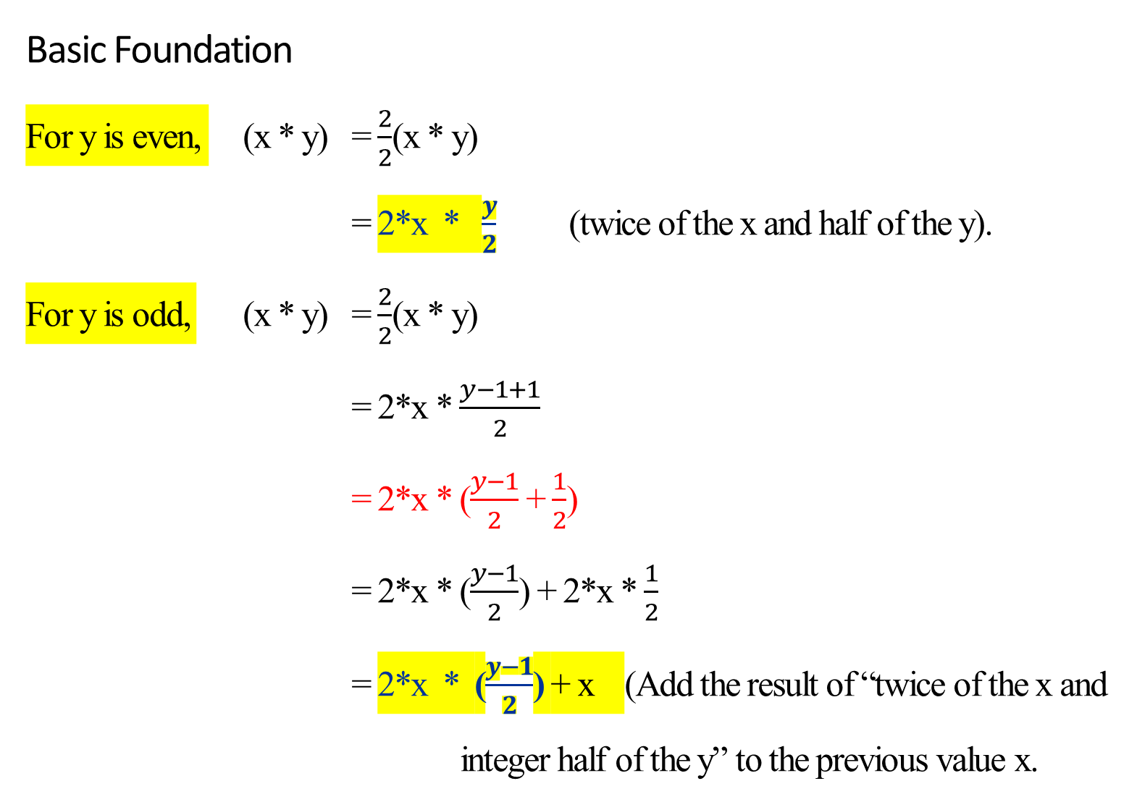
Basic Foundation
For y is even, (x * y) = $\frac{2}{2}$(x * y)
= 2*x * $\frac{y}{2}$ (twice of the x and half of the y).
For y is odd, (x * y) = $\frac{2}{2}$(x * y)
= 2*x * $\frac{y−1+1}{2}$
= 2*x * ($\frac{y−1}{2}$ + $\frac{1}{2}$)
= 2*x * ($\frac{y−1}{2}$) + 2*x * $\frac{1}{2}$
= 2*x * ($\frac{y−1}{2}$) + x (Add the result of “twice of the x and
integer half of the y” to the previous value x.
For example: 52 * 4 = 2 * 52 * 4/2
Reason: 208 = 104 * 2
= 208
52 * 5 = 52 + 2*52*5/2
Reason:
260 = 52 + 104 * 2
= 52 + 208
= 260

Slide 26
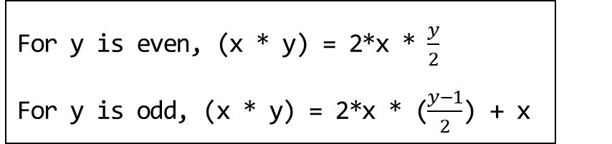
For y is even, (x * y) = 2*x * $\frac{y}{2}$
For y is odd, (x * y) = 2*x * ($\frac{y−1}{2}$) + x
Is there a faster algorithm for multiplication?
Al Khwarizmi’s Algorithm: x * y
Multiply two decimal numbers x and y: (multiplicand * multiplier)
  Repeat the following until the multiplier y gets down to 1:
      integer-divide the multiplier y by 2, and
      double the multiplicand x.
  Strike out all the rows in which the multiplier y in the first column is even (why?),
  Add up what remains in the second (multiplicand) column.
Is it because of the 0 digit in y?

Slide 27
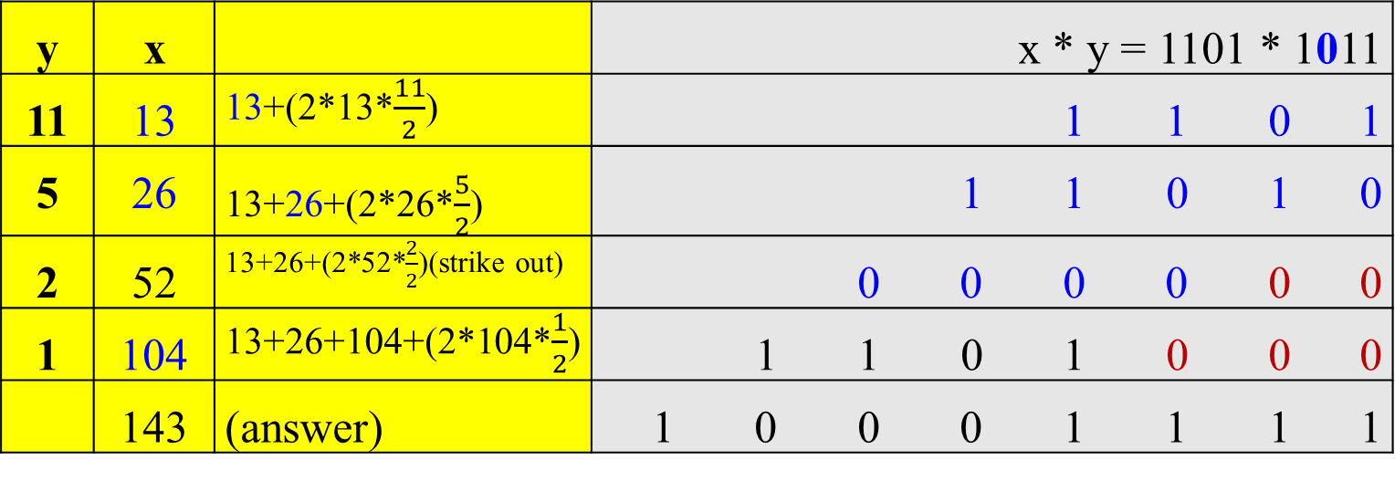
Example 0.7: Let y = 11₁₀ (1011₂) and x = 13₁₀ (1101₂).
x * y = 13 * 11 = 1101 * 1011.
The bit 0 in y yields 0000 for an intermediate row.
The algorithm is: Repeatedly until y = 1;
if y is odd, then x + 2z
else 2z, where z = x * (y/2) and (y/2) is an integer division.
x + 2 ( x * (y/2)), if y is odd
y * x =
2 (x * (y/2)), if y is even.
y | x |  | x * y = 1101 * 1011
11 | 13 | 13+(2*13*$\frac{11}{2}$) | 1 1 0 1
5 | 26 | 13+26+(2*26*$\frac{5}{2}$) | 1 1 0 1 0
2 | 52 | 13+26+(2*52*$\frac{2}{2}$)(strike out) | 0 0 0 0 0 0
1 | 104 | 13+26+104+(2*104*$\frac{1}{2}$) | 1 1 0 1 0 0 0
 | 143 | (answer) | 1 0 0 0 1 1 1 1
why y/2?
Each y shift right by one bit, x has to shift left by one bit.
11*13 = x + 2 (x * y/2) = 13 + 2(13 * 11/2) = 13 + 2 *13 * 5 = 13 + 26 *5 = 13 + 26 + 2(26 * 5/2) = 13 + 26 + (52*2)
= 13 + 26 + 2(52 * 2/2) = 13 + 26 + (104 * 1) = 13 + 26 + 104 + 2(104 * ½) = 13 + 26 + 104 = 143

Slide 28

5 * 26 = 26 + 2(26 * (5/2))
= 26 + 26 * 4
2 * 52 = 2(52 * (2/2))
4 * 52 = 2(52 * (4/2)) Facts!
x + 2 ( x * (y/2)), if y is odd
x * y =
2 (x * (y/2)), if y is even.
13 * 11 = 13 + 2( 13 * (11/2)) = 13 + (2 * 13 *5) since y is 11, an odd number.
= 13 + (26 * 5) = 13 + (26 + 2(26 * (5/2))), since y = 5, an odd number.
= 13 + (26 + (52 * (5/2)))
= 13 + (26 + (52 * 2))
= 13 + (26 + (2 (52 * (2/2)))) since y = 2, an even number.
= 13 + (26 + (104 *1))
= 13 + (26 + (104 + 2(104 * (1/ 2))))
= 13 + (26 + (104 + 2(104 * 0))
= 13 + 26 + 104
= 143.
y | x
11 | 13
5 | 26
2 | 52
1 | 104
 | 143
$$It is \text{O}\text{(}\text{n}\text{2}\text{).}$$

Slide 29
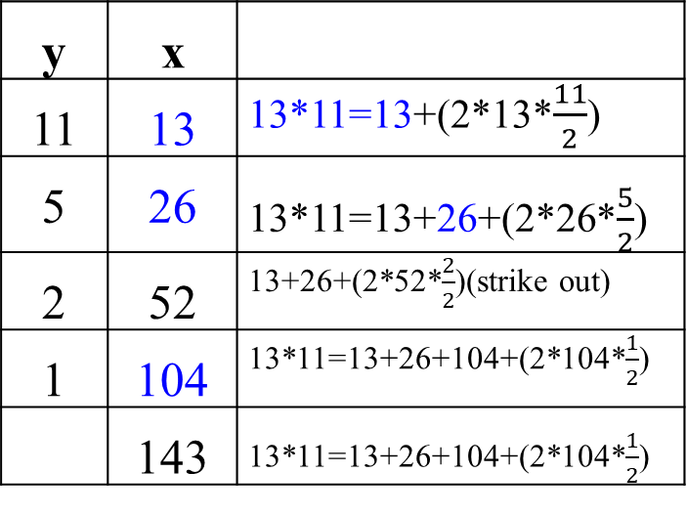
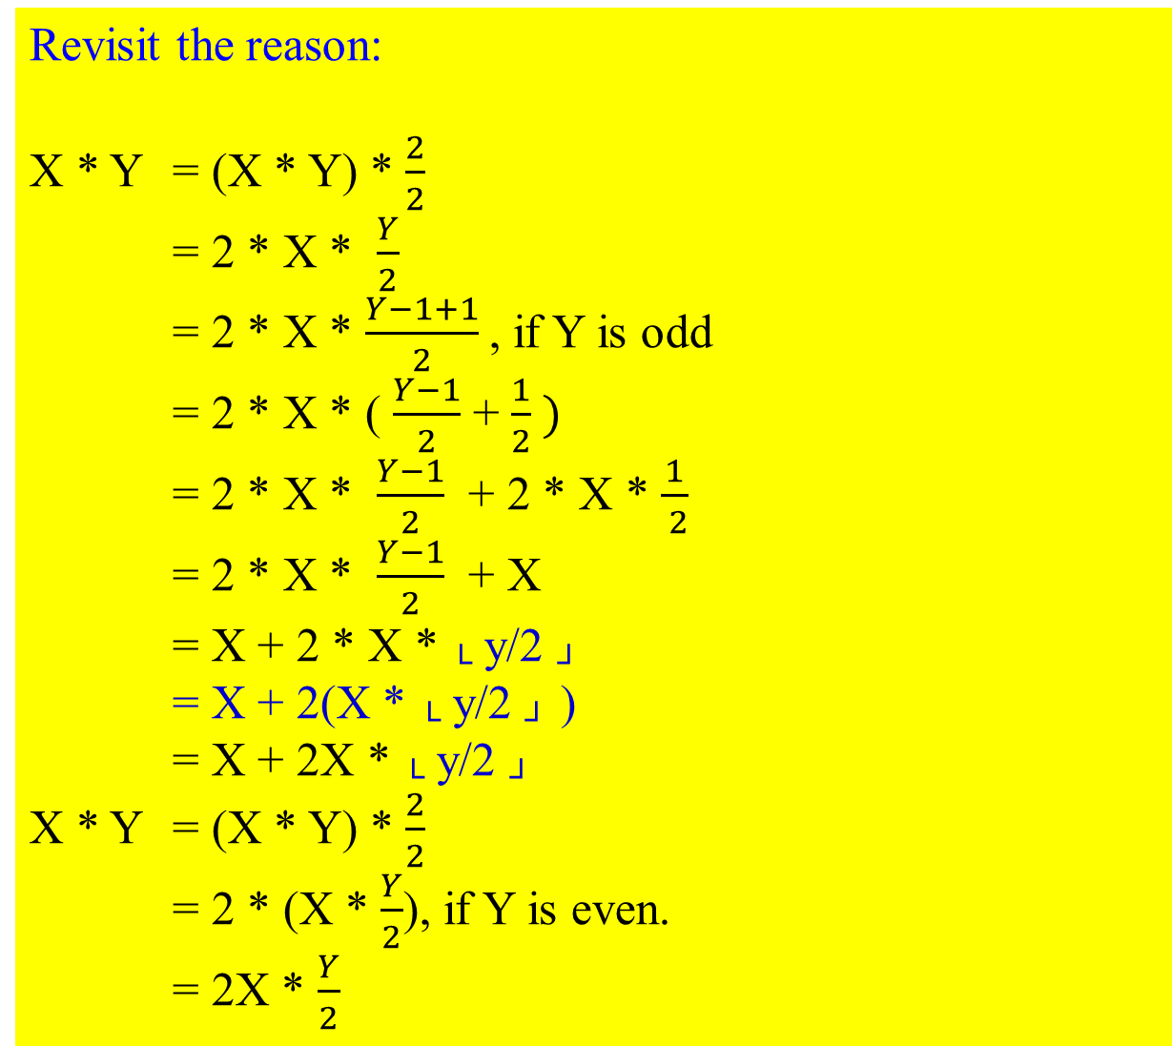
Revisit the reason:
X * Y = (X * Y) * $\frac{2}{2}$
= 2 * X * $\frac{Y}{2}$
= 2 * X * $\frac{Y−1+1}{2}$, if Y is odd
= 2 * X * ( $\frac{Y−1}{2}$ + $\frac{1}{2} )$
= 2 * X * $\frac{Y−1}{2}$ + 2 * X * $\frac{1}{ 2}$
= 2 * X * $\frac{Y−1}{2}$ + X
= X + 2 * X * └ y/2 ┘
= X + 2(X * └ y/2 ┘ )
= X + 2X * └ y/2 ┘
X * Y = (X * Y) * $\frac{2}{2}$
= 2 * (X * $\frac{Y}{2}$), if Y is even.
= 2X * $\frac{Y}{2}$
x + 2 ( x * (y/2)), if y is odd
y * x =
2 (x * (y/2)), if y is even.
y | x
11 | 13 | 13*11=13+(2*13*$\frac{11}{2}$)
5 | 26 | 13*11=13+26+(2*26*$\frac{5}{2}$)
2 | 52 | 13+26+(2*52*$\frac{2}{2}$)(strike out)
1 | 104 | 13*11=13+26+104+(2*104*$\frac{1}{2}$)
 | 143 | 13*11=13+26+104+(2*104*$\frac{1}{2}$)
11*13 = 13 + 5 * 26
= 13 + (26 + 2 (26 * 5/2) )
= 13 + (26 + (52 * 2))
= 13 + (26 + ( 2*(52 * 2/2)))
= 13 + (26 + (104 * 1)))
= 13 + (26 + (104))
= 143

Slide 30
Al khwarizmi’s algorithm is a fascinating mixture of decimal and binary.
Integer division
x + 2 ( x * (y/2)), if y is odd
y * x =
2 (x * (y/2)), if y is even. Al khwarizmi’s algorithm
The same algorithm can be rewritten in a different way based on the following rule:
2(x * └ y/2 ┘) if y is even
x * y =
x + 2(x * └ y/2 ┘) if y is odd

Slide 31
The number of bits require to represent x and y are j =└ log₂ x ┘ + 1 and k = └ log₂ y ┘ + 1, respectively. The product would be n = j + k bits long. The total number of shifts left of x (i.e., x = x*2) would be k-1 times, which is the total number of shifts right of y (i.e., y = y/2). This algorithm will compute x * y and generate k intermediate results. Thus, it requires (k-1)(n) number of additions. Assume that j = n, k = n. It requires (n-1)(2n) = 2n² – 2n = O(n² ).
Thus, if both x and y have n bits, then O(n² ).
y | x |  | x * y = 1101 * 1011
1011 | 1101 |  | 1 1 0 1
101 | 11010 |  | 1 1 0 1 0
10 | 110100 | (strike out) | 0 0 0 0 0 0
1 | 1101000 |  | 1 1 0 1 0 0 0
 | 10001111 | (answer) | 1 0 0 0 1 1 1 1
y | x
11 | 13
5 | 26
2 | 52
1 | 104
 | 143

Slide 32
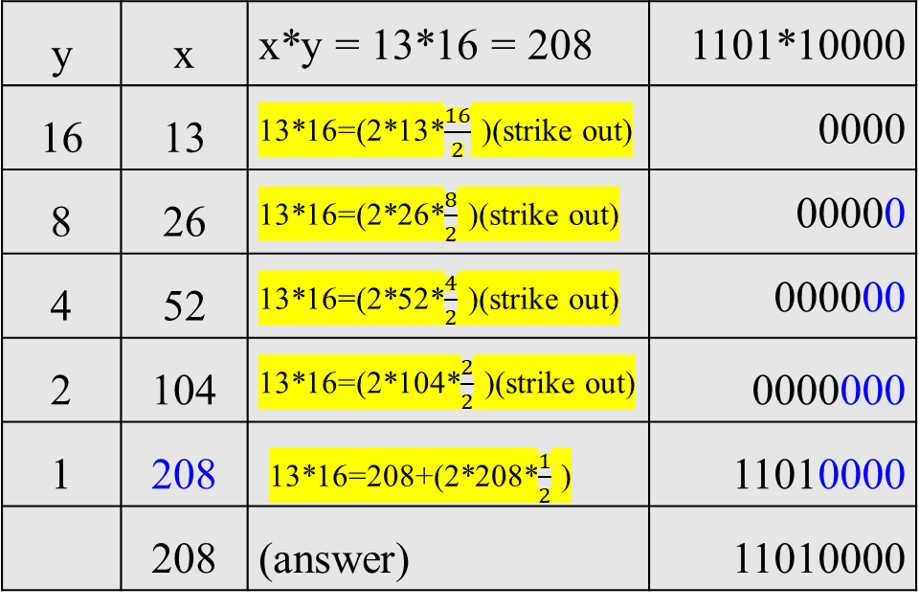
Example 0.8: Let x = 13 and y = 16. Find x * y. (13 = 1101, 16 = 10000)
(13 = 1101, 16 = 10000)
The use of the algorithm, we have
13 * 16 = 13 *2 * 16/2 = 2(13 * 8)
13 * 8 = 13*2 * 8/2 = 2(13 * 4)
13 * 4 = 13*2 * 4/2 = 2(13 * 2)
13 * 2 = 13 *2 * 2/2 = 2(13 * 1)
13 * 1 = 13 * (1 + 0) = 13 + 2(13*0/2).
13 * 16 = 2(13 *8) = 2(2(13 * 4))
= 2(2(2(13*2)))
= 2(2(2(2(13*1))))
= 2(2(2(2(13*(1+0)))))
= 2(2(2(2(13+ 2(13*0/2)))))
= 2(2(2(2(13))))
= 2(2(2(26)))
= 2(2(52))
= 2(104) = 208
Computed by hands
y | x | x*y = 13*16 = 208 | 1101*10000
16 | 13 | 13*16=(2*13*$\frac{16}{2}$ )(strike out) | 0000
8 | 26 | 13*16=(2*26*$\frac{8}{2}$ )(strike out) | 00000
4 | 52 | 13*16=(2*52*$\frac{4}{2}$ )(strike out) | 000000
2 | 104 | 13*16=(2*104*$\frac{2}{2}$ )(strike out) | 0000000
1 | 208 | 13*16=208+(2*208*$\frac{1}{2}$ ) | 11010000
 | 208 | (answer) | 11010000
208 * 1 = 208 + (2 * 208 * ½)
= 208 + (0)

Slide 33
Multiplication à la Franҫais

Slide 34

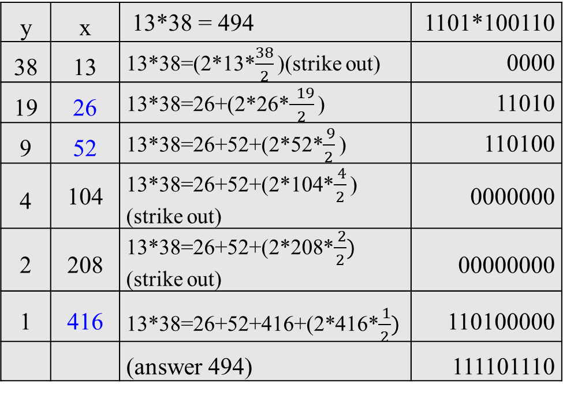
Example 0.9: Let x = 13 and y = 38. Find x * y. (13 = 1101, 38 = 100110)
Computed by bit-representations
The use of the algorithm, we have
13 * 38 = 2(13 * 38/2) = 2(13 * 19)
13 * 19 = 13 *(1 + 18) = 13 + (13 * 18)
= 13 + 2(13 * 18/2) = 13 + 2(13 * 9)
13 * 9 = 13 *(1 + 8) = 13 + 2(13 * 8/2)
= 13 + 2(13 * 4)
13 * 4 = 2(13 * 4/2) = 2(13 * 2)
13 * 2 = 2(13 * 2/2) = 2 (13*1)
13 * 1 = 13 *(1+0) =13 + 2 (13*0/2) = 13
13 * 38 = 2(13 * 19) = 2(13 + 2(13 * 9))
= 2(13 + 2(13 + 2(13 * 4)))
= 2(13 + 2(13 + 2(2(13 * 2))))
= 2(13 + 2(13 + 2(2(2(13 * 1) ))))
y | x | 13*38 = 494 | 1101*100110
38 | 13 | 13*38=(2*13*$\frac{38}{2}$ )(strike out) | 0000
19 | 26 | 13*38=26+(2*26*$\frac{ 19}{2}$ ) | 11010
9 | 52 | 13*38=26+52+(2*52*$\frac{ 9}{2}$ ) | 110100
4 | 104 | 13*38=26+52+(2*104*$\frac{ 4}{2}$ ) (strike out) | 0000000
2 | 208 | 13*38=26+52+(2*208*$\frac{ 2}{2})$ (strike out) | 00000000
1 | 416 | 13*38=26+52+416+(2*416*$\frac{ 1}{2})$ | 110100000
 |  | (answer 494) | 111101110

Slide 35
Figure 1.1: Multiplication à la Franҫais -
A recursive algorithm that directly implements this rule :
2(x *└ y/2 ┘), if y is even
x * y =
x + 2(x * └ y/2 ┘), if y is odd
function multiply(x, y)
Input: Two n-bit integers x and y, where y ≥ 0
Output: Their product
if (y = 0) then return 0;
z := multiply (x, └ y/2 ┘); //z = x *└ y/2 ┘
if (y is even) then return 2z
else return x + 2z;
Figure 1.1 Multiplication à la Franҫais
Using this algorithm, we have (example 0.9)
13 * 38 = 2(13 * 19)
13 * 19 = 13 + 2(13 * 9)
13 * 9 = 13 + 2(13 * 4)
13 * 4 = 2(13 * 2)
13 * 2 = 2(13 * 1) = 13 * 2 = 26,
13 * 1 = 13 + 2 ( 13* └ 1/2 ┘ )
= 13 + 2 (13 * 0) = 13
13 * 0 = 0
13 * 38 = 2(13 * 19)
= 2(13 + 2(13 * 9))
= 2(13 + 2(13 + 2(13 * 4)))
= 2(13 + 2(13 + 2(2(13 * 2))))
= 2(13 + 2(13 + 2(2(2(13 * 1) ))))

Slide 36
Analysis of an algorithm:
  Is this algorithm correct?
  How long does the algorithm take?
  Can we do better?
function multiply(x, y)
Input: Two n-bit integers x and y, where y ≥ 0
Output: Their product
if (y = 0) then return 0;
z := multiply (x, └ y/2 ┘);
if (y is even) then return 2z
else return x + 2z;

Slide 37
Is this algorithm correct?
Does the algorithm behave what it intends to do?
  Given input and output specifications, will the algorithm produce ouput_data that satisfies the output specification for all the input_data meeting the input specification?
Will the algorithm halt?
It is transparently correct; └ y/2 ┘ will reach 0. It also handles the base case (y = 0).
function multiply(x, y)
Input: Two n-bit integers x and y, where y ≥ 0
Output: Their product
if y = 0 then return 0;
z := multiply (x, └ y/2 ┘);
if y is even then return 2z
else return x + 2z;
2(x *└ y/2 ┘), if y is even
x * y =
x + 2(x * └ y/2 ┘), if y is odd
n = └ log₂y ┘ + 1
n = └ log₂x ┘ + 1

Slide 38
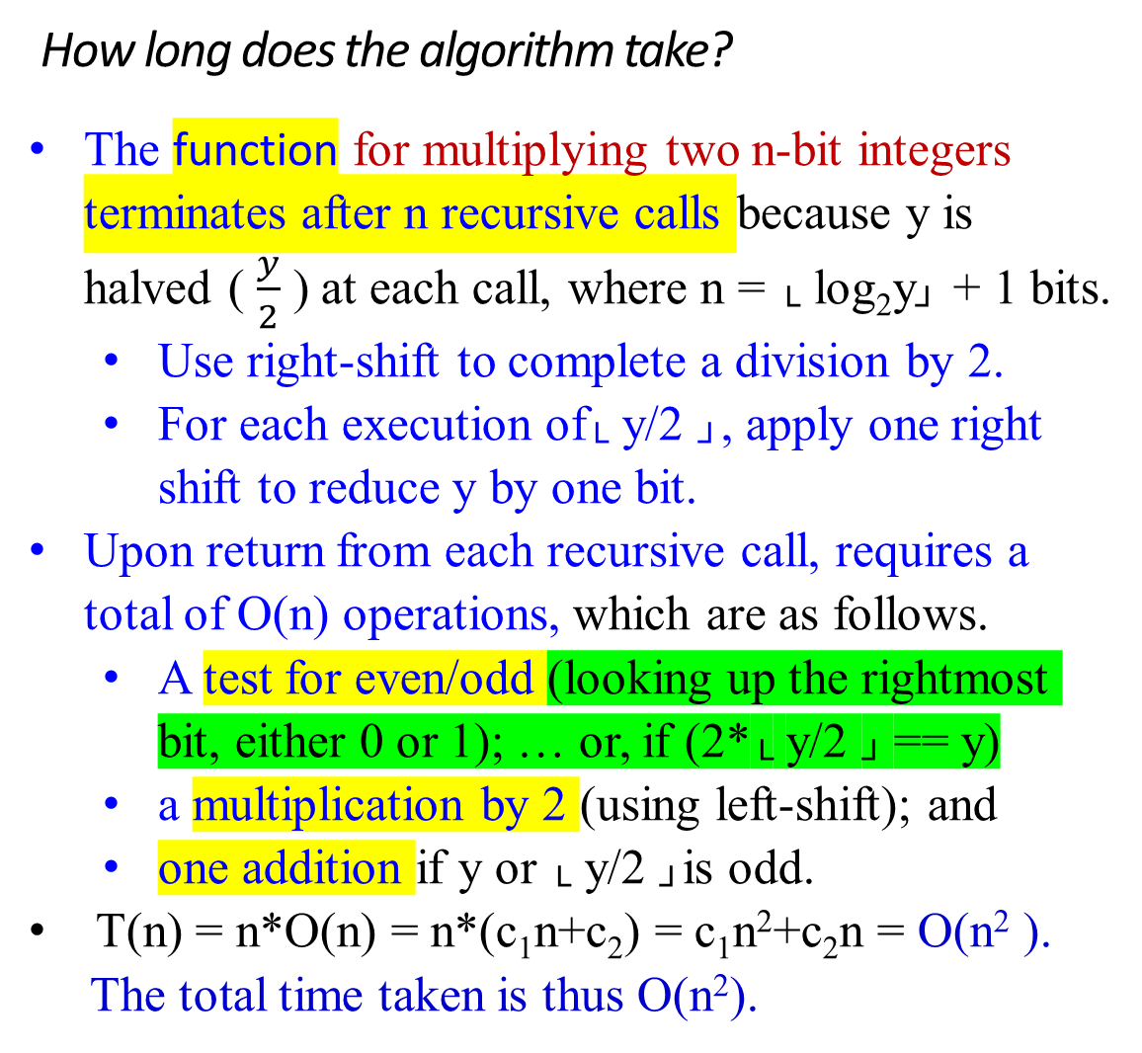
How long does the algorithm take?
The function for multiplying two n-bit integers terminates after n recursive calls because y is halved ( $\frac{y}{2}$ ) at each call, where n = └ log₂y┘ + 1 bits.
  Use right-shift to complete a division by 2.
  For each execution of└ y/2 ┘, apply one right shift to reduce y by one bit.
Upon return from each recursive call, requires a total of O(n) operations, which are as follows.
  A test for even/odd (looking up the rightmost bit, either 0 or 1); … or, if (2*└ y/2 ┘ == y)
  a multiplication by 2 (using left-shift); and
  one addition if y or └ y/2 ┘is odd.
T(n) = n*O(n) = n*(c₁n+c₂) = c₁n²+c₂n = O(n² ).
The total time taken is thus O(n²).
function multiply(x, y)
Input: Two n-bit integers x and y, where y ≥ 0
Output: Their product
if y = 0 then return 0;
z := multiply (x, └ y/2 ┘);
if y is even then return 2z
else return x + 2z;
//z = x *└ y/2 ┘
Shift right n times for n-bit y,
where n = └ log₂y ┘ + 1
Therefore, n recursive calls.

Slide 39
if y is even then return 2z
else return x + 2z;
This takes linear time to do it for each round.
function multiply(x, y)
Input: Two n-bit integers x and y, where y ≥ 0
Output: Their product
if y = 0 then return 0;
z := multiply (x, └ y/2 ┘);
if y is even then return 2z
else return x + 2z;
//z = x *└ y/2 ┘
Prove T(n) = O(n²)
T(n) = T(└ n/2 ┘) + c(n)
T(1) = c₀ (assume c₀ = 1);
Solution: (need to check the correctness of the following)
Let n = 2^{k}.
T(n) = T(2^{k}) = T(2^{k-1}) + 2^{k}
= T(2^{k--2}) + 2^{k-1} + 2^{k}
= …
= T(2^{k-i}) + (2^{k-i+1} ) + (2^{k-i+2} ) + … + (2^{k-3} ) + (2^{k-2} ) + (2^{k-1} ) + (2^{k} )
= T(2^{k-k}) + (2^{k-k+1} ) + (2^{k-k+2} ) + … + (2^{k-3} ) + (2^{k-2} ) + (2^{k-1} ) + (2^{k} ), k = i
= T(2^{k-k}) + (2^{k-k+1} ) + (2^{k-k+2} ) + … + (2^{k-3} ) + (2^{k-2} ) + (2^{k-1} ) + (2^{k} ),
= 1+ (2¹ ) + (2² ) + … + (2^{k-3} ) + (2^{k-2} ) + (2^{k-1} ) + (2^{k} ),
= (2^{k+1} -1)
= 2n -1 = O(n) for each recursive call
The algorithm will take n calls, and therefore O(n²).
Let n = 1.
return 0, if y = 0;
return x, if y = 1;
multiply(x, y) = since y = 1,
z := multiply(x, └ y/2 ┘)
= multiply(x, 0) = returns 0, since y = 0.
return x + 2*0 = x, since y = 0.
Conclusion: T(n =1bit) = c₀

Slide 40
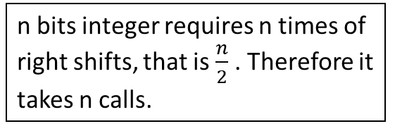

function multiply(x, y)
Input: Two n-bit integers x and y, where y ≥ 0
Output: Their product
if y = 0 then return 0;
z := multiply (x, └ y/2 ┘);
if y is even then return 2z
else return x + 2z;
//z = x *└ y/2 ┘
Prove T(n) = O(n²)
T(n) = T(└ n/2 ┘) + c(n)
T(1) = c₀ (assume c₀ = 1);
Solution: (check the correctness of the following)
Let n = 2^{k}.
T(n) = T(2^{k}) = T(2^{k-1}) + 2^{k}
= T(2^{k-2}) + 2^{k-1} + 2^{k}
= …
= T(2^{k-i}) + (2^{k-i+1} ) + (2^{k-i+2} ) + … + (2^{k-3} ) + (2^{k-2} ) + (2^{k-1} ) + (2^{k} )
= T(2^{k-k}) + (2^{k-k+1} ) + (2^{k-k+2} ) + … + (2^{k-3} ) + (2^{k-2} ) + (2^{k-1} ) + (2^{k} ), k = i
= T(2^{k-k}) + (2^{k-k+1} ) + (2^{k-k+2} ) + … + (2^{k-3} ) + (2^{k-2} ) + (2^{k-1} ) + (2^{k} ),
= 1+ (2¹ ) + (2² ) + … + (2^{k-3} ) + (2^{k-2} ) + (2^{k-1} ) + (2^{k} ),
= (2^{k+1} -1)
= 2n -1 = O(n) for each recursive call
The algorithm will take n calls. For each call’s
return, it requires O(n) for addition. Therefore O(n²).
T(n) = T($\frac{n}{2}$ ) + c(n)
T(2^{k}) = T(2^{k-1}) + (2^{k})
n bits integer requires n times of right shifts, that is $\frac{n}{2}$ . Therefore it takes n calls.

Slide 41

function multiply(x, y)
Input: Two n-bit integers x and y, where y ≥ 0
Output: Their product
if y = 0 then return 0;
z := multiply (x, └ y/2 ┘);
if y is even then return 2z
else return x + 2z;
//z = x *└ y/2 ┘
Can we do better?
We can do significantly better. (See Chapter 02)

Slide 42
Multiplication ẚ la Russe

Slide 43

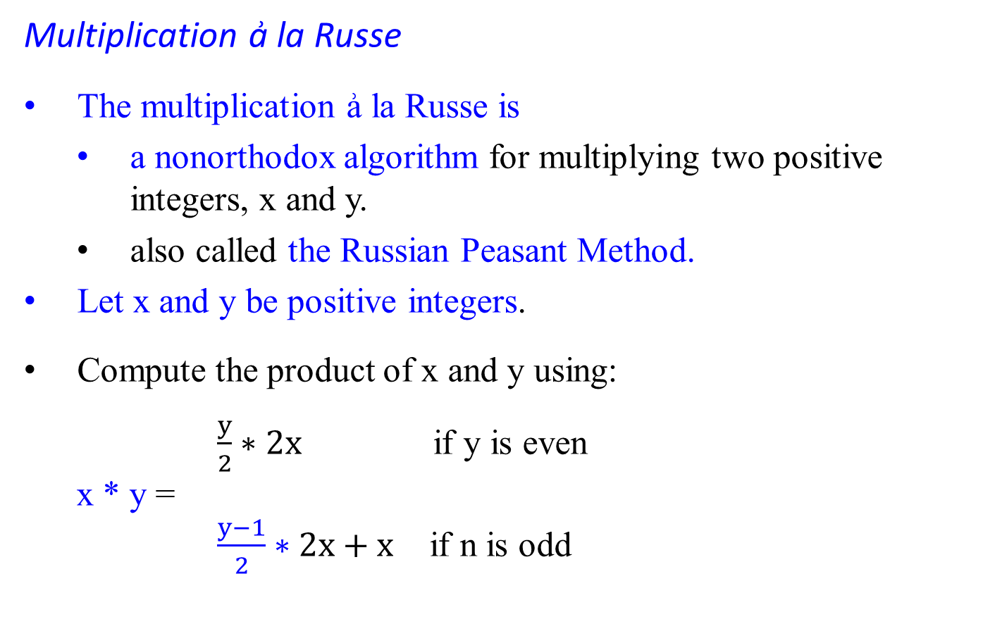
Multiplication ẚ la Russe
The multiplication ẚ la Russe is
  a nonorthodox algorithm for multiplying two positive integers, x and y.
  also called the Russian Peasant Method.
Let x and y be positive integers.
Compute the product of x and y using:
$\frac{y}{2}∗2x$ if y is even
  x * y =
$\frac{y−1}{2}∗2x+x$ if n is odd
Al khwarizmi’s method:
2(x * └ y/2 ┘) if y is even
x*y =
x + 2(x * └ y/2 ┘) if y is odd

Slide 44

Compute the product x * y, where y and x are positive integers.
Compute product x * y either recursively or iteratively.
The difference between the Russian Peasant Method and Al Khwarizmi’s algorithm (coded as Multiplication à la Franҫais) is that
  integer (even) division, and
  reduce the value of y by one(1) if y is an odd number.
Let’s measure the instance size by the value of y.
If y is even, an instance of half the size has to deal with y/2 or └ y/2 ┘:
y * x = (y/2) * 2x. (Multiplication ẚ la Russe)
= (2x * └ y/2 ┘) if y is even (Al khwarizmi’s )
If y is odd, we have
y * x = ((y – 1)/2) * 2x + x. (Multiplication ẚ la Russe)
= x + 2(x * └ y/2 ┘) if y is odd (Al khwarizmi’s )
= x + 2x * └ y/2 ┘
Use the trivial case of 1 * x = x to stop.

Slide 45

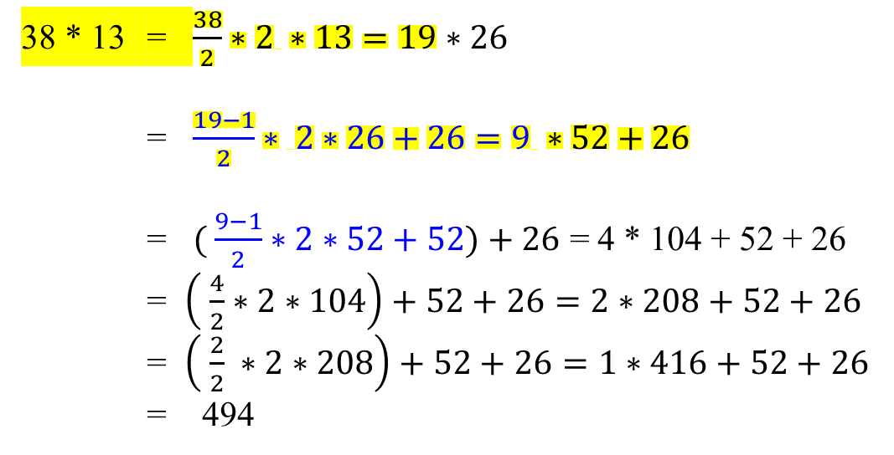
Example 0.10: Compute 38 * 13
38 * 13 = $\frac{38}{2}∗2 ∗13=19∗26$
= $\frac{19−1}{2}∗ 2∗26+26=9 ∗52+26$
= $( \frac{9−1}{2}∗2∗52+52)+26$ = 4 * 104 + 52 + 26
= $\left( \frac{4}{2}∗2∗104\right)+52+26=2∗208+52+26$
= $\left( \frac{2}{2} ∗2∗208\right)+52+26=1∗416+52+26$
= 494
y | x
38 | 13
19 | 26 |  | 38 is even
9 | 52 | (+26) | 19 is odd
4 | 104 | (+52) | 9 is odd
2 | 208 |  | 4 is even
1 | 416 |  | 2 is even
 | 494 | +26+52+416
What is the time efficiency class of Russian peasant multiplication?
The total time taken is thus O(n² ). [Prove it.]

Slide 46
Example 0.11
An example of computing 50 * 65 with this algorithm is given in Figure:
All the extra addends shown in the parentheses in the Figure are in the rows with odd values in the first column. Apply the Russian Peasant Method and Al Khwarizmi’s algorithm yielding the following results:
y | x
50 | 65
25 | 130 | since 50 is even
12 | 260 | (+130), since 25 is odd
6 | 520 | since 12 is even
3 | 1040 | since 6 is even
1 | 2080 | (+1040), since 3 is odd
 | 3250 | +(130 + 1040+2080)=3250
y | x
50 | 65 | strike-out
25 | 130
12 | 260 | strike-out
6 | 520 | strike out
3 | 1040
1 | 2080
 | 3205
the Russian Peasant Method Al Khwarizmi’s algorithm

Slide 47
There we can find the product by simply adding all the elements in the x column that have an odd number in the y column. (See figure below)
y | x
50 | 65
25 | 130 | 130
12 | 260
6 | 520
3 | 1040 | 1040
1 | 2080 | 2080
 |  | 3250
The algorithm involves only the simple operations of halving, doubling, and adding.
It also leads to very fast hardware implementation since doubling and halving of binary numbers can be performed using the left and right shifts, respectively, which are among the most basic operations at the machine level.

Slide 48
Division
Time efficiency and
Proof of Program Correction.

Slide 49

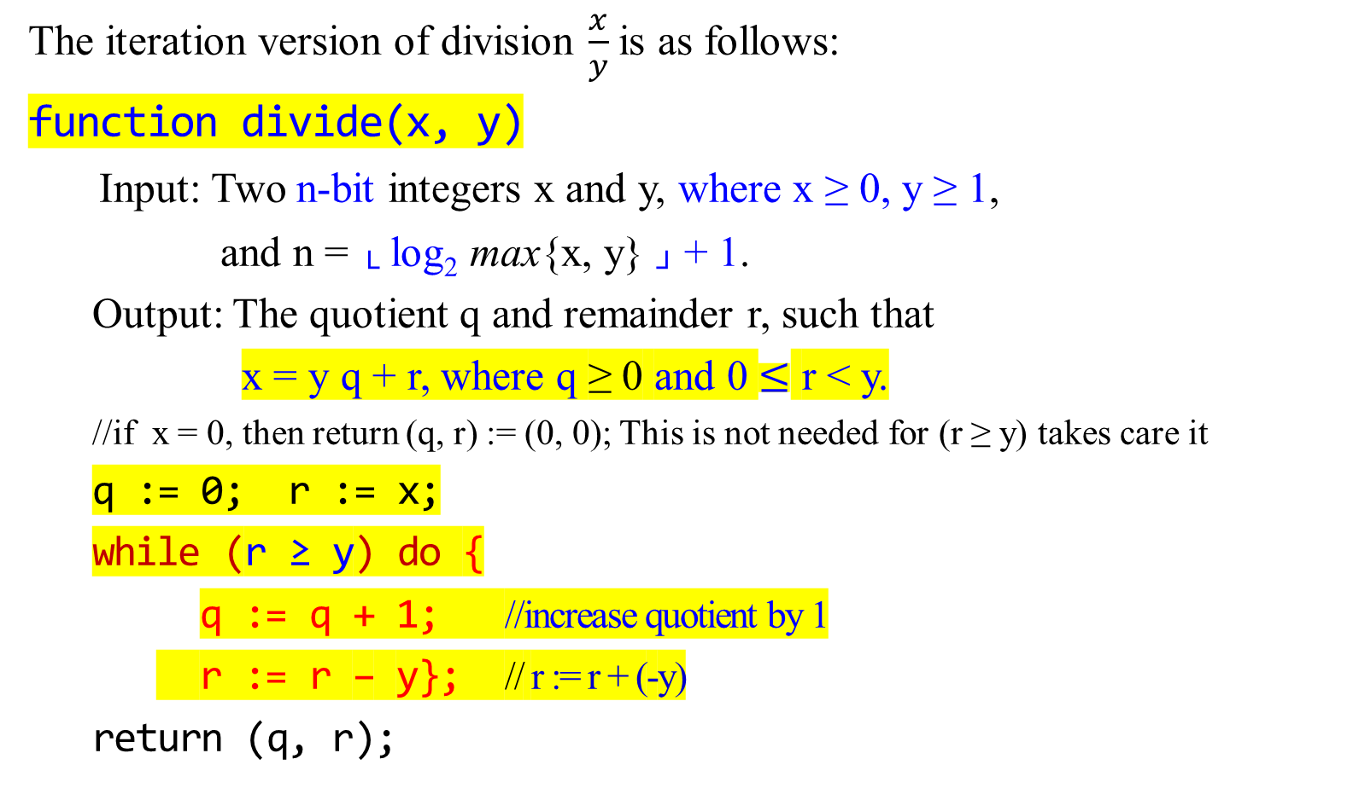
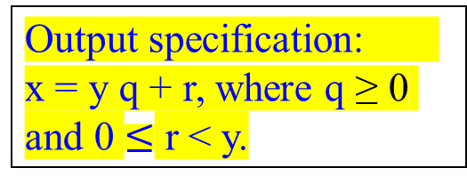
Analysis of the Division Algorithm
Output specification: x = y q + r, where q ≥ 0 and 0 $≤$ r < y.
The iteration version of division $\frac{x}{y}$is as follows:
function divide(x, y)
Input: Two n-bit integers x and y, where x ≥ 0, y ≥ 1,
and n = └ log₂ max{x, y} ┘ + 1.
Output: The quotient q and remainder r, such that
x = y q + r, where q ≥ 0 and 0 $≤$ r < y.
//if x = 0, then return (q, r) := (0, 0); This is not needed for (r ≥ y) takes care it
q := 0; r := x;
while (r ≥ y) do {
q := q + 1; //increase quotient by 1
r := r – y}; // r := r + (-y)
return (q, r);
ST q, 0
ST r, x
L R4, q
L R1, r
L R2, y
L1: SR R1, R1, R2
JNEG Ret
A R4, R4, 1
SR R1, R1, R2
J L1
Ret: STR r, R1
ST q, R4
…
x def
y def
q def
r def

Slide 50

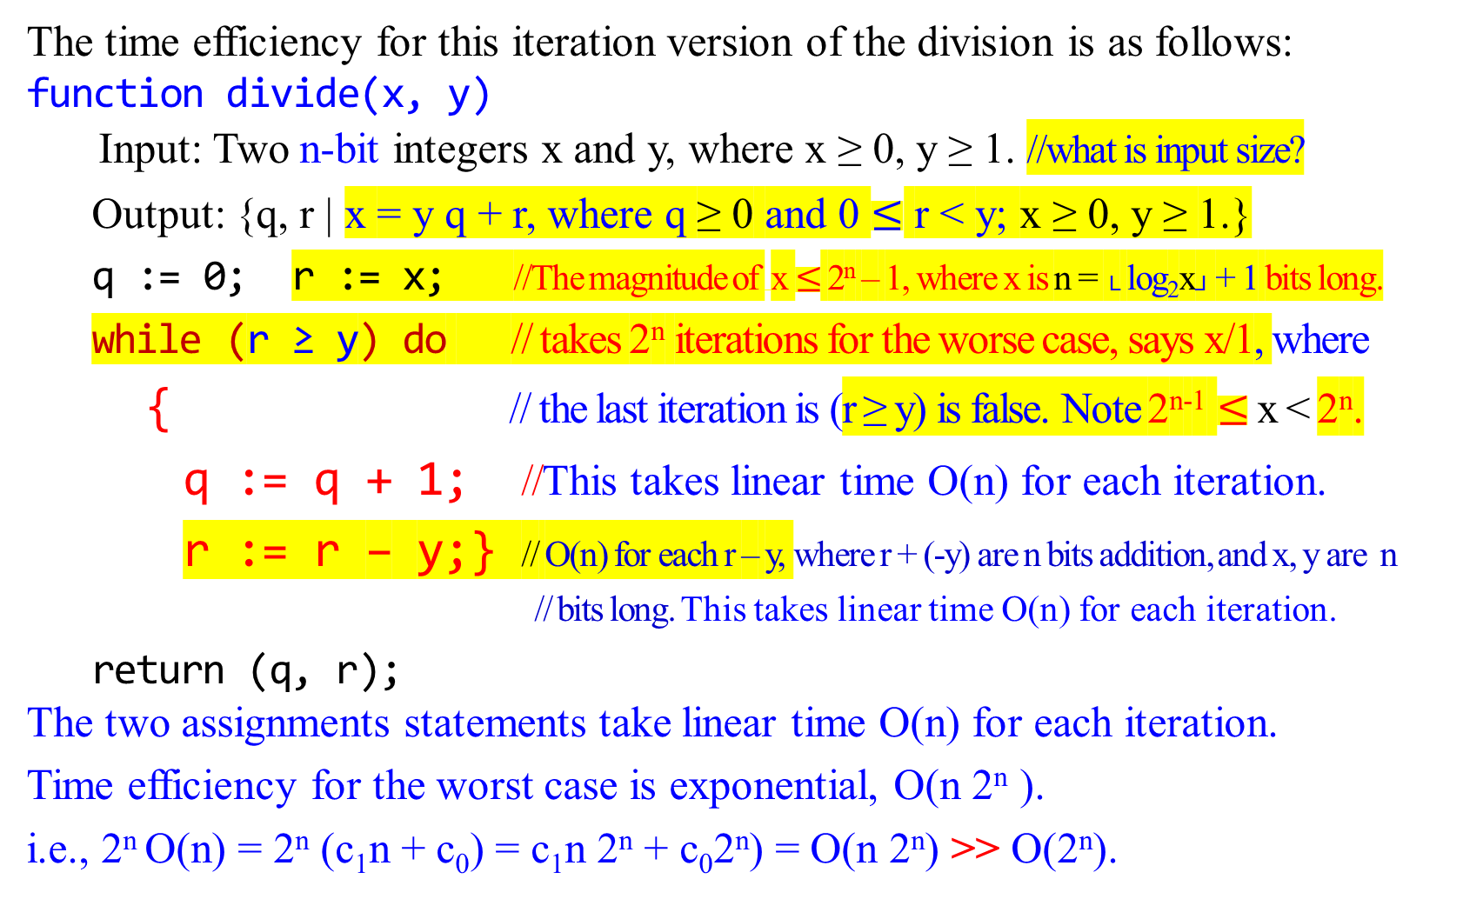
The time efficiency for this iteration version of the division is as follows:
function divide(x, y)
Input: Two n-bit integers x and y, where x ≥ 0, y ≥ 1. //what is input size?
Output: {q, r | x = y q + r, where q ≥ 0 and 0 $≤$ r < y; x ≥ 0, y ≥ 1.}
q := 0; r := x; //The magnitude of x $≤$ 2^{n} – 1, where x is n = └ log₂x┘ + 1 bits long.
while (r ≥ y) do // takes 2^{n} iterations for the worse case, says x/1, where
{ // the last iteration is (r ≥ y) is false. Note 2^{n-1} $≤$ x < 2^{n}.
q := q + 1; //This takes linear time O(n) for each iteration.
r := r – y;} // O(n) for each r – y, where r + (-y) are n bits addition, and x, y are n // bits long. This takes linear time O(n) for each iteration.
return (q, r);
The two assignments statements take linear time O(n) for each iteration.
Time efficiency for the worst case is exponential, O(n 2^{n} ).
i.e., 2^{n} O(n) = 2^{n} (c₁n + c₀) = c₁n 2^{n} + c₀2^{n}) = O(n 2^{n}) >> O(2^{n}).
n = 8 bits
2^{n} = 2⁸ = 256.
It requires 9 bits to hold this value. The largest value of 8 bits is 2⁸ - 1 = 255, i.e., 1111 1111.

Slide 51

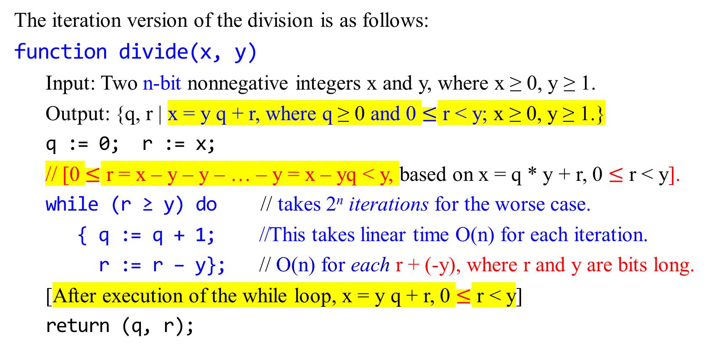

Correctness of the Division Algorithm
Output specification: x = y q + r, where q ≥ 0 and 0 $≤$ r < y.
The iteration version of the division is as follows:
function divide(x, y)
Input: Two n-bit nonnegative integers x and y, where x ≥ 0, y ≥ 1.
Output: {q, r | x = y q + r, where q ≥ 0 and 0 $≤$ r < y; x ≥ 0, y ≥ 1.}
q := 0; r := x;
// [0 $≤$ r = x – y – y – … – y = x – yq < y, based on x = q * y + r, 0 $≤$ r < y].
while (r ≥ y) do // takes 2^{n} iterations for the worse case.
{ q := q + 1; //This takes linear time O(n) for each iteration.
r := r – y}; // O(n) for each r + (-y), where r and y are bits long.
[After execution of the while loop, x = y q + r, 0 $≤$ r < y]
return (q, r);

Slide 52

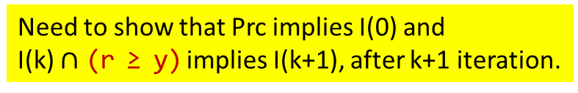
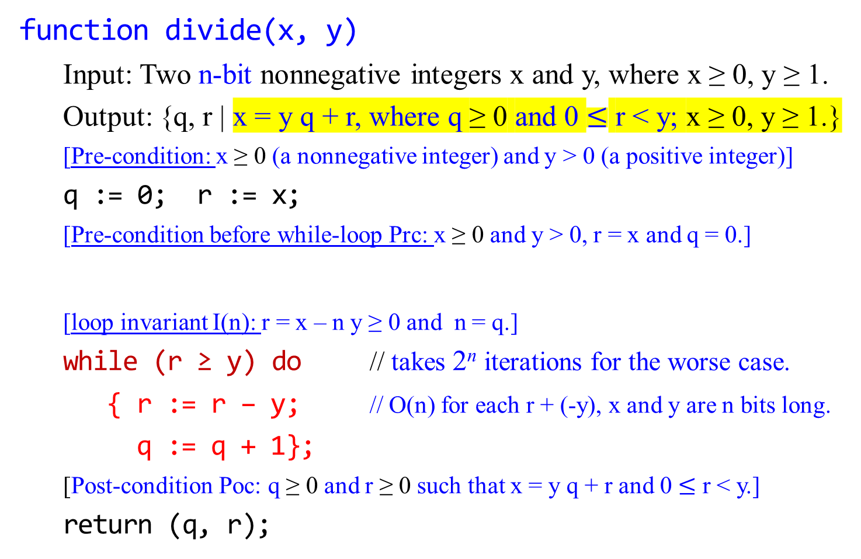


Correctness of the Division Algorithm
Output specification: x = y q + r, where q ≥ 0 and 0 $≤$ r < y.
function divide(x, y)
Input: Two n-bit nonnegative integers x and y, where x ≥ 0, y ≥ 1.
Output: {q, r | x = y q + r, where q ≥ 0 and 0 $≤$ r < y; x ≥ 0, y ≥ 1.}
[Pre-condition: x ≥ 0 (a nonnegative integer) and y > 0 (a positive integer)]
q := 0; r := x;
[Pre-condition before while-loop Prc: x ≥ 0 and y > 0, r = x and q = 0.]
[loop invariant I(n): r = x – n y ≥ 0 and n = q.]
while (r ≥ y) do // takes 2^{n} iterations for the worse case.
{ r := r – y; // O(n) for each r + (-y), x and y are n bits long.
q := q + 1};
[Post-condition Poc: q ≥ 0 and r ≥ 0 such that x = y q + r and 0 $≤$ r < y.]
return (q, r);
Need to show that Prc implies I(0) and
I(k) $∩$ (r ≥ y) implies I(k+1), after k+1 iteration.
Need to show that I(n) $∩$ $¬$(r ≥ y) implies Poc.

Slide 53
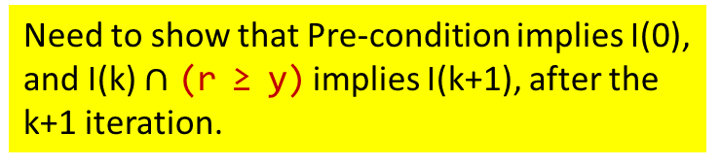
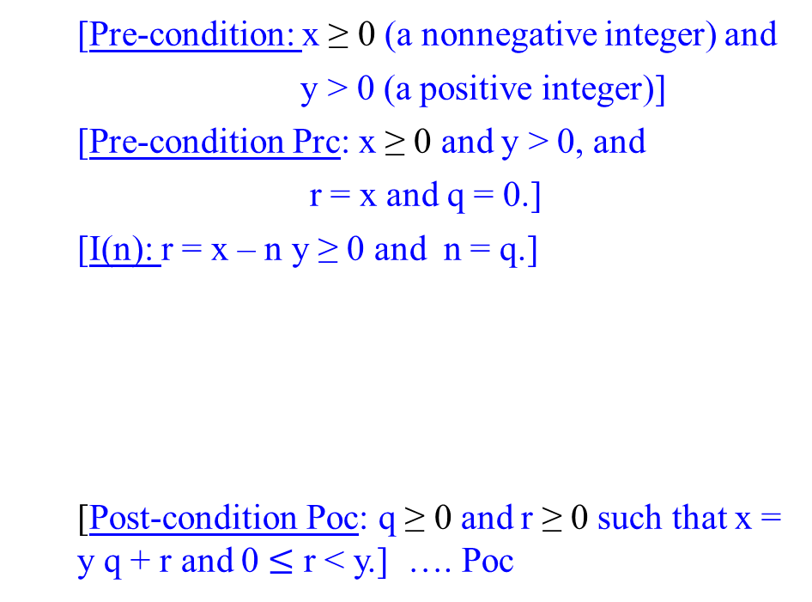
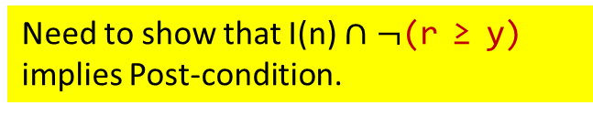
Correctness of the Division Algorithm
function divide(x, y)
[Pre-condition: x ≥ 0 (a nonnegative integer) and
y > 0 (a positive integer)]
[Pre-condition Prc: x ≥ 0 and y > 0, and
r = x and q = 0.]
[I(n): r = x – n y ≥ 0 and n = q.]
[Post-condition Poc: q ≥ 0 and r ≥ 0 such that x = y q + r and 0 $≤$ r < y.] …. Poc
Need to show that Pre-condition implies Prc.
q := 0;
r:= x;
1
2
I(k):
Need to show that Pre-condition implies I(0), and I(k) $∩$ (r ≥ y) implies I(k+1), after the k+1 iteration.
r≥y
r≥y
Return(q, r)
3
4
r := r – y;
q := q + 1
r := r – y;
q := q + 1
Need to show that I(n) $∩$ $¬$(r ≥ y) implies Post-condition.
I(k +1):

Slide 54


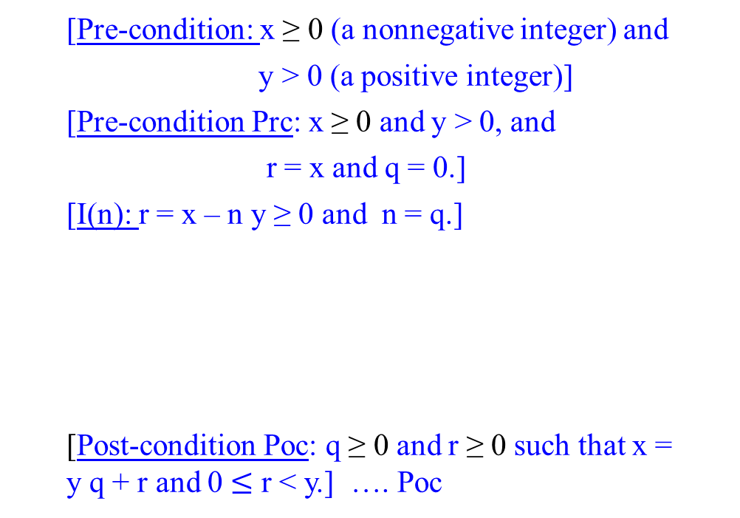
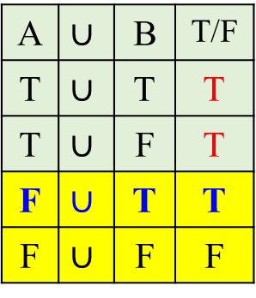
Correctness of the Division Algorithm
function divide(x, y)
[Pre-condition: x ≥ 0 (a nonnegative integer) and
y > 0 (a positive integer)]
[Pre-condition Prc: x ≥ 0 and y > 0, and
r = x and q = 0.]
[I(n): r = x – n y ≥ 0 and n = q.]
[Post-condition Poc: q ≥ 0 and r ≥ 0 such that x = y q + r and 0 $≤$ r < y.] …. Poc
q := 0;
r:= x;
1
Prove: That Pre-condition implies Prc is true.
Proof:
A $→$ B $≡$ $¬$A $∪$ B. To show that “Pre-condition $→$ Prc” is true, we need to show Prc is true if the Pre-condition is true. i.e., ($¬$ true $∪$ true) is true.
Assume that x and y inputs are two n-bit nonnegative integers x ≥ 0 and y > 0, which is the Pre-condition. Then $¬$Pre-condition (i.e. $¬$(x ≥ 0 and y > 0)), is false.
Then we need to show that Prc is true.
Prc is true because by assumption x ≥ 0 and y > 0, and x = x and 0 = 0 after executing the two assignment statements q := 0; r:= x; .
A | $$∪$$ | B | T/F
T | $$∪$$ | T | T
T | $$∪$$ | F | T
F | $$∪$$ | T | T
F | $$∪$$ | F | F
r≥y
Return(q, r)
r := r – y;
q := q + 1

Slide 55


Correctness of the Division Algorithm
function divide(x, y)
[Pre-condition: x ≥ 0 (a nonnegative integer) and
y > 0 (a positive integer)]
[Pre-condition Prc: x ≥ 0 and y > 0, and
r = x and q = 0.]
[I(n): r = x – n y ≥ 0 and n = q.]
[Post-condition Poc: q ≥ 0 and r ≥ 0 such that x = y q + r and 0 $≤$ r < y.] …. Poc
q := 0;
r:= x;
2
I. Basis Property:
Prove: That Prc implies I(0) is true.
Proof:
Use A $→$ B $≡$ $¬$A $∪$ B to prove the implication is true.
Assume that Prc: x ≥ 0 and y > 0, and r = x and q = 0 is true.
Need to show that “I(0): r = x - 0*y ≥ 0 and 0 = q”. is true, before entering the loop, where n = 0. [Note that I(0) is derived from I(n), when n = 0]
By assumption x ≥ 0, then we can write x = x – 0*y ≥ 0
By assumption r = x, then substitute x = x – 0*y ≥ 0 in r = x to yield r = x – 0*y ≥ 0 .
Thus, I(0): “r = x – 0 * y ≥ 0 and n = q $→$ 0 = q ” is true.
r≥y
Return(q, r)
r := r – y;
q := q + 1

Slide 56
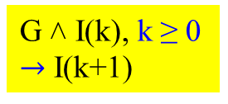
Correctness of the Division Algorithm
Proof:
To prove the correctness of the loop, let the loop invariant be
I(n): r = x – n y ≥ 0 and n = q.
The guard of the while loop is
G: r ≥ y
Inductive Property: [If G ˄ I(k) is true before k+1th loop’s iteration (where k ≥ 0, a nonnegative integer), then I(k+1) is true after iteration of the loop.]
Suppose k ≥ 0 such that G ˄ I(k) is true before the k+1th iteration of the loop. Since G: r ≥ y is true, the loop is entered. Since I(k) is true, that is,
I(k): r = x – k y ≥ 0 and k = q is true.
Before execution of statements “r := r – y; q := q +1;”,
G: r_{k} ≥ y and I(k): r_{k} = x – k y ≥ 0 and q_{k} = k.
Executing these statements “r := r – y; q := q + 1;” , we obtain
  r_{k+1} = r_{k} - y = x – k y – y = x – (k + 1) y ……….(D.01)
  and q_{k+1} = q_{k} + 1 = k + 1. ……….(D.02)
r ≥ y
3₁
r := r – y; q := q + 1;
I(k):
G ˄ I(k), k ≥ 0 $→$ I(k+1)
r≥y
r := r – y;
q := q + 1
I(k +1):

Slide 57
I(n): r = x – n y ≥ 0 and n = q.
The guard of the while loop is G: r ≥ y
since r_{k} ≥ y before execution of statements “r := r – y; q := q + 1;”,
after execution of these statements
r_{k+1} = r_{k} - y ≥ y – y ≥ 0. ……………...(D.03)
Combine these equations (D.01): r_{k+1} = r_{k} - y = x – (k + 1) y ,
(D.02): q_{k+1} = q_{k} + 1 = k + 1, and
(D.03): r_{k+1} = r_{k} - y ≥ 0
to yield that, after iteration of the loops,
r_{k+1} ≥ 0 and r_{k+1} = x – (k + 1) y ≥ 0 and q_{k+1} = k + 1.
Hence I(k+1): r_{k+1} = x – (k + 1) y ≥ 0 and q = k + 1 is true.
III. Eventual Falsity of the Guard: [After a finite number of loop iterations, G: r ≥ y becomes false.]

Slide 58

Correctness of the Division Algorithm
[Pre-condition Prc: x ≥ 0 and y > 0, and
r = x and q = 0.]
[I(n = k): r = x – n y ≥ 0 and n = q.]
[Post-condition Poc: q ≥ 0 and r ≥ 0 such that x = y q + r and 0 $≤$ r < y.] …. Poc
function divide(x, y)
q := 0;
r:= x;
[I(n = k + 1): r = x – n y ≥ 0 and n = q.]
3₂
G:r≥y
Return(q, r)
r := r – y;
q := q + 1

Slide 59


Correctness of the Division Algorithm
here
[Pre-condition Prc: x ≥ 0 and y > 0, and
r = x and q = 0.]
[I(n = k): r = x – n y ≥ 0 and n = q.]
[Post-condition Poc: q ≥ 0 and r ≥ 0 such that x = y q + r and 0 $≤$ r < y.] …. Poc
function divide(x, y)
q := 0;
r:= x;
Eventual Falsity of the Guard
Prove: For the least number of iterations N, G: r ≥ y is false,
Proof: The Guard G is r ≥ y.
For each iteration of the loop, r = r - y and r $≥0$, r is always a non-negative value. r > r – y > r – 2y > … > r – ny, for n > 0; The values of r form a decreasing sequence of nonnegative integers.
According to the well-ordering principle, there is an n such that r – ny $≥$ y and r – (n+1)y < y. i.e., there must have the smallest r, say r_{min}, such that r_{min} < y.
[If r_{min} $≥$y, there will have one more time iteration of the loop and generate a new value of r = r_{min} – y, such that r < r_{min}. This would contradict the fact that r_{min} is the smallest remainder obtained by repeated iterations of the loop.]
Hence when the value r = r_{min} is computed, then r < y. So guard G is a false
[I(n = k + 1): r = x – n y ≥ 0 and n = q.]
3₂
G:r≥y
Return(q, r)
r := r – y;
q := q + 1

Slide 60


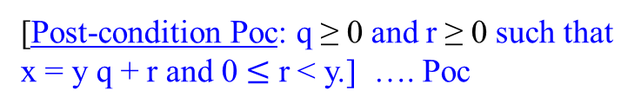
Correctness of the Division Algorithm
Correctness of the Post-Condition
Prove: For the least number of iterations N, G: r ≥ y is false, and
I(N) is true, then Poc is true.
Proof:
Suppose that for some nonnegative integer N ≥ 0, after N iterations,
I(N): r = x – N*y ≥ 0 and N = q is true, and
G: r ≥ y is false (i.e., r < y).
Since N ≥ 0 and N = q, This says q ≥ 0.
Then, we have r < y, r ≥ 0, r = x – Ny, and q = N ≥ 0.
Since q = N, and r = x – Ny yields, by substitution q for N,
  r = x - q y.
  That is, x = q y + r.
Combining the two inequalities r < y, r ≥ 0 gives
  0 $≤$ r < y.
  [Post-condition Poc: q ≥ 0 and r ≥ 0 such that x = y q + r and 0 $≤$ r < y.] is true QED.
[Pre-condition Prc: x ≥ 0 and y > 0, and
r = x and q = 0.]
[I(n = k): r = x – n y ≥ 0 and n = q.]
[Post-condition Poc: q ≥ 0 and r ≥ 0 such that x = y q + r and 0 $≤$ r < y.] …. Poc
function divide(x, y)
q := 0;
r:= x;
[I(n = k + 1): r = x – n y ≥ 0 and n = q.]
4
G:r≥y
Return(q, r)
r := r – y;
q := q + 1
[Post-condition Poc: q ≥ 0 and r ≥ 0 such that x = y q + r and 0 $≤$ r < y.] …. Poc

Slide 61

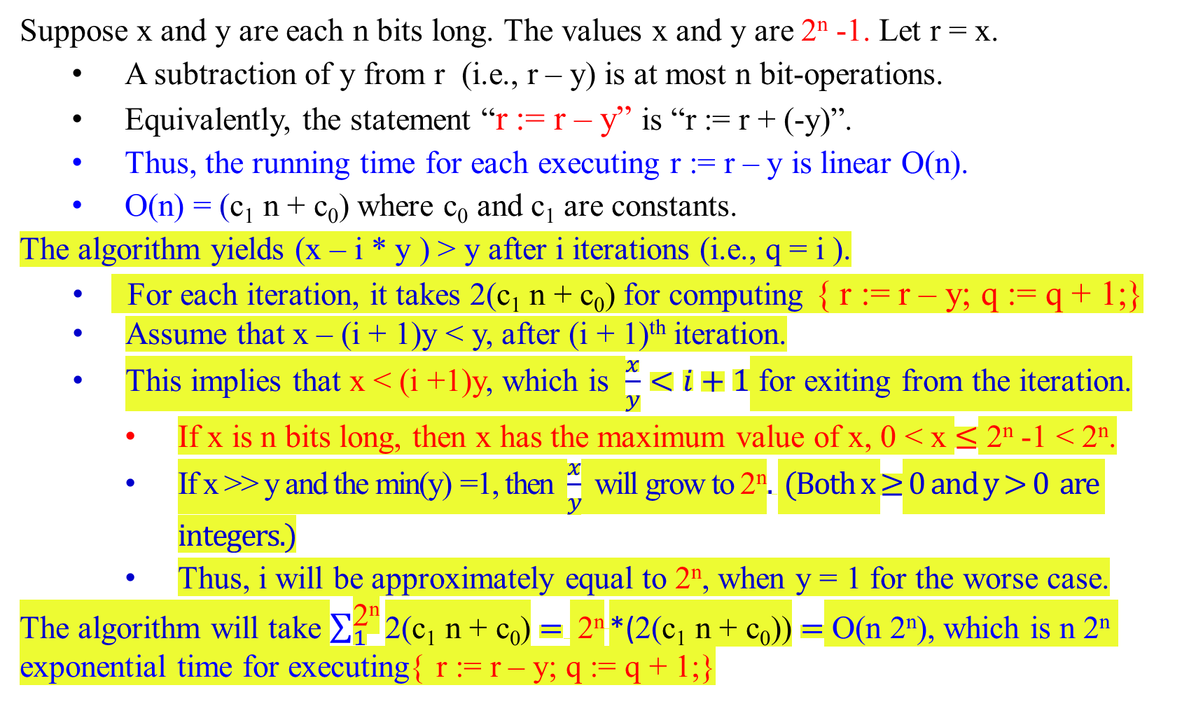
Time Efficiency
q := 0; r := x;
while r ≥ y do
{ r := r – y ;
q := q + 1;}
Suppose x and y are each n bits long. The values x and y are 2^{n} -1. Let r = x.
A subtraction of y from r (i.e., r – y) is at most n bit-operations.
Equivalently, the statement “r := r – y” is “r := r + (-y)”.
Thus, the running time for each executing r := r – y is linear O(n).
O(n) = (c₁ n + c₀) where c₀ and c₁ are constants.
The algorithm yields (x – i * y ) > y after i iterations (i.e., q = i ).
  For each iteration, it takes 2(c₁ n + c₀) for computing { r := r – y; q := q + 1;}
  Assume that x – (i + 1)y < y, after (i + 1)^{th} iteration.
  This implies that x < (i +1)y, which is $\frac{x}{y}<i+1$ for exiting from the iteration.
    If x is n bits long, then x has the maximum value of x, 0 < x $≤$ 2^{n} -1 < 2^{n}.
    If x >> y and the min(y) =1, then $\frac{x}{y}$ will grow to $\text{2}\text{n}.$ (Both x $≥$ 0 and y > 0 are integers.)
    Thus, i will be approximately equal to $\text{2}\text{n}$, when y = 1 for the worse case.
The algorithm will take $\sum_{1}^{\text{2}\text{n}}{\text{2(}\text{c}\text{1} \text{n}\text{ + }\text{c}\text{0}\text{)}= }$ $\text{2}\text{n}$*($\text{2(}\text{c}\text{1} \text{n}\text{ + }\text{c}\text{0}\text{))}=$ O(n 2^{n}), which is n 2^{n} exponential time for executing{ r := r – y; q := q + 1;}
15 is 01111.
15 < 1
15 – 15*1 < 1
15 < (15+1)*1

Slide 62
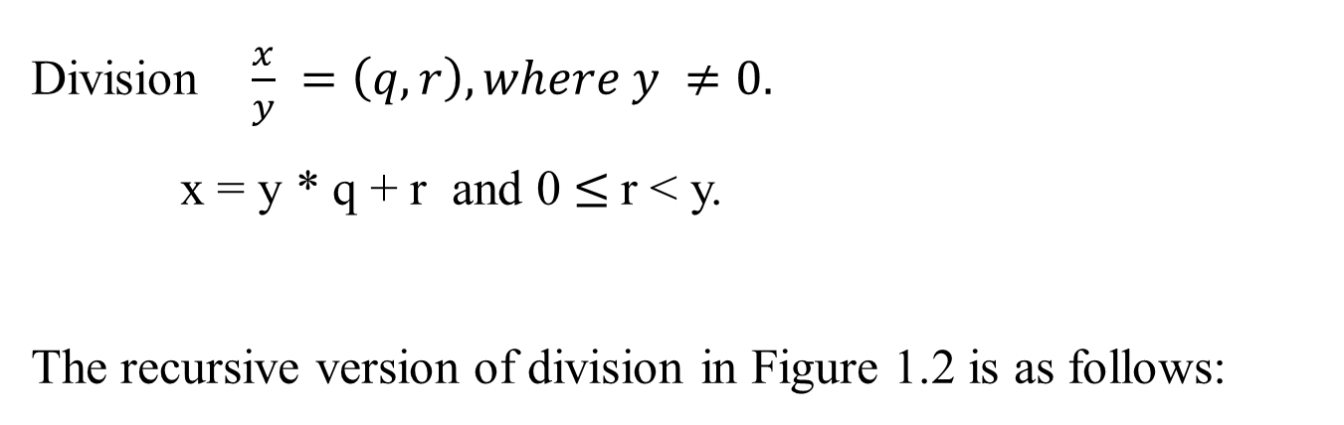
Division $\frac{x}{y} =\left(q, r\right), where y ≠0.$
x = y * q + r and 0 $≤$r < y.
The recursive version of division in Figure 1.2 is as follows:

Slide 63
Figure 1.2 The recursive version of
x = q * y + r , where r < y.
(5, 2) D(17, 3)
(2, 2) (q, r) := D(8, 3)
(1, 1) (q, r) := D(4, 3)
(0, 2) (q, r) := D(2, 3)
(0, 1) (q, r) := D(1, 3)
(0, 0) (q, r) := D(0, 3)
n = └ log₂x ┘ + 1
n = └ log₂y ┘ + 1
function divide(x, y)
Input: Two n-bit integers x and y, where x ≥ 0. y ≥ 1.
Output: The quotient and remainder of x divided by y.
if (x = 0) then return (q, r):=(0, 0);
(q, r) := divide(└x/2┘, y ) //requires n-bits right shift
q := 2 * q, r := 2 * r; // shift left one bit.
if (x is odd) then r := r + 1; // needs c*n-bits additions
if (r ≥ y) then
{ r := r – y; q := q + 1};
return (q, r);
The total time taken is thus O(n²).
x = q * y + r
D(0, 3) 0 = 0 * 3 + 0
D(1, 3) q = 2*0, r = 2*0
r = 0 + 1
1 = 0 * 3 + 1
D(2, 3) q = 2*0, r = 2*1
2 = 0*3 + 2
D(4, 3) q = 2*0, r = 2*2
(r≥y) = (4≥3)
r=4-3, q=0+1
4 = 1*3 + 1
D(8,3)q=2*1, r=2*1
8 = 2*3 + 2
D(17,3)q=2*2, r=2*2
15 is odd, r=4+1
(r≥y)=5≥3, r=5-3,
q=4+1; 17=5*3+2

Slide 64
Interpretation of the following statements:
(1) q := 2 * q, r := 2 * r; // shift left one bit.
(2) if (x is odd) then r := r + 1; // needs c*n-bits
(3) if (r ≥ y) then // additions
{ r := r – y; q := q + 1};
return (q, r);
According to x = q * y + r, the algorithm has (q, r) := divide(└x/2┘, y);
(1) when x is even, x/2 = q*y + r
x = 2*q*y + 2*r where Q = 2*q, R = 2*r
x = Q*y + R
when x is odd as it is flooring or rounding down the value of x the representation would be ( x – 1 ) / 2 = q*y + r
x – 1 = 2*q*y + 2*r
x = 2*q*y + 2*r + 1
x = Q*y + (R + 1) where Q = 2*q, R = 2*r
(3) It performs the usual function of a division operation. It checks whether the value of the remainder, r greater or equal to y. If true, update the value of r to be (r – y) and increase the quotient q by 1.

Slide 65
The next three slides is another way of interpretation:
Suppose that preparing for the first recursive call, according to x = q *y + r,
└x/2┘ = q₀ * y + r₀ ……………...…..…. (1)
Then, x = 2q₀ * y + 2r₀ , where x is even, e.g., 14/2 = 2 * 3 + 1, let y = 3. 14 = 2 * 2 * 3 + 2*2
or x = 2q₀ * y + 2r₀ + 1, where x is old. ……….(2) 15 = 2 * 2 * 3 + 2*2 + 1
From (2), q₁ = 2q₀ and r₁ = 2r₀, then q_{i+1} = 2q_{i} and r_{i+1} = 2r_{i};
these lead to “q := 2 * q, r := 2 * r;”,
(2) implies (2’): preparing for the i^{th} recursive call,
then, x = 2q_{i-1} * y + 2r_{i-1}, where x is even,
or x = 2q_{i-1} * y + 2r_{i-1} + 1, where x is old. .…….(2’)
That is, r₁ = 2r₀ , where x is even,
or r₁ = 2r₀ + 1, where x is old. ….…………..(3)

Slide 66
The previous slide summarizes as follows:
(2) implies (2’): preparing for the i^{th} recursive call,
then, x = 2q_{i-1} * y + 2r_{i-1} , where x is even,
or x = 2q_{i-1} * y + 2r_{i-1} + 1, where x is old. …….(2’)
That is, r₁ = 2r₀ , where x is even,
or r₁ = 2r₀ + 1, where x is old. ………………..(3)
(3) implies (3’):
That is, r_{i+1} = 2r_{i} , where x is even,
or r_{i+1} = 2r_{i} + 1, where x is old. ….…………..(3’)
This leads to “if (x is odd) then r := r + 1; ”, where x is odd.

Slide 67
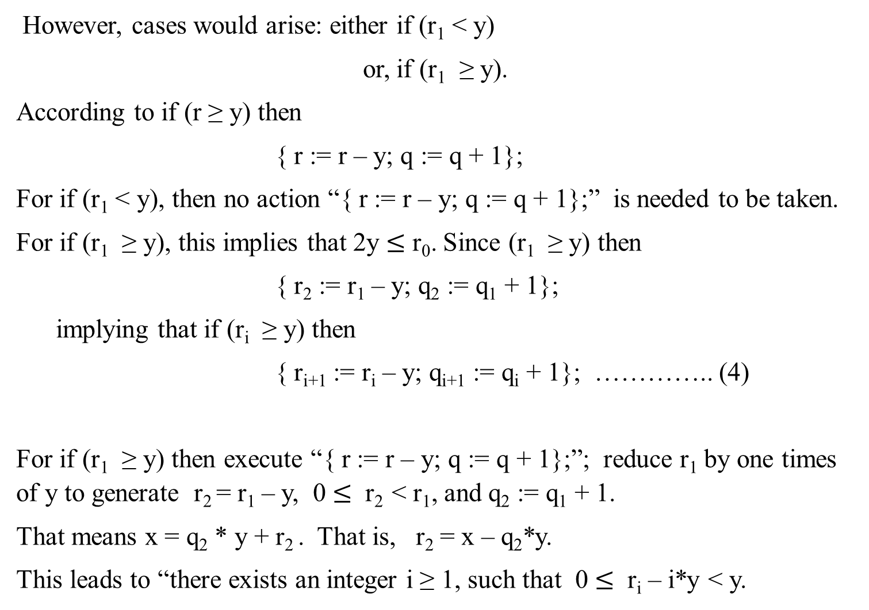
However, cases would arise: either if (r₁ < y)
or, if (r₁ ≥ y).
According to if (r ≥ y) then
{ r := r – y; q := q + 1};
For if (r₁ < y), then no action “{ r := r – y; q := q + 1};” is needed to be taken.
For if (r₁ ≥ y), this implies that 2y $≤$ r₀. Since (r₁ ≥ y) then
{ r₂ := r₁ – y; q₂ := q₁ + 1};
implying that if (r_{i} ≥ y) then
{ r_{i+1} := r_{i} – y; q_{i+1} := q_{i} + 1}; ………….. (4)
For if (r₁ ≥ y) then execute “{ r := r – y; q := q + 1};”; reduce r₁ by one times of y to generate r₂ = r₁ – y, 0 $≤$ r₂ < r₁, and q₂ := q₁ + 1.
That means x = q₂ * y + r₂ . That is, r₂ = x – q₂*y.
This leads to “there exists an integer i ≥ 1, such that 0 $≤$ r_{i} – i*y < y.

Slide 68
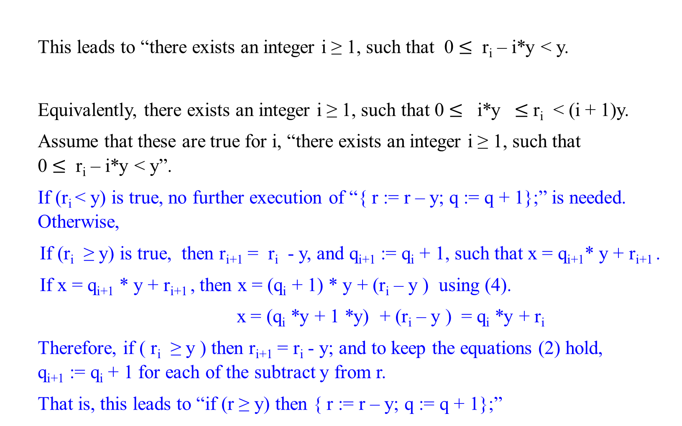
This leads to “there exists an integer i ≥ 1, such that 0 $≤$ r_{i} – i*y < y.
Equivalently, there exists an integer i ≥ 1, such that 0 $≤$ i*y $≤$r_{i} < (i + 1)y.
Assume that these are true for i, “there exists an integer i ≥ 1, such that 0 $≤$ r_{i} – i*y < y”.
If (r_{i} < y) is true, no further execution of “{ r := r – y; q := q + 1};” is needed. Otherwise,
If (r_{i} ≥ y) is true, then r_{i+1} = r_{i} - y, and q_{i+1} := q_{i} + 1, such that x = q_{i+1}* y + r_{i+1} .
If x = q_{i+1} * y + r_{i+1} , then x = (q_{i} + 1) * y + (r_{i} – y ) using (4).
x = (q_{i} *y + 1 *y) + (r_{i} – y ) = q_{i} *y + r_{i}
Therefore, if ( r_{i} ≥ y ) then r_{i+1} = r_{i} - y; and to keep the equations (2) hold, q_{i+1} := q_{i} + 1 for each of the subtract y from r.
That is, this leads to “if (r ≥ y) then { r := r – y; q := q + 1};”

Slide 69

T(n) = T(n/2) + 1 --- inc.one call
T(1) = 1 --- one call
Prove T(n) = O(n²)
T(n) = T(└ n/2 ┘) + 1
T(1) = 1
Solution:
(need to check the correctness of the following)
Let n = 2^{k}.
T(n) = T(2^{k}) = T(2^{k-1}) + 1
= T(2^{k--2}) + 1 + 1 = T (2^{k--2}) + 2*1
= …
= T(2^{k-i}) + i*1
= T(2^{k-k}) + k*1, where k = i
= T(2^{k-k}) + k
= 1+ k
= (k + 1)
= n +1 = O(n) recursive calls
The algorithm will take n calls and spend O(n) to execute the remaining statements upon each return of recursive call, therefore O(n²).
function divide(x, y)
if x = 0, then return (q, r) := (0, 0);
(q, r) := divide(└ x/2 ┘ , y )
q := 2 * q, r := 2 * r;
if x is odd then r := r +1;
if r ≥ y then { r := r – y; q := q +1};
return (q, r)

Slide 70
End of Proof of Program Correction.

