Slide 1
Chapter 01_02
What is an Algorithm?

Slide 2

Outline:
What is an algorithm?
What is a computer program?
What is a problem?
What are the parameters of a problem
What is an instance of the problem?
What is a solution to an instance of the problem?
What is an algorithm for the problem?

Slide 3
What is an algorithm for the problem?
An algorithm must specify
  a step-by-step procedure
    for producing the solution to each instance.
The algorithm solves all instances of the problem.

Slide 4
What is a problem (task)?
An example of a problem
Question: Determine whether the number x is in the list S of n
numbers.
Answer: yes, if x is in S, and no if it is not.

Slide 5
Summary: Problem? Questions? Answers? Parameters? Instances of an problem? An instance’s Solution?
What is an instance of the problem?
What is a solution to an instance of the problem?
A problem containing parameters represents a class of problems.
    A range of problems defined by different assignments of values to the parameters.
An instance of the problem:
  defined by a specific assignment of values to the parameters.
A solution to an instance of a problem:
  The answer to the question asked by the instance of a problem.

Slide 6
Summary: Problem? Questions? Answers? Parameters? Instances of an problem? An instance’s Solution?
What is an instance and its solution of the problem?
An example of a problem
  Question: Determine whether the number x is in the list S of n
  numbers.
  Answer: yes, if x is in S, and no if it is not.
An instance of this problem in the example is
  An instance of the problem: S = [10, 7, 11, 5, 13, 8], n = 6 and x = 5.
  An instance’s Solution: The solution to the instance is yes.

Slide 7

Algorithm for the Sequential Search
Problem Given: Is the key K in the array S of n keys?
Inputs (parameters): A positive integer n, array of keys S indexed from 0
to n-1 and a key K.
Outputs: The index (location) of the first found element of S that
matches K, or -1 if there are no matching elements.

Slide 8
Algorithm SequentialSearch(S[0 .. n-1], K)
// Searches for a given value K in a given array S by sequential search
Input: An array S[0 .. n-1] and a search key K
Output: The index (location) of the first element of S that matches K
or -1 if there are no matching elements
i := 0;
while (i < n and S[i] ≠ K)
do {i := i + 1; }
if (i < n) return i;
else return -1;
Q:
What is the input size?
Which is the basic operation? Why?
What is the running time (in terms
of execution time)?

Slide 9
Algorithm SequentialSearch(S[0 .. n-1], K)
// Searches for a given value K in a given array S by sequential search
Input: An array S[0 .. n-1, n] and a search key K
Output: The index (location) of the first element of S that matches K
or -1 if there are no matching elements
S[n] := K;
i := 0;
while (S[i] ≠ K)
do {i := i + 1; }
if (i < n) return i;
else return -1;
Q:
Which is the basic operation? Why?
Is there any difference in terms of execution time between this algorithm and the previous one? Why?
i := 0;
while (i < n and S[i] ≠ K)
do {i := i + 1; }
if (i < n) return i;
else return -1;

Slide 10
What is an Algorithm?
An algorithm is
a well-defined procedure
  a sequence of unambiguous instructions
  for solving a well-specified computational problem
    to obtain a desired, required output
    from any given valid input
    within a finite amount of time.
{input specifications} Algorithm {output specifications}

Slide 11
What is a computer program?
A computer program
  composed of individual modules of code,
    that are designed to work together to solve specific tasks,
    written in a programming language that can be compiled/interpreted by a computer.
    Examples of tasks include sorting data, searching for information, or performing various computations.

Slide 12

Basic questions about an algorithm
In designing and analyzing an algorithm, the following questions are considered.
What is the problem we have to solve? Does a solution exist?
Can we find a solution (algorithm)? Is there more than one solution?
Is the algorithm correct?
  Does it halt? (halting problem)
  Is it correct? (partial correctness)
How efficient is the algorithm?
  Is it fast? (Can it be faster?) (time efficient)
  How much memory does it use? (space efficient)
How does data communicate? (data representation/implementable)

Slide 14
Analysis, Design and Implementation of an Algorithm:
1.0 Analysis of Algorithms?
  Study the complexity of an algorithm according to
    time efficiency and
    space efficiency (the amount of resources required to run an algorithm).

Slide 15
Analysis, Design and Implementation of an Algorithm:
1.1 Why Analyze an Algorithm?
Reasons for analyzing an algorithm are:
  Discover an algorithm’s characteristics
    Evaluate its suitability for various applications
    Compare it with other algorithms for the same application.
  Understand it (algorithm) better, and improve it.
    Algorithms tend to become shorter, simpler, and more elegant during analysis.

Slide 16
1.2 Computational Complexity.
The study of computational complexity theory focuses on
  classifying:
    algorithms according to time and space efficiency, such as,
      sequential search is O(n); insertion sort is O(n²); merge sort is O(n log₂ n).
    computational problems into classes, such as
      P (Polynomial) class, and NP (Nondeterministic Polynomial) class, based on their inherent difficulty in defining algorithms for the problems;
      e.g., bubble sorting, shell sort, and insertion sort are P class problems; Knapsack and TSP are NP problems.
  They focus on order-of-growth worst-case performance.

Slide 17
1.3 Analysis of Algorithms.
A complete analysis of the running time of an algorithm involves the following steps:
[input] Develop a realistic model for the input to the program.
[input size] Analyze the unknown quantities of the modeled input.
[algorithm development] Implement the algorithm completely.
[algorithm analysis]
  Determine the time required for each basic operation.
  Identify unknown quantities f(n) that can be used to describe the frequency of execution of the basic operations.
[efficiency] Calculate the total running time T(n) by
  multiplying the time by the frequency for each operation,
  then adding all the products.
What are the domain of data and the representation of data?

Slide 18
1.3 Analysis of Algorithms.
How to measure efficiency
Machine-independent way:
  analyze the “pseudocode” version of the algorithm
  Assume an idealized machine model
    One instruction takes a one-time unit
"Big-Oh" notation (order of growth)
  order of magnitude as the problem size increases
Worst-case analyses
  provides an upper bound on time taken by the algorithm.
    The only “safe” analysis.
Average case analysis
  requires making some assumptions about the probability distribution of the inputs

Slide 19
1.4 Several Important Problem Types
Specifying and implementing algorithms
Basic complexity analysis
Sorting
  a set of items
Searching
  among a set of items
String processing
  text, bit strings, gene sequences
Graphs
  model objects and their relationships
Network flow algorithms
Tree traversals/State space search
Combinatorial
  find desired permutation, combination, or subset
Geometric
  graphics, imaging, robotics
Numerical
  continuous math: solving equations, evaluating functions

Slide 20
1.5 Algorithm Design Strategies/Techniques.
Simple Recursion
Brute Force & Exhaustive Search
  follow definition / try all possibilities
Divide & Conquer
  break problem into smaller subproblems
Transformation
  convert the problem to another one
Greedy
  repeatedly do what is best now
Dynamic Programming
  break problem into overlapping subproblems
  Backtracking and Branch and Bound
Iterative Improvement
  repeatedly improve the current solution
Randomization
  use random numbers
Space and Time Tradeoffs

Slide 22

Solution for a given Problem?
design
input Algorithm output
specifications (a way for finding its solu.) specifications
encode
Program Input “computer” Program output
Program code
Figure 1.0 Notion of Algorithm

Slide 23
Several characteristics of Algorithms:
[Non-ambiguity] The non-ambiguity requirement for each step of an algorithm cannot be compromised.
  Prime Factorization in Middle School Procedure for computing gcd(m, n) is defined ambiguously
[Well-specified inputs’ range] The range of inputs an algorithm works has to be precisely specified.
  Consecutive integer checking algorithm for computing gcd(m, n) does not work correctly when one of the input numbers is zero.
…

Slide 24
Several characteristics of Algorithms:
[Different ways for specifying an algorithm] The same algorithm can be written in different ways.
  Euclid’s algorithm can be defined recursively or non-recursively.
[Several algorithms for a problem] Several algorithms for solving the same problem may exist.
  Euclid, Consecutive Integer Checking, and Middle School Procedure for computing gcd(m, n)
…

Slide 25
Several characteristics of Algorithms:
…
  [Various Speeds of different Algorithms for solving the same problem] Algorithms for the same problem can be based on very different ideas and can solve the problem at dramatically different speeds.
    An exponential algorithm Fibonacci_Number_F(n) computes recursively the list of the n Fibonacci members based on its definition, and
    a polynomial Algorithm_Fib(n) computes non-recursively the list of its n members.

Slide 26
Input Size
For many algorithms, a reasonable measure of the input size – is the size of the input.
  For example, the input size is the number n of items in the array for sequential search, sorting, and binary search algorithms.
Some algorithms use two numbers to measure the size of the input.
  For example, when a graph G = (V, E) is the input to an algorithm, the input size consists of both parameters: number of vertices |V| and edges |E|.

Slide 27
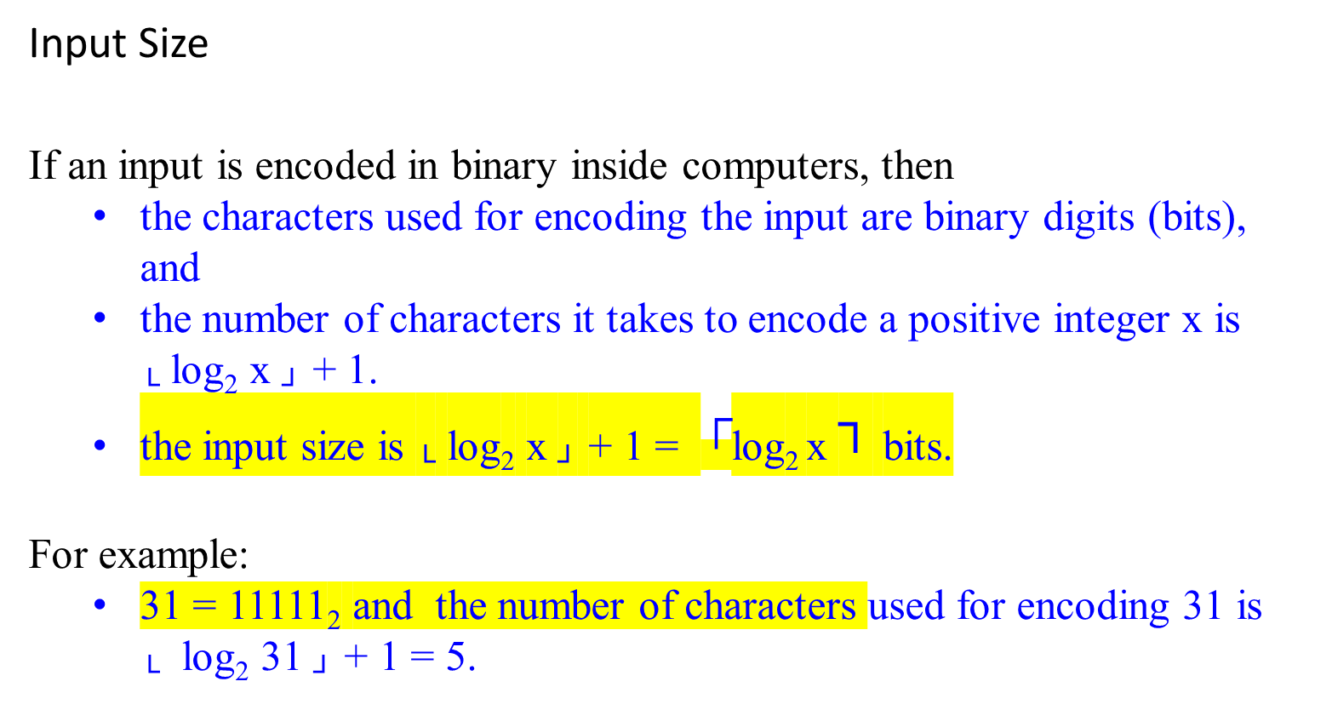
Input Size
If an input is encoded in binary inside computers, then
  the characters used for encoding the input are binary digits (bits), and
  the number of characters it takes to encode a positive integer x is └ log₂ x ┘ + 1.
  the input size is └ log₂ x ┘ + 1 = $┌$log₂ x ┐ bits.
For example:
  31 = 11111₂ and the number of characters used for encoding 31 is └ log₂ 31 ┘ + 1 = 5.

Slide 28
Using the number of symbols or bits required to encode the input parameter n as a measure of input size is a common and reasonable approach in algorithm analysis
  Algorithms Add(x, y), multiply(x, y), divide(x, y):
    the input size would be determined by the number of symbols or bits required to encode the numbers x and y.
  Algorithm Euclid(m, n):
    the input size would be determined by the number of symbols or bits needed to encode both m and n.
  Algorithm Sieve(n):
    Since n represents the upper limit for finding prime numbers, the input size would be determined by the number of symbols or bits required to encode n.

Slide 29
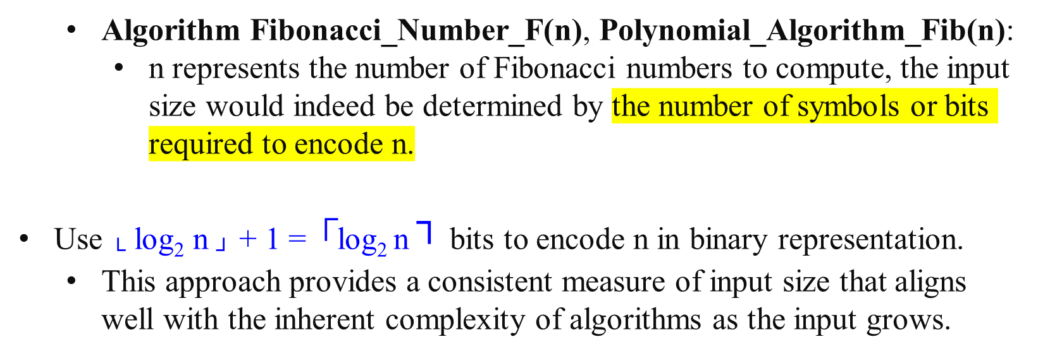
  Algorithm Fibonacci_Number_F(n), Polynomial_Algorithm_Fib(n):
    n represents the number of Fibonacci numbers to compute, the input size would indeed be determined by the number of symbols or bits required to encode n.
Use └ log₂ n ┘ + 1 = $┌$log₂ n ┐ bits to encode n in binary representation.
  This approach provides a consistent measure of input size that aligns well with the inherent complexity of algorithms as the input grows.

Slide 30
Modeling the Real World- Develop a realistic model for the input
Cast your application in terms of well-studied abstract data structures
Concrete | Abstract
arrangement, tour, ordering, sequence | permutation
cluster, collection, committee, group, packaging, selection | subsets
hierarchy, ancestor/descendants, taxonomy | trees
network, circuit, web, relationship | graph
sites, positions, locations | points
shapes, regions, boundaries | polygons
text, characters, patterns | strings

Slide 31
Real-World Applications
Hardware design: VLSI chips
Compilers
Computer graphics: movies, video games
Routing messages on the Internet
Searching the Web
Distributed file sharing
Computer-aided design and manufacturing
Security: e-commerce, voting machines
Multimedia: CD player, DVD, MP3, JPG, HDTV
DNA sequencing, protein folding
and many more!

Slide 32
  Separation of behavior and implementation

Slide 33
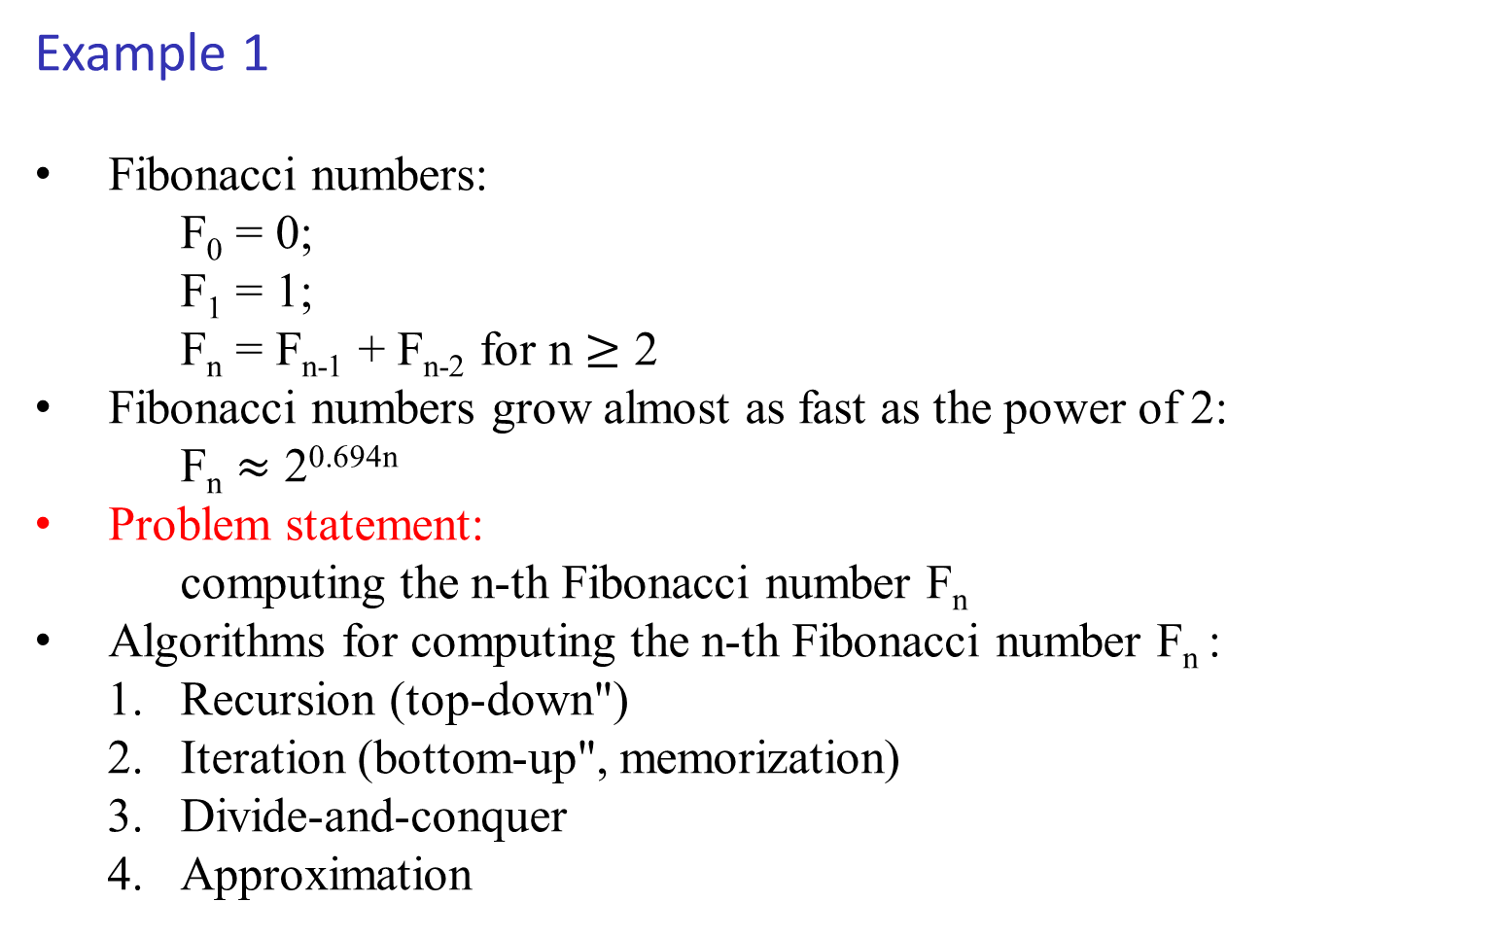
Example 1
Fibonacci numbers:
    F₀ = 0;
    F₁ = 1;
    F_{n} = F_{n-1} + F_{n-2} for n $≥$ 2
Fibonacci numbers grow almost as fast as the power of 2:
    F_{n} $≈$ 2^{0.694n}
Problem statement:
    computing the n-th Fibonacci number F_{n}
Algorithms for computing the n-th Fibonacci number F_{n} :
  Recursion (top-down")
  Iteration (bottom-up", memorization)
  Divide-and-conquer
  Approximation

Slide 34
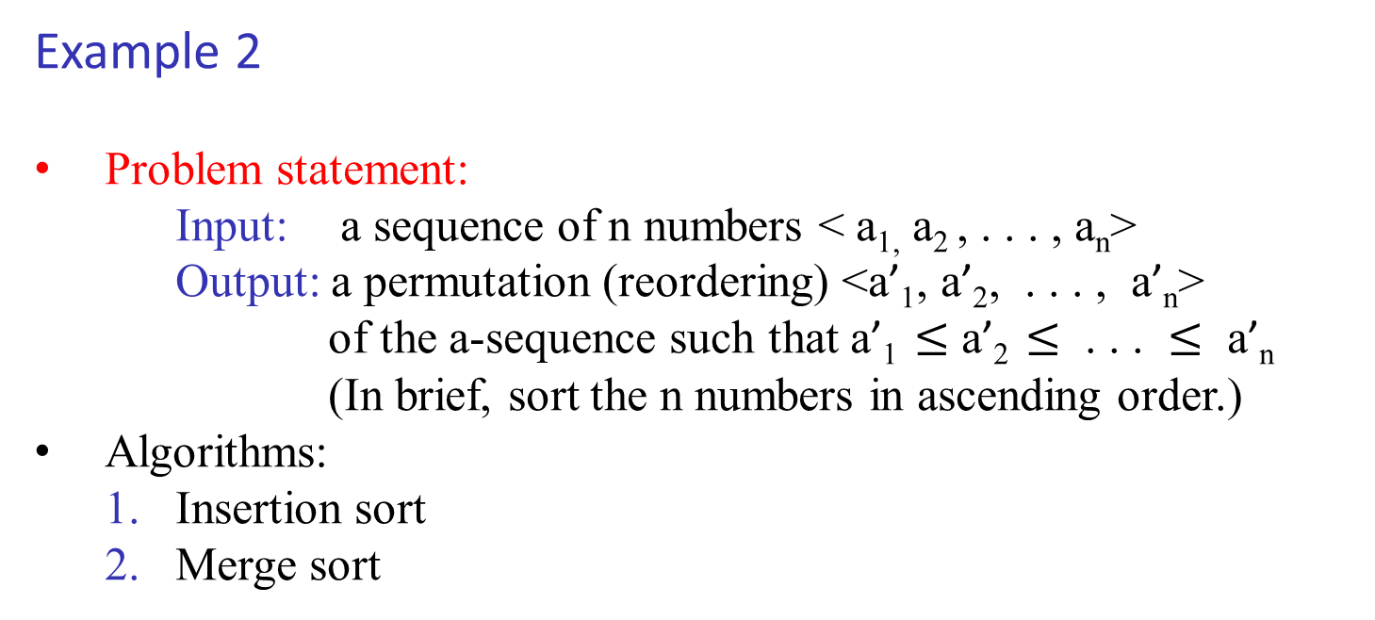
Example 2
Problem statement:
Input: a sequence of n numbers < a_{1,} a₂ , . . . , a_{n}>
Output: a permutation (reordering) <a’₁, a’₂, . . . , a’_{n}>
of the a-sequence such that a’₁ $≤$ a’₂ $≤$ . . . $≤$ a’_{n}
(In brief, sort the n numbers in ascending order.)
Algorithms:
  1. Insertion sort
  2. Merge sort

Slide 35
Example 2: Insert sort algorithm
  Idea: incremental approach
  Pseudocode
InsertionSort(A)
n = length(A);
for (j = 2 to n) {
key = A[j];
// insert ``key'' into sorted array A[1...j-1]
i = j-1;
while (i > 0 and A[i] > key) do {
A[i+1] = A[i];
i = i - 1;
} //end while
A[i+1] = key;
} //end for
return A;

Slide 36
Example 2: Insert sort algorithm
Remarks:
Correctness: argued by “loop-invariant” (a kind of induction)
Complexity analysis:
    best-case
    worst-case
    average-case
Insertion sort is a “sort-in-place”, no extra memory is necessary
Importance of writing good pseudocode = “expressing algorithm to human”
There is a recursive version of insertion sort (can you do it)

Slide 37
Example 2: Merge sort algorithm
  Idea: a divide-and-conquer approach
  Pseudocode
MergeSort(A, p, r) // Merge-sort of array A[p..r]
if (p < r) then // check for base case
q = flooring( (p+r)/2 ) // divide
MergeSort(A, p, q) // conquer
MergeSort(A, q+1, r) // conquer
Merge(A, p, q, r) // combine
end if

Slide 38
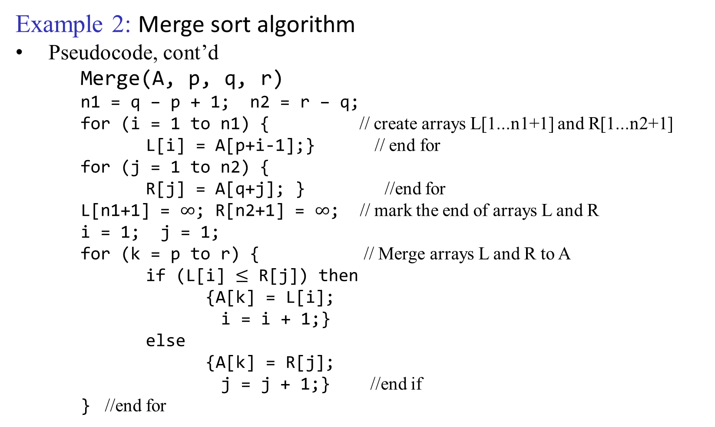
Example 2: Merge sort algorithm
Pseudocode, cont’d
Merge(A, p, q, r)
n1 = q – p + 1; n2 = r – q;
for (i = 1 to n1) { // create arrays L[1...n1+1] and R[1...n2+1]
L[i] = A[p+i-1];} // end for
for (j = 1 to n2) {
R[j] = A[q+j]; } //end for
L[n1+1] = $∞$; R[n2+1] = $∞$; // mark the end of arrays L and R
i = 1; j = 1;
for (k = p to r) { // Merge arrays L and R to A
if (L[i] $≤$ R[j]) then
{A[k] = L[i];
i = i + 1;}
else
{A[k] = R[j];
j = j + 1;} //end if
  } //end for

Slide 39
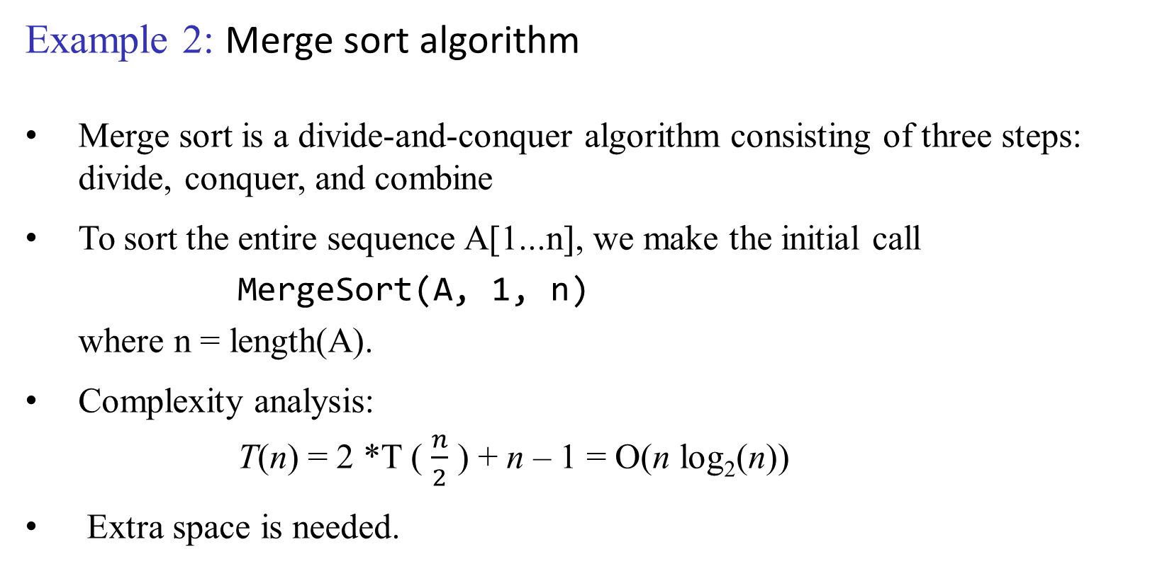
Example 2: Merge sort algorithm
Merge sort is a divide-and-conquer algorithm consisting of three steps: divide, conquer, and combine
To sort the entire sequence A[1...n], we make the initial call
MergeSort(A, 1, n)
where n = length(A).
Complexity analysis:
T(n) = 2 *T ( $\frac{n}{2}$ ) + n – 1 = O(n log₂(n))
Extra space is needed.

