Slide 1
Chapter 1
Fundamentals of
the Analysis of Algorithm Efficiency

Slide 2

The Asymptotic Efficiency of Algorithms:
Running Time as a Function (T(n) ∝ f(n)).
T(n); The running time of an algorithm or program is defined as a function f(n) of the size of its input n
f(n): A mathematical function that characterizes how the running time changes with the size of the input
T(n) ∝ f(n): The notation T(n) ∝ f(n) means that the running time T(n) grows asymptotically at the same rate as the function f(n) when n becomes large.
  Asymptotic Behavior:
  Asymptotic analysis focuses on the behavior of an algorithm’s running time T(n) increases in the limit, as the size of the input approaches infinity (i.e. increases without bound).

Slide 3
The Asymptotic Efficiency of Algorithms:
  Asymptotic analysis considers the behavior of T(n) as n grows very large.
  This helps in understanding how an algorithm scales with very large inputs.
  The asymptotic notations including big-O (O), big Omega (Ω), and Big Theta (Θ) are used to describe the running time and its growth rate. They describe the upper, lower, and tight bounds of the running time, respectively.
Note:
Let N = {0, 1, 2, …} be the set of natural numbers.
[non-negative integer 0, 1, .. ;
positive integer 1, 2, .. . (traditional way)]

Slide 4

Example 1.1
Ɵ(n): Linear growth. As n increases, the running time increases proportionally.
Ɵ(n²): Quadratic growth. The running time grows much faster as n increases.
Ɵ(log₂n): Logarithmic growth. The running time increases slowly even for large values of n.

Slide 5
Example:
The average-case running time of insertion sort is
T(n) = Ɵ(n²),
as the input size n becomes large enough.
  Ɵ(n²) is used for average-case or asymptotically tight bounds, indicating that the function grows exactly like n² within constant factors in both the lower and upper bounds.
The worst-case running time of insertion sort is
T(n) = O(n²).
  Big O notation describes an upper bound
The best-case running time of insertion sort is T(n) = Ω(n).
  Big Ω describes a lower bound

Slide 6
Since input sizes are natural numbers (i.e., non-negative integers), the function f(n) is naturally defined only for integer values of n. Here's how it can be described:
Discrete Nature of Input Sizes:
  The input size n is a natural number (n∈N), which means n takes on values 0, 1, 2, 3, and so on.
  The function f(n) is evaluated at these discrete points, corresponding to different input sizes.

Slide 7
2. Piecewise Description:
The function f(n) can be described using piecewise notation
if it has different behaviors for different ranges of n.
For example:
c₁ if n = 1
f(n) = c₂ . n² if 2 ≤ n ≤ 10
c₃ ⋅ nlog₂ n if n > 10
where c₁, c₂​, and c₃​ are constants.

Slide 8
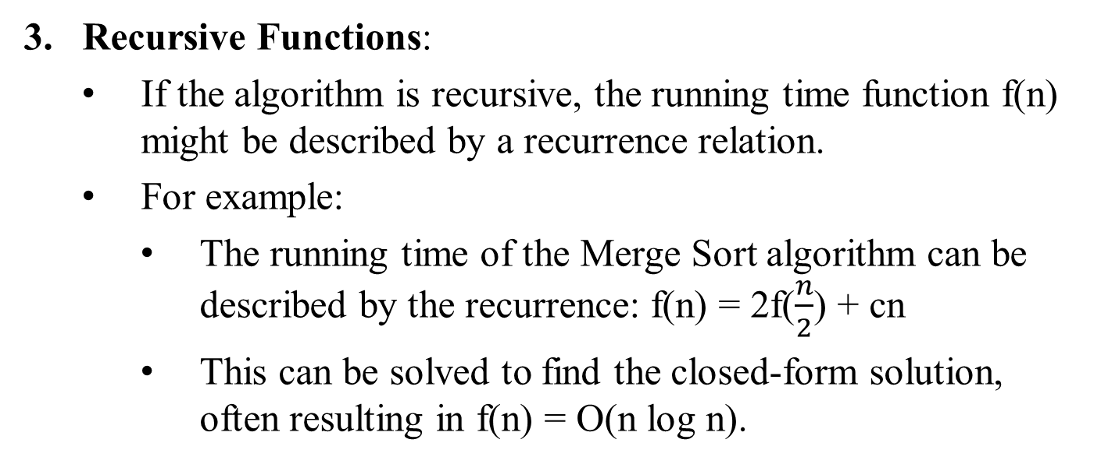
3. Recursive Functions:
If the algorithm is recursive, the running time function f(n) might be described by a recurrence relation.
For example:
  The running time of the Merge Sort algorithm can be described by the recurrence: f(n) = 2f($\frac{n}{2}$) + cn
  This can be solved to find the closed-form solution, often resulting in f(n) = O(n log n).

Slide 9
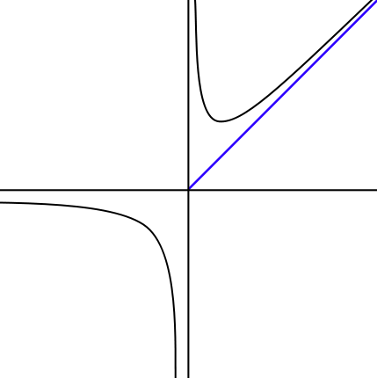
Asymptote: A line whose distance to a given curve tends to zero. An asymptote may or may not intersect its associated curve.
f(n)
The graph of a function f(n) with horizontal (y = 0), vertical (x = 0), and oblique (x = y) asymptotes.

Slide 10
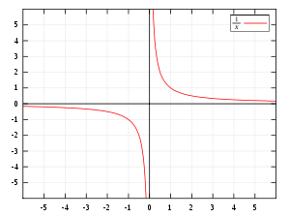

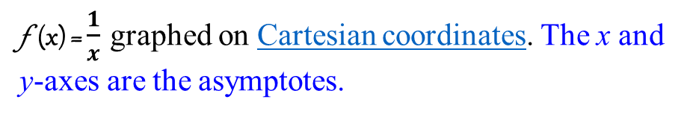
f(n)
f(x)
n
f (x) = $\frac{1}{x}$ graphed on Cartesian coordinates. The x and y-axes are the asymptotes.

Slide 11
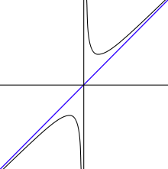

f(x)
In the graph of , the y-axis (x = 0) and the line y= x are both asymptotes. The function f(x) is asymptotic to x = 0 and y = x.

Slide 12
In mathematical analysis, asymptotic analysis is
  a method of describing limiting behavior;
  about the comparison of functions as inputs approach infinity.
Examples are
In the analysis of algorithms of computer science, considering the performance of algorithms when applied to huge input datasets
The behavior of physical systems when they are huge.

Slide 13
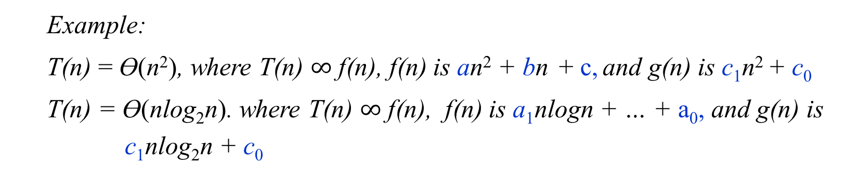
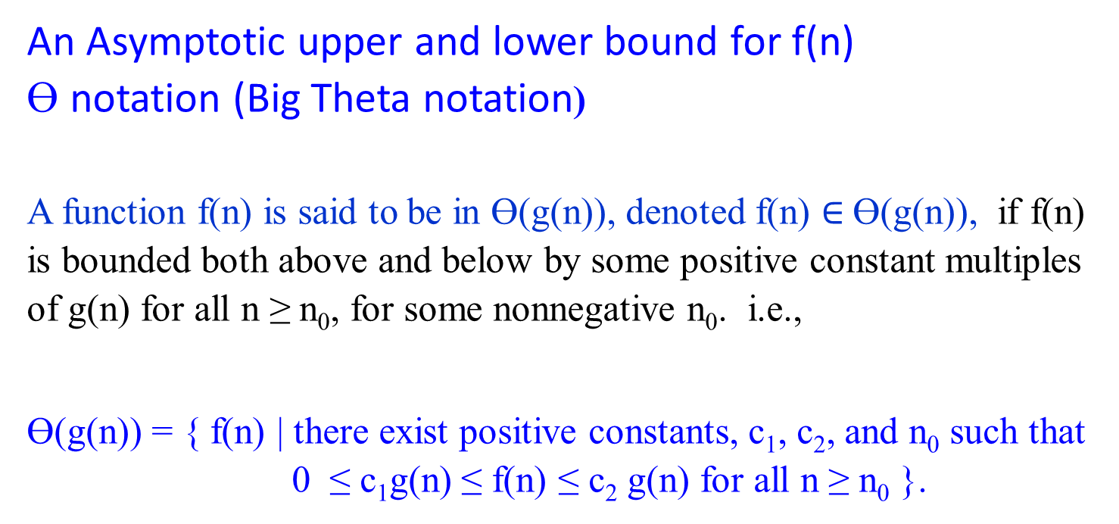
An Asymptotic upper and lower bound for f(n)
Ɵ notation (Big Theta notation)
A function f(n) is said to be in Ɵ(g(n)), denoted f(n) $∈$Ɵ(g(n)), if f(n) is bounded both above and below by some positive constant multiples of g(n) for all n ≥ n₀, for some nonnegative n₀. i.e.,
Ɵ(g(n)) = { f(n) | there exist positive constants, c₁, c₂, and n₀ such that 0 ≤ c₁g(n) ≤ f(n) ≤ c₂ g(n) for all n ≥ n₀ }.
Example:
T(n) = Ɵ(n²), where T(n) $∞$ f(n), f(n) is an² + bn + c, and g(n) is c₁n² + c₀
T(n) = Ɵ(nlog₂n). where T(n) $∞$ f(n), f(n) is a₁nlogn + … + a₀, and g(n) is
c₁nlog₂n + c₀

Slide 14
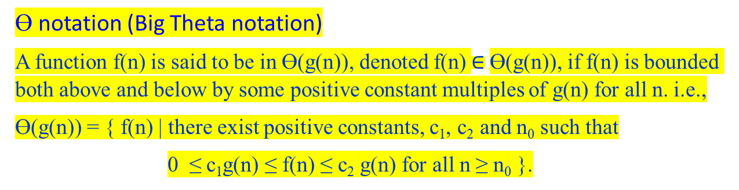

Ɵ notation (Big Theta notation)
A function f(n) is said to be in Ɵ(g(n)), denoted f(n) $∈$Ɵ(g(n)), if f(n) is bounded both above and below by some positive constant multiples of g(n) for all n. i.e.,
Ɵ(g(n)) = { f(n) | there exist positive constants, c₁, c₂ and n₀ such that
0 ≤ c₁g(n) ≤ f(n) ≤ c₂ g(n) for all n ≥ n₀ }.
f(n)
c₂g(n)
f(n)
c₁g(n)
n
n₀ f(n) $∈$ Θ(g(n))
Figure 1.2(a) Θ-notation bounds a function to within constant factors. We write f(n) = Θ(g(n)) if there exist positive constant n₀, c₁, and c₂ such that to the right of the minimum possible value n₀, the value of f(n) always lies between c₁g(n) and c₂g(n) inclusive.

Slide 15
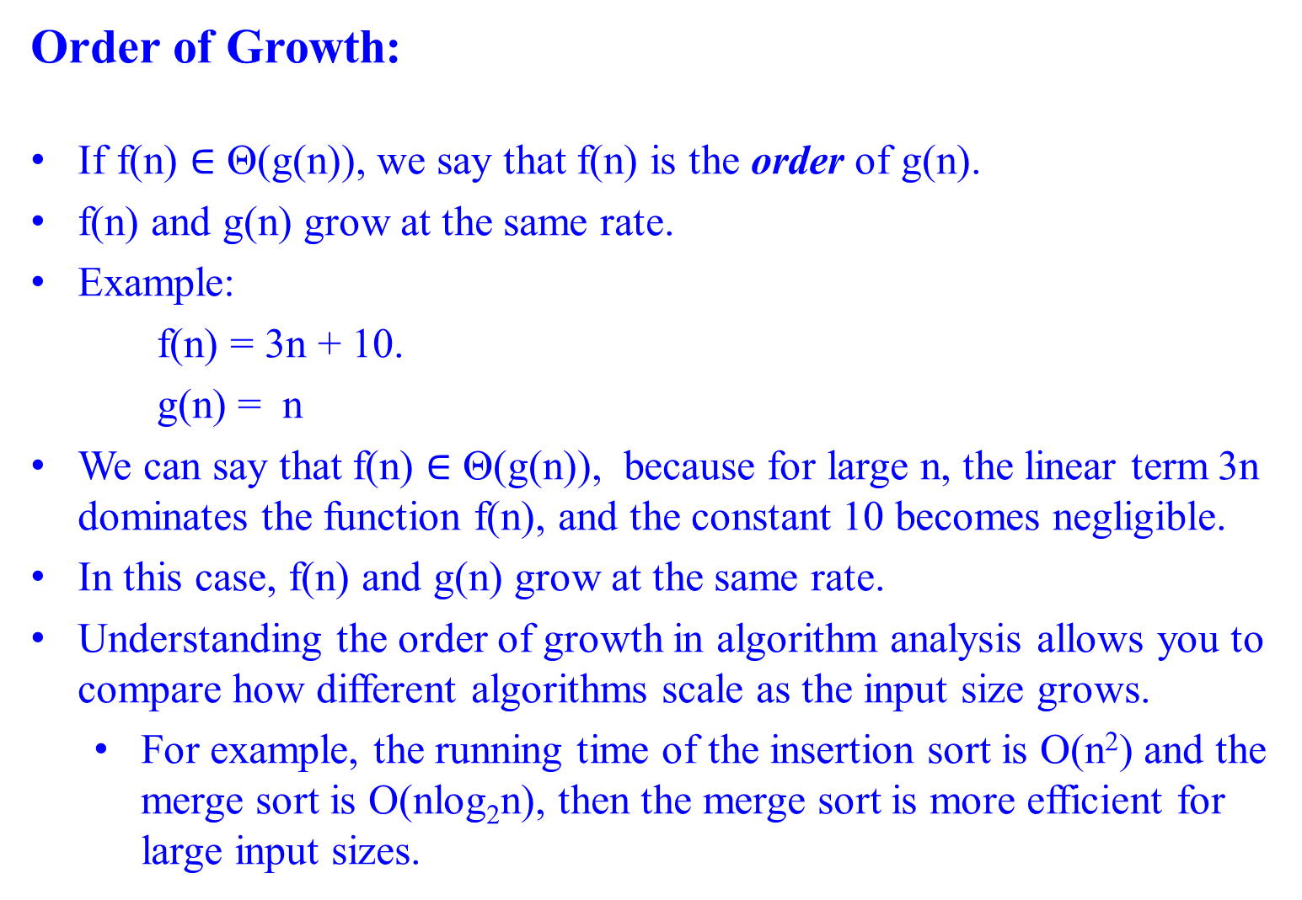
Order of Growth:
If f(n) $∈$ Θ(g(n)), we say that f(n) is the order of g(n).
f(n) and g(n) grow at the same rate.
Example:
    f(n) = 3n + 10.
    g(n) = n
We can say that f(n) $∈$ Θ(g(n)), because for large n, the linear term 3n dominates the function f(n), and the constant 10 becomes negligible.
In this case, f(n) and g(n) grow at the same rate.
Understanding the order of growth in algorithm analysis allows you to compare how different algorithms scale as the input size grows.
  For example, the running time of the insertion sort is O(n²) and the merge sort is O(nlog₂n), then the merge sort is more efficient for large input sizes.

Slide 16

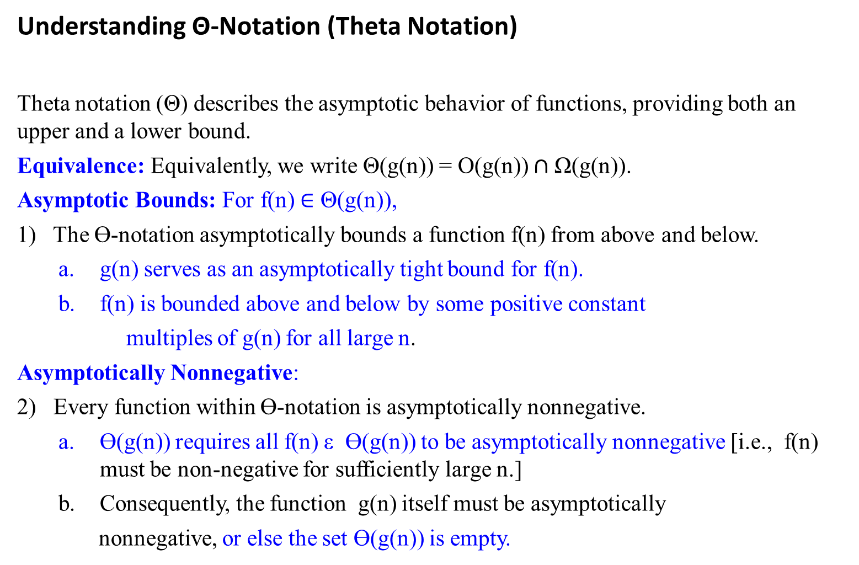
Understanding Θ-Notation (Theta Notation)
Theta notation (Θ) describes the asymptotic behavior of functions, providing both an upper and a lower bound.
Equivalence: Equivalently, we write Θ(g(n)) = O(g(n)) $∩$Ω(g(n)).
Asymptotic Bounds: For f(n) $∈$ Θ(g(n)),
1) The Ɵ-notation asymptotically bounds a function f(n) from above and below.
  g(n) serves as an asymptotically tight bound for f(n).
  f(n) is bounded above and below by some positive constant
multiples of g(n) for all large n.
Asymptotically Nonnegative:
2) Every function within Ɵ-notation is asymptotically nonnegative.
  Ɵ(g(n)) requires all f(n) ε Ɵ(g(n)) to be asymptotically nonnegative [i.e., f(n) must be non-negative for sufficiently large n.]
  Consequently, the function g(n) itself must be asymptotically
  nonnegative, or else the set Ɵ(g(n)) is empty.

Slide 17
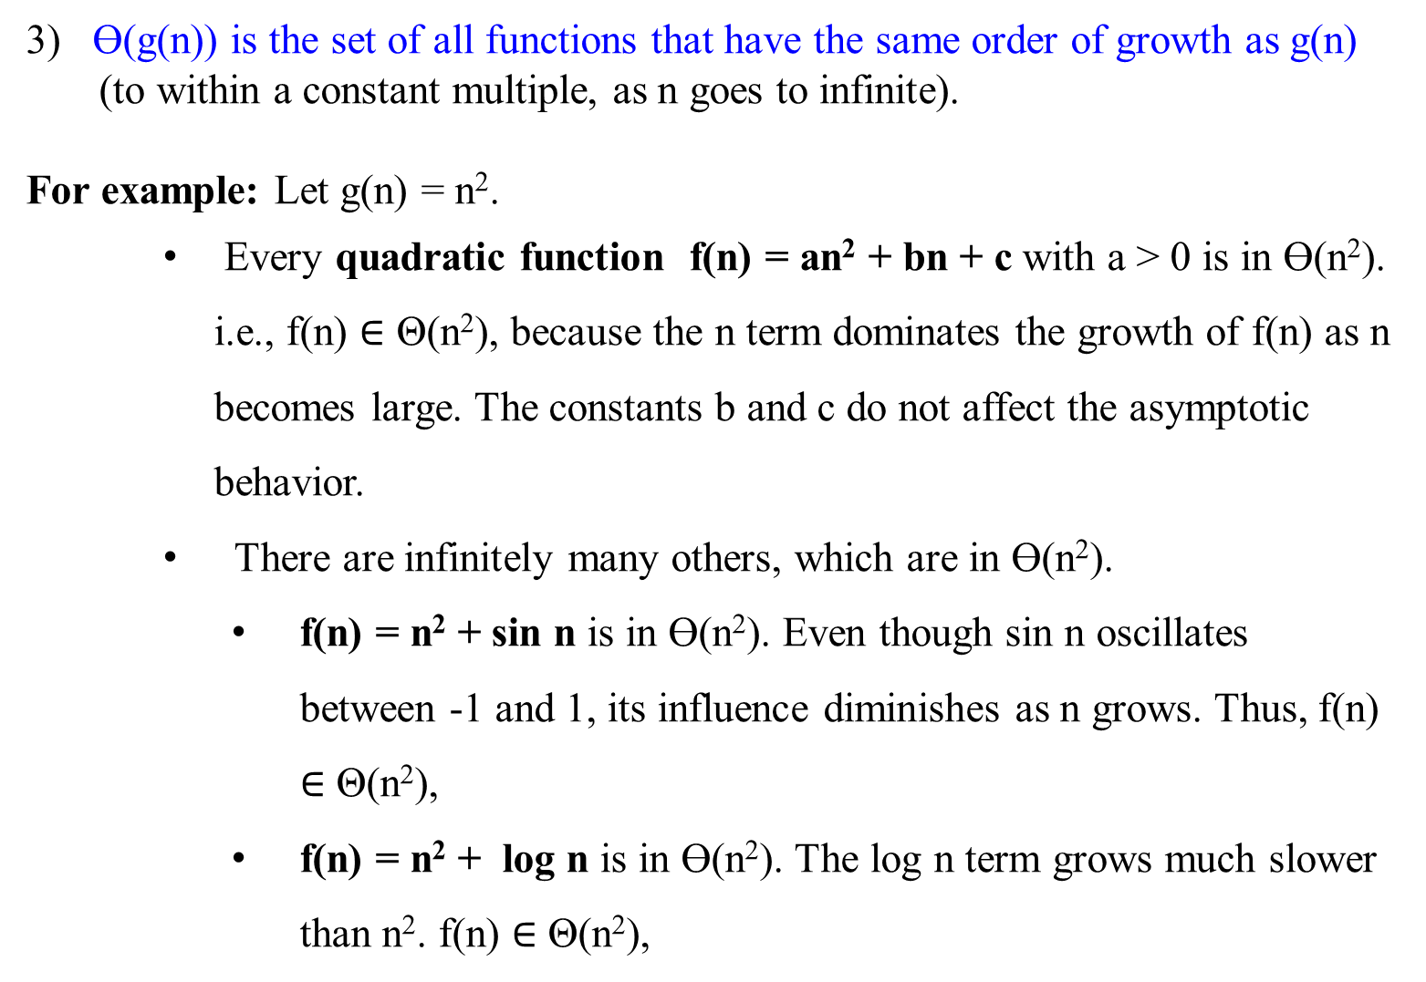
3) Ɵ(g(n)) is the set of all functions that have the same order of growth as g(n)
(to within a constant multiple, as n goes to infinite).
For example: Let g(n) = n².
    Every quadratic function f(n) = an² + bn + c with a > 0 is in Ɵ(n²). i.e., f(n) $∈$ Θ(n²), because the n term dominates the growth of f(n) as n becomes large. The constants b and c do not affect the asymptotic behavior.
    There are infinitely many others, which are in Ɵ(n²).
      f(n) = n² + sin n is in Ɵ(n²). Even though sin n oscillates between -1 and 1, its influence diminishes as n grows. Thus, f(n) $∈$ Θ(n²),
      f(n) = n² + log n is in Ɵ(n²). The log n term grows much slower than n². f(n) $∈$ Θ(n²),

Slide 18
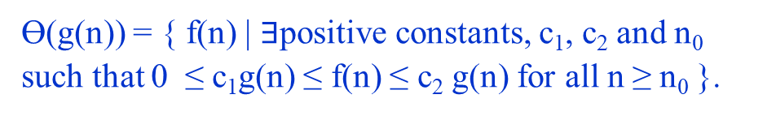
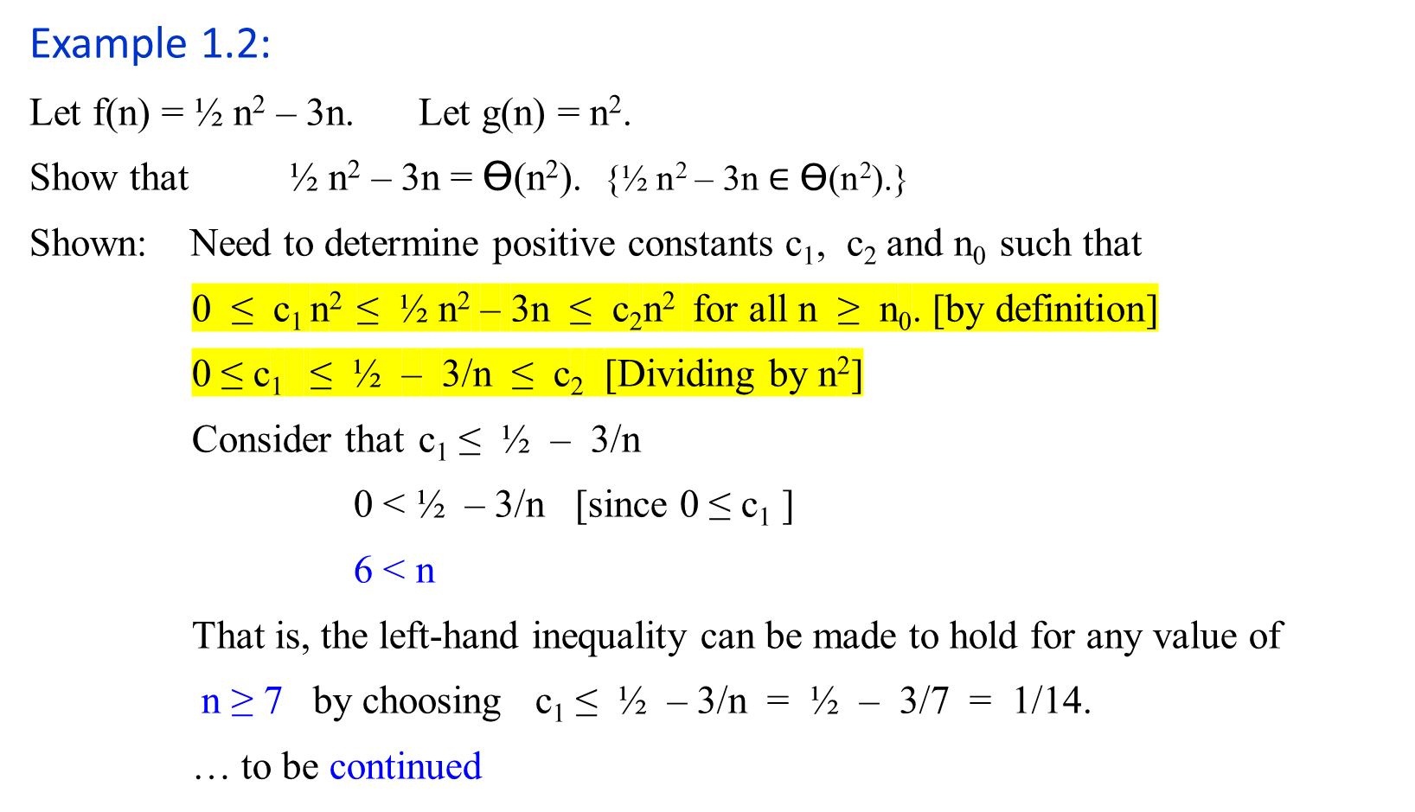
Ɵ(g(n)) = { f(n) | $∃$positive constants, c₁, c₂ and n₀ such that 0 ≤ c₁g(n) ≤ f(n) ≤ c₂ g(n) for all n ≥ n₀ }.
Example 1.2:
Let f(n) = ½ n² – 3n. Let g(n) = n².
Show that ½ n² – 3n = Ɵ(n²). {½ n² – 3n $∈$ Ɵ(n²).}
Shown: Need to determine positive constants c₁, c₂ and n₀ such that
0 ≤ c₁ n² ≤ ½ n² – 3n ≤ c₂n² for all n ≥ n₀. [by definition]
0 ≤ c₁ ≤ ½ – 3/n ≤ c₂ [Dividing by n²]
Consider that c₁ ≤ ½ – 3/n
0 < ½ – 3/n [since 0 ≤ c₁ ]
6 < n
That is, the left-hand inequality can be made to hold for any value of
n ≥ 7 by choosing c₁ ≤ ½ – 3/n = ½ – 3/7 = 1/14.
… to be continued

Slide 19
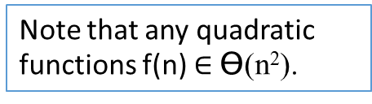
Example 1.2:
Let f(n) = ½ n² – 3n. Let g(n) = n².
Show that ½ n² – 3n = Ɵ(n²).
Shown: Continue …
Consider that ½ – 3/n ≤ c₂.
c₂ ≥ ½ as n is very large.
The right-hand inequality can be made to hold for any value of n ≥ 1 by choosing c₂ ≥ ½ .
Thus, by choosing c₁ = 1/14, c₂ = ½ and n₀ = 7, we verify that ½n² – 3n = Ɵ(n²). QED.
Note that any quadratic functions f(n) $∈$ Ɵ(n²).
Note that 1) Other choices for the constants exits.
2) A different function belonging to would usually require different constants.

Slide 20
Let f(n) = ½ n² – 3n. Let g(n) = n². c₁ = 1/14 = 0.071428571
n | ½ n² – 3n | n² | 0.07 n² | 0.5 n²
0 | 0 | 0 | 0 | 0
1 | -2.5 | 1 | 0.07 | 0.5
2 | -4 | 4 | 0.28 | 2
4 | -4 | 16 | 1.12 | 8
5 | -2.5 | 25 | 1.75 | 12.5
6 | 0 | 36 | 2.52 | 18
7 | 3.5 | 49 | 3.43 | 24.5
8 | 8 | 64 | 4.48 | 32
9 | 13.5 | 81 | 5.67 | 40.5
10 | 20 | 100 | 7 | 50
11 | 27.5 | 121 | 8.47 | 60.5
12 | 36 | 144 | 10.08 | 72
13 | 45.5 | 169 | 11.83 | 84.5
14 | 56 | 196 | 13.72 | 98
15 | 67.5 | 225 | 15.75 | 112.5
16 | 80 | 256 | 17.92 | 128
17 | 93.5 | 289 | 20.23 | 144.5
18 | 108 | 324 | 22.68 | 162
19 | 123.5 | 361 | 25.27 | 180.5
20 | 140 | 400 | 28 | 200
25 | 237.5 | 625 | 43.75 | 312.5
30 | 360 | 900 | 63 | 450
40 | 680 | 1600 | 112 | 800
50 | 1100 | 2500 | 175 | 1250
60 | 1620 | 3600 | 252 | 1800
70 | 2240 | 4900 | 343 | 2450
80 | 2960 | 6400 | 448 | 3200
90 | 3780 | 8100 | 567 | 4050
100 | 4700 | 10000 | 700 | 5000
200 | 19400 | 40000 | 2800 | 20000
500 | 123500 | 250000 | 17500 | 125000
1000 | 497000 | 1000000 | 70000 | 500000
5000 | 12485000 | 25000000 | 1750000 | 12500000
10000 | 49970000 | 100000000 | 7000000 | 50000000
20000 | 199940000 | 400000000 | 28000000 | 200000000
50000 | 1249850000 | 2500000000 | 175000000 | 1250000000
100000 | 4999700000 | 10000000000 | 700000000 | 5000000000

Slide 21

Let f(n) = ½ n² – 3n. Let g(n) = n². c₁ = 1/14 = 0.071428571 and c₂ = ½
n | ½ n² – 3n | n² | 0.07 n² | 0.5 n²
0 | 0 | 0 | 0 | 0
1 | -2.5 | 1 | 0.07 | 0.5
2 | -4 | 4 | 0.28 | 2
4 | -4 | 16 | 1.12 | 8
5 | -2.5 | 25 | 1.75 | 12.5
6 | 0 | 36 | 2.52 | 18
7 | 3.5 | 49 | 3.43 | 24.5
8 | 8 | 64 | 4.48 | 32
9 | 13.5 | 81 | 5.67 | 40.5
10 | 20 | 100 | 7 | 50
11 | 27.5 | 121 | 8.47 | 60.5
12 | 36 | 144 | 10.08 | 72
13 | 45.5 | 169 | 11.83 | 84.5
14 | 56 | 196 | 13.72 | 98
15 | 67.5 | 225 | 15.75 | 112.5
16 | 80 | 256 | 17.92 | 128
17 | 93.5 | 289 | 20.23 | 144.5
18 | 108 | 324 | 22.68 | 162
19 | 123.5 | 361 | 25.27 | 180.5
20 | 140 | 400 | 28 | 200

Slide 22
Let f(n) = ½ n² – 3n. Let g(n) = n². c₁ = 1/14 = 0.071428571
n | ½ n² – 3n | n² | 0.07 n² | 0.5 n²
20 | 140 | 400 | 28 | 200
25 | 237.5 | 625 | 43.75 | 312.5
30 | 360 | 900 | 63 | 450
40 | 680 | 1600 | 112 | 800
50 | 1100 | 2500 | 175 | 1250
60 | 1620 | 3600 | 252 | 1800
70 | 2240 | 4900 | 343 | 2450
80 | 2960 | 6400 | 448 | 3200
90 | 3780 | 8100 | 567 | 4050
100 | 4700 | 10000 | 700 | 5000
200 | 19400 | 40000 | 2800 | 20000
500 | 123500 | 250000 | 17500 | 125000
1000 | 497000 | 1000000 | 70000 | 500000
5000 | 12485000 | 25000000 | 1750000 | 12500000
10000 | 49970000 | 100000000 | 7000000 | 50000000
20000 | 199940000 | 400000000 | 28000000 | 200000000
50000 | 1249850000 | 2500000000 | 175000000 | 1250000000
100000 | 4999700000 | 10000000000 | 700000000 | 5000000000

Slide 23
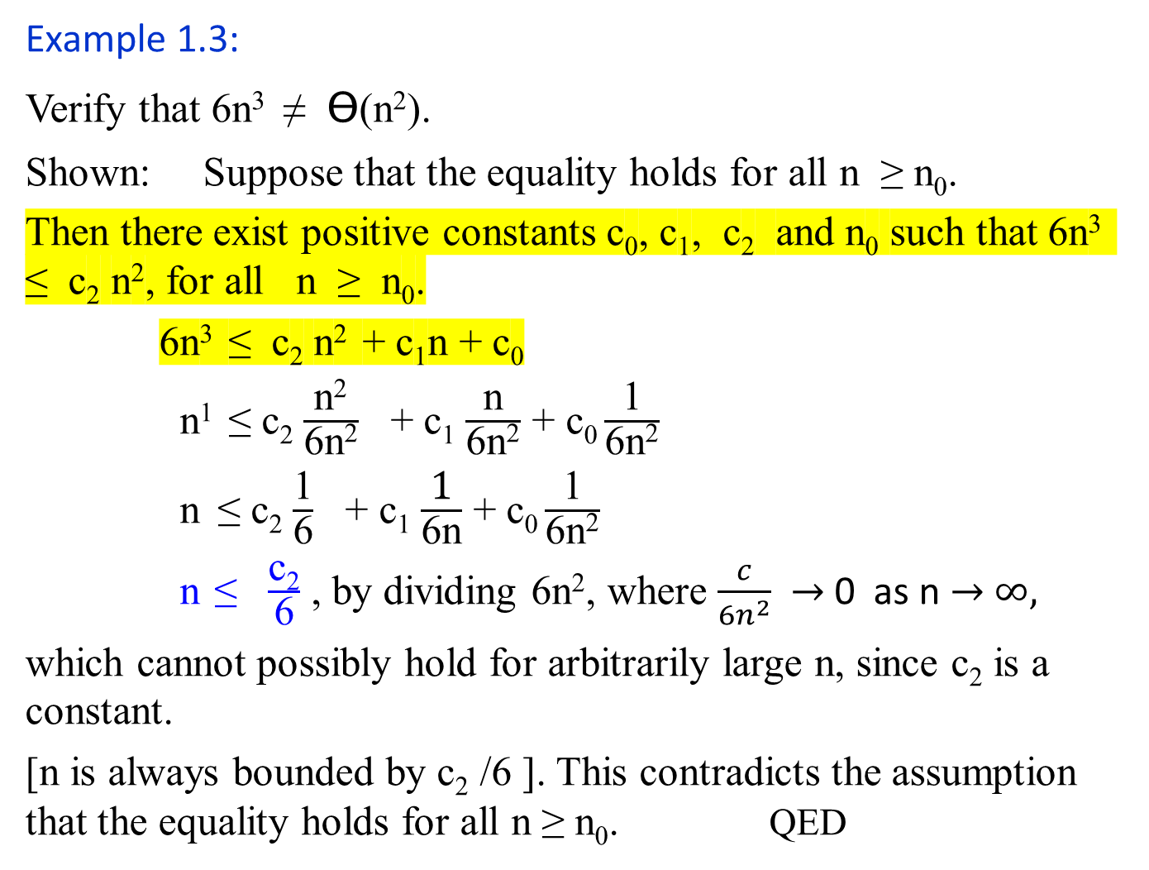
Example 1.3:
Verify that 6n³ ≠ Ɵ(n²).
Shown: Suppose that the equality holds for all n ≥ n₀.
Then there exist positive constants c₀, c₁, c₂ and n₀ such that 6n³ ≤ c₂ n², for all n ≥ n₀.
6n³ ≤ c₂ n² + c₁n + c₀
n¹ ≤ c₂ $\frac{\text{n}\text{2}}{\text{6}\text{n}\text{2}}$ + c₁ $\frac{\text{n}}{\text{6}\text{n}\text{2}}$ + c₀ $\frac{\text{1}}{\text{6}\text{n}\text{2}}$
n ≤ c₂ $\frac{\text{1}}{\text{6}}$ + c₁ $\frac{\text{1}}{\text{6}\text{n}}$ + c₀ $\frac{\text{1}}{\text{6}\text{n}\text{2}}$
n ≤ $\frac{\text{c}\text{2}}{\text{6}}$ , by dividing 6n², where $\frac{c}{{6n}^{2}}$ $→$ 0 as n $→$ $∞,$
which cannot possibly hold for arbitrarily large n, since c₂ is a constant.
[n is always bounded by c₂ /6 ]. This contradicts the assumption that the equality holds for all n ≥ n₀. QED
Ɵ(g(n)) = { f(n) | $∃$positive constants, c₁, c₂ and n₀ such that 0 ≤ c₁g(n) ≤ f(n) ≤ c₂ g(n) for all n ≥ n₀ }.

Slide 24
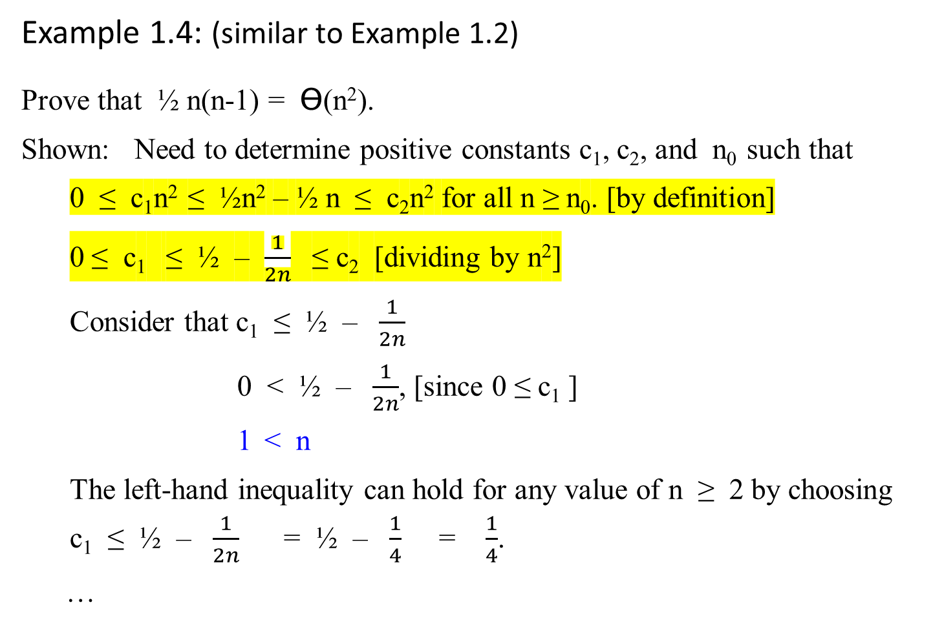
Example 1.4: (similar to Example 1.2)
Prove that ½ n(n-1) = Ɵ(n²).
Shown: Need to determine positive constants c₁, c₂, and n₀ such that
0 ≤ c₁n² ≤ ½n² – ½ n ≤ c₂n² for all n ≥ n₀. [by definition]
0 ≤ c₁ ≤ ½ – $\frac{1}{2n}$ ≤ c₂ [dividing by n²]
Consider that c₁ ≤ ½ – $\frac{1}{2n}$
0 < ½ – $\frac{1}{2n}$, [since 0 ≤ c₁ ]
1 < n
The left-hand inequality can hold for any value of n ≥ 2 by choosing c₁ ≤ ½ – $\frac{1}{2n}$ = ½ – $\frac{1}{4}$ = $\frac{1}{4}$.
…

Slide 25
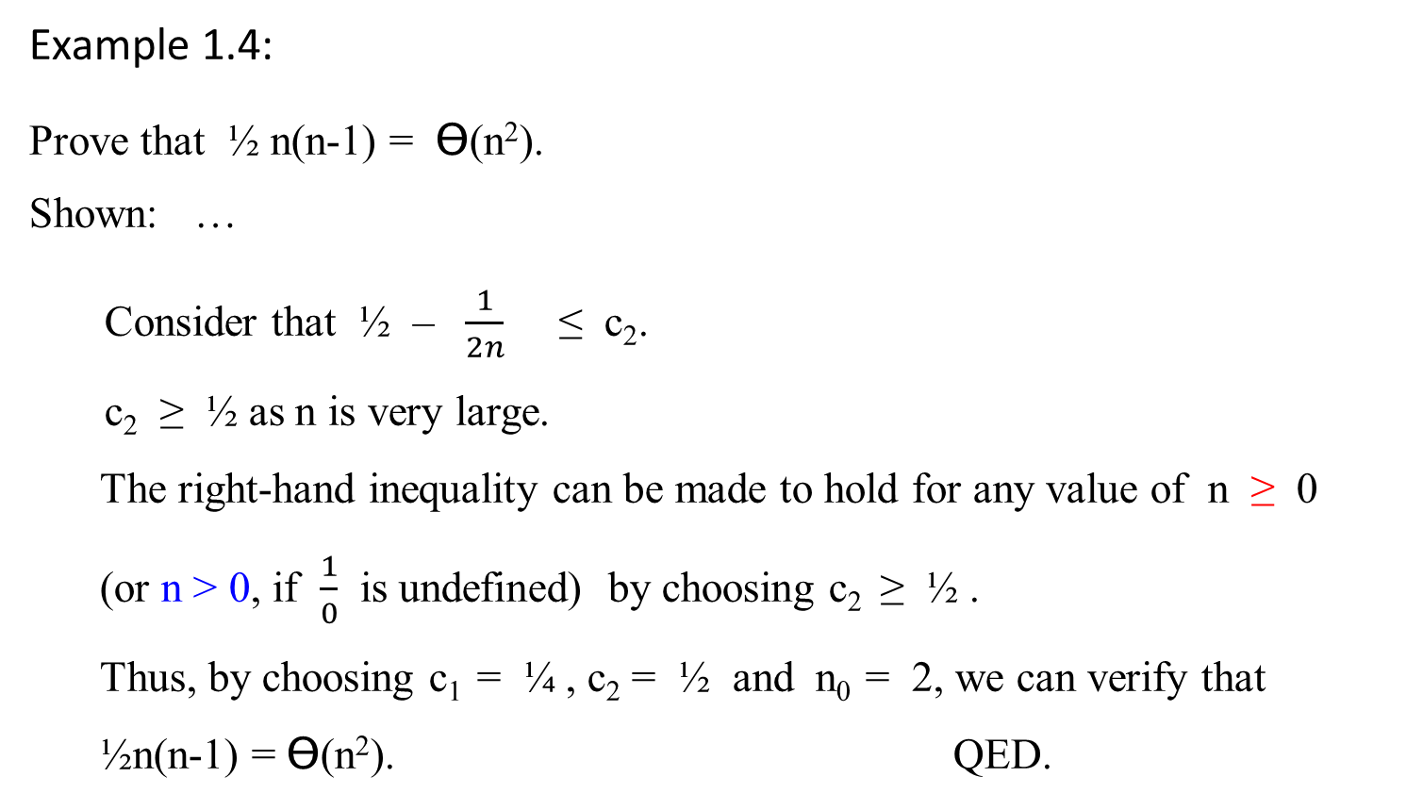
Example 1.4:
Prove that ½ n(n-1) = Ɵ(n²).
Shown: …
Consider that ½ – $\frac{1}{2n}$ ≤ c₂.
c₂ ≥ ½ as n is very large.
The right-hand inequality can be made to hold for any value of n ≥ 0
(or n > 0, if $\frac{1}{0}$ is undefined) by choosing c₂ ≥ ½ .
Thus, by choosing c₁ = ¼ , c₂ = ½ and n₀ = 2, we can verify that ½n(n-1) = Ɵ(n²). QED.

Slide 26
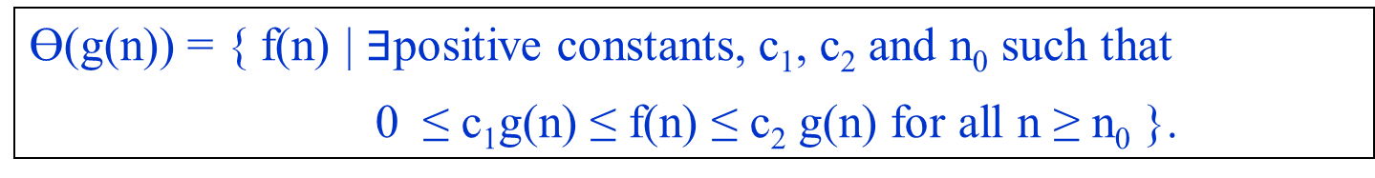
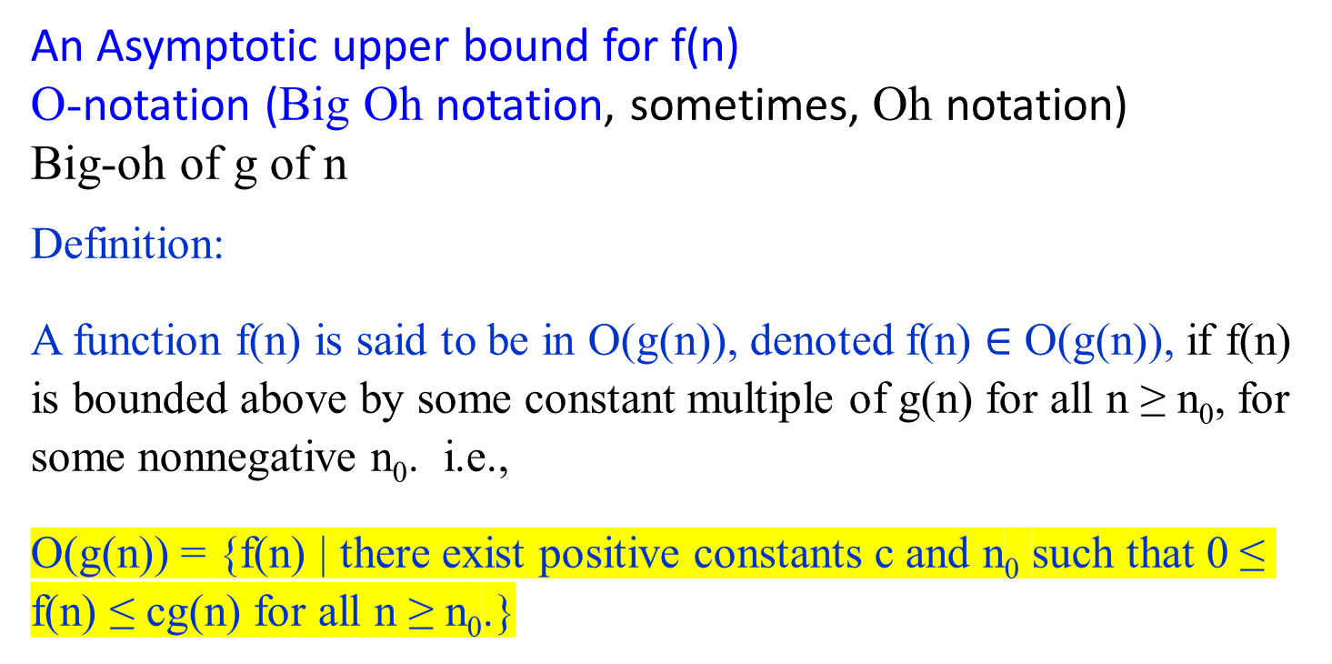
An Asymptotic upper bound for f(n)
O-notation (Big Oh notation, sometimes, Oh notation)
Big-oh of g of n
Definition:
A function f(n) is said to be in O(g(n)), denoted f(n) $∈$ O(g(n)), if f(n) is bounded above by some constant multiple of g(n) for all n ≥ n₀, for some nonnegative n₀. i.e.,
O(g(n)) = {f(n) | there exist positive constants c and n₀ such that 0 ≤ f(n) ≤ cg(n) for all n ≥ n₀.}
Ɵ(g(n)) = { f(n) | $∃$positive constants, c₁, c₂ and n₀ such that
0 ≤ c₁g(n) ≤ f(n) ≤ c₂ g(n) for all n ≥ n₀ }.

Slide 27

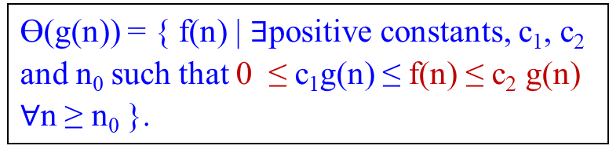
An Asymptotic upper bound for f(n)
O-notation (Big Oh notation)
Big-oh of g of n
For a given complexity function g(n),
O(g(n)) = {f(n) | there exist positive constants c and n₀ such that
0 ≤ f(n) ≤ cg(n) for all n ≥ n₀.}
Ɵ(g(n)) = { f(n) | $∃$positive constants, c₁, c₂ and n₀ such that 0 ≤ c₁g(n) ≤ f(n) ≤ c₂ g(n) $∀$n ≥ n₀ }.
cg(n)
f(n)
n₀ f(n) = O(g(n)) where c and n₀ are positive integer 1, 2, …
Figure 1.2. (b) O-notation gives an upper bound for a function to be within a constant factor.
If f(n) $∈$ O(g(n)), we say that f(n) is big O of g(n).

Slide 28
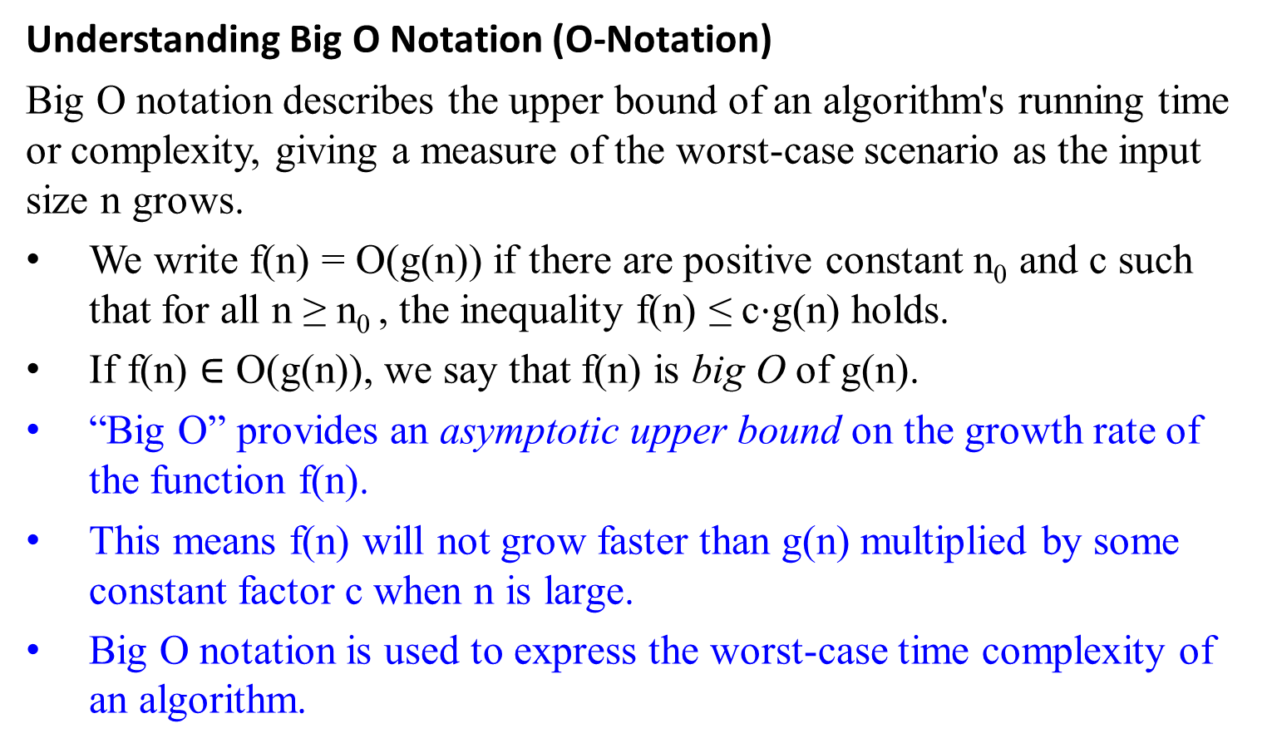
Understanding Big O Notation (O-Notation)
Big O notation describes the upper bound of an algorithm's running time or complexity, giving a measure of the worst-case scenario as the input size n grows.
We write f(n) = O(g(n)) if there are positive constant n₀ and c such that for all n ≥ n₀ ​, the inequality f(n) ≤ c⋅g(n) holds.
If f(n) $∈$ O(g(n)), we say that f(n) is big O of g(n).
“Big O” provides an asymptotic upper bound on the growth rate of the function f(n).
This means f(n) will not grow faster than g(n) multiplied by some constant factor c when n is large.
Big O notation is used to express the worst-case time complexity of an algorithm.

Slide 29
Example 1.5: Linear Function
Prove that Let f(n) = 100n + 5. Show that f(n) ∈ O(n).
Proof: 100n + 5 ≤ 100n + n (for all n ≥ 5)
= 101n. This implies that 100n + 5 ≤ 101n for all n ≥ 5.
Thus, c = 101 and n₀ = 5. Therefore, f(n) ∈ O(n).
Note that the definition gives us many choices for selecting constants c and n₀. For example:
100n + 5 ≤ 100n + 5n (for all n ≥ 1)
= 105n ≤ 105 n²
Thus, c = 105 and n₀ = 1.

Slide 30
Example 1.5: Quadratic Function
Consider f(n) = 5n² + 3n + 1.
Show f(n) = O(n²)
  Need to find constants c and n₀​ such that f(n) ≤ c⋅n² for all n ≥ n₀​.
  Choose c = 6 and n₀=1.
  5n² + 3n + 1 ≤ 6n² for all n ≥ 1
  Therefore, f(n) ∈ O(n²).

Slide 31
Example 1.5: Logarithmic Function:
Consider f(n) = log₂ n³.
Show f(n) = O(log₂ n), where g(n) = log₂ n.
  We need to find constants c and n_{0​} such that 3 log₂ n ≤ c⋅ log₂ n for all n ≥ n₀​.
  Choose c=3 and n₀​=1.
  3log n ≤ c⋅log n leads to 3 log₂ n ≤ 3 log₂ n for all n ≥ 1
  Therefore, f(n) ∈ O(log₂ n).

Slide 32
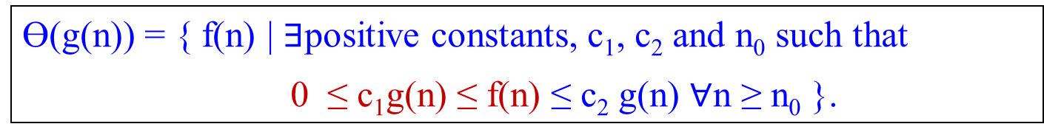
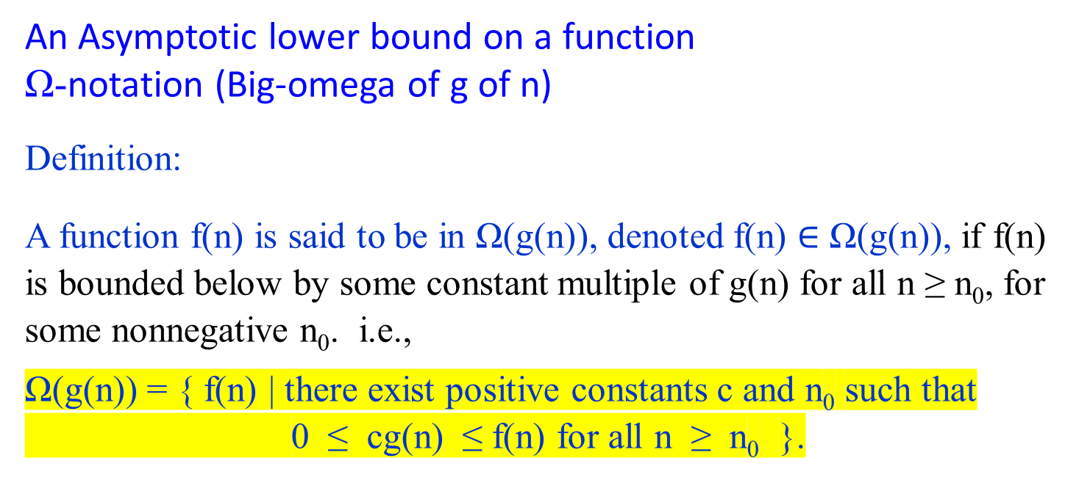
An Asymptotic lower bound on a function
Ω-notation (Big-omega of g of n)
Definition:
A function f(n) is said to be in Ω(g(n)), denoted f(n) $∈$ Ω(g(n)), if f(n) is bounded below by some constant multiple of g(n) for all n ≥ n₀, for some nonnegative n₀. i.e.,
Ω(g(n)) = { f(n) | there exist positive constants c and n₀ such that
0 ≤ cg(n) ≤ f(n) for all n ≥ n₀ }.
Ɵ(g(n)) = { f(n) | $∃$positive constants, c₁, c₂ and n₀ such that
0 ≤ c₁g(n) ≤ f(n) ≤ c₂ g(n) $∀$n ≥ n₀ }.

Slide 33

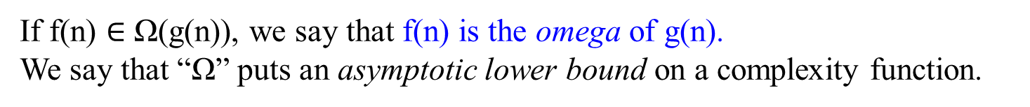
Figure 1.2. (c). Ω-notation gives a lower bound for a function to be within a constant factor.
We write f(n) = Ω(g(n)) if there are positive constants n₀ and c such that to the right of n₀, the value of f(n) always lies on or above cg(n).
f(n)
asymptote
cg(n)
n₀ f(n) = Ω(g(n))
If f(n) $∈$ Ω(g(n)), we say that f(n) is the omega of g(n).
We say that “Ω” puts an asymptotic lower bound on a complexity function.

Slide 34
Understanding Omega Notation (Ω-Notation)
Omega notation (Ω) describes the lower bound of an algorithm's running time or complexity, giving a measure of the best-case scenario as the input size n grows.
Ω-notation describes a lower bound.
  For all values n ≥ n₀, the value of f(n) is on or above cg(n), for sufficiently large n.
If f(n) ∈ Ω(g(n)), we say that f(n) is "big Omega" of g(n).
Omega notation provides an asymptotic lower bound on the growth rate of the function f(n).
2. This means f(n) will not grow slower than g(n) multiplied by some constant factor c when n is large.
3. Ω-notation is used to express the best-case running time of an algorithm on arbitrary inputs.
  For example: The running time of insertion sort falls between Ω(n) and O(n²) Best-case (Ω(n)): The input is already sorted.
  Worst-case (O(n²)): The input array is sorted in reverse order.
4. It is not contradictory to say that the worst-case running time of insertion sort is Ω(n²) since there exists an input that causes the algorithm to take Ω(n²) time.

Slide 35
Example 1.7:
Prove that n³ = Ω(n²).
Proof: 0 ≤ n² ≤ n³ , for all n ≥ 0.
That is, we can select c = 1 and n₀ = 0.
Example 1.8:
Ω(g(n)) stands for the set of all functions with a larger or same order of growth as g(n) (to within a constant multiple, as n goes to infinity).
n³ ε Ω (n²). ½ n(n-1) ε Ω (n²). But 100n + 5 ≠ Ω (n²).

Slide 36
Theorem 1.2:
For any two functions f(n) and g(n), we have f(n) = Ɵ(g(n)) if, and only if f(n) = O(g(n)) and f(n) = Ω(g(n)).
Proof: Followed by their definitions.
Example 1.9:
Our proof that an² + bn + c = Ɵ(n²) for any constant a, b, and c, where a > 0, immediately implies that an² + bn + c = Ω(n²) and an² + bn + c = O(n²).

Slide 37
What is f(n)?

Slide 38
The Asymptotic Analysis of Algorithms:
Given an algorithm A,
The running time of an algorithm T(n) is defined as T(n) ∝ f(n), a function f(n) of the size of its input n
T(n) ∝ f(n) means that the running time T(n) grows proportionally to f(n), asymptotically.
f(n) is a mathematical function that describes how the running time of the algorithm changes with the size of the input
What is and how do you find f(n) for a given algorithm A?

Slide 39
j
A[0] | A[1] | A[2] | A[3] | A[4] | A[5] | A[6] | A[7] | … | A[n-2] | A[n-1]
5 | 10 | 16 | 19 | 30 | 51 | 17
i = j-1
An example: Insertion Sort
Algorithm Insertion-Sort(A[0..n-1])
//sorts a given array by insertion sort
//Input: An array A[0..n-1] of n orderable elements
//Output: Array A[0..n-1] sorted in nondecreasing order
for (j ← 1 to n – 1)
do {key ← A[j]
//Insert A[j] into the sorted sequence A[1 .. j-1].
i ← j – 1
while (i ≥ 0 and A[i] > key) do { A[i+1] ← A[i]
i ← i – 1 } //end doWhile
A[i+1] ← key; } //end doFor
Q: Why j does not begin from 0?
Q: Why is A[j] assigned to the key?
Q: What is the reason for setting i = j-1 for each i?
Q: why i ≥ 0, A[i] > key, and “and”?
Q: What does the statement mean?
Q: What does the statement mean?

Slide 40

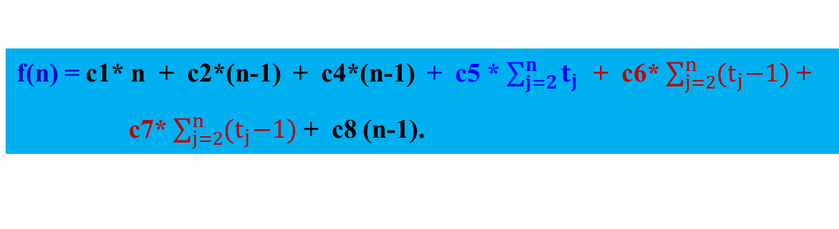
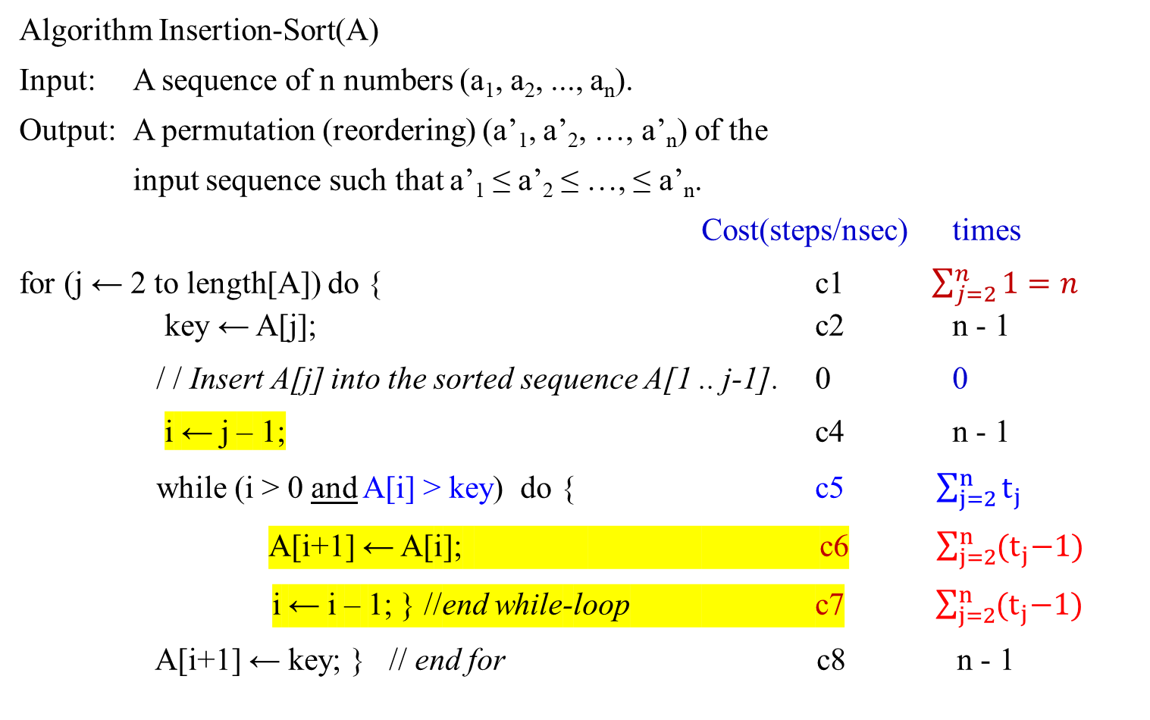
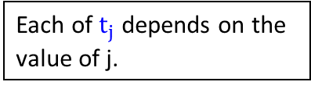
f(n) = c1* n + c2*(n-1) + c4*(n-1) + c5 * $\sum_{j=2}^{n}{t_{j}}$ + c6* $\sum_{j=2}^{n}{{(t}_{j}−1)}$ +
c7* $\sum_{j=2}^{n}{{(t}_{j}−1)}$ + c8 (n-1).
Algorithm Insertion-Sort(A)
Input: A sequence of n numbers (a₁, a₂, ..., a_{n}).
Output: A permutation (reordering) (a’₁, a’₂, …, a’_{n}) of the
input sequence such that a’₁ ≤ a’₂ ≤ …, ≤ a’_{n}.
Cost(steps/nsec) times
for (j ← 2 to length[A]) do { c1 $\sum_{j=2}^{n}{1=n}$ key ← A[j]; c2 n - 1
/ / Insert A[j] into the sorted sequence A[1 .. j-1]. 0 0
i ← j – 1; c4 n - 1
while (i > 0 and A[i] > key) do { c5 $\sum_{j=2}^{n}{t_{j}}$
A[i+1] ← A[i]; c6 $\sum_{j=2}^{n}{{(t}_{j}−1)}$
i ← i – 1; } //end while-loop c7 $\sum_{j=2}^{n}{{(t}_{j}−1)}$
A[i+1] ← key; } // end for c8 n - 1
In the last one, j = n+1, the guard is false.
Assume A[1..n].It starts j =2 to n, n-1 times of execution.
Each of $t_{j}$ depends on the value of j.
The inner loop execution is one less than the guard.

Slide 41
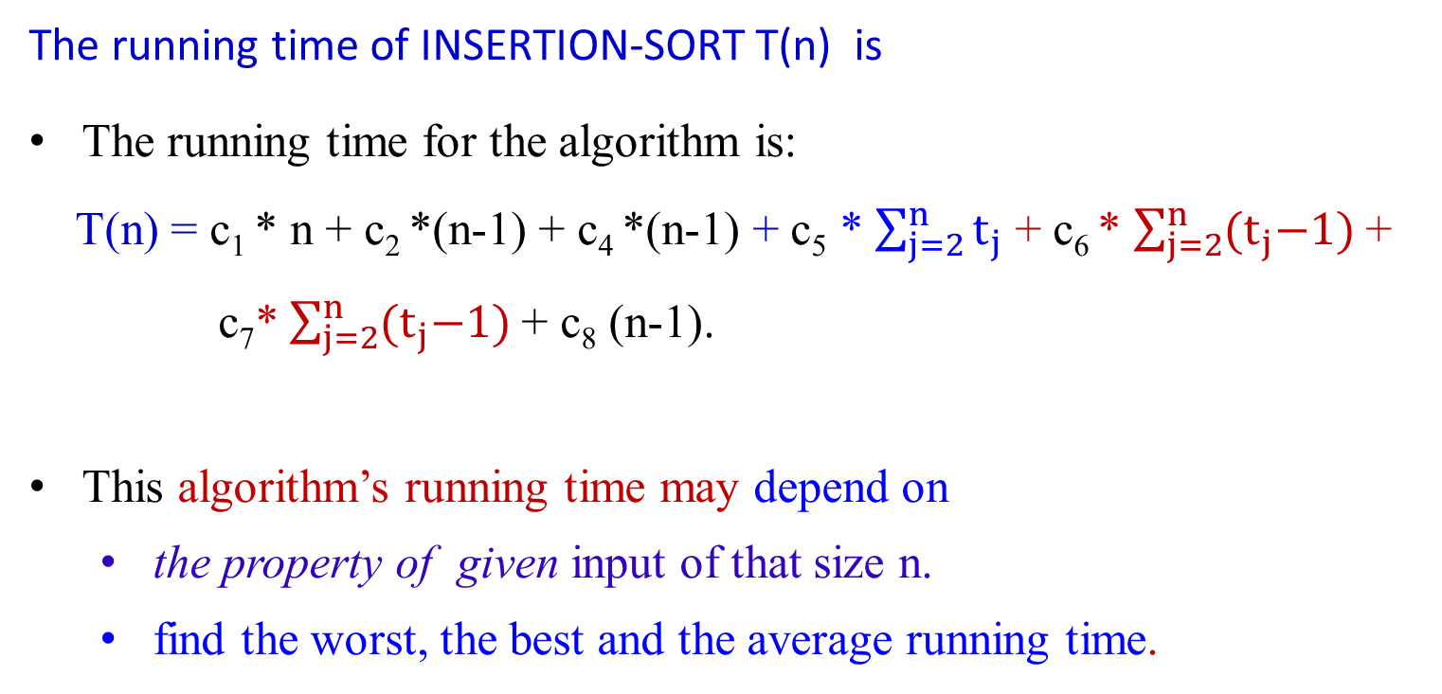
The running time of INSERTION-SORT T(n) is
The running time for the algorithm is:
T(n) = c₁ * n + c₂ *(n-1) + c₄ *(n-1) + c₅ * $\sum_{j=2}^{n}{t_{j}}$ + c₆ * $\sum_{j=2}^{n}{{(t}_{j}−1)}$ +
c₇* $\sum_{j=2}^{n}{{(t}_{j}−1)}$ + c₈ (n-1).
This algorithm’s running time may depend on
  the property of given input of that size n.
  find the worst, the best and the average running time.

Slide 42
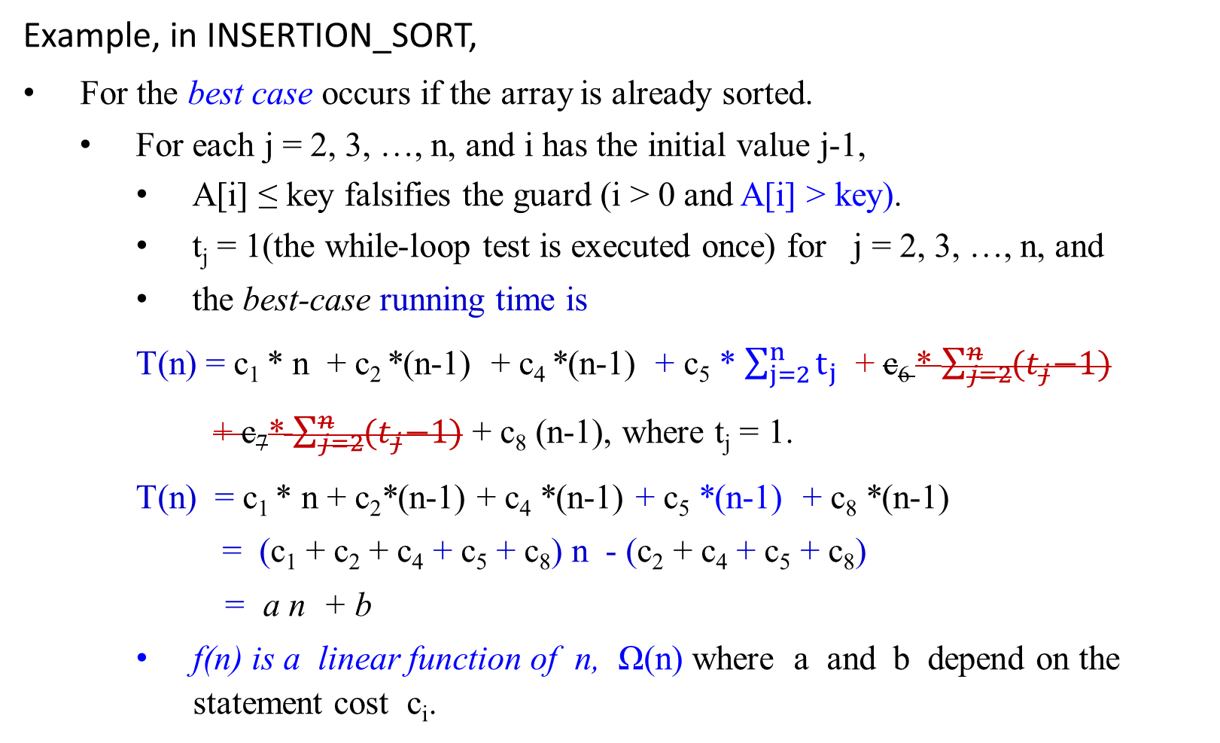
Example, in INSERTION_SORT,
For the best case occurs if the array is already sorted.
  For each j = 2, 3, …, n, and i has the initial value j-1,
    A[i] ≤ key falsifies the guard (i > 0 and A[i] > key).
    t_{j} = 1(the while-loop test is executed once) for j = 2, 3, …, n, and
    the best-case running time is
T(n) = c₁ * n + c₂ *(n-1) + c₄ *(n-1) + c₅ * $\sum_{j=2}^{n}{t_{j}}$ + c₆ * $\sum_{j=2}^{n}{{(t}_{j}−1)}$
+ c₇* $\sum_{j=2}^{n}{{(t}_{j}−1)}$ + c₈ (n-1), where t_{j} = 1.
T(n) = c₁ * n + c₂*(n-1) + c₄ *(n-1) + c₅ *(n-1) + c₈ *(n-1)
= (c₁ + c₂ + c₄ + c₅ + c₈) n - (c₂ + c₄ + c₅ + c₈)
= a n + b
f(n) is a linear function of n, Ω(n) where a and b depend on the statement cost c_{i}.

Slide 43
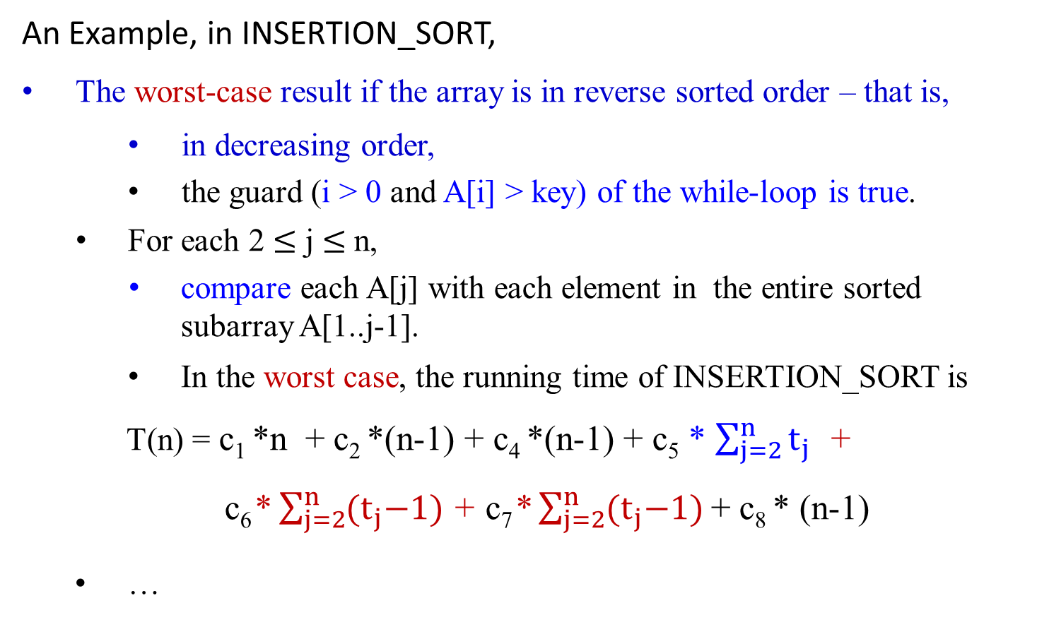
An Example, in INSERTION_SORT,
The worst-case result if the array is in reverse sorted order – that is,
    in decreasing order,
    the guard (i > 0 and A[i] > key) of the while-loop is true.
For each 2 $≤$ j $≤$ n,
  compare each A[j] with each element in the entire sorted subarray A[1..j-1].
    In the worst case, the running time of INSERTION_SORT is
T(n) = c₁ *n + c₂ *(n-1) + c₄ *(n-1) + c₅ * $\sum_{j=2}^{n}{t_{j}}$ +
c₆* $\sum_{j=2}^{n}{{(t}_{j}−1)}$ + c₇* $\sum_{j=2}^{n}{{(t}_{j}−1)}$+ c₈ * (n-1)
  …

Slide 44

  Note that
  $\sum_{j=1}^{n}{1}$ = n - j + 1 = n. $\sum_{j=1}^{n}{j}$ = $\frac{n(n+1)}{2}$ . $\sum_{j=1}^{n}{j^{2}}$ = $\frac{n(n+1)(2n+1)}{6}$.
  $\sum_{i=j−1}^{0}{1}$= $\sum_{0}^{i=j−1}{1}$= j
$\sum_{j=2}^{n}{j}$= $\frac{n(n+1)}{2}$ - 1 and also $\sum_{j=2}^{n}{1}$= n - 2 + 1 = n - 1
$\sum_{j=2}^{n}{\text{(}\text{j}\text{ – 1)}}$ = $\frac{n(n−1)}{2}$
$\sum_{j=2}^{n}{\text{(}\text{j}\text{ – 1)}}$ = $\sum_{j=2}^{n}{j}$- $\sum_{j=2}^{n}{1}$
  = { $\frac{n(n+1)}{2}$ - 1} - {n - 1}
  = $\frac{n(n−1)}{2}$

Slide 45

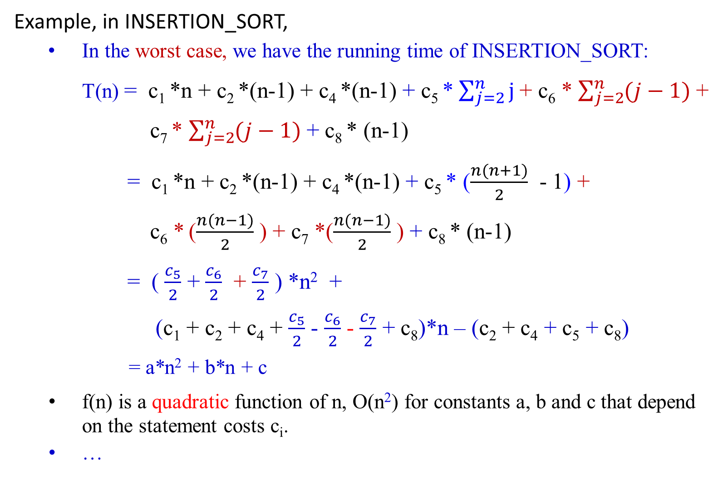
Example, in INSERTION_SORT,
  In the worst case, we have the running time of INSERTION_SORT:
T(n) = c₁ *n + c₂ *(n-1) + c₄ *(n-1) + c₅ * $\sum_{j=2}^{n}{j}$+ c₆ * $\sum_{j=2}^{n}{(j−1)}$+
c₇ * $\sum_{j=2}^{n}{(j−1)}$+ c₈ * (n-1)
= c₁ *n + c₂ *(n-1) + c₄ *(n-1) + c₅ * ($\frac{n(n+1)}{2}$ - 1) +
c₆ * ($\frac{n(n−1)}{2}$ ) + c₇ *($\frac{n(n−1)}{2}$ ) + c₈ * (n-1)
= ( $\frac{c_{5}}{2}$ + $\frac{c_{6}}{2}$ + $\frac{c_{7}}{2}$ ) *n² +
(c₁ + c₂ + c₄ + $\frac{c_{5}}{2}$ - $\frac{c_{6}}{2}$ - $\frac{c_{7}}{2}$ + c₈)*n – (c₂ + c₄ + c₅ + c₈)
= a*n² + b*n + c
f(n) is a quadratic function of n, O(n²) for constants a, b and c that depend on the statement costs c_{i}.
…

Slide 46
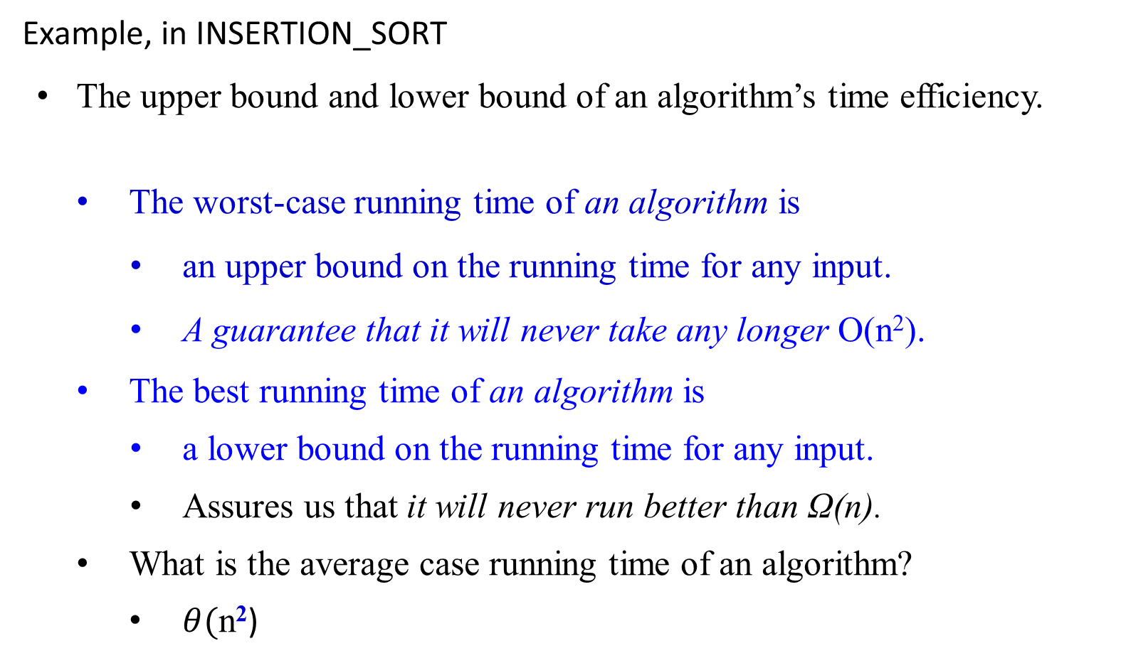
Example, in INSERTION_SORT
The upper bound and lower bound of an algorithm’s time efficiency.
The worst-case running time of an algorithm is
    an upper bound on the running time for any input.
    A guarantee that it will never take any longer O(n²).
The best running time of an algorithm is
    a lower bound on the running time for any input.
    Assures us that it will never run better than Ω(n).
What is the average case running time of an algorithm?
  $θ(\text{n}\text{2}$)

Slide 47
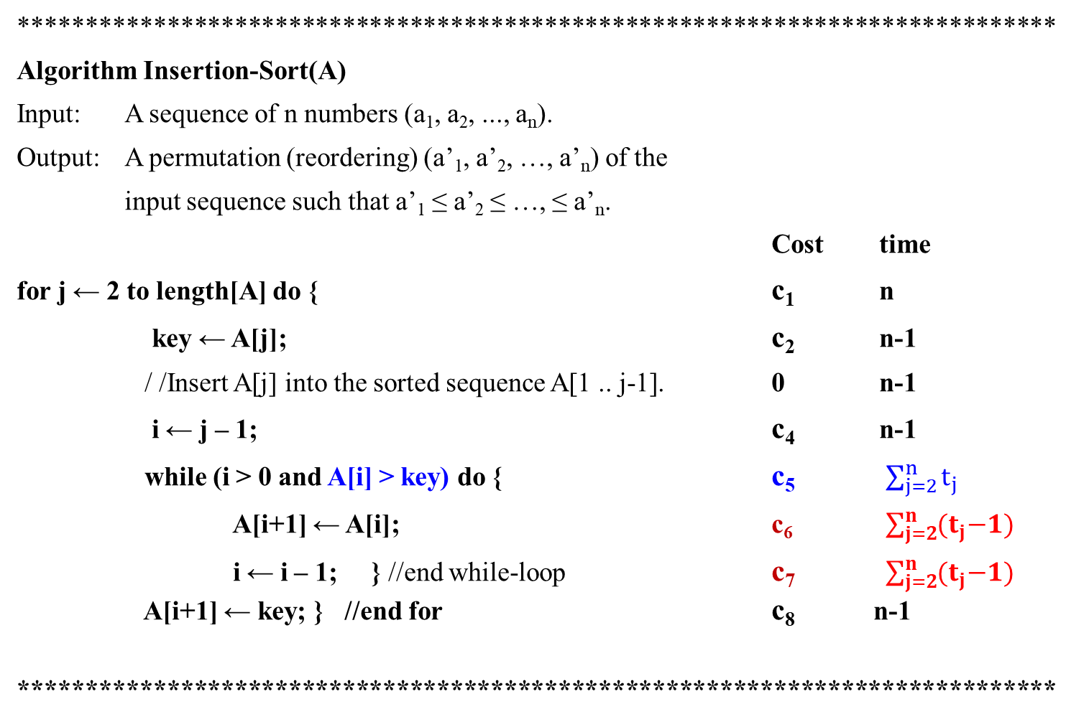
*****************************************************************************
Algorithm Insertion-Sort(A)
Input: A sequence of n numbers (a₁, a₂, ..., a_{n}).
Output: A permutation (reordering) (a’₁, a’₂, …, a’_{n}) of the
input sequence such that a’₁ ≤ a’₂ ≤ …, ≤ a’_{n}.
Cost time
for j ← 2 to length[A] do { c₁ n
key ← A[j]; c₂ n-1
/ /Insert A[j] into the sorted sequence A[1 .. j-1]. 0 n-1
i ← j – 1; c₄ n-1
while (i > 0 and A[i] > key) do { c₅ $\sum_{j=2}^{n}{t_{j}}$
A[i+1] ← A[i]; c₆ $\sum_{j=2}^{n}{{(t}_{j}−1)}$
i ← i – 1; } //end while-loop c₇ $\sum_{j=2}^{n}{{(t}_{j}−1)}$ A[i+1] ← key; } //end for c₈ n-1
*****************************************************************************

Slide 48

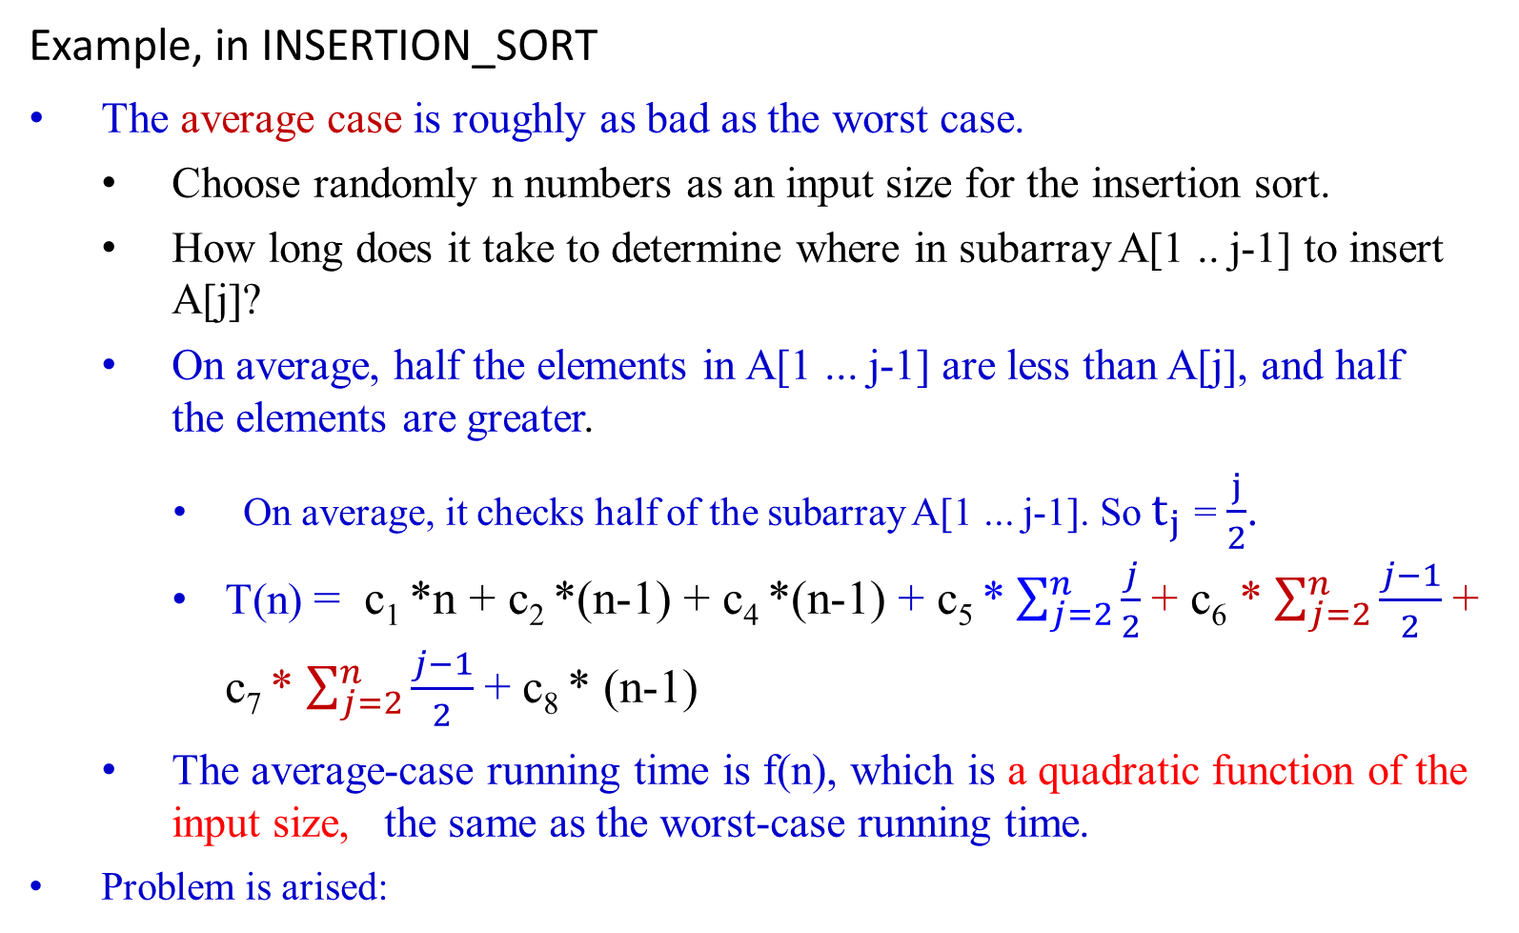
Example, in INSERTION_SORT
The average case is roughly as bad as the worst case.
Choose randomly n numbers as an input size for the insertion sort.
How long does it take to determine where in subarray A[1 .. j-1] to insert A[j]?
On average, half the elements in A[1 ... j-1] are less than A[j], and half the elements are greater.
  On average, it checks half of the subarray A[1 ... j-1]. So $t_{j}$ = $\frac{j}{2}$.
T(n) = c₁ *n + c₂ *(n-1) + c₄ *(n-1) + c₅ * $\sum_{j=2}^{n}{\frac{j}{2}}$+ c₆ * $\sum_{j=2}^{n}{\frac{j−1}{2}}$+ c₇ * $\sum_{j=2}^{n}{\frac{j−1}{2}}$+ c₈ * (n-1)
The average-case running time is f(n), which is a quadratic function of the input size, the same as the worst-case running time.
Problem is arised:

Slide 49
Example, in INSERTION_SORT
The average case is roughly as bad as the worst case.
…
Problem is arised:
Our assumption: all inputs of a given size are equally likely (for all instances).
  In practice, this assumption may be violated,
Use a randomized algorithm for making random choices.
  This allows a probabilistic analysis and yield an expected running time.
an incremental approach is used to design insertion sort.

Slide 50
Algorithm Analysis Framework with an example of Insert_Sort algorithm

Slide 51
Analysis of Algorithms. (for the first case)
A complete analysis of the running time of an algorithm involves the following steps:
[input] Develop a realistic model for the input to the program.
[input size] Analyze the unknown quantities of the modeled input.
[algorithm development] Implement the algorithm completely.
[algorithm analysis]
  Determine the time required for each basic operation.
  Identify unknown quantities that can be used to describe the frequency of execution of the basic operations.
[efficiency] Calculate the total running time by
  multiplying the time by the frequency for each operation,
  then adding all the products.
What are the domain of data and the representation of data?

Slide 52

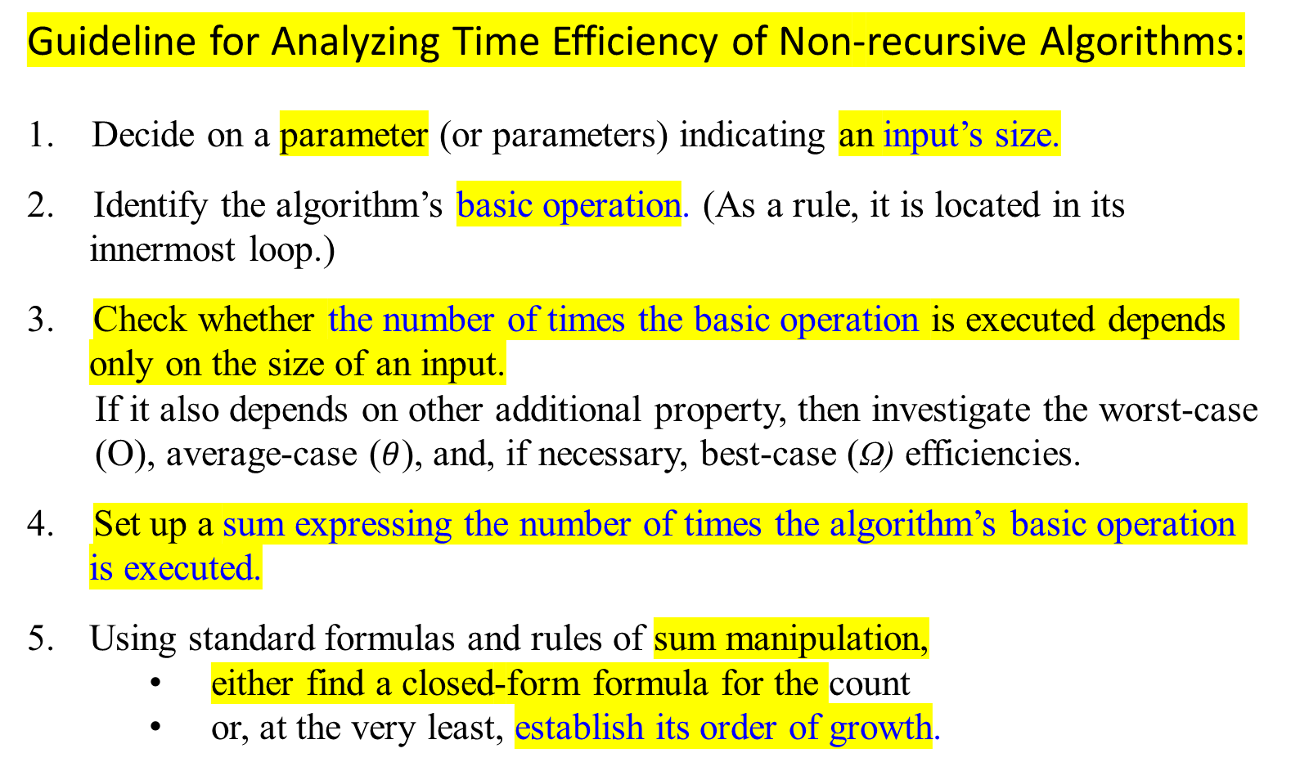
Guideline for Analyzing Time Efficiency of Non-recursive Algorithms:
Decide on a parameter (or parameters) indicating an input’s size.
2. Identify the algorithm’s basic operation. (As a rule, it is located in its innermost loop.)
3. Check whether the number of times the basic operation is executed depends only on the size of an input.
If it also depends on other additional property, then investigate the worst-case (O), average-case ($θ$), and, if necessary, best-case (Ω) efficiencies.
4. Set up a sum expressing the number of times the algorithm’s basic operation is executed.
Using standard formulas and rules of sum manipulation,
either find a closed-form formula for the count
or, at the very least, establish its order of growth.

Slide 53

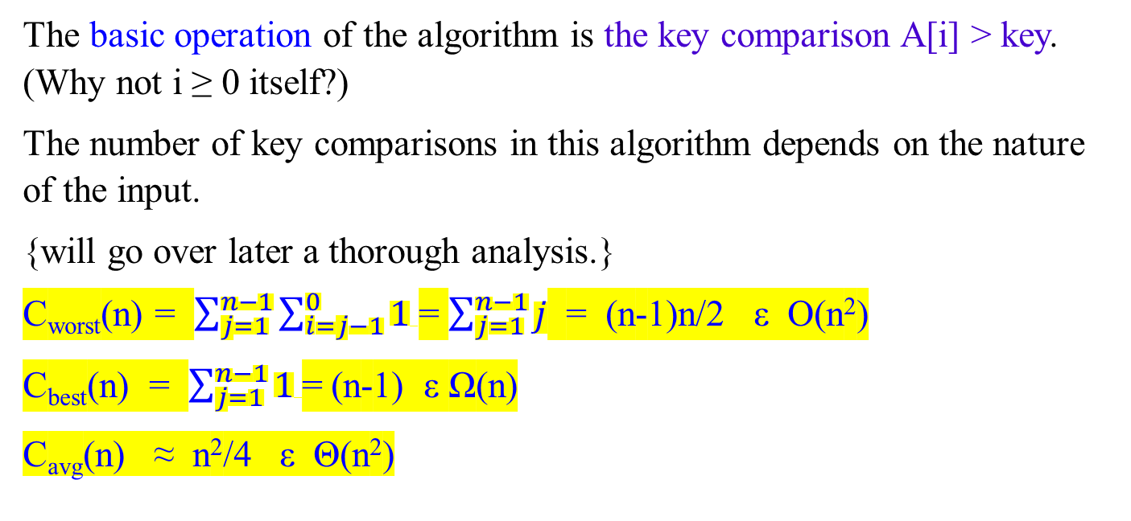
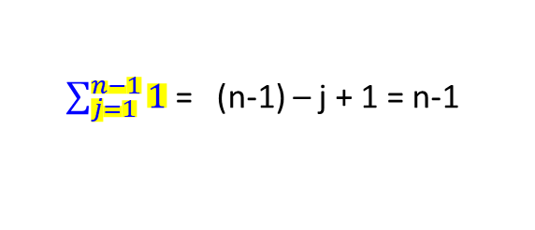
The basic operation of the algorithm is the key comparison A[i] > key. (Why not i ≥ 0 itself?)
The number of key comparisons in this algorithm depends on the nature of the input.
{will go over later a thorough analysis.}
C_{worst}(n) = $\sum_{j=1}^{n−1}{\sum_{i=j−1}^{0}{1}}$= $\sum_{j=1}^{n−1}{j}$ = (n-1)n/2 ε O(n²)
C_{best}(n) = $\sum_{j=1}^{n−1}{1}$= (n-1) ε Ω(n)
C_{avg}(n) ≈ n²/4 ε Θ(n²)
Assume A[0 .. n-1].
for j← 1 to n - 1
do { key ← A[j]
i ← j – 1
while i ≥ 0 and A[i] > key
do { A[i+1] ← A[i];
i ← i – 1; }
A[i+1] ← key; }
$\sum_{j=1}^{n−1}{1}$ = (n-1) – j + 1 = n-1

Slide 54
Useful Property Involving the Asymptotic Notations
Theorem 1.3.
If f₁(n) ε O(g₁(n)) and f₂(n) ε O(g₂(n)),
then
f₁(n) + f₂(n) ε O(max{g₁(n), g₂(n)}).
Proof:
Since f₁(n) ε O(g₁(n)), by definition of O-notation, there exist some positive constants c₁ and n₁ > 0 such that
f₁(n) ≤ c₁ g₁(n), for all n ≥ n_{1.}
Similarly, Since f₂(n) ε O(g₂(n)), by definition of O-notation, there exist some positive constants c₂ and n₂ > 0 such that
f₂(n) ≤ c₂ g₂(n), for all n ≥ n_{2.}
…

Slide 55
Corollary 1.3.1.
If f₁(n) ε Ω(g₁(n)) and f₂(n) ε Ω(g₂(n)), then
f₁(n) + f₂(n) ε Ω(max{g₁(n), g₂(n)}).
b. If f₁(n) ε Ɵ(g₁(n)) and f₂(n)ε Ɵ(g₂(n)), then
f₁(n) + f₂(n) ε Ɵ(max{g₁(n), g₂(n)}).

Slide 56

Example 1.10:
Consider a two-part algorithm:
  first, sort the array by applying some known sorting algorithm;
  second, scan the sorted array to check its consecutive element for equality.
  If a sorting algorithm is used in the first part to make no more than ½ n(n-1) comparisons, it is in O(n²).
  If the second part makes no more than n-1 comparisons, it is in O(n).
  Thus, the efficiency of the entire algorithm will be in ½ n(n-1) + n-1 O(max{n², n}) = O(n²).

Slide 57
Comparing the Orders of Growth of Two Functions

Slide 58

Using Limits for Comparing Orders of Growth
A convenient method for comparing the orders of growth of two specific functions is based on computing the limit of the ratio of the two functions in question.
Three principal cases may arise:
f(n) 0 implies that f(n) has a smaller order of growth than g(n)
lim ---- = c > 0 implies that f(n) has the same order of growth as g(n)
n → ∞ g(n) ∞ implies that f(n) has a larger order of growth than g(n).
Note that
The first two cases mean that f(n) ε O(g(n)).
The second case means that f(n) ε Ɵ(g(n))
The last two mean that f(n) ε Ω(g(n)).

Slide 59

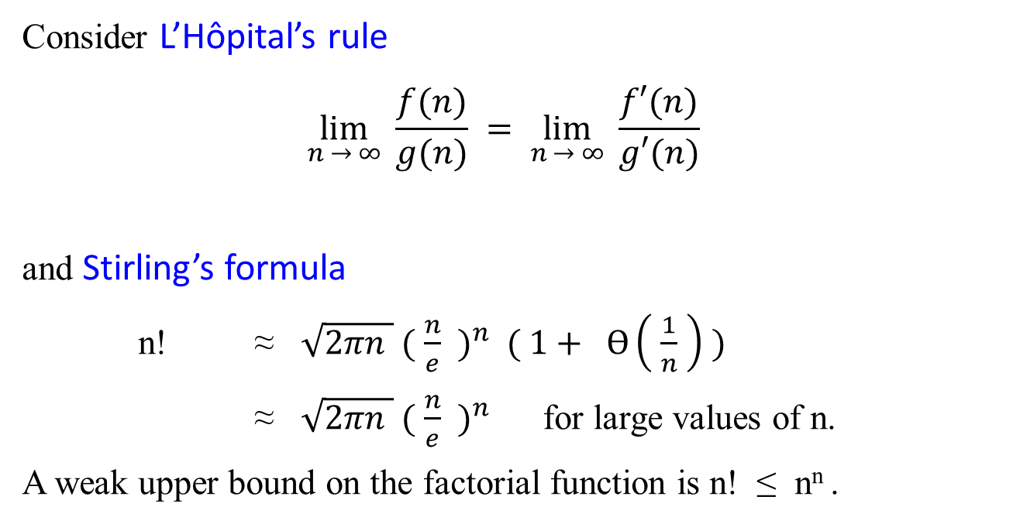
Consider L’Hôpital’s rule
$$\lim_{n → ∞}{\frac{f(n)}{g(n)}} = \lim_{n → ∞}{ \frac{f′(n)}{g′(n)}}$$
and Stirling’s formula
n! ≈ $\sqrt{2πn } {( \frac{n}{e} )}^{n} ( 1+ Ɵ\left( \frac{1}{n} \right) )$
≈ $\sqrt{2πn } {( \frac{n}{e} )}^{n}$ for large values of n.
A weak upper bound on the factorial function is n! ≤ n^{n} .

Slide 60
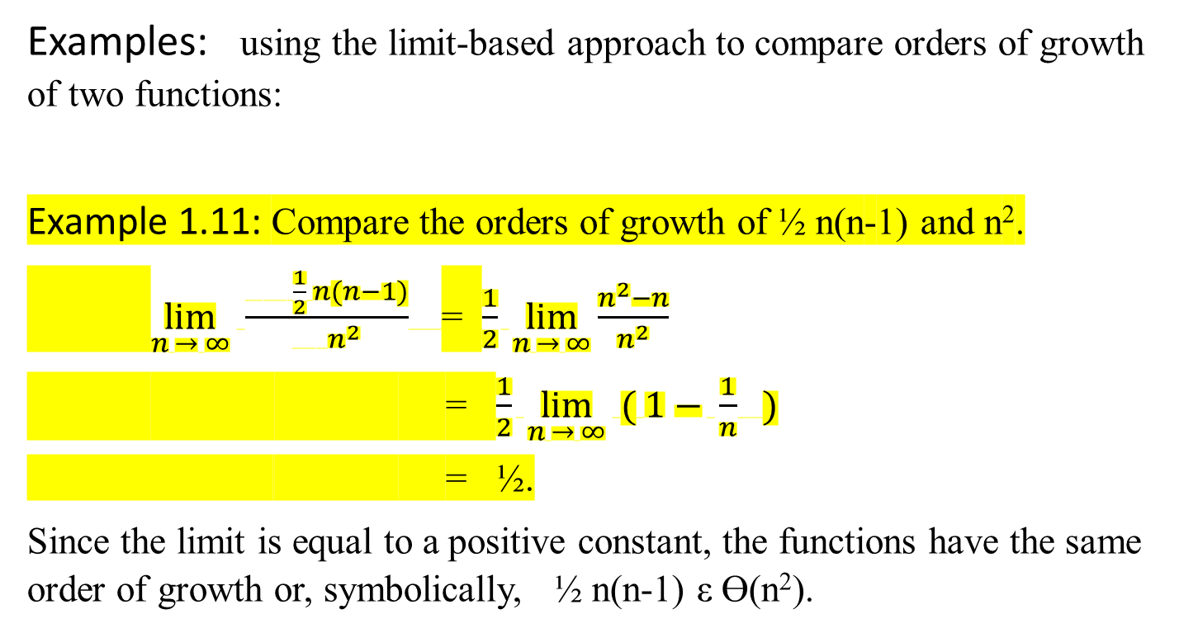
Examples: using the limit-based approach to compare orders of growth of two functions:
Example 1.11: Compare the orders of growth of ½ n(n-1) and n².
$\lim_{n → ∞}{ \frac{ \frac{1}{2} n(n−1)}{ n^{2}} }$= $\frac{1}{2} \lim_{n → ∞}{\frac{n^{2}−n}{n^{2}}}$
= $\frac{1}{2} \lim_{n → ∞}{ ( 1− \frac{1}{n} )}$
= ½.
Since the limit is equal to a positive constant, the functions have the same order of growth or, symbolically, ½ n(n-1) ε Ɵ(n²).

Slide 61

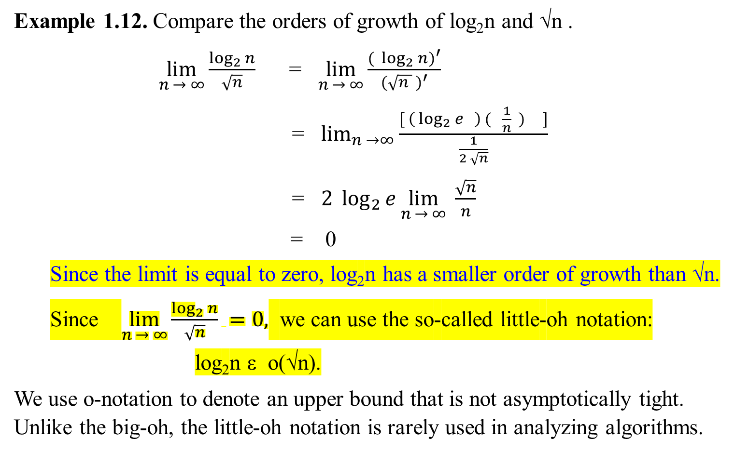

$${( \log_{2}{n})}^{′}$$
= $\left( \log_{2}{e} \right) ( \frac{n′}{n} )$
=$\left( \log_{2}{e} \right) ( \frac{1}{n} )$
Example 1.12. Compare the orders of growth of log₂n and √n .
$\lim_{n → ∞}{\frac{\log_{2}{n}}{\sqrt{n}}}$ = $\lim_{n → ∞}{\frac{{( \log_{2}{n})}^{′}}{{(\sqrt{n } )}^{′}}}$
= $\lim_{n →∞}{\frac{[ \left( \log_{2}{e} \right) ( \frac{1}{n} ) ]}{\frac{1}{2 \sqrt{n}}}}$
= $2 \log_{2}{e}\lim_{n → ∞}{\frac{\sqrt{n}}{n}}$
= 0
Since the limit is equal to zero, log₂n has a smaller order of growth than √n.
Since $\lim_{n → ∞}{\frac{\log_{2}{n}}{\sqrt{n}}} =0,$ we can use the so-called little-oh notation:
log₂n ε o(√n).
We use o-notation to denote an upper bound that is not asymptotically tight. Unlike the big-oh, the little-oh notation is rarely used in analyzing algorithms.
$$\lim_{n → ∞}{\frac{\sqrt{n}}{n}}$$
= $\lim_{n → ∞}{n^{1/2} ∗ n^{−1} }$
= $\lim_{n → ∞}{\frac{1}{n^{1/2}}}$ = 0

Slide 62
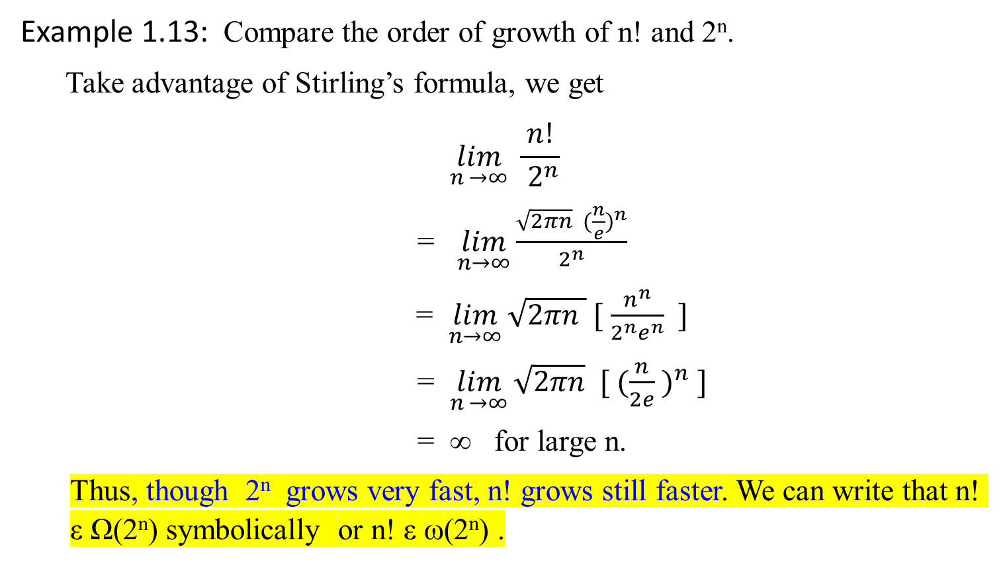
Example 1.13: Compare the order of growth of n! and 2^{n}.
Take advantage of Stirling’s formula, we get
$$\lim_{n →∞}{\frac{ n! }{{ 2}^{n}}}$$
= $\lim_{n→∞}{\frac{\sqrt{2πn} ({\frac{n}{e})}^{n}}{2^{n}}}$
= $\lim_{n→∞}{\sqrt{2πn } [ \frac{n^{n}}{2^{n}e^{n}} ]}$
= $\lim_{n →∞}{\sqrt{2πn} [ ({\frac{n}{2e} )}^{n} ]}$
= ∞ for large n.
Thus, though 2^{n} grows very fast, n! grows still faster. We can write that n! ε Ω(2^{n}) symbolically or n! ε ω(2^{n}) .

Slide 63
Class | Name | Comments / Table 1.2: Basis Efficiency Class
1 | Constant
log n | logarithmic | The result of cutting a problem’s size by a constant factor on each algorithm iteration. Binary search
n | linear | Algorithms that scan a list of size n belong to this class. Sequential search
nlogn | n-log-n | Many of divide-and-conquer algorithms, such as, merge sort, quicksort…
n² | quadratic | Two embedded loops algorithms; insertion sort; certain operation on n-by-n matrices.
n³ | cubic | Three embedded loops algorithms. Several nontrivial algorithms from linear algebra, such as multiplying two n-by-n matrices by the definition-based algorithm.
2^{n} | exponential | Algorithms generate all subsets of an n-element set
n! | factorial | Algorithms generate all permutations of an n-element set

Slide 64
Table 1.3: Values (some approximate) of several functions important for algorithms’ analysis. See how the functions grow as n grows from 10, 10², … 10⁶.
n | log₂ n | n | n log₂ n | n² | n³ | 2^{n} | n!
10 | 3.3 | 10¹ | 3.3*10¹ | 10² | 10³ | 10³ | 3.6*10⁶
10² 10³ | 6.6 | 10² | 6.6*10² | 10⁴ | 10⁶ | 1.3*10³⁰ | 9.3*10¹⁵⁷
 | 10 | 10³ | 1.0*10³ | 10⁶ | 10⁹
10⁴ | 13 | 10⁴ | 1.3*10⁴ | 10⁸ | 10¹²
10⁵ | 17 | 10⁵ | 1.7*10⁵ | 10¹⁰ | 10¹⁵
10⁶ | 20 | 10⁶ | 2.0*10⁶ | 10¹² | 10¹⁸

Slide 65
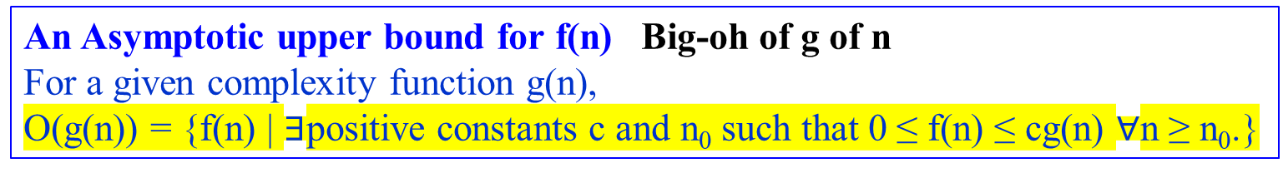
o-notation
The asymptotic upper bound provided by O-notation may or may not be asymptotically tight.
For example, The bound 2n² = O(n²) is asymptotically tight, but
the bound 2n = O(n²) is not.
Use o-notation to denote an upper bound that is not asymptotically tight.
Definition: little-oh of g of n
o(g(n)) = { f(n) | for any positive constant c > 0, there exists a constant
n₀ > 0 such that 0 ≤ f(n) < cg(n), for all n ≥ n₀.}
An Asymptotic upper bound for f(n) Big-oh of g of n
For a given complexity function g(n),
O(g(n)) = {f(n) | $∃$positive constants c and n₀ such that 0 ≤ f(n) ≤ cg(n) $∀$n ≥ n₀.}

Slide 66
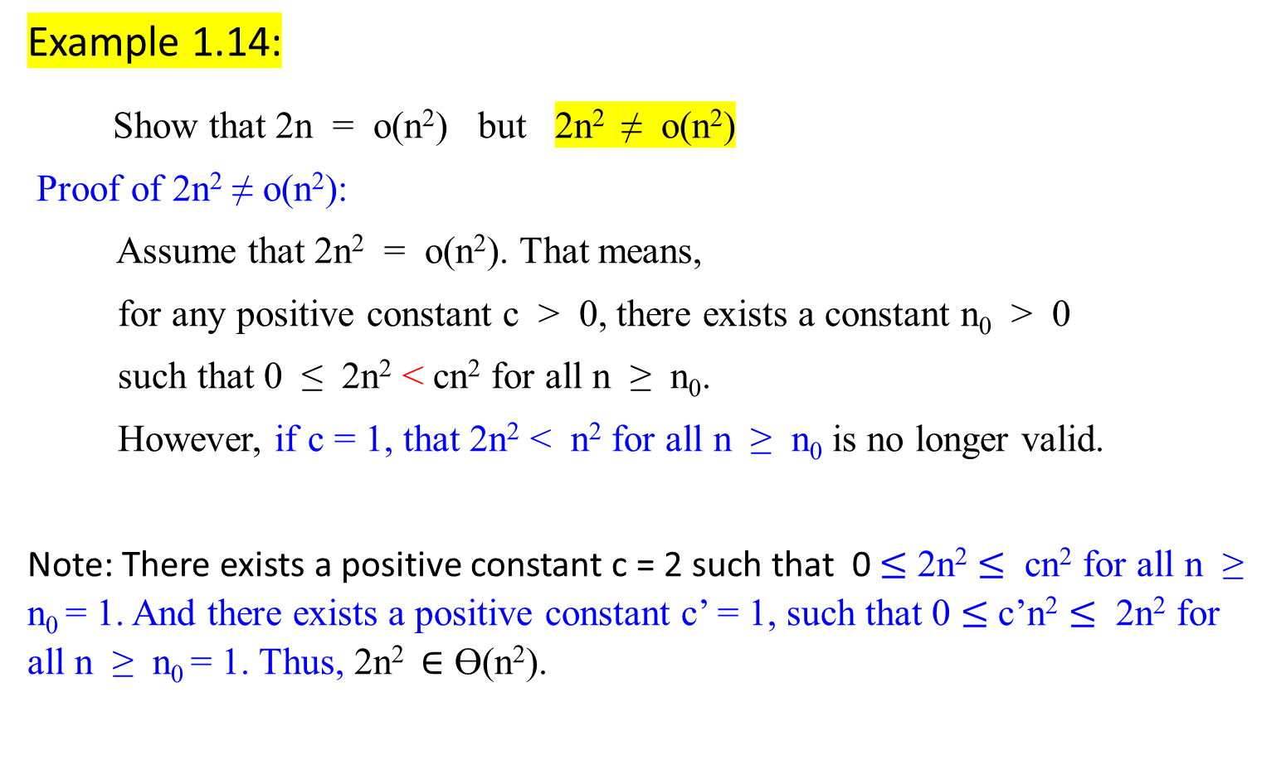
Example 1.14:
Show that 2n = o(n²) but 2n² ≠ o(n²)
Proof of 2n² ≠ o(n²):
Assume that 2n² = o(n²). That means,
for any positive constant c > 0, there exists a constant n₀ > 0
such that 0 ≤ 2n² < cn² for all n ≥ n₀.
However, if c = 1, that 2n² < n² for all n ≥ n₀ is no longer valid.
Note: There exists a positive constant c = 2 such that 0 $≤$ 2n² $≤$ cn² for all n ≥ n₀ = 1. And there exists a positive constant c’ = 1, such that 0 $≤$ c’n² $≤$ 2n² for all n ≥ n₀ = 1. Thus, 2n² $∈$ ϴ(n²).

Slide 67
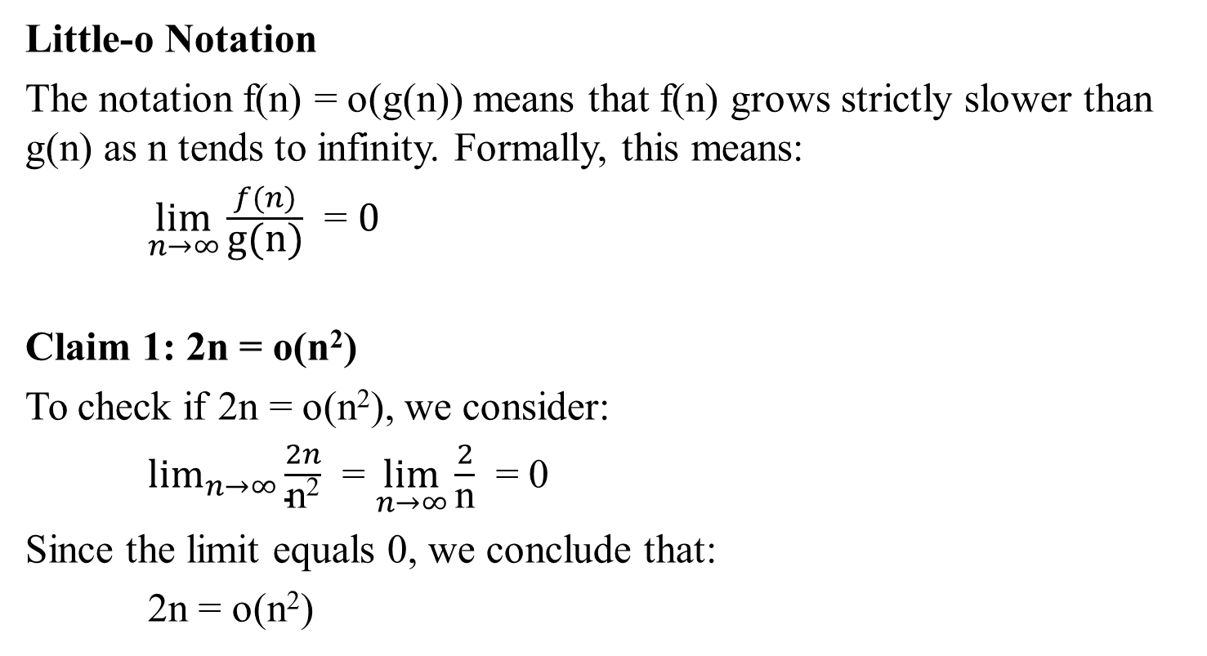
Little-o Notation
The notation f(n) = o(g(n)) means that f(n) grows strictly slower than g(n) as n tends to infinity. Formally, this means:
$\lim_{n→∞}{\frac{f(n)}{\text{g}\text{(}\text{n}\text{)}}}$ = $0$
Claim 1: 2n = o(n²)
To check if 2n = o(n²), we consider:
$\lim_{n→∞}{\frac{2n}{\text{n}\text{2}}}$ = $\lim_{n→∞}{\frac{2}{\text{n}}}$ = 0
Since the limit equals 0, we conclude that:
2n = o(n²)

Slide 68
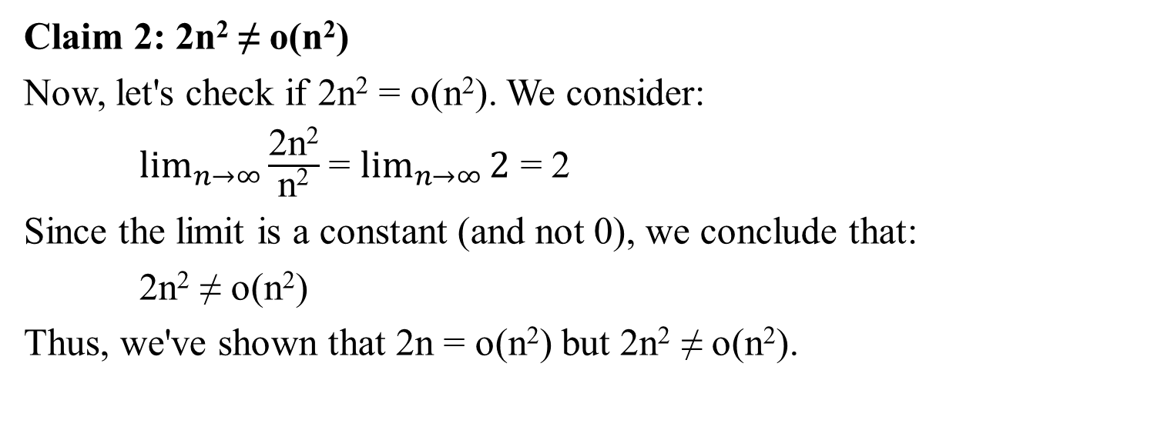
Claim 2: 2n² ≠ o(n²)
Now, let's check if 2n² = o(n²). We consider:
$\lim_{n→∞}{\frac{\text{2}\text{n}\text{2}}{\text{n}\text{2}}}$ = $\lim_{n→∞}{2}$ = 2
Since the limit is a constant (and not 0), we conclude that:
2n² ≠ o(n²)
Thus, we've shown that 2n = o(n²) but 2n² ≠ o(n²).

Slide 69
ω-notation
Use it to denote a lower bound that is not asymptotically tight.
Definition: little-omega of g of n
ω(g(n)) = { f(n) | for any positive constant c > 0, there exists a
constant n₀ > 0 such that 0 ≤ cg(n) < f(n), for all
n ≥ n₀.}
Another way to define it is by
f(n)ε ω(g(n)) if and only if g(n) ε o(f(n)).
Ω(g(n)) = { f(n) | there exist positive constants c and n₀ such that
0 ≤ cg(n) ≤ f(n) for all n ≥ n₀ }.

Slide 70
Example 1.15:
Show that n² / 2 = ω(n) but n² /2 ≠ ω(n²).
  The relation f(n) = ω(g(n)) implies that
    lim _{n → ∞} f(n)/g(n) = ∞,
  if the limit exists.
  i.e., f(n) becomes arbitrarily large relative to g(n) as n approaches infinity.
Proof of n² /2 ≠ ω(n²):
Assume that n² /2 = ω(n²). That means, for any positive constant c > 0, there exists a constant n₀ > 0 such that
0 ≤ c n² < n²/2 for all n ≥ n₀.
However, if c = 1, that n² < n²/2 for all n ≥ n₀ is no longer valid.

Slide 71
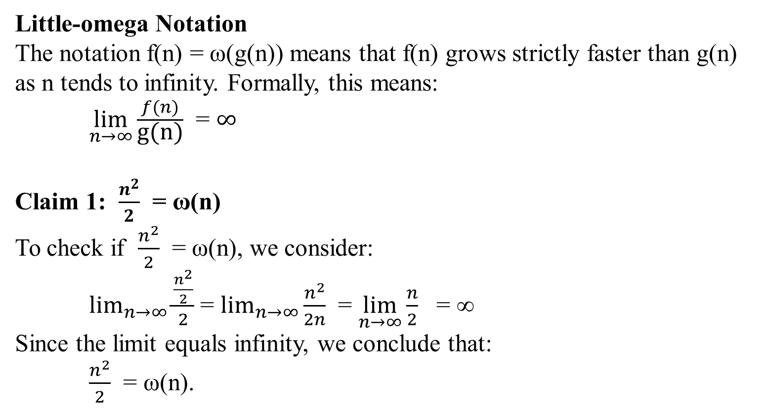
Little-omega Notation
The notation f(n) = ω(g(n)) means that f(n) grows strictly faster than g(n) as n tends to infinity. Formally, this means:
$\lim_{n→∞}{\frac{f(n)}{\text{g}\text{(}\text{n}\text{)}}}$ = $∞$
Claim 1: $\frac{n^{2}}{2}$ ​= ω(n)
To check if $\frac{n^{2}}{2}$ ​= ω(n), we consider:
$\lim_{n→∞}{\frac{\frac{n^{2}}{2}}{2}}$ ​= $\lim_{n→∞}{\frac{n^{2}}{2n}}$ = $\lim_{n→∞}{\frac{n}{2}}$ = ∞
Since the limit equals infinity, we conclude that:
$\frac{n^{2}}{2}$ ​= ω(n).

Slide 72
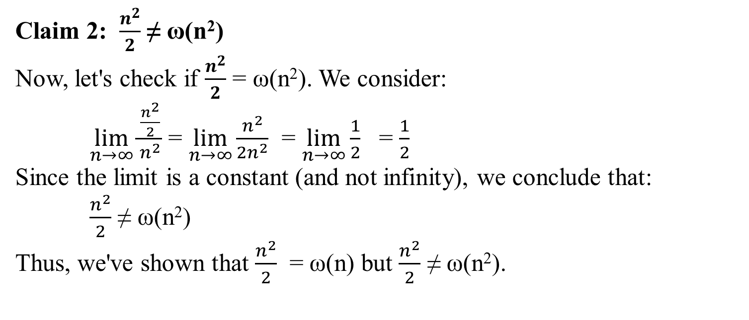
Claim 2: $\frac{n^{2}}{2}$ ≠ ω(n²)
Now, let's check if $\frac{n^{2}}{2}$ = ω(n²). We consider:
$\lim_{n→∞}{\frac{\frac{n^{2}}{2}}{n^{2}}}$ ​= $\lim_{n→∞}{\frac{n^{2}}{2n^{2}}}$ = $\lim_{n→∞}{\frac{1}{2}}$ = $\frac{1}{2}$
​Since the limit is a constant (and not infinity), we conclude that:
$\frac{n^{2}}{2}$ ≠ ω(n²)
Thus, we've shown that $\frac{n^{2}}{2}$ ​= ω(n) but $\frac{n^{2}}{2}$ ≠ ω(n²).

Slide 73
Background:
Standards, Notations,
and Common Functions

