Slide 1
Chapter 09
Introduction to Artificial Intelligence
Inference in First Order Logic (FOL)
aka. predicate calculus

Slide 2
Outline
Reducing first-order inference to propositional inference
Unification
Generalized Modus Ponens
Forward chaining
Backward chaining
Resolution

Slide 4
∧, ∨, ⇒, ⇔, ¬, $∀$, $∃$
First-Order Logic (FOL): Syntax
(specified in Backus-Naur form) ….Recalled
The syntax of the FOL with equality,
Term $→$ Function(Term₁, …, Term_{n} ) | Constant | Variable
AtomicSentence $→$ Predicate | Predicate(Term₁, …, Term_{n}) | Term₁ = Term₂
Sentence $→$ AtomicSentence | ComplexSentence
ComplexSentence $→$ ( Sentence ) | [ Sentence ] | ¬Sentence | Sentence ∧ Sentence | Sentence ∨ Sentence | Sentence ⇒ Sentence | Sentence ⇔ Sentence | Quantifier Variable, … Sentence

Slide 5
∧, ∨, ⇒, ⇔, ¬, $∀$, $∃$
First-Order Logic (FOL) Syntax…
Sentences are built up of terms and atoms:
A term (denoting a real-world object) is a constant symbol, a variable symbol, or a function e.g. left-leg-of ( ). For example, x and f(x₁, ..., x_{n}) are terms, where each x_{i} is a term.
An atom (which has value true or false) is either an n-place predicate of n terms, or, if P and Q are atoms, then ¬ P, P ∨ Q, P ∧ Q, P ⇒ Q, P ⇔ Q are atoms
A sentence is an atom, or, if P is a sentence and x is a variable, then ($∀$x)P and ($∃$x)P are sentences
A well-formed formula (wff) is a sentence containing no "free“ variables. i.e., all variables are "bound" by universal or existential quantifiers.
e.g., ($∀$x)P(x, y) has x bound as a universally quantified variable, but y is free.

Slide 6
Equality
term₁ = term₂ is true under a given interpretation if and only if term₁ and term₂ refer to the same object
e.g., definition of Sibling in terms of Parent:
(∀x,y) Sibling(x, y) ⇔ [¬(x = y) ∧ (∃m, f)( ¬(m = f) ∧ Parent(m, x) ∧ Parent(f, x) ∧ Parent(m, y) ∧ Parent(f, y))]

Slide 7
Using FOL
The kinship domain:
Brothers are siblings
∀x, y Brother(x, y) ⇔ Sibling(x, y)
One's mother is one's female parent
∀m, c Mother(c) = m ⇔ (Female(m) ∧ Parent(m, c))
“Sibling” is symmetric
∀x, y Sibling(x, y) ⇔ Sibling(y, x)

Slide 8
Using FOL
The set domain:
∀s Set(s) ⇔ (s = {} ) ∨ (∃x, s₂ Set(s₂) ∧ s = {x | s₂})
¬∃x, s {x|s} = {}
∀x, s x ∈ s ⇔ s = {x | s}
∀x, s x ∈ s ⇔ [ ∃y, s₂ (s = {y | s₂} ∧ (x = y ∨ x ∈ s₂))]
∀s₁, s₂ s₁ ⊆ s₂ ⇔ (∀x x ∈ s₁ ⇒ x ∈ s₂)
∀s₁, s₂ (s₁ = s₂) ⇔ (s₁ ⊆ s₂ ∧ s₂ ⊆ s₁)
∀x, s₁, s₂ x ∈ (s₁ ∩ s₂) ⇔ (x ∈ s₁ ∧ x ∈ s₂)
∀x, s₁,s ₂ x ∈ (s₁ ∪ s₂) ⇔ (x ∈ s₁ ∨ x ∈ s₂)

Slide 10
Universal instantiation (UI)
Every instantiation of a universally quantified sentence, α, is entailed by α : Let substitution θ be {v₁/g₁, v₂/g₂, …, v_{k}/g_{k}}, where v_{i} for any variable and g_{i}, for any ground term.
A substitution list θ = {v₁/g₁, v₂/g₂, …, v_{k}/g_{k}}, means to replace all occurrences of variable symbol v_{i} by term g_{i}.
Substitutions made in left-to-right order in the list.
subst({x/Cheese, y/Mickey}, eats(y, x)) = eats(Mickey, Cheese)
Let SUBST({v/g}, α) denote the result of applying the substitution θ to the sentence α. The inference rule for universal quantifier is
∀v α SUBST({v/g}, α)
for any variable v and ground term g.
Everyone is greedy. ∀v Greedy(v) $\text{⊨}$ Greedy(John)

Slide 11
Universal instantiation (UI)
For example:
Let KB contains an axiom stating “all greedy kings are evil”:
∀x King(x) ∧ Greedy(x) ⇒ Evil(x)
Three sentences are obtained with the substitutions {x/John}, {x/Richard} and {x/Father(John)}, and {x/Father(Father(John))},
King(John) ∧ Greedy(John) ⇒ Evil(John)
King(Richard) ∧ Greedy(Richard) ⇒ Evil(Richard)
King(Father(John)) ∧ Greedy(Father(John)) ⇒ Evil(Father(John))
King(Father(Father(John))) ∧ Greedy(Father(Father(John))) ⇒ Evil(Father(Father(John)))
etc.
Thus, the process eliminates universal quantifier.

Slide 12
Existential instantiation (EI)
For any sentence α, variable v, and constant symbol k that does not appear elsewhere in the knowledge base:
∃v α
SUBST({v/k}, α)
For example: Let the KB contain a sentence α
∃x Crown(x) ∧ OnHead(x, John) yields:
This can infer the sentence
Crown(C₁) ∧ OnHead(C₁, John)
provided C₁ is a new constant symbol, called a Skolem constant (namely, as long as C₁ does not appear elsewhere in the KB)

Slide 13
Existential instantiation (EI)
∧, ∨, ⇒, ⇔, ¬, $∀$, $∃$
Basically, the existential sentence says
there is some object satisfying a condition, and
apply the existential instantiation rule to give a name to that object, provided that name must not already belong to another object.

Slide 14
Reduction to propositional inference (Propositionalization)
Assume that the KB contains the following:
∀x King(x) ∧ Greedy(x) ⇒ Evil(x)
King(John)
Greedy(John)
Brother(Richard, John)
Instantiating the universal sentence in all possible ways, the new KB is propositionalized: The KB consists only proposition symbols which are :
King(John) ∧ Greedy(John) ⇒ Evil(John)
King(Richard) ∧ Greedy(Richard) ⇒ Evil(Richard)
King(John)
Greedy(John)
Brother(Richard, John)
Then, any of the complete propositional algorithm can be applied to obtain such as Evil(John). E.g., since both King(John) and Greedy(John) are true, we can conclude Evil(John) is true.

Slide 15
Reduction to propositional inference (Propositionalization)
Every FOL KB can be propositionalized so as to preserve entailment
(A ground sentence is entailed by new KB iff entailed by original KB)
Idea: propositionalize KB and query, apply resolution, return result
Problem: with function symbols, there are infinitely many ground terms,
e.g., Father(Father(Father(John)))
Father(… (Father(Father(John))) …)

Slide 16
Reduction to propositional inference (Propositionalization)
Theorem: Herbrand (1930). If a sentence α is entailed by an FOL KB, it is entailed by a finite subset of the propositionalized KB
Idea: For n = 0 to ∞ do
create a propositional KB by instantiating with depth - n of nesting among its ground terms substitution with function symbol until we are able to construct a propositional proof of the entailed sentence. i.e., to see if α is entailed by this KB
Problem: works if α is entailed, loops if α is not entailed since when the KB includes a function symbol, the set of possible ground-term substitutions is infinite. E.g., Father(Father(… (Father(John))…))
Theorem: Both Turing (1936) and Church (1936) proved: the question of entailment for FOL is semidecidable
(algorithms exist that say yes to every entailed sentence, but no algorithm exists that also says no to every non-entailed sentence.)

Slide 17
Reduction to propositional inference (Propositionalization)
We have sketched an approach to first-order inference via propositionalization that is complete; i.e., any entailed sentence can be proved.
This is a major achievement, given that the space of possible models is infinite.
But, what happens when the sentence is not entailed?
For the FOL, it turns out that we are unable to show that the sentence is not entailed.
Reason: Our proof procedure can go on and on, generate more and more deeply nested terms. We sill not know whether it is stuck in a hopeless loop or whether the proof is just about to pop out.

Slide 18
Automated inference for FOL
Automated inference using FOL is harder than PL
Variables can potentially take on an infinite number of possible values from their domains
Hence there are potentially an infinite number of ways to apply the Universal Elimination (i.e., universal instantiation) rule of inference
Godel's Completeness Theorem says that FOL entailment is only semidecidable
If a sentence is true given a set of axioms, there is a procedure that will determine this (i.e., there is a finite deduction (a formal proof) of the sentence.)
If the sentence is false, then there is no guarantee that a procedure will ever determine this —i.e., it may never halt

Slide 19
Problems with Propositionalization
Propositionalization seems to generate lots of irrelevant sentences.
For example: from the KB
∀x King(x) ∧ Greedy(x) ⇒ Evil(x)
King(John)
∀y Greedy(y)
Brother(Richard, John)
it seems obvious that Evil(John), but propositionalization produces lots of facts such as Evil(Richard), Greedy(Richard) that are irrelevant
With p k-ary predicates and n constants, there are p·n^{k} instantiations.

Slide 20
Problems with Propositionalization
A First-Order Inference Rule
For example: from the KB
∀x King(x) ∧ Greedy(x) ⇒ Evil(x)
King(John)
∀y Greedy(y)
Brother(Richard, John)
The inference of Evil(John) from the sentences is as follows: We can conclude that Evil(John) is true. From KB, King(John) states that John is a king. John is greedy because everyone is greedy.
Apply the substitution ground terms for variables, {x/John, y/John} to the implication sentences:
Substitute y/John in the FOL sentence, ∀y Greedy(y), to yield Greedy(John) which is true, because everyone is greedy.
Substitute x/John in the FOL sentence ∀x King(x) ∧ Greedy(x) ⇒ Evil(x) to obtain King(John) ∧ Greedy(John) ⇒ Evil(John). King(John) is given in the KB to be true. That is, true ∧ true ⇒ Evil(John). Thus we conclude that Evil(John) is true.

Slide 22
∧, ∨, ⇒, ⇔, ¬, $∀$, $∃,\text{⊨}$, ⊢_{I}
Generalized Modus Ponens
Modus Ponens (is an inference rule)
P, P ⇒ Q ⊨ Q
Generalized Modus Ponens (GMP) extends this to rules in FOL
Combines And-Introduction, Universal-Elimination, and Modus Ponens, e.g.,
P(c) and Q(c) and $∀$x P(x) ∧ Q(x) ⇒ R(x) derive R(c)
Need to deal with
more than one condition on left side of rule
variables
P, P ⇒ Q
Q
P(c), Q(c), P(c) ∧ Q(c) ⇒ R(c)
R(c)

Slide 23
Generalized Modus Ponens
∧, ∨, ⇒, ⇔, ¬, $∀$, $∃,\text{⊨}$, ⊢_{I}
General case: Given
atomic sentences P₁, P₂, ..., P_{n}
implication sentence (Q₁ ∧ Q₂ ∧ ... ∧ Q_{n}) ⇒ R
Q₁, ..., Q_{N} and R are atomic sentences
substitution SUBST(θ, P_{i}) = SUBST(θ, Q_{i}) for i =1,..., n
Derive new sentence: SUBST(θ, R)
Substitutions
SUBST(θ, α) denotes the result of applying a set of substitutions defined by θ to the sentence α
A substitution list θ = {v₁/t₁, v₂/t₂, ..., v_{n}/t_{n}} means to replace all occurrences of variable symbol v_{i} by term t_{i}
Substitutions made in left-to-right order in the list
SUBST({x/Cheese, y/Mickey}, eats(y, x)) = eats(Mickey, Cheese)

Slide 24
Generalized Modus Ponens (GMP)
For atomic sentences p_{i}, p_{i}', and q where there is a substitution θ, such that SUBST(θ, p_{i}') = SUBST(θ, p_{i}) for all i,
p₁', p₂', … , p_{n}', ( p₁ ∧ p₂ ∧ … ∧ p_{n} ⇒ q)
SUBST(θ, q)
The are n+1 premises to this rule: the n atomic sentences p_{i}' and the one implication. The conclusion is the result of applying the substitution θ to the consequent q.
For example:
p₁' is King(John) p₁ is King(x)
p₂' is Greedy(y) p₂ is Greedy(x)
θ is {x/John, y/John} q is Evil(x)
SUBST(θ, q) is Evil(John)
King(John), Greedy(y), ∀x King(x) ∧ Greedy(x) ⇒ Evil(x)
SUBST(θ, Evil(x))

Slide 25
Generalized Modus Ponens (GMP)
For atomic sentences p_{i}, p_{i}', and q where there is a substitution θ, such that SUBST(θ, p_{i}') = SUBST(θ, p_{i}) for all i,
p₁', p₂', … , p_{n}', ( p₁ ∧ p₂ ∧ … ∧ p_{n} ⇒ q)
SUBST(θ, q)
GMP used with KB of definite clauses (exactly one positive literal)
All variables assumed universally quantified
GMP is lifted version of Modus Ponens:
It raises Modus Ponens from ground (variable-free) propositional logic to first order logic.
The key advantage of lifted inference rules over propositionalization is:
they make only those substitutions that are required to allow particular inferences to proceed.

Slide 26
Soundness of GMP
Need to show that
p₁', …, p_{n}', (p₁ ∧ … ∧ p_{n} ⇒ q) $\text{⊨}$ SUBST(θ, q)
provided that SUBST(θ, p_{i}') = SUBST(θ, p_{i}) for all i .
Lemma: For any sentence p, we have p $\text{⊨}$ SUBST(θ, p) by Universal Instantiation (UI)
Apply UI to the sentences using all the ground terms substitutions θ, $∋$SUBST(θ, p_{i}') = SUBST(θ, p_{i}) for all i to form propositional KB, which consists proposition symbols:
(p₁ ∧ … ∧ p_{n} ⇒ q) $\text{⊨}$ SUBST(θ, (p₁ ∧ … ∧ p_{n} ⇒ q)) = (SUBST(θ, p₁) ∧ … ∧ SUBST(θ, p_{n}) ⇒ SUBST(θ, q)
p₁ ', …, p_{n}' $\text{⊨}$ p₁' ∧ … ∧ p_{n}' $\text{⊨}$ SUBST(θ, p₁') ∧ … ∧ SUBST(θ, p_{n}’), $∋$SUBST(θ, p_{i}') = SUBST(θ, p_{i}) for all i .
From 1 and 2, SUBST(θ, q) follows by ordinary Modus Ponens

Slide 28
Unification
Lifted inference rules requires finding substitutions that make different logical expressions look identical. This process is called unification.
Unification process is a key component of all FO inference algorithms.
The UNIFY algorithm takes two sentences p and q, and returns a unifier θ for them if one exists:
UNIFY(p, q) = θ
where subst(θ, p) = subst(θ, q) for two atomic sentences p and q.

Slide 29
Unification
We can get the inference immediately if we can find a substitution θ such that King(x) and Greedy(x) match King(John) and Greedy(y)
θ = {x/John, y/John} works
Unify(α, β) = θ if subst(θ, α) = subst(θ, β)
Consider Knows(John, x) to be “whom does John know?); Knows(y, Bill) means “everyone knows Bill”, etc. Find all the sentences in KB that unify with Knows(John).
p q θ
Knows(John, x) Knows(John, Jane)
Knows(John, x) Knows(y, Bill)
Knows(John, x) Knows(y, Mother(y))
Knows(John, x) Knows(x, Bill)

Slide 30
Unification
We can get the inference immediately if we can find a substitution θ such that King(x) and Greedy(x) match King(John) and Greedy(y)
θ = {x/John, y/John} works
Unify(α, β) = θ if SUBST(θ, α) = SUBST(θ, β)
p q θ
Knows(John, x) Knows(John, Jane) {x/Jane}
Knows(John, x) Knows(y, Bill)
Knows(John, x) Knows(y, Mother(y))
Knows(John, x) Knows(x, Bill)

Slide 31
Unification
We can get the inference immediately if we can find a substitution θ such that King(x) and Greedy(x) match King(John) and Greedy(y)
θ = {x/John,y/John} works
Unify(α, β) = θ if SUBST(θ, α) = SUBST(θ, β)
p q θ
Knows(John, x) Knows(John, Jane) {x/Jane} Knows(John, x) Knows(y, Bill) {x/Bill, y/John} Knows(John, x) Knows(y, Mother(y))
Knows(John, x) Knows(x, Bill)

Slide 32
Unification
We can get the inference immediately if we can find a substitution θ such that King(x) and Greedy(x) match King(John) and Greedy(y)
θ = {x/John, y/John} works
Unify(α, β) = θ if SUBST(θ, α) = SUBST(θ, β)
p q θ
Knows(John, x) Knows(John, Jane) {x/Jane} Knows(John, x) Knows(y, Bill) {x/Bill, y/John}
Knows(John, x) Knows(y, Mother(y)) {y/John, x/Mother(John)} Knows(John ,x) Knows(x, Bill)

Slide 33
Unification
We can get the inference immediately if we can find a substitution θ such that King(x) and Greedy(x) match King(John) and Greedy(y)
θ = {x/John,y/John} works
Unify(α, β) = θ if SUBST(θ, α) = SUBST(θ, β)
p q θ
Knows(John, x) Knows(John, Jane) {x/Jane}
Knows(John, x) Knows(y, Bill) {x/Bill, y/John}
Knows(John x) Knows(y, Mother(y)) {y/John, x/Mother(John)}
Knows(John, x) Knows(x, Bill) {fail}
Standardizing apart eliminates overlap of variables, e.g., Knows(z₁₇, Bill)

Slide 34
Unification
Unify(α, β) = θ if SUBST(θ, α) = SUBST(θ, β)
p q θ
Knows(John, x) Knows(John, Jane) {x/Jane}
Knows(John, x) Knows(y, Bill) {x/Bill, y/John}
Knows(John x) Knows(y, Mother(y)) {y/John, x/Mother(John)}
Knows(John, x) Knows(x, Bill) {fail}
Knows(x, Bill) means “everyone knows Bill.” so, it can infer that “John knows Bill.”
The problem is that the two sentences happen to use the same variable name x for different objects.
Standardizing apart eliminates overlap of variables, e.g., rename x as a new variable x₂₀ to be Knows(x₂₀, Bill) without changing its meanings.
UNIFY(Knows(John, x), Knows(x₂₀, Bill) ) = {x/Bill, x₂₀ /John}

Slide 35
Unification
To unify Knows(John, x) and Knows(y, z),
θ = {y/John, x/z } or θ = {y/John, x/John, z/John}
The first unifier is more general than the second, because it places fewer restriction on the values of the variables.
For every unifiable pair of express, there is a single most general unifier (MGU) that is unique up to renaming and substitution of variables.
For example, {y/John} and {x/John} are equivalent.
{x/John, y/John} and { x/John, y/z } are equivalent.
In this case, it is { y/John, x/z }.
MGU = { y/John, x/z }

Slide 36
Unification
Unification is a "pattern matching" procedure that takes two atomic sentences, called literals, as input, and returns "failure" if they do not match and a substitution list, θ, if they do match.
i.e., unify(p, q) = θ means subst(θ, p) = subst(θ, q) for two atomic sentences p and q.
θ is called the most general unifier (mgu)
All variables in the given two literals are implicitly universally quantified
To make literals match, replace (universally quantified) variables by terms

Slide 37
The unification algorithm

Slide 38
The unification algorithm

Slide 39
Unification algorithm
procedure unify(p, q, θ)
Scan p and q left-to-right and find the first corresponding terms
where p and q “disagree” (i.e., p and q not equal)
If there is no disagreement, return θ (success!)
Let r and s be the terms in p and q, respectively,
where disagreement first occurs
If variable(r) then {
Let θ = union(θ, {r/s})
Return unify(subst(θ, p), subst(θ, q), θ)
} else if variable(s) then {
Let θ = union(θ, {s/r})
Return unify(subst(θ, p), subst(θ, q), θ)
} else return “Failure”
end

Slide 40
Unification
Examples
Literal 1 | Literal 2 | Literal 3
parents(x, father(x), mother(Bill)) parents(x, father(x), mother(Bill)) parents(x, father(x), mother(Jane)) | parents(Bill, father(Bill), y) parents(Bill, father(y), z) parents(Bill, father(y), mother(y)) | {x/Bill, y/mother(Bill)} {x/Bill, y/Bill, z/mother(Bill)} Failure

Slide 41
Unification
Unify is a linear time algorithm that returns the most general unifier (mgu), i.e., a shortest length substitution list that makes the two literals match.
(In general, there is not a unique minimum length substitution list, but unify returns one of them.)
A variable can never be replaced by a term containing that variable. For example, x/f(x) is illegal.
This "occurs check" should be done in the above pseudocode before making the recursive calls.

Slide 42
More Unification Examples
Make sentences look alike.
Unify p(a, X) and p(a, b)
Unify p(a, X) and p(Y, b)
Unify p(a, X) and p(Y, f(Y))
Unify p(a, X) and p(X, b)
Unify p(a, X) and p(Y, b)
Unify p(a, b) and p(X, X)

Slide 43
More Unification Examples
Unify p(a, X) and p(a, b)
answer: X/b p(a, b)
Unify p(a, X) and p(Y, b)
answer: Y/a, X/b p(a,b)
Unify p(a, X) and p(Y, f(Y))
answer: Y/a, X/f(a) p(a, f(a))

Slide 44
More Unification Examples
Unify p(a, X) and p(X, b)
failure. θ is undefined for X/a and Y/b are not well defined.
Unify p(a, X) and p(Y, b)
answer: Y/a, X/b p(a, b)
Unify p(a, b) and p(X, X)
Failure. θ is undefined for a variable X cannot replace by a and b., i.e., X/a and X/b
Unify p(X, f(Y), b) and P(X, f(b), b)
answer: Y/b this is an mgu
X/b, Y/b this in not an mgu
X can be referred to different mgu.

Slide 45
Most General Unifier (mgu)
If s is any unifier of expressions E and g is the most general unifier of E, then for s applied to E there exists another unifier s’ such that subst(s, E) = subst(s’, subs(g, E)).
Basic idea: Commit a variable to an expression only if you have to; keep it as general as possible.

Slide 46
A statement is in conjunctive normal form if it is a conjunction (sequence of ANDs) consisting of one or more conjuncts, each of which is a disjunction (OR) of one or more literals (i.e., statement letters and negations of statement letters.
Examples of conjunctive normal forms (CNF) include
A
(A ˅ B) ˄ ($¬$A ˅ C)
A ˅ B
A ˄ (B ˅ C)

Slide 47
Horn formulas
Definition
A formula F in CNF is a Horn formula if every disjunction in F contains at most one positive literal.
A disjunction in a Horn formula can equivalently be viewed as an implication K → B where K is a conjunction of atoms or K = T and B is an atom or B = ⊥:
(¬A ∨ ¬B ∨ C) ≡ (A ∧ B → C)
(¬A ∨ ¬B) ≡ (A ∧ B → ⊥)
A ≡ (T → A)

Slide 48
∧, ∨, ⇒, ⇔, ¬, $∀$, $∃,\text{⊨}$, ⊢_{I}
Assume KB are Horn Clauses
A Horn clause is a sentence of the form:
P₁(x) ∧ P₂(x) ∧ ... ∧ P_{n}(x) ⇒ Q(x)
where
the P_{i}s and Q are positive (i.e., non-negated) literals
Equivalently: P₁(x) ∨ P₂(x) … ∨ P_{n}(x) where
the P_{i} are all literals and at most one is positive
Prolog is based on Horn clauses
Horn clauses represent a subset of the set of sentences representable in FOL

Slide 49
∧, ∨, ⇒, ⇔, ¬, $∀$, $∃,\text{⊨}$, ⊢_{I}
Horn Clauses II
Several cases
A fact: Q
Typical rule: P₁ ∧ P₂ ∧ ... ∧ P_{n} ⇒ Q
Constraint: P₁ ∧ P₂ ∧ ... ∧ P_{n} ⇒ false
In Prolog
Q.
Q :- P₁, P₂, ... , P_{n} .
?- P₁, P₂, ... , P_{n} . (only in a query)
These are not Horn clauses:
p(a) ∨ q(a)
(P ∧ Q) ⇒ (R ∨ S)

Slide 50
∧, ∨, ⇒, ⇔, ¬, $∀$, $∃,\text{⊨}$, ⊢_{I}
Horn Clauses III
Where are the quantifiers?
Variables appearing in clauses are universally quantified
Example: grandparent relation
parent(P1, X) ∧ parent(X, P2) ⇒ grandParent(P1, P2)
$∀$ P1, P2, X (parent(P1, X) ∧ parent(X, P2) ⇒ grandParent(P1, P2))
Prolog:
grandParent(P1, P2) :- parent(P1, X), parent(X, P2).

Slide 51
Example knowledge base
The law says that it is a crime for an American to sell weapons to hostile nations. The country Nono, an enemy of America, has some missiles, and all of its missiles were sold to it by Colonel West, who is American.
Prove that Col. West is a criminal

Slide 52
Example knowledge base contd.
... it is a crime for an American to sell weapons to hostile nations:
American(x) ∧ Weapon(y) ∧ Sells(x,y,z) ∧ Hostile(z) ⇒ Criminal(x)
Nono … has some missiles, i.e., ∃x Owns(Nono,x) ∧ Missile(x):
Owns(Nono,M₁) and Missile(M₁)
… all of its missiles were sold to it by Colonel West
Missile(x) ∧ Owns(Nono,x) ⇒ Sells(West,x,Nono)
Missiles are weapons:
Missile(x) ⇒ Weapon(x)
An enemy of America counts as "hostile“:
Enemy(x,America) ⇒ Hostile(x)
West, who is American …
American(West)
The country Nono, an enemy of America …
Enemy(Nono,America)

Slide 53
Forward & Backward Reasoning
We usually talk about two reasoning strategies:
Forward and backward ‘chaining’
Both are equally powerful
You can also have a mixed strategy

Slide 54
Forward Chaining
Proofs start with the given axioms/premises in KB, deriving new sentences using GMP until the goal/query sentence is derived
This defines a forward-chaining inference procedure because it moves “forward” from the KB to the goal [eventually]
Inference using GMP is sound and complete for KBs containing only Horn clauses

Slide 55
Forward chaining algorithm

Slide 56
Forward Chaining Algorithm
Note: Unification, forward chaining algorithm and backward chaining algorithm are in chapter 09 and their example.

Slide 57
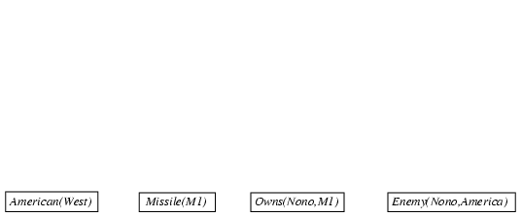
Forward chaining proof

Slide 58
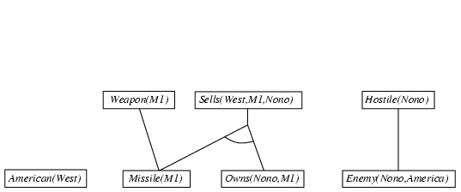
Forward chaining proof

Slide 59
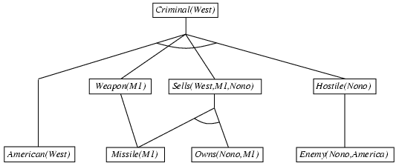
Forward chaining proof

Slide 60
∧, ∨, ⇒, ⇔, ¬, $∀$, $∃,\text{⊨}$, ⊢_{I}
Forward Chaining Example
KB:
allergies(X) ⇒ sneeze(X)
cat(Y) ∧ allergicToCats(X) ⇒ allergies(X)
cat(felix)
allergicToCats(mary)
Goal:
sneeze(mary)

Slide 61
∧, ∨, ⇒, ⇔, ¬, $∀$, $∃,\text{⊨}$, ⊢_{I}
Forward Chaining Example
Example: KB = All cats like fish, cats eat everything they like, and Ziggy
is a cat. In FOL, KB =
1. ($∀$x) cat(x) ⇒ likes(x, Fish)
2. ($∀$x)($∀$y) (cat(x) ∧ likes(x,y)) ⇒ eats(x,y)
3. cat(Ziggy)
• Goal query: Does Ziggy eat fish?
Proof:
1. Use GMP with (1) and (3) to derive: 4. likes(Ziggy, Fish)
2. Use GMP with (3), (4) and (2) to derive eats(Ziggy, Fish)
3. So, yes, Ziggy eats fish.

Slide 62
Properties of forward chaining
Sound and complete for first-order definite clauses
Datalog = first-order definite clauses + no functions
FC terminates for Datalog in finite number of iterations
May not terminate in general if α is not entailed
This is unavoidable: entailment with definite clauses is semidecidable

Slide 63
Efficiency of forward chaining
Incremental forward chaining: no need to match a rule on iteration k if a premise wasn't added on iteration k-1
⇒ match each rule whose premise contains a newly added positive literal
Matching itself can be expensive:
Database indexing allows O(1) retrieval of known facts
e.g., query Missile(x) retrieves Missile(M₁)
Forward chaining is widely used in deductive databases

Slide 64
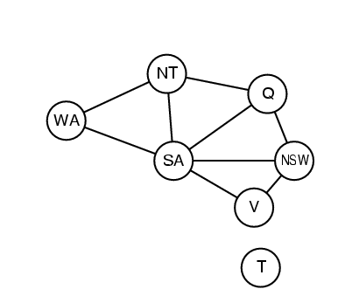
Hard matching example
Diff(wa,nt) ∧ Diff(wa,sa) ∧ Diff(nt,q) ∧ Diff(nt,sa) ∧ Diff(q,nsw) ∧ Diff(q,sa) ∧ Diff(nsw,v) ∧ Diff(nsw,sa) ∧ Diff(v,sa) ⇒ Colorable()
Diff(Red,Blue) Diff (Red,Green) Diff(Green,Red) Diff(Green,Blue) Diff(Blue,Red) Diff(Blue,Green)
Colorable() is inferred iff the CSP has a solution
CSPs include 3SAT as a special case, hence matching is NP-hard

Slide 65
Backward chaining algorithm
SUBST(COMPOSE(θ₁, θ₂), p) = SUBST(θ₂, SUBST(θ₁, p))

Slide 66
Backward Chaining Algorithm
Note: Unification, forward chaining algorithm and backward chaining algorithm are in chapter 09 and their example.

Slide 67
Backward chaining example

Slide 68
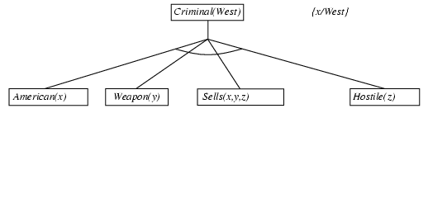
Backward chaining example

Slide 69
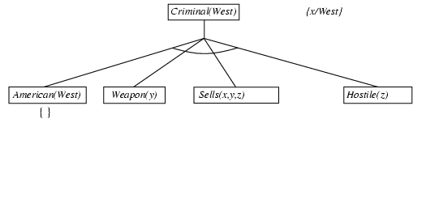
Backward chaining example

Slide 70
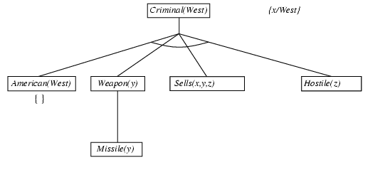
Backward chaining example

Slide 71
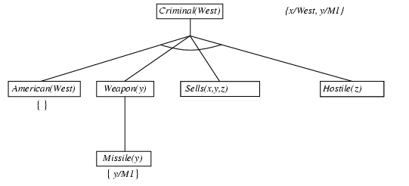
Backward chaining example

Slide 72
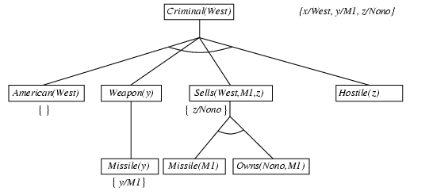
Backward chaining example

Slide 73
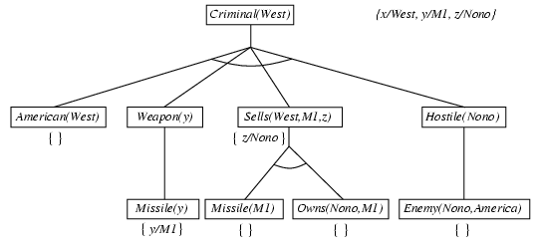
Backward chaining example

Slide 74
Backward chaining example

Slide 75
∧, ∨, ⇒, ⇔, ¬, $∀$, $∃,\text{⊨}$, ⊢_{I}
Backward Chaining Example
KB:
allergies(X) ⇒ sneeze(X)
cat(Y) ∧ allergicToCats(X) ⇒ allergies(X)
cat(felix)
allergicToCats(mary)
Goal:
sneeze(mary)

Slide 76
Properties of backward chaining
Depth-first recursive proof search: space is linear in size of proof
Incomplete due to infinite loops
⇒ fix by checking current goal against every goal on stack
Inefficient due to repeated subgoals (both success and failure)
⇒ fix using caching of previous results (extra space)
Widely used for logic programming

Slide 77
∧, ∨, ⇒, ⇔, ¬, $∀$, $∃,\text{⊨}$, ⊢_{I}
Forward vs Backward Chaining
FC is data-driven
Automatic, unconscious processing
e.g., object recognition, routine decisions
May do lots of work that is irrelevant to the goal
Efficient when you want to compute all conclusions
BC is goal-driven, better for problem-solving
Where are my keys? How do I get to my next class?
Complexity of BC can be much less than linear in the size of the KB
Efficient when you want one or a few decisions

Slide 78
∧, ∨, ⇒, ⇔, ¬, $∀$, $∃,\text{⊨}$, ⊢_{I} , ⇐ ,
Mixed Strategy
Many practical reasoning systems do both forward and backward chaining
The way you encode a rule determines how it is used, as in % this is a forward chaining rule
spouse(X,Y) ⇒ spouse(Y,X).
% this is a backward chaining rule
wife(X,Y) ⇐ spouse(X,Y), female(X).
Given a model of the rules you have and the kind of reason you need to do, it’s possible to decide which to encode as FC and which as BC rules.

Slide 79
∧, ∨, ⇒, ⇔, ¬, $∀$, $∃,\text{⊨}$, ⊢_{I} , ⇐ ,
Completeness of GMP
GMP (using forward or backward chaining) is complete for KBs that contain only Horn clauses
not complete for simple KBs with non-Horn clauses
The following entail that S(A) is true:
($∀$x) P(x) ⇒ Q(x)
($∀$x) ¬ P(x) ⇒ R(x)
($∀$x) Q(x) ⇒ S(x)
($∀$x) R(x) ⇒ S(x)
If we want to conclude S(A), with GMP we cannot, since the second one is not a Horn clause
It is equivalent to P(x) ∨ R(x)

Slide 80
∧, ∨, ⇒, ⇔, ¬, $∀$, $∃,\text{⊨}$, ⊢_{I} , ⇐ ,
Resolution Covers Many Cases
Modes Ponens
from P and P ⇒ Q derive Q
from P and ¬ P ∨ Q derive Q
Chaining
from P ⇒ Q and Q ⇒ R derive P ⇒ R
from (¬ P ∨ Q) and (¬ Q ∨ R) derive ¬ P ∨ R
Contradiction detection
from P and ¬ P derive false
from P and ¬ P derive the empty clause (=false)

Slide 81
∧, ∨, ⇒, ⇔, ¬, $∀$, $∃,\text{⊨}$, ⊢_{I} , ⇐ ,
Resolution in First-Order Logic
Given sentences in conjunctive normal form:
P₁∨ P₂ ∨ … ∨ P_{n} and Q₁∨ Q₂ ∨ … ∨ Q_{m}
P_{i} and Q_{i} are literals, i.e., positive or negated predicate symbol with its terms
if P_{j} and ¬Q_{k} unify with substitution list θ, then derive the resolvent sentence:
subst(θ, P₁∨ … ∨ P_{j-1} ∨ P_{j+1} ∨ … ∨ P_{n} ∨ Q₁∨ … ∨ Q_{k-1}∨ Q_{k+1}∨ … ∨ Q_{m} )
Example
from clause P(x, f(a)) ∨ P(x, f(y)) ∨ Q(y)
and clause ¬ P(z, f(a)) ∨ ¬Q(z)
derive resolvent P(z, f(y)) ∨ Q(y) ∨ ¬Q(z)
Using θ = {x/z}

Slide 82
∧, ∨, ⇒, ⇔, ¬, $∀$, $∃,\text{⊨}$, ⊢_{I} , ⇐ ,
A Resolution Proof Tree
¬P(w) v Q(w) ¬Q(y) v S(y)
¬True v P(x) v R(x)
P(x) v R(x)
¬P(w) v S(w)
¬R(w) v S(w)
S(x) v R(x)
S(A)
P(w) ⇒ Q(w)
Q(y) ⇒ S(y)
(y/w)
P(w) ⇒ S(w)
True ⇒ P(x) ∨ Q(x)
(w/x)
True ⇒ S(x) ∨ R(x)
R(z) ⇒ S(z)
(x/A z/A)
True ⇒ S(A)

Slide 83
∧, ∨, ⇒, ⇔, ¬, $∀$, $∃,\text{⊨}$, ⊢_{I}
Refutation Resolution Proof Tree Example
KB:
allergies(X) ⇒ sneeze(X)
cat(Y) ∧ allergicToCats(X) ⇒ allergies(X)
cat(felix)
allergicToCats(mary)
Goal:
sneeze(mary)

Slide 84
∧, ∨, ⇒, ⇔, ¬, $∀$, $∃,\text{⊨}$, ⊢_{I} , ⇐ ,
Resolution Example
allergies(w) ∨ sneeze(w) ¬ cat(y) ∨ ¬allergicToCats(z) ∨ allergies(z)
w/z
¬ cat(y) ∨ sneeze(z) ∨ ¬allergicToCats(z) cat(felix)
y/felix
sneeze(z) ∨ ¬allergicToCats(z) allergicToCats(mary)
z/mary
sneeze(mary) ¬sneeze(mary)
false
negated query
Notation: old/new

Slide 85
∧, ∨, ⇒, ⇔, ¬, $∀$, $∃,\text{⊨}$, ⊢_{I}
Questions to be Answered
How to convert FOL sentences to conjunctive normal form (a.k.a. CNF, clause form): normalization and skolemization
How to unify two argument lists, i.e., how to find their most general unifier (mgu) q: unification
How to determine which two clauses in KB should be resolved next (among all resolvable pairs of clauses) : resolution (search) strategy

Slide 86
Logic programming: Prolog
Algorithm = Logic + Control
Basis: backward chaining with Horn clauses + bells & whistles
Widely used in Europe, Japan (basis of 5th Generation project)
Compilation techniques ⇒ 60 million LIPS
Program = set of clauses = head :- literal₁, … literal_{n}.
criminal(X) :- american(X), weapon(Y), sells(X,Y,Z), hostile(Z).
Depth-first, left-to-right backward chaining
Built-in predicates for arithmetic etc., e.g., X is Y*Z+3
Built-in predicates that have side effects (e.g., input and output
predicates, assert/retract predicates)
Closed-world assumption ("negation as failure")
e.g., given alive(X) :- not dead(X).
alive(joe) succeeds if dead(joe) fails

Slide 87
Prolog
Appending two lists to produce a third:
append([],Y,Y).
append([X|L],Y,[X|Z]) :- append(L,Y,Z).
query: append(A,B,[1,2]) ?
answers: A=[] B=[1,2]
A=[1] B=[2]
A=[1,2] B=[]

Slide 88
Resolution: brief summary
Full first-order version:
l₁ ∨ ··· ∨ l_{k}, m₁ ∨ ··· ∨ m_{n}
(l₁ ∨ ··· ∨ l_{i-1} ∨ l_{i+1} ∨ ··· ∨ l_{k} ∨ m₁ ∨ ··· ∨ m_{j-1} ∨ m_{j+1} ∨ ··· ∨ m_{n})θ
where Unify(l_{i}, ¬m_{j}) = θ.
The two clauses are assumed to be standardized apart so that they share no variables.
For example,
¬Rich(x) ∨ Unhappy(x)
Rich(Ken)
Unhappy(Ken)
with θ = {x/Ken}
Apply resolution steps to CNF(KB ∧ ¬α); complete for FOL

Slide 89
Conversion to CNF
Everyone who loves all animals is loved by someone:
∀x [∀y Animal(y) ⇒ Loves(x,y)] ⇒ [∃y Loves(y,x)]
1. Eliminate biconditionals and implications
∀x [¬∀y ¬Animal(y) ∨ Loves(x,y)] ∨ [∃y Loves(y,x)]
2. Move ¬ inwards: ¬∀x p ≡ ∃x ¬p, ¬ ∃x p ≡ ∀x ¬p
∀x [∃y ¬(¬Animal(y) ∨ Loves(x,y))] ∨ [∃y Loves(y,x)]
∀x [∃y ¬¬Animal(y) ∧ ¬Loves(x,y)] ∨ [∃y Loves(y,x)]
∀x [∃y Animal(y) ∧ ¬Loves(x,y)] ∨ [∃y Loves(y,x)]

Slide 90
Conversion to CNF contd.
Standardize variables: each quantifier should use a different one
∀x [∃y Animal(y) ∧ ¬Loves(x,y)] ∨ [∃z Loves(z,x)]
Skolemize: a more general form of existential instantiation.
Each existential variable is replaced by a Skolem function of the enclosing universally quantified variables:
∀x [Animal(F(x)) ∧ ¬Loves(x,F(x))] ∨ Loves(G(x),x)
Drop universal quantifiers:
[Animal(F(x)) ∧ ¬Loves(x,F(x))] ∨ Loves(G(x),x)
6. Distribute ∨ over ∧ :
[Animal(F(x)) ∨ Loves(G(x),x)] ∧ [¬Loves(x,F(x)) ∨ Loves(G(x),x)]

Slide 91
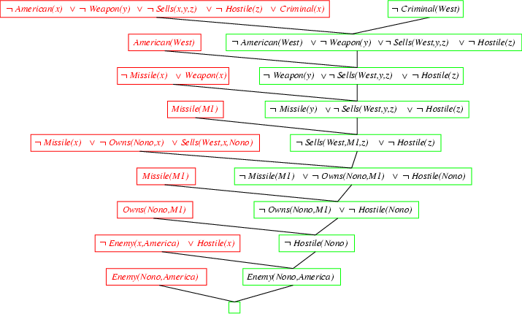
Resolution proof: definite clauses

