Slide 1
Chapter 01
Introduction to Artificial Intelligence

Slide 2
Inference in first-order logic
Chapter 9

Slide 3
Outline
Reducing first-order inference to propositional inference
Unification
Generalized Modus Ponens
Forward chaining
Backward chaining
Resolution

Slide 4
Universal instantiation (UI)
Every instantiation of a universally quantified sentence, α, is entailed by α : Let substitution θ be {v₁/g₁, v₂/g₂, …, v_{k}/g_{k}}, where v_{i} for any variable and g_{i}, for any ground term.
A substitution list θ = {v₁/g₁, v₂/g₂, …, v_{k}/g_{k}}, means to replace all occurrences of variable symbol v_{i} by term g_{i}.
Substitutions made in left-to-right order in the list.
subst({x/Cheese, y/Mickey}, eats(y, x)) = eats(Mickey, Cheese)
Let SUBST({v/g}, α) denote the result of applying the substitution θ to the sentence α. The inference rule for universal quantifier is
∀v α SUBST({v/g}, α)
for any variable v and ground term g.

Slide 5
Universal instantiation (UI)
For example:
Let KB contains an axiom stating “all greedy kings are evil”:
∀x King(x) ∧ Greedy(x) ⇒ Evil(x)
Three sentences are obtained with the substitutions {x/John}, {x/Richard} and {x/Father(John)}
King(John) ∧ Greedy(John) ⇒ Evil(John)
King(Richard) ∧ Greedy(Richard) ⇒ Evil(Richard)
King(Father(John)) ∧ Greedy(Father(John)) ⇒ Evil(Father(John))
.
.
.

Slide 6
Existential instantiation (EI)
For any sentence α, variable v, and constant symbol k that does not appear elsewhere in the knowledge base:
∃v α
SUBST({v/k}, α)
For example: Let the KB contain a sentence α
∃x Crown(x) ∧ OnHead(x,John) yields:
This can infer the sentence
Crown(C₁) ∧ OnHead(C₁,John)
provided C₁ is a new constant symbol, called a Skolem constant (namely, as long as C does not appear elsewhere in the KB)

Slide 7
Existential instantiation (EI)
∧, ∨, ⇒, ⇔, ¬, $∀$, $∃$
Basically, the existential sentence says there is some object satisfying a condition, and apply the existential instantiation rule just gives a name to that object, provided hat name must not already belong to another object.

Slide 8
Reduction to propositional inference (Propositionalization)
Suppose the KB containing just the following:
∀x King(x) ∧ Greedy(x) ⇒ Evil(x)
King(John)
Greedy(John)
Brother(Richard, John)
Instantiating the universal sentence in all possible ways, the new KB is propositionalized: proposition symbols are :
King(John) ∧ Greedy(John) ⇒ Evil(John)
King(Richard) ∧ Greedy(Richard) ⇒ Evil(Richard)
King(John)
Greedy(John)
Brother(Richard, John)
Then, any of the complete propositional algorithm can be applied to obtain such as Evil(John).

Slide 9
Reduction to propositional inference (Propositionalization)
Every FOL KB can be propositionalized so as to preserve entailment
(A ground sentence is entailed by new KB iff entailed by original KB)
Idea: propositionalize KB and query, apply resolution, return result
Problem: with function symbols, there are infinitely many ground terms,
e.g., Father(Father(Father(John)))

Slide 10
Reduction to propositional inference (Propositionalization)
Theorem: Herbrand (1930). If a sentence α is entailed by an FOL KB, it is entailed by a finite subset of the propositionalized KB
Idea: For n = 0 to ∞ do
create a propositional KB by instantiating with depth - n of nesting among its ground terms substitution with function symbol until we are able to construct a propositional proof of the entailed sentence. i.e., to see if α is entailed by this KB
Problem: works if α is entailed, loops if α is not entailed since when the KB includes a function symbol, the set of possible ground-term substitutions is infinite. E.g., Father(Father(… (Father(John))…))
Theorem: Both Turing (1936) and Church (1936) proved: the question of entailment for FOL is semidecidable
(algorithms exist that say yes to every entailed sentence, but no algorithm exists that also says no to every non-entailed sentence.)

Slide 11
Automated inference for FOL
Automated inference using FOL is harder than PL
Variables can potentially take on an infinite number of possible values from their domains
Hence there are potentially an infinite number of ways to apply the Universal Elimination rule of inference
Godel's Completeness Theorem says that FOL entailment is only semidecidable
If a sentence is true given a set of axioms, there is a procedure that will determine this
If the sentence is false, then there is no guarantee that a procedure will ever determine this —i.e., it may never halt

Slide 12
Problems with Propositionalization
Propositionalization seems to generate lots of irrelevant sentences.
For example: from the KB
∀x King(x) ∧ Greedy(x) ⇒ Evil(x)
King(John)
∀y Greedy(y)
Brother(Richard, John)
it seems obvious that Evil(John), but propositionalization produces lots of facts such as Evil(Richard), Greedy(Richard) that are irrelevant
With p k-ary predicates and n constants, there are p·n^{k} instantiations.

Slide 13
Problems with Propositionalization
A First-Order Inference Rule
For example: from the KB
∀x King(x) ∧ Greedy(x) ⇒ Evil(x)
King(John)
∀y Greedy(y)
Brother(Richard, John)
The inference of Evil(John) from the sentences as follows: We can conclude that Evil(John) is true. King(John) states that John is a king. John is greedy because everyone is greedy.
Apply the substitution ground terms for variables, {x/John, y/John} to the implication sentences:
Substitute y/John in the FO sentence ∀y Greedy(y) to yield Greedy(John) which is true, because everyone is greedy.
Substitute x/John in the FO sentence ∀x King(x) ∧ Greedy(x) ⇒ Evil(x) to obtain King(John) ∧ Greedy(John) ⇒ Evil(John). King(John) is given in the KB to be true. That is, true ∧ true ⇒ Evil(John). Thus we conclude that Evil(John) is true.

Slide 14
∧, ∨, ⇒, ⇔, ¬, $∀$, $∃,\text{⊨}$, ⊢_{I}
Generalized Modus Ponens
Modus Ponens
P, P ⇒ Q ⊨ Q
Generalized Modus Ponens (GMP) extends this to rules in FOL
Combines And-Introduction, Universal-Elimination, and Modus Ponens, e.g.,
from P(c) and Q(c) and $∀$x P(x) ∧ Q(x) ⇒ R(x) derive R(c)
Need to deal with
more than one condition on left side of rule
variables

Slide 15
Generalized Modus Ponens
∧, ∨, ⇒, ⇔, ¬, $∀$, $∃,\text{⊨}$, ⊢_{I}
General case: Given
atomic sentences P₁, P₂, ..., P_{N}
implication sentence (Q₁ ∧ Q₂ ∧ ... ∧ Q_{N}) ⇒ R
Q₁, ..., Q_{N} and R are atomic sentences
substitution subst(θ, P_{i}) = subst(θ, Q_{i}) for i=1,...,N
Derive new sentence: subst(θ, R)
Substitutions
subst(θ, α) denotes the result of applying a set of substitutions defined by θ to the sentence α
A substitution list θ = {v₁/t₁, v₂/t₂, ..., v_{n}/t_{n}} means to replace all occurrences of variable symbol vi by term ti
Substitutions made in left-to-right order in the list
subst({x/Cheese, y/Mickey}, eats(y, x)) = eats(Mickey, Cheese)

Slide 16
Generalized Modus Ponens (GMP)
For atomic sentences p_{i}, p_{i}', and q where there is a substitution θ, such that SUBST(θ, p_{i}') = SUBST(θ, p_{i}) for all i,
p₁', p₂', … , p_{n}', ( p₁ ∧ p₂ ∧ … ∧ p_{n} ⇒ q)
SUBST(θ, q)
The are n+1 premises to this rule: the n atomic sentences p_{i}' and the one implication. The conclusion is the result of applying the substitution θ to the consequent q.
For example:
p₁' is King(John) p₁ is King(x)
p₂' is Greedy(y) p₂ is Greedy(x)
θ is {x/John,y/John} q is Evil(x)
SUBST(θ, q) is Evil(John)

Slide 17
Generalized Modus Ponens (GMP)
For atomic sentences p_{i}, p_{i}', and q where there is a substitution θ, such that SUBST(θ, p_{i}') = SUBST(θ, p_{i}) for all i,
p₁', p₂', … , p_{n}', ( p₁ ∧ p₂ ∧ … ∧ p_{n} ⇒ q)
SUBST(θ, q)
GMP used with KB of definite clauses (exactly one positive literal)
All variables assumed universally quantified

Slide 18
Soundness of GMP
Need to show that
p₁', …, p_{n}', (p₁ ∧ … ∧ p_{n} ⇒ q) $\text{⊨}$ SUBST(θ, q)
provided that SUBST(θ, p_{i}') = SUBST(θ, p_{i}) for all i .
Lemma: For any sentence p, we have p $\text{⊨}$ SUBST(θ, p) by Universal Instantiation (UI)
(p₁ ∧ … ∧ p_{n} ⇒ q) $\text{⊨}$ SUBST(θ, (p₁ ∧ … ∧ p_{n} ⇒ q)) = (SUBST(θ, p₁) ∧ … ∧ SUBST(θ, p_{n}) ⇒ SUBST(θ, q)
p₁'; …; p_{n}’ $\text{⊨}$ p₁' ∧ … ∧ p_{n}' $\text{⊨}$ SUBST(θ, p₁') ∧ … ∧ SUBST(θ, p_{n}')
From 1 and 2, SUBST(θ, q) follows by ordinary Modus Ponens

Slide 19
Unification
We can get the inference immediately if we can find a substitution θ such that King(x) and Greedy(x) match King(John) and Greedy(y)
θ = {x/John, y/John} works
Unify(α, β) = θ if subst(θ, α) = subst(θ, β)
Consider Knows(John, x) to be “whom does John know?); Knows(y, Bill) means “everyone knows Bill”, etc. Find all the sentences in KB that unify with Knows(John).
p q θ
Knows(John, x) Knows(John, Jane)
Knows(John, x) Knows(y, Bill)
Knows(John, x) Knows(y, Mother(y))
Knows(John, x) Knows(x, Bill)

Slide 20
Unification
We can get the inference immediately if we can find a substitution θ such that King(x) and Greedy(x) match King(John) and Greedy(y)
θ = {x/John, y/John} works
Unify(α, β) = θ if SUBST(θ, α) = SUBST(θ, β)
p q θ
Knows(John, x) Knows(John, Jane) {x/Jane}
Knows(John, x) Knows(y, Bill)
Knows(John, x) Knows(y, Mother(y))
Knows(John, x) Knows(x, Bill)

Slide 21
Unification
We can get the inference immediately if we can find a substitution θ such that King(x) and Greedy(x) match King(John) and Greedy(y)
θ = {x/John,y/John} works
Unify(α, β) = θ if SUBST(θ, α) = SUBST(θ, β)
p q θ
Knows(John, x) Knows(John, Jane) {x/Jane} Knows(John, x) Knows(y, Bill) {x/Bill, y/John} Knows(John, x) Knows(y, Mother(y))
Knows(John, x) Knows(x, Bill)

Slide 22
Unification
We can get the inference immediately if we can find a substitution θ such that King(x) and Greedy(x) match King(John) and Greedy(y)
θ = {x/John, y/John} works
Unify(α, β) = θ if SUBST(θ, α) = SUBST(θ, β)
p q θ
Knows(John, x) Knows(John, Jane) {x/Jane} Knows(John, x) Knows(y, Bill) {x/Bill, y/John}
Knows(John, x) Knows(y, Mother(y)) {y/John, x/Mother(John)} Knows(John ,x) Knows(x, Bill)

Slide 23
Unification
We can get the inference immediately if we can find a substitution θ such that King(x) and Greedy(x) match King(John) and Greedy(y)
θ = {x/John,y/John} works
Unify(α, β) = θ if SUBST(θ, α) = SUBST(θ, β)
p q θ
Knows(John, x) Knows(John, Jane) {x/Jane}
Knows(John, x) Knows(y, Bill) {x/Bill, y/John}
Knows(John x) Knows(y, Mother(y)) {y/John, x/Mother(John)}
Knows(John, x) Knows(x, Bill) {fail}
Standardizing apart eliminates overlap of variables, e.g., Knows(z₁₇, Bill)

Slide 24
Unification
Unify(α, β) = θ if SUBST(θ, α) = SUBST(θ, β)
p q θ
Knows(John, x) Knows(John, Jane) {x/Jane}
Knows(John, x) Knows(y, Bill) {x/Bill, y/John}
Knows(John x) Knows(y, Mother(y)) {y/John, x/Mother(John)}
Knows(John, x) Knows(x, Bill) {fail}
Knows(x, Bill) means “everyone knows Bill.” so, it can infer that “John knows Bill.”
The problem is that the two sentences happen to use the same variable name x for different objects.
Standardizing apart eliminates overlap of variables, e.g., rename x as a new variable x₂₀ to be Knows(x₂₀, Bill) without changing its meanings.
UNIFY(Knows(John, x), Knows(x₂₀, Bill) ) = {x/Bill, x₂₀ /John}

Slide 25
Unification
To unify Knows(John, x) and Knows(y, z),
θ = {y/John, x/z } or θ = {y/John, x/John, z/John}
The first unifier is more general than the second, because it places fewer restriction on the values of the variables.
For every unifiable pair of express, there is a single most general unifier (MGU) that is unique up to renaming and substitution of variables.
For example, {y/John} and {x/John} are equivalent.
{x/John, y/John} and { x/John, y/z } are equivalent.
In this case, it is { y/John, x/z }.
MGU = { y/John, x/z }

Slide 26
The unification algorithm

Slide 27
The unification algorithm

Slide 28
Generalized Modus Ponens (GMP)
where p_{i}'θ = p_{i} θ for all i
p₁', p₂', … , p_{n}', ( p₁ ∧ p₂ ∧ … ∧ p_{n} ⇒q)
qθ
p₁' is King(John) p₁ is King(x)
p₂' is Greedy(y) p₂ is Greedy(x)
θ is {x/John,y/John} q is Evil(x)
q θ is Evil(John)
GMP used with KB of definite clauses (exactly one positive literal)
All variables assumed universally quantified

Slide 29
Soundness of GMP
Need to show that
p₁', …, p_{n}', (p₁ ∧ … ∧ p_{n} ⇒ q) ╞ qθ
provided that p_{i}'θ = p_{i}θ for all I
Lemma: For any sentence p, we have p ╞ pθ by UI
(p₁ ∧ … ∧ p_{n} ⇒ q) ╞ (p₁ ∧ … ∧ p_{n} ⇒ q)θ = (p₁θ ∧ … ∧ p_{n}θ ⇒ qθ)
p₁', \; …, \;p_{n}' ╞ p₁' ∧ … ∧ p_{n}' ╞ p₁'θ ∧ … ∧ p_{n}'θ
From 1 and 2, qθ follows by ordinary Modus Ponens

Slide 30
Example knowledge base
The law says that it is a crime for an American to sell weapons to hostile nations. The country Nono, an enemy of America, has some missiles, and all of its missiles were sold to it by Colonel West, who is American.
Prove that Col. West is a criminal

Slide 31
Example knowledge base contd.
... it is a crime for an American to sell weapons to hostile nations:
American(x) ∧ Weapon(y) ∧ Sells(x,y,z) ∧ Hostile(z) ⇒ Criminal(x)
Nono … has some missiles, i.e., ∃x Owns(Nono,x) ∧ Missile(x):
Owns(Nono,M₁) and Missile(M₁)
… all of its missiles were sold to it by Colonel West
Missile(x) ∧ Owns(Nono,x) ⇒ Sells(West,x,Nono)
Missiles are weapons:
Missile(x) ⇒ Weapon(x)
An enemy of America counts as "hostile“:
Enemy(x,America) ⇒ Hostile(x)
West, who is American …
American(West)
The country Nono, an enemy of America …
Enemy(Nono,America)

Slide 32
Forward chaining algorithm

Slide 33
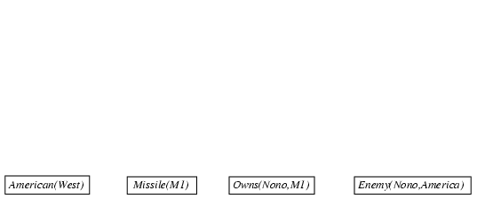
Forward chaining proof

Slide 34
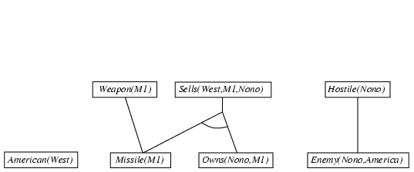
Forward chaining proof

Slide 35
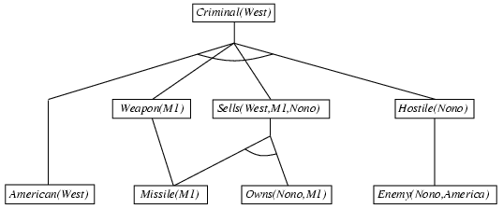
Forward chaining proof

Slide 36
Properties of forward chaining
Sound and complete for first-order definite clauses
Datalog = first-order definite clauses + no functions
FC terminates for Datalog in finite number of iterations
May not terminate in general if α is not entailed
This is unavoidable: entailment with definite clauses is semidecidable

Slide 37
Efficiency of forward chaining
Incremental forward chaining: no need to match a rule on iteration k if a premise wasn't added on iteration k-1
⇒ match each rule whose premise contains a newly added positive literal
Matching itself can be expensive:
Database indexing allows O(1) retrieval of known facts
e.g., query Missile(x) retrieves Missile(M₁)
Forward chaining is widely used in deductive databases

Slide 38
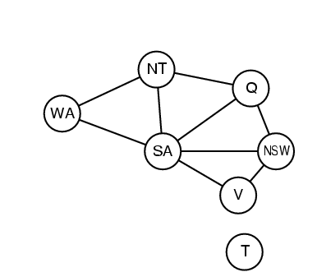
Hard matching example
Diff(wa,nt) ∧ Diff(wa,sa) ∧ Diff(nt,q) ∧ Diff(nt,sa) ∧ Diff(q,nsw) ∧ Diff(q,sa) ∧ Diff(nsw,v) ∧ Diff(nsw,sa) ∧ Diff(v,sa) ⇒ Colorable()
Diff(Red,Blue) Diff (Red,Green) Diff(Green,Red) Diff(Green,Blue) Diff(Blue,Red) Diff(Blue,Green)
Colorable() is inferred iff the CSP has a solution
CSPs include 3SAT as a special case, hence matching is NP-hard

Slide 39
Backward chaining algorithm
SUBST(COMPOSE(θ₁, θ₂), p) = SUBST(θ₂, SUBST(θ₁, p))

Slide 40
Backward chaining example

Slide 41
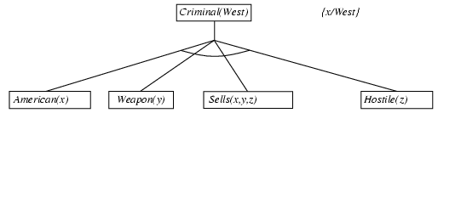
Backward chaining example

Slide 42
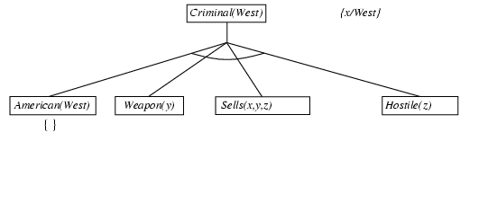
Backward chaining example

Slide 43
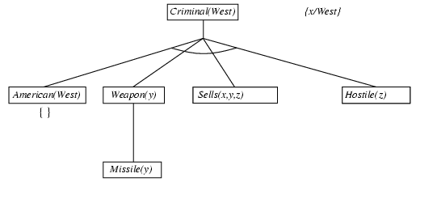
Backward chaining example

Slide 44
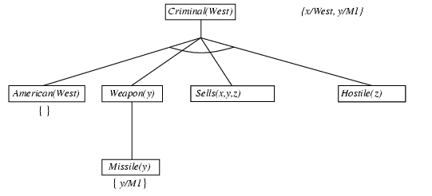
Backward chaining example

Slide 45
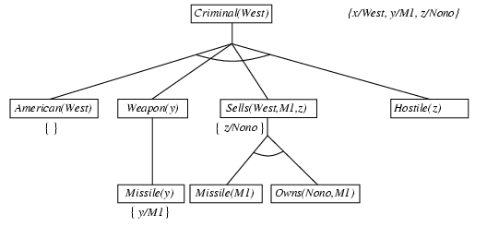
Backward chaining example

Slide 46
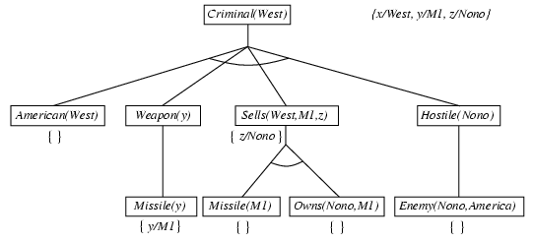
Backward chaining example

Slide 47
Backward chaining example

Slide 48
Properties of backward chaining
Depth-first recursive proof search: space is linear in size of proof
Incomplete due to infinite loops
⇒ fix by checking current goal against every goal on stack
Inefficient due to repeated subgoals (both success and failure)
⇒ fix using caching of previous results (extra space)
Widely used for logic programming

Slide 49
Logic programming: Prolog
Algorithm = Logic + Control
Basis: backward chaining with Horn clauses + bells & whistles
Widely used in Europe, Japan (basis of 5th Generation project)
Compilation techniques ⇒ 60 million LIPS
Program = set of clauses = head :- literal₁, … literal_{n}.
criminal(X) :- american(X), weapon(Y), sells(X,Y,Z), hostile(Z).
Depth-first, left-to-right backward chaining
Built-in predicates for arithmetic etc., e.g., X is Y*Z+3
Built-in predicates that have side effects (e.g., input and output
predicates, assert/retract predicates)
Closed-world assumption ("negation as failure")
e.g., given alive(X) :- not dead(X).
alive(joe) succeeds if dead(joe) fails

Slide 50
Prolog
Appending two lists to produce a third:
append([],Y,Y).
append([X|L],Y,[X|Z]) :- append(L,Y,Z).
query: append(A,B,[1,2]) ?
answers: A=[] B=[1,2]
A=[1] B=[2]
A=[1,2] B=[]

Slide 51
Resolution: brief summary
Full first-order version:
l₁ ∨ ··· ∨ l_{k}, m₁ ∨ ··· ∨ m_{n}
(l₁ ∨ ··· ∨ l_{i-1} ∨ l_{i+1} ∨ ··· ∨ l_{k} ∨ m₁ ∨ ··· ∨ m_{j-1} ∨ m_{j+1} ∨ ··· ∨ m_{n})θ
where Unify(l_{i}, ¬m_{j}) = θ.
The two clauses are assumed to be standardized apart so that they share no variables.
For example,
¬Rich(x) ∨ Unhappy(x)
Rich(Ken)
Unhappy(Ken)
with θ = {x/Ken}
Apply resolution steps to CNF(KB ∧ ¬α); complete for FOL

Slide 52
Conversion to CNF
Everyone who loves all animals is loved by someone:
∀x [∀y Animal(y) ⇒ Loves(x,y)] ⇒ [∃y Loves(y,x)]
1. Eliminate biconditionals and implications
∀x [¬∀y ¬Animal(y) ∨ Loves(x,y)] ∨ [∃y Loves(y,x)]
2. Move ¬ inwards: ¬∀x p ≡ ∃x ¬p, ¬ ∃x p ≡ ∀x ¬p
∀x [∃y ¬(¬Animal(y) ∨ Loves(x,y))] ∨ [∃y Loves(y,x)]
∀x [∃y ¬¬Animal(y) ∧ ¬Loves(x,y)] ∨ [∃y Loves(y,x)]
∀x [∃y Animal(y) ∧ ¬Loves(x,y)] ∨ [∃y Loves(y,x)]

Slide 53
Conversion to CNF contd.
Standardize variables: each quantifier should use a different one
∀x [∃y Animal(y) ∧ ¬Loves(x,y)] ∨ [∃z Loves(z,x)]
Skolemize: a more general form of existential instantiation.
Each existential variable is replaced by a Skolem function of the enclosing universally quantified variables:
∀x [Animal(F(x)) ∧ ¬Loves(x,F(x))] ∨ Loves(G(x),x)
Drop universal quantifiers:
[Animal(F(x)) ∧ ¬Loves(x,F(x))] ∨ Loves(G(x),x)
6. Distribute ∨ over ∧ :
[Animal(F(x)) ∨ Loves(G(x),x)] ∧ [¬Loves(x,F(x)) ∨ Loves(G(x),x)]

Slide 54
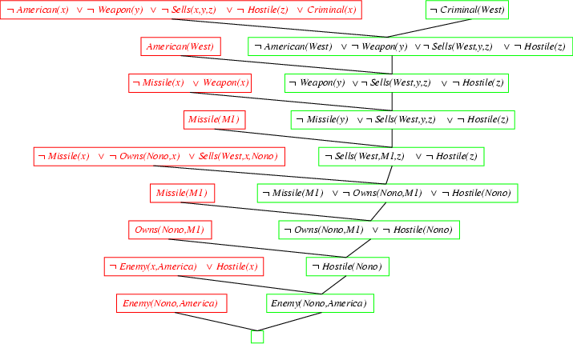
Resolution proof: definite clauses

