Slide 1
Chapter 07_04 part b
Introduction to Artificial Intelligence
Propositional Logic (PL)

Slide 2
Outline
Knowledge-based agents
Wumpus world
Logic in general - models and entailment
Propositional (Boolean) logic
Equivalence, validity, satisfiability
Inference rules and theorem proving
forward chaining
backward chaining
resolution

Slide 3
Forward and backward chaining

Slide 4
Horn Clauses and Definite Clauses
Some real-world knowledge bases satisfy certain restrictions on the form of sentences they contain.
This restricted form enables them(sentences) to use a more restricted and efficient inference algorithm.
One such restricted form is the definite clause.
A definite clause is a disjunction of literals of which exactly one is positive.
For example, the clause (¬L_{1,1} ∨ ¬Breeze ∨ B_{1,1}) is a definite clause, so is (B_{1,1} ∨ ¬ P_{1,2} ∨ ¬ P_{2,1}), but (¬B_{1,1} ∨ P_{1,2} ∨ P_{2,1}), (¬ P_{1,2} ∨ ¬ P_{2,1}), and ¬B_{1,1} are not definite clauses.
Definite clause: (conjunction of symbols) ⇒ symbol, such as implication p₁ ∧ … ∧ p_{n} ⇒ p, given (¬p₁ ∨ ¬p₂ ∨ … ∨ ¬p_{n} ∨ p)

Slide 5
Horn Clauses and Definite Clauses
A definite clause is a disjunction of literals of which exactly one is positive.
Consider a definite clause (¬L_{1,1} ∨ ¬Breeze ∨ B_{1,1}).
(¬L_{1,1} ∨ ¬Breeze ∨ B_{1,1}) $≡$ (L_{1,1} ∧ Breeze) ⇒ B_{1,1} .
It means, if the agent is in [1, 1] square and there is a breeze, then the square [1, 1] is breezy.
Every definite clause can be written as an implication whose premise is a conjunction of positive literals and whose conclusion is a single positive literals.
Definite clause: (conjunction of symbols) ⇒ symbol, such as implication p₁ ∧ … ∧ p_{n} ⇒ p

Slide 6
Horn Clauses and Definite Clauses
Slightly more general is the Horn clause.
A Horn clause is a disjunction of literals of which at most one is positive (i.e., a Horn clause can have no positive literal). e.g., (¬ P_{1,2} ∨ ¬ P_{2,1}), and ¬B_{1,1} are Horn clauses.
All definite clauses are Horn clauses, so are clauses with no positive literals; these are called goal clauses. (Horn clauses = definite clauses + goal clauses). e.g., (¬ P_{1,2} ∨ ¬ P_{2,1}), and ¬B_{1,1} are goal clauses.
Horn clauses are closed under resolution: that resolve two Horn clauses will yield back a Horn clause.
In Horn form, the premise is called the body and the conclusion is called the head.
A sentence consisting of a single positive literal, such as L_{1,1}, is called a fact. A fact can be written in implication form as True ⇒ L_{1,1}, but it is simpler to write just L_{1,1}.

Slide 7
Forward and backward chaining
Horn Clause: propositional symbol (p) or (conjunction of symbols) ⇒
symbol, such as implication p₁ ∧ … ∧ p_{n} ⇒ p
Horn Form (restricted): set of Horn clauses {C₁, . . . ,C_{n}} (understood as
C₁ ∧ … ∧ C_{n})
KB = conjunction of Horn clauses e.g., C ∧ (B ⇒ A) ∧ (C ∧ D ⇒ B)
Modus Ponens (for Horn Form): complete for Horn KBs
α₁, … ,α_{n}, α₁ ∧ … ∧ α_{n} ⇒ β
β
Sound and complete for Horn Form KBs
Can be used with forward chaining or backward chaining.
These algorithms are very natural and run in linear time

Slide 8
Horn Clauses and Definite Clauses
Figure 7.14 A grammar for conjunctive normal form, Horn clauses, and definite clauses.
CNFSentence $→$ Clause₁ ∧ … ∧ Clause_{n}
Clause $→$ Literal₁ ∨ … ∨ Literals_{m}
Literal $→$ Symbol | ¬Symbol
Symbol $→$ P | Q | R …
HornClauseForm $→$ DefiniteClauseForm | GoalClauseForm
DefiniteClauseForm $→$ (Symbol₁ ∧ … ∧ Symbol_{j} ) ⇒ Symbol
GoalClauseForm (Symbol₁ ∧ … ∧ Symbol_{j} ) ⇒ False
A clause such as ¬A ∨ ¬B ∨ C is a definite clause. However, ¬A ∨ ¬B ∨ C $≡$ (A ∧ B) ⇒ C, which is the canonical form for definite clauses.
One more class is the k-CNF sentence, which is a CNF sentence when each clause has at most k literals.

Slide 9
Horn Clauses and Definite Clauses
Knowledge bases containing only definite clauses are interesting for three reasons:
Every definite clauses can be written as an implication whose premise is a conjunction of positive literals and whose conclusion is a single positive literal. (e.g., (L_{1,1} ∧ Breeze) ⇒ B_{1,1}, ).
Any definite clause, such as (¬L_{1,1} ∨ ¬Breeze ∨ B_{1,1}) can be written as the implication (L_{1,1} ∧ Breeze) ⇒ B_{1,1}, since (¬L_{1,1} ∨ ¬Breeze ∨ B_{1,1}) $≡$ (L_{1,1} ∧ Breeze) ⇒ B_{1,1} . In the implication form, the sentence is easier to understand. This says, if the agent is in [1, 1] and there is a breeze, then [1, 1] is breezy.
In Horn form, a fact is a sentence consisting of a single positive literal, such as L_{1,1}, which can be written in implication form as True ⇒ L_{1,1}, but it is simpler to write just L_{1,1}.

Slide 10
Horn Clauses and Definite Clauses
Knowledge bases containing only definite clauses are interesting for three reasons:
1. …
Inference with Horn clauses can be done through the forward-chaining and backward-chaining algorithms.
Both of these algorithms are natural, in that the inference steps are obvious and easy for humans to follows.
This type of inference with Horn clauses is the basis for logic programming.
3. Deciding entailment with Horn clauses can be done in time that is linear in the size of the knowledge base.

Slide 12
$α≡β,$∧, ∨, ⇒, ⇔, ¬, $≡$ , $⊨$, ⊢_{I}
Forward and Backward Chaining Algorithm

Slide 13
Forward Chaining Algorithm PL-FC-ENTAILS?(KB, q)
determines if a single proposition symbol q – the query – is entailed by a knowledge base KB of definite clauses C_{i}.
C₁ ∧ C₂ ∧ … ∧ C_{k} $⊨$ q
It begins from known facts (positive literals) in the KB.
If all the premises of an implication are known, then add its conclusion to the set of known facts.
For example,
if L_{1, 1} and Breeze are known and (L_{1, 1} ∧ Breeze) ⇒ B_{1, 1} is in the KB, then add B_{1, 1} to the set of known facts.
This process continues until the query q is added or until no further inferences can be made.

Slide 14
Forward chaining
Idea: Fire any rule whose premises are satisfied in the KB,
add its conclusion to the KB, until query Q is found
A set of Horn clauses
An AND-OR graph
Shows a simple KB of Horn clauses with A and B as know facts; and the same KB drawn as an AND-OR graph. In the graph, multiple links without an arc indicate a disjunction (∨) – any link can be proved. Multiple links joined by an arc indicate a conjunction (∧) - every link must be proved. The known A and B are sets, and inference propagates up the graph as far as possible. Whenever a conjunction appears, the propagation waits until all the conjuncts are known before proceeding.

Slide 15
Forward chaining algorithm
Figure 7.15 The Forward-chaining algorithm for propositional logic.
Inputs: KB, the knowledge base, a set of propositional definite clauses.
q, the query, a propositional symbol.
The agenda keeps track of symbols known to be true but not yet processed.
The count table keeps track of how many premises of each implication are as yet unknown.
Whenever a new symbol p from the agenda is processed, reduce the count by one for each implication in whose premise p appears (easily identified in constant time with appropriate indexing.)
If a count reaches zero, all the premises of the implication are known, and add its conclusion to the agenda.
Need to keep track of which symbols have been processed; a symbol that is already in the set of inferred symbols need not be added to the agenda again. This avoids redundant work and prevents loops caused by implication such as P ⇒ Q and Q ⇒ P.
A ∧ P ⇒L
A
P

Slide 16
Forward chaining algorithm
Figure 7.15 The Forward-chaining algorithm for propositional logic.
function PL-FC-ENTAILS?(KB, q) return true or false
inputs: KB, the knowledge base, a set of propositional definite clauses.
q, the query, a propositional symbol.
count $←$ a table, where count[c] is the number of symbols in c’s premise.
inferred $←$ a table, where inferred[s] is initially false for all symbols.
agenda $←$ a queue of symbols, initially symbols known to be true in KB.
while agenda is not empty do
p $←$ Pop(agenda);
if p = q then return true;
if inferred[p] = false then }
inferred[p] $←$ true;
for each Horn clause c in KB where p is in c.PREMISE do
{decrement count[c]
if count[c] = 0 then add c.CONCLUSION to agenda;}}
return false;

Slide 17
Forward chaining algorithm
Forward chaining is sound and complete for Horn KB

Slide 18
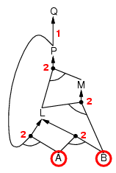
Forward chaining example

Slide 19
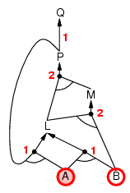
Forward chaining example

Slide 20
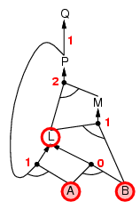
Forward chaining example

Slide 21
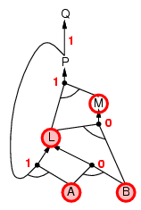
Forward chaining example

Slide 22
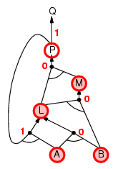
Forward chaining example

Slide 23
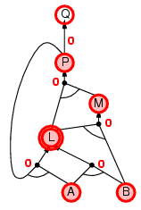
Forward chaining example

Slide 24
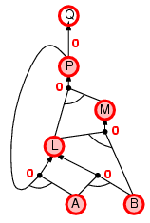
Forward chaining example

Slide 25
Forward chaining example

Slide 26
Forward Chaining is Sound and Complete
FC is sound:
every inference is essentially an application of Modus Ponens.
FC is complete:
FC derives every atomic sentence that is entailed by KB

Slide 27
Proof of completeness
FC derives every atomic sentence that is entailed by KB
FC reaches a fixed point where no new atomic sentences (propositional symbols) are inferred
Consider the final state as a model m, assigning true to the inferred symbols and false to the other symbols
Claim: Every clause in the original KB is satisfied (i.e., true) by m
Proof: Suppose a clause a₁ ∧ … ∧ a_{k} ⇒ b is falsified by m .
Then a₁ ∧ … ∧ a_{k} is satisfied by m while b is not.
But then b what not inferred, contradicting the assumption that
the algorithm had reached a fixed point!
Hence m is a model of KB
If KB $⊨$ q, q is true in every model of KB, including m

Slide 29
Backward chaining
Idea: work backwards from the query q: to infer q by BC,
check if q is known already, or
infer by BC all premises of some rule concluding q
Avoid loops: check if new subgoal is already on the goal stack
Avoid repeated work: check if new subgoal
has already been inferred (i.e., proved true), or
has already failed

Slide 30
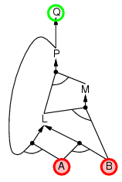
Backward chaining example

Slide 31
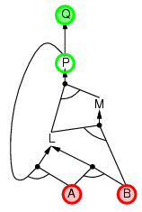
Backward chaining example

Slide 32
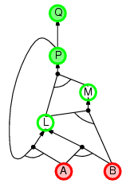
Backward chaining example

Slide 33
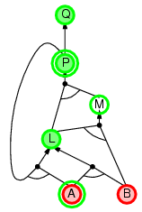
Backward chaining example

Slide 34
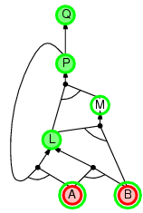
Backward chaining example

Slide 35
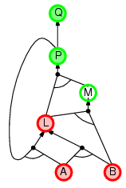
Backward chaining example

Slide 36
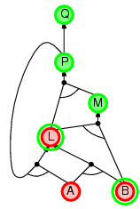
Backward chaining example

Slide 37
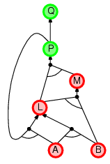
Backward chaining example

Slide 38
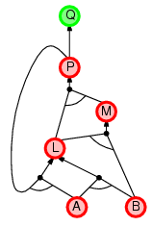
Backward chaining example

Slide 39
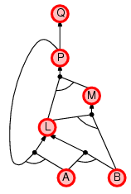
Backward chaining example

Slide 40
Forward vs. backward chaining
FC is data-driven, automatic, unconscious processing,
e.g., object recognition, routine decisions
May do lots of work that is irrelevant to the goal
BC is goal-driven, appropriate for problem-solving,
e.g., Where are my keys? How do I get into a PhD program?
Complexity of BC can be much less than linear in size of KB

Slide 42
Model Checking methods
The most effective procedures for propositional satisfiability are based on CSP techniques
Variable domain: {true, false}
Constraints: sets of clauses
Heuristic Improvements:
• unit propagation
• variable and value ordering
• intelligent backtracking
• clause learning
• random restarts
• clever indexing
• subproblem decomposition

Slide 43
Efficient propositional inference
Two families of efficient algorithms for propositional inference:
Complete backtracking search algorithms
DPLL algorithm (Davis, Putnam, Logemann, Loveland)
Incomplete local search algorithms
WalkSAT algorithm

Slide 44
The DPLL algorithm
Determine if an input propositional logic sentence (in CNF) is satisfiable.
Improvements over truth table enumeration:
Early termination
A clause is true if any literal is true.
A sentence is false if any clause is false.
Pure symbol heuristic
Pure symbol: always appears with the same "sign" in all clauses.
e.g., In the three clauses (A ∨ ¬B), (¬B ∨ ¬C), (C ∨ A), A and B are pure, C is impure.
Make a pure symbol literal true.
Unit clause heuristic
Unit clause: only one literal in the clause
The only literal in a unit clause must be true.

Slide 45
The DPLL algorithm

Slide 46
DPLL Exercise
(1) ¬p₁ ∨ p₂ (2) ¬p₃ ∨ p₄ (3) ¬p₆ ∨ ¬p₅ ∨ ¬p₂
(4) ¬p₅ ∨ p₆ (5) p₅ ∨ p₇ (6) ¬p₁ ∨ p₅ ∨ ¬p₇

Slide 47
The WalkSAT algorithm
Incomplete, local search algorithm
Evaluation function: The min-conflict heuristic of minimizing
the number of unsatisfied clauses
Balance between greediness and randomness

Slide 48
The WalkSAT algorithm

Slide 49
Hard satisfiability problems
Consider random 3-CNF sentences. e.g.,
(¬D ∨ ¬B ∨ C) ∧ (B ∨ ¬A ∨ ¬C) ∧ (¬C ∨ ¬B ∨ E) ∧ (E ∨ ¬D ∨ B) ∧ (B ∨ E ∨ ¬C)
m = number of clauses
n = number of symbols
Hard problems seem to cluster near m/n = 4.3 (critical point)

Slide 50
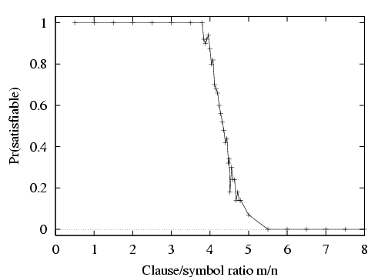
Hard satisfiability problems

Slide 51
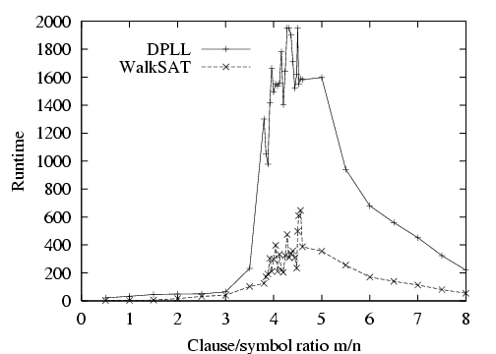
Hard satisfiability problems
Median runtime for 100 satisfiable random 3-CNF sentences, n = 50

Slide 52
Inference-based agents in the wumpus world
A wumpus-world agent using propositional logic:
¬P_{1,1}
¬W_{1,1}
B_{x,y} ⇔ (P_{x,y+1} ∨ P_{x,y-1} ∨ P_{x+1,y} ∨ P_{x-1,y})
S_{x,y} ⇔ (W_{x,y+1} ∨ W_{x,y-1} ∨ W_{x+1,y} ∨ W_{x-1,y})
W_{1,1} ∨ W_{1,2} ∨ … ∨ W_{4,4}
¬W_{1,1} ∨ ¬W_{1,2}
¬W_{1,1} ∨ ¬W_{1,3}
…
⇒ 64 distinct proposition symbols, 155 sentences

Slide 54
Expressiveness limitation of propositional logic
KB contains "physics" sentences for every single square
For every time t and every location [x,y],
L_{x,y} ∧ FacingRight ^{t} ∧ Forward ^{t} ⇒ L_{x+1,y}
Rapid proliferation of clauses
t
t

Slide 55
Summary
Logical agents apply inference to a knowledge base to derive new
information and make decisions
Basic concepts of logic:
syntax: formal structure of sentences
semantics: truth of sentences wrt models
entailment: necessary truth of one sentence given another
inference: deriving sentences from other sentences
soundness: derivations produce only entailed sentences
completeness: derivations can produce all entailed sentences
Wumpus world requires the ability to represent partial and negated
information, reason by cases, etc.
Resolution is complete for propositional logic Forward, backward chaining are linear-time, complete for Horn clauses
Propositional logic lacks expressive power

Slide 56
PL is a weak KR language
• Hard to identify “individuals” (e.g., Mary, 3)
• Can’t directly talk about properties of individuals
or relations between individuals (e.g., “Bill is tall”)
• Generalizations, patterns, regularities can’t easily
be represented (e.g., “all triangles have 3 sides”)
• First-Order Logic (FOL) is expressive enough to
represent this kind of information using relations,
variables and quantifiers, e.g.,
• Every elephant is gray: $∀$ x (elephant(x) → gray(x))
• There is a white alligator: $∃$ x (alligator(X) ∧ white(X))

Slide 57
PL Example
Consider the problem of representing the following information:
Every person is mortal.
Confucius is a person.
Confucius is mortal.
How can these sentences be represented so that we can infer the third sentence from the first two?

Slide 58
PL Example
In PL we have to create propositional symbols to stand for all or part of each sentence, e.g.:
P = “person”; Q = “mortal”; R = “Confucius”
The above 3 sentences are represented as:
P $→$ Q; R $→$ P; R $→$Q
The 3rd sentence is entailed by the first two, but we need an explicit symbol, R, to represent an individual, Confucius, who is a member of the classes person and mortal
Representing other individuals requires introducing separate symbols for each, with some way to represent the fact that all individuals who are “people” are also “mortal”

Slide 59
Propositional logic summary
Inference is the process of deriving new sentences from old
Sound inference derives true conclusions given true premises
Complete inference derives all true conclusions from a set of premises
A valid sentence is true in all worlds under all interpretations
If an implication sentence can be shown to be valid, then — given its premise — its consequent can be derived
Different logics make different commitments about what the world is made of and what kind of beliefs we can have
• Propositional logic commits only to the existence of facts that may or may not be the case in the world being represented
Simple syntax and semantics suffices to illustrate the process of inference
Propositional logic can become impractical, even for very small worlds

Slide 60
∧, ∨, ⇒, ⇔, ¬, $≡$ , $⊨$, ⊢_{I}
l₁ ∨ ・・・ ∨ l_{k} ∨ P, ¬P
l₁ ∨ ・・・ ∨ l_{k}
α₁ : $¬$P_{1,1}
α₂ : B_{1,1} ⇔ (P_{1,2} ∨ P_{2,1})
α₃ : B_{2,1} ⇔ (P_{1,1} ∨ P_{2,2} ∨ P_{3,1})
α₄ : ¬ B_{1,1}
α₅ : B_{2,1}
$$α, β$$
$α$∧ $β$

