Slide 1
Chapter 07_01
Introduction to Artificial Intelligence
Logical Agents

Slide 2
Outline
Knowledge-based agents
Wumpus world
Logic in general - models and entailment
Propositional (Boolean) logic
Equivalence, validity, satisfiability
Inference rules and theorem proving
forward chaining
backward chaining
resolution

Slide 3
The problem-solving agents, such as the transition model for the 8-puzzle, know things in a limited inflexible sense. That is, knowledge of what the actions do is hidden inside the domain-specific code.
The idea of representing states as assignments of values to variables allows some parts of the agent to work in a domain-independent way with efficient algorithms.

Slide 4
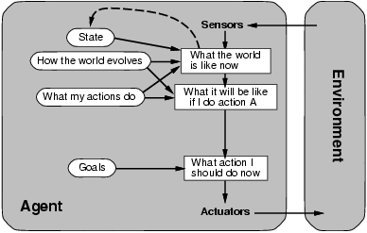
Reasoning Agents
Recall the model-based, Goal-based agent.
Keeps track of the world state and a set of goals to be achieved,
Chooses an action that will (eventually) lead to reaching its goals.

Slide 5
Knowledge-based Reasoning Agents
Three capabilities:
KB - Know about the world.
Agents maintain their Knowledge Base, which keeps a collection of facts (sentences, expressed in some formal language) about the world.
Inference Engine - Reason about the world.
Use some inference mechanism to derive new facts from those previous facts in the KB
Consequence - Act upon the world.
Map percepts to actions by querying and updating the KB

Slide 6
Automated Reasoning
Main Assumption (or the “Church Thesis” of AI)
Facts about the world can be represented as particular configurations of symbols (*)
Reasoning about the world can be achieved by symbol manipulation
Most AI researchers believe that reasoning is symbol manipulation,
nothing else (After all, the human brain is a physical system itself)
(*) i.e., physical entities such as marks on a piece of paper, states in a computer’s memory, and so on

Slide 7
Abstraction Levels
Every reasoning agent can be described at two different abstraction levels:
Knowledge level:
what the agent knows and what the agent’s goals are?
2. Symbol (or implementation) level:
what symbols the agent manipulates and how?
reasoning
knowledge level
symbol manipulation
symbol level
Agent’s Knowledge and Goals
Agent’s Knowledge and Goals
Internal Configuration of Symbols
Internal Configuration of Symbols

Slide 8
Abstraction Levels
At the knowledge level
Facts: Cars accident, and an ambulance is here
New facts: someone is injured.
Agents can be viewed at
• the knowledge level
i.e., what facts do they know and what new facts can be inferred, regardless of how implemented
• the implementation level
i.e., stored knowledge (symbols) and algorithms to manipulate them
Artificial agents,
the knowledge level is a metaphor for explaining the behavior of the agent at the symbol level.

Slide 9
Knowledge bases
Inference engine | domain – independent algorithms
Knowledge base | domain – specific content
Knowledge base = set of sentences (such as axiom) in a formal knowledge representation language
Declarative approach to building an agent (or other systems):
KB - Know about the world
The agent tells the KB what it perceives (what it needs to know).
Inference Engine - Reason about the world
then it can ask the KB what action it should perform. (Ask itself what to do - answers should follow from the KB);
Consequence - Act upon the world
then, it tells the KB which action was chosen, and the agent executes the action. (Answers are consequences of the KB)

Slide 10
A simple knowledge-based agent
Figure 7.1: A generic knowledge-based agent.
Given a percept, the agent
adds the percept to its knowledge base,
asks the knowledge base for the best action, and
tells the knowledge base it has in fact take that action.

Slide 11
A simple knowledge-based agent
The agent must be able to:
represent states, actions, etc. (facts, symbols in sentences)
incorporate new percepts (add new facts)
update internal representations of the world (KB of facts)
deduce hidden properties of the world (infer new facts)
deduce appropriate actions (draw an action or actions)

Slide 12
The wumpus world:
A cave consists of rooms connected by passengeways.
A wumpus is a beast that eats anyone who enters its room and is lurking somewhere in the cave.
An agent has only one arrow that can be used to shoot the wumpus.
Some rooms containing bottomless pits will trap anyone who wanders into these rooms (except for the wumpus, which is too big to fall in).
There is a possibility of finding a heap of gold, which is the only mitigating feature of this bleak environment.

Slide 13
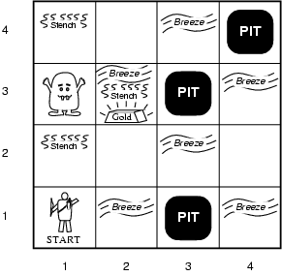
The Wumpus World PEAS Description
Performance measure
gold +1000, death -1000
-1 per step, -10 for using the arrow
Environment
Squares adjacent to wumpus are smelly
Squares adjacent to pit are breezy
Glitter iff gold is in the same square
Shooting kills wumpus if you are facing it
Shooting uses up the only arrow
Grabbing picks up gold if in same square
Releasing drops the gold in same square
Sensors: Stench, Breeze, Glitter, Bump, Scream
Actuators: Left turn, Right turn, Forward, Grab, Release, Shoot

Slide 14
The Wumpus World PEAS Description
Performance measure
+1000, if climbing out of the cave with
the gold
-1000, if falling into a pit or being eaten
by the wumpus
-1, per each action taken.
-10, for using the arrow
Environment

Slide 15
The Wumpus World PEAS Description - details
Environment
A 4 x 4 grid of rooms. The agent begins in
the same square labeled [1, 1], facing to
the right. The locations of the gold and the
wumpus are chosen randomly, with the uniform
distribution, from the squares other than the start
square. Each square other than the start can be
a pit, with probability 0.2.
Squares adjacent to wumpus are smelly
Squares adjacent to pit are breezy
Glitter iff gold is in the same square
Shooting kills wumpus if you are facing it
Shooting uses up the only arrow
Grabbing picks up gold if in same square
Releasing drops the gold in same square

Slide 16
The Wumpus World PEAS Description - details
Performance measure
Environment
Actuators:
The agent can move TurnLeft by 90º,
TurnRight by 90º, or Forward. If an agent
tries to move Forward and Bumps into a
wall, then the agent does not move. The agent
dies if entering a square containing a pit or a
live wumpus.
The agent can Grab the gold, if it is in the
same room (grid) as the agent.
Release (Climb), The agent can Release the gold and climb out of the cave but only at room square[1, 1].
The agent can Shoot the arrow in a straight line in the direction the agent is facing. The arrow continues until it either hits and kills the wumpus or hits a wall.
PIT

Slide 17
The Wumpus World PEAS Description - details
Environment
Actuators:
Sensors:
Stench, In the square containing the wumpus and in the directly (not diagonally) adjacent squares, the agent will perceive a Stench.
Breeze, In the squares directly adjacent to a pit, the
agent will perceive a Breeze.
Glitter, In the square where the gold is, the agent will
perceive a Glitter.
Bump, when an agent walks into a wall, it will
perceive a Bump.
Scream, when the wumpus is killed, it emits a woeful
Scream that can be perceived anywhere in the
cave.

Slide 18
The Wumpus World PEAS Description - Summary
Performance measure
gold +1000, death -1000
-1 per step, -10 for using the arrow
Environment
Squares adjacent to wumpus are smelly
Squares adjacent to pit are breezy
Glitter iff gold is in the same square
Shooting kills wumpus if you are facing it
Shooting uses up the only arrow
Grabbing picks up gold if in same square
Releasing drops the gold in same square
Sensors: Stench, Breeze, Glitter, Bump, Scream
Actuators: Left turn, Right turn, Forward, Grab, Release, Shoot
PIT

Slide 19
Wumpus World Characterization - PEAS
Fully Observable No – Partially, only local perception
Deterministic Yes – outcomes exactly specified
Episodic No –sequential at the level of actions
Static Yes –Wumpus and Pits do not move
Discrete Yes
Single-agent? Yes – Wumpus is essentially a natural feature

Slide 20
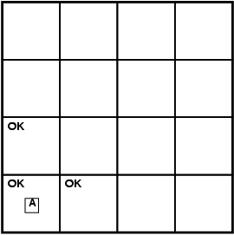
Exploring a wumpus world
PIT
PIT
PIT

Slide 21
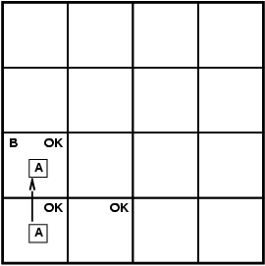
Exploring a wumpus world
S OK
OK | B OK
PIT

Slide 22
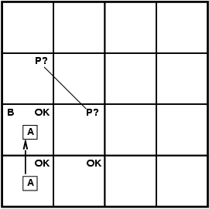
Exploring a wumpus world
W?
S OK | W?
OK | B OK
PIT

Slide 23
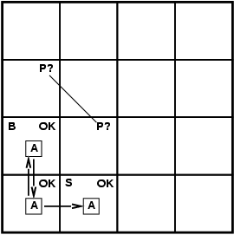
Exploring a wumpus world
W?
S OK | W?
OK | B OK
PIT
PIT
PIT

Slide 24
Exploring a wumpus world
W?
S OK | W?
OK | B OK
PIT
PIT
PIT

Slide 25
Exploring a wumpus world
W?
S OK | W? P? OK
OK | B OK | P?
PIT
PIT
PIT
PIT
PIT

Slide 26
Exploring a wumpus world
W? | S B G OK | P?
S OK | W? P? | B OK | P?
OK | B OK | P?
PIT
PIT
PIT
PIT

Slide 27
Exploring a wumpus world
W? | S B G OK | P?
S OK | W? P? | B OK | P?
OK | B OK | P?
PIT
PIT
PIT
PIT
PIT

Slide 29
Exploring a wumpus world
PIT
PIT
PIT

Slide 30
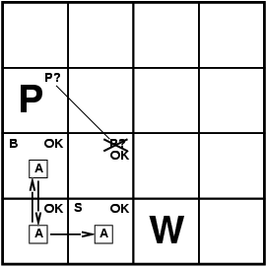
Exploring a wumpus world
PIT
PIT
PIT

Slide 31
Exploring a wumpus world
PIT
PIT
PIT

Slide 32
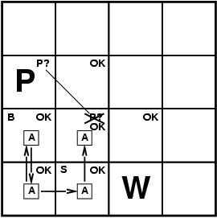
Exploring a wumpus world
PIT
PIT

Slide 33
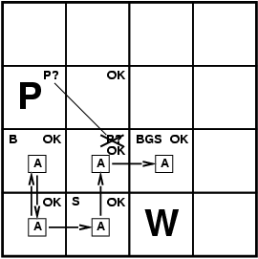
Exploring a wumpus world
PIT
PIT

Slide 34
Exploring a Wumpus World
1,4 | 2,4 | 3,4 | 4,4 | = agent B = Breeze G = Glitter, Gold OK = Safe square P = Pit S = Stench V = visited W = Wumpus |  | 1,4 | 2,4 | 3,4 | 4,4
1,3 | 2,3 | 3,3 | 4,3 |  |  | 1,3 | 2,3 | 3,3 | 4,3
1,2 | 2,2 | 3,2 | 4,2 |  |  | 1,2 | 2,2 | 3,2 | 4,2
1,1 | 2,1 | 3,1 | 4,1 |  |  | 1,1 | 2,1 | 3,1 | 4,1
A
P?
OK
OK
A
A
V
OK
OK
OK
OK
B
P?
(a)
• What are the safe moves from (1,1)?
Move to (1,2), (2,1), or stay in (1,1)
• Move to (2,1) then
• What are the safe moves from (2,1)?
B in (2,1) ⇒ P in (2,2) or (3,1) or (1,1)
• Move to (1,2) then
(b)

Slide 35
Exploring a Wumpus World
1,4 | 2,4 | 3,4 | 4,4 | = agent B = Breeze G = Glitter, Gold OK = Safe square P = Pit S = Stench V = visited W = Wumpus |  | 1,4 | 2,4 | 3,4 | 4,4
1,3 | 2,3 | 3,3 | 4,3 |  |  | 1,3 | 2,3 | 3,3 | 4,3
1,2 | 2,2 | 3,2 | 4,2 |  |  | 1,2 | 2,2 | 3,2 | 4,2
1,1 | 2,1 | 3,1 | 4,1 |  |  | 1,1 | 2,1 | 3,1 | 4,1
A
P?
A
W!
W!
P?
S G
B
A
S
v
v
OK
S
OK
OK
OK
B
B
v
v
v
v
OK
OK
P!
OK
OK
P!
(a)
S in (1,2) ⇒ W in (1,1) or (2,2) or (1,3)
Survived in (1,1) and no S in (2,1) ⇒ W in (1,3)
No B in (1,2) ⇒ P in (3,1)
• Move to (2,2), then to (2,3)
• G in (2,3)
• Grab G and come home
(b)

Slide 36
Exploring a Wumpus World – Other Considerations
A
1,4 | 2,4 | 3,4 | 4,4 | = agent B = Breeze G = Glitter, Gold OK = Safe square P = Pit S = Stench V = visited W = Wumpus |  | 1,4 | 2,4 | 3,4 | 4,4
1,3 | 2,3 | 3,3 | 4,3 |  |  | 1,3 | 2,3 | 3,3 | 4,3
1,2 | 2,2 | 3,2 | 4,2 |  |  | 1,2 | 2,2 | 3,2 | 4,2
1,1 | 2,1 | 3,1 | 4,1 |  |  | 1,1 | 2,1 | 3,1 | 4,1
P?
B
OK
P?
OK
A
A
B
OK
OK
OK
OK
A
A
P?
(a)
(b)
Breeze in (1,2) and (2,1) = ⇒ no safe actions
Assuming pits uniformly distributed, (2,2) has pit w/ prob 0.86,
vs. 0.31

Slide 38
Knowledge Representation
An (artificial) agent represents knowledge as a collection of sentences in some formal knowledge representation language.
A knowledge representation language is defined by its
Syntax: describes all the possible symbol configurations that constitute a sentence,
Semantics: maps each sentence of the language to a statement about the world
Ex: The language of Arithmetic
Syntax: x + y > 3 is a sentence; x + > y is not
Semantics: x + y > 3 is “true” iff the number x + y is greater than the number three
The semantics of x + y > 3 is either the fact “true” or the fact “false”
x + y > 3 is “false” in a world where x $≤$ -4, y = 7
x + y > 3 is “true” in a world where x $>$ -4, y = 7

Slide 39
Knowledge Representation and Reasoning
Reasoning is:
At the semantical level, the process of deriving new facts from previous facts
At the syntactical level, the process of producing new sentences from previous sentences
The production of sentences from previous ones should not be arbitrary. Only entailed sentences should be derivable

Slide 40
Entailment: $φ$ is an entailed sentence of sentences $τ$
Informally,
a sentence $φ$ is entailed by a set of sentences $τ$iff
the fact denoted by $φ$ follows logically from the facts denoted by $τ.$
Sentences Sentence
Entails
Representation
World
Follows
Facts Fact
$$τ$$
$$φ$$
Semant I cs
Semant I cs

Slide 41
Entailment
Notation: $τ$ $⊨$ $φ$ if the set of sentences $τ$ entail the sentence $φ$
Intuitive reading of $τ$ $⊨$ $φ$ :
whenever $τ$ is true in the world, $φ$is also true
Examples: Let $τ$ consist of the axioms of arithmetic
{x = y, y = z} $⊨$ x = z
$τ$ ∪ {x + y ≥ 0} $⊨$ x ≥ −y
$τ$ ∪ {x + y = 3, x − y = 1} $⊨$ x = 2
$τ$ ∪ {x + y = 3} $⊭$ x = 2

Slide 43
Entailment
Phi (uppercase Φ, lowercase φ)
Entailment means that one thing $φ$follows from another thing KB:
KB $⊨$ $φ$
Knowledge base KB entails sentence $φ$ if and only if $φ$ is true in all worlds where KB is true
For example:
The KB containing “the Giants won” and “the Reds won” entails “Either the Giants won or the Reds won”
x + y = 4 entails 4 = x + y
Entailment is a relationship between sentences (i.e., syntax) that is based on semantics

Slide 44
Entailment
Situation after detecting nothing in [1,1], moving right, breeze in [2,1]
Consider possible models for KB assuming only pits
3 Boolean choices ⇒ 8 possible models
{true, false}³
?
?
A
B
A
?

Slide 45
Models
Logicians typically think in terms of models, which are formally structured worlds with respect to which truth can be evaluated
m is a model of a sentence α if α is true in m
M(α) is the set of all models of α
Then KB $⊨$ α iff M(KB) ⊆ M(α)
e.g. KB = Giants won and Reds won; α = Giants won
x
x
x
x
x
x
x
x
x
x
x
x
x
x
x
M(α)
x
x
x
x
x
x
x
x
x
x
x
x
x
x
x
x
x
x
x
x
x
x
x
x
x
x
M(KB)
x
x
x
x
x
x
x
x
x
x
x

Slide 46
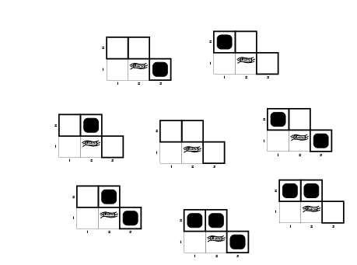
Wumpus models

Slide 47
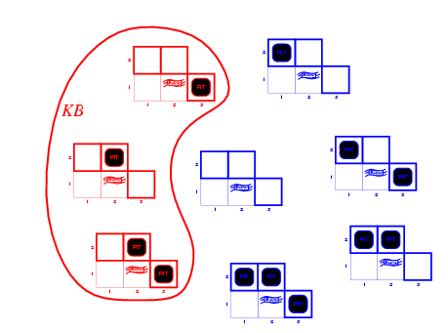
Wumpus models
KB = wumpus-world rules + observations

Slide 48
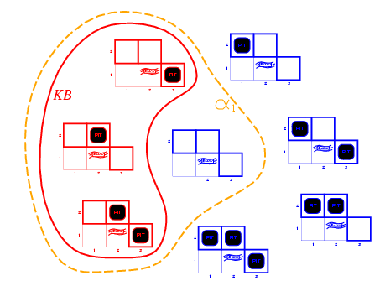
Wumpus models
KB = wumpus-world rules + observations
α₁ = "[1, 2] is safe", KB $⊨$ α₁, proved by model checking

Slide 49
Wumpus models
KB = wumpus-world rules + observations

Slide 50
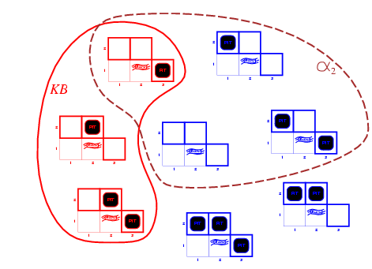
Wumpus models
KB = wumpus-world rules + observations
α₂ = "[2,2] is safe", KB $⊨$ α₂

Slide 53
Inference Systems
At the knowledge representation level, the reasoning is achieved by an
inference system I,
I a computational device able to derive new sentences from previous ones
Notation: $τ$ ⊢_{I} $φ$ if I can derive the sentence $φ$ from the set $τ$
To be useful at all,
an inference system must be sound:
if $τ$ ⊢_{I} $φ$ then $τ$ $⊨$ $φ$ holds as well
an inference system is also complete:
if $τ$ $⊨$ $φ$ then $τ$ ⊢_{I} $φ$ holds as well

Slide 54
Inference Systems
KB ⊢_{I} α = sentence α can be derived from KB by procedure i
Soundness: I is sound if whenever KB ⊢_{I} α, it is also true that KB $⊨$α
Completeness: i is complete if whenever KB $⊨$α, it is also true that KB ⊢_{I} α
Preview: we will define a logic (first-order logic) that is expressive enough to say almost anything of interest, and for which there exists a sound and complete inference procedure.
That is, the procedure will answer any question whose answer follows from what is known by the KB.

Slide 55
Inference Rules
An inference system is typically described as a set of inference (or derivation) rules
Each derivation rule has the form:
P₁, . . . , P_{n} ← premises
C ← conclusion

Slide 56
Derivation Rules and Soundness
A derivation rule is sound if it derives true conclusions from true Premises
All men are mortal
Aristotle is a man Sound Inference
Aristotle is mortal
All men are mortal
Aristotle is mortal Unsound Inference
All men are Aristotle

Slide 57
Knowledge Representation Languages
Why don’t we use natural language (e.g., English) to represent knowledge?
Natural language is certainly expressive enough!
But it is also too ambiguous for automated reasoning
Ex: I saw the boy on the hill with the telescope
I saw the boy on the hill with the telescope
Why don’t we use programming languages?
They are well-defined and unambiguous
But they are not expressive enough

Slide 58
Knowledge Representation and Logic
The field of Mathematical Logic provides powerful, formal knowledge representation languages and inference systems to build reasoning agents
Consider two languages, and associated inference systems, from mathematical logic:
Propositional Logic
First-order Logic

