Slide 1
Artificial Intelligence
Chapter 6
Adversarial Search
Section 1 – 4
Textbook: Chapter 5

Slide 2
Outline
Optimal Decisions in Games
Alpha-Beta (α-β) Pruning
Imperfect Real-Time Decisions
Adversarial Search
Optimal decisions
Minimax
α-β pruning
ExpectMinimax
Case study: Deep Blue

Slide 3
Generalizing Search Problem
What we have seen so far:
Our search problems have assumed agent has complete control of environment
  State does not change unless the agent changes it.
    All we need to compute is a single path to a goal state.
Assumption not always reasonable
  Stochastic environment (e.g., the weather, traffic accidents)
  Other agents whose interests conflict with yours
    Search can find a path to a goal state, but the actions might not lead you to the goal as the state can be changed by other agents (nature or other intelligent agents)

Slide 4
Generalizing Search Problem
Need to generalize the view of search to handle state changes that are not in the control of the agent.
The generalization yields game tree search
  Agent and some other agents
  The other agents are acting to maximize their profits
    This might not have a positive effect on their agents profits.

Slide 5
General Games Problem
What makes something a game?
  There are two or more agents making changes to the world (the state)
  Each agent has their own interests
    e.g., each agent has a different goal; or assigns different costs for different paths/states
  Each agent tries to alter the world so as to best benefit itself.

Slide 6
General Games Problem
What makes games hard?
  How an agent A should play depends on how the agent think the other agents Bs will play; but how they play depends on how they think A will play.
  So how A should play depends on how A thinks the other agents B think A will play; but how they play should depend on how they think A thinks they think the agent A will play; ….

Slide 9
Games vs. Search Problems
Multiagent environments is introduced in Chapter 2 :
  Each agent needs to consider the actions of other agents and
  how they affect their own welfare.
Introduce contingencies into the agent’s problem-solving process because of the unpredictability of these other agents in Chapter 4.
Competitive environments will be addressed in this Chapter,
  the agents’ goals are in conflict, giving rise to adversarial search problems – often known as games.

Slide 10
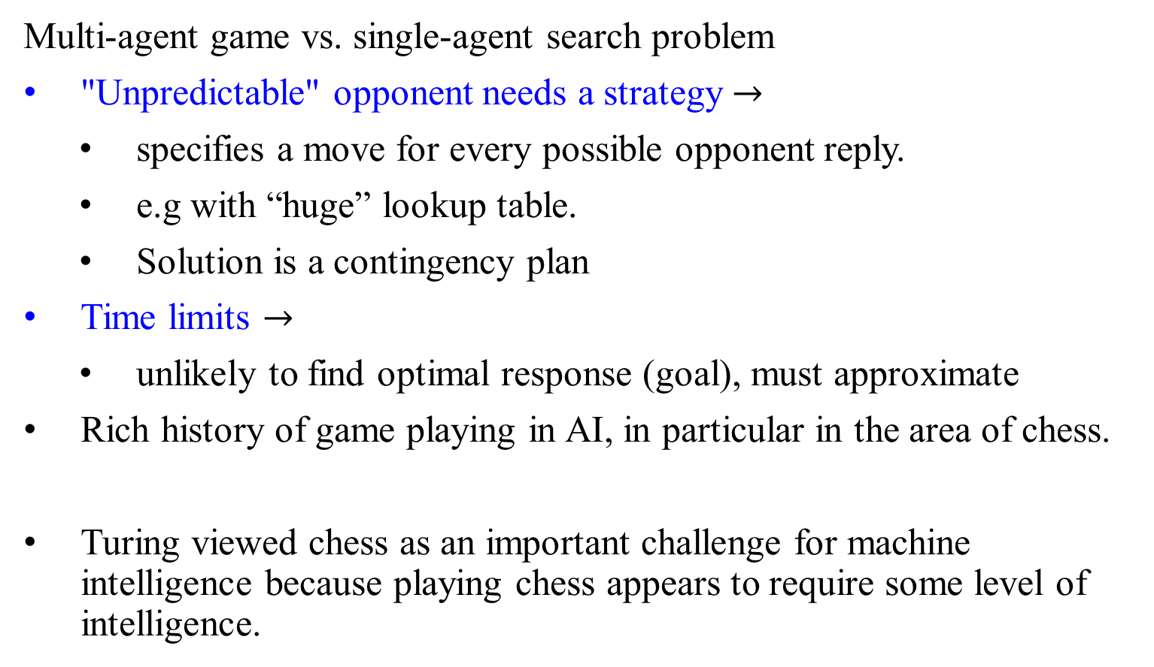
Games vs. Search Problems
Multi-agent game vs. single-agent search problem
"Unpredictable" opponent needs a strategy $→$
specifies a move for every possible opponent reply.
e.g with “huge” lookup table.
Solution is a contingency plan
Time limits $→$
unlikely to find optimal response (goal), must approximate
Rich history of game playing in AI, in particular in the area of chess.
Turing viewed chess as an important challenge for machine intelligence because playing chess appears to require some level of intelligence.

Slide 11
Why is Game-Playing a Challenge for AI?
Competent game playing
  Requires planning, reasoning and learning
some aspects of “intelligence”
Proxy for real-world decision making problems
Easy to represent states & define rules
Hard to obtaining good performance
“Adversary” can be nature
PSPACE-complete (or worse)
Computationally equivalent to hardware debugging, formal verification, logistics planning
PSPACE is harder than NP.

Slide 12
Traditional Board Games
Finite
Deterministic
Two-players
Turn-taking
Zero-sum
Perfect Information
Sequential

Slide 13
Properties of Games
Zero-sum games: Fully competitive
  Competitive: if one plays win, the other lose; e.g, tic-tac-toe – the player A wins what the other player loses
Games can be cooperative: some outcomes are preferred by both players, or at least their values aren’t diametrically opposed.
Deterministic: No chance involved
(no dice, or random deals of cards, or coin flips, etc.)
Perfect information: all aspects of the state are fully observable
(e.g., no hidden cards)

Slide 14
Types of Games
Deterministic Chance
Perfect information
Imperfect information
Chess, Checkers, Go, Othello, Tic-tac-toe | Backgammon, Monopoly
 | Bridge, Poker, Scrabble, Nuclear war

Slide 15
Game 1: Rock, Paper, Scissors
Scissors cut paper, paper covers rock, rock smashes scissors
Represented as a matrix: Player I chooses a row, Player II chooses a column
Payoff to each player in each cell (P1.I / P1.II)
1: win, 0: tie, -1: loss
So it’s zero-sum
Player II
 | R | P | S
R | 0/0 | -1/1 | 1/-1
P | 1/-1 | 0/0 | -1/1
S | -1/1 | 1/-1 | 0/0
Player I

Slide 16
Formal definition of a game:
Initial state S₀: Specified how the game is set up at the start.
PLAYER(s): Defines which player has the move in a state.
ACTION(s): Returns the set of legal moves in a state.
RESULT(s, a): The transition model, which defines the result of a move.
TERMINAL-TEST(s): Determines a
Terminal test: which is true when game over and false, otherwise.
Terminal states: which states where game ends
…

Slide 17
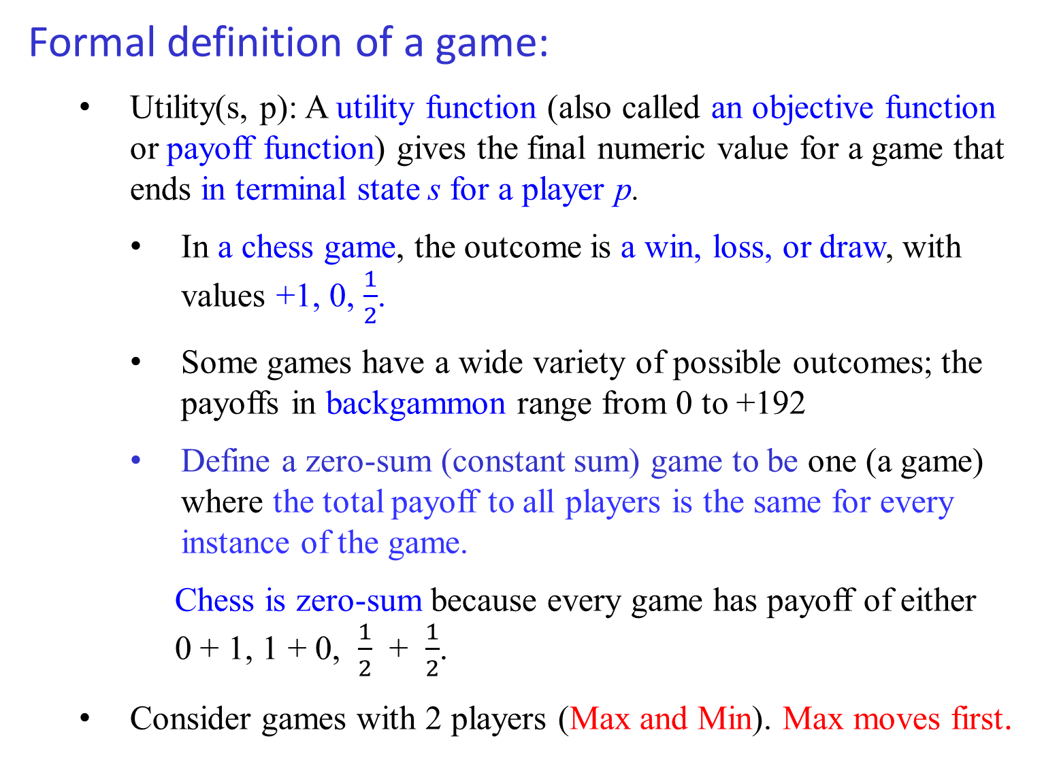
Formal definition of a game:
Utility(s, p): A utility function (also called an objective function or payoff function) gives the final numeric value for a game that ends in terminal state s for a player p.
  In a chess game, the outcome is a win, loss, or draw, with values +1, 0, $\frac{1}{2}$.
  Some games have a wide variety of possible outcomes; the payoffs in backgammon range from 0 to +192
  Define a zero-sum (constant sum) game to be one (a game) where the total payoff to all players is the same for every instance of the game.
  Chess is zero-sum because every game has payoff of either 0 + 1, 1 + 0, $\frac{1}{2}$ + $\frac{1}{2}$.
  Consider games with 2 players (Max and Min). Max moves first.

Slide 18
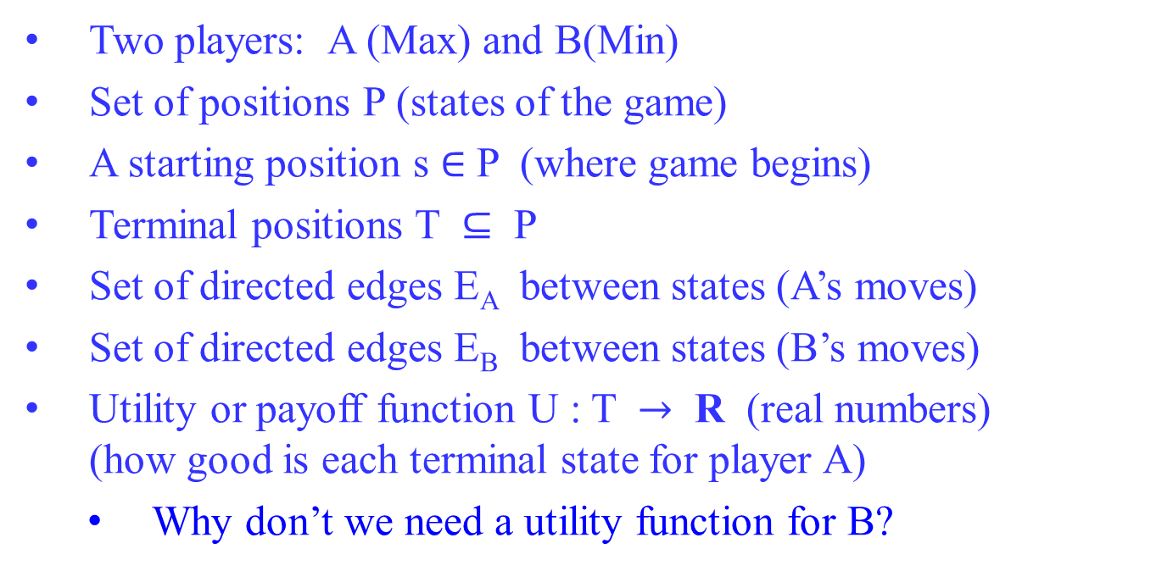
Two-Player Zero-Sum Game - Definition
Two players: A (Max) and B(Min)
Set of positions P (states of the game)
A starting position s $∈$ P (where game begins)
Terminal positions T $⊆$ P
Set of directed edges E_{A} between states (A’s moves)
Set of directed edges E_{B} between states (B’s moves)
Utility or payoff function U : T $→$ R (real numbers) (how good is each terminal state for player A)
Why don’t we need a utility function for B?

Slide 19
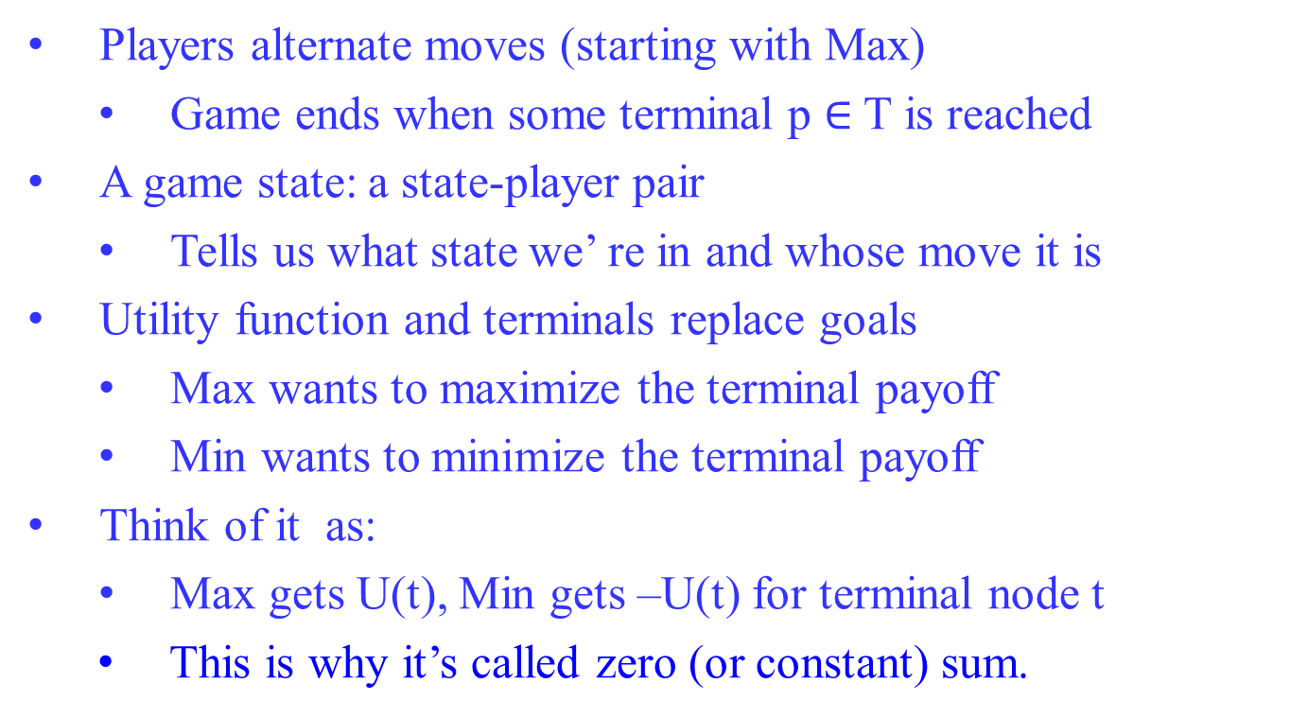
Two-Player Zero-Sum Game - Intuition
Players alternate moves (starting with Max)
  Game ends when some terminal p $∈$ T is reached
A game state: a state-player pair
  Tells us what state we’ re in and whose move it is
Utility function and terminals replace goals
  Max wants to maximize the terminal payoff
  Min wants to minimize the terminal payoff
Think of it as:
  Max gets U(t), Min gets –U(t) for terminal node t
This is why it’s called zero (or constant) sum.

Slide 20
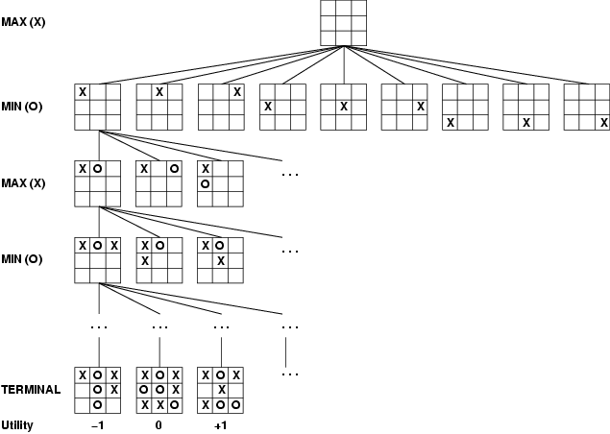
Game Tree: Tic-Tac-Toe (2-player, deterministic, turns)
Figure 5.1 A (partial) game tree for the game of the tit-tac-toe.
The top node is the initial state, and MAX moves first, placing an X in an empty square. Show part of the tree, giving alternating moves by MIN(O) and MAX(X), until eventually reach terminate states, which can be assigned utilities according to the rules of the game.
The initial state, ACTIONS function and RESULT function define the game tree for the game – a tree where the nodes are game states and the edges are moves.
Tree from
Max’s
perspective

Slide 21
Game Tree: Tic-Tac-Toe (noughts and crosses)
Game tree: a search tree
  Layers signified alternating moves between Max and Min
  The search tree in game playing is a subtree of the game tree
Player Max does not decide where to go alone
  After Max moves to a state, Min decides which of the states children to move to
Thus, Max must have a strategy
  Must know what to do for each possible move of Min
  One sequence of moves will not suffice: “what to do” will depend on how Min will play
What is a reasonable strategy?

Slide 22
Game Tree: Tic-Tac-Toe (noughts and crosses)
From the initial state, MAX has 9 possible moves.
  MAX’s job is to search for a good move.
Play alternates between MAX’s placing an X and MIN’s placing an O until the leaf nodes corresponding to terminal states are reached such that one player has three in a row or all the squares are filled.
The number on each leaf node
  indicates the utility value of the terminal state from the point of view of MAX:
    assume high value to be good for MAX and bad for MIN (which is how the players get their names).

Slide 23
Game Tree: Tic-Tac-Toe (noughts and crosses)
For tic-tac-toe the game tree is relatively small
  fewer than 9! = 362,880 terminal nodes.
For the chess there are over 10⁴⁰ nodes,
The game tree is best thought of as of theoretical construct that we cannot realize in the physical world.
Regardless of the size of the game tree, it is MAX’s job to search for a good move.
Use the term search tree for a tree that is superimposed on the full game tree, and examines enough nodes to allow a player to determine what move to make.

Slide 24
Key Idea: Look-ahead based Tic-Tac-Toe
3x3 Tic-Tac-Toe
optimal play
After 3 moves per player, the game is in:
X’s turn
O’s turn
11
1
loss
loss
X’s turn
11
1111
Tie
Tie
Tie
Tie

Slide 25
Look-ahead based Tic-Tac-Toe
X’s turn
O’s turn
11
1
Win for O
Win for O
X’s turn
11
Tie
Tie
Tie
Tie
1111

Slide 26
Look-ahead based Tic-Tac-Toe
X’s turn
O’s turn
11
Win for O
Win for O
1
X’s turn
Tie
11
Tie
Tie
Tie
1111

Slide 27
Look-ahead based Tic-Tac-Toe
X’s turn
Win for O
Tie
Win for O
O’s turn
11
Win for O
Tie
Tie
Tie
Tie
Win for O
1
X’s turn
Tie
11
Tie
Tie
Tie
1111

Slide 28
Look-ahead based Tic-Tac-Toe
X’s turn
Win for O
Tie
Win for O
O’s turn
11
Win for O
Tie
Tie
Tie
Tie
Win for O
1
X’s turn
Tie
11
Tie
Tie
Tie
1111

Slide 29
Each board in game tree gets unique game tree value (utility; -1/0/+1) under optimal rational play.
(Convince yourself.)
e.g. O for top board.
What if our opponent
does not play optimally?
X’s turn
Win for O
Tie
Win for O
Approach: Look first at bottom tree. Label bottom-most boards.
Then label boards one level up, according result of best possible move … and so on. Moving up layer by layer.
Termed the Minimax Algorithm
Implemented as a depth-first search
11
Win for O
Tie
Tie
Tie
Tie
Win for O
1
Tie
11
Tie
Tie
Tie
1111

Slide 30
Well… Why not use a strategy / knowledge, as humans do?
Consider for Tic-Tac-Toe:
Oops!!
Consider
Black uses
the strategy…

Slide 31
Although one can capture strategic knowledge of many games
in high-level rules (at least to some extent), in practice any
interesting game will revolve precisely around the exceptions to
those rules!
Issue has been studied for decades but research keeps coming back to game tree search (or most recently, game tree sampling).

Slide 32
Minimax Strategy
Assume that the other player will always play their best move,
  Max always lay a move that will minimize the payoff that could be gained by the other player, Min.
  Max plays to maximize his payoff but minimize the Min payoff
If Max knows that Min will play poorly in some circumstances, there might be a better strategy than MinMax (i.e., a strategy that gives Max a better payoff).
But in the absence of that knowledge minimax “plays it safe”
2

Slide 33
Minimax Algorithm
2

Slide 34
Minimax Algorithm
2

Slide 35
Minimax Algorithm
A
MAX
A
C
D
MIN
E
F
G
H
I
J
MAX
L
M
N
O
P
Q
R
S
T
U
V
2
3
5
9
0
7
4
2
1
5
6
Payoff for MAX

Slide 36
Minimax Algorithm
A
MAX
A
C
D
MIN
3
G
0
7
6
E
F
9
H
I
2
J
MAX
L
M
N
O
P
Q
R
S
T
U
V
2
3
5
9
0
7
4
2
1
5
6
Payoff for MAX

Slide 37
Minimax Algorithm
A
MAX
A
3
C
0
D
2
MIN
3
G
0
7
6
E
F
9
H
I
2
J
MAX
L
M
N
O
P
Q
R
S
T
U
V
2
3
5
9
0
7
4
2
1
5
6
Payoff for MAX

Slide 38
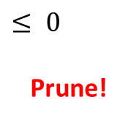
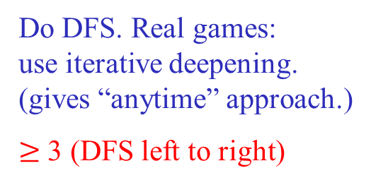
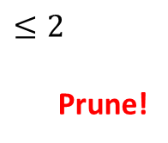
Minimax Algorithm
Do DFS. Real games:
use iterative deepening.
(gives “anytime” approach.)
$≥$ 3 (DFS left to right)
What if
payoff(Q) = 100
payoff(R) = 200
Starting DFS, left to right,
do we need to know eval(H)?
A
3
MAX
A
3
C
0
$$≤ 0$$
Prune!
D
2
$$≤2$$
Prune!
MIN
3
G
0
7
6
E
F
9
H
I
2
J
MAX
L
M
N
O
P
Q
R
S
T
U
V
2
3
5
9
0
7
4
2
1
5
6
Payoff for MAX

Slide 39
Optimal Decisions in Games
In a normal search problem,
  the optimal solution would be a sequence of actions leading to a goal state - a terminal state that is a win.
In adversarial search, MIN has something to say about it.
  MAX therefore must find a contingent strategy, which specifies MAX’s move in the initial state,
  then MAX’s moves in the states resulting from every possible response by MIN,
  then MAX’s moves in the states resulting from every possible response by MIN to those moves, and so on.
Roughly speaking, an optimal strategy leads to outcomes at least as good as any other strategy when one is playing an infallible opponent.
Let show how to find this optimal strategy.

Slide 40
Optimal Decisions in Games
3
A
Figure 5.2 A two-ply game tree.
MAX
a₁
a₃
a₂
3
B
2
2
D
MIN
C
d₃
c₁
c₃
d₁
b₁
b₃
b₂
c₂
d₂
3 12 8 2 4 6 14 5 2
The nodes are MAX nodes, in which it is MAX’s turn to move, and the nodes are MIN nodes. The terminal nodes show the utility values for MAX; the other nodes are labeled with their minimax values. MAX’s best move at the root is a₁ , because it leads to the state with the highest minimax value, and MIN’s best reply in b₁, because it leads to the state with the lowest minimax value.

Slide 41
Optimal Decisions in Games
In Figure 5.2, the possible moves for MAX at the root are labeled a₁, a₂, and a₃.
The possible replies to a₁ for MIN are b₁, b₂, and b₃, and so on.
This particular game ends after one move each by MAX and MIN.
(In game parlance, we say that this tree is one move deep, consisting of two half-moves, each of which is called a ply.)
The utilities of the terminal states in this game range from 2 to 14.

Slide 42
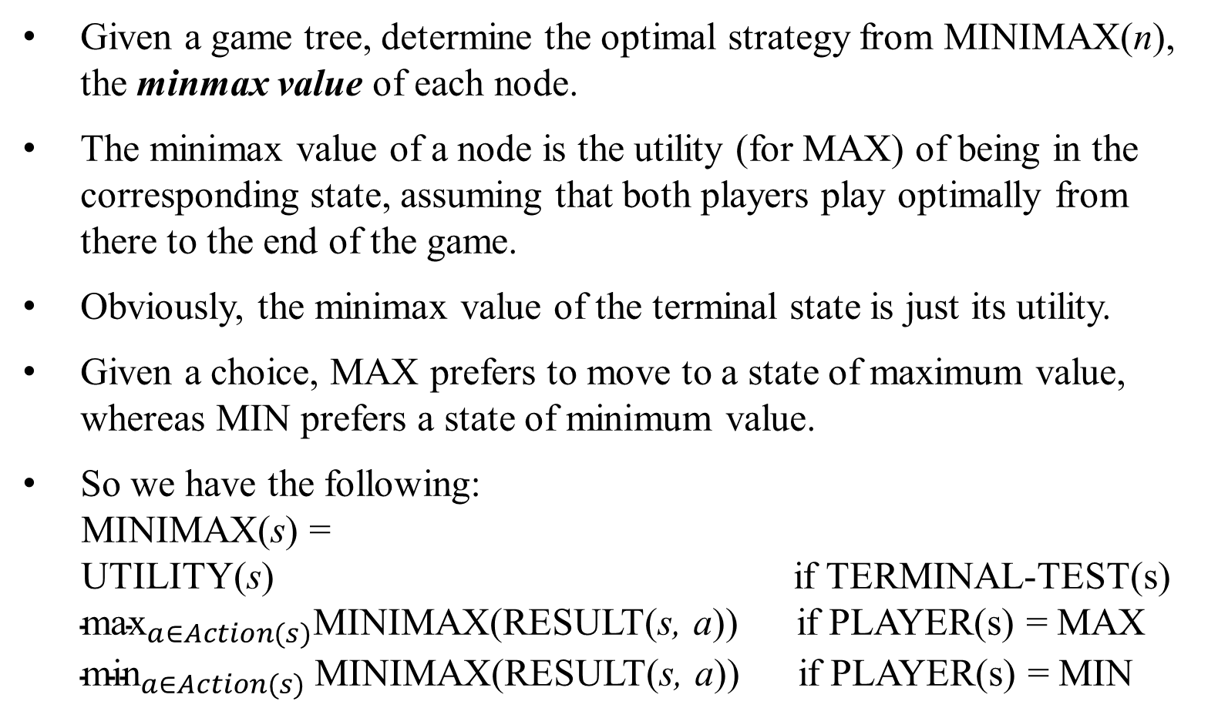
Optimal Decisions in Games
Given a game tree, determine the optimal strategy from MINIMAX(n), the minmax value of each node.
The minimax value of a node is the utility (for MAX) of being in the corresponding state, assuming that both players play optimally from there to the end of the game.
Obviously, the minimax value of the terminal state is just its utility.
Given a choice, MAX prefers to move to a state of maximum value, whereas MIN prefers a state of minimum value.
So we have the following:
MINIMAX(s) =
UTILITY(s) if TERMINAL-TEST(s)
${\text{max}}_{a∈Action(s)}$MINIMAX(RESULT(s, a)) if PLAYER(s) = MAX
${\text{min}}_{a∈Action(s)}$MINIMAX(RESULT(s, a)) if PLAYER(s) = MIN

Slide 43
Optimal Decisions in Games
Apply these definitions to the game tree in Figure 5.2:
The terminal nodes on the bottom level get their utility values from the game’s UTILITY function.
The first MIN node, labelled B, has three successor states with value 3, 12, and 8, so its minmax value is 3.
Likewise, the other two MIN nodes have minimax value 2.
The root node is a MAX node; its successor states have minimax values 3, 2, and 2; thus, it has a minimax value of 3.
Also can identify the minimax decision of the root: action a₁ is the optimal choice for MAX because it leads to the state with the highest minimax value.

Slide 44
Optimal Decisions in Games
This definition of optimal play for MAX assumes that MIN plays optimally – it maximizes the worst-case outcome for MAX.
What if MIN does not play optimally?
Then it is easy to show that MAX will do even better.
Other strategies against suboptimal opponents may do better than the minimax strategy, but these strategies necessarily do worse against optimal opponents.

Slide 45
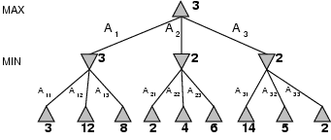
Minimax
Perfect play for deterministic games
Idea: choose move to position with highest minimax value
= best achievable payoff against best play
e.g., 2-ply game:

Slide 46
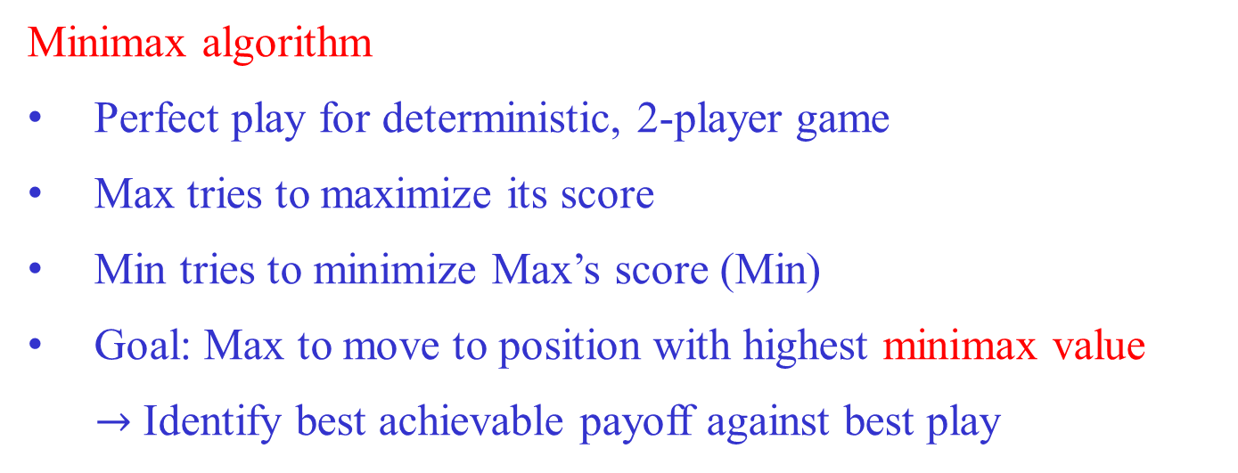
Minimax algorithm
Minimax algorithm
Perfect play for deterministic, 2-player game
Max tries to maximize its score
Min tries to minimize Max’s score (Min)
Goal: Max to move to position with highest minimax value
$→$ Identify best achievable payoff against best play

Slide 47
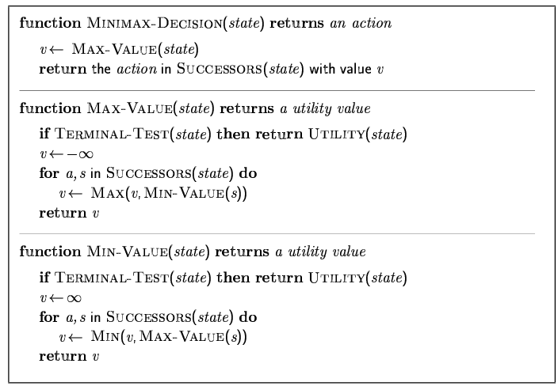
Minimax algorithm

Slide 48
Minimax Algorithm
A
MAX
A
3
C
0
D
2
MIN
3
G
0
7
6
E
F
9
H
I
2
J
MAX
L
M
N
O
P
Q
R
S
T
U
V
2
3
5
9
0
7
4
2
1
5
6
Payoff for MAX

Slide 49
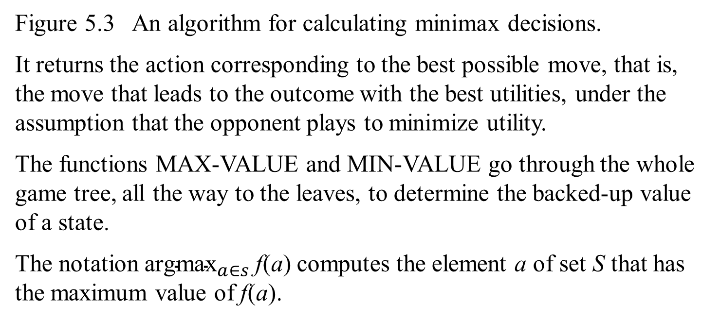
Figure 5.3 An algorithm for calculating minimax decisions.
It returns the action corresponding to the best possible move, that is, the move that leads to the outcome with the best utilities, under the assumption that the opponent plays to minimize utility.
The functions MAX-VALUE and MIN-VALUE go through the whole game tree, all the way to the leaves, to determine the backed-up value of a state.
The notation ${\text{argmax}}_{a∈s}$f(a) computes the element a of set S that has the maximum value of f(a).

Slide 50
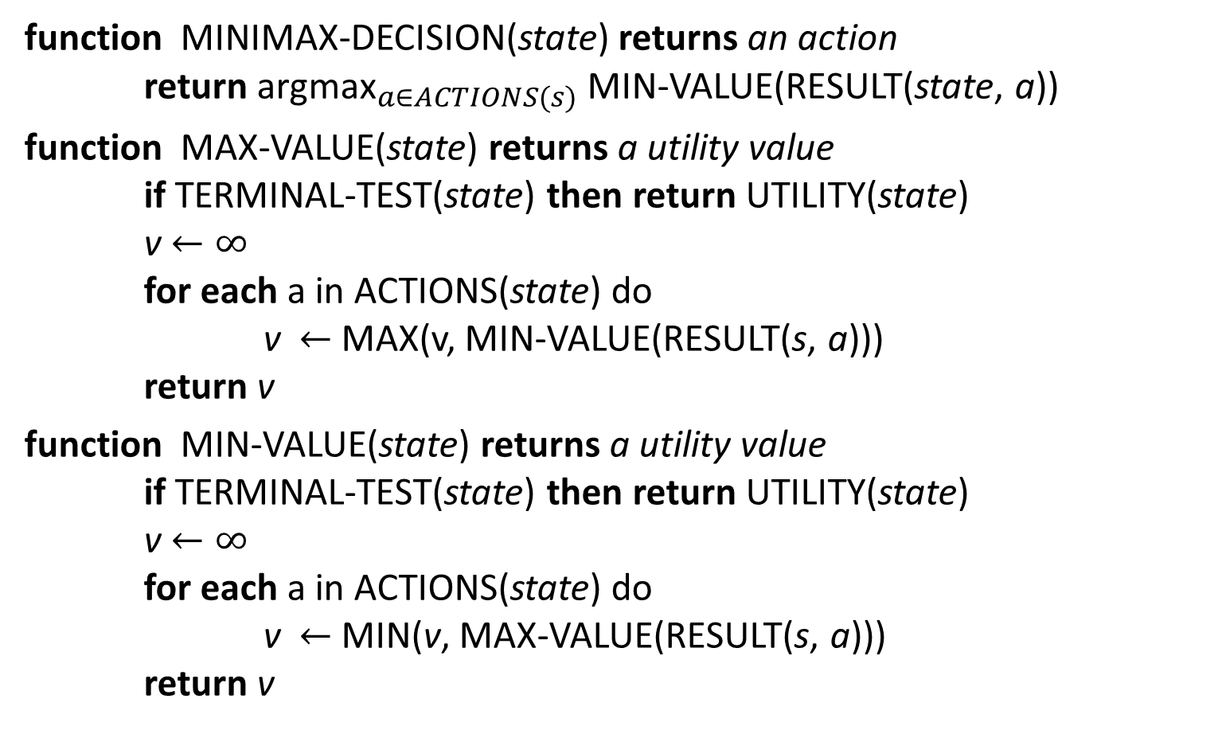
Minimax algorithm
function MINIMAX-DECISION(state) returns an action
return ${\text{argmax}}_{a∈ACTIONS(s)}$MIN-VALUE(RESULT(state, a))
function MAX-VALUE(state) returns a utility value
if TERMINAL-TEST(state) then return UTILITY(state)
v $←∞$
for each a in ACTIONS(state) do
v $←$ MAX(v, MIN-VALUE(RESULT(s, a)))
return v
function MIN-VALUE(state) returns a utility value
if TERMINAL-TEST(state) then return UTILITY(state)
v $←∞$
for each a in ACTIONS(state) do
v $←$ MIN(v, MAX-VALUE(RESULT(s, a)))
return v
Figure 5.3

Slide 51
The minimax algorithm
The algorithm computes the minimax decision from the current state.
It uses a simple recursive computation of the minimax values of each successor state, directly implementing the defining equations.
The recursion proceeds all the way down to the leaves of the tree, and then the minimax values are backed up through the tree as the recursion unwinds.
As in Figure 5.2, the algorithm first recurses down to the three bottom-left nodes and uses the UTILITY function on them to discover that their values are 3, 12, and 8, respectively. Then it takes the minimum of these values, 3, and returns it as the backed-up value of node B.
A similar process gives the backed-up values of 2 for C and 2 for D.
Finally, we take the maximum of 3, 2, and 2 to get the backed-up value of 3 for the root node.

Slide 52
The minimax algorithm
The minimax algorithm performs a complete depth-first exploration of the game tree.
If the maximum depth of the tree is m and there are b legal moves at each point, then the time complexity of the minimax algorithm is O(b^{m}).
The space complexity is O(bm) for an algorithm that generates all actions at once, or O(m) for an algorithm that generates actions one at a time.
For real games, the time cost is totally impractical, both this algorithm serves as the basis for the mathematical analysis of games and for more practical algorithms.

Slide 53
Properties of minimax
Complete? Yes (if tree is finite)
Optimal? Yes (against an optimal opponent)
Time complexity? O(b^{m})
Space complexity? O(bm) (depth-first exploration, if it generates all successors at once)
where m – maximum depth of the tree; b – legal moves
For chess, b ≈ 35, m ≈ [80, 100] for "reasonable" games
→ exact solution completely infeasible

Slide 54
Minimax Algorithm
Limitations
  Generally not feasible to traverse entire tree
  Time limitations
Key Improvements
Use evaluation function instead of utility (discussed earlier)
Evaluation function provides estimate of utility at given position
Alpha/beta pruning

Slide 55
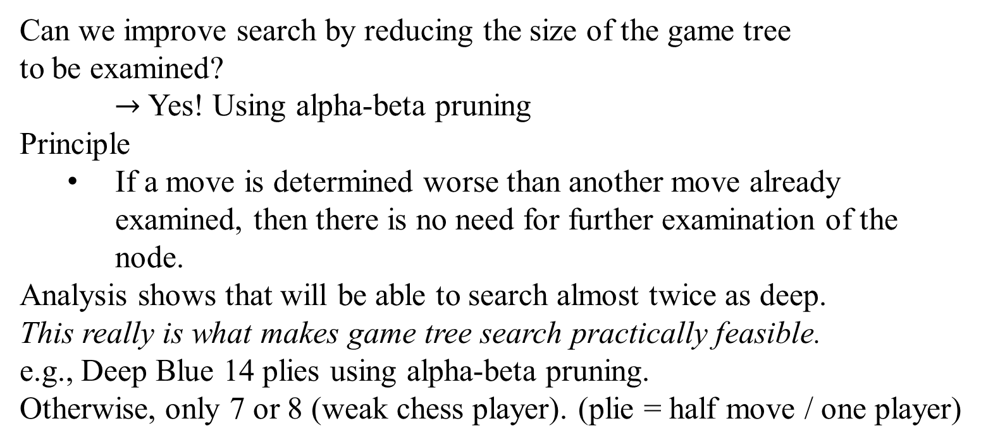
ALPHA-BETA PRUNING
Can we improve search by reducing the size of the game tree
to be examined?
$→$ Yes! Using alpha-beta pruning
Principle
  If a move is determined worse than another move already examined, then there is no need for further examination of the node.
Analysis shows that will be able to search almost twice as deep.
This really is what makes game tree search practically feasible.
e.g., Deep Blue 14 plies using alpha-beta pruning.
Otherwise, only 7 or 8 (weak chess player). (plie = half move / one player)

Slide 56
ALPHA-BETA PRUNING
The problem with minimax search is that
the number of game states it has to examine is exponential in the depth of the tree.
Unfortunately, we cannot eliminate the exponent.
However, we can effectively cut it in half. The trick is that
it is possible to compute the correct minmax decision without looking at every node in the game tree.
  That is, we can use alpha-beta pruning technique to eliminate large parts of the tree from consideration.
    When applied to a standard minimax tree, it returns the same move as minimax would, but prunes away branches that cannot possibly influence the final decision.

Slide 57
ALPHA-BETA PRUNING
Consider again the two-ply game tree from Figure 5.2.
Let’s go through the calculation of the optimal decision once more, this time paying careful attention to what we know at each point in the process.
The steps are explained in Figure 5.5.
The outcome is that we can identify the minimax decision without ever evaluating two of the leaf nodes.

Slide 58
Pag 168 Figure 5.5

Slide 59
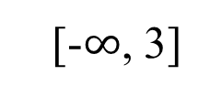
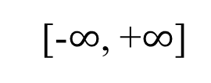
Figure 5.5 Stages in the calculation of the optimal decision for the game tree in Figure 5.2. At each point, we show the range of possible values for each node.
(a)
[-$∞$, +$∞$]
A
[-$∞$, 3]
B
(a) The first leaf below B has the value 3. Hence, B, which is a MIN node, has a value of at most 3.
3

Slide 60
Figure 5.5 Stages in the calculation of the optimal decision for the game tree in Figure 5.2. At each point, we show the range of possible values for each node.
(b)
[-$∞$, +$∞$]
A
[-$∞$, 3]
B
(b) The second leaf below B has the value 12; MIN would avoid this move, so the value of B is still at most 3.
3 12

Slide 61
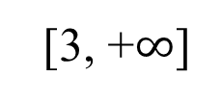
Figure 5.5 Stages in the calculation of the optimal decision for the game tree in Figure 5.2. At each point, we show the range of possible values for each node.
(c)
[3, +$∞$]
A
[3, 3]
B
(c) The third leaf below B has a value of 8; we have see all B’s successor states, so the value of B is exactly 3. Now, we can infer that the value of the root is at least 3, because MAX has a choice worth 3 at the root.
3 12 8

Slide 62
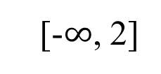
Figure 5.5 Stages in the calculation of the optimal decision for the game tree in Figure 5.2. At each point, we show the range of possible values for each node.
(d)
[3, +$∞$]
A
(d) The first leaf below C has a value 2. Hence, C, which is a MIN node, has a value of at most 2. But we know that B is worth 3, so MAX would never choose C. Therefore, there is no point in looking at the other successor states of C. This is an example of alpha-beta pruning
[3, 3]
B
[-$∞$, 2]
C
3 12 8 2

Slide 63
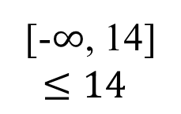
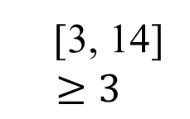
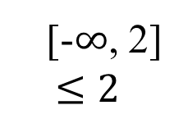
Figure 5.5 Stages in the calculation of the optimal decision for the game tree in Figure 5.2. At each point, we show the range of possible values for each node.
(e) The first leaf below D has a value 14, so D is worth at most 14. This is still higher than MAX’s best alternative (i.e., 3). So we need to keep exploring D’s successor states. Notice that we now have bounds on all of the successors of the root, so the root’s value is also at most 14.
(e)
[3, 14]
$$≥3$$
A
[3, 3]
3
B
[-$∞$, 2]
$$≤2$$
B
[-$∞$, 14]
$$≤14$$
D
3 12 8 2 14

Slide 64
Figure 5.5 Stages in the calculation of the optimal decision for the game tree in Figure 5.2. At each point, we show the range of possible values for each node.
(f) The second successor of D is worth 5, so we need to keep exploring. The third successor is worth 2, so now D is worth exactly 2. MAX’s decision at the root is to move to B, giving a value of 3.
(f)
[3, 3]
A
[3, 3]
B
[-$∞$, 2]
B
[2, 2]
D
3 12 8 2 14 5 2

Slide 65
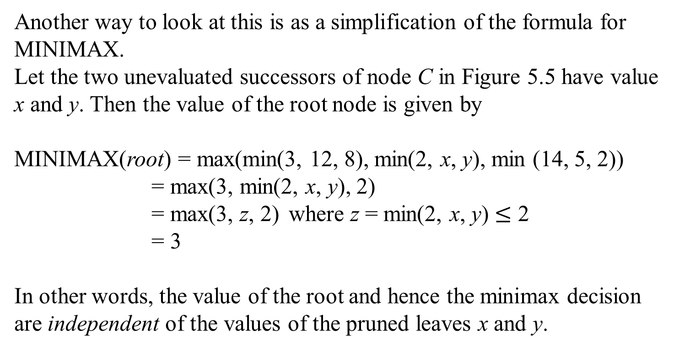
ALPHA-BETA PRUNING
Another way to look at this is as a simplification of the formula for MINIMAX.
Let the two unevaluated successors of node C in Figure 5.5 have value x and y. Then the value of the root node is given by
MINIMAX(root) = max(min(3, 12, 8), min(2, x, y), min (14, 5, 2))
= max(3, min(2, x, y), 2)
= max(3, z, 2) where z = min(2, x, y) $≤$ 2
= 3
In other words, the value of the root and hence the minimax decision are independent of the values of the pruned leaves x and y.

Slide 66
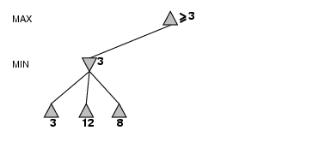
α-β pruning example

Slide 67
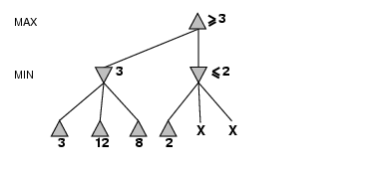
α-β pruning example

Slide 68
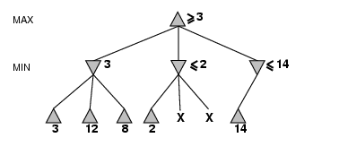
α-β pruning example

Slide 69
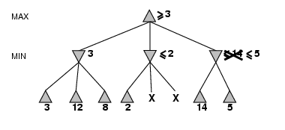
α-β pruning example

Slide 70
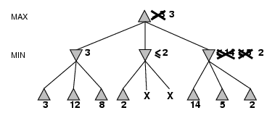
α-β pruning example
Note: order
children matters!
What gives best pruning?
Visit most promising (from min/max perspective) first.

Slide 71
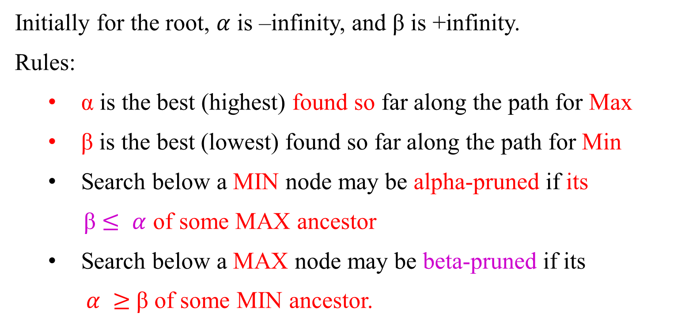
Alpha-Beta Pruning
Initially for the root, $α$ is –infinity, and β is +infinity.
Rules:
α is the best (highest) found so far along the path for Max
β is the best (lowest) found so far along the path for Min
Search below a MIN node may be alpha-pruned if its
β $≤ α$ of some MAX ancestor
Search below a MAX node may be beta-pruned if its
$α ≥$β of some MIN ancestor.

Slide 72
Properties of α-β
Pruning does not affect final result
Good move ordering improves effectiveness of pruning b(e.g., chess, try captures first, then threats, forward moves, then backward moves…)
With "perfect ordering," time complexity = O(b^{m/2})
  → doubles depth of search
A simple example of the value of reasoning about which computations are relevant (a form of metareasoning)

Slide 73
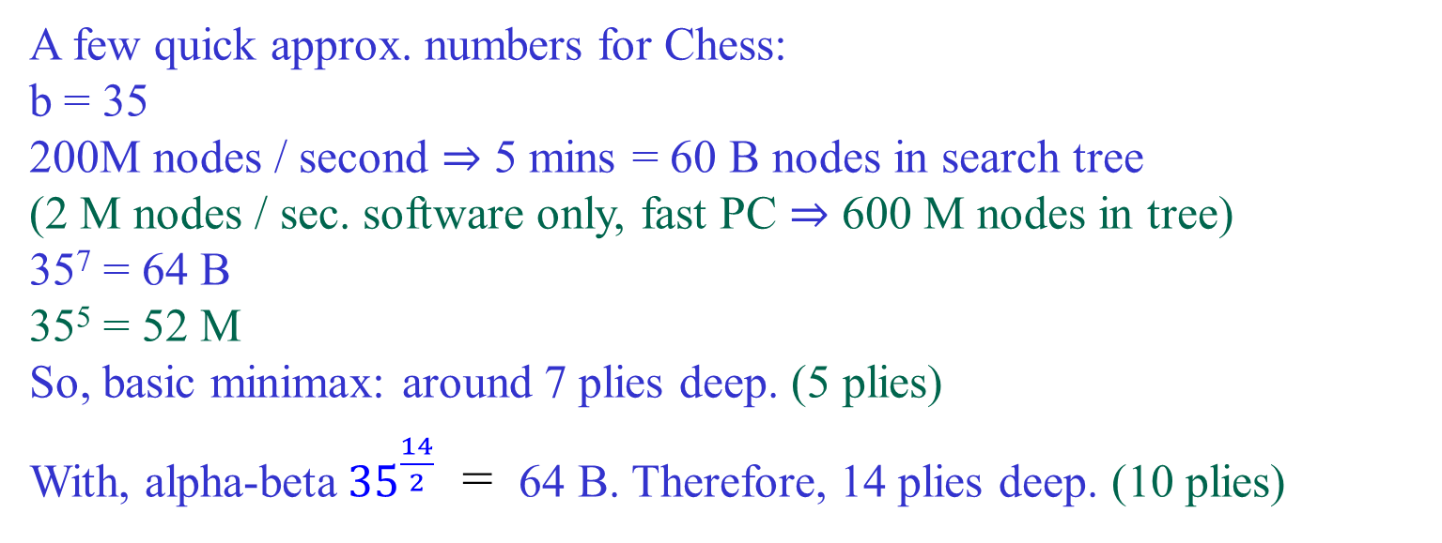
Cutoff Search
A few quick approx. numbers for Chess:
b = 35
200M nodes / second ⇒ 5 mins = 60 B nodes in search tree
(2 M nodes / sec. software only, fast PC ⇒ 600 M nodes in tree)
35⁷ = 64 B
35⁵ = 52 M
So, basic minimax: around 7 plies deep. (5 plies)
With, alpha-beta ${35}^{\frac{14}{2}}$ = 64 B. Therefore, 14 plies deep. (10 plies)
Aside:
4-ply ≈ human novice
8-ply / 10-ply ≈ typical PC, human master
14-ply ≈ Deep Blue, Kasparov (+ depth 25 for
“selective extensions”) / 7 moves by each player.

Slide 74
ALPHA-BETA PRUNING
Alpha-beta pruning can be applied to trees of any depth, and it is often possible to prune entire subtrees rather than just leaves.
The general principle is this:
Consider a node n somewhere in the tree (see Figure 5.6), such that the Player has a choice of moving to that node.
If Player has a better choice m either at the parent node of n or at any choice point further up, then n will never be reached in actual play.
So once we have found out enough about n (by examining some of its descendants) to reach this conclusion, we can prune it.

Slide 75
ALPHA-BETA PRUNING
Figure 5.6 The general case for alpha-beta pruning. If m is better than n for Player, we will never get to n in play.
Player
Opponent
.
.
.
Player
Opponent
m
n

Slide 76
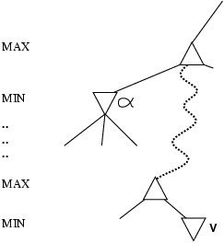
Why is it called α-β?
More abstractly
α is the value of the best (i.e., highest-value) choice found so far at any choice point along the path for MAX
If v is worse than α, MAX will avoid it
  → prune that branch
Define β similarly for MIN
β is the value of the best (i.e., lowest-value) choice found so far at any choice point along the path for MIN.

Slide 77
ALPHA-BETA PRUNING
Alpha-beta search updates the value of α and β as it goes along and prunes the remaining branches at a node (i.e., terminates the recursive call) as soon as the value of the current node is known to be worse than the current α or β value of MAX or MIN, respectively.
The complete algorithm is given in Figure 5.7. It can be trace its behavior when applied to the tree in Figure 5.5.

Slide 78
Properties of Alpa-Beta Prunning
Pruning does not affect final result
The effectiveness of alpha-beta pruning is highly dependent on the order in which the states are examined. For example:
  in Figure 5.5 (e and f), we could not prune any successors of D at all because the worst successors (from the point of view of MIN) were generated first.
  If the third successor D had been generated first, we would have been able to prune the other two.
  This suggests that it might be worthwhile to try to examine first the successors that are likely to be best.
Good move ordering improves effectiveness of pruning b
(e.g., chess, try captures first, then threats, forward moves, then backward moves…)

Slide 79
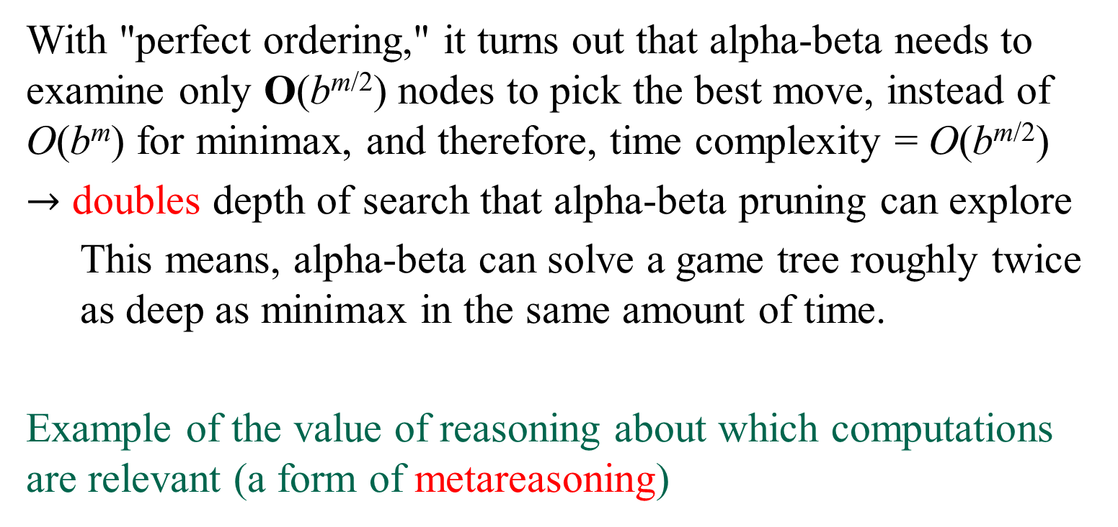
Properties of Alpa-Beta Prunning
With "perfect ordering," it turns out that alpha-beta needs to examine only O(b^{m/2}) nodes to pick the best move, instead of O(b^{m}) for minimax, and therefore, time complexity = O(b^{m/2})
$→$ doubles depth of search that alpha-beta pruning can explore
  This means, alpha-beta can solve a game tree roughly twice as deep as minimax in the same amount of time.
Example of the value of reasoning about which computations are relevant (a form of metareasoning)

Slide 80
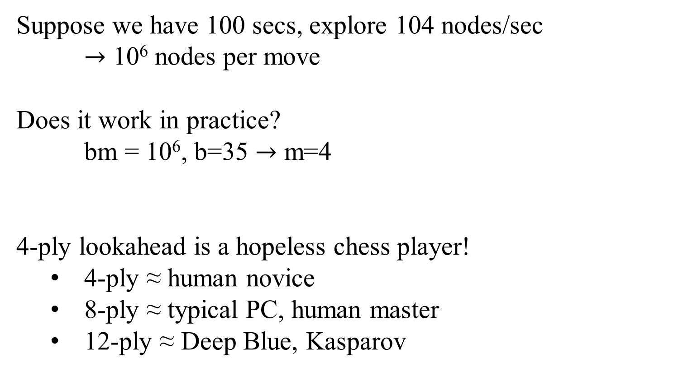
Cutoff Search
Suppose we have 100 secs, explore 104 nodes/sec
$→$ 10⁶ nodes per move
Does it work in practice?
bm = 10⁶, b=35 $→$ m=4
4-ply lookahead is a hopeless chess player!
  4-ply ≈ human novice
  8-ply ≈ typical PC, human master
  12-ply ≈ Deep Blue, Kasparov

Slide 81
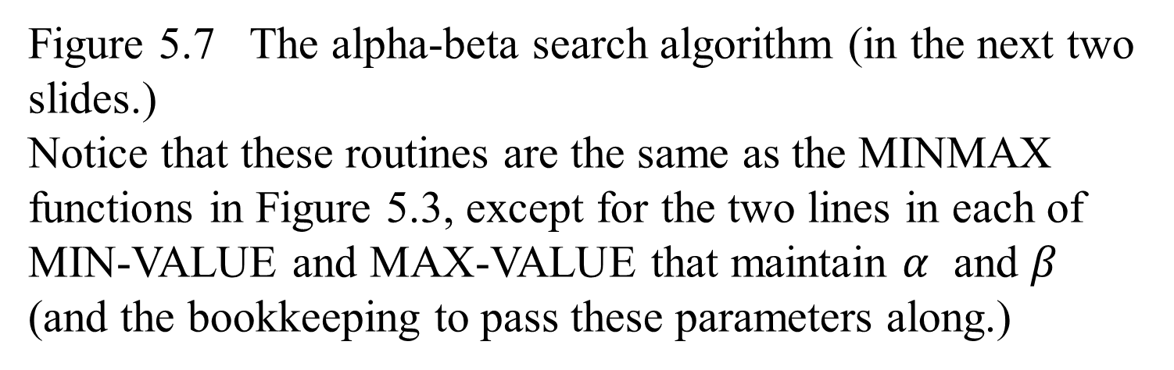
The α-β algorithm
Figure 5.7 The alpha-beta search algorithm (in the next two slides.)
Notice that these routines are the same as the MINMAX functions in Figure 5.3, except for the two lines in each of MIN-VALUE and MAX-VALUE that maintain $α$ and $β$ (and the bookkeeping to pass these parameters along.)

Slide 82
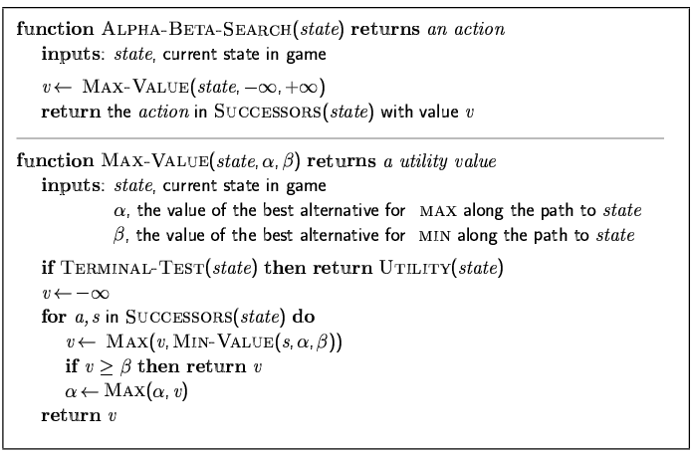
The α-β algorithm

Slide 83
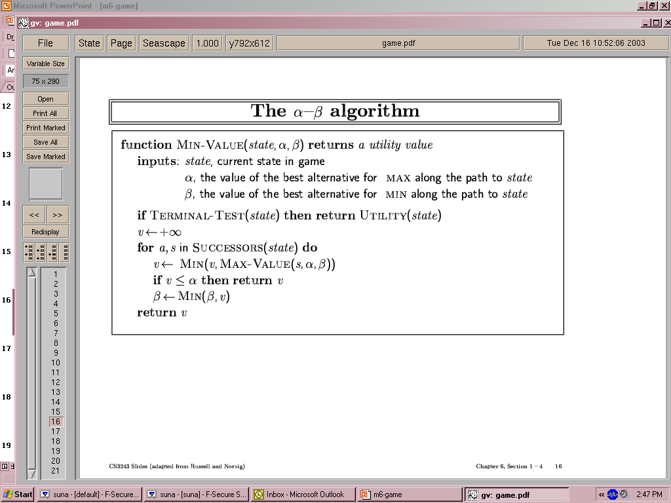
The α-β algorithm

Slide 84
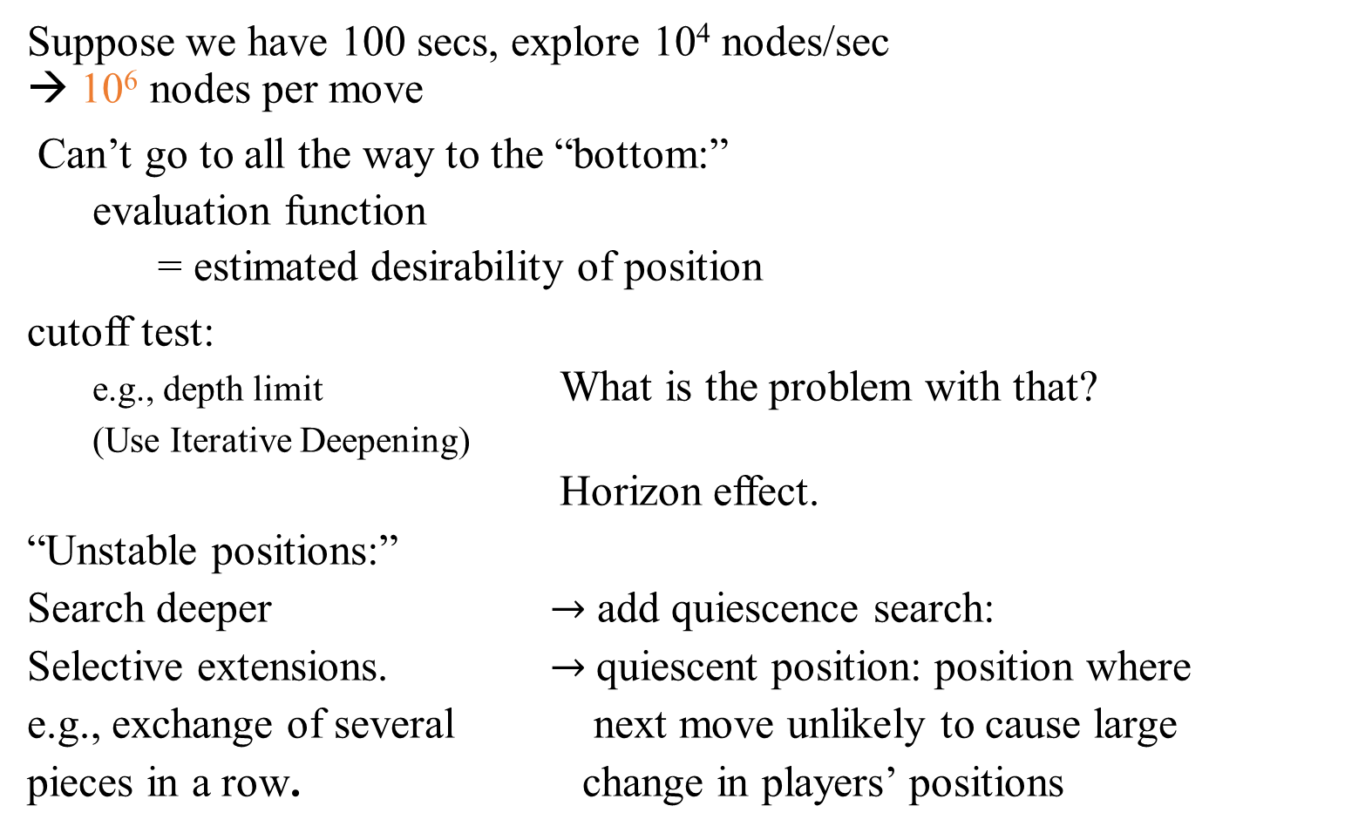
Imperfect Real-Time Decisions - Resource limits
Suppose we have 100 secs, explore 10⁴ nodes/sec
→ 10⁶ nodes per move
Can’t go to all the way to the “bottom:”
  evaluation function
    = estimated desirability of position
cutoff test:
  e.g., depth limit What is the problem with that?
  (Use Iterative Deepening)
  Horizon effect.
“Unstable positions:”
Search deeper $→$ add quiescence search:
Selective extensions. $→$quiescent position: position where
e.g., exchange of several next move unlikely to cause large
pieces in a row. change in players’ positions

Slide 85
Imperfect Real-Time Decisions - Resource limits
Suppose we have 100 secs, explore 10⁴ nodes/sec
→ 10⁶ nodes per move
The minmax algorithm generates the entire game search space, and the alpha-beta algorithm allows us to prune large parts of it. However
  alpha-beta has to search all the way to terminal states for at least a portion of the search space.
  The depth is usually not practical because moves must be made in a reasonable mount of time.
Standard approach: to alter minimax or alpha-beta in two ways:
  replace the utility function by a heuristic evaluation function EVAL, which estimates the position’s utility, and
  replace the terminal test by a cutoff test that decides when to apply EVAL.

Slide 86
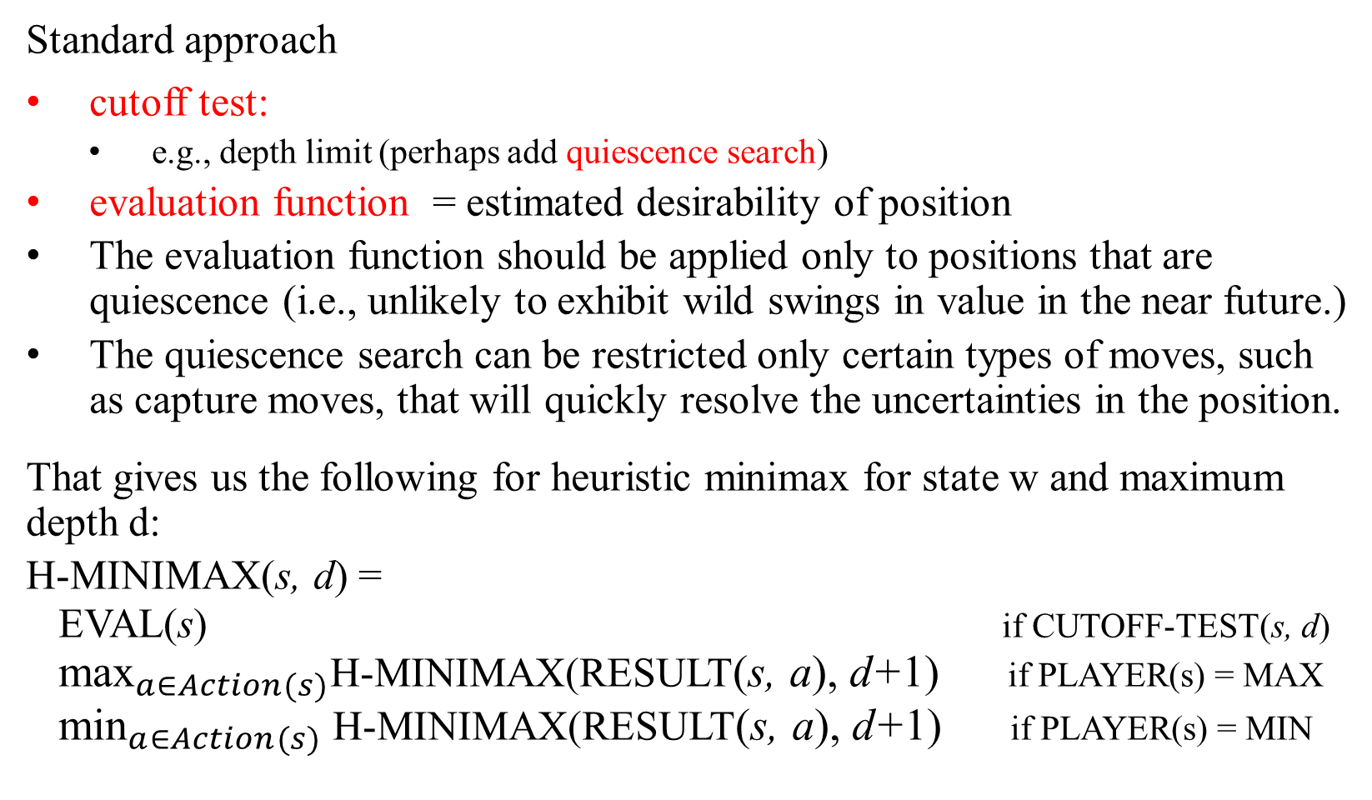
Imperfect Real-Time Decisions - Resource limits
Standard approach
cutoff test:
    e.g., depth limit (perhaps add quiescence search)
  evaluation function = estimated desirability of position
  The evaluation function should be applied only to positions that are quiescence (i.e., unlikely to exhibit wild swings in value in the near future.)
  The quiescence search can be restricted only certain types of moves, such as capture moves, that will quickly resolve the uncertainties in the position.
  That gives us the following for heuristic minimax for state w and maximum depth d:
  H-MINIMAX(s, d) =
EVAL(s) if CUTOFF-TEST(s, d)
${\text{max}}_{a∈Action(s)}$H-MINIMAX(RESULT(s, a), d+1) if PLAYER(s) = MAX
${\text{min}}_{a∈Action(s)}$H-MINIMAX(RESULT(s, a), d+1) if PLAYER(s) = MIN

Slide 87
Evaluation functions
Performed at search cutoff point
Must have same terminal/goal states as utility function
Tradeoff between accuracy and time → reasonable complexity
Accurate
Performance of game-playing system dependent on
accuracy/goodness of evaluation
Evaluation of nonterminal states strongly correlated with actual chances of winning

Slide 88
Evaluation functions
The evaluation functions work by calculating various features of the state –
  for example, in chess, we would have features for the number of the white pawns, black pawns, white queens, black queens, and so on.
For chess, typically linear weighted function which is sum of features
Eval(s) = w₁ f₁(s) + w₂ f₂(s) + … + w_{n} f_{n}(s)
where each w_{i} is a weight and each f_{i} is a feature of the position.
For chess, the f_{i} could be the number of each kind of piece on the board and could be the values of the pieces (1 for pawn, 3 for bishop, etc.).
e.g., w₁ = 9 with
f₁(s) = (number of white queens) – (number of black queens), etc.

Slide 89
Evaluation functions
Key challenge – find a good evaluation features:
  Not just material! (as used by novice)
  Isolated pawns are bad.
  How well protected is your king?
  How much maneuverability to you have?
  Do you control the center of the board?
  Strategies change as the game proceeds
Features are a form of chess knowledge. Hand-coded in eval function.
  Knowledge tightly integrated in search.
  Feature weights: can be automatically tuned (“learned”).
Standard issue in machine learning:
  Features, generally hand-coded; weights tuned automatically.

Slide 90
Cutting off search
MinimaxCutoff is identical to MinimaxValue except
  Terminal? is replaced by Cutoff?
  Utility is replaced by Eval
The next-step is to modify ALPHA-BETA-SEARCH to call the heuristic EVAL function when it is appropriate to cut off the search by
  Replacing the two lines in Figure 5.7 that mention TERMINAL-TEST with the following line:
If CUTOFF-TEST(state, depth) then return EVAL(state)

Slide 91
Cutting off search
MinimaxCutoff is identical to MinimaxValue except
  Terminal? is replaced by Cutoff?
  Utility is replaced by Eval
Does it work in practice?
b^{m} = 10⁶, b=35 → m=4
4-ply lookahead is a hopeless chess player!
  4-ply ≈ human novice
  8-ply ≈ typical PC, human master
  12-ply ≈ Deep Blue, Kasparov

Slide 92
Deterministic games in practice
Checkers: Chinook ended 40-year-reign of human world champion Marion Tinsley in 1994. Used a precomputed endgame database defining perfect play for all positions involving 8 or fewer pieces on the board, a total of 444 billion positions.
Chess: Deep Blue defeated human world champion Garry Kasparov in a six-game match in 1997. Deep Blue searches 200 million positions per second, uses very sophisticated evaluation, and undisclosed methods for extending some lines of search up to 40 ply.
Othello: human champions refuse to compete against computers, who are too good.
Go: human champions refuse to compete against computers, who are too bad. In go, b > 300, so most programs use pattern knowledge bases to suggest plausible moves.

Slide 93
Summary
Games are fun to work on!
They illustrate several important points about AI
perfection is unattainable → must approximate
good idea to think about what to think about

