Slide 1
Chapter 05
Constraint Satisfaction Problems
Artificial Intelligent
Section 1 – 3

Slide 2

Outline
Constraint Satisfaction Problems (CSP)
Backtracking search for CSPs
Local search for CSPs

Slide 3
Review
Standard search problem:
Problems solved by searching in a space of states.
  Evaluate these states by domain-specific, and
  test whether they are goal states.
From the search algorithm’s point of view,
  each state is atomic, or indivisible;
    a “black box” with no internal structure;
  each state employs any data structure that supports the successor function, heuristic (evaluation) function, and goal test

Slide 4

Feature Vectors – for our understanding:
We have
  A set of k variables (or features)
  Each variable has a domain of different values.
  A state is specified by an assignment of a value for each variable.
    height = {short, average, tall},
    weight = {light, average, heavy}
  A partial state is specified by an assignment of a value to some of the variables.
A partial state:
height = tall
weight = ?
A state:
height = tall
weight = light

Slide 5
Example: 8--‐Puzzle
Missionaries and Cannibals
Romania Map
Water Jugs Problem
N-queens Problem
Cell_{1,1} = 2
Cell_{1,2} = 3
Cell_{1,3} = 7
…
Cell_{3,2} = 1
Cell_{3,3} = B
2 | 3 | 7
6 | 4 | 8
5 | 1
state
Variables: 9 variables, Cell_{1,1}, Cell_{1,2}, …, Cell_{3,3}
Values: {‘B’, 1, 2, …, 8}
State: Each “Cell_{i,j}” variable specifies what is in that position of the tile.
          A state is completely specified, if every cell has an assigned value.
This is one of many ways to specify the state.

Slide 6

Constraint Satisfaction Problems
Constraints: These problems may have illegal settings of the variables.
  e.g., each variable in an 8-puzzle must have a distinct value (the same tile can’t be in two positions)
    e.g., Cell_{i,j} = Cell_{m,n} = 5 is illegal settings of the variables
The 8-puzzle problem,
  Gives the feature vector satisfying the goal. (the goal state)
  Cares about the sequence of moves (actions) needed to move the tiles into the goal configuration

Slide 7

Constraint Satisfaction Problems
Many of the CSPs,
do not care about the sequence of moves (actions) needed to get to a goal state.
only care about finding a feature vector (a setting of the variables) that satisfies the goal.
  Goal: A setting of the variables that satisfy some constraints.
2 | 3 | 7
6 | 4 | 8
5 | 1
8 | 7 | 6
5 | 4 | 3
2 | 1
$$→→ …→$$
the goal state

Slide 8

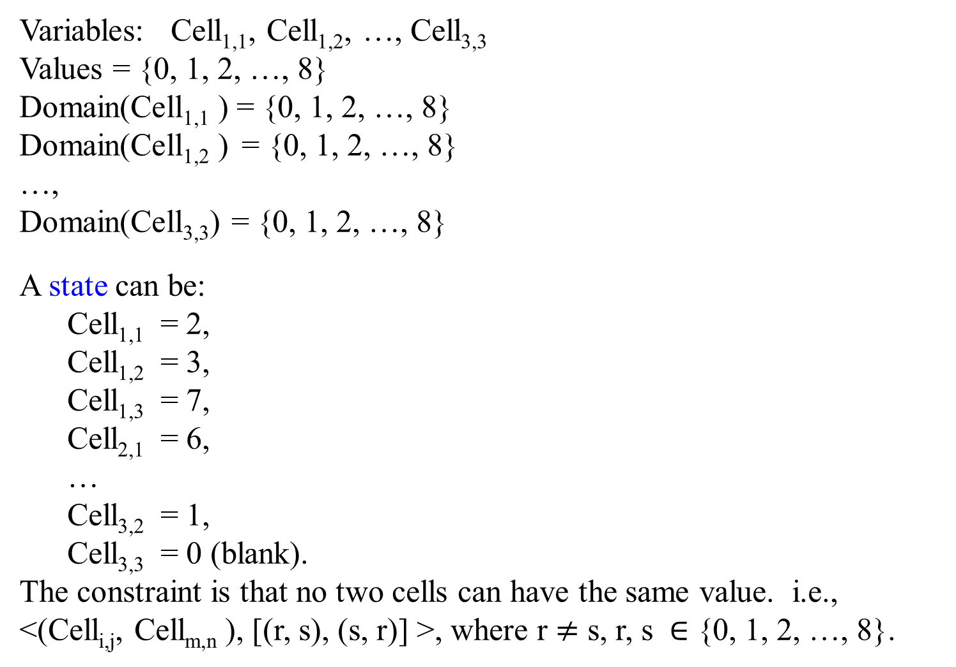
Variables: Cell_{1,1}, Cell_{1,2}, …, Cell_{3,3}
Values = {0, 1, 2, …, 8}
Domain(Cell_{1,1} ) = {0, 1, 2, …, 8}
Domain(Cell_{1,2} ) = {0, 1, 2, …, 8}
…,
Domain(Cell_{3,3}) = {0, 1, 2, …, 8}
A state can be:
  Cell_{1,1} = 2,
  Cell_{1,2} = 3,
  Cell_{1,3} = 7,
  Cell_{2,1} = 6,
  …
  Cell_{3,2} = 1,
  Cell_{3,3} = 0 (blank).
The constraint is that no two cells can have the same value. i.e., <(Cell_{i,j}, Cell_{m,n} ), [(r, s), (s, r)] >, where r $≠$ s, r, s $∈$ {0, 1, 2, …, 8}.
a factored representation for each state
2 | 3 | 7
6 | 4 | 8
5 | 1

Slide 9
Constraint satisfaction problems (CSPs)
CSP:
  state is defined by variables X_{i} with values from domain D_{i}
  goal test is a set of constraints specifying allowable combinations of values for subsets of variables
Simple example of a formal representation language
Allows useful general-purpose algorithms with more power than standard search algorithms

Slide 10
Constraint Satisfaction Problem (CSP)
A way to solve a wide variety of problems efficiently.
  Use a factored representation for each state:
    a set of variables, each of which has a value.
  A problem (CSP problem) is solved
    when each variable has a value that satisfies all the constraints on the variable.

Slide 11
Constraint Satisfaction Problem (CSP)
CSP search algorithms
  take advantage of the structure of states and
  use general-purpose rather than problem-specific heuristics to enable the solution of complex problems.
The main idea is
  to eliminate large portions of the search space by identifying variable/value combinations that violate the constraints.

Slide 12
Formalization of a Constraint satisfaction problem (CSP):
A CSP consists of :
  A set X of variables X_{i}, X = {X₁, …, X_{n} }.
  A set D of domains D_{i}, D = {D₁, …, D_{n} }, one for each variable.
    Each domain D_{i} consists of a set of allowable values, {v₁, …, v_{k} }, for each variable X_{i}. D_{i}[X_{i}] = {v₁, …, v_{k} }.
  A set C of constraints C = {C₁, …, C_{m}}, that specify allowable combinations of values.
  …

Slide 13
Formalization of a Constraint satisfaction problem (CSP):
A CSP consists of X, D, and C:
  …
  A set C of constraints C = {C₁,…, C_{m}}, that specify allowable combinations of values.
    Each constraint C_{i} is defined over a set of variables, called its scope
        e.g., C_{i}(X₁, X₂, X₄) is a constraint over the variables X₁, X₂, and X₄. The scope of C_{i} is {X₁, X₂, X₄}.
    Each constraint C_{i} consists of a pair <scope, rel>, where
      scope is a tuple of variables that participate in the constraint;
      rel is a relation that defines the values assigned to those variables satisfying the constraint.

Slide 14

Formalization of a Constraint satisfaction problem (CSP):
A relation can be represented as
  an explicit list of all tuples of values that satisfy the constraint, or
  an abstract relation that supports two operations:
    testing if a tuple is a member of the relation and
    enumerating the members of the relation.
    For example: Let the domain for both variables, X₁ and X₂ be {A, B}. Then the constraint saying “the two variables must have different values” can be written as a pair <scope, rel>
        < (X₁, X₂), [(A, B), (B, A)] > or
        < (X₁, X₂), X₁ $≠$ X₂ >.
Given an assignment to its variables, the constraint returns:
    True, this assignment satisfies the constraint
    False, this assignment falsifies the constraint.

Slide 15

Formalization of a Constraint satisfaction problem (CSP):
An example of specifying a constraint with a table
  C(X₁, X₂, X₄) is a constraint over the variables X₁, X₂, and X₄ where C(X₁, X₂, X₄) with D₁ [X₁] = {1,2,3} and D₂ [X₂] = D₄ [X₄] = {1, 2}
X₁ | X₂ | X₄ | C(X₁, X₂, X₄) is X₁= X₂ + X₄
1 | 1 | 1 | False
1 | 1 | 2 | False
1 | 2 | 1 | False
1 | 2 | 2 | False
2 | 1 | 1 | True
2 | 1 | 2 | False
2 | 2 | 1 | False
2 | 2 | 2 | False
3 | 1 | 1 | False
3 | 1 | 2 | True
3 | 2 | 1 | True
3 | 2 | 2 | False
Let D₁ [X₁] = {1,2,3} and D₂ [X₂] = D₄ [X₄] = {1, 2}.
Then
C(X₁, X₂, X₄) can be written as
< (X₁, X₂, X₄), X₁= X₂+X₄ >

Slide 16

Formalization of a Constraint satisfaction problem (CSP):
Often we can specify the constraint more compactly with an expression:
C(X₁, X₂, X₄): ( X₁ = X₂ + X₄ )
X₁ | X₂ | X₄ | C(X₁, X₂, X₄)
1 | 1 | 1 | False
1 | 1 | 2 | False
1 | 2 | 1 | False
1 | 2 | 2 | False
2 | 1 | 1 | True
2 | 1 | 2 | False
2 | 2 | 1 | False
2 | 2 | 2 | False
3 | 1 | 1 | False
3 | 1 | 2 | True
3 | 2 | 1 | True
3 | 2 | 2 | False

Slide 17

Formalization of a Constraint satisfaction problem (CSP):
Unary Constraints (over one variable)
  e.g., C(X): X = 2;
  C(Y): Y > 5
Binary Constraints (over two variables)
  e.g., C(X,Y): X + Y < 6
Higher-order constraints: over 3 or more variables.

Slide 18
Solving Constraint satisfaction problems (CSPs):
CPSs are best solved by a specialized version of depth-first search, because CSPs do not require finding a paths (to a goal),
Key intuitions: Solving CSPs,
  build up a solution by searching through the space of partial assignments.
  Does not matter about order for assigning the variables; eventually they all have to be assigned.
    Assign a suitable value for one variable at a time!
    This is the key idea of backtracking search.
  Reject immediately the current partial assignment, when falsify a constraint during the process of building up a solution:
    All extensions of this partial assignment will falsify that constraint, and none of these extensions can be the solutions.

Slide 19
CSP - Constraint satisfaction problem:
For solving CSPs, define a state space and the notion of a solution.
  Each state in a CSP is defined by {X_{i} = v_{i}, X_{j} = v_{j}, …}, an assignment of values to some or all the variables.
  A complete assignment - every variable is assigned.
  A partial assignment - assigns values to only some of the variables.
  An assignment that does not violate constraints is called a consistent or legal assignment.
  A solution to a CSP is a consistent, complete assignment.
    A solution to a CSP is an assignment of a value to each of all the variables such that every constraint is satisfied.
  A CSP is unsatisfiable if no solution exists.

Slide 20
CSP as a Search Problem
A CSP could be viewed as a more traditional search problem
  Initial state: the empty assignment
  Successor function: a value is assigned to any unassigned variable, which does not cause any constraint to return false.
  Goal test: the assignment is complete

Slide 21
Backtracking Search: The Algorithm BT
BT(Level)
  if all variables assigned
    PRINT Value of each Variable
    RETURN for more solutions, or
    EXIT for only one solution
X := PickUnassignedVariable()
Assigned[X] := TRUE
for d := each member of Domain[X] (the domain values of X)
  Value[X] := d
  ConstraintsOK = TRUE
  for each constraint C such that
    a) X is a variable of C and
    b) all other variables of C are assigned:
      if C is not satisfied with the set of current assignments:
        ConstraintsOK = FALSE
      if ConstraintsOk == TRUE:
        BT(Level+1)
Assigned[X]:= FALSE //UNDO as we have tried all of X’s values
return

Slide 22
Backtracking Search
The root has the empty set of assignments
Children of a node are all possible values of some (any) unassigned variable
Root { }
X_{i} = a
X_{i} = b
X_{i} = c
Search stops descending if the assignments on path to the node violate a constraint
X_{j} = 1
X_{j} = 2
Subtree

Slide 23
Backtracking Search
Heuristics are used to determine
  the order in which variables are assigned:
  PickUnassignedVariable( )
  the order of values tried for each variable.
The choice of the next variable can vary from branch to branch, e.g.,
  under the assignment X_{i} = a, we might choose to assign X₄ next, while under X_{i} = b, we might choose to assign X₅ next.
This “dynamically” chosen variable ordering has a tremendous impact on performance.
such as, Q1, Q2, …, Q8
such as, Qi = j

Slide 24
Example: N-Queens
Place N Queens on an N x N chess board so that no Queen can attack any other Queen.
1
2
3
4
5
6
7
8
a | b | c | d | e | f | g | h

Slide 25

Example: N-Queens
Problem formulation:
  N variables (N queens) e.g., N variables: {Q₁, Q₂, …, Q_{N}}
  N² values for each variable representing the positions on the chessboard e.g., Domain(Q_{j}) = {1, 2, 3, …., N²}
    Value i is i^{th} cell counting from the top left as 1, going left to right, top to bottom.
  For example Q₁ has a value 1, Q₂ has a value 15, Q₃ has a value 21, etc.

Slide 26

Example: N-Queens
Q₁ = 1,
Q₂ = 15,
Q₃ = 21,
Q₄ = 32,
Q₅ = 34,
Q₆ = 44,
Q₇ = 54,
Q₈ = 59
1
2
3
4
5
6
7
8
a | b | c | d | e | f | g | h

Slide 27
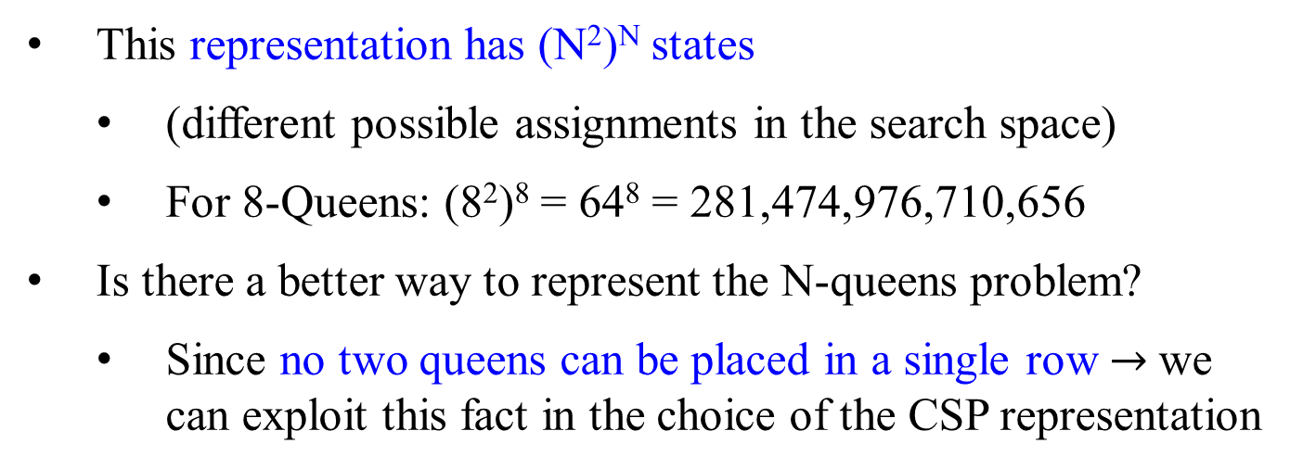
Example: N-Queens
This representation has (N²)^{N} states
  (different possible assignments in the search space)
  For 8-Queens: (8²)⁸ = 64⁸ = 281,474,976,710,656
Is there a better way to represent the N-queens problem?
  Since no two queens can be placed in a single row $→$we can exploit this fact in the choice of the CSP representation
(4²)⁴ = 16*16*16*16
= 256*256
= 65536 choices placing the 4 queens

Slide 28
Example: N-Queens
Better Modeling:
  N variables Q₁, Q₂, …, Q_{i}, …, Q_{n}, one per row.
  Value of Q_{i} is the column the Queen in row i is placed; possible values {1, …, N} columns.
This representation has N^{N} states:
  For 8-Queens: 8⁸ = 16,777,216
The choice of a representation can make the problem solvable or unsolvable!
vs (8²)⁸ = 64⁸ = 281,474,976,710,656
  4⁴ = 256 vs (4²)⁴ = 16⁴ = 65536

Slide 29
Example: N-Queens
8⁰
8¹
Q₁ = 1,
Q₂ = 7,
Q₃ = 5,
Q₄ = 8,
Q₅ = 2,
Q₆ = 4,
Q₇ = 6,
Q₈ = 3
1
2
3
4
5
6
7
8
8²
8³
Variable = Value
a | b | c | d | e | f | g | h

Slide 30
Example: N-Queens
Constraints: Let i and j be rows. Let Q_{i} and Q_{j} be columns.
Let Q_{i} be the column the Queen placed in row i.
  Can’t put two Queens in the same column
    Q_{i} ≠ Q_{j} for all i ≠ j
  Diagonal constraints
    abs(Q_{i} - Q_{j}) ≠ abs(i - j)
    i.e., the difference in the values assigned to Q_{i} and Q_{j} can’t be equal to the difference between i and j.

Slide 31
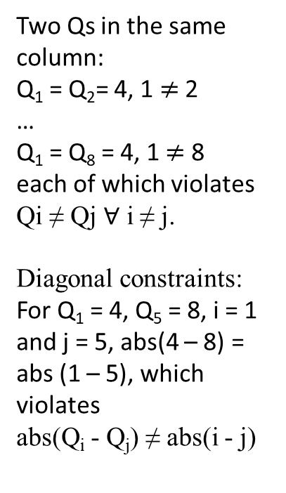
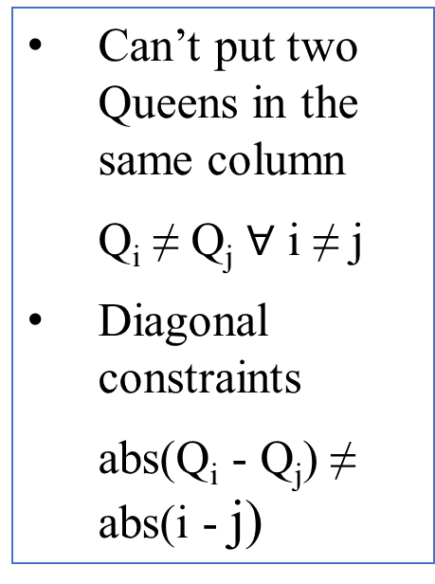
Example: N-Queens
Place N Queens on an N x N chess board so that no Queen can attack any other Queen.
1
2
3
4
5
6
7
8
Two Qs in the same column:
Q₁ = Q₂= 4, 1 $≠$ 2
…
Q₁ = Q₈ = 4, 1 $≠$ 8
each of which violates
  Qi ≠ Qj $∀$ i ≠ j.
  Diagonal constraints:
For Q₁ = 4, Q₅ = 8, i = 1 and j = 5, abs(4 – 8) = abs (1 – 5), which violates
  abs(Q_{i} - Q_{j}) ≠ abs(i - j)
Can’t put two Queens in the same column
  Q_{i} ≠ Q_{j} $∀$ i ≠ j
Diagonal constraints
  abs(Q_{i} - Q_{j}) ≠ abs(i - j)
_{a}1 | _{b}2 | _{c}3 | _{d}4 | _{e}5 | _{f}6 | _{g}7 | _{h}8

Slide 32
Example: N-Queens
4⁰
abs(Q_{i} - Q_{j}) ≠ abs(i - j)
4¹
4²
Q_{i} ≠ Q_{j} for all i ≠ j
4³
4⁴

Slide 33
Example: N-Queens

Slide 34
Example: N-Queens
Solution

Slide 35
Example: N-Queens Backtracking Search Space

Slide 36
Example: N-Queens Backtracking Search Space
Continue from previous viewgraph
Solution

Slide 37
Problems with Plain Backtracking
In the backtracking search we won’t detect that a cell has no possible value until all variables of the row/column or the subsquare constraint are assigned. So we have the following situation:
Leads to the idea of constraint propagation
A variable has no possible value. But we don’t detect this until we try to assign it a value

Slide 38
Constraint Propagation
Constraint propagation - A technique of “looking ahead” at those unassigned variables in the search.
  Try to detect obvious failures:
    “Obvious” means things we can test/detect efficiently.
  Be able to eliminate some possible parts of the future search. e.g., an example in previous slides.

Slide 39
Constraint Propagation
Apply propagation potentially at every node of the search tree, during the search.
Propagation is an inference step that needs some resources (such as time and space)
  The slow propagation, if it is, can slow down the search.
  Can take more time if propagation is used for finding a solution.
  There is a tradeoff between searching fewer nodes in the search and having a higher nodes (seconds) processing rate.
Consider two main types of propagation:
  Forward Checking & Generalized Arc Consistency
Such as A*,

Slide 40


Slide 41


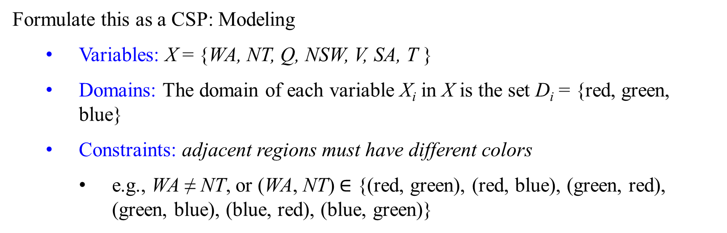
Example: Map-Coloring
Fig 6.1 (a) The principal states and territories of Australia.
The goal is to assign colors (values) to each region (variable) either red, green, or blue with the constraint that no neighboring regions have the same color.
NT
Q
WA
SA
NSW
V
Formulate this as a CSP: Modeling
  Variables: X = {WA, NT, Q, NSW, V, SA, T }
  Domains: The domain of each variable X_{i} in X is the set D_{i} = {red, green, blue}
  Constraints: adjacent regions must have different colors
    e.g., WA ≠ NT, or (WA, NT) $∈$ {(red, green), (red, blue), (green, red), (green, blue), (blue, red), (blue, green)}
T

Slide 42

Example: Map-Coloring
Fig 6.1 (a) The principal states and territories of Australia.
The task of coloring each region is either red, green, or blue with the constraint that no neighboring regions have the same color.
NT
Q
WA
SA
NSW
Formulate this as a CSP:
Variables: X = {WA, NT, Q, NSW, V, SA, T }
Domains: D_{i} = {red, green, blue}
Constraints: C = {<(SA, WA), SA $≠$ WA>, <(SA, NT), SA $≠$NT>, <(SA, Q), SA $≠$Q>, <(SA, NSW), SA $≠$NSW>, <(SA, V), SA $≠$V>, <(WA, NT), WA $≠$ NT>, <(NT, Q>), NT $≠$Q>, <(Q, NSW), Q $≠$NSW>, <(NSW, V), NSW $≠$V>}
    e.g., WA ≠ NT, or (WA, NT) can be fully enumerated in turn as {(red, green), (red, blue), (green, red), (green, blue), (blue, red), (blue, green)}
One of the possible solutions is {WA = red, NT = green, Q = red, NSW = green, V = red, SA = blue, T = red }
V
T

Slide 43
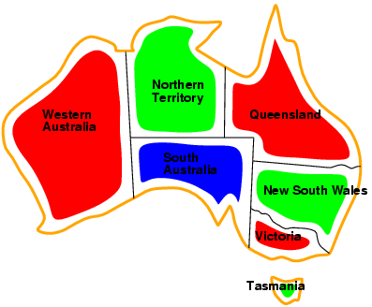
Example: Map-Coloring
Complete assignment: every variable is assigned to a value
Consistent assignment: the assignment does not violate any constraints.
Solutions are complete and consistent assignments,
  e.g., WA = red, NT = green, Q = red, NSW = green, V = red, SA = blue, T = green.

Slide 44
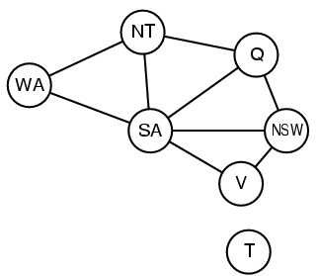
Constraint graph
- Visualize a CSP as a constraint graph
Binary CSP: each constraint relates at most two variables
Constraint graph: nodes are variables, arcs/edges show constraints
General-purpose CSP methods use the graph structure to speed up the search
Tasmania is an independent subproblem
NT
Q
WA
SA
Fig 6.1(b) The map-coloring problem represented as a constraint graph.
NSW
V
T

Slide 45


Why formulate a problem as a CSP?
A CSP solvers can be faster than state-space searchers.
Reason: the CSP solver eliminates early large swatches of the search space.
  e.g., in the Australia problem, once {SA $=$blue} is selected, none of the five neighboring variables can take on the value blue.
    Without applying constraint propagation, a search procedure would have to consider 3⁵ = 243 assignments for the five neighboring variables;
    with constraint propagation, we never have to consider blue as a value, so we have only 2⁵ = 32 assignments to look at, a reduction of 87%

Slide 46
B
R | R | R | R | R |  | R | G | R | R | R |  | G | R | R | R | R |  | G | G | R | R | R
R | R | R | R | G | 2¹ | R | G | R | R | G |  | G | R | R | R | G |  | G | G | R | R | G
R | R | R | G | R |  | R | G | R | G | R |  | G | R | R | G | R |  | G | G | R | G | R
R | R | R | G | G | 2² | R | G | R | G | G |  | G | R | R | G | G |  | G | G | R | G | G
R | R | G | R | R |  | R | G | G | R | R |  | G | R | G | R | R |  | G | G | G | R | R
R | R | G | R | G |  | R | G | G | R | G |  | G | R | G | R | G |  | G | G | G | R | G
R | R | G | G | R |  | R | G | G | G | R |  | G | R | G | G | R |  | G | G | G | G | R
R | R | G | G | G |  | R | G | G | G | G |  | G | R | G | G | G |  | G | G | G | G | G
 |  | 2³ |  |  |  |  | 2⁴ |  |  |  |  |  |  |  |  |  |  | 2⁵
2⁵ = 32 assignments

Slide 47
B | B | B | B | B |  | B | B | R | B | B |  | B | B | G | B | B
B | B | B | B | R |  | B | B | R | B | R |  | B | B | G | B | R
B | B | B | B | G |  | B | B | R | B | G |  | B | B | G | B | G
B | B | B | R | B |  | B | B | R | R | B |  | B | B | G | R | B
B | B | B | R | R |  | B | B | R | R | R |  | B | B | G | R | R
B | B | B | R | G |  | B | B | R | R | G |  | B | B | G | R | G
B | B | B | G | B |  | B | B | R | G | B |  | B | B | G | G | B
B | B | B | G | R |  | B | B | R | G | R |  | B | B | G | G | R
B | B | B | G | G |  | B | B | R | G | G |  | B | B | G | G | G
 |  |  | 3² |  |  |  |  |  |  |  |  |  |  | 3³ |  |  |  |  | 3⁴ |  |  |  | 3⁵
 |  |  | 9 |  |  |  |  |  |  |  |  |  |  | 27 |  |  |  | 27 | 27 | 2 7 |  | 81 | 81 | 81
 |  |  |  |  |  |  |  |  |  |  |  |  |  |  |  |  |  |  | 81 |  |  |  | 243
³⁵ = 243 assignments

Slide 48

Why formulate a problem as a CSP?
In regular state-space search we can only ask:
    Is this specific state a goal? No? What about this one?
With CSPs, when a partial assignment (inconsistent occurs after assigning values to only some of the variables) is found, this assignment is not a solution.
    discard further refinements of the partial assignment immediately.
    can see why the assignment is not a solution and
    which variable violates a constraint
    Then, we can focus attention on the variables that matter.
As a result, many problems that are intractable for regular state-space search can be solved quickly when formulated as a CSP.

Slide 50

CSP: Constraint Satisfaction Problems - recall
Define A CSP in terms of a set of variables,
  set of possible values for each variable, and
  set of constraints.
A solution to the CSP is an assignment of values to all the
variables (i.e., complete) so that all constraints are satisfied
(no “violated constraints.” i.e., consistent)
A CSP is inconsistent if no such solution exists for satisfying the given constraints.
e.g., try to place 9 non-attacking queens on an 8 x 8
board.

Slide 51

CSP: Constraint Satisfaction Problems - recall
Set of variables {X₁, X₂, …, X_{n}}
Each variable X_{i} has a domain D_{i} of possible values
  Usually D_{i} is discrete and finite
Set of constraints {C₁, C₂, …, C_{p}}
Each constraint C_{k} involves a subset of variables (the scope of C_{k}) and specifies the allowable combinations of values of
these variables
Goal: Assign a value to every variable (complete) such that all constraints are satisfied (consistent)

Slide 52
Varieties of CSPs
e.g., #variables = 8 queens (n)
Domain size d = 8 columns (d)
Discrete variables
  finite domains:
    n variables, domain size d → O(d^{n}) complete assignments
    e.g., Boolean CSPs, including Boolean satisfiability (NP-complete)
  infinite domains:
    integers, strings, etc.
    e.g., job scheduling, variables are start/end days for each job
    need a constraint language, e.g., StartJob₁ + 5 ≤ StartJob₃
    linear constraints solvable, nonlinear undecidable
Continuous variables
  e.g., start/end times for Hubble Space Telescope observations
  linear constraints solvable in polynomial time by linear programming methods

Slide 53

Varieties of constraints
Unary constraints involve a single variable,
  e.g., SA ≠ green
Binary constraints involve pairs of variables,
  e.g., SA ≠ WA
Higher-order constraints involve 3 or more variables,
  e.g., cryptarithmetic column constraints
Preferences are soft constraints
  e.g., red is better than green
often representable by a cost for each variable assignment
  → constrained optimization problems
Knapsacks

Slide 54
Example: Cryptarithmetic
Cryptarithmetic problems are
numbers are replaced with alphabets.
By using standard arithmetic rules we need to decipher the alphabet.
Consider a cryptarithmetic problem in Figure 6.2 of the following slide.
Each letter stands for a distinct digit;
find a substitution of digits for letters such that the resulting sum is arithmetically correct, with the added restriction that no leading zeroes are allowed.
The constraint hypergraph for the cryptarithmetic problem,
  the alldiff constraint (square box at the top)
  the column addition constraints (four square boxes in the middle).
  The variables X₁, X₂, and X₃ represent the carry digits for the three columns.

Slide 55
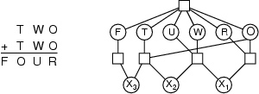
Example: Cryptarithmetic
the alldiff constraint
column addition constraints
the carry digits
Variables: F, T, U, W, R, O, X₁, X₂ , X₃
Domains: {0, 1, 2, 3, 4, 5, 6, 7, 8, 9}
Constraints: Alldiff (F, T, U, W, R, O)
  O + O = R + 10 · X₁
  X₁ + W + W = U + 10 · X₂
  X₂ + T + T = O + 10 · X₃
  X₃ = F, T ≠ 0, F ≠ 0

Slide 56
Example: Cryptarithmetic
8 6 7
+ 8 6 7
1 7 3 4
Variables: F, T, U, W, R, O, X₁, X₂ , X₃
Domains: {0, 1, 2, 3, 4, 5, 6, 7, 8, 9}
Constraints: Alldiff (F, T, U, W, R, O)
  O + O = R + 10 · X₁
  X₁ + W + W = U + 10 · X₂
  X₂ + T + T = O + 10 · X₃
  X₃ = F, T ≠ 0, F ≠ 0
F = 1; T = 8;
U = 3; W = 6;
R = 4; O = 7;
X1 = X2 = X3 = 1

Slide 57
Real-world CSPs
Assignment problems
  e.g., who teaches what class
Timetabling problems
  e.g., which class is offered when and where?
Hardware configuration
Transportation scheduling
Factory scheduling
Floor planning
Notice that many real-world problems involve real-valued variables

Slide 58
Application of Graph Coloring
Lots of applications involving scheduling and assignments.
Scheduling of final exams –
nodes represent finals, and
edges between finals denote that both finals have common students.
(Thus, they have to have different colors or different periods).
I 1, 5
II 2, 6
III 3
IV 4, 7
1
7 2
3
5 4
Graph of finals for 7 courses
1
7 2
6 3
5 4
Time Period →courses
I (red) → 1, 6
II (blue) → 2
III (green) → 3, 5
IV (black) → 4, 7

Slide 59
Standard search formulation (incremental)
Begin with a basic, naïve, straightforward approach, and then improve it or fix it.
View a CSP as a more traditional search problem.
Define states by the values assigned so far
  Initial state: the empty assignment { }
  Successor function: assign a value to an unassigned variable that does not conflict with the current assignment
    → fail if no legal assignments (not fixable!)
  Goal test: the current assignment is complete
This is the same for all CSPs
Every solution appears at depth n with n variables
→ use depth-first search
Path is irrelevant, so can also use complete-state formulation
With the domain of size d, branching factor b = (n − ℓ)d at depth ℓ, hence n!d^{n} leaves .
Each variable
o o o o o *4
o o o o *4
o o o *4
o o *4
o *4
20*16*12*8*4
= (5*4*3*2*1)4
At l=0, b=(5-0)4 = 20
At l=1, b=(5-1)4 = 16
At l=2, b=(5-2)4 = 12
At l=3, b=(5-3)4 = 8
At l=4, b=(5-4)4 = 4
At l=5, b=(5-5)4 = 0
n!d^{n} leaves
= 5!4⁵ leaves

Slide 60
Backtracking search
2⁰
2¹
2²
2³
Variable assignments are commutative
i.e., [WA = r then NT = g] same as [NT = g then WA = r]
Only need to consider assignments to a single variable at each node
⇒ b = d and there are d^{n} leaves [e.g., 3⁵ = 243 ]
Depth-first search for CSPs with single-variable assignments is called a backtracking search
Backtracking search is the basic uninformed algorithm for CSPs
  Can solve n-queens for n ≈ 25. (n²)^{n} states reduced to n^{n}

Slide 61
The following slide is Figure 6.5. A simple backtracking algorithm for constraint satisfaction problems.
The algorithm is modeled on the recursive depth-first search of chapter 03:
Modify the function SELECT-UNASSIGNED-VARIABLE and ORDER-DOMAIN-VALUES, we can implement the general-purpose heuristics.
Optionally use the function INFERENCE to impose arc-, path-, or k-consistency, as desired.
Remove value assignments (including those made by INFERENCE) from the current assignment, if a value choice leads to failure (noticed either by INFERENCE or by BACKTRACK), and then try a new value.

Slide 62
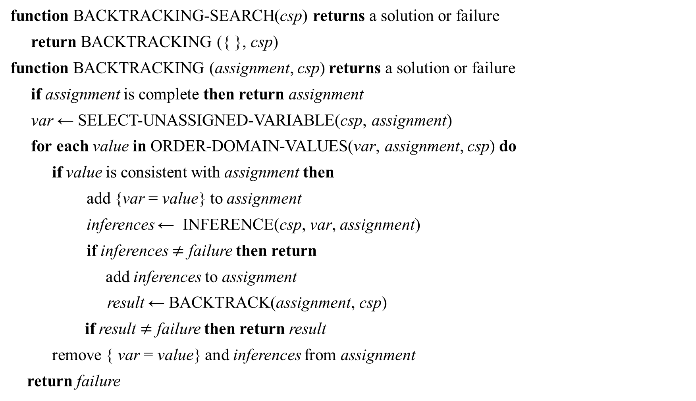
Backtracking search
function BACKTRACKING-SEARCH(csp) returns a solution or failure
return BACKTRACKING ({ }, csp)
function BACKTRACKING (assignment, csp) returns a solution or failure
if assignment is complete then return assignment
var ← SELECT-UNASSIGNED-VARIABLE(csp, assignment)
for each value in ORDER-DOMAIN-VALUES(var, assignment, csp) do
if value is consistent with assignment then
add {var = value} to assignment
inferences ← INFERENCE(csp, var, assignment)
if inferences $≠$ failure then return
add inferences to assignment
result ← BACKTRACK(assignment, csp)
if result $≠$ failure then return result
remove { var = value} and inferences from assignment
return failure

Slide 63

Solving CSP by Search: Backtracking search
BFS vs. DFS
BFS - not a good idea.
  Reduction by commutativity of CSP
    A solution is not in the permutations but in combinations.
    A tree with d^{n} leaves
DFS
  Used popularly
    Every solution must be a complete assignment and appear at depth n if there are n variables
    The search tree extends only to depth n.
  A variant of DFS: Backtrack search
    Chooses values for one variable at a time
    Backtracks when failed even before reaching a leaf
  Better than BFS due to backtracking but still need more “cleverness” (reasoning/propagation)

Slide 64

Backtrack Search
empty assignment
1st variable
2nd variable
3rd variable
Assignment = { }

Slide 65

Backtrack Search
Variables = {var1, var2, var3, ….}.
D_{var1} = {v11, v12}. D_{var2} = {v21, v22}. D_{var3} = {v31, v32}. …
empty assignment
1st variable
2nd variable
3rd variable
Assignment = {(var1=v11)}

Slide 66
Backtrack Search
empty assignment
1st variable v11
2nd variable v21
3rd variable
Assignment = {(var1=v11), (var2=v21)}
2³

Slide 67
Backtrack Search
empty assignment
1st variable v11
2nd variable v21
3rd variable v31
Assignment = { (var1=v11), (var2=v21), (var3=v31) }

Slide 68
Backtrack Search
empty assignment
1st variable v11
2nd variable v21
v32
3rd variable
Assignment = {(var1=v11), (var2=v21) , (var3=v32) }

Slide 69
Backtrack Search
empty assignment
1st variable v11
2nd variable v22
3rd variable
Assignment = {(var1=v11), (var2=v22)}

Slide 70
Backtrack Search
empty assignment
1st variable v11
2nd variable v22
3rd variable v31
Assignment = {(var1=v11), (var2=v22), (var3=v31)}

Slide 71
Backtrack Search
empty assignment
1st variable v11
2nd variable v22
3rd variable v32
Assignment = {(var1=v11), (var2=v22), (var3=v32)}

Slide 72
Backtrack Search
empty assignment
1st variable v12
2nd variable
3rd variable
Assignment = {(var1=v12)}

Slide 73
Backtrack Search
Using preorder traversal
empty assignment
1st variable v12
2nd variable v21
3rd variable
Assignment = {(var1=v12), (var2=v21)}

Slide 74
Backtrack Search
Using preorder traversal
empty assignment
1st variable v12
2nd variable v21
v31
3rd variable
Assignment = {(var1=v12), (var2=v21), (var3=v31)}

Slide 75
Backtrack Search
Using preorder traversal
empty assignment
1st variable v12
2nd variable v21
3rd variable v32
Assignment = {(var1=v12), (var2=v21), (var3 = v32)}

Slide 76
Backtrack Search
Using preorder traversal
empty assignment
1st variable v12
2nd variable v22
3rd variable
Assignment = {(var1=v12), (var2=v22)}

Slide 77
CSPs vs Search Problems
States and goal test have a standard representation.
Define states as variables X_{i} with values from domain D_{i}
Goal test is a set of constraints specifying allowable combinations of values for subsets of variables
Interesting tradeoff:
Constraints can use a formal representation language.
Allows useful general-purpose algorithms more powerful than standard search algorithms that have to resort to problem-specific heuristics to enable solutions to large problems.

Slide 78

CSPs vs Search Problems
Key issue:
For search problems:
  treat nodes in search trees as “black boxes,”
  only looked inside to check its heuristic value or
    whether the node is a goal state.
In CSPs,
  “look inside the nodes” and exploit the problem structure during the search.
  Sometimes, reasoning or inference (“propagation techniques”) will lead us to find solutions without any search!

Slide 79

Example: N-Queens
The standard NxN Queen’s problem asks how to place N Queens on an N x N chess board so that no Queen can attack any other Queen.
1
2
3
4
5
6
7
8
1 | 2 | 3 | 4 | 5 | 6 | 7 | 8

Slide 80

How do we search for a solution (CSP)?
Start with an empty variable assignment (no vars assigned).
  Then build up partial assignments until all variables vars are assigned.
Action: “assign a variable with a value.”
Goal test: “all vars assigned and no constraint violation.”
What is the search space? (n vars, each with d possible values)
  Top-level branching: n . d
  Next branching: (n-1) . d
  Next branching: (n-2) . d
  …
  Bottom level: 1 . d
“Only” n^{d} distinct value assignments!
Different var ordering can lead to the same assignment! Wasteful…
Just “fix” a variable ordering: Backtrack search.
Check only n^{d} full var-value assignments.
With the domain of size d, branching factor b = (n − ℓ)d at depth ℓ, hence n!d^{n} leaves.

Slide 81

Backtracking search
Aside: “legal” and “feasible”
Already assumes a bit of “reasoning.” (Next.)
There are many improvements on intuitive idea…
x | x | x | x
x |  | x | x | x
x |  | x |  | x | x
Intuitive: Let X_{i} be the column for a queen at i^{th} row.
Fix some ordering on the variables. e.g., X₁, X₂, X₃ …-c
Fix some ordering on possible values. e.g., 1, 2, 3, … -r
Assign the first variable, the first (legal) value.
Assign the next variable, its first (legal) value.
etc.
Until no remaining (feasible) value exists for variable X_{i},
backtrack to the previous var setting of X_{i-1} and try the next possible setting.
If none exists, move back to another level. etc.

Slide 82

Example: N-Queens
N=8 (another solution)
1
2
3
4
5
6
7
8
1 | 2 | 3 | 4 | 5 | 6 | 7 | 8

Slide 83

Backtracking search
Can a search program figure out that you can’t place 101 queens on a 100x100 board? --- huge state spaces vs complete and consistent
Not so easy! Most search approaches can’t. Need much more clever reasoning, instead of just searching. (Need to use the Pigeon Hole principle.)
Aside: Factored representation does not even allow one to ask the question. (Knowledge is built in.) [a reason is that D has to be {1, 2, …, 101} for all i.]
Alternative question: With N queens, is there a solution with the queen in the bottom right corner on a N x N board?
.
Reason for no solution if x₈ = 8.: For n = 8, D(x_{i} }= |{1,2, …, 7} – {i}| = 6, 1 $≤$ i $≤$ 7}. There is no way to assign distinctly one of the six values to one of seven variables.
The Pigeon Hole principle state: if there are more pigeons than pigeonholes, then there must be at least one pigeonhole with at least two pigeons in it.

Slide 84

Partially Filled N-queens
The N-queens problem is easy when we start with an empty, board.
What about if we pre-assign some queens and ask for a completion? (No soln if pre-assigned queens sit in the positions permanently.
Similar Problem: Sudoku Puzzles

Slide 85
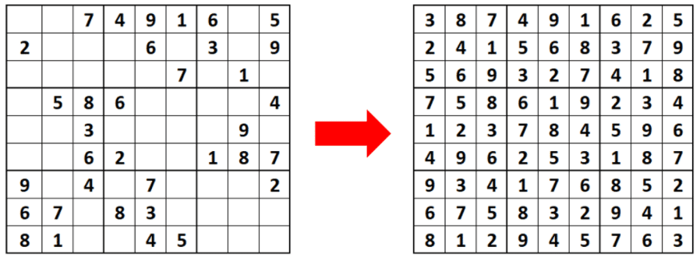
Partially Filled N-queens
The N-queens problem is easy when we start with an empty, board.
What about if we pre-assign some queens and ask for a completion?
Similar Problem: Sudoku Puzzles
Sudoku is a logic-based, combinatorial number-placement puzzle. In classic Sudoku, the objective is to fill a 9 × 9 grid with digits so that each column, each row, and each of the nine 3 × 3 subgrids that compose the grid contain all of the digits from 1 to 9.

Slide 86

Reasoning, Inference or Propagation.
Message: CSP propagation techniques can dramatically reduce the search. Sometimes to no search at all! e.g., Sudoku puzzles.
After placing the first queen, what would you do for the 2nd?

Slide 87

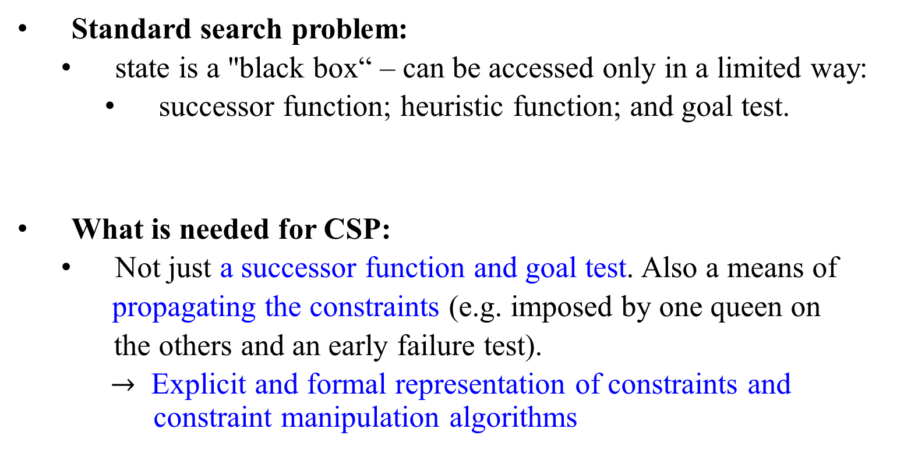
General Search vs. Constraint Satisfaction Problems (CS)s
Standard search problem:
  state is a "black box“ – can be accessed only in a limited way:
    successor function; heuristic function; and goal test.
What is needed for CSP:
  Not just a successor function and goal test. Also a means of
  propagating the constraints (e.g. imposed by one queen on
  the others and an early failure test).
  $→$ Explicit and formal representation of constraints and constraint manipulation algorithms

Slide 88


Motivational Example: 8-Queens
row $±$ column = value_{row, column}
N=8 (another solution)
x – y = 1
x – y =0
8
7
6
5
4
3
2
x=1
x + y = 10
How do we represent 8-Queens
as a CSP:
Variables?
Constraints?
Note: More than one option.
y=1 | 2 | 3 | 4 | 5 | 6 | 7 | 8
x – y= -5

Slide 89

x – y = entry
7 | 6 | 5 | 4 | 3 | 2 | 1 | 0
6 | 5 | 4 | 3 | 2 | 1 | 0 | -1
5 | 4 | 3 | 2 | 1 | 0 | -1 | -2
4 | 3 | 2 | 1 | 0 | -1 | -2 | -3
3 | 2 | 1 | 0 | -1 | -2 | -3 | -4
2 | 1 | 0 | -1 | -2 | -3 | -4 | -5
1 | 0 | -1 | -2 | -3 | -4 | -5 | -6
0 | -1 | -2 | -3 | -4 | -5 | -6 | -7
X = 8
X = 7
X = 6
X = 5
X = 4
X = 3
X = 2
X = 1
Another way for
representing
Constraints?
y = 1 2 3 4 5 6 7 8

Slide 90
x + y = entry
9 | 10 | 11 | 12 | 13 | 14 | 15 | 16
8 | 9 | 10 | 11 | 12 | 13 | 14 | 15
7 | 8 | 9 | 10 | 11 | 12 | 13 | 14
6 | 7 | 8 | 9 | 10 | 11 | 12 | 13
5 | 6 | 7 | 8 | 9 | 10 | 11 | 12
4 | 5 | 6 | 7 | 8 | 9 | 10 | 11
3 | 4 | 5 | 6 | 7 | 8 | 9 | 10
2 | 3 | 4 | 5 | 6 | 7 | 8 | 9
x = 8
x = 7
x = 6
x = 5
x = 4
x = 3
x = 2
x = 1
Another way for
representing
Constraints?
y = 1 2 3 4 5 6 7 8

Slide 91

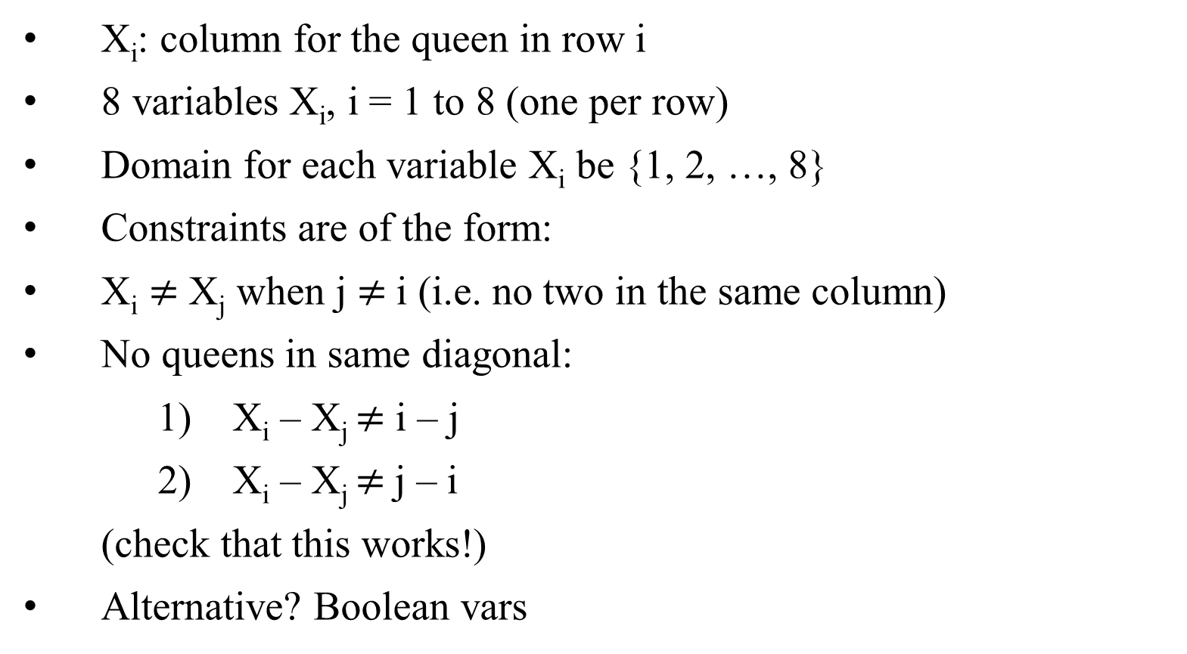
8-Queens Problem as CSP
X_{i}: column for the queen in row i
8 variables X_{i}, i = 1 to 8 (one per row)
Domain for each variable X_{i} be {1, 2, …, 8}
Constraints are of the form:
  X_{i} $≠$ X_{j} when j $≠$i (i.e. no two in the same column)
  No queens in same diagonal:
    1) X_{i} – X_{j} $≠$ i – j
    2) X_{i} – X_{j} $≠$j – i
  (check that this works!)
Alternative? Boolean vars

Slide 92

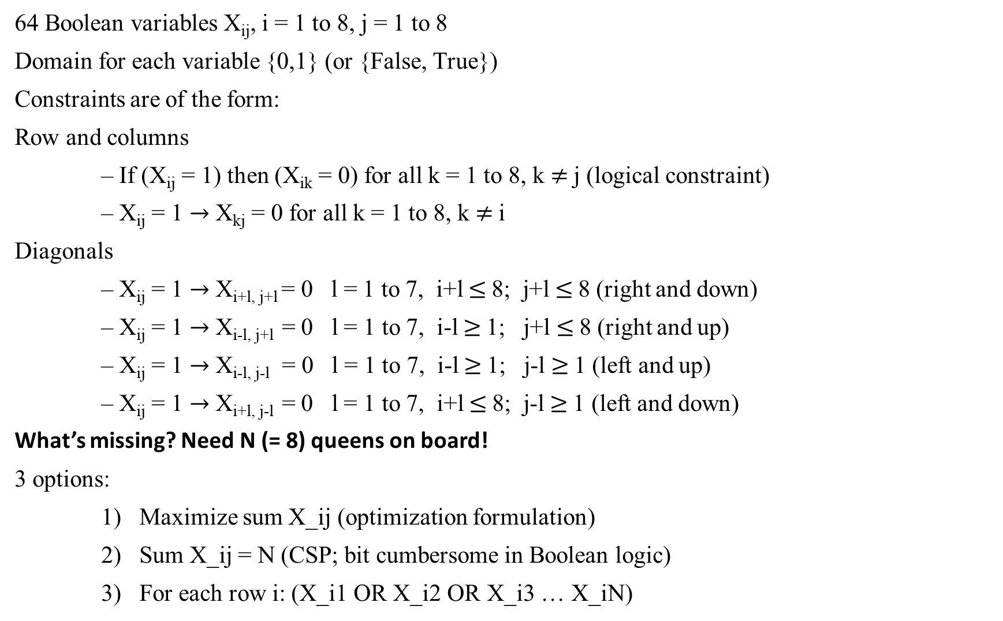
Boolean Encoding for 8-Queen
64 Boolean variables X_{ij}, i = 1 to 8, j = 1 to 8
Domain for each variable {0,1} (or {False, True})
Constraints are of the form:
Row and columns
– If (X_{ij} = 1) then (X_{ik} = 0) for all k = 1 to 8, k $≠$j (logical constraint)
– X_{ij} = 1 $→$ X_{kj} = 0 for all k = 1 to 8, k $≠$i
Diagonals
– X_{ij} = 1 $→$ X_{i+l, j+l} = 0 l = 1 to 7, i+l $≤$8; j+l $≤$8 (right and down)
– X_{ij} = 1 $→$ X_{i-l, j+l} = 0 l = 1 to 7, i-l $≥$1; j+l $≤$8 (right and up)
– X_{ij} = 1 $→$ X_{i-l, j-l} = 0 l = 1 to 7, i-l $≥$1; j-l $≥$1 (left and up)
– X_{ij} = 1 $→$ X_{i+l, j-l} = 0 l = 1 to 7, i+l $≤$8; j-l $≥$1 (left and down)
What’s missing? Need N (= 8) queens on board!
3 options:
1) Maximize sum X_ij (optimization formulation)
2) Sum X_ij = N (CSP; bit cumbersome in Boolean logic)
3) For each row i: (X_i1 OR X_i2 OR X_i3 … X_iN)
I,j=1 | J=2 | J=3 | J=4 | J=5
i=2
i=3
i=4
i=5

Slide 93


Logical equivalence
Two sentences p an q are logically equivalent ($≡$ or $⟺$) iff p $⟷$ q is a tautology
(and therefore p and q have the same truth value for all truth assignments)

Slide 94

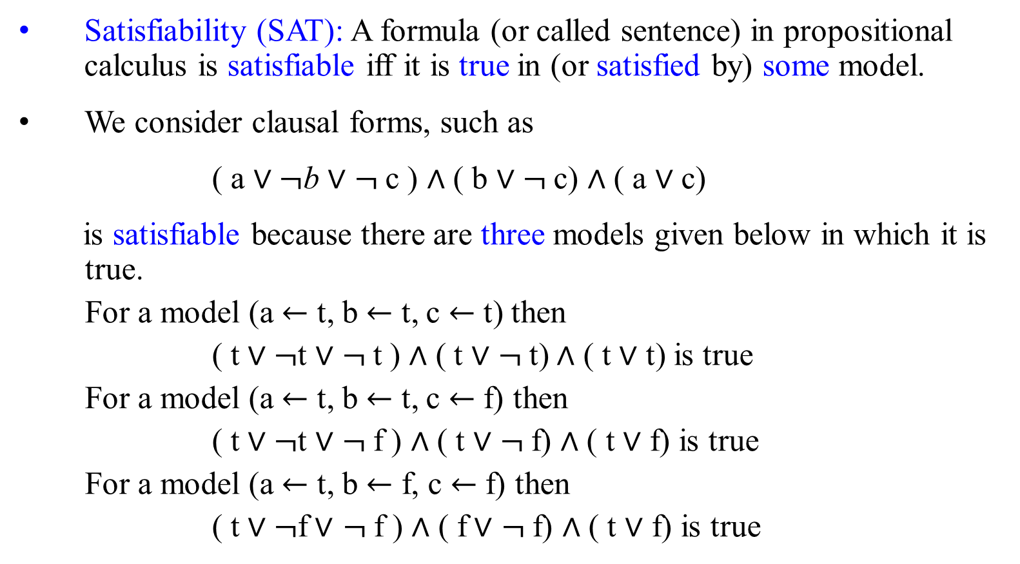
SAT: Propositional Satisfiability problem
Satisfiability (SAT): A formula (or called sentence) in propositional calculus is satisfiable iff it is true in (or satisfied by) some model.
We consider clausal forms, such as
( a $∨¬$b $∨$ $¬$c ) $∧$ ( b $∨$ $¬$c) $∧$ ( a $∨$ c)
is satisfiable because there are three models given below in which it is true.
For a model (a $←$ t, b $←$ t, c $←$ t) then
( t $∨¬$t $∨$ $¬$t ) $∧$ ( t $∨$ $¬$t) $∧$ ( t $∨$ t) is true
For a model (a $←$ t, b $←$ t, c $←$ f) then
( t $∨¬$t $∨$ $¬$f ) $∧$ ( t $∨$ $¬$f) $∧$ ( t $∨$ f) is true
For a model (a $←$ t, b $←$ f, c $←$ f) then
( t $∨¬$f$∨$ $¬$f ) $∧$ ( f$∨$ $¬$f) $∧$ ( t $∨$ f) is true
Do you have another model?

Slide 95

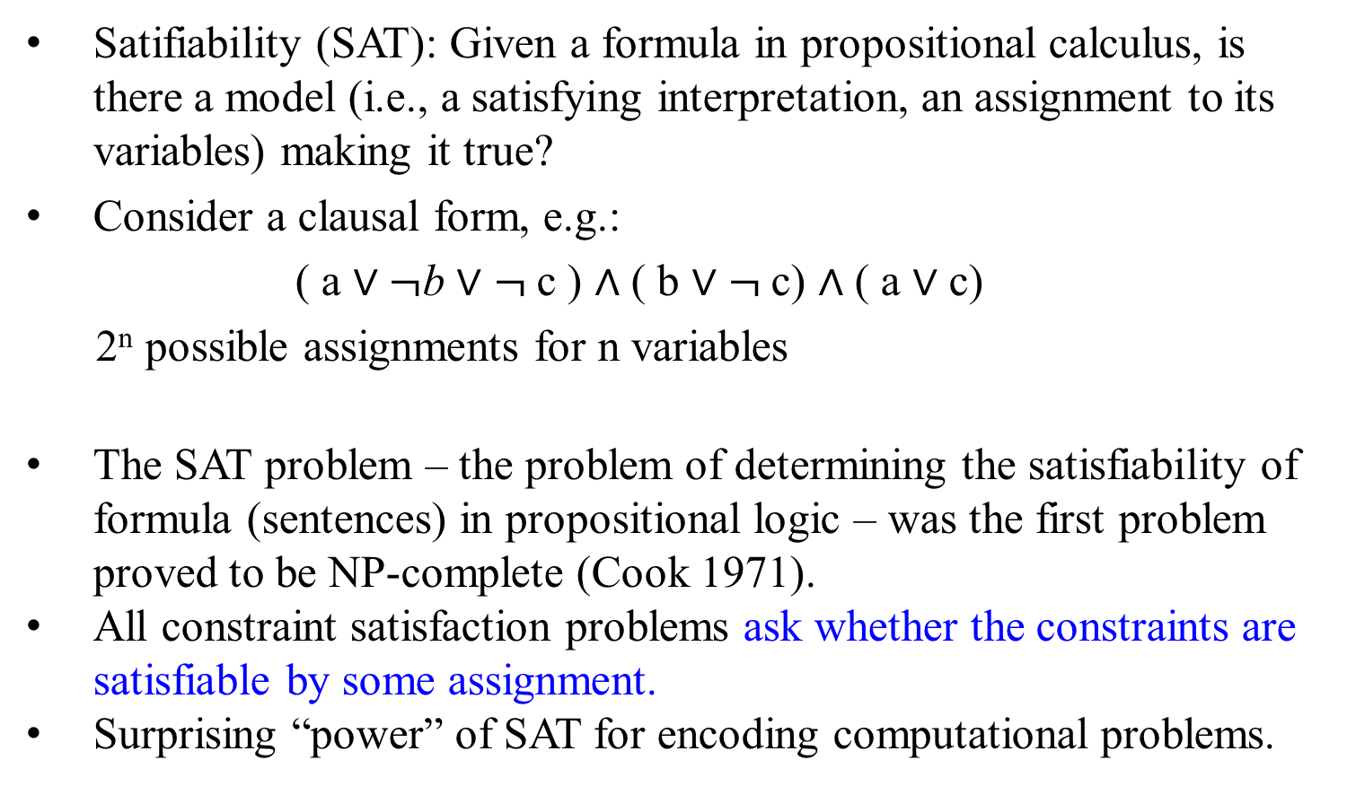
SAT: Propositional Satisfiability problem
Satifiability (SAT): Given a formula in propositional calculus, is there a model (i.e., a satisfying interpretation, an assignment to its variables) making it true?
Consider a clausal form, e.g.:
( a $∨¬$b $∨$ $¬$c ) $∧$ ( b $∨$ $¬$c) $∧$ ( a $∨$ c)
2^{n} possible assignments for n variables
The SAT problem – the problem of determining the satisfiability of formula (sentences) in propositional logic – was the first problem proved to be NP-complete (Cook 1971).
All constraint satisfaction problems ask whether the constraints are satisfiable by some assignment.
Surprising “power” of SAT for encoding computational problems.

Slide 96

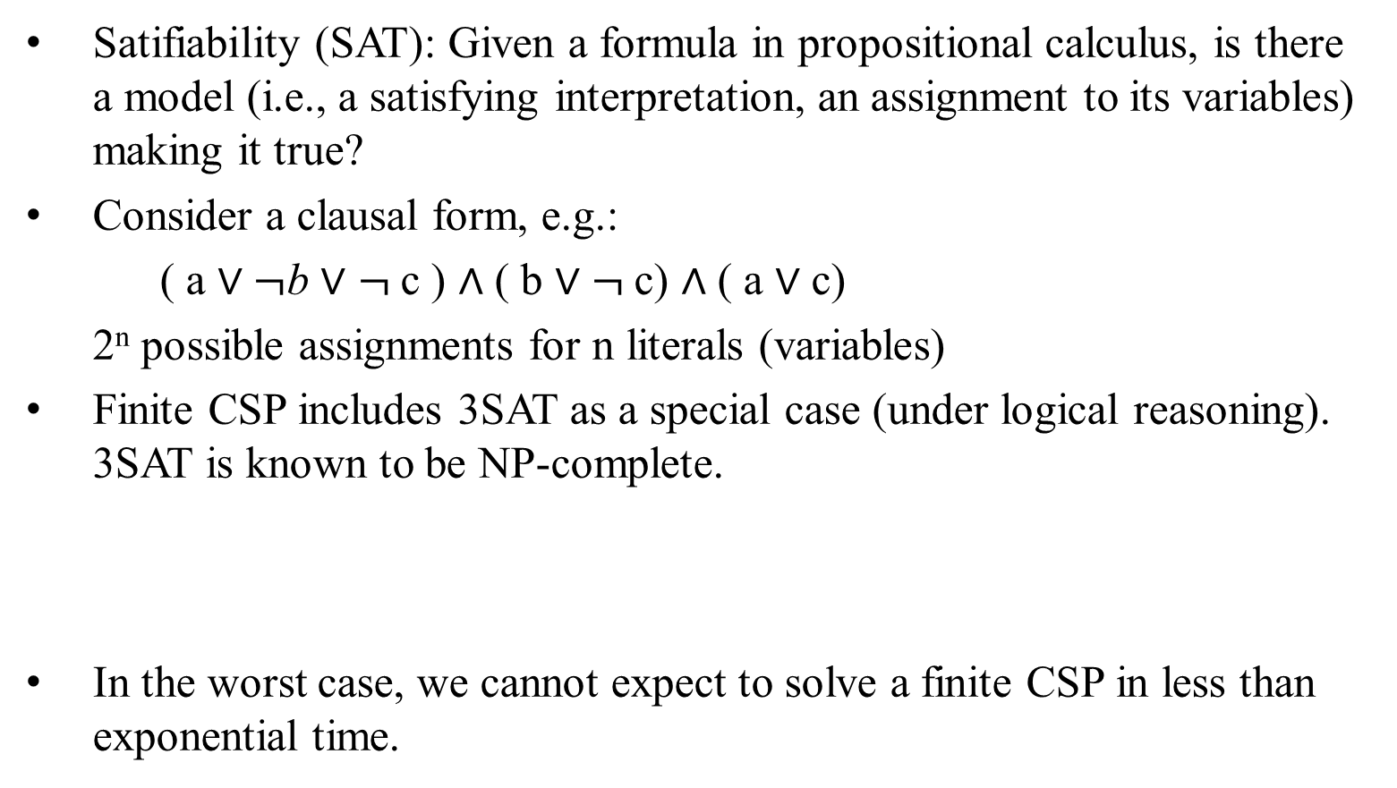
Remark
Satifiability (SAT): Given a formula in propositional calculus, is there a model (i.e., a satisfying interpretation, an assignment to its variables) making it true?
Consider a clausal form, e.g.:
( a $∨¬$b $∨$ $¬$c ) $∧$ ( b $∨$ $¬$c) $∧$ ( a $∨$ c)
2^{n} possible assignments for n literals (variables)
Finite CSP includes 3SAT as a special case (under logical reasoning). 3SAT is known to be NP-complete.
In the worst case, we cannot expect to solve a finite CSP in less than exponential time.
3SAT problem is a special case of SAT problem, where Boolean expression should have a very strict form. It should be divided into clauses, such that every clause contains of three literals.

Slide 97

Constraint graph
- Visualize a CSP as a constraint graph
Binary CSP: each constraint relates two variables
Constraint graph: nodes are variables, arcs are constraints
General-purpose CSP methods use the graph structure to speed up the search
e.g., Tasmania is an independent subproblem!
Fig 6.1(b) The map-coloring problem represented as a constraint graph.

Slide 98

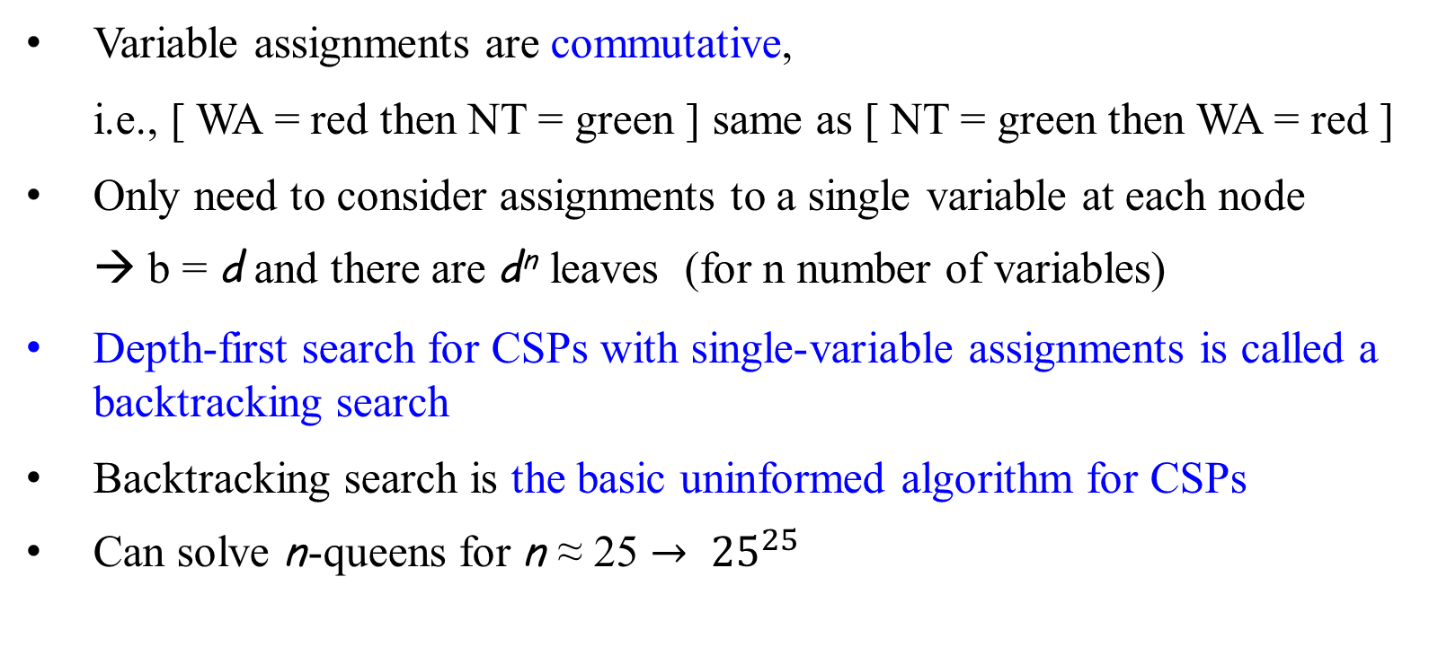
Backtracking search
Variable assignments are commutative,
i.e., [ WA = red then NT = green ] same as [ NT = green then WA = red ]
Only need to consider assignments to a single variable at each node
  → b = d and there are d^{n} leaves (for n number of variables)
Depth-first search for CSPs with single-variable assignments is called a backtracking search
Backtracking search is the basic uninformed algorithm for CSPs
Can solve n-queens for n ≈ 25 $→ {25}^{25}$
R R R
R R B
R B R
R B B
B R R
B R B
B B R
B B B
VV

Slide 99

Backtracking example
Variables: {WA, NT, SA, Q, NSW, V, T}
Values: {Red, Blue, Green}
Domain of WA is: {Red, Blue, Green}
Domain of NT is : {Red, Blue, Green}
Domain of SA is: {Red, Blue, Green}
…
Domain of T is: {Red, Blue, Green}
A state can be: each variable has a legally assigned value, either Red, Blue, or Green
Constraints: no neighboring region has the same color.
Goal state (solution): a complete and consistent assignments

Slide 100
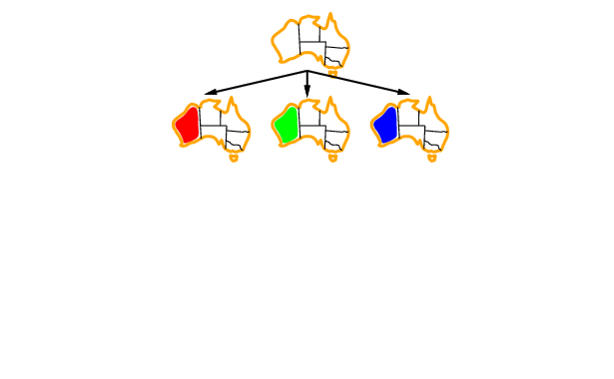
Backtracking example
Three possible assignment of the color for the variable WA.

Slide 101
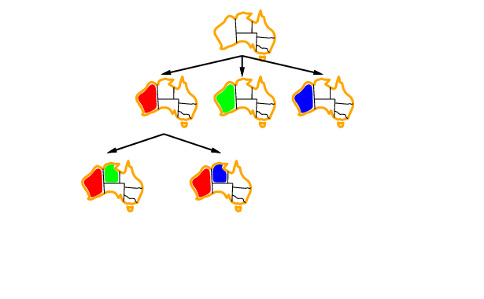
Backtracking example
After red color, two possible legal assignments of the color for the variable NT

Slide 102
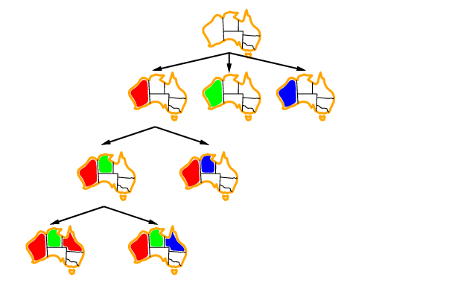
Backtracking example
R X
After red, only green or blue for NT
G X
After red and green for WA and NT respectively, only red or blue for Q

Slide 103

Improving backtracking efficiency
General-purpose methods - can give huge gains in speed:
  Which variable should be assigned next?
    Minimum Remaining Value heuristic
  In what order should its values be tried?
    Least Constraining Values heuristic
  Can we detect inevitable failure early?
    Forward Checking
    Constraint propagation (Arc Consistency)
  When a path fails, can the search avoid repeating this failure:
    Backjumping
  5. Can we take advantage of problem structure?
    Tree-structured CSP
Variable and value ordering to increase the likelihood to success
Early failure-detection to decrease the likelihood to fail
Restructuring to reduce the problem’s complexity.

Slide 104
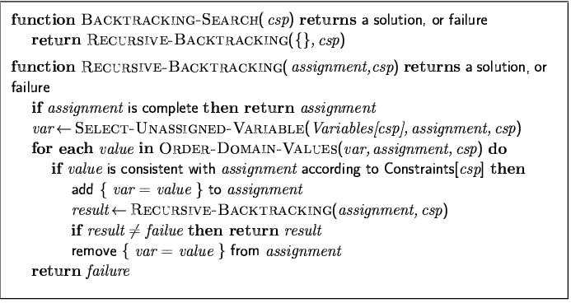

Backtracking Search: improving backtracking efficiency

Slide 105

Most constrained variable-Variable choice heuristics
Most constrained variable - a.k.a. minimum remaining values (MRV) heuristic:
  choose the variable with the fewest legal remaining values
  1. Which variable should be assigned next?
    Minimum Remaining Value (MRV) heuristic
    Pick one of these two states {NT, SA} can have only green or blue to
    choose from.
    The other four states {Q, NSW, V, T} has red, blue, or green

Slide 106

Most constrained variable-Variable choice heuristics
minimum remaining values (MRV) heuristic:
Tie-breaker among most constrained variables
2. Most constraining variable - Degree heuristic:
  choose the variable with the most constraints on remaining variables (e.g., choose SA to color for it has NT, Q, NSW, and V. NT has SA and Q only.}
  SA has the most constraints on remaining variables {NT, Q, NSW, V} than NT {SA, Q}.
  Latter (2.) is often used as a tie-breaker for the former (1.)

Slide 107
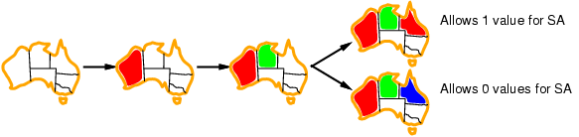
Least constraining value - Value choice heuristics
Least constraining value:
3. Given a variable, choose the least constraining value:
  rules out the fewest values in the remaining variables
  {rule out the blue for it allows 0 color for SA}
Combining these heuristics makes 1000 queens feasible
  In what order should its values be tried?
  Least Constraining Values heuristic

Slide 108
Constraint Propagation.
The process of determining how the possible values of one variable affect the possible values of other variables
14
16
1.2st: 2C
20
2nd: 4C
14

Slide 109



Forward Checking.
After a variable X is assigned a value v, look at each unassigned variable Y that is connected to X by a constraint and deletes from Y’s domain any value that is inconsistent with v
D(Y) $is$ the remaining grids that do not occupy by X and grids occupied by a blue circle.
Terminate the branch when any variable has no legal values and backtracks.
D(Y) = { - - },
for every Y $≠$ X.
Initially D(Y) = w.
w
w
X $←$ v
where v is (5, 1)

Slide 110
Constraint Propagation: Forward Checking
Forward checking is an extension of backtracking search that employs a “modest” amount of propagation (look ahead).
When a variable is instantiated,
  check all constraints that have only one uninstantiated variable remaining.
  For that uninstantiated variable, check all of its values, pruning those values that violate the constraint.

Slide 111
Forward Checking Algorithm
For a single constraint C:
FCCheck(C, X)
  // C is a constraint with all its variables already
  // assigned, except for variable X.
  for d := each member of CurDom[X]
    if making X = d together with previous assignments
      to variables in scope C falsifies C
    then remove d from CurDom[x]
  if CurDom[X] = { } then return DWO (Domain Wipe Out)
  else return ok

Slide 112
Forward Checking Algorithm
FC(Level) /*Forward Checking Algorithm */
  If all variables are assigned
    PRINT Value of each Variable
    RETURN or EXIT (RETURN for more solutions)
    (EXIT for only one solution)
  X := PickAnUnassignedVariable()
  Assigned[X] := TRUE
  for d := each member of CurDom(X)
    Value[X] := d
    DWOoccured:= False
    for each constraint C over X such that
      a) C has only one unassigned variable Y in its scope
      if(FCCheck(C, Y) == DWO) /* Y domain becomes empty*/
        DWOoccurred:= True
        break /* stop checking constraints */
    if(not DWOoccured) /*all constraints were ok*/
      FC(Level+1)
    RestoreAllValuesPrunedByFCCheck()
  Assigned[X] := FALSE //undo since we have tried all of X’s values
  return;

Slide 113
4‐Queens Problem
Encoding with Q1, …, Q4 denoting a queen per row
  cannot put two queens in the same column
1 | 2 | 3 | 4
Q1
{1, 2, 3, 4}
Q2
{1, 2, 3, 4}
1
2
3
4
Q3
{1, 2, 3, 4}
Q4
{1, 2, 3, 4}
Constraints graph supporting Forward Checking

Slide 114
4‐Queens Problem
Forward checking reduced the domains of all variables that are involved in a constraint with one uninstantiated variable, such as {1, 2} of uninstantiated Q2:
  Here all of uninstantiated variables Q2, Q3, Q4
1 | 2 | 3 | 4
Q1
{1, 2, 3, 4}
Q2
{ , , 3, 4}
1
2
3
4
Q3
{ , 2, , 4}
Q4
{ , 2, 3, }

Slide 115
4‐Queens Problem
1 | 2 | 3 | 4
Q1
{1, 2, 3, 4}
Q2
{ , , 3, 4}
1
2
3
4
Q3
{ , 2, , 4}
Q4
{ , 2, 3, }

Slide 116
4‐Queens Problem
1 | 2 | 3 | 4
Q1
{1, 2, 3, 4}
Q2
{ , , 3, 4}
1
2
3
4
Q3
{ , , , }
Q4
{ , 2, , }
DomainWipeOut

Slide 117
4‐Queens Problem
1 | 2 | 3 | 4
Q1
{1, 2, 3, 4}
Q2
{ , , , 4}
1
2
3
4
Q3
{ , 2, , 4}
Q4
{ , 2, 3, }

Slide 118
4‐Queens Problem
1 | 2 | 3 | 4
Q1
{1, 2, 3, 4}
Q2
{ , , , 4}
1
2
3
4
Q3
{ , 2, , }
Q4
{ , , 3, }

Slide 119
4‐Queens Problem
1 | 2 | 3 | 4
Q1
{1, 2, 3, 4}
Q2
{ , , , 4}
1
2
3
4
Q3
{ , 2, , }
Q4
{ , , 3, }

Slide 120
4‐Queens Problem
1 | 2 | 3 | 4
Q1
{1, 2, 3, 4}
Q2
{ , , , 4}
1
2
3
4
Q3
{ , 2, , }
Q4
{ , , , }
DWO

Slide 122
4‐Queens Problem
• Exhausted the subtree with Q1=1;
try now Q1=2
1 | 2 | 3 | 4
Q1
{ , 2, 3, 4}
Q2
{ 1, 2 , 3 , 4}
1
2
3
4
Q3
{ 1, 2, 3, 4}
Q4
{ 1, 2, 3, 4}

Slide 123
4‐Queens Problem
1 | 2 | 3 | 4
Q1
{ , 2, 3, 4}
Q2
{ , , , 4}
1
2
3
4
Q3
{ 1, , 3, }
Q4
{ 1, , 3, 4}

Slide 124
4‐Queens Problem
1 | 2 | 3 | 4
Q1
{ , 2, 3, 4}
Q2
{ , , , 4}
1
2
3
4
Q3
{ 1, , 3, }
Q4
{ 1, , 3, 4}

Slide 125
4‐Queens Problem
1 | 2 | 3 | 4
Q1
{ , 2, 3, 4}
Q2
{ , , , 4}
1
2
3
4
Q3
{ 1, , , }
Q4
{ 1, , 3, }

Slide 126
4‐Queens Problem
1 | 2 | 3 | 4
Q1
{ , 2, 3, 4}
Q2
{ , , , 4}
1
2
3
4
Q3
{ 1, , , }
Q4
{ , , 3, }

Slide 127
4‐Queens Problem
We have now found a solution: an assignment of all variables to values of their domain so that all constraints are satisfied
1 | 2 | 3 | 4
Q1
{ , 2, 3, 4}
Q2
{ , , , 4}
1
2
3
4
Q3
{ 1, , , }
Q4
{ , , 3, }

Slide 128
Example: N-Queens FC Search Space

Slide 129
FC: Restoring Values
After backtracking from the current assignment (in the for loop), we must restore the values that were pruned as a result of that assignment.
Some bookkeeping needs to be done, as we must remember which values were pruned by which assignment (FCCheck is called at every recursive invocation of FC).

Slide 130

FC: Minimum Remaining Values Heuristcs (MRV)
FC gives a powerful heuristic to guide us on which variables to try next:
  Always branch on a variable with the smallest remaining values (smallest CurDom).
  If a variable has only one value left, that value is forced, then propagate its consequences immediately.
  This heuristic tends to produce skinny, at the top of the trees, more variables can be instantiated with fewer nodes searched, and thus
  more constraint propagation/DWO failures occur when the tree starts to branch out (start selecting variables with larger domains)
  We can find an inconsistency much faster
FC alg/slide 106

Slide 132
Constraint graph
- Visualize a CSP as a constraint graph
Binary CSP: each constraint relates two variables
Constraint graph: nodes are variables, arcs are constraints
General-purpose CSP methods use the graph structure to speed up the search
e.g., Tasmania is an independent subproblem!
Fig 6.1(b) The map-coloring problem represented as a constraint graph.

Slide 133
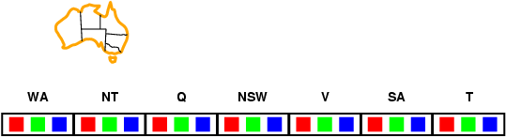
Forward checking
Idea:
  Keep track of remaining legal values for unassigned variables
  Terminate search when any variable has no legal values
  Example – Map Coloring
Color the following map using red, green, and
blue such that adjacent regions have different
colors.
Which variable should be assigned next?
  Minimum Remaining Value heuristic
In what order should its values be tried?
  Least Constraining Values heuristic

Slide 134
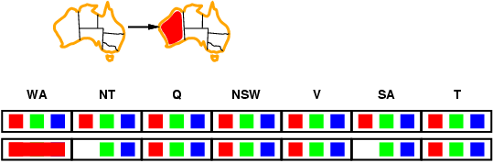
Forward checking
Idea:
  Keep track of remaining legal values for unassigned variables
  Terminate search when any variable has no legal values
• Assign {WA=red}
• Effects on other variables
connected by constraints to WA
  – NT can no longer be red
  – SA can no longer be red
x
x

Slide 135
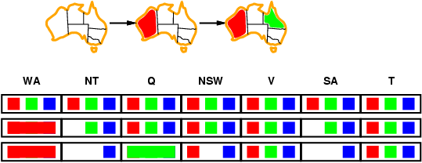
Forward checking
• Assign {Q=green} (Note: Not using MRV)
• Effects on other variables connected by constraints with Q
  – NT can no longer be green
  – NSW can no longer be green
  – SA can no longer be green
• MRV (minimum remaining values) heuristic: This
heuristic would automatically select NT or SA next
Idea:
  Keep track of remaining legal values for unassigned variables
  Terminate search when any variable has no legal values
x
x
x
x
x
x
x

Slide 136
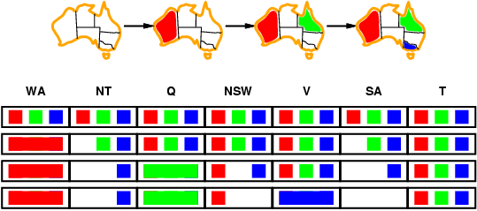
Forward checking
• Assign {V=blue} (not using MRV)
• Effects on other variables connected by constraints with V
  – NSW can no longer be blue
  – SA is empty
• FC has detected that partial assignment is inconsistent with the
constraints and backtracking can occur.
Idea:
  Keep track of remaining legal values for unassigned variables
  Terminate search when any variable has no legal values
x
x
x
x
x
x
x

Slide 137
Empirically
Forward Checking often is about 100 times faster than Backtracking
FC with MRV (minimal remaining values) is often 10000 times faster.
But on some problems, the speed up can be much greater
Converts problems that are not solvable to solvable problems.
Still FC is not that powerful. Other more powerful forms of constraint propagation are used in practice.
Try the previous map coloring example with MRV.

Slide 138
Constraint propagation
Forward checking propagates information from assigned to unassigned variables, but doesn't provide early detection for all failures:
NT and SA cannot both be blue!
Constraint propagation repeatedly enforces constraints locally
NT, SA

Slide 139

Definition (Arc consistency)
A constraint C_xy is said to be arc consistent w.r.t. x if and only if
for each (every) value v of x, there is an allowed value of y.
Similarly, we define that
A constraint C_xy is arc consistent w.r.t. y if and only if
for each (every) value u of y, there is an allowed value of x.
A binary CSP is arc-consistent iff every constraint C_xy is arc
consistent wrt x as well as wrt y.

Slide 140
Definition (Arc consistency)
When a CSP is not arc consistent, we can make it arc consistent.
This is also called “enforcing arc consistency”.

Slide 141

Definition (Arc consistency)
D_x | 1 | 2 | 3
Example
Let domains be
D_x = {1, 2, 3}, D_y = {3, 4, 5, 6}
One constraint
C_xy = {(1, 3), (1, 5), (3, 3), (3, 6)} [“allowed value pairs”]
C_xy is not arc consistent w.r.t. neither x nor w.r.t. y. Why?
2 does not pair with any in D_y. 4 does not pair with any in D_x.
To enforce arc consistency, we filter the domains, removing inconsistent values.
D’_x = {1, 3}, D’_y={3, 5, 6}
D_y | 3 | 4 | 5 | 6
D’_x | 1 | 3
D’_y | 3 | 5 | 6

Slide 142

Constraint graph
- Visualize a CSP as a constraint graph
Binary CSP: each constraint relates two variables
Constraint graph: nodes are variables, arcs are constraints
General-purpose CSP methods use the graph structure to speed up the search
e.g., Tasmania is an independent subproblem!
Fig 6.1(b) The map-coloring problem represented as a constraint graph.

Slide 143

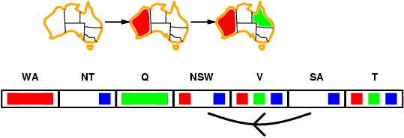
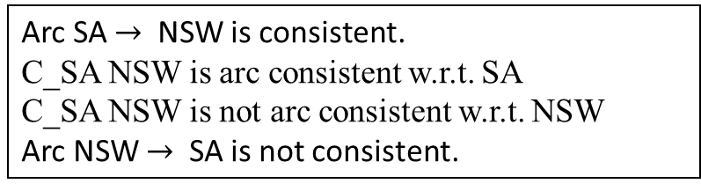
Arc consistency
Simplest form of propagation makes each arc consistent
Arc X → Y is consistent iff
  for every value x of X, there is some allowed y for Y
SA
NSW is blue, then SA cannot be blue
NSW
Arc SA $→$ NSW is consistent.
C_SA NSW is arc consistent w.r.t. SA
C_SA NSW is not arc consistent w.r.t. NSW
Arc NSW $→$ SA is not consistent.
SA is blue then NSW is red (no constraint is violated)

Slide 144
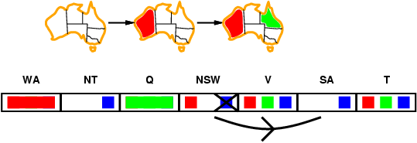
Arc consistency
Simplest form of propagation makes each arc consistent
Arc X → Y is consistent iff
  for every value x of X, there is some allowed y for Y
NT
Q
WA
SA
T
NSW
V
Enforced arc consistency by removing blue value from NSW

Slide 145
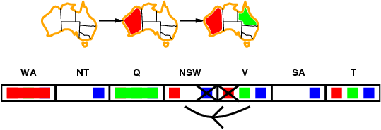
Arc consistency
Simplest form of propagation makes each arc consistent
Arc X → Y is consistent iff
  for every value x of X, there is some allowed y for Y
If X loses a value, neighbors of X need
to be rechecked
D
D
NSW
Initially, Arc NSW→ V is consistent wrt NSW. C_NSW V is not arc consistent wrt V.
After eliminating blue from NSW, V is no longer consistent wrt NSW since V is red, NSW cannot be in red. Enforce consistency by getting rid of red from V.
V

Slide 146
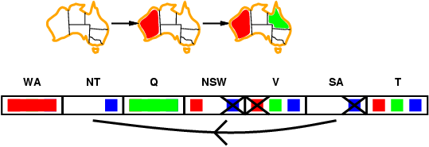
Arc consistency
Empty domain detected! Backtrack early.
Simplest form of propagation makes each arc consistent
Arc X → Y is consistent iff
  for every value x of X there is some allowed y for Y
If X loses a value, neighbors of X need to be rechecked
Arc consistency detects failure earlier than forward checking
Can be run as a preprocessor or after each assignment

Slide 147
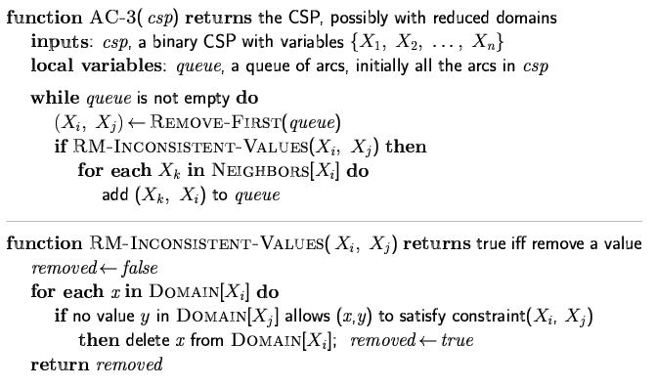
Arc consistency algorithm AC-3
//bewteeb X_{i} and X_{j}
O(n²d³), can be reduced to O(n²d²) (but detecting all is NP-hard)

Slide 148
Figure 6.3 The arc-consistency algorithm AC-3. After applying AC-3, either every arc is arc-consistent, or some variable has an empty domain, indicating that the CSP cannot be solved. The name “AC-3” was used by the algorithm’s inventor (Mackworth, 1977) because it’s the third version developed in the paper.

Slide 149

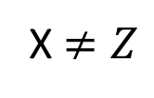
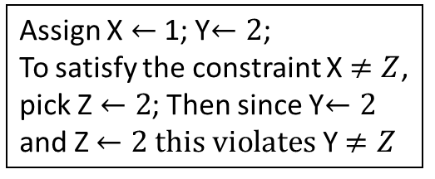
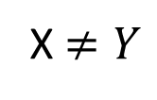
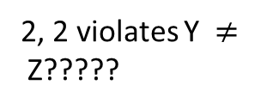
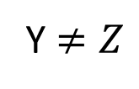
Beyond Arc Consistency
{1, 2}
{1, 2}
X $≠Y$
Y
X
Is this network arc consistent?
What is the solution?
Arc consistency is not enough to guarantee global consistency.
There are other forms of consistency, such as k-consistency.
When k = n (num vars), we are looking at the original problem! n-consistency.
X $≠Z$
Y $≠Z$
Z
2, 2 violates Y $≠$Z?????
{1, 2}
Assign X $←$1; Y$←2$;
To satisfy the constraint X $≠Z$, pick Z$←2$; Then since Y$←2$
and Z$←2 this violates$Y $≠Z$

Slide 150
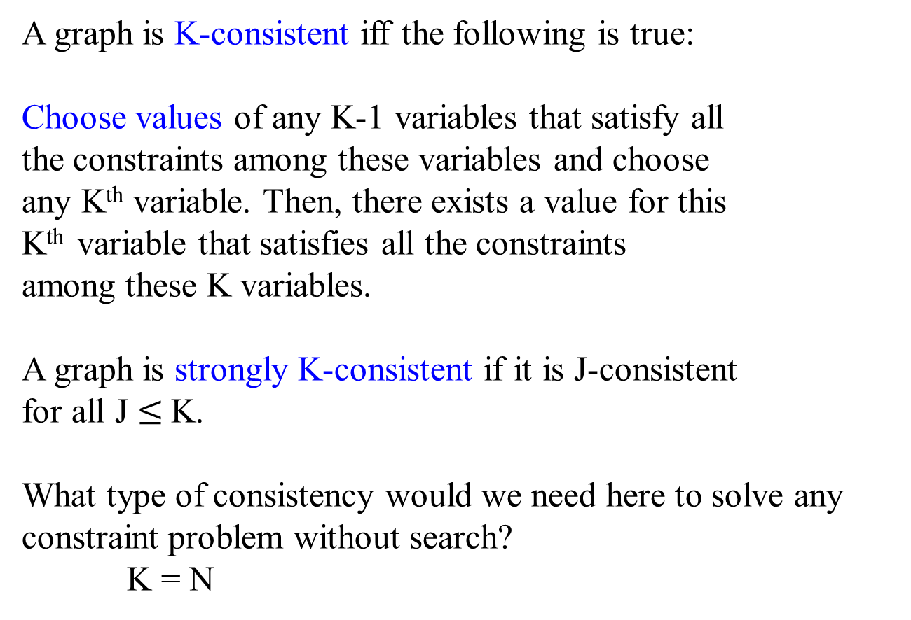
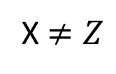
K- Consistency
{1. 2}
{1. 2}
X $≠Y$
Y
A graph is K-consistent iff the following is true:
Choose values of any K-1 variables that satisfy all
the constraints among these variables and choose
any K^{th} variable. Then, there exists a value for this
K^{th} variable that satisfies all the constraints
among these K variables.
A graph is strongly K-consistent if it is J-consistent
for all J $≤$K.
What type of consistency would we need here to solve any constraint problem without search?
K = N
X
X $≠Z$
Y $≠Z$
Z
2-consistent
{1. 2}
N-consistent

Slide 151
Consistency
Node consistency = strong 1 - consistency
Arc consistency = strong 2 - consistency
(note: arc consistency is usually assumed to include node consistency as well).
See Textbook sect. 6.2.3 for “path-consistency” = 3-consistency for binary CSPs.
Algorithms exist for making a constraint graph strongly K-consistent for K > 2 but in practice, they are rarely used because of efficiency issues.
Other consistency notions involve “global constraints,” spanning many
Variables. E.g. AllDiff constraint can handle the Pigeon Hole principle.

Slide 152

Summary: Solving a CSP
Search:
– can find solutions, but may examine many non-solutions along
the way
Constraint Propagation:
– can rule out non-solutions, but may not lead to a full solution.
Interweave constraint propagation and search
– Perform constraint propagation at each search step.
– Goal: Find the right balance between search (backtracking) and
propagation (reasoning).
Surprising efficiency (last 10 yrs):
100K + up to one million variable CSP problems are now
solvable!
See also local search. Textbook 6.4

Slide 153
Arc –consistency algorithm
function AC-3( csp) returns the CSP, possibly with reduced domains
inputs: csp, a binary CSP with variables {X₁, X₂, . . . , X_{n}}
local variables: queue, a queue of arcs, initially all the arcs in csp
while queue is not empty do
(X_{i}, X_{j} ) ← REMOVE-FIRST(queue)
if REMOVE-INCONSISTENT-VALUES(X_{i}, X_{j} ) then
for each X_{k} in NEIGHBORS[X_{i}] do
add (X_{k}, X_{i}) to queue
function REMOVE-INCONSISTENT-VALUE(Xi, Xj ) returns true iff we remove a value
removed ← false
for each x in DOMAIN[X_{i}] do
if no value y in DOMAIN[X_{j} ] allows (x,y) to satisfy the constraint between X_{i} and X_{j}
then delete x from DOMAIN[X_{i}]; removed ← true
return removed
O(n²d³), can be reduced to O(n²d²) (but detecting all is NP-hard)

Slide 154
Further notions of consistency
Node consistency: A single variable X is node-consistent if all the values in X’s domain D(X) satisfy the unary constraints on X
Example
  D(X) = {1, 2, 3} C₁ = (X > 0) X node-consistent with C₁
  D(X) = {1, 2, 3} C₂ = (X > 5) X not node-consistent with C₂

Slide 155

Further notions of consistency
Constraint Propagation: Generalized Arc Consistency
Arc-consistency for n-constraints
Generalized arc consistency: A variable X_{i} is generalized arc-consistent with respect to an n-ary constraint C(X₁, . . . , X_{i}, . . . , X_{n}) if, for every v_{i} ∈ D(X_{i}), there is a (v₁, . . . , v_{i}, . . . , v_{n}) ∈ D(X₁) × ・・・ × D(X_{i}) × ・・・ × D(X_{n}) that satisfies C
Example:
D(X) = D(Y ) = D(Z) = {1, 2, 3}
C₁ = (X + Y > Z) Z generalized arc-consistent with C₁
C₂ = (X + Y < Z) Z not generalized arc-consistent with C₂
When Z = 1, X and Y can be any of {1, 2, 3} such that X + Y > 1.
When Z = 2, then X = 1, y = 2 such that X+Y > 2.
When Z = 3, X = 3, Y = 1 such that X + Y > Z
When Z = 1, there is no X + Y < 1.

Slide 156

Further notions of consistency
Constraint Propagation: Generalized Arc Consistency
Arc-consistency for n-constraints
By removing values from the variable domains during the search, variables that are Generalized arc consistency (GAC) in a constraint might become inconsistent (non-GAC).
Given D(X) = D(Y ) = D(Z) = {1, 2, 3},
C₁ = (X + Y > Z) Z generalized arc-consistent with C₁
By removing 3 from D(X) and D(Y), and then removing 2 from D(Y) and D(Z) for some reason, then
D(X) = {1, 2}, D(Y) = {1} and Z = {1, 3}. When Z = 3, there is no value of X and Y, such that X + Y > Z.

Slide 157

Further notions of consistency
Constraint Propagation: Generalized Arc Consistency
Arc-consistency for n-constraints
An n-ary constraint C(X₁, . . . , X_{i}, . . . , X_{n}) is GAC if and only if, it is GAC with respect to every variable in its scope.
That means every variable in its scope is GAC with respect to C.
A CSP is GAC if and only if, all of its constraints are GAC.

Slide 158

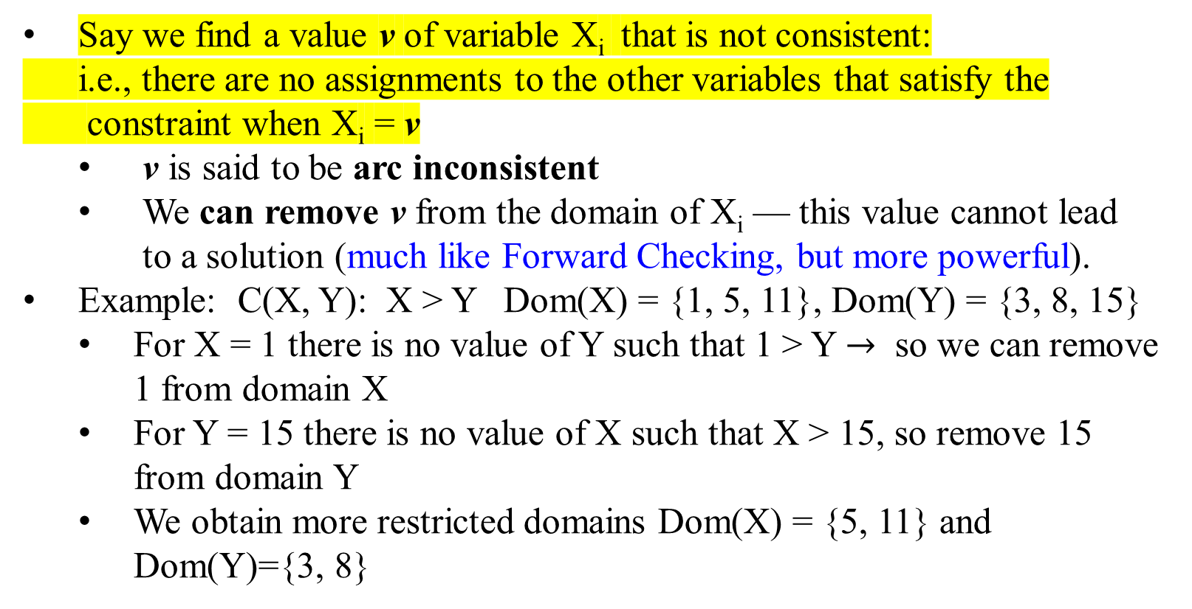
Further notions of consistency
Constraint Propagation: Arc Consistency
Say we find a value v of variable X_{i} that is not consistent:
i.e., there are no assignments to the other variables that satisfy the
constraint when X_{i} = v
  v is said to be arc inconsistent
  We can remove v from the domain of X_{i} — this value cannot lead
  to a solution (much like Forward Checking, but more powerful).
Example: C(X, Y): X > Y Dom(X) = {1, 5, 11}, Dom(Y) = {3, 8, 15}
  For X = 1 there is no value of Y such that 1 > Y $→$ so we can remove 1 from domain X
  For Y = 15 there is no value of X such that X > 15, so remove 15 from domain Y
  We obtain more restricted domains Dom(X) = {5, 11} and Dom(Y)={3, 8}

Slide 159

Further notions of consistency
Constraint Propagation: Arc Consistency
If we apply arc consistency propagation during the search, the (search) tree’s size will typically be much reduced in size.
Removing a value from a variable domain may trigger further inconsistency, so we have to repeat the procedure until everything is consistent.
  We put constraints on a queue and add new constraints to the queue as we need to check for arc consistency.

Slide 160

Example: N-Queens FC Search Space
o
 |  | o | o
 | o |  | o
 | o | o
wrt X₁ = 1
Arc consistency stages:
1. X₂ = {3, 4}, X₃ = {2, 4}, X₄ = {2, 3}
(where X₂ =1, 2 & X₃ = 1, 3 & X₄ = 1, 4 are
inconsistent with X₁ = 1).
2. X₂ = {4} (where X₂ = 3 is inconsistent with both values in CurDom[X₃]).
3. X₃ = {2} (where X₃ = 4 is inconsistent with values in CurDom[X₂]).
4. X₄ = {} (for both values for X₄ inconsistent with values in CurDom[X₃]).
DWO

Slide 161
Example – Map Coloring
Assign {WA=red}
Effects on other variables connected by constraints to WA
  NT can no longer be red = {G, B}
  SA can no longer be red = {G, B}
All other values are arc-consistent

Slide 162

Example – Map Coloring
Assign {Q=green}
Effects on other variables connected by constraints with Q
  NT can no longer be green = {B}
  NSW can no longer be green = {R, B}
  SA can no longer be green = {B}
DWO there is no value for SA that will be consistent with NT ≠ SA and NT = B
Note Forward Checking would not have detected this DWO (domain wiped out).

Slide 163
Further notions of consistency
Recalled
Node consistency:
A single variable X is node-consistent if all the values in X’s domain D(X) satisfy the unary constraints on X
Ex.
D(X) = {1, 2, 3} C₁ = (X > 0) X node-consist. with C₁
D(X) = {1, 2, 3} C₂ = (X > 5) X not node-consist. with C₂

Slide 164
Further notions of consistency
Recalled
Arc-consistency for n-constraints
Generalized arc consistency:
A variable X_{i} is generalized arc-consistent wrt an n-ary constraint
C(X₁, . . . , X_{i}, . . . , X_{n}) if, for every v ∈ D(X_{i}), there is
a (v₁, . . . , v, . . . , v_{n}) ∈ D(X₁) × . . .× D(X_{i}) × . . . × D(X_{n})
that satisfies C
Ex.
D(X) = D(Y ) = D(Z) = {1, 2, 3}
C₁ = (X + Y > Z) Z generalized arc-consist. with C₁
C₂ = (X + Y < Z) Z not generalized arc-consist. with C₂

Slide 165
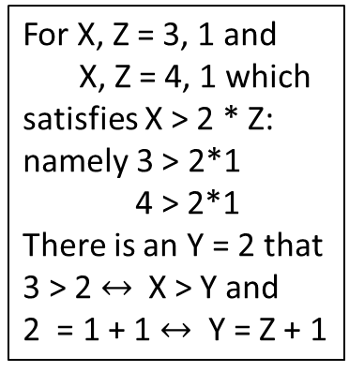
Further notions of consistency
Chained arc-consistency
Path consistency: A two-variable set {X, Z} is path-consistent with respect to a third variable Y if, for every assignment satisfying the constraints on {X, Z}, there is an assignment to Y that satisfies the constraints on {X, Y } and {Y, Z}
Example:
D(X) = D(Y ) = D(Z) = {1, 2, 3, 4}
{X > 2 * Z, X > Y, Y = Z + 1} {X, Z} path-consistent wrt Y
{X > 2 * Z, X < Y, Y = Z + 1} not {X, Z} path-consistent wrt Y
For X, Z = 3, 1 and
X, Z = 4, 1 which
satisfies X > 2 * Z:
namely 3 > 2*1
4 > 2*1
There is an Y = 2 that
3 > 2 $↔$X > Y and
2 = 1 + 1 $↔$ Y = Z + 1
???
For the previous case, X will not be less than Y

Slide 166

GAC Algorithm
We make all constraints GAC at every node of the search space.
This is accomplished by removing from the domains of the variables all arc inconsistent values.

Slide 167
GAC Algorithm, enforce GAC during search
GAC(Level) /*Maintain GAC Algorithm */
  If all variables are assigned
    PRINT Value of each Variable
    RETURN or EXIT (RETURN for more solutions)
    (EXIT for only one solution)
  X := PickAnUnassignedVariable( )
  Assigned[X] := TRUE
  for v := each member of CurDom(X)
    Value[X] := v
    Prune all values of X ≠ v from CurDom[X]
    for each constraint C whose scope contains X
    Put C on GACQueue
    if(GAC_Enforce() != DWO)
    GAC(Level+1) /*all constraints were ok*/
    RestoreAllValuesPrunedFromCurDoms()
  Assigned[X] := FALSE
  return;

Slide 168
Enforce GAC (prune all GAC inconsistent values)
GAC_Enforce()
  // GAC-Queue contains all constraints one of whose variables has had its domain reduced. // At the root of the search tree first we run GAC_Enforce with all constraints on GAC -
  // Queue
  while GACQueue not empty
    C = GACQueue.extract()
    for X := each member of scope(C)
      for v := CurDom[X]
        Find an assignment A for all other variables in scope(C) such that
          C(A ∪ X = v) = True
        if A not found
          CurDom[X] = CurDom[X] – v
          if CurDom[X] = ∅
            empty GACQueue
            return DWO //return immediately
          else
            push all constraints C’ such that X ∈ scope(C’) and C’ ∉ GACQueue
            on to GACQueue
  return TRUE //while loop exited without DWO

Slide 169
Enforce GAC
A support for X = v in constraint C is an assignment A to all of the other variables in scope(C) such that A U {X = v} satisfies C. (A is what the algorithm’s inner loop looks for).
Smarter implementations keep track of “supports” to avoid having to search though all possible assignments to the other variables for a satisfying assignment.

Slide 170
Enforce GAC
Rather than search for a satisfying assignment to C containing X_{i} = v, we check to see if the current support is still valid: i.e., all values it assigns still lie in the variable’s current domains
Also we take advantage of that supports for X_{i} = v, e.g.
{X_{i} = v, X = a, Y = b, Z = c}
is also a support for X = a, Y = b, and Z = c

Slide 171

Enforce GAC
However, finding support for X_{i} = v in constraint C still in the worst case requires O(2^{k}) work, where k is the arity of C, i.e., |scope(C)|.
Another key development in practice is that for some constraints this computation can be done in polynomial time.
  e.g., all-diff(X₁, …. X_{n}) we can check if X_{i} = v has support in the current domains of the other variables in polynomial time using ideas from graph theory.
  We do not need to examine all combinations of values for the other variables looking for a support

Slide 172
Problem structure
Tasmania and the mainland are independent subproblems
Identifiable as connected components of the constraint graph

Slide 173
Problem structure
Suppose each subproblem has c variables out of n total
Worst-case solution cost is n/c *d^{c}, linear in n
e.g., n = 80, d = 2, c = 20
    2⁸⁰ = 4 billion years at 10 million nodes/sec
    4 ・ 2²⁰ = 0.4 seconds at 10 million nodes/sec

Slide 174
Tree-structured CSPs
A
E
B
D
C
F
Theorem: If the constraint graph has no loops, the CSP can be solved in O(n d²) time
Compare to general CSPs, where the worst-case time is O(d^{n})
This property also applies to logical and probabilistic reasoning:
an important example of the relation between
• syntactic restrictions and
• the complexity of reasoning

Slide 175
Algorithm for Tree-Structured CSPs
A
E
B
D
C
F
A
B
C
D
E
F
Choose a variable as root, and order variables from root to leaves
so that every node’s parent precedes it in the ordering
2. For j from n down to 2, apply
REMOVEINCONSISTENTVALUES(Parent(X_{j}), X_{j})
3. For j from 1 to n, assign X_{j} consistently with Parent(X_{j})

Slide 176
Nearly Tree-structure CSPs
NT
Q
WA
SA
NSW
V
T
Conditioning: instantiate a variable, prune its neighbors’ domains
Cutset conditioning: instantiate (in all ways) a set of variables
so that the remaining constraint graph is a tree
Cutset size c =⇒ runtime O(d^{c} * (n − c)d²), very fast for small c

Slide 177
Further Optimizations
• Tree decomposition
• Symmetry breaking

Slide 178
Local search for CSPs: Iterative algorithms for CSPs
Hill-climbing, simulated annealing typically work with "complete" states, i.e., all variables assigned
To apply to CSPs:
  allow states with unsatisfied constraints
  operators reassign variable values
Variable selection: randomly select any conflicted variable
Value selection by min-conflicts heuristic:
  choose a value that violates the fewest constraints
  i.e., hill-climb with h(n) = total number of violated constraints

Slide 179
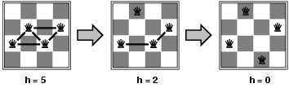
Example: 4-Queens
States: 4 queens in 4 columns (4⁴ = 256 states)
Actions/Operators: move queen in column
Goal test: no attacks
Evaluation: h(n) = number of attacks
Given a random initial state, can solve n-queens in almost constant time for arbitrary n with high probability (e.g., n = 10,000,000)

Slide 180
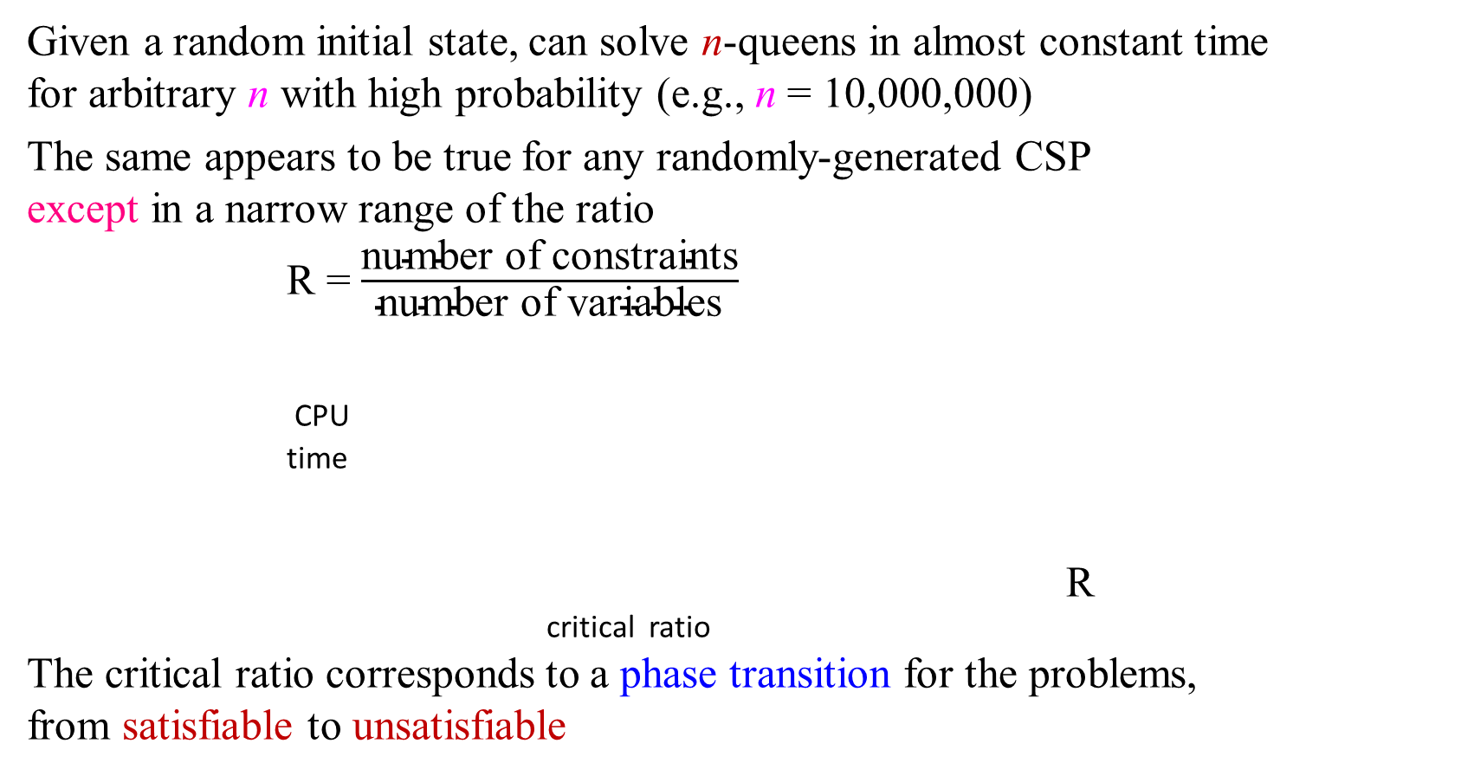
Performance of min-conflicts
Given a random initial state, can solve n-queens in almost constant time
for arbitrary n with high probability (e.g., n = 10,000,000)
The same appears to be true for any randomly-generated CSP
except in a narrow range of the ratio
R = $\frac{\text{number} \text{of} \text{constraints}}{\text{number} \text{of} \text{variables}}$
CPU
time
R
critical ratio
The critical ratio corresponds to a phase transition for the problems,
from satisfiable to unsatisfiable

Slide 181
Summary
CSPs are a special kind of problem:
  states defined by values of a fixed set of variables
  goal test defined by constraints on variable values
Backtracking = depth-first search with one variable assigned per node
Variable ordering and value selection heuristics help significantly
Forward checking prevents assignments that guarantee later failure
Constraint propagation (e.g., arc consistency) does additional work to constrain values and detect inconsistencies
Iterative min-conflicts are usually effective in practice

Slide 182
Many real-world applications of CSP
Assignment problems
  who teaches what class
Timetabling problems
  exam schedule
Transportation scheduling
Floor planning
Factory scheduling
Hardware configuration
  a set of compatible components

