Slide 1
Chapter 04
Artificial Intelligence
Informed search algorithms
and
Beyond Classical Search

Slide 2
Beyond Classical Search
Local search algorithms/Iterative Improvement Algorithms and Optimization Problems
  Hill-Climbing Search
  Simulated Annealing
  Genetic Algorithms

Slide 3
Beyond Classical Search
We have seen methods that systematically explore the search space, possibly using principled pruning (e.g., A*)
The best of these methods can currently handle search spaces of up to 10¹⁰⁰ states / ~1,000 binary variables (ballpark figure)
What if we have much larger search spaces?
Search spaces for some real-world problems may be much larger e.g., 10^{30,000} states as in certain reasoning and planning tasks
Some of these problems can be solved by Iterative Improvement Methods

Slide 4
Local search /Iterative Improvement Algorithms
In many optimization problems the goal state itself is the solution
  Just want to reach goal state
  the solution path to the goal is irrelevant
The state space is a set of complete configurations
  Search is about finding
    the optimal configuration (as in TSP) or
    just a feasible configuration (as in scheduling problems),or
    at least one that satisfies goal constraints, e.g., n-queens)
For these cases, use iterative improvement, or local search, methods.
    Keep a single current state
    Try to improve it
    Constant memory
…

Slide 5
Local search /Iterative Improvement Algorithms
The state space is a set of complete configurations
  Search is about finding
    the optimal configuration (as in TSP) or
    just a feasible configuration (as in scheduling problems),or
    at least one that satisfies goal constraints, e.g., n-queens)
For these cases, use iterative improvement, or local search, methods.
    Keep a single current state
    Try to improve it
    Constant memory
An evaluation (or objective) function h must be available that measures the quality of each state
Main Idea: Start with a random initial configuration and make small, local changes to it that improve its quality

Slide 6
Local Search Algorithms
They operate on a single current node and move only to the neighbors of that node in an effort to improve a solution.
Although not systematic, local search has two advantages
  Use very little memory – usually a constant amount
  Often can find reasonable solutions in large or continuous state spaces

Slide 7
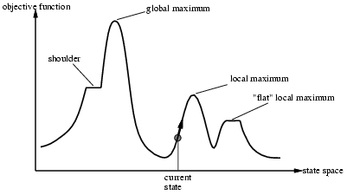
Local Search: The State-Space Landscape
Goal is to find a global minimum (minimize cost) or global maximum (maximize objective function).

Slide 8
Local Search: The State-Space Landscape
Ideally, the evaluation function h should be monotonic: the closer a state to an optimal goal state the better its h-value.
Each state can be seen as a point on a surface.
The search consists in moving on the surface, looking for its highest peaks (or, lowest valleys): the optimal solutions.
evaluation
current state

Slide 9
Iterative Improvement Algorithms:
Hill Climbing Search
Hill-climbing search (HC) is the most basic local search technique.
  At each step, move towards the increasing value.
  Stop when there are no larger successors.
No search tree is maintained
  Uses a single node, and
  Update its state and value, as better states are discovered.
Does not look ahead - past the immediate neighbors of the current state.

Slide 10
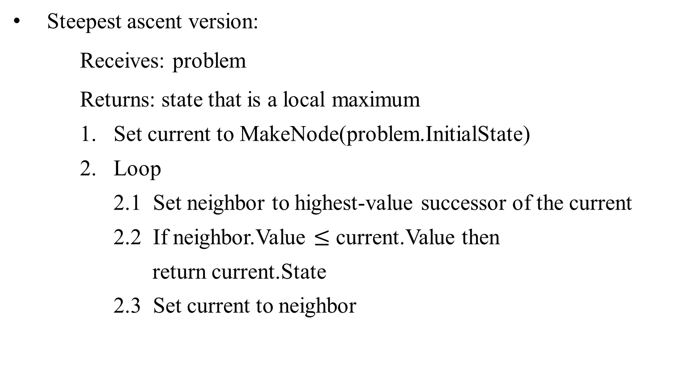
Hill Climbing Search
Steepest ascent version:
Receives: problem
Returns: state that is a local maximum
    Set current to MakeNode(problem.InitialState)
    Loop
      2.1 Set neighbor to highest-value successor of the current
      2.2 If neighbor.Value $≤$ current.Value then
      return current.State
      2.3 Set current to neighbor

Slide 11
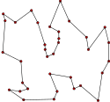
Travelling salesman problem
The travelling salesman problem (TSP) asks the following question:
  "Given a list of cities and the distances between each pair of cities, what is the shortest possible route that visits each city and returns to the origin city?"
an NP-hard problem in combinatorial optimization,
important in operations research and theoretical computer science.

Slide 12
Local Search Example: TSP
TSP: Travelling Salesperson Problem
h = length of the tour
Strategy: Start with any complete tour, perform pairwise exchanges
0
Variants of this approach get within 1% of optimal very quickly with thousands of cities

Slide 13
Example: TSP
c₁
Traveling salesman
Start with any complete tour
Operator: Perform pairwise exchanges
9
5
10
c₃
6
3
c₂
c₄
9
Traveling Salesman Problem
Tour: c₁, c₃, c₄, c₂
Cost = 17

Slide 15
Local Search Example: n-queens
Put n queens on an n × n board with no two queens on the same row, column, or diagonal
h = number of conflicts
Strategy/Operator: Move a queen to reduce the number of conflicts
h = 5 h = 2 h = 0
Almost solves n-queens problems nearly-instantaneously for very large n, e.g., n = 10⁶

Slide 16
Local Search Example: n-queens
Put n queens on an n × n board with no two queens on the same row, column, or diagonal
h = number of conflicts
Strategy/Operator: Move a queen to reduce the number of conflicts
h = 5 h = 2 h = 1 h = 0
Almost solves n-queens problems nearly-instantaneously for very large n, e.g., n = 10⁶

Slide 17
Local Search Example: n-queens
Put n queens on an n × n board with no two queens on the same row, column, or diagonal
h = number of conflicts
Strategy/Operator: Move a queen to reduce the number of conflicts
h = 5 h = 5 h = 3 h = 0
Almost solves n-queens problems nearly-instantaneously for very large n, e.g., n = 10⁶

Slide 18
Local Search Example: n-queens
Put n queens on an n × n board with no two queens on the same row, column, or diagonal
h = number of conflicts
Strategy/Operator: Move a queen to reduce the number of conflicts
h = 5 h = 3 h = 1 h = 0
Almost solves n-queens problems nearly-instantaneously for very large n, e.g., n = 10⁶

Slide 19
Local Search Example: n-queens
Put n queens on an n × n board with no two queens on the same row, column, or diagonal
h = number of conflicts
Strategy/Operator: Move a queen to reduce the number of conflicts
h = 5 h = 5 h = 3 h = 0
Almost solves n-queens problems nearly-instantaneously for very large n, e.g., n = 10⁶

Slide 20
Iterative Improvement Algorithms
The 8-queens problem:
The goal of the 8-queens problem is
  to place eight queens on a chessboard such that no queen attacks directly or indirectly any other.
  Only the final state counts, regardless the path cost.
Two main kinds of formulation:
  An incremental-state formulation
    involves operators that augment the state description by,
      starting with an empty state;
      adding a queen to the state for each action.
  A complete-state formulation
    starts with all 8 queens on the board and
    moves them around.

Slide 21
Iterative Improvement Algorithms
The 8-queens problem:
The incremental-state formulation
    States: a state is any arrangement of 0 to 8 queens on the board.
    Initial state: no queens on the board.
    Actions: Add a queen to any empty square.
    Transition model: Returns the board with a queen added to the specified square.
    Goal state: 8 queens on the board, none attacked.
There is 64! Possible sequences to investigate.
Can this to be improved?

Slide 22
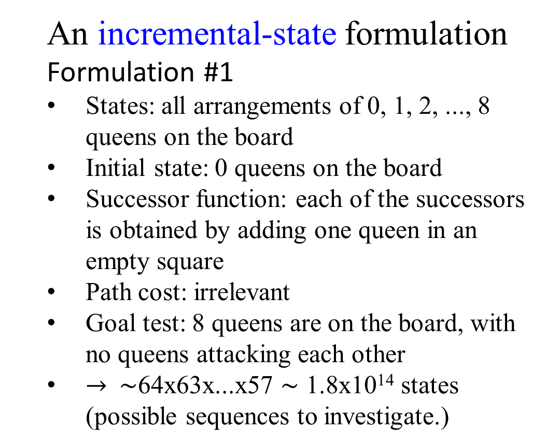
  An incremental-state formulation
  Formulation #1
  States: all arrangements of 0, 1, 2, ..., 8 queens on the board
  Initial state: 0 queens on the board
  Successor function: each of the successors is obtained by adding one queen in an empty square
  Path cost: irrelevant
  Goal test: 8 queens are on the board, with no queens attacking each other
  $→$ $\sim$64x63x...x57 $\sim$ 1.8x10¹⁴ states (possible sequences to investigate.)
…

Slide 23
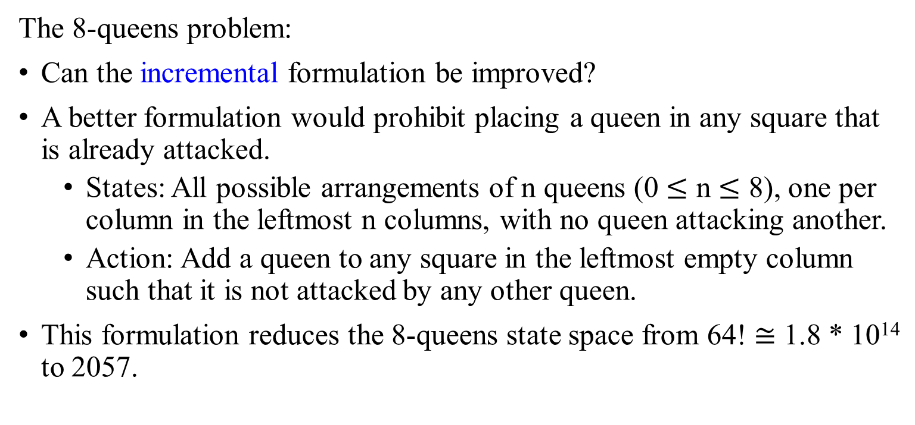
Iterative Improvement Algorithms
The 8-queens problem:
Can the incremental formulation be improved?
A better formulation would prohibit placing a queen in any square that is already attacked.
  States: All possible arrangements of n queens (0 $≤$ n $≤$ 8), one per column in the leftmost n columns, with no queen attacking another.
  Action: Add a queen to any square in the leftmost empty column such that it is not attacked by any other queen.
This formulation reduces the 8-queens state space from 64! $≅$ 1.8 * 10¹⁴ to 2057.

Slide 24
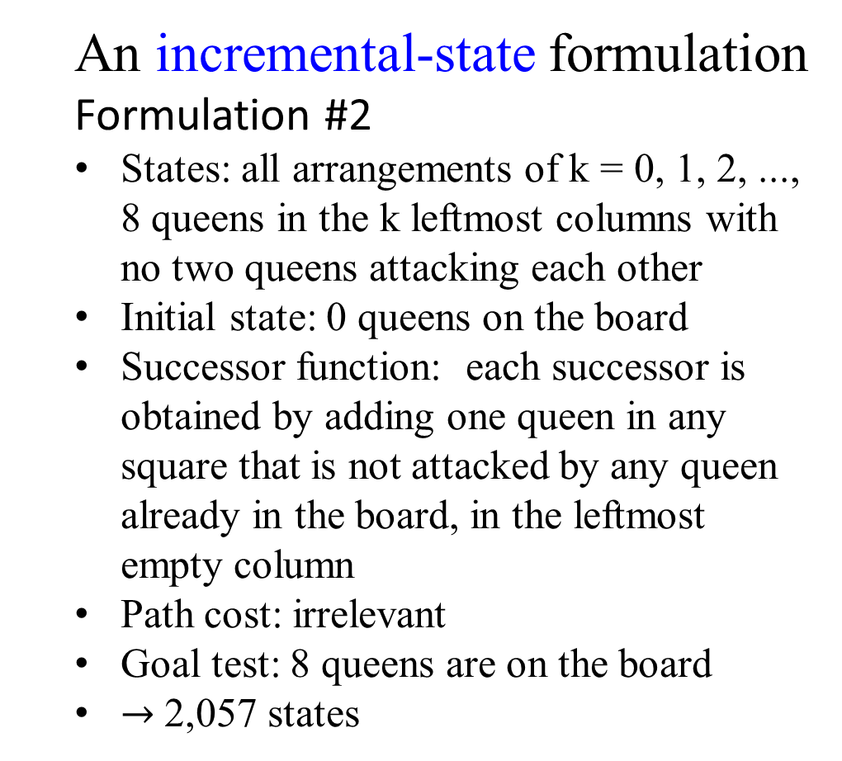
  An incremental-state formulation
  Formulation #2
  States: all arrangements of k = 0, 1, 2, ..., 8 queens in the k leftmost columns with no two queens attacking each other
  Initial state: 0 queens on the board
  Successor function: each successor is obtained by adding one queen in any square that is not attacked by any queen already in the board, in the leftmost empty column
  Path cost: irrelevant
  Goal test: 8 queens are on the board
  $→$2,057 states
…

Slide 25
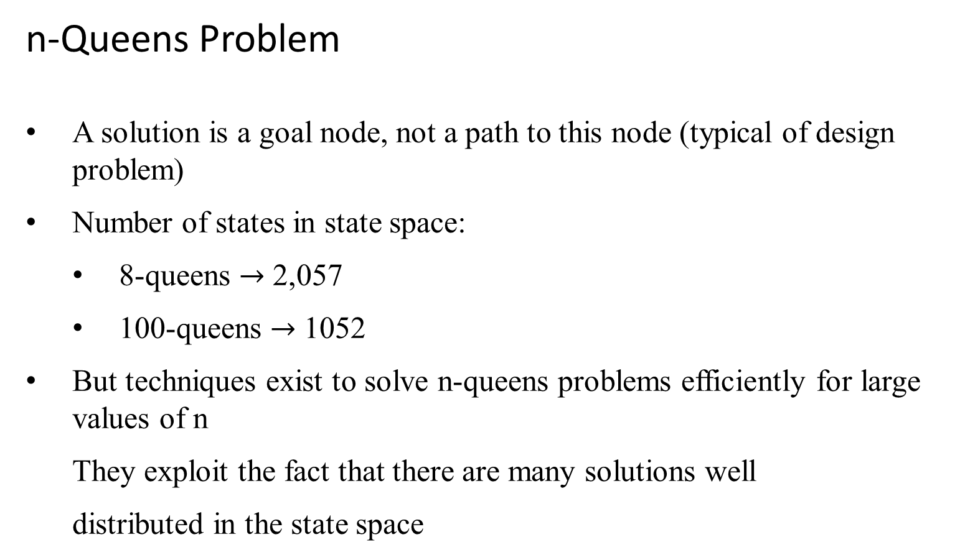
n-Queens Problem
A solution is a goal node, not a path to this node (typical of design problem)
Number of states in state space:
  8-queens $→$ 2,057
  100-queens $→$ 1052
But techniques exist to solve n-queens problems efficiently for large values of n
They exploit the fact that there are many solutions well
distributed in the state space

Slide 27
n-Queens Problem
Use a complete-state formulation - Typically used by the local search algorithm.
states are potential solutions.
  For 8-queens, states where there is one queen in each column.
The successors of a state are all possible states generated by moving a single queen to another square in the same column (so each state has 8 *7 = 56 successors). – Successor function.
The heuristic cost function h is the number of pairs of queens that are attacking each other, either directly or indirectly.
The global minimum of this function is zero, which occurs only at perfect solutions.

Slide 28
A complete-state formulation:
Figure 4.3(a) shows a state with h = 17.
The figure also shows the values of all its successors, with the best successor having h = 12.
Hill-climbing algorithm typically choose randomly among the set of best successors if there is more than one.

Slide 29
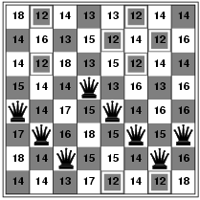
Hill-climbing search: 8-queens problem
Fig 4.3 (a) An 8-queens state with heuristic cost estimate h = 17.
The value of h for each possible successor state is obtained by moving a queen with its column.
The best moves are marked to h = 12.
h = number of pairs of queens that are attacking each other, either directly or indirectly
h = 17 for the above state

Slide 30
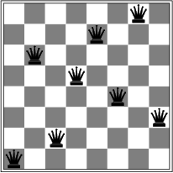
Hill-climbing search: 8-queens problem
3
3
Fig 4.3 (b) A local minimum in the 8-queens state space; the state has h=1 but every successor has a higher cost.
3
3
2
3
2
3
3
3
5
2
4
3
3
A local minimum with h = 1
h = 1, but all successors higher,
local minimum

Slide 31
Successors function
Use a complete-state formulation:
Typically used by local search algorithm.
states are potential solutions.
For the 8-queens problem
  Each state has 8 queens on the board, one per column.
  The successors of a state are all possible states generated by moving a single queen to another square in the same column (so each state has 8 *7 = 56 successors).
    A successor function (transition model): Given a state, generates its successor states

Slide 32
  A successor function (transition model): Given a state, generates its successor states
… There are 8 possibilities where the queen could be placed in the first column
… (7)

Slide 33
  A successor function (transition model): Given a state, generates its successor states
… There are 8 possibilities where the queen could be placed in the first column
… (7)

Slide 34
  A successor function (transition model): Given a state, generates its successor states
… There are 8 possibilities where the queen could be placed in the first column
… (7)

Slide 35
  A successor function (transition model): Given a state, generates its successor states
… There are 8 possibilities where the queen could be placed in the first column
… (7)

Slide 36
Use a complete-state formulation –
…
The heuristic cost function h is the number of pairs of queens that are attacking each other, either directly or indirectly.
The global minimum of this functions is zero, which occurs only at perfect solutions (i.e., when have an actual solution).

Slide 38
Hill-climbing search: 8-queens problem
Fig 4.3 (b) A local minimum in the 8-queens state space; the state has h=1 but every successor has a higher cost.
A local minimum with h = 1

Slide 39
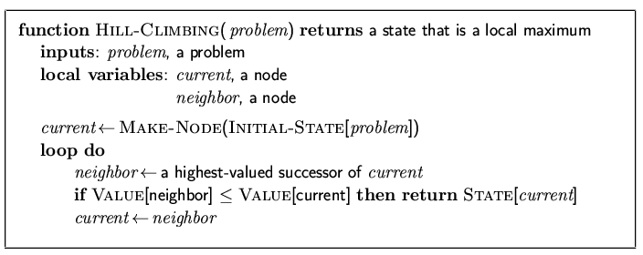
Hill Climbing (a.k.a gradient ascent/descent search)
“Like climbing Mount Everest in thick fog with amnesia”
Fig 4.2 The hill climbing algorithm.

Slide 40
Hill Climbing (gradient ascent/descent search)
Fig 4.2 The hill-climbing search algorithm which is the most basic local search technique.
At each step the current node is replaced by the best neighbor;
  in this version, that means the neighbor with the highest VALUE.
  If a heuristic cost estimate h is used, we would have find the neighbor with the lowest h.
  It is simply a loop that continually moves in the direction of increasing value – that is, uphill. It terminates when it reaches a “peak” where no neighbor has a higher value.

Slide 41
Hill Climbing (gradient ascent/descent search)
Fig 4.2 The hill-climbing search algorithm which is the most basic local search technique.
  The algorithm does not maintain a search tree, so the data structure for the current node need only record the state and the value of the objective function.
  Hill climbing does not look ahead beyond the immediate neighbors of the current state.

Slide 42
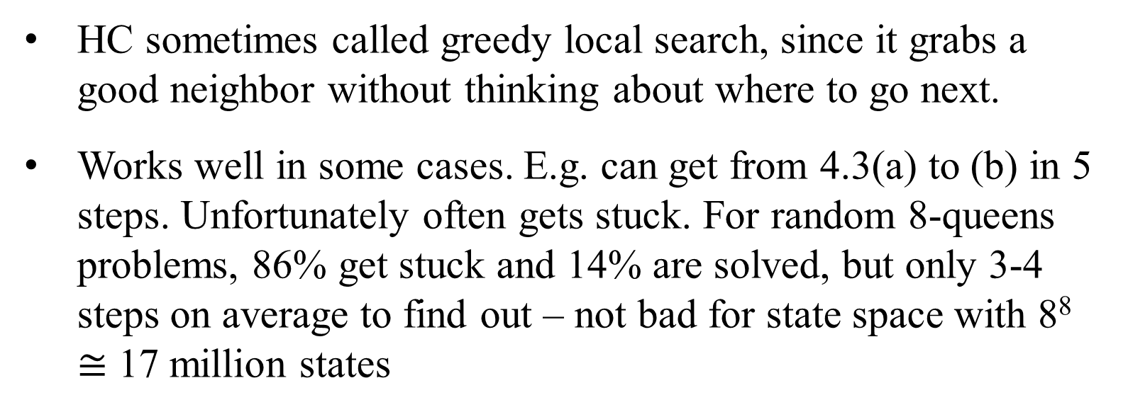
Hill Climbing Search - (Greedy Local Search)
HC sometimes called greedy local search, since it grabs a good neighbor without thinking about where to go next.
Works well in some cases. E.g. can get from 4.3(a) to (b) in 5 steps. Unfortunately often gets stuck. For random 8-queens problems, 86% get stuck and 14% are solved, but only 3-4 steps on average to find out – not bad for state space with 8⁸ $≅$ 17 million states

Slide 43
Hill Climbing Search
Gets stuck due to:
Local maxima – goes towards peak, but stops before getting to global maximum (i.e., a local minimum for the cost h). E.g., state in Figure 4.3(b). Every move of a single queen makes the situation worse.
Plateaux – flat areas (a flat local maximum) where there is no uphill exit, just wander around. Could be a shoulder or "mesa". A hill-climbing search might get lost on the plateau.
Ridges – result in a sequence of
local maxima (difficult for greedy
algorithm to navigate).

Slide 44
Figure 4.1 A plateau is a flat area of the state-space landscape. It can be a flat local maximum, from which no uphill eit exists, or a shoulder. From which progress is possible. A hill-climbing search might get lost on the plateau.

Slide 45
Figure 4.4 Ridges cause difficulties for hill climbing: The grid of states (dark circles) is superimposed on a ridge rising from left to right, creating a sequence of local maxima that are not directly connected to each other. From each local maximum, all the available actions point downhill.

Slide 46
Hill Climbing (Greedy Local Search)
Given HC algorithm stops when reaches a plateau.
  Can try sideways moves – moves to states with same value – in hopes that a plateau is really a shoulder.
  Must be careful not to allow infinite loop if on a real plateau.
Common to limit number of consecutive sideways moves.
  E.g., 100 consecutive sideways moves for 8-queens.
  Solved goes up to 94%, but average number of steps is 21 for solutions and 64 for failures.

Slide 47
Hill Climbing (Greedy Local Search)
HC variants choose next state in different ways
  Stochastic hill-climbing:
    choose at random from uphill moves;
    probability of selection correlated with steepness.
    Usually converges slower than steepest ascent, but can find better solutions.
  First-choice hill-climbing:
    generate successors at random until get one that is better than current state.
    Good when states have many (e.g., thousands) of successors.

Slide 48
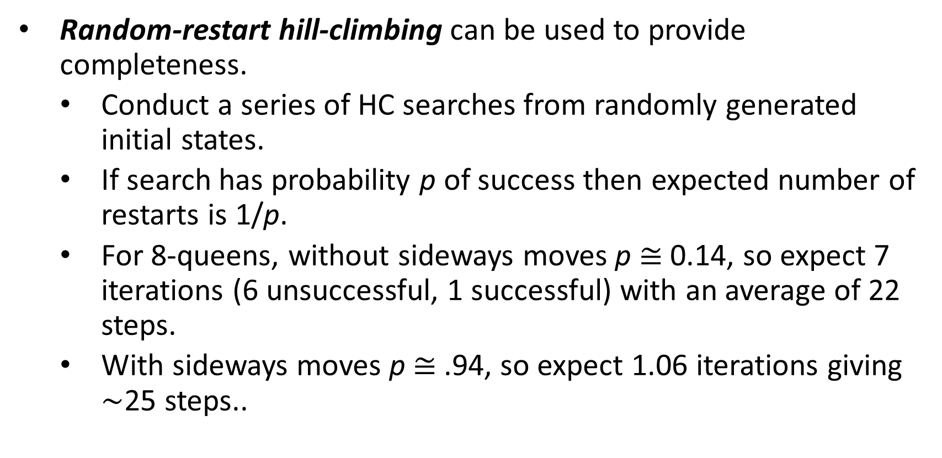
Hill Climbing (Greedy Local Search)
Random-restart hill-climbing can be used to provide completeness.
  Conduct a series of HC searches from randomly generated initial states.
  If search has probability p of success then expected number of restarts is 1/p.
  For 8-queens, without sideways moves p $≅$ 0.14, so expect 7 iterations (6 unsuccessful, 1 successful) with an average of 22 steps.
  With sideways moves p $≅$ .94, so expect 1.06 iterations giving $\sim$25 steps..

Slide 49
Hill Climbing (Greedy Local Search)
QueueingFn is sort-by-h
  Only keep lowest-h state on open list
Best-first search is tentative
Hill climbing is irrevocable
Features
  Much faster
  Less memory
  Dependent upon h(n)
  If bad h(n), may prune away all goals
  Not complete

Slide 50
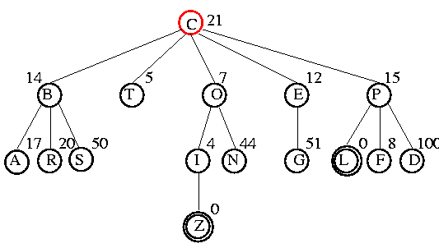
Example

Slide 51
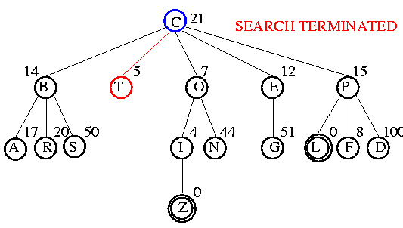
Example

Slide 52
Hill-climbing search: Shortcomings
Depending on the initial state, it can get stuck on local maxima
It may converge very slowly
In continuous spaces, choosing the step-size is non-obvious
Fig 4.1

Slide 53
Hill Climbing: Improvements
Various possible alternatives:
• Restart from a random point in the space
• Look ahead: expand up to m > 1 generations of descendants
before choosing best node
• Introduce noise: allow down-hill moves sometimes
• Keep n > 1 nodes in the fringe at each step

Slide 54
Hill Climbing Issues
Also referred to as gradient descent
Foothill problem / local maxima / local minima
Can be solved with random walk or more steps
Other problems: ridges, plateaus (shoulder)
global maxima
local maxima
plateaus (shoulder)

Slide 55
Fig 4.1 A one-dimensional state-space landscape in which elevation corresponds the objective function.
The aim is to find the global maximum.
Hill-climbing search modifies the current state to try to improve it, as shown by the arrow.
However, true local optima are surprisingly rare in high-dimensional
spaces. There often is an escape to a better state

Slide 56
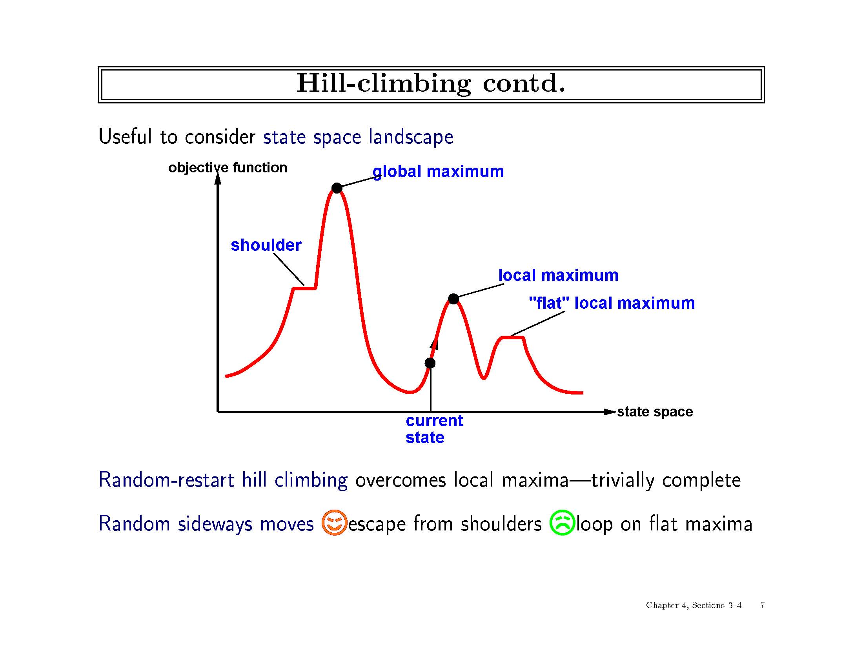

Slide 57

Comparison of Search Techniques
 | DFS | BFS | UCS | IDS | Best | HC
Complete | N | Y | Y | Y | N | N
Optimal | N | N | Y | N | N | N
Heuristic | N | N | N | N | Y | Y
Time | b^{m} | b^{d+1} | b^{m} | b^{d} | b^{m} | mn
Space | bm | b^{d+1} | b^{m} | bd | b^{m} | b

Slide 59
Simulated Annealing Search
Basic hill-climbing is incomplete, since it never goes downhill and can get stuck on a local maxima.
A purely random walk – choosing a successor uniformly at random – is complete, but extremely inefficient.
Simulated annealing offers a compromise.
Simulated annealing (SA) combines ideas of hill-climbing and random walk.
Annealing is a physical process used to harden (temper) metals and glass by heating to a high temperature then cool gradually.

Slide 60
Simulated Annealing
Inspired by annealing process of gradually cooling a liquid until it changes to a low-energy state.
Very similar to hill climbing, except include a user-defined temperature schedule.
When temperature is “high”, allow some random moves.
When temperature “cools”, reduce probability of random move.
If T is decreased slowly enough, guaranteed to reach best state.

Slide 61
Simulated Annealing Search
In computing, SA is usually done to minimize cost, so look at gradient descent trying to find the global minimum.
Idea is to "escape" a local minima by "shaking" it out.
Start out by shaking hard (i.e., high temperature) causing large and/or frequent jumps at the beginning, but gradually reducing
the intensity of shaking (i.e., lower the temperature) causing decreased size and frequency of jumps.

Slide 62
Simulated Annealing Search
Idea: improve hill-climbing by allowing occasional down-hill steps, to minimize the probability of getting stuck in a local maximum
Down-hill steps taken randomly but with probability that decreases with time
Probability controlled by a given annealing schedule for a temperature parameter T
If schedule lowers T slowly enough, search is guaranteed to end in a global maximum
Catch: it may take several tries with test problems to devise a good annealing schedule

Slide 63
Simulated Annealing Search
Receives: problem, schedule // a time -> temp map
Returns: solution state
1. Initialize current to MakeNode (problem.InitialState)
2. For t from 1 to infinity do
  2.1 T = schedule[t] // get current temp. from sched.
  2.2 If T = 0 then return current.State
  2.3 next = random successor of current
  2.4 ΔE = next.Value – current.Value
  2.5 If ΔE > 0 then current = next // if better than accept state
  2.6 Else current = next only with probability e^{ΔE/T}

Slide 64
Simulated Annealing Search
e^{ΔE/T} decreases exponentially with the "badness" of the move (ΔE) and decreases as T (temperature) decreases.
If the schedule lowers T slowly enough, the global minimum will be found with probability approaching 1.

Slide 65
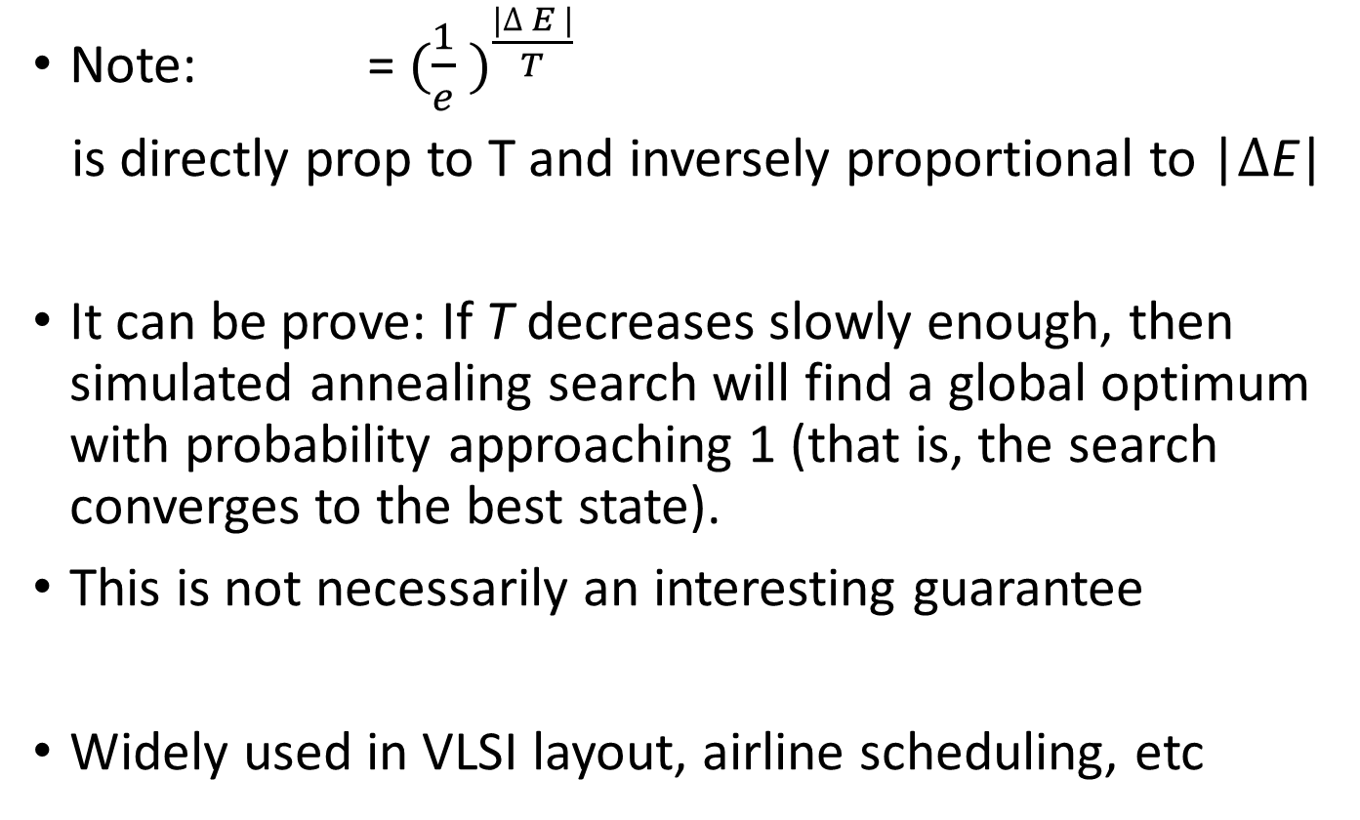
Properties of simulated annealing search
Note: = $({\frac{1}{e} )}^{\frac{|∆ E |}{T}}$
is directly prop to T and inversely proportional to |$∆$E|
It can be prove: If T decreases slowly enough, then simulated annealing search will find a global optimum with probability approaching 1 (that is, the search converges to the best state).
This is not necessarily an interesting guarantee
Widely used in VLSI layout, airline scheduling, etc

Slide 66
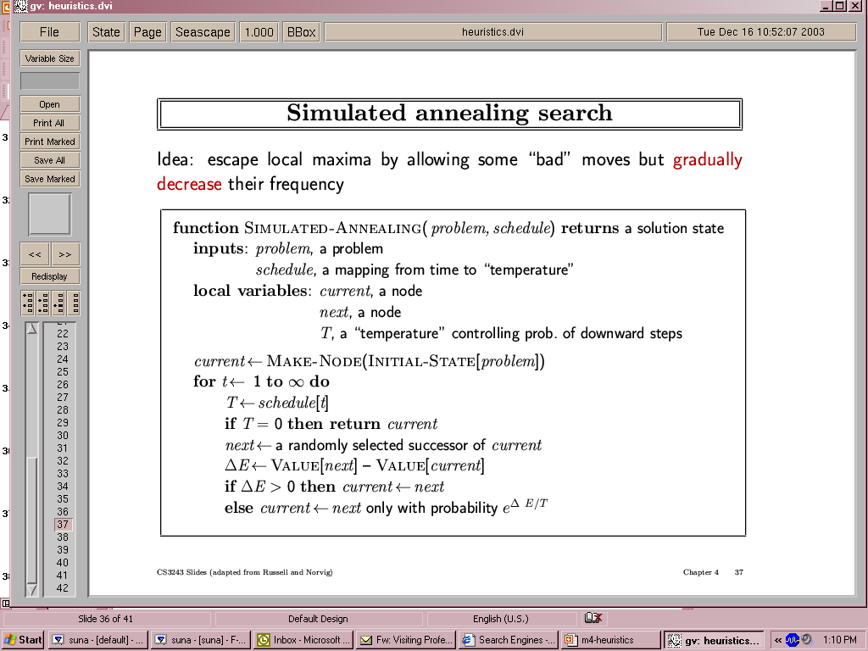
Simulated annealing search
Idea: escape local maxima by allowing some "bad" moves but gradually decrease their frequency

Slide 68
Local Beam Search
Idea: improve hill-climbing by
keeping k states instead of 1;
choose top k of all their successors.
Not the same as k searches run in parallel!
Searches that find good states recruit other searches to join them
Problem: quite often, all k states end up on same local maximum
Solution: choose k successors randomly, biased towards good ones

Slide 69
Local Beam Search
Keep track of k states rather than just one
//Choose top k of all successors and
Start with k randomly generated states
At each iteration, all the successors of all k states are generated
  If any one is a goal state, stop; else select the k best successors from the complete list and repeat.
Problem
  Many times all k states end up on same local hill
Solution:
  Choose k successors RANDOMLY, bias toward good ones
  Similar to natural selection

Slide 70
Beam Search – local bean search is an adaptation of beach search, which is a path-based algorithm
QueueingFn is sort-by-h
  Only keep best (lowest-h) n nodes on open list
n is the “beam width”
  n = 1, Hill climbing
  n = infinity, Best first search

Slide 71
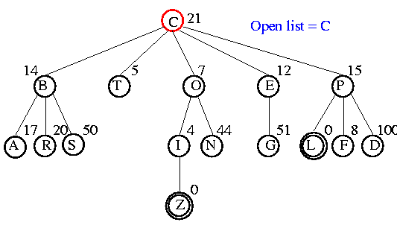
Example

Slide 72
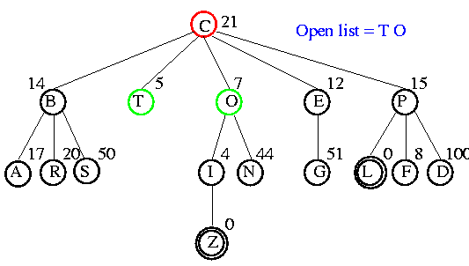
Example

Slide 73
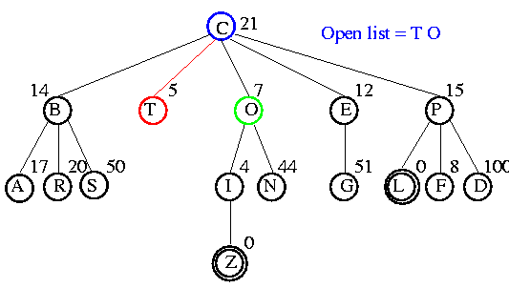
Example

Slide 74
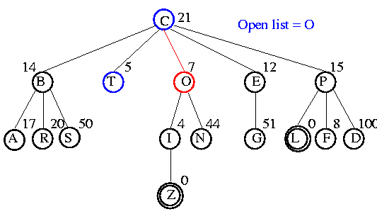
Example

Slide 75
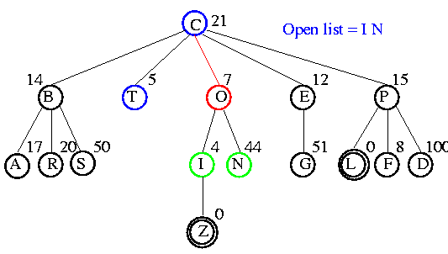
Example

Slide 76
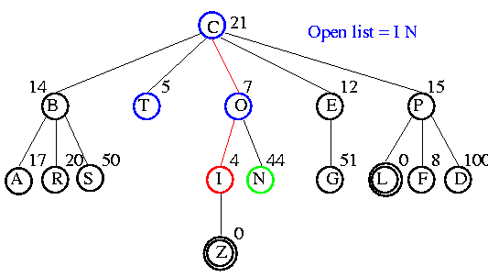
Example

Slide 77
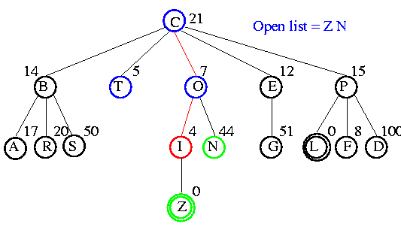
Example

Slide 78
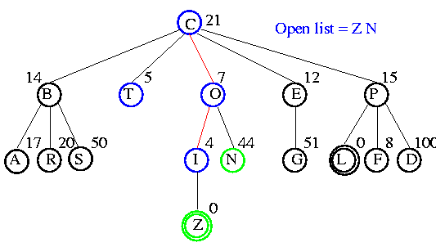
Example

Slide 79
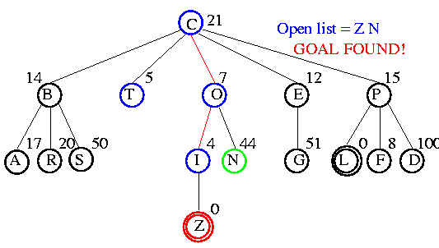
Example

Slide 80
Comparison of Search Techniques
 | DFS | BFS | UCS | IDS | Best | HC | Beam
Complete | N | Y | Y | Y | N | N | N
Optimal | N | N | Y | N | N | N | N
Heuristic | N | N | N | N | Y | Y | Y
Time | b^{m} | b^{d+1} | b^{m} | b^{d} | b^{m} | bm | nm
Space | bm | b^{d+1} | b^{m} | bd | b^{m} | b | bn

Slide 81
Genetic Algorithms
A successor state is generated by combining two parent states
Start with k randomly generated states (population)
A state is represented as a string over a finite alphabet (often a string of 0s and 1s)
Evaluation function (fitness function). Higher values for better states.
Produce the next generation of states by selection, crossover, and mutation

Slide 82
Genetic Algorithms
Inspired by Darwin’s theory of natural selection
Each state is seen as an individual in a population
A genetic algorithm applies selection and reproduction operators to an initial population
The aim is to generate individuals that are most successful, according to a given fitness function
It is basically a stochastic local beam search, but with successors generated from pairs of states
Local maxima are avoided by giving a nonzero chance of reproduction to low-scoring individuals

Slide 83
The Basic Genetic Algorithm
function GENETIC-ALGORITHM( population, FITNESS-FN) returns as individual
inputs: population, a set of individuals
FITNESS-FN, a function that measures the fitness of an individual
repeat
parents = SELECTION( population, FITNESS-FN)
population = REPRODUCTION( parents )
until some individual s fit enough
return the best individual in population, according to FITNESS-FN
• Variation operators used in Reproduction create the necessary diversity, facilitating novelty
• Selection reduces diversity but pushes quality by increasing fitness

Slide 84
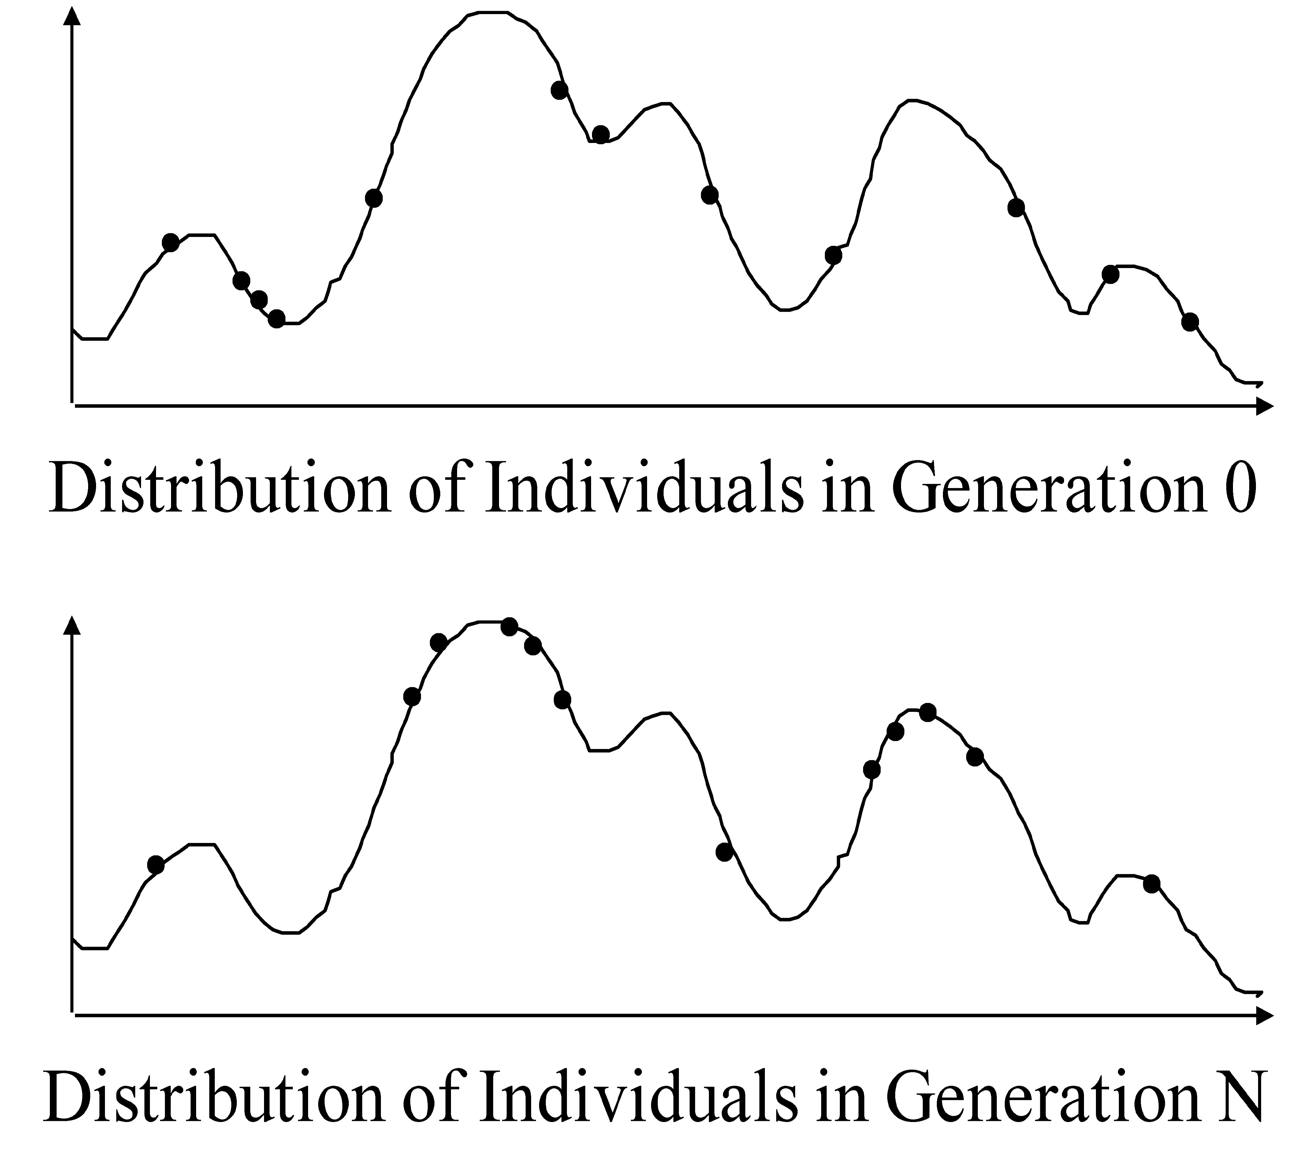
Improving fitness
Abstract example: changes of values of fitness function

Slide 85
Genetic Algorithms
In a Genetic algorithm (GA) successor states are generated by
    combining two parent states rather than
    modifying a single state.
Combination depends on
  Fitness function that ranks states
  Probability of selection as parents
  Probability of crossover – how much of parent continues into next generation
  Probability of mutation

Slide 86
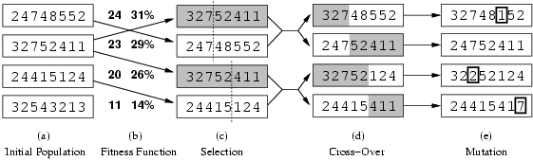
Genetic Algorithms: 8-Queens Problem
k randomly generated states is a population
Individual represented as strings, e.g. position of each queen in 8 columns
Fitness function = # of non-attacking pairs of queens. Selection probability proportional to score.
Fig. 4.6 The genetic algorithm, ….

Slide 87
Genetic Algorithms
Fitness function: number of non-attacking pairs of queens (min = 0, max = 8 × 7/2 = 28)
24/(24+23+20+11) = 31%
23/(24+23+20+11) = 29% etc
Fig. 4.6 The genetic algorithm, ….

Slide 88
Fig 4.6 The genetic algorithm, illustrated for digit strings representing 8-queens states.
The initial population in (a) is ranked by the fitness function in (b), resulting in pairs for mating in (c) .
They produce off-spring in (d), which are subject to mutation in (e) .

Slide 89
Genetic Algorithms: 8-Queens Problem
States of first pair of parents combined into first new child state.
Shaded part is lost while unshaded part is retained in next generation.
In the beginning, children can be very different from parents => large steps; later population is similar, so children are similar => small steps.

Slide 90
Fig 4.7 The 8-queens states corresponding to the first two Figure 4.6(c) and the first offspring in Figure 4.6(d).
The shaded columns are lost in the crossover step and the unshaded columns are retained.

Slide 91
Or

Slide 92
Genetic Algorithms: Classic Approach
• Each state is represented by a finite string over a finite alphabet.
• Each character in the string is a gene.
• The selection mechanism is randomized, with the probability of
selection proportional to the fitness measure.
• Reproduction is accomplished by crossover and mutation.
Fig. 4.6 The genetic algorithm, ….

Slide 93
Possible Encodings
Character strings 0101 · · · 1100
Sequences of real numbers (43.2 -33.1 · · · 0.0 89.2)
Tuples of elements (E11 E3 E7 · · · E1 E15)
Lists of rules (R1 R2 R3 · · · R22 R23)
Program elements (genetic programming)
. . .

Slide 94
Encodings for Genetic Algorithms
Choosing the right encoding of state configurations to strings is crucial.
Crossover helps only if substrings are meaningful components that can be reassembled into a new meaningful configuration.
shaded columns shaded columns
Note: GAs are not evolution: e.g., real genes encode replication machinery!

Slide 95
Problem Encoding
Problem: Find location that is to several given cities
Population encoding: Express location l as a 16-bit string
l = 1001010101011100
with the first 8 bits representing the location’s X-coordinate and the second 8 bits representing the Y-coordinate
Fitness function: Median distance of location from each city
Combination: Crossover of X-coordinate from one parent and Y-coordinate from the other
Mutation: one or more bit flips

Slide 96
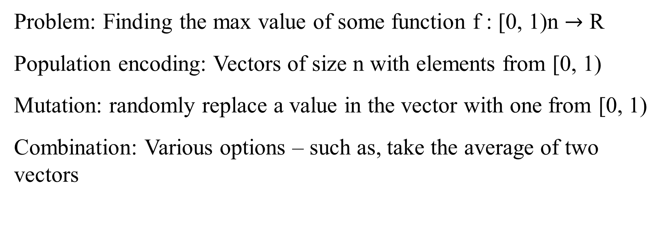
Problem Encoding
Problem: Finding the max value of some function f : [0, 1)n $→$ R
Population encoding: Vectors of size n with elements from [0, 1)
Mutation: randomly replace a value in the vector with one from [0, 1)
Combination: Various options – such as, take the average of two vectors

Slide 97
Discrete Recombination
Similar to crossover
Equal probability of receiving each parameter from either parent
Example:
(8, 12, 31, ... , 5) (2, 5, 23, ... , 14)
(2, 12, 31, ... , 14)

Slide 98
Intermediate Recombination
Each child component is the average of the corresponding parent
Components
Example:
(8, 12, 31, ... , 5) (2, 5, 23, ... , 14)
(5, 8.5, 27, ... , 9.5)

Slide 99
GA for the Traveling Salesperson Problem
Problem: Find a tour of a given set of cities so that
        each city is visited only once and
        total traveled is minimal
Representation: An ordered list of city numbers
(known as order-based GA)
1) London 3) Iowa City 5) Beijing 7) Tokyo
2) Venice 4) Singapore 6) Phoenix 8) Victoria
Ex.,
CityList1 (3 5 7 2 1 6 4 8)
CityList2 (2 5 7 6 8 1 3 4)

Slide 100
GA for the Traveling Salesperson Problem
Combination: Order 1 crossover (Crossover combines inversion and recombination):
  1. Copy a randomly selected portion of Parent 1 to Child
  Fill the blanks in Child with those numbers in Parent 2
  from left to right, avoiding duplicates in Child
  Parent 1 (3 5 7 2 1 6 4 8)
  Parent 2 (2 5 7 6 8 1 3 4)
  _________________________________________ _________________
  Child (5 8 7 2 1 6 3 4)

Slide 101
GA for the Traveling Salesperson Problem
Mutation: swap two numbers in the list
  1. Copy a randomly selected portion of Parent 1 to Child
  2. Fill the blanks in Child with those numbers in Parent 2 from left to right, avoiding duplicates in Child
* *
Before: (5 8 7 2 1 6 3 4)
After: (5 8 6 2 1 7 3 4)

Slide 102
Different Recombination
(Crossover) for TSP
TSP: The Traveling Salesman Problem
  Near Neighbor Crossover
  Greedy Edge Crossover

Slide 103
Nearest Neighbor Crossover (NNX)
Input: Two TSP tours T1, T2
Output: one new TSP tour T3.
Step 1: Create a graph of n nodes and 2n
edges from T1 and T2
Step 2: Randomly choose a node and let T3
contains only this node
Step 3: Repeat until all n nodes are in T3:
  Pick the nearest node x (not in T3) to the
  last node in T3 and add x into T3.

Slide 105
Greedy Edge Crossover (GEX)
Input: Two TSP tours T1, T2
Output: one new TSP tour T3.
Step 1: Sort the edges from T1 and T2
Step 2: For each edge e in the sorted list, if
adding e into T3 creates neither a node with
three neighbors, nor a cycle of less than n
node, add e into T3.

Slide 107
Domains of Application
Numerical, Combinatorial Optimization
System Modeling and Identification
Planning and Control
Engineering Design
Data Mining
Machine Learning
Artificial Life

Slide 108
Drawbacks of GA
■ Difficult to find an encoding for a problem
■ Difficult to define a valid fitness function
■ May not return the global maximum

Slide 109
Why use a GA?
■ requires little insight into the problem
■ the problem has a very large solution space
■ the problem is non-convex
■ does not require derivatives
■ objective function need not be smooth
■ variables do not need to be scaled
■ fitness function can be noisy (e.g. process data)
■ when the goal is a good solution

Slide 110
When NOT to use a GA?
■ if global optimality is required
■ if problem insight can:
  ■ significantly impact algorithm performance
  ■ simplify problem representation
■ if the problem is highly constrained
■ if the problem is smooth and convex
  ■ use a gradient-based optimizer
■ if the search space is very small
  ■ use enumeration

Slide 111
Taxonomy
COMPUTATIOAL INTELLIGENCE OF SOFT COMPUTING
Neural
Networks
Evolutionary Algorithms
Fuzzy
Systems
Evolutionary Programming
Evolution Strategies
Genetic
Algorithms
Genetic
Programming

Slide 112
Application to Stock Trading
■ There are many technical indicators of stock movements
■ A model using these indicators can be represented
by a tree
■ Use the past market data to define the fitness function
■ Use Genetic Programming to create trees

Slide 113
Example: A Function on Stock Market

Slide 115
Questions?
IDA*

Slide 116
Avoiding Repeated States - Can we do it?
Do not return to parent or grandparent state
  In 8 puzzle, do not move up right after down
Do not create solution paths with cycles
Do not generate repeated states
  (need to store and check potentially large number of states)

Slide 117
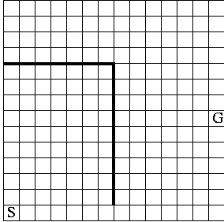
Maze Example
States are cells in a maze
Move N, E, S, or W
What would BFS do (expand E, then N, W, S)?
What would DFS do?
What if order changed to N, E, S, W and loops are prevented?

Slide 119
IDA*
Series of Depth-First Searches
Like Iterative Deepening Search, except
  Use A* cost threshold instead of depth threshold
  Ensures optimal solution
QueuingFn enqueues at front if f(child) <= threshold
Threshold
  h(root) first iteration
  Subsequent iterations
    f(min_child)
    min_child is the cut off child with the minimum f value
  Increase always includes at least one new node
  Makes sure search never looks beyond optimal cost solution

Slide 120
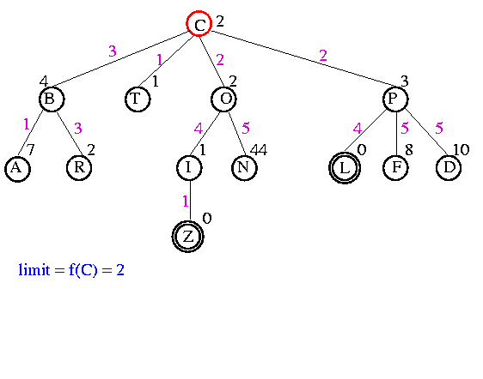
Example

Slide 121
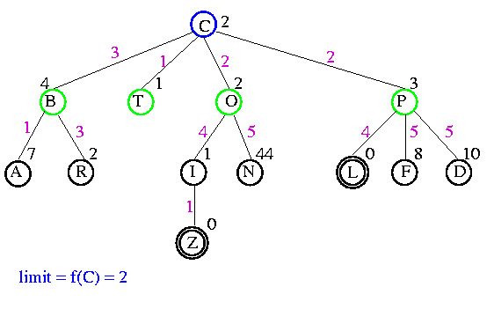
Example

Slide 122
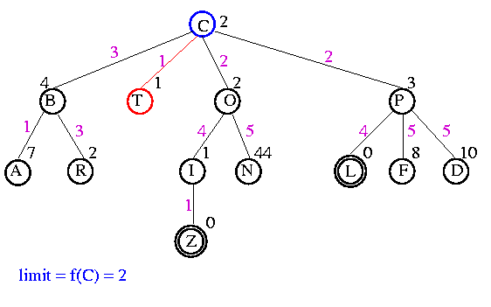
Example

Slide 123
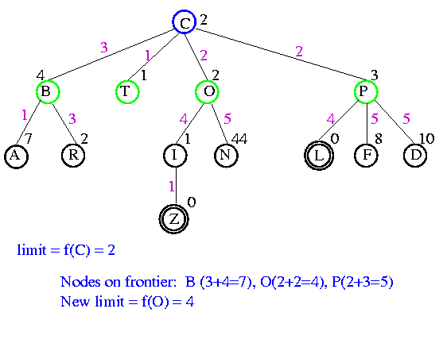
Example

Slide 124

Example

Slide 125
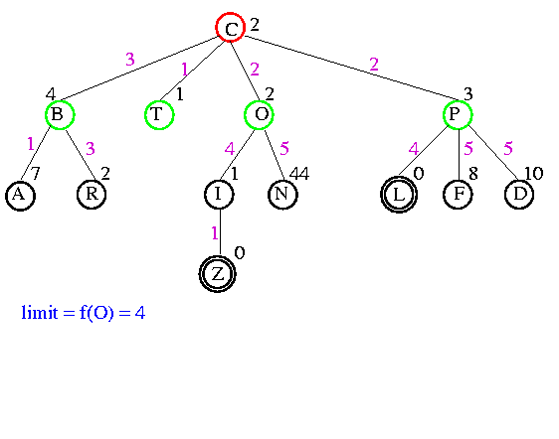
Example

Slide 126
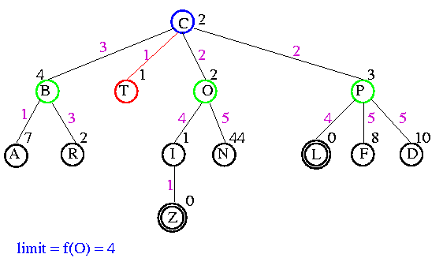
Example

Slide 127
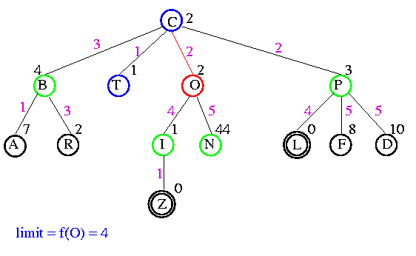
Example

Slide 128
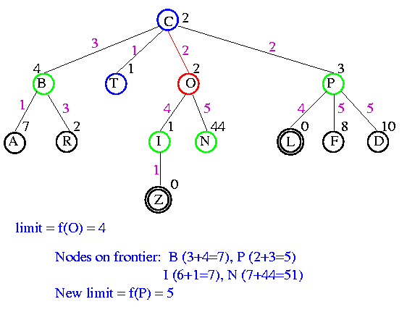
Example

Slide 129

Example?

Slide 130

Example

Slide 131

Example

Slide 132
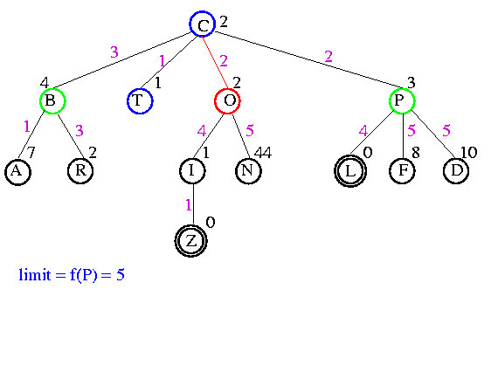
Example

Slide 133
Example

Slide 134
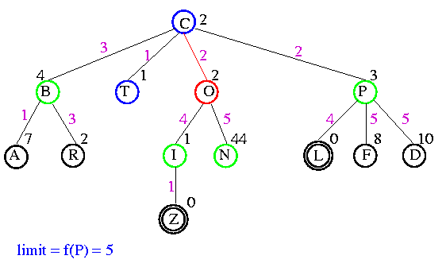
Example

Slide 135
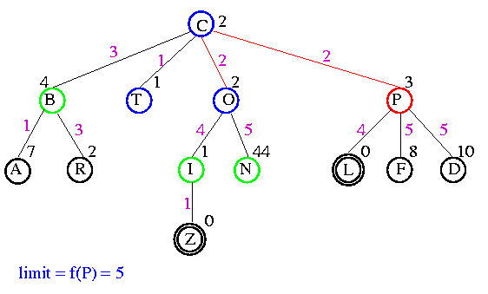
Example

Slide 136
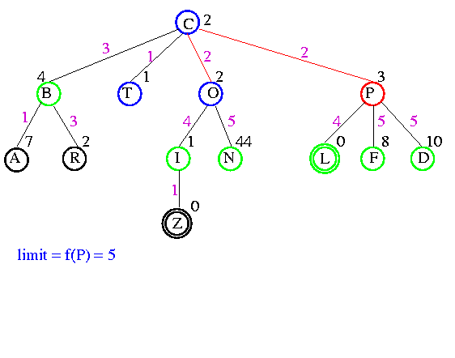
Example

Slide 137
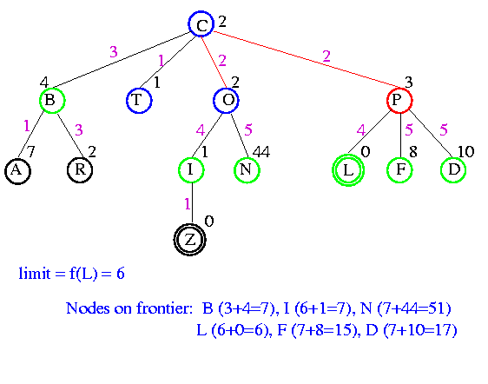
Example

Slide 138

Example

Slide 139

Example

Slide 140

Example

Slide 141

Example

Slide 142
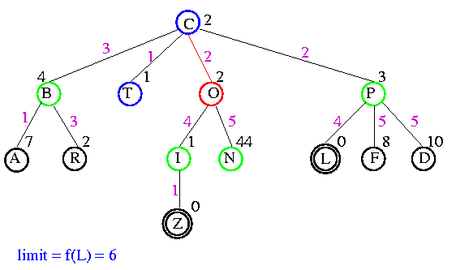
Example

Slide 143

Example

Slide 144
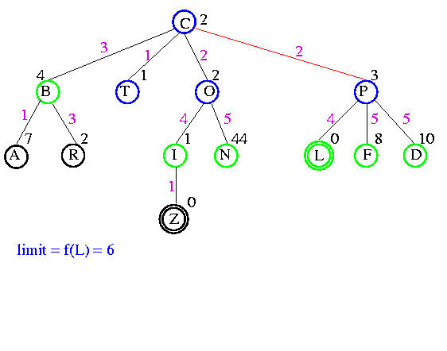
Example

Slide 145
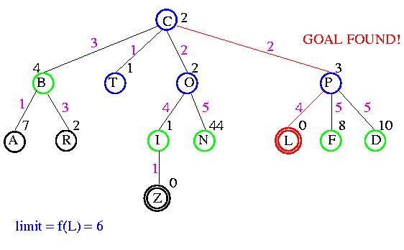
Example

Slide 146
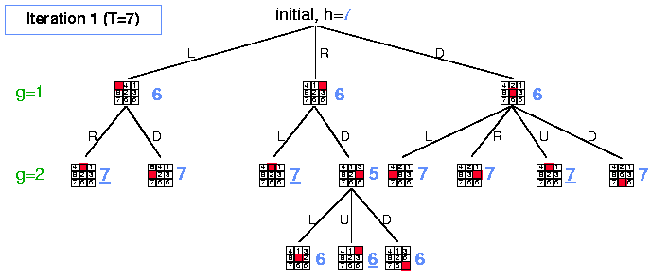
Example

Slide 147
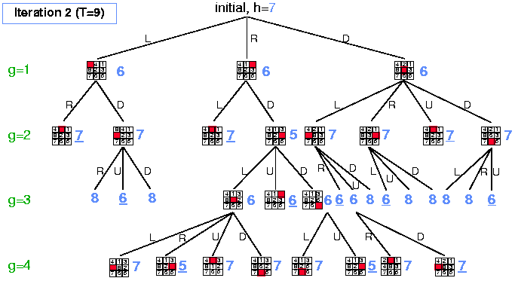
Example

Slide 148
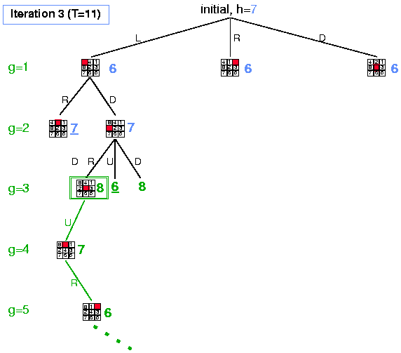
Example

Slide 149
Analysis
Some redundant search
  Small amount compared to work done on last iteration
Dangerous if continuous-valued h(n) values or if values very close
  If threshold = 21.1 and value is 21.2, probably only include 1 new node each iteration
Time complexity is O(b^{m})
Space complexity is O(m)

Slide 150
Comparison of Search Techniques
 | DFS | BFS | UCS | IDS | Best | HC | Beam | A* | IDA*
Complete | N | Y | Y | Y | N | N | N | Y | Y
Optimal | N | N | Y | N | N | N | N | Y | Y
Heuristic | N | N | N | N | Y | Y | Y | Y | Y
Time | b^{m} | b^{d+1} | b^{m} | b^{d} | b^{m} | bm | nm | b^{m} | b^{m}
Space | bm | b^{d+1} | b^{m} | bd | b^{m} | b | bn | b^{m} | bm

Slide 151
RBFS
Recursive Best First Search
  Linear space variant of A*
Perform A* search but discard subtrees when perform recursion
Keep track of alternative (next best) subtree
Expand subtree until f value greater than bound
Update f values before (from parent)
and after (from descendant) recursive call

Slide 152
Algorithm
// Input is current node and f limit
// Returns goal node or failure, updated limit
RBFS(n, limit)
if Goal(n)
return n
children = Expand(n)
if children empty
return failure, infinity
for each c in children
f[c] = max(g(c)+h(c), f[n]) // Update f[c] based on parent
repeat
best = child with smallest f value
if f[best] > limit
return failure, f[best]
alternative = second-lowest f-value among children
newlimit = min(limit, alternative)
result, f[best] = RBFS(best, newlimit) // Update f[best] based on descendant
if result not equal to failure
return result

Slide 153
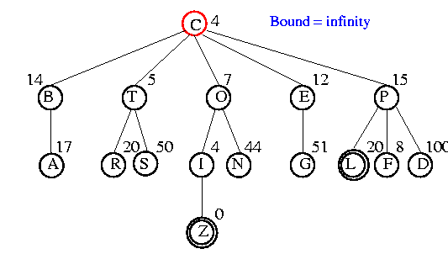
Example

Slide 154

Example

Slide 155

Example

Slide 156

Example

Slide 157

Example

Slide 158

Example

Slide 159
Analysis
Optimal if h(n) is admissible
Space is O(bm)
Features
  Potentially exponential time in cost of solution
  More efficient than IDA*
  Keeps more information than IDA* but benefits from storing this information

Slide 160
SMA*
Simplified Memory-Bounded A* Search
Perform A* search
When memory is full
  Discard worst leaf (largest f(n) value)
  Back value of discarded node to parent
Optimal if solution fits in memory

Slide 161

Example
Let MaxNodes = 3
Initially B&G added to open list, then hit max
B is larger f value so discard but save f(B)=15 at parent A
  Add H but f(H)=18. Not a goal and cannot go deper, so set f(h)=infinity and save at G.
Generate next child I with f(I)=24, bigger child of A. We have seen all children of G, so reset f(G)=24.
Regenerate B and child C. This is not goal so f(c) reset to infinity
Generate second child D with f(D)=24, backing up value to ancestors
D is a goal node, so search terminates.

Slide 163


Slide 164
Genetic Algorithms
What is a Genetic Algorithm (GA)?
  An adaptation procedure based on the mechanics of natural genetics and natural selection
Gas have 2 essential components
  Survival of the fittest
  Recombination
Representation
  Chromosome = string
  Gene = single bit or single subsequence in string, represents 1 attribute

Slide 165
Humans
DNA made up of 4 nucleic acids (4-bit code)
46 chromosomes in humans, each contain 3 billion DNA
4^{3 billion} combinations of bits
Can random search find humans?
  Assume only 0.1% genome must be discovered, 3(10⁶) nucleotides
  Assume very short generation, 1 generation/second
  3.2(¹⁰¹⁰⁷) individuals per year, but 10^{1.8(107)} alternatives
  10¹⁸¹⁰⁶ years to generate human randomly
Self reproduction, self repair, adaptability are the rule in natural systems, they hardly exist in the artificial world
Finding and adopting nature’s approach to computational design should unlock many doors in science and engineering

Slide 166
GAs Exhibit Search
Each attempt a GA makes towards a solution is called a chromosome
  A sequence of information that can be interpreted as a possible solution
Typically, a chromosome is represented as sequence of binary digits
  Each digit is a gene
A GA maintains a collection or population of chromosomes
  Each chromosome in the population represents a different guess at the solution

Slide 167
The GA Procedure
Initialize a population (of solution guesses)
Do (once for each generation)
  Evaluate each chromosome in the population using a fitness function
  Apply GA operators to population to create a new population
Finish when solution is reached or number of generations has reached an allowable maximum.

Slide 168
Common Operators
Reproduction
Crossover
Mutation

Slide 169
Reproduction
Select individuals x according to their fitness values f(x)
  Like beam search
Fittest individuals survive (and possibly mate) for next generation

Slide 170
Crossover
Select two parents
Select cross site
Cut and splice pieces of one parent to those of the other
1 1 1 1 1
0 0 0 0 0
1 1 0 0 0
0 0 1 1 1

Slide 171
Mutation
With small probability, randomly alter 1 bit
Minor operator
An insurance policy against lost bits
Pushes out of local minima
Population:
1 1 0 0 0 0
1 0 1 0 0 0
1 0 0 1 0 0
0 1 0 0 0 0
Goal: 0 1 1 1 1 1
Mutation needed to find the goal

Slide 172
Example
Solution = 0 0 1 0 1 0
Fitness(x) = #digits that match solution
A) 0 1 0 1 0 1 Score: 1
B) 1 1 1 1 0 1 Score: 1
C) 0 1 1 0 1 1 Score: 3
D) 1 0 1 1 0 0 Score: 3
Recombine top two twice.
Note: 64 possible combinations

Slide 173
Example
Solution = 0 0 1 0 1 0
C) 0 1 1 0 1 1
D) 1 0 1 1 0 0
E) 0 | 0 1 1 0 0 Score: 4
F) 1 | 1 1 0 1 1 Score: 3
G) 0 1 1 0 1 | 0 Score: 4
H) 1 0 1 1 0 | 1 Score: 2
Next generation:
E) 0 0 1 1 0 0
F) 0 1 1 0 1 0
G) 0 1 1 | 1 0 0 Score: 3
H) 0 0 1 | 0 1 0 Score: 6
I) 0 0 | 1 0 1 0 Score: 6
J) 0 1 | 1 1 0 0 Score: 3
DONE! Got it in 10 guesses.

Slide 174
Issues
How select original population?
How handle non-binary solution types?
What should be the size of the population?
What is the optimal mutation rate?
How are mates picked for crossover?
Can any chromosome appear more than once in a population?
When should the GA halt?
Local minima?
Parallel algorithms?

Slide 175

GAs for Mazes

Slide 176
GAs for Optimization
Traveling salesman problem
Eaters
Hierarchical GAs for game playing

Slide 177
GAs for Control
Simulator

Slide 178
GAs for Graphic Animation
Simulator
Evolving Circles
3D Animation
Scientific American Frontiers

Slide 179

Biased Roulette Wheel
For each hypothesis, spin the roulette wheel to determine the guess

Slide 180
Inversion
Invert selected subsequence
1 0 | 1 1 0 | 1 1 -> 1 0 0 1 1 1 1

Slide 181
Elitism
Some of the best chromosomes from previous generation replace some of the worst chromosomes from current generation

Slide 182
K-point crossover
Pick k random splice points to crossover parents
Example
  K = 3
  1 1 | 1 1 1 | 1 1 | 1 1 1 1 1 -> 1 1 0 0 0 1 1 0 0 0 0 0
  0 0 | 0 0 0 | 0 0 | 0 0 0 0 0 0 0 1 1 1 0 0 1 1 1 1 1

Slide 183
Diversity Measure
Fitness ignores diversity
As a result, populations tend to become uniform
Rank-space method
  Sort population by sum of fitness rank and diversity rank
  Diversity rank is the result of sorting by the function 1/d²

Slide 184
Classifier Systems
GAs and load balancing
SAMUEL

Slide 185
End of Chapter 3 and 4

