Slide 1
Artificial Intelligence
Chapter 01
Introduction to AI

Slide 2
Recommended Textbook:
Artificial Intelligence: A Modern Approach
Stuart Russell and Peter Norvig
3rd Edition, 2010

Slide 3
Outline
Course overview
What is AI?
A brief history
The state of the art

Slide 4

Course Overview
Tentatively, let’s try to cover these topics with the listed chapters.
  Introduction and Agents (Chapters 1, 2)
Problem-Solving
  Search (chapters 3, 4, 5, 6)
Knowledge, Reasoning, and Planning
  Logic (Chapters 7, 8, 9)
  Planning (Chapters 10, 11, 12)
Uncertain Knowledge and Reasoning
  Uncertainty (Chapters 13, 14)
Learning
  Learning (Chapters 18, 19, 20)
Communicating, Perceiving, and Acting
  Natural Language Processing (Chapters 22, 23)

Slide 6
What is Artificial Intelligence?
Develop a machine engine to make a robot capable behave humanly or rationally! We need these principles.
A scientific and engineering discipline devoted to:
understanding principles that make intelligent behavior possible in natural or artificial systems;
developing methods for the design and implementation of useful, intelligent artifacts. [Poole, Mackworth, Goebel]
Artifact: something made or given shape by man,

Slide 7
Building AI systems is hard!
I went to the grocery store, I saw the milk on the shelf and
I bought it.
What did I buy in the grocery store?
The milk?
The shelf?
The store?
An awful lot of knowledge of the world is needed to answer simple questions like this one.

Slide 8
What is Intelligence Then?
Fast thinking?
Knowledge?
Ability to pass as a human?
Ability to reason logically?
Ability to learn?
Ability to perceive and act upon one’s environment?
Ability to play chess at grand-master’s level?
. . .

Slide 10

Cognition : Knowledge Acquisition
The mental process of knowing (knowledge is acquired), through, such as,
    awareness,
    perception,
    intuition,
    reasoning, and
    judgment.
Perception: The process or state of being aware of something with the senses.
Intuition: knowing or understanding something without reasoning or perception.
(instinct)

Slide 11
Cognitive Science
The interdisciplinary study of the mind, intelligence, and learning, including research in the traditional disciplines of
  psychology,
  philosophy,
  semantics, and
  linguistics, together with
  artificial intelligence and computer science.

Slide 12
What is AI? - (Views of AI fall into four categories:)
The science of making machines (somethings made by men) that:
Cognitive Science
A system is rational if, given what it knows, it does the “right thing”.
The system is “ acting rationally.” (advocated by the textbook)
 | Like humans | Not necessarily like humans
Think | Thinking humanly | Thinking rationally
Act | Acting humanly | Acting rationally

Slide 13
What is the Definition of AI?
The top are concerned with thought processes and reasoning
The bottom are addressed behaviors
Systems that think like humans | Systems that think rationally
Systems that act like humans | Systems that act rationally
The left column measure success in terms of fidelity to human performance
The right column measure against rationality (an ideal performance measure).

Slide 14
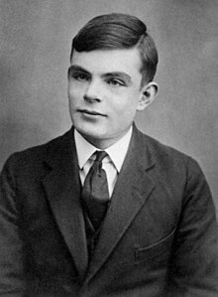

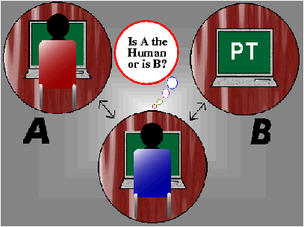
Acting Humanly: The Turing Test Approach
Turing test: ultimate test for acting humanly
  Computer and human both interrogated by judge
  Computer passes test if judge can’t tell the difference

Slide 15
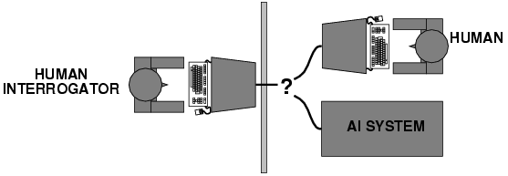
Acting Humanly: The Turing Test Approach
Turing (1950) "Computing machinery and intelligence":
  "Can machines think?" → "Can machines behave intelligently?"
Operational test for intelligent behavior:
  the Imitation Game – Enigma Code
Suggested major components of AI: knowledge, reasoning, language understanding, learning

Slide 16
Acting Humanly: The Turing Test Approach
Problem?: Turing test is not reproducible, constructive, or
amenable to mathematical analysis.
(amenable - Ready to consent; agreeable)

Slide 17
How effective is this test?
Example:
Alice, Loebner prize winner as “the most human computer” at the annual Turing Test contests in 2000, 2001 and 2004
  Alice is a computer chat program
    (a conversational robot),
    develop since 1995 by Dr. Richard Wallace.

Slide 18
Suggested major components of AI:
knowledge, reasoning, language understanding, learning
The six disciplines compose most of the AI
Knowledge representation: store what it knows or hears (knowledge)
Automated reasoning: use the stored information to answer questions and to draw new conclusions (reasoning and making decisions)
Natural language processing: enable it to communicate successfully in English (language understanding)
Machine learning: adapt to new circumstances and to detect and extrapolate patterns (learning).
The total Turing Test requires the above components and
  Computer vision to perceive an object
  robotics to manipulate objects and move about
Perceive:To become aware of (something) directly through any of the senses, especially sight or hearing.

Slide 19
State of the art –
What do we accomplish in these areas?
  Perception: computer vision, speech understanding
  Machine learning, neural networks
  Robotics
  Natural language processing
  Automated reasoning and decision making
    Knowledge representation (FOL and Inference in FOL)
    Reasoning (logical, probabilistic reasoning)
    Decision-making (search, planning, decision theory)

Slide 20
What can I do for an intelligent artifact?
Agent (the machine) must:
  have command of the language
  Have a wide range of knowledge
  demonstrate human traits (humor, emotion)
  be able to reason
  be able to learn
An agent is anything that is capable of
  perceiving its environment through sensors and
  acting upon that environment through actuators.

Slide 21
Thinking Humanly: Cognitive Modeling Approach
Requires scientific theories of internal activities of the brain
  knowledge of brain function
  What level of abstraction? “Knowledge” or “circuits”?
  How can we validate this (how to validate)?
    It requires
      1) predicting and testing behavior of human subjects
      (top-down, Cognitive Science), or
      2) direct identification from neurological data
      (bottom-up, Cognitive Neuroscience)
    Both approaches (roughly, Cognitive Science and Cognitive Neuroscience) are now distinct from AI
Notes:
What level of abstraction? Knowledge, circuitry, chemical?

Slide 22
Thinking Humanly: Cognitive Modeling Approach
“Cognitive revolution“ in 1960s:
  information-processing psychology replaced prevailing orthodoxy of behaviorism
The focus of Cognitive Science is
  bringing together
    computer models from AI and
    experimental techniques from psychology
    to construct precise and testable theories of the human mind

Slide 24
Thinking Rationally: The “Laws of Thought” Approach
Aristotle attempted to codify “right thinking,”- irrefutable reasoning processes.
  His syllogisms (deductive reasoning) provided patterns for argument structures:
    always yield correct conclusions for given correct premises.
    “Socrates is a human (minor premise);
    all humans are mortal (major premise);
    therefore, Socrates is mortal (conclusion).”
  The laws of thought were supposed to govern the operation of the mind;
What are correct arguments or thought processes?
Impossible to refute or disprove

Slide 25
Thinking Rationally: The “Laws of Thought“ Approach
Aristotle: what are correct arguments or thought processes?
  Several Greek schools developed:
    Various forms of logic:
      notation and rules of derivation for thoughts;
      provided foundation of AI through mathematics and philosophy
    Problems: …

Slide 26
Thinking Rationally: The “Laws of Thought“ Approach
  Problems:
    Not easy to state informal and uncertain knowledge in the form terms required by logical notation.
    Not all intelligent behavior is mediated by logical deliberation/controlled by logic
      What is our goal?
      What is the purpose of thinking?
      What thoughts should I have?
For their wedding, maybe I will go; maybe not!
At the store, what do I want to buy?
Milk? (Milk is on the self.) Shelf? (Milk on a shelf in the store) Store?

Slide 27
Acting Rationally: The Rational Agent Approach
Act to achieve goals, given set of beliefs
Rational behavior is doing the “right thing”
    Thing? expects to maximize goal achievement, given the available information
    (adopted by Russell & Norvig)
Aristotle:
  Every act (action) and every inquiry (pursuit) is aiming at some good
Systems that think like humans | Systems that think rationally
Systems that act like humans | Systems that act rationally

Slide 28
Rational Agents
P* = {Different sized Milk cartons, Milk cartons on shelves,
Milk cartons on shelves in the stores,
Consumers take milk cartons of different sizes, …}
An agent is an entity that perceives and acts
An agent is a function from percept histories to actions:
f : P* → A
For any given class of environments and tasks, we seek the agent (or class of agents) with the best performance
This course is about designing rational agents
Caveat: perfect rationality unachievable, due to computational limitations.
  → Approach: design best program for given machine resources
A = {pick up 1 gallon of milk, buy the whole shelf of milk, …}
The best performance = {Get half a gallon or a gallon of milk. }
Percept-a concept that depends on recognition by the senses, such as sight, of some external object or phenomenon

Slide 29
Intelligence: Operational Definition of AI
Systems that act like humans
Turing test.
Systems that think like humans
Cognitive Science
Systems that think rationally
Logic-based AI
Systems that act rationally
Rational Agents
Systems that think like humans | Systems that think rationally
Systems that act like humans | Systems that act rationally

Slide 30
Rational Decisions
Get a one-gallon carton of milk.
The term rational is used in a particular way:
  Rational: maximally achieving pre-defined goals
  Rational only concerns what decisions are made
(not the thought process behind them)
  Goals are expressed in terms of the utility of outcomes
  Being rational means maximizing your expected utility
Either a one-gallon carton or two half-gallon cartons of milk
1 gallon carton of milk (10pts.)
2 half-gallon cartons of milk (9 pts.)
4 quarters cartons of milk (5 pts.)
otherwise (0 pt.)
(Economics) economics
a. the ability of a commodity to satisfy human wants
b. the amount of such satisfaction. See disutility

Slide 31
Degrees of Intelligence
Ref
Building an intelligent system as capable as humans
  remains an elusive (hard to define or explain) goal.
Systems have been built
  exhibit various specialized degrees of intelligence.
Formalisms and algorithmic ideas are
  useful for constructing “intelligent” systems.
  the foundation of our attempt to understand intelligence as a computational process.
This course will examine some of these formalisms and see how they can be used to achieve various degrees of intelligence.

Slide 32
AI’s Foundations
Philosophy logic, methods of reasoning,
mind as physical system
foundations of learning, language, rationality,
Mathematics formal representation and proof,
algorithms, computation, (un)decidability,
(in)tractability, probability
Psychology adaptation, perception and motor control,
experimental techniques
Economics formal theory of rational decisions
Linguistics knowledge representation, grammar
Neuroscience plastic physical substrate for mental activity
Control theory homeostatic systems, stability,
simple optimal agent designs

Slide 33
Ref
Additional Materials

Slide 34
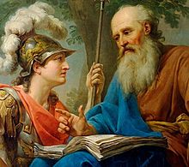
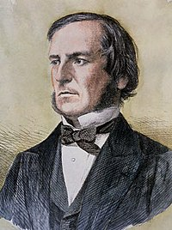
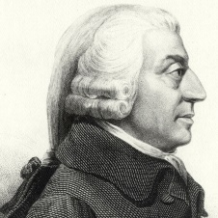
AI Prehistory- Foundations of AI
Ref
Philosophy
  450 BC, Socrates asked for algorithm to distinguish pious from non-pious individuals
  Aristotle developed laws for reasoning
  Logic, methods of reasoning, mind as physical system foundations of learning, language, rationality
Mathematics
  1847, George Boole introduced formal language for making logical inference
  Formal representation and proof algorithms, computation, (un)decidability, (in)tractability, probability
Economics
  1776, Adam Smith views economies as consisting of agents maximizing their own well being (payoff)
  utility “preferred outcomes”, decision theory
Neuroscience …

Slide 35
AI Prehistory- Foundations of AI
Ref
…
Neuroscience
  1861, Study how brains process information
  physical substrate for mental activity
Psychology
  1879, Cognitive psychology initiated phenomena of perception and motor control, experimental techniques.
  Cognitive psychology views the brain as an information-processing device.
Computer engineering
  1940, Alan Turing’s team built the first operational computer, the electromechanical Health Robinson for deciphering German message.
  Building fast computers
Control theory …

Slide 36
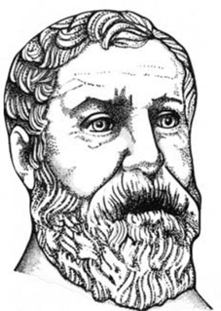
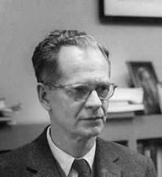
AI Prehistory- Foundations of AI
Ref
…
Control theory
  In 250 B.C., Ktesibios of Alexandria built the first self-controlling machine: a water clock with a regulator that maintained a constant flow-rate. This invention changed the definition of what an artifact could do.
  design systems that maximize an objective function over time
Linguistics
  1957, Skinner studied behaviorist approach to language learning
  knowledge representation, grammar

Slide 37
Abridged history of AI
Ref
1943 McCulloch & Pitts: Boolean circuit model of brain
1950 Turing's "Computing Machinery and Intelligence"
1956 Dartmouth meeting: "Artificial Intelligence" adopted
1952—69 Look, Ma, no hands!
1950s Early AI programs, including Samuel's checkers
program - IBM, Newell & Simon's Logic Theorist - CMU,
Gelernter's Geometry Engine - IBM
1965 Robinson's complete algorithm for logical reasoning
1966—73 AI discovers computational complexity
Neural network research almost disappears
1969—79 Early development of knowledge-based systems
1980-- AI becomes an industry
1986-- Neural networks return to popularity
1987-- AI becomes a science
1995-- The emergence of intelligent agents
2001- The availability of VL datasets

Slide 38
Abridged history of AI
Ref
CS-based AI started with “Dartmouth Conference” in 1956
Attendees
  John McCarthy
    LISP, application of logic to reasoning
  Marvin Minsky
    Popularized neural networks
    Slots and frames
    The Society of the Mind
  Claude Shannon
    Computer checkers
    Information theory
    Open-loop 5-ball juggling
  Allen Newell and Herb Simon
    General Problem Solver (GPS)

Slide 39
State of the art of AI: since then
Ref
IBM’s Deep Blue defeated the reigning world chess champion Garry Kasparov in 1997
Proved a mathematical conjecture (Robbins conjecture) unsolved for decades
No hands across America (driving autonomously 98% of the time from Pittsburgh to San Diego)
During the 1991 Gulf War, US forces deployed an AI logistics planning and scheduling program that involved up to 50,000 vehicles, cargo, and people
NASA's on-board autonomous planning program controlled the scheduling of operations for a spacecraft
Proverb solves crossword puzzles better than most humans
In machine translation, a computer program automatically translates from Arabic to English. Computer scientists use statistical model and machine learning algorithms built from examples of Arabic-to-English translations.

Slide 40
State of the art : Which of the following can be done at present?
Play a decent game of table tennis
Drive along a curving mountain road
Drive in the center of Cairo, Chicago or New York City
Buy a week’s worth of groceries at the supermarket or on the web
Play a decent game of bridge
Discover and prove a new mathematical theorem
Write an intentionally funny story
Give competent legal advice in a specialized area of law
Translate spoken English into spoken Swedish in real time
Perform a complex surgical operation.
… Reaching beyond human cognitive horizon
… Main developments in AI, analytics, machine learning, data science, deep learning research)
… A deep learning based virtual assistant
… Applying robots at workplace, such as chatbot (interface evolution)
… Predictive analytics in exploration and production industry
Ref

Slide 41
AI Successes
Ref
Games: chess, checkers, poker, bridge, backgammon…
  Search
Physical skills: driving a car, flying a plane or helicopter, vacuuming...
Sensing, machine learning, planning, search, probabilistic reasoning
Language: machine translation, speech recognition, character
recognition, …
Knowledge representation, machine learning, probabilistic reasoning
Vision: face recognition, face detection, digital photographic processing, motion tracking, …
Commerce page rank for searching, fraud detection,
and industry: trading on financial markets…
Search, machine learning, probabilistic reasoning

Slide 42
AI Questions
Ref
Can we make something that is as intelligent as a human?
Can we make something that is as intelligent as a bee?
Can we make something that is evolutionary, self improving, autonomous, and flexible?
Can we save this plant $20M/year by pattern recognition?
Can we save this bank $50M/year by automatic fraud detection?
Can we start a new industry of handwriting recognition agents?

Slide 43
Which of these exhibits intelligence?
Ref
You beat somebody at chess.
You prove a mathematical theorem using a set of known axioms.
You need to buy some supplies, meet three different colleagues, return books to the library, and exercise. You plan your day in such a way that everything is achieved in an efficient manner.
You are a lawyer who is asked to defend someone. You recall three similar cases in which the defendant was guilty, and you turn down the potential client.
A stranger passing you on the street notices your watch and asks, “Can you tell me the time?” You say, “It is 3:00.”
You are told to find a large Phillips screwdriver in a cluttered workroom. You enter the room (you have never been there before), search without falling over objects, and eventually find the screwdriver.

Slide 44
Which of these exhibits intelligence?
Ref
You are a six-month-old infant. You can produce sounds with your vocal organs, and you can hear speech sounds around you, but you do not know how to make the sounds you are hearing. In the next year, you figure out what the sounds of your parents' language are and how to make them.
You are a one-year-old child learning Arabic. You hear strings of sounds and figure out that they are associated with particular meanings in the world. Within two years, you learn how to segment the strings into meaningful parts and produce your own words and sentences.
Someone taps a rhythm, and you are able to beat along with it and to continue it even after it stops.
You are some sort of primitive invertebrate. You know nothing about how to move about in your world, only that you need to find food and keep from bumping into walls. After lots of reinforcement and punishment, you get around just fine.

Slide 45
Which of these can currently be done?
Ref
Play a decent game of table tennis
Drive autonomously along a curving mountain road
Drive autonomously in the center of Cairo
Play a decent game of bridge
Discover and prove a new mathematical theorem
Write an intentionally funny story
Give competent legal advice in a specialized area of law
Translate spoken English into spoken Swedish in real time
Plan schedule of operations for a NASA spacecraft
Defeat the world champion in chess

Slide 46

Conclusion

Slide 47
End of Chapter 01

