Slide 1
Artificial Intelligence
Chapter 04
Informed search algorithms
And
Heuristic Functions

Slide 2
Material
Chapter 3 Section 3.5 – 3.6
Exclude memory-bounded heuristic search
Chapter 4 Section 4.1

Slide 3
Outline
Best-first search
Greedy best-first search
A* search
Heuristics
Local search algorithms
Hill-climbing search
Simulated annealing search
Local beam search
Genetic algorithms

Slide 4
Review: Tree search
function Tree-Search( problem, fringe) returns a solution, or failure
fringe ← Insert(Make-Node(Initial-State[problem]), fringe)
loop do
if fringe is empty then return failure
node ← Remove-Front(fringe)
if Goal-Test[problem] applied to State(node) succeeds return node
fringe ← InsertAll(Expand(node, problem), fringe)
A search strategy is defined by picking the order of node expansion

Slide 5
Informed Search Strategies
Uninformed search strategies
  look for solutions by systematically generating new states and checking each of them against the goal
  Such strategies have minimal problem-specific knowledge
  A bad choice for most successor states
  A very inefficient approach in most cases
Informed search strategies
  exploit problem-specific knowledge to drive the search
  always more efficient than uninformed searches and
  often also optimal

Slide 6
Informed (Heuristic) Searches Strategies -
Informed Searches
An informed search strategy
  uses problem-specific knowledge beyond the definition of the problem itself for
  finds solutions efficiently (than an uninformed strategy).
Examples
  Best-first search,
  Hill climbing,
  Beam search,
  A*,
  IDA*,
  RBFS,
  SMA*

Slide 7
Informed Searches
New terms
  Heuristics – use an evaluation function f(n) to construct a heuristic function h(n).
  Optimal solution – expand the node with the lowest evaluation
  Informedness
  Hill climbing problems
  Admissibility – h(n) be an admissible heuristic, required for optimality.
New parameters
  g(n) = estimated cost from initial state to state n
  h(n) = estimated cost (distance) from state n to closest goal
  h(n) is a heuristic function
    Robot path planning, h(n) could be Euclidean distance
    8 puzzle, h(n) could be number of tiles out of place
Search algorithms which use h(n) to guide search are heuristic search algorithms

Slide 8
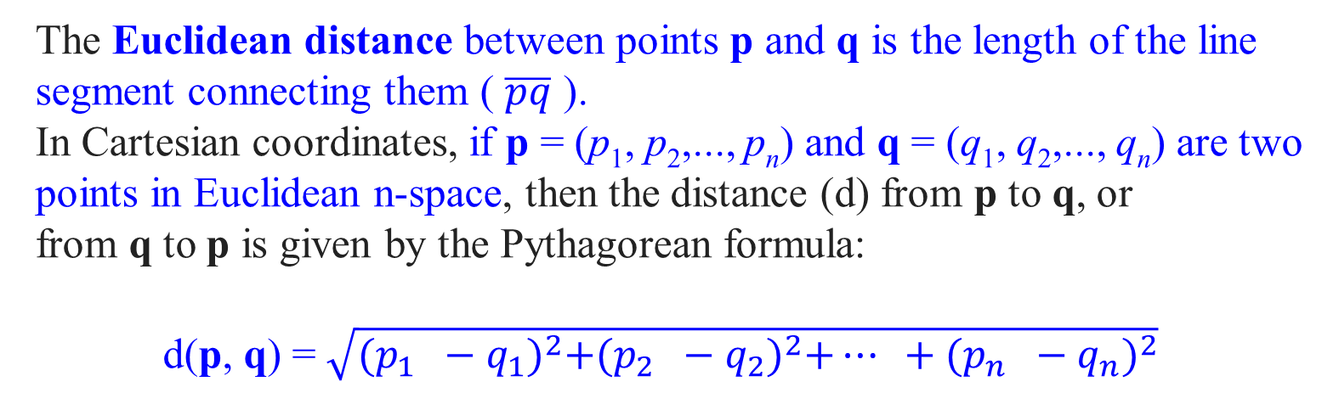
The Euclidean distance between points p and q is the length of the line segment connecting them ( $\overline{pq}$ ).
In Cartesian coordinates, if p = (p₁, p₂,..., p_{n}) and q = (q₁, q₂,..., q_{n}) are two points in Euclidean n-space, then the distance (d) from p to q, or from q to p is given by the Pythagorean formula:
d(p, q) = $\sqrt{{(p_{1} −q_{1})}^{2}+{(p_{2} −q_{2})}^{2}+… +{(p_{n} −q_{n})}^{2}}$

Slide 9
Informed Search Strategies
Main Idea
Use the knowledge of the problem domain to build an evaluation function f
For every node n in the search space, f(n) quantifies the desirability of expanding n in order to reach the goal
Then use the desirability value of the nodes in the fringe to decide which node to expand next

Slide 10
Informed Search Strategies
The evaluation function f is typically an imperfect measure of the goodness of the node
  i.e., the right choice of nodes is not always the one suggested by f
Note:
It is possible to build a perfect evaluation function, which will always suggest the right choice.
How? Why don’t we use perfect evaluation functions then?

Slide 11
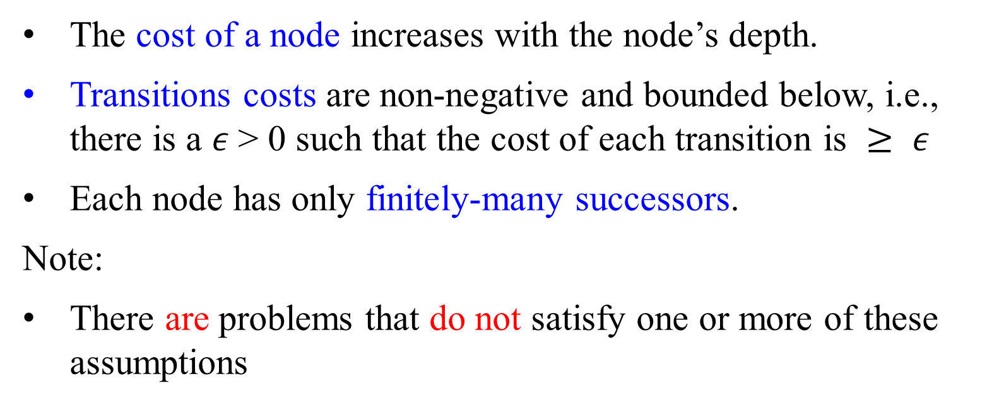
Standard Assumptions on Search Spaces
The cost of a node increases with the node’s depth.
Transitions costs are non-negative and bounded below, i.e., there is a $ε$> 0 such that the cost of each transition is $≥ ε$
Each node has only finitely-many successors.
Note:
There are problems that do not satisfy one or more of these assumptions

Slide 12
Best-First Search
Idea: use an evaluation function f(n) for each node
  estimate of "desirability“
Strategy: Always expand the most desirable unexpanded node.
Implementation: Order the nodes in fringe in decreasing order of desirability
Special cases:
  greedy best-first search
  A* search
Note:
Since f is only an approximation, ”Best-First” is a misnomer.
Each time we choose the node at that point appears to be the best.

Slide 13
Best-first Search Strategies
Best-first is a family of search strategies, each with a different evaluation function
Strategies use estimates of the cost of reaching the goal and try to minimize it
Uniform Cost Search also tries to minimize a cost measure. Is it a best-first search strategy?
  Not in spirit, because the evaluation function should incorporate a cost estimate of going from the current state to the closest goal state

Slide 14
Best-First Search
Select a node for expansion based on an evaluation function f(n).
The evaluation function is construed as a cost estimate, so the node with the lowest evaluation is expanded first.
The choice of f determines the search strategy.
Most best-first algorithm include as a component of f a heuristic function, denoted h(n):
h(n) = estimated cost of the cheapest path from
the state at node n to a goal state.
In Greedy best-first search, it evaluates nodes by using the heuristic function f(n) = h(n).

Slide 16
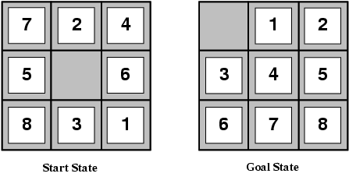
Best-First Search
QueueingFn is sort-by-h
Best-first search only as good as heuristic
  Example: Look at heuristics for 8 puzzle:
    The number of misplaced tiles h₁ is an admissible heuristic
      At the start state, all the eight tiles are out of position, h₁ = 8
    Manhattan Distance (i.e., the city block distance) -The sum of the distances of the tiles from their goal positions h₂,
      Tiles 1 to 8 in the start state give a Manhattan distance
    h₂, = 3 + 1 + 2 +2 + 2 + 3 + 3 + 2 = 18
    The average solution cost for a randomly generated 8-puzzle is about 22 steps.
    The solution cost for this 8-puzzle instance is 26 steps

Slide 17
Admissible heuristics
E.g., for the 8-puzzle:
h₁(n) = number of misplaced tiles
= 8 (At the start state, all the eight tiles are out of position)
h₂(n) = total Manhattan distance
(i.e., no. of squares from desired location of each tile)
      Tiles 1 to 8 in the start state give a Manhattan distance
      h₂ (8) = 3 + 1 + 2 +2 + 2 + 3 + 3 + 2 = 18

Slide 18
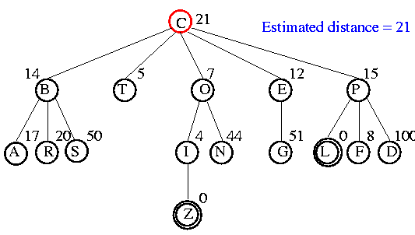
Example - Best-First Search

Slide 19
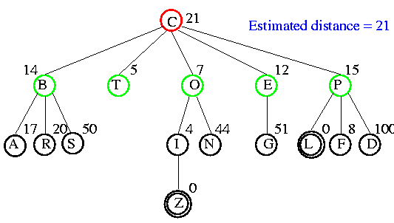
Example

Slide 20
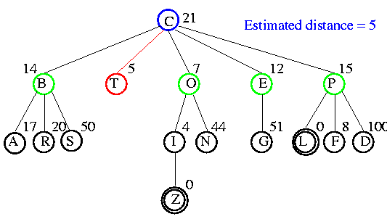
Example

Slide 21
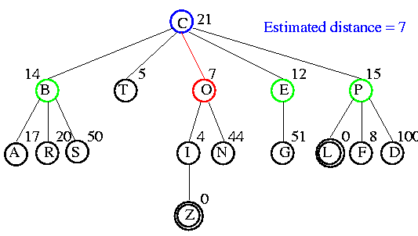
Example

Slide 22
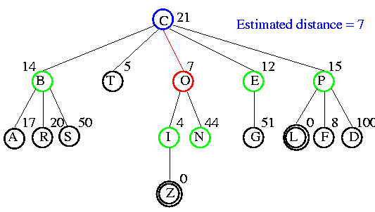
Example

Slide 23
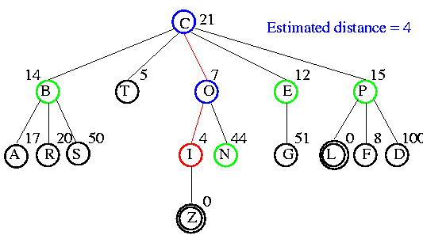
Example

Slide 24
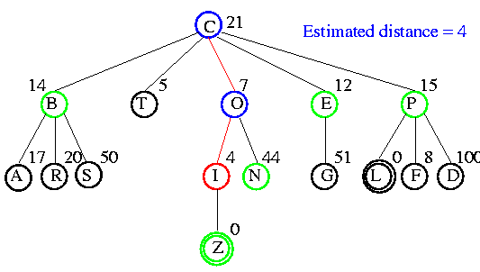
Example

Slide 25
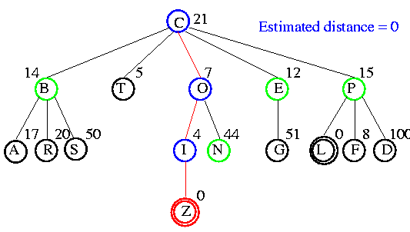
Example

Slide 26
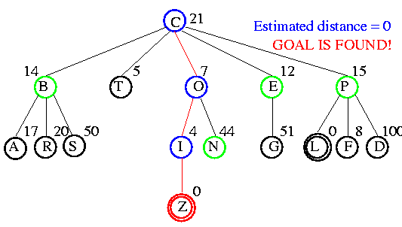
Example

Slide 27

Comparison of Search Techniques
 | DFS | BFS | UCS | IDS | Best
Complete | N | Y | Y | Y | N
Optimal | N | N | Y | N | N
Heuristic | N | N | N | N | Y
Time | b^{m} | b^{d+1} | b^{m} | b^{d} | b^{m}
Space | bm | b^{d+1} | b^{m} | bd | b^{m}
Where m is the maximum depth of the search space. b is the branching factor. d is the depth of the shallowest solution.

Slide 28
Greedy best-first search

Slide 29
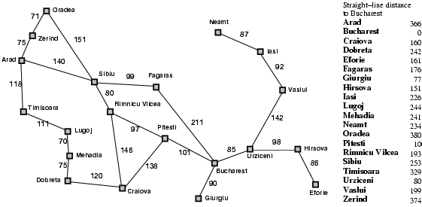
Romania with Step Costs in Km – Fig 3.22 Values of h_{SLD}

Slide 30
Greedy Best-First Search
Evaluation function f(n) = h(n) (heuristic)
  h(n) = estimate of cost of cheapest path from n to closest goal
  e.g., h_{SLD}(n) = straight-line distance from n to Bucharest
Greedy best-first search expands the node that appears to be closest to goal

Slide 31

Greedy best-first search - Example

Slide 32
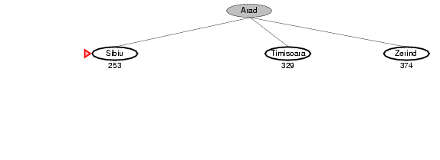
Greedy best-first search - Example

Slide 33
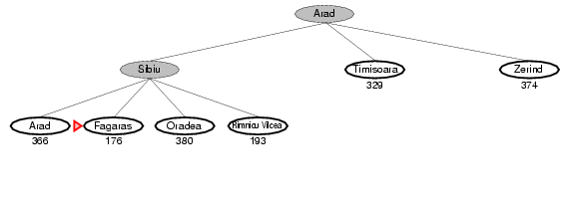
Greedy best-first search - Example

Slide 34
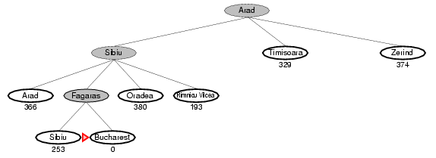
Greedy best-first search - Example

Slide 35
Properties of greedy best-first search
Complete? No
      Only in finite spaces with repeated-state checking
      Otherwise, can get stuck in loops:, e.g., Iasi → Neamt → Iasi → Neamt →
Time? O(b^{m}) — may have to expand all nodes,
but a good heuristic can give dramatic improvement
Space? O(b^{m}) -- keeps all nodes in memory
Optimal? No
A good heuristic can nonetheless produce dramatic time/space improvements in practice

Slide 37
A*: A Better Best-First Strategy
  g(n) = estimated cost from initial state to state n
  h(n) = estimated cost (distance) from state n to closest goal
Greedy Best-first search
  minimizes estimated cost h(n) from current node n to goal
  is informed but almost always suboptimal and incomplete
Uniform cost search
  minimizes actual cost g(n) from initial state to current node n
  is, in most cases, optimal and complete but uninformed
A* search
  combines the two by minimizing f(n) = g(n) + h(n)
  is, under reasonable assumptions, optimal and complete, and
also informed

Slide 38
A* Search
Idea: avoid expanding paths that are already expensive
Evaluation function f(n) = g(n) + h(n)
  g(n) = cost so far to reach n
  h(n) = estimated cost from n to goal
  f(n) = estimated total cost of path through n to goal
A* search uses an admissible heuristic:
  for all n, h(n) h∗(n) where h∗(n) is the true/actual cost from n
  e.g., h_{SLD}(n) never overestimates the actual road distance

Slide 39
Romania with Step Costs in Km – Fig 3.22 Values of h_{SLD}

Slide 40

A* Search Example

Slide 41
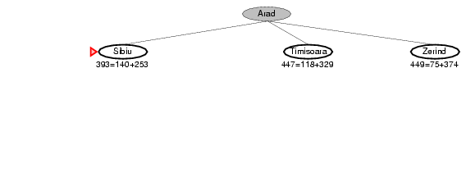
A* Search Example

Slide 42
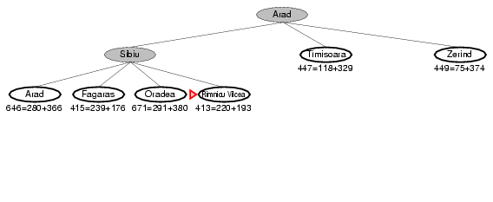
A* Search Example

Slide 43
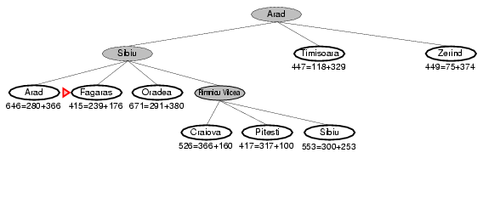
A* Search Example

Slide 44
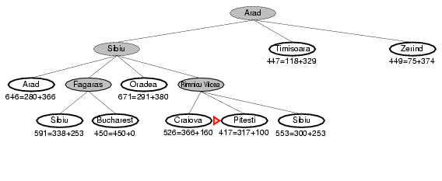
A* Search Example

Slide 45
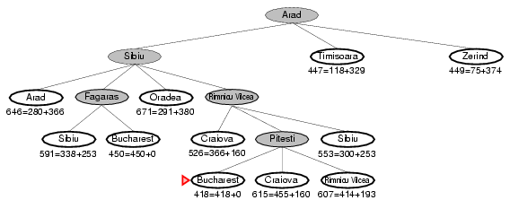
A* Search Example

Slide 46
A* Search: Why an Admissible Heuristic
If h is admissible, f(n) never overestimates the actual cost of the best solution through n.
A* adopts f(n) = g(n) + h(n)
Overestimates are dangerous, such as h(40) = 40 is inadmissible.
S
5 40
3 5 G 0
4 2 3 4
. . . . . .
real cost = 1
The optimal path is never found! (or maybe after a long time)

Slide 47
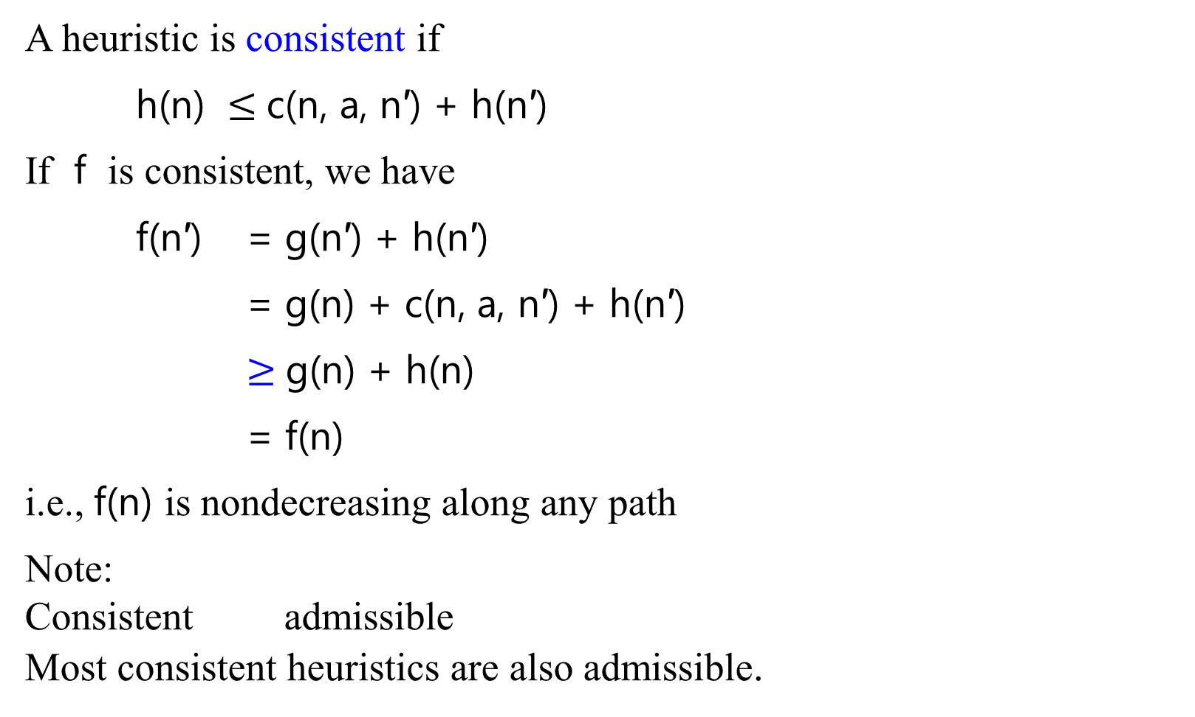
Consistent heuristics
A heuristic is consistent if
h(n) $≤$c(n, a, n′) + h(n′)
If f is consistent, we have
f(n′) = g(n′) + h(n′)
= g(n) + c(n, a, n′) + h(n′)
$≥$g(n) + h(n)
= f(n)
i.e., f(n) is nondecreasing along any path
Note:
Consistent admissible
Most consistent heuristics are also admissible.
f(n), g(n), h(n)
n
c(n, a, n′)
h(n)
f(n’), g(n’), h(n’)
n′
h(n′)
G

Slide 48
A* Search
Let h be any admissible heuristic function
Theorem: A* search using h is optimal
Proof is easier under the stronger assumption that h is consistent
A* expands all nodes with f(n) < C∗ = cost of optimal goal
A* expands some nodes with f(n) = C∗
A* expands no nodes with f(n) > C∗
Theorem: A* is optimally efficient for h: no other optimal strategy
using h expands fewer nodes than A*

Slide 49
Admissible Heuristics
A heuristic h(n) is admissible if for every node n,
h(n) ≤ h*(n), where h*(n) is the true cost to reach the goal state from n.
An admissible heuristic never overestimates the cost to reach the goal, i.e., it is optimistic
Example: h_{SLD}(n) (never overestimates the actual road distance)
Theorem: If h(n) is admissible, A* using TREE-SEARCH is optimal

Slide 50
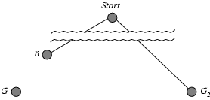
Optimality of A* (proof - Basic Argument)
Suppose some suboptimal goal G₂ has been generated and is in the fringe. Let n be an unexpanded node in the fringe such that n is on a shortest path to an optimal goal G.
f(G₂) = g(G₂) since h(G₂) = 0
g(G₂) > g(G) since G₂ is suboptimal
f(G) = g(G) since h(G) = 0
f(G₂) > f(G) from above

Slide 51
Optimality of A* (proof)
Suppose some suboptimal goal G₂ has been generated and is in the fringe. Let n be an unexpanded node in the fringe such that n is on a shortest path to an optimal goal G.
f(G₂) > f(G) from above
h(n) ≤ h*(n) since h is admissible
g(n) + h(n) ≤ g(n) + h*(n)
f(n) ≤ f(G) This yields f(G₂) > f(G) > f(n).
Hence f(G₂) > f(n), and A* will never select G₂ for expansion

Slide 52
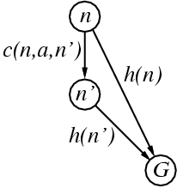
Consistent heuristics
A heuristic is consistent if for every node n, every successor n' of n generated by any action a,
h(n) ≤ c(n,a,n') + h(n')
If h is consistent, we have
  f(n') = g(n') + h(n')
  = g(n) + c(n, a, n') + h(n')
  ≥ g(n) + h(n)
  = f(n)
i.e., f(n) is non-decreasing along any path.
Theorem: If h(n) is consistent, A* using GRAPH-SEARCH is optimal.

Slide 53
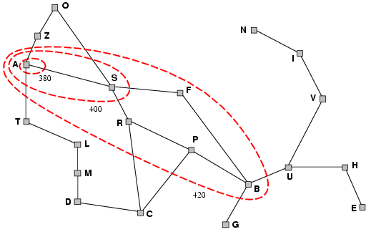
Optimality of A* (more useful)
Lemma: A* expands nodes in order of increasing f value.
It gradually adds "f-contours" of nodes (cf. breadth-first adds layers)
Contour i has all nodes with f = f_{i}, where f_{i} < f_{i+1}

Slide 54
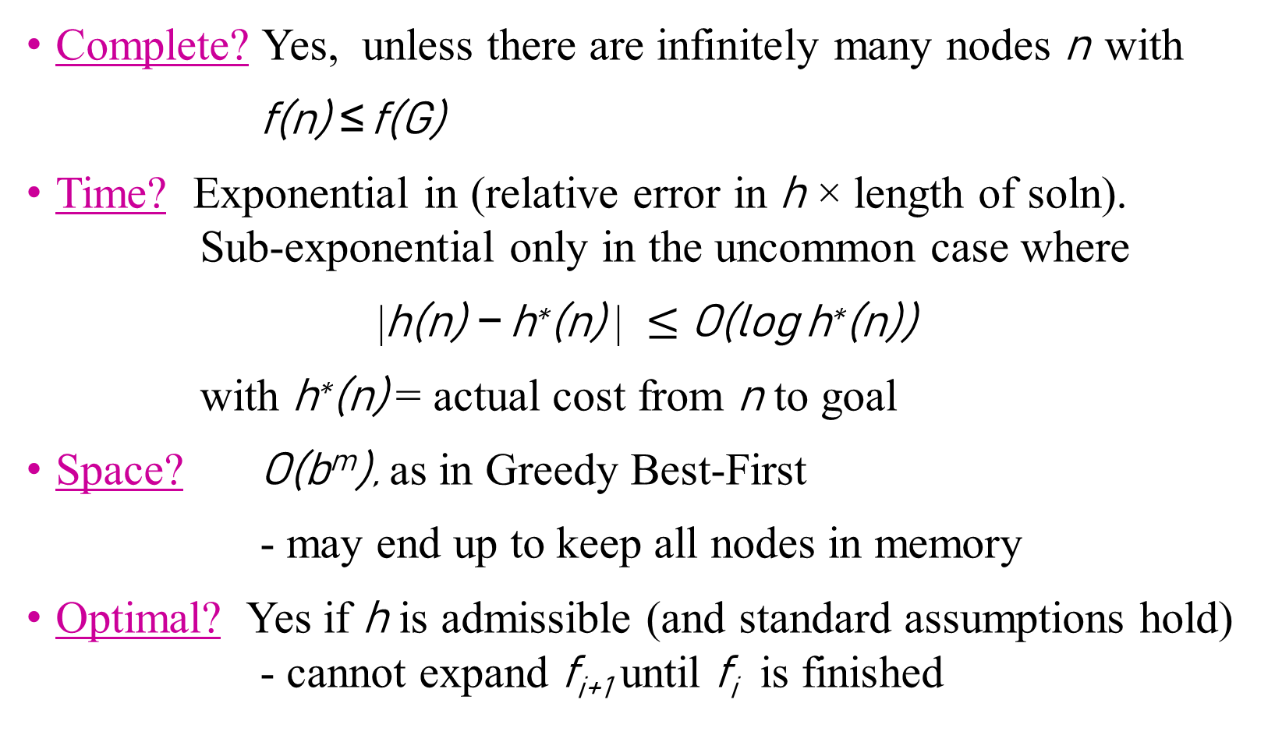
Properties of A*
Complete? Yes, unless there are infinitely many nodes n with
f(n) ≤ f(G)
Time? Exponential in (relative error in h × length of soln). Sub-exponential only in the uncommon case where
|h(n) − h∗(n) | $≤$O(log h∗(n))
with h∗(n) = actual cost from n to goal
Space? O(b^{m}), as in Greedy Best-First
- may end up to keep all nodes in memory
Optimal? Yes if h is admissible (and standard assumptions hold) - cannot expand f_{i+1} until f_{i} is finished

Slide 55
Comparison of Search Techniques
 | DFS | BFS | UCS | IDS | Best | HC | Beam | A*
Complete | N | Y | Y | Y | N | N | N | Y
Optimal | N | N | Y | N | N | N | N | Y
Heuristic | N | N | N | N | Y | Y | Y | Y
Time | b^{m} | b^{d+1} | b^{m} | b^{d} | b^{m} | bm | nm | b^{m}
Space | bm | b^{d+1} | b^{m} | bd | b^{m} | b | bn | b^{m}

Slide 56
A problem may arise such as overestimating the f.
The following slides show the overestimates of f.

Slide 57
A*
QueueingFn is sort-by-f
  f(n) = g(n) + h(n)
Note that UCS and Best-first both improve search
  UCS keeps solution cost low
  Best-first helps find solution quickly
A* combines these approaches

Slide 58
Power of f
If heuristic function is wrong it either
  overestimates (guesses too high)
  underestimates (guesses too low)
Overestimating is worse than underestimating
A* returns optimal solution if h(n) is admissible
  heuristic function is admissible if never overestimates true cost to nearest goal
  if search finds optimal solution using admissible heuristic, the search is admissible

Slide 59
The following slides also show the overestimates of f.
More examples of A* search.
.

Slide 60
Overestimating
A (15)
3
3
2
B (6)
C (20)
D (10)
15
6
20
10
5
E (20)
F(0)
G (12)
H (20)
I(0)
Solution cost:
  ABF = 9
  ADI = 8
Open list:
  A (15) B (9 = 3+6) F (9 = 3 + 6+ 0)
Missed optimal solution

Slide 61
Romania with Step Costs in Km – Fig 3.22 Values of h_{SLD}

Slide 62
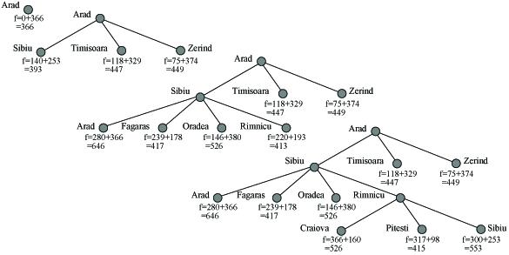
Example
A* search on Romania Road Map

Slide 63
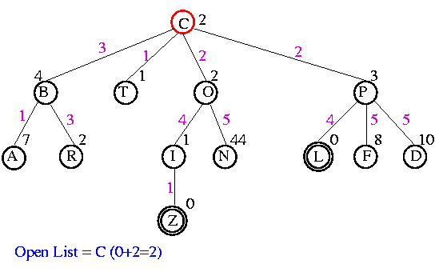
Example
At C, actual cost 0 + heuristic cost 2

Slide 64
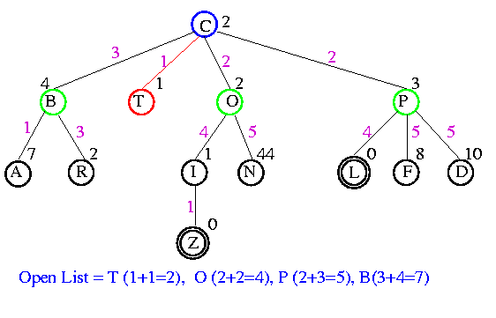
Example

Slide 65
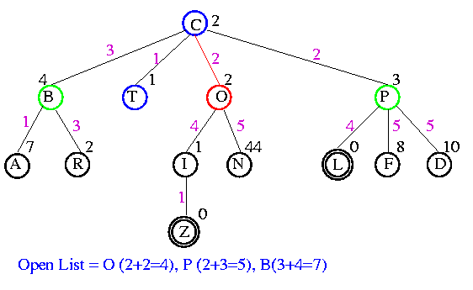
Example

Slide 66
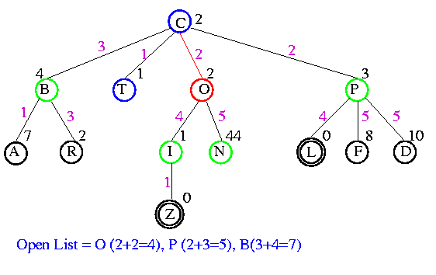
Example

Slide 67
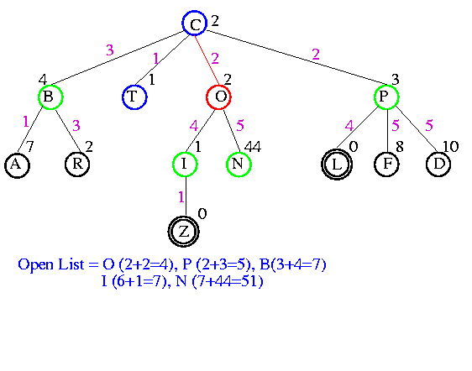
Example

Slide 68
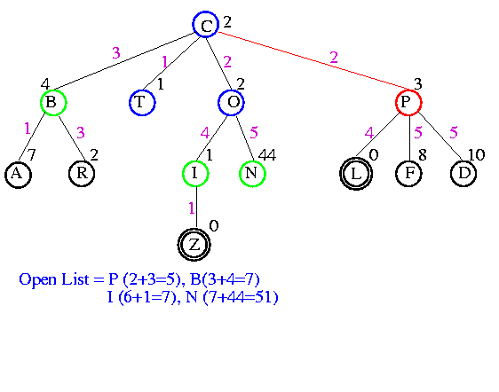
Example

Slide 69
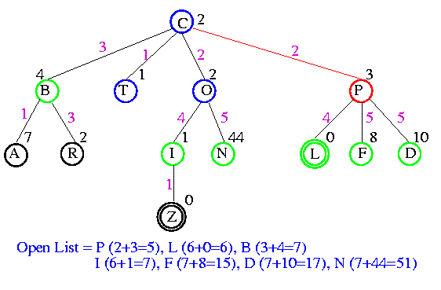
Example

Slide 70
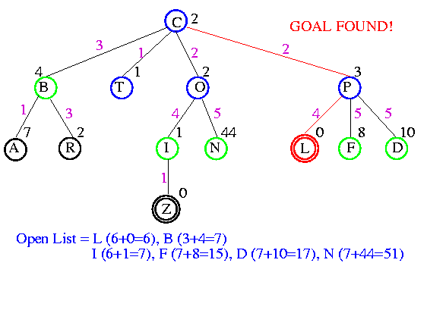
Example

Slide 71
Comparison of Search Techniques
 | DFS | BFS | UCS | IDS | Best | HC | Beam | A*
Complete | N | Y | Y | Y | N | N | N | Y
Optimal | N | N | Y | N | N | N | N | Y
Heuristic | N | N | N | N | Y | Y | Y | Y
Time | b^{m} | b^{d+1} | b^{m} | b^{d} | b^{m} | bm | nm | b^{m}
Space | bm | b^{d+1} | b^{m} | bd | b^{m} | b | bn | b^{m}

Slide 73
Beyond A*
A* generally runs out of memory before it runs out of time
Other best-first strategies
  keep the good properties on A*while trying to reduce memory consumption:
    Recursive Best-First search (RBFS)
    Iterative Deepening A* (IDA*)
    Memory-bounded A* (MA*)
    Simple Memory-bounded A* (SMA*)

Slide 74
Admissible Heuristics
A* search is optimal with an admissible heuristic function h
How do we devise good heuristic functions for a given problem?
  Typically, that depends on the problem domain
  However, there are some general techniques that work reasonably well across several domains

Slide 75
Heuristic Functions
f(n), g(n), h(n)
Q: Given that we will only use heuristic functions that do not overestimate, what type of heuristic functions (among these) perform best?
A: Those that produce higher h(n) values.

Slide 76
Reasons
Higher h value means closer to the actual distance
Any node n on the open list with
  f(n) < f*(goal), the actual optimum cost
  will be selected for expansion by A*
This means if a lot of nodes have a low underestimate (lower than the actual optimum cost)
  all of them will be expanded
  results in increased search time and space

Slide 77
Informedness
Let h1 and h2 are both admissible
For all x, h1(x) > h2(x), then h1 “dominates” h2
  Can also say h1 is “more informed” than h2
Example
  h1(x): Euclidean distance
  h2(x):
  h1 dominates h2

Slide 78
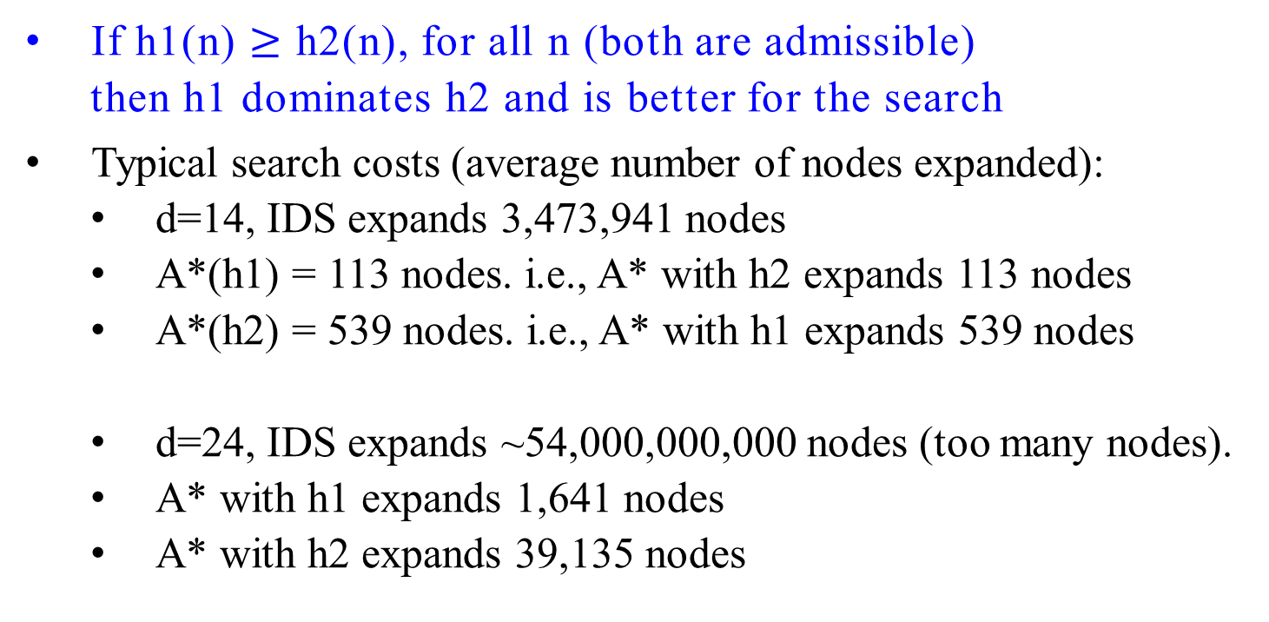
Effect on Search Cost-Dominance
If h1(n) $≥$ h2(n), for all n (both are admissible)
  then h1 dominates h2 and is better for the search
Typical search costs (average number of nodes expanded):
  d=14, IDS expands 3,473,941 nodes
  A*(h1) = 113 nodes. i.e., A* with h2 expands 113 nodes
  A*(h2) = 539 nodes. i.e., A* with h1 expands 539 nodes
  d=24, IDS expands ~54,000,000,000 nodes (too many nodes).
  A* with h1 expands 1,641 nodes
  A* with h2 expands 39,135 nodes

Slide 79
Admissible heuristics
Example: for the 8-puzzle:
h₁(n) = number of tiles in the wrong position at state n
h₂(n) = sum of the Manhattan distances of each tile from its
goal position. (i.e., no. of squares from the desired
location of each tile)
h₁(S) = ?
h₂(S) = ?

Slide 80
Admissible heuristics
Example: for the 8-puzzle:
H₁(n) = number of misplaced tiles
H₂(n) = total Manhattan distance
(i.e., no. of squares from the desired location of each tile)
h₁(S) = ? 8
h₂(S) = ? 3+1+2+2+2+3+3+2 = 18

Slide 81
Admissible heuristics
Example: for the 8-puzzle:
H₁(n) = number of misplaced tiles
H₂(n) = total Manhattan distance
(i.e., no. of squares from the desired location of each tile)
h₁(S) = ? 7
h₂(S) = ? 4 + 0 + 3 + 3 + 1 + 0 + 2+ 1 = 14
1
2
3
4
5
6
7
8

Slide 82
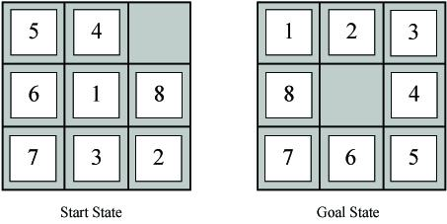
Which of these heuristics is admissible?
Which is more informed?
h1(n) = #tiles in wrong position
h2(n) = Sum of Manhattan distance between each tile and goal location for the tile
h3(n) = 0
h4(n) = 1
h5(n) = min(2, h*[n])
h6(n) = Manhattan distance for blank tile
h7(n) = max(2, h*[n])
Notes:
h1(S) = 7
h2(S) = 2+3+3+2+4+2+0+2 = 18

Slide 83
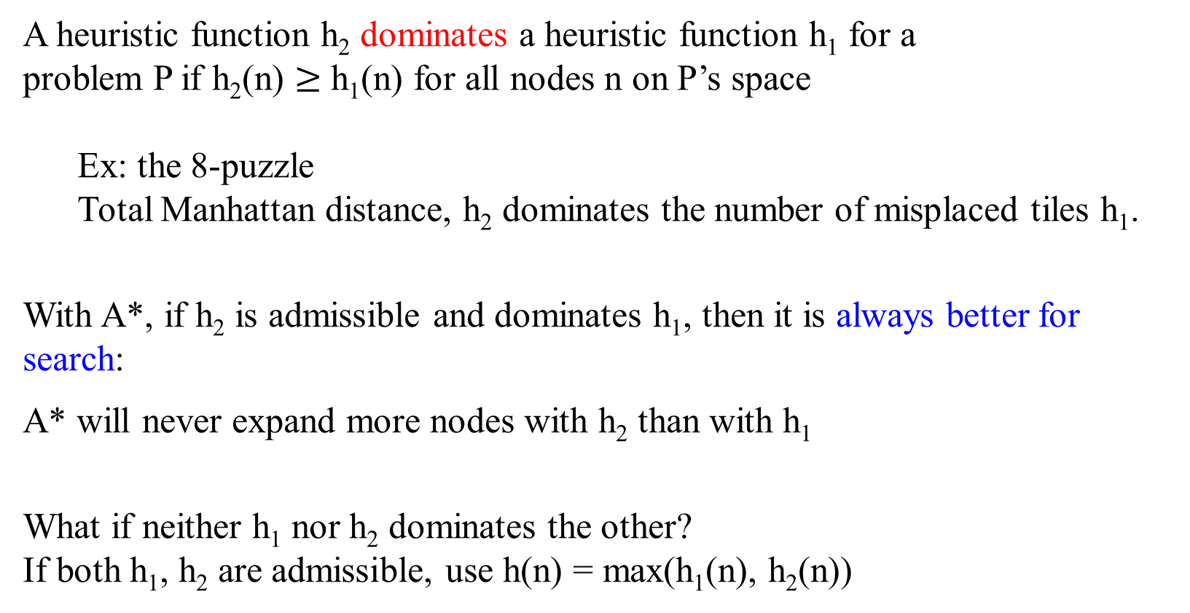
Dominance
A heuristic function h₂ dominates a heuristic function h₁ for a
problem P if h₂(n) $≥$ h₁(n) for all nodes n on P’s space
  Ex: the 8-puzzle
  Total Manhattan distance, h₂ dominates the number of misplaced tiles h₁.
With A*, if h₂ is admissible and dominates h₁, then it is always better for search:
A* will never expand more nodes with h₂ than with h₁
What if neither h₁ nor h₂ dominates the other?
If both h₁, h₂ are admissible, use h(n) = max(h₁(n), h₂(n))

Slide 84
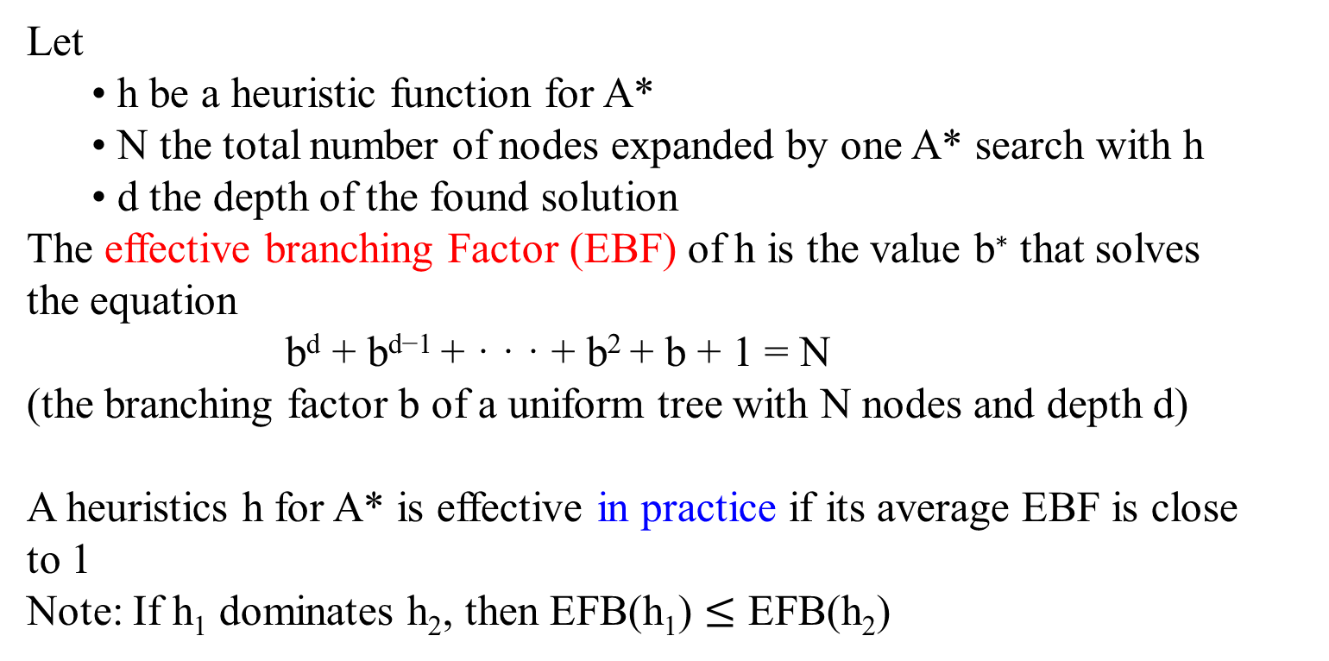
Effectiveness of Heuristic Functions
Let
  • h be a heuristic function for A*
  • N the total number of nodes expanded by one A* search with h
  • d the depth of the found solution
The effective branching Factor (EBF) of h is the value b∗ that solves
the equation
b^{d} + b^{d−1} + · · · + b² + b + 1 = N
(the branching factor b of a uniform tree with N nodes and depth d)
A heuristics h for A* is effective in practice if its average EBF is close
to 1
Note: If h₁ dominates h₂, then EFB(h₁) $≤$ EFB(h₂)

Slide 85
Dominance and EFB: The 8-puzzle
 | Search Cost |  |  | Effective Branching Factor
d | IDS | A*(h1) | A*(h2) | IDS | A*(h1) | A*(h2)
2 4 6 8 10 12 14 16 18 20 22 24 | 10 112 680 6384 47127 364404 3473941 - - - - - | 6 13 20 39 93 227 539 1301 3056 7276 18094 39135 | 6 12 18 25 39 73 113 211 363 676 1219 1641 | 2.45 2.87 2.73 2.80 2.79 2.78 2.83 - - - - - | 1.79 1.48 1.34 1.33 1.38 1.42 1.44 1.45 1.46 1.47 1.48 1.48 | 1.79 1.45 1.30 1.24 1.22 1.24 1.23 1.25 1.26 1.27 1.28 1.26
Average values over 1200 random instances of the problem
  d, depth of solution
  Search cost, # of expanded nodes
  IDS, iterative deepening search
  h₁, number of misplaced tiles
  h₂, total Manhattan distance

Slide 86
Dominance and EFB: The 8-puzzle
 | Search Cost |  |  | Effective Branching Factor
d | IDS | A*(h1) | A*(h2) | IDS | A*(h1) | A*(h2)
2 4 6 8 10 12 14 16 18 20 22 24 | 10 112 680 6384 47127 364404 3473941 - - - - - | 6 13 20 39 93 227 539 1301 3056 7276 18094 39135 | 6 12 18 25 39 73 113 211 363 676 1219 1641 | 2.45 2.87 2.73 2.80 2.79 2.78 2.83 - - - - - | 1.79 1.48 1.34 1.33 1.38 1.42 1.44 1.45 1.46 1.47 1.48 1.48 | 1.79 1.45 1.30 1.24 1.22 1.24 1.23 1.25 1.26 1.27 1.28 1.26

Slide 88
Devising Heuristic Functions
A relaxed problem is a version of a search problem with less
restrictions on the applicability of the next-state operators
Example: n-puzzle
  • original: “A tile can move from position p to position q if p is
  adjacent to q and q is empty”
  • relaxed-1: “A tile can move from p to q if p is adjacent to q”
  • relaxed-2: “A tile can move from p to q if q is empty”
  • relaxed-3: “A tile can move from p to q”
The exact solution cost of a relaxed problem is often a good
(admissible) heuristics for the original problem
Key point: the optimal solution cost of the relaxed problem is no
greater than the optimal solution cost of the original problem

Slide 89
Relaxed problems
A relaxed problem: a problem with
  fewer restrictions on the actions
The cost of an optimal solution to a relaxed problem is
  an admissible heuristic for the original problem
If the rules of the 8-puzzle are relaxed so that a tile can move anywhere, then
  h₁(n) gives the shortest solution
If the rules are relaxed so that a tile can move to any adjacent square, then
  h₂(n) gives the shortest solution
h₁

Slide 90
Generating Heuristic Functions
Generate heuristic for the simpler (relaxed) problem
  Relaxed problem has fewer restrictions
  Eight puzzle problem where multiple tiles can be in the same spot
  Cost of the optimal solution to the relaxed problem is an admissible heuristic for the original problem
Learn heuristics from experience

Slide 91
Relaxed Problems: Another Example
Traveling salesperson problem
Original problem: Find the shortest tour visiting n cities exactly once
Complexity: NP-complete
Relaxed problem: Find a tree with the smallest cost that connects the
n cities (minimum spanning tree)
    Complexity: O(n²)
    Cost of tree is a lower bound on the shortest (open) tour.

Slide 92
Devising Heuristic Functions Automatically
• Relaxation of formally described problems
• Pattern databases
• Learning

