Slide 1

Artificial Intelligence
Chapter 03
Informed (Heuristic) Search Algorithms
And
Heuristic Functions

Slide 2
Material
Chapter 3
  Section 3.5 Informed (Heuristic) Search Strategies
  Section 3.6 Heuristic Functions
  Exclude memory-bounded heuristic search
  Chapter 4
Section 4.1 Local Search Algorithms and Optimization Problems

Slide 3
Heuristics
An approach to make decisions or solve problems quickly and efficiently,
  Using rules of thumb, past experiences, intuition, or common sense rather than exhaustive reasoning or analysis.
Heuristics can help simplify complex tasks, and allow individuals to reach decisions rapidly, but they can also lead to biases and errors in judgment.

Slide 4
Informed search strategies, also known as heuristic search strategies,
in artificial intelligence and computer science
algorithms used to search through problem spaces efficiently by incorporating heuristic information.
uninformed search strategies explore the search space without any additional knowledge.
informed search strategies utilize domain-specific information to guide the search towards the most promising areas.

Slide 5
Outline
Informed (Heuristic) Search Strategies (Ch 03 Sect 3.5 – 3.6)
  Best-first search
  Greedy best-first search
  A* search
  Heuristics
Local Search Algorithms (Ch 04 Sect 4.1)
  Hill-climbing search
  Simulated annealing search
  Local beam search
  Genetic algorithms

Slide 6
Review: Tree search
function Tree-Search( problem, fringe) returns a solution, or failure
fringe ← Insert(MAKE-NODE(INITIAL-STATE[problem]), fringe)
loop do
if fringe is empty then return failure
node ← REMOVE-FRONT(fringe)
if GOAL-TEST[problem] applied to STATE(node) succeeds return node
fringe ← INSERTALL(EXPAND(node, problem), fringe)
A search strategy is defined by picking the order of node expansion

Slide 7
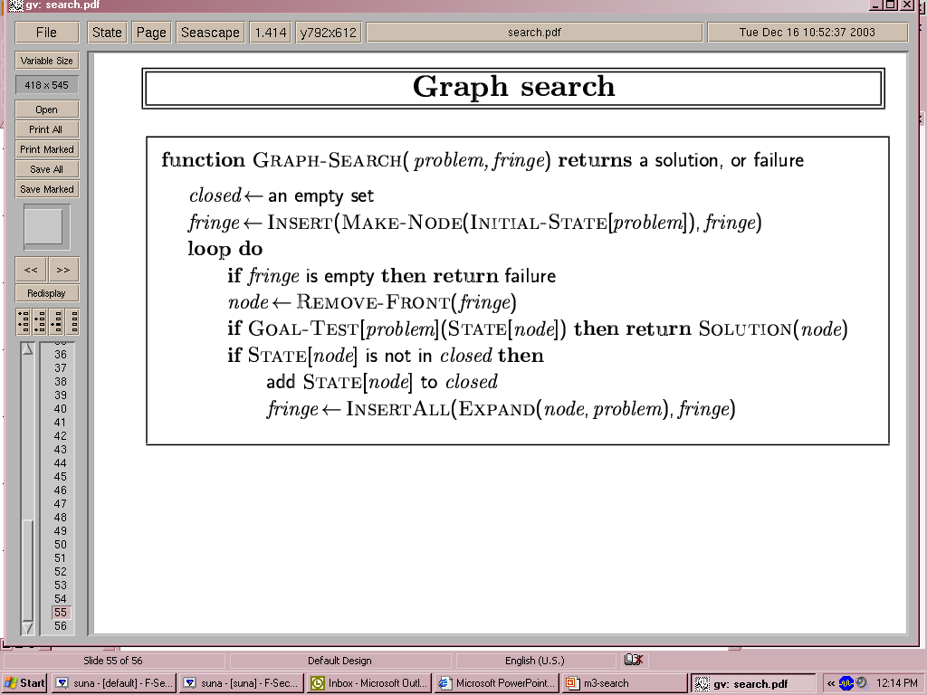
Graph search
Fig 3.7 An informal description of the general graph-search algorithm.

Slide 8

Uninformed vs Informed Search Strategies
Uninformed search strategies look for solutions by
  systematically generating new states and checking each of them against the goal
  inefficient approach for most cases
  most successor states are “obviously” a bad choice
  strategies have minimal problem-specific knowledge (use the definition of the problem itself)
Informed search strategies
  exploit and use problem-specific knowledge as much as possible to drive the search
  more efficient than uninformed searches for finding solutions
  often optimal
    number of tiles out of place
    Problem domain

Slide 9
Informed (Heuristic) Searches Strategies -
Informed Searches
An informed search strategy
  uses problem-specific knowledge (such as heuristic information) beyond the definition of the problem itself to find solutions
Examples of using informed search strategies
  Best-first search,
  Hill climbing,
  Beam search,
  A*,
  IDA*,
  RBFS,
  SMA*

Slide 10
Informed Searches
New terms
  Heuristics – use an evaluation function f(n) to construct a heuristic function h(n).
  Optimal solution – expand the node with the lowest evaluation
  Informedness – some guidance on where to look for solutions.
  Hill climbing problems
  Admissibility – h(n) be an admissible heuristic, required for optimality.
New parameters
  g(n) = estimated/actual cost from initial state to state n
  H(n) = estimated cost (e.g., distance) from state n to the closest goal
    h(n) is a heuristic function
      Robot path planning: h(n) could be Euclidean distance
      8 puzzle: h(n) could be number of tiles out of place
Heuristic search algorithms use h(n) to guide search

Slide 11

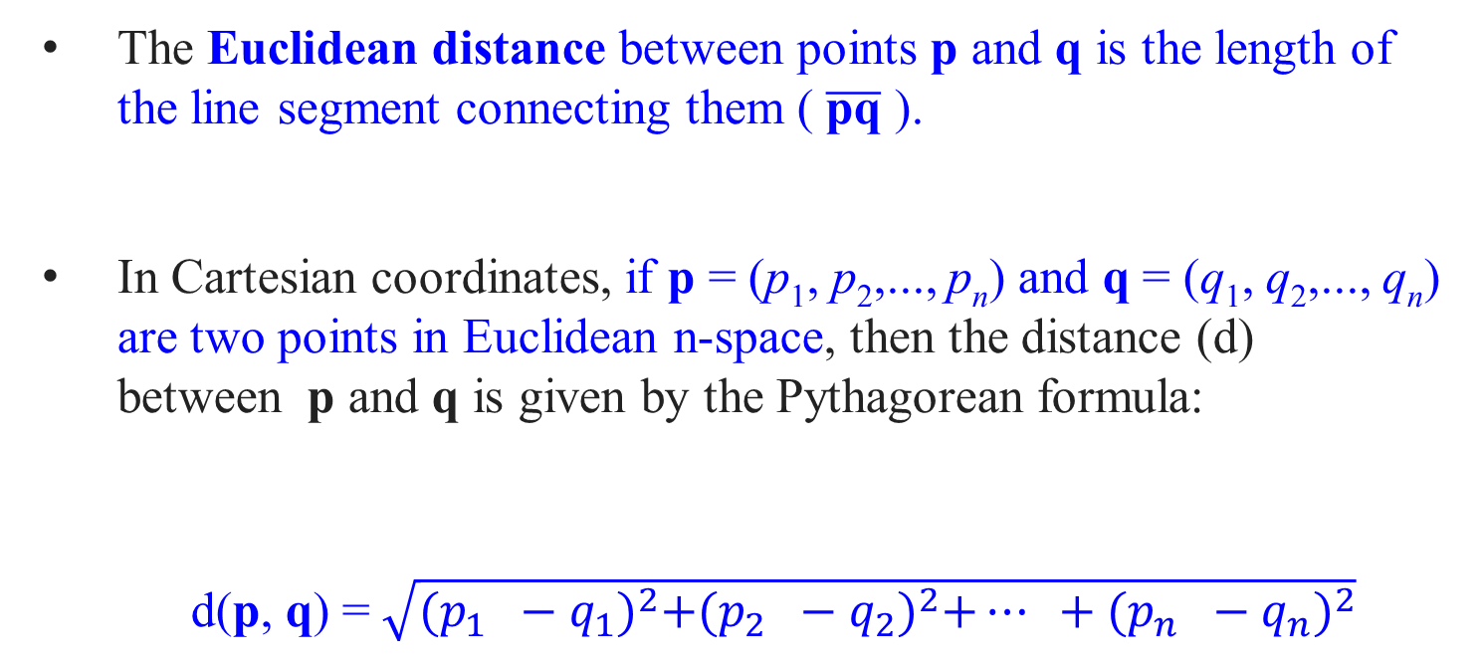
The Euclidean distance between points p and q is the length of the line segment connecting them ( $\overline{\text{pq}}$ ).
In Cartesian coordinates, if p = (p₁, p₂,..., p_{n}) and q = (q₁, q₂,..., q_{n}) are two points in Euclidean n-space, then the distance (d) between p and q is given by the Pythagorean formula:
d(p, q) = $\sqrt{{(p_{1} −q_{1})}^{2}+{(p_{2} −q_{2})}^{2}+… +{(p_{n} −q_{n})}^{2}}$
(p₁, p₂, p₃)
(q₁, q₂, q₃)

Slide 12
Informed Search Strategies : f(n) = g(n) + h(n)
Main Idea
Use the knowledge of the problem domain:
  For every node n in the search space,
  construct an evaluation function f(n)
    f(n) quantifies the desirability of expanding n in order to reach the goal.
  Decide which node to expand next
    using the desirability value of the nodes in the fringe

Slide 13
Informed Search Strategies
The evaluation function f
  is an imperfect measure of the goodness(right choice) of the node
    the right choice of nodes is not always the one suggested by f
Question?
Build a perfect evaluation function?
  Always suggest the right choice.
  Is it possible? How?
Why don’t we use perfect evaluation functions then?

Slide 14
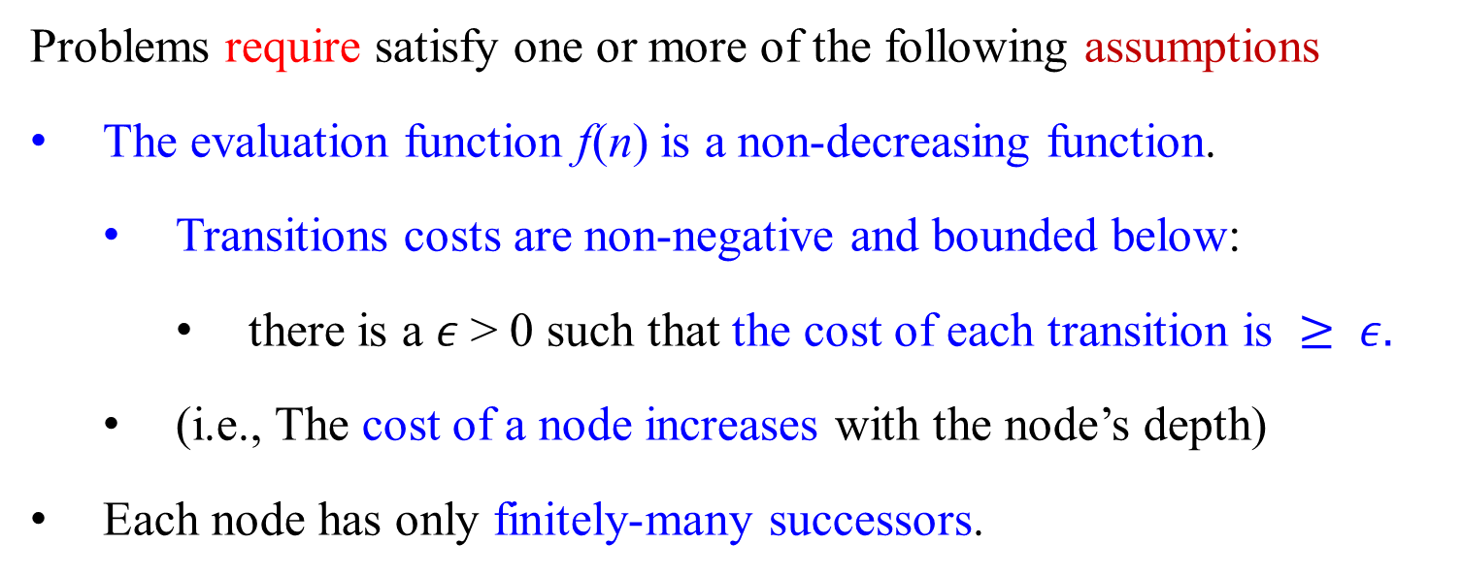
Standard Assumptions on Search Spaces
Problems require satisfy one or more of the following assumptions
The evaluation function f(n) is a non-decreasing function.
  Transitions costs are non-negative and bounded below:
    there is a $ε$> 0 such that the cost of each transition is $≥ ε.$
  (i.e., The cost of a node increases with the node’s depth)
Each node has only finitely-many successors.

Slide 15
Best-First Search:
In this strategy,
nodes are expanded based on:
  an evaluation function to estimate which node is most likely to lead to the goal.
The evaluation function f(n) = g(n) + h(n), where
  g(n) is the cost from the root to the current node, and
  the heuristic function h(n) estimates the cost from the current node to the goal.
Examples include Greedy Best-First Search and A* search .

Slide 16
Best-First Search
Idea: use an evaluation function f(n) for each node
  f is only an approximation,
    an estimate of “desirability” for each node
Strategy:
  Each time, always expand the most desirable unexpanded node which appears to be the best.
Implementation:
  Order the nodes in fringe in decreasing order of desirability
Special cases:
  Greedy Best-First search
  A* search
Since f is only an approximation, ”Best-First” is a misnomer.

Slide 17
Best-first Search vs Uniform Cost Search Strategies
Best-first is a family of search strategies
  Each node (a state) n has a different evaluation function f (n, G), where G is a goal node (goal state).
  Strategies use cost estimates to reach the goal and try to minimize the cost
Uniform Cost Search also tries to minimize a cost measure. Is it a best-first search strategy?
  The evaluation function of a best-first search is a cost estimate of going from the current node (state) to the closest goal state
  The cost for UCS is from the root node to the current node
ISC/BFS
UCS
root
n, f(n, G)
n, g(r, n)
m, f(m, G)
m, g(r, m)
G

Slide 18
Best-First Search
Is an instance of the general TREE-SEARCH or GRAPH SEARCH algorithm:
Select a node for expansion based on an evaluation function f(n) = g(n) + h(n).
The evaluation function is a cost estimate,
  Expand first the node with the lowest evaluation.
The choice of f determines the search strategy
  (use f to order the priority queue).
Most Best-First algorithms include a heuristic function, h(n) as a component of f :
h(n) = estimated cost of the cheapest path from the state at node n to a goal state. h(n) = 0, if n is a goal state.
An example: h(Arad) is a straight-line distance from Arad to Bucharest (destination).
Greedy Best-First search uses the heuristic function f(n) = h(n) to evaluate nodes.

Slide 20
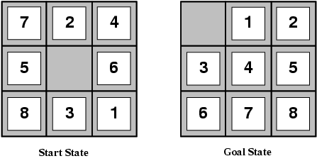
Best-First Search
A heuristic is admissible if it never overestimates
the cost to reach the goal
For the Best-First search algorithms such as A* search,
  heuristics play a crucial role in guiding the search towards the goal state efficiently.
  QueueingFn is sort-by-h

Slide 21
Best-First Search
  Example: Look at heuristics for 8 puzzle:
    The number of misplaced tiles h₁ :
      The heuristic counts the number of tiles that are not in their goal position.
        At the start state, all the eight tiles are out of position, h₁ = 8
      It is an admissible heuristic because it underestimates the actual cost to reach the goal.
        In the worst case, it will be equal to the number of moves required to reach the goal.
    The solution cost for this 8-puzzle instance is 26 steps
    The average solution cost for a randomly generated 8-puzzle is about 22 steps.

Slide 22
Best-First Search
  Example: Look at heuristics for 8 puzzle:
    Manhattan Distance h₂ : (i.e., the city block distance)
    The heuristic calculates the sum of the Manhattan distance of the tiles from their goal positions
    Tiles 1 to 8 in the start state give a Manhattan distance
    h₂ = 3₁ + 1₂ + 2₃ +2₄ + 2₅ + 3₆ + 3₇ + 2₈ = 18
  This heuristic is admissible because it calculates the exact cost to move each tile to its goal position without considering other tiles.
  The solution cost for this 8-puzzle instance is 26 steps
  The average solution cost for a randomly generated 8-puzzle is about 22 steps.

Slide 23
Admissible heuristics
e.g., for the 8-puzzle:
Let n be a node associated with Start State.
h₁(n) = number of misplaced tiles
= 8 (At the start state, all the eight tiles are out of position)
h₂(n) = total Manhattan distance
(i.e., no. of squares from desired location of each tile)
      Tiles 1 to 8 in the start state give a Manhattan distance
      h₂ (8) = 3 + 1 + 2 +2 + 2 + 3 + 3 + 2 = 18

Slide 24
Admissible heuristics
The effectiveness of a best-first search algorithm like A* depends on the quality of the heuristic function used.
A good heuristic should provide accurate estimates of the remaining cost to reach the goal
This allows the algorithm to efficiently explore promising paths while avoiding unnecessary exploration of less promising ones.

Slide 25
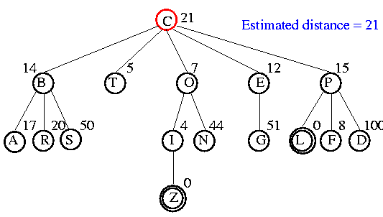
Example - Best-First Search
C(21)
QueueingFn is sort-by-h

Slide 26
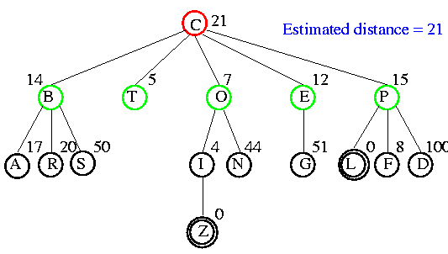
Example
T(5) O(7) E(12), B(14) P(15)
QueueingFn is sort-by-h

Slide 27
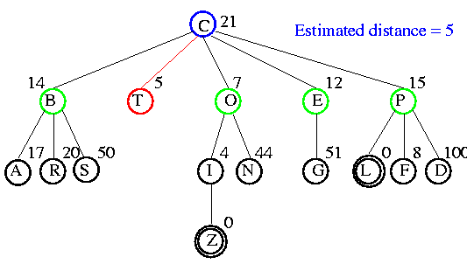
Example
O(7) E(12), B(14) P(15)
QueueingFn is sort-by-h

Slide 28
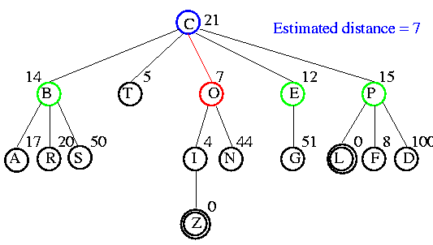
Example
O(7) E(12), B(14) P(15)
QueueingFn is sort-by-h

Slide 29
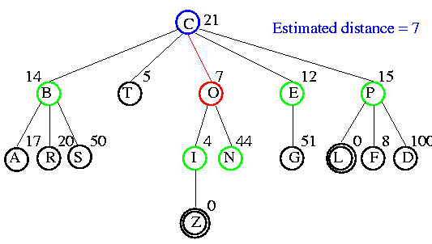
Example
E(12), B(14), P(15), I(4), N(44)
QueueingFn is sort-by-h

Slide 30
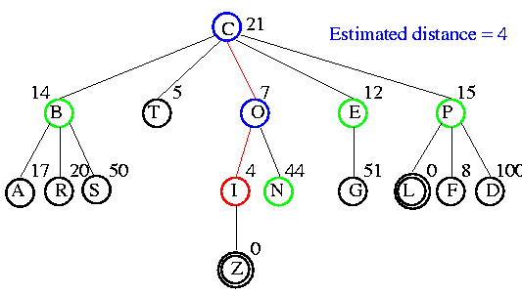
Example
I(4) E(12) B(14) P(15) N(44)
QueueingFn is sort-by-h

Slide 31
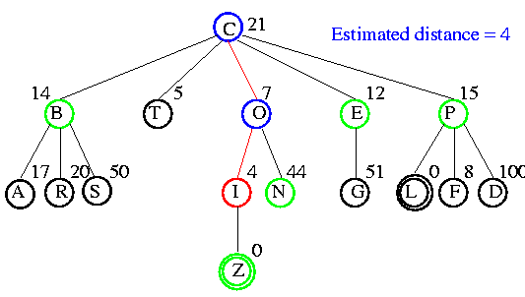
Example
E(12) B(14) P(15) N(44) Z(0)
QueueingFn is sort-by-h

Slide 32
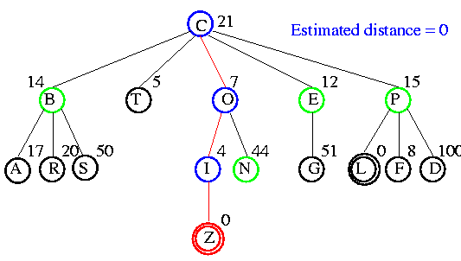
Example
Z(0) E(12) B(14) P(15) N(44)
QueueingFn is sort-by-h

Slide 33
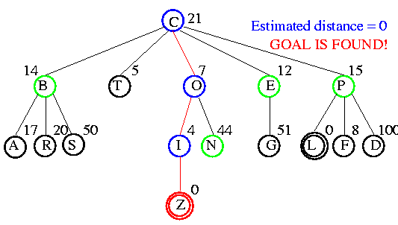
Example
E(12) B(14) P(15) N(44)
QueueingFn is sort-by-h

Slide 34


Comparison of Search Techniques
 | DFS | BFS | UCS | IDS | Best-First
Complete | N | Y | Y | Y | N
Optimal | N | N | Y | N | N
Heuristic | N | N | N | N | Y
Time | b^{m} | b^{d+1} | b^{m} | b^{d} | b^{m}
Space | bm | b^{d+1} | b^{m} | bd | b^{m}
where
m is the maximum depth of the search space,
b is the branching factor,
d is the depth of the shallowest solution.

Slide 35
Greedy Best-First Search

Slide 36
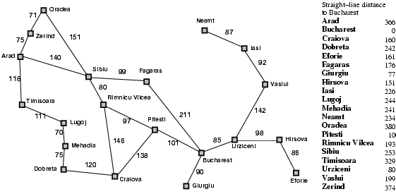
Romania with Step Costs in Km – Fig 3.22 Values of h_{SLD}
=450
=418

Slide 37
Greedy Best-First Search
Evaluation function f(n) = h(n) (uses heuristic function only)
  h(n) = estimate of cost of cheapest path from n to closest goal.
  e.g., if the goal is Bucharest, the straight-line distance (SLD) heuristic
  h_{SLD}(n) = straight-line distance from n to Bucharest
Greedy best-first search expands the node that appears to be closest to goal

Slide 38

Greedy Best-First Search - Example
Arad(366)
QueueingFn is sort-by-h

Slide 39
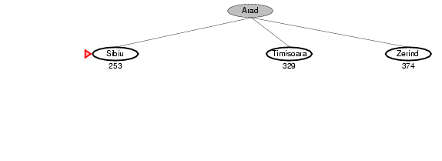
Greedy Best-First Search - Example
Sibiu(253) Timisoara(329) Zerind(374)
QueueingFn is sort-by-h

Slide 40
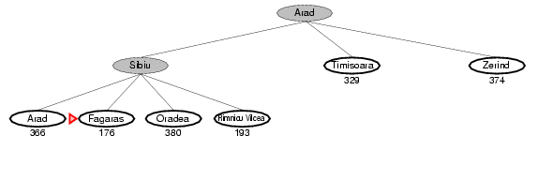
Greedy Best-First Search - Example
Fagaras(176) Rimilnicu Vilcea(193) Timisoara(329) Arad(366) Zerind(374)
QueueingFn is sort-by-h

Slide 41
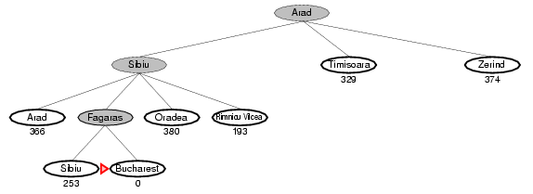
Greedy Best-First Search - Example
Bucharest(0) Rimnicu Vilcea(193) Sibiu(253) Timisoara(329) Arad(366) Zerind(374)
QueueingFn is sort-by-h

Slide 42
Greedy Best-First Search
For this problem, Greedy Best-First search
  uses h_{SLD} to find a solution without ever expanding a node that is not on the solution path:
  the search cost is minimal (i.e., least number of steps).
It is called “greedy”, because
  at each step it tries to get as close to the goal as it can.
It is not optimal because
  the path via Sibiu and Fagaras to Bucharest (310) > the path through Rimnicu Vilcea and Pitesti (278km).

Slide 43
Greedy Best-First Search
Greedy Best-First tree-search is incomplete
  even in a finite state space,
  much like depth-first search,
Example: Consider the problem is getting from Iasi to Fagaras.
  The h_{SLD} suggests that Neamt be expanded first
    It is closest to Fagaras, but it is a dead end.
  The algorithm will never find this solution,
    Expanding Neamt puts Iasi back into the frontier.
      Iasi is closer to Fagaras than Vaslui is,
    and Iasi will be expanded again,
    leading to an infinite loop.
Iasi(200)
Iasi(200)
Neamt(180)
Vaslui (210)
Neamt(180) Vaslui (210)
Iasi(200)
Iasi(200) Vaslui(210)
QueueingFn is sort-by-h
180
200
210

Slide 44
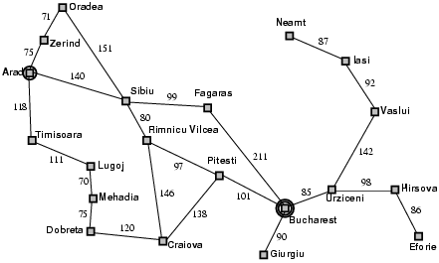
For the problem getting from Iasi to Fagaras:
The solution is to go first to Vaslui,
  a step that is actual farther from the goal according to the heuristic.
Then continue to Urziceni, Bucharest, and Fagaras.
Priority Queue:
Iasi(200)
Neamt(180) Vaslui (210)
Iasi(200) Vaslui(210)
180
200
210
199

Slide 45

For the problem is getting from Iasi to Fagaras:
The graph search version is complete in finite space, but not in infinite ones.)
The worst time and space complexity for the tree version is O(b^{m}) , where m is the maximum depth of the search space.
The complexity can be reduced substantially with a good heuristic.
  The amount of the reduction depends on
    the particular problem and
    the quality of the heuristic.
Iasi(200)
Neamt(180) Vaslui (210)
Iasi(200) Vaslui(210)

Slide 46
Properties of Greedy Best-First Search
Complete? No
      Only in finite spaces with repeated-state checking
      Otherwise, can get stuck in loops,
      e.g., Iasi → Neamt → Iasi → Neamt →
Time? O(b^{m}) -- may have to expand all nodes, but
a good heuristic can give dramatic improvement
Space? O(b^{m}) -- keeps all nodes in memory
Optimal? No
A good heuristic can produce dramatic time/space improvements in practice

Slide 48
A* search
combines the advantages of both breadth-first and best-first searches by using both
the actual cost of getting from the initial state to the current state (the "cost-so-far ", f(n) = g(n) + h(n)) and
an estimate of the cost from the current state to the goal (the heuristic function).
A* expands nodes in order of their total estimated cost, which is the sum of the cost-so-far and the heuristic estimate.

Slide 49
A*: A Better Best-First Strategy
Let g(n) = (actual) cost to reach state n (from initial state).
Let h(n) = estimated cost (distance) from state n to closest goal.
Greedy Best-first search
  minimizes estimated cost h(n) from current node n to goal
  is informed but almost always suboptimal and incomplete
Uniform cost search
  minimizes actual cost g(n) from initial state to current node n
  is, in most cases, optimal and complete but uninformed
A* search
  minimizes f(n) = g(n) + h(n)
  is, under reasonable assumptions, optimal and complete, and
also informed

Slide 50
A* Search
Idea: avoid expanding paths that are already expensive
Evaluation function f(n) = g(n) + h(n)
  g(n) = cost so far to reach n from the initial node
  h(n) = estimated cost from n to a goal (cheapest path)
  f(n) = estimated total cost of the path through n to a goal (cheapest solution)
A* search uses an admissible heuristic:
  …

Slide 51
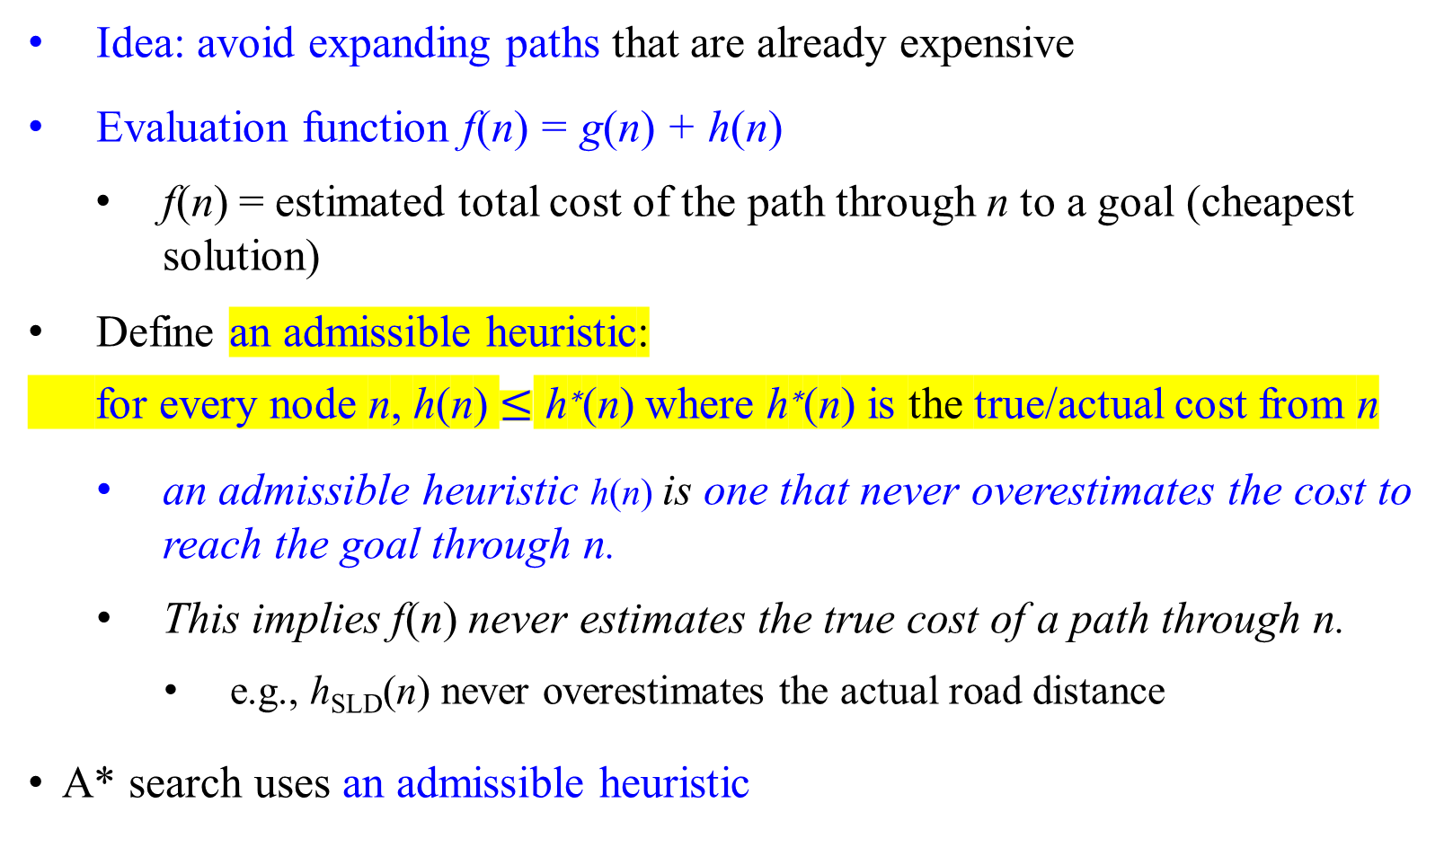
A* Search
Idea: avoid expanding paths that are already expensive
Evaluation function f(n) = g(n) + h(n)
  f(n) = estimated total cost of the path through n to a goal (cheapest solution)
Define an admissible heuristic:
for every node n, h(n) $≤$ h∗(n) where h∗(n) is the true/actual cost from n
    an admissible heuristic h(n) is one that never overestimates the cost to reach the goal through n.
    This implies f(n) never estimates the true cost of a path through n.
      e.g., h_{SLD}(n) never overestimates the actual road distance
A* search uses an admissible heuristic

Slide 52
Conditions for Optimality: Admissibility and Consistency
An admissible heuristic h(n) is
  h(n) never overestimates the cost to reach the goal through n.
  e.g., the straight line distance h_{SLD} is admissible.
The estimated cost of an evaluation function, f(n), of the cheapest path from the current node n to the goal is
  f(n) = g(n) + h(n), where
    g(n) is the path cost from the start node to node n, and
    h(n) is the estimated cost of the cheapest path from node n to the goal.
The first condition required for optimality of A*:
  h(n) must be an admissible heuristic.
g(n)
f(n)
h(n)
goal

Slide 53
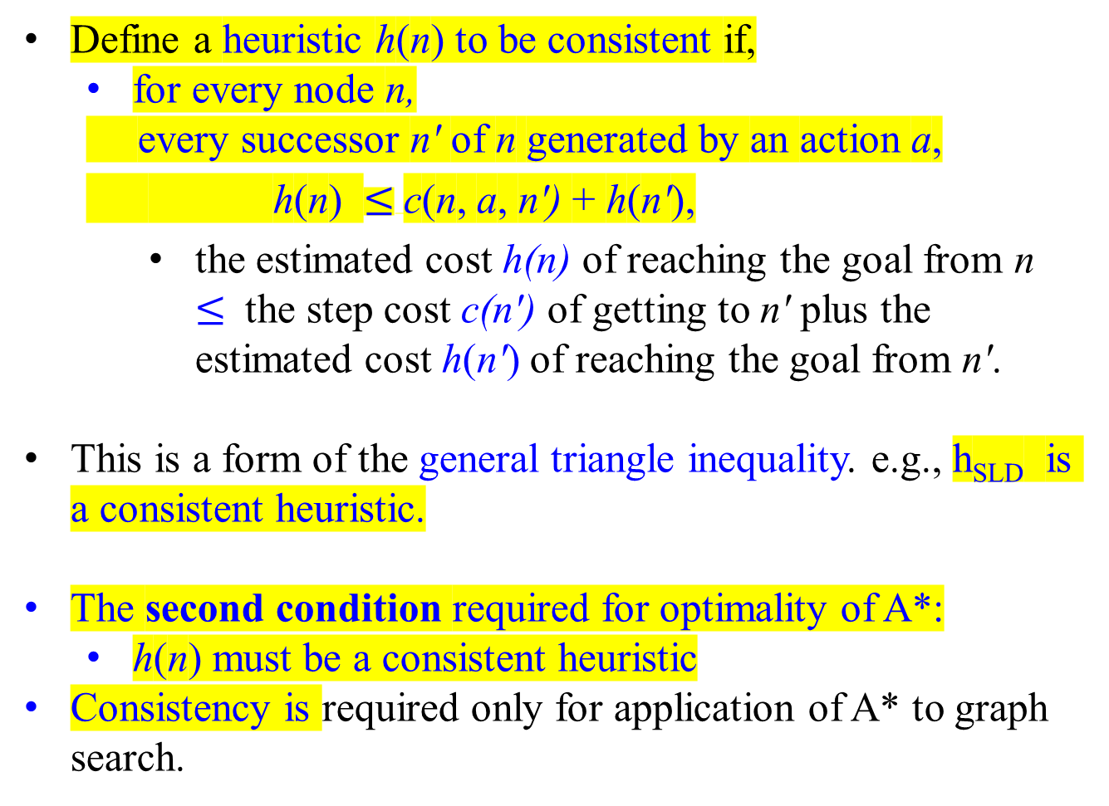
Conditions for Optimality: Admissibility and Consistency
Define a heuristic h(n) to be consistent if,
  for every node n,
  every successor n′ of n generated by an action a,
  h(n) $≤$c(n, a, n′) + h(n′),
    the estimated cost h(n) of reaching the goal from n $≤$ the step cost c(n′) of getting to n′ plus the estimated cost h(n′) of reaching the goal from n′.
This is a form of the general triangle inequality. e.g., h_{SLD} is a consistent heuristic.
The second condition required for optimality of A*:
  h(n) must be a consistent heuristic
Consistency is required only for application of A* to graph search.
f(n), g(n), h(n)
n
c(n, a, n′)
h(n)
f(n′), g(n′), h(n′)
n'
h(n′)
G

Slide 54
Conditions for Optimality: Admissibility and Consistency
Every consistent heuristic is admissible.
Consistency is a stricter requirement than admissibility.
It is hard to concoct heuristics that are admissible but not consistent.

Slide 55
Romania with Step Costs in Km – Fig 3.22 Values of h_{SLD} (SLD stands for straight-line distance)

Slide 56

A* Search Example

Slide 57
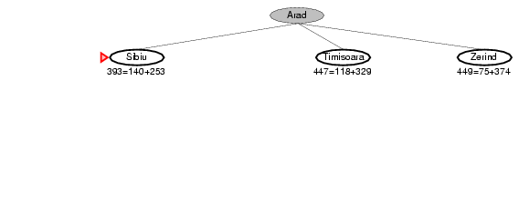
A* Search Example

Slide 58
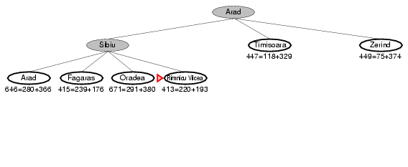
A* Search Example
393=140+253

Slide 59
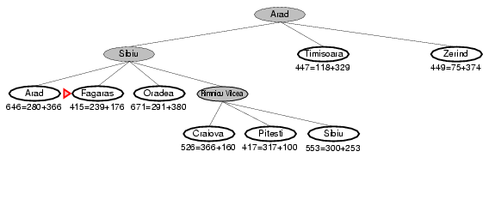
A* Search Example
413=220+193
Be noted: At d=1, the node which is under 417 will be visited.
(RV,413), (F, 415,) (P, 417), (T, 447), (Z, 449), (C, 526), (S, 553), (A, 646), (O, 671)
QueueingFn is sort-by-f = g + h

Slide 60
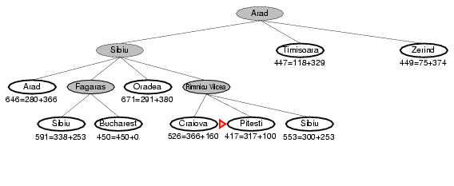
A* Search Example

Slide 61
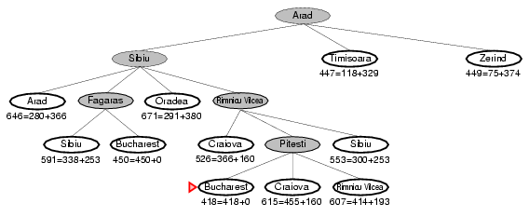
A* Search Example

Slide 62
A* Search: Why an Admissible Heuristic
If h is admissible, f(n) never overestimates the actual cost of the best solution through n.
A* adopts f(n) = g(n) + h(n)
Overestimates are dangerous, such as h(40) = 40 is inadmissible.
S
5 40
3 5 G 0
4 2 3 4
. . . . . .
real cost = 1
The optimal path is never found! (or maybe after a long time)

Slide 63
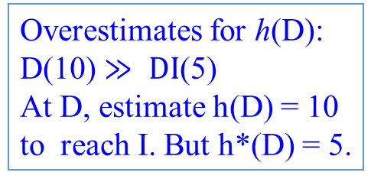
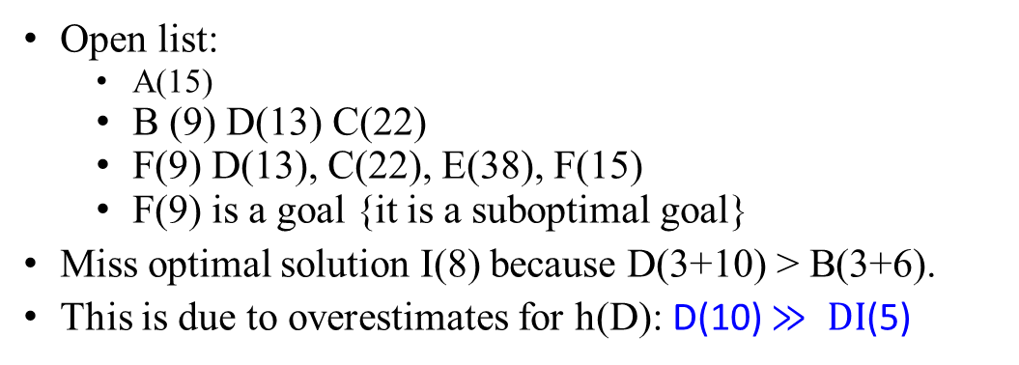
A* with Overestimating
A (15) B (3+6) F (9+0)
A (15) D (3+10) I (8+0)
A (15)
3
3
2
B (6)
C (20)
D (10)
Overestimates for h(D): D(10) $≫ DI$(5)
At D, estimate h(D) = 10 to reach I. But h*(D) = 5.
15
6
20
10
5
E (20)
F(0)
G (12)
H (20)
I(0)
Solution cost:
  ABF = 9
  ADI = 8
Open list:
  A(15)
  B (9) D(13) C(22)
  F(9) D(13), C(22), E(38), F(15)
  F(9) is a goal {it is a suboptimal goal}
Miss optimal solution I(8) because D(3+10) > B(3+6).
This is due to overestimates for h(D): D(10) $≫ DI$(5)

Slide 64

A* with Overestimating
A (15) B (3+6) F (9+0)
A (15) D (3+10) I (8+0)
A (8)
3
3
2
B (6)
C (20)
D (5)
Overestimates for h(D): D(10) $≫ DI$(5)
At D, estimate h(D) = 10 to reach I. But h*(D) = 5.
15
6
20
10
5
E (20)
F(0)
G (12)
H (20)
I(0)
Solution cost:
  ABF = 9
  ADI = 8
Open list:
  A(15)
  B (9) D(13) C(22)
  F(9) D(13), C(22), E(38)
  F(9) is a goal {it is a suboptimal goal}
Miss optimal solution I(8) because D(3+10) > B(3+6).
This is due to overestimates for h(D): D(10) $≫ DI$(5)

Slide 65
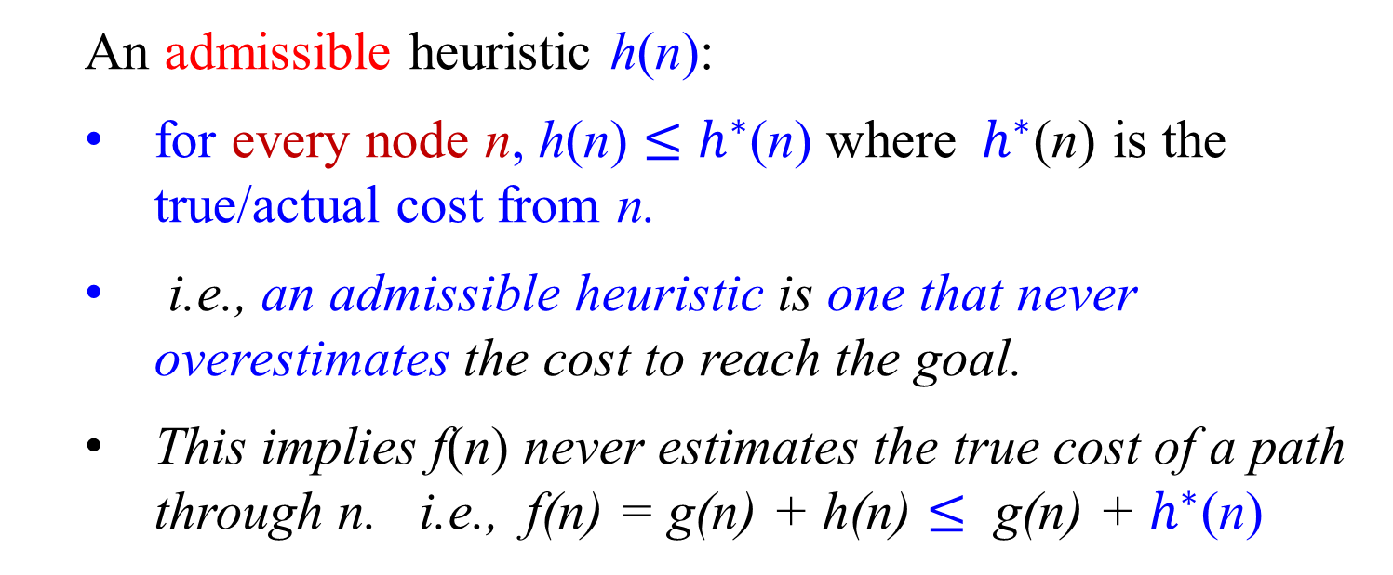
Recall
  An admissible heuristic h(n):
  for every node n, h(n) $≤$ $h^{∗}$(n) where${ h}^{∗}$(n) is the true/actual cost from n.
  i.e., an admissible heuristic is one that never overestimates the cost to reach the goal.
  This implies f(n) never estimates the true cost of a path through n. i.e., f(n) = g(n) + h(n) $≤$ g(n) + $h^{∗}$(n)

Slide 66
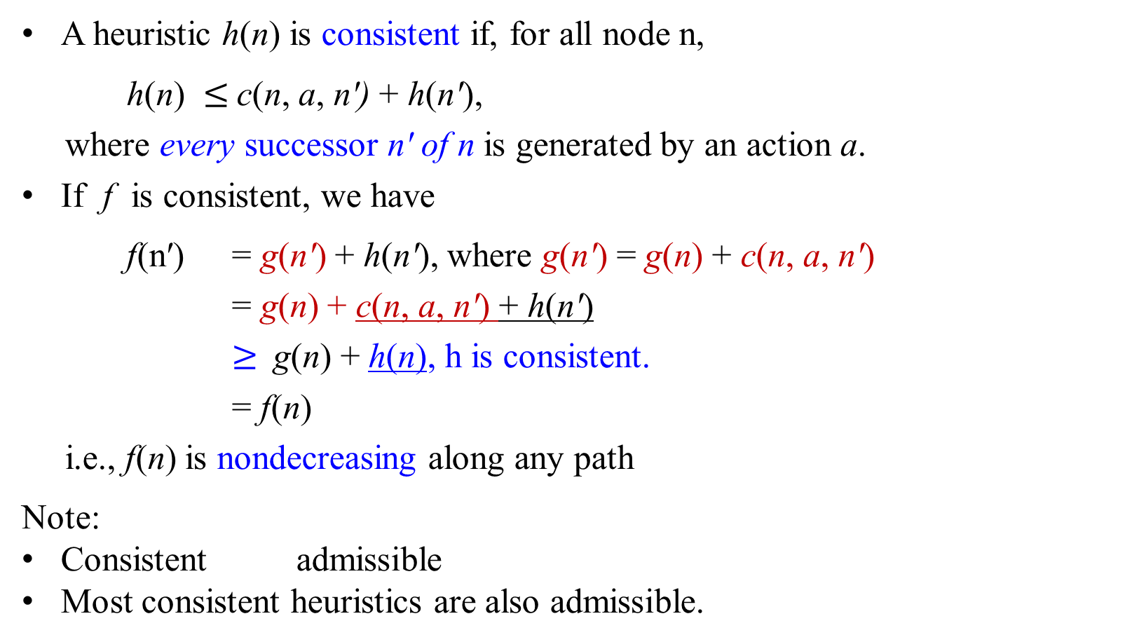
Consistent heuristics
A heuristic h(n) is consistent if, for all node n,
h(n) $≤$c(n, a, n′) + h(n′),
where every successor n′ of n is generated by an action a.
If f is consistent, we have
f(n′) = g(n′) + h(n′), where g(n′) = g(n) + c(n, a, n′)
= g(n) + c(n, a, n′) + h(n′)
$≥$g(n) + h(n), h is consistent.
= f(n)
i.e., f(n) is nondecreasing along any path
Note:
Consistent admissible
Most consistent heuristics are also admissible.
f(n), g(n), h(n)
n
c(n, a, n′)
h(n)
f(n′), g(n′), h(n′)
n′
h(n′)
G

Slide 67
A* Search
A* has the following properties:
Theorem: The tree-search version of A* is optimal if h(n) is admissible.
The graph-search version of A* is optimal if h(n) is consistent.
Proof can be done under the stronger assumption that h is consistent for the graph search version (or that h is admissible for tree-search version).

Slide 68
A* Search
28
Theorem: The tree-search version of A* is optimal if h(n) is admissible.
The graph-search version of A* is optimal if h(n) is consistent.
Proof: Let, under the stronger assumption, h is consistent for the graph search version (or let h is admissible for tree-search version).
1st step: if h(n) is consistent, then the values of f(n) along any path are nondecreasing. (from previous slide)
2nd step: need to prove that whenever A* selects a node n for expansion, the optimal path to that node has been found. If this is not the case, then there is another frontier node n′ on the optimal path from the start node to n because f is nondecreasing along any path, n′ would have lower f-cost than n and would have been selected first.

Slide 69
A* Search
Figure 3.25 Map of Romania showing contours at f = 380, f = 400, f = 420, with Arad as the start state. Nodes inside a given contour having f-costs less than or equal to the contour value.
O
N
Z
A
I
380
F
See slides 56-60
S
T
V
400
11
L
O
P
B
H
M
U
D
420
C
E
G
The fact that f-costs are nondecreasing along any path means that contours can be drawn in the state space. Inside the contour labeled 400, all nodes have f(n) $≤$ 400, etc.

Slide 70

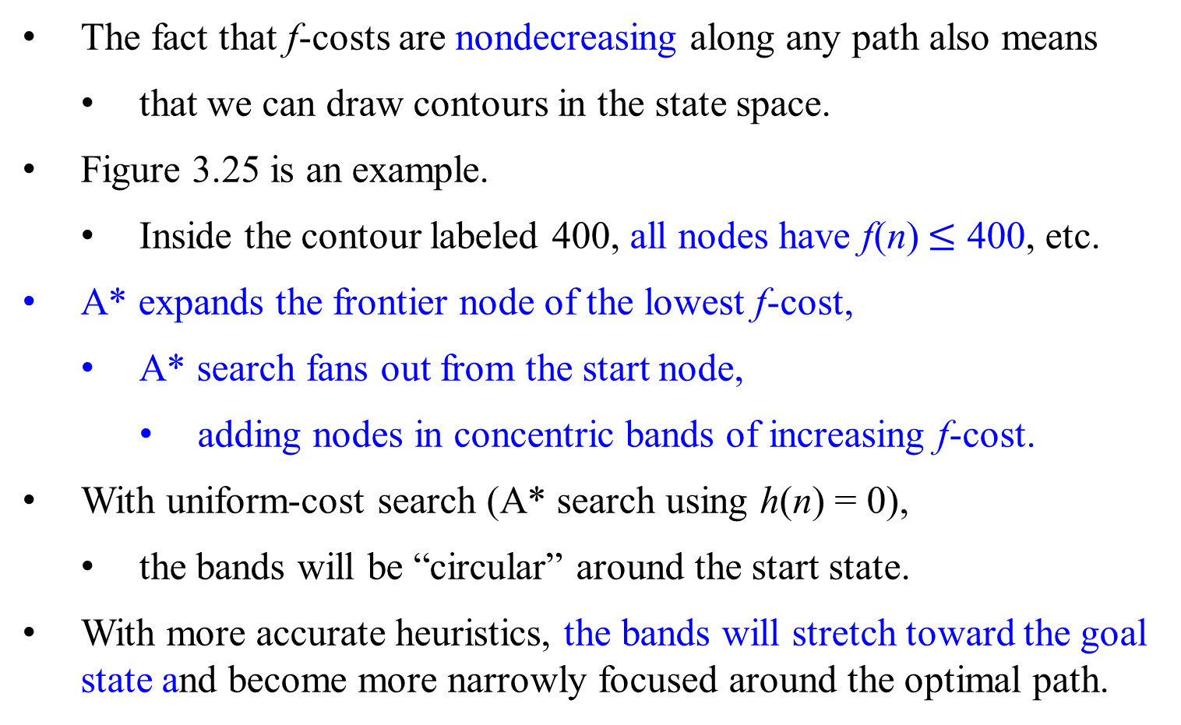
A* Search - Let f(n) = g(n) + h(n).
The fact that f-costs are nondecreasing along any path also means
  that we can draw contours in the state space.
Figure 3.25 is an example.
  Inside the contour labeled 400, all nodes have f(n) $≤$ 400, etc.
A* expands the frontier node of the lowest f-cost,
  A* search fans out from the start node,
    adding nodes in concentric bands of increasing f-cost.
With uniform-cost search (A* search using h(n) = 0),
  the bands will be “circular” around the start state.
With more accurate heuristics, the bands will stretch toward the goal state and become more narrowly focused around the optimal path.

Slide 71
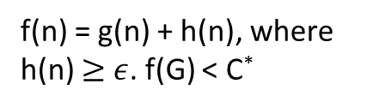
A* Search
If C* is the cost of the optimal solution path, then we can say:
A* expands all nodes with f(n) < C∗ = cost of optimal goal
A* expands some nodes with f(n) = C∗
  A* might then expand some of the nodes right on the “goal contour” (where f(n) = C∗) before selecting a goal node.
A* expands no nodes with f(n) > C∗
  For example, Timisoara is not expanded even though it is a child of the root.
  We say that Timisoara is pruned; because h_{SLD} is admissible, the algorithm can safely ignore this subtree while still guaranteeing optimality.
f(n) = g(n) + h(n), where h(n) $≥$ $ε$. f(G) < C*
n
G
n₁
f(G) = g(G) + h(G), where h(G) = 0. f(G) = C*

Slide 72

A* Search
Theorem:
A* is optimally efficient for any given consistent heuristic h: no other optimal strategy using h expands fewer nodes than A*
Rationale:
This is because any algorithm that does not expand all nodes with f(n) < C* runs the risk of missing the optimal solution.

Slide 73
Summary:

Slide 74

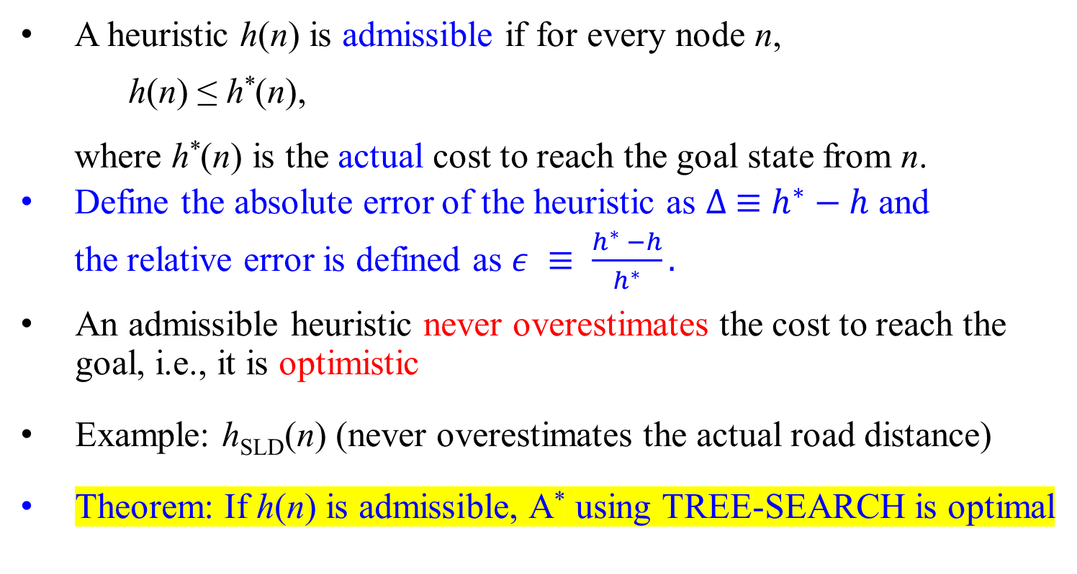
Admissible Heuristics
  A heuristic h(n) is admissible if for every node n,
    h(n) ≤ h*(n),
    where h*(n) is the actual cost to reach the goal state from n.
  Define the absolute error of the heuristic as $∆ ≡h^{∗}−h$ and
    the relative error is defined as $ε ≡ \frac{h^{∗} −h}{h^{∗}}.$
An admissible heuristic never overestimates the cost to reach the goal, i.e., it is optimistic
Example: h_{SLD}(n) (never overestimates the actual road distance)
Theorem: If h(n) is admissible, A* using TREE-SEARCH is optimal

Slide 75

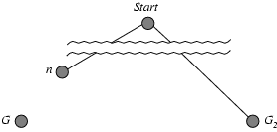
Optimality of A* (proof - Basic Argument)
Suppose some suboptimal goal G₂ has been generated and is in the fringe (i.e., queue).
Let n be an unexpanded node in the fringe such that n is on a shortest (i.e., least-cost) path to an optimal goal G.
f(G₂) = g(G₂) since h(G₂) = 0, f(G₂) = g(G₂) + h(G₂)
g(G₂) > g(G) since G₂ is suboptimal
g(G) = f(G) since h(G) = 0, h is admissible, f(G) = g(G) + h(G)
f(G₂) > f(G) conclusion
See slide 61, let n be Pitesti which generates Burcharest in the fringe
on a shortest path
See slide 61, the first Burcharest in the fringe
optimal goal G
suboptimal goal G₂

Slide 76
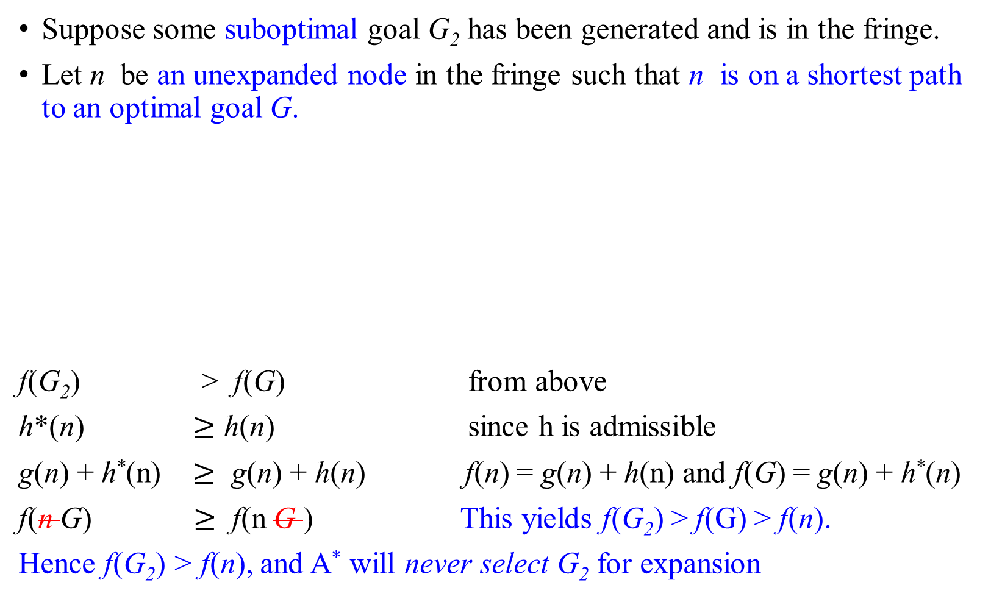
Optimality of A* (proof)
Suppose some suboptimal goal G₂ has been generated and is in the fringe.
Let n be an unexpanded node in the fringe such that n is on a shortest path to an optimal goal G.
f(G₂) > f(G) from above
h*(n) $≥$ h(n) since h is admissible
g(n) + h*(n) $≥$ g(n) + h(n) f(n) = g(n) + h(n) and f(G) = g(n) + h*(n)
f(n G) $≥$ f(n G ) This yields f(G₂) > f(G) > f(n).
Hence f(G₂) > f(n), and A* will never select G₂ for expansion
on a shortest path
optimal goal G
suboptimal goal G₂

Slide 77

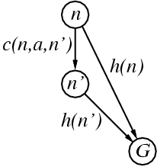
Consistent heuristics
A heuristic is consistent if for every node n, every successor n' of n generated by any action a,
h(n) ≤ c(n, a, n') + h(n')
If h is consistent, we have
  f(n') = g(n') + h(n')
  = g(n) + c(n, a, n') + h(n')
  ≥ g(n) + h(n)
  = f(n)
Thus f(n') ≥ f(n); i.e., f(n) is non-decreasing along any path.
Theorem: If h(n) is consistent, A* using GRAPH-SEARCH is optimal.

Slide 78

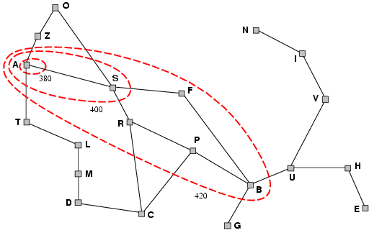
Optimality of A* (more useful)
Lemma: A* expands nodes in order of increasing f value*.
It gradually adds "f-contours" of nodes (cf. breadth-first adds layers)
Contour i has all nodes with f = f_{i}, where f_{i} < f_{i+1}

Slide 79
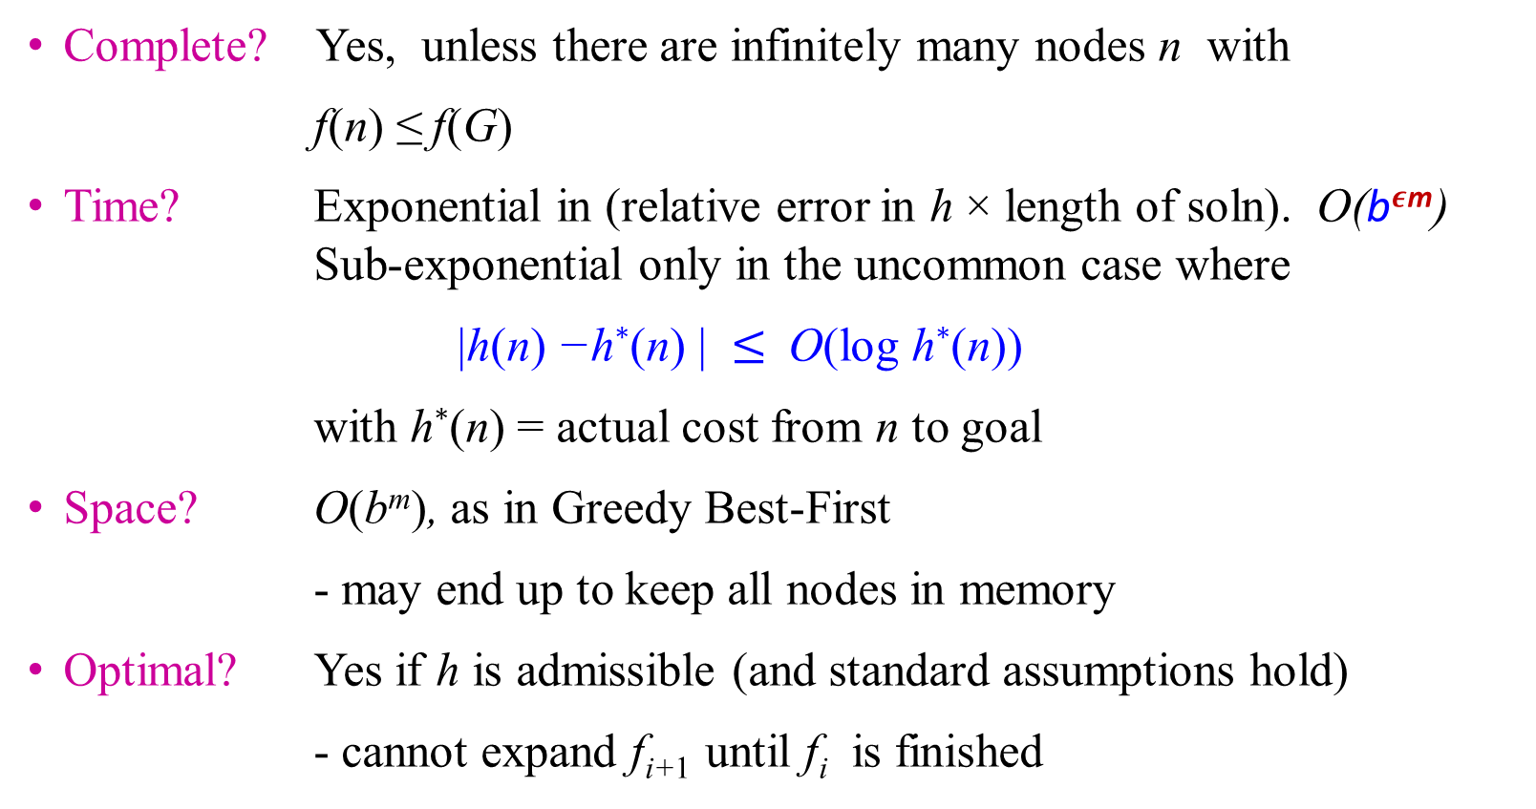
Properties of A*
Complete? Yes, unless there are infinitely many nodes n with
f(n) ≤ f(G)
Time? Exponential in (relative error in h × length of soln). O(b$ε$^{m}) Sub-exponential only in the uncommon case where
|h(n) −h∗(n) | $≤$ O(log h∗(n))
with h∗(n) = actual cost from n to goal
Space? O(b^{m}), as in Greedy Best-First
- may end up to keep all nodes in memory
Optimal? Yes if h is admissible (and standard assumptions hold)
  - cannot expand f_{i+1} until f_{i} is finished
Pick the lowcost f(n) to expand first.

Slide 80
Comparison of Search Techniques
 | DFS | BFS | UCS | IDS | Best | HC | Beam | A*
Complete | N | Y | Y | Y | N | N | N | Y
Optimal | N | N | Y | N | N | N | N | Y
Heuristic | N | N | N | N | Y | Y | Y | Y
Time | b^{m} | b^{d+1} | b^{m} | b^{d} | b^{m} | bm | nm | b^{m}
Space | bm | b^{d+1} | b^{m} | bd | b^{m} | b | bn | b^{m}

Slide 81

A*
A problem may arise such as overestimating the f.
The following slides show the overestimates of f.

Slide 82
A*
QueueingFn is sort-by-f
  Evaluation function f(n) = g(n) + h(n), where
    g(n) = cost so far to reach n, and
  h(n) = estimated cost to goal from n
f(n) = estimated total cost of path through n to goal
Note that UCS and Best-first both improve search
  UCS keeps solution cost low
  Best-first helps find solution quickly
A* combines these approaches

Slide 83
Power of f
Heuristic function is wrong if it
  either overestimates (guesses too high)
  or underestimates (guesses too low)
Overestimating is worse than underestimating
A* returns optimal solution if h(n) is admissible
  heuristic function is admissible if never overestimates true cost to nearest goal
if search finds optimal solution using admissible heuristic, the search is admissible

Slide 84
The following slides also show the overestimates of f.
More examples of A* search.
.

Slide 85
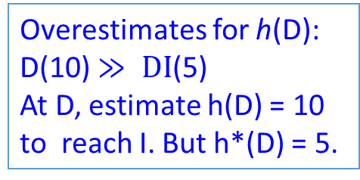
A* with Overestimating
A (15) B (3+6) F (9+0)
A (15) D (3+10) I (8+0)
A (15)
3
3
2
B (6)
C (20)
D (10)
Overestimates for h(D): D(10) $≫ DI$(5)
At D, estimate h(D) = 10 to reach I. But h*(D) = 5.
15
6
20
10
5
E (20)
F(0)
G (12)
H (20)
I(0)
Solution cost:
  ABF = 9
  ADI = 8
Open list:
  A(15)
  B (9) D(13) C(22)
  F(9) D(13), C(22), E(38), F(15)
  F(9) is a goal {it is a suboptimal goal}
Miss optimal solution I(8) because D(3+10) > B(3+6).
This is due to overestimates for h(D): D(10) $≫ DI$(5)

Slide 86
A* with Overestimating
A (15)
A (15) B (3+6) F (9+0)
A (15) D (3+10) I (8+0)
A (8)
3
3
2
D (10)
B (6)
C (20)
D (5)
Overestimates for h(D): D(10) $≫ DI$(5)
At D, estimate h(D) = 10 to reach I. But h*(D) = 5.
15
6
20
10
5
E (20)
F(0)
G (12)
H (20)
I(0)
Solution cost:
  ABF = 9
  ADI = 8
Open list:
  A(15)
  B (9) D(13) C(22)
  F(9) D(13), C(22), E(38)
  F(9) is a goal {it is a suboptimal goal}
Miss optimal solution I(8) because D(3+10) > B(3+6).
This is due to overestimates for h(D): D(10) $≫ DI$(5)

Slide 87

Romania with Step Costs in Km – Fig 3.22 Values of h_{SLD}

Slide 88
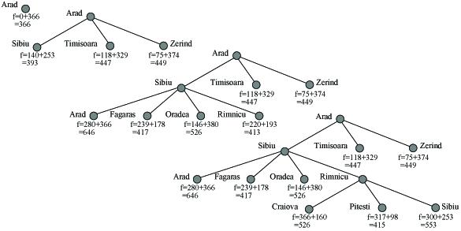
Example
A* search on Romania Road Map

Slide 89
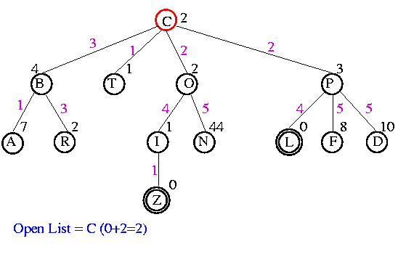
A* - Example
U?
since f(C) = g(C) + h(C) = 0 + 2 = 2

Slide 90
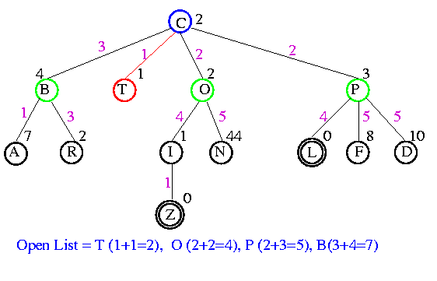
A* - Example
since f(T) = g(T) + h(T) = 1 + 1 = 2, …, f(B) = g(B) + h(B) = 3 + 4 = 7.

Slide 91
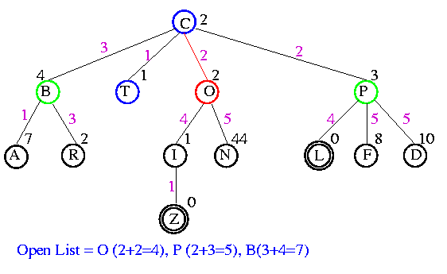
A* - Example
since f(O) = g(O) + h(O) = 2 + 2 = 4, …, f(B) = g(B) + h(B) = 3 + 4 = 7.

Slide 92
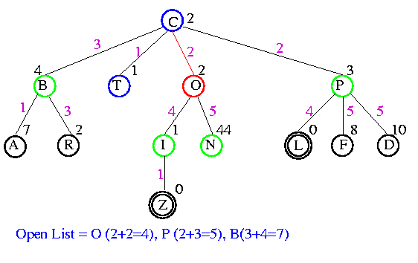
A* - Example

Slide 93
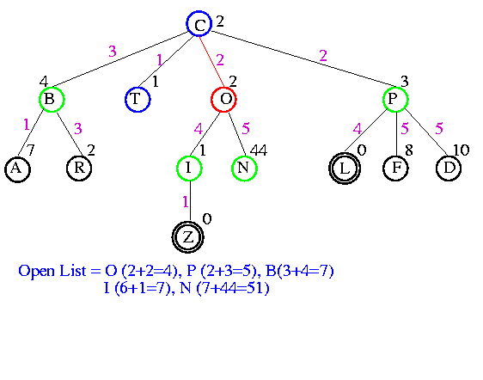
A* - Example
since f(I) = g(I) + h(I) = 2 + 4 + 1 = 7 and f(N) = g(N) + h(N) = 2 + 5 + 44 = 51.

Slide 94
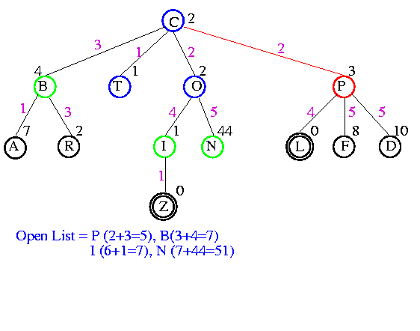
A* - Example

Slide 95
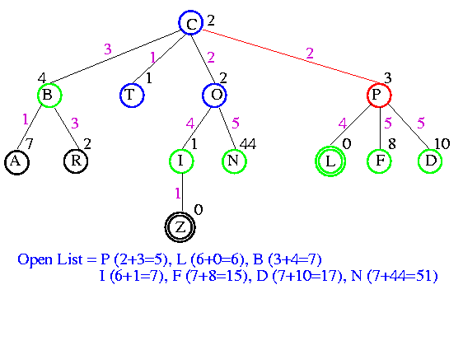
A* - Example
since f(L) = g(L) + h(L) = 2 + 4 + 0 = 6, …, f(F) = g(F) + h(F) = 2 + 5 + 8 = 15…

Slide 96
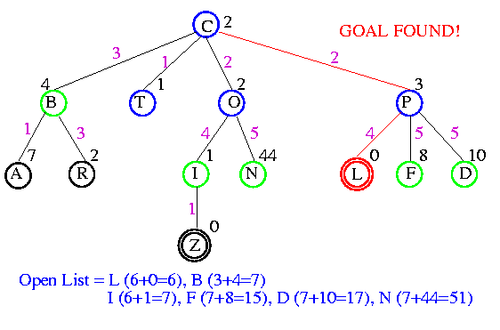
A* - Example

Slide 97

Comparison of Search Techniques
 | DFS | BFS | UCS | IDS | Best | HC | Beam | A*
Complete | N | Y | Y | Y | N | N | N | Y
Optimal | N | N | Y | N | N | N | N | Y
Heuristic | N | N | N | N | Y | Y | Y | Y
Time | b^{m} | b^{d+1} | b^{m} | b^{d} | b^{m} | bm | nm | b^{m}
Space | bm | b^{d+1} | b^{m} | bd | b^{m} | b | bn | b^{m}

Slide 99
Beyond A*
A* generally runs out of memory before it runs out of time
Other best-first strategies keep the good properties on A*
while trying to reduce memory consumption:
  • Recursive Best-First search (RBFS)
  • Iterative Deepening A* (IDA*)
  • Memory-bounded A* (MA*)
  • Simple Memory-bounded A* (SMA*)

Slide 100
IDA Search*: Iterative Deepening A* (IDA*)
It is a memory-efficient variant of A* search that iteratively deepens the search until the goal is found.
It uses a depth-first search with increasing depth limits, pruning branches that exceed a given threshold.

Slide 101
IDA with Memory Cutoffs*:
This is an enhancement to IDA* that uses memory cutoffs to store the best cost-so-far for each state encountered during the search. This allows the algorithm to avoid redundant exploration of states and improve efficiency.

Slide 102
RBFS (Recursive Best-First Search)
It is a memory-efficient variant of A* search that performs a depth-first search in the most promising direction.
It recursively explores the most promising path until a complete solution is found or the search space is exhausted.

Slide 103
Adaptive A*
It is a variant of A* search that dynamically adjusts the heuristic function during the search based on the cost of the solution found so far.
This adaptation helps in focusing the search on the most promising areas of the search space.

Slide 104
Admissible Heuristics
A* search is optimal with an admissible heuristic function h
How do we devise good heuristic functions for a given problem?
  That depends on the problem domain
  However, there are some general techniques that work reasonably well across several domains

Slide 105

Heuristic Functions
Q: When we use only heuristic functions that do not overestimate, what type of heuristic functions (among these) perform best?
A: Those that produce higher h(n) values.
Reason: Since these heuristic functions are admissible, higher h value means closer to actual cost/distance
f(n₁)=g(n₁)+h(n₁) < C*
So pick higher h(n) value but less than or equal to h*(n).
Or pick a h function generates large value but less than or equal to actual cost.

Slide 106

Reasons
Higher h value means closer to actual cost/distance
Any node n on open list with
  f(n) < f *(goal) will be selected for expansion by A*
This means if a lot of nodes have a low underestimate (lower than actual optimum cost)
  All of them will be expanded
  Results in increased search time and space

Slide 107

Informedness
If h₁ and h₂ are both admissible and for all x, h₁(x) > h₂(x),
then h₁ “dominates” h₂ .
  Can also say h₁ is “more informed” than h₂ ?
Example
  h₁(x):
  h₂(x): Euclidean distance
  h₂ dominates h₁

Slide 108

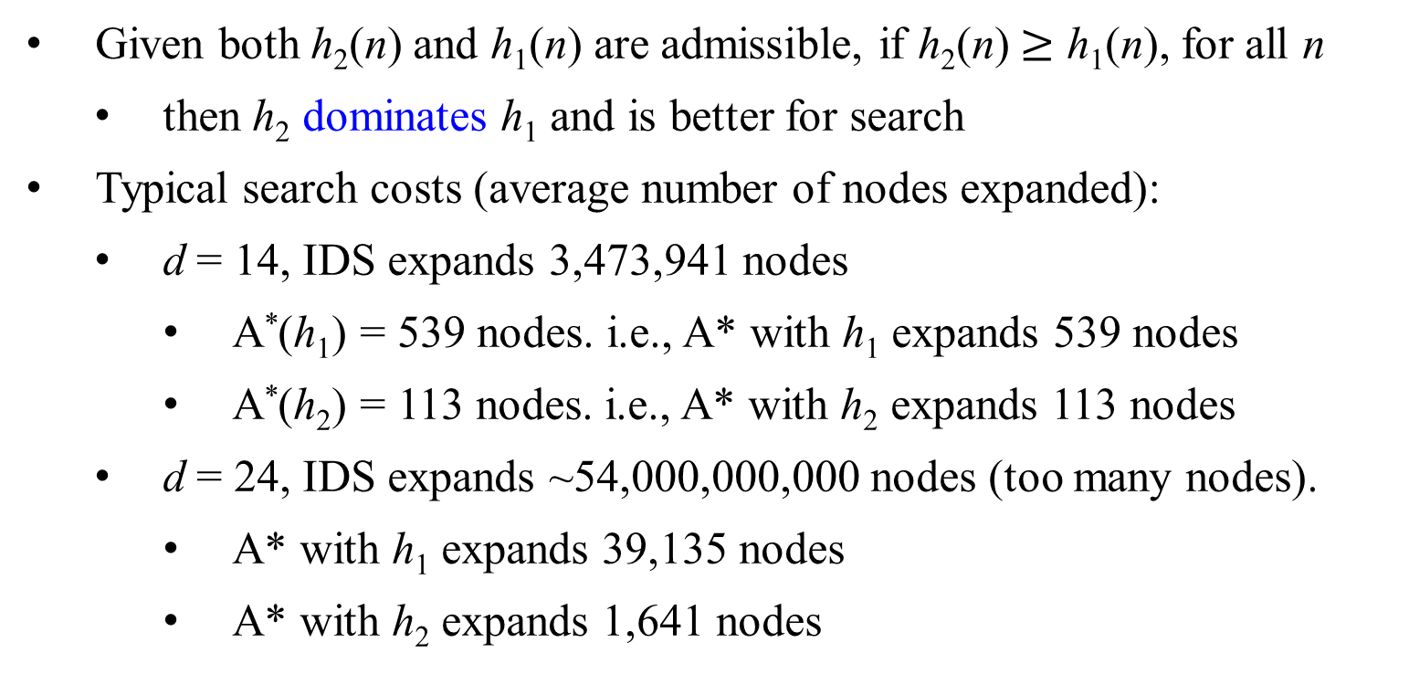
Effect on Search Cost-Dominance
Given both h₂(n) and h₁(n) are admissible, if h₂(n) $≥$ h₁(n), for all n
  then h₂ dominates h₁ and is better for search
Typical search costs (average number of nodes expanded):
  d = 14, IDS expands 3,473,941 nodes
    A*(h₁) = 539 nodes. i.e., A* with h₁ expands 539 nodes
    A*(h₂) = 113 nodes. i.e., A* with h₂ expands 113 nodes
  d = 24, IDS expands ~54,000,000,000 nodes (too many nodes).
    A* with h₁ expands 39,135 nodes
    A* with h₂ expands 1,641 nodes

Slide 109

Examples of Admissible heuristics
e.g., for the 8-puzzle:
h₁(n) = number of tiles in the wrong position at state n
h₂(n) = sum of the Manhattan distances of each tile from its
goal position. (i.e., no. of squares from desired location of
each tile)
h₁(S) = ?
h₂(S) = ?
Figure 3.28 A typical instance of the 8-puzzle. The solution is 26 steps long.

Slide 110

Examples of Admissible heuristics
For 8-puzzle problem:
h₁(n) = number of misplaced tiles at state n
h₂(n) = total Manhattan distance for each tile from its goal position
(i.e., no. of squares from desired location of each tile)
Let S be Start (initial state)
h₁(S) = 8
h₂(S) = 3+1+2+2+2+3+3+2 = 18
Neither of these overestimates of true solution cost, which is 26.

Slide 111
Examples of Admissible heuristics
For 8-puzzle problem:
h₁(n) = number of misplaced tiles
h₂(n) = total Manhattan distance
(i.e., no. of squares from desired location of each tile)
h₁(S) = ? 6
h₂(S) = ? 4 + 0 + 3 + 3 + 1 + 0 + 2+ 1 = 14
1
2
3
4
5
6
7
8

Slide 112
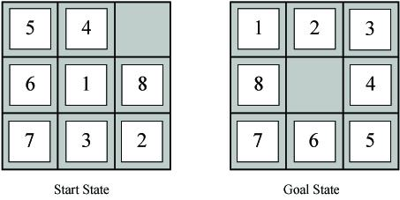
Which of these heuristics are admissible?
Which are more informed?
h₁(n) = #tiles in wrong position
h₂(n) = Sum of Manhattan distance between each tile and goal location for the tile
h₃(n) = 0 [i.e., estimate cost be 0]
h₄(n) = 1 [estimate cost be 1]
h₅(n) = min(2, h*(n))
h₆(n) = Manhattan distance for blank tile
h₇(n) = max(2, h*(n))
Notes:
h1(S) = 7
h2(S) = 2+3+3+2+4+2+0+2 = 18

Slide 113
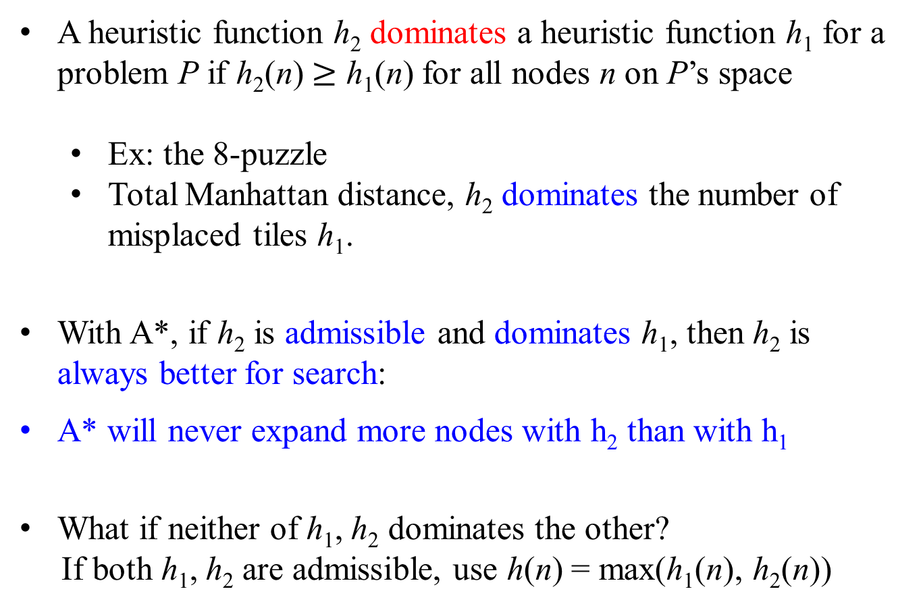
Dominance
A heuristic function h₂ dominates a heuristic function h₁ for a problem P if h₂(n) $≥$ h₁(n) for all nodes n on P’s space
  Ex: the 8-puzzle
  Total Manhattan distance, h₂ dominates the number of misplaced tiles h₁.
With A*, if h₂ is admissible and dominates h₁, then h₂ is always better for search:
A* will never expand more nodes with h₂ than with h₁
What if neither of h₁, h₂ dominates the other?
If both h₁, h₂ are admissible, use h(n) = max(h₁(n), h₂(n))
Reverse
Since h₂ (n) has higher value and therefore closer to the goal.

Slide 114
Effectiveness of Heuristic Functions:
The effect of heuristic accuracy on performance
Let
  • h be a heuristic function for A*
  • N the total number of nodes expanded by one A* search with h
  • d the depth of the found solution
The effective branching Factor (EBF) of h is the value b∗ that solves the equation
( b∗ )^{d} + (b∗ )^{d−1} + · · · + (b∗ )² + b∗ + 1 = N + 1
where the branching factor b∗ of a uniform tree with N + 1 nodes
and depth d .
For example, if A* finds a solution at depth 5 using 52 nodes, then the EBF is 1.92

Slide 115

Effectiveness of Heuristic Functions
The EBF can vary across problem instances, but usually it is fairly constant for sufficiently hard problem.
The existence of an EBF follows from the result that the number of nodes expanded by A* grows exponentially with solution depth.
Experimental measurement of b∗ on a small set of problems can provide a good guide to the heuristic’s overall usefulness.
A heuristics h for A* is effective in practice if its average EBF is close to 1, allowing fairly large problems to be solved at reasonable computational cost.
Note: If h₁ dominates h₂, then EFB(h₁) $≤$ EFB(h₂)

Slide 116
Dominance and EFB: The 8-puzzle
 | Search Cost |  |  | Effective Branching Factor (EBF)
d | IDS | A*(h₁) | A*(h₂) | IDS | A*(h₁) | A*(h₂)
2 4 6 8 10 12 14 16 18 20 22 24 | 10 112 680 6384 47127 364404 3473941 - - - - - | 6 13 20 39 93 227 539 1301 3056 7276 18094 39135 | 6 12 18 25 39 73 113 211 363 676 1219 1641 | 2.45 2.87 2.73 2.80 2.79 2.78 2.83 - - - - - | 1.79 1.48 1.34 1.33 1.38 1.42 1.44 1.45 1.46 1.47 1.48 1.48 | 1.79 1.45 1.30 1.24 1.22 1.24 1.23 1.25 1.26 1.27 1.28 1.26
Average values over 1200 random instances of the problem
  • d, depth of solution
  • Search cost, # of expanded nodes
  • IDS, iterative deepening search
  • h₁, number of misplaces tiles
  • h₂, total Manhattan distance
Figure 3.29 Data are average over 100 instances of the 8-puzzle for each of various solution of depths d

Slide 117
Dominance and EFB: The 8-puzzle
 | Search Cost |  |  | Effective Branching Factor
d | IDS | A*(h₁) | A*(h₂) | IDS | A*(h₁) | A*(h₂)
2 4 6 8 10 12 14 16 18 20 22 24 | 10 112 680 6384 47127 364404 3473941 - - - - - | 6 13 20 39 93 227 539 1301 3056 7276 18094 39135 | 6 12 18 25 39 73 113 211 363 676 1219 1641 | 2.45 2.87 2.73 2.80 2.79 2.78 2.83 - - - - - | 1.79 1.48 1.34 1.33 1.38 1.42 1.44 1.45 1.46 1.47 1.48 1.48 | 1.79 1.45 1.30 1.24 1.22 1.24 1.23 1.25 1.26 1.27 1.28 1.26

Slide 118

For 8-puzzle problem: For h₁(n) = number of misplaced tiles and
h₂(n) = total Manhattan distance, h₂ is always better than h₁.
Since for every node n, h₂(n) $≥$ h₁(n), h₂ dominates h₁.
Domination translates directly into efficiency: A* using h₂ will never expand more nodes than A* using h₁ (except possibly for some nodes with f(n) = C*).
Every node with f(n) < C* (i.e., h(n) < C* - g(n) ) will surely be expanded.
Because h₂ is at least as large as h₁ for all nodes, every node that is surely expanded by A* search with h₂ will also surely be expanded with h₁, and h₁ might cause other nodes to be expanded as well.
Hence, it is generally better to use a heuristic function with higher values, provided it is consistent and that the computation time for the heuristic is not too long.

Slide 120
Devising Heuristic Functions
• Relaxation of formally described problems
  Generating admissible heuristics from relaxed problems
• Pattern databases
  Generating admissible heuristics from subproblems
• Learning heuristic from experience

Slide 121
Devising Heuristic Functions
A relaxed problem is a version of a search problem with less restrictions on the actions (i.e., the applicability of the next-state operators).

Slide 122
Devising Heuristic Functions
The relaxed problem adds edges to the state space graph for the removal of restrictions. Then
  the state-space graph of the relax problem is a super-graph of the original state space;
  any optimal solution in the original problem is also a solution in the relaxed problem; and
  the relaxed problem may have betters solutions if the added edges provide short cuts.
Therefore, the cost of an optimal solution to a relaxed problem is an admissible heuristic for the original problem.
The derived heuristic is an exact cost for the relaxed problem, it must obey the triangle inequality and is therefore consistent.

Slide 123
Devising Heuristic Functions
Example: n-puzzle
  original: “A tile can move from position p to position q if p is adjacent to q and q is empty”
  relaxed-1: “A tile can move from p to q if p is adjacent to q”
  relaxed-2: “A tile can move from p to q if q is empty”
  relaxed-3: “A tile can move from p to q”

Slide 124
Devising Heuristic Functions
Example: 8-puzzle
  relaxed-1: “A tile can move from p to q if p is adjacent to q”
    We can derive h₂ (Manhattan distance). h₂ would be the proper score if we moved each tile in turn to its destination.
  relaxed-2: “A tile can move from p to q if q is empty”
    Gaschnig’s heuristic defined the exact solution of this problem. It underestimates the distance function of 8-puzzle, it is a closer approximation of the 8-puzzle’s distance.
  relaxed-3: “A tile can move from p to q”
    We can derive h1 (misplaced titles) because it would be the proper score if tile could move to their intended destination in one step.

Slide 125
Devising Heuristic Functions
Example: n-puzzle
  original: “A tile can move from position p to position q if p is
  adjacent to q and q is empty”
  relaxed-1: “A tile can move from p to q if p is adjacent to q”
  relaxed-2: “A tile can move from p to q if q is empty”
  relaxed-3: “A tile can move from p to q”
The exact solution cost of a relaxed problem is often a good
(admissible) heuristics for the original problem
Key point: the optimal solution cost of the relaxed problem is no
greater than the optimal solution cost of the original problem

Slide 126
Devising Heuristic Functions - summary
A relaxed problem is a version of a search problem with less restrictions on the applicability of the next-state operators/actions
Example: n-puzzle
  original: “A tile can move from position p to position q if p is
  adjacent to q and q is empty”
  relaxed-1: “A tile can move from p to q if p is adjacent to q”
  relaxed-2: “A tile can move from p to q if q is empty”
  relaxed-3: “A tile can move from p to q”
The exact solution cost of a relaxed problem is often a good
(admissible) heuristics for the original problem
Key point: the optimal solution cost of the relaxed problem is no
greater than the optimal solution cost of the original problem

Slide 127
Relaxed problems
A relaxed problem: a problem with
  fewer restrictions on the actions
The cost of an optimal solution to a relaxed problem is
  an admissible heuristic for the original problem
If the rules of the 8-puzzle are relaxed so that a tile can move anywhere, then
  h₁(n) gives the shortest solution
If the rules are relaxed so that a tile can move to any adjacent square, then
  h₂(n) gives the shortest solution
h₁

Slide 128
Generating Heuristic Functions
Generate heuristic for simpler (relaxed) problem
  Relaxed problem has fewer restrictions
  Eight puzzle where multiple tiles can be in the same spot
  Cost of optimal solution to relaxed problem is an admissible heuristic for the original problem
Learn heuristic from experience

Slide 129
Relaxed Problems: Another Example
Traveling salesperson problem
Original problem: Find the shortest tour visiting n cities exactly
once
Complexity: NP-complete
Relaxed problem: Find a tree with the smallest cost that connects
the n cities (minimum spanning tree)
    Complexity: O(n²)
    Cost of tree is a lower bound on the shortest (open) tour.

Slide 130
Devising Heuristic Functions Automatically
• Relaxation of formally described problems
• Pattern databases
• Learning heuristic from experience

Slide 131
Devising Heuristic Functions Automatically
Pattern databases
Admissible heuristic can be derived from the solution cost of a subproblem of a given problem.
Start State Goal State
Figure 3.30 A subproblem of the 8-puzzle instance given in Figure 3.28. The task is to get tiles 1, 2, 3, 4 into their correct positions, without worrying about what happens to the other tiles.
2
4
1
2
3
4
3
1
1
Clearly, the cost of the optimal solution of this subproblem is a lower bound on the cost of the complete problem. It turns out to be more accurate than Manhattan distance in some cases.

Slide 132
Devising Heuristic Functions Automatically
Pattern databases
Pattern databases are used to store these exact solution costs for every possible subproblem instance. In this example, we store every possible configuration of the four tiles and the blank.
For the purpose of solving this problem, the location of the other four tiles are irrelevant, but moves of those tiles do count toward the cost.
Then we compute an admissible heuristic h_{DB} for each complete state encountered during a search simply by looking up the corresponding subproblem configuration in the database.
The database itself is constructed by searching back from the goal and recording the cost of each new pattern encountered. The expense of this search is amortized over many subsequent problem instances.

Slide 133
Devising Heuristic Functions Automatically
Pattern databases
The choice of 1-2-3-4 is arbitrary; We could construct databases for other tile combinations such as 2-4-6-8 etc.
Each database yields an admissible heuristic, and these heuristics can be combined, by taking their maximum value.
A combined heuristic of this kind is much more accurate than the Manhattan distance;
  For example, the number of nodes generated when solving random 15-puzzles can be reduced by a factor of 1000.

Slide 134
Devising Heuristic Functions Automatically
Pattern databases
Could be added the two heuristics obtained from the 1-2-3-4 database and the 5-6-7-8, since the two subproblems seem not to overlap?
The answer is no, because the solutions of the 1-2-3-4 subproblem and the 5-6-7-8 subproblem for a given state will almost certainly share some moves. It is unlikely that 1-2-3-4 can be moved into place without touching 5-6-7-8, and vice versa.
What if we record not the total cost of solving the 1-2-3-4 subproblem, but just the number of moves involving 1-2-3-4. Then it is easy to see that the sum of the two costs is still a lower bound on the cost of solving the entire problem.
  This is the idea behind disjoint pattern databases.

Slide 135
Devising Heuristic Functions Automatically
Pattern databases
This is the idea behind disjoint pattern databases.
Disjoint pattern databases work for sliding-tile puzzle because the problem can be divided up in such a way that each move affects only one subproblem – because only one tile is moved at a time.
With such databases, it is possible to solve random 15-puzzle in a few milliseconds: the number of nodes generated is reduced by a factor of 10,000 compared with the use of Manhattan distance. For 24-puzzle, a speeding of roughly a factor of a million can be obtained.
What about our mice-maze problem?

