Slide 1
Artificial Intelligence
Chapter 03-02
Solving Problems by Searching:
Uninformed Search Strategies

Slide 2
Outline: Ch 03_01_F
Problem-solving agents Ch 03 Sect 3.1 [Ch 03_01_F]
Problem types Ch 03 Sect 3.2-3.3 [Ch 03_01_F]
Problem formulation Ch 03 Sect 3.1-3,3 [Ch 03_01_F]
Example problems Ch 03 Sect 3.2 [Ch 03_01_F]
Basic search algorithms Ch 03 Sect 3.3-3.6
  Uninformed Search Strategies Ch 03 Sect 3.4 [Ch 03_02_F]
  Informed Search Strategies Ch 03 Sect 3.5 [Ch 03-03_3]

Slide 3
Outline: Ch 03_02_F
    Uninformed (blind) Search Strategies [Ch 03 Sect 3.4]
    Breadth-first search
    Uniform-cost search
    Depth-first search
    Depth-limited search
    Iterative deepening (depth-first) search
    Bidirectional search

Slide 4

Formulating Problem as a Labeled Graph
In the graph
each node represents a possible state; (INTERPRET_INPUT(Percept))
a node is designated as the initial state;
one or more nodes represent goal states, states in which the agent’s goal is considered accomplished.
each edge represents a state transition caused by a specific agent action;
associated to each edge is the cost of performing that transition.

Slide 5
Search Graph
How do we reach a goal state?
There may be several possible ways. Or none!
Factors to consider:
  cost of finding a path;
  cost of traversing a path.
C
Initial state
A
B
F
S
goal states
D
E
G

Slide 6
Problem Solving as Search
Search space: set of states reachable from an initial state S₀ via a (possibly empty/finite/infinite) sequence of state transitions.
To achieve the problem’s goal
  search the space for a (possibly optimal) sequence of transitions starting from S₀ and leading to a goal state;
  execute (orderly) the actions associated to each transition in the identified sequence.
Depending on the features of the agent’s world (such as, for contingency problems[Nondeterministic and/or partially observable ]), the two steps above can be interleaved
Find a path
Then execute their associated actions

Slide 7
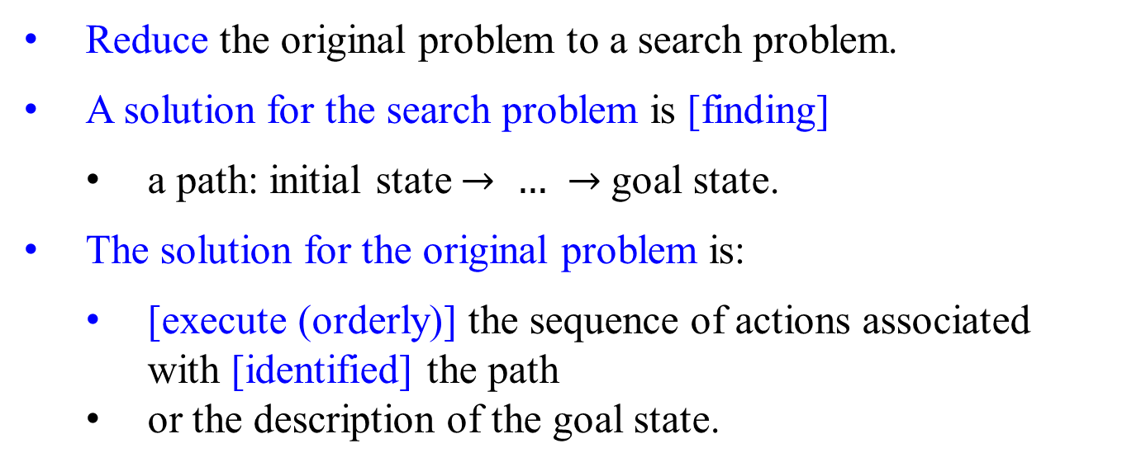
Problem Solving as Search
Reduce the original problem to a search problem.
A solution for the search problem is [finding]
  a path: initial state $→ …$ $→$goal state.
The solution for the original problem is:
  [execute (orderly)] the sequence of actions associated with [identified] the path
  or the description of the goal state.
Finding from a state space for a path
Execute its associated sequence of actions

Slide 8
More on Graphs

Slide 9
Search Graph
A graph is a set of nodes and edges (arcs) between them.
A graph is directed if an edge can be traversed only in a specified direction.
When an edge is directed from n_{i} to n_{j}
  it is univocally identified by the pair (n_{i}, n_{j})
  n_{i} is a parent (or predecessor, or ancestor) of n_{j}
  n_{j} is a child (or successor, or descendant ) of n_{i}
C
Initial state
A
B
F
S
goal states
D
E
G

Slide 10
Directed Graph
Initial state
C
A
B
F
S
goal states
D
E
G
A path of length k ≥ 0, is a sequence <(n₁, n₂), (n₂, n₃), . . . , (n_{k}, n_{k+1})> of k successive edges.
Ex: < >, <(S, D)>, <(S, D), (D, E), (E, B)>
A path of length k > 0 contains k + 1 nodes.
A graph is cyclic if it has a path starting from and ending in the same node. Ex: <(A, D), (D, E), (E, A)>

Slide 11
From Search Graphs to Search Trees
The set of all possible paths of a graph can be represented as a tree.
  A tree is a directed acyclic graph (dag) all of whose nodes have at most one parent.
  A root of a tree is a node with no parents.
  A leaf is a node with no children.
  The branching factor of a node is the number of its children.
Graphs can be turned into trees by
  duplicating nodes and
  breaking cyclic paths, if any.

Slide 12
From Graphs to Trees – a search-space problem
S
depth 0
Initial state
C
A
B
D
A
F
depth 1
S
E
D
B
goal states
depth 2
D
E
G
A
B
G
E
F
C
depth 3
D
A
B
G
. . .
depth 4

Slide 13
From Graphs to Trees - a formulated problem
To unravel a graph into a tree,
choose a root node and
trace every path from that node
until you reach a leaf node or a node already in that path.
Initial state
C
A
B
F
S A D E A B G
S A D E A D E A B G
S
goal states
D
E
G
must remember which nodes have been visited
a node may get duplicated several times in the tree
the tree has infinite paths iff the graph has infinite non-cyclic paths

Slide 14
A solution for a formulated (original) problem is an action sequence.
Search algorithms work by considering various possible action sequences.
  Starting at the initial state, apply the possible action sequences to form a search tree with
    the initial state at the root,
    the branches are actions and
    the nodes corresponding to states in the state space of the problem.
e.g., a mouse takes a sequence of actions (based on percepts) running within any given maze which has its associated graph.
e.g., Based on search algorithms applied, for each possible action sequence, form a search tree. (The conversion from graph to tree(s).

Slide 15
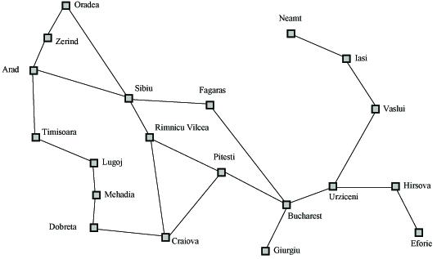
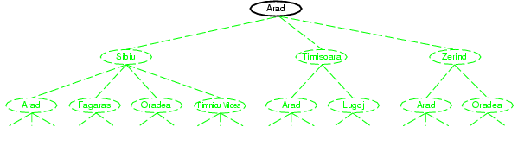
A Tree Search Example: Search Problem Example as a Tree
Think: given a maze, which could be represented as a graph like this map. In(A) an agent will see only the states In(Z), In(S), and In(T).
Based on the search algorithm used, following through all possible action sequences, a search tree is formed.
Figure 3.6 A map

Slide 16
Formulate A Tree Search Problem
Given the map in Figure 3.6 as a search (state) space graph, formulate a search (tree) space problem for finding a route from Arad to Bucharest:
Choose the initial state, In(Arad) as the root node of a tree.
Test whether this is a goal state, In(Bucharest).
If it is not a goal state, then consider taking various actions:
  expanding the current state by
    applying each legal action, such as Go(In(Arad), In(Sibiu)), to the current state In(Arad), therefore
  generating a new set of states.
    e.g., add three branches from the parent node In(Arad) leading to three new child nodes: In(Sibiu), In(Timisoara), and In(Zerind).
Search actions to be applied
Resulting from applied actions
A
S
T
Z

Slide 17
Formulate A Tree Search Problem (Continued)
Obtain the parent node In(Arad) leading to three new child nodes: In(Sibiu), In(Timisoara), and In(Zerind).
Apply the search strategy:
  Many options in the tree search, such as S, T, or Z, to choose from.
  If the first choice fails to lead to a solution, follow up with the others.
  Example: let’s choose Sibiu first. Check whether it is a goal state.
    Since it is not, expand the state In(Sibiu) by applying Go(In(Sibiu), In(Arad)), Go(In(Sibiu), In(Fagara)), Go(In(Sibiu), In(Oradea)), and Go(In(Sibiu), In(RimnicuVilcea)).
    Next, choose any of these four or go back to choose Timisoara or Zerind.
    These six leaf nodes are available for expansion at any given point, which is called the frontier (or called the fringe or the open list).
    frontier = {In(Zerind), In(Timisoara) In(Arad), In(Fagara), In(Oradea), In(RimnicuVilcea)}
A
S
T
Z
A
F
O
R

Slide 18
Formulate A Tree Search Problem (Continued)
[Frontier] The search algorithms vary in choosing which state to expand next based on their search strategy.
[Exploration] Augment the Tree-Search algorithm with a data structure called the explored set (also called the closed list).
  To avoid exploring redundant(repeated) paths, remember where one has been visited.
e.g. uninformed search algorithms.
The tree-search algorithm with data structures:
the frontier (open list), stored the states ready to be visited; and
the explored set(closed list) stored the states that have been visited.

Slide 19

Formulate A Tree Search Problem (Continued)
Given the map in Figure 3.6 as a search (state) space graph, formulate a search (tree) space problem for finding a route from Arad to Bucharest:
The following viewgraphs are constructing partial search trees for finding a route from Arad to Bucharest.
Nodes that have been expanded are shaded;
nodes that have been generated but not yet expanded are outlined in bold;
nodes that have not yet been generated are shown in faint dashed lines.
Figure 3.6

Slide 20
Formulate A Tree Search Problem (Continued)
Figure 3.6 A map - a search graph
Frontier = { Arad }.
node that has been generated
the initial node

Slide 21
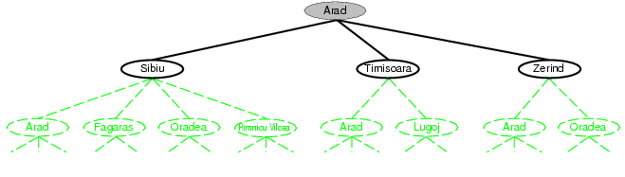
Formulate A Tree Search Problem
(Continued)
After expanding Arad
The chosen node has been expanded
frontier = { Sibiu, Timisoara, Zerind}
exploration = {Arad}
nodes that have been generated

Slide 22
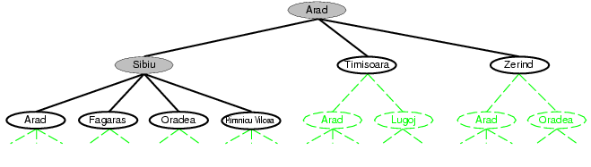
Formulate A Tree Search Problem
(Continued)
frontier = {Timisoara, Zerind, Arad, Fagaras, Oradea, HimniaVilosa}
The node that has been expanded
Exploration = {Arad, Sibiu}
After expanding Sibiu
nodes that have been generated
node that has been expanded
nodes that have been generated

Slide 23
Tree Search and Graph Search Algorithms
Figure 3.7 An informal description of the general tree-search and graph-search algorithms is in the following two viewgraphs.
The part of GRAPH-SEARCH marked in bold italics are the additions needed to handle repeated states.
Basic idea:
offline, simulated exploration (closed list) of state space by generating successors of already-explored states (also know as ~expanding states (open list))
By expanding the current state, it means apply each legal action to the current state to generate a new set of states

Slide 24
Fig 3.7 An informal description of the general tree-search algorithm.
function TREE-SEARCH(problem) returns a solution, or failure
initialize the frontier using the initial state of a problem;
loop do
if the frontier is empty then return failure;
choose a leaf node and remove it from the frontier;
if the node contains a goal state
then return the corresponding solution;
else expand (apply possible actions)the chosen node;
generate (add) the resulting nodes(its successors) to the frontier;
A
S | T | Z

Slide 25
Fig 3.7 An informal description of the general graph-search algorithm.
function Graph-SEARCH(problem) returns a solution, or failure
initialize the frontier using the initial state of a problem;
initialize the explored set to be empty;
loop do
if the frontier is empty then return failure;
choose a leaf node and remove it from the frontier;
if the node contains a goal state
then return the corresponding solution;
else add the chosen node to the explored set;
expand the chosen node;
  generate (add) the resulting nodes to the frontier
    only if not in the frontier or explored set;
frontier
A
explored set
A
S | T | Z

Slide 26
Abstraction:
State (search) Space:
Percepts of a map (the world E) to form states with transitions (actions)
Tree Search Algorithms
Search tree problem with defined action for each edge.

Slide 27

Tree Search Algorithms: a different version
function TREE_SEARCH( problem, strategy) returns a solution, or failure
initialize the search tree using the initial state of problem;
loop do
if there are no candidates for expansion //if the frontier is empty
then return failure
else
choose a leaf node for expansion according to strategy;
if the node contains a goal state
then return the corresponding solution
else
expand the node and add its successors to the tree;
done
Fig 3.7 An informal description of the general tree-search algorithm.

Slide 28
Tree-search algorithms: Visualize Search Space as a Tree
Terminologies:
Nodes: the data structures for constructing the search tree.
n.STATE: the state n in the state space STATE to which the node n
corresponds, and thus corresponds a configuration of the world (E).
n.ACTION : The action that was applied to the parent to generate the node n. There are edges. GO(In(Arad), n) GO(PARENT(n), n)
Edges: Sometimes edges have associated costs.
n.PARENT: The parent node in the search tree that generated this node n.
Initial state: Root
SOLUTION: Path (a sequence of actions that leads) from root to goal node
n.PATH-COST: The cost g(n) of the path from the initial state to the node n.
GOAL-TEST: Are the search reaches the final destination specified by the user’s requirements.

Slide 29
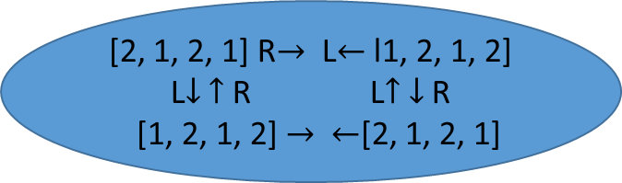
n.STATE: the state n in the state space STATE to which the node
corresponds, and thus corresponds a configuration of the world (E).
] [
The state space STATE = { , , , , , , …. }
State
n.PARENT: The parent node generates a child node associated with state n.
A
n.ACTION: At node A, take move forward to reach a child node associated with state n.
a grid n
a node n
state
n.PATH-COST: The cost g(n) of the path from the initial state to the node n.
The association of the state with a node n can be expressed as:
B
State
(2, 1, 2, 1)
[2, 1, 2, 1] R$→$ L$←$ l1, 2, 1, 2]
L$↓$ $↑$ R L$↑$ $↓$ R
[1, 2, 1, 2] $→$ $←$[2, 1, 2, 1]
a node n
state

Slide 30
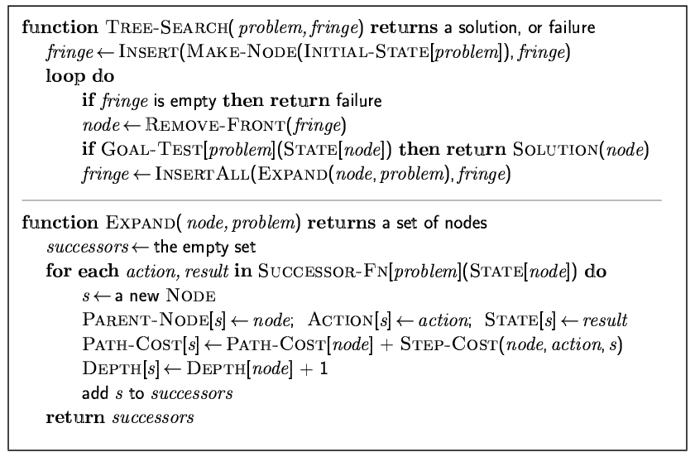
Implementation: general tree-search
frontier and fringe are the same.
Problem can be represented in terms of graph, map, ...

Slide 31
Implementation: states vs. nodes
A state is a (representation of) a physical configuration
A node is a data structure constituting part of a search tree (and includes information, such as parent, children, depth, path cost g(x))
States do not have parents, children, depth, or path cost!
5
4
State
6
1
8
PARENT
state
5
4
7
3
2
Node n
ACTION = Right
PATH-COST, g(n) = 6
depth = 6
6
1
8
state
7
3
2
children
Fig 3.10 Nodes are the data structures from which tree is constructed. Each has a parent, a state, and various bookkeeping fields. Arrows point from child to parent.

Slide 32
Visualize Search Space as a Tree
Nodes: the data structures for constructing the search tree.
n.STATE: the state n in the state space STATE to which the node corresponds, and thus corresponds a configuration of the world
n.ACTION : The action that was applied to the parent to generate the node Node n. There are edges.
Edges: Possibly, associated costs
n.PARENT: the node in the search tree that generated this node Node n.
Initial state: root
SOLUTION: a path from the root to goal node
n.PATH-COST: the cost g(n) of the path from the initial state to the node.
State
PARENT
5
4
ACTION = Right
PATH-COST, g(n) = 6
depth = 6
Node n
6
1
8
state
7
3
2
children
Fig 3.10 Nodes are the data structures from which the tree is constructed. Each has a parent, a state, and various bookkeeping fields. Arrows point from parent to child.

Slide 33
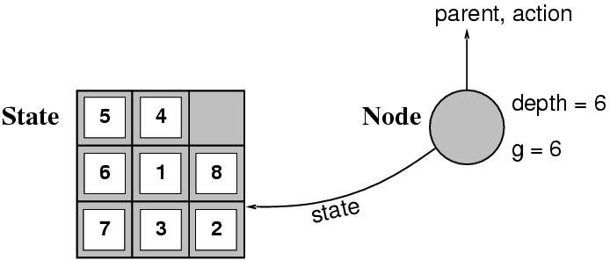
Implementation: states vs. nodes
A state is a (representation of) a physical configuration
A node is a data structure constituting part of a search tree (and includes state, parent, action, depth, path cost g(n)
The Expand function creates new nodes, filling in the various fields and using the Successor-Fn of the problem to create the corresponding states.

Slide 34
function CHILD-NODE(problem, parent, action) returns a _{child}node
return a node with
STATE = problem.RESULT(parent.STATE, action),
PARENT = parent,
ACTION = action,
PATH-COST = parent.PATH-COST +
problem.STEP-COST(parent.STATE, action)
Given the components for a parent node, it is easy to see how to compute the necessary components for a child node. The function CHILD-NODE takes a parent node and an action and returns the resulting child node.

Slide 35
The node data structure is depicted in Figure 3.10. (in slide 33)
The PARENT pointers keep(string) the nodes together into a tree structure.
These pointers allow the solution path to be extracted when a goal node is found.
  Use the SOLUTION function to return the sequence of actions, obtained by following parent pointers back to the root.
The distinction between nodes and States:
A node is a bookkeeping data structure representing the search tree.
And a State corresponds to a configuration of the world.
Nodes are on particular paths, as defined by PARENT pointers; and states are not.
Two different nodes can contain the same world state if that state is generated via two different search paths.

Slide 36
Need to put nodes somewhere:
The frontier – stores nodes in a way that the search algorithm can easily choose the next node to expand according to its preferred strategy.
  Queue - An appropriate data structure for the frontier. It has the following operations:
    EMPTY? (queue) returns true only if no more elements are in the queue.
    POP(queue) removes the first element of the queue and returns it.
    INSERT(element, queue) inserts an element and returns the resulting queue.
    Queues are
      FIFO queue,
      LIFO queue (stack) and
      the priority queue, which pops the queue element with the highest priority according to some ordering function.

Slide 37
Need to put nodes somewhere:
The frontier – stores nodes in a way that the search algorithm can easily choose the next node to expand according to its preferred strategy.
  …
The explored set – is implemented with a hash table to allow efficient
  checking for repeated states,
  Insertion, and lookup.
  to be done in constant time no matter how many states are stored.

Slide 38
Search strategies:
Measuring problem-solving performance

Slide 39
Search strategies: Measuring problem-solving performance
Define a search strategy by picking the order of node expansion
Evaluate search strategies along the following dimensions:
  Solution completeness: Does it always find a solution if one exists?
  Time complexity: How long does it take to find a solution?
              the number of nodes expanded/generated
                cost of search
  Space complexity: How much memory is needed to perform the search?
              maximum number of nodes in memory
              cost of search
  Optimality: does it always find a least-cost solution?
              cost of the solution
Time and space complexity are measured in terms of
  …

Slide 40
Search strategies: Measuring problem-solving performance
…
Time and space complexity are measured in terms of
  b: maximum branching factor of the search tree
  (maximum number of successors of any node).
  d: depth of the least-cost solution
  (the number of steps along the path from the root)
  m: maximum depth of the state space (can be ∞)
  (the maximum length of any path in the state space).

Slide 41
Search Function –
Uninformed (or Blind) Searches as an example
open = initial state; // open(frontier) list is all generated states
// that have not been “expanded”.
while open not empty // An iteration of the search algorithm:
state = First(open); // Current state is First state in open.
Pop(open); // Remove new current state from open.
if Goal(state) // Test if the current state is the Goal state,
return “succeed”; // search is complete.
// else expand the current state by
// generating its children and
// reorder open list per search strategy.
else open = QueueFunction(open, Expand(state));
return “fail”;

Slide 42
Search Strategies – summary of previous 3 slides
Search strategies differ only in QueuingFunction
  Queuing Function defines search strategies.
Compare search strategies in terms of:
  Completeness (always find a solution)
  Cost of search (time and space)
  Cost of solution (optimal solution, g(n))
  Make use of knowledge of the domain
    “uninformed (or Blind) search” vs. “informed (or heuristic) search”

Slide 43
Search Strategies
Uninformed (or Blind) Search Strategies
  Little or no information about the search space is available.
  All we know is how to
    Generate (expand) new states and
    recognize a goal state.
Informed (or Heuristic) Search Strategies
  An estimate of the number of steps or
  the path cost from current state to goal state is available.
  The estimate is not perfect (otherwise no search is needed!)
    but can help prune the search space considerably.
Apply an action at one state resulting transiting to another state.

Slide 44

What is fringe in search tree?
In computer science, fringe search is a graph search algorithm that finds the least-cost path from a given initial node to one goal node.
In essence, fringe search is a middle ground between A* and the iterative deepening A* variant (IDA*).
The fringe is processed as FIFO queue.

Slide 45
Uninformed search strategies
Uninformed (blind) search strategies use only the information available in the problem definition
    Breadth-first search
    Uniform-cost search
    Depth-first search
    Depth-limited search
    Iterative deepening (depth-first) search
    Bidirectional search
  Little or no information about the search space is available.
  All we know is how to generate new states and recognize a goal state.

Slide 46
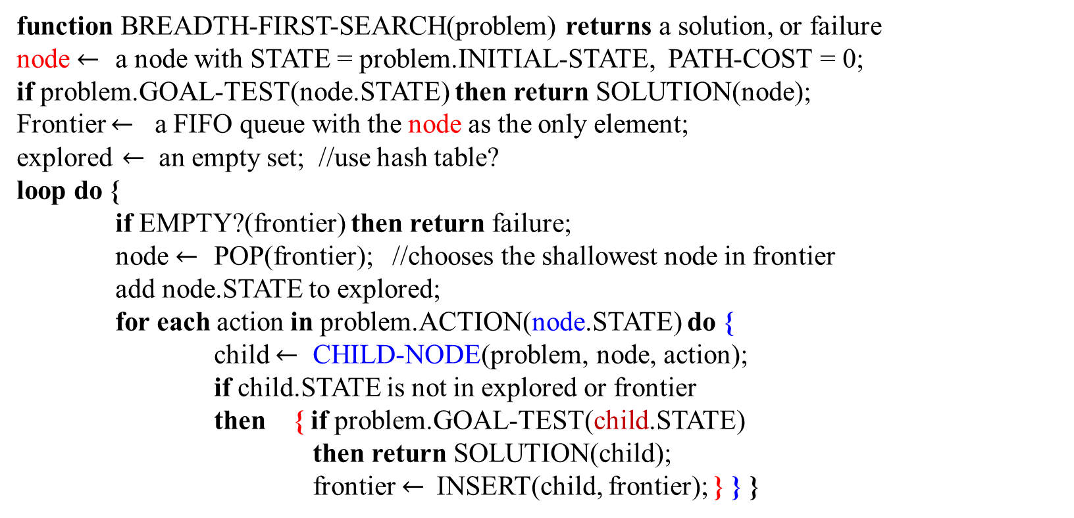
Breadth-First Search (BFS)
function BREADTH-FIRST-SEARCH(problem) returns a solution, or failure
node $←$ a node with STATE = problem.INITIAL-STATE, PATH-COST = 0;
if problem.GOAL-TEST(node.STATE) then return SOLUTION(node);
Frontier $←$ a FIFO queue with the node as the only element;
explored $←$ an empty set; //use hash table?
loop do {
if EMPTY?(frontier) then return failure;
node $←$ POP(frontier); //chooses the shallowest node in frontier
add node.STATE to explored;
for each action in problem.ACTION(node.STATE) do {
child $←$ CHILD-NODE(problem, node, action);
if child.STATE is not in explored or frontier
then { if problem.GOAL-TEST(child.STATE)
then return SOLUTION(child);
frontier $←$INSERT(child, frontier); } } }
n
node
A₃
A₁
A₂
c
c
c
child
Open_frontier_fringe = QueuingFn(open_frontier_fringe, Expand(state))
Figure 3.11 Breadth-first search on a graph

Slide 47

child $←$ CHILD-NODE(problem, node, action);
function CHILD-NODE(problem, parent, action) returns a _{child}node
return a node with
STATE = problem.RESULT(parent.STATE, action),
PARENT = parent,
ACTION = action,
PATH-COST = parent.PATH-COST +
problem.STEP-COST(parent.STATE, action)
parent, g(n)
n
A₃
A₁
A₂
child
c
c
c
parent, g(c)=g(n)+sc(A₁)
How to compute the necessary components for a child node from given components for a parent node?
The function CHILD-NODE takes a parent node and an action and returns the resulting child node.

Slide 48
Breadth-First Search (BFS)
Generate children of a state, (child nodes of a given (parent) node).
QueueingFn adds the children to the end of the open list (open list, open, fringe, and frontier are used interchangeably.)
Level-by-level search
Order in which children are inserted on an open list (such as FIFO queue) is arbitrary
In the tree, assume children are considered left-to-right unless specified differently
Number of children (b child nodes) of a node is the “branching factor” b
: insert child nodes in arbitrary order at the same level.
m is the maximum length of any path in the state space;
d is the depth of the shallowest goal node (the number
of steps along the path from the root).
b is the branching factor, the maximum number of
successors of any node.

Slide 49
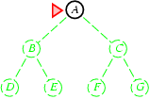
Breadth-first search
Strategy: Expand the shallowest unexpanded node
Implementation:
  The current set of unexpanded nodes, the fringe, is processed as a FIFO queue, i.e., new successors go at the end
A node that have been generated
OPEN_LIST, b = 2
A

Slide 50
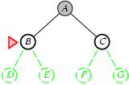
Breadth-first search
Strategy: Expand the shallowest unexpanded node
Implementation:
  fringe is a FIFO queue, i.e., new successors go at the end.
A node that have been expanded
OPEN_LIST, b = 2
B | C
State space
B and C nodes that have been generated

Slide 51
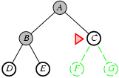
Breadth-first search
Expand the shallowest unexpanded node
Implementation:
  fringe is a FIFO queue, i.e., new successors go at the end
OPEN_LIST, b = 2
C | D | E
A node that have been expanded
B node that have been expanded
D and E nodes that have been generated

Slide 52
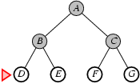
Breadth-first search
Expand the shallowest unexpanded node
Implementation:
  fringe is a FIFO queue, i.e., new successors go at the end
OPEN_LIST, b = 2
D | E | F | G
A node that have been expanded
Nodes that have been expanded
Nodes that have been generated

Slide 53
From Graphs to Trees: applying bfs
S
Level 5
depth 0
Initial state
C
A
B
D
A
Level 4
depth 1
F
S
E
D
B
Level 3
depth 2
goal states
D
E
G
A
G
E
F
C
Level 1
depth 3
D
A
G
. . .
Level 1
depth 4

Slide 54
Analysis : Cost of breadth-first search
Worst-case Time complexity - measured in terms of :
  number of nodes generated/expanded
For the worst case, assume that
  a goal node is a rightmost node at depth d with constant branching factor b.
For finding a goal state at depth d,
  Except for the goal state, all nodes through depth d must be expanded
We must process
1 (depth 0) + b(depth 1) + b²(depth 2) + … + b^{d}(goal) + (b^{d+1} – b)
      1 + b + b² + … + b^{d} + (b^{d+1} – b)
      = O(1 + b + b² + . . . + b^{d} + b^{d+1} − b)
      = O(b^{d+1}) nodes (exponential time), where b = maximum branching factor, = O(b^{d}) d = depth of shallowest goal state.

Slide 55
Analysis : Cost of breadth-first search
Assume a goal node at depth d with constant branching factor b
At depth d, it has b^{d} nodes.
Assume that the goal is the far right node at the depth d. All the nodes, except the goal node, will be expanded.
The total nodes generated at depth d+1 will have (b^{d+1} – b) nodes before the goal node is reached at depth d.
Note: The above assumes that the search space is finite. What if it is not?
depth d, b^{d} nodes.
depth d+1, (b^{d+1} – b) nodes

Slide 56
Breadth-first search
OPEN_LIST, b = 2
D | E | F | G
Expand the shallowest unexpanded node
Implementation:
  fringe is a FIFO queue, i.e., new successors go at the end
A node that have been expanded
OPEN_LIST, b = 2
G | H | I | J | K | L | M
A
at depth 0
B
C
at depth 1
      1 + b + b² + (b²⁺¹ – b)
      1 + 2 + 4 + (8 – 2)
Nodes that have been expanded
D
E
F
G
at depth 2
Total of nodes generated at depth 2+1
H
I
J
K
L
M
N
O
at depth 3
Nodes that have been generated

Slide 57
Analysis : Cost of breadth-first search
Worst-case Space complexity (measured in the number of nodes in memory)
  All nodes at depth d of the search tree are in the fringe when the procedure finds the goal state. (D, E, F, G)
  The number of nodes at depth d +1 in a tree with branching factor b is
  b^{d+1} nodes. Thus it is bound by O(b^{d+1}) (exponential space)
  If the goal node is at the rightmost node of depth d, then all the b^{d} -1 nodes are expanded before the process selects from the Queue the last node at depth d and tests whether it is a goal node. (G, H, I, J, K, L, M)
    Before the process selects this last node G at depth d, the FIFO Queue has b(b^{d} – 1) nodes generated at depth d+1 plus the last node at depth d. (G, H, I, J, K, L, M)
  At most, majority of nodes at depth d + majority of nodes at depth d+1 = 1 + b(b^{d} – 1) nodes = O(b^{d+1}) (keeps every node in memory)

Slide 58
Analysis : Cost of breadth-first search
Assume goal node at depth d with constant branching factor b
Memory requirements are a bigger problem than time requirements for BFS.
  e.g., Search for a node at depth 12 with b = 10 requires 1 petabyte memory for 10¹² nodes, with 13 days of execution time
  (when 1 million nodes/sec; 1000 bytes/node).
Exponential complexity problems become unmanageable.
A megabyte is equal to 1,048,576 megabytes (2²⁰ bytes). One million bytes.
A gigabyte is equal to 1,024 megabytes (2³⁰ bytes). One billion bytes.
A terabyte is equal to 1,024 gigabytes (2⁴⁰ bytes). One trillion bytes.
A petabyte is equal to 1,024 terabytes (2⁵⁰ bytes). One quadrillion bytes.

Slide 59

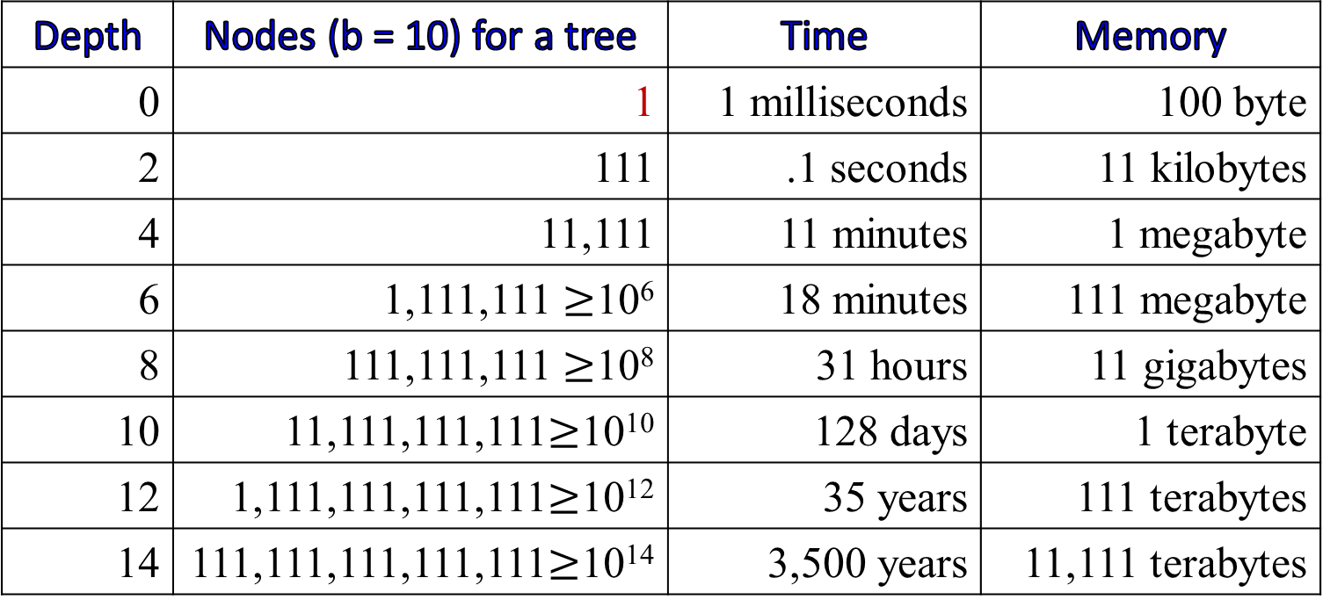
Analysis: Time and memory requirements for breadth-first search
See what happens with branching factor b=10
  Expand rate at 1 ms per node (i.e., roughly 10,000 nodes/second?)
  100 bytes/node
Depth | Nodes (b = 10) for a tree | Time | Memory
0 | 1 | 1 milliseconds | 100 byte
2 | 111 | .1 seconds | 11 kilobytes
4 | 11,111 | 11 minutes | 1 megabyte
6 | 1,111,111 $≥$10⁶ | 18 minutes | 111 megabyte
8 | 111,111,111 $≥$10⁸ | 31 hours | 11 gigabytes
10 | 11,111,111,111$≥$10¹⁰ | 128 days | 1 terabyte
12 | 1,111,111,111,111$≥$10¹² | 35 years | 111 terabytes
14 | 111,111,111,111,111$≥$10¹⁴ | 3,500 years | 11,111 terabytes

Slide 60
Analysis : Optimality of breadth-first search
Assume goal node at depth d with constant branching factor b
Features
  Simple to implement
  Breadth-first search is complete (if b is finite)
  Is it optimal (time and space)? It depends. (always find the shallowest goal)
  Finds shortest path solution (not necessarily least-cost unless all operators have equal cost)
    A breadth-first search always finds the shallowest goal state (a path with the least number of nodes from the root to this goal).
    The path to that goal state may have a cost higher than one to a deeper goal state.

Slide 61
Analysis : Optimality of breadth-first search
  Breadth-first search always finds the shallowest goal state.
  The path to that goal state may have a higher cost than one to a deeper goal state.
A
Cost of AC: 24
Cost of ABE: 10+8=18
10
24
B
C
11
8
If we are looking for least-cost solutions, breadth-first is suboptimal unless all step costs are identical.
Open List: change from A, then BC, and then C D E. C is generated and is a goal.
D
E
C | D | E

Slide 62
Uniform Cost Search (Branch&Bound)

Slide 63
Uniform Cost Search (Branch&Bound)
QueueingFn is SortByCostSoFar – (cost to reach each of the generated nodes from the root node)
Cost from root to current node n is g(n)
    Add operator/action-costs along the path
The first goal found is the least-cost solution
Space & time can be exponential because
Explore large subtrees with inexpensive steps before useful paths with costly steps
Time and space complexity are O(b^{d+1}) if costs are equal,
  otherwise, complexity related to cost of optimal solution

Slide 64
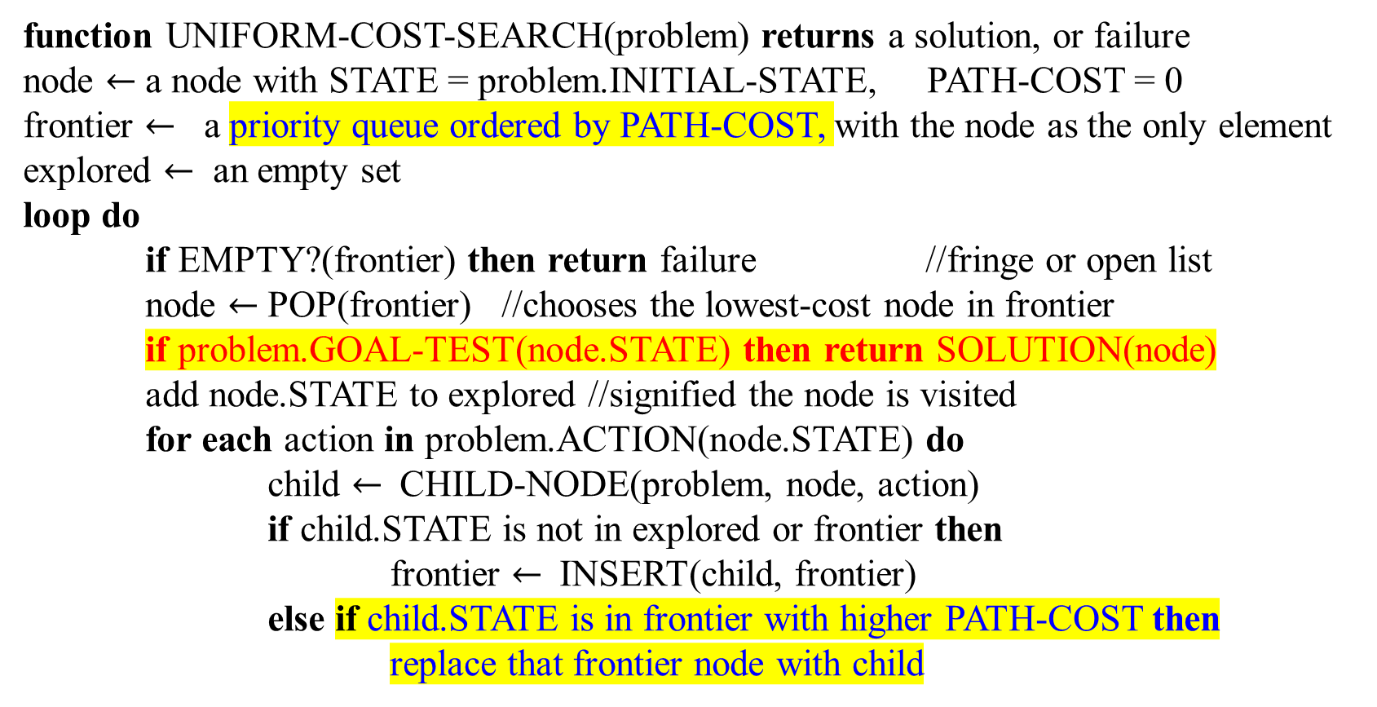
Uniform Cost Search
function UNIFORM-COST-SEARCH(problem) returns a solution, or failure
node $←$ a node with STATE = problem.INITIAL-STATE, PATH-COST = 0
frontier $←$ a priority queue ordered by PATH-COST, with the node as the only element
explored $←$ an empty set
loop do
if EMPTY?(frontier) then return failure //fringe or open list
node $←$ POP(frontier) //chooses the lowest-cost node in frontier
if problem.GOAL-TEST(node.STATE) then return SOLUTION(node)
add node.STATE to explored //signified the node is visited
for each action in problem.ACTION(node.STATE) do
child $←$CHILD-NODE(problem, node, action)
if child.STATE is not in explored or frontier then
frontier $←$INSERT(child, frontier)
else if child.STATE is in frontier with higher PATH-COST then
replace that frontier node with child
For comparison Goal Test conducts when the node is selected to expand, as well as replace the higher path-cost child.STATE
E, 4
D, 5; C, 5; E, 8; F, 9;
E, 4; D, 5; C, 5; F, 9;
Figure 3.14 Uniform-cost search on a graph

Slide 65
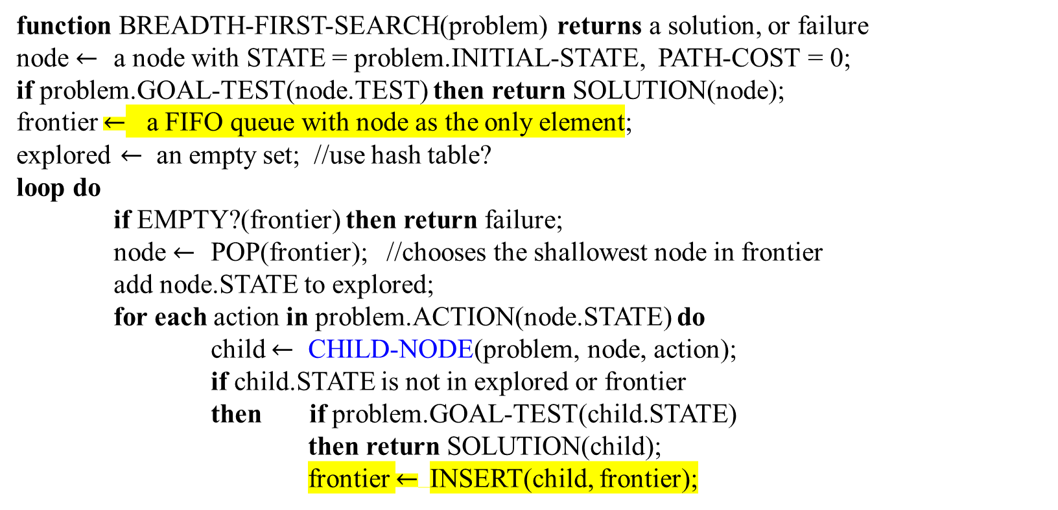
Breadth-First Search (BFS)
function BREADTH-FIRST-SEARCH(problem) returns a solution, or failure
node $←$ a node with STATE = problem.INITIAL-STATE, PATH-COST = 0;
if problem.GOAL-TEST(node.TEST) then return SOLUTION(node);
frontier $←$ a FIFO queue with node as the only element;
explored $←$ an empty set; //use hash table?
loop do
if EMPTY?(frontier) then return failure;
node $←$ POP(frontier); //chooses the shallowest node in frontier
add node.STATE to explored;
for each action in problem.ACTION(node.STATE) do
child $←$ CHILD-NODE(problem, node, action);
if child.STATE is not in explored or frontier
then if problem.GOAL-TEST(child.STATE)
then return SOLUTION(child);
frontier $←$INSERT(child, frontier);
For comparison Goal Test conducts when is first generating
open = QueuingFunction(open, Expand(state))
Figure 3.11 Breadth-first search on a graph

Slide 66
Tree Search Algorithms: a different version
function TREE_SEARCH( problem, strategy) returns a solution, or failure
initialize the search tree using the initial state of problem;
loop do
if there are no candidates for expansion //if the frontier is empty
then return failure
else
choose a leaf node for expansion according to strategy;
if the node contains a goal state
then return the corresponding solution
else
expand the node and add its successors to the tree;
done
For Tree Search Alg., the process is in the graph, but not the tree structure. No tree structure will be generated.
Fig 3.7 An informal description of the general tree-search algorithm.

Slide 67
Implementation: general tree-search
frontier and fringe are the same.
Problem can be represented in terms of graph, map, ...
Fig 3.7 A detailed description of the general tree-search algorithm.

Slide 68
Uniform Cost Search
The algorithm of Uniform-cost search given in Fig 3.14 is identical to the general graph search algorithm in Figure 3.7, except
for the use of a priority queue and
an extra check in case a shorter path to a frontier state is discovered.
The data structure for frontier needs to support efficient membership testing (GOAL-TEST),
it should combine the capabilities of a priority queue and a hash table.

Slide 69
Uniform Cost Search
UCS algorithm is optimal with any step-cost function:
  UCS expands the node n with the lowest path-cost g(n).
    Not expanding the shallowest node (by BFS).
    Storing the frontier as a priority queue ordered by g.
  The goal test is applied to a node when it is selected for expansion (priority queue)
    But not when it is first generated as in the algorithm (Fig 3.7)
    The reason is that the first goal node that is generated may be on a suboptimal path. (suboptimal goal is in the shallowest path)
  A test is added in case a better node is found to a node currently on the frontier. (see else if)

Slide 70
At Sibiu, find an optimal path for going from Sibiu to Bucharest.
At Sibiu, cost for (Sibiu, 99, Fagaras) and cost for (Sibiu, 80, RimnicuVilcea).
The least cost node Rimnicu Vilcea is expanded next. Pitesti is generated and cost for (RimnicuVilcea, 97, Pitesti). Then the path-cost g(Pitesti) is 80 + 97 = 177 from Sibiu, Rimnicu Vilcea to Pitesti..
Now the least path-cost g(Fagaras) is 99 in comparison with the path-cost(Pitesti) = 177. Thus, Fagaras is expanded and cost for (Fagaras, 211, Bucharest). The path-cost g(Bucharest) is 99 + 211 = 310 from Sibiu, then Fagaras and then Bucharest, which is goal state.
…continue
Since g(Pitesti) = 177 which is less than g(Bucharest) = 310, Pitesti is expanded and cost for (Pitesti, 101, Bucharest) is 177 + 101 = 278.
The algorithm checks to see if the new path-cost is better than the old one. It is. The old one is discard. Bucharest with g = 278 is selected for expansion and the solution is found.
99
80
211
97
140
101
138

Slide 71
S, g(S)
RV, g(RV) = g(s) + 80; F, g(F) = g(S) + 99;
F, g(F) = g(S) + 99; P, g(P) = g(S) + 80 + 97; C, g(C) = g(S) + 80 + 102;
P, g(P) = g(S) + 80 + 97; C, g(C) = g(S) + 80 + 102; B, g(B) = g(S) + 99 + 211;
C, g(C) = g(S) + 80 + 142 (vs g(C) = g(S) + 80 + 97 + 138); B, g(B) = g(S) + 80 + 97 + 101;
P has been visited before. No generated node with path-cost
g(B) = g(S) + 80 + 97 + 101;

Slide 72

Uniform-cost search
Assumption:
A path cost function g such that g(p) - g(p′) ≥ ε > 0 for all paths p and proper subpaths p′ of p
Strategy: Expand least-cost unexpanded node
Implementation:
  fringe = priority queue ordered by path cost
Equivalent to breadth-first if step costs all equal
A(B, C, …, F), the step costs for AB, AC, … AF are equal. These are true for all depths.

Slide 73

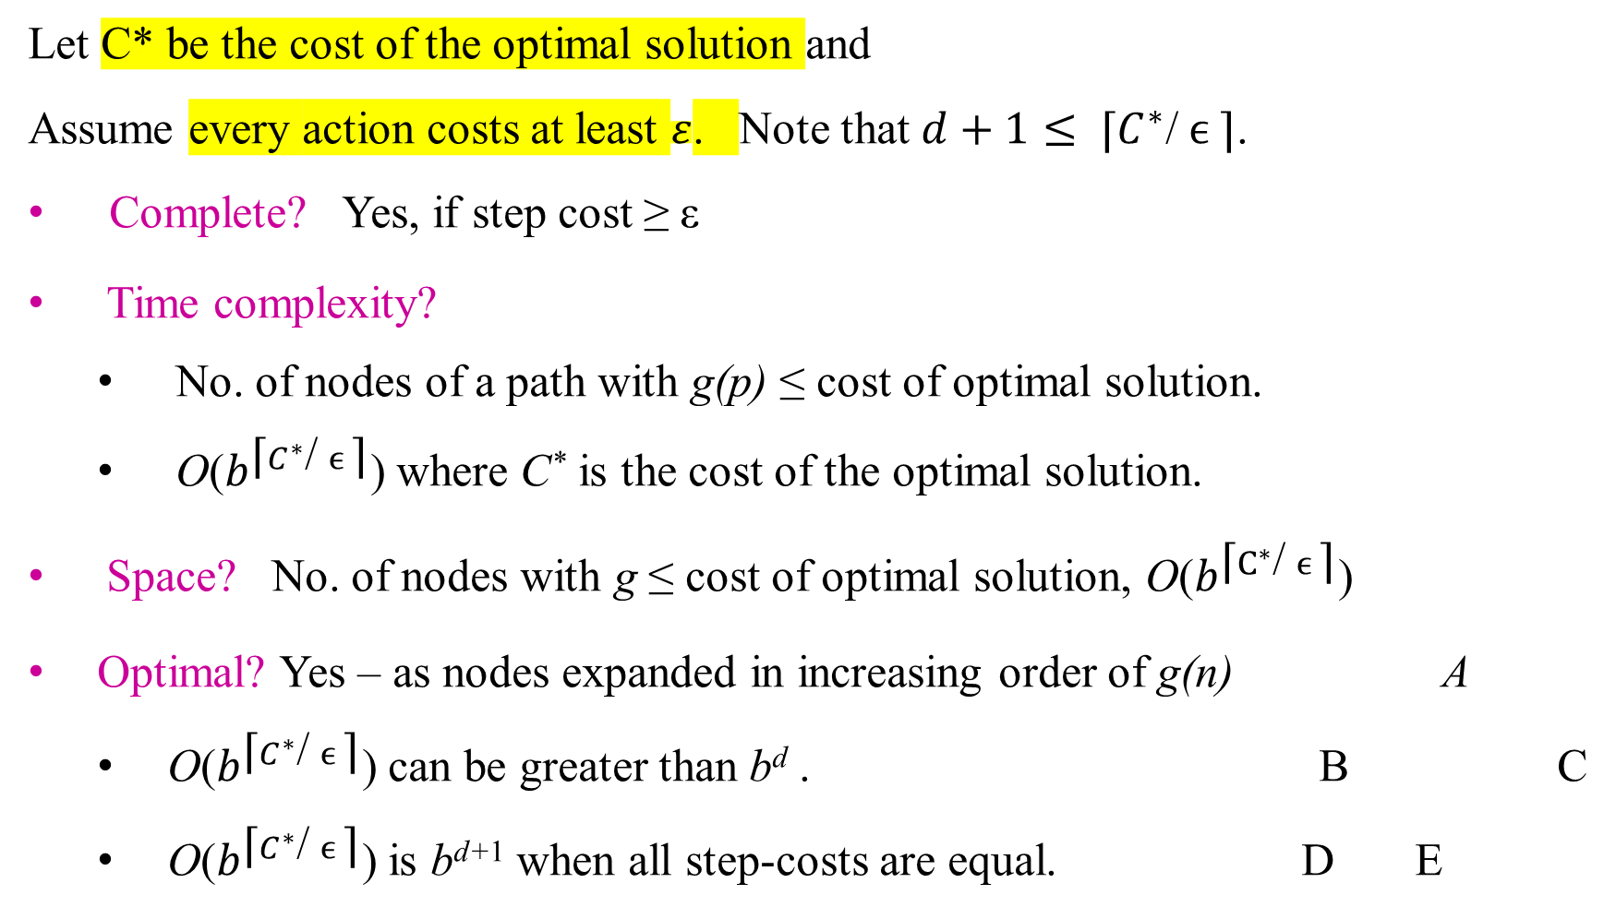
Uniform-cost search
Let C* be the cost of the optimal solution and
Assume every action costs at least $ε$. Note that $d+1≤ \text{⌈}C^{∗}\text{/} ϵ \text{⌉}\text{.}$
Complete? Yes, if step cost ≥ ε
Time complexity?
  No. of nodes of a path with g(p) ≤ cost of optimal solution.
  O($b^{\text{⌈}C^{∗}\text{/} ϵ \text{⌉}}\text{)}$where C* is the cost of the optimal solution.
Space? No. of nodes with g ≤ cost of optimal solution, O($b^{\text{⌈}C^{∗}\text{/} ϵ \text{⌉}}\text{)}$
Optimal? Yes – as nodes expanded in increasing order of g(n) A
  O($b^{\text{⌈}C^{∗}\text{/} ϵ \text{⌉}}\text{)}$ can be greater than b^{d} . B C
  O($b^{\text{⌈}C^{∗}\text{/} ϵ \text{⌉}}\text{)}$ is b^{d+1} when all step-costs are equal. D E
Assume the C is at depth d.
O(b^{d+1}) nodes

Slide 74
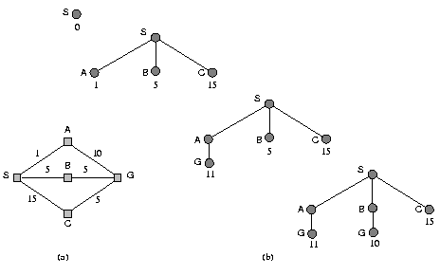

Uniform-Cost Search: Example
Find the cheapest route from S to G.
S(0) |  |  |  | Front
A(1) | B(5) | C(15)
B(5) | G(11) | C(15)
G(10) | C(15)
C(15)
S(0) |  |  |  | Expl
S(0) | A(1)
S(0) | A(1) | B(5)
S(0) | A(1) | B(5)
S
A
1
B
5
C
15
G
11
G
10

Slide 75

$$←$$
node = S(0)S( )
F: {S(0)S( ) } //node S with STATE
E: { }
Loop do
F is not empty.
Pop F, F = { }, and node = S(0)
GT(S( )) fail
E: {S( ) }
For each action in problem:
{goTo(A( )), goTo(B ( ), goTo(C ( )}
For goTo(A( )):
child = CHILD-NODE(pbm, S, goTo(A( ))
child A(1) is not in E or F (true)
F = { A(1) };
For goTo(B( )):
child = CHILD-NODE(pbm, S, goTo(B( ))
child B(5) is not in E or F (true)
F = { A(1), B(5) };
For goTo(C( )):
child = CHILD-NODE(pbm, S, goTo(C( ))
child C(15) is not in E or F (true)
F = { A(1), B(5), C(15) };
Loop do
F is not empty.
Pop F, F = {B(5), C(15) }, and node = A(1)
GT(A( )) fails
E: { S( ), A( ) }
For each action in problem:
{goTo(S( )), goTo(G( ))
For goTo(S( )):
child = CHILD-NODE(pbm, A, goTo(S( ))
child S(2) is not in E or F (false, S is in E)
Else if S(2) is in F(false);
For goTo(G( )):
child = CHILD-NODE(pbm, A, goTo(G( ))
child G(11) is not in E or F (true)
F = {B(5), G(11), C(15) };
F is not empty.
Pop F, F = {G(11), C(15) } and node = B(5)
GT(B(5)) fails
E: { S( ), A( ), B( )}
For each action in problem:
{goTo(S( )), goTo(G( ))

Slide 76
For goTo(S( )):
child = CHILD-NODE(pbm, B, goTo(S( ))
child S(10) is not in E or F (false, S is in E)
Else if S(10) is in F(false);
For goTo(G( )):
child = CHILD-NODE(pbm, B, goTo(G( ))
child G(10) is not in E or F (false)
Else if G is in F with G(11)
F = {G(10)G(11), C(15) };

Slide 77
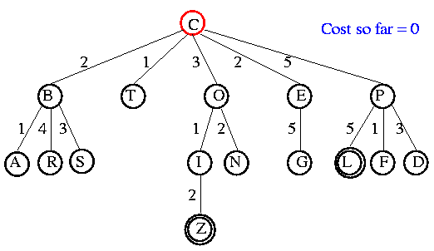
Uniform-Cost Search: Another Example
R(expand/firstVisited)
G(generate_n_Sort(openList))
B(completed)
3 | C |  |  | Exp
1 | C(0) |  |  |  |  |  |  | OpL
2
OpL not empty, pop, GOAL_TEST, explored
Open list: C

Slide 78
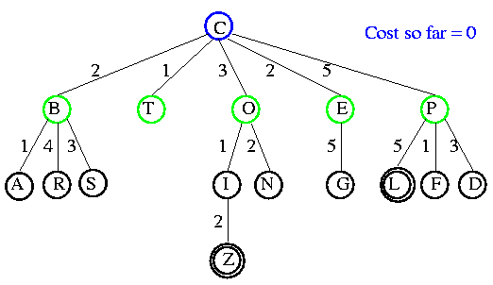
Uniform-Cost Search: Another Example
3 | C
1 | C(0) |  |  |  |  |  |  | Open
2
4 | T(1) | B(2) | E(2) | O(3) | P(5)
For each action in pbm, generate, and arrange
Open list: B(2) T(1) O(3) E(2) P(5)

Slide 79
UCS Example
Open list: T(1) B(2) E(2) O(3) P(5)

Slide 80
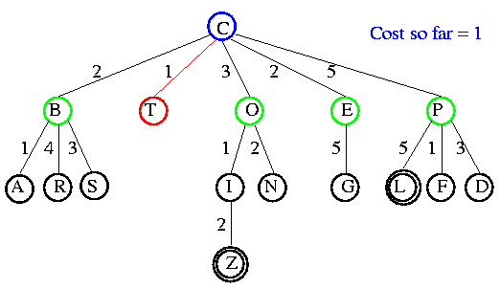
UCS Example
1 | C(0)
2
4 | T(1) | B(2) | E(2) | O(3) | P(5)
5 | T(1) | B(2) | E(2) | O(3) | P(5)
6 |  | B(2) | E(2) | O(3) | P(5)
3 | C
7 | C | T
Open list: B(2) E(2) O(3) P(5)

Slide 81
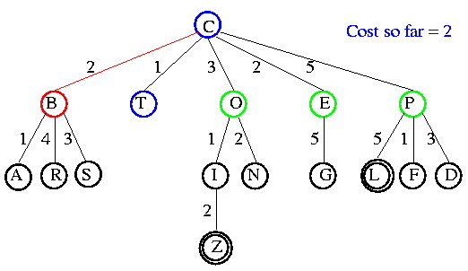
UCS Example
8 | B(2) | E(2) | O(3) | P(5)
9 |  | E(2) | O(3) | P(5)
Open list: E(2) O(3) P(5)

Slide 82
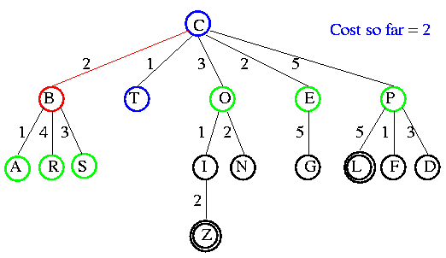
UCS Example
3 | C
7 | C | T
10 | C | T | B
8 | B(2) | E(2) | O(3) | P(5)
9 |  | E(2) | O(3) | P(5)
11 | E(2) | O(3) | A(3) | S(5) | P(5) | R(6)
Open list: E(2) O(3) A(3) S(5) P(5) R(6)

Slide 83
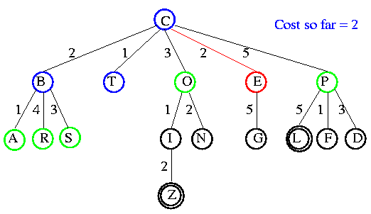
UCS Example
3 | C
7 | C | T
10 | C | T | B
13 | C | T | B | E
8 | B(2) | E(2) | O(3) | P(5)
9 |  | E(2) | O(3) | P(5)
11 | E(2) | O(3) | A(3) | S(5) | P(5) | R(6)
12 |  | O(3) | A(3) | S(5) | P(5) | R(6)
Open list: O(3) A(3) S(5) P(5) R(6)

Slide 84
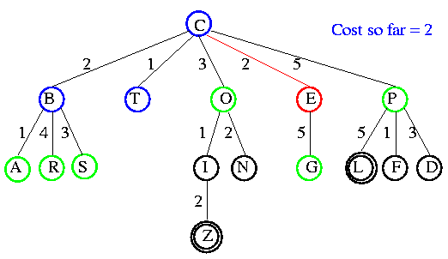
UCS Example
3 | C
7 | C | T
10 | C | T | B
13 | C | T | B | E
8 | B(2) | E(2) | O(3) | P(5)
9 |  | E(2) | O(3) | P(5)
11 | E(2) | O(3) | A(3) | S(5) | P(5) | R(6)
12 |  | O(3) | A(3) | S(5) | P(5) | R(6)
14 | O(3) | A(3) | S(5) | P(5) | R(6) | G(7)
Open list: O(3) A(3) S(5) P(5) R(6) G(7)

Slide 85
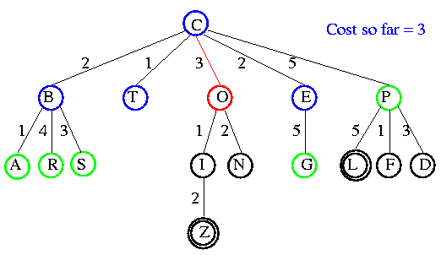
UCS Example
Open list: A(3) S(5) P(5) R(6) G(7)

Slide 86
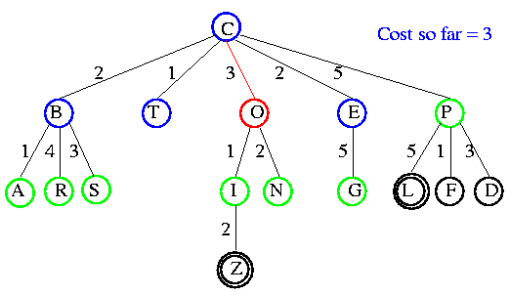
UCS Example
3 | C
7 | C | T
10 | C | T | B
13 | C | T | B | E | O
Open list: A(3) I(4) S(5) N(5) P(5) R(6) G(7)

Slide 87
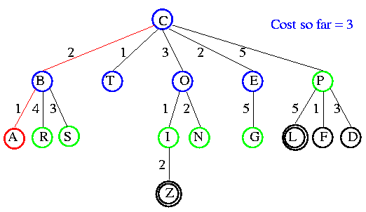
UCS Example
C | T | B | E | O | A
Open list: I(4) P(5) S(5) N(5) R(6) G(7)

Slide 88
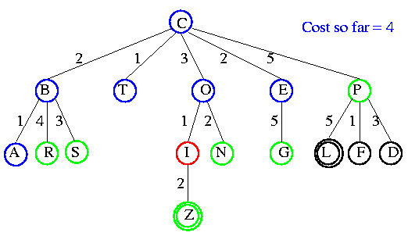
UCS Example
C | T | B | E | O | A | I
Open list: P(5) S(5) N(5) R(6) Z(6) G(7)

Slide 89
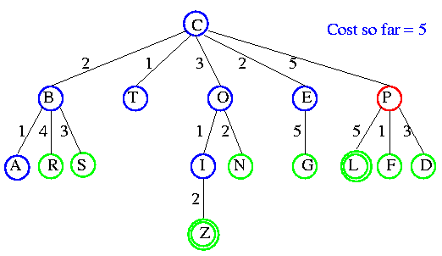
UCS Example
C | T | B | E | O | A | I | P
Open list: S(5) N(5) R(6) Z(6) F(6) G(7) D(8) L(10)

Slide 90
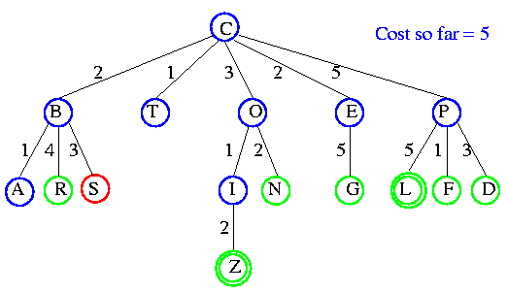
UCS Example
C | T | B | E | O | A | I | P | S
Open list: N(5) R(6) Z(6) F(6) G(7) D(8) L(10)

Slide 91
UCS Example
N
C | T | B | E | O | A | I | P | S | N
Open list: R(6) Z(6) F(6) G(7) D(8) L(10)

Slide 92
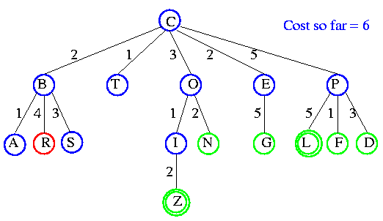
UCS Example
N
C | T | B | E | O | A | I | P | S | N | R
Open list: Z(6) F(6) G(7) D(8) L(10)

Slide 93
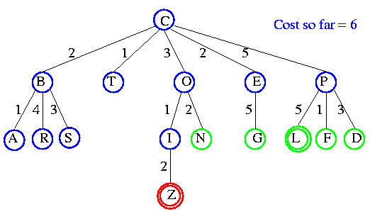
UCS Example
N
C | T | B | E | O | A | I | P | S | N | R
Open list: F(6) D(8) G(7) L(10)

Slide 94
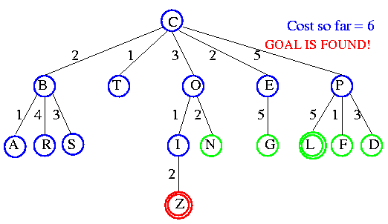
UCS Example
N

Slide 95
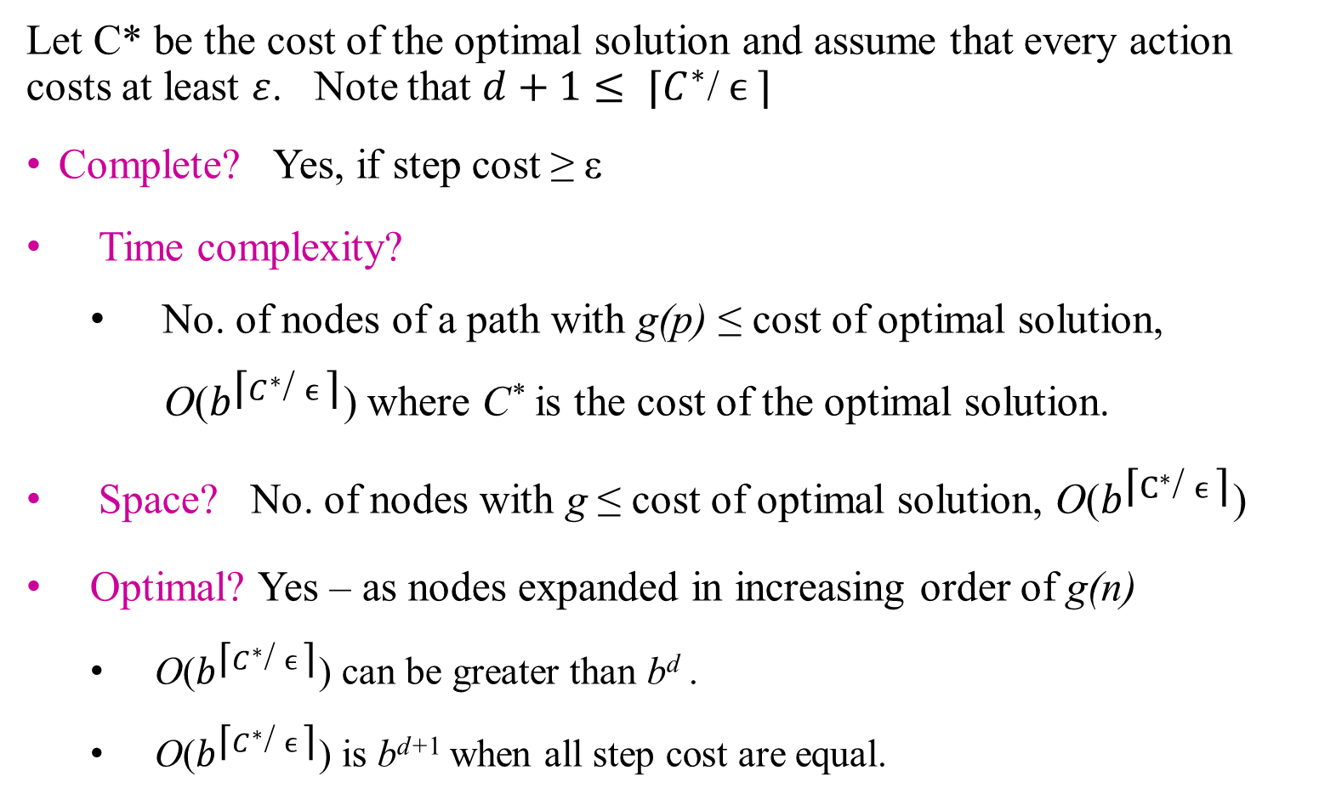
Uniform-cost search
Let C* be the cost of the optimal solution and assume that every action costs at least $ε$. Note that $d+1≤ \text{⌈}C^{∗}\text{/} ϵ \text{⌉}$
Complete? Yes, if step cost ≥ ε
Time complexity?
  No. of nodes of a path with g(p) ≤ cost of optimal solution,
  O($b^{\text{⌈}C^{∗}\text{/} ϵ \text{⌉}}\text{)}$where C* is the cost of the optimal solution.
Space? No. of nodes with g ≤ cost of optimal solution, O($b^{\text{⌈}C^{∗}\text{/} ϵ \text{⌉}}\text{)}$
Optimal? Yes – as nodes expanded in increasing order of g(n)
  O($b^{\text{⌈}C^{∗}\text{/} ϵ \text{⌉}}\text{)}$ can be greater than b^{d} .
  O($b^{\text{⌈}C^{∗}\text{/} ϵ \text{⌉}}\text{)}$ is b^{d+1} when all step cost are equal.
some nodes at d+1 depth are expanded before gold node is found at d
O(b^{d+1}) nodes

Slide 96
Uniform-Cost Search: Example
Exercise: For “Fig 3.2 A simple road map of part of Romania,” find a cheapest route from Sibiu to Bucharest. Use Path cost = sum of step costs.
Fig 3.2 is provided in the next slide.

Slide 97
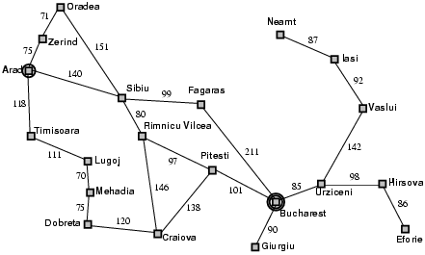
Example: Fig 3.2 A simple road map of part of Romania

Slide 98
Uniform-Cost Search: Example – Path cost = sum of step costs. Exercise: Find cheapest route from Sibiu to Bucharest.
BFS
A
Z
S
T
A
O
A
0
R
F
A
L
Z
S
S
P
C
S
B
T
M
R
C
B
R
P
D

Slide 99
Uniform-Cost Search: Example – Path cost = sum of step costs. Exercise: Find cheapest route from Sibiu to Bucharest.
UCS
A
g(Z)=75
Z
g(S)=140
S
T
g(T)=118
g(O)=291
g(F)=239
g(L)=229
g(O)=146
g(R)=220
A
O
A
0
R
F
A
L
g(O)=297
g(P)=317
g(C)=366
g(B)=450
g(M)=299
Z
S
S
P
C
S
B
T
M
g(F)=396
g(B)=408
g(R)=377
g(C)=455
g(P)=504
g(D)=486
g(D)=374
R
F
R
C
B
R
P
D
D
g(P)=474
g(B)=607
g(D)=497
P
B
C

Slide 100
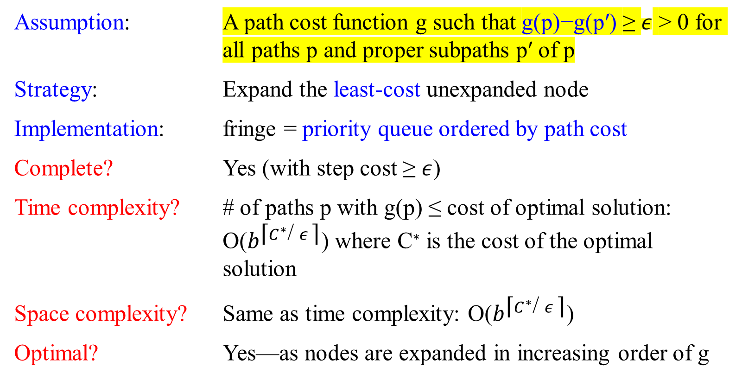
Properties of Uniform-Cost Search
Assumption: A path cost function g such that g(p)−g(p′) ≥ $ε$ > 0 for all paths p and proper subpaths p′ of p
Strategy: Expand the least-cost unexpanded node
Implementation: fringe = priority queue ordered by path cost
Complete? Yes (with step cost ≥ $ε$)
Time complexity? # of paths p with g(p) ≤ cost of optimal solution: O($b^{\text{⌈}C^{∗}\text{/} ε \text{⌉}}$) where C∗ is the cost of the optimal solution
Space complexity? Same as time complexity: O($b^{\text{⌈}C^{∗}\text{/} ε \text{⌉}}$)
Optimal? Yes—as nodes are expanded in increasing order of g

Slide 101

Comparison of Search Techniques
m is the maximum length of any path in the state space;
d is the depth of the shallowest goal node (the number of steps along the path from the root).
b is the branching factor, the maximum number of successors of any node .
 | DFS | BFS | UCS
Complete | N | Y | Y
Optimal | N | N | Y
Heuristic | N | N | N
Time | b^{m} | b^{d+1} | b^{m}
Space | bm | b^{d+1} | b^{m}

Slide 102
Depth-First Search (DFS)
Expand root node
Repeat,
Expand node at deepest level of tree
Warning:
There are two implementations which produce different results
  Recursive one
  Using a stack

Slide 103
Recursive DFS
Boolean recDFS(node X) {
markAsFound(X);
if isGoal(X) return true
for each node Y in myNeighbors(X)
if (not found(Y))
if (recDFS(Y)) return true ;
// markAsFinished(X);
return false;
}

Slide 104
DFS on graph
function Graph-SEARCH(problem) returns a solution, or failure
initialize the frontier (LIFO stack) using the initial state of the problem;
initialize the explored set to be empty;
loop do
if the frontier is empty then return failure;
choose a node from top(frontier);
if the node contains a goal state
then return the corresponding solution;
expand the chosen node; //according to actions
add the node to the explored set;
adding (generating) the resulting nodes to the frontier
only if any resulting node is not in the explored set;
if all these generated resulting nodes of the chosen node are in the explored set
then remove the chosen node from the frontier;

Slide 105
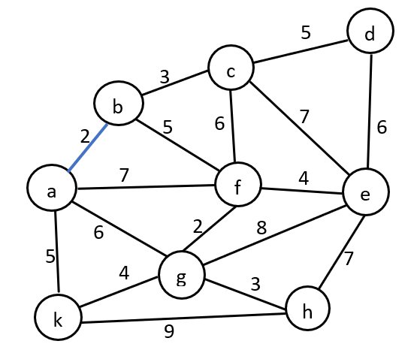
a | b | f | g | k
b | a | f | c
c | b | d | e | f
d | c | e
e | g | f | c | d
f | a | b | c | e | g
g | a | e | f | h | k
h | g | e
k | a | g | h

Slide 106
a
ExploreSet = a
k g f b
ExploreSet = a k
h g
ExploreSet = a k h
e g
ExploreSet = a k h e
d c f g Frontier = bfgk / bfggh / bfggge / bfggggfcd /bfgggfcc /bfgggfcbf/
bfgggfcbbg/bfgggfcbb/bfgggfcb
ExploreSet = a k h e d
c e
ExploreSet = a k h e d c
f b ExploreSet = a k h e d c f g b
ExploreSet = a k h e d c f
g b ExploreSet = a k h e d c f g

Slide 107
a
?Q
k g f b
h g
e g
d c f g Frontier = bfgk / bfggh / bfggge / bfggggfcd /bfgggfcec /bfgggfcebf/
bfgggfcebbg/bfgggfcebb/bfgggfceb
c e
f b ExploreSet = a k h e d c f g b
g b

Slide 108
Depth-First Search (DFS)
QueueingFn adds the children to the front of the open list
BFS emulates FIFO queue
DFS emulates LIFO stack
Net effect
  Follow leftmost path to bottom, then backtrack
  Expand deepest node first
The following viewgraphs is Figure 3.16. Depth-first search on a binary tree.
  The unexplored region is shown in light green.
  Explored nodes with no descendants in the frontier are removed from memory.
  Nodes at depth 3 (i.e., at level 4) have no successors and M is the only goal node.

Slide 109
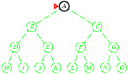
Depth-first (tree) search
Strategy: Expand deepest unexpanded node
Implementation: fringe = LIFO stack, i.e., put successors at front
Open List (LIFO stack)
W | A
M

Slide 110
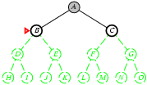
Depth-first search
Strategy: Expand deepest unexpanded node
Implementation: fringe = LIFO queue, i.e., put successors at front
W | B
W | C
G | A

Slide 111
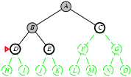
Depth-first search
Strategy: Expand deepest unexpanded node
Implementation: fringe = LIFO queue, i.e., put successors at front
W | D
W | E
G | B
W | C
G | A

Slide 112
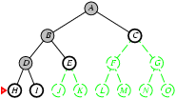
Depth-first search
Strategy: Expand deepest unexpanded node
Implementation: fringe = LIFO queue, i.e., put successors at front
W | H
W | I
G | D
W | E
G | B
W | C
G | A

Slide 113
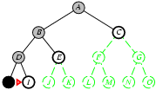
Depth-first search
Strategy: Expand deepest unexpanded node
Implementation: fringe = LIFO queue, i.e., put successors at front
G/B | H
W | I
G | D
W | E
G | B
W | C
G | A
W | I
G | D
W | E
G | B
W | C
G | A
H
Black circles indicate that nodes have been removed from the memory LIFO stack.

Slide 114
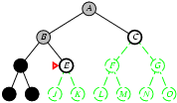
Depth-first search
Strategy: Expand deepest unexpanded node
Implementation: fringe = LIFO queue, i.e., put successors at front
G/B | D
W | E
G | B
W | C
G | A
G/B | I
G | D
W | E
G | B
W | C
G | A
W | E
G | B
W | C
G | A
D
H
I

Slide 115
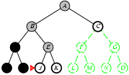
Depth-first search
Strategy: Expand deepest unexpanded node
Implementation: fringe = LIFO queue, i.e., put successors at front
W | J
W | K
G | E
G | B
W | C
G | A
D
H
I

Slide 116
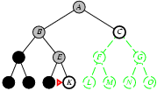
Depth-first search
Strategy: Expand deepest unexpanded node
Implementation: fringe = LIFO queue, i.e., put successors at front
G/B | J
W | K
G | E
G | B
W | C
G | A
D
W | K
G | E
G | B
W | C
G | A
H
I
J

Slide 117
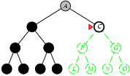
Depth-first search
Strategy: Expand deepest unexpanded node
Implementation: fringe = LIFO queue, i.e., put successors at front
W | C
G | A
B
G/B | K
G | E
G | B
W | C
G | A
B | E
G | B
W | C
G | A
B | B
W | C
G | A
D
E
H
I
J
K

Slide 118
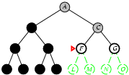
Depth-first search
Strategy: Expand deepest unexpanded node
Implementation: fringe = LIFO queue, i.e., put successors at front
B
B | B
W | C
G | A
W | F
W | G
G | C
G | A

Slide 119
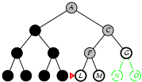
Depth-first search
Strategy: Expand deepest unexpanded node
Implementation: fringe = LIFO queue, i.e., put successors at front
W | L
W | M
G | F
W | G
G | C
G | A

Slide 120
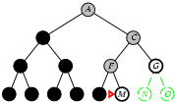
Depth-first search
Strategy: Expand deepest unexpanded node
Implementation: fringe = LIFO queue, i.e., put successors at front
G/B | L
W | M
G | F
W | G
G | C
G | A
W | M
G | F
W | G
G | C
G | A
L

Slide 121

Analysis: Properties of depth-first search
Complete?
  No: fails in infinite-depth spaces, spaces with loops
  Modify to avoid repeated states along path
    → Complete (Yes) in finite spaces
Time Complexity
  Goal may be at level d but tree may continue to level m, m $≥$d
  O(b^{m}), terrible if m $≫$d
  In the worst case, search entire space
    Particularly bad if tree is infinitely deep
  If solutions are dense, it may be much faster than breadth-first

Slide 122
Analysis: Properties of depth-first search
Space Complexity:
  Only need to save one set of children at each level
  1 + b + b + … + b (m levels total) = O(bm),
  i.e., linear space!
Optimal? :
  No, not always can find the optimal cost.

Slide 123
Analysis: Properties of depth-first search
Benefits
  May not always find solution
  Solution is not necessarily shortest path or least cost
  If many solutions, may find one quickly (quickly moves to depth d)
  Simple to implement
  For space, BFS often bigger constraint; but DFS is more usable than BFS for large problems
  A variant of depth-first search called backtracking search

Slide 124
Analysis: Properties of depth-first search
Benefits
  A variant of depth-first search called backtracking search
    Only one successor is generated at a time rather than all successors;
    each partially expanded node remembers which successor to generate next.
    Only O(m) memory is needed rather than O(bm).

Slide 125
Comparison of Search Techniques
Denote that
m is the maximum length of any path in the state space;
d is the depth of the shallowest goal node (the number of steps along the path from the root).
b is the branching factor, the maximum number of successors of any node .
 | DFS | BFS | UCS
Complete | N | Y | Y
Optimal | N | N | Y
Heuristic | N | N | N
Time | b^{m} | b^{d+1} | b^{m}
Space | bm | b^{d+1} | b^{m}

Slide 126


Depth-limited search
b^{m} $≅$ 2⁴
Let m be the maximum depth of any node, and d be the depth of the shallowest solution.
The depth-first tree search fails if the state space is infinite.
  generate all of the O(b^{m} ) nodes in the search tree.
    much greater than the size of the state space (the graph).
  m $≫$d .
  m is infinite if the tree is unbounded.
Depth-limited search is the depth-first search with a predetermined depth limit ℓ.
  Could overcome the failure of DFS.
  The depth-limit solves the infinite-path problem for DFS.

Slide 127

Depth-limited search
The depth-limited search introduces incompleteness:
  where the shallowest goal d is likely unknown.
  when we choose ℓ < d, (i.e., the shallowest goal located beyond the depth limit).
Depth-limit search will be nonoptimal if we choose ℓ < d .
Its time complexity is O(b^{ℓ} ).
Its space complexity is O(b ℓ ) .
DFS is a special case of depth-limited search with ℓ = $∞$.

Slide 128

Depth-limited search
Represent a pbm in terms of a graph with state spaces
function DEPTH-LIMITED-SEARCH(problem, limit) returns a solution, or failure/cutoff
return RECURSIVE-DLS(MAKE-NODE(problem.INITIAL-STATE), problem, limit)
end function
function RECURSIVE-DLS(node, problem, limit) returns a solution, or failure/cutoff
if problem.GOAL-TEST(node.STATE) then return SOLUTION(node)
else if limit = 0 then return cutoff
else
cutoff_occurred? $←$ false
for each action in problem.ACTION(node.STATE) do
child $←$ CHILD-NODE(problem, node, action)
result $←$ RECURSIVE-DLS(child, problem, limit – 1)
if result = cutoff then cutoff_occurred? $←$ True
else if result $≠$ failure then return result
if cutoff_occurred? then return cutoff else return failure
Figure 3.17 A recursive implementation of depth-limited tree search

Slide 129
Depth-limited search: a different version
= depth-first search with depth limit ℓ. i.e., nodes at the depth ℓ have no successors
A recursive implementation of depth-limited tree search:
function Depth-Limited-Search (problem, limit) return soln/fail/cutoff
return Recursive-DLS(Make-Node(Initial-State(problem)), problem, limit)
end function
function Recursive-DLS (node, problem, limit) return soln/fail/cutoff
cutoff-occurred := false;
if (Goal-State(problem, State(node))) then return node;
else if (Depth(node) == limit) then return cutoff;
else for each successor in Expand(node, problem) do
result := Recursive-DLS(successor, problem, limit)
if (result == cutoff) then cutoff-occurred := true;
else if (result != fail) then return result;
end for
if (cutoff-occurred) then return cutoff; else return fail;
end function

Slide 130
Avoiding Repeated States
Can we do it?
Do not return to parent or grandparent state
  In 8 puzzle, do not move up right after down
Do not create solution paths with cycles
Do not generate repeated states
  (need to store and check potentially large number of states)

Slide 131

Maze Example
States are cells in a maze
Move N, E, S, or W
What would BFS do (expand E, then N, W, S)?
What would DFS do?
What if order changed to N, E, S, W and loops are prevented?

Slide 132
Iterative deepening depth-first search
(Iterative deepening search)

Slide 133

Iterative Deepening Search
DFS with depth bound
QueuingFn is enqueue at front as with DFS
  Expand(state) only returns children such that depth(child) $≤$ threshold
    This prevents search from going down infinite path
First threshold is 1
  If do not find solution, increment threshold and repeat

Slide 134

Iterative deepening search
function ITERATIVE-DEEPENING-SEARCH (problem) return solution, or failure
input: problem, a problem
for depth = 0 to $∞$ do
result := DEPTH-LIMITED-SEARCH(problem, depth)
if (result $≠$ cutoff) then return result
Figure 3.18 The iterative deepening search algorithm, which repeatedly applies depth-limited search with increasing limits. It terminates when a solution is found or if the depth-limited search returns failure, meaning that no solution exists.

Slide 135
Iterative deepening search: a different version
function Iterative-Deepening-Search (problem) return soln
for limit from 0 to MAX-INT do
result := Depth-Limited-Search(problem, limit)
if (result != cutoff) then return result
end for
end function

Slide 136

Iterative Deepening Search : Examples
Fig 3.19 Four iterations of iterative deepening search on a binary tree.
Black circles indicate nodes have been removed from memory.

Slide 137

Iterative Deepening Search: Examples

Slide 138

Iterative Deepening Search: Examples

Slide 139
Iterative Deepening Search Examples

Slide 140
Iterative deepening search - Analysis
Iterative deepening search (IDS) requires that states are generated multiple times, but is not too costly.
  In a search tree with branching factor, say, b at each level, most of the nodes are in the bottom level.
    It does not matter much that the upper levels are generated multiple times.
  In the IDS, the nodes on the bottom level (depth d) are generated once, those on the next-to-bottom level are generated twice, and so on, up to the children of the root, which are generated (d + 1) times.
    Thus, the total number of nodes generated in the worst case is
N_{IDS} = (d+1)b⁰ + d b¹ + (d-1)b² + … + 3b^{d-2} +2b^{d-1} + 1b^{d}
    which gives a time complexity of O(b^{d})

Slide 141
Iterative deepening search - Analysis
Number of nodes generated in a DLS to depth d with branching factor b:
N_{DLS} = b⁰ + b¹ + b² + … + b^{d-2} + b^{d-1} + b^{d} = O(b^{d+1})
Number of nodes generated in an IDS to depth d with branching factor b:
N_{IDS} = (d+1)b⁰ + d b¹ + (d-1)b² + … + 3b^{d-2} +2b^{d-1} + 1b^{d} = O(b^{d})
For b = 10, d = 5,
  N_{DLS} = 1 + 10 + 100 + 1,000 + 10,000 + 100,000 = 111,111
  N_{IDS} = 6 + 50 + 400 + 3,000 + 20,000 + 100,000 = 123,456
Overhead = (123,456 - 111,111)/111,111 = 11%

Slide 142
Iterative deepening search - Analysis
Numerical comparison between IDS and BFS:
Assume b = 10, d = 5, and solution at ”far right” of search tree:
For b = 10, d = 5,
  N_{BFS} = 10 + 100 + 1,000 + 10, 000 + 100,000 + 999,990 = 1,111,100
  N_{IDS} = 6 + 50 + 400 + 3,000 + 20,000 + 100,000 = 123,456
IDS is actually faster than BFS!
because other nodes at depth d are not expanded

Slide 143
Analysis – Properties of Iterative deepening search
What about the repeated work?
Time complexity (number of generated nodes)
  [b] + [b + b²] + .. + [b + b² + .. + b^{d}]
  (d)b + (d-1) b² ⁺ … + (1) b^{d} = O(b^{d})
  Iterative deepening search uses only linear space and not much more time than other uninformed algorithms
  In general, when the search space is large and the depth of the solution is not known, iterative deepening is the preferred uniformed search method.

Slide 144
Properties of iterative deepening search
Complete? Yes
Time? (d+1)b⁰ + d b¹ + (d-1)b² + … + b^{d} = O(b^{d})
Space? O(bd)
Optimal? Yes, if step cost = 1

Slide 145

Analysis
Repeated work is approximately 1/b of total work:
  Negligible
  Example: b=10, d=5
    N_{BFS} = 1,111,100
    N_{IDS} = 123,456 ($≅\text{1,111,100}\text{/10)}$
Features
  Shortest solution, not necessarily least cost
  Is there a better way to decide threshold? (IDA*)

Slide 146
Comparison of Search Techniques
 | DFS | BFS | UCS | IDS
Complete | N | Y | Y | Y
Optimal | N | N | Y | N
Heuristic | N | N | N | N
Time | b^{m} | b^{d+1} | b^{m} | b^{d}
Space | bm | b^{d+1} | b^{m} | bd

Slide 147
Summary of algorithms
Criterion | Breadth- Uniform- Depth- Depth- Iterative First Cost First Limited Deepening
Complete? Time Space Optimal? | Yesª Yesª, ^{b} No Yes, if l ≥ d Yesª O(b^{d+1}) O( b^{⌈ C*/ ε ⌉} ) O(b^{m}) O(b^{l} ) O(b^{d}) O(b^{d+1}) O( b^{⌈ C*/ ε ⌉} ) O(b^{m} O(b^{l} ) O(b^{d}) Yes^{c} Yes No No Yes^{c}
b, branching factor d, depth of shallowest solution l, depth limit
m, depth of search tree C∗, cost of optimal solution
ª if b is finite
^{b} is step costs > ∊ for some ∊ > 0
^{c} is all step costs are the same

Slide 149

Repeated states
Failure to detect repeated states can turn a linear problem into an exponential one!

Slide 150
Repeated states - continued
Failure to detect repeated states can turn a linear problem into an exponential one!

Slide 151

Graph search
Fig 3.7 An informal description of the general graph-search algorithm.

Slide 152
Implementation: general tree search

Slide 153
Summary
Problem formulation usually requires abstracting away real-world details to define a state space that can feasibly be explored
Variety of uninformed search strategies
Iterative deepening search uses only linear space and not much more time than other uninformed algorithms
End?

Slide 155
Bidirectional Search
to reduce the search time

Slide 156



Bidirectional Search
Two simultaneous search: Begin search form both direction simultaneously, using such as BFS/DFS;
Search forward from initial state to goal AND search backward from goal state to initial state
Hoping that the two searches meet in the middle (Figure 3.20).
The motivation: that O($b^{d/2}$ + $b^{d/2}$) is much less than O($b^{d}$).
The area of two circles is less than the area of one big circle centered on the start and reaching to the goal.
Figure 3.20 A schematic view of a bidirectional search that is about to succeed when a branch from the start node meets a branch from the goal node.

Slide 157
Bidirectional Search
Instead using the goal test,
Implement a check to see whether the two search frontiers intersect (i.e., the same node to be visited next or to be expanded); if they do, a solution has been found.
  The algorithm can reconstruct a single path that extends from the start state through the frontier intersection to the goal.
  The check will take constant time, when each node is generated or selected for expansion with a hash table.
The first such solution found may not be optimal, even if the two searches are both breadth-first. Additional search is required to make sure there isn’t another short-cut across the gap.

Slide 158
Bidirectional Search
Completeness : Bidirectional search is complete if BFS is used in both searches.
Optimality : It is optimal if BFS is used for search and paths
have uniform cost

Slide 159

Bidirectional Search
For example:
Let a problem’s solution be at depth d = 6. Assume that each direction runs breadth-first search one node at a time, and in the worst case the two searches meet when they have generated all of the nodes at depth 3.
  For b = 10, compare a total of 2,220 (i.e., 2*(10¹ + 10²+ 10³)) node generations for a bidirectional search,
  with 1,111,110 ($\sum_{i=1}^{i=6}{{10}^{i}}$) for a standard breadth-first search.
The time complexity of bidirectional search using breadth-first search in both direction is ${ O(b}^{d/2}).$
The space complexity is also ${ O(b}^{d/2}).$

Slide 160
Bidirectional Search
Can prune many options
  Time and space is O(b^{d/2}),
  if two BFS searches are used
Considerations
  Which goal state(s) to use?
  How determine when searches overlap?
  Which search to use for each direction?

Slide 161
Bidirectional Search
Space complexity can be reduced by half if one of the two searches is done by iterative deepening ( O(b^{d/2}) >> O(bd/2) ), but at least one of the frontiers must be kept in memory so that the intersection check can be done.
The space requirement is the most significant weakness of bidirectional search.
The reduction in time complexity makes bidirectional search attractive.

Slide 162
Bidirectional Search
predecessor(x)
…
How do we search forward? It is not an easy problem.
Let the predecessor of a state x be all those states that have x as a successor.
  Bidirectional search requires a method for computing predecessors. When all the actions in the state space are reversible, the predecessors of x are just its successors.
Other cases may require substantial ingenuity.
x

Slide 163
Bidirectional Search
Meanings of “Search forward from initial state to goal AND backward from goal state to initial state”
For the 8-puzzle and for finding a route in Romania, there is only one goal state, So the backward search is very much like the forward search. It is from the goal state to the initial state.
Arad
Zerind Sibiu Timisoara
Sibiu Timisorara Arad Oradea
===========Frontier (Open): FIFO Q
Bacharest
Fagaras Pitesti Giurigiu Urzuceni
Pitesti Giurigiu Urzuceni Sibiu Bucharest

Slide 164
Bidirectional Search
If there are several explicitly listed goal states:
  For the two dirt-free goal states (checks whether all the squares are clean), we can construct a new dummy goal state whose immediate predecessors are all the actual goal states.
  If the goal is an abstract description, such as the goal that “no queen attacks another queen” in the n-queen problem, then bidirectional search is difficult to use.

Slide 165
Advantages
reduces the search time by having simultaneous searches.
requires less memory capacity to store all the searches.
Disadvantages
Must know the goal state when bidirectional search is applied and thereby decrease its applied cases drastically.
Difficult to implement this algorithm.
The algorithm must be robust enough to end the search when the intersection is found or else there’s a possibility of an infinite loop.
Not possible to search backwards through all states.

Slide 166


Summary of Uninformed Search Strategies
Criterion | Breadth- First | Uniform-Cost | Depth- First | Depth-Limit | Iterative Deepening | Bidirectional (if applicable)
Complete? | $${Yes}^{a}$$ | $${Yes}^{ab}$$ | $$No$$ | $$No$$ | $${Yes}^{a}$$ | $${Yes}^{ad}$$
Time | $${ O(b}^{d})$$ | $$O(b^{1+└\frac{c^{∗}}{∈}┘} )$$ | $${ O(b}^{m})$$ | $${ O(b}^{l})$$ | $${ O(b}^{d})$$ | $${ O(b}^{d/2})$$
Space | $${ O(b}^{d})$$ | $$O(b^{1+└\frac{c^{∗}}{∈}┘} )$$ | $$O(bm)$$ | $$O(bl)$$ | $$O(bd)$$ | $${ O(b}^{d/2})$$
Optimal | $${Yes}^{c}$$ | Y$es$ | $$No$$ | $$No$$ | $${Yes}^{c}$$ | $${Yes}^{cd}$$
Figure 3.21 Evaluation of tree-search strategies. b is the branching factor; d is the depth of the shallowest solution. m is the maximum depth of the search tree; l is the dept limit. Superscript caveats are as follows: ª complete if b is finite; ^{b} complete if step cost $≥ ∈$ for positive $∈$. ^{c} optimal if step costs are all identical; ^{d} if both directions use breadth-first search.

Slide 167

Summary of algorithms
Bidirectional (if applicable)
Yes
O(b^{d/2})
O(b^{d/2})
Yes

Slide 168
End?

