Slide 1
Artificial Intelligence
Chapter 03-01
Solving Problems by Searching:
Introduction to Problem Solving

Slide 2
Outline
Problem-solving agents
Problem types
Problem formulation
Example problems
Basic search algorithms
  Uninformed Search Strategies [Ch 03_02]
  Informed Search Strategies [Ch 03-03]

Slide 3
Search
Search permeates all of AI
What choices are we searching through?
  Problem solving
  Action combinations (move 1, then move 3, then move 2...)
  Natural language
  Ways to map words to parts of speech
  Computer vision
  Ways to map features to object model
  Machine learning
  Possible concepts that fit examples seen so far
  Motion planning
  Sequence of moves to reach goal destination
An intelligent agent is trying to find a set or sequence of actions to achieve a goal - a goal-based agent

Slide 4

Fig 3.1 A simple problem-solving agent.
  Formulates first a goal and a problem.
  Searches for a sequence of actions for solving the problem.
  Executes the actions one at a time.
  When these are complete,
    it formulates another goal and starts over.

Slide 5
Problem-solving agents (goal-based agents)
function SIMPLE-PROBLEM-SOLVING-AGENT(percept) returns an action
persistent: seq, an action sequence, initially empty
state, some description of the current world state
goal, a goal, initially null
problem, a problem formulation
state UPDATE-STATE(state, percept)
if seq is empty then do
goal FORMULATE-GOAL(state)
problem FORMULATE-PROBLEM(state, goal)
seq SEARCH(problem)
if seq = failure then return a null action
action FIRST(seq)
seq REMAINDER(seq)
return action
  formulates first a goal and a problem,
  searches for a sequence of actions for solving the problem and then
  executes the actions one at a time.
  When these are complete,
    it formulates another goal and starts over.
Fig 3.1 A simple problem-solving agent.
persistent: Existing or remaining in the same state for an indefinitely long time.

Slide 6
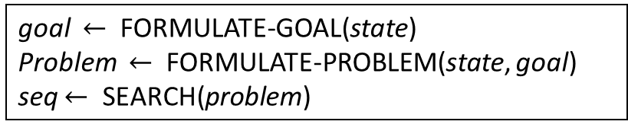
Example: Romania
Problem: The agent is currently in Arad, Romania.
Flight leaves tomorrow from Bucharest
Find a short route driving from Arad to Bucharest.
Formulate goal:
  goal: be in Bucharest
Formulate problem:
  states: various cities
  actions: operators drive between pairs of cities (paths)
Formulate(Find) solution:
  Find a sequence of cities (e.g., Arad, Sibiu, Fagaras, Bucharest), that leads from the current state to a state meeting the goal condition
goal $←$ FORMULATE-GOAL(state)
Problem $←$ FORMULATE-PROBLEM(state, goal)
seq $←$ SEARCH(problem)

Slide 7
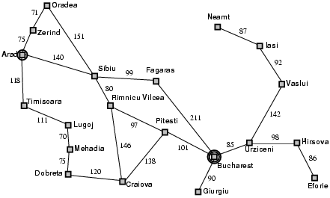
Example: Fig 3.2 A simple road map of part of Romania

Slide 8
Specifying the task environments – recalled PEAS Description
Agent Type | Performance Measure | Environment | Actuators | Sensors
The problem-solving agent | Goal: getting to Bucharest on time. | ??? | Given a state s Action(s) returns the set of actions that can be executed in s. e.g., given the state In(Arad), the applicable actions are {Go(Sibiu), Go(Timisoara) Go(Zerind)} | An accurate map for meeting the condition (the agent knows which states are reached by each action).

Slide 9
Specifying the task environments – for the Problem-Solving agent
Task Environment | Observable | Agents | Deterministic | Episodic | Static | Discrete | Known
Problem-Solving Agent | fully, partial | single, multi-agent | deterministic, strategic, stochastic* | Sequential, episodic | Static, dynamic, semi-dynamic* | discrete, continuous | Known, unknown
Task environments and their characters for a problem-solving agent.
  *Stochastic: the next state of environment is randomly determined. Taxis driver.
  *semi-dynamic: Play chess with a clock.

Slide 10
Assumptions
Static or dynamic?
The geography of Romania is static.
The paths from Arad city to Bucharest city are static.
Then, the task environment for the problem-solving agent is assumed to be static (without any change).
Environment is static
The environment is unchanged while the agent is deliberating.

Slide 11
Assumptions
if sequence is empty then
goal = FormulateGoal(state)
problem = FormulateProblem(state, goal)
sequence = Search(problem)
Fully or partially observable?
Once adopted the goal of driving to Bucharest, the agent is considering where to go from Arad.
For the unknown environment, the agent will:
  not know which of its possible actions (paths) is best.
  have to try one of the actions (paths) of unknown value at random.
Environment is fully observable?

Slide 12
Assumptions
Access to the complete state of environment
Fully or partially observable?
Assume that the agent has a map of Romania.
The map provides the agent with information about
  the states (cities, directions, distances between cities) and
  the actions (paths).
The agent can use the map to:
  decide what to do by “examining future actions”.
  The decision eventually leads to states (cities) of known value.
Assume that each city has a sign indicating its arrival at the city:
the agent knows the current state (city).
The task environment is assumed to be fully observable.
Environment is fully observable
The environment is partially observable
Access to the complete state of environment

Slide 13
Assumptions
Static or dynamic?
Fully or partially observable?
Discrete or continuous?
On Romania’s map
Connect each city to several other cities
Displays only finitely many actions (paths) to choose from at any given state (city).
For the known environment, the agent knows
  which are states (cities) reached by each action (path).
The task environment is assumed to be discrete:
  at any given state (city), there are only finite many actions (paths) to choose from.
The environment is discrete
Environment is discrete
A finite number of distinct sets of states (percepts, actions).

Slide 14
Specifying the task environments – recalled
Task Environment | Observable | Agents | Deterministic | Episodic | Static | Discrete
Problem-Solving Agent | Fully |  |  |  | Static* | Discrete*
Task environments and their characters for a problem-solving agent.
*Static: The environment is unchanged while the agent is deliberating
*Discrete: A finite number of distinct sets of states (percepts, actions)

Slide 15
Assumptions
Static or dynamic?
Fully or partially observable?
Discrete or continuous?
Deterministic or stochastic?
In Romania,
  under the ideal condition,
    if one chooses to drive from Arad to Sibiu, it does end up in Sibiu.
  Conditions are not always ideal: detour.
  The task environment of the agent is assumed to be deterministic.
The environment is deterministic.
Environment is deterministic
The current state and the execution of action determine the next state.

Slide 16
Specifying the task environments – recalled
Task Environment | Observable | Agents | Deterministic | Episodic | Static | Discrete
Problem-Solving Agent | Fully |  | deterministic |  | Static | Discrete
Task environments and their characters for a problem-solving agent.

Slide 17
Assumptions
Static or dynamic?
Fully or partially observable?
Discrete or continuous?
Deterministic or stochastic?
Episodic or sequential?
Under these assumptions, the solution to any problem is a fixed sequence of actions.
Given the initial state and the known and deterministic environment, the agent knows exactly
  where it will be after the first action and
  what it will perceive. (i.e., the reached city – one percept!)
The task environment for the agent is sequential
Since only one percept is possible after the first action, the
solution can specify only one possible second action, and so forth.
Environment is sequential
The environment is sequential
Current decisions (short-term actions) could affect all future decisions (long-term consequences).

Slide 18
Specifying the task environments – recalled
Task Environment | Observable | Agents | Deterministic | Episodic | Static | Discrete
Problem-Solving Agent | Fully |  | Deterministic | Sequential | Static | Discrete
Task environments and their characters for a problem-solving agent.

Slide 19
Assumptions
Static or dynamic?
Fully or partially observable?
Discrete or continuous?
Deterministic or stochastic?
Episodic or sequential?
Single agent or multiple agent?
An agent solving this problem by itself is clearly a single-agent environment
Environment is single agent
Agent operating by itself in an environment
The environment is single agent

Slide 20
Specifying the task environments – recalled
Task Environment | Observable | Agents | Deterministic | Episodic | Static | Discrete
Problem-Solving Agent | Fully | Single | Deterministic | Sequential | Static | Discrete
Task environments and their characters for a problem-solving agent.

Slide 21
Problem-solving agents (goal-based agents)
function SIMPLE-PROBLEM-SOLVING-AGENT(percept) returns an action
persistent: seq, an action sequence, initially empty
state, some description of the current world state
goal, a goal, initially null
problem, a problem formulation
state UPDATE-STATE(state, percept)
if seq is empty then do
goal FORMULATE-GOAL(state)
problem FORMULATE-PROBLEM(state, goal)
seq SEARCH(problem)
if seq = failure then return a null action
action FIRST(seq)
seq REMAINDER(seq)
return action
Fig 3.1 A simple problem-solving agent.
persistent: Existing or remaining in the same state for an indefinitely long time.

Slide 22
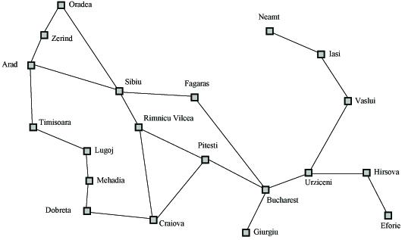
Summary: Search Example - Romania Map Example
Formulate goal: Be in Bucharest.
Formulate problem: states are cities;
operators drive between pairs of cities (actions)
Find a solution: Find a sequence of cities (e.g., a path of Arad, Sibiu, Fagaras, Bucharest) that leads from the current state to a state meeting the goal condition
Fig 3.2 A Simplified road map of part of Romania

Slide 23
Search Space Definitions (1)
Maze-Problem Solver?
State
  Description of a possible state of the world (e.g., cities, In(Arad))
  Includes all features of the world that are pertinent to the problem (e.g., directions and distance between two cities) (In(Arad), d, Zerind )
Initial state
  Description of the state, the agent starts the search (e.g., In(Arad))
    Includes all aspects of the state that are pertinent to the problem.
Goal test
  Conditions the agent is trying to meet (e.g., arrived in Bucharest at 8:00 am.)
Goal state
  Any state which meets the goal condition (e.g., be In(Bucharest).)
Action
  Function that maps (transits) from one state to another (e.g., {Go(Arad, Sibiu), Go(Arad, Timisoara), Go(Arad, Zerind)}

Slide 24
Search Space Definitions (2)
Problem formulation
  Describe a general problem as a search problem
    A shortest path from In(Arad) to In(Bucharest).)
Solution
  Sequence of actions that transits from the initial state to a goal state
  A path of Go(In(Arad), In(Sibiu)), Go(In(Sibiu), In(Fagaras)), Go(In(Fagaras), In(Bucharest))
Solution cost (additive)
  Sum of the cost of actions to be taken
  Alternative: sum of distances, number of steps, etc.
Search
  A process of finding a solution
  Searching through a space of possible states
  Search algorithm takes problem as input and returns solution
Execution
  Process of executing a sequence of actions (solution)
Maze-Problem Solver?

Slide 25
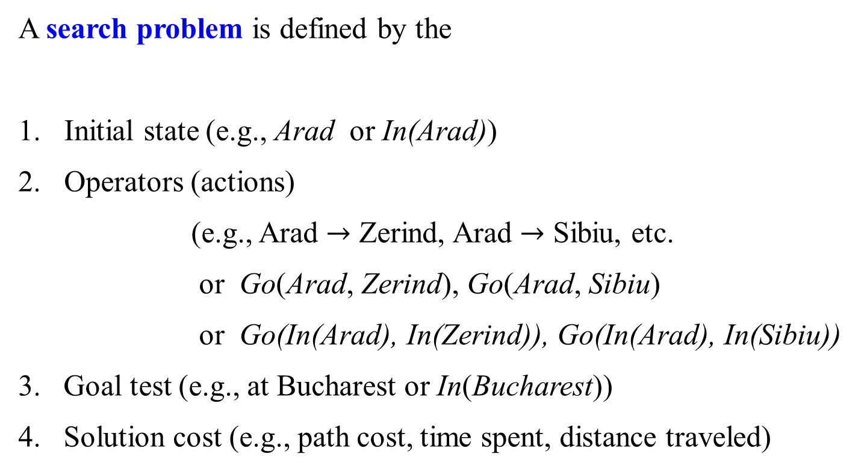
Problem Formulation: Romania Map Example (I)
A search problem is defined by the
Initial state (e.g., Arad or In(Arad))
Operators (actions)
(e.g., Arad $→$ Zerind, Arad $→$ Sibiu, etc.
  or Go(Arad, Zerind), Go(Arad, Sibiu)
  or Go(In(Arad), In(Zerind)), Go(In(Arad), In(Sibiu))
3. Goal test (e.g., at Bucharest or In(Bucharest))
4. Solution cost (e.g., path cost, time spent, distance traveled)
Maze-Problem Solver?

Slide 26
Problem Solving: Romania Map Example (II)
Consider the simpler cases in which the following holds.
The agent’s world (environment) is static and deterministic.
The agent’s world is representable by a discrete set of states.
  (e.g., {Arad, Sibiu, Zerind, Bucharest, Timisoara, … } which is a finite number of given cities.)
The agent’s actions are representable by a discrete set of operators.
  (e.g., {Go(Sibiu, Sibiu), Go(Sibiu, Timisoara), Go(Sibiu, Zerind), … } )

Slide 27
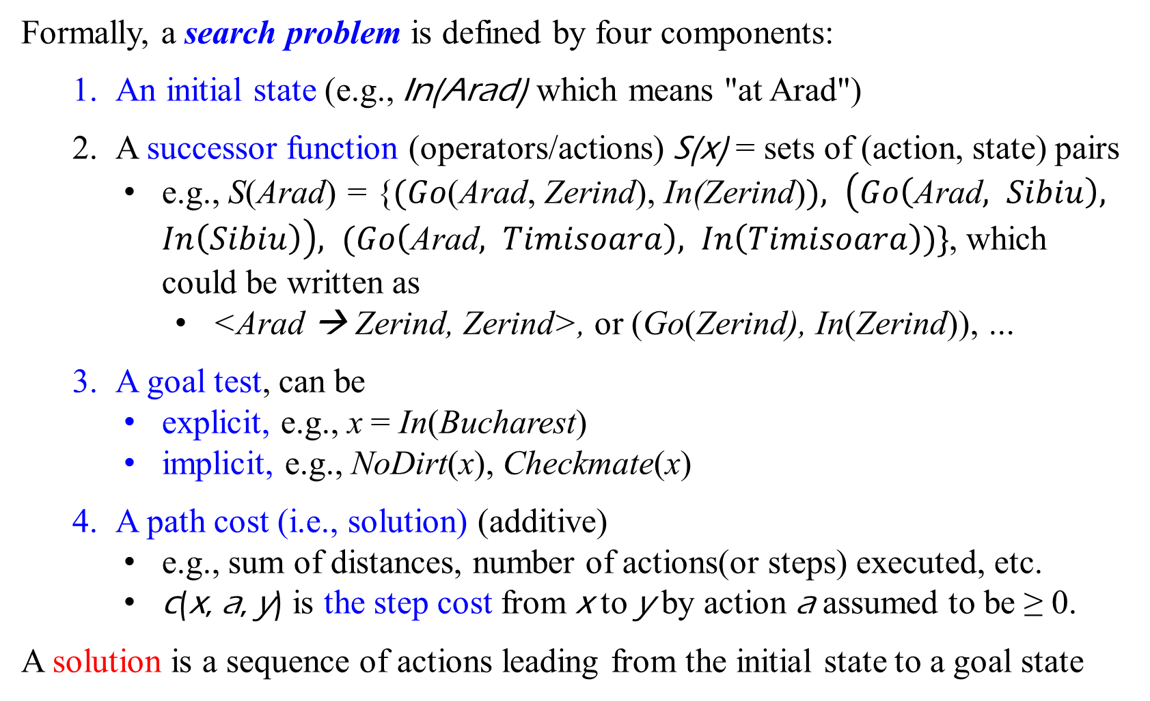
Single-State Problem Formulation – Summary (i)
Formally, a search problem is defined by four components:
  An initial state (e.g., In(Arad) which means "at Arad")
  A successor function (operators/actions) S(x) = sets of (action, state) pairs
    e.g., S(Arad) = {$(Go$(Arad, Zerind), In(Zerind)$), \left(Go\left(\text{Arad}, Sibiu\right), In\left(Sibiu\right)\right), (Go\left(\text{Arad}, Timisoara\right), In\left(Timisoara\right))\}$, which could be written as
      <Arad → Zerind, Zerind>, or (Go(Zerind), In(Zerind)), …
  A goal test, can be
    explicit, e.g., x = In(Bucharest)
    implicit, e.g., NoDirt(x), Checkmate(x)
  A path cost (i.e., solution) (additive)
    e.g., sum of distances, number of actions(or steps) executed, etc.
    c(x, a, y) is the step cost from x to y by action a assumed to be ≥ 0.
A solution is a sequence of actions leading from the initial state to a goal state
Maze-Problem Solver?

Slide 28
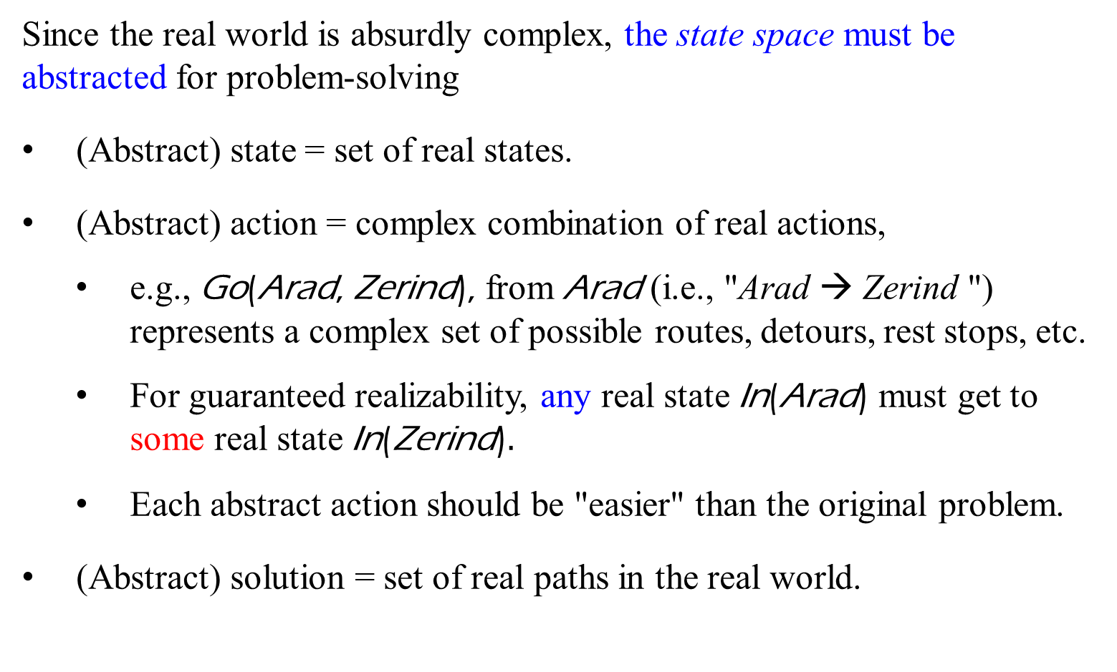
Selecting a State Space – Summary (ii)
Since the real world is absurdly complex, the state space must be abstracted for problem-solving
(Abstract) state = set of real states.
(Abstract) action = complex combination of real actions,
  e.g., Go(Arad, Zerind), from Arad (i.e., "Arad → Zerind ") represents a complex set of possible routes, detours, rest stops, etc.
    For guaranteed realizability, any real state In(Arad) must get to some real state In(Zerind)$.$
    Each abstract action should be "easier" than the original problem.
(Abstract) solution = set of real paths in the real world.

Slide 29
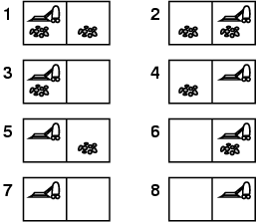
Example: the vacuum world
Single-state problem,
initial start = 5.
goal states = {7, 8}
Solution? [Right, Suck]
[Right, Suck, Left]
Comment: Vacumn moves Right then Suck.
A single-state consists of two locations with dirt or clean condition.

Slide 30
Example: the vacuum world
Conformant (Sensorless) Problem
initial start = {1,2,3,4,5,6,7,8}
Right goes to {2,4,6,8}
Left goes to {1, 3, 5, 7}
Solution? [Right, Suck, Left, Suck]
or [Left, Suck, Right, Suck]
Comments: V can begin to go from
1 to 2, 3 to 4, 5 to 6, or 7 to 8.
It needs Right, Suck, Left, Suck
(since V is sensorless. etc.)

Slide 31
Example: vacuum world
Contingency problem
  *Nondeterministic: Suck may
  dirty a clean carpet (i.e., Suck occasionally fails).
  Partially observable: location, dirt at the current location (i.e., local sensing: dirt, location).
  Percept: [L, Clean], i.e., start in state = 5 or state = 7. The initial state = {5, 7}
  Solution? [Right, if dirt then Suck]
*Nondeterministic: actions have possible outcomes without any attached probabilities

Slide 32
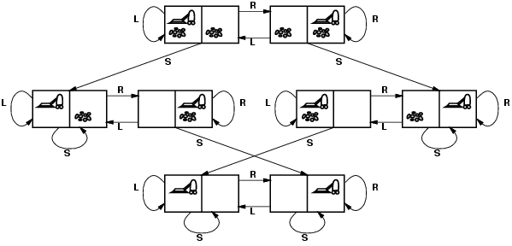
Example: Vacuum world state space graph
1
2
states?
actions?
goal test?
path cost?
5
6
3
4
7
8
Fig 3.3 The state space for the vacuum world. Links denote actions: L = Left, R = Right, S = Suck.

Slide 33
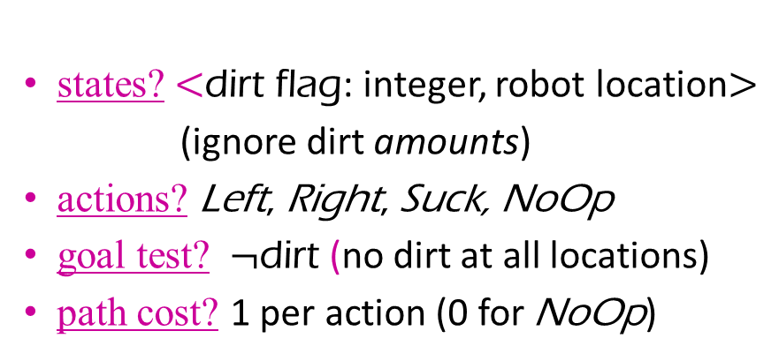
Example: Vacuum world state space graph
1
2
5
6
3
4
states? $<$dirt flag: integer, robot location$>$
(ignore dirt amounts)
actions? Left, Right, Suck, NoOp
goal test? $¬$dirt (no dirt at all locations)
path cost? 1 per action (0 for NoOp)
7
8

Slide 34
Formulating Problem as a Labeled Graph
R
L
1
2
R
L
S
S
R
R
L
5
6
L
3
4
In the graph (search graph)
each node represents a possible state;
a node is designated as the initial state;
one or more nodes represent goal states,
  states the agent is considered accomplished.
each edge represents a state transition caused by a specific agent action;
associated with each edge is the cost of performing that transition.
R
R
L
L
S
S
S
S
R
L
7
8
R
S
S

Slide 35
Initial state: Percepts In(A), either In(2, 2, 0, 1) or In(0, -, -, -). The state is [2, 2, 0, 1] or [0, -, -, -].
Goal states: Percepts In(g1) and In(g2)
In(g2) is In(0, 1, 2, 1) or In(-, -, 0, -). The state is [0, 1, 2, 1] or [-, -, 0, -].
In(g1) is In(0, 1, 2, 1) or In(-, -, 0, -). The state is [0, 1, 2, 1] or [-, -, 0, -].
State and percept specifications are interchangeable. The state specification is [h, r, t, l], where h is the side that the mouse heads to, r/l is the right/left side of the mouse, and t is the mouse’s tail.
h t
l r r l
h
t h
l r
t
The actions of the mouse agent are defined as follows:
leftTurn([h, r, t, l], [l, h, r, t]),
rightTurn([h, r, t, l], [r, t, l, h]),
forward([h, r, t, l ], [h’, r,’ t’, l’])
For Example, a number of choices for specifying the actions:
leftTurn(In(2, 2, 0, 1), 0, In(1, 2, 2, 0)), where a middle parameter is a number of grid forwarded.
rightTurn(In(2, 2, 0, 1), 0, In(2, 0, 1, 2)). rightTurn([2, 2, 0, 1], 0, [2, 0, 1, 2]). rightTurn([2, 2, 0, 1], [2, 0, 1, 2]).
forward(In(0, 1, 2, 1), 1, In(-, -, 0, -)). forward([0, 1, 2, 1], 1, [-, -, 0, -]). forward([0, 1, 2, 1], [-, -, 0, -]).
Let 0, 1, and 2 represent hole, wall, and open, respectively.
Let h, r, l, and t be assigned a value 0, 1, and 2 for the adjacent hole, wall, and open.
g1
g2
A

Slide 36
SADBEGCF
Search Graph
S
How do we reach a goal state from the initial node S?
initial node with a state
10 4
3
7
5 2 5
4 Tree Search Graph
1 3 goal nodes with states
There may be several possible ways. Or none!
Factors to consider:
  cost of finding a path;
  cost of traversing a path.
A
D
A
B
C
E
B
F
G
C
F
S
D
E
G
Reachability
Shortest Paths
Algorithms’ Efficiency
S
A
B
E
D
G
C
F

Slide 37
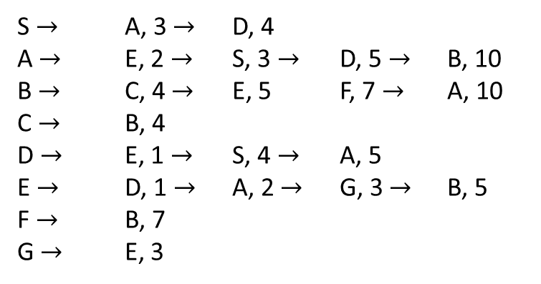
S $→$ A, 3 $→$ D, 4
A $→$ E, 2 $→$ S, 3 $→$ D, 5 $→$ B, 10
B $→$ C, 4 $→$ E, 5 F, 7 $→$ A, 10
C $→$ B, 4
D $→$ E, 1 $→$ S, 4 $→$ A, 5
E $→$ D, 1 $→$ A, 2 $→$ G, 3 $→$ B, 5
F $→$ B, 7
G $→$ E, 3
1
S
3, 2
4. 3
2
5, 5
3
A
D
10, 6
2, 4
1,7
(S. 0, 0)
(S, 3, A), (S, 4, D),
(S, 4, D), {(A, 2, E), (A, 3, S), (A, 5, D), (A, 10, B)}
{(A, 2, E), (A, 3, S), (A, 5, D), (A, 10, B)} {(D, 1, E), (D, 4, S), (D, 5, A)}
(A, 3, S), (A, 5, D), (A, 10, B)} {(D, 1, E), (D, 4, S), (D, 5, A)} {( E, 1, D),
(E, 2, A), (E, 3, G), (E, 5, B)}
(A, 5, D), (A, 10, B)} {(D, 1, E), (D, 4, S), (D, 5, A)} {( E, 1, D),
(E, 2, A), (E, 3, G), (E, 5, B)}
(A, 10, B) {(D, 1, E), (D, 4, S), (D, 5, A)} {(E, 1, D), (E, 2, A), (E, 3, G),
(E, 5, B)} {(B, 4, C), (B, 5, E), (B, 7, F), (B, 10, A)}
4
E
B
6
5, 9
3, 8
7, 11
4, 10
8
10
11
G
C
F

Slide 38
SADBEGCF
Search Graph
S
S
How do we reach a goal state from the initial node S?
initial node with a state
10 4
3
7
5 2 5
4 Tree search graph
2 3 goal nodes with states
There may be several possible ways. Or none!
Factors to consider:
  cost of finding a path;
  cost of traversing a path.
A
D
A
A
B
C
B
E
D
F
C
F
G
E
S
B
G
G
D
E
C
F
Reachability
Shortest Paths
Algorithms’ Efficiency

Slide 39
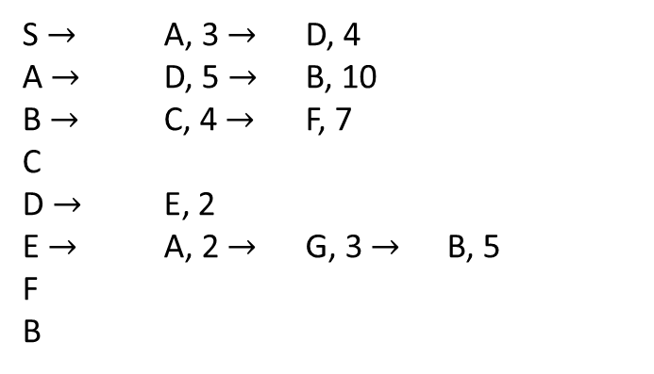
S $→$ A, 3 $→$ D, 4
A $→$ D, 5 $→$ B, 10
B $→$ C, 4 $→$ F, 7
C
D $→$ E, 2
E $→$ A, 2 $→$ G, 3 $→$ B, 5
F
B
1
S
4, 3
3, 2
A
5, 4
D
3
2
2, 9
2, 6
10, 5
(S, -, -)
(S, 3, A) (S, 4, D)
(S, 4, D) { (A, 5, D) (A, 10, B) }
{(A, 5, D) (A, 10, B) } {D, 2, E)}
{(A, 10, B) } {D, 2, E)}
{D, 2, E)} { (B, 4, C) (B, 7, F)}
{ (B, 4, C) (B, 7, F)} {(E, 2, A) (E, 3, G) (E, 5, B)}
{(B, 7, F)} {(E, 2, A) (E, 3, G) (E, 5, B)}
{(E, 2, A) (E, 3, G) (E, 5, B)}
{(E, 3, G) (E, 5, B)}
(E, 5, B)}
5
6
B
E
5, 11
4, 7
7, 8
3, 10
7
C
8
F
G
10

Slide 40
Problem Solving as Search - State Search space
Search space: a set of states reachable from an initial state S₀ via a (possibly empty/finite/infinite) sequence of state transitions.
To achieve the problem’s goal
  search the space for a (possibly optimal) sequence of state transitions starting from S₀ and leading to a goal state;
  execute (in order) the actions associated with each transition in the identified sequence of state transitions.
The two steps above can be interleaved depending on the features of the agent’s world (such as for contingency problems).
State-actions for our case.
Nondeterministic and/or partially observable → contingency problem
  percepts provide new information about current state
  Solution is a tree or policy
often interleave search and execution

Slide 41
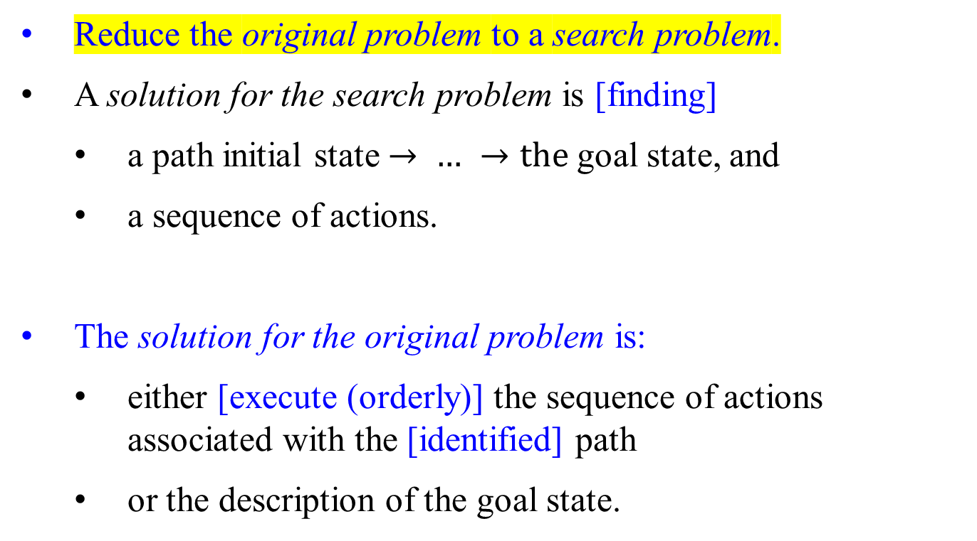
Problem Solving as Search
Reduce the original problem to a search problem.
A solution for the search problem is [finding]
  a path initial state $→ …$ $→the$goal state, and
  a sequence of actions.
The solution for the original problem is:
  either [execute (orderly)] the sequence of actions associated with the [identified] path
  or the description of the goal state.

Slide 42
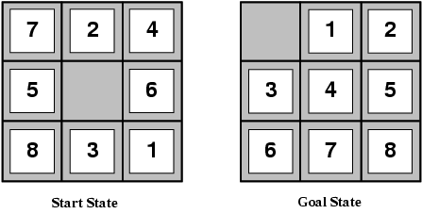
Example: The 8-puzzle
states? Locations of tiles (i.e., puzzle environments)
actions? Move blank left, right, up, down
goal test? = goal state (given)
path cost? 1 per move (total number of moves)
[Note: optimal solution of the n-Puzzle family is NP-hard]

Slide 43
Example: The 8-puzzle: some properties
12 | 8 | 13 | 9
1 | 6 | 4 | 14
7 |  | 15 | 2
10 | 5 | 3 | 11
2
8 3
1
6
4
7
5
It can be generalized to (n² − 1)-puzzle for n ≥ 3; e.g., 8-puzzle if n = 3; 15-puzzle if n = 4; 24-puzzle if n = 5.

Slide 44
PERMUTATIONS and Combination
A permutation of size 𝑛 is
  a way of arranging the numbers between 1 and 𝑛.
  Each number must be used and can only be used once.
Permutation is a number of ways of selecting and arranging items in which order matters.
Combination is a number of ways of selecting items in which order does not matter.

Slide 45
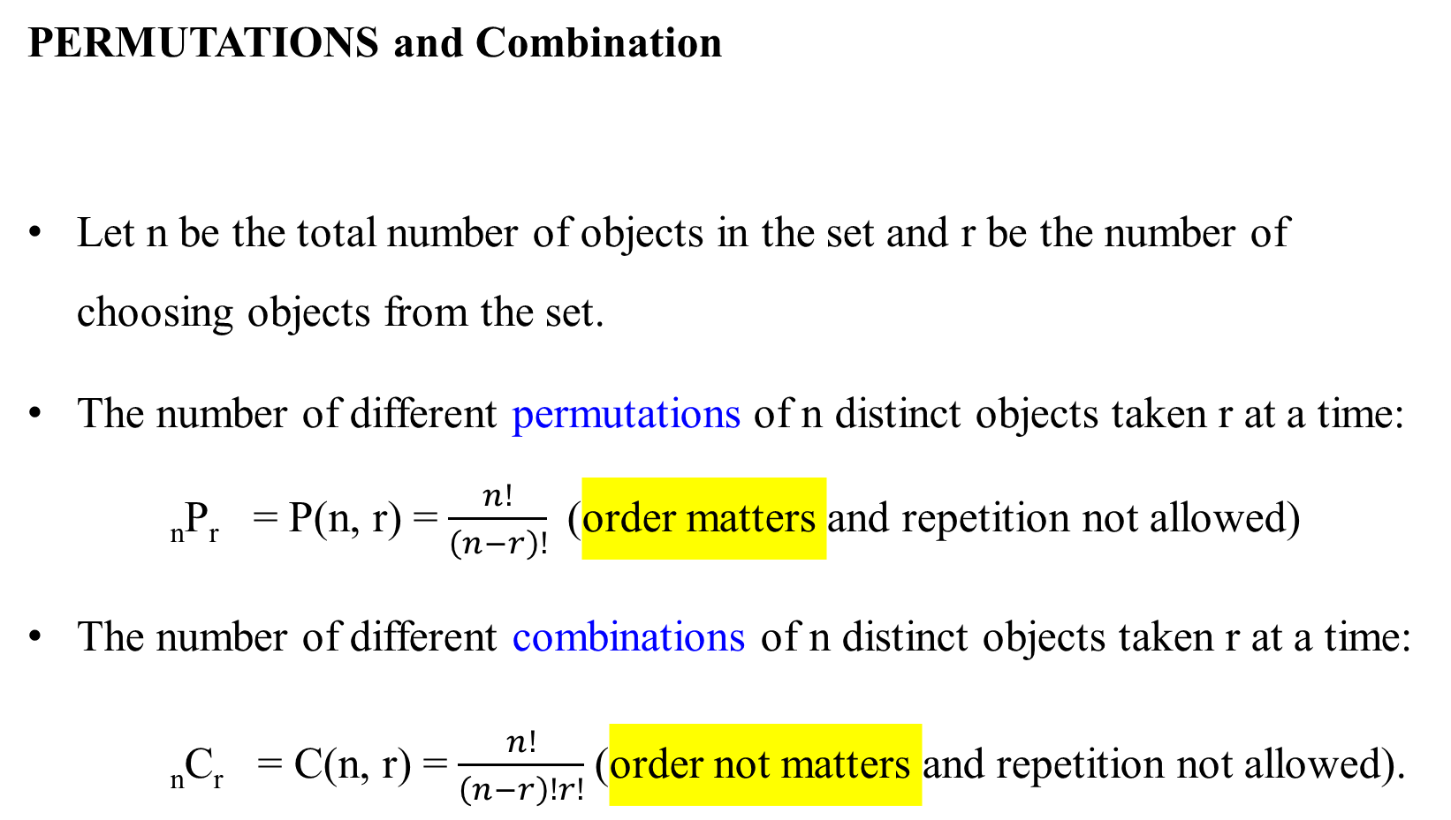
PERMUTATIONS and Combination
Let n be the total number of objects in the set and r be the number of choosing objects from the set.
The number of different permutations of n distinct objects taken r at a time: _{n}P_{r} = P(n, r) = $\frac{n!}{\left(n−r\right)!}$(order matters and repetition not allowed)
The number of different combinations of n distinct objects taken r at a time:
_{n}C_{r} = C(n, r) = $\frac{n!}{\left(n−r\right)!r!}$(order not matters and repetition not allowed).

Slide 46
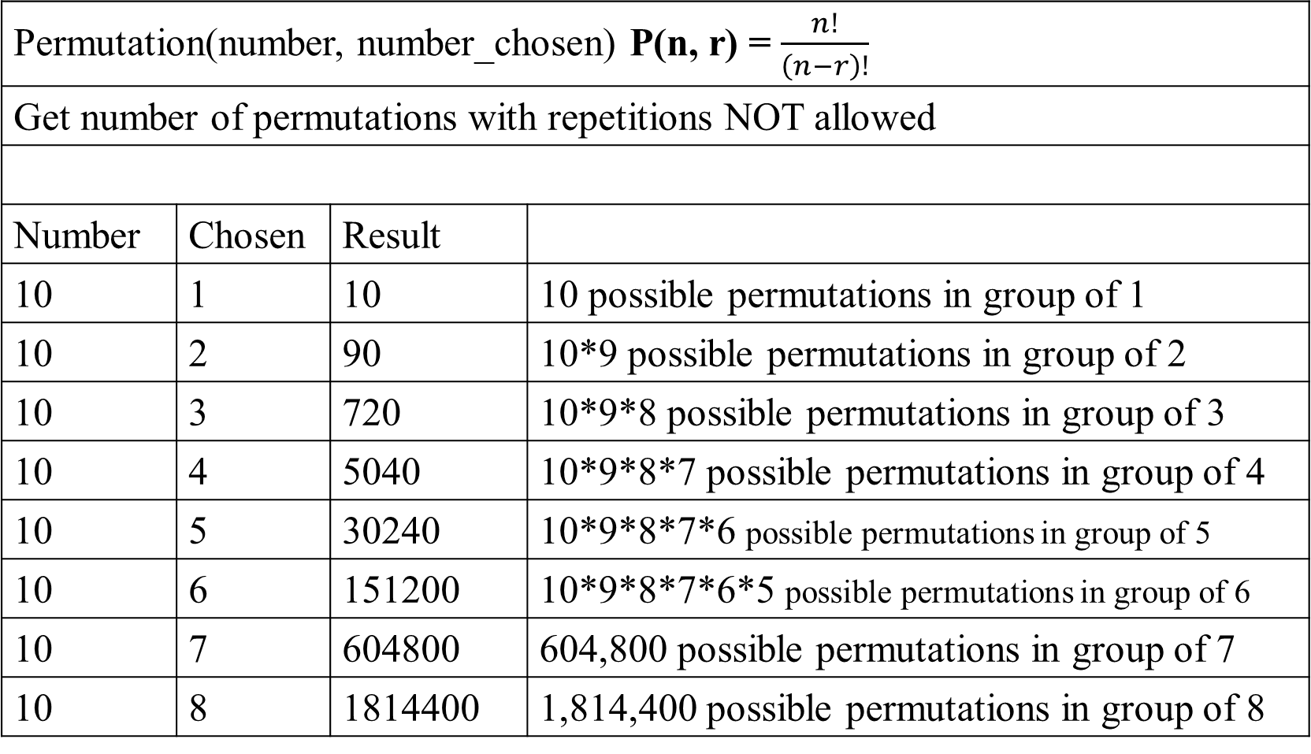
Permutation(number, number_chosen) P(n, r) = $\frac{n!}{\left(n−r\right)!}$
Get number of permutations with repetitions NOT allowed
Number | Chosen | Result
10 | 1 | 10 | 10 possible permutations in group of 1
10 | 2 | 90 | 10*9 possible permutations in group of 2
10 | 3 | 720 | 10*9*8 possible permutations in group of 3
10 | 4 | 5040 | 10*9*8*7 possible permutations in group of 4
10 | 5 | 30240 | 10*9*8*7*6 possible permutations in group of 5
10 | 6 | 151200 | 10*9*8*7*6*5 possible permutations in group of 6
10 | 7 | 604800 | 604,800 possible permutations in group of 7
10 | 8 | 1814400 | 1,814,400 possible permutations in group of 8

Slide 47
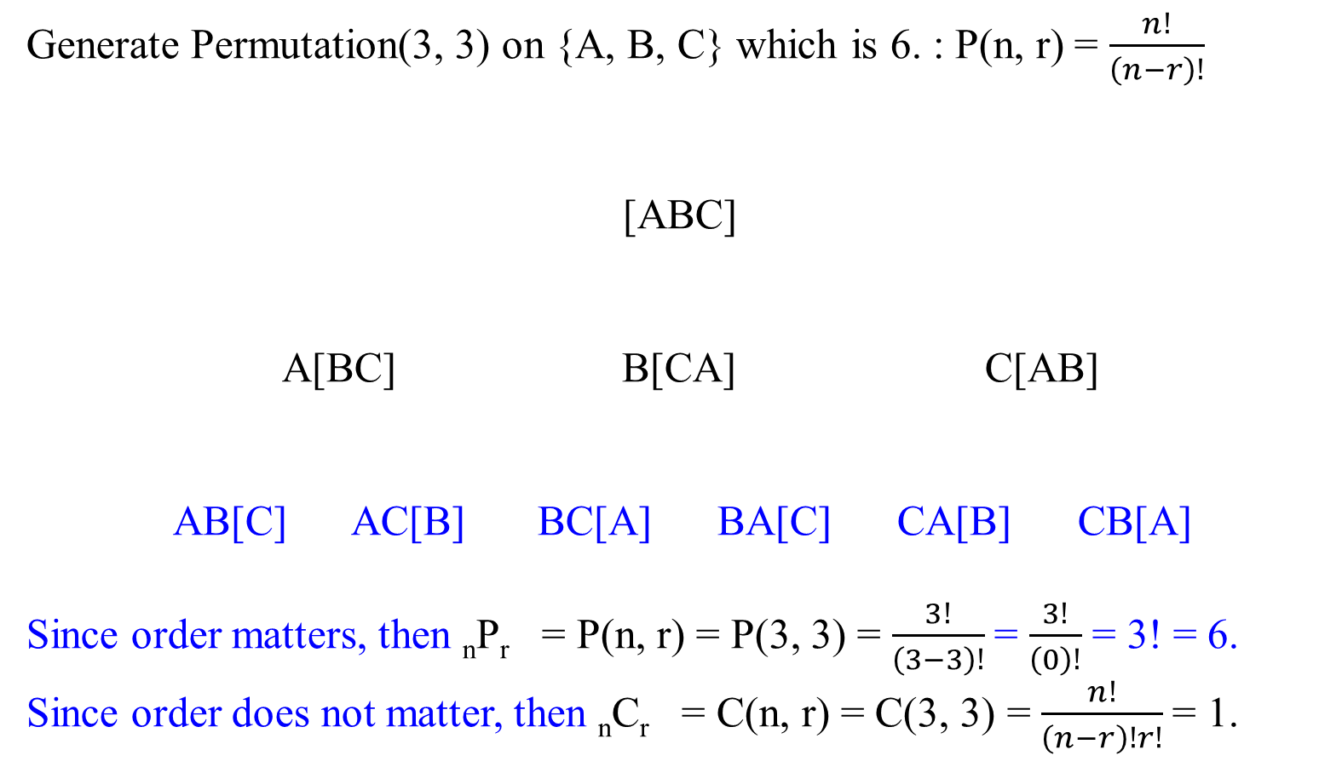
Generate Permutation(3, 3) on {A, B, C} which is 6. : P(n, r) = $\frac{n!}{\left(n−r\right)!}$
[ABC]
A[BC] B[CA] C[AB]
AB[C] AC[B] BC[A] BA[C] CA[B] CB[A]
Since order matters, then _{n}P_{r} = P(n, r) = P(3, 3) = $\frac{3!}{\left(3−3\right)!}$= $\frac{3!}{\left(0\right)!}$ = 3! = 6.
Since order does not matter, then _{n}C_{r} = C(n, r) = C(3, 3) = $\frac{n!}{\left(n−r\right)!r!}$= 1.
Combination(3, 3)
Permutation(3, 3)

Slide 48
Generate Permutation(4, 4) on {A, B, C, D} which is 24.
[ABCD]
A[BCD] B[CDA] C[DAB] D[ABC]
AB[CD] AC[DB] AD[BC] BC[DA] BD[AC] BA[CD] CD[AB] CA[BD] CB[DA] DA[BC] DB[CA] DC[AB]
ABC[D] ABD[C] ACD[B] ACB[D] ADB[C] ADC[B] BCD[A] BCA[D] BDA[C] BDC[A] BAC[D] BAD[C]
CDA[B] CDB[A] CAB[D] CAD[B] CBD[A] CBA[D]
DAB[C] DAC[B] DBC[A] DBA[C] DCA[B] DCB[A]
Combination(4, 4)
Permutation(4, 4)

Slide 50
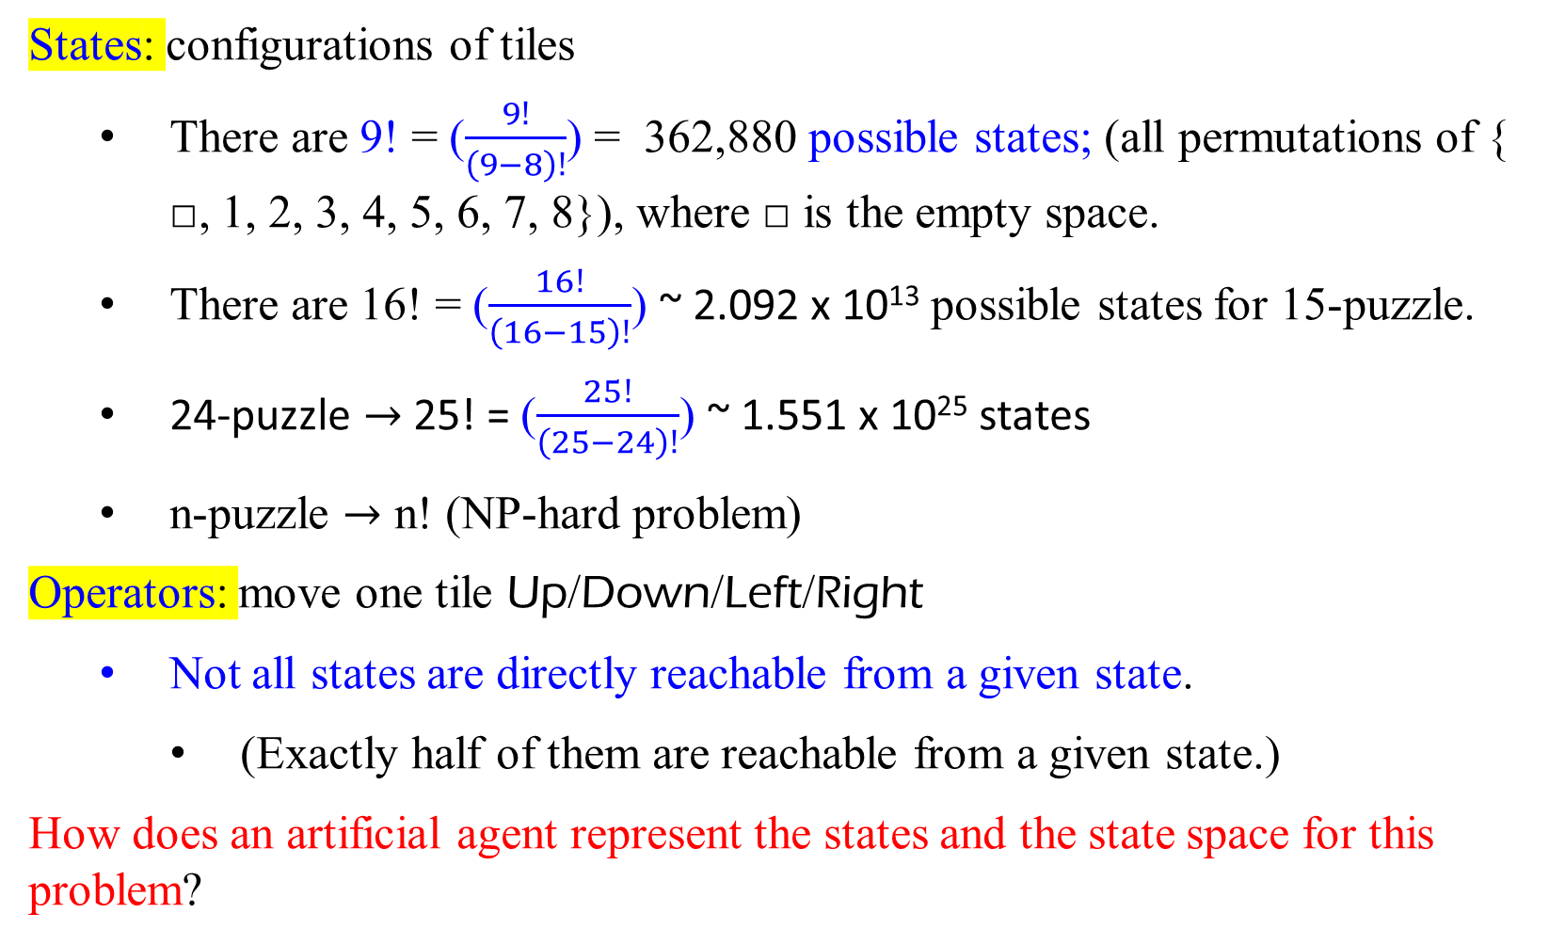
Formulating the 8-puzzle Problem
States: configurations of tiles
  There are 9! = ($\frac{9!}{\left(9−8\right)!}$) = 362,880 possible states; (all permutations of { □, 1, 2, 3, 4, 5, 6, 7, 8}), where □ is the empty space.
  There are 16! = ($\frac{16!}{\left(16−15\right)!}$) ~ 2.092 x 10¹³ possible states for 15-puzzle.
  24-puzzle $→$ 25! = ($\frac{25!}{\left(25−24\right)!}$) ~ 1.551 x 10²⁵ states
  n-puzzle $→$ n! (NP-hard problem)
Operators: move one tile Up/Down/Left/Right
  Not all states are directly reachable from a given state.
    (Exactly half of them are reachable from a given state.)
How does an artificial agent represent the states and the state space for this problem?

Slide 51

The 8-puzzle – Successor Function
The successor function is knowledge about the 8-puzzle game,
but it does not tell us
which outcome
to use, nor
to which state of the board should it be applied?
2 | 8 | 3
1 | 6 | 4
 | 7 | 5
SUCC(state) $→$ subset of states
L
2 | 8 | 3
1 | 6 | 4
7 |  | 5
U
2 | 8 | 3
1 |  | 4
7 | 6 | 5
R
Search is about the exploration of alternatives
1 | 2 | 3
8 | 6 | 4
7 | 5

Slide 52
L
R
Example: The 8-puzzle
2 | 8 | 3
1 | 6 | 4
7 |  | 5
(S)
 | 2 | 3
1 | 8 | 4
7 | 6 | 5
L
R
R
U
D
L
D
U
2 | 8 | 3
1 | 6 | 4
 | 7 | 5
2 | 8 | 3
1 |  | 4
7 | 6 | 5
2 | 8 | 3
1 | 6 | 4
7 | 5
1 | 2 | 3
 | 8 | 4
7 | 6 | 5
R
L
R
U
D
R
U
D
L
U
D
R
L
L
1 | 2 | 3
8 |  | 4
7 | 6 | 5
2 | 8 | 3
1 | 6 | 4
7 |  | 5
2 | 8 | 3
 | 6 | 4
1 | 7 | 5
2 | 8 | 3
 | 1 | 4
7 | 6 | 5
2 |  | 3
1 | 8 | 4
7 | 6 | 5
2 | 8 | 3
1 | 4
7 | 6 | 5
2 | 8 | 3
1 | 6
7 | 5 | 4
(G)

Slide 53
Problem Formulation
Choose an appropriate data structure to represent the world states.
Define each operator as a precondition/effects pair where the
  precondition holds exactly in the states the operator applies to,
  effects describe how a state changes into a successor state by applying the operator.
Specify an initial state.
Provide a description of the goal (used to check if a reached state is a goal state).

Slide 54
Formulating the 8-puzzle Problem
States: each represented by a 3 × 3 array of numbers in [0 . . . 8],
where value 0 is for the empty cell.
2
8 3
2 8 3
becomes A = 1 6 4
7 0 5
1
6
4
7
5

Slide 55
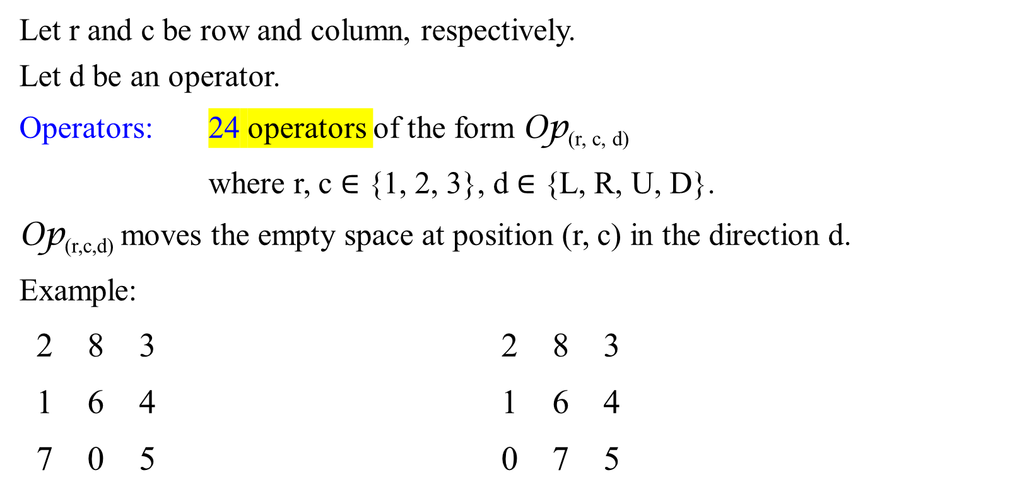
Formulating the 8-puzzle Problem (state-space)
24 operators
Let r and c be row and column, respectively.
Let d be an operator.
Operators: 24 operators of the form Op_{(r, c, d)}
where r, c ∈ {1, 2, 3}, d ∈ {L, R, U, D}.
Op_{(r,c,d)} moves the empty space at position (r, c) in the direction d.
Example:
2 8 3 2 8 3
1 6 4 1 6 4
7 0 5 0 7 5
Preconditions: A[3, 2] = 0
A[3, 2] ← A[3, 1]
Effects:
A[3, 1] ← 0
Op_{(3,2,L)}

Slide 56
Preconditions and Effects
Example: Op_{(3,2,R)}
  2 8 3 2 8 3
  1 6 4 1 6 4
7 0 5 7 5 0
Preconditions: A[3, 2] = 0
A[3, 2] ← A[3, 3]
Effects:
A[3, 3] ← 0
We have 24 operators in this problem formulation . . . 20 too many!
Op_{(3,2,R)}

Slide 57
A Better Formulation of the Problem
States: each represented by a pair (A,(i, j)) where:
  A is a 3 × 3 array of numbers in [0 . . . 8]
  (i, j) is the position of the empty space (0) in the array.
node
2
8 3
2 8 3
state ( 1 6 4 , (3, 2))
7 0 5
1
6
4
7
5

Slide 58
A Better Formulation
Operators: 4 operators of the form Op_{d} (also called action)
where d ∈ {L, R, U, D}.
Op_{d} moves the empty space in the direction d.
Example:
2 8 3 2 8 3
( 1 6 4 , (3, 2)) ( 1 6 4 , (3, 1))
7 0 5 0 7 5
Op_{L}

Slide 59
Preconditions and Effects
Example: Op_{L}
2 8 3 2 8 3
( 1 6 4 , (3, 2) ) ( 1 6 4 , (3, 1))
7 0 5 0 7 5
Let (r₀, c₀) be the position of 0 in A.
Preconditions: c₀ > 1 //allow to move L
A[r₀, c₀] ← A[r₀, c₀ − 1] //assign 7 to 0 loc…
Effects: A[r₀, c₀ − 1] ← 0 //assign 0 to A[…
(r₀, c₀) ← (r₀, c₀ − 1) //set new loc (3, 1) having 0
Op_{L}

Slide 60

Half states are not reachable?
G: 1 2 3 4 5 6 8 7
S : 1 2 3 4 5 6 7 8
n_{i} = 0, i $∈\left[1, 6\right]U \{8\}$
7, n₇ = 1, since 7 has a successor 8 in S, and 7 has a predecessor 8 in G.
N(S) = 1 inversion.
(not solvable)
(G) cannot be reached by (S) because:
The input state (S) does not satisfy the following the statement:
If a state (S) is such that
if the width is odd, then the state has an even number of inversions from (G).
1 | 2 | 3
4 | 5 | 6
7 | 8
Can this be done?
(S) (G)
any steps
N(S) = 0 + 1 N(G) = 1 + 1
(0 tile not in order, (1 tile 7 not in order,
empty tile in row 1) empty tile in row 1)
Can anyone do it?
Their parity (mod 2) are distinct. No solution.
1 | 2 | 3
4 | 5 | 6
7 | 8
1 | 2 | 3
4 | 5 | 6
8 | 7
⟾

Slide 61
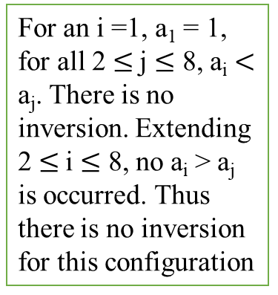
Half states are not reachable?
a₁ | a₂ | a₃
a₄ | a₅ | a₆
a₇ | a₈ | a₉
Let the 8-puzzle be represented by tiles that have the face values {a₁, a₂, a₃, a₄, a₅, a₆, a₇, a₈, a₉}.
We say (a_{i}, a_{j} ) is an inversion if neither tile a_{i} nor tile a_{j} is blank, when their locations i < j, their face values s a_{i} > a_{j} .
(a_{i} = 8, a_{j} = 7), where i = 7, j = 8
This yields that i < j and a_{i} > a_{j} .
For this configuration, there is only one inversion for a₇ = 8. This is because for 1 < 2, a₁ = 1 < a₂ = 2; for 1 < 3, a₁ = 1 < a₃ = 3; …, 1< 8, a₁ = 1 < a₈ = 7; no inversion for a₁ = 1 ; for 2 < 3, a₂ = 2 < a₃ = 3; 2 < 4, a₂ = 2 < a₄ = 4; …, for a₂ = 2 < a₈ = 7; no inversion for a₂ = 2; etc.
For an i =1, a₁ = 1, for all 2 $≤$j $≤$ 8, a_{i} $<$ a_{j}. There is no inversion. Extending 2 $≤$i $≤$ 8, no a_{i} > a_{j} is occurred. Thus there is no inversion for this configuration
1 | 2 | 3
4 | 5 | 6
7 | 8
1 | 2 | 3
4 | 5 | 6
8 | 7
The one on the left has 0 inversions and the second on the right has 1 (8 > 7, tile 7 is only one appeared after the tile 8).
Claim: # of inversions modulo two remains the same after each move.

Slide 62
Half states are not reachable?
Can this be done?
?
Can anyone solve it? But no one ever do it!
1 | 2 | 3 | 4
5 | 6 | 7 | 8
9 | 10 | 11 | 12
13 | 14 | 15
1 | 2 | 3 | 4
5 | 6 | 7 | 8
9 | 10 | 11 | 12
13 | 15 | 14
⟾
⟾
Represent a number of transitions

Slide 63
What is the Actual State Space?
The set of all states?
  [e.g., a set of 16! states (configurations) for the 15-puzzle]
The set of all states reachable from a given initial state?
  [e.g., a set of 16!/2 states for the 15-puzzle]
In general, the answer is a)
[because one does not know in advance which states are reachable]
But a fast test determining whether a state is reachable from another is very useful, as search techniques are often inefficient when a problem has no solution

Slide 64
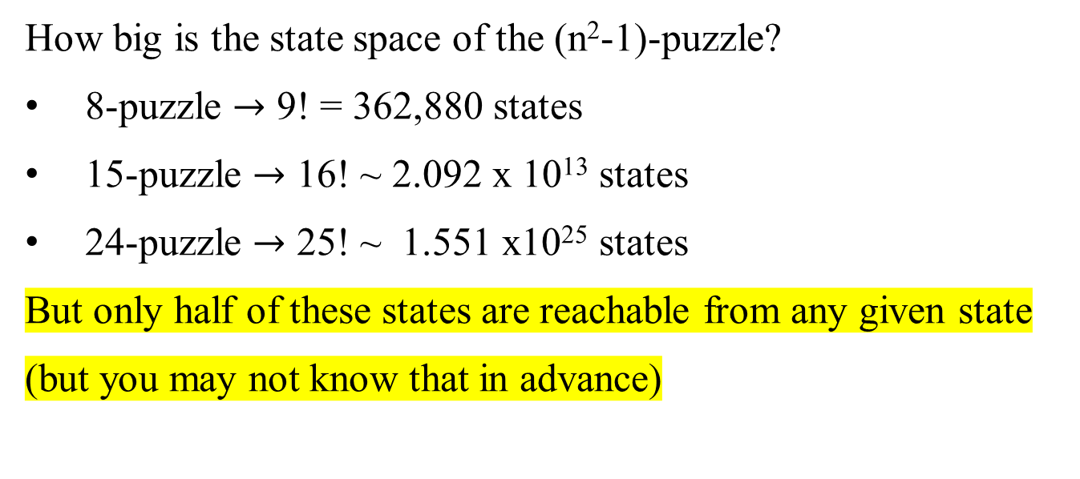
How big is the state space of the (n²-1)-puzzle?
8-puzzle $→$ 9! = 362,880 states
15-puzzle $→$ 16! ~ 2.092 x 10¹³ states
24-puzzle $→$ 25! ~ 1.551 x10²⁵ states
But only half of these states are reachable from any given state
(but you may not know that in advance)

Slide 65
Example: The 8-puzzle
states? locations of tiles
actions? move blank left, right, up, down
goal test? = goal state (given)
path cost? 1 per move
[Note: optimal solution of n-Puzzle family is NP-hard]

Slide 66
INVERSION NUMBER
An inversion in a permutation is a pair of numbers such that the larger number appears to the left of the smaller one in the permutation.
For example, in n-puzzle, (a_{i}, a_{j} ) is an inversion if neither tile a_{i} nor tile a_{j} is blank when their locations i < j, their face values s a_{i} > a_{j}.
The inversion number of a permutation is the total number of inversions.
Comments:
One way to help calculate the inversion number is to look at each position in the permutation and count how many smaller numbers are to the right, and then add those numbers up.
Inversion number can be thought of as a measure of how “out of order” a permutation is.

Slide 67
Example:
1 2 3 4 5 6
4 6 2 5 1 3
Inversion number: 3 + 4 + 1 + 2 + 0 + 0 = 10
1 2 3 4 5 6
4 2 1 6 5 3
Inversion number: 3 + 1 + 0 + 2 + 1 + 0 = 7
4 2 1 6 5 3
4 6 2 5 1 3
Inversion number: 0 + 2 + 0 + 1 + 0 + 0 = 3
4 6 2 5 1 3
1 2 3 4 5 6 = 3
4 6 2 5 1 3
1 2 3 4 5 6 = 4
4 6 2 5 1 3
1 2 3 4 5 6 = 1
4 6 2 5 1 3
1 2 3 4 5 6 = 2
4 6 2 5 1 3
1 2 3 4 5 6 = 0
4 6 2 5 1 3
1 2 3 4 5 6 = 0
For 4, {1, 2, 3,} has to be before 4, which yields 3.

Slide 68
Puzzle Solvability
For a given grid of width N, check whether if a N*N – 1 puzzle is solvable or not by following below simple rules :
If N is odd, then puzzle instance is solvable if number of inversions is even in the input state.
If N is even, puzzle instance is solvable if
    the blank is on an even row counting from the bottom (second-last, fourth-last, etc.) and number of inversions is odd.
    the blank is on an odd row counting from the bottom (last, third-last, fifth-last, etc.) and number of inversions is even.
For all other cases, the puzzle instance is not solvable.

Slide 69
Solvable
Time Complexity : O(n²)
Space Complexity: O(n)
How does this works?
Fact 1: For a grid of odd width, all legal moves preserve the polarity
(even or odd) of the number of inversions.
Proof of Fact 1
Moving a tile along the row (left or right) doesn’t change the number of inversions, and therefore doesn’t change its polarity.
Moving a tile along the column (up or down) can change the number of inversions. The tile moves past an even number of other tiles (N – 1). So move either increases/decreases inversion count by 2, or keeps the inversion count same.

Slide 70
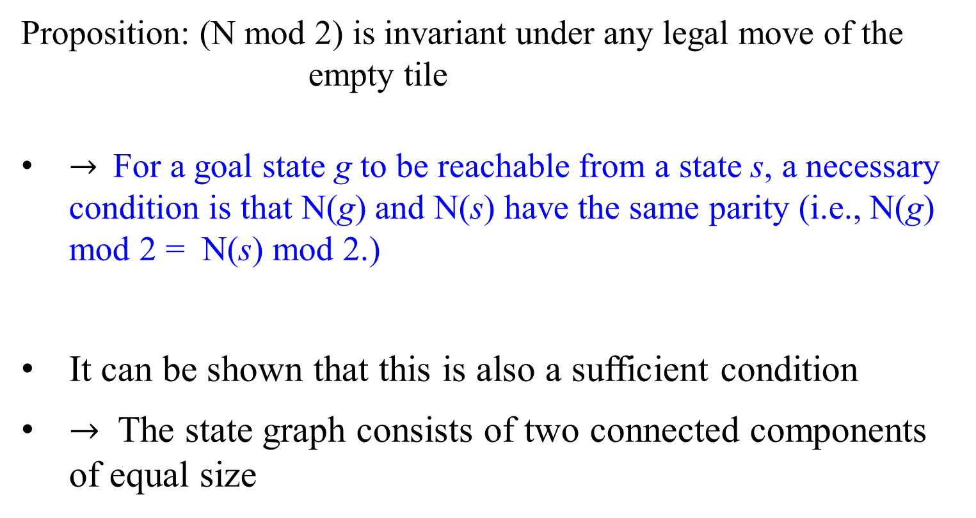
Proposition: (N mod 2) is invariant under any legal move of the empty tile
$→$For a goal state g to be reachable from a state s, a necessary condition is that N(g) and N(s) have the same parity (i.e., N(g) mod 2 = N(s) mod 2.)
It can be shown that this is also a sufficient condition
$→$ The state graph consists of two connected components of equal size

Slide 71
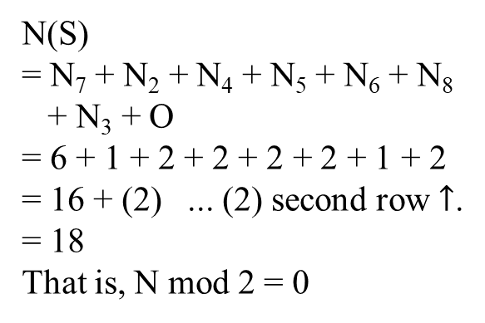
Example: The 8-puzzle
N = 0 + 3 = 3. That is, N mod 2 = 1.
N(S)
= N₇ + N₂ + N₄ + N₅ + N₆ + N₈
+ N₃ + O
= 6 + 1 + 2 + 2 + 2 + 2 + 1 + 2
= 16 + (2) ... (2) second row $↑$.
= 18
That is, N mod 2 = 0
states?
actions?
goal test?
path cost?
Fig 3.4 A Typical Instance of the 8-Puzzle. Both have the distinct parity. The goal state cannot be reached from the starting state. Thus this does not have a solution.

Slide 72
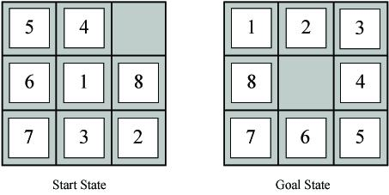
Example Problems – Eight Puzzle
States: tile locations
Initial state: one specific tile configuration
Operators: move (blank?) tile left, right, up, or down
Goal: tiles are numbered from one to eight around the square
Path cost: cost of 1 per move (solution cost same as number of most or path length)
Eight puzzle applet
N(S) = 16 + (3) = 19 N(G) = 7 + (2)
17 mod 2 = 1 9 mod 2 = 1
They have the same parity, and the goal state can be reached from the starting state. Thus, it has the solution.

Slide 73
G : (2, 8, 3, 1, 6, 4, 7, 0, 5)
(S): (1, 2, 3, 8, 0, 4, 7, 6, 5)
At (S),
1, n₁ = 3 (All the integers after 1 in (S), 2, 3, 8 are successors of 1 in (S),
but are the predecessors of 1 in G).
2, n₂ = 0 (All the integers after 2 in (S) are
not the predecessor of 2 in G).
3, n₃ = 1 (Only 8 is the successor of 3 in (S)
but 8 is the predecessor of 3 in G).
8, n₄ = 0 (4, 7, 6, 5 are the successors of 8 in
(S) and are successor of 8 in G).
4, n₅ = 1 (6 is the successor of 4 in (S), but is
the predecessor of 4 in G).
7, n₆ = 1 (6 is a successor of 7 in (S). and is
the predecessor of 7 in G).
6 n₇ = 0 (5 is the successor 6 in (S), and is
also a successor of 6 in G).
5, n₈ = 0 (5 in both (S) and G has no
successor.)
Inversions Number:
N((S)) = 3 + 0 + 1 + 0 + 1 + 1 + 0+ 0 = 6
Example: The 8-puzzle
Problem: Go from state A to state G.⇰
1 | 2 | 3
8 |  | 4
7 | 6 | 5
2 | 8 | 3
1 | 6 | 4
7 |  | 5
⟾
(S)input state … G goal State
  (G) is reachable from (S) because:
  (S) does satisfy the following statement:
  If a state (S) is such that
  if the width is odd, then the state (S) has an even number of inversions from (G).
  So as vice versa, (G) is reachable by (S).

Slide 74
Example: The 8-puzzle
(S) is reachable from (G) because the input state (G) satisfies the following statement:
If a state (G) is such that
if the width is odd, then the state (G) has an even number of inversions from (S).
So as vice versa that (S) is reachable from (G).
Problem: Go from state S to state G.⇰
1 | 2 | 3
8 |  | 4
7 | 6 | 5
2 | 8 | 3
1 | 6 | 4
7 |  | 5
⟾
1 | 2 | 3
8 |  | 4
7 | 6 | 5
⟾
(S) input state … G goal state
G input state … (S) goal state
G: | 2 | 8 | 3 | 1 | 6 | 4 | 7 | 0 | 5
(S): | 1 | 2 | 3 | 8 | 0 | 4 | 7 | 6 | 5
n_{i} | 3 | 0 | 1 | 0 |  | 1 | 1 | 0 | 0
(S): | 1 | 2 | 3 | 8 | 0 | 4 | 7 | 6 | 5
G: | 2 | 8 | 3 | 1 | 6 | 4 | 7 | 0 | 5
n_{i} | 1 | 2 | 1 | 0 | 2 | 0 | 0 |  | 0
N((G)) = 3 + 0 + 1 + 1 + 0 + 0 + 1+ 0 = 6
N((S)) = 1 + 2 + 1 + 0 + 2 + 0 + 0+ 0 = 6

Slide 75
Example: The 8-puzzle
(S) : (2, 8, 3, 1, 6, 4, 7, 0, 5)
S: (1, 2, 3, 4, 0, 5, 6, 7, 8)
At S,
1, n₁ = 3 (2,3,8 are successors of 1 in S, but
are the predecessors of 1 in (S).
2, n₂ = 0 (All the six integers after 2 in S are
the successors of 2 in (S)).
3, n₃ = 1 (Only 8 is the successor of 3 in S but
8 is the predecessor of 3 in (S)).
4, n₄ = 2 (6, 8 are successors of 4 in S but
they are predecessors of 4 in (S)).
5, n₅ = 3 (6,7,8 are successors of 5 in S, but
are the predecessor of 5 in (S)).
6, n₆ = 1 (8 is a successor of 6 in S but a
predecessor of 6 in (S)).
7, n₇ = 1 (8 is the successor 7 in S, and is a
predecessor of 7 in (S().
8, n₈ = 0 (8 has no successor in S).
Inversions Number:
N(S) = 3 + 0 + 1 + 2 + 3 + 1 + 1+ 0 = 11
Problem: Go from state S to state (S).⇰
1 | 2 | 3
4 |  | 5
6 | 7 | 8
2 | 8 | 3
1 | 6 | 4
7 |  | 5
⟾?
S … X (S)
Is (S) reached from S?
This N = 3 (width)
N(S) = (3 + 0 + 1 + 2 + 3 + 1 + 1+ 0 )
= 11.
Since N =3 and N(S) is not even, then (S) cannot be reached by S.

Slide 76
Example: The 8-puzzle
Problem: Go from state S to state G.⇰
(S) is not reachable by S because the input state S dissatisfies the statement:
“(S) is reachable from S
if a state S is such that
if the width is odd, then the state S has an even number of inversions from (S). ”
So as vice versa that S cannot reach from (S).
1 | 2 | 3
4 |  | 5
6 | 7 | 8
2 | 8 | 3
1 | 6 | 4
7 |  | 5
⟾?
S input state … X (S) goal state
(S): | 2 | 8 | 3 | 1 | 6 | 4 | 7 | 0 | 5
S: | 1 | 2 | 3 | 4 | 0 | 5 | 6 | 7 | 8
n_{i} | 3 | 0 | 1 | 2 |  | 3 | 1 | 1 | 0
S: | 1 | 2 | 3 | 4 | 0 | 5 | 6 | 7 | 8
(S): | 2 | 8 | 3 | 1 | 6 | 4 | 7 | 0 | 5
n_{i} | 1 | 6 | 1 | 0 | 2 | 0 | 1 |  | 0
N(S) = 3 + 0 + 1 + 2 + 3 + 1 + 1+ 0 = 11
N((S)) = 1 + 6 + 1 + 0 + 2 + 0 + 1+ 0 = 11
(S) cannot be reached by S, or vice versa. These are not solvable.

Slide 77
How to check if an instance of 15-puzzle is solvable?
Given a 4×4 board with 15 tiles (every tile has one number from 1 to 15) and one empty space.
The objective is to place the numbers on tiles in order using the empty space.
Allow to slide four adjacent (left, right, above and below) tiles into the empty space.
For example,
? N is defined by #inversions + blank in a row (bottom-up)
if both mod(N/2) = mod(N’/2), then the problem is solvable.
Otherwise, it is not solvable (Use the parity to solve it)

Slide 78
Not a solvable state because Even(#Inversions) == Odd(empty tile row number) is false == true yielding a false result.
How to check if an instance of 15-puzzle is solvable?
mod(2/2) = 0
mod(1/2) = 1
their parity
is distinct. Not solvable
Initial Configuration N=1+1=2 Final Configuration N’=0+1
Puzzle’s Width N = 4 (even)
Final Configuration: 1 2 3 4 5 6 7 8 9 10 11 12 13 14 15
Initial Configuration: 2 1 3 4 5 6 7 8 9 10 11 12 13 14 15
Inversion Number: 1+0+0+0+0+0+0+0+0+0+0+0+0+0+0 = 1 (odd)
Empty tile is located on row 1 (counting from bottom up) (odd)
2 | 1 | 3 | 4
5 | 6 | 7 | 8
9 | 10 | 11 | 12
13 | 14 | 15
1 | 2 | 3 | 4
5 | 6 | 7 | 8
9 | 10 | 11 | 12
13 | 14 | 15
not solvable!?

Slide 79
Puzzle Solvability
For a given grid of width N, check whether if a N*N – 1 puzzle is solvable or not by following below simple rules :
If N is odd, then puzzle instance is solvable if number of inversions is even in the input state.
If N is even, puzzle instance is solvable if
    the blank is on an even row counting from the bottom (second-last, fourth-last, etc.) and number of inversions is odd.
    the blank is on an odd row counting from the bottom (last, third-last, fifth-last, etc.) and number of inversions is even.
For all other cases, the puzzle instance is not solvable.

Slide 80
Fact 2: For a grid of even width, the following is invariant:
boolean((#inversions even) == (blank on odd row from bottom)).
Proof of Fact 2
Moving a tile along the row (left or right) doesn’t change the number of inversions and doesn’t change the row of the blank.
Moving a tile along the column (up or down) does change the number of inversions. The tile moves past an odd number of other tiles (N – 1). So the number of inversions changes by odd number of times. The row of the blank also changes, from odd to even, or from even to odd. So both halves of the invariant changes. So its value is preserved.
If N is even, puzzle instance is solvable if
    the blank is on an even row counting from the bottom (second-last, fourth-last, etc.) and number of inversions is odd.
    the blank is on an odd row counting from the bottom (last, third-last, fifth-last, etc.) and number of inversions is even.

Slide 81
Example: Consider the move (blank) above. The number of inversions on the left is 49, and the blank is on an even row from the bottom. So the value of the invariant is “false == false”, which is true. The number of inversions on the right is 48, because the 11 has lost two inversions, but the 14 has gained one. The blank is on an odd row from the bottom. So the value of the invariant is “true==true”, which is still true.
Parity: mod((49+2)/2) = 1
mod((48+3)/2) = 1. It is solvable for their polarity are the same.
12 | 1 | 10 | 2
7 | 11 | 4 | 14
5 |  | 9 | 15
8 | 13 | 6 | 3
12 | 1 | 10 | 2
7 |  | 4 | 14
5 | 11 | 9 | 15
8 | 13 | 6 | 3
N(49) = 3. Since w is even, N is odd(3) and blank is even(2).
N(49) is solvable state.
49 inversions
blank on even row from bottom
48 inversions
blank on odd row from bottom
Mod((49+2)/2) == Mod((48+3)/2) implies it is solvable. They preserve the parity.

Slide 82
Combining Fact 1 + Fact 2 = Fact 3:
If the width is odd, then every solvable state has an even number of inversions.
If the width is even, then every solvable state has
  an even number of inversions if the blank is on an odd numbered row counting from the bottom;
  an odd number of inversions if the blank is on an even numbered row counting from the bottom;
Proof of fact 3:
The initial (solved) state has those properties.
Those properties are preserved by every legal move.
Any solvable state can be reached from the initial state by some sequence of legal moves.

Slide 83
What is an inversion here?
Consider the tiles written out in a row:
1 8 2 X 4 3 7 6 5
Number of inversions = 0 + 6 + 0 + 1 + 0 + 2 + 1 + 0 = 10.
Illustration:
1 | 8 | 2
X | 4 | 3
7 | 6 | 5
N = 3 (Odd)
Inversion Count = 10 (Even)
Solvable
If N is odd, then puzzle instance is solvable if number of inversions is even in the input state.

Slide 84
What is an inversion here?
If we assume the tiles written out in a single row (1D Array) instead of being spread in N-rows (2D Array), a pair of tiles (a, b) form an inversion if a appears before b but a > b.
For above example, consider the tiles written out in a row, like this:
2 1 3 4 5 6 7 8 9 10 11 12 13 14 15 X
The above grid forms only 1 inversion i.e. (2, 1).
Illustration:
2 | 1 | 3 | 4
5 | 6 | 7 | 8
9 | 10 | 11 | 12
13 | 14 | 15
N = 4 (Even) Position of X from bottom = 1 (odd)
Inversion Count = 1 (Odd)
Not Solvable
1 | 2 | 3 | 4
5 | 6 | 7 | 8
9 | 10 | 11 | 12
13 | 14 | 15
Not a solvable state because Even(#Inversions) == Odd(empty tile row number) is false == true yielding a false result.

Slide 85
Not a solvable state because Even(#Inversions) == Odd(empty tile row number) is false == false yielding a true result.
13 | 2 | 10 | 3
1 | 12 | 8 | 4
5 |  | 9 | 6
15 | 14 | 11 | 7
N = 4 (Even)
Position of X from bottom = 2 (Even)
Inversion Count = 41 (Odd)
Solvable
1 | 2 | 3 | 4
5 | 6 | 7 | 8
9 | 10 | 11 | 12
13 | 14 | 15
Not a solvable state because Even(#Inversions) == Odd(empty tile row number) is true == true yielding a true result.
N = 4 (Even)
Position of X from bottom = 3 (Odd)
Inversion Count = 62 (Even)
Solvable
6 | 13 | 7 | 10
8 | 9 | 11
15 | 2 | 12 | 5
14 | 3 | 1 | 4
Mod((41+2)/2) = Mod((0+1)/2). Solvable.
Mod((62+3)/2) = Mod((0+1)/2). Solvable
If N is even, puzzle instance is solvable if
    the blank is on an even row counting from the bottom (second-last, fourth-last, etc.) and number of inversions is odd.
    the blank is on an odd row counting from the bottom (last, third-last, fifth-last, etc.) and number of inversions is even.

Slide 86
Not a solvable state because Even(#Inversions) == Odd(empty tile row number) is true == false yielding a false result.
N = 4 (Even)
Position of X from bottom = 2 (Even)
Inversion Count = 56 (Even)
Not Solvable
3 | 9 | 1 | 15
14 | 11 | 4 | 6
13 |  | 10 | 12
2 | 7 | 8 | 5
1 | 2 | 3 | 4
5 | 6 | 7 | 8
9 | 10 | 11 | 12
13 | 14 | 15
The parity: Mod((56+2)/2) $≠$ Mod((0+1)/2). Not Solvable.
If N is even, puzzle instance is solvable if
    the blank is on an even row counting from the bottom (second-last, fourth-last, etc.) and number of inversions is odd.
    the blank is on an odd row counting from the bottom (last, third-last, fifth-last, etc.) and number of inversions is even.

Slide 88
S is not a solvable state for Even(#Inversion) == Odd(blank row) yielding Even(1) == Odd(1) which leads to false == true and therefore it is false (that is it is not a solvable state..
Half states are not reachable?
Can this be done? Can anyone solve it? But no one ever do it!
S G
?
N(S) = 1
1 | 2 | 3 | 4
5 | 6 | 7 | 8
9 | 10 | 11 | 12
13 | 15 | 14
1 | 2 | 3 | 4
5 | 6 | 7 | 8
9 | 10 | 11 | 12
13 | 14 | 15
N(S) = 1 + 1 = 2 and N(G) = 0 + 1 = 1.
Since they have different parity, they have no solution from S to G or vice versa.
⟾
G | 1 | 2 | 3 | 4 | 5 | 6 | 7 | 8 | 9 | 10 | 11 | 12 | 13 | 14 | 15 | 0
S | 1 | 2 | 3 | 4 | 5 | 6 | 7 | 8 | 9 | 10 | 11 | 12 | 13 | 15 | 14 | 0
n_{i}(S) | 0 | 0 | 0 | 0 | 0 | 0 | 0 | 0 | 0 | 0 | 0 | 0 | 0 | 1 | 0 | 0
  G cannot be reached by input state S because:
  the input state S does not satisfy the following statement:
  If a state S is such that
  If the width is even (4) and the blank is on an odd (1) numbered row counting from the bottom, then the state has an even number of inversions. (But N(S) is an odd number 1.)
⟾
Represent a number of transitions

Slide 89
Permutation Inversions - Formula
Without loss of generality, let the goal be:
1 | 2 | 3 | 4
5 | 6 | 7 | 8
9 | 10 | 11 | 12
13 | 14 | 15
Tiles Game: Formula for determining solvability ??????
There is a method to check whether any given game is solvable.
The formula are:
  If a state is such that
  if the width is odd, then the state has an even number of inversions.
  If the width is even and the blank is on an odd numbered row counting from the bottom, then the state has an even number of inversions
  If the width is even and the blank is on an even numbered row counting from the bottom, then the state has an odd number of inversions
  For all other cases, the puzzle instance is not solvable.
Starting from the following configuration
1 | 2 | 3 | 4
5 | 10 | 7 | 8
9 | 6 | 11 | 12
13 | 14 | 15

Slide 90
Even(#Inversions) == Odd(blank row) implies that Even(7) == Odd(1) yields false == true leading to false. Thus S is not solvable state.
1 | 2 | 3 | 4
5 | 10 | 7 | 8
9 | 6 | 11 | 12
13 | 14 | 15
1 | 2 | 3 | 4
5 | 6 | 7 | 8
9 | 10 | 11 | 12
13 | 14 | 15
S input state
⟾
(G) goal state
Not Solvable
(G): | 1 | 2 | 3 | 4 | 5 | 6 | 7 | 8 | 9 | 10 | 11 | 12 | 13 | 14 | 15
S: | 1 | 2 | 3 | 4 | 5 | 10 | 7 | 8 | 9 | 6 | 11 | 12 | 13 | 14 | 15
n_{i} | 0 | 0 | 0 | 0 | 0 | 4 | 1 | 1 | 1 | 0 | 0 | 0 | 0 | 0 | 0
N(S) = 0 + 0 + 0 + 0 + 0 + 4 + 1 + 1 + 1 + 0 + 0 + 0+ 0 + 0+ 0 = 7
N = 4 (even in width); row where empty tile at = 1 (bottom-up)
If N is even, puzzle instance is solvable if
    the blank is on an odd row counting from the bottom (last, third-last, fifth-last, etc.) and number of inversions is even.

Slide 91
Puzzle Solvability
For a given grid of width N, check whether if a N*N – 1 puzzle is solvable or not by following below simple rules :
If N is odd, then puzzle instance is solvable if number of inversions is even in the input state.
If N is even, puzzle instance is solvable if
    the blank is on an even row counting from the bottom (second-last, fourth-last, etc.) and number of inversions is odd.
    the blank is on an odd row counting from the bottom (last, third-last, fifth-last, etc.) and number of inversions is even.
For all other cases, the puzzle instance is not solvable.

Slide 93

The Missionaries and Cannibals problem is a classic AI puzzle that can be defined as follows:
Three missionaries and three cannibals are on one bank of a river.
Only one two-people boat (holding up to two people) can cross the river.
The missionaries will be eaten if the cannibals ever outnumber the missionaries on either of the river’s banks.
How can the boat safely carry all the missionaries and cannibals across the river?

Slide 94

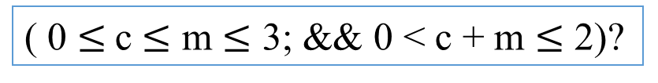
Example Problems – Missionaries and Cannibals
States: number of missionaries, cannibals, and the boat near the river bank
Initial state: all objects near the riverbank
Operators: move the boat with m missionaries and c cannibals to the other side of the river
no more cannibals than missionaries on either river bank or in boat
boat holds at most 2 occupants
Goal: all objects on the far river bank
Path cost: 1 per river crossing
Missionaries and cannibals applet
( 0 $≤$c $≤$ m $≤$ 3; && 0 < c + m $≤$ 2)?

Slide 95
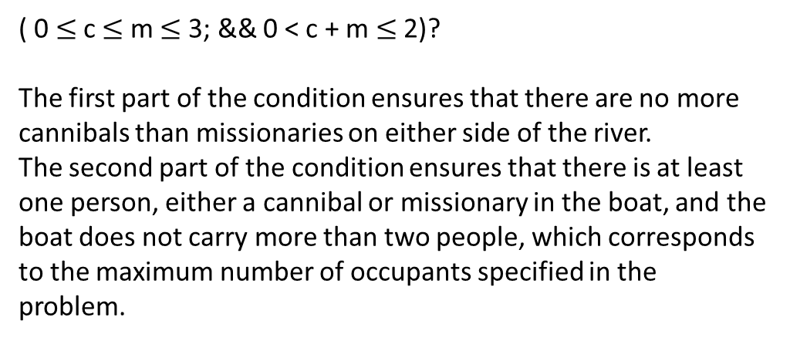
( 0 $≤$c $≤$ m $≤$ 3; && 0 < c + m $≤$ 2)?
The first part of the condition ensures that there are no more cannibals than missionaries on either side of the river.
The second part of the condition ensures that there is at least one person, either a cannibal or missionary in the boat, and the boat does not carry more than two people, which corresponds to the maximum number of occupants specified in the problem.

Slide 96
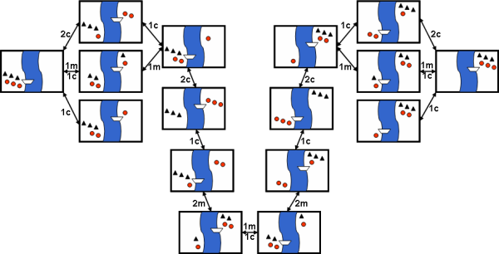
The complete search space is
Cannibal
Missionary
breadth first search

Slide 97
Solution:-
The state of this problem can be defined as
{(m_{i}, c_{j}) | m_{i} = 0, 1, 2, 3, and c_{j} = 0, 1, 2, 3} where
m_{i} represents the number of missionaries on one side of a river, and
c_{j} represents the number of cannibals on the same side of the river.
The initial state is (3, 3) at bank 1 and (0, 0) at bank 2.
    It means that three missionaries and three cannibals are on one side (Bank 1) of a river and ( 0, 0) on another side (bank 2) of the river.
The goal state is to get (3,3) at bank 2 and (0,0) at bank 1.

Slide 98
Solution:-
…
To solve this problem, we will make the following assumptions:
  The number of cannibals should be less than the number of missionaries on either side.
  2. Only one boat is available to travel.
  Only one or a maximum of two people can go in the boat at a
  time.
  4. All six have to cross the river from the bank.
  There is no restriction on the number of trips that can be made to reach the goal.
  6. Both the missionaries and cannibals can row the boat.

Slide 99
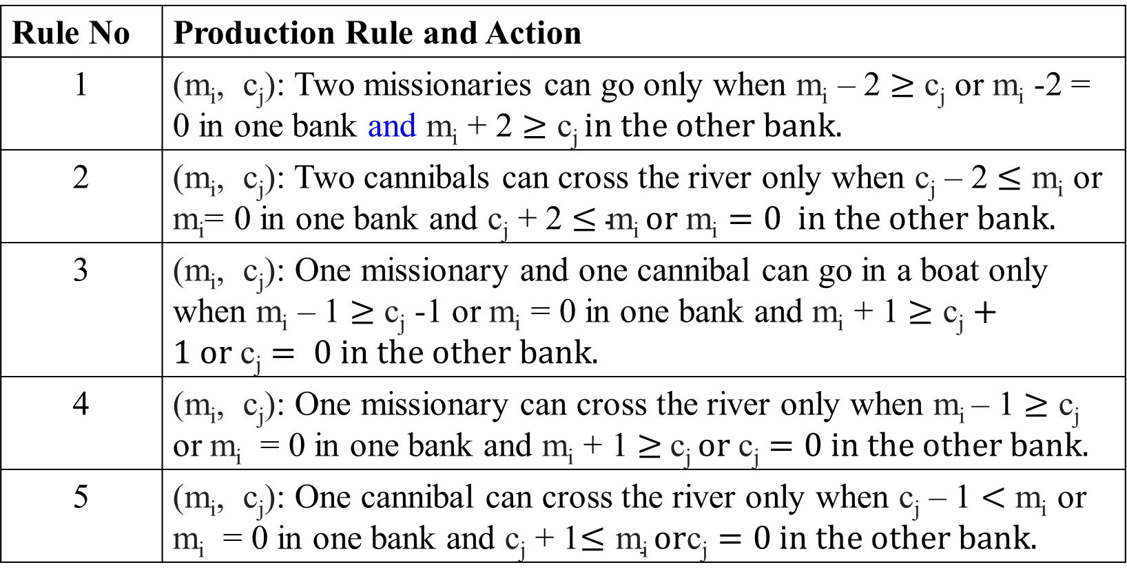
Production Rules for Missionaries m_{i} and Cannibal c_{j} Problem.
Rule No | Production Rule and Action
1 | (m_{i}, c_{j}): Two missionaries can go only when m_{i} – 2 $≥$ c_{j} or m_{i} -2 = 0 in one bank and m_{i} + 2 $≥\text{c}\text{j} in the other bank.$
2 | (m_{i}, c_{j}): Two cannibals can cross the river only when c_{j} – 2 $≤$ m_{i} or m_{i}= 0 in one bank and c_{j} + 2 $≤\text{m}\text{i} or \text{m}\text{i}=0 in the other bank.$
3 | (m_{i}, c_{j}): One missionary and one cannibal can go in a boat only when m_{i} – 1 $≥$ c_{j} -1 or m_{i} = 0 in one bank and m_{i} + 1 $≥\text{c}\text{j}+1 or \text{c}\text{j}= 0 in the other bank.$
4 | (m_{i}, c_{j}): One missionary can cross the river only when m_{i} – 1 $≥$ c_{j} or m_{i} = 0 in one bank and m_{i} + 1 $≥$c_{j} $or \text{c}\text{j}=0$in the other bank.
5 | (m_{i}, c_{j}): One cannibal can cross the river only when c_{j} – 1 $<$ m_{i} or m_{i} = 0 in one bank and c_{j} + 1$≤\text{m}\text{i} or\text{c}\text{j}=0$in the other bank.

Slide 100
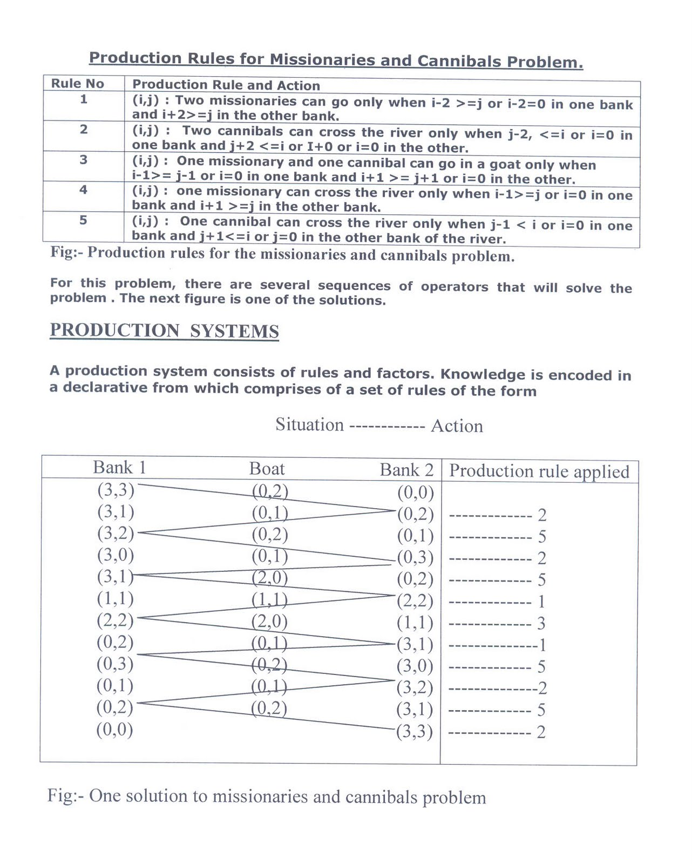

Slide 101
from collections import deque
class State:
def __init__(self, missionaries, cannibals, boat):
self.missionaries = missionaries
self.cannibals = cannibals
self.boat = boat
def is_valid(self):
if self.missionaries < 0 or self.cannibals < 0:
return False
if self.missionaries > 3 or self.cannibals > 3:
return False
if self.missionaries < self.cannibals and self.missionaries > 0:
return False
if 3 - self.missionaries < 3 - self.cannibals and 3 - self.missionaries > 0:
return False
return True
def is_goal(self):
return self.missionaries == 0 and self.cannibals == 0 and self.boat == 0
def __eq__(self, other):
return self.missionaries == other.missionaries and self.cannibals == other.cannibals and self.boat == other.boat
def __hash__(self):
return hash((self.missionaries, self.cannibals, self.boat))
def __repr__(self):
return f"State({self.missionaries}, {self.cannibals}, {self.boat})"
def get_successors(state):
successors = []
moves = [(1, 0), (2, 0), (0, 1), (0, 2), (1, 1)]
for move in moves:
if state.boat == 0: # Boat is on the near side
new_state = State(state.missionaries - move[0], state.cannibals - move[1], 1)
else: # Boat is on the far side
new_state = State(state.missionaries + move[0], state.cannibals + move[1], 0)
if new_state.is_valid():
successors.append(new_state)
return successors
def bfs(initial_state):
visited = set()
queue = deque([initial_state])
while queue:
state = queue.popleft()
if state.is_goal():
return state
visited.add(state)
successors = get_successors(state)
for successor in successors:
if successor not in visited:
queue.append(successor)
return None
def print_solution(solution):
path = []
while solution:
path.append(solution)
solution = solution.parent
for t in reversed(path):
print(t)
initial_state = State(3, 3, 1)
solution = bfs(initial_state)
print_solution(solution)

Slide 102
WaterJugProblem
Statement:-
Given 2 jugs, one 4-gallon jug and one 3-gallon jug.
Neither has any measuring markers on it.
A pump can be used to fill the jugs with water.
How can we get exactly 2 gallons of water into the 4-gallon jugs?
( 0 0)
( 0 4)
( 3 1)
( 0 1)
( 1 0)
( 1 4)
( 3 2)
(0, 0)
(0, 3)
(3, 0)
(3, 3)
(4, 2)
(0, 2)
(2, 0)
4 gl
(4, 1)
3 gl

Slide 103
To solve this, we must make some assumptions not mentioned in the problem. They are
  We can fill a jug from the pump.
  We can pour water out of a jug to the ground.
  We can pour water from one jug to another.
  There is no measuring device available.

Slide 104
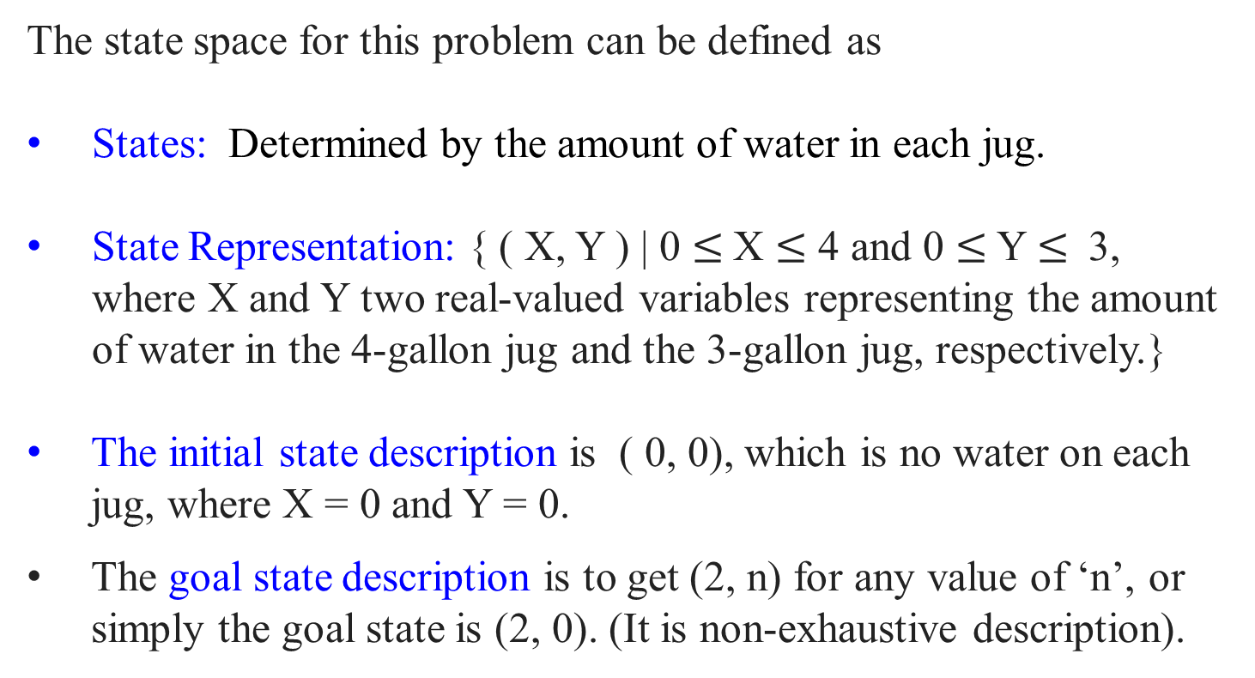
The Water Jugs Problem
The state space for this problem can be defined as
States: Determined by the amount of water in each jug.
State Representation: { ( X, Y ) | 0 $≤$X $≤$ 4 and 0 $≤$Y $≤$ 3, where X and Y two real-valued variables representing the amount of water in the 4-gallon jug and the 3-gallon jug, respectively.}
The initial state description is ( 0, 0), which is no water on each jug, where X = 0 and Y = 0.
The goal state description is to get (2, n) for any value of ‘n’, or simply the goal state is (2, 0). (It is non-exhaustive description).

Slide 105

Example Problems –Water Jug
States: Contents of 4-gallon jug X and 3-gallon jug Y
Initial state: (0, 0)
Operators:
fill jug X from the faucet
pour contents of jug X into jug Y until Y is full
dump contents of jug X down drain
Goal: (2, n)
Path cost: 1 per fill the jug
X
Y

Slide 106
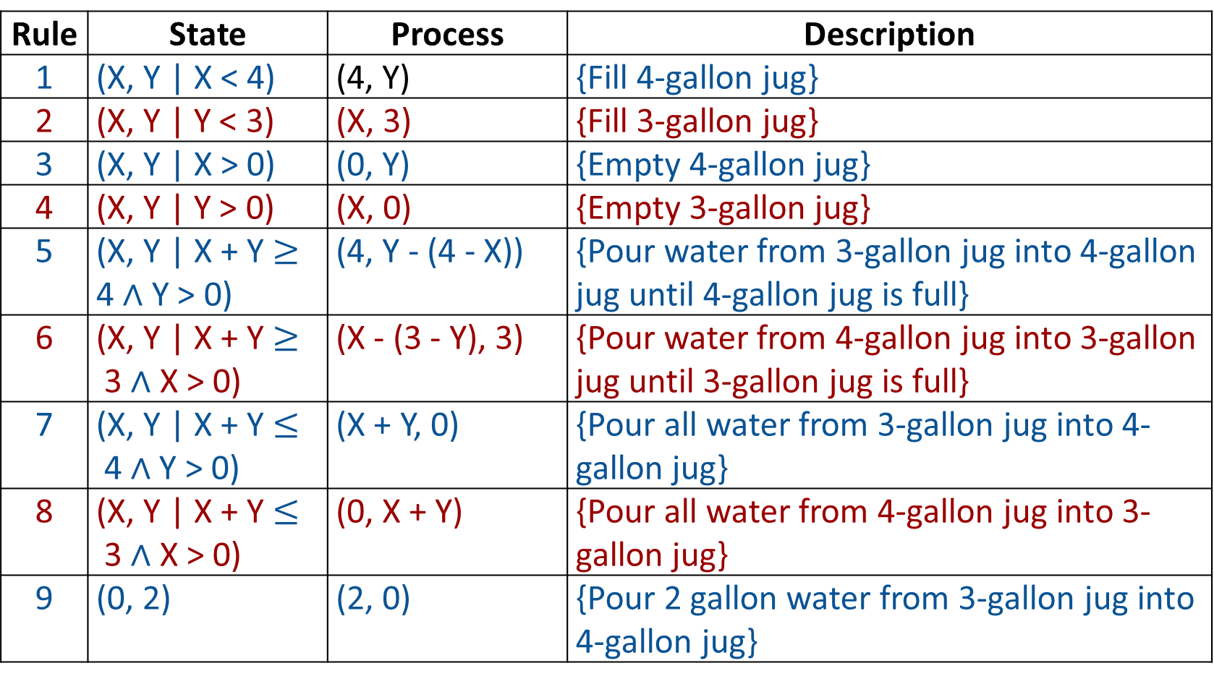
Production rules for the water jug problem
Rule | State | Process | Description
1 | (X, Y | X < 4) | (4, Y) | {Fill 4-gallon jug}
2 | (X, Y | Y < 3) | (X, 3) | {Fill 3-gallon jug}
3 | (X, Y | X > 0) | (0, Y) | {Empty 4-gallon jug}
4 | (X, Y | Y > 0) | (X, 0) | {Empty 3-gallon jug}
5 | (X, Y | X + Y $≥$ 4 $∧$ Y > 0) | (4, Y - (4 - X)) | {Pour water from 3-gallon jug into 4-gallon jug until 4-gallon jug is full}
6 | (X, Y | X + Y $≥$3 $∧$ X > 0) | (X - (3 - Y), 3) | {Pour water from 4-gallon jug into 3-gallon jug until 3-gallon jug is full}
7 | (X, Y | X + Y $≤$4 $∧$Y > 0) | (X + Y, 0) | {Pour all water from 3-gallon jug into 4-gallon jug}
8 | (X, Y | X + Y $≤$3 $∧$ X > 0) | (0, X + Y) | {Pour all water from 4-gallon jug into 3- gallon jug}
9 | (0, 2) | (2, 0) | {Pour 2 gallon water from 3-gallon jug into 4-gallon jug}

Slide 107
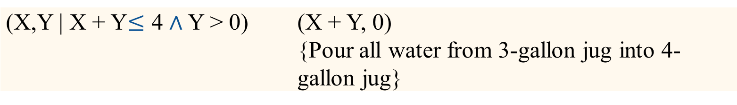
(0, 0)
(0, 3)
(3, 0)
(3, 3)
(4, 2)
(0, 2)
(2, 0)
Initialization:
Start State: (0,0)
Apply Rule 2:
(X,Y | Y < 3) → (X, 3)
{Fill 3-gallon jug}
Now the state is (0, 3)
Iteration 1:
Current State: (0, 3)
Apply Rule 7:
Now the state is (3, 0)
(X,Y | X + Y$≤$ 4 $∧$ Y > 0) | (X + Y, 0) {Pour all water from 3-gallon jug into 4-gallon jug}

Slide 108
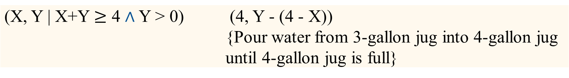
Iteration 2:
Current State : (3,0)
Apply Rule 2:
(X, Y | Y < 3) → (3, 3)
{Fill 3-gallon jug}
Now the state is (3, 3)
Iteration 3:
Current State:(3, 3)
Apply Rule 5:
Now the state is (4, 2)
(0, 0)
(0, 3)
(3, 0)
(3, 3)
(4, 2)
(0, 2)
(2, 0)
(X, Y | X+Y $≥$ 4 $∧$ Y > 0) | (4, Y - (4 - X)) {Pour water from 3-gallon jug into 4-gallon jug until 4-gallon jug is full}

Slide 109
(0, 0)
(0, 3)
(3, 0)
(3, 3)
(4, 2)
(0, 2)
(2, 0)
Iteration 4:
Current State : (4, 2)
Apply Rule 3:
Now the state is (0, 2)
Iteration 5:
Current State : (0, 2)
Apply Rule 9:
Now the state is (2, 0)
Goal Achieved.
(X,Y | X > 0) | (0, Y) {Empty 4-gallon jug}
(0, 2) | (2, 0) {Pour 2-gallon water from 3-gallon jug into 4-gallon jug}

Slide 110
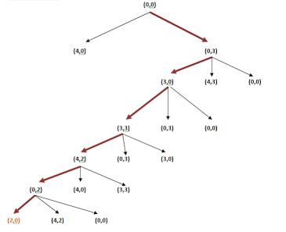
State Space Tree:
(1, 3)
(1, 0)
(0, 1)
(0, 3)
(4, 1)
(3, 0)
(3, 0)
(2, 3)

Slide 111
The Water Jugs Problem – Another Way for formulating the problem.

Slide 112
The Water Jugs Problem
States: Determined by the amount of water in each jug.
State Representation: Two real-valued variables, J3 and J4, indicate the amount of water in the two jugs, with the constraints:
0 ≤ J3 ≤ 3, 0 ≤ J4 ≤ 4
Initial State Description:
J3 = 0, J4 = 0
Goal State Description:
J4 = 2 ⇐ non exhaustive description

Slide 113
The Water Jugs Problem: Some of the Operators are:
F4: fill jug4 from the pump.
precond: J4 < 4 effect: J′4 = 4
E4: empty jug4 on the ground.
precond: J4 > 0 effect: J′4 = 0
E4-3: pour water from jug4 into jug3 until jug3 is full.
precond: J3 < 3, effect: J′3 = 3,
J4 ≥ 3 − J3 J′4 = J4 − (3 − J3)
P3-4: pour water from jug3 into jug4 until jug4 is full.
precond: J4 < 4, effect: J′4 = 4,
J3 ≥ 4 − J4 J′3 = J3 − (4 − J4)
E3-4: pour water from jug3 into jug4 until jug3 is empty.
precond: J3 + J4 < 4, effect: J′4 = J3 + J4,
J3 > 0 J′3 = 0

Slide 114
The Water Jugs Problem
Search Graph:
Problem:
J3 = 0
J4 = 0
J3 = 0
J4 = 0
J4 = 2
F4
F3
J3 = 0
J4 = 4
J3 = 3
J4 = 0
F3
P4-3
F4
E3-4
J3 = 3
J4 = 4
J3 = 3
J4 = 1
J3 = 3
J4 = 4
J3 = 0
J4 = 3
…
…
…
F3
J3 = 0
J4 = 2
E3-4
J3 = 2
J4 = 0
E4
J3 = 2
J4 = 4
P3-4
J3 = 3
J4 = 3

Slide 115
Real-World Search Problems
Route Finding
(computer networks, airline travel planning systems, . . . )
Travelling Salesman Optimization Problem
(package delivery, automatic drills, . . . )
Layout Problems
(VLSI layout, furniture layout, packaging, . . . )
Assembly Sequencing
(assembly of electric motors, . . . )
Task Scheduling
(manufacturing, timetables, . . . )

Slide 116
More Sample Search Problems
Graph coloring
Protein folding
Game playing
Airline travel
Proving algebraic equalities
Robot motion planning

Slide 117
Problem Solution
A problem’s solution is a description of how to reach a goal state from the initial state:
Examples:
  n-puzzle
  route-finding problem
  assembly sequencing
Occasionally, a problem’s solution is simply a description of the goal state itself:
Examples:
  8-queen problem
  scheduling problems
  layout problems

Slide 118
Other Problem Examples for References

Slide 119
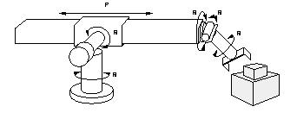
Example Problems – Robot Assembly
States: real-valued coordinates of
robot joint angles
parts of the object to be assembled
Operators/Actions: rotation of joint angles - continuous motions of robot joints
Goal test: complete assembly
Path cost: time to complete assembly

Slide 120

Example Problems – Towers of Hanoi
States: combinations of poles and disks
Operators: move disk x from pole y to pole z subject to constraints
cannot move a disk on top of a smaller disk
cannot move a disk if other disks on top of the disk
Goal test: disks from largest (at the bottom) to smallest on the goal pole
Path cost: 1 per move
Towers of Hanoi applet
1 2 3

Slide 121
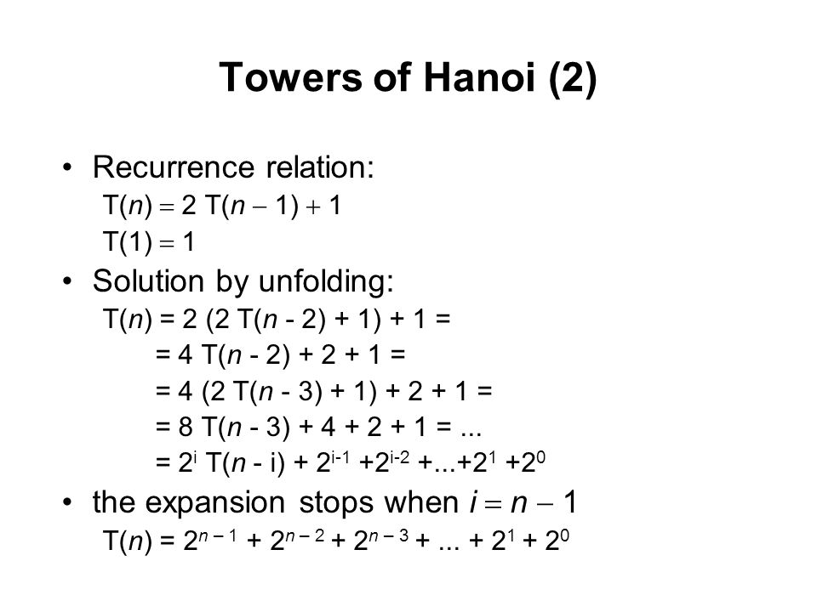
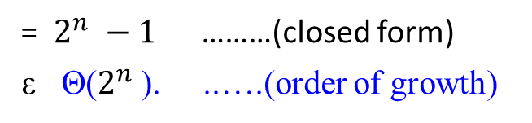
Example Problems – Towers of Hanoi
= $2^{n} −1$………(closed form)
ε Θ($2^{n}$). ..….(order of growth)

Slide 122
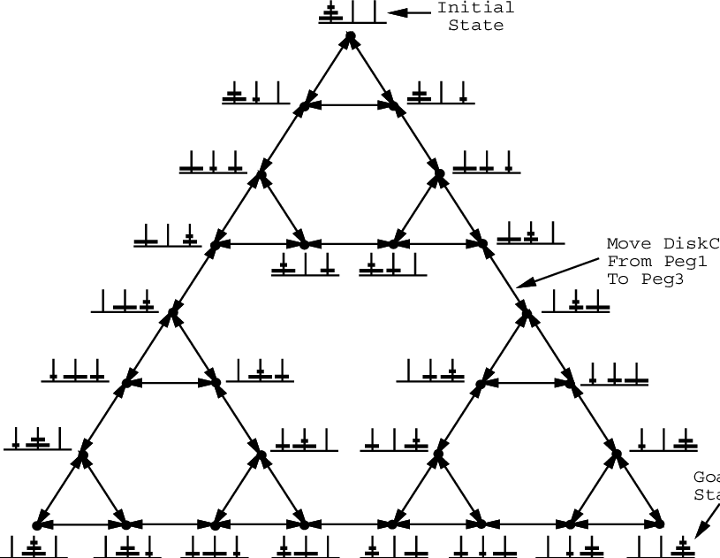
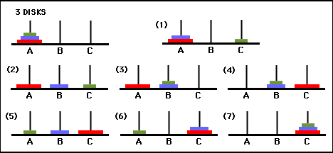

Slide 123
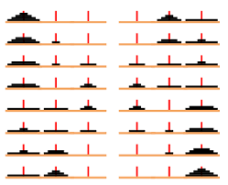
Disks | Move
1 | 1
2 | 3
3 | 7
4 | 15
5 | 31
6 | 63
7 | 127
8 | 255
9 | 5111023
10

Slide 124
n | Number of moves using the 3-peg algorithm | Number of moves using the 4-peg algorithm
1 | 1 | 1
2 | 3 | 3
3 | 7 | 5
4 | 15 | 9
5 | 31 | 13
6 | 63 | 17
7 | 127 | 25
8 | 255 | 33
9 | 511 | 41
10 | 1023 | 49
16 | 65535 | 161
32 | 4294967295 | 1281
64 | 18446744073709551615 | 18433
 | T(n) = 2 T(n-1) + 1 T(n) = n² – 1 T(1) = 1

Slide 125
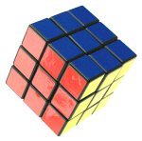
Example Problems – Rubik’s Cube
States: list of colors for each cell on each face
Initial state: one specific cube configuration
Operators/actions: rotate row x or column y on face z direction a
Goal: configuration has only one color on each face
Path cost: 1 per move
Rubik’s cube applet

Slide 126
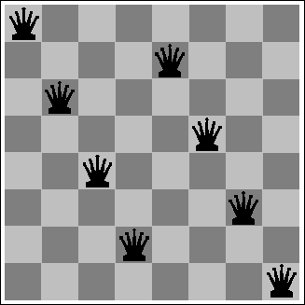
Example Problems – Eight Queens
States: locations of 8 queens on chess board
Initial state: one specific queen configuration
Operators/Actions: move queen x to row y and column z
Goal: no queen can attack another (cannot be in the same row, column, or diagonal)
Path cost: 0 per move
Eight queens applet

Slide 127

Example Problems – Eight Queens
The eight queens puzzle has 92 distinct solutions. If solutions that differ only by the symmetry operations of rotation and reflection of the board are counted as one, the puzzle has 12 solutions. These are called fundamental solutions.
The problem of finding all solutions to the 8-queens problem can be quite computationally expensive, as there are 4,426,165,368 (i.e., ₆₄C₈) possible arrangements of eight queens on an 8×8 board, but only 92 solutions if using the brute-force computational techniques. ..
₆₄C₈ = $\frac{64!}{8!\left(64 −8\right)!}, where\frac{64!}{\left(64 −8\right)!} is permutation.$

Slide 128
Backtracking Algorithm
The idea is to place queens one by one in different columns,
starting from the leftmost column.
When placing a queen in a column,
  We check for clashes with already placed queens.
In the current column,
  If we find a row for which there is no clash,
    We mark this row and column as part of the solution.
  If we do not find such a row due to clashes,
    then we backtrack and return false.

Slide 129
Backtracking Algorithm
The idea is to place queens one by one in different columns, starting from the leftmost column.
Start in the leftmost column
If all queens are placed, return true
Try all rows in the current column.
Do the following for every tried row.
  If the queen can be placed safely in this row
  then mark this [row, column] as part of the solution and
  recursively check if placing queen here leads to a solution.
  b) If placing the queen in [row, column] leads to a solution
  then return true.
  c) If placing queen doesn't lead to a solution
  then unmark this [row, column] (Backtrack) and
  go to step (a) to try other rows.
In 3), if all rows have been tried and nothing worked,
return false to trigger backtracking.

Slide 130
More on Graphs

