Slide 1
Artificial Intelligence
Chapter 02
Intelligent Agents

Slide 2
Outline
Agents and environments
Rationality
PEAS (Performance measure, Environment, Actuators, Sensors)
Environment types
Agent types

Slide 3
Agents
An agent is a system (entity) that can
    perceive (recognize) its environment through sensors and
    act on the environment through actuators/effectors
The agent’s behavior (act) is described by its function f that maps
percept P* to action A.
        f : P* → A
• A rational agent is an agent whose acts try to maximize some
performance measure.
perceive - to become aware of through the senses;

Slide 4
Turing (1950) "Computing machinery and intelligence":
"Can machines think?" → "Can machines behave intelligently? "
  Measure in terms of fidelity to human performance
    (i.e., think and act like humans)
  Measure against rationality
    (think and act rationally).
A system is rational if,
  given what it knows, it does the “right thing”.

Slide 5
As in economics, the term rational is defined:
  Rational: maximally achieving pre-defined goals
  Rational only concerns what decisions are made
not how the decisions are made
  Being rational means maximizing your expected utility
    Goals are expressed in terms of the utility of outcomes
Agent Type | Percepts (S) P* | Actions (A) A | Goals (P) | Environment (E)
Part-picking robot | Pixels of varying intensity | Pick up parts and sort into bins | Place parts in correct bins | Conveyor belt with parts
Utility – in economics, the benefit that a chosen course of action affords,
_ usefulness

Slide 6
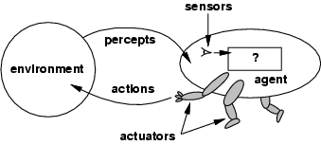

Agents and environments
Sensors
Agent
Environment
Percepts
?
Actions
Actuators

Slide 7
Summary: Definition of an Intelligent Agent
What is an Intelligent Agent?
An agent
  gets percepts, one at a time, to form states and
  maps this percept sequence to actions through the decision-action rules.
  is rational (as defined in economics)
    the agent directs its activity toward achieving goals
    learns or uses knowledge to achieve their goals.

Slide 8
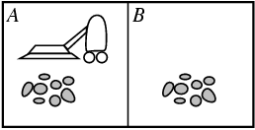

Vacuum-cleaner world: An Agent
The vacuum agent:
Percepts: The agent senses its’ location and “cleanliness”, e.g.,
  two locations: squares A and B
  contents: dirt or no dirt in the square
  location and contents, e.g., [A, Dirty], [A, Clean], [B, Dirty], [B, Clean]
  With 2 locations, there are 4 possible distinct sensor inputs (percepts).
Actions: move Left or Right, Suck up the dirt, NoOp - do nothing

Slide 9
A Vacuum-Cleaner Agent
Percept sequence P* | Action A
[A, Clean] [A, Dirty] [B, Clean] [B, Dirty] [A, Clean], [A, Clean] [A, Clean], [A, Dirty] [A, Clean], [A, Clean] [B, Dirty] [A, Clean], [A, Clean] [B, Clean] ... [A, Clean], [A, Clean], [A, Clean] [A, Clean], [A, Clean], [A, Dirty] ... | Right Suck Left Suck Right Suck Suck Left ... Right Suck ...

Slide 10
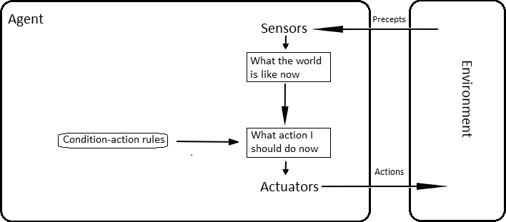
A vacuum-cleaner agent
Simple reflex agent
The agent’s simple function (condition-action
rules) is:
  if the current square is dirty, then suck;
  otherwise, move to the other square.
It’s a simple reflex agent because it:
is in a two-state vacuum environment,
(Location, Dirty) or (Location, Clean)
get percepts
  selects actions
    based on the current percept,
    disregard the rest of the percept history.
  makes its (rational) decision based only on
    the current location and
    whether that location contains dirt.
A simple reflex agent is a type of agent in artificial intelligence (AI) that selects actions based on the current percept without considering the percept history. Its behavior is determined by a set of condition-action rules, which specify what action to take in response to certain conditions or percepts.

Slide 11
A vacuum-cleaner agent
An agent program for this simple reflex vacuum agent is:
function REFLEX_VACUUM_AGENT(location, status) returns an action
if status = Dirty then return Suck
else if location = A then return Right
else if location = B then return Left
Pbm: How do you evaluate status = Dirty?
location = A?
location = B?

Slide 12
A vacuum-cleaner agent
Problem:
Consider a simple reflex vacuum agent
has only a dirt sensor without a location sensor, and
has only two percepts: [Dirty] and [Clean].
Its action is that it can Suck in response to [Dirty].
Fails to move Left if it starts in square A.
Fails to move Right if it starts in square B.
Infinite loops are often unavoidable for simple reflex agents operating in partially observable environments.

Slide 13
Consider the drive of an automated car C.
If the car in front brakes and its brake lights come on,
  C sees this and initiates braking. (car_in_front, braking) …state
Based on the percepts perceived as input,
  the agent program C has a connection to a condition-action rule:
if car_in_front_is_braking then initiate_braking.

Slide 14
Consider the drive of an automated car C.
If the car in front brakes and its brake lights come on,
  C sees this and initiates braking. (car_in_front, braking) …state
Based on the percepts perceived as input,
  the agent program C has a connection to a condition-action rule:
if car_in_front_is_braking then initiate_braking.

Slide 15
An example illustrates a simple reflex agent in the context of an automated car.
Scenario:
The automated car (agent) observes its environment through sensors.
If it detects that the car in front is braking (via brake lights or speed reduction), it must react to avoid a collision.
Agent's Percepts:
Input percept:
The agent's sensors detect that the car in front is braking (e.g., via brake lights or reduced speed).
State:
The perceived input maps to a state: (car_in_front, braking).

Slide 16
Condition-Action Rule:
The agent uses a predefined condition-action rule to respond:
Condition: If car_in_front_is_braking.
Action: Then initiate_braking.
Execution:
When the agent program receives the percept:
It matches the percept (car_in_front, braking) to the corresponding condition in its rule base.
The condition triggers the action initiate_braking, causing the car to reduce its speed or stop.

Slide 17
Example in Real-Time Driving:
Percept:
    Car C detects the brake lights of the car in front.
    Sensors calculate the distance between C and the car ahead.
Rule Application:
    The condition car_in_front_is_braking evaluates as true.
    The action initiate_braking is executed.
Outcome:
    Car C slows down, maintaining a safe following distance.
Advantages:
Immediate Reaction: The simple reflex agent provides quick, real-time responses.
Safety: Ensures basic collision avoidance in straightforward scenarios.

Slide 18
Explore how this setup could be extended with additional states (e.g., weather, speed, or road conditions) or advanced agent designs (e.g., learning agents).

Slide 19
The simple reflex agent program
  perceives an instance from an environment. (percept)
  interprets a percept to form a state in schematic for condition-action rules
  applies Rule_Match(state, rules) to determine a rule set
  then, creates rule sets for specific task environments. (action = rule.Action)

Slide 20
The working process of a simple reflex agent program, highlighting its key functions:
Perceives an Instance from an Environment:
The agent perceives its environment through its sensors, receiving input in the form of a percept.
Interprets the Percept to Form a State:
The agent processes the percept and maps it to a specific state, which represents the current condition of the environment.
Applies Condition-Action Rules:
Based on the state, the agent uses a predefined set of condition-action rules. These rules match the current state to determine the appropriate action to perform.
Creates Rule Sets:
The rules are specific to the task environment the agent is designed for. The output action (derived from the rule) is executed.

Slide 21
Schematic diagram of a simple reflex agent.
Use simple “if then” rules
Agent
Sensors
percept
State: What the world is like now
Environment
Rule_Match(state, rules)
Action: What action I should do now
Condition-action rules
rule sets
action = rule.Action)
Actuators

Slide 22

function SIMPLE_REFLEX_AGENT(percept) returns an action
  persistent: rules, a set of condition-action rules
  state INTERPRET_INPUT(percept)
  rule RULE_MATCH(state, rules)
  action rule.ACTION
  return action
This will work only if
the correct decision can be made
  based on only the current percept,
  the environment is fully observable.
  A little bit of unobservability can cause serious trouble.
Persistent: continuing to grow; retained permanently

Slide 23
Example:
In a vacuum-cleaner environment:
  Percept: "Location A is dirty."
  State: "Dirty at A."
  Rule: If "Dirty at A," then "Clean A."
  Action: Clean A.
This type of agent does not maintain the memory of past states and acts solely based on its current percept.

Slide 24
More Examples of Artificial Agents
Agent Type | Percepts (S) | Actions (A) | Goals (P) | Environment (E)
Medical diagnosis system | Symptoms, findings, patient’s answers | Questions, tests, treatments | Healthy patient, minimize costs | Patient, hospital
Satellite image analysis system | Pixels of varying intensity, color | Print a categorization of scene | Correct categorization | Images from orbiting satellite
Part-picking robot | Pixels of varying intensity | Pick up parts and sort into bins | Place parts in correct bins | Conveyor belt with parts
Refinery controller | Temperature, pressure readings | Open, close valves; adjust temperature | Maximize purity, yield, safety | Refinery
Interactive English tutor | Typed words | Print exercises, suggestions, corrections | Maximize student’s score on test | Set of students

Slide 25
Rational Agents
The rationality of an agent depends on PEAS
Performance: the performance measure
  defining the agent’s criterion and degree of success (goals)
Sensors: the percept sequence
the sequence of all the things perceived by the agent
Environment: the agent’s knowledge of the environment
Actuators: the actions that the agent can perform
For each possible percept sequence, an ideally rational agent
    does (A) whatever is possible to maximize its performance (P),
based on the percept sequence (S) and its built-in knowledge (E).

Slide 26
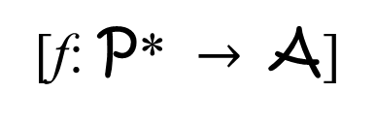
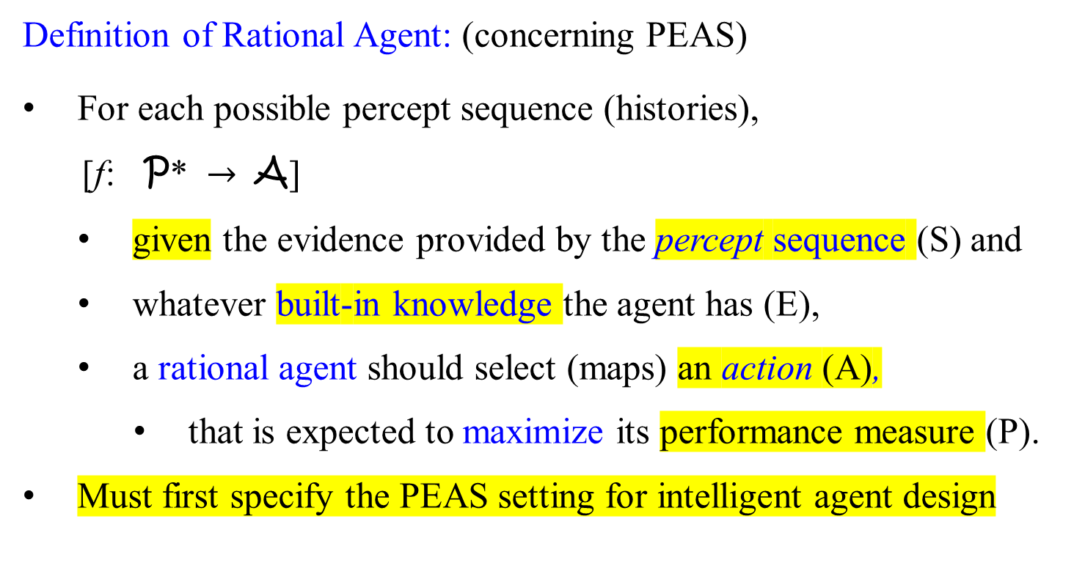
Rational agents
[f: P* $→$ A]
Definition of Rational Agent: (concerning PEAS)
For each possible percept sequence (histories),
[f: P* $→$ A]
given the evidence provided by the percept sequence (S) and
whatever built-in knowledge the agent has (E),
a rational agent should select (maps) an action (A),
that is expected to maximize its performance measure (P).
Must first specify the PEAS setting for intelligent agent design

Slide 27

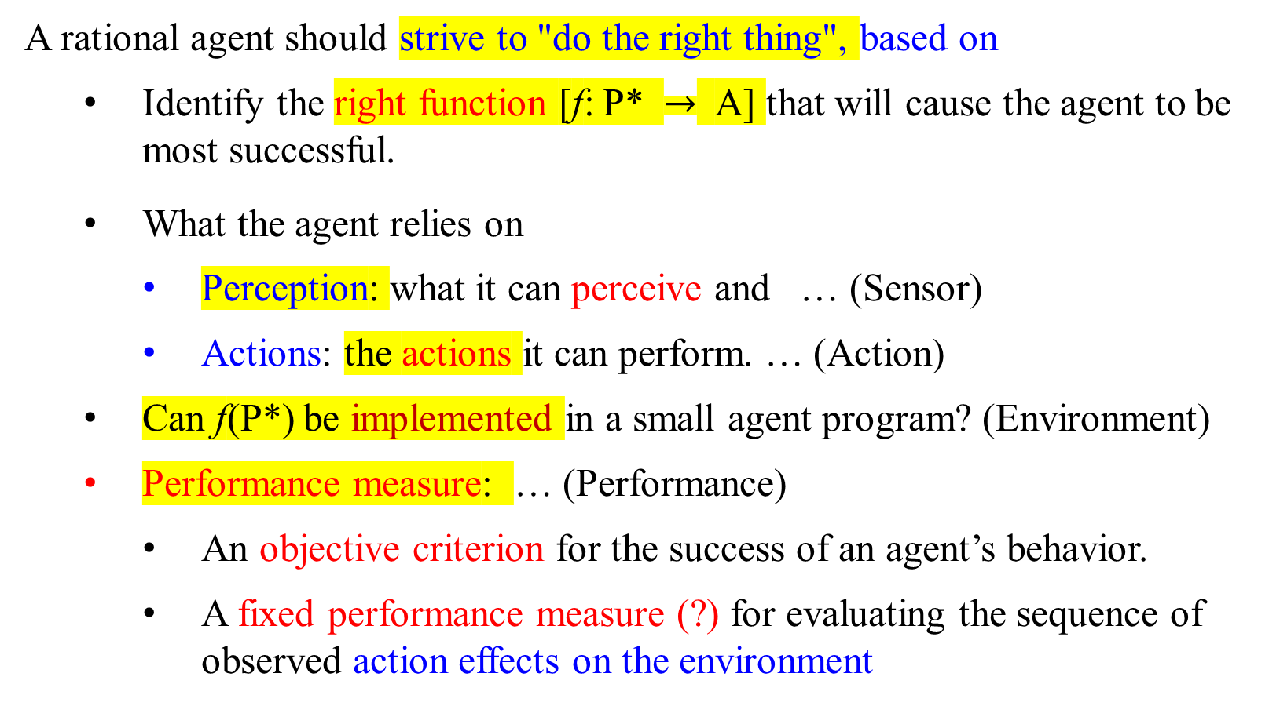
Rationality
A rational agent should strive to "do the right thing", based on
  Identify the right function [f: P* $→$ A] that will cause the agent to be most successful.
What the agent relies on
  Perception: what it can perceive and … (Sensor)
  Actions: the actions it can perform. … (Action)
    Can f(P*) be implemented in a small agent program? (Environment)
  Performance measure: … (Performance)
    An objective criterion for the success of an agent’s behavior.
    A fixed performance measure (?) for evaluating the sequence of observed action effects on the environment

Slide 28
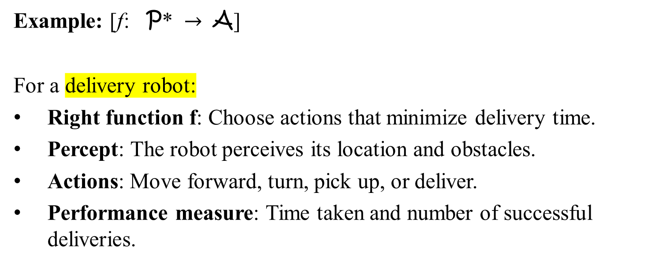
Example: [f: P* $→$ A]
For a delivery robot:
Right function f: Choose actions that minimize delivery time.
Percept: The robot perceives its location and obstacles.
Actions: Move forward, turn, pick up, or deliver.
Performance measure: Time taken and number of successful deliveries.

Slide 29
PEAS : Applications
To design a rational agent, we must specify:
  Performance measure
  Environment
  Actuators
  Sensors

Slide 30
Rationality
Example: For a vacuum-cleaner agent,
its performance measure metrics could be:
amount of dirt cleaned up, ………….numbers of steps to reach an exit
amount of time taken, ………………amount of time taken to reach it
amount of electricity consumed,
amount of noise generated, etc.
Fixed performance measure for evaluating the environment sequence:
one point per square cleaned up in time T?
one point per clean square, per time step, minus one point per move?
penalize for > k dirty squares? ……minus points per dead end
Minus one point per action (step, turn)……minus 1 point per action (step, turn).

Slide 32
PEAS : Applications
Example: Taxi Driver
Consider the task of designing an agent type, an automated taxi driver.
Need to define the PEAS from various “sources”:
Agent: Automated Taxi Driver
  Performance measure?
    Safe, fast, legal, comfortable trip, maximize profits, …
  Environment?
    Roads (streets/freeways), traffic, pedestrians, weather, …
  Actuators?
    Steering wheel, accelerator, brake, signal, horn, display, speaker, …
  Sensors?
    Cameras, speedometer, GPS, odometer, gauges, sonar, engine sensors, accelerometer

Slide 33
PEAS : Applications
Agent: Medical diagnosis system
Performance measure?
  Correct diagnosis(findings) for patient’s symptom, minimize costs, lawsuits, healthy patient
Environment?
  Patient, hospital, staff
Actuators?
  Screen display (questions, tests, diagnoses, treatments, referrals)
Sensors?
  Keyboard (entry of symptoms, findings, patient's answers)

Slide 34
PEAS : Applications
Agent: Part-picking robot
Performance measure?
  Percentage of parts in correct bins
Environment?
  Conveyor belt with parts, bins
Actuators?
  Jointed arm and hand
Sensors?
  Camera, joint angle sensors

Slide 35
PEAS : Applications
Agent: Interactive English tutor
Performance measure?
  Maximize student's score on test
Environment?
  Set of students
Actuators?
  Screen display (exercises, suggestions, corrections)
Sensors?
  Keyboard

Slide 37
Environment types
With respect to an agent, an environment may or may not be:
observable: the agent’s sensors detect all aspects of current percepts relevant to the choice of actions :(full, partial, un-)
deterministic: the current state and the actions selected by the agent determine the next state. :(stochastic, strategic)
episodic: divide the agent’s experience into “episodes”; the quality of the agent’s choice of actions does not depend on previous episodes :(sequential)
static: the environment remains unchanged while the agent is deliberating :(dynamic, semi-dynamic)
discrete: there are a limited number of defined and distinct percepts and actions :(continuous)
single-agent: there is only one agent in the environment :(multi-agent)
Experience:
Sequences of {States and actions}

Slide 38
Environment types - Examples
Environment | Observable | Deterministic | Episodic | Static | Discrete | Agents
Chess with a clock | Fully | Strategic | Sequential | Semi | Discrete | Multi
Chess without a clock | Fully | Strategic | Sequential | Static | Discrete | Multi
Poker | Partial | Strategic | Sequential | Static | Discrete | Multi
Backgammon | Fully | Stochastic | Sequential | Static | Discrete | Multi
Taxi driving | Partial | Stochastic | Sequential | Dynamic | Continuous | Multi
Medical diagnosis | Partial | Stochastic | Episodic | Static | Continuous | Single
Image analysis | Fully | Deterministic | Episodic | Semi | Discrete | Single
Robot part picking | Fully | Deterministic | Episodic | Semi | Discrete | Single
Interactive English tutor | Partial | Stochastic | Sequential | Dynamic | Discrete | Multi

Slide 39
Environment Type: the task environment is | Reasons: | Examples:
Full observable | an agent has access to the complete state of the environment with respect to the choice of actions. | Chess Robot part picking
Partial observable | incomplete state of environment | Poker Taxi driving Medical diagnosis
Unobservable | no sensors (The task environment is unobservable )

Slide 40
Environment types
Fully observable (vs. partially observable, unobservable):
  The task environment is fully observable:
  Example: robot part pick is fully observable
  taxi driver is partially observable.
  The task environment is unobservable:
  if the agent has no sensors at all.

Slide 41
Environment Type: the task environment is | Reasons: | Examples:
Deterministic | if the next state of the environment is completely determined by the current state and the action executed by the agent. | Image Analysis Robot part picking
Stochastic | the next state of the environment is randomly determined | Taxi Driving (changes from others)
Strategic | if the environment is deterministic and if also engaged in other agents’ actions; (waiting for the opponent’s move to derive the next state). | Chess with clock Chess without clock Poker
Involving random variable or proces. - stochastic

Slide 42
Environment types
Deterministic (vs. stochastic, strategic):
  The task environment is deterministic:
  Example: robot park picking is deterministic
  The task environment is stochastic:
  Example: taxi driver is stochastic
  The task environment is strategic:
  Example: chess with clock or without clock is strategic

Slide 43
Environment Type: the task environment is | Reasons: | Examples:
Episodic | If the agent's experience is divided into atomic "episodes“. For each episode, the agent perceives (receives a percept) and then performs a single action. The choice of action in each episode depends only on the episode itself. The agent does not need to think ahead. | Medical Diagnosis Image analysis Robot part picking
Sequential | If the current decision (short-term actions) could affect all future decisions (long-term consequences). i.e., short-term actions can have long-term consequences. | Chess Taxi-driving Poker

Slide 44
Environment types
Episodic (vs. sequential):
  The task environment is episodic:
    Example: To spot defective parts on an assembly line, an agent
    makes a decision on the current part, regardless of previous decisions.
    The current decision doesn’t affect whether the next part is defective.
  The task environment is sequential :
    Example: Chess and Taxi Driver are sequential.
    The short-term actions can have long-term consequences.
  Episodic environments are much simpler than sequential environments because the agent does not need to think ahead.
M

Slide 45

Environment Type: the task environment is: | Reasons: | Examples:
Static | If the environment is unchanged while the agent is deliberating | Crossword Puzzle Chess without clock Poker
Dynamic | Environment changes | Taxi driving
Semi-dynamic | if the environment itself does not change with the passage of time but the agent's performance score does change. | Chess with clock

Slide 46
Environment types
Static (vs. dynamic):
  Example:
    Taxi driving is dynamic: the other cars and the taxi itself keep moving while the driving algorithm dithers about what to do next.
    Chess, when played with a clock is semidynamic.
    Crossword puzzles are static.
M

Slide 47
Environment Type: the task environment is: | Reasons: | Examples:
Discrete | A limited number of distinct, clearly defined percepts and actions. | Chess Poker
Continuous | Continuous state, action and time problems The discrete/continuous distinction applies to: the state of the environment, the way time is handled, and the percepts and actions of the agent. | Taxi-driving

Slide 48
Environment types
Discrete (vs. continuous):
    Example:
    The chess environment has a finite number of distinct states (excluding the clock).
    chess has a discrete set of percepts and actions.
    Taxi driving is a continuous-state and continuous-time problem:
    the speed and location of the taxi and of the other vehicles sweep through a range of continuous values and do so smoothly over time.
    Taxi-driving actions are continuous (steering angles, etc.).
    Input from digital cameras is discrete.
    treated as representing continuously varying intensities and location.
M

Slide 49
Environment Type: the task environment is | Reasons: | Examples:
Single agent | Agent operating by itself in an environment | Crossword Puzzle
multiagent | two or more agents | Chess, Poker Taxi driving

Slide 50
Environment types
Single agent (vs. multiagent):
  Example:
    An agent solving a crossword puzzle by itself is clearly in a single-environment.
    An agent playing chess is in a two agent environment.
    An agent A (the taxi driver for example) treats
      an object B (another vehicle) as an agent or
      merely as an object behaving according to the laws of physics,
        analogous to waves at the beach or
        leaves blowing in the wind.
    The key distinction is whether B’s behavior is best described as maximizing a performance measure whose value depends on agent A’s behavior.
M

Slide 51
Environment Types
The environment type largely determines the agent design
The real world is (of course)
• partially observable,
• stochastic (instead of deterministic),
• sequential (instead of episodic),
• dynamic (instead of static),
• continuous (instead of discrete),
• multi-agent (instead of single-agent).

Slide 52
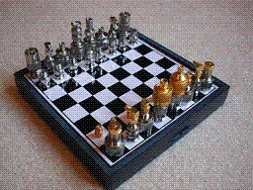
Environment Examples
Environment | Observable | Deterministic | Episodic | Static | Discrete | Agents
Chess with a clock | Fully | Strategic | Sequential | Semidyn… | Discrete | Multi
Chess without a clock | Fully | Strategic | Sequential | Static | Discrete | Multi
Given Environment Properties: slides referred
Fully observable vs. partially observable …..39
Deterministic vs. Stochastic/Strategic …..41
Episodic vs. Sequential …..43
Static vs. Dynamic …..45
Discrete vs. Continuous …..47
Single-agent vs. multiagent …...49

Slide 53
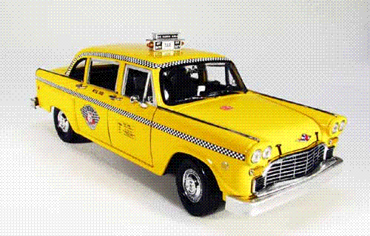
Environment Examples
Fully observable vs. partially observable
Deterministic vs. stochastic / strategic
Episodic vs. sequential
Static vs. dynamic
Discrete vs. continuous
Single agent vs. multiagent
Environment | Observable | Deterministic | Episodic | Static | Discrete | Agents
Chess with a clock | Fully | Strategic | Sequential | Semi | Discrete | Multi
Chess without a clock | Fully | Strategic | Sequential | Static | Discrete | Multi
Taxi driving | Partial | Stochastic | Sequential | Dynamic | Continuous | Multi

Slide 54

Environment Examples
Fully observable vs. partially observable
Deterministic vs. stochastic / strategic
Episodic vs. sequential
Static vs. dynamic
Discrete vs. continuous
Single agent vs. multiagent
Environment | Observable | Deterministic | Episodic | Static | Discrete | Agents
Chess with a clock | Fully | Strategic | Sequential | Semi | Discrete | Multi
Chess without a clock | Fully | Strategic | Sequential | Static | Discrete | Multi
Taxi driving | Partial | Stochastic | Sequential | Dynamic | Continuous | Multi
Medical diagnosis | Partial | Stochastic | Episodic | Static | Continuous | Single

Slide 55
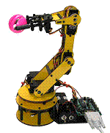
Environment Examples
Fully observable vs. partially observable
Deterministic vs. stochastic / strategic
Episodic vs. sequential
Static vs. dynamic
Discrete vs. continuous
Single agent vs. multiagent
Environment | Observable | Deterministic | Episodic | Static | Discrete | Agents
Chess with a clock | Fully | Strategic | Sequential | Semi | Discrete | Multi
Chess without a clock | Fully | Strategic | Sequential | Static | Discrete | Multi
Taxi driving | Partial | Stochastic | Sequential | Dynamic | Continuous | Multi
Medical diagnosis | Partial | Stochastic | Episodic | Static | Continuous | Single
Robot part picking | Fully | Deterministic | Episodic | Semi | Discrete | Single

Slide 56

Environment Examples
Fully observable vs. partially observable
Deterministic vs. stochastic / strategic
Episodic vs. sequential
Static vs. dynamic
Discrete vs. continuous
Single agent vs. multiagent
Environment | Observable | Deterministic | Episodic | Static | Discrete | Agents
Chess with a clock | Fully | Strategic | Sequential | Semi | Discrete | Multi
Chess without a clock | Fully | Strategic | Sequential | Static | Discrete | Multi
Taxi driving | Partial | Stochastic | Sequential | Dynamic | Continuous | Multi
Medical diagnosis | Partial | Stochastic | Episodic | Static | Continuous | Single
Robot part picking | Fully | Deterministic | Episodic | Semi | Discrete | Single
Interactive English tutor | Partial | Stochastic | Sequential | Dynamic | Discrete | Multi

Slide 57
Approaches to Agent Design

Slide 58
Agent Programs
An agent is a mapping from percepts to actions
        f : P* → A
we can design a program to implement this mapping.
An agent program could be as simple as a table lookup.

Slide 59
Percept sequence P* | Action A
[A, Clean] [A, Dirty] [B, Clean] [B, Dirty] [A, Clean], [A, Clean] [A, Clean], [A, Dirty] [A, Clean], [A, Clean] [B, Dirty] [A, Clean], [A, Clean] [B, Clean] ... [A, Clean], [A, Clean], [A, Clean] [A, Clean], [A, Clean], [A, Dirty] ... | Right Suck Left Suck Right Suck Suck Left ... Right Suck ...
Table-Lookup Driven Agents
Uses a percept_sequence_action table in memory to find the next action.
A Vacuum-Cleaner Agent
Implemented as a (large) lookup table.
Drawbacks:
Too large a table
Takes a long time to build/learn the table

Slide 60

Approaches to Agent Design
Simple Reflex Agent
  Table lookup of percept-action pairs defines all possible condition-action rules necessary to interact in an environment
  Problems
    Too big to generate and store
      Chess has about 10¹²⁰ states [… v.s. our problem: distinct grids_states]
      No knowledge of the non-perceptual parts of the current state (e.g., a losing move may trigger a sequence of winning moves)
    Not adaptive to changes in the environment;
      requires entire table to be updated if changes occur
    Looping: Can't make actions to be conditional

Slide 61
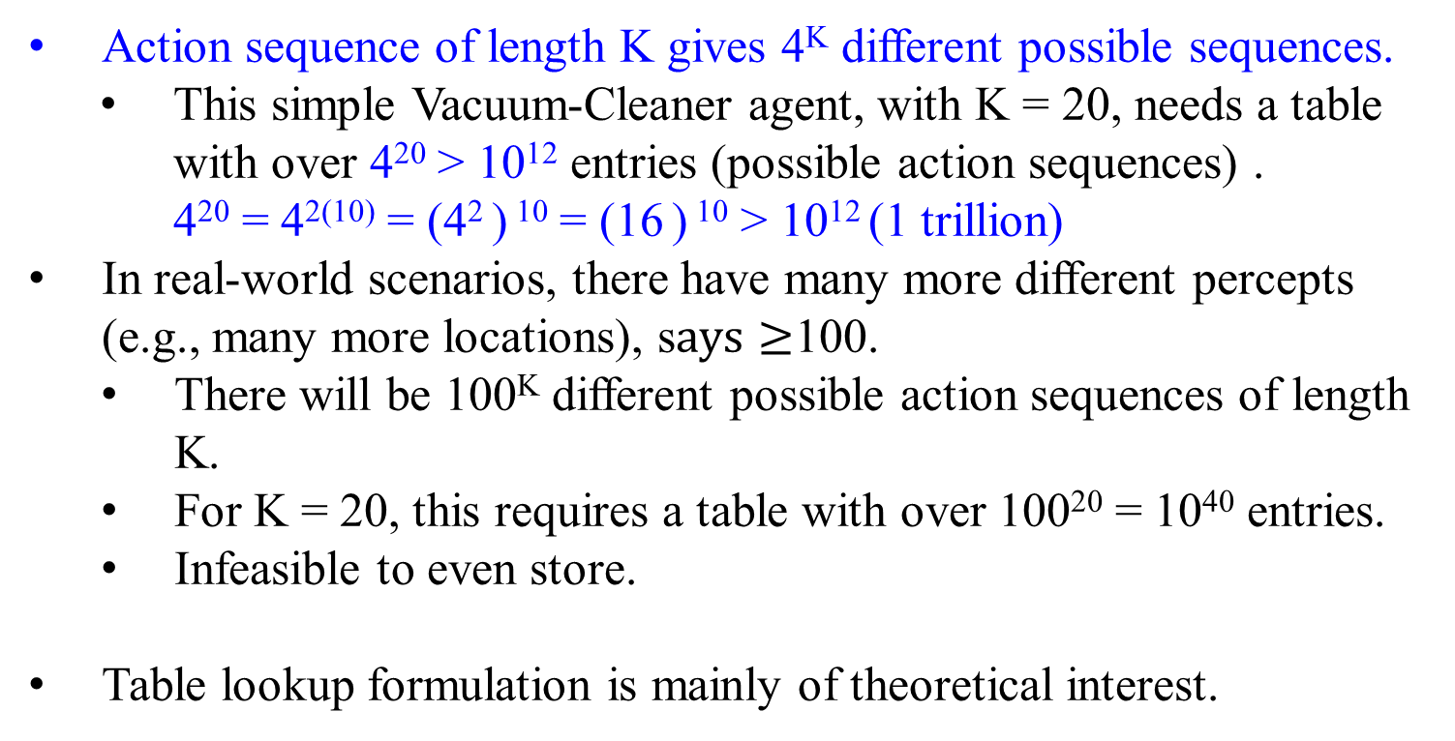
Table lookup
Action sequence of length K gives 4^{K} different possible sequences.
This simple Vacuum-Cleaner agent, with K = 20, needs a table with over 4²⁰ > 10¹² entries (possible action sequences) .
4²⁰ = 4²⁽¹⁰⁾ = (4² ) ¹⁰ = (16 ) ¹⁰ > 10¹² (1 trillion)
In real-world scenarios, there have many more different percepts (e.g., many more locations), s$ays≥$100.
  There will be 100^{K} different possible action sequences of length K.
  For K = 20, this requires a table with over 100²⁰ = 10⁴⁰ entries.
  Infeasible to even store.
Table lookup formulation is mainly of theoretical interest.
K=2, 4^{K} = 16
possible sequences:
A1, A1
A1, A2
A1, B1
A1, B2
A2, A1
A2, A2
A2, B1
A2, B2
B1, A1
B1, A2
B1, B1
B1, B2
B2, A1
B2, A2
B2, B1
B2, B2

Slide 62
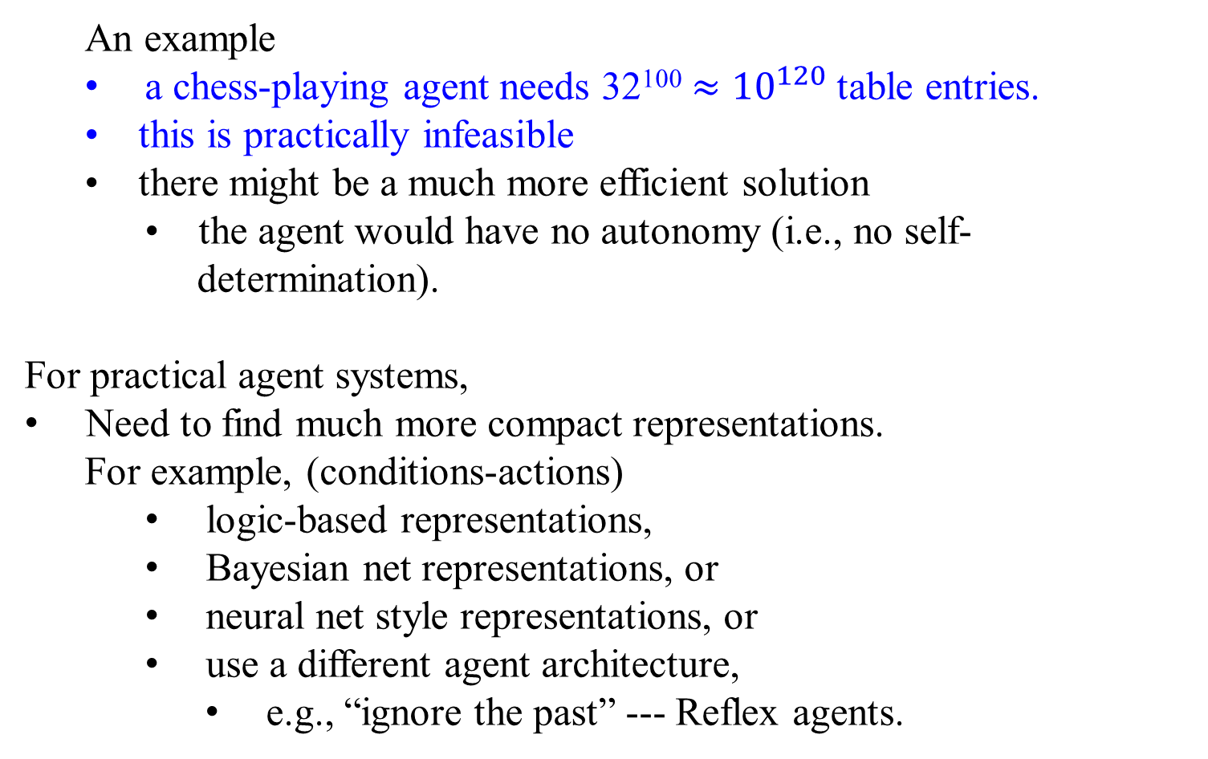
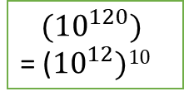
Table lookup
An example
a chess-playing agent needs 32¹⁰⁰ $≈$ ${10}^{120}$ table entries.
• this is practically infeasible
• there might be a much more efficient solution
  • the agent would have no autonomy (i.e., no self-determination).
For practical agent systems,
Need to find much more compact representations.
  For example, (conditions-actions)
    logic-based representations,
    Bayesian net representations, or
    neural net style representations, or
    use a different agent architecture,
      e.g., “ignore the past” --- Reflex agents.
$${ (10}^{120})$$
= (${10}^{12})10$

Slide 64

Implementation Issues
Types of Agents
: Approaches to Agent Design

Slide 65
Different Types of Agents
Agents programs can be divided into the following classes, with increasing levels of sophistication:
• Stateless reflex agents
• Stateful reflex agents
• Goal-based agents
• Utility-based agents
All these can be designed to be learning agents
Reflex: An automatic, involuntary response to a stimulus,

Slide 67
Agent types : Classes of intelligent agents
Four basic types (in order of increasing generality) -
Based on their ability to handle complex environments, i.e., their degree of perceived intelligence and capability :
  Simple reflex agents (stateless reflex agents):
    respond directly to percepts (e.g., red light, stop)
  Model-based reflex agents (stateful reflex agents) :
    maintain internal state to track
      Act on percepts that are not evident in the current percept.
      (e.g., green light, go; but a car crosses.)
  Goal-based agents :
    act to achieve their goals (e.g., reach a destination)
  Utility-based agents :
    try to maximize their own expected “happiness”
  Learning agents :
    improve their performance through learning.

Slide 68

Simple reflex agents
Agents do not have memory of past percepts (states of a given environment) or world states.
actions depend solely on current percept (state).
Action is a “reflex” of the current percept (state)
Uses condition-action rules.
    If the car’s tail light in front is red, then brake.
    If the traffic light in front becomes (is) yellow, then stop.
    If the traffic light in front becomes (is) red, then stop.
    If the traffic light in front becomes (is) green, then go.

Slide 69
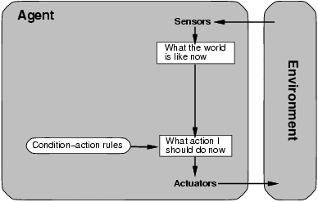

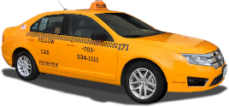

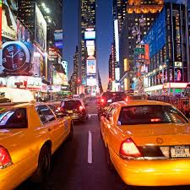
Simple reflex agents
Agent selects actions on the basis of current percept only.
Reflex agents can be implemented efficiently.
Respond (action) direct to percepts (states).
Use simple “if-then” rules
However, they have limited applicability.
If tail-light of car in front is red,
then brake.
If traffic-light in front is red
then brake.
SIMPLE_REFLEX_AGENT(percept)
state = INTERPRET_INPUT(percept)
rule = RULE_MATCH(state, rules)
action = rule.ACTION
return action

Slide 70
A Reflex Taxi-Driver Agent - Example
Difficult to implement the agent as a table lookup:
  complex percepts:
    if two cars in the left lane are distant apart and
    if the car in front on the right lane is braking,
    then move forward to switch to the left lane)
The agent could abstract some portions of the table by coding common input/output associations.
  Do this with a list of condition-action rules:
  if car-in-front-is-braking then brake
  if light-becomes-green then move-forward
  if intersection-has-stop-sign then stop
what can we do for the above complex percepts?
cond | act
(c f, b) | brake
(c I, g) | forw
(c I, ss) | stop

Slide 71

Reflex Taxi-Driver Agent with State
The agent needs two kinds of knowledge for updating its state:
1. How the world evolves independently from the agent;
Ex: an overtaking car gets closer with time.
(disregard the agent).
The car in front is slowing down with the left signal on.
2. How the world is affected by the agent’s actions.
Ex: if I turn right, what was to my left is now behind me.
      if I apply complete brake suddenly, what was to my left is now moving ahead of me.

Slide 72

Reflex Agent with Internal State
  Use internal state to encode different world states to
    remember the earlier (past) percepts
    capture the perception of the environment over time
    represent a change in the world, not only the latest state. (How the world evolves?)
      This ability allows the agent to reason about courses of action. (What do my actions do?)

Slide 73

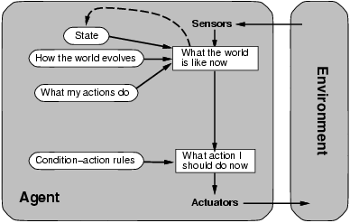
Model-based reflex agents

Slide 74
Model-based reflex agents - Reflex Agent With State
Module:
Logical Agents
Representation and Reasoning:
Key differences (from simple reflex agents)
Store previously-observed information
Agents have an internal state used to keep track of past states of the world.
Agents can represent changes in the world.
Agents can reason about unobserved aspects of the current state
“1. Infers potentially
dangerous driver
in front.”
2. If “dangerous driver in front,”
then “keep distance.”
REFLEX_AGENT_WITH_STATE(percept)
state = UPDATE_DATE(state, action, percept)
rule = RULE_MATCH(state, rules)
action = rule.ACTION
return action

Slide 75
Model-based reflex agents
How much of an internal model of the world?
For planning and reasoning about our surroundings
  require some kind of internal representation of our world,
    the effect of actions or a sequence of actions in the memory.
  The more detailed the internal model, the better.
    Combining simple behavior to form increasingly complex behaviors.
Shortcomings:
The representations of storing models of the world in dynamic and unpredictable environments can be outdated and incorrect.
Agents require the ability to react quickly to the present.
  use minimal internal state representation,
  Complement each time step with sensor input.

Slide 76
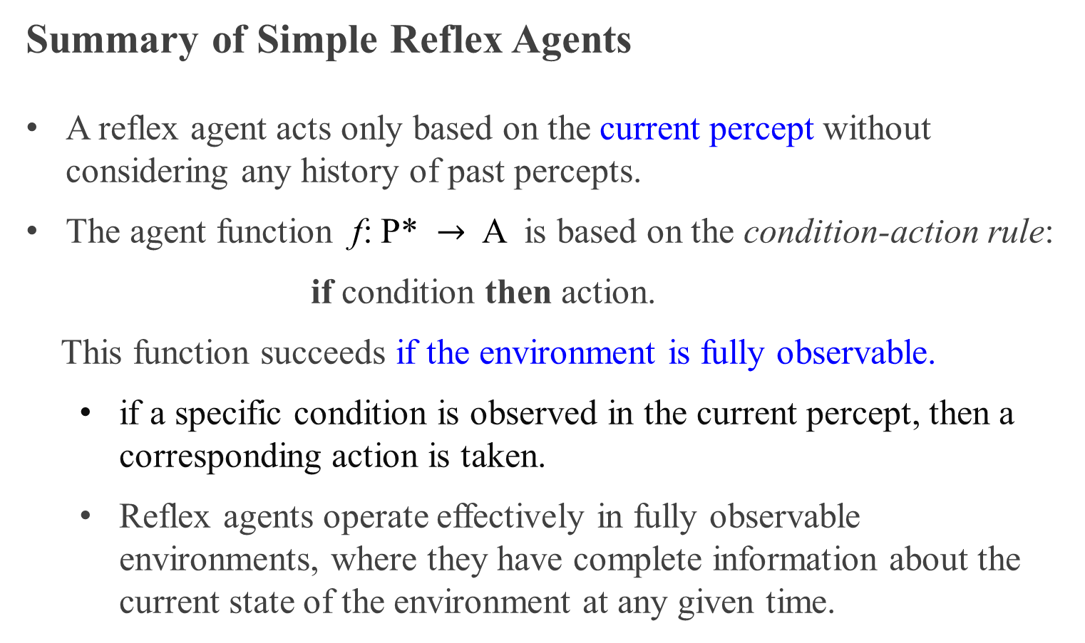
Summary of Simple Reflex Agents
A reflex agent acts only based on the current percept without considering any history of past percepts.
The agent function f: P* $→$ A is based on the condition-action rule:
if condition then action.
This function succeeds if the environment is fully observable.
  if a specific condition is observed in the current percept, then a corresponding action is taken.
  Reflex agents operate effectively in fully observable environments, where they have complete information about the current state of the environment at any given time.

Slide 77
Summary of Simple Reflex Agents
Reflex agents may enter infinite loops or make suboptimal decisions in such environments since they depend only on the current percept.
Since reflex agents may incorporate information about their current internal state, allowing them to disregard specific conditions and directly trigger actions based on their state, this approach may not always be feasible or effective, especially in complex or dynamic environments.

Slide 78
Summary of Model-based reflex agents
A model-based agent can handle partially observable environments by maintaining an internal model of the world.
The internal model stores the agent’s current state, including information about the unseen part of the environment.
A “model-based agent” is a model of the world, which has knowledge about ”how the world works”.
The internal model:
    Enables the agent to determine percept history, which can be used to infer the current state of the environment, and the impact of action on the environment;
    Reflects the unobserved aspects of the current state of the environment and chooses an action in the same way as the reflex agent.

Slide 79
Summary of Model-based reflex agents
A model-based reflex agent evaluates the current state of the environment and selects actions based on predefined rules or heuristics.
By maintaining an internal model of the world, the model-based agent can make more informed decisions and adapt to partially observable environments more effectively.

Slide 80

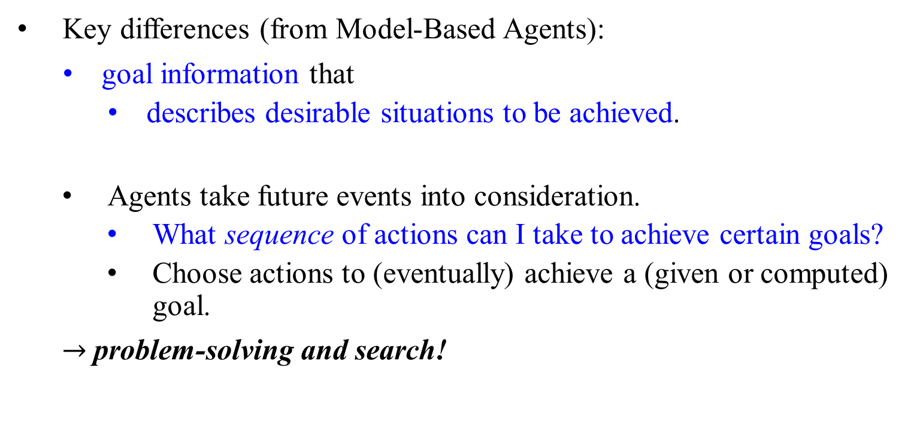
Goal-based agents
Key differences (from Model-Based Agents):
goal information that
  describes desirable situations to be achieved.
  Agents take future events into consideration.
    What sequence of actions can I take to achieve certain goals?
    Choose actions to (eventually) achieve a (given or computed) goal.
$→$problem-solving and search!

Slide 81
Goal-Based Agent
Knowing about the world alone is
  not always enough for an agent to decide what to do (actions). --insufficient
  Keeping track of the current state is often not enough
    need to add goals to decide which situations are good
    Goal - a description of a desirable situation
  Choose actions to achieve a (given or computed) goal
  May have to consider long sequences of possible actions before deciding if the goal is achieved
    involves consideration of the future, “What will happen if I do...? "

Slide 82

A Goal-based Taxi-Driver Agent
Here’s how goal information complements an agent’s knowledge of the world:
Direction at an intersection: Ex: what direction do I take at an intersection? An agent needs to know its current location and also its intended destination.
Combining Goals with the knowledge of its actions: The agent needs goal information, such as the passenger’s destination, to select actions that lead it closer to the destination.
Require a new kind of decision-making (“what-if reasoning”): Considering the potential outcomes of different action sequences, the agent can identify the most promising course of action to achieve its goals
Apply Search and Planning to find action sequences that achieve an agent’s goal..,

Slide 83
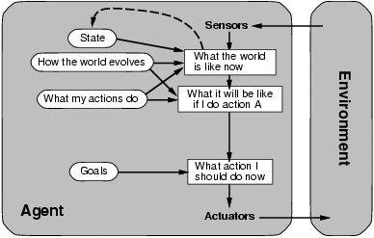
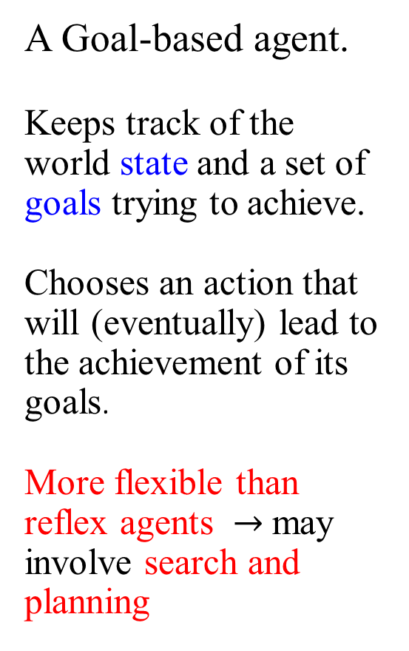
Goal-based agents
A Goal-based agent.
Keeps track of the world state and a set of goals trying to achieve.
Chooses an action that will (eventually) lead to the achievement of its goals.
More flexible than reflex agents $→$may involve search and planning
Considers “future”
“passenger’s destination”

Slide 84
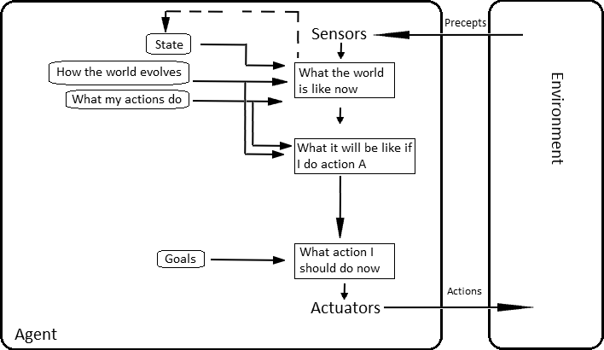
Goal-Based Agents
Agents are much more flexible in
responding to a changing environment;
accepting different goals.
Goal reflects desires of agents
May project actions to see if they are consistent with goals
Act to achieve their goals
Takes time; the world may change during reasoning
Model-based, goal-based agent

Slide 85
Summary of Goal-based Agents
Goal-based agents use “goal” information to further extend the capabilities of the model-based agents.
Goal information describes the desirables of agents.
Allows the agent to choose the one (action) that reaches a goal state from multiple possibilities.
Search and planning are ways to find action sequences that achieve the agent's goals.
It is more flexible because the knowledge that supports its decisions is represented explicitly and can be modified.

Slide 86
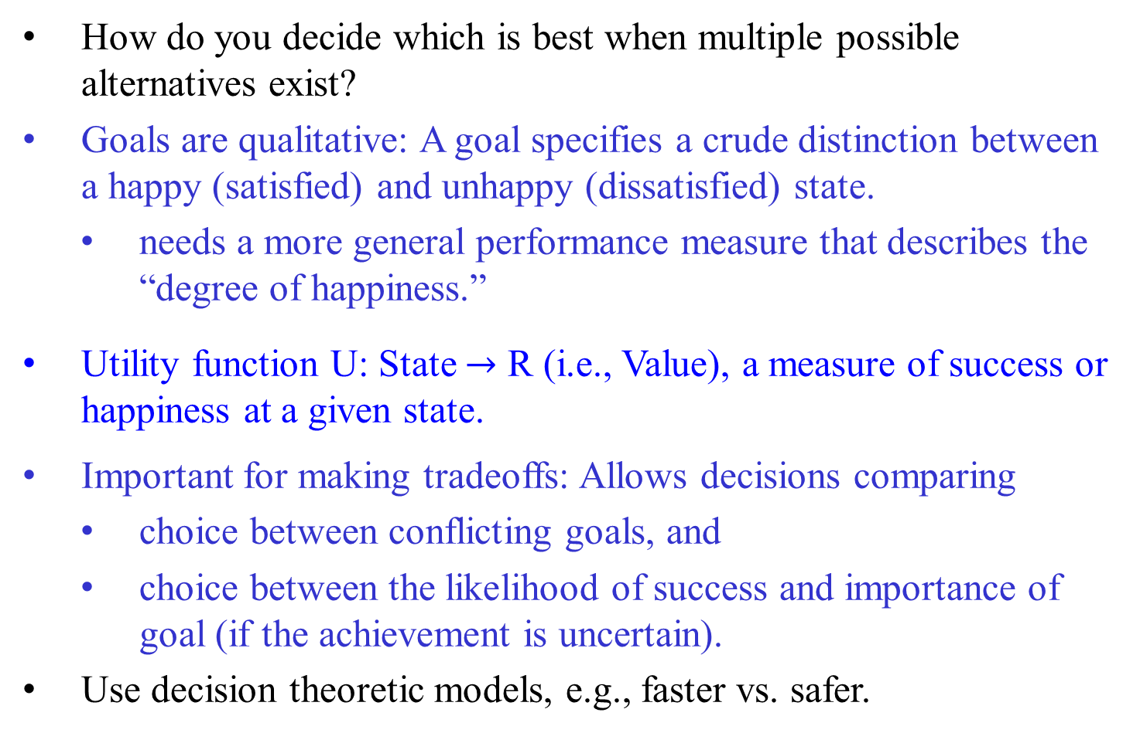
Utility-based agents
How do you decide which is best when multiple possible alternatives exist?
Goals are qualitative: A goal specifies a crude distinction between a happy (satisfied) and unhappy (dissatisfied) state.
  needs a more general performance measure that describes the “degree of happiness.”
Utility function U: State $→$ R (i.e., Value), a measure of success or happiness at a given state.
Important for making tradeoffs: Allows decisions comparing
  choice between conflicting goals, and
  choice between the likelihood of success and importance of goal (if the achievement is uncertain).
Use decision theoretic models, e.g., faster vs. safer.

Slide 87

Utility-based Taxi-Driver Agent
Many ways to get to a destination, but some may be better than others.
  Ex: this way is faster/cheaper/more comfortable/. . .
Assign a utility value (the quality of being useful for the agent) to a world state (i.e., a particular configuration of the world).
  Prefer a sequence of actions that leads to a goal state with higher utility value.
A utility function helps decision-making in case of
  conflicting goals (by finding a trade-off).
  Ex: minimize trip time and also fuel consumption.
none of the several possible goals is achievable with certainty.

Slide 88

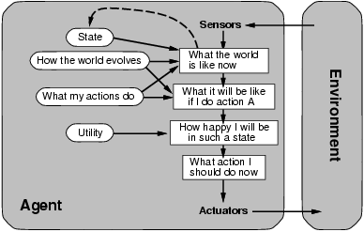
Utility-based agents
A model-based, utility-based agent.
Uses a model of the world, and a utility function that measures its preferences among states of the world.
Chooses the action that leads to the best expected utility.
Computes the expected utility by averaging over all possible outcome states, weighted by the probability of the outcome.
Module: Decision Making
Decision theoretic actions:
e.g. faster vs. safer

Slide 89

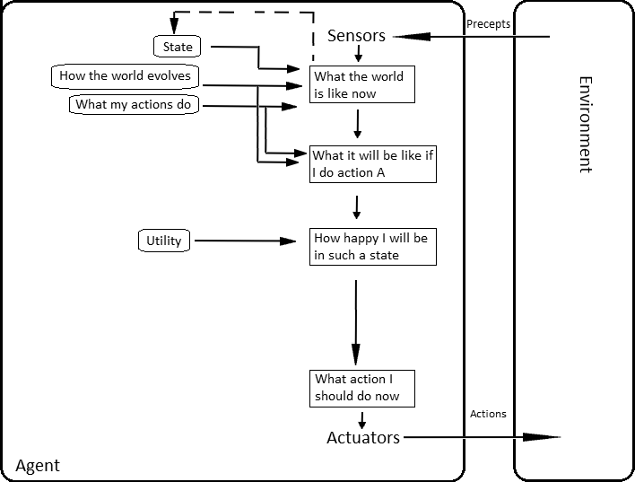
Utility-Based Agents
Define an evaluation function to measure utility
f(state) value
Useful for evaluating competing goals
Useful for maximizing their own expected “happiness.”
Model-based, utility-based agent

Slide 90
Utility-based agents
Goal-based agents
  distinguish only between goal states and non-goal states.
An utility function
  maps a state to a measure of the utility of the state.
  defines a measure of how desirable a particular state is.
  uses the term utility to describe how "happy“ the agent is for the state.
A rational utility-based agent
  chooses the action that maximizes the expected utility of the action outcomes, given the probabilities and utilities of each outcome.
An utility-based agent
  models and keeps track of its environment and task
  involves research on perception, representation, reasoning and learning.

Slide 91
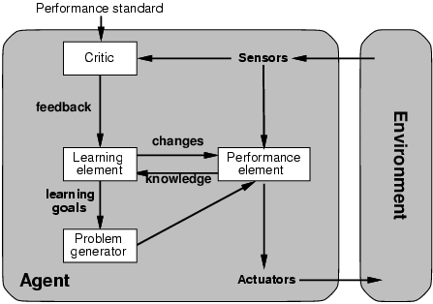
Learning agents
A general learning agent: Adapt and improve over time. More complicated when agent needs to learn utility information: Reinforcement learning (based on action payoff)
Module:
Learning
“Quick turn is not safe”
No quick turn
Road conditions, etc
Takes percepts
and selects actions
Try out the brakes on
different road surfaces

Slide 92
Learning agents
Learning allows the agents to
  initially operate in unknown environments and
  become more competent than its initial knowledge alone might allow.

Slide 93
☹
Learning agents
The most important distinction is between
  the "learning element“:
    is responsible for making improvements;
    uses feedback from the “critic” on how the agent is doing and
    determines how the performance element should be modified to do better in the future
  the "performance element“:
    is responsible for selecting external actions.
    takes in percepts and decides on actions.

Slide 94
Learning agents
The last component of the learning agent is
  the "problem generator " :
    It is responsible for suggesting actions that will lead to new and informative experiences.
☹

Slide 95
Summary

Slide 96

Summary
Agents interact with environments through actuators and sensors
The agent function describes what the agent does in all circumstances
The performance measure evaluates the environment sequence
A perfectly rational agent maximizes expected performance
Agent programs implement (some) agent functions
PEAS descriptions define task environments

Slide 97

Summary
An agent perceives and acts in an environment, has an architecture, and is implemented by an agent program.
A rational agent always chooses the action that maximizes its expected performance, given its percept sequence.
An autonomous agent uses its own experience rather than the designer's built-in knowledge of the environment.

Slide 98

Summary
An agent program maps from percept to action and updates its internal state.
  Reflex agents (simple / model-based) respond immediately to percepts.
  Goal-based agents act to achieve their goal(s), possible sequence of steps.
  Utility-based agents maximize their own utility function.
  Learning agents improve their performance through learning.
Representing knowledge is important for successful agent design.
The most challenging environments are partially observable, stochastic, sequential, dynamic, and continuous and contain multiple intelligent agents.

Slide 99

Summary
Table-driven agents
use a percept sequence/action table in memory to find the next action. A (large) lookup table implements them.
2) Simple reflex agents
are based on condition-action rules, implemented with an appropriate production system. They are stateless devices that do not have a memory of past world states.
3) Agents with memory – Model-based reflex agents
Have an internal state, which is used to keep track of past states of the world.

Slide 100

Summary
4) Agents with goals – Goal-based agents
are agents that, in addition to state information, have goal information that describes desirable situations.
Agents of this kind take future events into consideration.
5) Utility-based agents
base their decisions on classic axiomatic utility theory in order to act rationally.
6) Learning agents
they have the ability to improve performance through learning.

Slide 101
Summary
Environments are categorized along several dimensions:
observable?
deterministic?
episodic? static?
discrete?
single-agent?
There are several basic agent architectures:
reflex
reflex with state
goal-based
utility-based

Slide 102
The END

