Slide 1
Artificial Intelligence
Chapter 01_02
Introduction to AI

Slide 2
Recommended Textbook:
Artificial Intelligence: A Modern Approach
Stuart Russell and Peter Norvig
3rd Edition, 2010

Slide 3
Outline
Course overview
What is AI?
A brief history
The state of the art

Slide 5
What is Artificial Intelligence?
Develop a machine engine to make a robot capable behave humanly or rationally! We need these principles.
A scientific and engineering discipline devoted to:
understanding principles that make intelligent behavior possible in natural or artificial systems;
developing methods for the design and implementation of useful, intelligent artifacts. [Poole, Mackworth, Goebel]
intelligent artifacts (software, algorithms, and systems)

Slide 6
Artificial Intelligence (AI) is a multidisciplinary field of science and engineering focused on
  creating systems or machines that simulate, mimic, or replicate intelligent behavior.
It involves
  understanding and
  developing principles and methods
  to make systems capable of performing tasks that typically require human intelligence.

Slide 7
Two Core Goals of AI:
Understanding Intelligence:
  Exploring principles that make intelligent behavior possible in natural (e.g., human and animal minds) or artificial systems.
  This involves studying cognitive processes such as reasoning, learning, problem-solving, perception, and language understanding.
Building Intelligent Systems:
  Designing and implementing artifacts (such as software, algorithms, or robots) that exhibit intelligent behavior.
  These systems aim to perform tasks such as recognizing patterns, making decisions, or learning from data.

Slide 8
AI Definition (Based on the Textbook View):
AI can be described as creating systems that act rationally, meaning they:
  Make decisions (reasoning) based on what they know (knowledge).
  Select actions (action) that lead to desired outcomes, even under uncertainty.
AI combines knowledge acquisition, reasoning, and action to solve complex problems in the real world effectively.

Slide 9
About AI
The Science of Making Machines (Cognitive Science)
Cognitive science is an interdisciplinary field that
  studies how intelligent natural or artificial systems process, acquire, and utilize knowledge.
  It integrates insights from psychology, computer science, neuroscience, philosophy, linguistics, and more.
Making machines means creating systems capable of cognitive functions, such as reasoning, learning, and decision-making.

Slide 10
About AI
Rationality in Systems
A system is considered rational if it performs (a sequence of )actions logically consistent with its knowledge base (what is known) to achieve its goals.
Rational behavior does not imply perfection;
  it means making decisions or taking actions that maximize success or utility, given the information available to the system at a particular time.
Acting Rationally
The concept of "acting rationally" emphasizes goal-directed behavior:
Input: The system gathers data (what it knows).
Process: It evaluates options based on reasoning or logic.
Output: It selects and performs the "right thing" or most
appropriate action in alignment with its objectives.

Slide 11
This definition emphasizes practical applications of intelligence rather than mimicking human behavior.
The goal is to design systems that can solve real-world problems effectively and efficiently.

Slide 13
What is AI? - (Views of AI fall into four categories:)
The science of making machines (somethings made by men) that:
Cognitive Science
A system is rational if, given what it knows, it does the “right thing”.
The system is “ acting rationally.” (advocated by the textbook)
 | Like humans | Not necessarily like humans
Think | Thinking humanly | Thinking rationally
Act | Acting humanly | Acting rationally

Slide 14
What is the Definition of AI?
The top are concerned with thought processes and reasoning
The bottom are addressed behaviors
Systems that think like humans | Systems that think rationally
Systems that act like humans | Systems that act rationally
The left column measures success in terms of fidelity to human performance
The right column measures against rationality (an ideal performance measure).

Slide 15
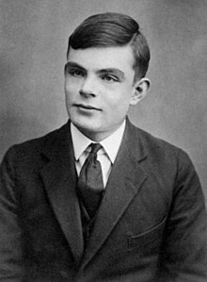

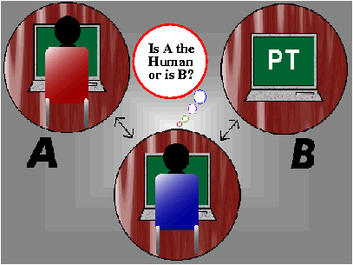
Acting Humanly: The Turing Test Approach
Turing test: ultimate test for acting humanly
  Computer and human both interrogated by judge
  Computer passes test if judge can’t tell the difference

Slide 16
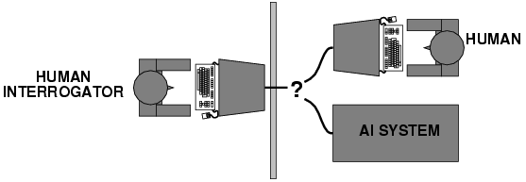
Acting Humanly: The Turing Test Approach
Turing (1950) "Computing machinery and intelligence":
  "Can machines think?" → "Can machines behave intelligently?"
Operational test for intelligent behavior:
  the Imitation Game – cracking the Enigma Code
Suggested major components of AI: knowledge, reasoning, language understanding, learning

Slide 17
Acting Humanly: The Turing Test Approach
Problem?: Turing test is not reproducible, constructive, or
amenable to mathematical analysis.
(amenable - Ready to consent; agreeable)

Slide 18
Why it is not considered reproducible, constructive, or amenable to mathematical analysis:
1. Not Reproducible
  The Turing Test relies on subjective evaluation by a human interrogator.
  Results can vary depending on the skill, biases, and knowledge of the interrogator.
  There is no standardized process for conducting the test, making it difficult to reproduce consistently across different scenarios or evaluators.
2. Not Constructive
3. Not Amenable to Mathematical Analysis

Slide 19
Why it is not considered reproducible, constructive, or amenable to mathematical analysis:
Not Reproducible
2. Not Constructive
  The test does not provide insights into how to build intelligent systems.
  Passing the Turing Test focuses on mimicking human behavior, but it does not inform us about the principles or mechanisms required to create intelligence.
  It emphasizes imitation rather than understanding or achieving intelligence in a systematic, constructive way.
3. Not Amenable to Mathematical Analysis

Slide 20
Why it is not considered reproducible, constructive, or amenable to mathematical analysis:
1. Not Reproducible
Not Constructive
3. Not Amenable to Mathematical Analysis
  The Turing Test is a qualitative measure based on subjective judgments of human-likeness, which are not easily quantifiable.
  AI research often seeks precise, mathematical frameworks for analyzing intelligence, but the Turing Test offers no formal structure for defining or measuring intelligence mathematically.
  The test lacks objective metrics for evaluation and cannot be integrated into theoretical models of AI.

Slide 21
The Turing Test has historical and philosophical significance
But modern AI research prioritizes formal methods (e.g., computational models, logic, optimization, and machine learning) that are reproducible, constructive, and mathematically analyzable.
These approaches allow researchers to build, evaluate, and improve intelligent systems systematically.

Slide 23
Suggested major components of AI:
knowledge, reasoning, language understanding, learning
The six disciplines compose most of the AI
Knowledge representation: store what it knows or hears (knowledge)
Automated reasoning: use the stored information to answer questions and to draw new conclusions (reasoning and making decisions)
Natural language processing: enable it to communicate successfully in English (language understanding)
Machine learning: adapt to new circumstances and to detect and extrapolate patterns (learning).
The total Turing Test requires the above components and
  Computer vision to perceive an object
  robotics to manipulate objects and move about
Perceive:To become aware of (something) directly through any of the senses, especially sight or hearing.

Slide 24
State of the art –
What do we accomplish in these areas?
  Perception: computer vision, speech understanding
  Machine learning, neural networks
  Robotics
  Natural language processing
  Automated reasoning and decision making
    Reasoning (logical, probabilistic reasoning)
    Decision-making (search, planning, decision theory)
  Knowledge representation (FOL and Inference in FOL)

Slide 25
What can I do for an intelligent artifact?
Agent (the machine) must:
  have command of the language
  Have a wide range of knowledge
  be able to reason
  be able to learn
  demonstrate human traits (mental process and behavior, humor, emotion)
An agent is anything that is capable of
  perceiving its environment through sensors and
  acting upon that environment through actuators.

Slide 26
Thinking Humanly: Cognitive Modeling Approach
Requires scientific theories of internal activities of the brain
  knowledge of brain function
  What level of abstraction? “Knowledge” or “circuits”?
  How can we validate this (how to validate)?
    It requires
      1) predicting and testing behavior of human subjects
      (top-down, Cognitive Science), or
      2) direct identification from neurological data
      (bottom-up, Cognitive Neuroscience)
    Both approaches (roughly, Cognitive Science and Cognitive Neuroscience) are now distinct from AI
Notes:
What level of abstraction? Knowledge, circuitry, chemical?

Slide 27
Thinking Humanly: Cognitive Modeling Approach
“Cognitive revolution“ in 1960s:
  information-processing psychology replaced prevailing orthodoxy of behaviorism
The focus of Cognitive Science is
  bringing together
    computer models from AI and
    experimental techniques from psychology
    to construct precise and testable theories of the human mind

Slide 29
Thinking Rationally: The “Laws of Thought” Approach
Aristotle attempted to codify “right thinking,”- irrefutable reasoning processes.
  His syllogisms (deductive reasoning) provided patterns for argument structures:
    always yield correct conclusions for given correct premises.
    “Socrates is a human (minor premise);
    all humans are mortal (major premise);
    therefore, Socrates is mortal (conclusion).”
  The laws of thought were supposed to govern the operation of the mind;
What are correct arguments or thought processes?
Impossible to refute or disprove

Slide 30
Thinking Rationally: The “Laws of Thought“ Approach
Aristotle: what are correct arguments or thought processes?
  Several Greek schools developed:
    Various forms of logic:
      notation and rules of derivation for thoughts;
      provided foundation of AI through mathematics and philosophy
    Problems: …

Slide 31
Thinking Rationally: The “Laws of Thought“ Approach
  Problems:
    Not easy to state informal and uncertain knowledge in the form terms required by logical notation.
    Not all intelligent behavior is mediated by logical deliberation/controlled by logic
      What is our goal?
      What is the purpose of thinking?
      What thoughts should I have?
For their wedding, maybe I will go; maybe not!
At the store, what do I want to buy?
Milk? (Milk is on the self.) Shelf? (Milk on a shelf in the store) Store?

Slide 32
Acting Rationally: The Rational Agent Approach
Act to achieve goals, given set of beliefs
Rational behavior is doing the “right thing”
    Thing? expects to maximize goal achievement, given the available information
    (adopted by Russell & Norvig)
Aristotle:
  Every act (action) and every inquiry (pursuit) is aiming at some good
Systems that think like humans | Systems that think rationally
Systems that act like humans | Systems that act rationally

Slide 33
Rational Agents
P* = {Different sized Milk cartons, Milk cartons on shelves,
Milk cartons on shelves in the stores,
Consumers take milk cartons of different sizes, …}
An agent is an entity that perceives and acts
An agent is a function from percept histories to actions:
f : P* → A
For any given class of environments and tasks, we seek the agent (or class of agents) with the best performance
This course is about designing rational agents
Caveat: perfect rationality unachievable, due to computational limitations.
  → Approach: design best program for given machine resources
A = {pick up 1 gallon of milk, buy the whole shelf of milk, …}
The best performance = {Get half a gallon or a gallon of milk. }
Percept-a concept that depends on recognition by the senses, such as sight, of some external object or phenomenon

Slide 34
Intelligence: Operational Definition of AI
Systems that act like humans
Turing test.
Systems that think like humans
Cognitive Science
Systems that think rationally
Logic-based AI
Systems that act rationally
Rational Agents
Systems that think like humans | Systems that think rationally
Systems that act like humans | Systems that act rationally

Slide 35
Rational Decisions
Get a one-gallon carton of milk.
The term rational is used in a particular way:
  Rational: maximally achieving pre-defined goals
  Rational only concerns what decisions are made
(not the thought process behind them)
  Goals are expressed in terms of the utility of outcomes
  Being rational means maximizing your expected utility
Either a one-gallon carton or two half-gallon cartons of milk
1 gallon carton of milk (10pts.)
2 half-gallon cartons of milk (9 pts.)
4 quarters cartons of milk (5 pts.)
otherwise (0 pt.)
(Economics) economics
a. the ability of a commodity to satisfy human wants
b. the amount of such satisfaction. See disutility

Slide 36
Degrees of Intelligence
Ref
Building an intelligent system as capable as humans
  remains an elusive (hard to define or explain) goal.
Systems have been built
  exhibit various specialized degrees of intelligence.
Formalisms and algorithmic ideas are
  useful for constructing “intelligent” systems.
  the foundation of our attempt to understand intelligence as a computational process.
This course will examine some of these formalisms and see how they can be used to achieve various degrees of intelligence.

Slide 37
AI’s Foundations
Philosophy logic, methods of reasoning,
mind as physical system
foundations of learning, language, rationality,
Mathematics formal representation and proof,
algorithms, computation, (un)decidability,
(in)tractability, probability
Psychology adaptation, perception and motor control,
experimental techniques
Economics formal theory of rational decisions
Linguistics knowledge representation, grammar
Neuroscience plastic physical substrate for mental activity
Control theory homeostatic systems, stability,
simple optimal agent designs

Slide 38
Ref
Additional Materials

Slide 39
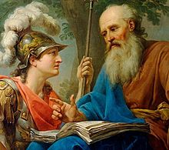
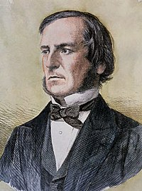
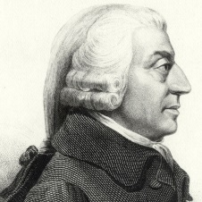
AI Prehistory- Foundations of AI
Ref
Philosophy
  450 BC, Socrates asked for algorithm to distinguish pious from non-pious individuals
  Aristotle developed laws for reasoning
  Logic, methods of reasoning, mind as physical system foundations of learning, language, rationality
Mathematics
  1847, George Boole introduced formal language for making logical inference
  Formal representation and proof algorithms, computation, (un)decidability, (in)tractability, probability
Economics
  1776, Adam Smith views economies as consisting of agents maximizing their own well being (payoff)
  utility “preferred outcomes”, decision theory
Neuroscience …

Slide 40
AI Prehistory- Foundations of AI
Ref
…
Neuroscience
  1861, Study how brains process information
  physical substrate for mental activity
Psychology
  1879, Cognitive psychology initiated phenomena of perception and motor control, experimental techniques.
  Cognitive psychology views the brain as an information-processing device.
Computer engineering
  1940, Alan Turing’s team built the first operational computer, the electromechanical Health Robinson for deciphering German message.
  Building fast computers
Control theory …

Slide 41
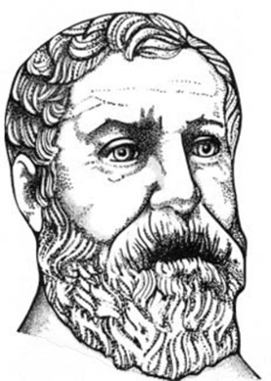
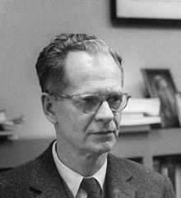
AI Prehistory- Foundations of AI
Ref
…
Control theory
  In 250 B.C., Ktesibios of Alexandria built the first self-controlling machine: a water clock with a regulator that maintained a constant flow-rate. This invention changed the definition of what an artifact could do.
  design systems that maximize an objective function over time
Linguistics
  1957, Skinner studied behaviorist approach to language learning
  knowledge representation, grammar

Slide 42

Conclusion

Slide 43
End of Chapter 01_02

