Slide 1
Course for CRN: 23609 CS 57200 Heuristic Problem Solving (3 cr.) Your level status must be: Graduate
Course Description
P: CS 26000, or consent of instructor.
Design and development of heuristic problem-solving systems. The emphasis is on the development of general data representations, heuristics, and problem-solving strategies which can be applied to wide classes of problems. The task areas explored include game playing, theorem proving, pattern recognition, semantic information processing, cognitive psychology, design synthesis, robotology, and integrated artificial intelligence systems.

Slide 2
http://www.free-management-ebooks.com/news/heuristic-techniques-for-problem-solving/

Slide 3
“heuristic” means "to discover, " derived from a Greek word, ‘eurisko’,
A heuristic is a rule or a method that
comes from experience and
helps you think through things, such as
the process of elimination, or
the process of trial and error.
helps solve problems faster than if you did all the computing.
Know a heuristic as a "rule of thumb."
Think, a heuristic is a shortcut.

Slide 4
Heuristic Techniques for Problem-Solving
Heuristic techniques are not formal problem-solving models.
The techniques can be used as
an approach to problem-solving, where
solutions are NOT expected to produce a perfect or optimal solution.

Slide 6
Relying on only heuristics to solve a problem works
when a quick fix is needed or
when the alternative solution (technique) is impractical because of:
high cost,
unusable in the current environment, or
a long-term project.

Slide 7
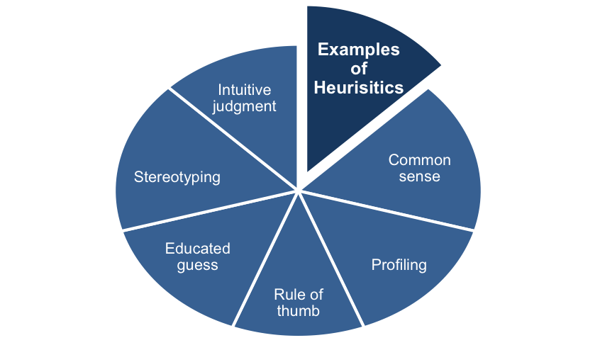
Examples of heuristics include using:
A rule of thumb
An educated guess
An intuitive judgment
Stereotyping
Profiling
Common sense
They can be used as
part of creative problem-solving techniques,
but should only be used as
one of the ways to generate ideas, or overcome a barrier
A rule of thumb:
A general principle or rule, or a rough or practical approach, based on experience or practice, as opposed to a scientific calculation or precision one based on theory.

Slide 8
Formal method problem solvers should be aware:

Slide 9
Overview
Heuristics are simple, efficient rules
that helps to explain how people solve problems focusing on doable.
These rules usually work but
are prone to preconceptions (an idea formed beforehand), and
can introduce errors, bias, and prejudice.
For example, an educated guess is
based on knowledge and experience, but
excludes what you have not learned (what you have yet to learn).

Slide 10
Heuristics do not aim for novel solutions,
but aim to implement
the known,
readily accessible,
loosely applicable. ?prototyping
It often uses trial and error
to find the solution that works.

Slide 11
Area of the Shaped Regions (Area)
= A + B + C
Area = (A+ B + X) + ( B + Y + C) – (X + B + Y)
= (A + X + Y + C + 2B) – (X + B + Y)
= (A + B + C)
After the about heuristic method, compute:
Area of the Shaped Regions
= ½(3.14 * 4² ) + ½(3.14 * 1² ) - ½(8 * 4)
= 14.69 cm².
C
Y
A
4cm
B
X
8cm

Slide 13
“In computer science, a heuristic is a technique designed
for solving a problem more quickly
when classic methods are too slow, or
for finding an approximate solution
when classic methods fail to find any exact solution.
This is achieved by trading
optimality,
completeness,
accuracy, or
precision
for speed.
In a way, it can be considered a shortcut.”
(Source: Wikipedia)
https://www.101computing.net/heuristic-approaches-to-problem-solving/

Slide 14
The objective of a heuristic algorithm is
to apply a rule of thumb approach
to produce a “good enough” solution for solving the problem at hand in a reasonable time frame.
There is no guarantee that the solution found will be
the most accurate or
optimal solution
for the given problem.
Often refer the solution as “good enough” in most cases.

Slide 15
Heuristic Algorithms can be found in:
Artificial Intelligence
Language recognition
Big Data Analysis
Shortest Path Algorithms
Machine Learning

Slide 16
Let’s investigate a few basic examples where a heuristic algorithm can be used:
Noughts & Crosses
Game of Chess
Top Trumps
Language Recognition
Shortest Path Algorithms

Slide 17
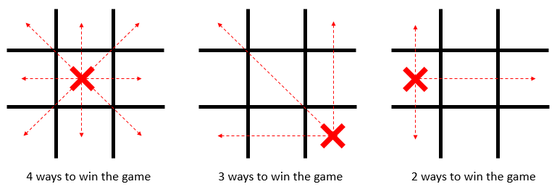
To help the computer make a decision as to where to place a token on a 3×3 noughts and crosses grid, a basic heuristic algorithm should be based on the rule of thumb that some cells of the grid are more likely to lead to a win:
Based on this approach, can you think of how a similar approach could be used for an algorithm to play:
Othello (also known as, Reversi Game)
A Battleship game?
Rock/Paper/Scissors?

Slide 18
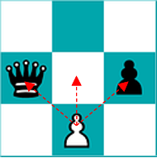
Expert players can “see” several moves ahead, when playing a game of chess, .
Tempted to design an algorithm that could investigate
every single possible move that players can make, and
the impacts of such moves on the outcome of the game.
Such an algorithm would
have to investigate too many possible moves and
become too slow and too demanding in terms of memory resources
in order to perform effectively.
Use a heuristic approach
quickly discard some moves which would most likely lead to a defeat
focus on moves that would seem to be a good step towards a win!

Slide 19
White pawn has three decisions:
Moves forward
Moves diagonally right to take away bishop
Moves diagonally left to take away queen.
The impacts from the choice of a move:
The queen takes away white pawn
The queen takes away white pawn
White pawn has a safely move.
Consider the above scenario:
when investigating all the possible moves for this white pawn.
Can the computer make a quick decision as to what would most likely be the best option?
Heuristic approaches do not always give you the best solution.
Can you explain how this could be the case with this scenario?

Slide 20
Language Recognition:
Heuristic methods can be used when developing algorithms which try to understand what the user is saying, or asking for.
For instance, by looking for words associations, an algorithm can narrow down the meaning of words especially when a word can have two different meanings:

Slide 21
For example: When using Google search
a user types “Raspeberry Pie Hardware”, we can deduct that in this case Raspberry has nothing to do with the piece of fruit, so there is no need to give results on healthy eating, cooking recipes or grocery stores…
However, if the user searches for “Raspeberry Pie ingredients”, we can deduct that the user is searching for a recipe and is less likely to be interested in programming blogs or computer hardware online shops.

Slide 22
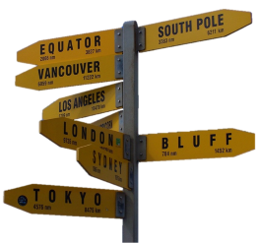
Short Path Algorithms used by GPS systems.
Self-driving cars use a heuristic approach to decide on the best route to go from A to Z.
This is the case for the A* Search algorithm which takes into consideration the distance as the crow flies between two nodes
to decide which paths to explore first and hence more effectively find the shortest path between two nodes.

Slide 23
Let compare two different algorithms used to find the shortest route from two nodes of a graph:
Dijkstra’s Shortest Path Algorithm (without using a heuristic approach)
A* Search Algorithm (Using a heuristic approach)

Slide 25
There is an article that explains the concept of the Heuristic Method, developed by George Pólya in a practical way.
After reading it, you will understand the basics of this powerful problem-solving tool.

Slide 26
What is the Heuristic Method?
A heuristic method is an approach to finding (searching, discovering) a solution to a problem.
It uses a practical method that doesn’t necessarily need to be perfect.
Heuristic methods speed up the process of reaching a satisfactory solution.
It uses previous experiences with comparable problems for dealing with problem situations concerning people, machines, or abstract issues.
One of the founders of heuristics is the Hungarian mathematician György (George) Pólya who is one of the founders of heuristics, published a book about the subject in 1945 called ‘How to Solve It’.
He used four principles that form the basis for problem-solving.

Slide 27
Four principles
Pólya describes the following four principles in his book:
try to understand the problem
make a plan
carry out this plan
evaluate and adapt (Look back, evaluate, and adjust)

Slide 28
If this sequence doesn’t lead to the right solution, Pólya advises
first looking for a simpler problem, or
looking at a similar problem that was possible to solve, or
possibly looking at the current problem in another way.
A solution may potentially be found,

Slide 29
The first principle – understand the problem
Look at the problem from another angle.
Questions can help with the first evaluation of a problem issue, such as
what is the problem?
what is happening?
can the problem be explained in other words?
is there enough information available? etc.

Slide 30
The second principle – make a plan
There are many ways to solve problems.
Choose the right strategy that best fits the problem at hand.
Choose the reversed ‘working backward’ strategy;
assume a solution and
use this assumed solution as a starting point for working toward the problem.
It is also useful to
make an overview of the possibilities,
delete some of them immediately,
work with comparisons, or apply symmetry.
Creativity comes into play here and will improve the ability to judge.

Slide 31
The third principle – carry out the plan
Once a strategy has been chosen, the plan can quickly be implemented.
It requires time and patience because the solution will not simply appear.
If the plan doesn’t go anywhere, the advice is to throw it overboard and find a new way.

Slide 32
The fourth principle – evaluate and adapt
Take the time to carefully consider and reflect upon the work that’s already been done.
The things that are going well should be maintained, and those leading to a lesser solution should be adjusted.
Some things simply work, while others simply don’t.

Slide 33
Heuristics
There are many different heuristic methods.
The most well-known heuristics are found below:
1. Dividing technique
Divide the original problem into smaller sub-problems that can be solved more easily.
Link and combine these sub-problems, which will eventually lead to the solving of the original problem.

Slide 34
2. Inductive method
[Solve a smaller problem first]
This involves a problem that has already been solved, but is smaller than the original problem.
[Generalize the previously solved problem]
Generalization can be derived from the previously solved problem, which can help in solving the bigger, original problem.

Slide 35
3. Reduction method
[Plenty room without limits: Too generalized]
Use the reduction method to set limits for the problem in advance, because the problem is larger than assumed and deals with different causes and factors,
[Reduce plenty of leeways]
This reduces the leeway of the original problem, making it easier to solve.

Slide 36
4. Constructive method
[Solving problem step by step]
Work on the problem step by step, from small to large.
[Continue solving next with the current solution]
Take consecutive steps to solve the problem with the smaller solutions that already have.
[Make the best choices in every step]
The way of making the best choices will eventually lead to a successful end result.

Slide 37
5. Local search method
Search for the most attainable solution to the problem.
Improve this solution along the way.
This method ends when improvement is no longer possible.

Slide 38
Exact solutions versus heuristics
The heuristic approach is a mathematical method with which proof of a good solution to a problem is delivered.
[Application of good solutions]
Use good solutions to a large number of different problems.
[Processing speed and finding solution]
When the processing speed is equally as important as the obtained solution, we speak of a heuristic method.

Slide 39
The Heuristic Method | Exact Solution Methods
Tries to find a good, but not necessarily optimal solution | Find an optimal solution to a problem
Quicker and more flexible | Time-consuming and less flexible
Prove preferable | Less preferable
The heuristic method does have to satisfy several criteria.
The heuristic solution must offer a reasonable calculation effort.
There must be a high probability that the solution is feasible (optimal functioning), and
The chance of the creation of a bad solution must be minimal.

Slide 40
More information
Groner, R., Groner, M., & Bischof, W. F. (2014). Methods of heuristics. Routledge.
Newell, A. (1983). The heuristic of George Polya and its relation to artificial intelligence. Methods of heuristics, 195-243.
Polya, G. (2014, 1945). How to solve it: A new aspect of mathematical method. Princeton university press.
https://www.toolshero.com/problem-solving/heuristic-method/

Slide 42
Why Use Heuristics?
Heuristics facilitate timely decisions.
Analysts in every industry use rules of thumb such as
intelligent guesswork,
trial and error,
process of elimination,
past formulas and
the analysis of historical data
to solve a problem.
Heuristic methods make decision-making simpler and faster through shortcuts and good-enough calculations.

Slide 43
The Disadvantages of Using Heuristics
There are trade-offs with the use of heuristics that render the approach prone to bias and errors in judgment.
The user’s final decision may not be the optimal or best solution,
the decision made may be inaccurate and
the data selected might be insufficient leading to an imprecise solution to a problem.
For example, copycat investors often imitate the investment pattern of successful investment managers who use tested methods to avoid researching securities and the associated quantitative and qualitative information.

Slide 44
By using a heuristic approach underlying past performance, copycat investors hope that the formulas used by these managers will continually earn them profits, but this is not always the case.
The crash of Valeant Pharmaceutical International was a shock to investors when the company saw its stock plunge 90% from 2015 to 2016.
Valeant was a stock held in the portfolios of many hedge fund managers.

Slide 45
Representativeness Heuristics
A popular shortcut method in problem-solving is Representativeness Heuristics.
Representativeness uses mental shortcuts to make decisions based on past events or traits that are representative of or similar to the current situation.
For example, in 2017, Fast Food ABC expanded its operations to India and its stock price soared.
An analyst mentally noted that India is a profitable venture for all fast food chains.

Slide 46
Therefore, when Fast Food XYZ announced its plan to explore the Indian market in 2018, the analyst wasted no time in giving XYZ a “buy” recommendation.
His shortcut approach, although it saved reviewing data for both companies, may not have been the best decision.
XYZ may have food that is not appealing to Indian consumers, which research would have revealed.
Other prevalent heuristic approaches for decision-making and problem-solving include Availability Bias, Anchoring and Adjustment, Familiarity Heuristic, Hindsight Bias and Naïve Diversification.

