Slide 1
Chapter 00
Introducing Foundations

Slide 2

Direct-Addressing Tablse[4 – 11]
Hash tables [12 – 22]
Comparison between Direct-Addressing Tables and Hash Tables [23-26]
Collision Resolutions [26-54]
Linear Probing [27-31]
Open Hashing (Chaining) [32 - 56]
Load Factor [38], Simple Uniform hashing [19, 43], and
Performance Analysis [42-54]
Good Hash functions [57 – 112 ]
Assumptions [59], Key Interpretations [65-70],
Modular Hashing [72 - 76], Multiplication Hashing [77 - 83],
Universal hashing [84-112]
Open Addressing (Closed Hashing)[113 - 175]
Linear Probing [130 - 139], Quadratic Probing [141 -143 ],
Double Hashing [145 - 153]
Analysis of Open Addressing [155 - 175 ]
Contents

Slide 3
Direct-Address Tables
Scenario: In healthcare, when you need to make or change an appointment, healthcare personnel use your birthdate and name to locate your existing file. However, it can be challenging to identify the correct file if many patients share the exact birthdate or name. In such situations, your SSN is required to create a unique identifier for your file, ensuring it's correctly associated with you.

Slide 4
A dynamic set is a data structure that allows the management (operations) of a collection of elements (key, value pairs).
Each element has (key, satellite data) pairs and
The operations supported by a dynamic set include INSERT, SEARCH, and DELETE.
Example: Dictionary, a type of dynamic set:
A dictionary is a data structure that
stores elements as (key, value) pairs and
supports operations INSERT, SEARCH, and DELETE on these (key, value) pairs.
Implementations of Dictionaries:
Balanced binary search tree, which supports all these operations in O(log n) time.
Doubly linked list, which supports INSERT and DELETE in O(1) time but SEARCH in O(n) time.
Hash table, which supports all of these operations O(1) time, under the assumption of a good hash function and uniform distribution of keys.

Slide 5
Direct-Address Tables
Direct-address tables
A direct-address table is a simple and efficient data structure for implementing a dynamic set, given certain assumptions about the input.
Suppose an application needs a dynamic set.
The dynamic set has elements (key, satellite data).
Characteristics of Keys
Each element has a key drawn from a finite set of all possible keys called the universe U = {0, 1, . . . , m − 1}.
The assumption is that m is not too large, allowing the direct-address table to be of manageable size.
Each key is unique within the dynamic set, meaning no two elements have the same key.

Slide 6
Direct-Address Tables
Structure
Array Representation:
The direct-address table is represented as an array T of size m.
Each index i in the array corresponds directly to a key in the universe U.
Storage:
The element with key k is stored at T[k].
If there is no element with key i, then T[i] = NIL
The dynamic set can then be implemented as an array or direct-address table, T[0..m-1], in which each position or slot corresponds to a key in the universe U.
Place the value at T(k) or just a pointer to the value, depending on the application,

Slide 7
Direct-Address Tables
Operations
INSERT:
  Place the element with key k at T[k].
  Time complexity: O(1).
SEARCH:
  Retrieve the element with key k by accessing T[k].
  Time complexity: O(1).
DELETE:
  Remove the element with key k by setting T[k]=NIL.
  Time complexity: O(1).

Slide 8
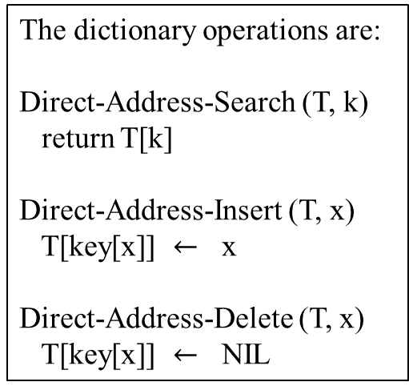
T
Direct-Address Table T
 | 0
 | 1
 | 2
 | 3
 | 4
 | 5
 | 6
 | 7
 | 8
 | 9
Key satellite data
U (Universe of keys)
0 6
1 4 7
2
3
1111
1111
1111
5
1111
K (actual keys)
2
3
5 8
The dictionary operations are:
Direct-Address-Search (T, k)
return T[k]
Direct-Address-Insert (T, x)
T[key[x]] $←$ x
Direct-Address-Delete (T, x)
T[key[x]] $←$ NIL
8
Implement a dynamic set by a direct-address table T[0 .. m-1], in which each position or slot corresponds to a key in the universe U.
Each key in the universe U = {0, 1, 2, …, 9} corresponds to an index in table T.
The set K = {2, 3, 5, 8} of actual keys determines the slots in the table, containing pointers to elements. The other slots contain / (NIL).
Each of the dictionary operations is fast: only O(1) time is required.

Slide 9
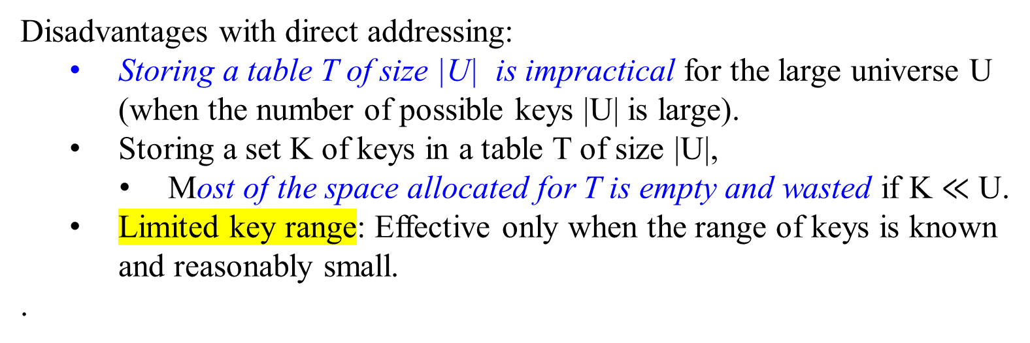
Direct-addressing
Disadvantages with direct addressing:
  Storing a table T of size |U| is impractical for the large universe U (when the number of possible keys |U| is large).
Storing a set K of keys in a table T of size |U|,
  Most of the space allocated for T is empty and wasted if K $≪$ U.
  Limited key range: Effective only when the range of keys is known and reasonably small.
.

Slide 10
Direct-addressing
Advantages:
  Speed: All operations are O(1) since they involve direct access to an array index.
  Simplicity: Implementation is straightforward as it avoids the complexity of handling collisions or probing sequences.
  For some applications, to save memory space, the elements in the dynamic set can be saved in slots of the direct-address table T
  Do not have to store the element’s key and satellite data in an object external to the direct-address table T, with a pointer from a slot in the table to the object.
  It is unnecessary to store the key field of an object in the slot if we have the object’s index in the table as its key.
    There must be some way to tell if the slot is empty if the key is not stored.

Slide 11
Direct-addressing
Summary:
Direct-address tables provide an efficient way to manage a dynamic set with operations INSERT, SEARCH, and DELETE all running in O(1) time.
Assumptions: This approach is effective if the universe of keys U is reasonably small and the keys are unique.
Memory Usage: The primary drawback is the potentially high memory usage, especially if the universe U is large, but the actual number of elements in the dynamic set is small.

Slide 12
Hash Tables

Slide 13
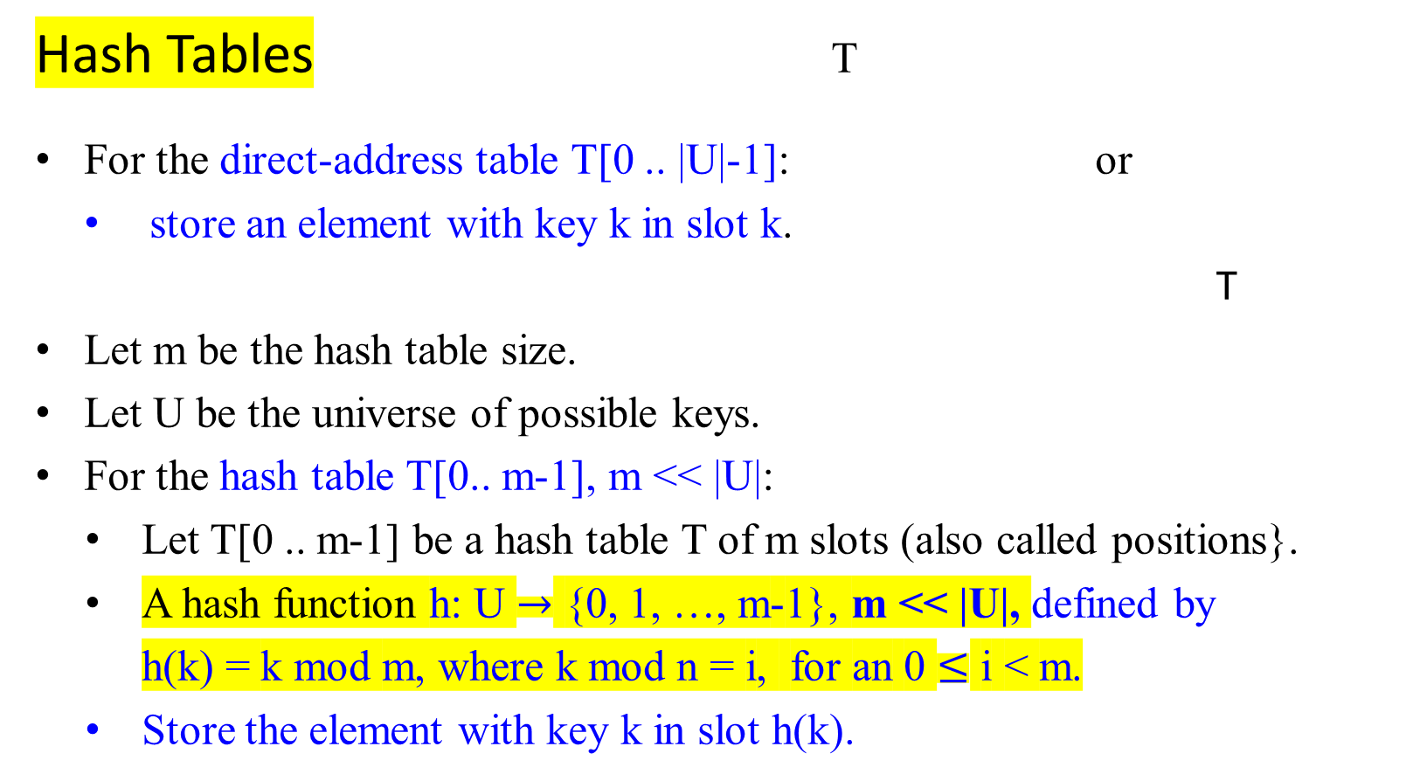
…
slot k-1
slot k, element
slot k+1
…
Hash Tables T
For the direct-address table T[0 .. |U|-1]: or
store an element with key k in slot k.
T
Let m be the hash table size.
Let U be the universe of possible keys.
For the hash table T[0.. m-1], m << |U|:
  Let T[0 .. m-1] be a hash table T of m slots (also called positions}.
  A hash function h: U $→$ {0, 1, …, m-1}, m << |U|, defined by
h(k) = k mod m, where k mod n = i, for an 0 $≤$ i < m.
Store the element with key k in slot h(k).
k | element
…
slot h(k)
…
k | element

Slide 14
Hash Tables
T
 | 0
 | h(k₁ )
 | h(k₄ )
 | h(k₂ ) = h(k₅)
 | h(k₃ )
 | m-1
U, Universe of keys
Actual keys K
k₁ k₄
k₅
k₂
k₃
Figure Hash Table: Using a hash function h to map keys to hash-table slots. Both keys h(k₂ ) and h(k₅) map to the same slot, so they collide.

Slide 15
Hash Tables vs Direct-Address Tables
Example: Encode the location of a computer on the Internet:
use a 32-bit IP (Internet protocol) address,
  Often represented in four 8-bit fields, such as 128.32.168.80.
For direct addressing,
  achieve fast lookup times (constant time O(1))
    if the records are maintained in an array indexed by IP address.
  Waste memory space:
    the array would have 2³² ≈ 4 * 10⁹ entries,
    a large majority of them are blank.

Slide 16
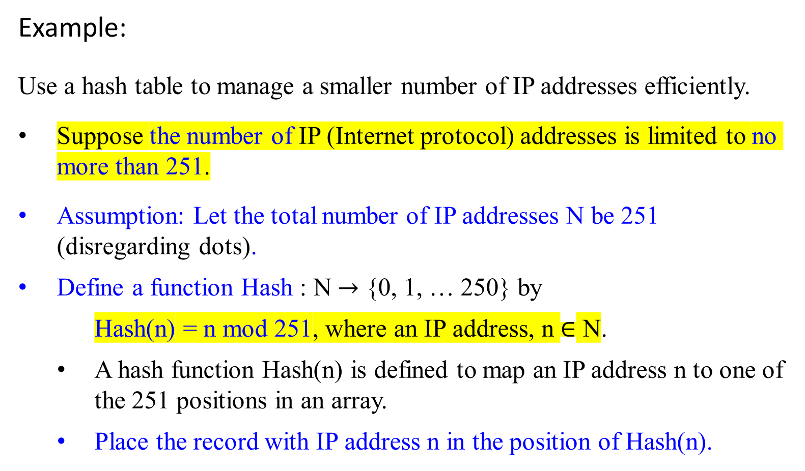
Example:
Use a hash table to manage a smaller number of IP addresses efficiently.
Suppose the number of IP (Internet protocol) addresses is limited to no more than 251.
Assumption: Let the total number of IP addresses N be 251 (disregarding dots).
Define a function Hash : N $→$ {0, 1, … 250} by
    Hash(n) = n mod 251, where an IP address, n $∈$ N.
    A hash function Hash(n) is defined to map an IP address n to one of the 251 positions in an array.
    Place the record with IP address n in the position of Hash(n).

Slide 17
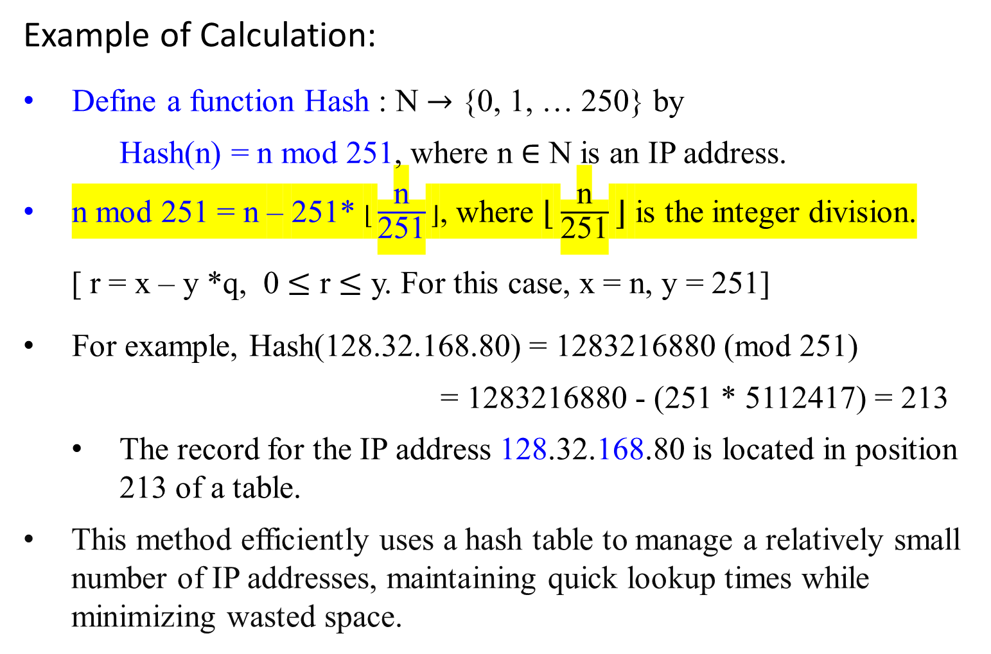
Example of Calculation:
Define a function Hash : N $→$ {0, 1, … 250} by
    Hash(n) = n mod 251, where n $∈$ N is an IP address.
n mod 251 = n – 251* ⌊ $\frac{\text{n}}{\text{251}}$ ⌋, where ⌊ $\frac{\text{n}}{\text{251}}$ ⌋ is the integer division.
[ r = x – y *q, 0 $≤$ r $≤$ y. For this case, x = n, y = 251]
For example, Hash(128.32.168.80) = 1283216880 (mod 251)
    = 1283216880 - (251 * 5112417) = 213
  The record for the IP address 128.32.168.80 is located in position 213 of a table.
This method efficiently uses a hash table to manage a relatively small number of IP addresses, maintaining quick lookup times while minimizing wasted space.

Slide 18
Hash Table
Hash | IP Addresses
0
1
2
…
171 | 73.102.177.154
172 | 73.102.177.405
…
212
213 | 128.32.168.80
214
…
250
Hash(73.102.177.154) = 171
Hash(73.102.177.405) = 171
They collide. (collision occurs)

Slide 19
Hash Tables
Deterministic Nature:
A hash function h must be deterministic.
  h always produces the same output h(k) for the given input k.
  This ensures consistency and reliability when storing and retrieving data.
    The same input key will always hash to the same output value, which is essential for reliable data retrieval.
Collisions:

Slide 20
Hash Tables
Collisions:
Pigeonhole Principle:
  Impossible to avoid collisions due to the Pigeonhole Principle
  Since the number of possible input keys |U| is greater than the number of available hash table slots m, |U| > m, at least two distinct keys will hash to the same value.
Minimize the number of collisions:
  Achieving uniform distribution of keys: A well-designed hash function should distribute keys randomly and evenly across the hash table to minimize collisions.
Collision Resolution:

Slide 21
Hash Tables
Collision Resolution:
Need for resolution methods: Since collisions are inevitable, it is necessary to have methods for resolving them when they occur.
Common collision resolution methods include
  Chaining: Store multiple keys that hash to the same slot in a linked list
  Open Addressing: Find another slot within the table using a probing sequence.
    e.g., linear probing, quadratic probing, double hashing.

Slide 22
Hash Tables
Collision Resolution in Hash Tables
Every hashing scheme must have a collision resolution mechanism
  To handle cases where multiple keys hash to the same value.
Performance and efficiency:
The performance and efficiency of the hash table can be maintained if the hash function is well-designed with effective collision resolution.

Slide 23
Comparison of Hash Tables and Direct-Address Tables

Slide 24
Comparison of Hash Tables and Direct-Address Tables
Definition of Direct-Address Tables:
Let U be the universe of possible keys, U={0,1,…, m−1}, m = |U|.
A direct-address table T[0 .. m-1] stores an element with key k in slot k.
Each key directly corresponds to a slot in the table.
Definition of Hash Tables:
Let U be the universe of possible keys, and m be the hash table size.
A hash table T[0 .. m-1], m << |U| uses a hash function h to map keys to positions in the table
The hash function h maps keys from the universe U to {0,1,…, m−1}: h(k) = k mod m.

Slide 25
Comparison of Hash Tables and Direct-Address Tables
Operations of Direct-Address Tables :
INSERT: T[k]=element.
SEARCH: Return T[k].
DELETE: Set T[k]=NIL.
Operations of Hash Tables :
INSERT: Place the element at T[h(k)].
SEARCH: Look for the element at T[h(k)].
DELETE: Remove the element at T[h(k)].

Slide 26
Comparison of Hash Tables and Direct-Address Tables
Time Complexity of Direct-Address Tables :
All operations (INSERT, SEARCH, DELETE) run in O(1) time, guaranteed worst-case.
Time Complexity of Hash Tables :
All operations (INSERT, SEARCH, DELETE) run in O(1) average time, assuming a good hash function that distributes keys uniformly.
The worst-case time complexity can be higher due to collisions, but with techniques like chaining or open addressing, performance remains efficient in practice.
Storage Requirements of Direct-Address Tables :
The table size is Θ(m), where m is the size of the universe ∣U∣.
Storage Requirements of Hash Tables :
The table size is Θ(∣K∣), where ∣K∣ is the number of actual keys.
Typically, ∣K∣≪∣U∣, so Θ(∣K∣) storage is much smaller than Θ(m) of direct-address tables.

Slide 27
Collision Resolution in Hash Tables

Slide 28
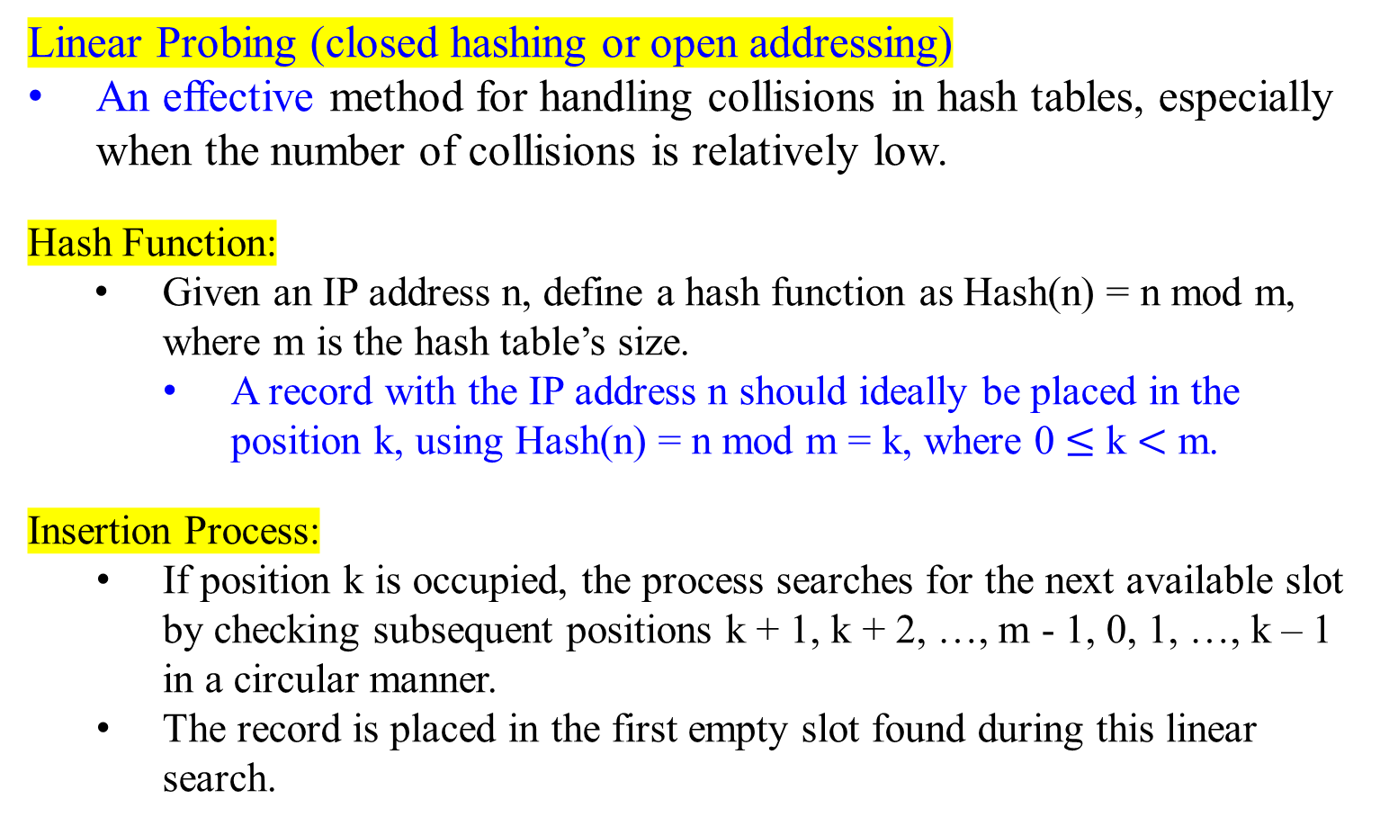
Hash Tables - Collision Resolution by Linear Probing
Linear Probing (closed hashing or open addressing)
An effective method for handling collisions in hash tables, especially when the number of collisions is relatively low.
Hash Function:
Given an IP address n, define a hash function as Hash(n) = n mod m, where m is the hash table’s size.
  A record with the IP address n should ideally be placed in the position k, using Hash(n) = n mod m = k, where 0 $≤$ k $<$ m.
    Insertion Process:
    If position k is occupied, the process searches for the next available slot by checking subsequent positions k + 1, k + 2, …, m - 1, 0, 1, …, k – 1 in a circular manner.
    The record is placed in the first empty slot found during this linear search.

Slide 29
Hash Tables - Collision Resolution by Linear Probing (closed hashing)
Linear Probing
Search Process:
To search a record with its IP address n in the table,
    Compute the hash function Hash(n) = n mod m = k, where m is the table size. Then the search for a record with its IP address n will begin at the starting position k.
    The search proceeds linearly from this position k through m - 1, then from position 0 through k-1 if necessary, until the record is found or an empty slot is encountered (indicating the record is not in the table), or the process proceeds from the position k through k-1 (indicating the record is not in the table).

Slide 30
Hash Tables - Collision Resolution by Linear Probing (closed hashing)
Linear Probing
Deletion Process:
Deletion is trickier because removing a key may break the probing sequence.
One common solution: Deletion requires special “tombstone” markers. Instead of clearing the slot, mark it as “deleted” (a special marker).
During search, treat “deleted” as occupied (keep probing).
During insertion, the “deleted” slots can be reused.

Slide 31
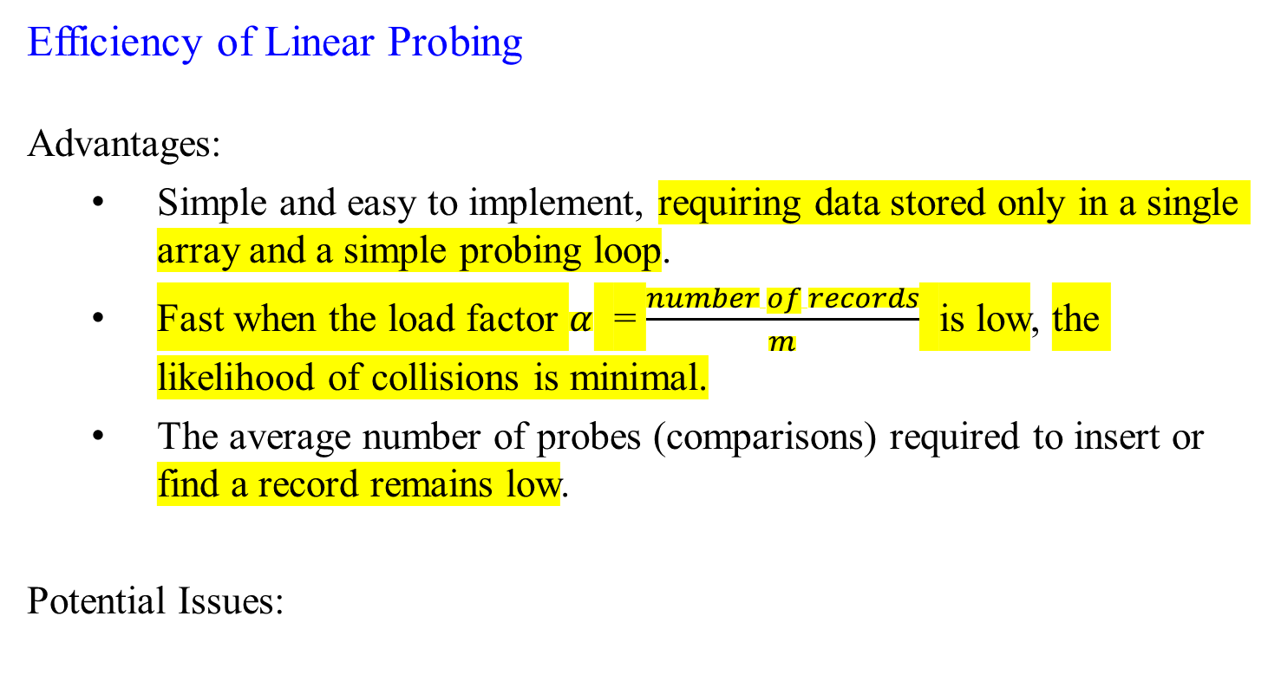
Hash Tables - Collision Resolution by Linear Probing
Efficiency of Linear Probing
Advantages:
Simple and easy to implement, requiring data stored only in a single array and a simple probing loop.
Fast when the load factor $α$ = $\frac{number of records}{m}$ is low, the likelihood of collisions is minimal.
The average number of probes (comparisons) required to insert or find a record remains low.
Potential Issues:

Slide 32
Hash Tables - Collision Resolution by Linear Probing
Efficiency of Linear Probing
Potential issues:
Primary Clustering:
Over time, linear probing can lead to clusters of occupied slots, known as primary clustering
A new collision that occurred tends to prolong the cluster, increasing the number of probes required for subsequent operations.
Performance Degradation and High Load Factors:
As the load factor increases (i.e., the table becomes fuller), the probability of collisions rises, leading to longer probe sequences.
This degrades performance, making insertion and search operations more time-consuming.

Slide 33
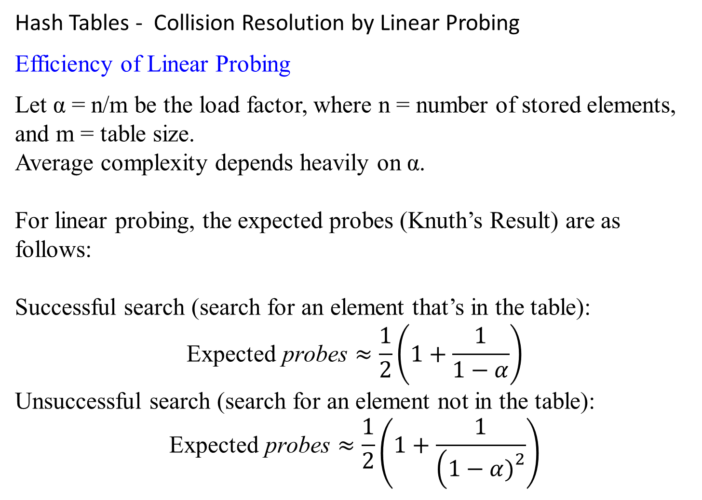
Hash Tables - Collision Resolution by Linear Probing
Efficiency of Linear Probing
Let α = n/m be the load factor, where n = number of stored elements, and m = table size.
Average complexity depends heavily on α.
For linear probing, the expected probes (Knuth’s Result) are as follows:
Successful search (search for an element that’s in the table):
$$\text{Expected} \text{probes}≈\frac{1}{2}\left(1+\frac{1}{1−α}\right)$$
Unsuccessful search (search for an element not in the table):
$$\text{Expected} \text{probes}≈\frac{1}{2}\left(1+\frac{1}{\left(1−α{\left.)\right.}^{2}\right.}\right)$$

Slide 34
Hash Tables - Collision Resolution by Linear Probing
Efficiency of Linear Probing
Average Time Complexity
When α is small (say ≤ 0.5):
Both successful and unsuccessful searches take about O(1) time on average.
When α → 1 (table almost full):
Expected probes blow up (approach infinity), and performance degrades to O(n) in the worst case.

Slide 35
Hash Tables - Collision Resolution by Linear Probing
Efficiency of Linear Probing
Average Time Complexity
Summary Table
Operation | Average Case (α small) | Worst Case (α ≈ 1 or clustering)
Insertion | O(1) | O(n)
Search (success) | O(1) | O(n)
Search (fail) | O(1) | O(n)
Deletion | O(1) | O(n)

Slide 37

Collision Resolution by Chaining (or called Open Hashing)
slots linked lists
T
Hash Table
k₁
k₄
U, Universe of keys
Actual keys K
k₁
k₄ k₅
k₇
k₂ k₃
k₈
k₆
k₅
k₇
k₂
k₃
k₈
k₆
Figure 4: Collision resolution by chaining: Each hash-table slot T[j] contains a linked list of all the keys whose hash value is j. For example, h(k₁ ) = h(k₄) and h(k₅) = h(k₇ ) = h(k₂), where h() is a defined hash-function.

Slide 38
Collision Resolution by Chaining (or called Open Hashing)
Collisions resolved by chaining
Storage:
Store all the elements that hash to the same slot (position) in the same linked list (or chain).
Structure:
The hash table T is an array of linked lists. Each slot T[i] points to the head of a linked list that contains all elements hashing to the i slot.

Slide 39
Collision Resolution by Chaining (or called Open Hashing)
Collisions resolved by chaining
Dictionary Operations on a Hash Table T
Let x be an element with the key k, k = key[x]. When collisions are resolved by chaining, the Dictionary Operations on a hash table T are:
  Chained-Hash-Insert(T, x)
  Compute the hash value h(key[x]).
  Insert element x at the head of the linked list at slot T[h(key[x])]
  Chained-Hash-Search(T, k)
  Compute the hash value h(k).
  Search the linked list at slot T[h(k)] for an element with key k
  Chained-Hash-Delete(T, x)
  Find x in the linked list at slot T[h(key[x])]
  Adjust the pointers in the linked list to Delete x

Slide 40
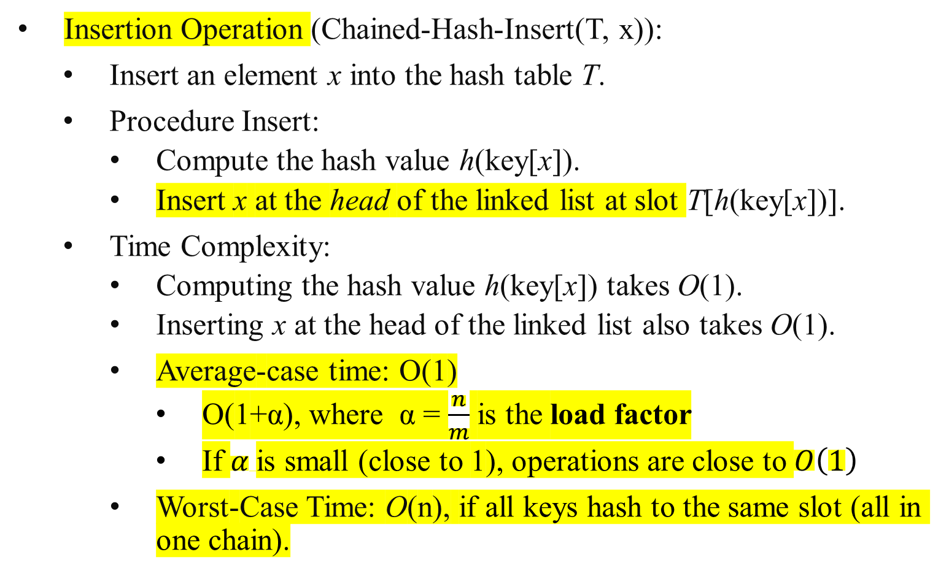
Time Efficiency for the Collision Resolution by Chaining
Insertion Operation (Chained-Hash-Insert(T, x)):
Insert an element x into the hash table T.
Procedure Insert:
  Compute the hash value h(key[x]).
  Insert x at the head of the linked list at slot T[h(key[x])].
Time Complexity:
  Computing the hash value h(key[x]) takes O(1).
  Inserting x at the head of the linked list also takes O(1).
Average-case time: O(1)
  O(1+α), where α = $\frac{n}{m}$ is the load factor
  If $α$is small (close to 1), operations are close to $O\left(1\right)$
Worst-Case Time: O(n), if all keys hash to the same slot (all in one chain).

Slide 41
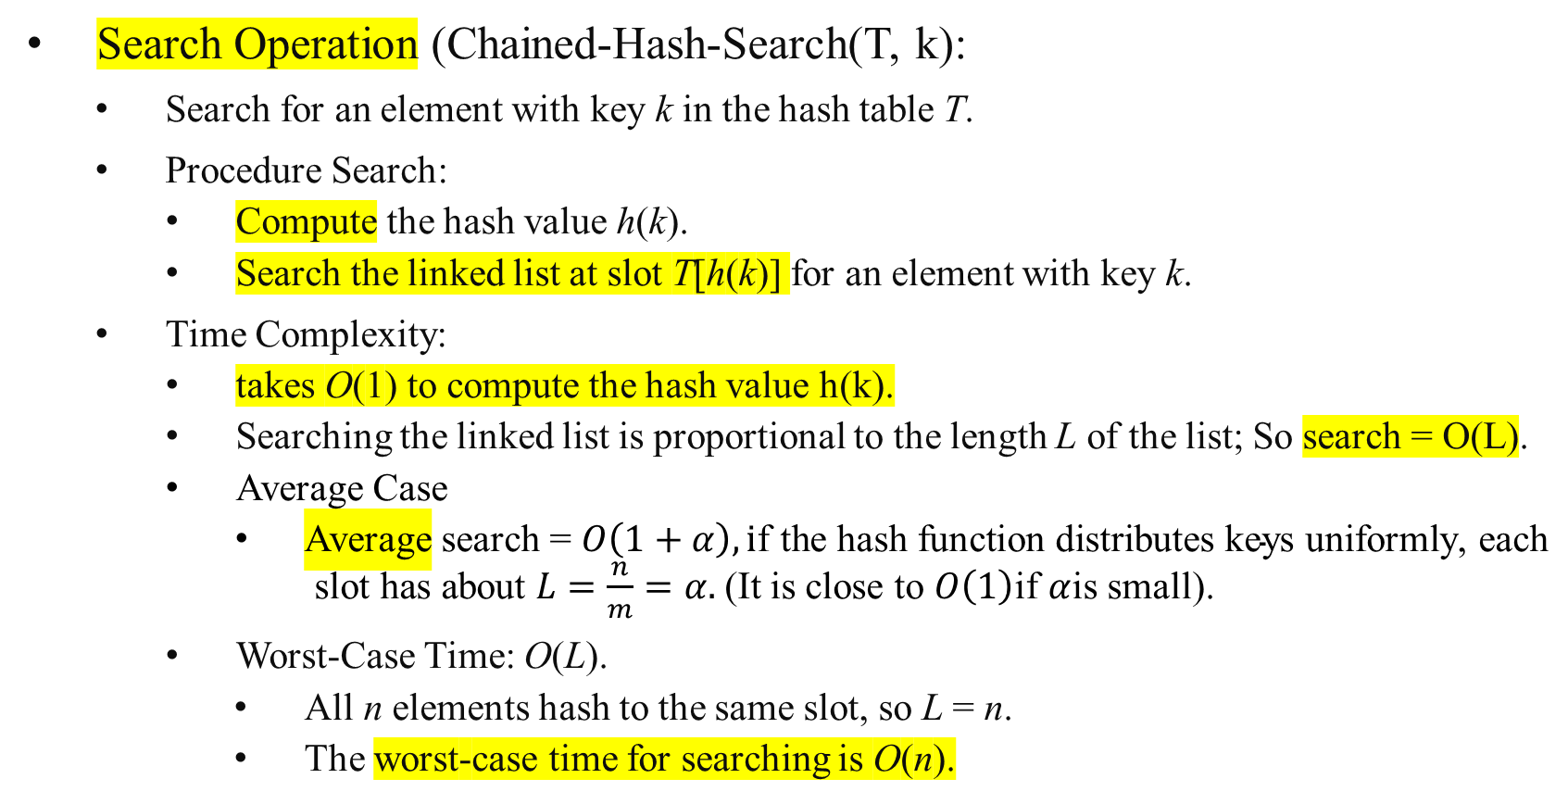
Time Efficiency for the Collision Resolution by Chaining
Search Operation (Chained-Hash-Search(T, k):
Search for an element with key k in the hash table T.
Procedure Search:
  Compute the hash value h(k).
  Search the linked list at slot T[h(k)] for an element with key k.
Time Complexity:
  takes O(1) to compute the hash value h(k).
  Searching the linked list is proportional to the length L of the list; So search = O(L).
  Average Case
      Average search = $O\left(1+α\right),\text{i}\text{f} \text{the} \text{hash} \text{function} \text{distributes} \text{keys} \text{uniformly}\text{, }\text{each} \text{slot} \text{has} \text{about} L=\frac{n}{m}=α.$(It is close to $O\left(1\right)$if $α$is small).
Worst-Case Time: O(L).
  All n elements hash to the same slot, so L = n.
  The worst-case time for searching is O(n).

Slide 42
Time Efficiency for the Collision Resolution by Chaining
A
Deletion Operation (Chained-Hash-Delete(T, x):
Delete an element x from the hash table T.
Procedure Deletion:
  Compute the hash value h(key[x]).
  Find x in the linked list at slot T[h(key[x])].
  Adjust the pointers in the linked list to remove x.
Time Complexity:
  Takes O(1) to compute the hash value h(key[x]).
  Takes O(L) to search for x from the list.
  Takes O(1) to delete x from a singly or doubly linked list, once x is found.
Worst-Case Time: O(L).
Combined Search and Deletion:
  Compute h(key[x]) slot for x: O(1).
  Searching for x: O(L).
  Deleting x: O(1).
Total Worst-Case Time: O(1) + O(L) + O(1) = O(L) = n, when all n elements are in one chain. The worst-case time for searching is O(n).
Average case: O(1+α)
delete
C
A
C
A
delete
C
A
C

Slide 43
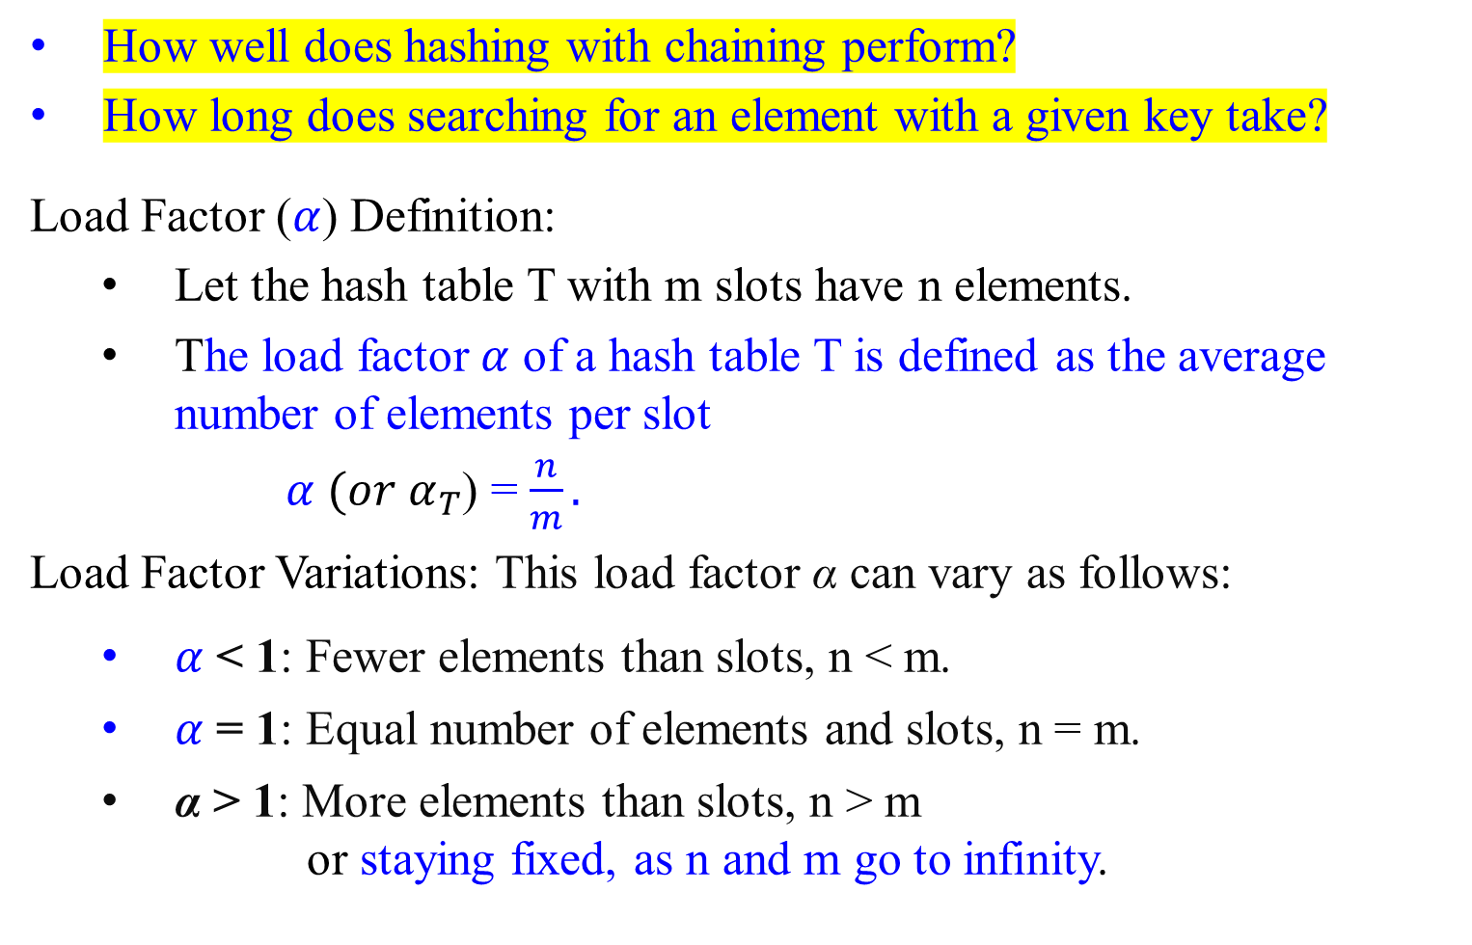
Performance of Hashing with Chaining (or called Open Hashing)
How well does hashing with chaining perform?
How long does searching for an element with a given key take?
Load Factor ($α$) Definition:
Let the hash table T with m slots have n elements.
The load factor $α$ of a hash table T is defined as the average number of elements per slot
$α$ ${(or α}_{T}$) = $\frac{n}{m}.$
Load Factor Variations: This load factor α can vary as follows:
$α$ < 1: Fewer elements than slots, n < m.
$α$ = 1: Equal number of elements and slots, n = m.
α > 1: More elements than slots, n > m
or staying fixed, as n and m go to infinity.

Slide 44
Performance of Hashing with Chaining (or called Open Hashing)
How well does hashing with chaining perform?
How long does searching for an element with a given key take?
Average Case Performance
In the average case, assuming a good hash function that distributes keys uniformly (which minimizes the collision occurrences):
Insertion: O(1) time on average. The element is inserted at the beginning or end of the linked list in its slot.
Deletion: O(1) time on average. Assuming we have a pointer to the element to be deleted.
Search: O(1) time on average, as the expected length of the linked list in each slot is α.
Therefore, operations are efficient if the hash function is good and the hash table is not too full (i.e., a low load factor (α)).
Average case: O(1).

Slide 45
Analysis of Hashing with Chaining (or called Open Hashing)
How well does hashing with chaining perform?
How long does searching for an element with a given key take?
Worst-Case Performance
In the worst-case scenario, all n keys hash to the same slot.
This creates a single linked list of length n.
Therefore, the worst-case time complexity for search, insertion, and deletion becomes:
  Search: Θ(n). we might need to traverse the entire list to find the element.
  Insertion: Θ(n) if we check for duplicates before insertion, otherwise O(1)
  Deletion: Θ(n)
  Worst case: Θ(n)

Slide 46
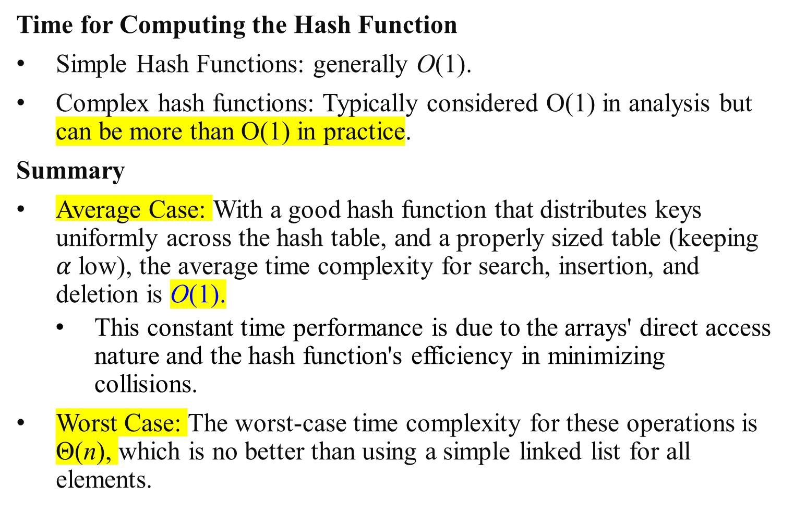
Analysis of Hashing with Chaining (or called Open Hashing)
Time for Computing the Hash Function
Simple Hash Functions: generally O(1).
Complex hash functions: Typically considered O(1) in analysis but can be more than O(1) in practice.
Summary
Average Case: With a good hash function that distributes keys uniformly across the hash table, and a properly sized table (keeping $α$ low), the average time complexity for search, insertion, and deletion is O(1).
  This constant time performance is due to the arrays' direct access nature and the hash function's efficiency in minimizing collisions.
Worst Case: The worst-case time complexity for these operations is Θ(n), which is no better than using a simple linked list for all elements.

Slide 47
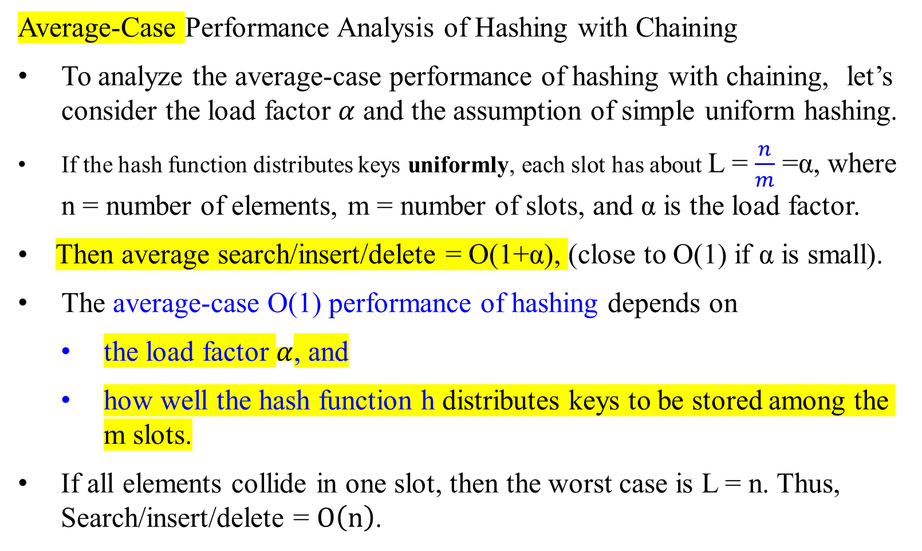
Performance of Hashing with Chaining (or called Open Hashing)
Average-Case Performance Analysis of Hashing with Chaining
To analyze the average-case performance of hashing with chaining, let’s consider the load factor $α$ and the assumption of simple uniform hashing.
If the hash function distributes keys uniformly, each slot has about L = $\frac{n}{m}$ =α, where n = number of elements, m = number of slots, and α is the load factor.
Then average search/insert/delete = O(1+α), (close to O(1) if α is small).
The average-case O(1) performance of hashing depends on
  the load factor $α$, and
  how well the hash function h distributes keys to be stored among the m slots.
If all elements collide in one slot, then the worst case is L = n. Thus, Search/insert/delete = $O\left(n\right)$.

Slide 48
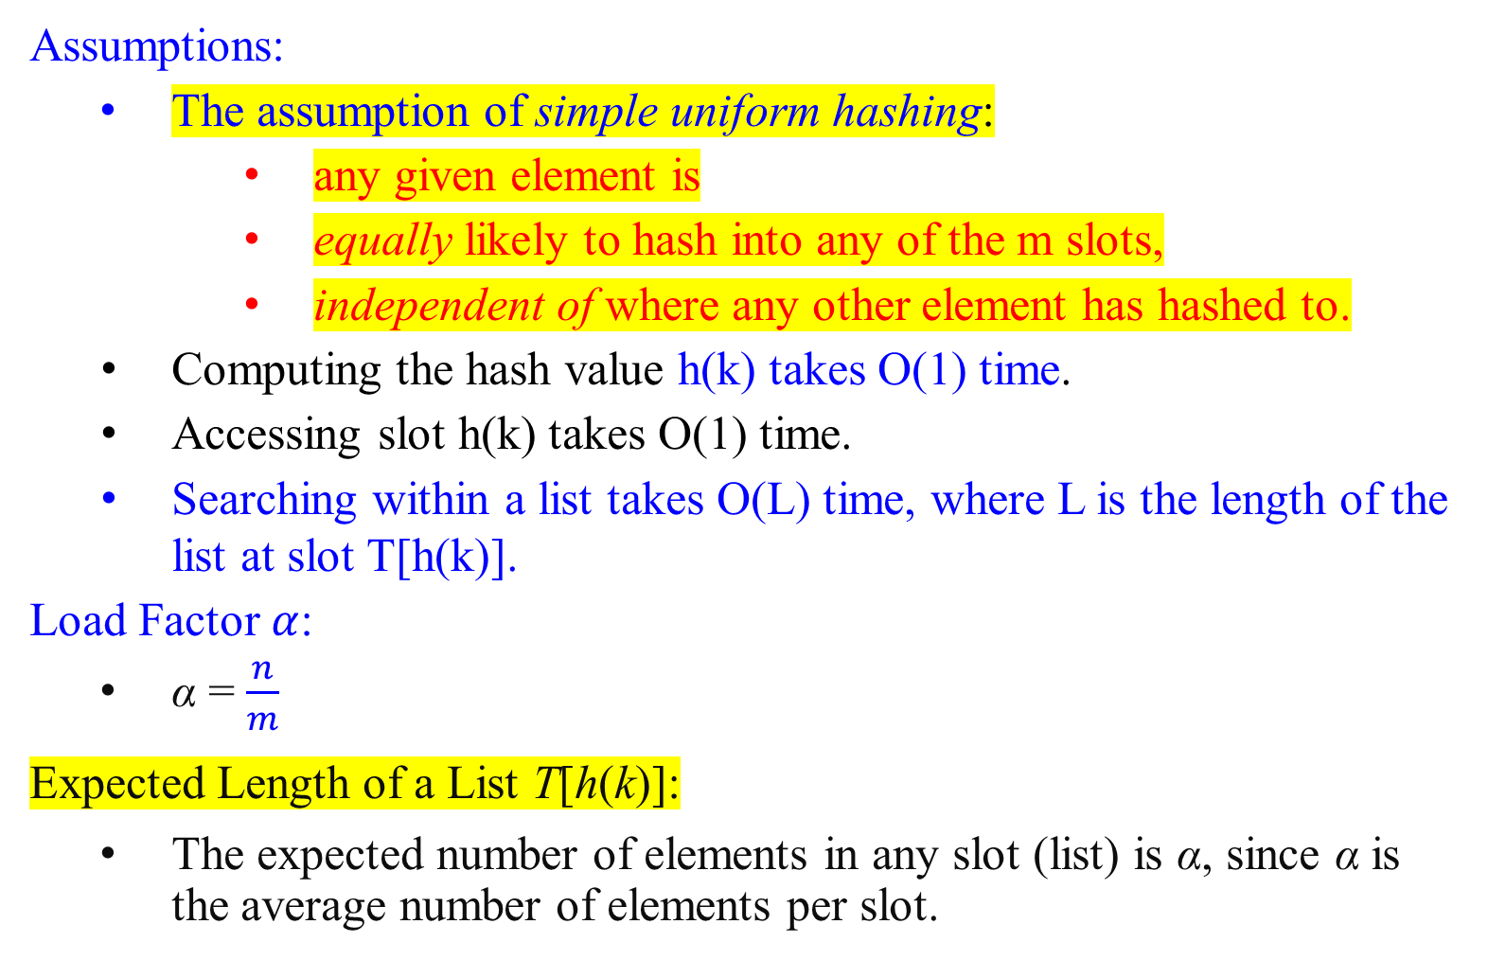
Performance of Hashing with Chaining (or called Open Hashing)
Assumptions:
The assumption of simple uniform hashing:
  any given element is
    equally likely to hash into any of the m slots,
    independent of where any other element has hashed to.
  Computing the hash value h(k) takes O(1) time.
  Accessing slot h(k) takes O(1) time.
  Searching within a list takes O(L) time, where L is the length of the list at slot T[h(k)].
  Load Factor $α$:
  α = $\frac{n}{m}$
Expected Length of a List T[h(k)]:
The expected number of elements in any slot (list) is α, since α is the average number of elements per slot.

Slide 49
Average-Case Performance Analysis of Hashing with Chaining (or called Open Hashing)
  To analyze the expected (average) number of elements in the list T[h(k)], we check to see if any element has a key equal to k using a search algorithm. We have two cases:
    Case I: Unsuccessful Search
    In an unsuccessful search, no element in the table has key k.
    Case II: Successful Search
    The search successfully finds an element with key k.
    On average, half of the elements in the list need to be checked before finding the key k.

Slide 50
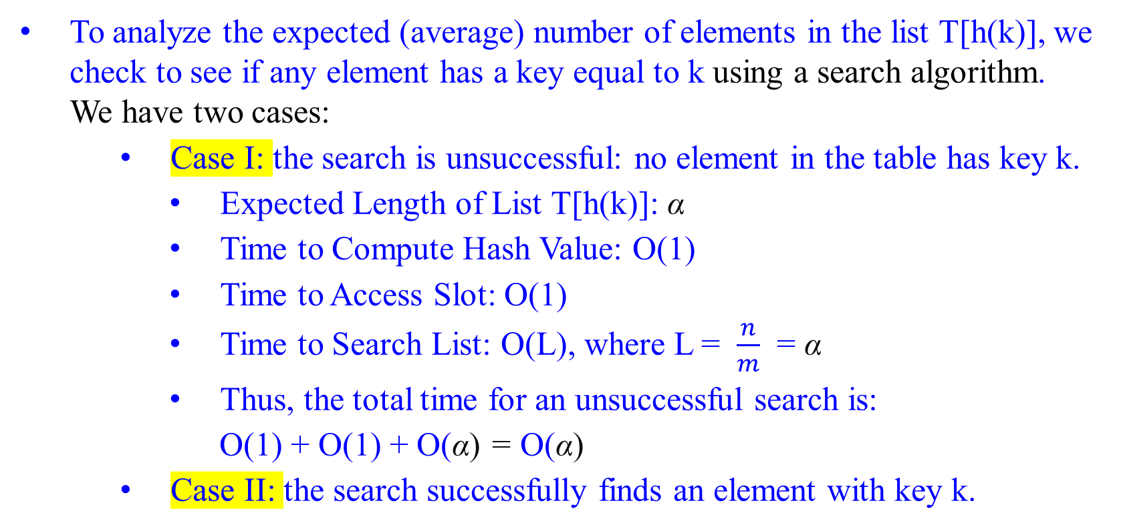
Average-Case Performance Analysis of Hashing with Chaining (or called Open Hashing)
  To analyze the expected (average) number of elements in the list T[h(k)], we check to see if any element has a key equal to k using a search algorithm. We have two cases:
    Case I: the search is unsuccessful: no element in the table has key k.
    Expected Length of List T[h(k)]: α
    Time to Compute Hash Value: O(1)
    Time to Access Slot: O(1)
    Time to Search List: O(L), where L = $\frac{n}{m}$ = α
    Thus, the total time for an unsuccessful search is:
    O(1) + O(1) + O(α) = O(α)
    Case II: the search successfully finds an element with key k.

Slide 51
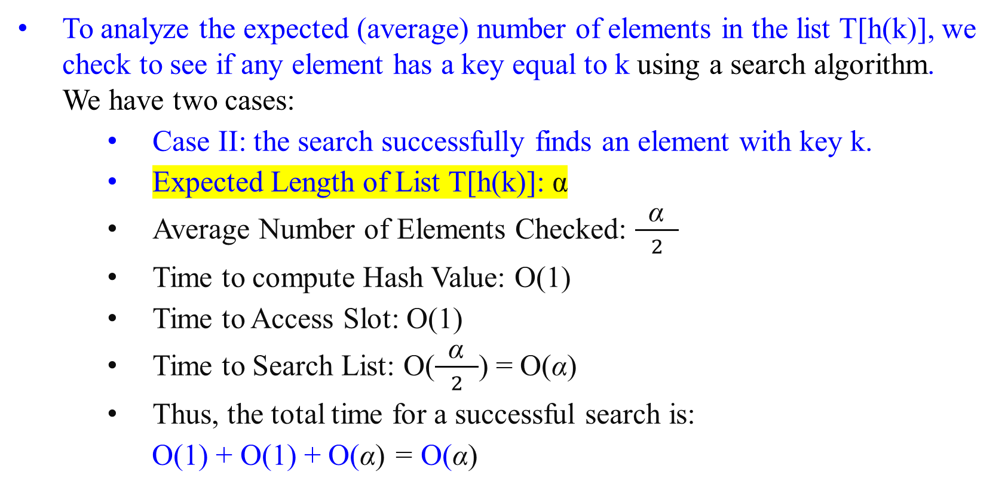
Average-Case Performance Analysis of Hashing with Chaining (or called Open Hashing)
  To analyze the expected (average) number of elements in the list T[h(k)], we check to see if any element has a key equal to k using a search algorithm. We have two cases:
    Case II: the search successfully finds an element with key k.
    Expected Length of List T[h(k)]: α
    Average Number of Elements Checked: $\frac{ \text{α} }{2}$
    Time to compute Hash Value: O(1)
    Time to Access Slot: O(1)
    Time to Search List: O($\frac{ \text{α} }{2}$) = O(α)
    Thus, the total time for a successful search is:
    O(1) + O(1) + O(α) = O(α)

Slide 52
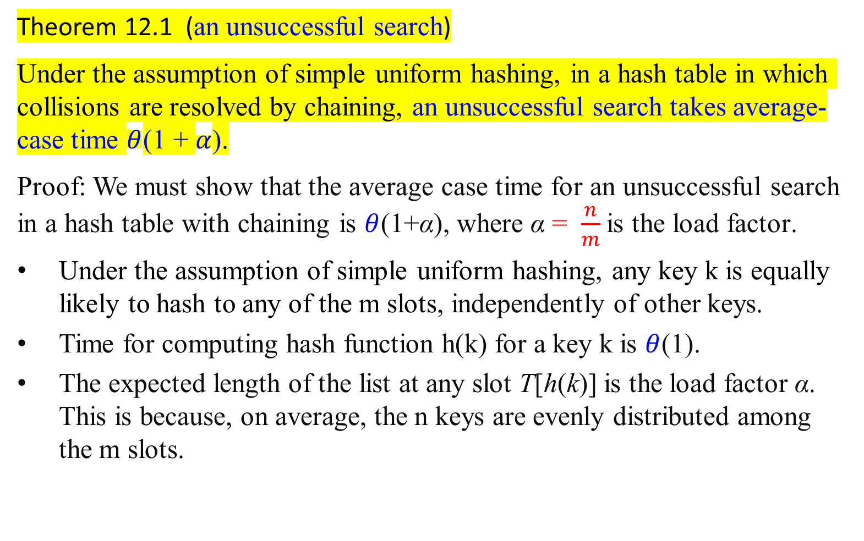
Analysis of Hashing with Chaining (or called Open Hashing)
Theorem 12.1 (an unsuccessful search)
Under the assumption of simple uniform hashing, in a hash table in which collisions are resolved by chaining, an unsuccessful search takes average-case time $θ$(1 + $α$).
Proof: We must show that the average case time for an unsuccessful search in a hash table with chaining is $θ$(1+α), where α = $\frac{n}{m}$is the load factor​.
Under the assumption of simple uniform hashing, any key k is equally likely to hash to any of the m slots, independently of other keys.
Time for computing hash function h(k) for a key k is $θ$(1).
The expected length of the list at any slot T[h(k)] is the load factor α. This is because, on average, the n keys are evenly distributed among the m slots.

Slide 53
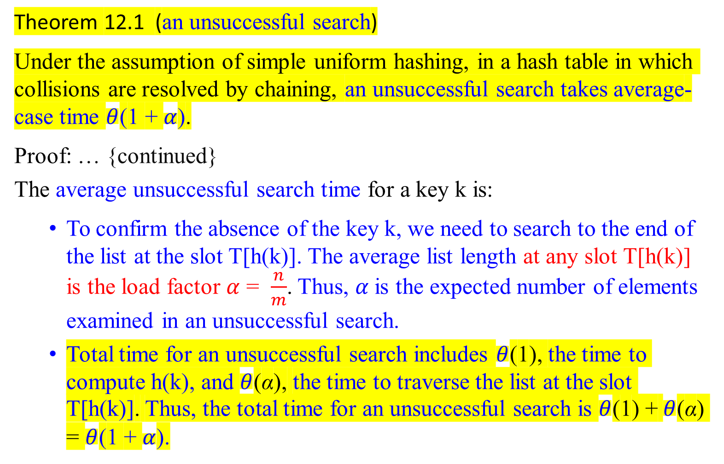
Analysis of Hashing with Chaining (or called Open Hashing)
Theorem 12.1 (an unsuccessful search)
Under the assumption of simple uniform hashing, in a hash table in which collisions are resolved by chaining, an unsuccessful search takes average-case time $θ$(1 + $α$).
Proof: … {continued}
The average unsuccessful search time for a key k is:
  To confirm the absence of the key k, we need to search to the end of the list at the slot T[h(k)]. The average list length at any slot T[h(k)] is the load factor $α$ = $\frac{n}{m}$. Thus, $α$is the expected number of elements examined in an unsuccessful search.
  Total time for an unsuccessful search includes $θ$(1), the time to compute h(k), and $θ$(α), the time to traverse the list at the slot T[h(k)]. Thus, the total time for an unsuccessful search is $θ$(1) + $θ$(α) = $θ$(1 + $α$).

Slide 54
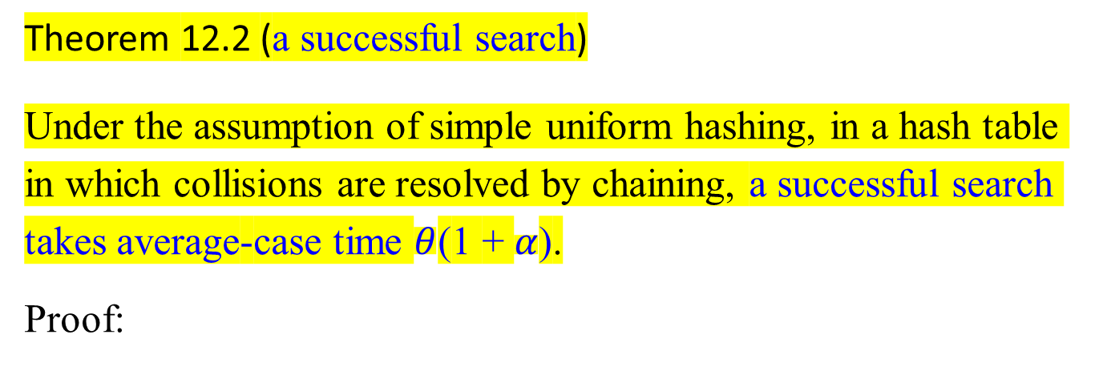
Analysis of Hashing with Chaining (or called Open Hashing)
Theorem 12.2 (a successful search)
Under the assumption of simple uniform hashing, in a hash table in which collisions are resolved by chaining, a successful search takes average-case time $θ$(1 + $α$).
Proof:

Slide 55
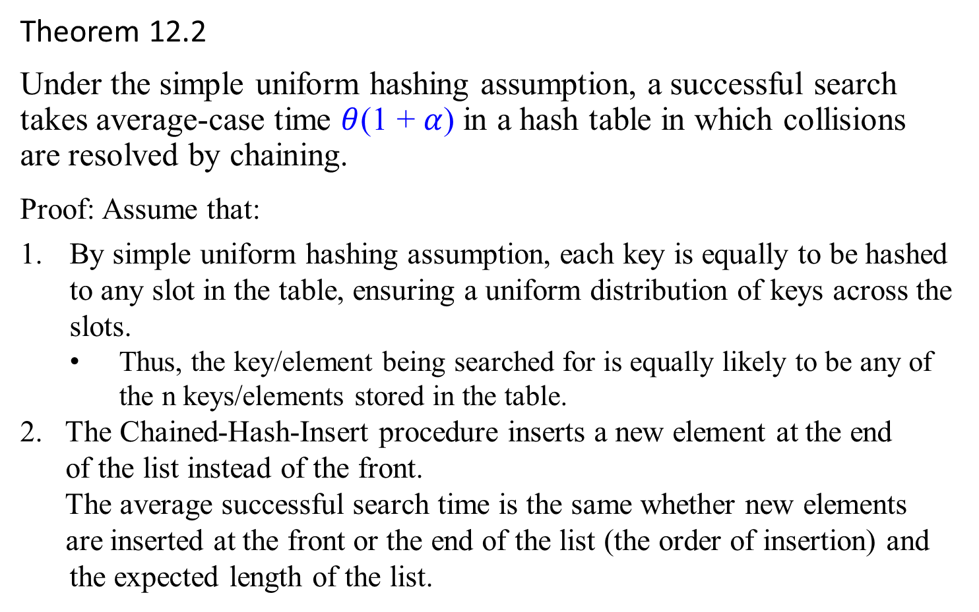
Theorem 12.2
Under the simple uniform hashing assumption, a successful search takes average-case time $θ$(1 + $α$) in a hash table in which collisions are resolved by chaining.
Proof: Assume that:
By simple uniform hashing assumption, each key is equally to be hashed to any slot in the table, ensuring a uniform distribution of keys across the slots.
  Thus, the key/element being searched for is equally likely to be any of the n keys/elements stored in the table.
2. The Chained-Hash-Insert procedure inserts a new element at the end
of the list instead of the front.
The average successful search time is the same whether new elements
are inserted at the front or the end of the list (the order of insertion) and the expected length of the list.

Slide 56
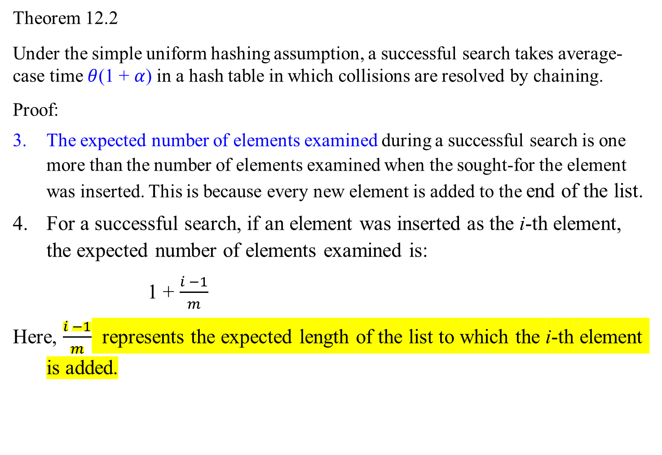
Theorem 12.2
Under the simple uniform hashing assumption, a successful search takes average-case time $θ$(1 + $α$) in a hash table in which collisions are resolved by chaining.
Proof:
The expected number of elements examined during a successful search is one more than the number of elements examined when the sought-for the element was inserted. This is because every new element is added to the end of the list.
For a successful search, if an element was inserted as the i-th element, the expected number of elements examined is:
  1 + $\frac{i −1}{m}$
Here, $\frac{i −1}{m}$​ represents the expected length of the list to which the i-th element is added.

Slide 57
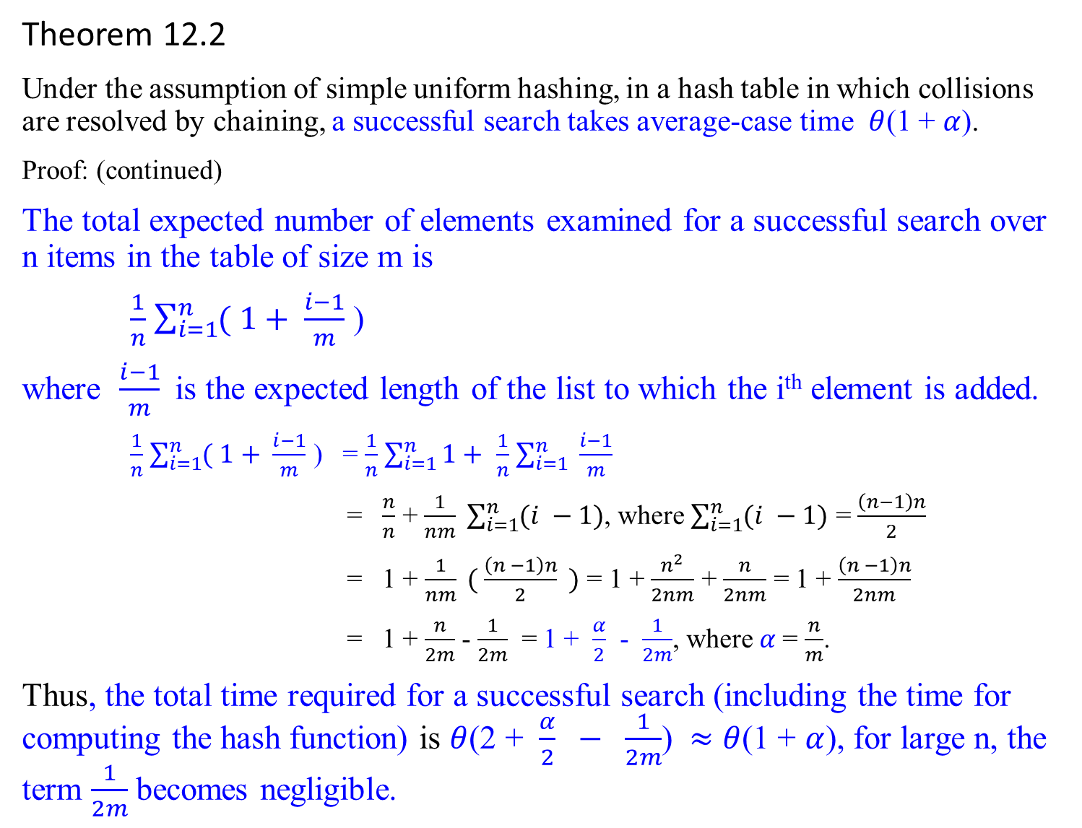
Theorem 12.2
Under the assumption of simple uniform hashing, in a hash table in which collisions are resolved by chaining, a successful search takes average-case time $θ$(1 + $α$).
Proof: (continued)
The total expected number of elements examined for a successful search over n items in the table of size m is
$\frac{1}{n}$ $\sum_{i=1}^{n}{( 1+ \frac{i−1}{m}}$ )
where $\frac{i−1}{m}$is the expected length of the list to which the i^{th} element is added.
$\frac{1}{n}$ $\sum_{i=1}^{n}{( 1+ \frac{i−1}{m}}$ ) = $\frac{1}{n}$ $\sum_{i=1}^{n}{1+ }$ $\frac{1}{n}$ $\sum_{i=1}^{n}{ \frac{i−1}{m}}$
= $\frac{n}{n}$ + $\frac{1}{nm} \sum_{i=1}^{n}{(i −1)}$, where $\sum_{i=1}^{n}{(i −1)}$ = $\frac{\left(n−1\right)n}{2}$
= 1 + $\frac{1}{nm} ( \frac{\left(n −1\right)n}{2} )$ = 1 + $\frac{n^{2}}{2nm}$ + $\frac{n}{2nm}$ = 1 + $\frac{\left(n −1\right)n}{2nm}$
= 1 + $\frac{n}{2m}$ - $\frac{1}{2m}$ = 1 + $\frac{α}{2}$ - $\frac{1}{2m}$, where $α$= $\frac{n}{m}$.
Thus, the total time required for a successful search (including the time for computing the hash function) is $θ$(2 + $\frac{α}{2} − \frac{1}{2m}$) $≈$ $θ$(1 + $α$), for large n, the term $\frac{1}{2m}$ becomes negligible.

Slide 58
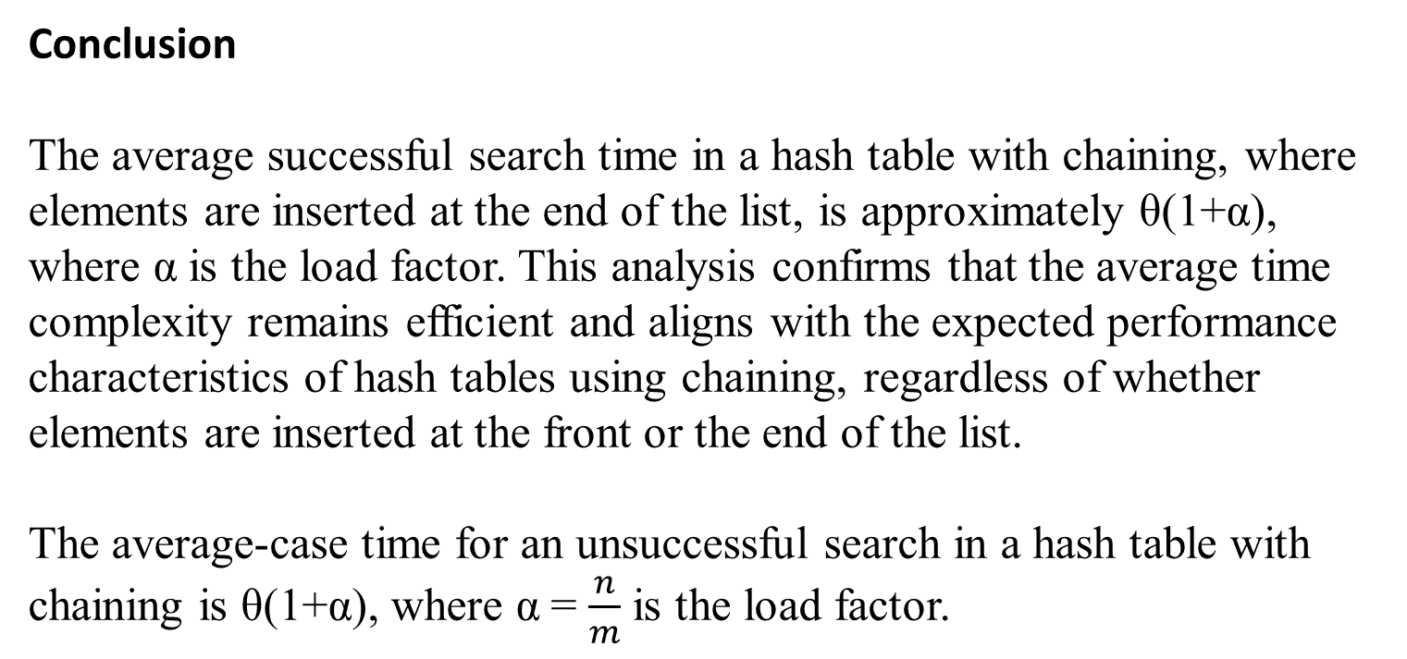
Conclusion
The average successful search time in a hash table with chaining, where elements are inserted at the end of the list, is approximately θ(1+α), where α is the load factor. This analysis confirms that the average time complexity remains efficient and aligns with the expected performance characteristics of hash tables using chaining, regardless of whether elements are inserted at the front or the end of the list.
The average-case time for an unsuccessful search in a hash table with chaining is θ(1+α), where α = $\frac{n}{m}$ is the load factor.

Slide 59
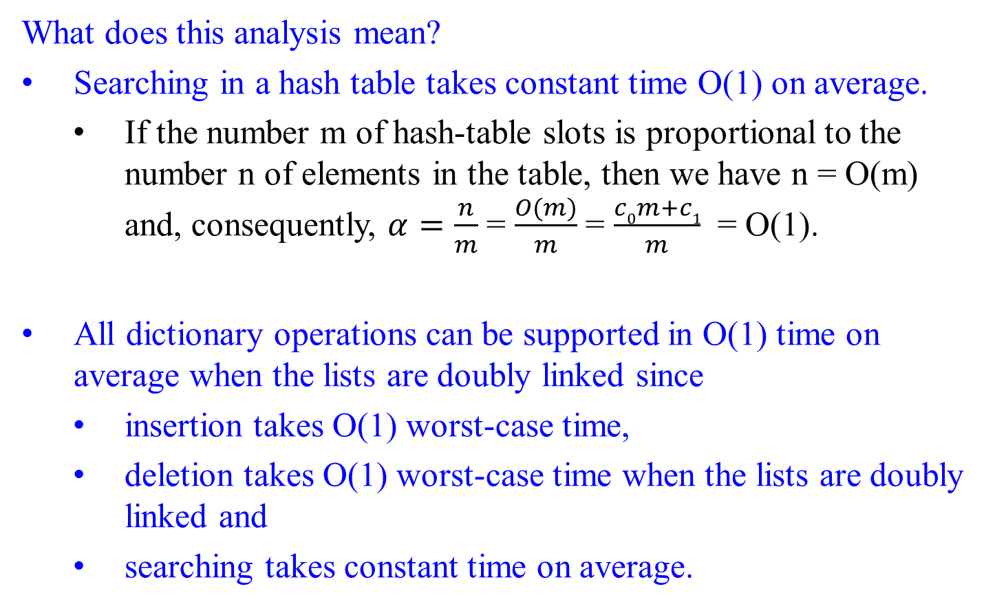
Analysis of Hashing with Chaining (or called Open Hashing)
What does this analysis mean?
Searching in a hash table takes constant time O(1) on average.
  If the number m of hash-table slots is proportional to the number n of elements in the table, then we have n = O(m) and, consequently, $α=\frac{n}{m}$ = $\frac{O(m)}{m}$ = $\frac{c0m+c1}{m}$ = O(1).
All dictionary operations can be supported in O(1) time on average when the lists are doubly linked since
  insertion takes O(1) worst-case time,
  deletion takes O(1) worst-case time when the lists are doubly linked and
  searching takes constant time on average.

Slide 60
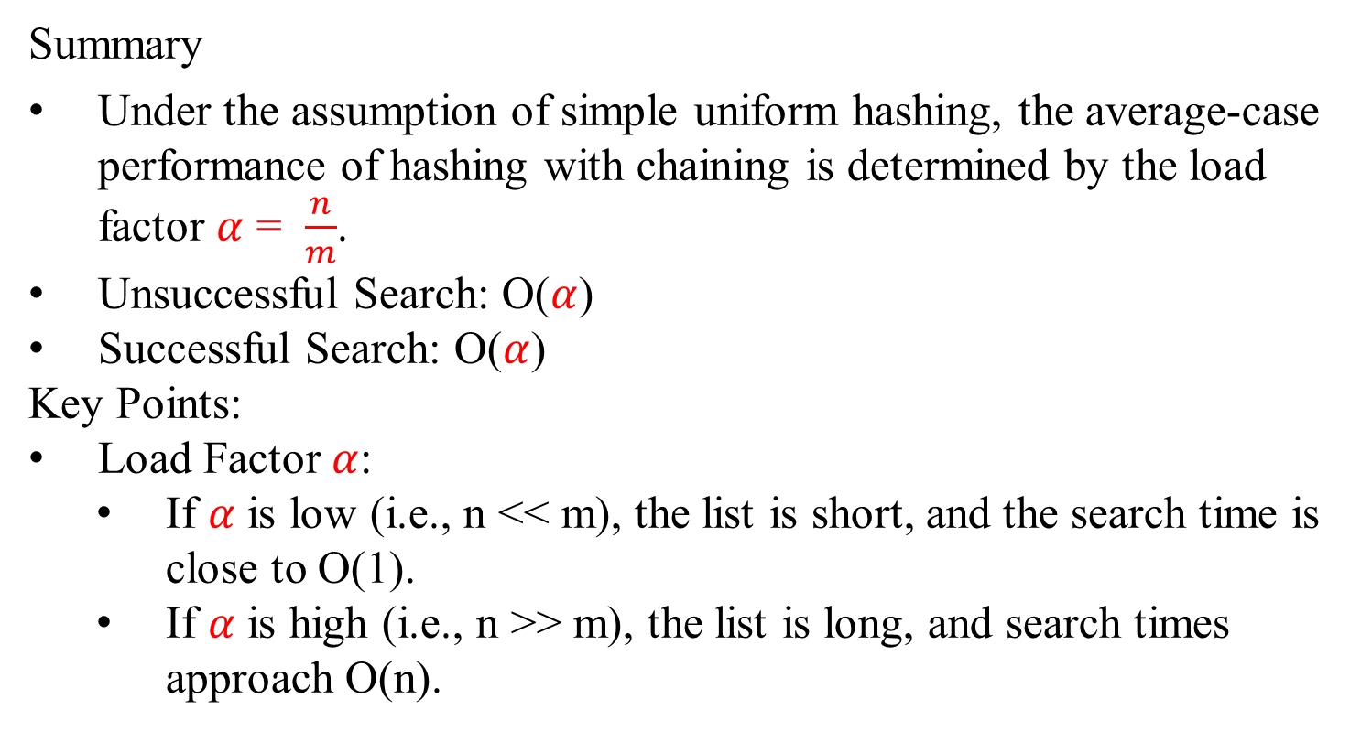
Analysis of Hashing with Chaining (or called Open Hashing)
Summary
Under the assumption of simple uniform hashing, the average-case performance of hashing with chaining is determined by the load factor $α$ = $\frac{n}{m}$.
Unsuccessful Search: O($α$)
Successful Search: O($α$)
Key Points:
Load Factor $α$:
If $α$ is low (i.e., n << m), the list is short, and the search time is close to O(1).
If $α$ is high (i.e., n >> m), the list is long, and search times approach O(n).

Slide 61
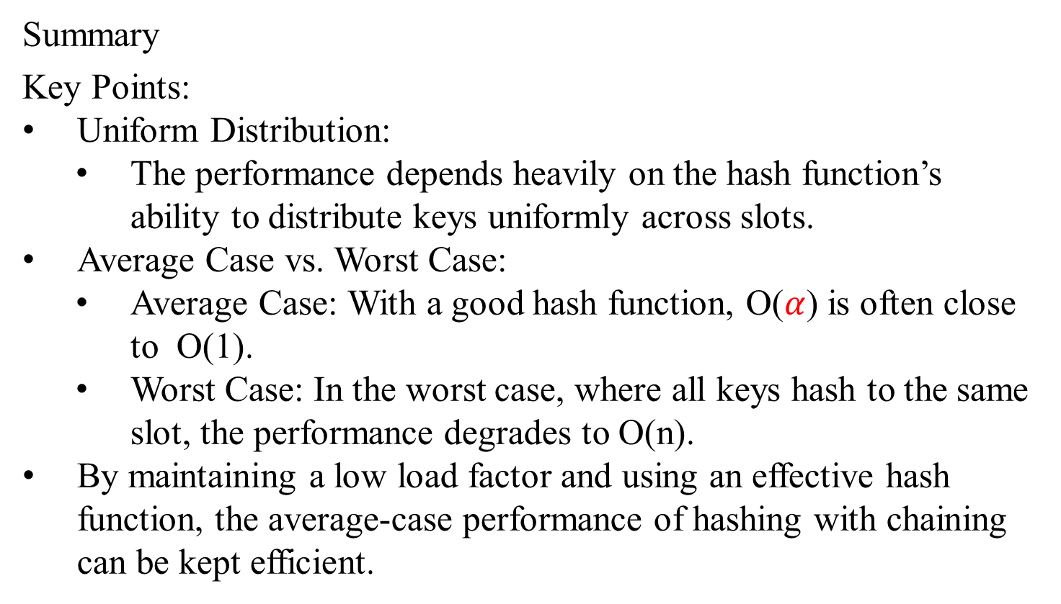
Analysis of Hashing with Chaining (or called Open Hashing)
Summary
Key Points:
Uniform Distribution:
The performance depends heavily on the hash function’s ability to distribute keys uniformly across slots.
Average Case vs. Worst Case:
Average Case: With a good hash function, O($α$) is often close to O(1).
Worst Case: In the worst case, where all keys hash to the same slot, the performance degrades to O(n).
By maintaining a low load factor and using an effective hash function, the average-case performance of hashing with chaining can be kept efficient.

Slide 62
What makes a good hash function?

Slide 63
Hash Function – What makes a good hash function?
Characteristics of a Good Hash Function
A good hash function is crucial for ensuring the efficiency and effectiveness of hashing with chaining.
The key characteristics that make a hash function good are:
  Ease of Computation:
  The hash function should be easy to compute. Ideally, computing the hash value h(k) should take O(1).
  Minimal Collisions:
  A good hash function minimizes the number of collisions.
  Minimizing collisions helps maintain short linked lists in the hash table,
  ensuring that search, insertion, and deletion operations remain efficient.
  Simple Uniform Hashing (Uniform Distribution):

Slide 64
Hash Function – What makes a good hash function?
Characteristics of a Good Hash Function
The key characteristics that make a hash function good are:
  Simple Uniform Hashing (Uniform Ditribustion):
  The good hash function should satisfy (approximately) the assumption of simple uniform hashing:
  Each key is equally likely to hash to any of the m slots, independently of where any other key has hashed.
  Ensure the hash function distributes keys uniformly across all available slots.
    Ensure that keys and their records are distributed evenly throughout the hash table, preventing clustering and maintaining efficient operations.
    Deterministic:

Slide 65
Hash Function – What makes a good hash function?
Characteristics of a Good Hash Function
The key characteristics that make a hash function good are:
  Deterministic:
  The hash function should be deterministic.
  This ensures that the same key always hashes to the same slot.
  This ensures consistency and predictability in the behavior of the hash table.
    Avalanche Effect:
    A small change in the input key should produce a significantly different hash value.
    This property helps achieve a uniform distribution and reduces the chances of similar keys causing collisions.

Slide 66
Hash Functions – What makes a good hash function?
Common Hash Function Techniques
Division Method:
Multiplication Method:
Universal Hashing:
Cryptographic Hash Functions:

Slide 67
Division Method:
The hash value is computed as h(k) = k mod m, where k is the key and m is the size of the hash table.
Choosing m as a prime number can reduce collisions and achieve a more uniform distribution.
Multiplication Method:
The hash value is computed as h(k) = ⌊m(kA mod 1)⌋, where A is a constant (usually 0 < A<1) and m is the size of the hash table.
This method tends to distribute keys more uniformly and can be more effective than the division method.
“k A mod 1” means the fractional part of k A. See slide 85.

Slide 68
Universal Hashing:
Universal Hashing involves randomly selecting a hash function from a set of predefined hash functions, known as a universal family of hash functions.
Random Selection: A hash function is chosen randomly from a universal family of predefined hash functions.
Collision Reduction: This method helps reduce the probability of collisions, particularly in adversarial situations where the keys might be chosen to cause collisions.

Slide 69
Cryptographic Hash Functions:
Cryptographic hash functions are designed to provide strong hash properties and are commonly used in security-related applications.
Functions like: MD5 (Message Digest Algorithm 5), SHA-1 (Secure Hash Algorithm 1), and SHA-256 (Secure Hash Algorithm 256).
Good Distribution: These functions produce hash values that are well-distributed.
Avalanche Effect: A small change in the input significantly changes the output hash.
Computationally Expensive: These functions are generally more computationally expensive.
Use Cases: Often used in security-related applications rather than in hash tables for general-purpose computing due to their computation cost.

Slide 70
Practical Considerations
Prime Table Size:
When using the division method, choosing the table size m to be a prime number helps reduce collisions and achieve a more uniform distribution.
Key Transformation:
Transform non-numeric keys into numeric values using techniques like folding, digit extraction, or converting characters to ASCII values and combining them.
Load Factor Management:
Keeping the load factor α low (e.g., α ≤ 1) by resizing the hash table when necessary helps maintain efficient operations.

Slide 71
Hash Functions – What makes a good hash function?
Interpreting keys as large natural numbers and computing their hash values
Step-by-Step Process
Convert the Key to an Integer:
If the key is not already a natural number, convert it into one.
For character strings as keys, interpret them as integers expressed in a suitable radix notation (e.g., ASCII values).
Convert each character to its ASCII value
Combine the ASCII values using the specified radix (base).
Compute the Hash Value Using Horner’s Rule:
Use Horner’s rule to calculate the hash value efficiently for long character strings.

Slide 72
Hash Functions – What makes a good hash function?
Interpreting keys as large natural numbers and computing their hash values
Example: Character Strings as Keys
  For converting “pt” to a radix-128 integer
  Interpret pt as the pair of decimal integers (112, 116), according to the ASCII character set.
  Then, combine ASCII values using Radix-128, pt becomes an integer using Honer’s rule to calculate
  (112*128) + 116 = 14452, where 128 is 2⁷.
  opt can be computed as integer (((111*128) + 112)*128) + 116 = 1833076, using Horner Rule. This obtains from 111*128² + 112*128 + 116

Slide 73
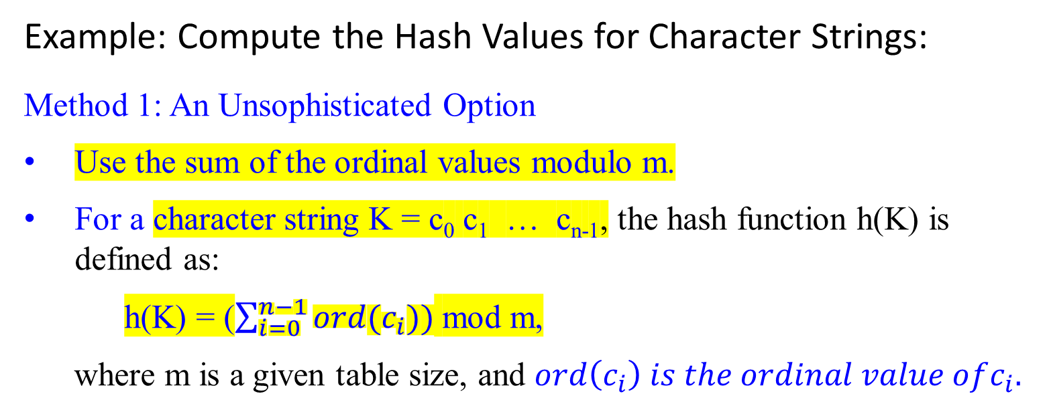
Example: Compute the Hash Values for Character Strings:
Method 1: An Unsophisticated Option
Use the sum of the ordinal values modulo m.
For a character string K = c₀ c₁ … c_{n-1}, the hash function h(K) is defined as:
h(K) = ($\sum_{i=0}^{n−1}{ord(c_{i}))}$ mod m,
where m is a given table size, and $ord\left(c_{i}\right) is the ordinal value ofc_{i}.$

Slide 74
Example: Compute the Hash Values for Character Strings:
Method 2: An Efficient Method Using Horner’s Rule
For a long character string K = c₀ c₁ … c_{n-1}, the hash function h(K) is calculated piecewise using Horner’s rule:
h ← 0;
for (i ← 0 to n – 1) do {
h ← (h * C + ord(c_{i})) mod m; }
where C is a constant larger than every ord(c_{i}) in the string. e.g., C can be 128 if ASCII codes are used.
As an example, when i = 2, h(c₀c₁c₂ ) is
((ord(c₀)mod m * C + ord(c₁))mod m * C + ord(c₂))mod m
h(c₀c₁c₂ …c_{n-1})
= ord(c₀)%m * C^{n-1} + ord(c₁)*m * C^{n-2} + … + ord(c_{n-3})*m * C² + ord(c_{n-2})%m * C + ord(c_{n-1})%m

Slide 75
Example: Compute the Hash Values for Character Strings:
Let’s calculate the hash values for the string "opt" with a table size m=1000:
Method 1: Unsophisticated Option
ASCII values=[111,112,116]
Sum=111+112+116=339
h("opt") = 339 mod 1000=339.
Method 2: Horner’s Rule Using C=128:
h ← 0
h ← (0×128+111) mod 1000 = 111
h ← (111×128+112) mod 1000 = 14320 mod 1000 = 320
h ← (320×128+116) mod 1000 = 40956 mod 1000 = 196
h("opt") = 196

Slide 77
Hash Functions – What makes a good hash function?
Modular Hashing – the Division Method for creating hash functions:
The modular hashing method (a widely used method for creating hash functions) is:
  The hash function is h(k) = k mod m. Map a key k into one of the m slots.
Choosing the value of m:
Choose a prime number m, not too close to the exact powers of 2
Avoid Powers of Two:
  If m = 2^{p}, h(k) uses only the lowest-order p bits of k. This can lead to a high frequency of collisions if the lower bits of the keys have less randomness.
  An example: let m = 2⁴ = 10000₂. Keys k =13 (1101), 29 (11101), 45 (101101), 61 (111101) … all have the same hash value h(k) = k (mod m) = 1101₂, which is just the 4 lowest-order bits of k. In comparison with m = 13, then their hash value h(k) would be 0000, 0011, 0110, 1001, … respectively.
Avoid Multiples of 10:
Avoid choosing m = 10^{p}, if the application deals with decimal numbers as keys. If m = 10, keys 10, 20, … etc., would all hash to 0, a clustering of values.

Slide 78
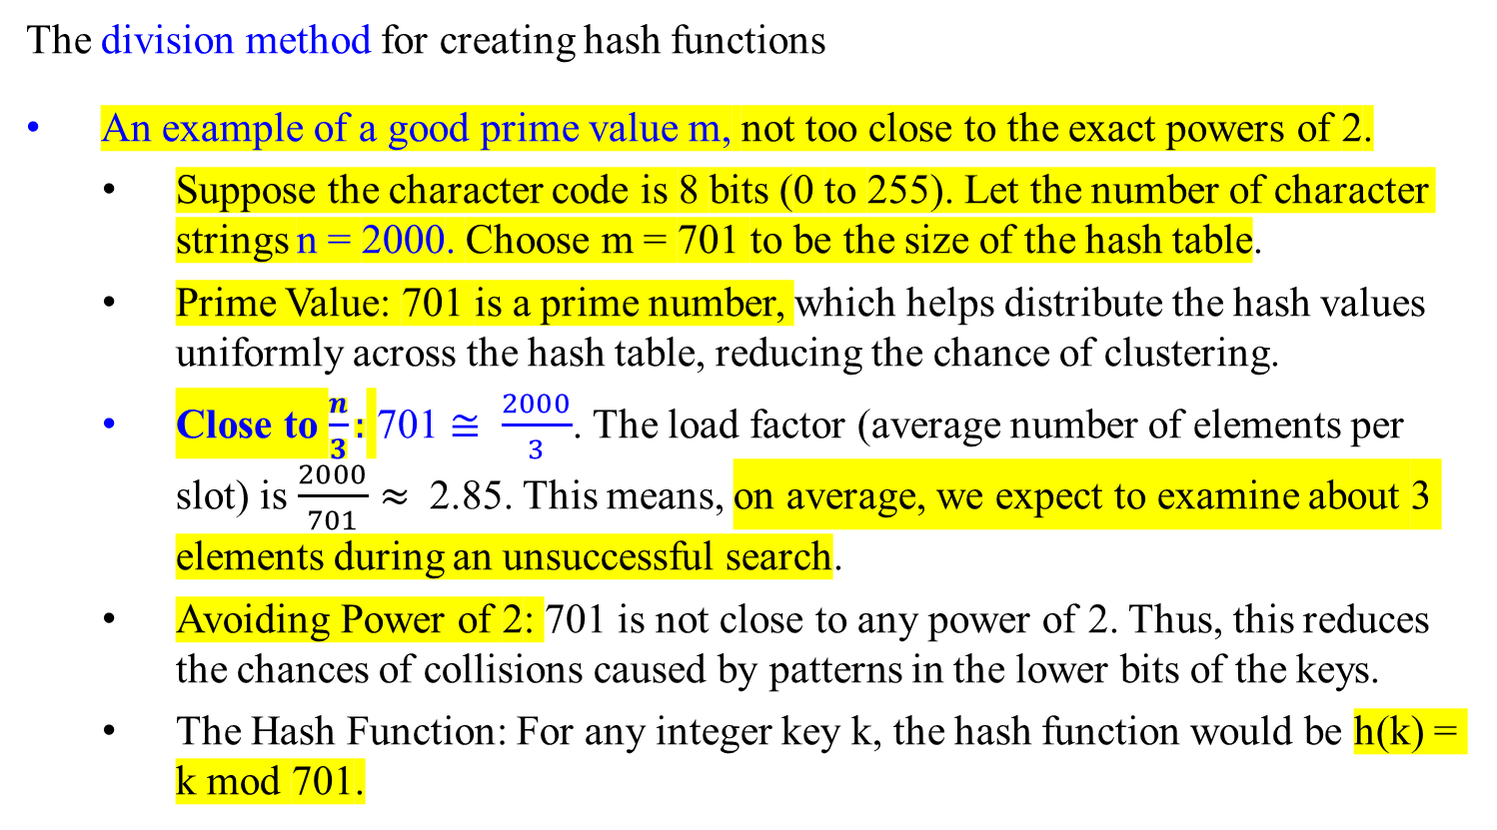
Hash Functions – What makes a good hash function?
The division method for creating hash functions
An example of a good prime value m, not too close to the exact powers of 2.
  Suppose the character code is 8 bits (0 to 255). Let the number of character strings n = 2000. Choose m = 701 to be the size of the hash table.
  Prime Value: 701 is a prime number, which helps distribute the hash values uniformly across the hash table, reducing the chance of clustering.
  Close to $\frac{n}{3}:$ 701 $≅ \frac{2000}{3}$. The load factor (average number of elements per slot) is $\frac{2000}{701}$ $≈$ 2.85. This means, on average, we expect to examine about 3 elements during an unsuccessful search.
  Avoiding Power of 2: 701 is not close to any power of 2. Thus, this reduces the chances of collisions caused by patterns in the lower bits of the keys.
  The Hash Function: For any integer key k, the hash function would be h(k) = k mod 701.
6/12 = 6
18/12 = 6
30/12 = 6
6/11 = 6
18/11 = 7
30/11 = 8
8/16 = 8
24/16 = 8
40/16 = 8
101000/10000 = 1000
8/11 = 8
24/11 = 2
40/11 = 7

Slide 79

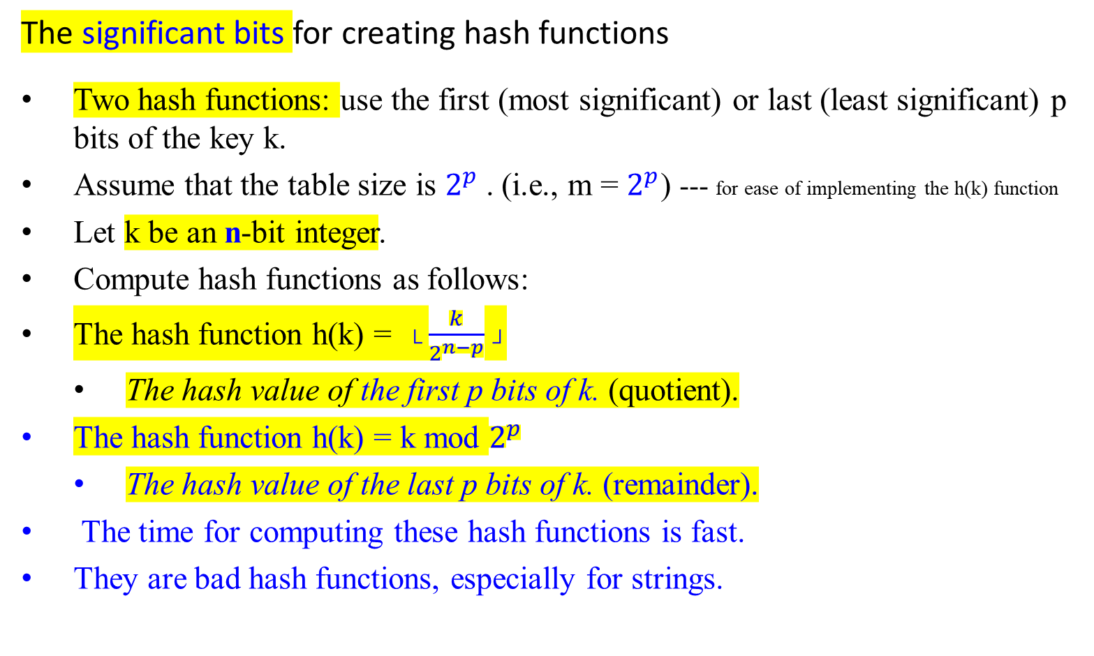
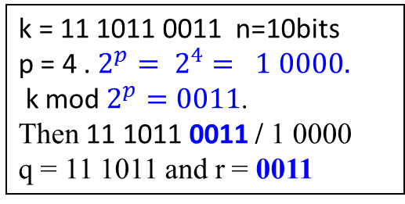
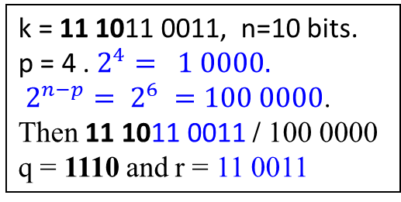
Hash Functions – What makes a good hash function?
The significant bits for creating hash functions
Two hash functions: use the first (most significant) or last (least significant) p bits of the key k.
Assume that the table size is $2^{p}$. (i.e., m = $2^{p}$) --- for ease of implementing the h(k) function
Let k be an n-bit integer.
Compute hash functions as follows:
The hash function h(k) = └ $\frac{k}{2^{n−p}}$ ┘
  The hash value of the first p bits of k. (quotient).
The hash function h(k) = k mod $2^{p}$
  The hash value of the last p bits of k. (remainder).
The time for computing these hash functions is fast.
They are bad hash functions, especially for strings.
k = 11 1011 0011, n=10 bits.
p = 4 . $2^{4}= 1 0000.$
$2^{n−p}= 2^{6} =100 0000$.
Then 11 1011 0011 / 100 0000
q = 1110 and r = 11 0011
k = 11 1011 0011 n=10bits
p = 4 . $2^{p}= 2^{4}= 1 0000.$
k mod $2^{p}=0011$.
Then 11 1011 0011 / 1 0000
q = 11 1011 and r = 0011
e.g., h(xbcde) = h(ybcde) = h(zbcde)

Slide 80
Hash Functions – What makes a good hash function?
The significant bits for creating hash functions - Analysis
Efficiency:
Both hash functions are very efficient. The most significant p bits are extracted via a division and floor operation. Extracting the least significant p bits is done via a modulus operation, both of which are computationally fast.
Problems with Uniformity:
Most Significant Bits:
If the most significant bits of the keys are similar (common prefixes), this hash function will result in many collisions. For example, all keys with the prefix “1100” will map to the same hash value.
Least Significant Bits:
If the least significant bits of the keys have patterns or lack randomness, this hash function will also result in many collisions. For example, keys ending in “1101”, “1111”, etc., will frequently hash to the same value.

Slide 81
Hash Functions – What makes a good hash function?
The significant bits for creating hash functions - Analysis
String Keys:
These hash functions perform poorly with strings, especially when keys have common prefixes or suffixes. For example,
Least Significant Bits (suffix):
Strings like "xbcde", "ybcde", and "zbcde“ might hash to the value corresponding to “bcde”, if the hash function only looks at the last four characters of each string.
In this case, all these strings would hash to the same value because their suffixes are identical.
Most Significant Bits (prefix):
Strings with the same initial character (e.g., "abxyz" and "abcde") would hash to the same value (e.g. " ab " for this case).

Slide 82
The Multiplication method for creating hash functions

Slide 83
Hash Functions – What makes a good hash function?
Consider the bits in the middle for improving the method of the significant bits.
The Multiplication method for creating hash functions
That can help improve the distribution of keys across a hash table.
This method involves two steps:
  Multiplication and Fraction Extraction:
  Multiply the key k by a constant A where 0 < A < 1.
  Extract the fractional part of kA by computing (kA mod 1), which is the same as (kA –└ k A ┘). ---(3210*0.62 –└ 3210*0.62 ┘) = 0.2
  Scaling and Flooring:
  Scale this fractional part by the table size m and take the floor of the result via └ m(kA –└ k A ┘) ┘ = └ m(k A mod 1) ┘.
  The hash function is given by: h(k) = └ m(k A mod 1) ┘ = └ m(kA –└ k A ┘) ┘.

Slide 84
Hash Functions – What makes a good hash function?
Consider the bits in the middle for improving the method of the significant bits.
The Multiplication method for creating hash functions
That can help improve the distribution of keys across a hash table.
This method involves two steps: (Continued)
  Example: Key (k) : 3210; Constant (A) : 0.62; and Table Size (m) = 128.
  Steps:
  Multiply: kA = 3210 x 0.62 = 1990.20
  Extract Fractional Part: kA mod 1 = 1990.20 - 1*└ 1990.20┘ = 1990.20 – 1990 = 0.20
  Scale and Floor: compute └ m(kA –└ k A ┘) ┘ = └ 128 x 0.20┘ = └ 25.60┘ = 25
  Thus, the hash value for the key 3210 using this method is 25.

Slide 85
Hash Functions – What makes a good hash function?
Consider the bits in the middle for improving the method of the significant bits.
The Multiplication method for creating hash functions
That can help improve the distribution of keys across a hash table.
This method involves two steps: (Continued)
  …
  Scale and floor: by computing └ m(kA –└ k A ┘) ┘. --- └ m(kA –└ k A ┘) ┘= └ 128(3210*0.62 –└ 3210*0.62 ┘) ┘ = └ 128(1990.20 - └ 1990.20 ┘ ) ┘ = └ 128*0.2 ┘=25
  Then the hash function is h(k) = └ m (kA mod 1) ┘ = └ m(kA –└ k A ┘) ┘, where “k A mod 1” means the fractional part of k A.

Slide 86

Hash Functions – What makes a good hash function?
w bits
The Multiplication method for creating hash functions
An advantage of the multiplication method is that the value of m is not critical, allowing flexibility in its choice.
Choosing m: Choose m = 2^{p} for some integer p.
Word Size Consideration: Suppose the machine’s word size is w bits, and a key k fits into a single word; the w-bit represents the key k.
Choosing the Constant A: Restrict A to be a fraction of the form s / 2^{w} where s is an integer in the range 0 < s < 2^{w}. Set s = └ A * 2^{w} ┘.
Multiplication: Multiply k by the w-bit integer └ A * 2^{w} ┘, 0 < A < 1
k
*(multiply)
└ A * 2^{w} ┘
r₁
r₀
extract p bits
h(k)
Fig: The multiplication method
of hashing.
h(k) = └ $\frac{k}{2^{n−p}}$ ┘ where k = r₀, n = 32,

Slide 87

Hash Functions – What makes a good hash function?
The Multiplication method for creating hash functions
The result is a 2w-bit value represented as r₁ 2^{w} + r₀, where
  r₁ is the high-order word of the product and
  r₀ is the low-order word of the product.
Extracting the Hash Value:
The desired p-bit hash value consists of
the p most significant bits of r₀.
w bits
k
*(multiply)
└ A * 2^{w} ┘
r₁
r₀
extract p bits
h(k)
Fig: The multiplication method of hashing.
h(k) = └ $\frac{k}{2^{n−p}}$ ┘ where k = r₀, n = 32,

Slide 88
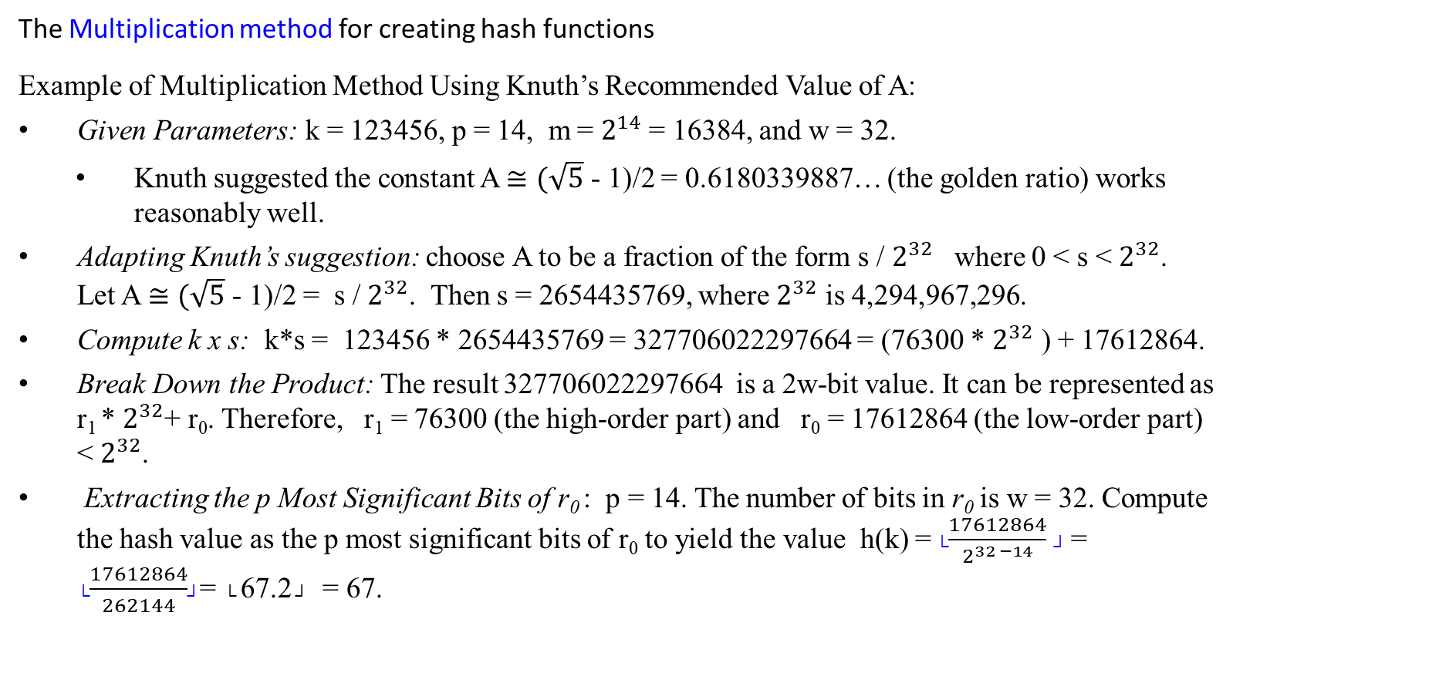
Hash Functions – What makes a good hash function?
The Multiplication method for creating hash functions
Example of Multiplication Method Using Knuth’s Recommended Value of A:
Given Parameters: k = 123456, p = 14, m = $2^{14}$ = 16384, and w = 32.
Knuth suggested the constant A $≅(\sqrt{5}$ - 1)/2 = 0.6180339887… (the golden ratio) works reasonably well.
Adapting Knuth’s suggestion: choose A to be a fraction of the form s / $2^{32}$ where 0 < s < $2^{32}$. Let A $≅(\sqrt{5}$ - 1)/2 = s / $2^{32}$. Then s = 2654435769, where $2^{32}$ is 4,294,967,296.
Compute k x s: k*s = 123456 * 2654435769 = 327706022297664 = (76300 * $2^{32}$ ) + 17612864.
Break Down the Product: The result 327706022297664 is a 2w-bit value. It can be represented as r₁ * $2^{32}$+ r₀. Therefore, r₁ = 76300 (the high-order part) and r₀ = 17612864 (the low-order part) < $2^{32}$.
Extracting the p Most Significant Bits of r₀ : p = 14. The number of bits in r₀ is w = 32. Compute the hash value as the p most significant bits of r₀ to yield the value h(k) = └$\frac{17612864}{2^{32 −14}}$ ┘ = └$\frac{17612864}{262144}$┘= └ 67.2 ┘ = 67.

Slide 89
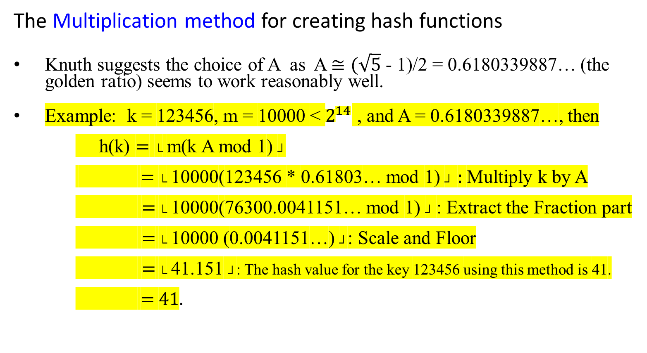
Hash Functions – What makes a good hash function?
The Multiplication method for creating hash functions
Knuth suggests the choice of A as A $≅(\sqrt{5}$ - 1)/2 = 0.6180339887… (the golden ratio) seems to work reasonably well.
Example: k = 123456, m = 10000 < $2^{14}$ , and A = 0.6180339887…, then
    h(k) = └ m(k A mod 1) ┘
    = └ 10000(123456 * 0.61803… mod 1) ┘ : Multiply k by A
    = └ 10000(76300.0041151… mod 1) ┘ : Extract the Fraction part
    = └ 10000 (0.0041151…) ┘: Scale and Floor
    = └ 41.151 ┘: The hash value for the key 123456 using this method is 41.
    = 41.
2¹⁴ = 32768; 2⁷ = 128 (1 byte); 2¹⁶ = 131072 (2 bytes)
If m = 2¹⁴ , then h(k) = 67

Slide 90
Universal hashing

Slide 91
Hash Functions – What makes a good hash function?
Universal hashing
Ideal hash function
An ideal hash function evenly distributes keys across the available slots in a hash table to minimize collisions.
In practice, any fixed hash function h can potentially lead to a "bad set of keys" where multiple keys collide into the same slot.

Slide 92
Hash Functions – What makes a good hash function?
Analysis of Hash Functions and the Issue of Bad Sets of Keys
Potential Bad Set of Keys
For any hash function h, a potential “bad set of keys” exists that all n keys hash to the same slot. This scenario causes several issues:
Average Retrieval Time:
If all n keys hash to the same slot, the retrieval time is ϴ(n), which requires searching through all n keys in the linked list.
Collision Resolution by Chaining:
  When using chaining to resolve collisions in a hash table with m slots, if a bad set of n keys causes collisions, n >> m, the time complexity for n operations (inserts, deletes, and searches) is Θ(n).
  Each operation may require traversing a linked list of length n.

Slide 93
Hash Functions – What makes a good hash function?
Analysis of Hash Functions and the Issue of Bad Sets of Keys
Potential Bad Set of Keys
  Cost Comparison:
This scenario is worse than searching through a simple linked list. This is due to the additional overhead of computing the hash function, which is not present in a linked list search.
Solutions to Bad Set of Keys
To avoid the issue of bad sets of keys, distribute keys evenly across the hash table slots and minimize the probability of collisions.
Do not use a single, fixed hash function.
Choose a hash function randomly from a family of hash functions.

Slide 94
Solutions to Bad Sets of Keys
Use randomized hash functions to overcome the issue of bad sets of keys consistently causing poor performance. Here’s how this approach works:
Avoiding a Fixed Hash Function:
  Using a single, fixed hash function h can be problematic because a specific set of keys could hash to the same slot, leading to poor performance.
Using Randomly Chosen Hash Functions:
  Select a hash function randomly from a family of hash functions. This approach minimizes the probability that a bad set of keys will hash to the same slot every time.
  Universal hashing is a technique where a hash function is chosen randomly from a universal family of hash functions designed to reduce the probability of collisions.

Slide 95
Solution: Randomized Hash Functions
Benefits of Random Selection
  Uniform Distribution:
    By randomly selecting a hash function from a family, the distribution of keys across the slots tends to be more uniform, reducing the likelihood of long chains.
  Expected Performance:
    The expected time complexity for operations (search, insert, delete) remains O(1) on average. This is because the chance of consistently encountering a bad set of keys across different randomly chosen hash functions is very low.

Slide 96
Hash Functions – What makes a good hash function?
Key Points About the Universal Hashing Approach:
Random Selection of Hash Function:
The universal hashing approach randomly selects the hash function from a family of hash functions independent of the keys to be stored.
Run-Time Selection:
The universal hashing is to select the hash function at random at run time from a well-designed class of hash functions.
Collision Probability:
In a well-designed family of hash functions, the probability of a collision between any two keys k₁ and k₂ (i.e., h(k₁) = h(k₂)) is provably 1/m, where m is the number of slots in the hash table.

Slide 97
Hash Functions – What makes a good hash function?
Universal hashing
Two approaches for implementing universal hash functions involving randomization:
  First approach: Select the hash function at random at run time from a pre-defined class of functions.
    Family of Hash Functions H: Define a family of hash functions H.
    Initialization: At the initialization of the hash table, randomly select a hash function h from H.
    Consistency: Use this hash function h for all operations (insertion, deletion, and search) until the table is re-initialized.
  Second approach: Randomize the hash function itself.

Slide 98
Hash Functions – What makes a good hash function?
Universal hashing
Two approaches for implementing universal hash functions involving randomization:
  Second approach: Randomize the hash function itself.
    Example Scheme:
    Choose a set of integers a and b randomly from a large prime number p.
    Define the hash function as:
    h(k) = ((a*k + b) mod p) mod m,
    where a and b are chosen randomly at the time of hash table initialization, and k is the key to be hashed. This ensures the probability of collision remains low due to the random nature of a and b.

Slide 99
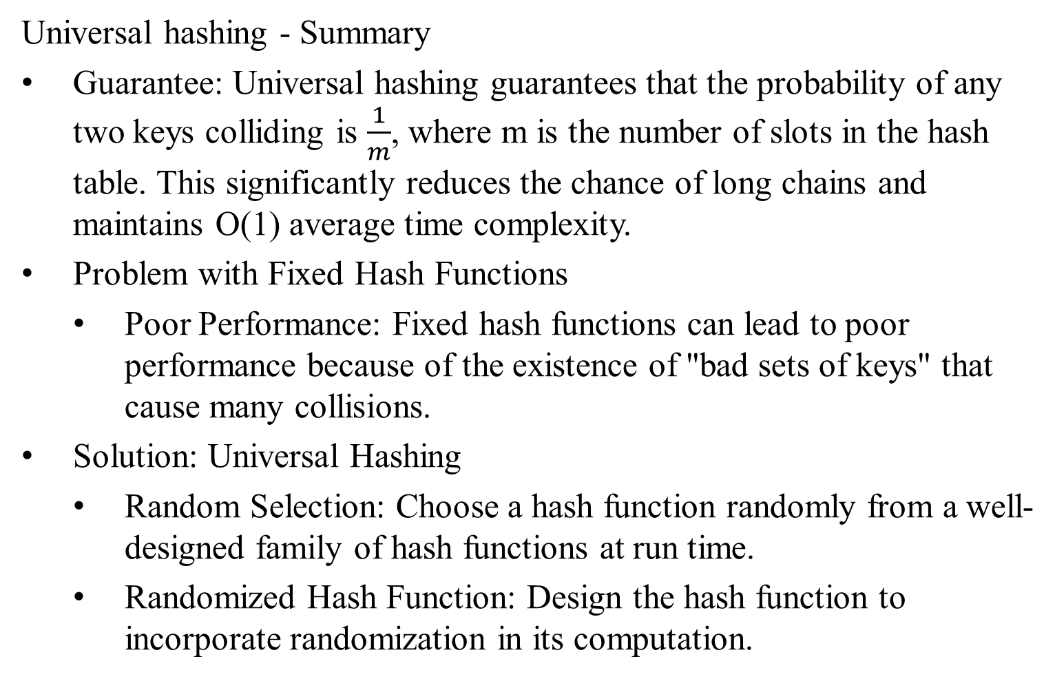
Hash Functions – What makes a good hash function?
Universal hashing - Summary
Guarantee: Universal hashing guarantees that the probability of any two keys colliding is $\frac{1}{m}$, where m is the number of slots in the hash table. This significantly reduces the chance of long chains and maintains O(1) average time complexity.
Problem with Fixed Hash Functions
  Poor Performance: Fixed hash functions can lead to poor performance because of the existence of "bad sets of keys" that cause many collisions.
Solution: Universal Hashing
  Random Selection: Choose a hash function randomly from a well-designed family of hash functions at run time.
  Randomized Hash Function: Design the hash function to incorporate randomization in its computation.

Slide 100
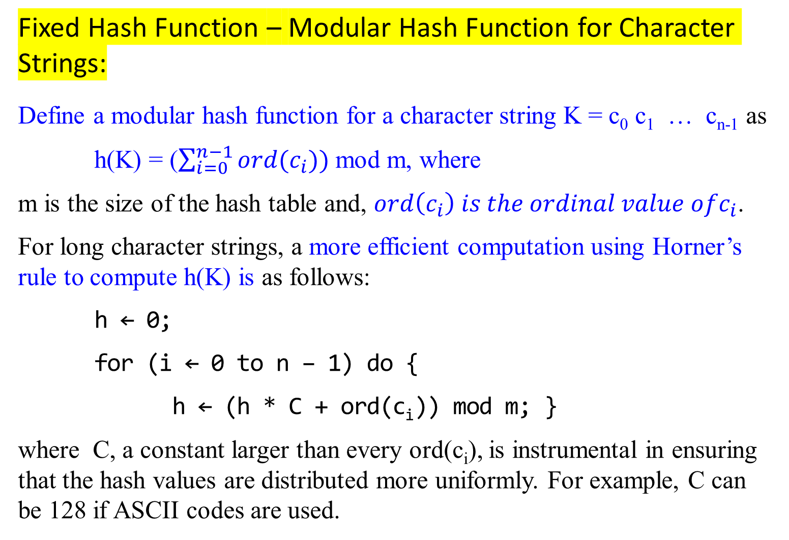
Fixed Hash Function – Modular Hash Function for Character Strings:
Define a modular hash function for a character string K = c₀ c₁ … c_{n-1} as
h(K) = ($\sum_{i=0}^{n−1}{ord(c_{i}))}$ mod m, where
m is the size of the hash table and, $ord\left(c_{i}\right) is the ordinal value ofc_{i}$.
For long character strings, a more efficient computation using Horner’s rule to compute h(K) is as follows:
h ← 0;
for (i ← 0 to n – 1) do {
h ← (h * C + ord(c_{i})) mod m; }
where C, a constant larger than every ord(c_{i}), is instrumental in ensuring that the hash values are distributed more uniformly. For example, C can be 128 if ASCII codes are used.

Slide 101
Example
For a string K = "abc", using ASCII values where ord(′a′) = 97, ord(′b′) = 98, and ord(′c′) = 99, and assuming m=1000 and C=128:
Initialize h = 0.
For the first character 'a’:
h ← (0 ∗ 128 + 97) mod 1000 = 97
For the second character 'b’:
h ← (97 ∗ 128 + 98) mod 1000 = 12514 mod 1000 = 514
For the third character 'c’:
h ← (514 ∗ 128 + 99) mod 1000 = 65921 mod 1000 = 921
So, the hash value for the string "abc" is 921.
Or we write: (((((0 * 128 + 97) mod 1000) * 128 + 98) mod 1000) * 128 + 99) mod 1000 = 921.

Slide 102
Hash Functions – What makes a good hash function?
Universal Hash Function for Strings
Consider a modular hash function for strings – a fixed hash function.
A way to randomize this hash function is to randomize the value of constant C by another constant x.
Use a simple pseudo-random number generator for this purpose.
  function hash(str, m)
  h ← 0; C ← 31415; x ← 27183; //choose
  for (i ← 0 to n – 1) do {
  h ← (h * C + ord(c_{i})) mod m; //update h using the current value of
  //C and the ordinal value of c_{i}.
  C ← (C + x) mod (m - 1)} //update C using a pseudo-random number
  //generator
  if (h < 0) return h + m //if h is negative, adjust it by adding m
  else return h; //return the computed hash value h
h ← 0;
for (i ← 0 to n – 1) do {
h ← (h * C + ord(c_{i})) mod m; }

Slide 103
Hash Functions – What makes a good hash function?
A Universal Hash Function for Strings
  hash(str, m)
  h ← 0; C ← 31415; x ← 27183;
  for (i ← 0 to n – 1) do {
  h ← (h * C + ord(c_{i})) mod m;
  C ← (C + x) mod (m-1)}
  if (h < 0) return h + m
  else return h;
This method produces a universal hash function, assuming the coefficients are random.
By varying C with a pseudo-random number generator for each character, the function introduces randomness, reducing the chance of collisions for different keys.
The method helps achieve a more uniform distribution of hash values across the table.

Slide 104
Example (?)
Let's consider an example to illustrate the process:
For the string K = "abc", with m = 1000, C = 31415, and x = 27183:
Initialize h = 0, C = 31415, and x = 27183.
For the first character 'a' (ord(′a′) = 97):
h ← (0 ∗ 31415 + 97) mod 1000 = 97
C ← (31415 ∗ 27183) mod 999 = 2
3. For the second character 'b' (ord(′b′) = 98):
h ← (97 ∗ 2 + 98) mod 1000 = 292
C ← (2 ∗ 27183) mod 999 = 549
4. For the third character 'c' (ord(′c′) = 99):
h ← (292 ∗ 549 + 99) mod 1000 = 380
C ← (549 ∗ 27183) mod 999 = 93
5 Since h = 380 is not negative, the final hash value is 380.
  h ← 0; C ← 31415; x ← 27183;
  for (i ← 0 to n – 1) do {
  h ← (h * C + ord(c_{i})) mod m;
  C ← (C + x) mod (m-1)}
  if (h < 0) return h + m
  else return h;

Slide 105
Example
Let's consider an example to illustrate the process:
For the string K = "abc", with m = 1000, C = 31415, and x = 27183:
Initialize h = 0, C = 31415, and x = 27183.
For the first character 'a' (ord(′a′) = 97):
h ← (0 ∗ 31415 + 97) mod 1000 = 97
C ← (31415 + 27183) mod 999 = 656
3. For the second character 'b' (ord(′b′) = 98):
h ← (97 ∗ 656 + 98) mod 1000 = 292/730
C ← (656 + 27183) mod 999 = 549/866
4. For the third character 'c' (ord(′c′) = 99):
h ← (730 ∗ 866 + 99) mod 1000 = 279
C ← (866 + 27183) mod 999 = 79
5 Since h = 279 is not negative, the final hash value is 279.
  h ← 0; C ← 31415; x ← 27183;
  for (i ← 0 to n – 1) do {
  h ← (h * C + ord(c_{i})) mod m;
  C ← (C + x) mod (m-1)}
  if (h < 0) return h + m
  else return h;

Slide 106
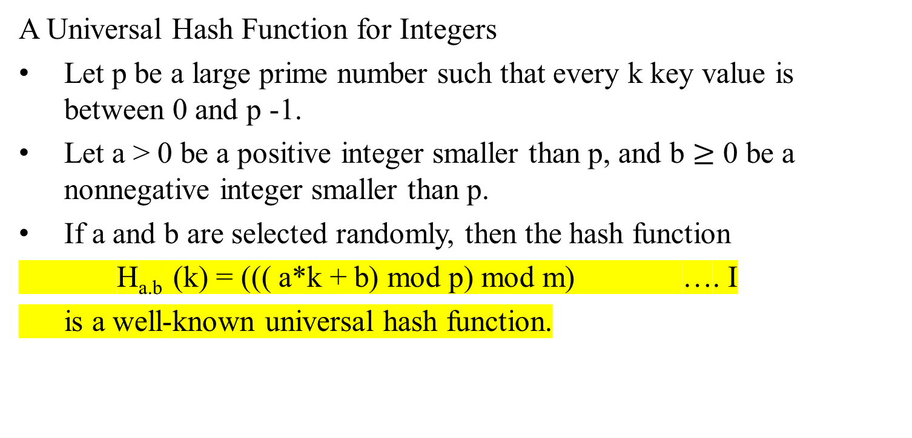
Hash Functions – What makes a good hash function?
A Universal Hash Function for Integers
Let p be a large prime number such that every k key value is between 0 and p -1.
Let a > 0 be a positive integer smaller than p, and b $≥$ 0 be a nonnegative integer smaller than p.
If a and b are selected randomly, then the hash function
H_{a.b} (k) = ((( a*k + b) mod p) mod m) …. I
is a well-known universal hash function.

Slide 107
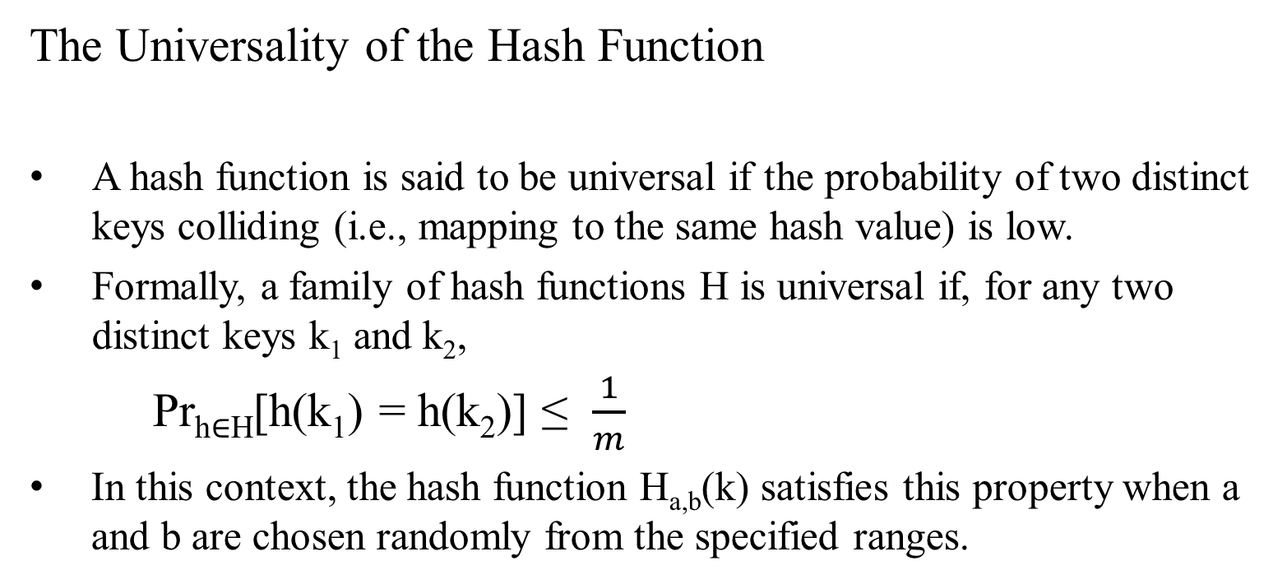
The Universality of the Hash Function
A hash function is said to be universal if the probability of two distinct keys colliding (i.e., mapping to the same hash value) is low.
Formally, a family of hash functions H is universal if, for any two distinct keys k₁ and k₂,
Pr_{h∈H}​[h(k₁​) = h(k_{2​})] ≤ $\frac{1}{m}$​
In this context, the hash function H_{a,b}(k) satisfies this property when a and b are chosen randomly from the specified ranges.

Slide 108
Explanation
The hash function
H_{a.b}(k) = ((( a*k + b) mod p) mod m) …. I
is universal when a and b are randomly chosen.
Prime Number p: Using a large prime number p ensures a good distribution of hash values.
The modulo operation with p helps distribute keys uniformly across the available hash space.
Random Coefficients a and b: The random coefficients a and b ensure that the hash function behaves differently for different choices, reducing the likelihood of collisions.
Modulo m: The final modulo operation with m ensures that the hash value falls within the desired range (0 to m-1).
In this context, the hash function H_{a,b}(k) satisfies this property when a and b are chosen randomly from the specified ranges.

Slide 109
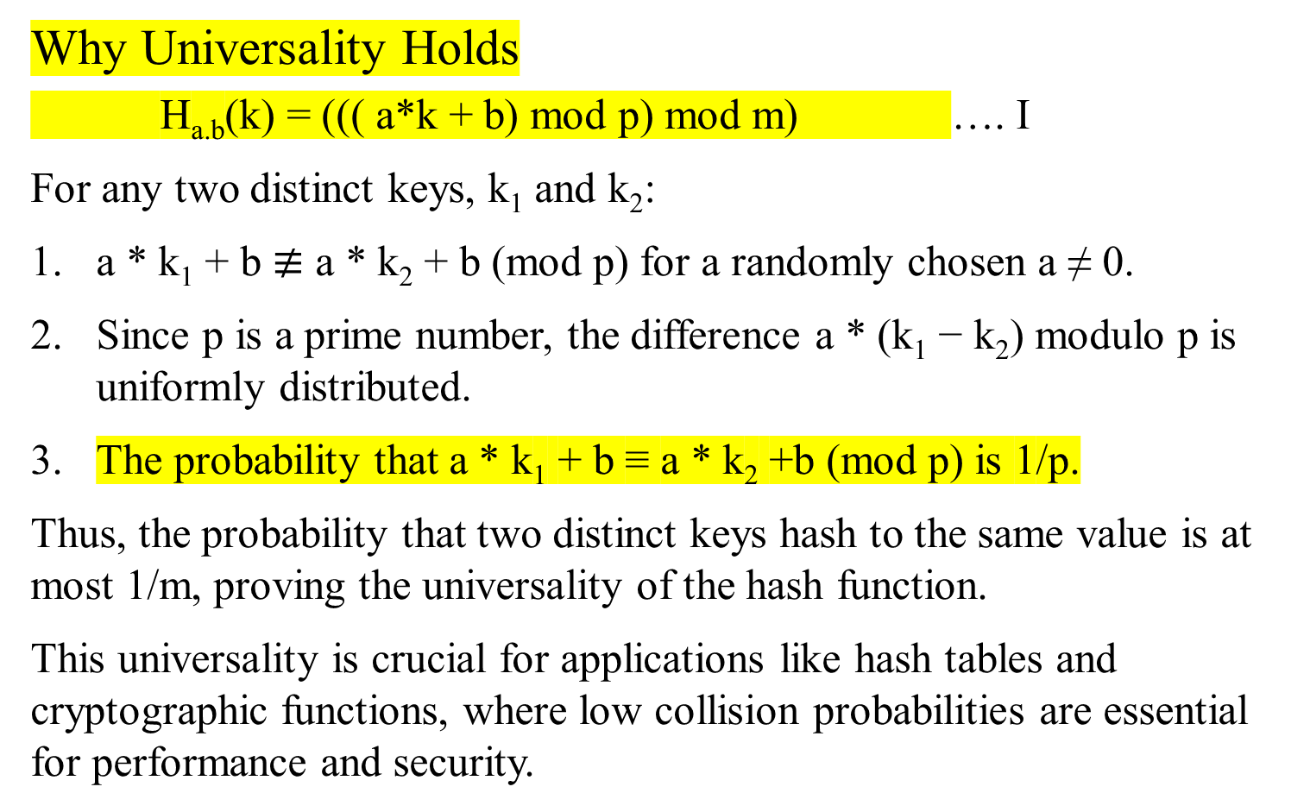
Why Universality Holds
H_{a.b}(k) = ((( a*k + b) mod p) mod m) …. I
For any two distinct keys, k₁ and k₂:
a * k₁ + b $≢$ a * k₂ + b (mod p) for a randomly chosen a ≠ 0.
Since p is a prime number, the difference a * (k₁ − k₂) modulo p is uniformly distributed.
The probability that a * k₁ + b ≡ a * k₂ +b (mod p) is 1/p.
Thus, the probability that two distinct keys hash to the same value is at most 1/m, proving the universality of the hash function.
This universality is crucial for applications like hash tables and cryptographic functions, where low collision probabilities are essential for performance and security.

Slide 110
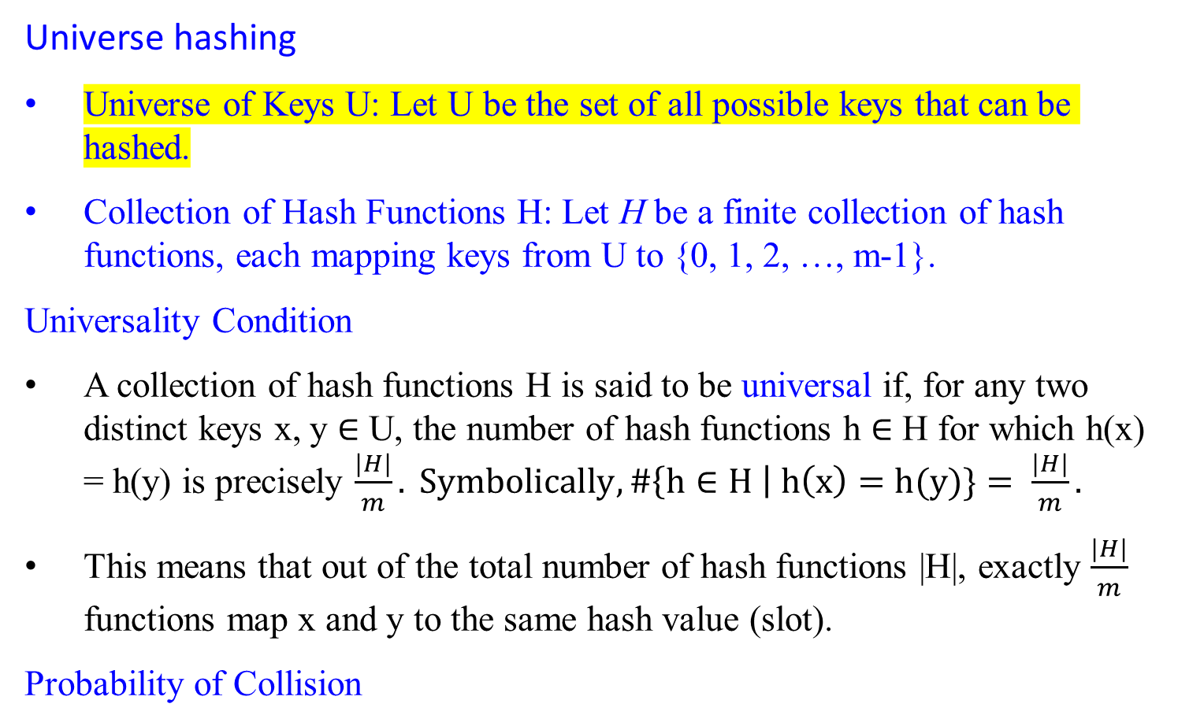
Hash Functions – What makes a good hash function?
Universe hashing
Universe of Keys U: Let U be the set of all possible keys that can be hashed.
Collection of Hash Functions H: Let H be a finite collection of hash functions, each mapping keys from U to {0, 1, 2, …, m-1}.
Universality Condition
A collection of hash functions H is said to be universal if, for any two distinct keys x, y $∈$ U, the number of hash functions h $∈$ H for which h(x) = h(y) is precisely $\frac{|H|}{m}. Symbolically, \#\left\{h∈H \right| h\left(x\right)=h(y)\}= \frac{|H|}{m}.$
This means that out of the total number of hash functions |H|, exactly $\frac{|H|}{m}$ functions map x and y to the same hash value (slot).
Probability of Collision

Slide 111
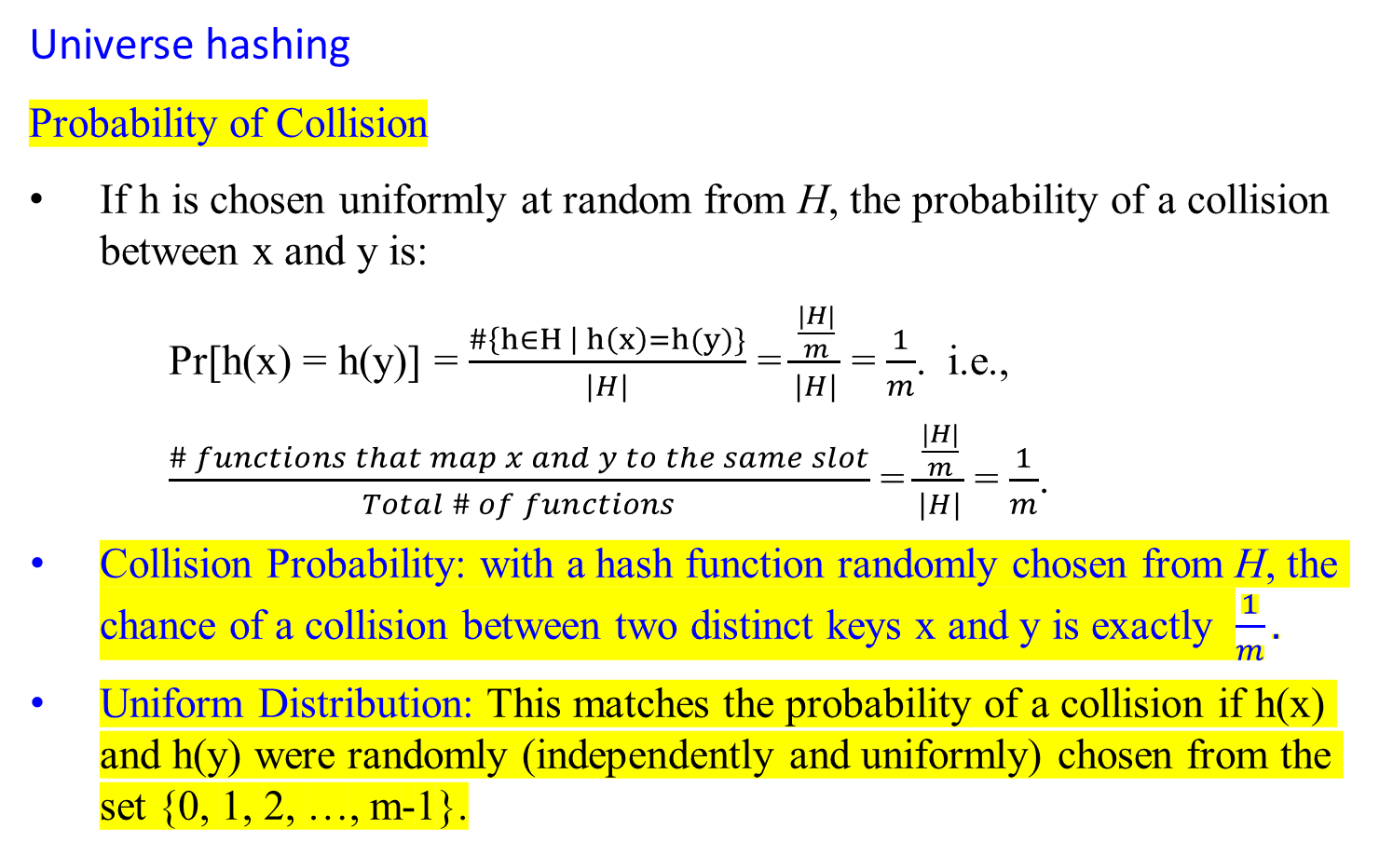
Hash Functions – What makes a good hash function?
Universe hashing
Probability of Collision
If h is chosen uniformly at random from H, the probability of a collision between x and y is:
Pr[h(x) = h(y)] = $\frac{\#\left\{h∈H \right| h\left(x\right)=h(y)\}}{|H|}$ = $\frac{\frac{|H|}{m}}{|H|}$ = $\frac{1}{m}$. i.e.,
  $\frac{\# functions that map x and y to the same slot}{Total \# of functions}$ = $\frac{\frac{|H|}{m}}{|H|}$ = $\frac{1}{m}$.
  Collision Probability: with a hash function randomly chosen from H, the chance of a collision between two distinct keys x and y is exactly $\frac{1}{m}.$
  Uniform Distribution: This matches the probability of a collision if h(x) and h(y) were randomly (independently and uniformly) chosen from the set {0, 1, 2, …, m-1}.

Slide 112
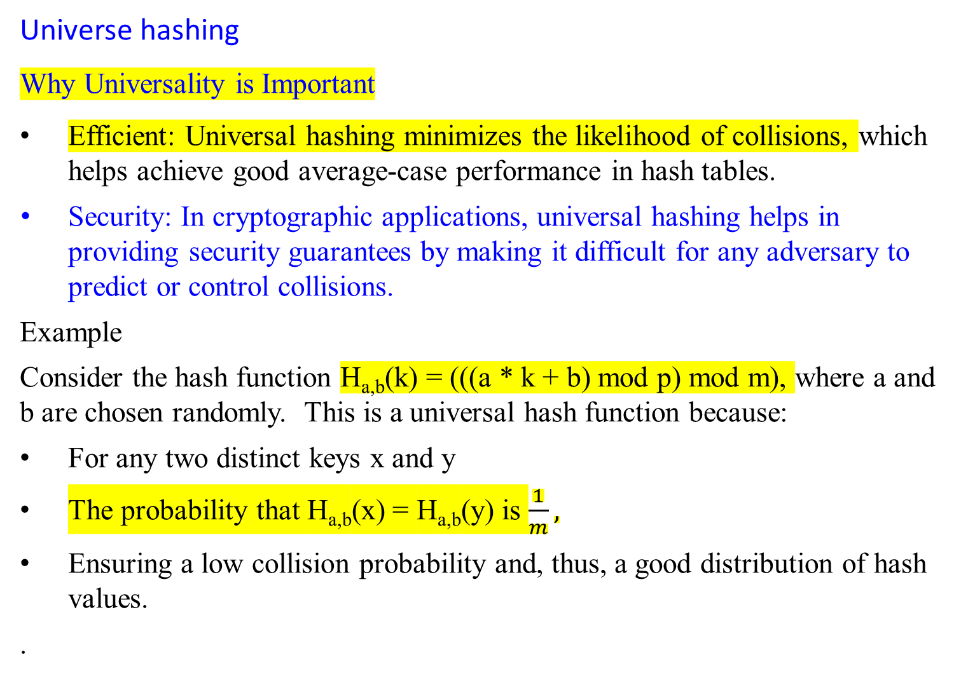
Hash Functions – What makes a good hash function?
Universe hashing
Why Universality is Important
Efficient: Universal hashing minimizes the likelihood of collisions, which helps achieve good average-case performance in hash tables.
  Security: In cryptographic applications, universal hashing helps in providing security guarantees by making it difficult for any adversary to predict or control collisions.
  Example
  Consider the hash function H_{a,b}(k) = (((a * k + b) mod p) mod m), where a and b are chosen randomly. This is a universal hash function because:
  For any two distinct keys x and y
  The probability that H_{a,b}(x) = H_{a,b}(y) is $\frac{1}{m},$
  Ensuring a low collision probability and, thus, a good distribution of hash values.
  .

Slide 113
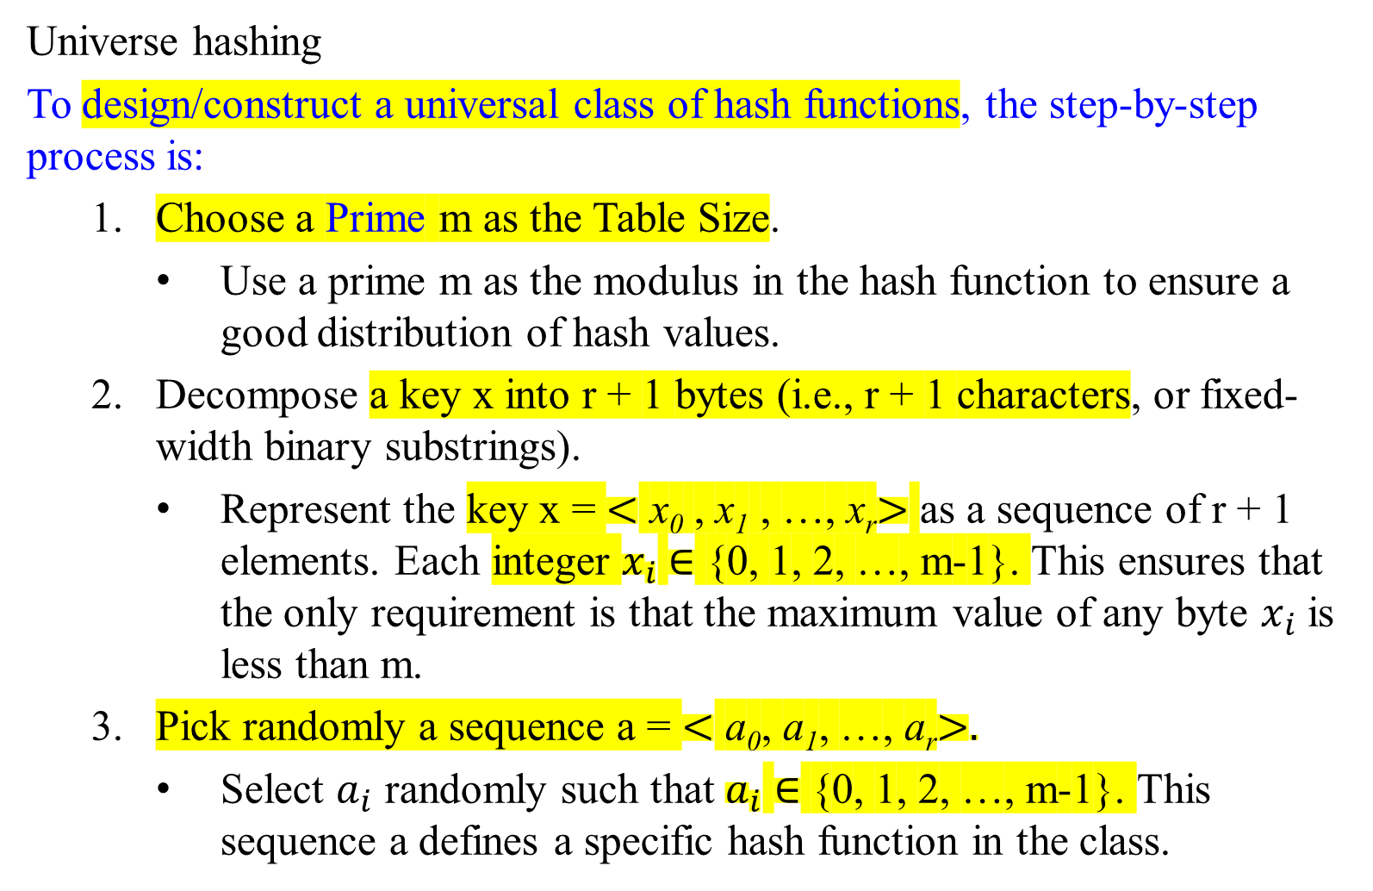
Hash Functions – What makes a good hash function?
Universe hashing
To design/construct a universal class of hash functions, the step-by-step process is:
  Choose a Prime m as the Table Size.
    Use a prime m as the modulus in the hash function to ensure a good distribution of hash values.
  Decompose a key x into r + 1 bytes (i.e., r + 1 characters, or fixed-width binary substrings).
    Represent the key x = $<$ x₀ , x₁ , …, x_{r}$>$ as a sequence of r + 1 elements. Each integer $x_{i}$ $∈$ {0, 1, 2, …, m-1}. This ensures that the only requirement is that the maximum value of any byte $x_{i}$ is less than m.
  Pick randomly a sequence a = $<$ a₀, a₁, …, a_{r}$>.$
    Select $a_{i}$ randomly such that $a_{i}$ $∈$ {0, 1, 2, …, m-1}. This sequence a defines a specific hash function in the class.

Slide 114
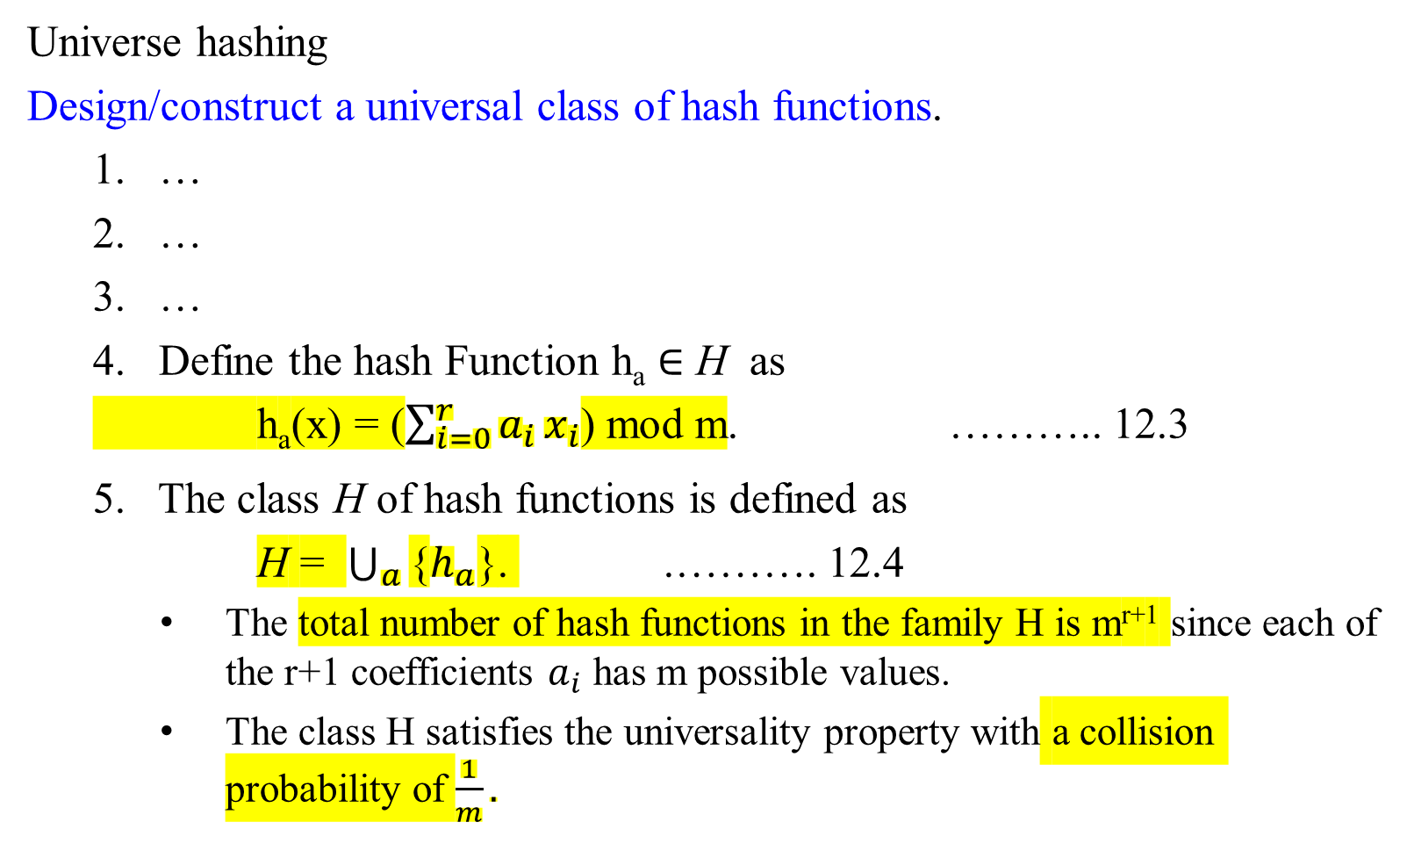
Hash Functions – What makes a good hash function?
Universe hashing
Design/construct a universal class of hash functions.
  …
  …
  …
  Define the hash Function h_{a} $∈$ H as
  h_{a}(x) = ($\sum_{i=0}^{r}{a_{i}}x_{i}$) mod m. ……….. 12.3
  5. The class H of hash functions is defined as
  H = $\bigcup_{a}{\text{\{}h_{a}\text{\}}}$. .………. 12.4
  The total number of hash functions in the family H is m^{r+1} since each of the r+1 coefficients $a_{i}$ has m possible values.
  The class H satisfies the universality property with a collision probability of $\frac{1}{m}.$

Slide 115
Example
Let's construct a concrete example to illustrate the process:
Choose a prime m:
  Suppose m = 7
Decompose the key x:
  Assume r = 2, so each key x is decomposed into 3 bytes:
  x = ⟨x_{0​}, x₁​, x₂​⟩.
  An example key: x = ⟨3, 5, 6⟩.
Pick Random Sequence a:
  Randomly select a = ⟨2, 4, 1⟩.

Slide 116
Example
Let's construct a concrete example to illustrate the process:
Define the hash function h_{a} :
Using the formula to compute:
h_{a}(x) = (2*3 + 4*5 +1*6) mod 7
= 32 mod 7
= 4
6. Number of Hash Functions:
  For r = 2 and m = 7, the total number of hash functions in the family is 7³ = 343.
This construction ensures that the hash functions are chosen from a large family of possible functions, which helps spread out the keys uniformly and minimizes collisions. This method of randomly selecting a hash function from a well-designed class of functions makes it universal.

Slide 117
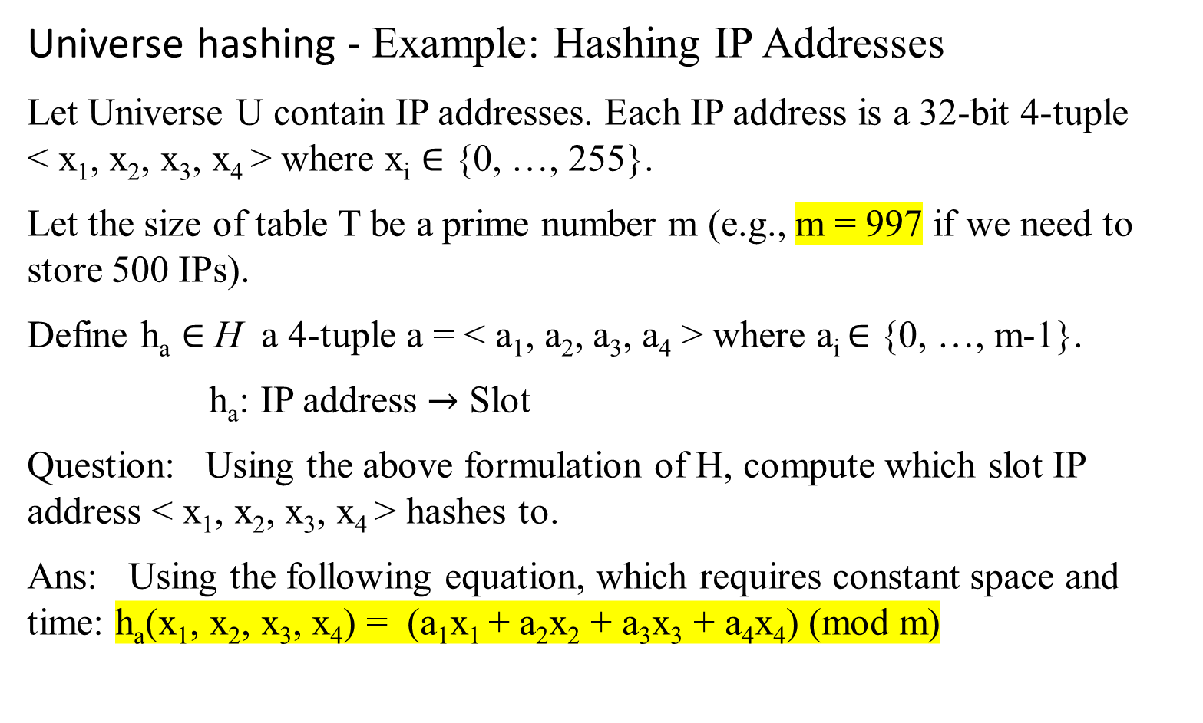
Hash Functions – What makes a good hash function?
Universe hashing - Example: Hashing IP Addresses
Let Universe U contain IP addresses. Each IP address is a 32-bit 4-tuple < x₁, x₂, x₃, x₄ > where x_{i} ∈ {0, …, 255}.
Let the size of table T be a prime number m (e.g., m = 997 if we need to store 500 IPs).
Define h_{a} $∈$ H a 4-tuple a = < a₁, a₂, a₃, a₄ > where a_{i} ∈ {0, …, m-1}.
h_{a}: IP address $→$ Slot
Question: Using the above formulation of H, compute which slot IP address < x₁, x₂, x₃, x₄ > hashes to.
Ans: Using the following equation, which requires constant space and time: h_{a}(x₁, x₂, x₃, x₄) = (a₁x₁ + a₂x₂ + a₃x₃ + a₄x₄) (mod m)

Slide 118
Universe hashing - Example: Hashing IP Addresses
Steps to Compute the Slot for an IP Address
Choose Random Coefficients: Select random values for a₁, a₂, a₃, and a₄ from {0,1,2,…,m−1}.
Decompose IP Address: Represent the IP address as the 4-tuple < x₁, x₂, x₃, x₄ >
Compute Hash Value: Substitute the values of x₁, x₂, x₃, x₄ ​ and a₁, a₂, a₃, a₄ ​into the hash function to compute the hash value.
Modulo Operation: Perform the modulo operation with m to get the slot number.

Slide 119
Universe hashing - Example: Hashing IP Addresses
Example Calculation:
Compute the Slot for an IP Address <192, 168, 1, 1>
IP Address: <192, 168, 1, 1>
Choose Random Coefficients: <a₁, a₂, a₃, a₄> = <13, 27, 45, 72>
Table size: m = 997
Compute the hash value:
h_{a}(192, 168, 1, 1) = (13*192 + 27*168 + 45*1 + 72*1) mod 997
= (2496 + 4536 + 45 + 72) mod 997
= 170
Conclusion:
Using a prime number for m helps distribute the hash values uniformly, minimize the chances of collisions, and maintain the hash function's universality property.

Slide 120
  Collision Resolution
  open hashing (also called separate chaining, or chaining) and
  closed hashing (also called open addressing).

Slide 121
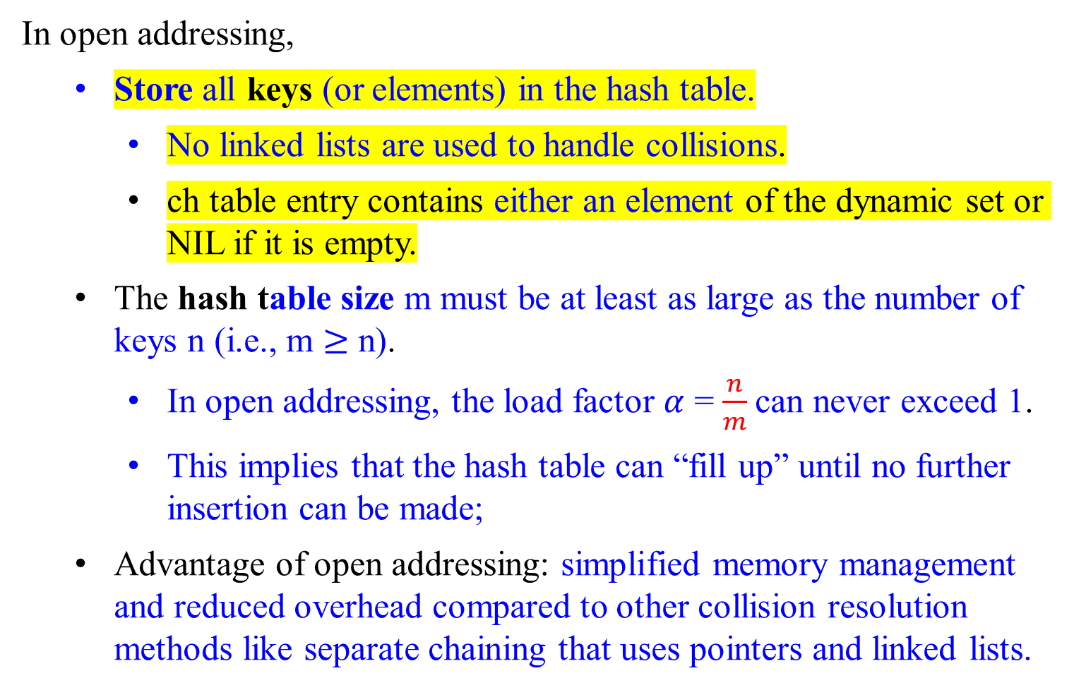
Closed Hashing (Open Addressing )
In open addressing,
  Store all keys (or elements) in the hash table.
    No linked lists are used to handle collisions.
    ch table entry contains either an element of the dynamic set or NIL if it is empty.
  The hash table size m must be at least as large as the number of keys n (i.e., m $≥$ n).
    In open addressing, the load factor $α$ = $\frac{n}{m}$can never exceed 1.
    This implies that the hash table can “fill up” until no further insertion can be made;
  Advantage of open addressing: simplified memory management and reduced overhead compared to other collision resolution methods like separate chaining that uses pointers and linked lists.

Slide 122
A permutation of ⟨0,1,2,…,m−1⟩ is any possible arrangement of the elements in the set {0,1,2,…,m−1}.
For a set of m elements, there are m! different permutations.
For example, if m=3, the set is {0,1,2}. The permutations of this set of are:
    {0,1,2}
    {0,2,1}
    {1,0,2}
    {1,2,0}
    {2,0,1}
    {2,1,0}

Slide 123
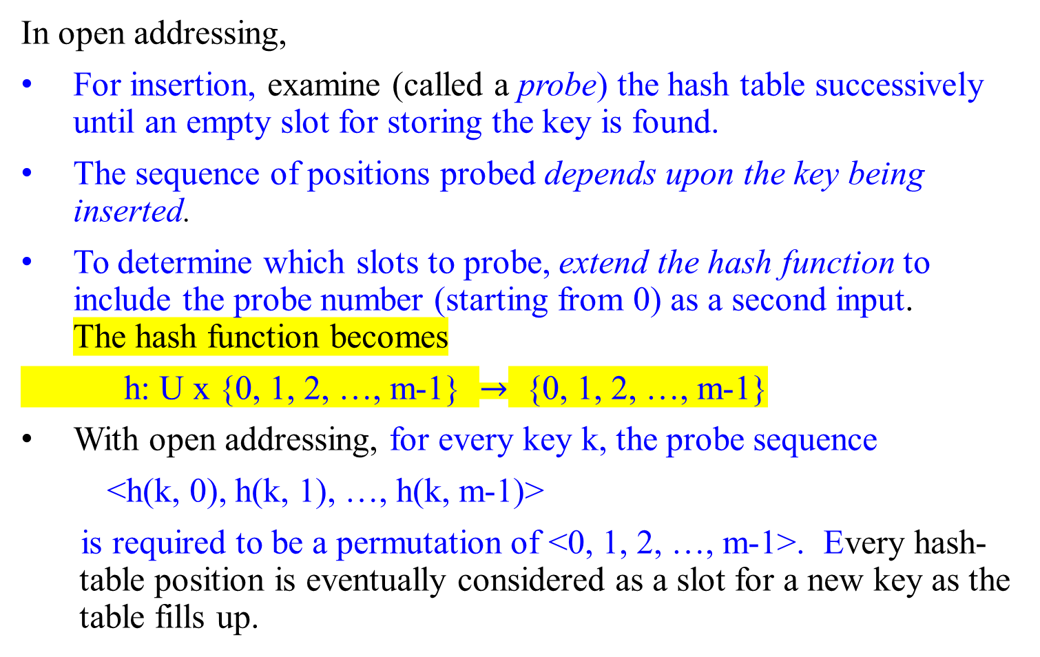
Closed Hashing (Open Addressing )
In open addressing,
For insertion, examine (called a probe) the hash table successively until an empty slot for storing the key is found.
The sequence of positions probed depends upon the key being inserted.
To determine which slots to probe, extend the hash function to include the probe number (starting from 0) as a second input. The hash function becomes
h: U x {0, 1, 2, …, m-1} $→$ {0, 1, 2, …, m-1}
With open addressing, for every key k, the probe sequence
<h(k, 0), h(k, 1), …, h(k, m-1)>
is required to be a permutation of <0, 1, 2, …, m-1>. Every hash-table position is eventually considered as a slot for a new key as the table fills up.

Slide 124
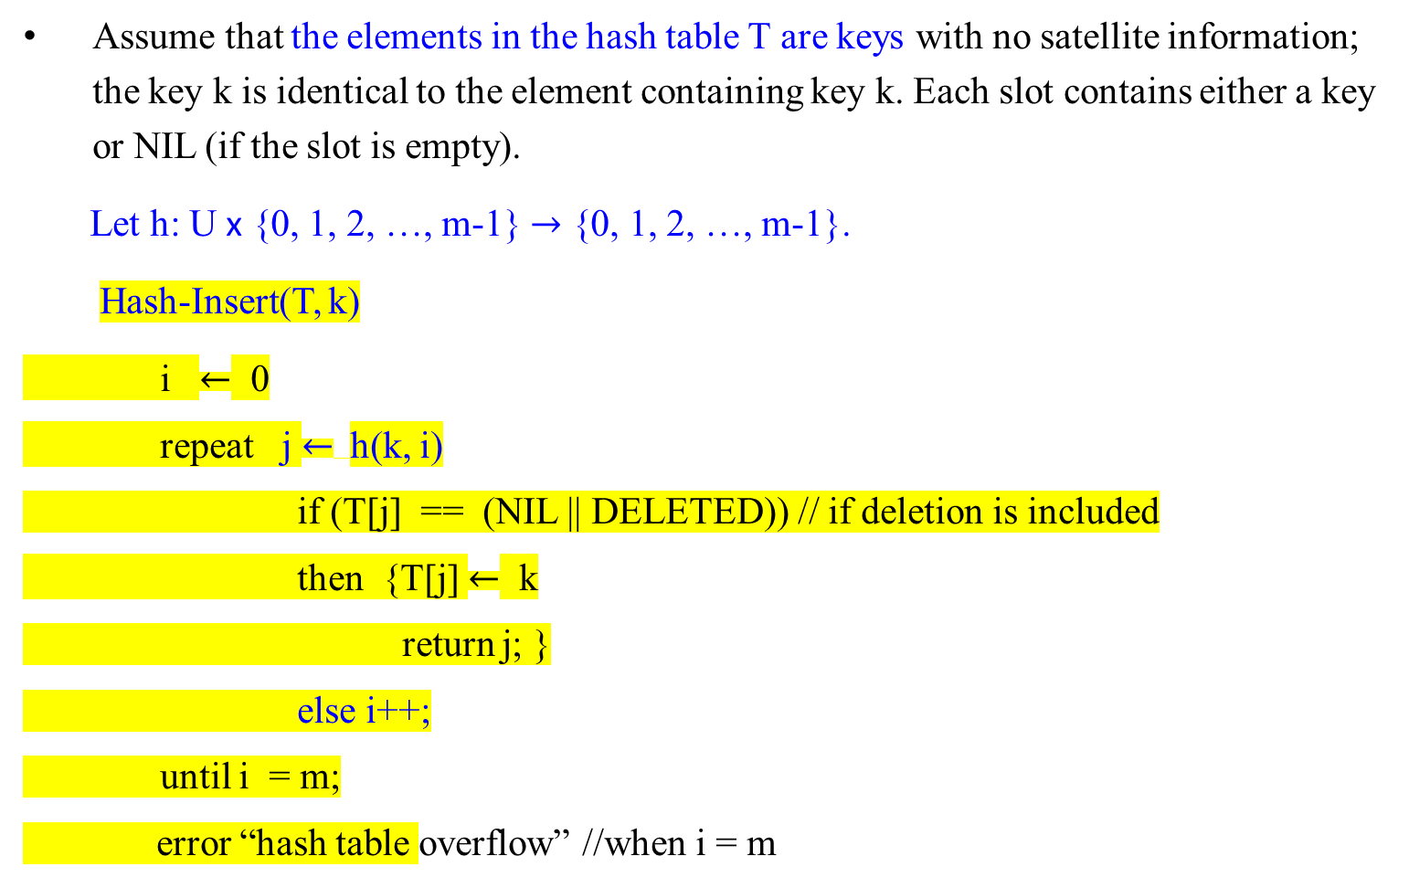
Closed Hashing (Open Addressing )
Assume that the elements in the hash table T are keys with no satellite information; the key k is identical to the element containing key k. Each slot contains either a key or NIL (if the slot is empty).
Let h: U x {0, 1, 2, …, m-1} $→$ {0, 1, 2, …, m-1}.
Hash-Insert(T, k)
i $←$ 0
repeat j $←$h(k, i)
if (T[j] == (NIL || DELETED)) // if deletion is included
then {T[j] $←$ k
return j; }
else i++;
until i = m;
error “hash table overflow” //when i = m

Slide 125

Closed Hashing (Open Addressing )
The procedure Hash-Search takes as input a hash table T and a key k, returning j if slot j contains key k or NIL if key k is not present in table T.
Let h: U x {0, 1, 2, …, m-1} $→$ {0, 1, 2, …, m-1}.
Hash-Search(T, k)
i $←$ 0
repeat j $←$h(k, i)
if (T[j] == k)
then return j;
i++;
until T[j] == (NIL || DELETED) or i == m;
return NIL

Slide 126
Closed Hashing (Open Addressing )
Handle carefully deletions from an open-address hash table.
Deleting a key from slot i :
  Cannot simply marking this slot empty (NIL).
  If slot i is marked NIL, it would be impossible to retrieve any key k that had probed slot i during its insertion and found it occupied.
  A solution is to mark the slot with a special value DELETED instead of NIL to avoid disrupting the probe sequence.
    This approach ensures that the probe sequence can continue correctly for other keys that might have probed this slot.

Slide 127
Closed Hashing (Open Addressing )
Handle carefully deletions from an open-address hash table.
Modify the Hash-Search procedure to skip DELETED slots and to keep looking when the value DELETED is encountered.
This ensures that keys can still be found even if they were inserted after encountering the new-deleted slot.
Modify the Hash-Insert procedure to insert a new key if a slot has DELETED.
This allows keys to be inserted into slots previously occupied by deleted keys, maintaining efficient use of the tale.
Efficiency: Handling deletions in open addressing can lead to inefficiencies, making chaining a preferred collision resolution technique when deletions are frequent.
  Chaining allows for easier and more efficient handling of deletions, as each slot in the table to a linked list of keys that hashed to the same slot, and deleting a key involves removing it from the list.

Slide 128
Closed Hashing (Open Addressing )?
Consider the assumption of uniform hashing :
Uniform hashing is a theoretical model in which each key in a hash table is equally likely to be mapped to any of the m! permutations of the hash table slots {0, 1, 2, …, m-1}. This model assumes that:
  Each key has an equal probability of being assigned to any slot.
  The probe sequences for resolving collisions are uniformly distributed across all possible permutations.

Slide 129
Closed Hashing (Open Addressing )?
Consider the assumption of uniform hashing :
The assumption of uniform hashing in closed hashing means that:
  Each key’s probe sequence is equally likely to be any permutation of the table slots.
This assumption is crucial for theoretical analysis and ensures that all slots are probed with equal probability, leading to a more uniform distribution of keys.

Slide 130
Closed Hashing (Open Addressing )?
Benefits of Uniform Hashing in closed hashing means:
Reduced clustering: Uniform hashing reduces primary and secondary clustering, common issues in linear probing where keys tend to cluster together causing long probe sequences.
Improved performance: By evenly distributing keys, uniform hasing improves the performance of hash table operations, making them closer to the ideal O(1) average-case time complexity.

Slide 131
Closed Hashing (Open Addressing )?
Example
Consider a hash table of size m = 5. Under uniform hashing, if a key hashes to a slot that is already occupied, the probe sequence could be any of the 5! (= 120) possible permutations of the slots {0, 1, 2, 3, 4}.
Imagine a scenario where we have the following slots in the hash table:
If another key B also hashes to slot 0, the probe sequence could be:
  One possible sequence: 0, 1, 2, 3, 4
  Another possible sequence: 0, 4, 3, 2, 1
Slot index | 0 | 1 | 2 | 3 | 4
Key | A

Slide 132
Importance of Uniform Hashing?
Collision Resolution:
  Uniform hashing ensures a more balanced and fair distribution of keys in the hash table, which reduces the likelihood of clustering and improves the performance of operations such as insertion, deletion, and search.
  By producing a whole probe sequence, uniform hashing can better handle collisions compared to simpler methods that might produce predictable patterns.
Theoretical Model:
  While practical implementations may not achieve perfect uniform hashing, the model provides an ideal scenario to aim for.
  It helps analyze the expected performance of hashing algorithms and serves as a benchmark for designing more effective hashing techniques.

Slide 133
Linear Probing
  quadratic probing
  double hashing

Slide 134
Closed Hashing (Open Addressing )
Collision resolution in open addressing and how different probing techniques work:
Open addressing handles collisions by probing for the next available slot using a predetermined sequence when a collision occurs.
Three common probing techniques:
  linear probing,
    The probe sequence is linear. If the initial hash slot is occupied, the algorithm checks the next slot in a sequential manner (e.g., h(k), h(k) +1, h(k) + 2, …
  quadratic probing,
  The probe sequence follows a quadratic function, avoiding primary clustering (e.g., h(k), h(k) + 1², h(k) + 2², …)
  double hashing.

Slide 135
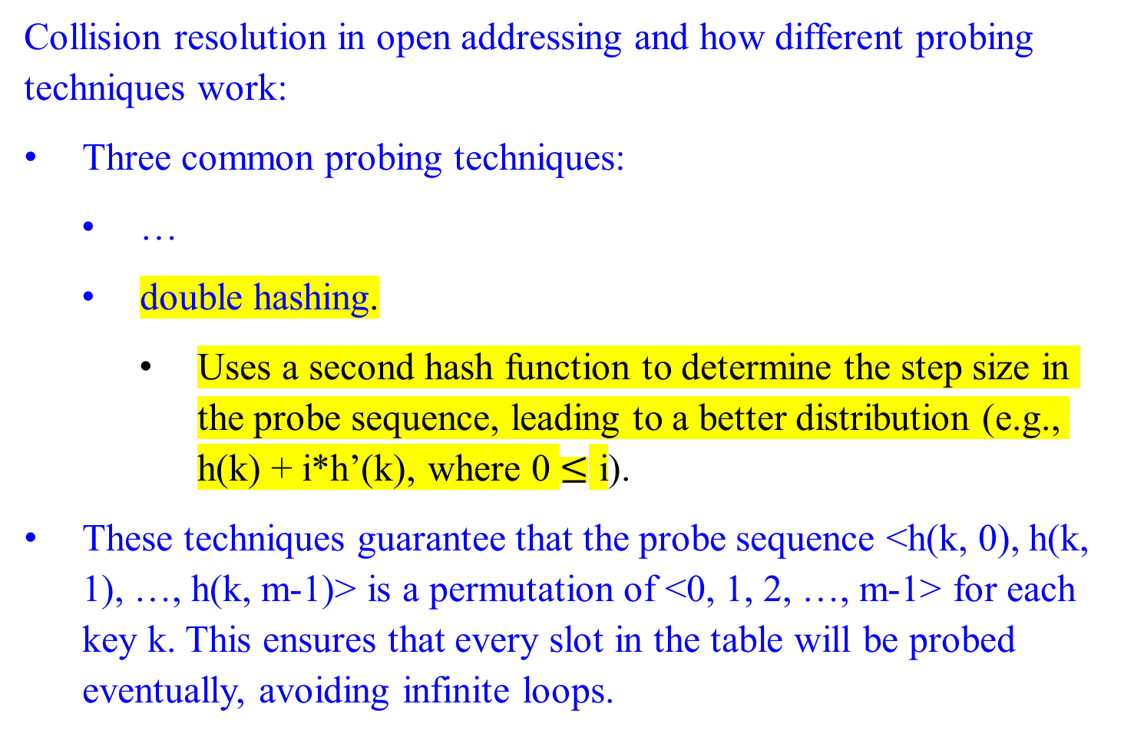
Closed Hashing (Open Addressing )
Collision resolution in open addressing and how different probing techniques work:
Three common probing techniques:
  …
  double hashing.
  Uses a second hash function to determine the step size in the probe sequence, leading to a better distribution (e.g., h(k) + i*h’(k), where 0 $≤$ i).
These techniques guarantee that the probe sequence <h(k, 0), h(k, 1), …, h(k, m-1)> is a permutation of <0, 1, 2, …, m-1> for each key k. This ensures that every slot in the table will be probed eventually, avoiding infinite loops.

Slide 136
Closed Hashing (Open Addressing )
Three common probing techniques:
Probe Sequence and Permutation
These techniques guarantee that the probe sequence <h(k, 0), h(k, 1), …, h(k, m-1)> is a permutation of <0, 1, 2, …, m-1> for each key k.
This ensures that every slot in the table will eventually be probed, thus avoiding infinite loops.
Comparison with Uniform Hashing:
None of these techniques fully satisfy the assumption of uniform hashing. Uniform hashing requires m! different probe sequences, but these probing techniques generate at most m² different sequences.
Double hashing has the highest number of probe sequences and provides the best distribution of keys across the slots. It approximates uniform hashing more closely compared to linear and quadratic probing.

Slide 137
Summary
Linear Probing is simple but suffers from primary clustering.
Quadratic Probing reduces clustering but can still leave some slots unutilized.
Double Hashing offers the best distribution and is the closest to achieving the uniform hashing model.

Slide 138
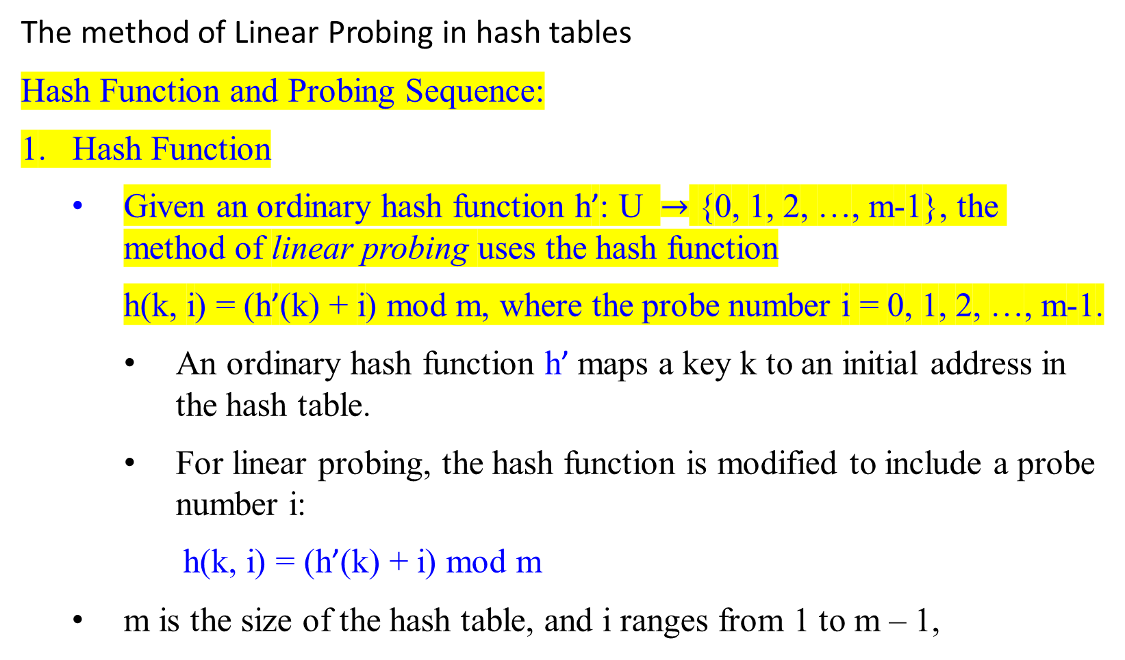
Closed Hashing (Open Addressing )
The method of Linear Probing in hash tables
Hash Function and Probing Sequence:
1. Hash Function
Given an ordinary hash function h’: U $→$ {0, 1, 2, …, m-1}, the method of linear probing uses the hash function
h(k, i) = (h’(k) + i) mod m, where the probe number i = 0, 1, 2, …, m-1.
An ordinary hash function h’ maps a key k to an initial address in the hash table.
For linear probing, the hash function is modified to include a probe number i:
h(k, i) = (h’(k) + i) mod m
m is the size of the hash table, and i ranges from 1 to m – 1,

Slide 139

Closed Hashing (Open Addressing )
The method of Linear Probing in hash tables
Hash Function and Probing Sequence:
Given an ordinary hash function h’: U $→$ {0, 1, 2, …, m-1}, the method of linear probing uses the hash function
h(k, i) = (h’(k) + i) mod m, where the probe number i = 0, 1, 2, …, m-1.
2. Probing Sequence:
When inserting a key k:
The initial slot probed is T[h’(k)].
When a collision occurs (i.e., if this slot is occupied), the next slot probed is T[h’(k) + 1], continuing up to T[m – 1].
If necessary, it wraps around to T[0], T[1], …, until it reaches T[h’(k) - 1].
An item is inserted into the first empty slot found during this sequence.

Slide 140

Closed Hashing (Open Addressing )
The method of Linear Probing in hash tables
Hash Function and Probing Sequence:
Given an ordinary hash function h’: U $→$ {0, 1, 2, …, m-1}, the method of linear probing uses the hash function
h(k, i) = (h’(k) + i) mod m, where the probe number i = 0, 1, 2, …, m-1.
3. Search Operation:
To search for an item with key k:
Start at the hash address T[h’(k)].
Continue probing each subsequent address in the probing sequence until a match is found or an empty slot is encountered.

Slide 141
Closed Hashing (Open Addressing )
The method of Linear Probing in hash tables
Deletion Issues and Solutions
4. Deletion Problem:
Simply removing an item from the hash table can disrupt the probing sequence, potentially causing search operations for other keys to fail.
Deletion Solutions:
Use Sentinel Value.
Replace the deleted item with a sentinel value “DELETED”.
This sentinel does not match any key and indicates that the slot was previously occupied but can be replaced by inserting another item later.
Rehashing Items:
Rehash all items between the deleted item slot and the next empty slot to fill the gap left by the deletion.
This ensures that the probing sequence remains intact, maintaining the correctness of search operations.

Slide 142
Hash Function and Probing Sequence:
Characteristics of Linear Probing
Linear probing is a popular collision resolution method for hash tables due to its simplicity and memory efficiency.
Simple Implementation:
Linear probing does not require pointers or additional data structures, making it easy to implement.
Memory Saving:
It uses the array space of the hash table efficiently without needing extra memory for linked lists or other structures.
However, it has inherent issues, particularly with complex deletion handling and primary clustering, which can significantly impact performance.

Slide 143
Hash Function and Probing Sequence:
Primary Clustering
Definition:
  Primary clustering refers to the phenomenon where consecutive elements cluster together, leading to create long runs of occupied slots, or clusters i.e., longer probe sequences.
  This clustering increases the average search time for elements, as large clusters require more steps to resolve collisions.
  2. Formation of Clusters:
  When an empty slot is preceded by I full slots, the probability that this empty slot is the next one filled is (i+1)/m, compared to a probability of 1/m if the preceding slot was empty.
  This results in runs of occupied slots tending to get longer as more elements are inserted, leading to significant clusters.

Slide 144

Hash Function and Probing Sequence:
Impact on Search Time
Average Unsuccessful Search:
  If the hash table has n=m/2 keys, and every even-indexed slot is occupied while every odd-indexed slot is empty, the average unsuccessful search time is calculated as follows:
  1 + $\frac{n}{m}$ =1 + $\frac{\frac{m}{2}}{m}$ =1+0.5=1.5 probes
Increased Probes with Occupied Locations:
  If the first n=m/2 locations are occupied, the average number of probes required increases to approximately n/4=m/8. This is because searches must probe through the initial occupied slots before finding an empty one, increasing the average search time.

Slide 145
Hash Function and Probing Sequence:
Comparison to Uniform Hashing
Non-Uniform Distribution:
  Linear probing does not approximate uniform hashing well because clusters are more likely to form. In uniform hashing, the distribution of keys is more evenly spread across the table, reducing the probability of long runs of occupied slots.

Slide 146
Hash Function and Probing Sequence:
Summary
Advantages:
Simple Implementation: Linear probing is easy to implement, as it only requires a single array and no additional data structures like linked lists.
Memory Efficiency: It makes efficient use of the array space without needing pointers or extra memory allocations.
Disadvantages:
Primary Clustering: The main issue with linear probing is primary clustering, where clusters of occupied slots form, leading to increased search times.
Performance Degradation: As clusters grow, the efficiency of the hash table degrades, making unsuccessful searches particularly costly.
Performance Metrics:
Unsuccessful Search Time: Increases with clustering, with specific patterns of occupied and empty slots significantly affecting average search times.

Slide 147
Quadratic Probing

Slide 148

Closed Hashing (Open Addressing )
Quadratic Probing in Hash Tables
A method used to resolve collision in hash tables. This alleviates the primary clustering problem found in linear probing by skipping slots.
Uses a hashing function of the form
  h(k, i) = (h’(k) + c₁i + c₂i² ) mod m
where h’ is an auxiliary hash function;
c₁ and c₂ $≠$ 0 are constants;
m is the size of the hash table, and
i is the probe number, ranging 0 $≤i$ < m.
Constraints for the Method’s Effective Use:
The values of c₁, c₂, and m must be chosen carefully to ensure that all slots in the hash table can be probed, thus making full use of the table’s capacity.

Slide 149
Closed Hashing (Open Addressing )
Quadratic Probing in Hash Tables
h(k, i) = (h’(k) + c₁i + c₂i² ) mod m
Initial Position Probing:
The initial position probed is T[h’(k)];
Quadratic Offsets:
Later positions are probed with offsets that increase quadratically with the probe number i.
Advantages Over Linear Probing:
Reduction of Clustering - Quadratic probing skips slots in a quadratic manner, reducing the primary clustering problem found in linear probing, where consecutive slots are probed sequentially.

Slide 150
Closed Hashing (Open Addressing )
Quadratic Probing in Hash Tables
h(k, i) = (h’(k) + c₁i + c₂i² ) mod m
Secondary Clustering:
Identical Probe Sequences for Colliding Keys - If two keys have the same initial probe position, then their probe sequences are the same, since h(k₁, 0) = h(k₂, 0) implies h(k₁, i) = h(k₂, i). This leads to a milder form of clustering called secondary clustering.
Fixed Probe Sequences: As in linear probing, since the initial probe position determines the entire sequence, there are only m distinct probe sequences corresponding to the initial m positions.
h’(k) + c₁i + c₂i²
⁼ h’(k’)+c₁i+c₂i²

Slide 151
Double Hashing

Slide 152

Closed Hashing (Open Addressing )
Double hashing - A technique used in hash tables to resolve collisions.
The formula for the double hash function is:
h(k, i) = (h₁(k) + i h₂(k) ) mod m
where h₁ and h₂ are auxiliary hash functions to determine the probing sequence; the probe number i, with 0 $≤$ i < m; and m is the size of the hash table
Key Requirements for h₂(k): Relative primality
The h₂(k) value must be relatively prime to m
This ensures that the entire hash table can be searched, i.e., the sequence to include all possible addresses.
  Otherwise, if GCD(h₂(k), m) = d > 1 for some key k, then a search for key k would examine $\frac{1}{d}th$of the hash table.

Slide 153
Closed Hashing (Open Addressing )
Double hashing
The formula for the double hash function is: h(k, i) = (h₁(k) + i h₂(k) ) mod m
Ensuring Relative Primality: The following strategies are to ensure that h₂(k) is relatively prime to m
Let m be a power of 2. Design h₂(k) to always return and produce an odd number.
Example: if m = 2^{n} , any odd h₂(k) will be relatively prime to m.
2. Let m be a prime. Design h₂ so that it always returns a positive integer less than m.
This can be achieved by a secondary modulus operation with a number m’ slightly less than m.
Example: Choose m to be a prime number, and define
h₁(k) = k mod m; h₂(k) = 1 + (k mod m’),
where m’ is chosen to be slightly less than m (says, m-1 or m-2).

Slide 154
Closed Hashing (Open Addressing )
Double hashing
Benefits:
Avoids Clustering:
Double hashing reduces clustering compared to linear or quadratic probing.
Efficient Probing Sequence:
Ensures that the entire hash table is utilized, reducing the likelihood of collisions.

Slide 155
Closed Hashing (Open Addressing )
Double hashing: The formula for the double hash function is: h(k, i) = (h₁(k) + i h₂(k) ) mod m
An Example in Practice:
If m=7 (a prime number), and m′=5
h₁(k) = k mod 7
h₂(k) = 1 + (k mod 5)
For key k = 10,
h₁(10) = 10 mod 7 = 3
h₂(10) = 1 + (10 mod 5) = 1 + 0 = 1
The probing sequence would be
h(10, 0) = (3 + 0 ⋅ 1) mod 7 = 3
h(10, 1) = (3 + 1 ⋅ 1) mod 7 = 4
h(10, 2 )= (3 + 2 ⋅ 1) mod 7 =5
Thus, the key 10 would be placed in one of the positions 3, 4, 5, etc., depending on the availability.

Slide 156

Closed Hashing (Open Addressing )
Double hashing
The formula for the double hash function is h(k, i) = (h₁(k) + i h₂(k) ) mod m,
where h₁ and h₂ are auxiliary hash functions, and 0 $≤$ i < m.
Example:
Let k = 123456. Choose m = 701 (a prime) and m’ = 700.
Define h₁(k) = k mod m; and h₂(k) = 1 + (k mod m’).
Then h₁(k) = 123456 mod 701 = 80 and
h₂(k) = 1 + (123456 mod 700) = 257.
So, probing sequence:
the first probe is to position 80, and
subsequent probes are to every 257th slot (mod m)
h(k, 1) = (80 + 1 . 257) mod 701 = 337
h(k, 2) = (80 + 2 . 257) mod 701 = 594
And so on, examined until the key is found or every slot is examined.

Slide 157
Closed Hashing (Open Addressing )
Double hashing
Benefits: Improved Distribution
Double hashing produces ϴ(m²) probe sequences compared to ϴ(m) in linear or quadratic probing. Each possible (h₁(k), h₂(k)) pair yields a distinct probe sequence, ensuring a more uniform distribution of keys. As we vary the key, the initial probe position h₁(k) and the offset h₂(k) may vary independently.
As a result, the performance of double hashing appears to be very close to the performance of the “idea” scheme of uniform hashing.
Drawbacks: The drawback is that we cannot delete items by rehashing, as in linear probing, because rehashing can disrupt the probe sequence.
Use a sentinel value to delete an item from the slot.

Slide 158
Closed Hashing (Open Addressing )
Double hashing
Uses a hashing function of the form
h(k, i) = (h₁(k) + i h₂(k) ) mod m,
where h₁ and h₂ are auxiliary hash functions.
The initial position probed is T[h₁ (k)]; successive probe positions are offset from previous positions by the amount h₂ (k), modulo m. Thus, the probe sequence depends in two ways upon the key k, since the initial probe position, the offset, or both, may vary.
An example of insertion by double hashing is given below.

Slide 159

Example: The process of inserting keys using double hashing
h(k, i) = (h₁(k) + i h₂(k) ) mod m, where i is the probe number.
Choose m = 13 as the hash table’s size; m’ = 11.
Define h₁(k) = k mod 13 and h₂(k) = 1 + (k mod 11).
To insert keys 79, 96, 72, 14, 50:
h₁(79) = 79 mod 13 = 1. h₂(79) = 1 + (79 mod 11) = 9 since 79 $≡$ 1 mod 13 and 79 $≡$ 8 mod 11.
The first probe position is h(79, 0) = (1 + 0*(9)) mod 13 = 1.
Insert 79 in slot 1 since slot 1 is empty.
h₁(96) = 96 mod 13 = 5. h₂(96) = 1+ (96 mod 11) = 9, since 96 $≡$ 5 mod 13 and 96 $≡$ 8 mod 11.
Then, the first probe position is h(96, 0) = (5 + 0* (9)) mod 13 = 5.
Insert 96 in slot 5, since slot 5 is empty.
h₁(72) = 72 mod 13 = 7. h₂(72) = 1+ (72 mod 11) = 7.
The first probe position is h(72, 0) = (7 + 0* (7)) mod 13 = 7.
Insert 72 in slot 7, since slot 7 is empty.
0
1 | 79
2
3
4 | 69
5 | 96
6
7 | 72
8
9 | 14
10
11 | 50
12

Slide 160

Example: The process of inserting keys using double hashing
h(k, i) = (h₁(k) + i h₂(k) ) mod m, where i is the probe number.
Choose m = 13 as the hash table’s size; m’ = 11.
Define h₁(k) = k mod 13 and h₂(k) = 1 + (k mod 11).
To insert keys 79, 96, 72, 14, 50:
h₁(14) = 14 mod 13 = 1. h₂(72) = 1+ (14 mod 11) = 4 since 14 $≡$ 1 mod 13 and 14 $≡$ 3 mod 11.
The first probe position is h(14, 0) = (1 + 0*(4)) mod 13 = 1, where slot 1 is occupied by 79.
The second probe h(14, 1) = (1 + 1*(4)) mod 13 = 5, where the slot 5 is occupied by 96.
The third probe h(14, 2) = (1 + 2*(4)) = 9. Insert the key 14 into empty slot 9, after slots 1 and 5 have been examined and found to be already occupied.
h₁(50) = 50 mod 13 = 11. h₂(50) = 1+ (50 mod 11) = 7 since 50 $≡$ 11 mod 13 and 50 $≡$ 6 mod 11.
The first probe position is h(50, 0) = (11 + 0*(7)) mod 13 = 11. Insert the key 50 in the empty slot 11.
0
1 | 79
2
3
4 | 69
5 | 98
6
7 | 72
8
9 | 14
10
11 | 50
12

Slide 161
Analysis of Open-address Hashing

Slide 162

Analysis of Open-address Hashing
Open addressing is a collision resolution technique in hash tables, where each slot can contain at most one element. When a collision occurs, the algorithm probes or searches through the table using a predetermined sequence to find the next available slot.
Load Factor ($α$):
The load factor $α$ is defined as the ratio of the number of elements n to the number of slots m in the hash table
$α$ = $\frac{n}{m}$
If n elements (i.e., keys) are stored in a table with m slots, the average number of elements per slot is $α$ = $\frac{n}{m}$ .
In open addressing, each slot has at most one element, and thus, n $≤$m implies $α$ $≤$ 1. That is, $α$ = $\frac{n}{m}$ $≤$ 1.

Slide 163
Analysis of Open-address Hashing
Uniform Hashing Assumption:
Under the uniform hashing assumption, each key k is equally likely to be hashed to any of the m slots.
Additionally, the probe sequence <h(k, 0), h(k, 1), …, h(k, m-1)> for each key k is equally likely to be any permutation of <0, 1, …, m-1>. That means,
each possible probe sequence is equally likely.
Each key has a unique fixed probe sequence associated with it.

Slide 164

Analysis of Open-address Hashing
Average Case Analysis
To understand the performance of open addressing, we analyze the average number of probes required for insertion and a search under uniform hashing.
Insertion
The expected number of probes needed to insert a key can be derived by considering the probability of finding an empty slot.
The first probe will find an empty slot with probability 1− α.
If the first probe fails, the second probe will find an empty slot with probability (1−α).
In general, the expected number of probes for an insertion is:
E[probes] = $\sum_{i=1}^{m}{i}$ * Pr(first empty slot at i)
For large m and assuming uniform distribution, this simplifies to:
E[probes] ≈ $\frac{1}{1 − \text{α}}$
This indicates that as α approaches 1, the expected number of probes increases significantly.

Slide 165

Analysis of Open-address Hashing
Search
For a successful search (assuming the key is in the table), the expected number of probes is the same as for insertion:
E[probes for search] = $\frac{1}{1 − \text{α}}$
For an unsuccessful search, the search will typically examine all slots in the worst case, resulting in an expected number of probes of approximately:
E[probes for unsuccessful search] ≈ ​$\frac{1}{{(1 −\text{α})}^{2}}$
This result follows because the search must check all possible slots, and each slot is checked with decreasing probability of finding the key as more slots are checked.

Slide 166

Analysis of Open-address Hashing
Conclusion
The performance of open addressing with uniform hashing is heavily influenced by the load factor α. As α increases, the number of probes required for insertion and search operations increases. This analysis demonstrates the importance of keeping the load factor below a certain threshold to ensure the efficient operation of the hash table. Typically, a load factor of α ≤ 0.7 is recommended to balance space utilization and performance.
To summarize:
Insertion Probes: $\frac{1}{1 − \text{α}}$​
Successful Search Probes: $\frac{1}{1 − \text{α}}$​
Unsuccessful Search Probes: $\frac{1}{{(1 −\text{α})}^{2}}$
Understanding these relationships helps in designing and maintaining hash tables for optimal performance. ​

Slide 168

Analysis of Double Hashing
Given an open-address hash table with load factor $α$ = $\frac{n}{m}$ < 1.
When collisions are resolved by double hashing,
  the expected number of probes in a successful search is at most $\frac{1}{α}ln({\frac{1}{1 −α})}+\frac{1}{α}$, assuming uniform hashing and assuming that each key in the table is equally to be searched for; and
  and the expected number of probes in an unsuccessful search is at most $\frac{1}{1 −α}$, assuming uniform hashing.
It is a big improvement over linear probing and quadratic probing.
Double hashing allows us to achieve the same performance with a much smaller table.

Slide 169

Analysis of Open-address Hashing
Let’s analyze the expected number of probes for hashing with open addressing under the assumption of uniform hashing, beginning with an analysis of the number of probes made in an unsuccessful search.
Theorem 12.5: Given an open-address hash table with load factor $α$ = $\frac{n}{m}$ < 1, the expected number of probes in an unsuccessful search is at most $\frac{1}{(1−α)}$, assuming uniform hashing.
Comment: If $α$ is a constant, Theorem 12.5 predicts that an unsuccessful search runs in O(1) time. For example, if the hash table is half full, the average number of probes in an unsuccessful search is $\frac{1}{(1−.5)}$ = 2. If it is 90% full, the average number of probes is $\frac{1}{(1−.9)}$ = 10.
Corollary 12.6: Inserting an element into an open-address hash table with load factor $α$ requires at most $\frac{1}{(1−α)}$ probes on average, assuming uniform hashing.

Slide 170

Analysis of Open-address Hashing
Computing the expected number of probes for a successful search requires a little more work.
Theorem 12.7: Given an open-address hash table with load factor $α$ < 1, the expected number of probes in a successful search is at most $\frac{1}{α}$ ln $\frac{1}{(1−α)}$ + $\frac{1}{α}$ , assuming uniform hashing and assuming that each key in the table is equally likely to be searched for.
Comment: If the hash table is half full, the expected number of probes is less than 3.387. If the hash table is 90% full, the expected number of probes is less than 3.670.

Slide 172
Summary:
A hash function needs to satisfy somewhat conflicting requirements:
A hash table’s size should not be excessively large compared to the number of keys but should not jeopardize the implementation’s time efficiency.
A hash function needs to distribute keys among the cells of the hash table as evenly as possible.
A hash function has to be easy to compute.

Slide 173

The efficiency of searching depends on
  the lengths of the linked lists, which, in turn,
    depend on the dictionary and table sizes, as well as
  the quality of the hash function.
If the hash function evenly distributes n keys among m cells of the hash table, each list will be about n/m keys long.
  The ratio 𝛂 = n/m, called the load factor of the hash table, plays a crucial role in the efficiency of hashing.

Slide 174

The average number of pointers (chain links) inspected
    in successful searches, S ≈ 1 + $\frac{α}{2}$ , and
    unsuccessful search, U = 𝛂, (7.4)
under the standard assumptions of searching for a randomly selected element and a hash function distributed keys uniformly (evenly) among the table’s cells.
They are almost identical to searching sequentially in a linked list;
What we have gained by hashing is a reduction in average list size by a factor of the size of the hash table m.

Slide 175
The two other dictionary operations – insertion and deletion – are almost identical to searching.
  Insertions are normally done at the end of a list.
  Deletion is performed by searching for a key to be deleted and then removing it from its list.
Hence, the efficiency of these operations is identical to that of searching, and they are all Θ(1) in the average case if the number of keys n is about equal to the hash table’s size m.

Slide 176
Closed Hashing (Open Addressing)
In closed hashing,
  all keys are stored in the hash table itself without linking lists.
  This implies that the table size m must be at least as large as the number of keys n).

Slide 177

The mathematical analysis of linear probing is a much more difficult problem than that of separate chaining.
For the linear probing approach,
  the average number of times the search algorithm for a key must access the hash table with the load factor 𝛂 in successful and unsuccessful searches is, respectively.
S ≈ $\frac{1}{2} (1+ \frac{1}{1− ∝ })$ and U ≈ $\frac{1}{2} ( 1+ \frac{1}{{(1− ∝ )}^{2}}$ ) … (7.5)
(and the accuracy of these approximations increases with larger
sizes of the hash table).
  These numbers are surprisingly small even for densely populated tables, i.e., for large percentage values of 𝛂:

Slide 178

𝛂 | $$\frac{1}{2} (1+ \frac{1}{1− ∝ })$$ | $\frac{1}{2} ( 1+ \frac{1}{{(1− ∝ )}^{2}}$ )
50% | 1.5 | 2.5
75% | 2.5 | 8.5
90% | 5.5 | 50.5

Slide 179
It is worthwhile to compare the main properties of hashing with balanced search trees – its principal competitor for implementing dictionaries.
  Asymptotic time efficiency
  Ordering preservation
  Application of Hashing

Slide 180
Asymptotic time efficiency
With hashing, searching insertion and deletion can be implemented to take Θ(1) time on average but Θ(n) time in the very unlikely worst case. For balanced search trees, the average time efficiencies are Θ(log n) for both the average and worst cases.

Slide 181
Ordering preservation
Unlike balanced search trees, hashing does not assume the existence of key ordering and usually does not preserve it.
This makes hashing less suitable for applications that need to iterate over the keys in order or require range queries such as counting the number of keys between some lower and upper bounds.

Slide 182
Application of Hashing
Hashing has found by IBM researchers, many important applications. It becomes a standard technique for storing a symbol table – a table of a computer program’s symbols generating during compilation.
Hashing is quite handy for such AI applications as checking whether positions generated by a chess-playing computer program have already been considered.
With some modifications, it has also proved to be useful for storing very large dictionaries on disks; this variation of hashing is called extendible hashing. Accordingly, a location computed by a hash function in extendible hashing indicates a disk address of a bucket that can hold up to b keys. When a key’s bucket is identified all its keys are read into main memory and then searched for the key is question.

Slide 183
End of Chapter 0
☺

