Slide 1
Chapter 00_03
Prime Numbers

Slide 2

Outlines
Congruence Modulo
Primality testing
Relative Prime

Slide 3
Congruence Modulo n

Slide 4
Elementary Number-Theoretic Notions
An application of number-theoretic algorithms is in cryptography
  the discipline concerned with encrypting a message sent from one party to another, such that someone who intercepts the message will not be able to decode it.
Let the set Z = { …., -2, -1, 0, 1, 2, 3, ….} of integers.
Let the set N = {0, 1, 2, 3, ….} of natural numbers (nonnegative integers.
The notation d | a (read “d divides a”) means
  that a = k*d for some integer k, (i.e., a is k multiple of d).

Slide 5

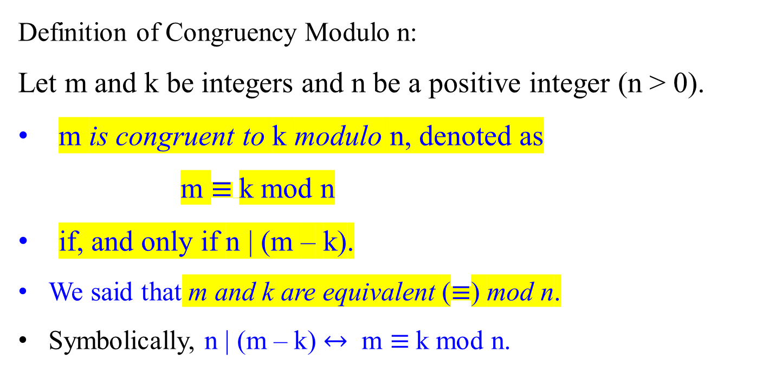
Congruence Modulo n : m and k are congruent modulo n
Definition of Congruency Modulo n:
Let m and k be integers and n be a positive integer (n > 0).
m is congruent to k modulo n, denoted as
m $≡$k mod n
if, and only if n | (m – k).
We said that m and k are equivalent ($≡$) mod n.
Symbolically, n | (m – k) $↔$ m $≡$k mod n.

Slide 6
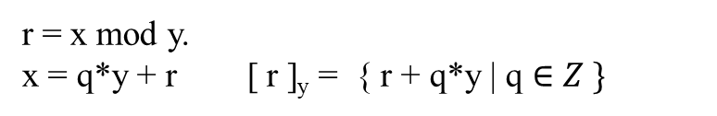

r = x mod y.
x = q*y + r [ r ]_{y} = { r + q*y | q $∈Z \}$
Let Z be the set of integers {…, -2, -1, 0, 1, 2, … }.
All integers can be partitioned into n equivalence classes, according to their remainders modulo n.
Define the equivalence class modulo n containing an integer a to be
[a]_{n} = {a + k n | k ɛ Z},
For example, [3]₇ = { …, - 25, -18, -11, -4, 3, 10, 17, 24, 31, 38, …}.
i.e., b $∈$ [a]_{n} iff b ≡ a (mod n).
iff n | (b – a). i.e., b = a + kn.

Slide 7

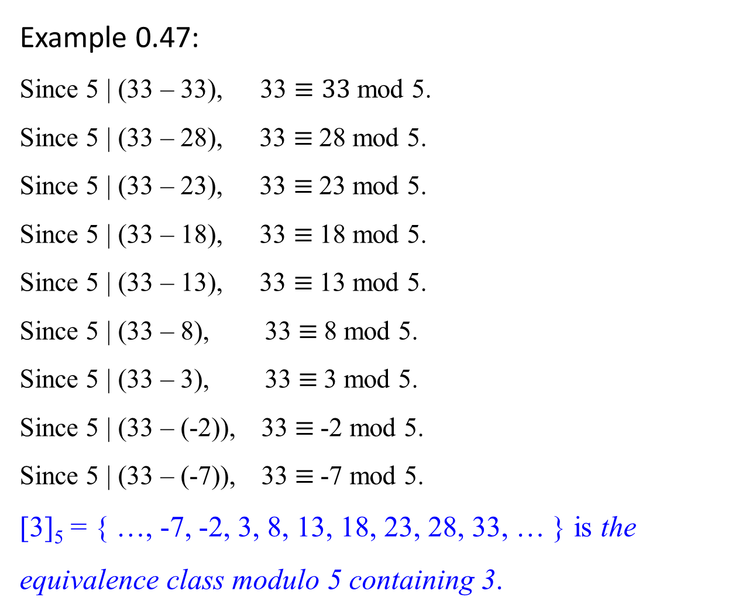
Example 0.47:
Since 5 | (33 – 33), 33 $≡33$ mod 5.
Since 5 | (33 – 28), 33 $≡$28 mod 5.
Since 5 | (33 – 23), 33 $≡$23 mod 5.
Since 5 | (33 – 18), 33 $≡$18 mod 5.
Since 5 | (33 – 13), 33 $≡$13 mod 5.
Since 5 | (33 – 8), 33 $≡$8 mod 5.
Since 5 | (33 – 3), 33 $≡$3 mod 5.
Since 5 | (33 – (-2)), 33 $≡$-2 mod 5.
Since 5 | (33 – (-7)), 33 $≡$-7 mod 5.
[3]₅ = { …, -7, -2, 3, 8, 13, 18, 23, 28, 33, … } is the equivalence class modulo 5 containing 3.
5 | (33 – (-7)) or 5 | (-7-33)

Slide 8

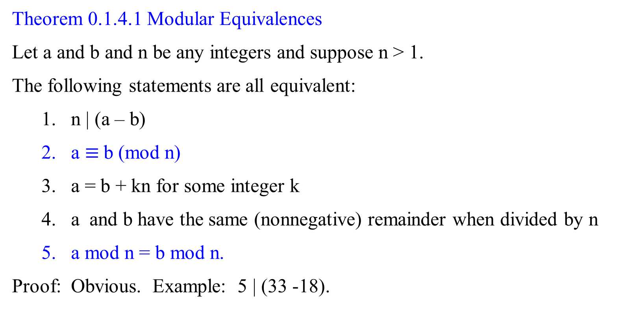
Theorem 0.1.4.1 Modular Equivalences
Let a and b and n be any integers and suppose n > 1.
The following statements are all equivalent:
  n | (a – b)
  a $≡$b (mod n)
  a = b + kn for some integer k
  a and b have the same (nonnegative) remainder when divided by n
  a mod n = b mod n.
Proof: Obvious. Example: 5 | (33 -18).

Slide 9
Primality testing

Slide 10

Primality testing
Do we have any way to know a number is prime without actually trying to factor the number?
Fermat's little theorem states that if p is a prime number, then for any integer a, the number a^{p} − a is an integer multiple of p.
In the notation of modular arithmetic, a^{p} ≡ a (mod p).
That is, p | (a^{p} – a)
For example,
  if a = 2 and p = 11, 2¹¹ = 2048, and
  2048 − 2 = 186 × 11, an integer 186 multiple of 11.
  That is, 11 | 2¹¹ – 2, where 11 is a prime. i.e., 2¹¹ ≡ 2(mod p).
  If a = 2, and p = 12, 2¹² = 4096, then 12 ┼ 2¹² -2
i.e., (a^{p} – a) mod p = 0.

Slide 11
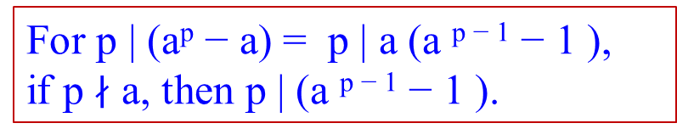
Primality testing
Can we know a number is prime without actually trying to factor the number?
Fermat’s little theorem states that:
  If p is a prime number,
  then, for any integer a, the number a^{p} − a is an integer
  multiple of p.
  In the notation of modular arithmetic, a^{p} ≡ a (mod p).
If a is not divisible by p, Fermat's little theorem is equivalent to the statement that a^{p − 1} − 1 is an integer multiple of p, or in symbols.
a^{p-1} ≡ 1 (mod p).
i.e., (a^{p} – a) mod p = 0.
a(a^{p-1} – 1) mod p = 0
(a^{p-1} – 1) mod p = 0
a^{p-1} ≡ 1 (mod p)
For p | (a^{p} − a) = p | a (a ^{p − 1} − 1 ),
if p $∤$ a, then p | (a ^{p − 1} − 1 ).
gcd(a^{p-1}, p) = 1

Slide 12
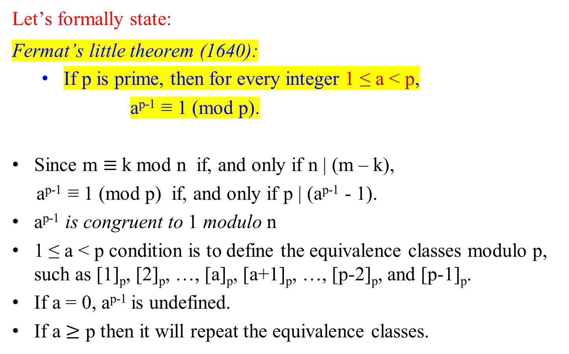
Let’s formally state:
Fermat’s little theorem (1640):
  If p is prime, then for every integer 1 ≤ a < p,
a^{p-1} ≡ 1 (mod p).
Since m $≡$k mod n if, and only if n | (m – k),
a^{p-1} ≡ 1 (mod p) if, and only if p | (a^{p-1} - 1).
a^{p-1} is congruent to 1 modulo n
1 ≤ a < p condition is to define the equivalence classes modulo p, such as [1]_{p}, [2]_{p}, …, [a]_{p}, [a+1]_{p}, …, [p-2]_{p}, and [p-1]_{p}.
If a = 0, a^{p-1} is undefined.
If a $≥$ p then it will repeat the equivalence classes.

Slide 13


Congruence Modulo n
[3]₅ = { …, -7, -2, 3, 8, 13, 18, 23, 28, 33, … } is the equivalence class modulo 5 containing 3.
Theorem 0.1.4.1 Modular Equivalences
Let a, b, and n be any integers. Let n > 1.
The following statements are all equivalent:
  n | (a – b)
  a $≡$b (mod n), a is congruent to b modulo n
  a = b + i*n for some integer i, the division theorem a = i*n + b
  a and b have the same (nonnegative) remainder when divided by n;
  i.e., $\frac{a}{n}$ = $\frac{b}{n}$ = r
  5. a mod n = b mod n.
Proof: Obvious. Example: 5 | (33 -18).

Slide 14

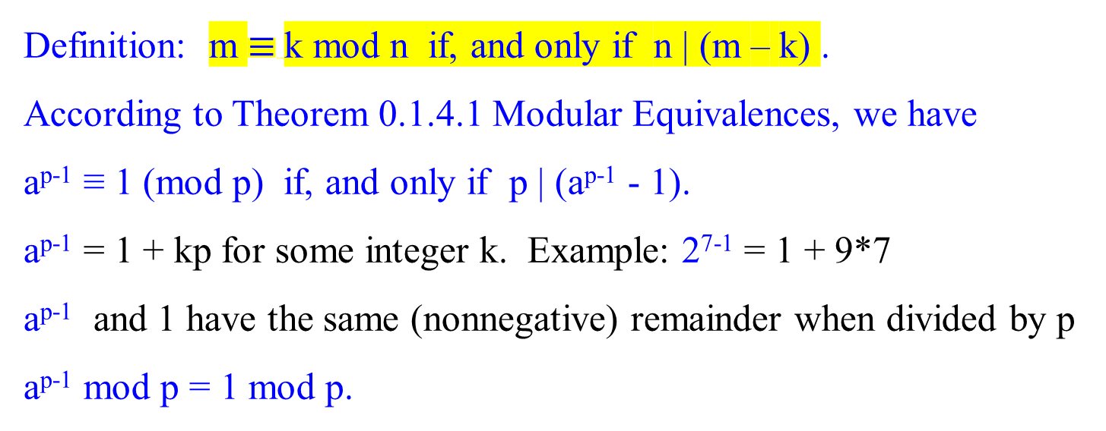
Definition: m $≡$k mod n if, and only if n | (m – k) .
According to Theorem 0.1.4.1 Modular Equivalences, we have
a^{p-1} ≡ 1 (mod p) if, and only if p | (a^{p-1} - 1).
a^{p-1} = 1 + kp for some integer k. Example: 2⁷⁻¹ = 1 + 9*7
a^{p-1} and 1 have the same (nonnegative) remainder when divided by p
a^{p-1} mod p = 1 mod p.

Slide 15

Recall:
Fermat’s little theorem (1640):
If p is prime, then for every integer 1 ≤ a < p,
a^{p-1} ≡ 1 (mod p).
i.e., gcd(a^{p-1}, p) = 1; p|(a^{p-1} -1); a^{p-1} mod p = 1 mod p.
This theorem suggests a “factorless” test for determining whether a number N is prime:
Determine whether 13 is a prime.
Assume that p =13 is a prime.
Pick a = 2, such that 1 ≤ 2 < 13.
Check whether 2¹³⁻¹ ≡ 1 (mod 13).
1. gcd(2¹³⁻¹ , 13) = 1; or
2. 13| 2¹³⁻¹ - 1; i.e., 13|4096-1.
3. 2¹³⁻¹ mod 13 = 1 mod 13
Pass “prime”
Pick some a
Fail “composite” Fermat’s test
Is a^{N-1} ≡ 1 mod N?

Slide 16
The problem is that Fermat’s theorem :
  The Fermat’s theorem is not an if-and-only-if condition;
  It says that p is prime → a^{p-1} ≡ 1 (mod p). But not vice versa.
It does not say what happens when N is not prime.
If N is not prime, Fermat’s test diagram is questionable. i.e.,
    for any N, if a^{N-1} ≡ 1 (mod N), can we say that N is prime?
In fact, a composite number N can possibly pass Fermat’s test (that is, a^{N-1} ≡ 1 (mod N), for certain choices of a.
  e.g., for a non-prime N = 341 = 11 * 31, 2³⁴⁰ ≡ 1 (mod 341).
But it is true that for composite N, most values of a will fail the test.
Show 2³⁴⁰ mod 341= 2²⁵⁶⁺⁶⁴⁺¹⁶⁺⁴ mod 341
= (2²⁵⁶ mod 341 * 2⁶⁴ mod 341 * 2¹⁶ mod 341 * 2⁴ mod 341) mod 341
= (64 * 16 * 64 *16) mod 341
= (1024 mod 341 * 1024 mod 341) mod 341
= (1 * 1) mod 341 = 1

Slide 17
Figure 1.7 An algorithm for testing primality.
For this algorithm, choose a randomly from {1, 2, … N-1}, rather than fixing an arbitrary value of a in advance.
function primality(N)
Input: Positive integer N
Output: yes/no
Pick a positive integer a < N at random
if a^{N-1} ≡ 1 (mod N)
then return yes;
else return no;
Test whether N | a^{N-1} – 1?
or gcd(a^{N-1}, N) = 1?
or a^{N-1} mod N = 1 mod N?

Slide 18
In analyzing the behavior of this algorithm for testing primality:
  It turns out that
    certain extremely rare composite numbers N, called Carmichael numbers, pass Fermat’s test for all a relatively prime to N. [i.e., a^{N-1} ≡ 1 (mod N)]
    On such numbers, this algorithm will fail.

Slide 19

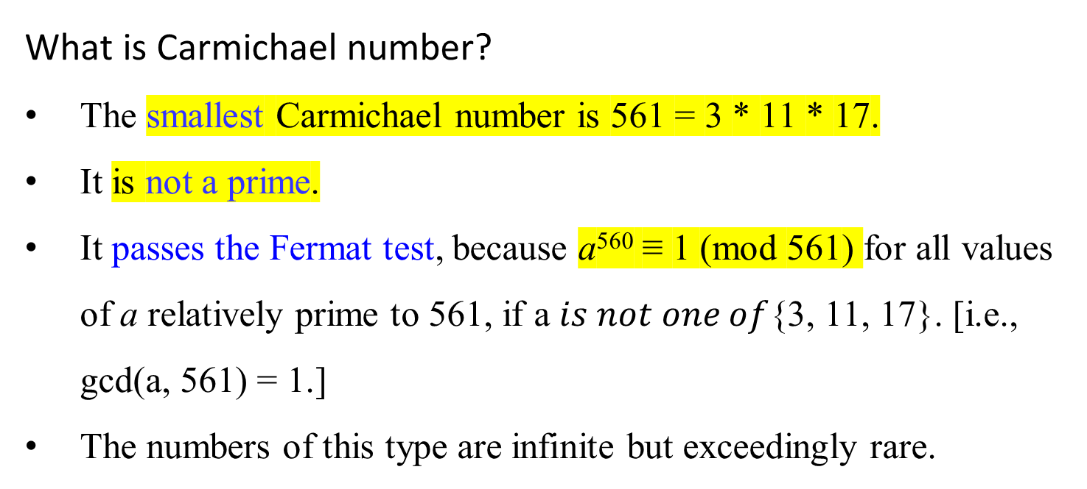
What is Carmichael number?
The smallest Carmichael number is 561 = 3 * 11 * 17.
It is not a prime.
It passes the Fermat test, because a⁵⁶⁰ ≡ 1 (mod 561) for all values of a relatively prime to 561, if a $is not one of${3, 11, 17}. [i.e., gcd(a, 561) = 1.]
The numbers of this type are infinite but exceedingly rare.

Slide 20

Disregarding the Carmichael numbers, let us assert
if N is prime, then a^{N-1} ≡ 1 (mod N), for all a < N.
if N is not prime, then a^{N-1} ≡ 1 (mod N), for at most half the values of a < N.
The algorithm of Figure 1.7, therefore, has the following probabilistic behavior.
  Pr(Algorithm 1.7 returns yes when N is prime) = 1
  Pr(Algorithm 1.7 returns yes when N is not prime) ≤ $\frac{1}{2}$ .
Reduce this one-sided error by repeating the procedure many times, by randomly picking several values of a and testing them all (Figure 1.8).
Pr(Algorithm 1.8 returns yes when N is not prime) ≤ $\frac{1}{{ 2}^{k }}$ .

Slide 21
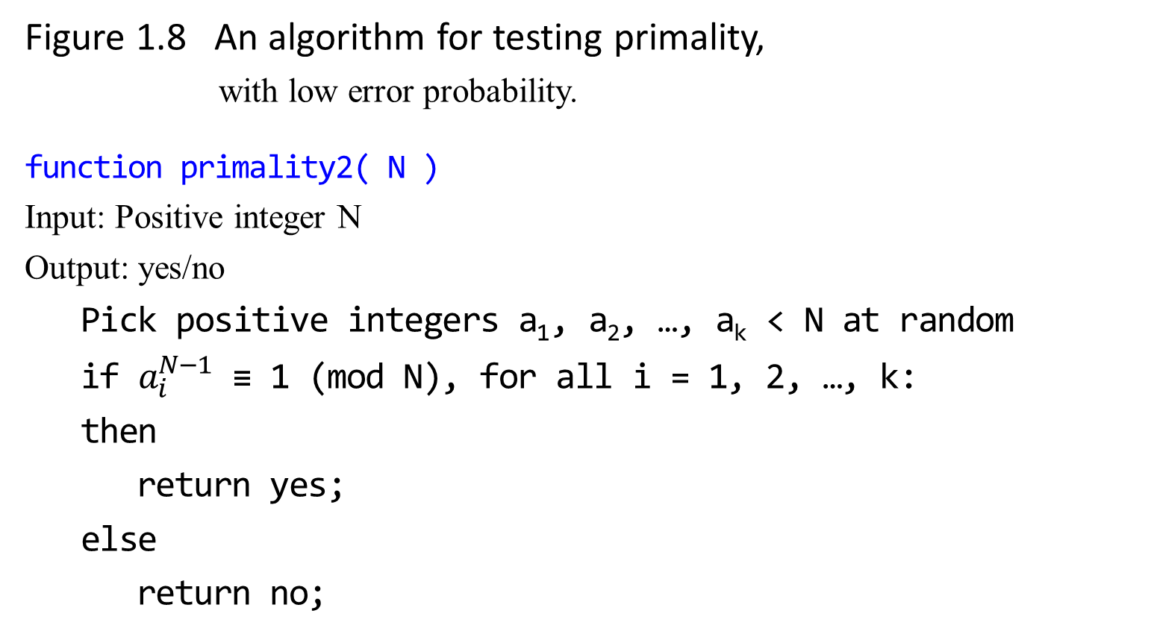
Figure 1.8 An algorithm for testing primality, with low error probability.
function primality2( N )
Input: Positive integer N
Output: yes/no
Pick positive integers a₁, a₂, …, a_{k} < N at random
if $a_{i}^{N−1}$ ≡ 1 (mod N), for all i = 1, 2, …, k:
then
return yes;
else
return no;

Slide 22
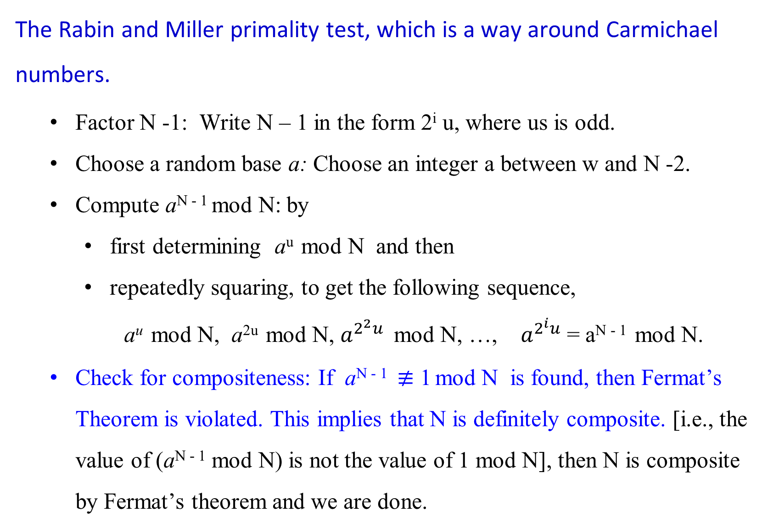
The Rabin and Miller primality test, which is a way around Carmichael numbers.
Factor N -1: Write N – 1 in the form 2^{i} u, where us is odd.
Choose a random base a: Choose an integer a between w and N -2.
Compute a^{N - 1} mod N: by
  first determining a^{u} mod N and then
  repeatedly squaring, to get the following sequence,
  a^{u} mod N, a^{2u} mod N, $a^{2^{2}u}$ mod N, …, $a^{2^{i}u}$ = a^{N - 1} mod N.
Check for compositeness: If a^{N - 1} $≢$ 1 mod N is found, then Fermat’s Theorem is violated. This implies that N is definitely composite. [i.e., the value of (a^{N - 1} mod N) is not the value of 1 mod N], then N is composite by Fermat’s theorem and we are done.

Slide 23
Why this is important
Fermat’s test alone can be fooled by Carmichael numbers, because those composites can satisfy a^{N−1} ≡ 1 (mod N) for many bases a.
The Miller–Rabin refinement looks at the entire chain of intermediate squaring steps. If N is composite, these steps almost always reveal it, instead of trusting only the final result a^{N−1} ≡ 1 (mod N).
If N is prime, the sequence will always behave exactly as expected.

Slide 24
In a Carmichael-free universe, the algorithm (Figure 1.7) works well.
  Any prime number N will pass Fermat’s test and produce the right answer.
  Any non-Carmichael composite number N must fail Fermat’s test for some value of a; and
  this implies immediately that N fails Fermat’s test for at least half the possible values of a!

Slide 25
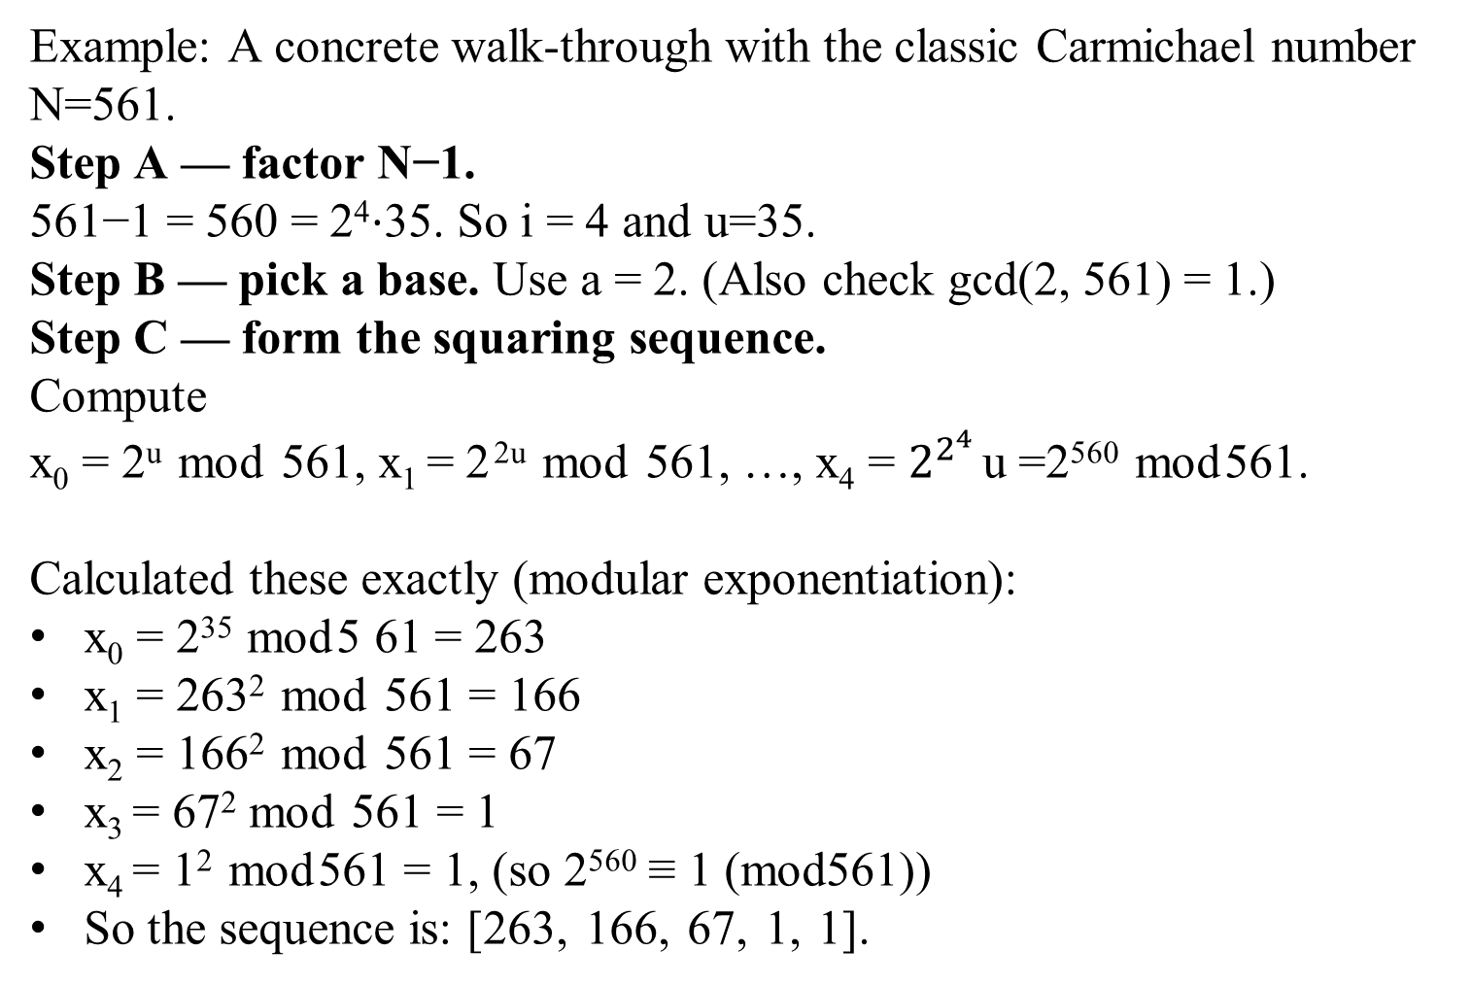
Example: A concrete walk-through with the classic Carmichael number N=561.
Step A — factor N−1.
561−1 = 560 = 2⁴⋅35. So i = 4 and u=35.
Step B — pick a base. Use a = 2. (Also check gcd(2, 561) = 1.)
Step C — form the squaring sequence.
Compute
x₀ = 2^{u} mod 561, x₁ = 2 ^{2u} mod 561, …, x₄ = $2^{2^{4 }}$u =2⁵⁶⁰ mod 561.
Calculated these exactly (modular exponentiation):
x₀ = 2³⁵ mod 5 61 = 263
x₁ = 263² mod 561 = 166
x₂ = 166² mod 561 = 67
x₃ = 67² mod 561 = 1
x₄ = 1² mod 561 = 1, (so 2⁵⁶⁰ ≡ 1 (mod561))
So the sequence is: [263, 166, 67, 1, 1].

Slide 26
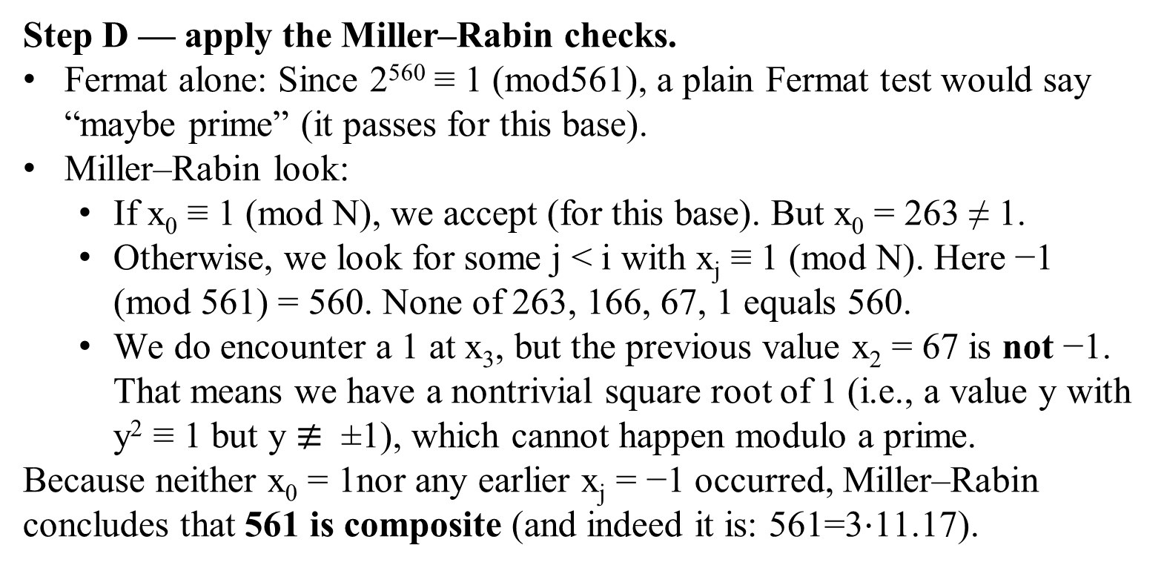
Step D — apply the Miller–Rabin checks.
Fermat alone: Since 2⁵⁶⁰ ≡ 1 (mod561), a plain Fermat test would say “maybe prime” (it passes for this base).
Miller–Rabin look:
  If x₀ ≡ 1 (mod N), we accept (for this base). But x₀ = 263 ≠ 1.
  Otherwise, we look for some j < i with x_{j} ≡ 1 (mod N). Here −1 (mod 561) = 560. None of 263, 166, 67, 1 equals 560.
  We do encounter a 1 at x₃​, but the previous value x₂ = 67 is not −1. That means we have a nontrivial square root of 1 (i.e., a value y with y² ≡ 1 but y $≢$ ±1), which cannot happen modulo a prime.
Because neither x₀ = 1nor any earlier x_{j} = −1 occurred, Miller–Rabin concludes that 561 is composite (and indeed it is: 561=3⋅11.17).

Slide 27
Prime Factorization and Relative Prime

Slide 28
Relatively prime integers
Two integers a and b are relatively prime if, and only if gcd(a, b) = 1, that is, iff their only common divisor is 1.
For example:
8 and 15 are relatively prime, because gcd(8, 15) =1.
gcd(8 15) = 1, because
the divisors of 8 are 1, 2, 4, and 8, and
the divisors of 15 are 1, 3, 5, and 15.

Slide 29
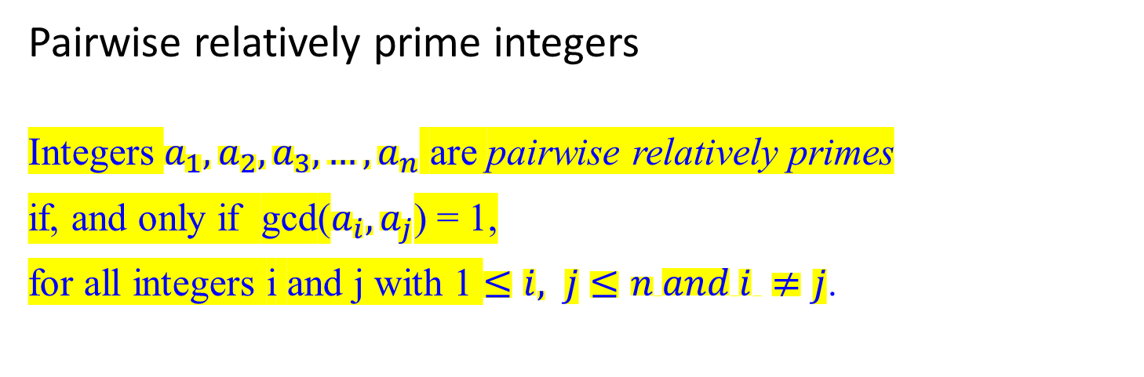
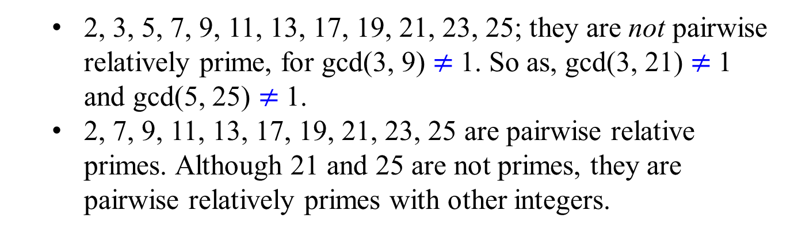
Pairwise relatively prime integers
Integers $a_{1},a_{2},a_{3}, …,a_{n}$ are pairwise relatively primes
if, and only if gcd($a_{i},a_{j}$) = 1,
for all integers i and j with 1 $≤i, j≤n and i ≠j$.
  2, 3, 5, 7, 9, 11, 13, 17, 19, 21, 23, 25; they are not pairwise relatively prime, for gcd(3, 9) $≠$1. So as, gcd(3, 21) $≠$1 and gcd(5, 25) $≠$1.
  2, 7, 9, 11, 13, 17, 19, 21, 23, 25 are pairwise relative primes. Although 21 and 25 are not primes, they are pairwise relatively primes with other integers.

Slide 30
Prime Factorization and Relative Prime
Every integer greater than one can be written as a unique product of primes.
We next develop theory that proves this assertion.
The following theorem states that if two integers are each relatively prime to an integer p, then their product is relatively prime to p.
Example: Let p = 15, x = 4, y = 16 such that gcd(4, 15) = 1 and gcd(16, 15) = 1. Then gcd(4*16, 15) = 1.

Slide 31
Theorem 0.7
For all primes p and all integers a, b, if p | ab, then p | a or p | b (or both).
Example: Let p = 7, x = 5, y = 7 such that 7 | 5*7, and 7 | 7. gcd(5, 7) = 1.
Note: gcd(4, 15) = 1 and gcd(16, 15) = 1. Then gcd(4*16, 15) = 1.
A consequence of Theorem 0.7 is that
  every integer n > 1 has a unique factorization as a product of prime numbers.

Slide 32

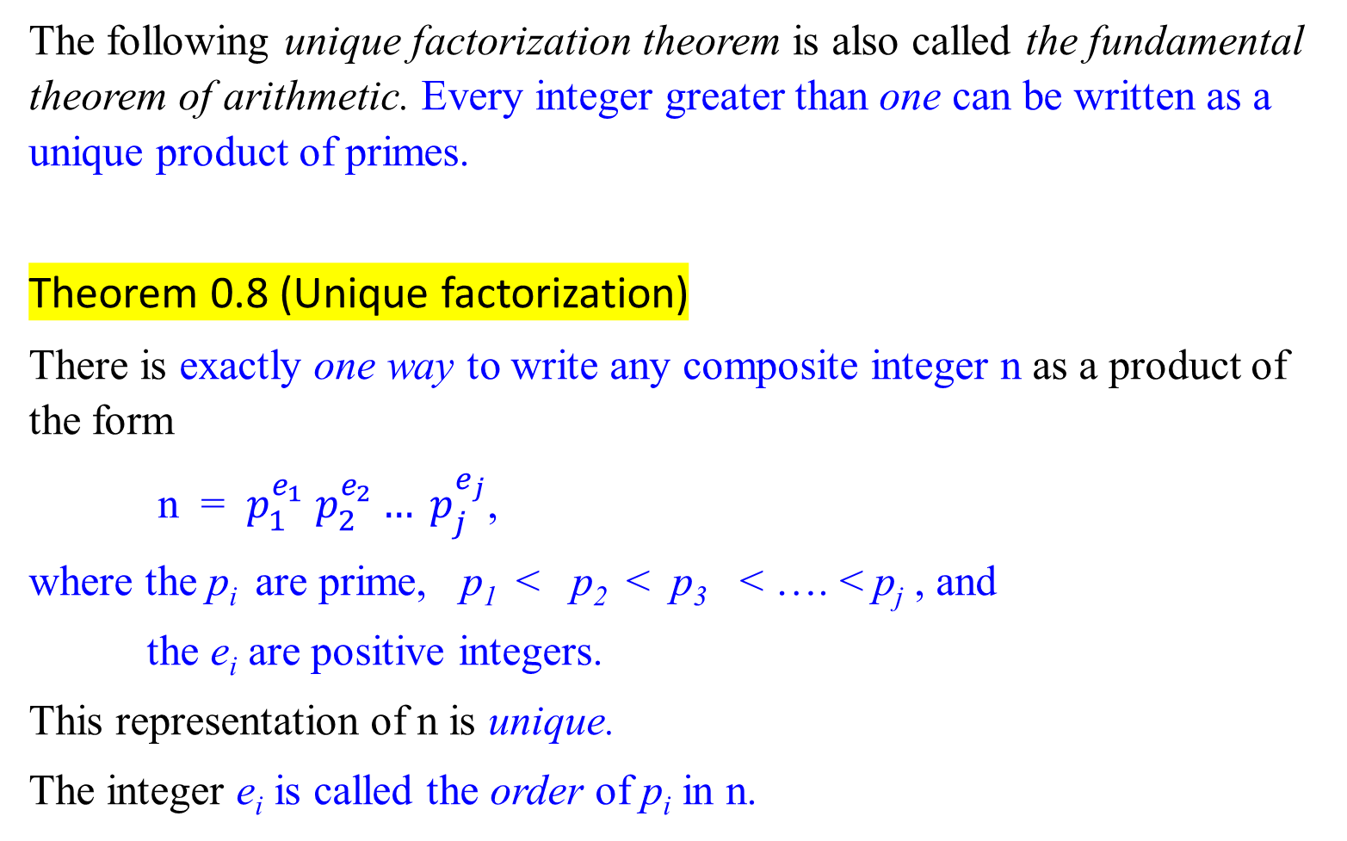
The following unique factorization theorem is also called the fundamental theorem of arithmetic. Every integer greater than one can be written as a unique product of primes.
Theorem 0.8 (Unique factorization)
There is exactly one way to write any composite integer n as a product of the form
n = $p_{1}^{e_{1}} p_{2}^{e_{2}}… p_{j}^{e_{j}}$,
where the p_{i} are prime, p₁ < p₂ < p₃ < …. < p_{j} , and
the e_{i} are positive integers.
This representation of n is unique.
The integer e_{i} is called the order of p_{i} in n.
?

Slide 34

Cryptography – The RSA Public Key Cryptosystem
The Rivest-Shamir-Adleman (RSA) cryptosystem uses all the ideas we have introduced in this lecture note. It derives very strong guarantees of security by ingeniously exploiting the wide gulf between the polynomial-time computability of certain number-theoretic tasks: (
  modular exponentiation,
  greatest common divisor,
  primality testing) and
  the intractability of others (factoring).

