Slide 1
Chapter 00_03
Prime Numbers

Slide 2

Outlines
Use the Sieve of Eratosthenes to find all the primes that are less than a given number n and their time efficiency.
Several characteristics of Algorithms

Slide 3

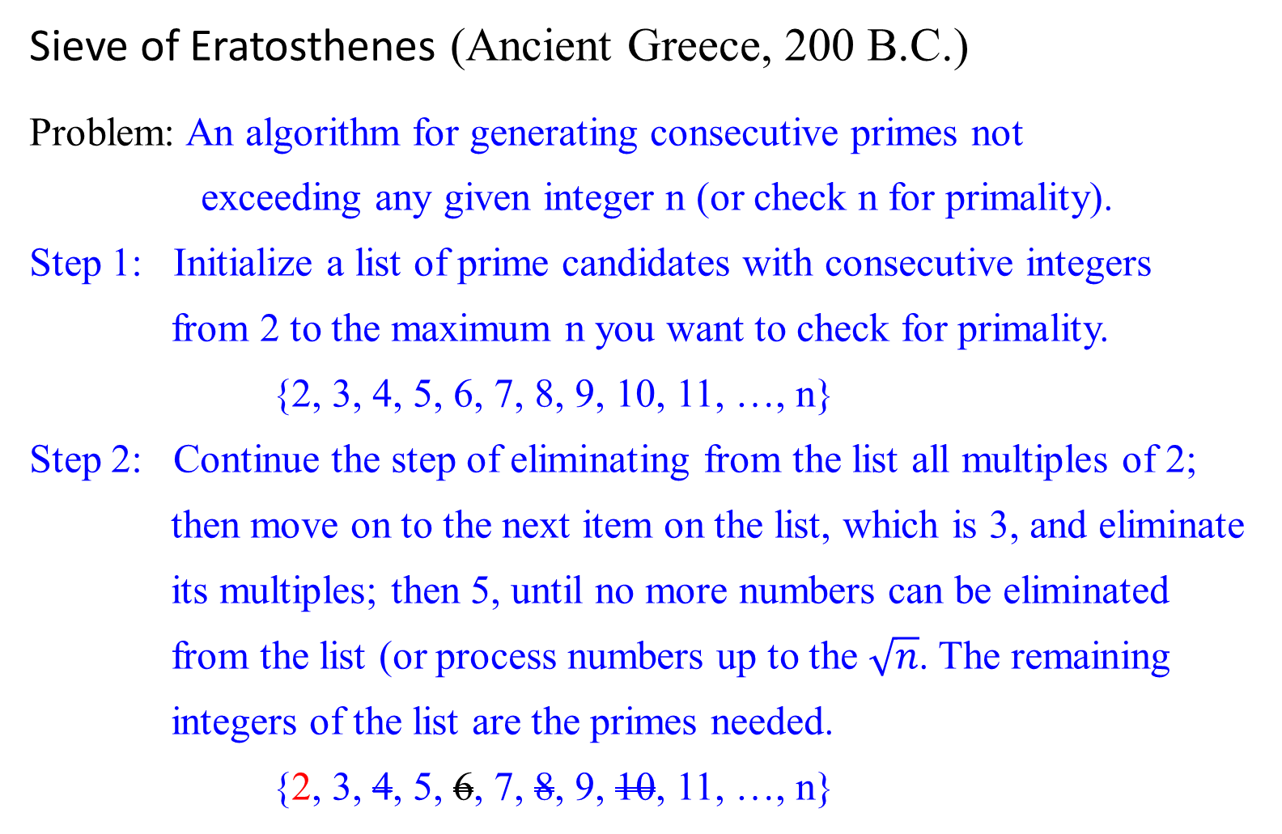
Sieve of Eratosthenes (Ancient Greece, 200 B.C.)
Problem: An algorithm for generating consecutive primes not
exceeding any given integer n (or check n for primality).
Step 1: Initialize a list of prime candidates with consecutive integers
from 2 to the maximum n you want to check for primality.
{2, 3, 4, 5, 6, 7, 8, 9, 10, 11, …, n}
Step 2: Continue the step of eliminating from the list all multiples of 2;
then move on to the next item on the list, which is 3, and eliminate
its multiples; then 5, until no more numbers can be eliminated
from the list (or process numbers up to the $\sqrt{n}$. The remaining
integers of the list are the primes needed.
{2, 3, 4, 5, 6, 7, 8, 9, 10, 11, …, n}

Slide 4

Example 0.37: Let n = 31. [p = 2, 3, 5]
How far do you go to eliminate the non-prime number for a given n?
What is the largest number p whose multiples can remain on the list?
  e.g., for this case, the largest number p is 5 since p = 5 $≤$ $\sqrt{31}$.
if p = | 2 | 3 | 4 | 5 | 6 | 7 | 8 | 9 | 10 | 11 | 12 | 13 | 14 | 15 | 16 | 17 | 18 | 19 | 20 | 21 | 22 | 23 | 24 | 25 | 26 | 27 | 28 | 29 | 30 | 31
2 | 2 | 3 | d | 5 | d | 7 | d | 9 | d | 11 | d | 13 | d | 15 | d | 17 | d | 19 | d | 21 | d | 23 | d | 25 | d | 27 | d | 29 | d | 31
3 | 2 | 3 |  | 5 |  | 7 |  | d |  | 11 | r | 13 |  | d |  | 17 | r | 19 |  | d |  | 23 | r | 25 |  | d |  | 29 | r | 31
5 | 2 | 3 |  | 5 |  | 7 |  |  |  | 11 |  | 13 |  |  |  | 17 |  | 19 |  |  |  | 23 |  | d |  |  |  | 29 | r | 31

Slide 5
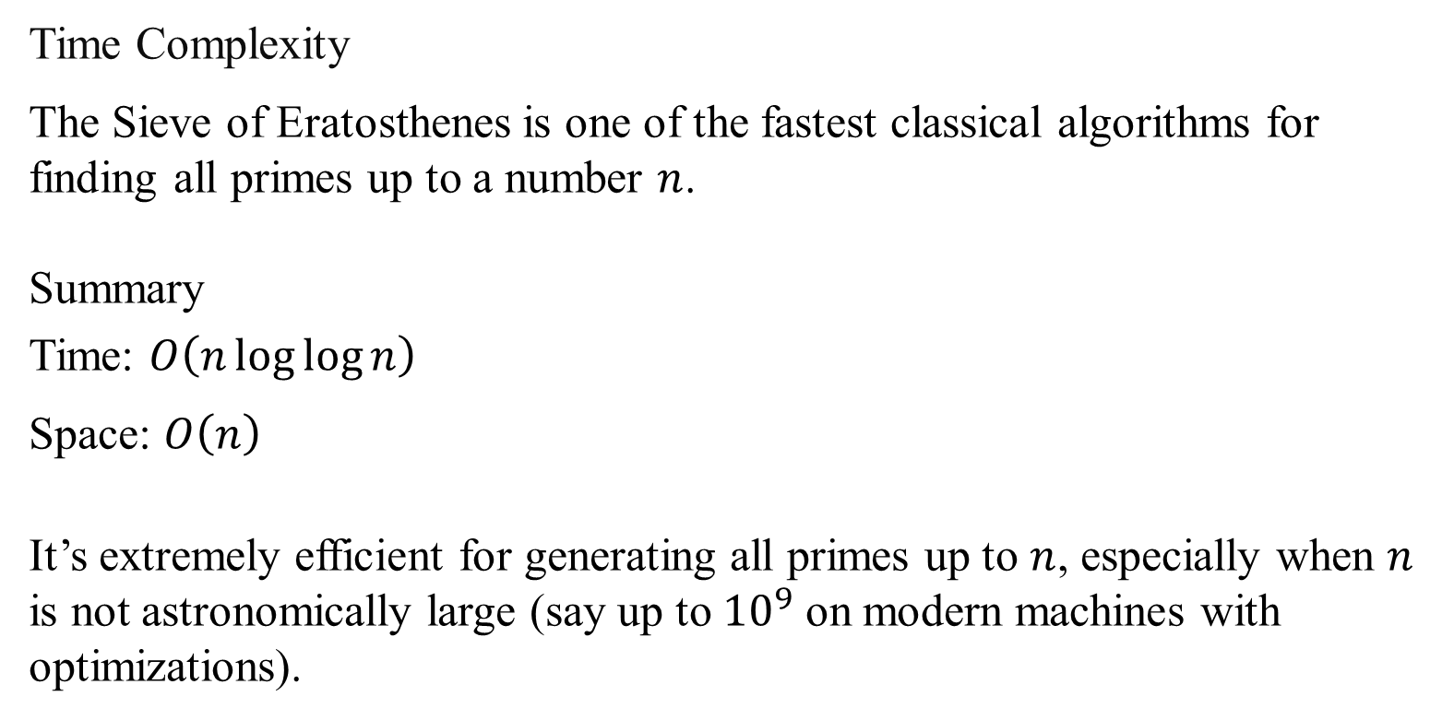
Time Complexity
The Sieve of Eratosthenes is one of the fastest classical algorithms for finding all primes up to a number $n$.
Summary
Time: $O\left(n\log{log}{n}\right)$
Space: $O\left(n\right)$
It’s extremely efficient for generating all primes up to $n$, especially when $n$ is not astronomically large (say up to ${10}^{9}$ on modern machines with optimizations).

Slide 6
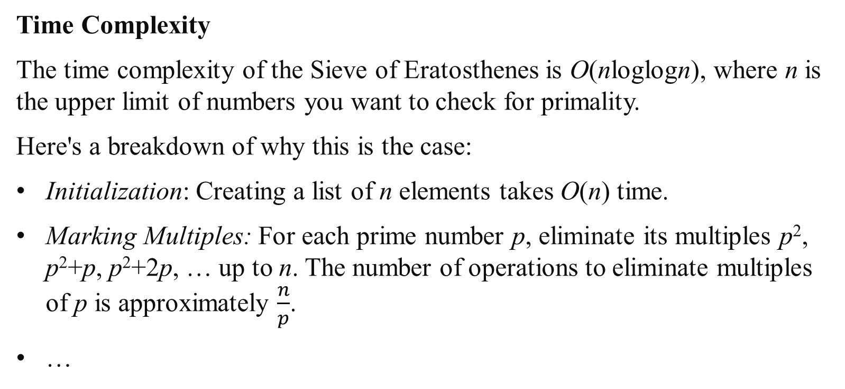
Time Complexity
The time complexity of the Sieve of Eratosthenes is O(nloglogn), where n is the upper limit of numbers you want to check for primality.
Here's a breakdown of why this is the case:
Initialization: Creating a list of n elements takes O(n) time.
Marking Multiples: For each prime number p, eliminate its multiples p², p²+p, p²+2p, … up to n. The number of operations to eliminate multiples of p is approximately $\frac{n}{p}$​.
…

Slide 7
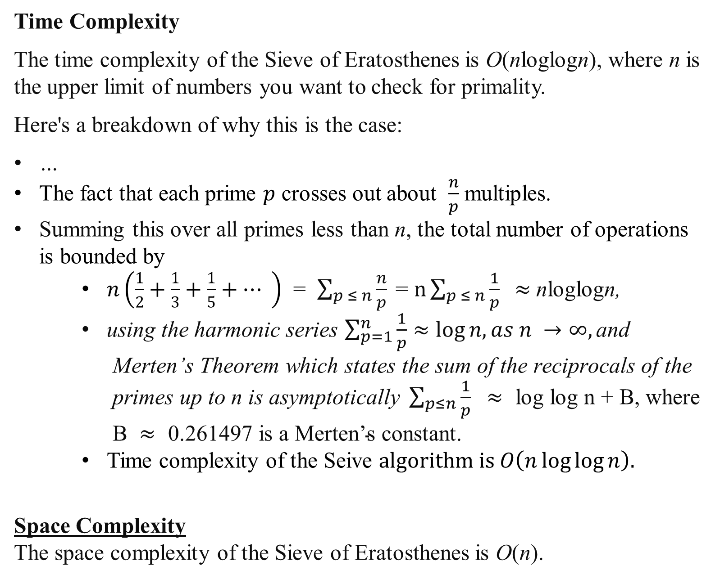
Time Complexity
The time complexity of the Sieve of Eratosthenes is O(nloglogn), where n is the upper limit of numbers you want to check for primality.
Here's a breakdown of why this is the case:
…
The fact that each prime $p$ crosses out about $\frac{n}{p}$ multiples.
Summing this over all primes less than n, the total number of operations is bounded by
    $n\left(\frac{1}{2}+\frac{1}{3}+\frac{1}{5}+⋯ \right)$ = $\sum_{p ≤ n}{\frac{n}{p}\text{​}}$= $n\sum_{p ≤ n}{\frac{1}{p}\text{​}} ≈$nloglogn,
    using the harmonic series $\sum_{p=1}^{n}{\frac{1}{p}}≈\log{n, as n →∞,}\text{and} \text{Merten}\text{’}\text{s} \text{Theorem} \text{which} \text{states} \text{the} \text{sum} \text{of} \text{the} \text{reciprocals} \text{of} \text{the} \text{primes} \text{up} \text{to} \text{n} \text{is} \text{asymptotically} \sum_{p≤n}{\frac{1}{p}} ≈ \text{log} \text{log} \text{n}\text{ + }\text{B}\text{, }\text{where} \text{B} ≈\text{ 0.261497 }\text{is} \text{a} \text{Merten}\text{’}\text{s} \text{constant}\text{.}$
    Time complexity of the Seive $algorithm is O\left(n\log{log}{n}\right).$
Space Complexity
The space complexity of the Sieve of Eratosthenes is O(n).

Slide 8
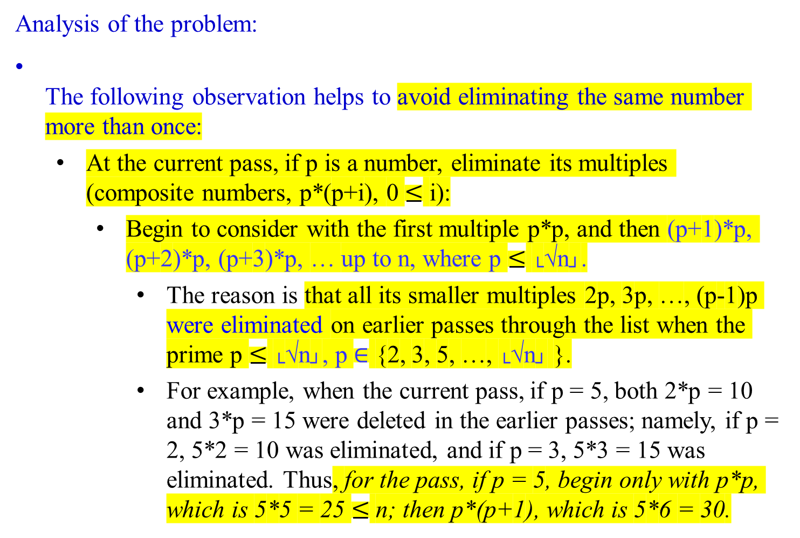
Analysis of the problem:
The following observation helps to avoid eliminating the same number more than once:
At the current pass, if p is a number, eliminate its multiples (composite numbers, p*(p+i), 0 $≤$ i):
  Begin to consider with the first multiple p*p, and then (p+1)*p, (p+2)*p, (p+3)*p, … up to n, where p $≤$ └√n┘.
    The reason is that all its smaller multiples 2p, 3p, …, (p-1)p were eliminated on earlier passes through the list when the prime p $≤$ └√n┘, p $∈$ {2, 3, 5, …, └√n┘ }.
    For example, when the current pass, if p = 5, both 2*p = 10 and 3*p = 15 were deleted in the earlier passes; namely, if p = 2, 5*2 = 10 was eliminated, and if p = 3, 5*3 = 15 was eliminated. Thus, for the pass, if p = 5, begin only with p*p, which is 5*5 = 25 $≤$ n; then p*(p+1), which is 5*6 = 30.

Slide 9

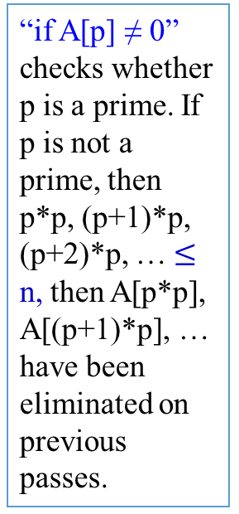
Algorithm Sieve(n)
//Implements the sieve of Eratosthenes
Input: An integer n ≥ 2
Output: Array L of all prime numbers less than or equal to n
for p ← 2 to n do A[p] ← p; //Generate a copy of the number from 2 on.
for p ← 2 to └√n┘ do { // $n^{\frac{1}{2}}$ times
if A[p] ≠ 0 //p has not been eliminated on previous passes
{ j ← p * p; // size of p * size of p $≤$ size of $n^{\frac{1}{2}}$ * size of $n^{\frac{1}{2}}$
while j ≤ n do { //says n times
A[j] ← 0; //mark the element as eliminated
j ← j + p; //j = p*p + p = (p+1)p}//end while_do
} //end if (else back to for after p = p+1)
p = p + 1;
} //end for
//copy the remaining elements of A to array L of the primes
i ← 0;
for p ← 2 to n do {
if A[p] ≠ 0 {
L[i] ← A[p];
i ← i + 1; } //end if
} //end for
return L
“if A[p] ≠ 0” checks whether p is a prime. If p is not a prime, then p*p, (p+1)*p, (p+2)*p, … $≤$ n, then A[p*p], A[(p+1)*p], … have been eliminated on previous passes.
A[2] = 2, A[4] = 0 A[6]=0, A[8]=0, A[10]=0, A[12] =0, A[14]=0, A[16]=0, A[18]=0, A[20]=0, A[22]=0, A[24]=0, A[26]=0, A[28]=0, A[30]=0, …, A[48]=0.
A[3]= 3, A[9]=0, A[12] = 0, A[15] = 0, A[18]=0, A[21] = 0, A[24] = 0, A[27]=0, A[30]=0, A[33]=0, …, A[45]=0, A[48]=0.
A[5] =5, A[25] = 0, A[30]=0, A[35]=0, A[40]=0, A[45]=0.

Slide 10
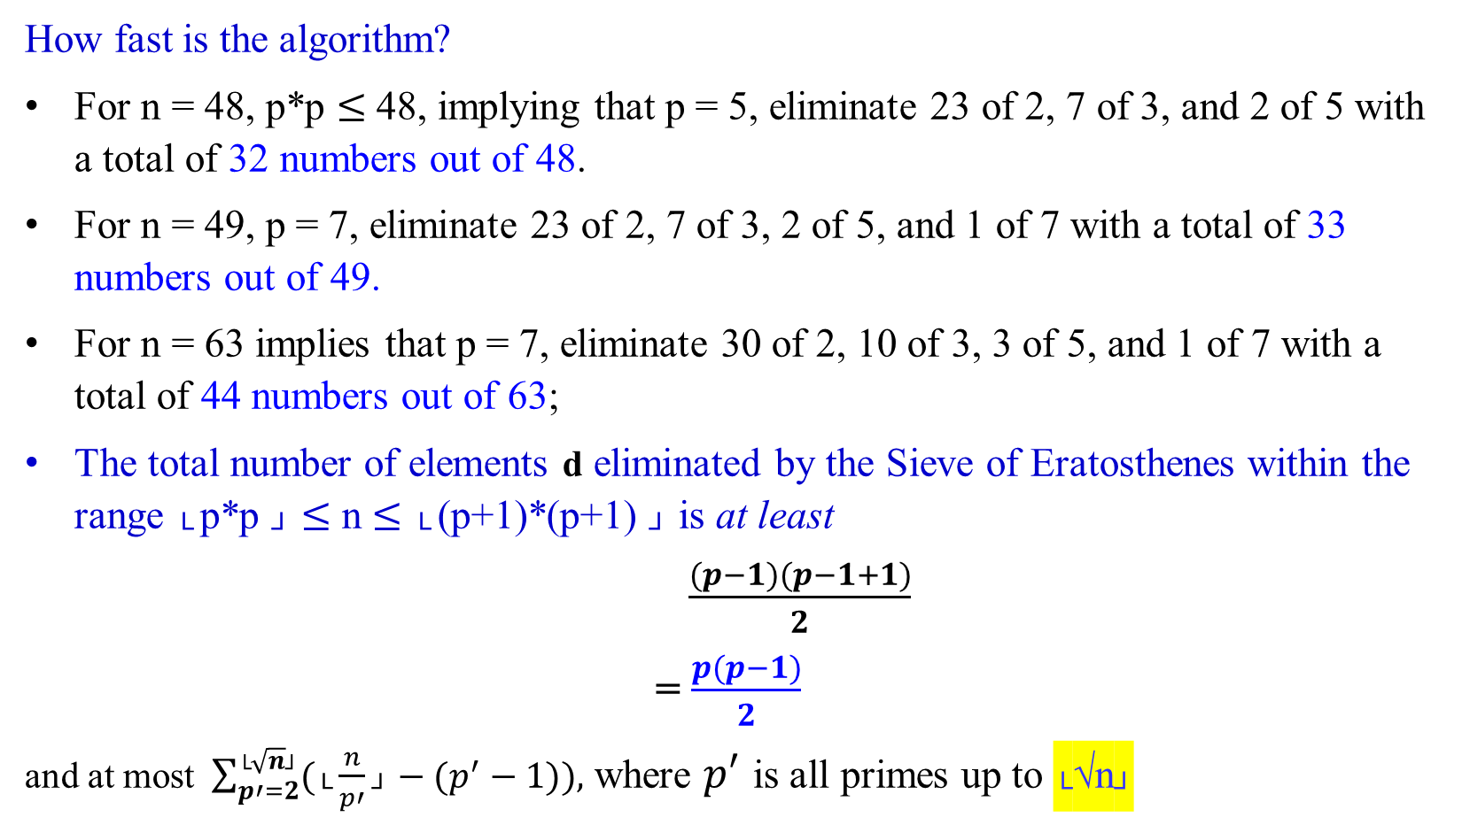
How fast is the algorithm?
For n = 48, p*p $≤$48, implying that p = 5, eliminate 23 of 2, 7 of 3, and 2 of 5 with a total of 32 numbers out of 48.
For n = 49, p = 7, eliminate 23 of 2, 7 of 3, 2 of 5, and 1 of 7 with a total of 33 numbers out of 49.
For n = 63 implies that p = 7, eliminate 30 of 2, 10 of 3, 3 of 5, and 1 of 7 with a total of 44 numbers out of 63;
The total number of elements d eliminated by the Sieve of Eratosthenes within the range └ p*p ┘ $≤$ n $≤$ └ (p+1)*(p+1) ┘ is at least
$\frac{(p−1)(p−1+1)}{2}$
= $\frac{p(p−1)}{2}$
and at most $\sum_{p′=2}^{\text{└}\sqrt{n}\text{┘}}{(\text{└}\frac{n}{p′}\text{┘}}−(p^{′}−1)),$ where $p′$ is all primes up to └√n┘

Slide 11
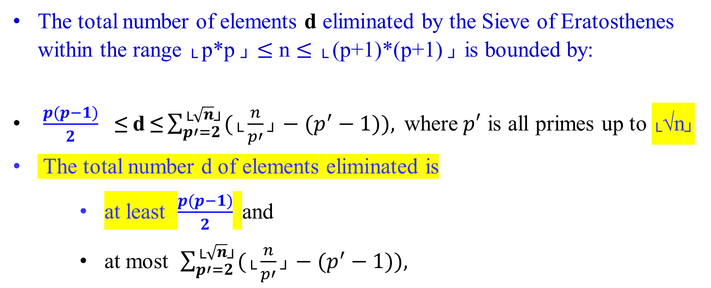
The total number of elements d eliminated by the Sieve of Eratosthenes within the range └ p*p ┘ $≤$ n $≤$ └ (p+1)*(p+1) ┘ is bounded by:
$\frac{p(p−1)}{2}$ ≤ d ≤$\sum_{p′=2}^{\text{└}\sqrt{n}\text{┘}}{(\text{└}\frac{n}{p′}\text{┘}}−(p^{′}−1)), \text{where} p′$ is all primes up to └√n┘
The total number d of elements eliminated is
    at least $\frac{p(p−1)}{2}$ and
    at most $\sum_{p′=2}^{\text{└}\sqrt{n}\text{┘}}{(\text{└}\frac{n}{p′}\text{┘}}−(p^{′}−1)),$

Slide 12

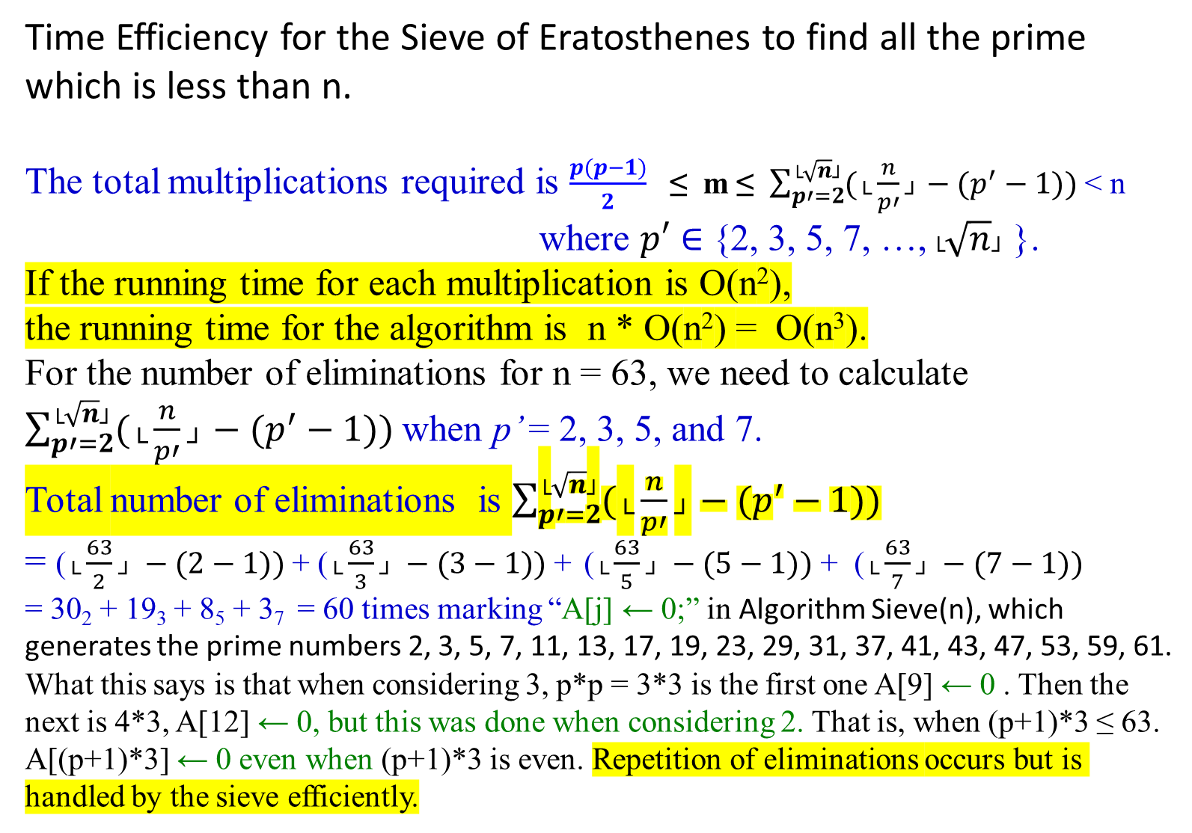
Time Efficiency for the Sieve of Eratosthenes to find all the prime which is less than n.
The total multiplications required is $\frac{p(p−1)}{2}$ ≤ m ≤ $\sum_{p′=2}^{\text{└}\sqrt{n}\text{┘}}{(\text{└}\frac{n}{p′}\text{┘}}−(p^{′}−1))$ < n
where $p′$ $∈$ {2, 3, 5, 7, …, $\text{└}\sqrt{n}\text{┘}$ }.
If the running time for each multiplication is O(n²),
the running time for the algorithm is n * O(n²) = O(n³).
For the number of eliminations for n = 63, we need to calculate
$\sum_{p′=2}^{\text{└}\sqrt{n}\text{┘}}{(\text{└}\frac{n}{p′}\text{┘}}−(p^{′}−1))$when p’ = 2, 3, 5, and 7.
Total number of eliminations is $\sum_{p′=2}^{\text{└}\sqrt{n}\text{┘}}{(\text{└}\frac{n}{p′}\text{┘}}−(p^{′}−1))$
= ($\text{└}\frac{63}{2}\text{┘} −(2−1))$ + ($\text{└}\frac{63}{3}\text{┘} −(3−1))$ + ($\text{└}\frac{63}{5}\text{┘} −(5−1))$ + ($\text{└}\frac{63}{7}\text{┘} −(7−1))$
= 30₂ + 19₃ + 8₅ + 3₇ = 60 times marking “A[j] ← 0;” in Algorithm Sieve(n), which generates the prime numbers 2, 3, 5, 7, 11, 13, 17, 19, 23, 29, 31, 37, 41, 43, 47, 53, 59, 61.
What this says is that when considering 3, p*p = 3*3 is the first one A[9] ← 0 . Then the next is 4*3, A[12] ← 0, but this was done when considering 2. That is, when (p+1)*3 ≤ 63. A[(p+1)*3] ← 0 even when (p+1)*3 is even. Repetition of eliminations occurs but is handled by the sieve efficiently.

Slide 13
Despite the O(n³) time complexity analysis for individual multiplications, the actual running time of the Sieve of Eratosthenes in practice is much better, approximating O(n log log n) for eliminating multiples.
The practical efficiency of the Sieve of Eratosthenes, despite theoretical bounds, is due to the efficient elimination process and low actual computational overhead.

Slide 15
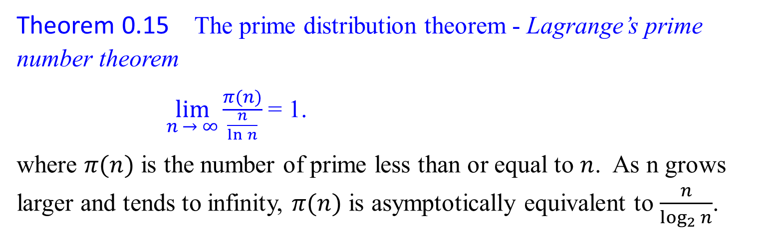
Search of a Large Prime
Theorem 0.15 The prime distribution theorem - Lagrange’s prime number theorem
$\lim_{n → ∞}{\frac{π(n)}{\frac{n}{\ln{n}}}}$ = 1.
where $π(n)$ is the number of prime less than or equal to $n$. As n grows larger and tends to infinity, $π(n)$ is asymptotically equivalent to $\frac{n}{\log_{2}{n}}$.

Slide 16
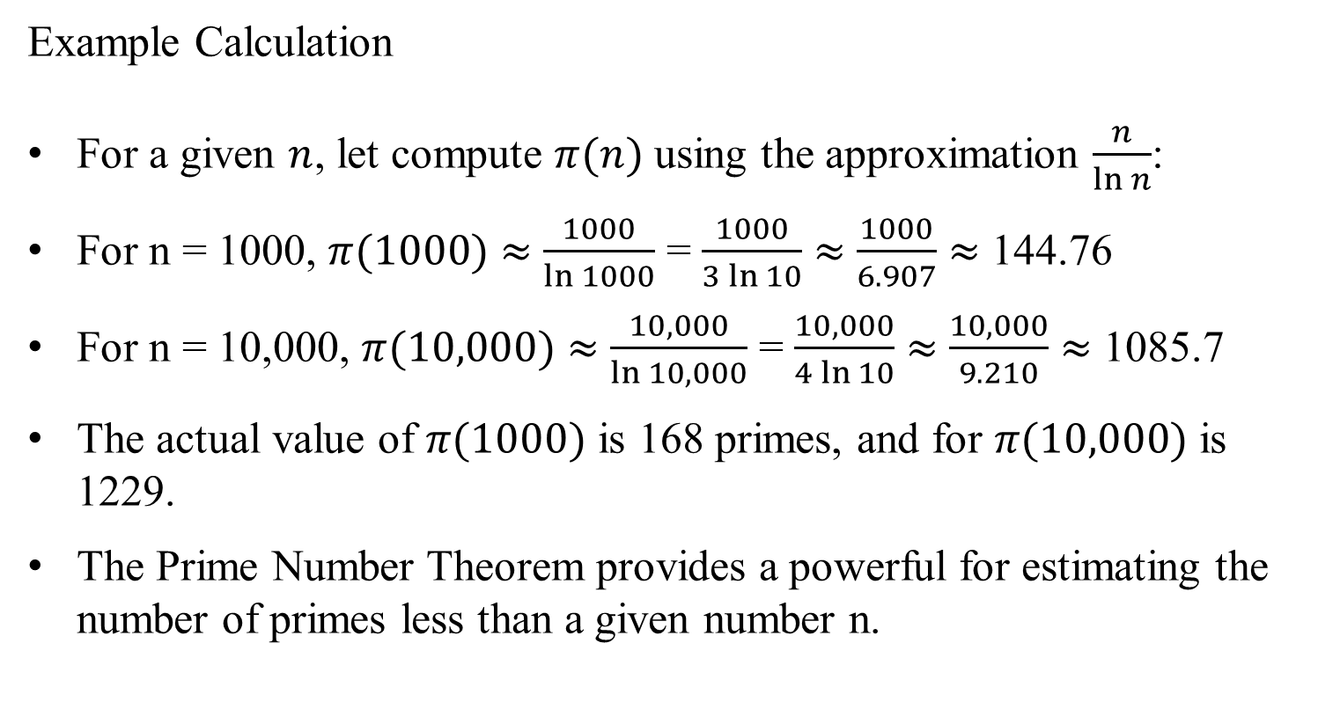
Example Calculation
For a given $n$, let compute $π(n)$ using the approximation $\frac{n}{\ln{n}}$:
For n = 1000, $π(1000)$ $≈$ $\frac{1000}{\ln{1000}}$ = $\frac{1000}{3\ln{10}}$ $≈$ $\frac{1000}{6.907}$ $≈$ 144.76
For n = 10,000, $π(10,000)$ $≈$ $\frac{10,000}{\ln{10,000}}$ = $\frac{10,000}{4\ln{10}}$ $≈$ $\frac{10,000}{9.210}$ $≈$ 1085.7
The actual value of $π(1000)$ is 168 primes, and for $π(10,000)$ is 1229.
The Prime Number Theorem provides a powerful for estimating the number of primes less than a given number n.

Slide 17
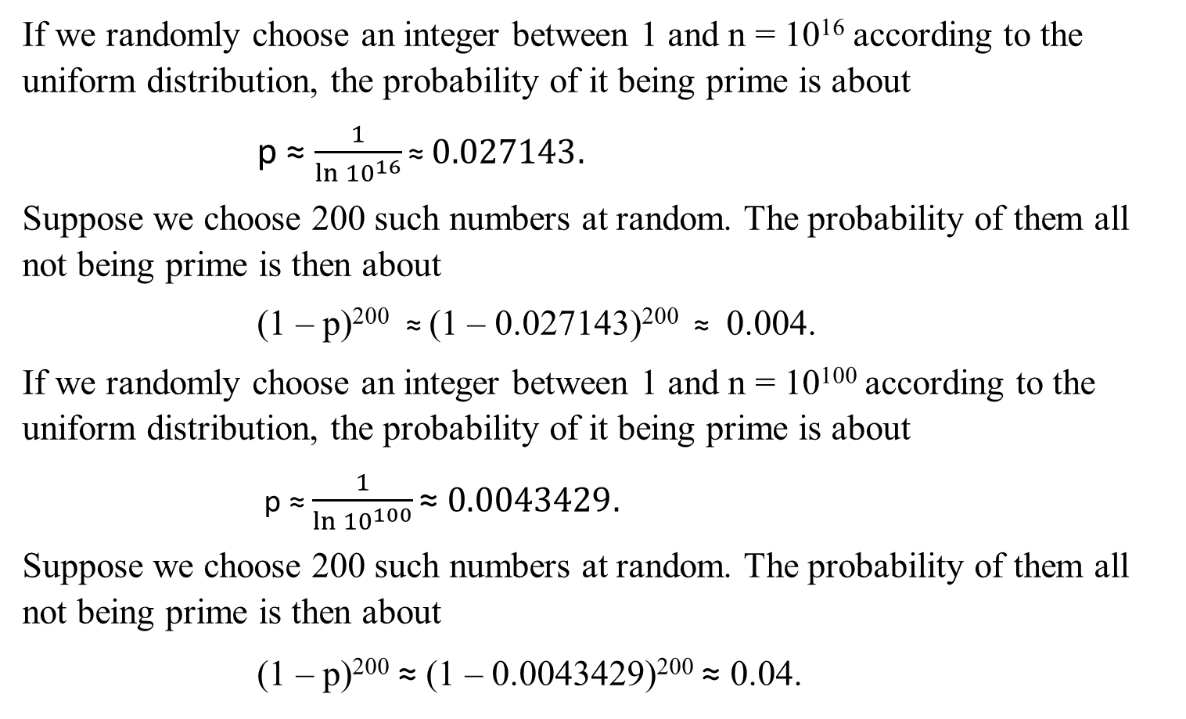
If we randomly choose an integer between 1 and n = 10¹⁶ according to the uniform distribution, the probability of it being prime is about
p ≈ $\frac{1}{\ln{{10}^{16}}}\text{≈} 0.027143.$
Suppose we choose 200 such numbers at random. The probability of them all not being prime is then about
(1 – p)²⁰⁰ ≈ (1 – 0.027143)²⁰⁰ ≈ 0.004.
If we randomly choose an integer between 1 and n = 10¹⁰⁰ according to the uniform distribution, the probability of it being prime is about
p ≈ $\frac{1}{\ln{{10}^{100}}}\text{≈} 0.0043429.$
Suppose we choose 200 such numbers at random. The probability of them all not being prime is then about
(1 – p)²⁰⁰ ≈ (1 – 0.0043429)²⁰⁰ $\text{≈}$ 0.04.

Slide 18
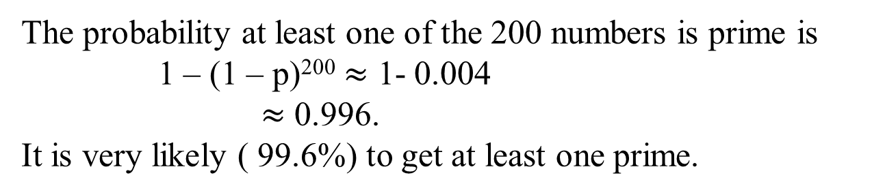
The probability at least one of the 200 numbers is prime is
1 – (1 – p)²⁰⁰ $≈$ 1- 0.004
$≈$ 0.996.
It is very likely ( 99.6%) to get at least one prime.

Slide 19
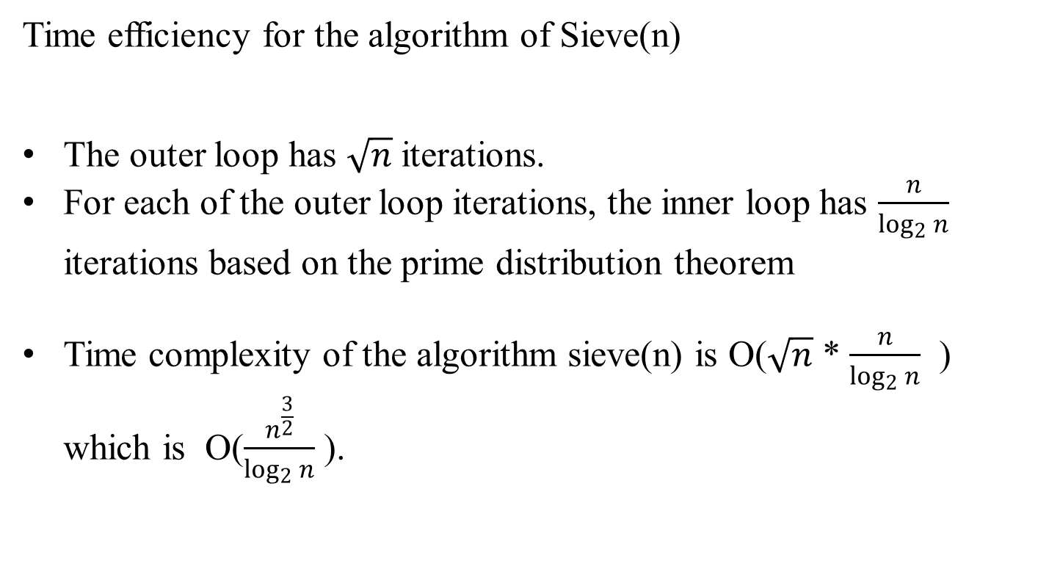
Time efficiency for the algorithm of Sieve(n)
The outer loop has $\sqrt{n}$ iterations.
For each of the outer loop iterations, the inner loop has $\frac{n}{\log_{2}{n}}$ iterations based on the prime distribution theorem
Time complexity of the algorithm sieve(n) is O($\sqrt{n}$ * $\frac{n}{\log_{2}{n}}$ ) which is O($\frac{n^{\frac{3}{2}}}{\log_{2}{n}}$ ).

Slide 20
Prime Factorization and Relative Prime

Slide 21

Cryptography – The RSA Public Key Cryptosystem
The Rivest-Shamir-Adleman (RSA) cryptosystem uses all the ideas we have introduced in this lecture note. It derives very strong guarantees of security by ingeniously exploiting the wide gulf between the polynomial-time computability of certain number-theoretic tasks: (
  modular exponentiation,
  greatest common divisor,
  primality testing) and
  the intractability of others (factoring).

