Slide 1
Chapter 0_02
Introducing Foundation

Slide 2

Body of Knowledge Coverage:
Basis Analysis (AL)
Basis Analysis (AL)
Asymptotic Analysis, empirical measurement.
Differences among best, average, and worst case behaviors of an algorithm.
Complexity classes, such as constant, logarithmic linear, quadratic, and exponential.
Recurrence Relations and their solutions.
Time and space trade-offs in algorithms.

Slide 3

Outlines:
Sum of any three single-digit numbers is at most two digits long.
Number of digits needed to represent the number N ≥ 0 in base b.
Algorithm for determining the number of binary digits needed in the binary representation of a positive decimal integer n.
Algorithm analysis framework
How much does the size of a number change, when changing base?

Slide 4

Number Theory Review
A basic property of numbers in any base b ≥ 2:
The sum of any three single-digit numbers is at most two digits long.
Example 0.1:
For binary numbers in base 2: 1 + 1 + 1 = 11₂
For Octal numbers in base 8: 7 + 7 + 7 = 111 + 111 + 111
= 25₈
For decimal numbers in base 10: 9 + 9 + 9 = 27₁₀
For hexadecimal numbers in base 16: F + F + F = 1111 + 1111 + 1111
= 2D₁₆
Note that D₁₆ = 1101₂ = 13₁₀
010 101 = 25₈
1111 F
+1111 F
0001 1110
+1111
0010 1101
0010 1101 = 2D₁₆

Slide 5
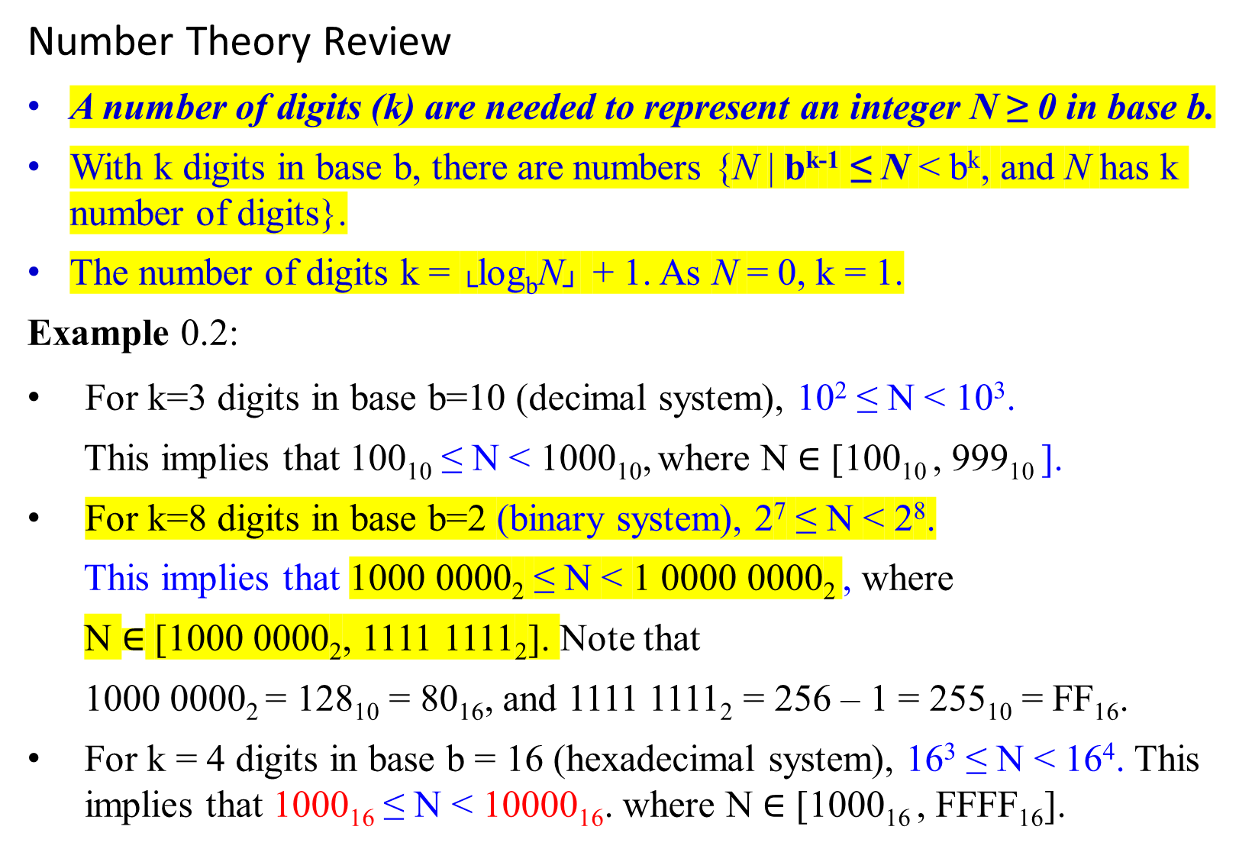
Number Theory Review
A number of digits (k) are needed to represent an integer N ≥ 0 in base b.
With k digits in base b, there are numbers {N | b^{k-1} ≤ N < b^{k}, and N has k number of digits}.
The number of digits k = └log_{b}N┘ + 1. As N = 0, k = 1.
Example 0.2:
For k=3 digits in base b=10 (decimal system), 10² ≤ N < 10³.
This implies that 100₁₀ ≤ N < 1000₁₀, where N $∈$ [100₁₀ , 999₁₀ ].
For k=8 digits in base b=2 (binary system), 2⁷ ≤ N < 2⁸.
This implies that 1000 0000₂ ≤ N < 1 0000 0000₂ , where
N $∈$ [1000 0000₂, 1111 1111₂]. Note that
1000 0000₂ = 128₁₀ = 80₁₆, and 1111 1111₂ = 256 – 1 = 255₁₀ = FF₁₆.
For k = 4 digits in base b = 16 (hexadecimal system), 16³ ≤ N < 16⁴. This implies that 1000₁₆ ≤ N < 10000₁₆. where N $∈$ [1000₁₆ , FFFF₁₆].
log_{b} b^{k-1} ≤ log_{b} N
(k-1) log_{b} b ≤ log_{b} N
(k-1) ≤ log_{b} N

Slide 6
Example of Binary(N)
Design an algorithm:
to find the number k of binary digits in a decimal system's binary representation of a positive integer N.
Analysis: When N = 0, k = 1. Let 1 ≤ N.
Since 2^{k-1} ≤ N < 2^{k}, then log₂ 2^{k-1} ≤ log₂ N < log₂ 2^{k}.
k-1 ≤ log₂ N < k. i.e., k-1 ≤ └ log₂ N ┘ < k.
k ≤ └ log₂ N ┘ + 1 < k + 1.
For example, it needs
one binary digit to represent 0 or 1. i.e., (0 or 1 );
two binary digits to represent 2. i.e., (10) through 3 (11),
three binary digits to represent 4. i.e., (100) through 7 (111 ), and
four binary digits to represent 8. i.e., ( 1000 ) through 15 ( 1111 ),
etc.

Slide 7
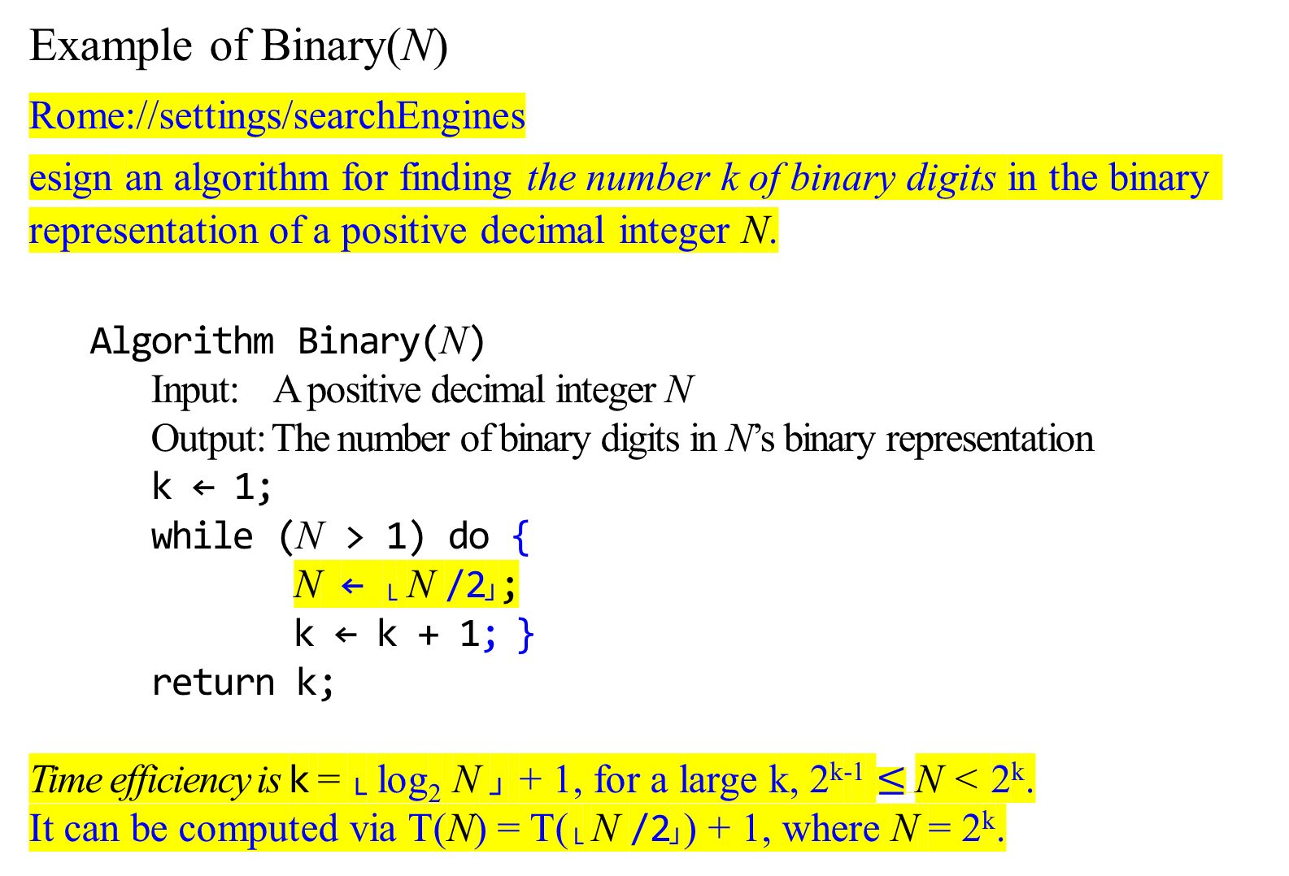
Example of Binary(N)
Rome://settings/searchEngines
esign an algorithm for finding the number k of binary digits in the binary representation of a positive decimal integer N.
Algorithm Binary(N)
Input: A positive decimal integer N
Output: The number of binary digits in N’s binary representation
k ← 1;
while (N > 1) do {
N ← └ N /2┘;
k ← k + 1; }
return k;
Time efficiency is k = └ log₂ N ┘ + 1, for a large k, 2^{k-1} $≤$N < 2^{k}.
It can be computed via T(N) = T(└ N /2┘) + 1, where N = 2^{k}.
The number of executions of > is 4 times.
The number of executions of + is 3 times.
The number of executions of / is 3 times.
(N > 1) | 15 > 1 | 7 > 1 | 3 > 1 | 1 > 1 (false)
N =15 | └15/2┘ | └7/2┘ | └3/2┘ | exitWhile at N=1
k = 1 | k = 2 | k = 3 | k = 4 | return k = 4
1 1 1 1
2³ 2² 2¹ 2⁰
Requires four bits to encode 15 as 1111.

Slide 8

Analysis Framework
Measuring an input’s size:
The input for this algorithm is the magnitude of an integer N.
Define the input size as the number of symbols (i.e., binary digits (bits)) used for encoding a positive integer N.
The input size is └ log₂ N ┘ + 1 bits.
Example:
If N = 15, the input size is └ log₂15 ┘ + 1 = 3 + 1 bits. i.e., 15 in binary representation is 1111₂
If N = 16, the input size is └ log₂16 ┘ + 1 = 4 + 1 bits. i.e., 16 in binary representation is 10000₂

Slide 9
Algorithm Binary(N)
k ← 1;
while (N > 1) do {
k ← k + 1;
N ← └ N / 2┘; }
…
Analysis Framework
2. Units for measuring running time
The most frequently executed operation:
The comparison N > 1
determines whether the loop’s body is to be executed.
The number of times the comparison is to be executed = the number of repetitions of the loop’s body + 1.
For the loop’s variable (i.e., N):
The value of N is about halved on each repetition of the loop (i.e., N ← └ N /2 ┘), where 2^{k-1} ≤ N < 2^{k} and k is the number of times dividing the number N by 2.
The number of times the loop to be executed would be about
k = └ log₂ N ┘ + 1.
[i.e., 2^{k-1} ≤ N < 2^{k}, then (k-1) log₂2 ≤ log₂ N < k log₂2, k-1 ≤ log₂ N < k]
2^{k-1} ≤ N < 2^{k}
If k = 4 bits then 1000 ≤ N < 1111

Slide 10
Example 0.6:
The exact formula for the number of times, C(N), the comparison N > 1 to be executed is:
C(N) = k, if N = 2^{k-1}, then log₂ N = log₂ 2^{k-1}
= (k-1) log₂2
= k -1
= └ log₂ N ┘ + 1, where 2^{k-1} ≤ N < 2^{k}
= Θ( log₂ N )?
The number of bits in the binary representation of N is
k = └ log₂ N ┘ + 1 bits
Algorithm Binary(N)
k← 1;
while (N > 1) do {
N ← └ N /2┘;
k ← k + 1;
}
…

Slide 11
Note: For 2^{k-1} ≤ N < 2^{k}, the number of bits k for representing N is k = └ log₂ N ┘ + 1
The number of bits representing 8 ≤ N < 16 are:
└ log₂8 ┘ + 1 = 3 + 1, where 8 = 2³ 1 0 0 0
└ log₂9 ┘ + 1 = 3 + 1 1 0 0 1 …
└ log₂15┘ + 1 = 3 + 1 1 1 1 1
└ log₂16┘ + 1 = 4 + 1 where 16 = 2⁴ 1 0 0 0 0
We can show └ log₂ N ┘ + 1 = ⌈log (N + 1)⌉.
How much does the size of a number change when we change the base?

Slide 12
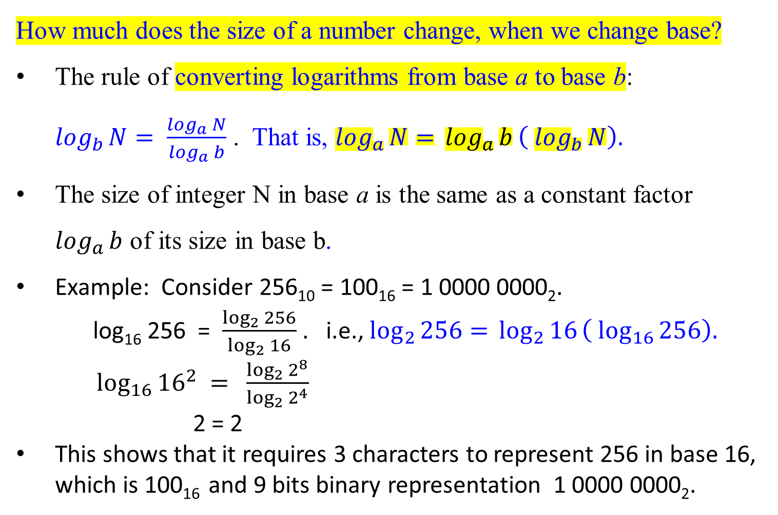
How much does the size of a number change, when we change base?
The rule of converting logarithms from base a to base b:
$\log_{b}{N}= \frac{\log_{a}{N}}{\log_{a}{b}}$ . That is, $\log_{a}{N= }\log_{a}{b}\left( \log_{b}{N}\right).$
The size of integer N in base a is the same as a constant factor $\log_{a}{b}$ of its size in base b.
Example: Consider 256₁₀ = 100₁₆ = 1 0000 0000₂.
log₁₆ 256 = $\frac{\log_{2}{256}}{\log_{2}{16}}$ . i.e., $\log_{2}{256= }\log_{2}{16}\left( \log_{16}{256}\right).$
$\log_{16}{{16}^{2}} =$ $\frac{\log_{2}{2^{8}}}{\log_{2}{2^{4}}}$
2 = 2
This shows that it requires 3 characters to represent 256 in base 16, which is 100₁₆ and 9 bits binary representation 1 0000 0000₂.

Slide 14

Addition:
How long does the addition algorithm take to add two given numbers?

Slide 15
Construct an addition algorithm of two numbers in any base.
Analysis
By the basic property of numbers in any base,
sum of two single-digit numbers is a two-digit number;
the carry is always a single digit; and
at any given step, three single-digit numbers are added.
sum of three single-digit numbers is a two-digit number.
Algorithm
Align their right-hand ends, and then
perform a single right-to-left pass in which
the sum is computed digit by digit,
maintaining the overflow as a carry.
Q: Given two binary numbers x and y, how long does our algorithm
take to add them?

Slide 16
How long does our algorithm take to add two given binary numbers x = 53₁₀ and y = 35₁₀?
Carry 1 1 1 1
1 1 0 1 0 1 (53)
1 0 0 0 1 1 (35)
1 0 1 1 0 0 0 (88)
Total running time as a function of the size of the input: the maximum number of bits of x or y.

Slide 17
Analysis: Total running time as a function of the size of the input:
the number of bits for representing two integers x and y.
Assume that each of x and y is n bits long.
The sum of x and y is n+1 bits at most.
Adding three binary digits requires a fixed amount of time.
Adding two n-bit numbers requires n operations, disregarding at least reading them and writing down the answer.
The total running time for the addition algorithm is of the form c₀ + c₁ n, where c₀ and c₁ are some constants.
It is linear. The running time is O(n).

Slide 18
Is there a faster algorithm for adding two numbers?
The addition algorithm is optimal, up to multiplicative constants.
The total running time for the addition algorithm is of the form c₀ + c₁ n, where c₀ and c₁ are some constants.

Slide 19
Multiplication and Division
Left-shifting is a quick way to multiply by the power of 2.
Right-shifting is a quick way to integer-divide by the power of 2.
How long does the multiplication algorithm take?

Slide 20
Left-shifting is a quick way to multiply an integer by a power of 2 - Reason:
Given two integers 13 and 2, 13 x 2 can be written in binary representation as 1101 x 10. The result 26 (11010 in bit representation) can be obtained by left-shifting one bit position 1101 and packing a 0 on the rightmost bit to form 11010.
1 1 0 1 (multiplicand)
x 1 0 (multiplier)
0 0 0 0 (multiply 1101 by 0)
1 1 0 1 0 (multiply 1101 by 1, left-shift once)
1 1 0 1 0
In binary multiplication, each intermediate row is
either filling with 0’s if the multiplier’s bit is 0,
or copying the multiplicand if the multiplier’s bit is 1.
right-align the multiplicand with the multiplier’s bit,
left-shifted an appropriate number of times with packing 0 on the rightmost bit(s).
An array of intermediate sums

Slide 21

Multiplication
1 3
x 1 1
1 3
1 3 1 4 3
How long does the grade-school algorithm take?
Consider 13 x 11, which is (1101 x 1011)
The multiplication would proceed as follows.
1 1 0 1
x 1 0 1 1
1 1 0 1 (1101 times 1)
1 1 0 1 0 (1101 times 1, shift once)
0 0 0 0 0 0 (1101 times 0, shift twice)
+ 1 1 0 1 0 0 0 (1101 times 1, shift thrice)
1 0 0 0 1 1 1 1 (binary for 143)
n-1 times row additions

Slide 22
Let x and y be both n bits.
There are n intermediate rows,
with lengths of up to 2n bits (take the shifting into account).
The total time taken is to add up these rows:
doing two numbers (per two rows) at a time.
O(n) + O(n) + … + O(n), [Sum of each two intermediate rows
requires O(n).]
n – 1 times [Requires n-1 times of 2 number addition
for n rows]
[ i.e., (n-1) * O(n) = O(n² ).
i.e., (n-1) * (c₁n + c₀) = c₁n² – (c₁ – c₀)n - c₀]
The time efficiency is O(n² ), quadratic in the size of the inputs:
It is polynomial, but much slower than addition.

Slide 23
Likewise, the effect of a right shift (for division by 2) is to divide by the base, rounding down if needed. – Integer Division
An example: 13/2 is 1101 ÷ 10.
The result is └ 13/2 ┘ = 6 (0110 in bit representation) can be obtained by right-shift one-bit position 1101 and pack a 0 on the leftmost bit to form 0110, which is 6. (integer division).
Example: 13/4, which is (13/2)/2.
Allows to shift-right 1101 twice and packs 00 on the leftmost (i.e., significant) bits to obtain 0011, which is equal to 3. That is 13/2 = 6, and then 6/2 = 3.
Example: 13/8 = ((13/2)/2)/2.
Allows to shift-right thrice 1101 and packs 000 on the significant bits to obtain 0001, which is equal to 1. Since └ (13/2)/2 ┘ = 3, then └ 3/2 ┘ = 1.
Example: 13/16 = (((13/2)/2)/2)/2.
Allows us to shift right four times and pack 0000 on the significant bits to obtain 0000, which is equal to 0. Continue from above, └ 1/2 ┘ = 0.

Slide 24
Is there a faster algorithm for multiplication?
Al Khwarizmi’s Algorithm: (Persian mathematician)
Multiplication à la Franҫais - function multiply(x, y)
A recursive algorithm
Algorithm analysis
Multiplication ẚ la Russe - a nonorthodox algorithm for multiplying two positive integers.

Slide 25

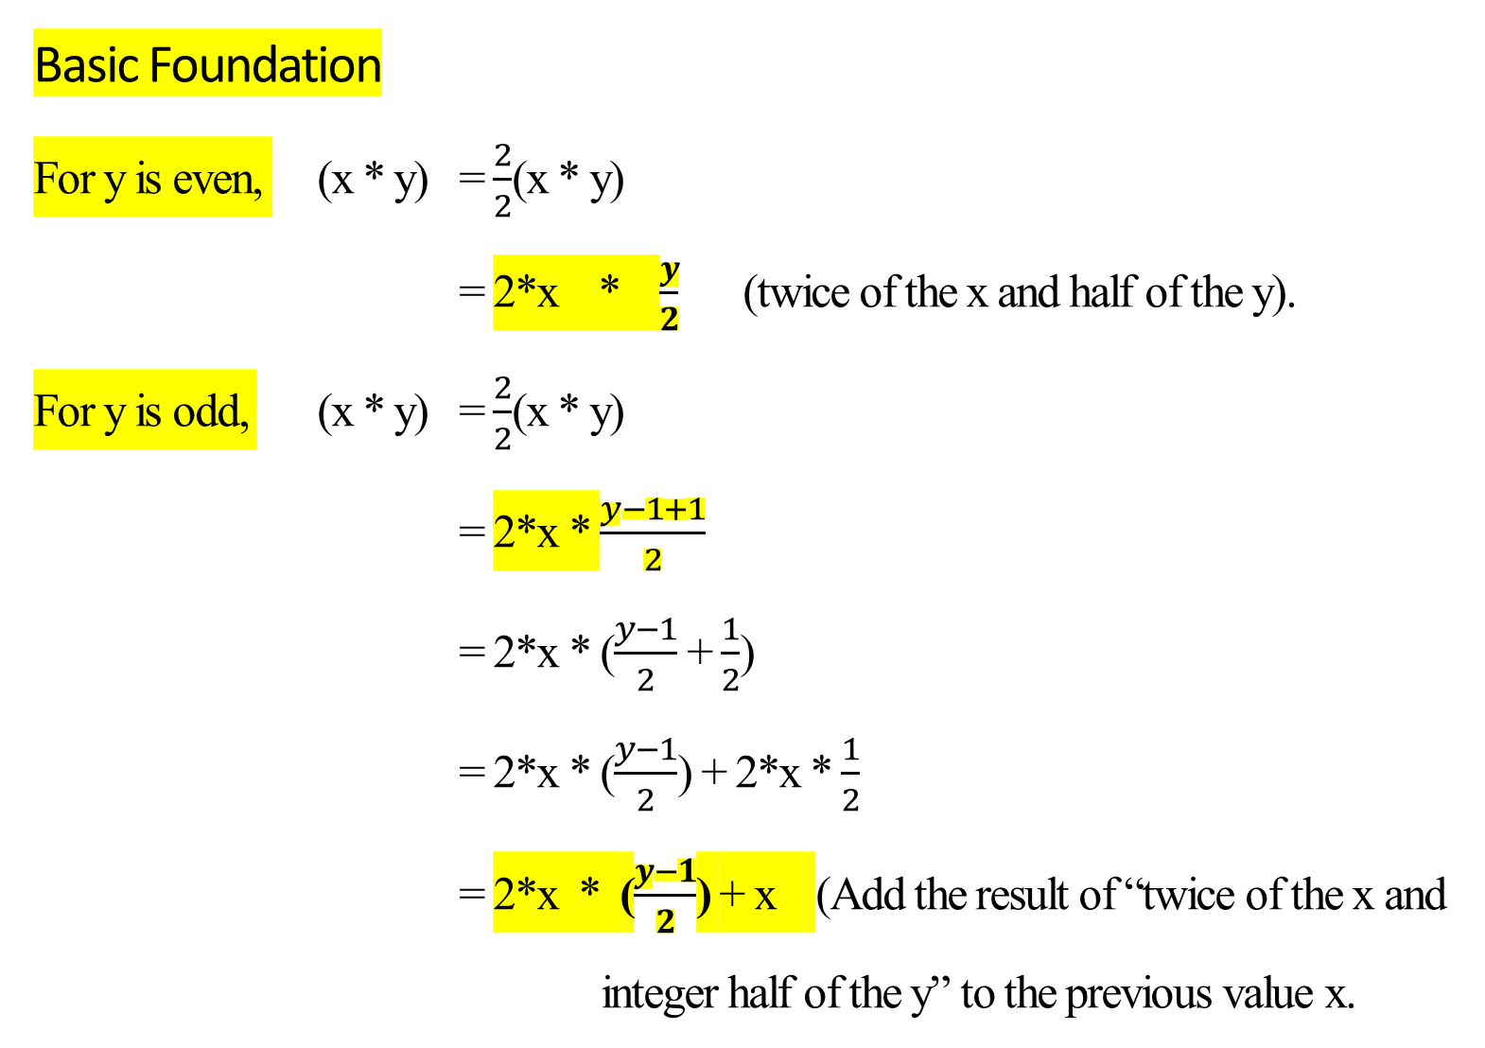
Basic Foundation
For y is even, (x * y) = $\frac{2}{2}$(x * y)
= 2*x * $\frac{y}{2}$ (twice of the x and half of the y).
For y is odd, (x * y) = $\frac{2}{2}$(x * y)
= 2*x * $\frac{y−1+1}{2}$
= 2*x * ($\frac{y−1}{2}$ + $\frac{1}{2}$)
= 2*x * ($\frac{y−1}{2}$) + 2*x * $\frac{1}{2}$
= 2*x * ($\frac{y−1}{2}$) + x (Add the result of “twice of the x and
integer half of the y” to the previous value x.

Slide 26
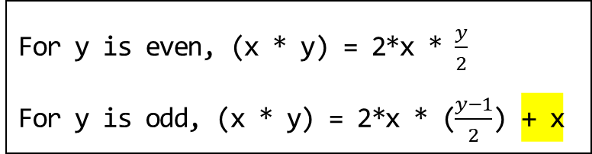
For y is even, (x * y) = 2*x * $\frac{y}{2}$
For y is odd, (x * y) = 2*x * ($\frac{y−1}{2}$) + x
Is there a faster algorithm for multiplication?
Al Khwarizmi’s Algorithm: x * y
Multiply two decimal numbers x and y: (multiplicand * multiplier)
Repeat the following until the multiplier y gets down to 1:
integer-divide the multiplier y by 2, and
double the multiplicand x.
Strike out all the rows in which the y in the first (multiplier) column is even (why?),
Add up what remains in the second (multiplicand) column.
Is it because of the 0 digit in y?

Slide 27
Example 0.7: Let y = 11 (1011) and x = 13 (1101).
x * y = 13 * 11 = 1101 * 1011.
The bit 0 in y yields 0000 for an intermediate row.
The algorithm is:
if y is odd, then x + 2z
else 2z, where z = x * (y/2) and (y/2) is an integer division.
x + 2 ( x * (y/2)), if y is odd
y * x =
2 (x * (y/2)), if y is even.
y | x |  | x * y = 1101 * 1011
11 | 13 |  | 1 1 0 1
5 | 26 | (why x*2?) | 1 1 0 1 0
2 | 52 | (strike out) | 0 0 0 0 0 0
1 | 104 | (why x*2?) | 1 1 0 1 0 0 0
 | 143 | (answer) | 1 0 0 0 1 1 1 1
(why y/2?)
11*13 = x + 2 (x * y/2) = 13 + 2(13 * 11/2) = 13 + 26 *5 = 13 + 26 + 2(26 * 5/2) = 13 + 26 + (52*2)
= 13 + 26 + 2(52 * 2/2) = 13 + 26 + (104 * 1) = 13 + 26 + 104 + 2(104 * ½) = 13 + 26 + 104 = 143

Slide 28

5 * 26 = 26 + 2(26 * (5/2))
= 26 + 26 * 4
2 * 52 = 2(52 * (2/2))
4 * 52 = 2(52 * (4/2)) Facts!
x + 2 ( x * (y/2)), if y is odd
x * y =
2 (x * (y/2)), if y is even.
13 * 11 = 13 + 2( 13 * (11/2)) = 13 + (2 * 13 *5) since y is 11, an odd number.
= 13 + (26 * 5) = 13 + (26 + 2(26 * (5/2))), since y = 5, an odd number.
= 13 + (26 + (52 * (5/2)))
= 13 + (26 + (52 * 2))
= 13 + 26 + (2 (52 * (2/2))) since y = 2, an even number.
= 13 + 26 + (104 *1)
= 13 + 26 + (104 + 2(104 * (1/ 2)))
= 13 + 26 + 104 + 2(104 * 0)
= 13 + 26 + 104
= 143.
y | x
11 | 13
5 | 26
2 | 52
1 | 104
 | 143
$$It is \text{O}\text{(}\text{n}\text{2}\text{).}$$

Slide 29
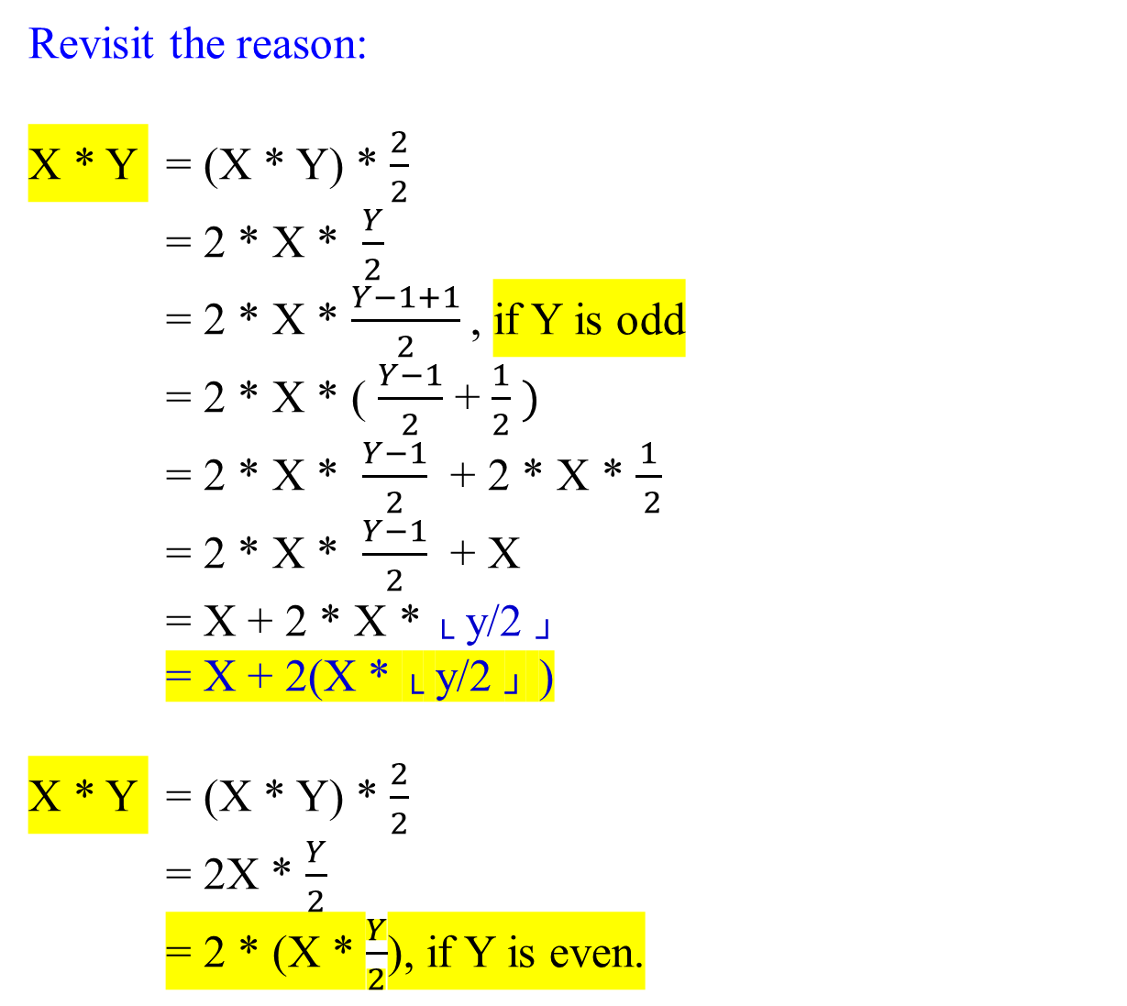
Revisit the reason:
X * Y = (X * Y) * $\frac{2}{2}$
= 2 * X * $\frac{Y}{2}$
= 2 * X * $\frac{Y−1+1}{2}$, if Y is odd
= 2 * X * ( $\frac{Y−1}{2}$ + $\frac{1}{2} )$
= 2 * X * $\frac{Y−1}{2}$ + 2 * X * $\frac{1}{ 2}$
= 2 * X * $\frac{Y−1}{2}$ + X
= X + 2 * X * └ y/2 ┘
= X + 2(X * └ y/2 ┘ )
X * Y = (X * Y) * $\frac{2}{2}$
= 2X * $\frac{Y}{2}$
= 2 * (X * $\frac{Y}{2}$), if Y is even.
x + 2 ( x * (y/2)), if y is odd
y * x =
2 (x * (y/2)), if y is even.
y | x
11 | 13 | 13*11 = 13 + (26*11/2)
5 | 26 | 26*5 = 26 + (52*5/2)
2 | 52 | 52*2 = (104*2/1)
1 | 104 | 104*1 = 104 + (104*2/1)
 | 143 | 143 = 13+26+104
11*13 = 13 + 5 * 26
= 13 + (26 + 2 (26 * 5/2) )
= 13 + 26 + (52 * 2)
= 13 + 26 + ( 2*(52 * 2/2))
= 13 + 26 + (104 * 1))
= 13 + 26 + (104)
= 143

Slide 30
Al khwarizmi’s algorithm is a fascinating mixture of decimal and binary.
Integer division
x + 2 ( x * (y/2)), if y is odd
y * x =
2 (x * (y/2)), if y is even. Al khwarizmi’s algorithm
The same algorithm can be rewritten in a different way based on the following rule:
2(x * └ y/2 ┘) if y is even
x * y =
x + 2(x * └ y/2 ┘) if y is odd

Slide 31
The number of bits require to represent x and y are j =└ log₂ x ┘ + 1 and k = └ log₂ y ┘ + 1, respectively. The product would be atmost n = j + k bits long. The total number of shifts left of x (i.e., x = x*2) would be k-1 times, which is the total number of shifts right of y (i.e., y = y/2). This algorithm will compute x * y and generate k intermediate results. Thus, it requires (k-1)(n) number of additions. Assume that j = n, k = n. It requires (n-1)(2n) = 2n² – 2n = O(n² ).
Thus, if both x and y have n bits, then O(n² ).
y | x |  | x * y = 1101 * 1011
1011 | 1101 |  | 1 1 0 1
101 | 11010 |  | 1 1 0 1 0
10 | 110100 | (strike out) | 0 0 0 0 0 0
1 | 1101000 |  | 1 1 0 1 0 0 0
 | 10001111 | (answer) | 1 0 0 0 1 1 1 1
y | x
11 | 13
5 | 26
2 | 52
1 | 104
 | 143

Slide 32
Example 0.8: Let x = 13 and y = 16. Find x * y. (13 = 1101, 16 = 10000)
(13 = 1101, 16 = 10000)
x + 2 ( x * (y/2)), if y is odd
y * x =
2 (x * (y/2)), if y is even. Al khwarizmi’s algorithm
Computed by hands
y | x |  | 1101*10000
16 | 13 | (strike out) | 0000
8 | 26 | (strike out) | 00000
4 | 52 | (strike out) | 000000
2 | 104 | (strike out) | 0000000
1 | 208 | 208 | 11010000
 | 208 | 208(answer) | 11010000
The use of the algorithm, we have
13 * 16 = 13 *2 * 16/2 = 2(13 * 8)
26 * 8 = 26*2 * 8/2 = 2(26 * 4)
52 * 4 = 52*2 * 4/2 = 2(52 * 2)
104 * 2 = 104 *2 * 2/2 = 2(104 * 1)
208 * 1 = 208 + 2*(208* 1/2) = 208.

Slide 33
Example 0.8: Let x = 13 and y = 16. Find x * y. (13 = 1101, 16 = 10000)
(13 = 1101, 16 = 10000)
Computed by bit-representations
y | x |  | 1101*10000
10000 | 1101 | (strike out) | 0000
1000 | 11010 | (strike out) | 00000
100 | 110100 | (strike out) | 000000
10 | 1101000 | (strike out) | 0000000
1 | 11010000 | 11010000 | 11010000
 | 11010000 | (answer 208) | 11010000
The use of the algorithm, we have
13 * 16 = 13 *2 * 16/2 = 2(13 * 8)
26 * 8 = 26*2 * 8/2 = 2(26 * 4)
52 * 4 = 52*2 * 4/2 = 2(52 * 2)
104 * 2 = 104 *2 * 2/2 = 2(104 * 1)
208 * 1 = 208 + 2*(208* 1/2) = 208.

Slide 34
Multiplication à la Franҫais

Slide 35

Example 0.9: Let x = 13 and y = 38. Find x * y. (13 = 1101, 38 = 100110)
The use of the algorithm, we have
13 * 38 = 2(13 * 38/2) = 2(13 * 19)
13 * 19 = 13 *(1 + 18) = 13 + (13 * 18)
= 13 + 2(13 * 18/2) = 13 + 2(13 * 9)
13 * 9 = 13 *(1 + 8) = 13 + 2(13 * 8/2)
= 13 + 2(13 * 4)
13 * 4 = 2(13 * 4/2) = 2(13 * 2)
13 * 2 = 2(13 * 2/2) = 2 (13*1)
13 * 1 = 13 *(1+0) =13 + 2 (13*0/2) = 13
13 * 38 = 2(13 * 19) = 2(13 + 2(13 * 9))
= 2(13 + 2(13 + 2(13 * 4)))
= 2(13 + 2(13 + 2(2(13 * 2))))
= 2(13 + 2(13 + 2(2(2(13 * 1) ))))
Computed by bit-representations
y | x |  | 1101*100110
100110 (38) | 1101 (13) | (strike out) | 0000
10011 (19) | 11010 (26) | 11010 | 11010
1001 (9) | 110100 (52) | 110100 | 110100
100 (4) | 0000000 (104) | (strike out) | 0000000
10 (2) | 00000000 (208) | (strike out) | 00000000
1 (1) | 110100000 (416) | 110100000 | 110100000
 | 111101110 (494) | (answer 494) | 111101110

Slide 36

Figure 1.1: Multiplication à la Franҫais -
A recursive algorithm that directly implements this rule :
2(x *└ y/2 ┘), if y is even
x * y =
x + 2(x * └ y/2 ┘), if y is odd
function multiply(x, y)
Input: Two n-bit integers x and y, where y ≥ 0
Output: Their product
if (y = 0) then return 0;
z := multiply (x, └ y/2 ┘); //z = x *└ y/2 ┘
if (y is even) then return 2z
else return x + 2z;
Figure 1.1 Multiplication à la Franҫais
Using this algorithm, we have (example 0.9)
13 * 38 $→$ 2(247) = 494
13 * 19 $→$ 13 + 2(117) = 247
13 * 9 $→$ 13 + 2(52) = 117
13 * 4 $→$ z = 2(26) = 52
13 * 2 $→$ z = 2(13) = 26,
13 * 1 $→$ z = 13 + 2 (0) = 13
13 * 0 $→$ z = 0
13 * 38 = 2(13 * 19)
= 2(13 + 2(13 * 9))
= 2(13 + 2(13 + 2(13 * 4)))
= 2(13 + 2(13 + 2(2(13 * 2))))
= 2(13 + 2(13 + 2(2(2(13 * 1) ))))

Slide 37
Analysis of an algorithm:
Is this algorithm correct?
How long does the algorithm take?
Can we do better?
function multiply(x, y)
Input: Two n-bit integers x and y, where y ≥ 0
Output: Their product
if (y = 0) then return 0;
z := multiply (x, └ y/2 ┘);
if (y is even) then return 2z
else return x + 2z;

Slide 38
Is this algorithm correct?
Does the algorithm behave what it intends to do? (partial correctness)
Given input and output specifications, will the algorithm produce output_data that satisfies the output specification for all the input_data meeting the input specification?
Will the algorithm halt? (halting pbm)
It is transparently correct; └ y/2 ┘ will reach 0. It also handles the base case (y = 0).
function multiply(x, y)
Input: Two n-bit integers x and y, where y ≥ 0
Output: Their product
if y = 0 then return 0;
z := multiply (x, └ y/2 ┘);
if y is even then return 2z
else return x + 2z;
2(x *└ y/2 ┘), if y is even
x * y =
x + 2(x * └ y/2 ┘), if y is odd
n = └ log₂y ┘ + 1
n = └ log₂x ┘ + 1

Slide 39
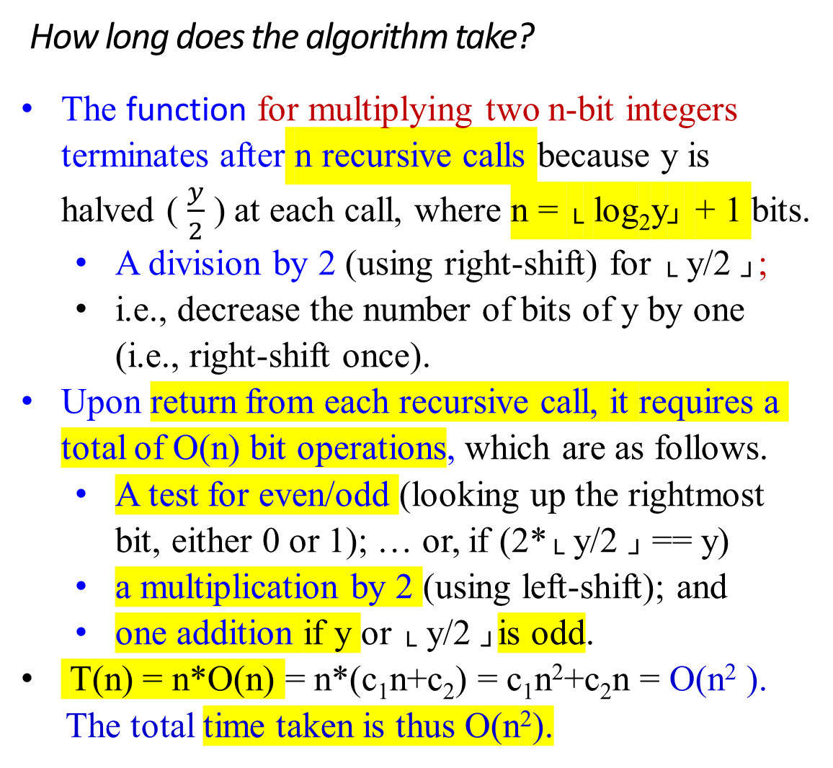
How long does the algorithm take?
The function for multiplying two n-bit integers terminates after n recursive calls because y is halved ( $\frac{y}{2}$ ) at each call, where n = └ log₂y┘ + 1 bits.
A division by 2 (using right-shift) for └ y/2 ┘;
i.e., decrease the number of bits of y by one (i.e., right-shift once).
Upon return from each recursive call, it requires a total of O(n) bit operations, which are as follows.
A test for even/odd (looking up the rightmost bit, either 0 or 1); … or, if (2*└ y/2 ┘ == y)
a multiplication by 2 (using left-shift); and
one addition if y or └ y/2 ┘is odd.
T(n) = n*O(n) = n*(c₁n+c₂) = c₁n²+c₂n = O(n² ).
The total time taken is thus O(n²).
function multiply(x, y)
Input: Two n-bit integers x and y, where y ≥ 0
Output: Their product
if y = 0 then return 0;
z := multiply (x, └ y/2 ┘);
if y is even then return 2z
else return x + 2z;
//z = x *└ y/2 ┘
Shift right n times for n-bit y,
where n = └ log₂y ┘ + 1
Therefore, n recursive calls.

Slide 40
function multiply(x, y)
Input: Two n-bit integers x and y, where y ≥ 0
Output: Their product
if y = 0 then return 0;
z := multiply (x, └ y/2 ┘);
if y is even then return 2z
else return x + 2z;
//z = x *└ y/2 ┘
Prove T(n) = O(n²)
T(n) = T(└ n/2 ┘) + 1 --- measured in terms of nos. of calls.
T(1) = c₀ (assume c₀ = 1);
Solution: (need to check the correctness of the following)
Let n = 2^{k}. i.e., n is
T(n) = T(2^{k}) = T(2^{k-1}) + 1
= T(2^{k-2}) + 1 + 1
= …
= T(2^{k-i}) + 1 *1 + 1 + … + 1 --- i nos. of time of recursive call.
= T(2^{k-k}) + k*1, if k = i
= T(2⁰) + k,
= 1+ (2¹ ) + (2² ) + … + (2^{k-3} ) + (2^{k-2} ) + (2^{k-1} ) + (2^{k} ),
= (2^{k+1} -1)
= 2n-1 times of the recursive call
The algorithm will take at most n calls. Upon returning from each recursive call, an “if statement” must be executed, which requires linear time O(n). and therefore O(n²).
if y is even then return 2z
else return x + 2z;
This takes linear time to do it for each round.
Let n = 1.
return 0, if y = 0;
when y = 1,
multiply(x, y) = z := multiply(x, └ y/2 ┘)
= multiply(x, 0) = returns 0, since y = 0.
.
Conclusion: T(n =1bit) = c₀

Slide 41
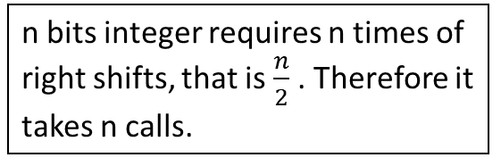
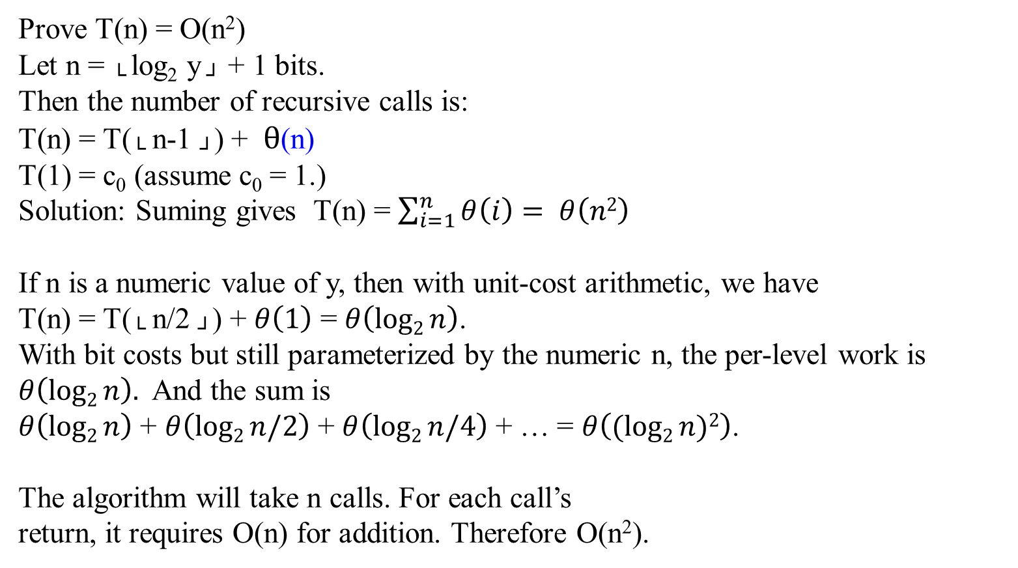
if y is even then return 2z
else return x + 2z;
This takes linear time, an n-bit addition/shift.
function multiply(x, y)
Input: Two n-bit integers x and y, where y ≥ 0
Output: Their product
if y = 0 then return 0;
z := multiply (x, └ y/2 ┘);
if y is even then return 2z
else return x + 2z;
//z = x *└ y/2 ┘
Prove T(n) = O(n²)
Let n = └ log₂ y ┘ + 1 bits.
Then the number of recursive calls is:
T(n) = T(└ n-1 ┘) + $θ$(n)
T(1) = c₀ (assume c₀ = 1.)
Solution: Suming gives T(n) = $\sum_{i=1}^{n}{θ\left(i\right)}= θ\left(n2\right)$
If n is a numeric value of y, then with unit-cost arithmetic, we have
T(n) = T(└ n/2 ┘) + $θ\left(1\right)$ = $θ\left(log2{n}\right)$.
With bit costs but still parameterized by the numeric n, the per-level work is $θ\left(log2{n}\right).$ And the sum is
$θ\left(log2{n}\right)$ + $θ\left(log2{n/2}\right)$ + $θ\left(log2{n/4}\right)$ + … = $θ\left((log2{n)2}\right)$.
The algorithm will take n calls. For each call’s
return, it requires O(n) for addition. Therefore O(n²).
n bits integer requires n times of right shifts, that is $\frac{n}{2}$ . Therefore it takes n calls.

Slide 42
function multiply(x, y)
Input: Two n-bit integers x and y, where y ≥ 0
Output: Their product
if y = 0 then return 0;
z := multiply (x, └ y/2 ┘);
if y is even then return 2z
else return x + 2z;
//z = x *└ y/2 ┘
Prove T(n) = O(n²)
Clean proof (bit complexity)
Let b be the bit length of y. Then
T(b) = T(b−1) + Θ(b),
T(1) = Θ(1)
Unrolling: since T(b-1) = T(b-2) + Θ(b-1),
T(b) = T(b-2) + Θ(b-1) + Θ(b)
…
T(b) = T(b-i) + Θ(b-i+1) + … + Θ(b-1) + Θ(b)
T(b) = T(b-b+1) + Θ(b-b+1+1) +… + Θ(b-1) + Θ(b), i = b-1
T(b) = Θ(b) + Θ(b−1) + ⋯ + Θ(1)
= Θ(b²).
So, with inputs of n bits, the algorithm runs in Θ(n²) time.

Slide 43

function multiply(x, y)
Input: Two n-bit integers x and y, where y ≥ 0
Output: Their product
if y = 0 then return 0;
z := multiply (x, └ y/2 ┘);
if y is even then return 2z
else return x + 2z;
//z = x *└ y/2 ┘
Can we do better?
We can do significantly better. (See Chapter 02)

Slide 44
Multiplication ẚ la Russe

Slide 45

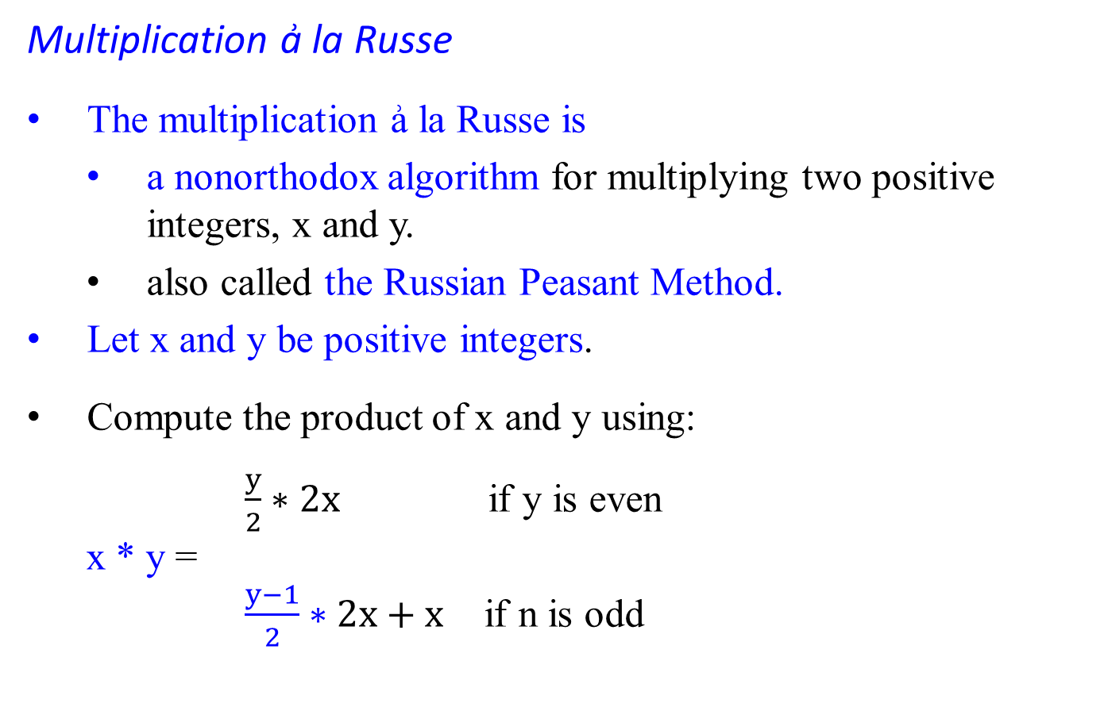
Multiplication ẚ la Russe
The multiplication ẚ la Russe is
a nonorthodox algorithm for multiplying two positive integers, x and y.
also called the Russian Peasant Method.
Let x and y be positive integers.
Compute the product of x and y using:
$\frac{y}{2}∗2x$ if y is even
x * y =
$\frac{y−1}{2}∗2x+x$ if n is odd
Al khwarizmi’s method:
2(x * └ y/2 ┘) if y is even
x*y =
x + 2(x * └ y/2 ┘) if y is odd

Slide 46

Compute the product x * y, where y and x are positive integers.
Compute product x * y either recursively or iteratively.
The difference between the Russian Peasant Method and Al Khwarizmi’s algorithm (coded as Multiplication à la Franҫais) is that
integer (even) division, and
reduce the value of y by one(1) if y is an odd number.
Let’s measure the instance size by the value of y.
If y is even, an instance of half the size has to deal with y/2 or └ y/2 ┘:
y * x = (y/2) * 2x. (Multiplication ẚ la Russe)
= (2x * └ y/2 ┘) if y is even (Al khwarizmi’s )
If y is odd, we have
y * x = ((y – 1)/2) * 2x + x. (Multiplication ẚ la Russe)
= x + 2(x * └ y/2 ┘) if y is odd (Al khwarizmi’s )
= x + 2x * └ y/2 ┘
Use the trivial case of 1 * x = x to stop.

Slide 47

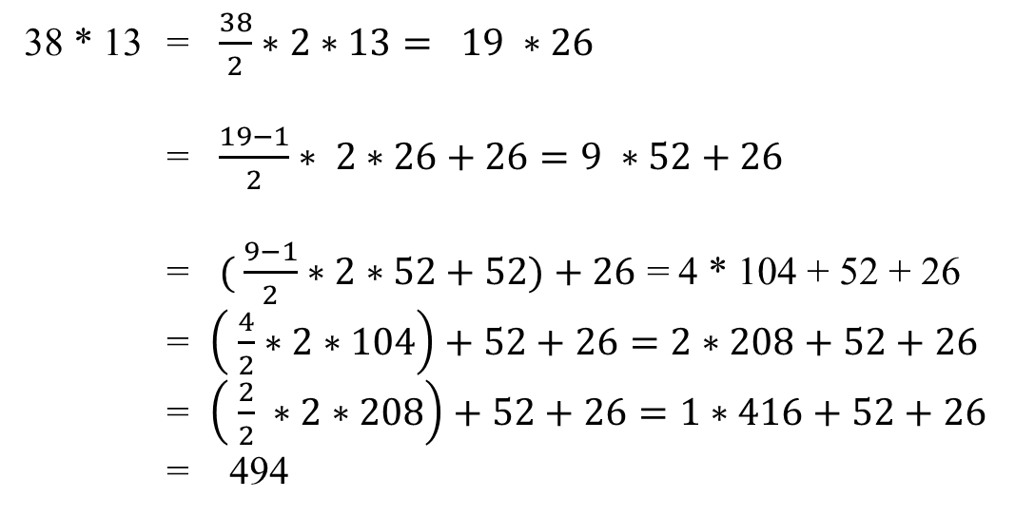
Example 0.10: Compute 38 * 13
38 * 13 = $\frac{38}{2}∗2∗13= 19 ∗26$
= $\frac{19−1}{2}∗ 2∗26+26=9 ∗52+26$
= $( \frac{9−1}{2}∗2∗52+52)+26$ = 4 * 104 + 52 + 26
= $\left( \frac{4}{2}∗2∗104\right)+52+26=2∗208+52+26$
= $\left( \frac{2}{2} ∗2∗208\right)+52+26=1∗416+52+26$
= 494
y | x
38 | 13
19 | 26 |  | 38 is even
9 | 52 | (+26) | 19 is odd
4 | 104 | (+52) | 9 is odd
2 | 208 |  | 4 is even
1 | 416 |  | 2 is even
 | 494 | +26+52+416
What is the time efficiency class of Russian peasant multiplication?
The total time taken is thus O(n² ). [Prove it.]

Slide 48
Example 0.11
An example of computing 50 * 65 with this algorithm is given in Figure:
All the extra addends shown in the parentheses in the Figure are in the rows with odd values in the first column. Apply the Russian Peasant Method and Al Khwarizmi’s algorithm yielding the following results:
y | x
50 | 65
25 | 130 | since 50 is even
12 | 260 | (+130), since 25 is odd
6 | 520 | since 12 is even
3 | 1040 | since 6 is even
1 | 2080 | (+1040), since 3 is odd
 | 3250 | +(130 + 1040+2080)=3250
y | x
50 | 65 | strike-out
25 | 130
12 | 260 | strike-out
6 | 520 | strike out
3 | 1040
1 | 2080
 | 3205
the Russian Peasant Method Al Khwarizmi’s algorithm

Slide 49
There we can find the product by simply adding all the elements in the x column that have an odd number in the y column. (See figure below)
y | x
50 | 65
25 | 130 | 130
12 | 260
6 | 520
3 | 1040 | 1040
1 | 2080 | 2080
 |  | 3250
The algorithm involves only the simple operations of halving, doubling, and adding.
It also leads to very fast hardware implementation since doubling and halving of binary numbers can be performed using the left and right shifts, respectively, which are among the most basic operations at the machine level.

Slide 50
Division
Proof of Program Correction.

Slide 51

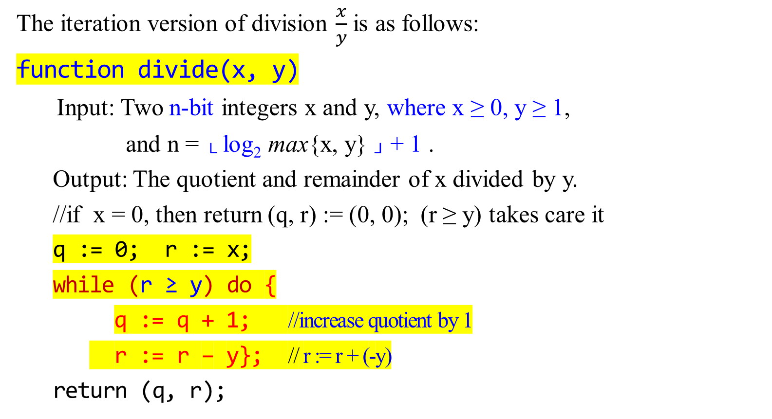
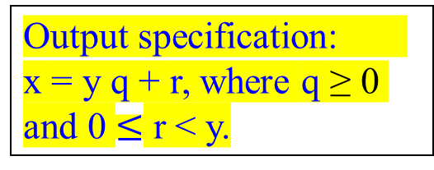
Analysis of the Division Algorithm
Output specification: x = y q + r, where q ≥ 0 and 0 $≤$ r < y.
The iteration version of division $\frac{x}{y}$is as follows:
function divide(x, y)
Input: Two n-bit integers x and y, where x ≥ 0, y ≥ 1,
and n = └ log₂ max{x, y} ┘ + 1 .
Output: The quotient and remainder of x divided by y.
//if x = 0, then return (q, r) := (0, 0); (r ≥ y) takes care it
q := 0; r := x;
while (r ≥ y) do {
q := q + 1; //increase quotient by 1
r := r – y}; // r := r + (-y)
return (q, r);
ST q, 0
ST r, x
L R4, q
L R1, r
L R2, y
L1: SR R5, R1, R2
JNEG Ret, R5
A R4, R4, 1
SR R1, R1, R2
J L1
Ret: STR r, R1
ST q, R4
…
x def
y def
q def
r def

Slide 52

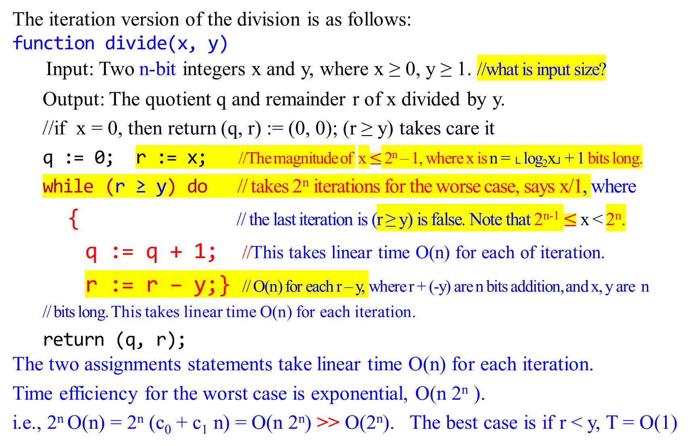
The iteration version of the division is as follows:
function divide(x, y)
Input: Two n-bit integers x and y, where x ≥ 0, y ≥ 1. //what is input size?
Output: The quotient q and remainder r of x divided by y.
//if x = 0, then return (q, r) := (0, 0); (r ≥ y) takes care it
q := 0; r := x; //The magnitude of x $≤$ 2^{n} – 1, where x is n = └ log₂x┘ + 1 bits long.
while (r ≥ y) do // takes 2^{n} iterations for the worse case, says x/1, where
{ // the last iteration is (r ≥ y) is false. Note that 2^{n-1} $≤$ x < 2^{n}.
q := q + 1; //This takes linear time O(n) for each of iteration.
r := r – y;} // O(n) for each r – y, where r + (-y) are n bits addition, and x, y are n // bits long. This takes linear time O(n) for each iteration.
return (q, r);
The two assignments statements take linear time O(n) for each iteration.
Time efficiency for the worst case is exponential, O(n 2^{n} ).
i.e., 2^{n} O(n) = 2^{n} (c₀ + c₁ n) = O(n 2^{n}) >> O(2^{n}). The best case is if r < y, T = O(1)

Slide 53

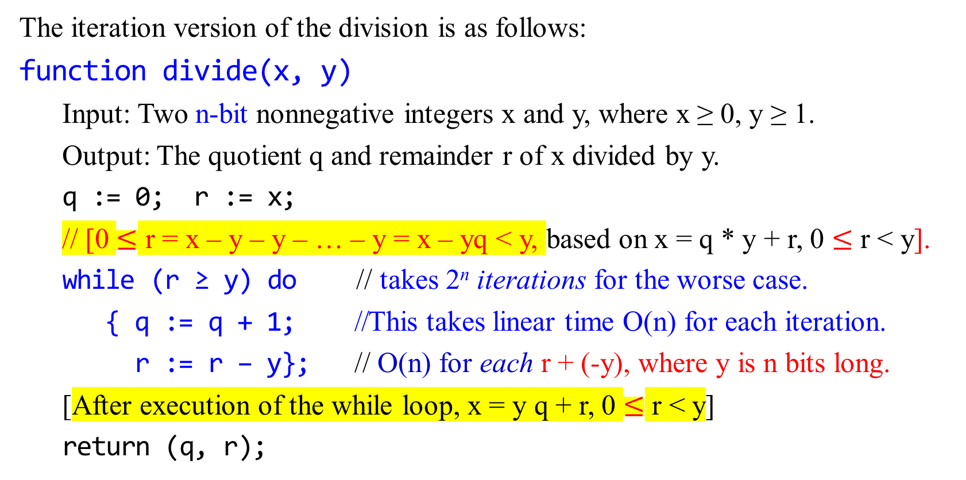

Correctness of the Division Algorithm
Output specification: x = y q + r, where q ≥ 0 and 0 $≤$ r < y.
The iteration version of the division is as follows:
function divide(x, y)
Input: Two n-bit nonnegative integers x and y, where x ≥ 0, y ≥ 1.
Output: The quotient q and remainder r of x divided by y.
q := 0; r := x;
// [0 $≤$ r = x – y – y – … – y = x – yq < y, based on x = q * y + r, 0 $≤$ r < y].
while (r ≥ y) do // takes 2^{n} iterations for the worse case.
{ q := q + 1; //This takes linear time O(n) for each iteration.
r := r – y}; // O(n) for each r + (-y), where y is n bits long.
[After execution of the while loop, x = y q + r, 0 $≤$ r < y]
return (q, r);

Slide 54

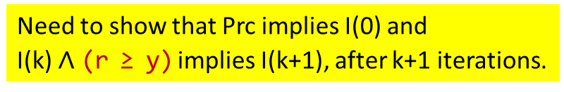
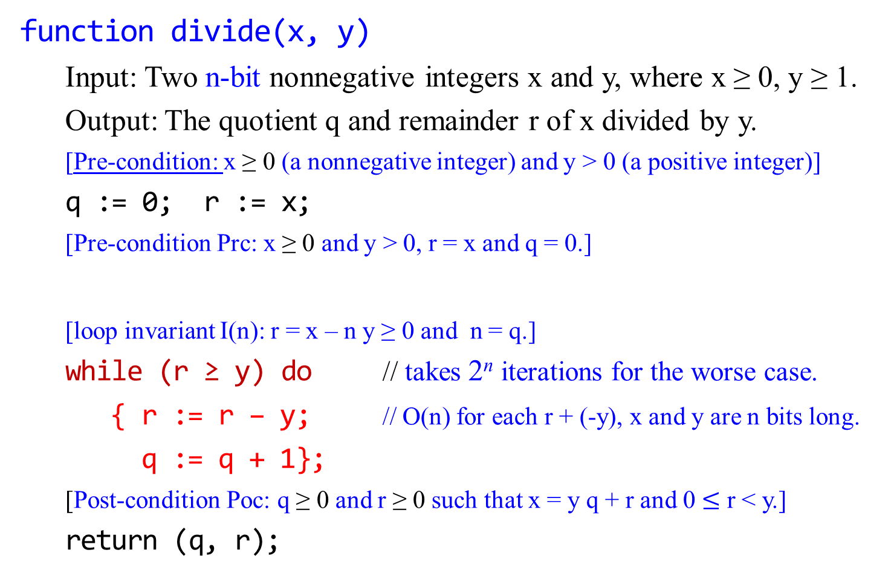


Correctness of the Division Algorithm
Output specification: x = y q + r, where q ≥ 0 and 0 $≤$ r < y.
function divide(x, y)
Input: Two n-bit nonnegative integers x and y, where x ≥ 0, y ≥ 1.
Output: The quotient q and remainder r of x divided by y.
[Pre-condition: x ≥ 0 (a nonnegative integer) and y > 0 (a positive integer)]
q := 0; r := x;
[Pre-condition Prc: x ≥ 0 and y > 0, r = x and q = 0.]
[loop invariant I(n): r = x – n y ≥ 0 and n = q.]
while (r ≥ y) do // takes 2^{n} iterations for the worse case.
{ r := r – y; // O(n) for each r + (-y), x and y are n bits long.
q := q + 1};
[Post-condition Poc: q ≥ 0 and r ≥ 0 such that x = y q + r and 0 $≤$ r < y.]
return (q, r);
Need to show that Prc implies I(0) and
I(k) $∧$ (r ≥ y) implies I(k+1), after k+1 iterations.
Need to show that I(n) $∧¬$(r ≥ y) implies Poc.

Slide 55
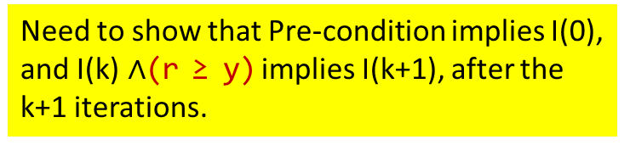
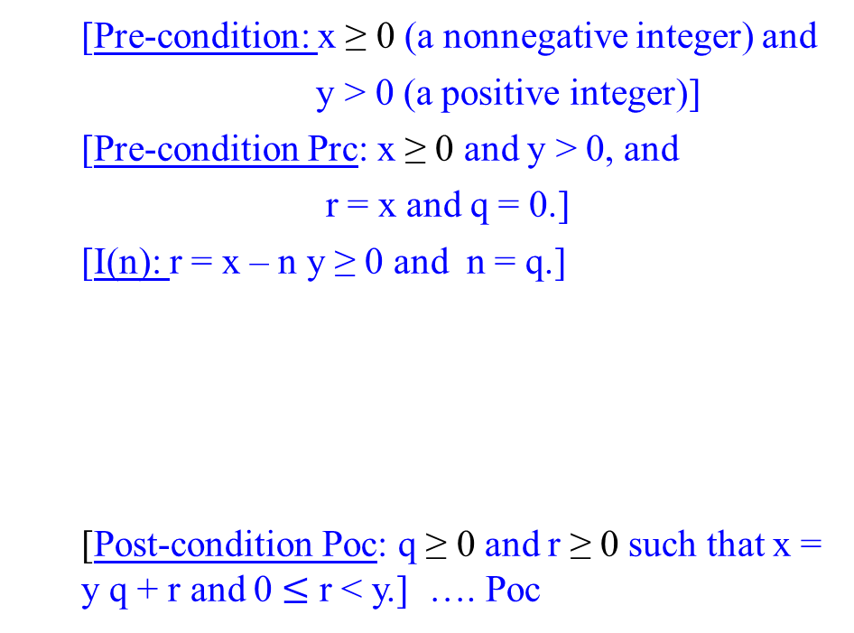
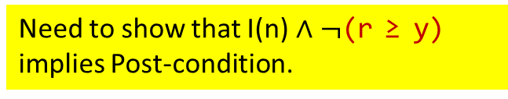
Correctness of the Division Algorithm
function divide(x, y)
[Pre-condition: x ≥ 0 (a nonnegative integer) and
y > 0 (a positive integer)]
[Pre-condition Prc: x ≥ 0 and y > 0, and
r = x and q = 0.]
[I(n): r = x – n y ≥ 0 and n = q.]
[Post-condition Poc: q ≥ 0 and r ≥ 0 such that x = y q + r and 0 $≤$ r < y.] …. Poc
Need to show that Pre-condition implies Prc.
q := 0;
r:= x;
1
2
I(k):
Need to show that Pre-condition implies I(0), and I(k)$∧$(r ≥ y) implies I(k+1), after the k+1 iterations.
r≥y
r≥y
Return(q, r)
3
4
r := r – y;
q := q + 1
r := r – y;
q := q + 1
Need to show that I(n)$∧¬$(r ≥ y) implies Post-condition.
I(k +1):

Slide 56


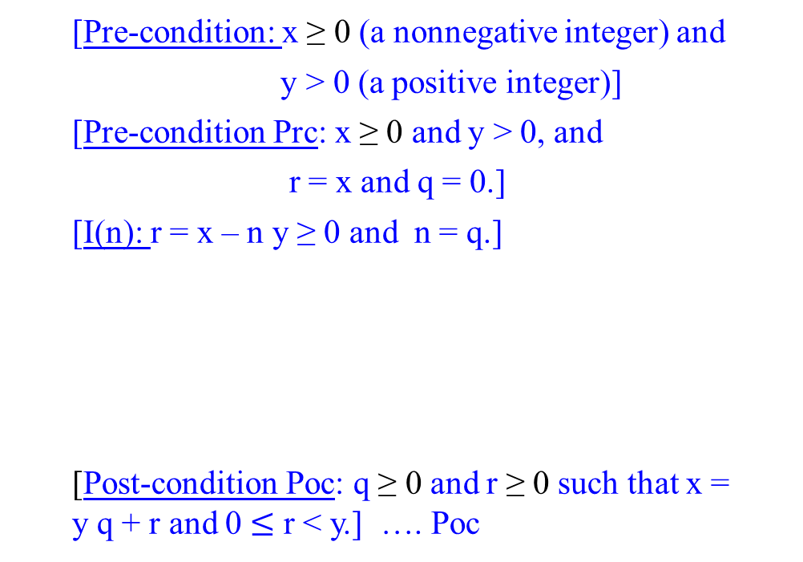
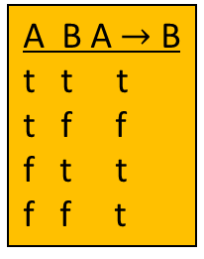
Correctness of the Division Algorithm V
function divide(x, y)
[Pre-condition: x ≥ 0 (a nonnegative integer) and
y > 0 (a positive integer)]
[Pre-condition Prc: x ≥ 0 and y > 0, and
r = x and q = 0.]
[I(n): r = x – n y ≥ 0 and n = q.]
[Post-condition Poc: q ≥ 0 and r ≥ 0 such that x = y q + r and 0 $≤$ r < y.] …. Poc
q := 0;
r:= x;
1
Prove: That Pre-condition implies Prc is true.
Proof:
A $→$ B $≡$ $¬$A V B. To show that “Pre-condition $→$ Prc” is true, we need to show Prc is true if the Pre-condition is true. i.e., ($¬$ true V true) is true.
Assume that x and y inputs are two n-bit nonnegative integers x ≥ 0 and y > 0, which is the Pre-condition. Then $¬$Pre-condition is false.
Then we need to show that Prc is true.
Prc is true because by assumption x ≥ 0 and y > 0, and x = x and 0 = 0 after executing the two assignment statements q := 0; r:= x; .
A B A $→$ B
t t t
t f f
f t t
f f t
r≥y
Return(q, r)
r := r – y;
q := q + 1

Slide 57


Correctness of the Division Algorithm
function divide(x, y)
[Pre-condition: x ≥ 0 (a nonnegative integer) and
y > 0 (a positive integer)]
[Pre-condition Prc: x ≥ 0 and y > 0, and
r = x and q = 0.]
[I(n): r = x – n y ≥ 0 and n = q.]
[Post-condition Poc: q ≥ 0 and r ≥ 0 such that x = y q + r and 0 $≤$ r < y.] …. Poc
q := 0;
r:= x;
2
I. Basis Property:
Prove: That Prc implies I(0) is true.
Proof:
Use A $→$ B $≡$ $¬$A V B to prove the implication is true.
Assume that Prc: x ≥ 0 and y > 0, and r = x and q = 0 is true.
Need to show that “I(0): r = x - 0*y ≥ 0 and 0 = q”. is true, before entering the loop, where n = 0. [Note that I(0) is derived from I(n), when n = 0]
By assumption x ≥ 0, then we write x = x – 0*y ≥ 0
By assumption r = x, then substitute x = x – 0*y ≥ 0 in r = x to yield r = x – 0*y ≥ 0 .
Thus, I(0): “r = x – 0 * y ≥ 0 and n = q $→$ 0 = q ” is true.
r≥y
Return(q, r)
r := r – y;
q := q + 1

Slide 58
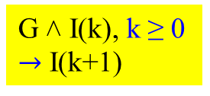
Correctness of the Division Algorithm
Proof:
To prove the correctness of the loop, let the loop invariant be
I(n): r = x – n y ≥ 0 and n = q.
The guard of the while loop is
G: r ≥ y
Inductive Property: [If G ˄ I(k) is true before k+1th loop’s iteration (where k ≥ 0, a nonnegative integer), then I(k+1) is true after iteration of the loop.]
Suppose k ≥ 0 such that G ˄ I(k) is true before the k+1th iteration of the loop. Since G: r ≥ y is true, the loop is entered. Since I(k) is true, that is,
I(k): r = x – k y ≥ 0 and k = q is true.
Before execution of statements “r := r – y; q := q +1;”,
G: r_{k} ≥ y and I(k): r_{k} = x – k y ≥ 0 and q_{k} = k.
Executing these statements “r := r – y; q := q + 1;” , we obtain
r_{k+1} = r_{k} - y = x – k y – y = x – (k + 1) y ……….(D.01)
and q_{k+1} = q_{k} + 1 = k + 1. ……….(D.02)
r ≥ y
3₁
r := r – y; q := q + 1;
I(k):
G ˄ I(k), k ≥ 0 $→$ I(k+1)
r≥y
r := r – y;
q := q + 1
I(k +1):

Slide 59
I(n): r = x – n y ≥ 0 and n = q.
The guard of the while loop is G: r ≥ y
Since r_{k} ≥ y before execution of statements “r := r – y; q := q + 1;”,
after execution of these statements
r_{k+1} = r_{k} - y ≥ y – y ≥ 0. ……………...(D.03)
Combine these equations (D.01): r_{k+1} = r_{k} - y = x – (k + 1) y ,
(D.02): q_{k+1} = q_{k} + 1 = k + 1, and
(D.03): r_{k+1} = r_{k} - y ≥ 0
to yield that, after iteration of the loops,
r_{k+1} ≥ 0 and r_{k+1} = x – (k + 1) y ≥ 0 and q_{k+1} = k + 1.
Hence I(k+1): r_{k+1} = x – (k + 1) y ≥ 0 and q = k + 1 is true.
III. Eventual Falsity of the Guard: [After a finite number of loop iterations, G: r ≥ y becomes false.]

Slide 60

Correctness of the Division Algorithm
[Pre-condition Prc: x ≥ 0 and y > 0, and
r = x and q = 0.]
[I(n = k): r = x – n y ≥ 0 and n = q.]
[Post-condition Poc: q ≥ 0 and r ≥ 0 such that x = y q + r and 0 $≤$ r < y.] …. Poc
function divide(x, y)
q := 0;
r:= x;
[I(n = k + 1): r = x – n y ≥ 0 and n = q.]
3₂
G:r≥y
Return(q, r)
r := r – y;
q := q + 1

Slide 61


Correctness of the Division Algorithm
here
[Pre-condition Prc: x ≥ 0 and y > 0, and
r = x and q = 0.]
[I(n = k): r = x – n y ≥ 0 and n = q.]
[Post-condition Poc: q ≥ 0 and r ≥ 0 such that x = y q + r and 0 $≤$ r < y.] …. Poc
function divide(x, y)
q := 0;
r:= x;
Eventual Falsity of the Guard
Prove: For the least number of iterations N, G: r ≥ y is false,
Proof: The Guard G is r ≥ y.
For each iteration of the loop, r = r - y and r $≥0$, r is always a non-negative value. r > r – y > r – 2y > … > r – ny, for n > 0; The values of r form a decreasing sequence of nonnegative integers.
According to the well-ordering principle, there is an n such that r – ny > y and r – (n+1)y < y. i.e., there must have the smallest r, say r_{min}. Then r_{min} < y.
[If r_{min} $≥$y, there will have one more time iteration of the loop and generate a new value of r = r_{min} – y, such that r < r_{min}. This would contradict the fact that r_{min} is the smallest remainder obtained by repeated iterations of the loop.]
Hence when the value r = r_{min} is computed, then r < y. So guard G is a false
[I(n = k + 1): r = x – n y ≥ 0 and n = q.]
3₂
G:r≥y
Return(q, r)
r := r – y;
q := q + 1

Slide 62


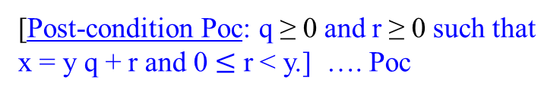
Correctness of the Division Algorithm
Correctness of the Post-Condition
Prove: For the least number of iterations N, G: r ≥ y is false, and
I(N) is true, then Poc is true.
Proof:
Suppose that for some nonnegative integer N ≥ 0, after N iterations,
I(N): r = x – N*y ≥ 0 and N = q is true, and
G: r ≥ y is false (i.e., r < y).
Since N ≥ 0 and N = q, This says q ≥ 0.
Then, we have r < y, r ≥ 0, r = x – Ny, and q = N ≥ 0.
Since q = N, and r = x – Ny yields, by substitution q for N,
r = x - q y.
That is, x = q y + r.
Combining the two inequalities r < y, r ≥ 0 gives
0 $≤$ r < y.
[Post-condition Poc: q ≥ 0 and r ≥ 0 such that x = q y + r and 0 $≤$ r < y.] is true QED.
[Pre-condition Prc: x ≥ 0 and y > 0, and
r = x and q = 0.]
[I(n = k): r = x – n y ≥ 0 and n = q.]
[Post-condition Poc: q ≥ 0 and r ≥ 0 such that x = y q + r and 0 $≤$ r < y.] …. Poc
function divide(x, y)
q := 0;
r:= x;
[I(n = k + 1): r = x – n y ≥ 0 and n = q.]
4
G:r≥y
Return(q, r)
r := r – y;
q := q + 1
[Post-condition Poc: q ≥ 0 and r ≥ 0 such that x = y q + r and 0 $≤$ r < y.] …. Poc

Slide 63

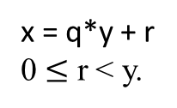

q := 0; r := x;
while r ≥ y do
{ r := r – y ;
q := q + 1;}
Time Efficiency
Suppose x and y are each n bits long. The values x and y are 2^{n} -1. Let r = x.
A subtraction of y from r (i.e., r – y) is at most n bit-operations.
Equivalently, it is r := r + (-y).
Thus, the running time for each executing r := r – y is O(n). It is linear.
O(n) = (c₀ + c₁ n) where c₁ and c₀ are constants.
The algorithm yields (x – i * y ) < y at i iterations (i.e., q = i ).
For each iteration, it takes (c₀ + c₁ n) additions/subtraction.
Then x < (i +1) * y, which is $\frac{x}{y}<i+1$ for exiting from the iteration.
If x is n bits long, then x has the maximum value of x, 0 < x $≤$ 2^{n} -1 < 2^{n}.
If x >> y and the min(y) =1, then $\frac{x}{y}$ will grow to $\text{2}\text{n}.$ (Both x $≥$ 0 and y > 0 are integers.)
Thus, i will be approximately equal to $\text{2}\text{n}$, when y = 1 for the worse case.
The algorithm will take $\sum_{1}^{\text{2}\text{n}}{\text{(}\text{c}\text{0}\text{ + }\text{c}\text{1}\text{n}\text{)}= }$ $\text{2}\text{n}$*$\text{(}\text{c}\text{0}\text{ + }\text{c}\text{1} \text{n}\text{)}=$ O(n*2^{n}), which is n*2^{n} exponential time to execute these{ r := r – y; q := q + 1;}
3₁₀ -1-1-1 = 0
11₂ – 01= 10-01= 01-01=00
x = q*y + r
0 $≤$ r < y.
15 is 01111.
15 < 1
15 – 15*1 < 1
15 < (15+1)*1

Slide 64
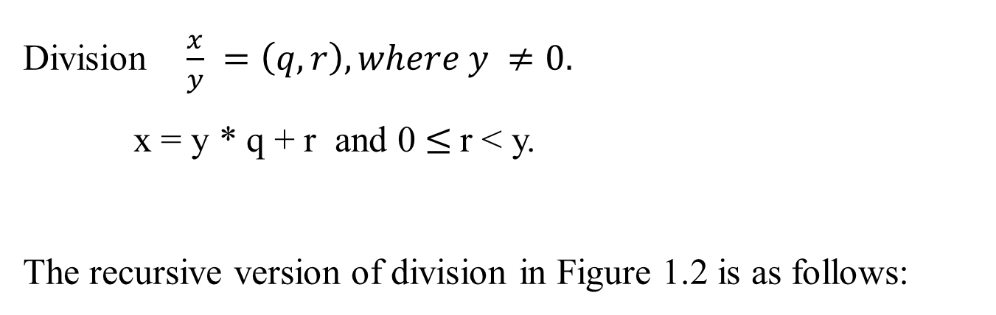
Division $\frac{x}{y} =\left(q, r\right), where y ≠0.$
x = y * q + r and 0 $≤$r < y.
The recursive version of division in Figure 1.2 is as follows:

Slide 65
Figure 1.2 The recursive version of
x = q * y + r , where r < y.
(5, 2) D(17, 3)
(2, 2) (q, r) := D(8, 3)
(1, 1) (q, r) := D(4, 3)
(0, 2) (q, r) := D(2, 3)
(0, 1) (q, r) := D(1, 3)
(0, 0) (q, r) := D(0, 3)
function divide(x, y)
Input: Two n-bit integers x and y, where x ≥ 0. y ≥ 1.
Output: The quotient and remainder of x divided by y.
if (x = 0) then return (q, r):=(0, 0);
(q, r) := divide(└x/2┘, y ) //requires n-bits right shift
q := 2 * q, r := 2 * r; // shift left one bit.
if (x is odd) then r := r + 1; // needs c*n-bits additions
if (r ≥ y) then
{ r := r – y; q := q + 1};
return (q, r);
The total time taken is thus O(n²).
n = └ log₂y ┘ + 1
x = q * y + r
D(0, 3) 0 = 0 * 3 + 0
D(1, 3) q = 2*0, r = 2*0
r = 0 + 1
1 = 0 * 3 + 1
D(2, 3) q = 2*0, r = 2*1
2 = 0*3 + 2
D(4, 3) q = 2*0, r = 2*2
(r≥y) = (4≥3)
r=4-3, q=0+1
4 = 1*3 + 1
D(8,3)q=2*1, r=2*1
8 = 2*3 + 2
D(17,3)q=2*2, r=2*2
15 is odd, r=4+1
(r≥y)=5≥3, r=5-3,
q=4+1; 17=5*3+2

Slide 66
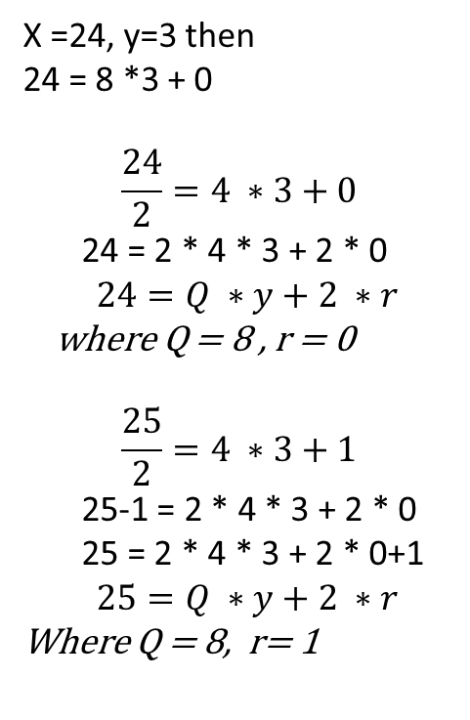
Interpretation of the following statements:
(1) q := 2 * q, r := 2 * r; // shift left one bit.
(2) if (x is odd) then r := r + 1; // needs c*n-bits
(3) if (r ≥ y) then // additions
{ r := r – y; q := q + 1};
return (q, r);
According to x = q * y + r, the algorithm has (q, r) := divide(└x/2┘, y);
(1) when x is even, x/2 = q*y + r
x = 2*q*y + 2*r where Q = 2*q, R = 2*r
x = Q*y + R
when x is odd as it is flooring or rounding down the value of x the representation would be ( x – 1 ) / 2 = q*y + r
x – 1 = 2*q*y + 2*r
x = 2*q*y + 2*r + 1
x = Q*y + (R + 1) where Q = 2*q, R = 2*r
(3) It performs the usual function of a division operation. It checks whether the value of the remainder, r greater or equal to y. If true, update the value of r to be (r – y) and increase the quotient q by 1.
X =24, y=3 then
24 = 8 *3 + 0
$$\frac{24}{2}=4 ∗3+0$$
24 = 2 * 4 * 3 + 2 * 0
$$24=Q ∗y+2 ∗r$$
where Q = 8 , r = 0
$$\frac{25}{2}=4 ∗3+1$$
25-1 = 2 * 4 * 3 + 2 * 0
25 = 2 * 4 * 3 + 2 * 0+1
$$25=Q ∗y+2 ∗r$$
Where Q = 8, r= 1

Slide 67
Suppose that preparing for the first recursive call, according to x = q *y + r,
└x/2┘ = q₀ * y + r₀ ……………...…..…. (1)
Then, x = 2q₀ * y + 2r₀ , where x is even, e.g., 14/2 = 2 * 3 + 1, let y = 3. 14 = 2 * 2 * 3 + 2*1
or x = 2q₀ * y + 2r₀ + 1, where x is old. ……….(2) 15 = 2 * 2 * 3 + 2*1 + 1
From (2), q₁ = 2q₀ and r₁ = 2r₀, then q_{i+1} = 2q_{i} and r_{i+1} = 2r_{i};
these lead to “q := 2 * q, r := 2 * r;”,
(2) implies (2’): preparing for the i^{th} recursive call,
then, x = 2q_{i-1} * y + 2r_{i-1}, where x is even,
or x = 2q_{i-1} * y + 2r_{i-1} + 1, where x is old. .…….(2’)
That is, r₁ = 2r₀ , where x is even,
or r₁ = 2r₀ + 1, where x is old. ….…………..(3)

Slide 68
The previous slide summarizes as follows:
(2) implies (2’): preparing for the i^{th} recursive call,
then, x = 2q_{i-1} * y + 2r_{i-1} , where x is even,
or x = 2q_{i-1} * y + 2r_{i-1} + 1, where x is old. …….(2’)
That is, r₁ = 2r₀ , where x is even,
or r₁ = 2r₀ + 1, where x is old. ………………..(3)
(3) implies (3’):
That is, r_{i+1} = 2r_{i} , where x is even,
or r_{i+1} = 2r_{i} + 1, where x is old. ….…………..(3’)
This leads to “if (x is odd) then r := r + 1; ”, where x is odd.

Slide 69
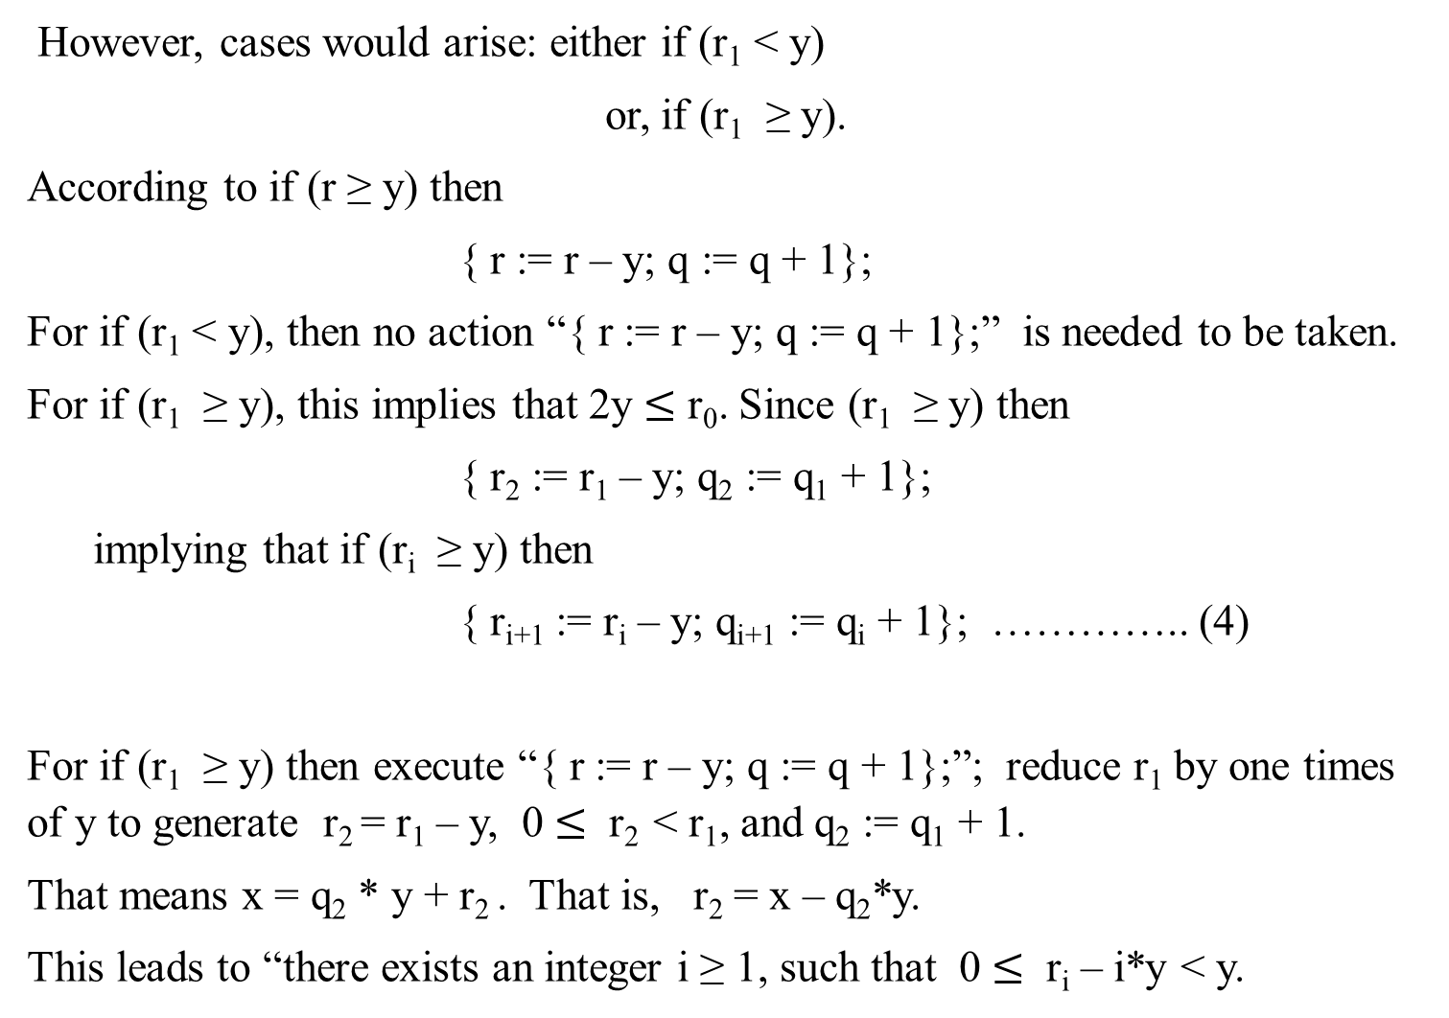
However, cases would arise: either if (r₁ < y)
or, if (r₁ ≥ y).
According to if (r ≥ y) then
{ r := r – y; q := q + 1};
For if (r₁ < y), then no action “{ r := r – y; q := q + 1};” is needed to be taken.
For if (r₁ ≥ y), this implies that 2y $≤$ r₀. Since (r₁ ≥ y) then
{ r₂ := r₁ – y; q₂ := q₁ + 1};
implying that if (r_{i} ≥ y) then
{ r_{i+1} := r_{i} – y; q_{i+1} := q_{i} + 1}; ………….. (4)
For if (r₁ ≥ y) then execute “{ r := r – y; q := q + 1};”; reduce r₁ by one times of y to generate r₂ = r₁ – y, 0 $≤$ r₂ < r₁, and q₂ := q₁ + 1.
That means x = q₂ * y + r₂ . That is, r₂ = x – q₂*y.
This leads to “there exists an integer i ≥ 1, such that 0 $≤$ r_{i} – i*y < y.

Slide 70
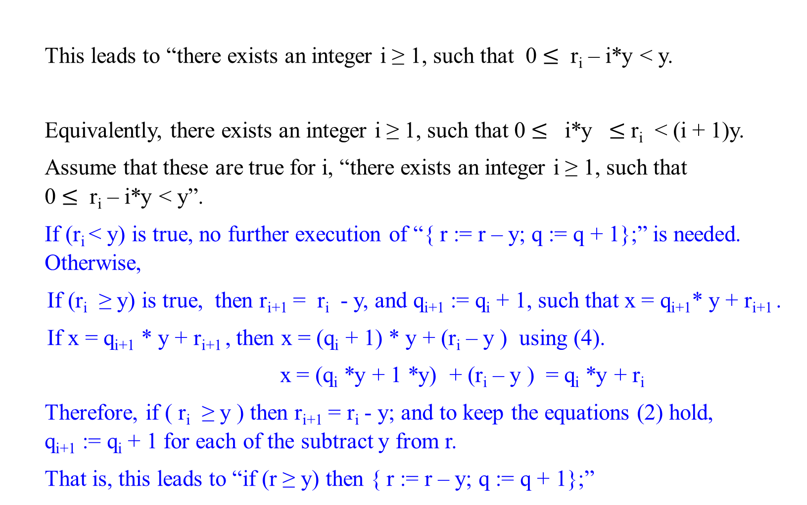
This leads to “there exists an integer i ≥ 1, such that 0 $≤$ r_{i} – i*y < y.
Equivalently, there exists an integer i ≥ 1, such that 0 $≤$ i*y $≤$r_{i} < (i + 1)y.
Assume that these are true for i, “there exists an integer i ≥ 1, such that 0 $≤$ r_{i} – i*y < y”.
If (r_{i} < y) is true, no further execution of “{ r := r – y; q := q + 1};” is needed. Otherwise,
If (r_{i} ≥ y) is true, then r_{i+1} = r_{i} - y, and q_{i+1} := q_{i} + 1, such that x = q_{i+1}* y + r_{i+1} .
If x = q_{i+1} * y + r_{i+1} , then x = (q_{i} + 1) * y + (r_{i} – y ) using (4).
x = (q_{i} *y + 1 *y) + (r_{i} – y ) = q_{i} *y + r_{i}
Therefore, if ( r_{i} ≥ y ) then r_{i+1} = r_{i} - y; and to keep the equations (2) hold, q_{i+1} := q_{i} + 1 for each of the subtract y from r.
That is, this leads to “if (r ≥ y) then { r := r – y; q := q + 1};”

Slide 71

It has to be the number of iterations, 1 for each n/2, but not c(n).
Prove T(n) = O(n²)
T(n) = T(└ n/2 ┘) + c(n)
T(1) = c₀ (assume c₀ = 1);
Solution:
(need to check the correctness of the following)
Let n = 2^{k}.
T(n) = T(2^{k}) = T(2^{k-1}) + 2^{k}
= T(2^{k--2}) + 2^{k-1} + 2^{k}
= …
= T(2^{k-i}) + (2^{k-i+1} ) + (2^{k-i+2} ) + … + (2^{k-3} ) + (2^{k-2} ) + (2^{k-1} ) + (2^{k} )
= T(2^{k-k}) + (2^{k-k+1} ) + (2^{k-k+2} ) + … + (2^{k-3} ) + (2^{k-2} ) + (2^{k-1} ) + (2^{k} ), k = i
= T(2^{k-k}) + (2^{k-k+1} ) + (2^{k-k+2} ) + … + (2^{k-3} ) + (2^{k-2} ) + (2^{k-1} ) + (2^{k} ),
= 1+ (2¹ ) + (2² ) + … + (2^{k-3} ) + (2^{k-2} ) + (2^{k-1} ) + (2^{k} ),
= (2^{k+1} -1)
= 2n -1 = O(n) recursive calls
The algorithm will take n calls, and therefore O(n²).
function divide(x, y)
if x = 0, then return (q, r) := (0, 0);
(q, r) := divide(└ x/2 ┘ , y )
q := 2 * q, r := 2 * r;
if x is odd then r := r +1;
if r ≥ y then { r := r – y; q := q +1};
return (q, r)

Slide 72
End of Proof of Program Correction.

Slide 73
Let’s contrast the naïve iterative division as above with an efficient division algorithm that works in polynomial time.
The Efficient Division Algorithm (Binary Long Division)
The standard method used in computers (and what you learned in school in base 10, but here in base 2) is long division in binary. It avoids repeated subtraction and instead uses shifts and subtractions to compute the quotient bit by bit.

Slide 74
Pseudocode: Binary Long Division
function divide(x, y):
Input: x, y are n-bit integers, with x ≥ 0, y ≥ 1
Output: (q, r) such that x = q*y + r, with 0 ≤ r < y
q := 0 // quotient
r := 0 // remainder
for i from n-1 downto 0 do
{// shift r left and bring down the next bit of x
r := 2*r + bit_{i}(x) //most significant bit of x first.
if r ≥ y then
{ r := r - y
q := q + 2^{i} } } // set the i^{th} bit of the quotient
return (q, r)

Slide 75
Pseudocode: Binary Long Division
function divide(x, y):
bit_{i}(x) is the i-th bit of (starting from the most significant).
At each step, we “bring down” one bit of x, update the remainder, and decide whether to subtract y.
This is exactly like decimal long division, but in binary.

Slide 76
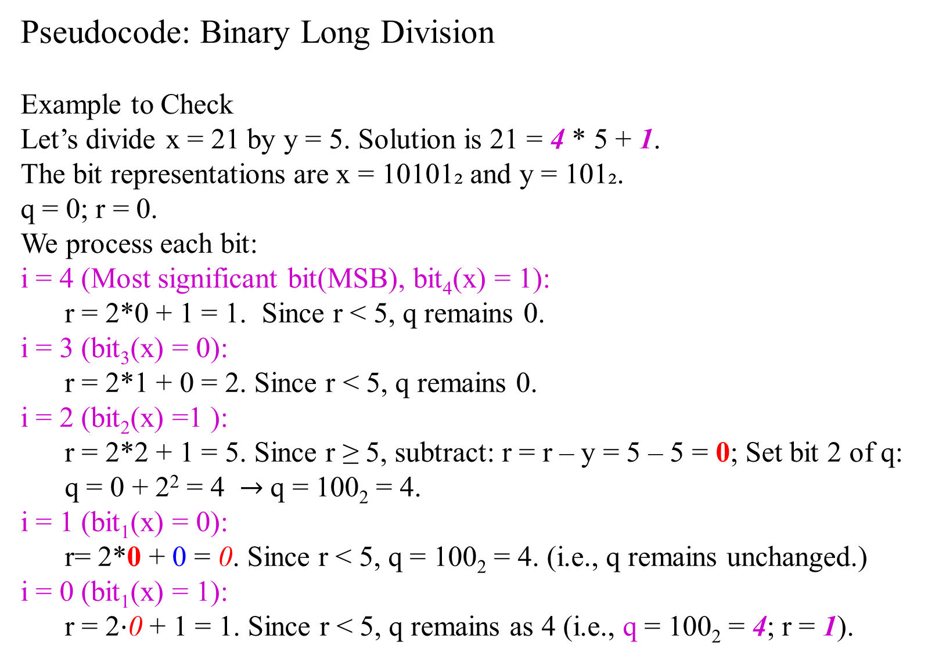
Pseudocode: Binary Long Division
Example to Check
Let’s divide x = 21 by y = 5. Solution is 21 = 4 * 5 + 1.
The bit representations are x = 10101₂ and y = 101₂.
q = 0; r = 0.
We process each bit:
i = 4 (Most significant bit(MSB), bit₄(x) = 1): r = 2*0 + 1 = 1. Since r < 5, q remains 0.
i = 3 (bit₃(x) = 0): r = 2*1 + 0 = 2. Since r < 5, q remains 0.
i = 2 (bit₂(x) =1 ): r = 2*2 + 1 = 5. Since r ≥ 5, subtract: r = r – y = 5 – 5 = 0; Set bit 2 of q: q = 0 + 2² = 4 $→$q = 100₂ ​= 4.
i = 1 (bit₁(x) = 0): r= 2*0 + 0 = 0. Since r < 5, q = 100₂ ​= 4. (i.e., q remains unchanged.)
i = 0 (bit₁(x) = 1): r = 2⋅0 + 1 = 1. Since r < 5, q remains as 4 (i.e., q = 100₂ ​= 4; r = 1).

Slide 77
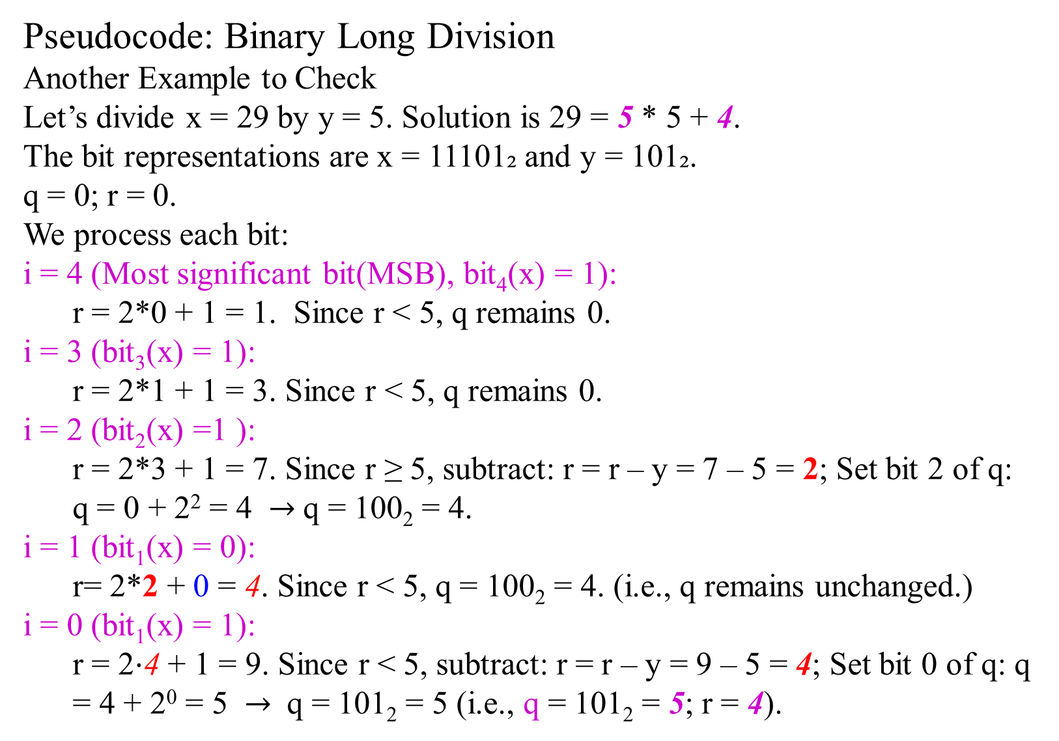
Pseudocode: Binary Long Division
Another Example to Check
Let’s divide x = 29 by y = 5. Solution is 29 = 5 * 5 + 4.
The bit representations are x = 11101₂ and y = 101₂.
q = 0; r = 0.
We process each bit:
i = 4 (Most significant bit(MSB), bit₄(x) = 1): r = 2*0 + 1 = 1. Since r < 5, q remains 0.
i = 3 (bit₃(x) = 1): r = 2*1 + 1 = 3. Since r < 5, q remains 0.
i = 2 (bit₂(x) =1 ): r = 2*3 + 1 = 7. Since r ≥ 5, subtract: r = r – y = 7 – 5 = 2; Set bit 2 of q: q = 0 + 2² = 4 $→$q = 100₂ ​= 4.
i = 1 (bit₁(x) = 0): r= 2*2 + 0 = 4. Since r < 5, q = 100₂ ​= 4. (i.e., q remains unchanged.)
i = 0 (bit₁(x) = 1): r = 2⋅4 + 1 = 9. Since r < 5, subtract: r = r – y = 9 – 5 = 4; Set bit 0 of q: q = 4 + 2⁰ = 5 $→$ q = 101₂ = 5 (i.e., q = 101₂ ​= 5; r = 4).

Slide 78
Pseudocode: Binary Long Division
The binary long division algorithm is correct and runs in O(n²) time.
Number of iterations: n (one per bit of x).
Inside loop: shift (multiply remainder by 2), addition of a bit, comparison with y, possible subtraction of y.
Each of these is an O(n)-bit operation. So each iteration costs O(n).
Thus, T(n) = O(n)*O(n) = O(n²).
This is polynomial time, much faster than the naive subtraction-based division Θ(2^{n}).

Slide 79
Newton–Raphson fast division algorithm
used for very large integers in cryptography and big-integer libraries,
which improves this to almost linear O(nlognloglogn) when using FT multiplication.
Newton–Raphson division computes a high-precision reciprocal of the divisor using Newton iterations and gets the quotient by one multiplication and a shift, then corrects the result.
Cost = O(M(n)) where M(n) is multiplication cost.
Using FFT multiplication M(n) = O(nlogn loglogn) gives division in O(nlogn loglogn)

