Slide 1
Chapter 00_01
CS 48600-01 – Analysis of Algorithms (3 cr.)
Introducing Foundation

Slide 2
Body of Knowledge Coverage:
Software Development Fundamentals (SDF)
Algorithms and Design (SDF)
  Concept and properties of algorithms,
  Role of algorithms,
  Problem-solving strategies,
  Separation of behavior and implementation

Slide 3

Introduction –
What is an algorithm?
What is a computer program?
What is a problem?
What are the parameters of a problem
What is an instance of the problem?
What is a solution to an instance of the problem?
What is an algorithm for the problem?

Slide 4
Introduction – What is an algorithm for the problem?
An algorithm must specify
  a step-by-step procedure
    for producing the solution to each instance.
The algorithm solves all instances of the problem.

Slide 5
Introduction – What is a problem (task)?
An example of a problem
Question: Determine whether the number x is in the list S of n
numbers.
Answer: yes if x is in S and no if it is not.

Slide 6
Introduction – What are the parameters of a problem?
  They are variables without assigned specific values to the statement of the problem.
An example of a problem
  Question: Determine whether the number x is in the list S of n
  numbers.
  Answer: yes if x is in S and no if it is not.
  The 3 parameters of the problem are:
    S (the list), n (the number of numbers in S), and the number x.
    The parameter n is redundant
      since its value is uniquely determined by S.
      n facilitates the problems’ descriptions.

Slide 7
Introduction – An algorithm for the problem
An example of a problem
Question: Determine whether the number x is in the list S of n
numbers.
Answer: yes if x is in S and no if it is not.
An algorithm for the problem example:
  Start with the first item in S.
  Compare x with each item in S in sequence
    until x is found or S is exhausted.
  If x is found, answer yes;
  if x is not found, answer no.

Slide 8
Summary: Problem? Questions? Answers? Parameters? Instances of a problem? An instance’s Solution?
Introduction – What is an instance of the problem?
What is a solution to an instance of the problem?
A problem containing parameters represents a class of problems.
    A range of problems defined by different assignments of values to the parameters.
An instance of the problem:
  defined by a specific assignment of values to the parameters.
A solution to an instance of a problem:
  The answer to the question asked by the instance of a problem.

Slide 9
Summary: Problem? Questions? Answers? Parameters? Instances of an problem? An instance’s Solution?
Introduction – What is an instance and its solution to the problem?
An example of a problem
  Question: Determine whether the number x is in the list S of n
  numbers.
  Answer: yes if x is in S and no if it is not.
An instance of this problem in the example is
    An instance of the problem: S = [10, 7, 11, 5, 13, 8], n = 6, and x = 5.
    An instance’s Solution: The solution to the instance is yes.

Slide 10

Algorithm for the Sequential Search
Problem Given: Is the key K in the array S of n keys?
Inputs (parameters): A positive integer n, array of keys S indexed from 0
to n-1 and a key K.
Outputs: The index (location) of the first found element of S that
matches K, or -1 if there are no matching elements.

Slide 11
Algorithm SequentialSearch(S[0 .. n-1], K)
// Searches for a given value K in a given array S by sequential search
Input: An array S[0 .. n-1] and a search key K
Output: The index (location) of the first element of S that matches K
or -1 if there are no matching elements
i := 0;
while (i < n and S[i] ≠ K)
do {i := i + 1; }
if (i < n) return i;
else return -1;
Q:
What is the input size?
Which is the basic operation? Why?
What is the running time (in terms
of execution time)?

Slide 12
Compare their running time:
Algorithm SequentialSearch(S[0 .. n-1], K)
// Searches for a given value K in a given array S[0 .. n-1] by sequential search
i := 0;
while (i < n and S[i] ≠ K)
do {i := i + 1; }
if (i < n) return i;
else return -1;
Q: Which is the basic operation? Why?
Is there any difference in terms of execution time,
if we design the while-do as the following?
Which one costs the most?
i := 0;
while (i < n)
{if (S[i] ≠ K) {i := i +1;}}//end while-do
if (i < n) return i;
else return –i;
Or
i := 0;
while (i < n)
do { if (S[i] = K) {return i;}
i := i +1;} //end while-do
return -1;
Multiple version of the algorithm:

Slide 13
Algorithm SequentialSearch(S[0 .. n-1], K)
// Searches for a given value K in a given array S by sequential search
Input: An array S[0 .. n-1] and a search key K
Output: The index (location) of the first element of S that matches K
or -1 if there are no matching elements
S[n] := K;
i := 0;
while (S[i] ≠ K)
do {i := i + 1; }
if (i < n) return i;
else return -1;
Q:
Which is the basic operation? Why?
Is there any difference in terms of execution time between this algorithm and the previous one? Why?
i := 0;
while (i < n and S[i] ≠ K)
do {i := i + 1; }
if (i < n) return i;
else return -1;

Slide 14
Introduction – What is an Algorithm?
An algorithm is
a well-defined procedure
  a sequence of unambiguous instructions
  for solving a well-specified computational problem
    to obtain a desired, required output
    from any given valid input
    within a finite amount of time.
{input specifications} Algorithm {output specifications}
Time t
Input size n

Slide 15
Introduction – What is a computer program?
A computer program
  composed of individual modules of code,
    that are designed to work together to solve specific tasks,
    written in a programming language that can be compiled/interpreted by a computer.
    Examples of tasks include sorting data, searching for information, or performing various computations.
Our concern is
  focused on the detailed design of individual modules
    for solving specific tasks, which are called problems.
  But NOT the design of entire programs

Slide 16

Basic questions about an algorithm
In designing and analyzing an algorithm, the following questions are considered.
What is the problem we have to solve? Does a solution exist?
Can we find a solution (algorithm), and is there more than one solution? (such as, mergesort, quicksort, insertion sort for sorting data)
Is the algorithm correct?
  Does it halt? (halting problem)
  Is it correct? (partial correctness)
How efficient is the algorithm?
  Is it fast? (Can it be faster?) (time efficient)
  How much memory does it use? (space efficient)
How does data communicate? (data representation/implementable)
Need to know about
  Design and modeling techniques
  Resources – avoid reinventing the wheel

Slide 17
Skip slides from 17 to 23

Slide 18
Logical methods of checking the correctness
of an algorithm with respect to its input and output.
Testing
  involves running the algorithm with various inputs and comparing the actual outputs to the expected outputs.
  Methods
    Unit Testing: Tests individual modules.
    Integration Testing: Tests the interaction between integrated modules.
    System Testing: Tests the entire system as a whole
    Acceptance Testing: Validates the system against user requirements.
Correctness proof (such as program verification)
  A mathematical proof that verifies the algorithm meets its specification for all possible inputs.
  Method: Program verification
    Uses formal methods to prove that the algorithm adheres to its specification.

Slide 19
Logical methods of checking the correctness
of an algorithm with respect to its input and output.
Confidence in algorithms from testing and correctness proof
  Testing provides empirical evidence of correctness but cannot prove correctness for all possible inputs
  Correctness Proof offers a theoretical guarantee that the algorithm is correct for all possible inputs.
Correctness of recursive algorithms: prove directly by induction
Correctness of iterative algorithms: prove using loop invariants and induction

Slide 20
Correctness of Recursive and Iterative Algorithms
Recursive Algorithms
Prove Correctness by Induction:
  Base Case: Prove that the algorithm works for the simplest (base) case.
  Inductive Step: Assume the algorithm works for an arbitrary case n. Then prove it works for case n+1.
Iterative Algorithms
Prove Correctness Using Loop Invariants and Induction:
  Loop Invariant: A condition that holds true before and after each iteration of the loop.
  Steps to Prove Correctness:
    Initialization: Show that the invariant holds before the loop starts.
    Maintenance: Show that if the invariant holds before an iteration, it holds after the iteration.
    Termination: Show that when the loop terminates, the invariant (along with the loop condition) implies the correctness of the algorithm.

Slide 21
Summary
Testing and correctness proofs
  are essential for ensuring the reliability and correctness of algorithms.
Recursive algorithms
  are typically proven correct through induction.
Iterative algorithms
  are proven correct using loop invariants combined with induction.
Combining testing with correctness proofs
  provides a robust assurance of an algorithm's reliability.

Slide 22
Testing vs Correctness Proofs
Testing
  Try the algorithm on sample inputs
  Cannot guarantee the absence of bugs, since it is impractical to test all possible inputs.
  Testing may uncover rare or obscure bugs that only occur with specific inputs or conditions.
Correctness Proof
  Proving mathematically can also contain bugs.
  Proofs themselves can contain mistakes, leading to incorrect conclusions about correctness.
Use a combination of testing and correctness proofs
  Testing helps to identify bugs in practical scenarios
  Correctness Proofs offer a theoretical foundation that the algorithm is fundamentally sound.
  Provides a more robust, reliable verification process.

Slide 23
Reliability in the Context of Algorithms
Reliability of an algorithm means the ability of an algorithm to:
consistently perform its intended function correctly over time, i.e., produces the correct output for the same input every time it is executed. (Consistency)
produce outputs which are correct and meet the specified requirements for all valid inputs. (Accuracy)
handle a variety of inputs under any conditions, without failing. (Robustness)
gracefully handle errors or unexpected situation without crashing or producing incorrect results. (Tolerate Faults)
maintain stable performance levels, e.g., speed, resource usage, across different runs and environments. (Performance Stability)

Slide 25
Analysis, Design and Implementation of an Algorithm:
1.0 Analysis of Algorithms?
  Study the complexity of an algorithm according to
    time efficiency and
    space efficiency (the amount of resources required to run an algorithm).

Slide 26
Analysis, Design and Implementation of an Algorithm:
1.1 Why Analyze an Algorithm?
Reasons for analyzing an algorithm are:
  Discover an algorithm’s characteristics
    Evaluate its suitability for various applications
    Compare it with other algorithms for the same application.
  Understand it (algorithm) better, and improve it.
    Algorithms tend to become shorter, simpler, and more elegant during analysis.

Slide 27
Analysis, Design and Implementation of an Algorithm:
1.2 Computational Complexity.
In theoretical computer science,
the study of computational complexity theory delves into the complexity of problems:
  goes beyond finding algorithms that can solve problems;
  understanding if there are more efficient algorithms out there, and
  understanding the inherent difficulty in defining algorithms for solving certain computational problems.
    about understanding the fundamental limits and constraints inherent in solving computational problems.

Slide 28
1. P (Polynomial time)
Problems that can be solved efficiently (in polynomial time).
Example: Sorting numbers → O(nlogn).
2. NP (Nondeterministic Polynomial time)
Problems for which a given solution can be verified in polynomial time, even if finding the solution might be hard.
Example: Given a path in Traveling Salesman Problem (TSP), you can easily check its length in O(n).
3. NP-Hard
Problems that are at least as hard as the hardest problems in NP.
They don’t need to be in NP (they might not have efficiently verifiable solutions).
Example: Halting Problem (not in NP, undecidable, but NP-hard).

Slide 29
NP-Complete Problems
A decision problem P is NP-Complete if:
this problem P is in NP (a candidate solution can be verified in polynomial time); i.e., P∈NP.
Every problem in NP can be reduced to P in polynomial time.
  i.e., it is as hard as any NP problem.
This means: NP-Complete problems are the "hardest problems in NP."
Why important?
If one NP-Complete problem can be solved in polynomial time, then all NP problems can be solved in polynomial time.
  That would prove P = NP.
But if no polynomial-time solution exists, then P ≠ NP.
This is the famous “P vs NP Problem”, one of the seven Millennium Prize Problems.

Slide 30
Classic Examples of NP-Complete Problems:
Traveling Salesman Problem (decision version)
0/1 Knapsack Problem (decision version)
Subset Sum – Given a set of integers S, is there a subset of S of integers, whose sum is exactly the target of integer T?
Boolean Satisfiability (SAT) ← first proven NP-Complete (Cook–Levin theorem, 1971)
Graph Coloring – Can the vertices of G be colored at most k colors, such that no two adjacent vertices have the same color.
Hamiltonian Cycle – Does there exist a cycle that visits every vertex in G exactly once and returns to the starting vertex?

Slide 31
In short:
NP-Complete problems = hardest verifiable problems.
We don’t know if they can be solved efficiently.
They are the "gateway" to understanding P vs NP.
The relationship between these complexity classes, like P and NP, is a central theme in computational complexity theory and has profound implications, especially concerning the concept of NP-completeness.

Slide 33
The Traveling Salesman Problem (TSP) and the Knapsack Problem are classic examples that illustrate the characteristics of NP problems:
Traveling Salesman Problem (TSP):
Given a list of cities and the distances between them, the task is to find the shortest possible route that visits each city exactly once and returns to the original city.
Verifying a solution (i.e., checking if a given route indeed visits each city exactly once and returns to the original city) can be done efficiently. - O(n)
Finding the shortest route itself is notoriously difficult, especially as the number of cities increases. – a NP-complete problem

Slide 34
Exact algorithms: exponential time
Brute force: O(n!)
Dynamic programming with bitmasking (avoid repeating computations): O(n² 2² )
Approximation/heuristics: polynomial time O(n² ) or O(n³ ), but do not guarantee exact solutions.

Slide 35
Knapsack Problem: - A NP-Complete problem
Given a set of items, each with a weight and a value, and a knapsack with a maximum weight capacity, the task is to determine the most valuable combination of items to include in the knapsack without exceeding its capacity. (i.e., Is there a subset of items whose total weight is ≤ W and whose total value is ≥ V?)
Verifying if a given combination of items satisfies the constraints (weight capacity) can be done efficiently.
The Knapsack Problem is another classic NP-hard optimization problem. Its time efficiency depends on the algorithm used and the type of knapsack variant.
Finding the optimal combination with the maximum value is challenging, particularly as the number of items grows.

Slide 36
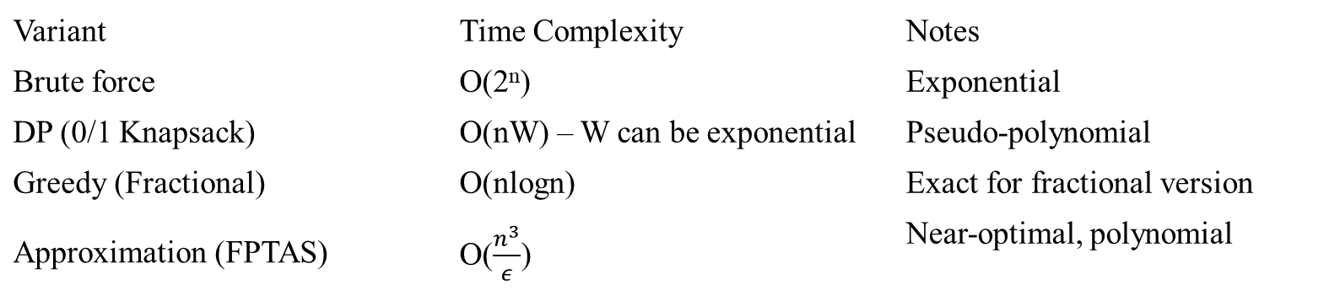
Variant | Time Complexity | Notes
Brute force | O(2^{n}) | Exponential
DP (0/1 Knapsack) | O(nW) – W can be exponential | Pseudo-polynomial
Greedy (Fractional) | O(nlogn) | Exact for fractional version
Approximation (FPTAS) | O($\frac{n^{3}}{ε}$) | Near-optimal, polynomial
FPTAS stands for the Fully Polynomial-Time Approximation Scheme.
0/1 Knapsack stands for a binary (yes-or-no) decision for each item:
You either take the item (1)
Or you leave it (0)
No splitting or partial taking is allowed.
Fractional Knapsack:
Items can be broken into fractions (e.g., take half of an item).
  This version is solvable in polynomial time using a greedy algorithm.

Slide 37
These problems belong to the complexity class NP because
  a potential solution can be verified in polynomial time.
  no polynomial-time algorithm is currently known for finding solutions to these problems.
This distinguishes them from problems in the class P, where both solution finding and verification can be done efficiently.

Slide 39
1.3 Analysis of Algorithms.
A complete analysis of the running time of an algorithm involves the following steps:
[input] Develop a realistic model for the input to the program.
[input size] Analyze the unknown quantities of the modeled input.
[algorithm development] Implement the algorithm completely.
[algorithm analysis]
  Determine the time required for each basic operation.
  Identify unknown quantities that can be used to describe the frequency of execution of the basic operations.
[efficiency] Calculate the total running time by
  multiplying the time by the frequency for each operation,
  then adding all the products.
What are the domain of data and the representation of data?

Slide 40
1.3 Analysis of Algorithms.
Efficiency
Software is always outstripping hardware
  need faster CPU, more memory for the latest version of popular programs
Given a problem:
  what is an efficient algorithm?
  what is the most efficient algorithm?
  does there even exist an algorithm?

Slide 41
1.3 Analysis of Algorithms.
How to measure efficiency
Machine-independent way:
  analyze the “pseudocode” version of the algorithm
  Assume an idealized machine model
    One instruction takes a one-time unit
"Big-Oh" notation (order of growth)
  order of magnitude as the problem size increases
Worst-case analyses
  provides an upper bound on time taken by the algorithm.
    The only “safe” analysis.
Average case analysis
  requires making some assumptions about the probability distribution of the inputs

Slide 42
1.4 Several Important Problem Types
Specifying and implementing algorithms
Basic complexity analysis
Sorting
  a set of items
Searching
  among a set of items
String processing
  text, bit strings, gene sequences
Graphs
  model objects and their relationships
Network flow algorithms
Tree traversals/State space search
Combinatorial
  find desired permutation, combination, or subset
Geometric
  graphics, imaging, robotics
Numerical
  continuous math: solving equations, evaluating functions

Slide 43
1.5 Algorithm Design Strategies/Techniques.
Simple Recursion
Brute Force & Exhaustive Search
  follow definition / try all possibilities
Divide & Conquer
  break problem into smaller subproblems
Transformation
  convert the problem to another one
Greedy
  repeatedly do what is best now
Dynamic Programming
  break problem into overlapping subproblems
  Backtracking and Branch and Bound
Iterative Improvement
  repeatedly improve the current solution
Randomization
  use random numbers
Space and Time Tradeoffs

Slide 44
Divide and Conquer
Break the problems into smaller sub-problems
Solve each of the sub-problems
Combine the solutions to obtain the solution to the original problem
Examples
Binary search in a sorted array (recursion)
Quick sort algorithm (recursion)
Merge sort algorithm (recursion)

Slide 45
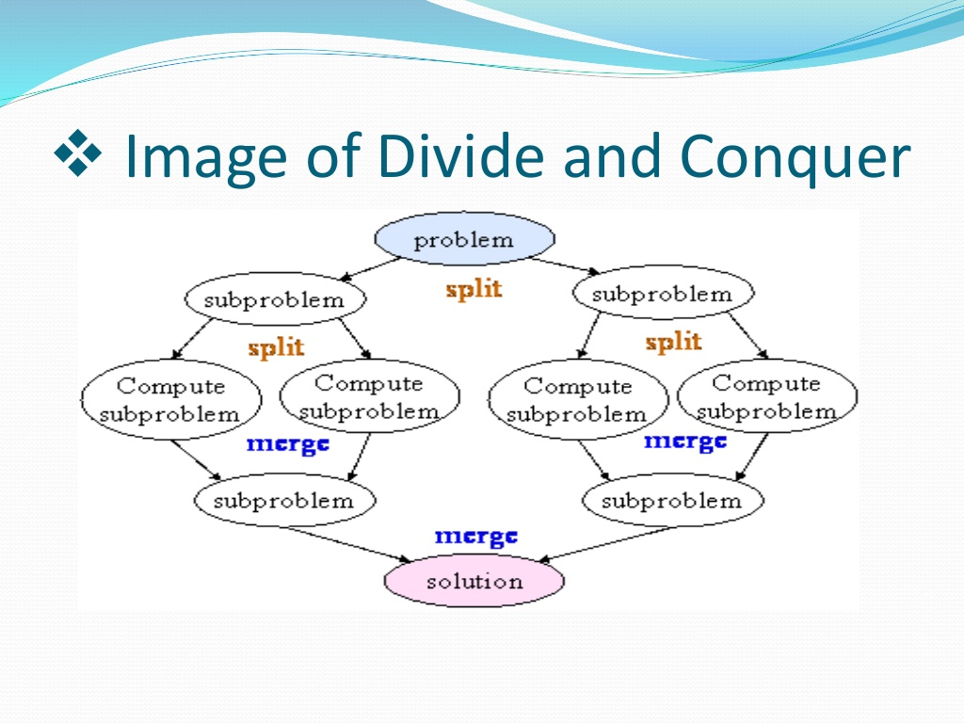
Divide and Conquer

Slide 46
Input: An array S[0 .. n-1] and a search key K
Output: The index (location) of the first found element of S that matches K
or -1 if there are no matching elements
Method: Use sequential search. The order of growth is O(n).
Use binary search. The order of growth is O( log₂ n).
Analysis: Using binary search requires sorting the given array S in order.
Use the merge sort or quick sort algorithm, which requires O(n log₂ n).
Therefore, the total time would be T(n) = O(n log₂ n) + O( log₂ n).

Slide 47
Greedy Algorithms
An algorithm always takes the best immediate or local solution while finding an answer.
Greedy algorithms
  always find the overall or globally optimal solution for some optimization problems,
  but may find less-than-optimal solutions for some instances of other problems.
Examples: Greedy algorithm for
  the Knapsack problem – a combinatorial optimization pbm
  Minimal spanning tree - minimum weight spanning tree for a weighted, connected, undirected graph

Slide 48
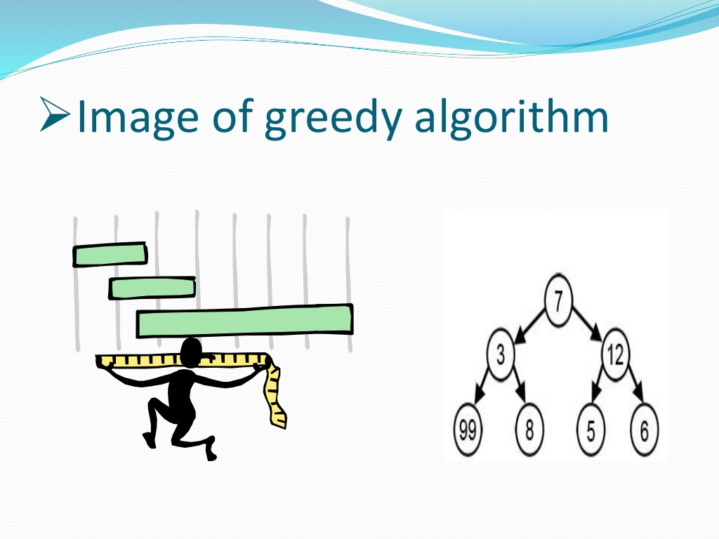
Greedy Algorithm

Slide 49
Dynamic Programming
used to solve an optimization problem that requires the principle of optimality:
  An optimal solution to any instance of an optimization problem is composed of optimal solutions to its sub-instances.
Is a bottom-up technique
  Solve the smallest sub-instances first and
  Use the results of these to construct solutions to progressively larger sub-instances.
Examples
  Fibonacci numbers are computed by iteration.
  Warshall’s algorithm for computing all paths in a directed graph is implemented by iterations.

Slide 50
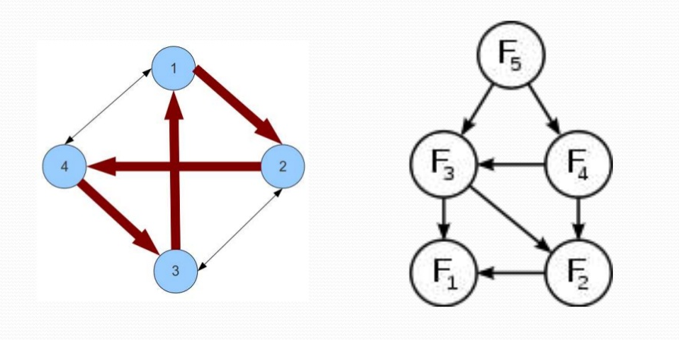
Dynamic Programming

Slide 51
BackTracking
Backtracking is a general algorithm for finding all solutions to some computational problems
  incrementally builds candidates to the solutions, and
  abandons each partial candidate c ("backtracks") when it determines that c cannot possibly be completed to a valid solution.
Examples
  N-queens problem.
  Traveling salesman problem (TSP).
  Sudoku solving: Fill the grid while respecting rules.
  Graph coloring: Assign colors to vertices so adjacent vertices differ.
  Hamiltonian cycle & Knight’s tour in graphs.

Slide 52
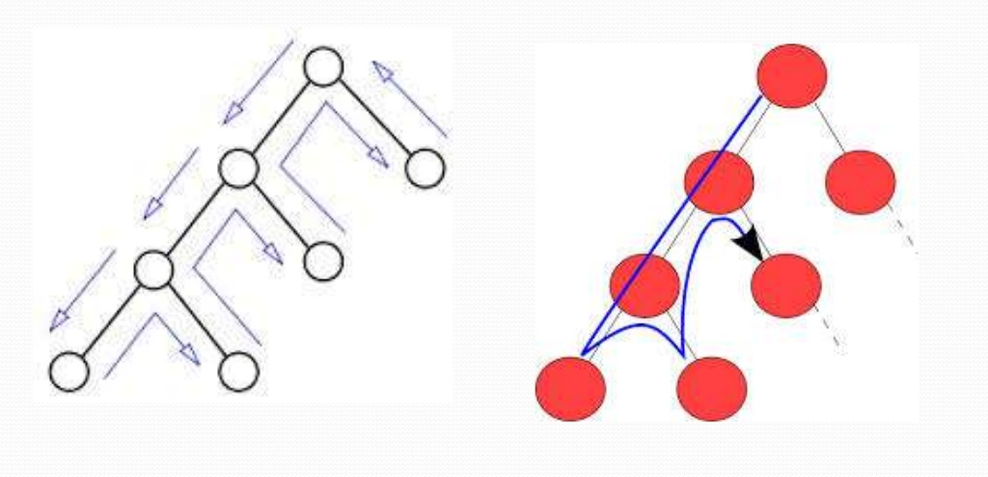
Backtracking

Slide 53
Graph Algorithm
A graph algorithm takes one or more graphs as inputs.
Performance constraints on graph algorithms are generally expressed in terms of
  the number of vertices (|V|) and
  the number of edges (|E|)
in the input graph.
Adjacency Matrix representation: input size n = ∣V∣²
Adjacency List representation: input size n = |V| + |E|

Slide 54
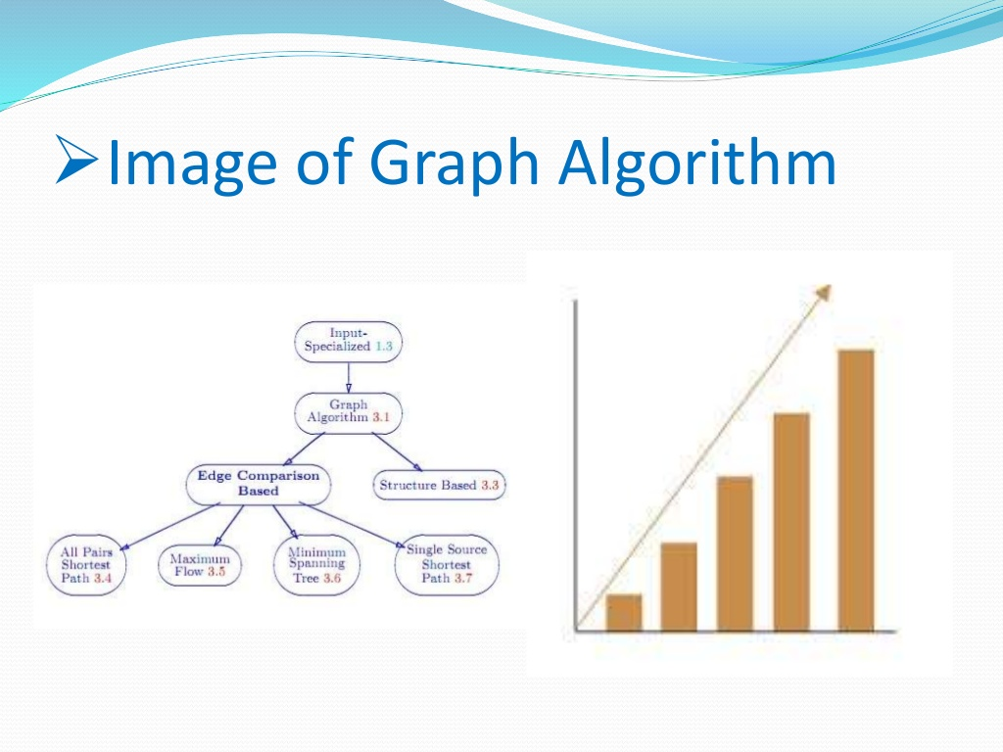
Graph Algorithms

Slide 55

Solution for a given Problem?
design
input Algorithm output
specifications (a way for finding its solu.) specifications
encode
Program Input “computer” Program output
Program code
Figure 1.0 Notion of Algorithm

Slide 56
Several characteristics of Algorithms:
[Non-ambiguity] The non-ambiguity requirement for each step of an algorithm cannot be compromised.
  Prime Factorization in Middle School Procedure for computing gcd(m, n) is defined ambiguously – very slow.
  Euclidean Algorithm (Divide, remainder, repeat) – non-ambiguity, logarithmic time
[Well-specified inputs’ range] The range of inputs an algorithm works has to be precisely specified.
  Consecutive integer checking algorithm for computing gcd(m, n) does not work correctly when one of the input numbers is zero. - linear
…

Slide 57
Several characteristics of Algorithms:
[Different ways for specifying an algorithm] The same algorithm can be written in different ways.
  Euclid’s algorithm can be defined recursively or non-recursively.
[Several algorithms for a problem] Several algorithms for solving the same problem may exist.
  Euclid, Consecutive Integer Checking, and Middle School Procedure for computing gcd(m, n)
…

Slide 58
Several characteristics of Algorithms:
…
  [Various Speeds of different Algorithms for solving the same problem] Algorithms for the same problem can be based on very different ideas and can solve the problem at dramatically different speeds.
    An exponential algorithm Fibonacci_Number_F(n) computes recursively the list of the n Fibonacci members based on its definition, and
    a polynomial Algorithm_Fib(n) computes non-recursively the list of its n members.

Slide 59
Input Size
For many algorithms, a reasonable measure of the input size – is the size of the input.
  For example, the input size is the number n of items in the array for sequential search, sorting, and binary search algorithms.
Some algorithms use two numbers to measure the size of the input.
  For example, when a graph G = (V, E) is the input to an algorithm, the input size consists of both parameters: number of vertices |V| and edges |E|.

Slide 60
Input Size
Must be cautious about referring to parameters as “input size” in algorithms as the term might not always accurately reflect what the parameter represents. For example,
  Algorithm Euclid (m, n) computes the greatest common divisor of two numbers m and n. (The total bits = (⌊log_{2​}m⌋+1) + ⌊log_{2​}n⌋+1 bits .)
  Algorithm Sieve(n) finds all prime numbers less than or equal to n using the sieve of Eratosthenes method, Calling the parameter n “input size” might be misleading, as it’s specifically the upper limit for finding primes. (Input is n, and the input size is ⌊log_{2​}n⌋+1 bits )
  Algorithm Fibonacci_Number_F(n) computes the list of the n Fibonacci members recursively based on its definition. (input is n, and input size is ⌊log_{2​}n⌋+1 bits.)
  Polynomial_Algorithm_Fib(n) computes the list of its n members non-recursively. (Input size = number of bits in n = ⌊log_{2​}n⌋+1 bits.).)

Slide 61
Using the number of symbols or bits required to encode the input parameter n as a measure of input size is a common and reasonable approach in algorithm analysis
Add(x, y), multiply(x, y), divide(x, y):
  In these algorithms, the input size would be determined by the number of symbols or bits required to encode the numbers x and y.
Algorithm Euclid(m, n):
  For algorithm to compute the greatest common divisor, the input size would be determined by the number of symbols or bits needed to encode both m and n.
Algorithm Sieve(n):
  Since n represents the upper limit for finding prime numbers, the input size would be determined by the number of symbols or bits required to encode n.

Slide 62
Algorithm Fibonacci_Number_F(n), Polynomial_Algorithm_Fib(n):
  In both of these algorithms, where n represents the number of Fibonacci numbers to compute, the input size would indeed be determined by the number of symbols or bits required to encode n.
Use └ log₂ n ┘ + 1 bits to encode n in binary representation.
  This ensures that the smallest number n=1 is represented with at least one bit. ( Since 2⁰ = 1, └ log₂ 1 ┘ = └ log₂ 2⁰ ┘ = 0.)
This approach provides a consistent measure of input size that aligns well with the inherent complexity of algorithms as the input grows.

Slide 63
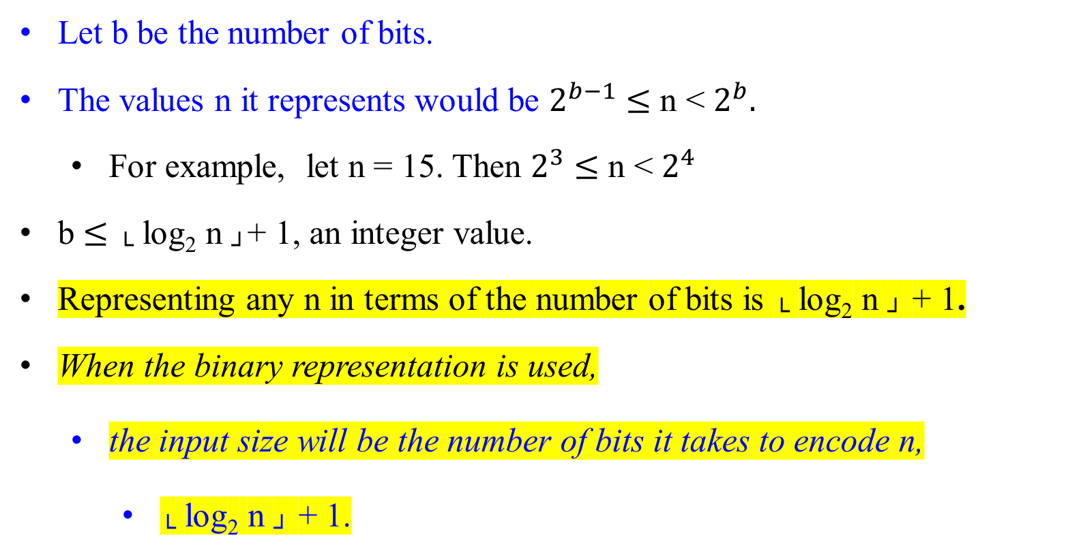
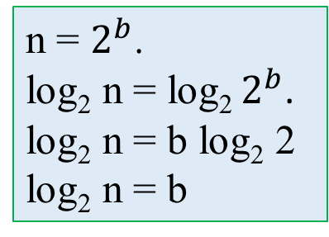
Input Size
Let b be the number of bits.
The values n it represents would be $2^{b−1}$ $≤$ n < $2^{b}.$
  For example, let n = 15. Then $2^{3}$ $≤$ n < $2^{4}$
b $≤$ └ log₂ n ┘+ 1, an integer value.
Representing any n in terms of the number of bits is └ log₂ n ┘ + 1.
When the binary representation is used,
  the input size will be the number of bits it takes to encode n,
    └ log₂ n ┘ + 1.
n = $2^{b}$.
log₂ n = log₂ $2^{b}$.
log₂ n = b log₂ 2
log₂ n = b

Slide 64
Input Size
For a given algorithm, the input size is defined as
the number of characters it takes to write the input.

Slide 65
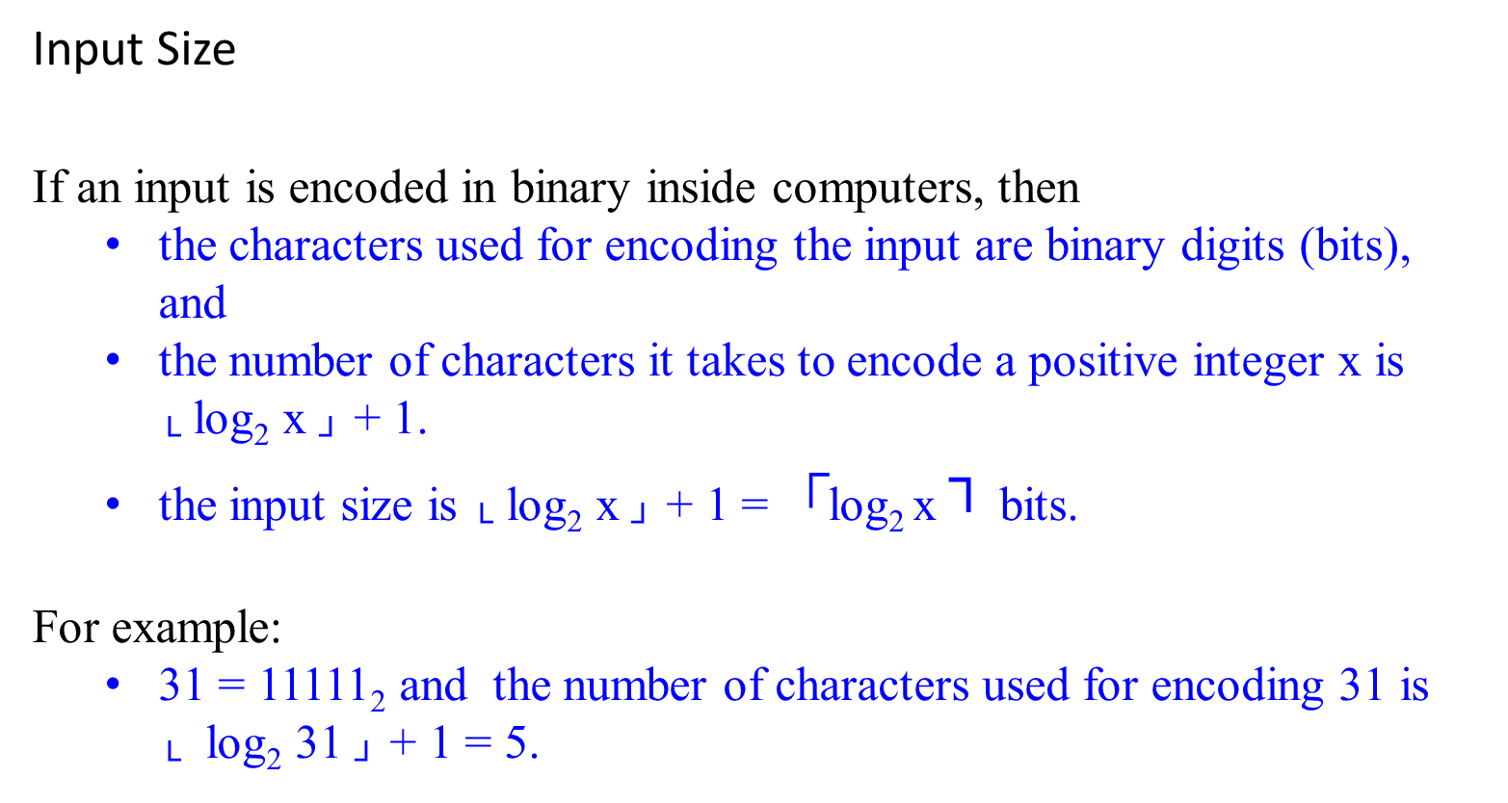
Input Size
If an input is encoded in binary inside computers, then
  the characters used for encoding the input are binary digits (bits), and
  the number of characters it takes to encode a positive integer x is └ log₂ x ┘ + 1.
  the input size is └ log₂ x ┘ + 1 = $┌$log₂ x ┐ bits.
For example:
  31 = 11111₂ and the number of characters used for encoding 31 is └ log₂ 31 ┘ + 1 = 5.

Slide 66
Modeling the Real World- Develop a realistic model for the input
Cast your application in terms of well-studied abstract data structures
Concrete | Abstract
arrangement, tour, ordering, sequence | permutation
cluster, collection, committee, group, packaging, selection | subsets
hierarchy, ancestor/descendants, taxonomy | trees
network, circuit, web, relationship | graph
sites, positions, locations | points
shapes, regions, boundaries | polygons
text, characters, patterns | strings

Slide 67
Real-World Applications
Hardware design: VLSI chips
Compilers
Computer graphics: movies, video games
Routing messages on the Internet
Searching the Web
Distributed file sharing
Computer-aided design and manufacturing
Security: e-commerce, voting machines
Multimedia: CD player, DVD, MP3, JPG, HDTV
DNA sequencing, protein folding
and many more!

Slide 68
The Objectives of the Course
1. Be able to identify and abstract computational problems.
Know important algorithmic techniques and a range of useful algorithms.
Be able to implement algorithms as a solution to any solvable problem.
Be able to analyze the complexity and correctness of algorithms.
5. Be able to design correct and efficient algorithms.

Slide 69
  Separation of behavior and implementation

Slide 70
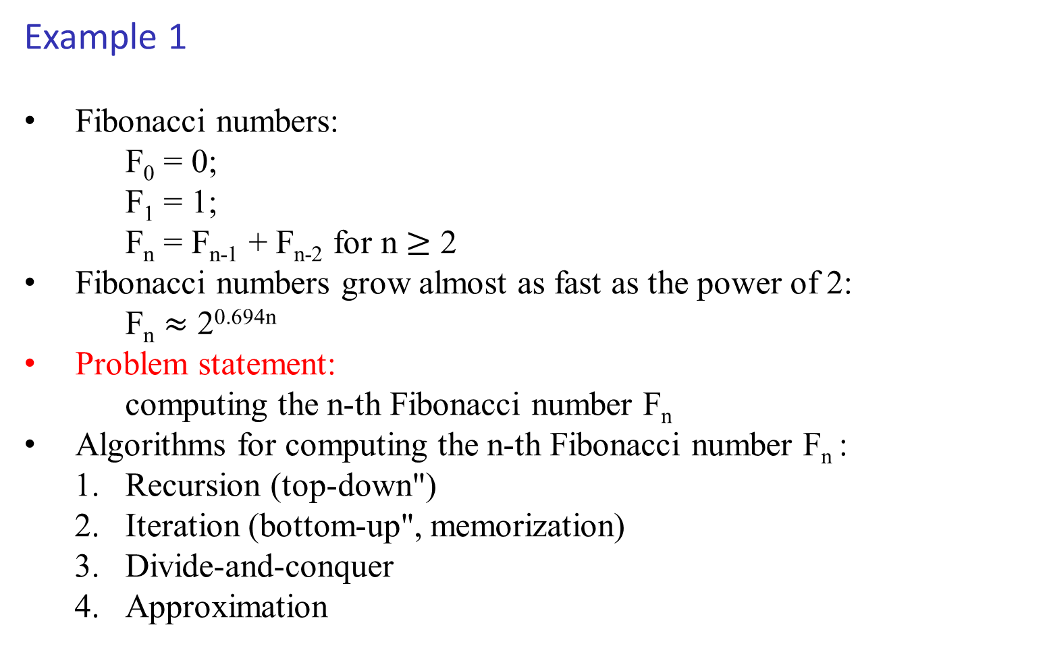
Example 1
Fibonacci numbers:
    F₀ = 0;
    F₁ = 1;
    F_{n} = F_{n-1} + F_{n-2} for n $≥$ 2
Fibonacci numbers grow almost as fast as the power of 2:
    F_{n} $≈$ 2^{0.694n}
Problem statement:
    computing the n-th Fibonacci number F_{n}
Algorithms for computing the n-th Fibonacci number F_{n} :
  Recursion (top-down")
  Iteration (bottom-up", memorization)
  Divide-and-conquer
  Approximation

Slide 71
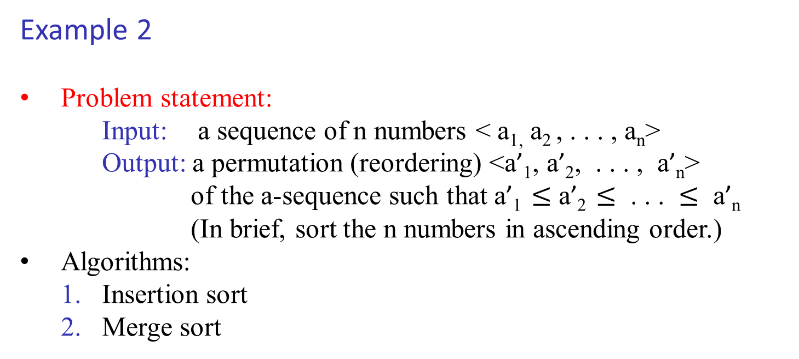
Example 2
Problem statement:
Input: a sequence of n numbers < a_{1,} a₂ , . . . , a_{n}>
Output: a permutation (reordering) <a’₁, a’₂, . . . , a’_{n}>
of the a-sequence such that a’₁ $≤$ a’₂ $≤$ . . . $≤$ a’_{n}
(In brief, sort the n numbers in ascending order.)
Algorithms:
  1. Insertion sort
  2. Merge sort

Slide 72
Example 2: Insert sort algorithm
  Idea: incremental approach
  Pseudocode
InsertionSort(A)
n = length(A);
for (j = 2 to n) {
key = A[j];
// insert ``key'' into sorted array A[1...j-1]
i = j-1;
while (i > 0 and A[i] > key) do {
A[i+1] = A[i];
i = i - 1;
} //end while
A[i+1] = key;
} //end for
return A;

Slide 73
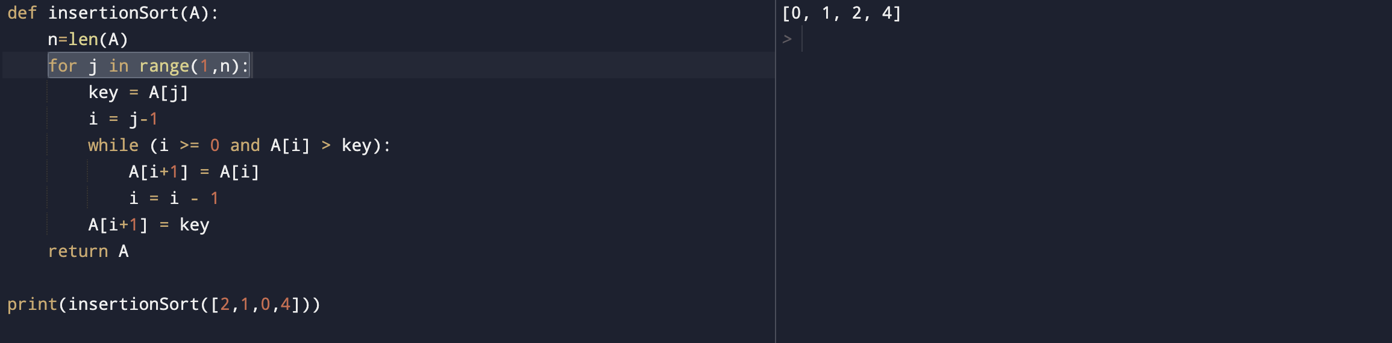
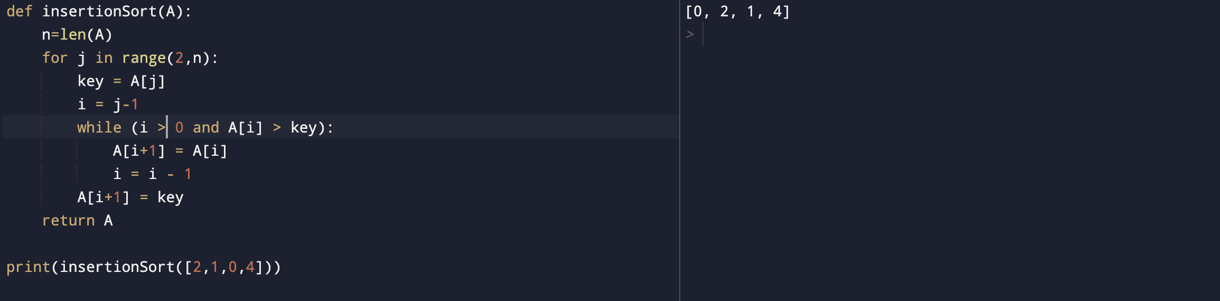
From:
Sent: Monday, September 18, 2023 6:45 AM
To: Peter Ng <ngp@pfw.edu>
Subject: Regarding a mild correction in ppt- chapter 00_01_IntroFoundationLec- insertionSort
Hi Professor,
As I was going through the chapter 00_01_IntroFoundationLec ppt, I found that insertionSort algorithm in the ppt is yielding wrong results. Instead of ">=", ">" is used in the while loop condition(while (i > 0 and A[i] > key):) and for loop starts at index 2 for(j = 2 to n)
Correct logic that yields right result is while (i >= 0 and A[i] > key): and for(j = 1 to n)
I've also attached the screenshot of the result for both code snippets. I kindly request to take this change into account in the ppt.
Yours sincerely,
Am I wrong? Or is he right?
Great! Thank you.
Your are correct if A[0: n-1]. Check for me whether my one is also correct if A[1:n]

Slide 74
Example 2: Insert sort algorithm
Remarks:
Correctness: argued by “loop-invariant” (a kind of induction)
Complexity analysis:
    best-case
    worst-case
    average-case
Insertion sort is a “sort-in-place”, no extra memory is necessary
Importance of writing good pseudocode = “expressing algorithm to human”
There is a recursive version of insertion sort (can you do it)

Slide 75
Example 2: Merge sort algorithm
  Idea: a divide-and-conquer approach
  Pseudocode
MergeSort(A, p, r) // Merge-sort of array A[p..r]
if (p < r) then // check for base case
q = flooring( (p+r)/2 ) // divide
MergeSort(A, p, q) // conquer
MergeSort(A, q+1, r) // conquer
Merge(A, p, q, r) // combine
end if

Slide 76
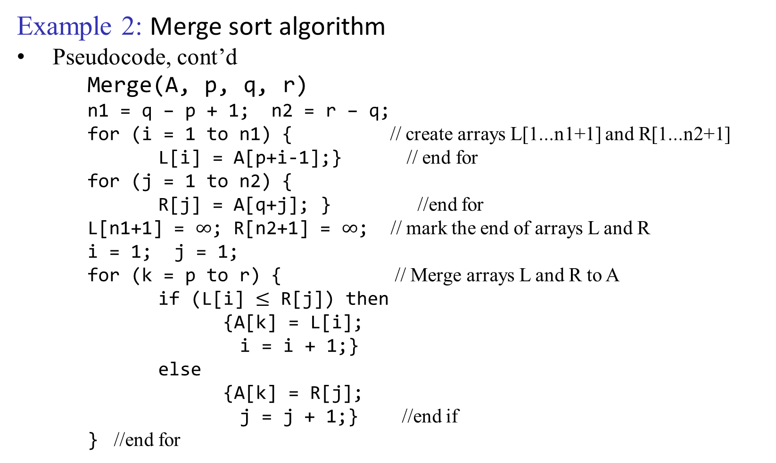
Example 2: Merge sort algorithm
Pseudocode, cont’d
Merge(A, p, q, r)
n1 = q – p + 1; n2 = r – q;
for (i = 1 to n1) { // create arrays L[1...n1+1] and R[1...n2+1]
L[i] = A[p+i-1];} // end for
for (j = 1 to n2) {
R[j] = A[q+j]; } //end for
L[n1+1] = $∞$; R[n2+1] = $∞$; // mark the end of arrays L and R
i = 1; j = 1;
for (k = p to r) { // Merge arrays L and R to A
if (L[i] $≤$ R[j]) then
{A[k] = L[i];
i = i + 1;}
else
{A[k] = R[j];
j = j + 1;} //end if
  } //end for

Slide 77
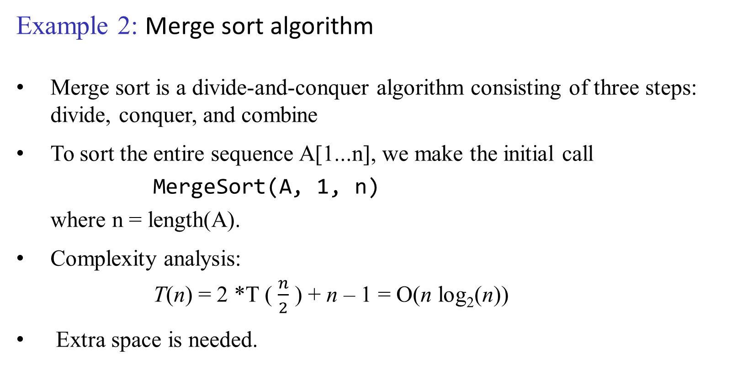
Example 2: Merge sort algorithm
Merge sort is a divide-and-conquer algorithm consisting of three steps: divide, conquer, and combine
To sort the entire sequence A[1...n], we make the initial call
MergeSort(A, 1, n)
where n = length(A).
Complexity analysis:
T(n) = 2 *T ( $\frac{n}{2}$ ) + n – 1 = O(n log₂(n))
Extra space is needed.

