Slide 1
Chapter 6
A First Look at Classes

Slide 2
Chapter Topics
Chapter 6 discusses the following main topics:
  Objects and Classes
  Writing a Simple Class, Step by Step
  Instance Fields and Methods
  Constructors
  Passing Objects as Arguments
  Overloading Methods and Constructors
  Scope of Instance Fields
  Packages and import Statements

Slide 3
Objects and Classes
An object exists in memory and performs a specific task.
Objects have two general capabilities:
  Objects can store data. The pieces of data stored in an object are known as fields.
  Objects can perform operations. The operations that an object can perform are known as methods.
Rectangle
Fields
(data)
Methods

Slide 4
Object-Oriented Programming
Object
Attributes (data) - fields
3. OOP: addresses the problem of code/data separation through encapsulation and data hiding.
Methods
(behaviors / procedures)
1. Encapsulation:
refers to the combining of data and code (behaviors, procedures, methods) into a single object.
2. Data hiding : refers to an object’s ability to hide its data from code(such as main method) that is outside the object.

Slide 5
Object-Oriented Programming
Object
Data hiding from outside code and allowing access to that data restricted to the object’s methods:
Protect the data from accidental corruption; and
the code outside the object does not need to know about the format or internal structure of the object’s data.
Programming
Interface
Attributes (data)
typically private to this object
Methods
(behaviors / procedures)
Other
Objects:
Code outside
the object

Slide 6
Objects and Classes
ScannerObject
Attributes (data)
typically private to this object
You have already used the following objects:
  Scanner objects, for reading input
    Scanner kb = new Scanner(System.in);
    String filename = kb.nextLine();
  Random objects, for generating random numbers
    Random rN = new Random();
    int number = rN.nextInt();
    double number = rN.nextDouble() + 1.0;
    //range [1.0 .. 2.0);
  PrintWriter objects, for writing data to files
When a program needs the services of a particular type of object, it creates that object in memory, and then calls that object's methods as necessary.
rN.nextDouble()is a method of a Random object. It range is [0.0, 1.0).
Methods
(behaviors / procedures)

Slide 7
//Classes in the java API
import java.util.Scanner;
import java.util.Random;
import java.io.*; //need for the file I/O classes.
//public static void main (String[] args) throws IOException {
//Create a Scanner object for keyboard input.
Scanner keyboard = new Scanner(System.in);
System.out.println(keyboard.nextLine());
//Create a Random object to generate a random number.
Random rand = new Random();
System.out.println(rand.nextDouble());
//Create a PrintWriter object to open the file.
PrintWriter outputFile = new PrintWriter(“number.txt”);
outputFile.println(rand.nextInt());

Slide 8
Classes in the java API
//Get the random number to write.
System.out.print(“Number of random numbers should I write”);
int maxNumbers = keyboard.nextInt();
for(int i = 0; i < maxNumbers; i++){
//Generate a random integer;
int number = rand.nextInt();
//int number = rand.nextInt(12) - 14/2;
//range = [-7, 4] or [-7, 5)
//Write the random numbers to the file.
outputFile.println(number);
}
//Close the file.
outputFile.close();
} //end of main
Objects and Classes
Random Object
Attributes (data)
typically private to this object
Methods
(behaviors / procedures)
12-7= 5
Range is [14/2, 5)

Slide 9
Classes in the java API
//Get the random number to write.
System.out.print(“Number of random numbers should I write”);
int maxNumbers = keyboard.nextInt(); //10 random integers
for(int i = 0; i < maxNumbers; i++){
//Generate a random integer;
int number = rand.nextInt();
//int number = rand.nextInt(12) - 12/2;//range = [-6, 5] or [-6, 6)
//Write the random numbers to the file.
outputFile.println(number);
}
//Close the file.
outputFile.close();
-5
3
-6
-5
-3
-3
5
0
2
-4

Slide 10
Classes in the java API (Application Programmer Interface)
keyboard variable
Scanner object
Scanner Object
Attributes (data)
typically private to this object
Methods
(behaviors / procedures)
rand variable
Random object
outputFile variable
PrintWrite object
Objects created by the program.

Slide 11
package randomNumbersCh05;
import java.util.Random;
public class RandomNosCh05 {
public static void main(String[] args) {
int rNumber;
double rDoubleNumber;
Random rand = new Random();
System.out.println("rNumber is " + rand.nextInt()); //(-2,147,483,648, +2,147,483,647)
System.out.println("rDoubleNumber is " + rand.nextDouble()); //(0.0, 1.0)
rDoubleNumber = rand.nextDouble()*10;
System.out.println("rDoulbeNumber is " + rDoubleNumber); //(0.0, 10.0)
System.out.println("rNumber is " + rand.nextInt(3)); //[0, 3)
System.out.println("rDoulbeNumber is " + rand.nextDouble()*100); //(0.0, 100.0)
rNumber = RandomNosGen(3, 1); //
System.out.println("The random number is " + rNumber);
System.out.printf("The 2nd random number is: %d\n", RandomNosGen(rand, 3, 1));
System.out.printf("The double random number is: %.4f\n", RandomDNosGen(rand, 1));
}// end of main

Slide 12
public static int RandomNosGen(int range, int between) {
Random rand = new Random();
int rNumber = rand.nextInt(range) - between;// [0-between, range-between) = [-1, 2)
return rNumber;
}
public static int RandomNosGen(Random rand, int range, int between) {
//Random rand = new Random();
int rNumber = rand.nextInt(range) + between;//[0+between, range+between) = [1, 4)
return rNumber;
}
public static double RandomDNosGen(Random rand, int between) {
//Random rand = new Random();
double rNumber = rand.nextDouble() + between;//[0.0+between, 1.0+between) = [1.0, 4.0)
return rNumber;
}
}//end of public class RandomNosCho5

Slide 13
Ouputs:
rNumber is 781838747
rDoubleNumber is 0.8568670931857342
rDoulbeNumber is 2.623551901909079
rNumber is 1
rDoulbeNumber is 21.091065254997744
The random number is -1
The 2nd random number is: 2
The double random number is: 1.4059
Ouputs:
rNumber is 781838747
rDoubleNumber is 0.8568670931857342
rDoulbeNumber is 2.623551901909079
rNumber is 1
rDoulbeNumber is 21.091065254997744
The random number is -1
The 2nd random number is: 2
The double random number is: 1.4059

Slide 15
Objects and Classes
Classes: Where Objects Come From
  A class is code that describes a particular type of object. It specifies
    the data
      that an object can hold (the object's fields), and
    the actions
      that an object can perform (the object's methods).
  You can think of a class as a code "blueprint"
    that can be used to create a particular type of object (an instance of the class).
ClassName
jane(data)
get(Methods) Set(Methods)
ClassName
John(data)
get(Methods) Set(Methods)
ClassName
Fields(data)
Methods get(Methods) Set(Methods)

Slide 16
Objects and Classes
When a program is running, it can use the class to create, in memory, as many objects of a specific type as needed.
An instance of the class is an object that is created from a class.
instances of the class Rectangle
class
Rectangle
private int length;
private int width;
Methods…
box1
objects
box2
Rectangle
length = 1
width = 2
Methods…
Rectangle
length = 1
Width = 5
Methods…

Slide 17
Objects and Classes
Example:
This expression creates a Scanner object in memory.
ClassName:
Scanner keyboard = new Scanner(System.in);
The object's memory address is assigned to the keyboard (reference)variable.
keyboard variable
Scanner
object
String name = keyboard.nextLine();
Use Scanner class to create an object referenced by keyboard.

Slide 18
Objects and Classes
Example:
This expression creates a Random object in memory.
className
Random
Data(fields)
nextInt()
nextInt(r)
nextDouble()
nextDouble(r)
Random rand = new Random();
The object's memory address is assigned to the rand (reference)variable.
rand variable
Random
object
int rNumber = rand.nextInt();
Use Random class to create an object referenced by rand.

Slide 19
Objects and Classes
This expression creates a PrintWriter object in memory.
Example:
PrintWriter outputFile = new PrintWriter("numbers.txt");
The object's memory address is assigned to the outputFile variable.
outputFile variable
PrintWriter
object
outputFile.println("I am");
Use PrintWriter class to create an object referenced by outputFile.

Slide 20
UML (unified modeling language) diagram for the Scanner class
ClassName
Scanner
private String string;
setString()
next()
nextLine()
nextByte()
nextDouble()
nextFloat()
nextInt()
nextLong()
nextShort()
Fields
Methods

Slide 21
Objects and Classes
The Java API provides many classes
  So far, the classes that you have created objects from are provided by the Java API.
  Examples of classes provided by Java API:
    Scanner
    Random
    PrintWriter
    File
(API stands for application programming interface)
See ObjectDemo.java

Slide 22
Java Development Kit (JDK) is comprised of three basic components, as follows:
Java compiler
Java Virtual Machine (JVM)
Java Application Programming Interface (API)
Java application programming interface (API)
provides a list of all prewritten classes that are part of the (JDK).
includes all Java packages, classes, and interfaces, along with their methods, fields, and constructors.
These prewritten classes provide a tremendous amount of functionality to a programmer. A programmer should be aware of these classes and should know how to use them.
A complete listing of all classes in Java API can be found on Oracle’s website: http://docs.oracle.com/javase/7/docs/api/.

Slide 23
Writing a Class, Step by Step
A Rectangle object will have the following fields:
  length. The length field will hold the rectangle’s
  length.
  width. The width field will hold the rectangle’s
  width.
Rectangle
length
width
Rectangle(d len, d w)
setLength(double len)
setWidth(double w)
getLength()
getWidth()
getArea()
//create a Rectangle object
Rectangle alongsquare = new Rectangle(3, 2);
Rectangle(3, 2) is an object and
referred to as an instance of the class Rectangle.

Slide 24
Writing a Class, Step by Step
The Rectangle class will also have the following methods:
  setLength. The setLength method will store a value in an object’s length field.
  setWidth. The setWidth method will store a value in an object’s width field.
  getLength. The getLength method will return the value in an object’s length field.
  getWidth. The getWidth method will return the value in an object’s width field.
  getArea. The getArea method will return the area of the rectangle, which is the result of the object’s length multiplied by its width.

Slide 25
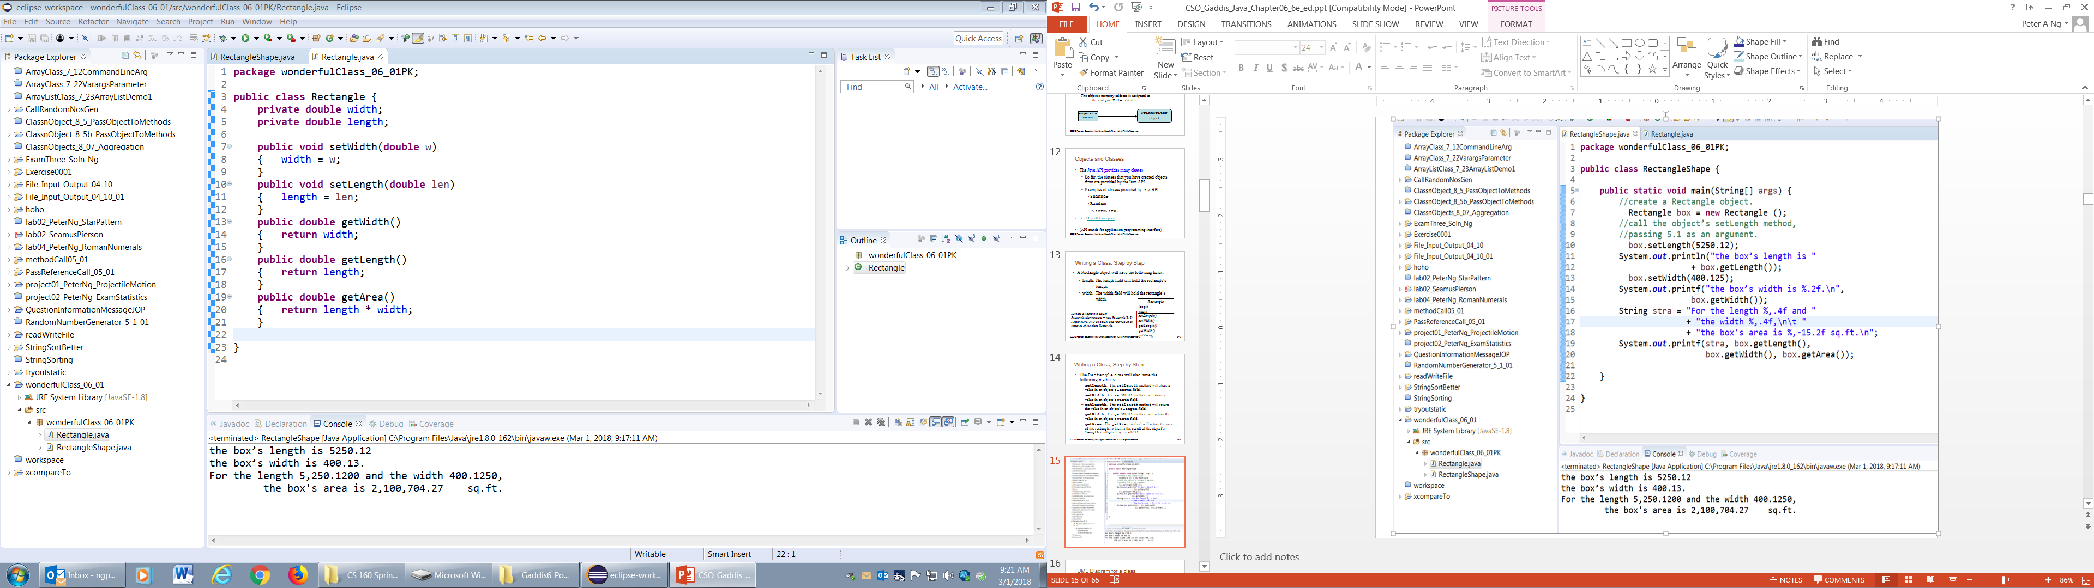
Achieve “data/code separation
ClassName: Rectangle
ClassFields:
private double length
private double width
Methods:
Rectangle(d len, d w)
setLength(double len)
setWidth(double w)
getLength()
getWidth()
getArea()
A BLUEPRINT
Encapsulation in an object
Data Hiding using private
Data/code separation

Slide 26
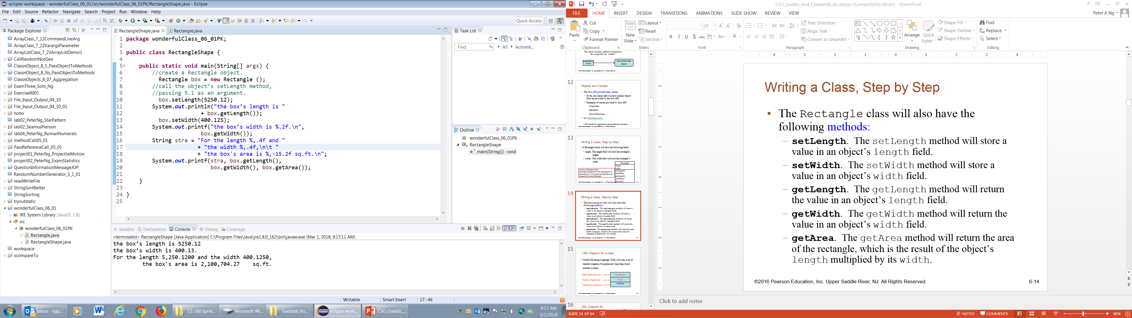
box
Rectangle
private double length = 5250.12; private double width = 400.15
public void getLength() { …} public void setLength(…) {….} public void getWidth() {…} public void setWidth(…) {…}
Achieve “data/code separation

Slide 27
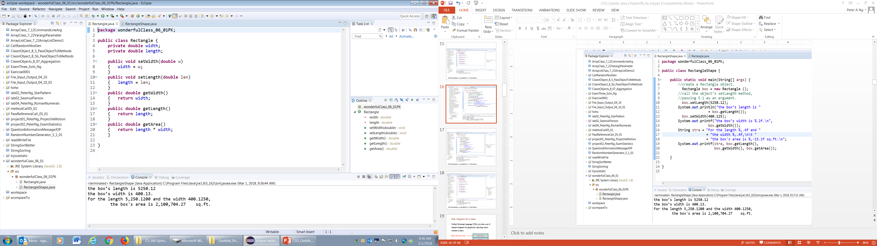

Slide 28
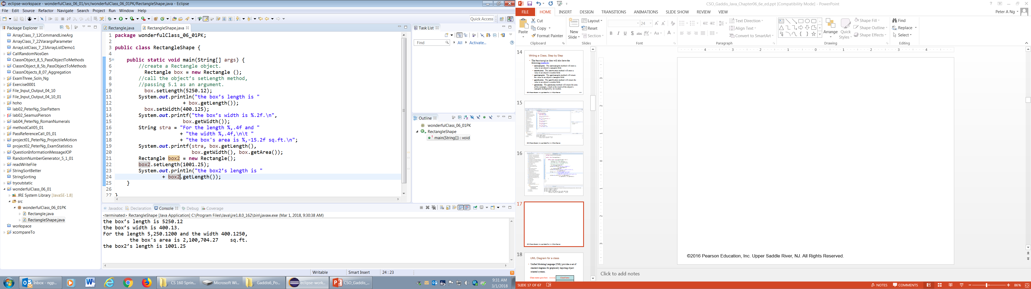

Slide 29
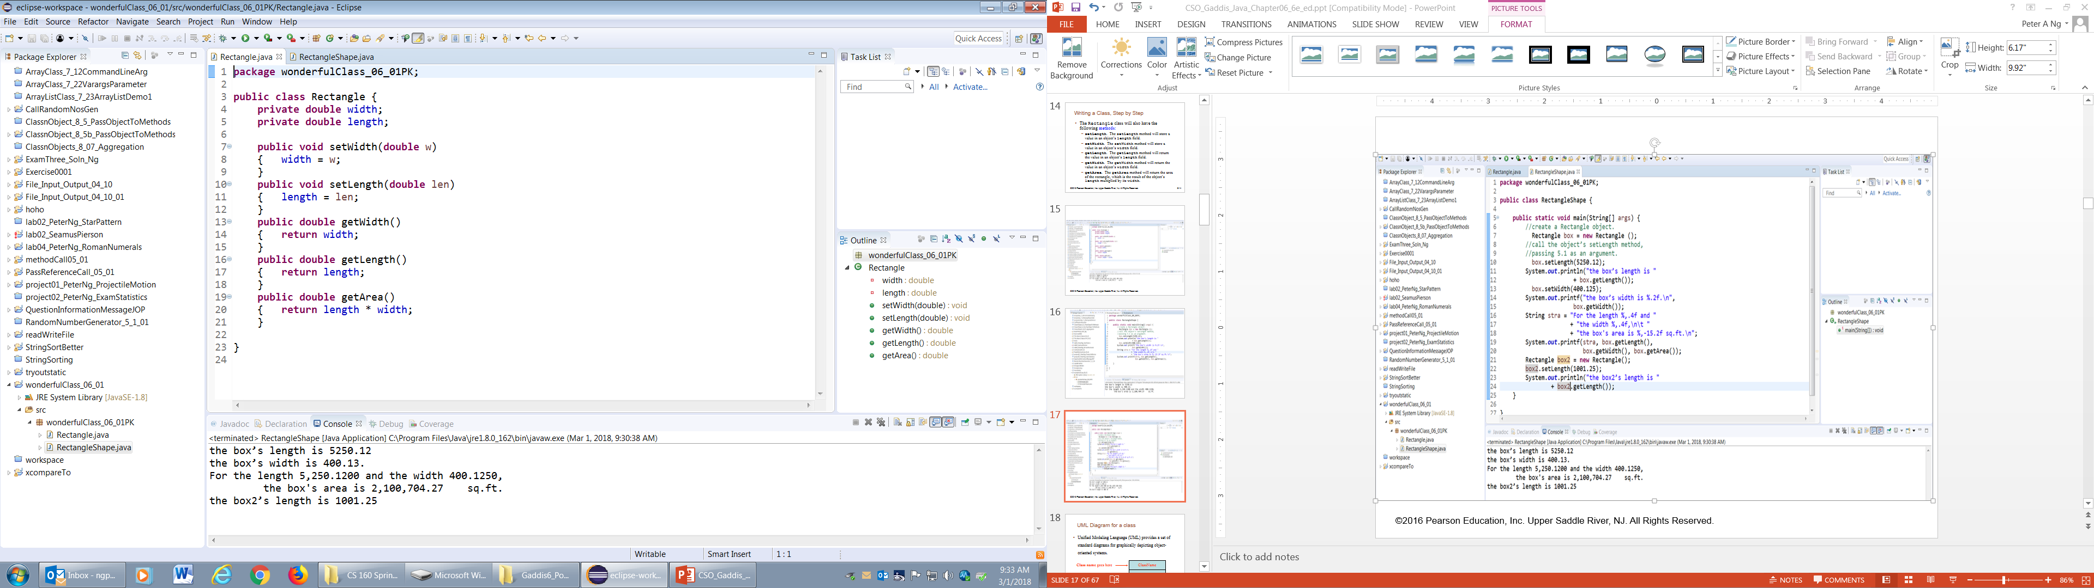

Slide 30
UML Diagram for a class
Unified Modeling Language (UML) provides a set of standard diagrams for graphically depicting object-oriented systems.
ClassName
Class name goes here
Fields
Fields are listed here
Methods
Methods are listed here

Slide 31
UML Diagram for Rectangle class
When a program is executing, it can use the class to create, in memory, as many objects of a specific type as needed.
Each object that is created from a class is called an instance of the class.
You can think of a class as a code “blueprint” that can be used to create a particular type of object.
Rectangle
length width
setLength() setWidth() getLength() getWidth() getArea()
A class is not an object, but a description of an object.

Slide 32
Writing the Code for the Class Fields
public class Rectangle
{
private double length;
private double width;
}

Slide 33
Access Specifiers
An access specifier is a Java keyword that indicates how a field or method can be accessed.
public
  When the public access specifier is applied to a class member, such
  as for the
  public class Rectangle { …
  public double getLength(){ return length; }
  public void setLength(){ … } }
  the member, getLength or setLength, can be accessed by code inside the class or outside.
private
  When the private access specifier is applied to a class member, the member such as private double length, where length has a value of 5024.10 cannot be accessed by code outside the class. The member, length can be accessed only by methods that are members, such as setlength() and getLength() of the same class, such as the class Rectangle.

Slide 34
Header for the setLength Method
Notice the word static does not appear in the method header.
When a method is designed to work on an instance of a class (referred to as an instance method), do not write the word static in the header.
Return Type
This is an instance method because this method will store a value in the length field of an instance of the Rectangle class.
Access specifier
Method Name
public void setLength (double len)
Instance of Rectangle class (an object)
Parameter variable declaration
Instance of Rectangle class (an object)
Blueprint Rectangle class (an object)

Slide 35
Writing and Demonstrating the setLength Method
public class Rectangle
{
private double length;
private double width;
/**
The setLength method stores a value in the
length field.
@param len The value to store in length.
*/
public void setLength(double len)
{
length = len;
}
public double getLength()
{
return length;
}
}//end of class Rectangle
Rectangle box = new Rectangle ();
box.setLength(5.1);
double length = box.getLength();
Examples: Rectangle.java, LengthDemo.java

Slide 36
Creating a Rectangle object
//create a Rectangle object which is
//referenced by the box variable.
Rectangle box = new Rectangle ();
This expression creates a Rectange object in memory.
The object's memory address is assigned to the box variable.
A Rectangle object
The box variable holds the address of the Rectangle object.
length:
0.0
address
width:
0.0
State of the box object

Slide 37
Creating a Rectangle object
public class lengthWidthArea
{
public static void main(String[] args)
{
//create a Rectangle object.
Rectangle box = new Rectangle ();
//call the object’s setLength method,
//passing 5.1 as an argument.
box.setLength(5.1);
System.out.println(“the box’s length is ”
+ box.getLength());
}
}

Slide 38
Calling the setLength Method
box.setLength(10.0);
The box variable holds the address of the Rectangle object.
A Rectangle object
length:
10.0
address
box
width:
2.0
This is the state of the box object after the setLength method executes.

Slide 39
Writing the getLength Method
/**
The getLength method returns a Rectangle
object's length.
@return The value in the length field.
*/
public double getLength()
{
return length;
}
Similarly, the setWidth and getWidth methods can be created.
Examples: Rectangle.java, LengthWidthDemo.java

Slide 40
Writing and Demonstrating the getArea Method
/**
The getArea method returns a Rectangle
object's area.
@return The product of length times width.
*/
public double getArea()
{
return length * width;
}
Examples: Rectangle.java, RectangleDemo.java
has the potential to become stale.
…
private double rArea;
public double getArea(){
rArea = length * width;
return rArea;
}

Slide 41
a method used to control changes to a variable
Accessor and Mutator Methods
Because of the concept of data hiding, fields in a class are private.
The methods that retrieve the data of fields are called accessors. (e.g., getLength() )
The methods that modify the data of fields are called mutators. (e.g., setLength(…) )
Each field that the programmer wishes to be viewed by other classes needs an accessor.
Each field that the programmer wishes to be modified by other classes needs a mutator.

Slide 42
Accessor and Mutator Methods
For the Rectangle example, the accessors and mutators are:
  setLength: Sets the value of the length field.
    public void setLength(double len) …
  setWidth : Sets the value of the width field.
    public void setLength(double w) …
  getLength : Returns the value of the length field.
    public double getLength() …
  getWidth : Returns the value of the width field.
    public double getWidth() …
Other names for these methods are getters and setters.

Slide 43
Data Hiding
An object hides its internal, private fields from code that is outside the class
  the object is an instance of (the class).
Only the class's methods may directly access and make changes to the object’s internal data.
Code outside the class must use the class's public methods to operate on an object's private fields.

Slide 44
Data Hiding
Classes are typically used as components in large software systems, involving a team of programmers.
  Data hiding is important
  Data hiding helps enforce the integrity of an object's internal data.

Slide 45
Stale Data
public class Rectangle()
{
private double area;
public void setArea( double area)
{
this.area = area;
}
}
Some data is the result of a calculation.
Consider the area of a rectangle.
  length * width
It would be impractical to use an area variable here.
Data that requires the calculation of various factors has the potential to become stale.
To avoid stale data, it is best to calculate the value of that data within a method rather than store it in a variable.

Slide 46
Stale Data
Rather than use an area variable in a Rectangle class:
  public double getArea()
  {
  return length * width;
  }
This dynamically calculates the value of the rectangle’s area when the method is called.
Now, any change to the length or width variables will not leave the area of the rectangle stale.

Slide 47
UML Data Type and Parameter Notation
UML diagrams are language-independent.
UML diagrams use an independent notation to show return types, access modifiers, etc.
Rectangle
Access modifiers are denoted as:
  + public
  - private
- width : double
+ setWidth(w : double) : void

Slide 48
UML Data Type and Parameter Notation
UML diagrams are language-independent.
UML diagrams use an independent notation to show return types, access modifiers, etc.
Variable types are placed after the variable name, separated by a colon.
Rectangle
- width : double
+ setWidth(w : double) : void

Slide 49
UML Data Type and Parameter Notation
UML diagrams are language-independent.
UML diagrams use an independent notation to show return types, access modifiers, etc.
Rectangle
Method return types are placed after the method declaration name, separated by a colon.
- width : double
+ setWidth(w : double) : void

Slide 50
UML Data Type and Parameter Notation
UML diagrams are language-independent.
UML diagrams use an independent notation to show return types, access modifiers, etc.
Method parameters are shown inside the parentheses using the same notation as variables.
Rectangle
- width : double
+ setWidth(w : double) : void

Slide 51
Converting the UML Diagram to Code
Putting all of this information together, a Java class file can be built easily using the UML diagram.
The UML diagram parts match the Java class file structure.
class header
{
Fields
Methods
}
ClassName
Fields
Methods

Slide 52
Converting the UML Diagram to Code
The structure of the class can be compiled and tested without having bodies for the methods. Just be sure to put in dummy return values for methods that have a return type other than void.
public class Rectangle
{
private double width;
private double length;
public void setWidth(double w)
{ }
public void setLength(double len)
{ }
public double getWidth()
{ return 0.0; }
public double getLength()
{ return 0.0; }
public double getArea()
{ return 0.0; }
}
Rectangle
width : double
length : double
+ setWidth(w : double) : void
+ setLength(len : double): void
+ getWidth() : double
+ getLength() : double
+ getArea() : double

Slide 53
Converting the UML Diagram to Code
Once the class structure has been tested, the method bodies can be written and tested.
public class Rectangle {
private double width;
private double length;
public void setWidth(double w)
{ width = w; }
public void setLength(double len)
{ length = len; }
public double getWidth()
{ return width; }
public double getLength()
{ return length; }
public double getArea()
{ return length * width; }
}
Rectangle
width : double
length : double
+ setWidth(w : double) : void
+ setLength(len : double): void
+ getWidth() : double
+ getLength() : double
+ getArea() : double

Slide 54
Class Layout Conventions
The layout of a source code file can vary by employer or instructor.
A common layout is:
  Fields listed first
  Methods listed second
Accessors and mutators are typically grouped.
Some tools can help in formatting layout to specific standards.

Slide 55
Instance Fields and Methods
Fields and methods that are declared as previously shown are called instance fields and instance methods.
Objects created from a class each have their copy of instance fields.
    Rectangle livingRm = new Rectangle( );
    livingRm.setWidth() = 12.0;
    livingRm.setLength() = 14.0;
Instance methods are methods that are not declared with a special keyword, static.
    public void setWidth(double w){ width = w;}
    public void setLength(double len) {length = len;}
Rectangle
width = 20.0; length = 120.0;
…
width = 15.0; length = 114.0
…
width = 12.0; length = 14.0;
…
width : double
length : double
+ setWidth(w : double) : void
+ setLength(len : double): void
+ getWidth() : double
+ getLength() : double
+ getArea() : double

Slide 56
public static void main(String[] args)
Why main must be declared public?
The access specifier of the main method has to be public because it is invoked by the JVM to run the method which is outside the scope of the (java) project.
Therefore the access specifier has to be public to permit a call from anywhere outside the application.
The main method is always public because it has to be accessed by the runtime engine, the JVM, whenever the program execution starts and the JVM does not belong to the program package.
If the main() declares as anything other than public it shows a Run time Error but not a Compilation time error.
Recall!

Slide 57
Recall!
Why main must be declared static?
When the JVM makes a call to the main method no object exists for the class being called, therefore it has to have a static method to allow invocation from the class.
Main() must be declared as static because JVM does not know how to create an object of a class, so it needs a standard way to access the main method which is possible by declaring main() as static, without creating an object of a class.
If a method is declared as static then we can call that method outside the class without creating an object using the syntax ClassName.methodName();. So in this way, JVM can call our main method as
<ClassName>.<Main-Method>

Slide 58
Recall!
Why main must be declared void?
main() must be declared void because JVM is not expecting any value from main(). So, it must be declared void.
If other return type is provided, then it is a RunTimeError i.e., NoSuchMethodFoundError.
Why main must have String Array Arguments?
main() must have String arguments as arrays because JVM calls the main method by passing a command line argument. As they are stored in a string array object it is passed as an argument to main().

Slide 59
Recall! In brief:
public :
This is the access modifier of the main method. It has to be public so that the Java runtime can execute this method.
static :
When the Java runtime starts, there is no object of the class present. That’s why the main method has to be static so that JVM can load the class into memory and call the main method.
void :
Java programming mandates that every method signature provide the return type. Java’s main method doesn’t return anything, that’s why its return type is void.
main() :
This is the name of the Java main method. It’s fixed and when we start a Java program, it looks for the main method.
String[] args :
Java’s main method accepts a single argument of a type String array. This is also called Java command line arguments.

Slide 60
Instance Fields and Methods
Instance fields and instance methods require an object to be created to be used.
Note that each room represented in this example can have different dimensions.
    Rectangle kitchen = new Rectangle();
    Rectangle bedroom = new Rectangle();
    Rectangle den = new Rectangle();
    Rectangle livingRm = new Rectangle();
    kitchen.setLength(10);
    kitchen.setWidth(5);
    See example: RoomAreas.java

Slide 61
States of Three Different Rectangle Objects
The kitchen variable holds the address of a Rectangle Object.
length:
0.0
address
width:
0.0
The bedroom variable holds the address of a Rectangle Object.
length:
0.0
address
width:
0.0
Rectangle
The den variable holds the address of a Rectangle Object.
width : double
length : double
length:
0.0
address
+ setWidth(w : double) : void
+ setLength(len : double): void
+ getWidth() : double
+ getLength() : double
+ getArea() : double
width:
0.0

Slide 62
States of Three Different Rectangle Objects
The kitchen variable holds the address of a Rectangle Object.
length:
10.0
address
width:
14.0
The bedroom variable holds the address of a Rectangle Object.
length:
15.0
address
width:
12.0
Rectangle
width : double
length : double
The den variable holds the address of a Rectangle Object.
length:
20.0
address
+ setWidth(w : double) : void
+ setLength(len : double): void
+ getWidth() : double
+ getLength() : double
+ getArea() : double
width:
30.0

Slide 63
Constructors
Constructors have a few special properties that set them apart from normal methods.
  Constructors have the same name as the class.
  Constructors have no return type (not even void).
  Constructors may not return any values.
  Constructors are typically public.

Slide 64
Constructors
Classes can have special methods called constructors.
A constructor is a method automatically called when an object is created.
  Constructors typically
    initialize instance fields and
    perform other object initialization tasks.
    e.g., Rectangle den = new Rectangle (12.0, 10.0);
  Constructors perform these operations at the time an object is created.

Slide 65
Constructor for Rectangle Class
public class Rectangle
{
private double length;
private double width;
// java provide a Default Constructor
public void setlength(double len){
length = len; }
public void setWidth(double w){
width = w; }
public double getLength( ){
return length; }
public double getWidth( ){
return width; }
}
Examples: Rectangle.java, ConstructorDemo.java
//create a Rectangle object
Rectangle alongsquare = new Rectangle( );

Slide 66
Constructor for Rectangle Class
Examples: Rectangle.java, ConstructorDemo.java
public class Rectangle
{
private double length;
private double width;
/**
No-arg Constructor
*/
public Rectangle()
{
length = 0.0;
width = 1.0;
}
…
}
alongsquare
Rectangle
Rectangle
width : double
length : double
width = 1.0
length = 0.0
+ Rectangle( )
+ setWidth(w : double) : void
+ setLength(len : double): void
+ getWidth() : double
+ getLength() : double
+ getArea() : double
+ Rectangle( )
+ setWidth(w : double) : void
+ setLength(len : double): void
+ getWidth() : double
+ getLength() : double
+ getArea() : double
//create a Rectangle object
Rectangle alongsquare = new Rectangle( );
6-66

Slide 67
Constructor for Rectangle Class
public class Rectangle {
private double length;
private double width;
/**
Constructor
@param len The length of the rectangle.
@param w The width of the rectangle.
*/
public Rectangle(double len, double w) {
length = len;
width = w;
}
…
}
Examples: Rectangle.java, ConstructorDemo.java
Rectangle
width = 3.0
length = 2.0
+ Rectangle( )
+ setWidth(w : double) : void
+ setLength(len : double): void
+ getWidth() : double
+ getLength() : double
+ getArea() : double
//create a Rectangle object
Rectangle alongsquare = new Rectangle(3, 2);

Slide 68
Constructors in UML
In UML, the most common way constructors are defined is:
Rectangle
Notice there is no
return type listed
for constructors.
width : double
length : double
+Rectangle(len:double, w:double)
+ setWidth(w : double) : void
+ setLength(len : double): void
+ getWidth() : double
+ getLength() : double
+ getArea() : double

Slide 69
Uninitialized Local Reference Variables
Declare reference variables without being initialized.
Rectangle box;
  This statement does not create a Rectangle object.
  box is an uninitialized local reference variable.
A local reference variable must reference an object before it can be used,
box = new Rectangle(7.0, 14.0);
  otherwise a compiler error will occur.
  box will now reference a Rectangle object of length 7.0 and width 14.0.
Rectangle box = new Rectangle(7.0, 14.0);

Slide 70
The Default Constructor
When an object of a class is created, the constructor for the class is always called.
If you do not write a constructor for a class, Java provides the default constructor when the class is compiled.
  It sets all of the object’s numeric fields to 0.
  It sets all of the object’s boolean fields to false.
  It sets all of the object’s reference variables to the special value null.

Slide 71
The Default Constructor
The default constructor is a constructor with no parameters, used to initialize an object in a default configuration.
The only time that Java provides a default constructor is when you do not write any constructor for a class.
  See example: First version of Rectangle.java
  Jave does not provide a default constructor if a constructor for the class is already written.
  See example: Rectangle.java with Constructor

Slide 72
Writing Your Own No-Arg Constructor
A no-arg constructor is a constructor that does not accept arguments.
Rectangle square = new Rectangle();
The default constructor (provided by Java) is a no-arg constructor.
We can write our no-arg constructor, e.g.,
  public class Rectangle {
    private double length;
    private double width;
    ….
  public Rectangle() {
  length = 1.0;
  width = 1.0;}
  …
  } //end of class Rectangle

Slide 74
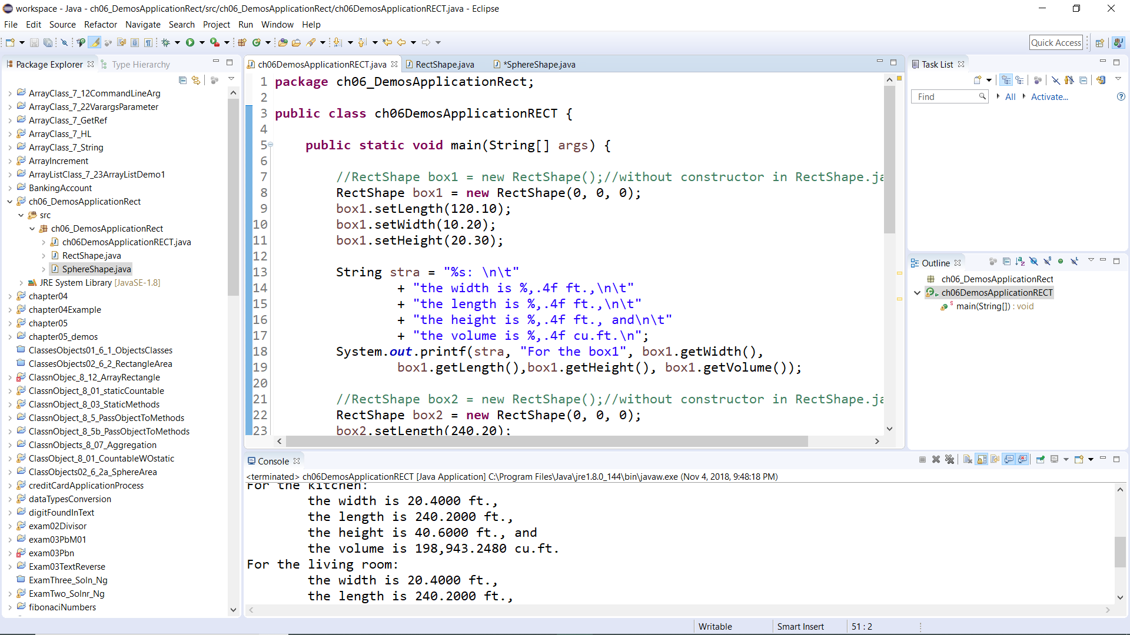

Slide 76
package ch06_DemosApplicationRect;
public class ch06DemosApplicationRECT {
public static void main(String[] args) {
//no-arg constructor in RectShape.java
//RectShape box1 = new RectShape();
RectShape box1 = new RectShape(0, 0, 0);
box1.setLength(120.10);
box1.setWidth(10.20);
box1.setHeight(20.30);
String stra = "%s: \n\t"
+ "the width is %,.4f ft.,\n\t"
+ "the length is %,.4f ft.,\n\t"
+ "the height is %,.4f ft., and\n\t"
+ "the volume is %,.4f cu.ft.\n";
System.out.printf(stra, "For the box1", box1.getWidth(),
box1.getLength(),box1.getHeight(),
box1.getVolume());

Slide 77
//no-arg constructor in RectShape.java
//RectShape box2 = new RectShape(); compilation error if stated
RectShape box2 = new RectShape(0, 0, 0);
box2.setLength(240.20);
box2.setWidth(20.40);
box2.setHeight(40.60);
System.out.printf(stra, "For the box2", box2.getWidth(), box2.getLength(), box2.getHeight(), box2.getVolume());
RectShape kitchen = new RectShape(20, 18, 10);
System.out.printf(stra, "For the kitchen", box2.getWidth(), box2.getLength(),
box2.getHeight(), box2.getVolume());
RectShape liveRoom = new RectShape(20, 24, 18);
System.out.printf(stra, "For the living room", box2.getWidth(), box2.getLength(),
box2.getHeight(), box2.getVolume());

Slide 78
SphereShape crystalBall = new SphereShape();
System.out.println("For the Crystal Ball: the volume is "
+ Math.PI * Math.pow(crystalBall.getRadius(), 2));
SphereShape tennisBall = new SphereShape();
tennisBall.setRadius(2.0);
System.out.println("For the Tennis Ball: the volume is " +
Math.PI * Math.pow(tennisBall.getRadius(), 2));
SphereShape basketBall = new SphereShape(0);
basketBall.setRadius(6.0);
System.out.println("For the Basket Ball: the volume is " +
Math.PI * Math.pow(basketBall.getRadius(), 2));
}
}

Slide 79
package ch06_DemosApplicationRect;
public class RectShape {
private double width;
private double length;
private double height;
//Constructor. Cannot have RectShape kitchen = new RectShape();
public RectShape(double len, double w, double h) {
length = len;
width = w;
height = h;}
public void setWidth(double w) {
width = w;}
public void setLength(double len) {
length = len;}
public void setHeight(double h) {
height = h;}
public double getWidth() {
return width;}
public double getLength() {
return length;}
public double getHeight() {
return height;}
public double getVolume() {
return length * width * height;}
}

Slide 80
package ch06_DemosApplicationRect;
public class SphereShape {
private double radius;
public SphereShape(){//no-arg constructor
radius = 1.0;
}
public SphereShape(double r) {
radius = r;}
public void setRadius(double r) {
radius = r;}
public double getRadius() {
return radius;}
}

Slide 81
For the box1:
the width is 10.2000 ft.,
the length is 120.1000 ft.,
the height is 20.3000 ft., and
the volume is 24,867.9060 cu.ft.
For the box2:
the width is 20.4000 ft.,
the length is 240.2000 ft.,
the height is 40.6000 ft., and
the volume is 198,943.2480 cu.ft.
For the kitchen:
the width is 20.4000 ft.,
the length is 240.2000 ft.,
the height is 40.6000 ft., and
the volume is 198,943.2480 cu.ft.
For the living room:
the width is 20.4000 ft.,
the length is 240.2000 ft.,
the height is 40.6000 ft., and
the volume is 198,943.2480 cu.ft.
For the Crystal Ball: the volume is 3.141592653589793
For the Tennis Ball: the volume is 12.566370614359172
For the Basket Ball: the volume is 113.09733552923255

Slide 83
//Another way of writing
RectShape masterBedRoom, bedRoom, den;
kitchen = new RectShape(14, 14, 10);
masterBedRoom = new RectShape();
masterBedRoom.setLength(20);
masterBedRoom.setWidth(18);
masterBedRoom.setHeight(12);
bedRoom = new RectShape(14, 14, 10);
den = new RectShape(8, 12, 10);
String stra = "%s: \n\t"
+ "the width is %,.4f ft.,\n\t"
+ "the length is %,.4f ft.,\n\t"
+ "the height is %,.4f ft., and\n\t"
+ "the volume is %,.4f cu.ft.\n";
String strb = "%s: \n\t"
+ "the width is %,.4f ft.,\n\t"
+ "the length is %,.4f ft.,\n\t"
+ "the area is %,.4f cu.ft.\n";

Slide 84
//Another way of writing
…
System.out.printf(stra, "For the master bedroom volume: ",
masterBedRoom.getWidth(), masterBedRoom.getLength(),
masterBedRoom.getHeight(), masterBedRoom.getVolume());
System.out.printf(strb, "For the master bedroom area: ",
masterBedRoom.getWidth(), masterBedRoom.getLength(),
masterBedRoom.getArea());
System.out.printf(stra, "For the den volume: ",
den.getWidth(), den.getLength(),
den.getHeight(), den.getVolume());
System.out.printf(strb, "For the den area: ",
den.getWidth(), den.getLength(),
den.getArea());

Slide 86
package ch06_LearnPK;
public class Ch06_Learn {
public static void main(String[] args) {
ScannerMy kb = new ScannerMy("Peter Ng");
System.out.println("The first word is "
+ kb.getWord());
//System.out.println("My middle initial is "
+ kb.getWord());
System.out.println("The line is " + kb.getLine());
}//end of main()
}//end of class

Slide 87
package ch06_LearnPK;
import java.util.Scanner;
public class ScannerMy {
private String string01;
public ScannerMy(String str) {
string01 = str;
}
public String getWord() {
Scanner str01 = new Scanner(string01);
//str01.next();//skip the first word
return str01.next();
}
public String getLine() {
Scanner str01 = new Scanner(string01);
return str01.nextLine();
}
}

Slide 89
The String Class Constructor
One of the String class constructors accepts a string literal as an argument.
This string literal is used to initialize a String object.
For instance:
String name = new String("Michael Long");

Slide 90
The String Class Constructor
String name = new String("Michael Long");
This creates a new reference variable name that points to a String object that represents the name "Michael Long"
Because they are used so often, String objects can be created with a shorthand:
  String name = "Michael Long";

Slide 91
Passing Objects as Arguments
When you pass an object as an argument, the thing that is passed into the parameter variable is the object's memory address.
  As a result, parameter variable references the object, and the receiving method has access to the object.
See DieArgument.java
String name = new String("Michael Long");
public class String{
private String str;
private String(String line){
str = line;}
… }

Slide 92
Overloading Methods and Constructors
Two or more methods in a class may have the same name as long as their parameter lists are different.
When this occurs, it is called method overloading. This also applies to constructors.
    public Rectangle( ) { length = 0.0; width = 2.5;}
    public Rectangle(double len, double w) { length = len; width = w; }
Method overloading is important because sometimes you need several different ways to perform the same operation.
    Rectangle box1 = new Rectangle( );
    Rectangle box 2 = new Rectangle (12.0, 14.0);

Slide 93
Overloaded Method add
public int add(int num1, int num2)
{
int sum = num1 + num2;
return sum;
}
public String add(String str1, String str2)
{
String combined = str1 + str2;
return combined;
}

Slide 94
Method Signature and Binding
A method signature consists of the method’s name and the data types of the method’s parameters, in the order that they appear. The return type is not part of the signature.
  add(int, int)
  add(String, String)
The process of matching a method call with the correct called method is known as binding. The compiler uses the method signature to determine which version of the overloaded method to bind the call to.
Signatures of the add methods of previous slide

Slide 95
Writing Your Own No-Arg Constructor – slide 72
A constructor that does not accept arguments is known as a no-arg constructor.
The default constructor (provided by Java) is a no-arg constructor.
We can write our no-arg constructor
public Rectangle() //called method
{
length = 1.0;
width = 1.0;
}

Slide 96
Constructor for Rectangle Class
public class Rectangle
{
private double length;
private double width;
/**
Constructor
@param len The length of the rectangle.
@param w The width of the rectangle.
*/
public Rectangle(double len, double w){
length = len;
width = w;
}
public Rectangle(){
length = 0;
width = 0;
}
}//end of class Rectangle
Examples: Rectangle.java, ConstructorDemo.java
//create a Rectangle object
Rectangle alongsquare = new Rectangle(3, 2);
//create a Rectangle object
Rectangle alongsquare1 = new Rectangle( );

Slide 97
Rectangle Class Constructor Overload
If we were to add the no-arg constructor we wrote previously to our Rectangle class in addition to the original constructor we wrote, what would happen when we execute the following calls?
  Rectangle box1 = new Rectangle();//method call
  Rectangle box2 = new Rectangle(5.0, 10.0);
The first call would use the no-arg constructor and box1 would have a length of 1.0 and width of 1.0.
The second call would use the original constructor and box2 would have a length of 5.0 and a width of 10.0.

Slide 98
The BankAccount Example
BankAccount
-balance:double
+BankAccount()
+BankAccount(startBalance:double)
+BankAccount(str:String):
+deposit(amount:double):void
+deposit(str:String):void
+withdraw(amount:double):void
+withdraw(str:String):void
+setBalance(b:double):void
+setBalance(str:String):void
+getBalance():double
Overloaded Constructors
Overloaded deposit methods
Overloaded withdraw methods
Overloaded setBalance methods
BankAccount.java AccountTest.java

Slide 99
Scope of Instance Fields
Variables declared as instance fields in a class can be accessed by any instance method in the same class as the field.
If an instance field is declared with the public access specifier, it can also be accessed by code outside the class, as long as an instance of the class exists.
  public class Rectangle {
    private int length;
    private int width;
    public int height;
    }

Slide 100
Shadowing
Cannot have two local variables with the same name in the same scope.
For example: The wrong way!
for (int index = 0; index < 10; index++)
{ int index;
index = index + 5;
}
int index = 0;
for (; index < 10; index ++)
{ int index = 1;
System.out.println(index =
index +5);
}
System.out.println(index);
The wrong way also!

Slide 101
Shadowing
A parameter variable is a local variable. Cannot have two parameters with the same name in the same scope.
For example: The wrong way.
…
double xyz = shadow(123, 321.10);
….
public static double shadow(int abc, double abc)
{
return abc + abc;
}

Slide 102
Shadowing
  public void setLength(double len) {
  length = len; }
A parameter variable len is, in effect, a local variable.
Within a method, variable names must be unique.
A method may have a local variable (or a parameter variable) with the same name as an instance field.
This is called shadowing.
The name of the local variable shadows the name of the field. That is, the field name is hidden by the name of the local or parameter variable.
Shadowing is discouraged and local variable names should not be the same as instance field names.
Rectangle
private double length;
public void setlength(double l){ length = l;}
  public void setLength(double len) {
  double length;
  length = len; }

Slide 103
Shadowing
For example: A wrong way!
  private double length;
  public void setLength(double len) {
    double length; //local variable
    length = len;
  }
A local variable is given the same name as a field.
The local variable’s name shadows the field’s name.
When the statement length = len; is executed, the value len is assigned to the local variable length, not to the field.

Slide 104
Packages and import Statements
Classes in the Java API are organized into packages.
Explicit and Wildcard import statements
  Explicit imports name a specific class
    import java.util.Scanner;
  Wildcard imports name a package, followed by an *
    import java.util.*;
The java.lang package is automatically made available to any Java class.

Slide 105
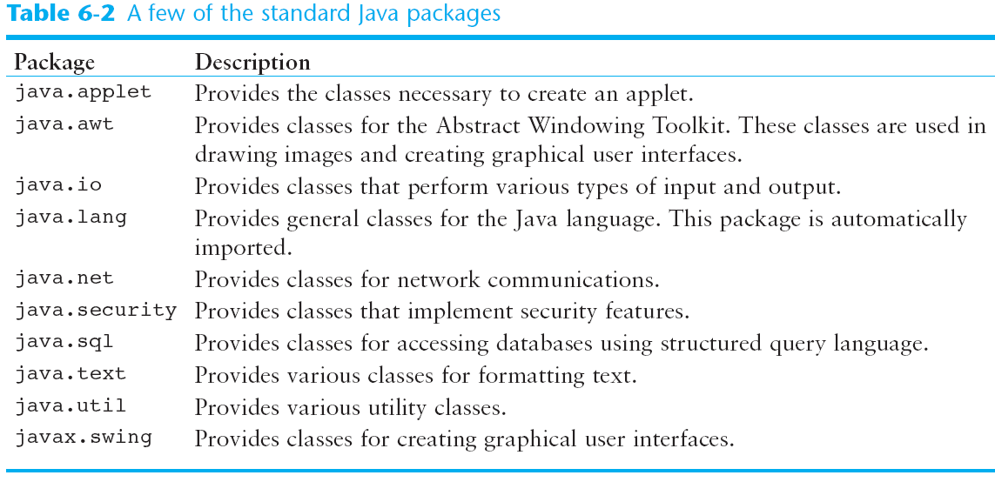
Some Java Standard Packages

Slide 106
Object Oriented Design
Finding Classes and Their Responsibilities
Finding the classes
  Get a written description of the problem domain
  Identify all nouns, each is a potential class
  Refine the list to include only classes relevant to the problem
Identify the responsibilities
  Things a class is responsible for knowing
  Things a class is responsible for doing
  Refine the list to include only classes relevant to the problem

